Slide 1
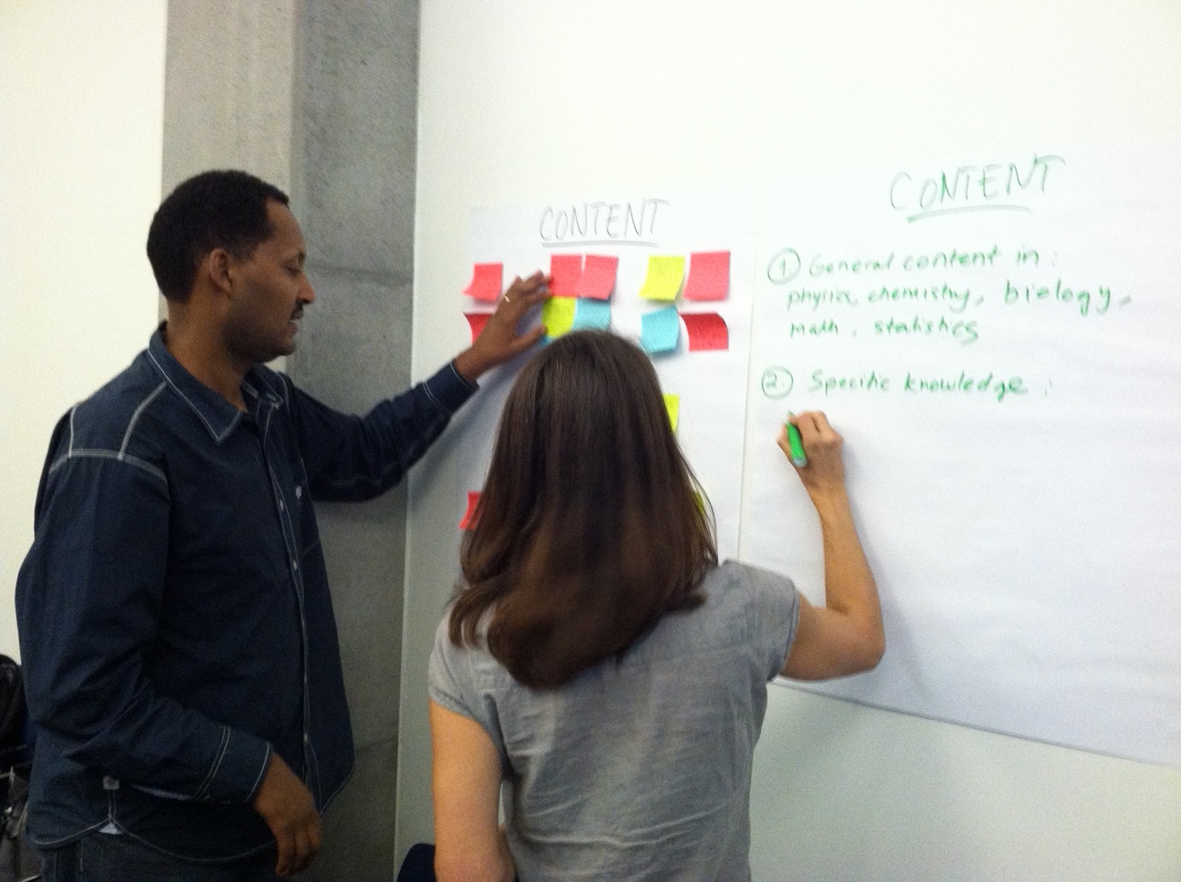
Helping Geoscience Departments Navigate the Relationship Between
“Geological” and “Environmental”:
NAGT’s Traveling Workshop Program
Anne E. Egger
Geological Sciences, Central Washington University
Executive Director, NAGT

Slide 2
What is NAGT?
National Association of Geoscience Teachers
Mission
NAGT supports a diverse, inclusive, and thriving community of educators and education researchers to improve teaching and learning about the Earth.
Goals
To promote high-quality Earth education;
To foster and disseminate research in geoscience education;
To drive change toward an equitable and inclusive system of geoscience education;
To support current and future geoscience educators throughout their careers.
We are a
member-supported professional society
The Traveling Workshops are one way that we make progress towards these goals.

Slide 3
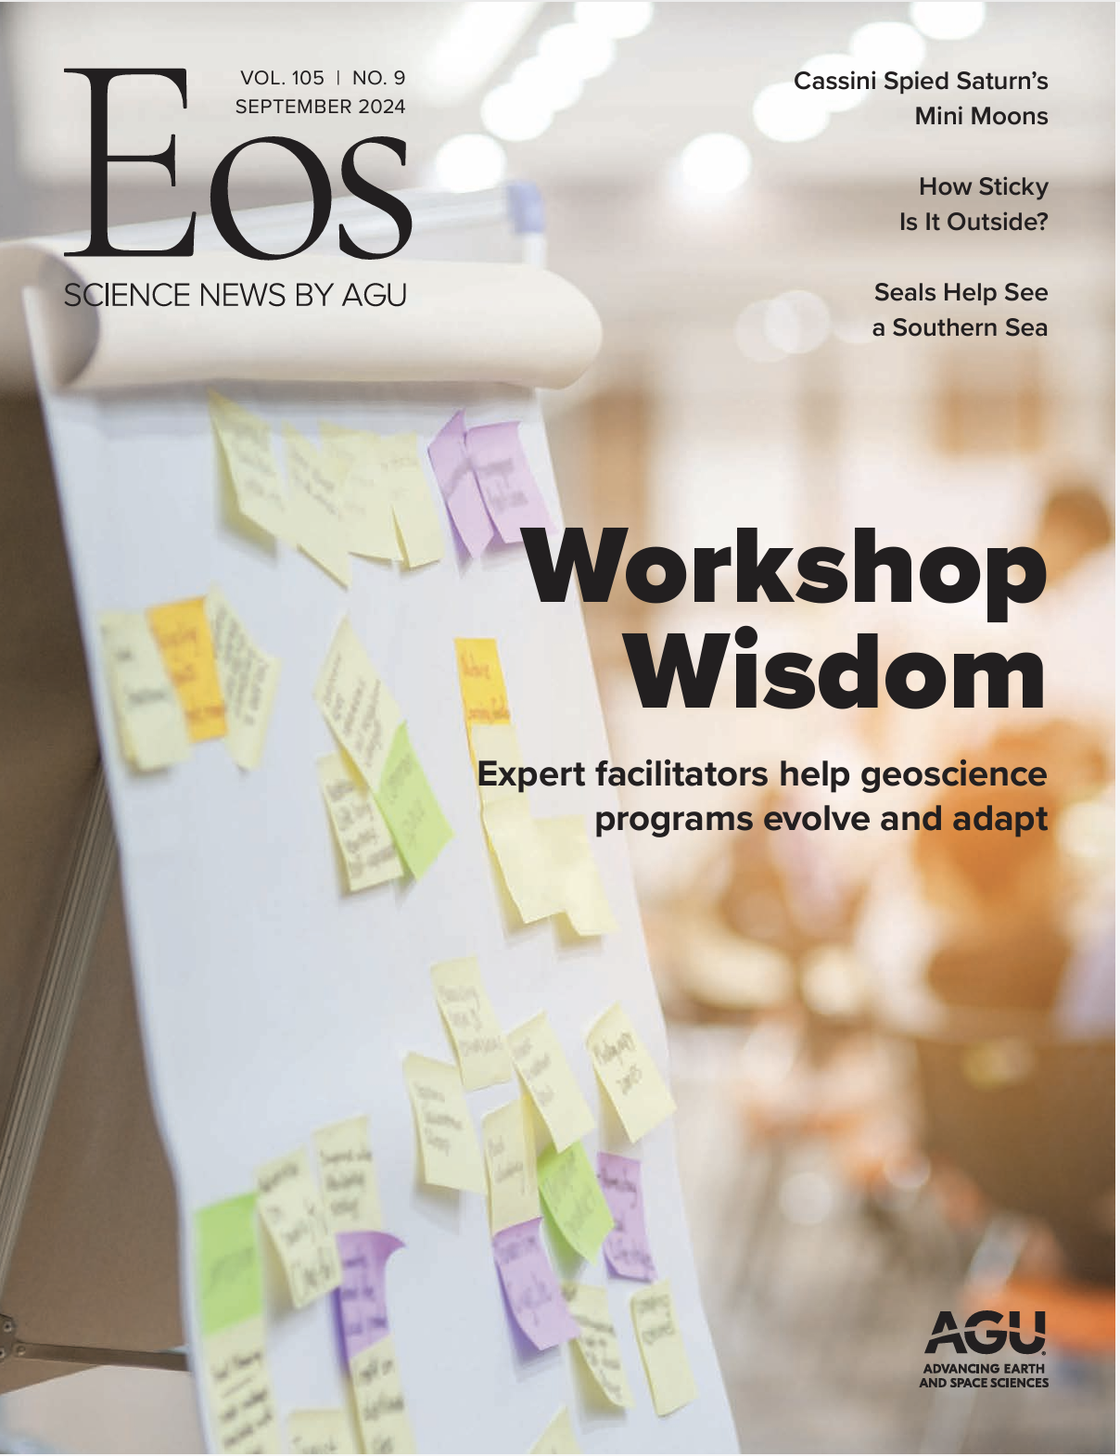
What is the Traveling Workshops Program?
An outcome of the NSF-funded Building Strong Geoscience Departments program that began in 2004
NAGT started managing in 2014 and expanded the topics
All workshop types include:
Personalized facilitation from two experienced leaders who come to you
A dedicated, private web space to keep track of resources and work
A focus on actionable work, and a collective or individual action plan for moving forward after the workshop.

Slide 4
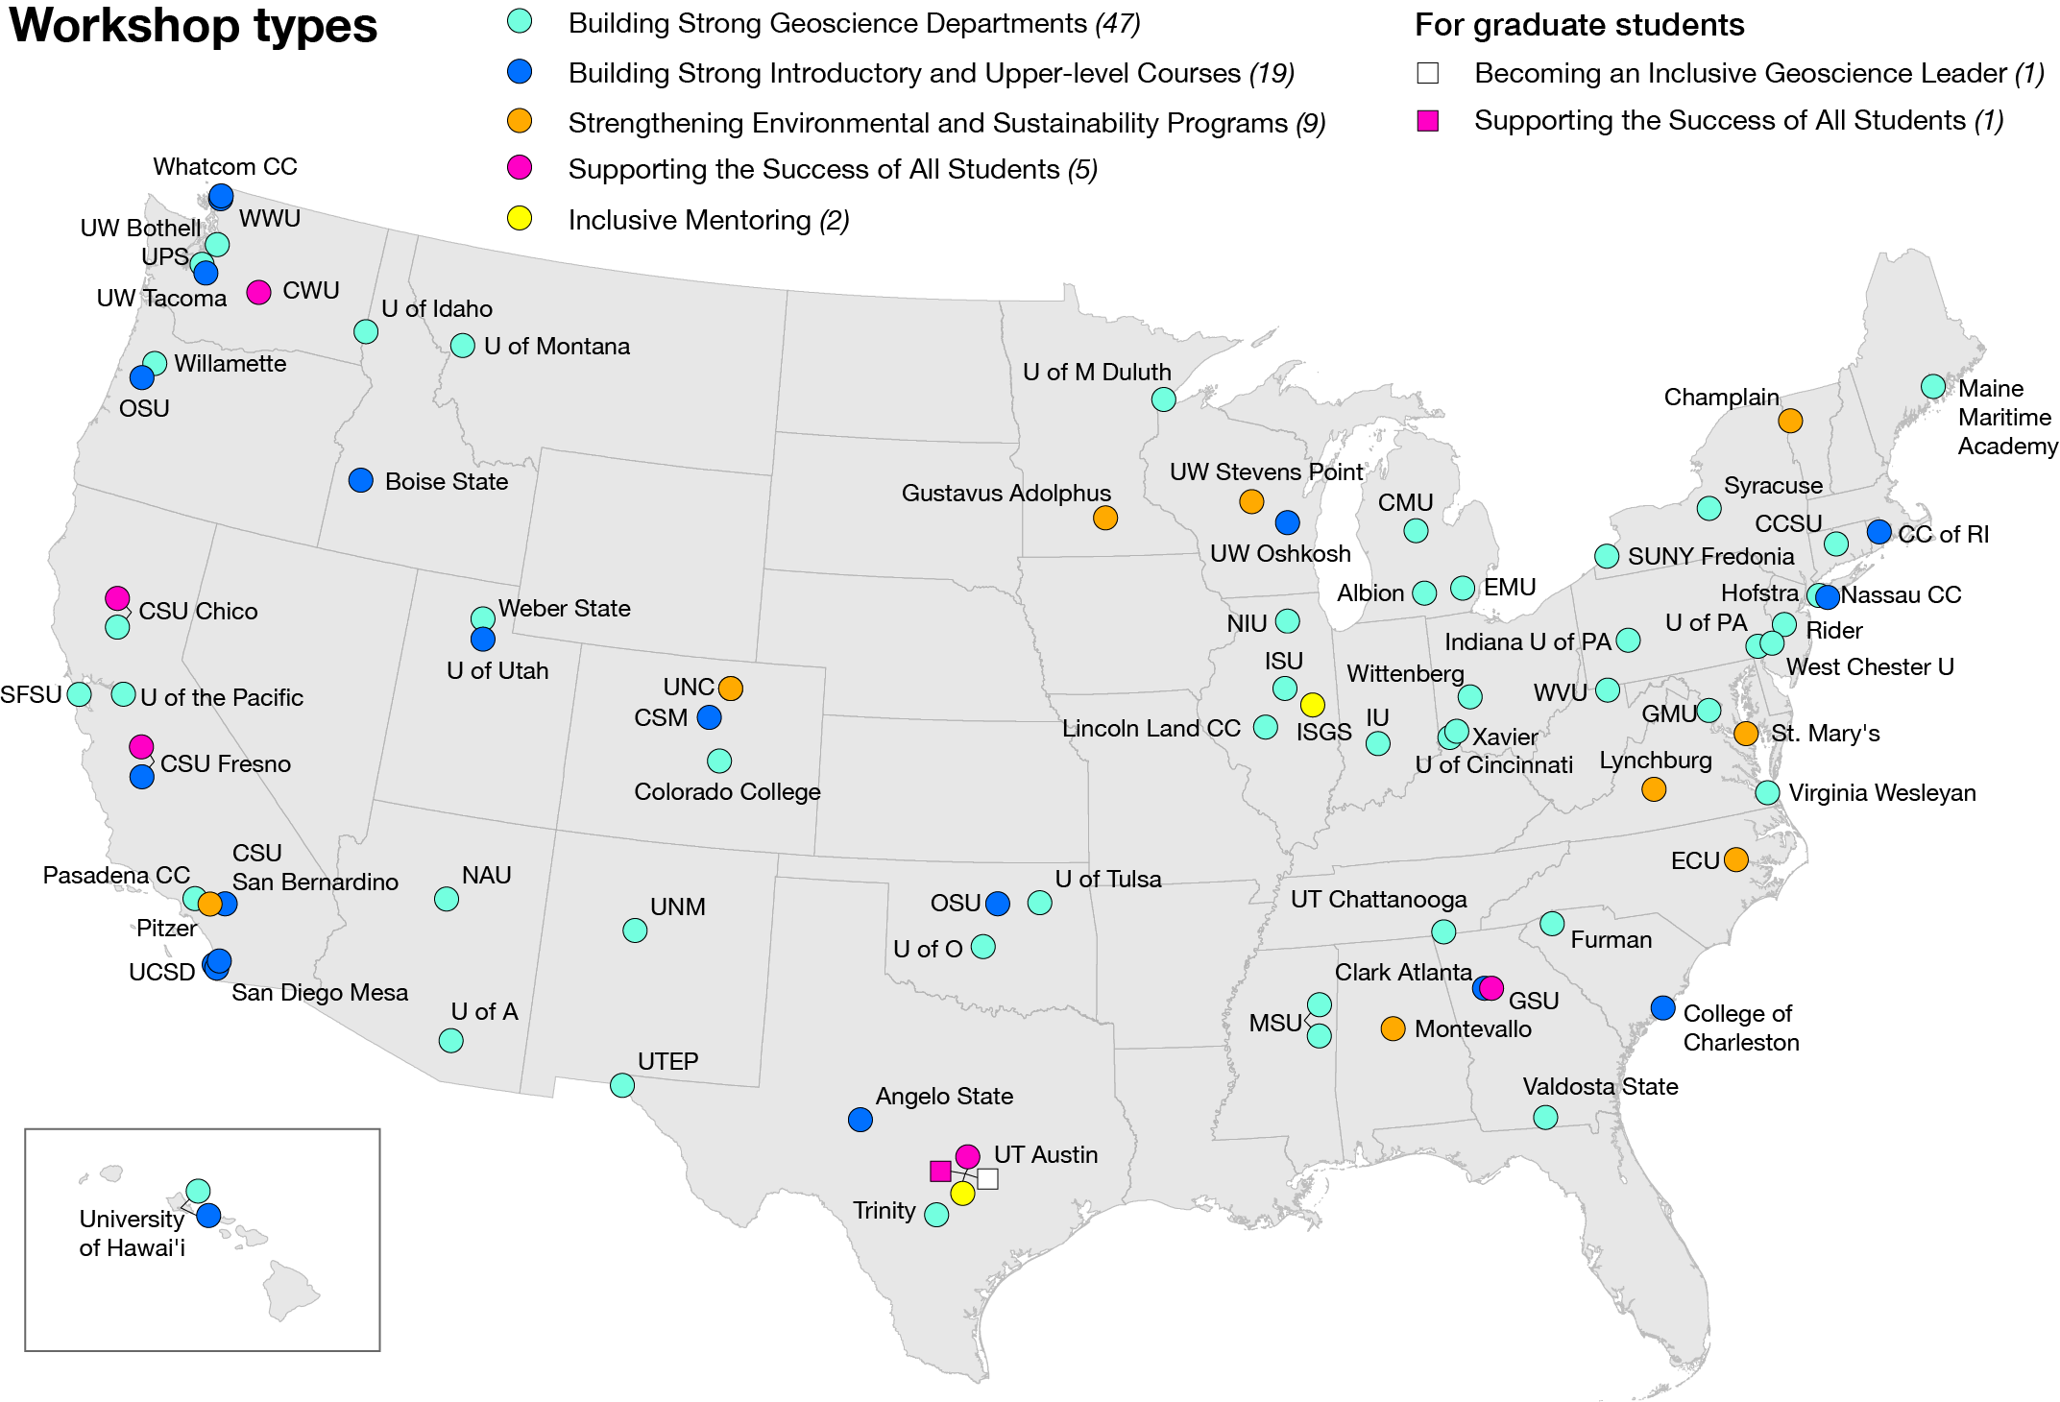
Question: To what extent were these departments wrestling with the concepts of “environmental” and ”geological”?

Slide 5
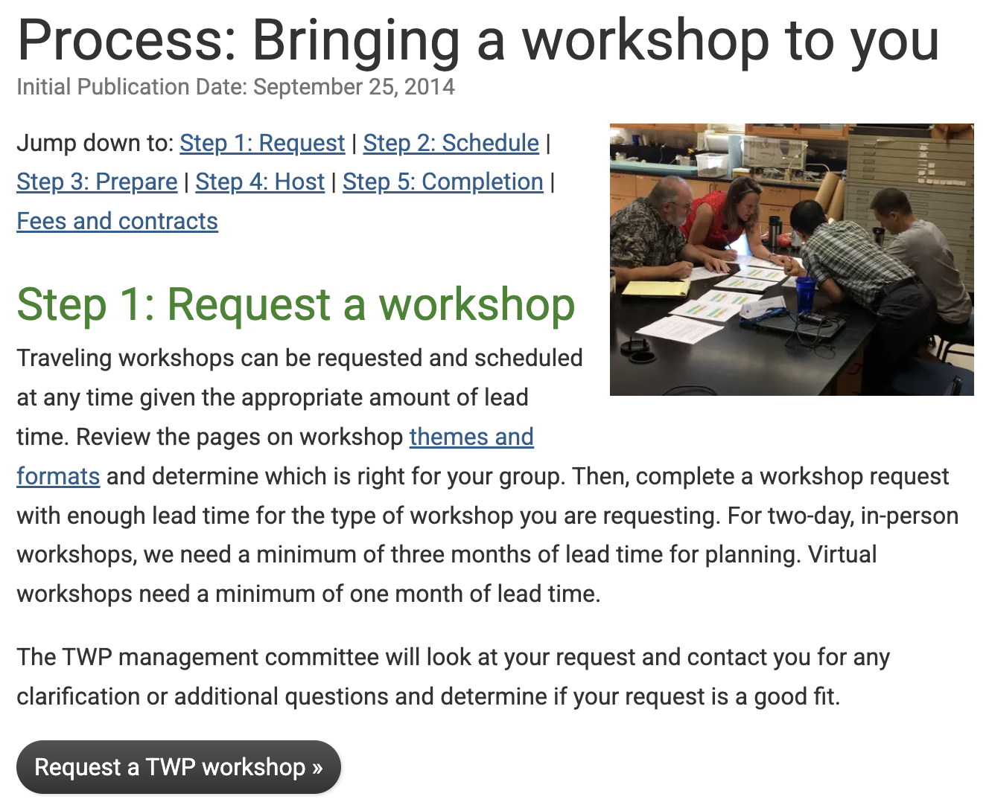
Methods
Explored requests from 2014 to 2024 (n = 109)
Looked at responses to the questions:
  Why are you interested in hosting a workshop?
  What do you hope to learn?
  Why now?
Allowed for themes to emerge

Slide 6
Types of requests
Out of 109 requests, 49 included reference to two “entities” (45%)
  Two majors in one department
  Two departments
  One department and one program or initiative
The requests spanned institution types
Roughly equally distributed across the ten years

Slide 7
Themes in requests
Two majors exist: They may be in one department or two, or a department and an interdisciplinary program; they are “geological” and “environmental”
Questioning or revising core curriculum: They may be wanting to add more environmental components, or better distinguish between tracks, or…
Top-down re-envisioning: They have been told to revise their major or to align with a new initiative and are responding
Bottom-up re-envisioning: They have collectively decided to revise their major from within the department
Competition: They explicitly mention being in competition with the environmental program (which is a different entity than the requestor)
Internal conflict: They explicitly mention internal conflict within the department (which houses two majors, or two approaches)

Slide 8
Themes in requests
 | Two majors | Revising curriculum | Top-down | Bottom-up | Comp-etition | Internal conflict
Two majors | 3 | 10 |  | 2 | 1
Revising curriculum | 10 | 5 | 1 | 8 | 4 | 3
Top-down |  | 1 | 6 | 1 |  | 1
Bottom-up | 2 | 8 | 1 | 5
Competition | 1 | 4 |  |  | 2 | 1
Internal conflict |  | 3 | 1 |  | 1

Slide 9
How the TWP responds
Facilitators have conversations with the local host/chair to:
  Learn more about the department needs and interests
  Determine who they should meet with to get an outside perspective on the department and its context (usually a dean or associate provost)
  Begin to establish the workshop program
Facilitators develop a workshop program that customizes well-tested sessions, including:
  Envisioning your program
  Building a thriving and valued program, including a SWOT analysis
  The matrix approach to program design

Slide 10
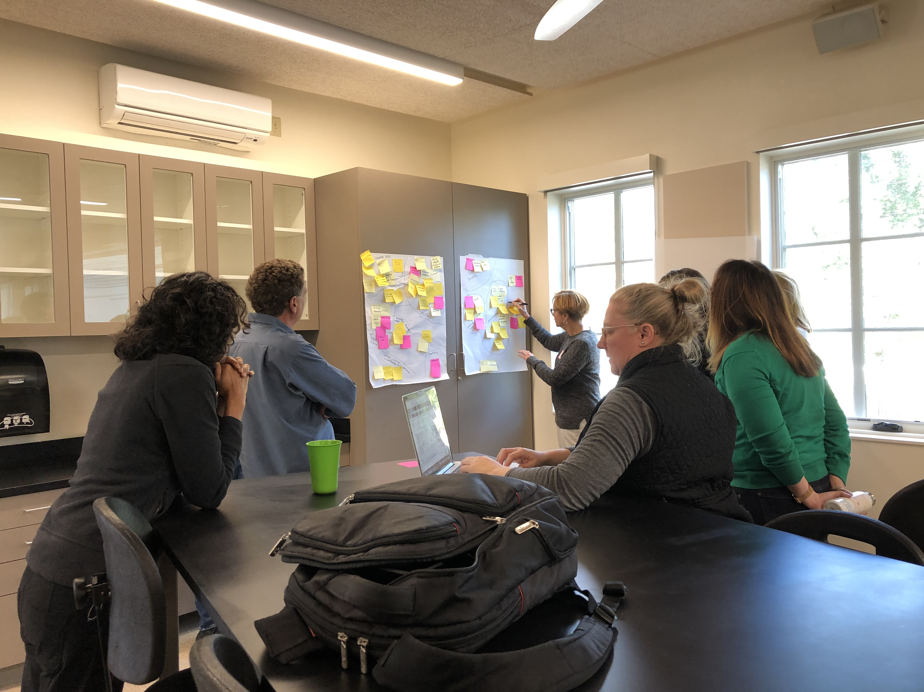
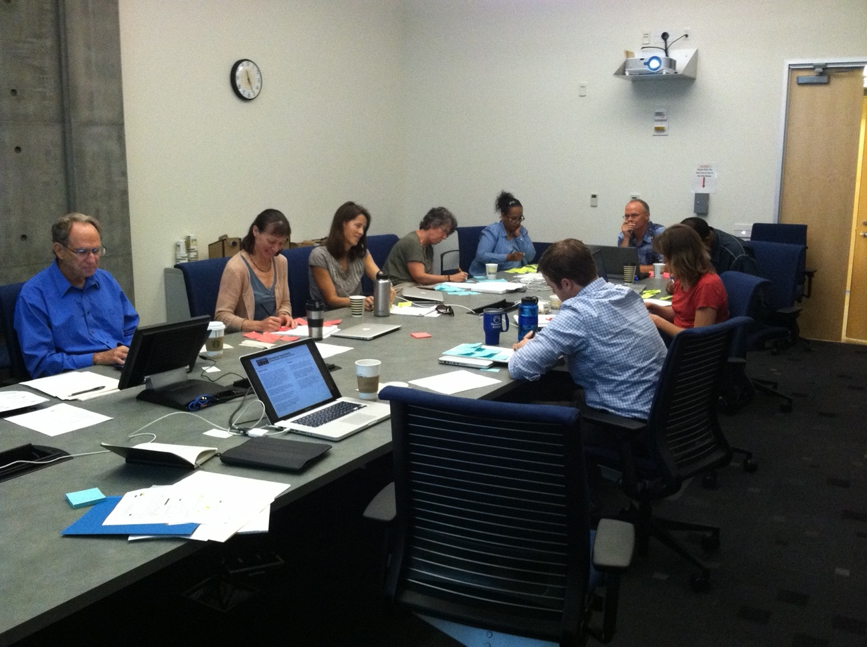
Then the workshop happens over two days

Slide 11
Evaluation: Reconciling two ideas
This workshop really helped us to consider the future direction of our department. Like many traditional geology departments, we have to consider broadening our curriculum to address current market preference for a systems' science background to geoscience...
Thinking about how to partner with other departments and resources on campus was particularly useful. This workshop helped us articulate how and why we are moving more towards interdisciplinary/ environmental science approach to geosciences.
Most of my background is in geoscience and this workshop provided great discussion in sustainability and environmental studies. This provided broader context for our department.
I am optimistic that we have moved past a persistent obstacle that has hindered the relationship between the departments/programs, and especially, in our ability to better serve our environmentally-minded students.

Slide 12
Evaluation: Most valuable
The most valuable aspect was the discussion fostered among department members.
Without the dedicated time and facilitation (i.e., being forced to sit down for two full days and focus) we never would have been able to think through and agree on the plans and, more importantly, action plan that we managed to come up with in our two-day workshop.
I think the biggest benefit I saw was that this workshop gave everyone a chance to share their voices. We don't always get that chance when we have faculty meetings.
Getting a fresh perspective from people in other geoscience departments is invaluable for coming up with creative approaches to solving problems. Also, we were given useful advice and strategies for how to approach redesigning our curriculum and programs.

Slide 13
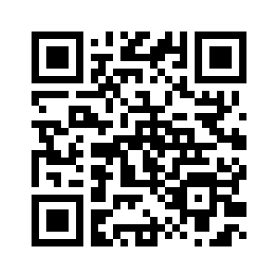
Considering your next steps?
Come by the
Innovation Spotlight Stage
Tuesday 10–10:30
to meet other facilitators and share your current challenges
Learn more about the TWP and request a workshop
Get in touch:
Anne Egger
exdir@nagt.org
Stop by the
NAGT Booth 716
In the Exhibit Hall
Thank you!

