Slide 1

Webinar Participation
As you enter, please review the Zoom controls below. Leave your audio and video off, unless prompted by a host.
Chat: brief questions about technical issues. Q & A: used to hold a discussion among all participants.
Please leave your audio muted and video off (both indicated by a red slash)
Click to open the Chat. This will allow you to participate in a discussion with all attendees.
Notes:
Missy

Slide 2
Engaging Students in Scientific Practices:
Evaluating Evidence and Explanation in Secondary Earth and Space Science
Webinar 2: Introduction to MEL Diagrams - Crosscutting Concepts
Notes:
Donna: Welcome back! This is our second and final webinar before our workshop next month. Tonight we are going to focus on Cross Cutting Concepts as a part of 3-Dimensional Learning in the standards, and have an introduction to MEL Diagrams.

Slide 3
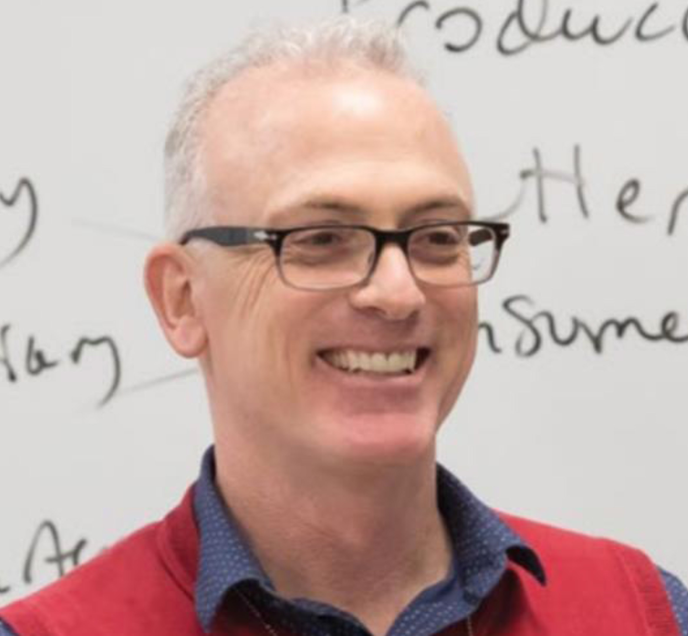
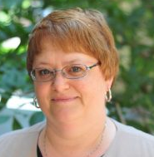


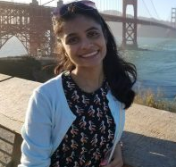
SLRG Investigators
The Science Learning Research Group (SLRG) at Temple University conducts classroom-based research in the learning and teaching of Earth and space science.
30+ combined years educational research
20+ combined years university faculty
50+ combined years classroom teaching & PD
Doug Lombardi
Janelle Bailey
Ananya Matewos
Tim Klavon
Archie Dobaria
Notes:
Donna: Again, these are some of the people you will meet at the workshop next month. Doug and Janelle are our Principal Investigators on the project. Ananya, Archie and Tim are also key investigators.

Slide 4
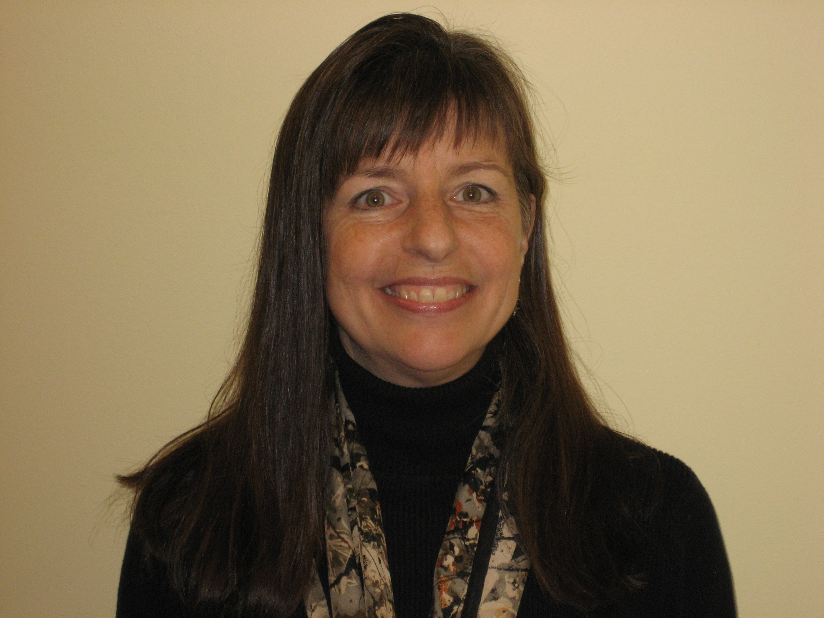
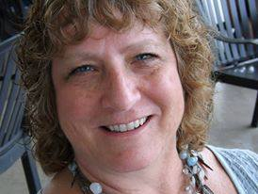
Project Investigators
Missy Holzer (NJ)
Donna Governor (GA)
30+ years 9-12 Classroom
PhD Science Education
20+ years PD provider
NESTA President (2012-2014)
NJESTA Board
Adjunct Prof - Rutgers, Rider, AMNH
MEL 1 Project Team Member
32 years K-12 Classroom
Currently University of North Georgia - Asst. Professor of Science Education
2007 PAEMST Awardee
Past President GSTA
NSTA District Director
Author NSTA Press book: “Big Data, Small Devices”
Notes:
Donna: Missy will be leading the workshop in New Jersey and I will be leading the Georgia workshop.

Slide 5


Master Teachers
Christopher Roemmele (NJ)
Kristina Strickland (GA)
Assistant Professor at West Chester University, teaching Science Methods for Educators, Introductory Geology
PhD in Earth Science Education
15 years high school science teacher in NJ
Former NJESTA President
Published in The Science Teacher, Science Scope, The Earth Scientist, Science in School
Earth Science Teacher @ North Forsyth High School
17 years middle & high school
Ed.S. Curriculum & Instruction
Facilitator for Ceismc Program @ Georgia Tech
Notes:
Donna: Christopher and Kristy are our master teachers for this project.

Slide 6
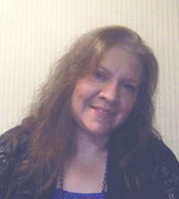
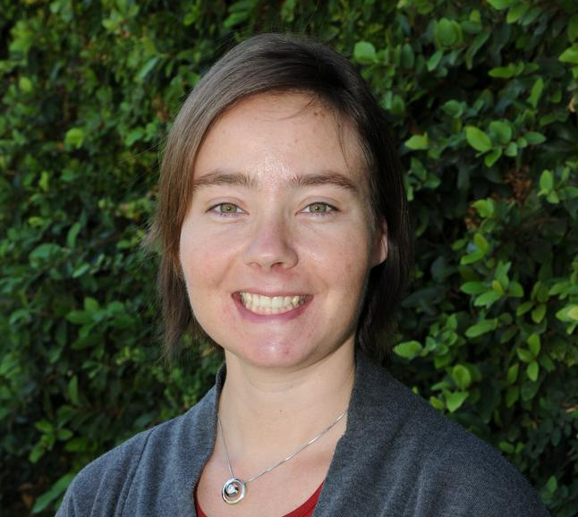
Project Investigators
Carla McAuliffe
Sanlyn Buxner
TERC, Senior Researcher & Curriculum Developer
PhD Learning & Instructional Technology
NESTA Executive Director
10+ years Middle & High School Classroom
25+ years PD provider
Project Evaluator
Research Scientist, Planetary Science Institute
PhD Science Education
20+ years PD provider
Adjunct Prof - University of Arizona
Notes:
Donna: You’ll also be meeting Carla and Sanlyn at the workshop.

Slide 7


Feedback from First Webinar
Lots of excitement & interest about the summer institute!
Some confusion about the role of plausibility judgments in learning
Notes:
Doug - Janelle

Slide 8
Webinar Outline
Review S&EP in MEL Diagrams
Introduction to Crosscutting Concepts
Crosscutting Concepts and the MEL Project
Evidence of Crosscutting Concepts - Student Explanatory Task
What is a MEL Diagram?
Next Steps
Notes:
Missy

Slide 9
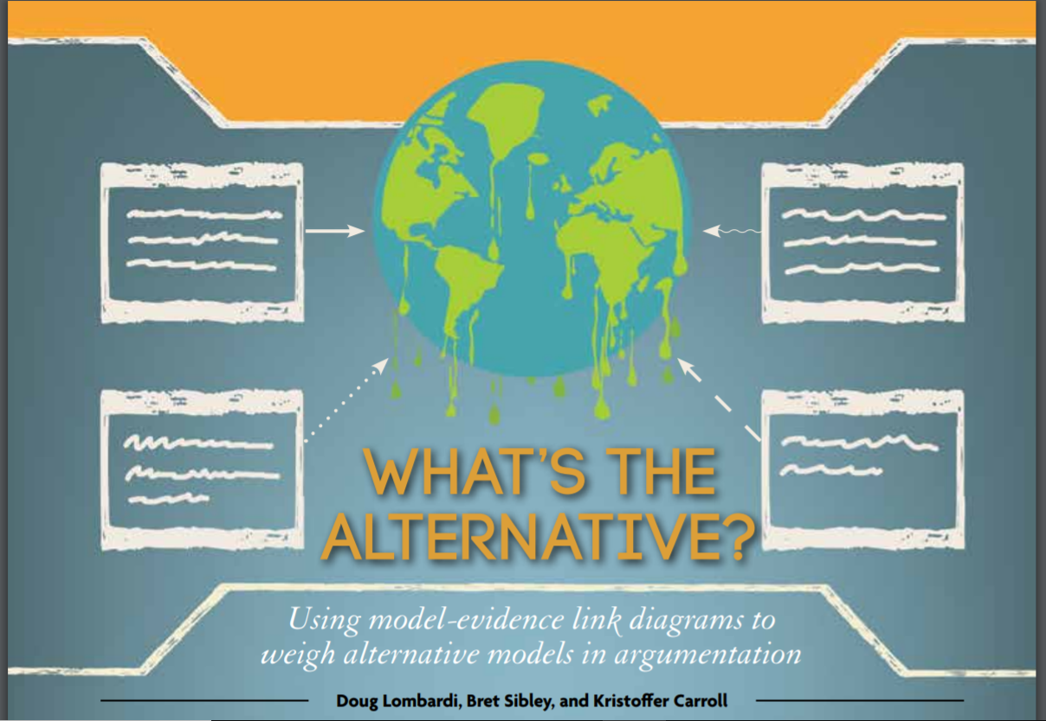
Revising the Scientific & Engineering Practices
Article Discussion: What’s the Alternative?
Use Chat Box to contribute to the discussion:
What specific Scientific & Engineering practices are evident in the use of MEL diagrams?
What makes a good model for use in a MEL diagram?
Notes:
Missy - Q&A; Understand what MEL diagrams are, and where the workshop is going
Developing and Using Models
· Evaluate merits and limitations of two different models of the same proposed tool, process, mechanism, or system in order to select or revise a model that best fits the evidence or design criteria.
Analyzing and Interpreting Data
· Consider limitations of data analysis when analyzing and interpreting data.
· Compare and contrast various types of datasets to examine consistency of measurements and observations
· Evaluate the impact of new data on a working explanation and/or model of a proposed process or system.
Constructing Explanations and Designing Solutions
· Construct and revise an explanation based on valid and reliable evidence obtained from a variety of sources and the assumption that theories and laws that describe the natural world operate today as they did in the past and will continue to do so in the future.
· Apply scientific reasoning, theory, and/or models to link evidence to the claims to assess the extent to which the reasoning and data support the explanation or conclusion.
Engaging in Argument from Evidence
· Compare and evaluate competing arguments or design solutions in light of currently accepted explanations, new evidence, limitations, constraints, and ethical issues.
· Evaluate the claims, evidence, and/or reasoning behind currently accepted explanations or solutions to determine the merits of arguments.

Slide 10
Webinar Outline
Review S&EP in MEL Diagrams
Introduction to Crosscutting Concepts
Crosscutting concepts and the MEL Project
Evidence of Crosscutting Concepts - Student Explanatory Task
What is a MEL Diagram?
Next Steps
Notes:
Missy

Slide 11
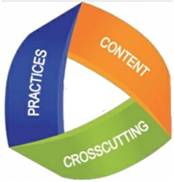
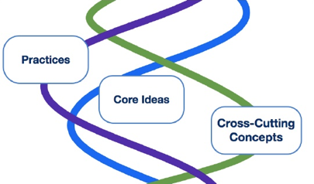
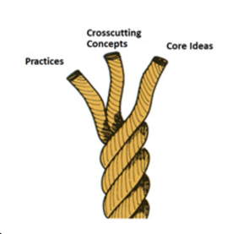

Review of 3-Dimensional Learning:
The Basis of NGSS and GSES
Core concepts (DCIs): content students learn
Crosscutting concepts: Concepts that link domains of science; Conceptual tools that help students organize learning
Scientific & engineering practices: How students engage in learning
Notes:
Missy - recall that in 3-D teaching and learning students employ science and engineering practices and crosscutting concepts to make sense of phenomena (disciplinary core ideas). This evening, we will take a closer look at the role of crosscutting concepts in sense making.

Slide 12
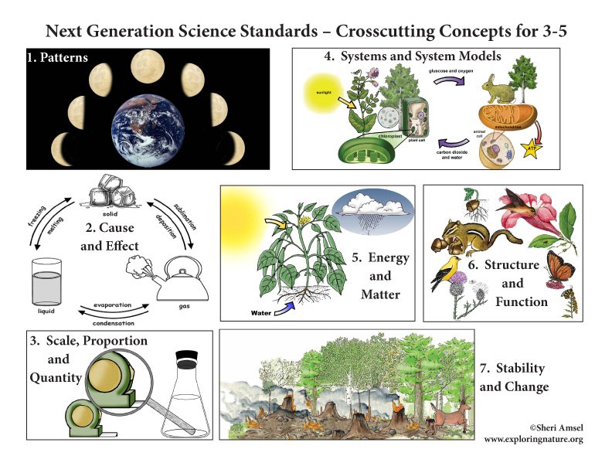
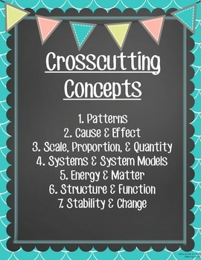
Today’s Focus:
Crosscutting Concepts
Notes:
Missy - “Some important themes pervade science, mathematics, and technology and appear over and over again, whether we are looking at an ancient civilization, the human body, or a comet. They are ideas that transcend disciplinary boundaries and prove fruitful in explanation, in theory, in observation, and in design.” - AAAS, 1989

Slide 13
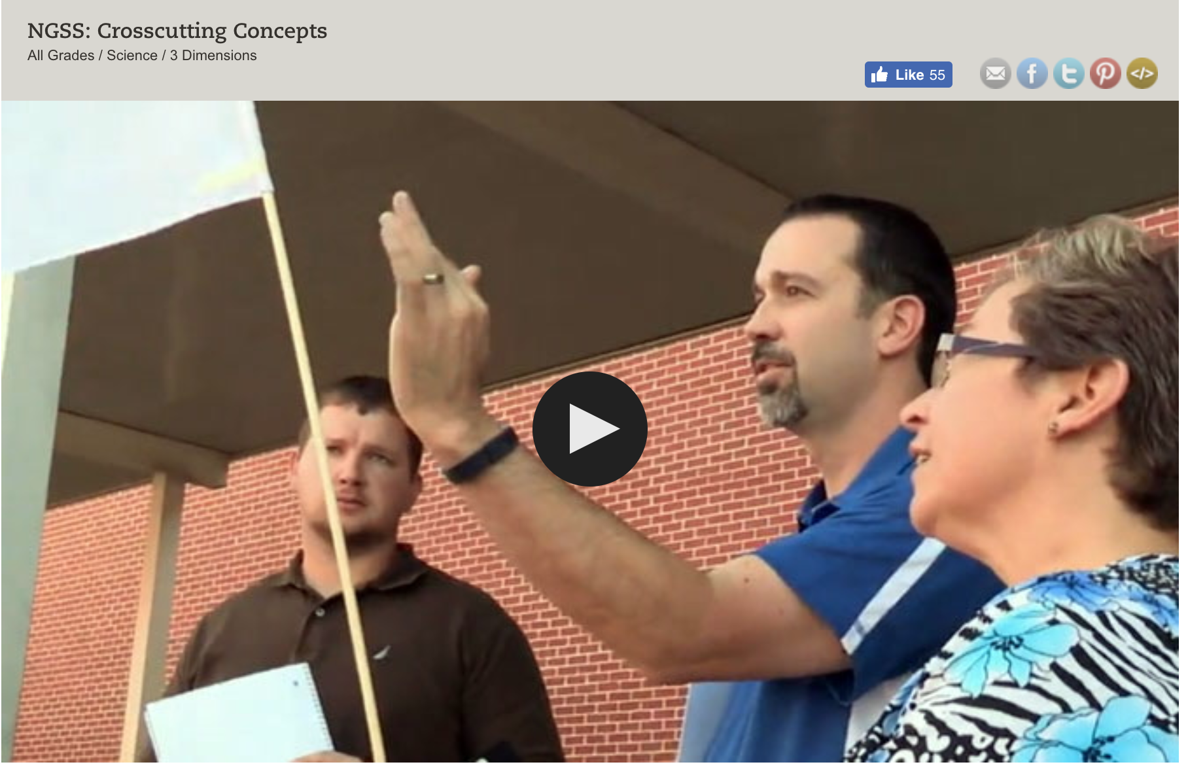
3-Dimensional Instruction:
Crosscutting Concepts
Link: https://www.teachingchannel.org/videos/crosscutting-concepts-achieve
Notes:
WHO needs to run this?

Slide 14
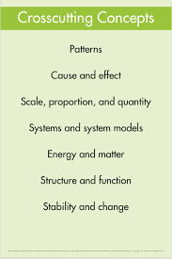
Let’s Debrief… (please use the chat box)
How do students benefit from understanding the Crosscutting Concepts?
How do the NGSS use Crosscutting Concepts in a new way?
How did the task prompt participants to use the Crosscutting Concepts?
Notes:
Missy (ask teachers to put their grade level next to their responses)

Slide 15
Webinar Outline
Review S&EP in MEL Diagrams
Introduction to Crosscutting Concepts
Crosscutting Concepts and the MEL Project
Evidence of Crosscutting Concepts - Student Explanatory Task
What is a MEL Diagram?
Next Steps
Notes:
Missy

Slide 16
Crosscutting Concepts Supported by MELs
Patterns
Cause & Effect
Scale Proportion & Quantity
Systems & System Models
Energy & Matter
Structure & Function
Stability & Change
Use the Chat Box to address the question:
Based on what we’ve seen so far, which Crosscutting Concepts are best supported by using MEL diagrams?
Notes:
Donna

Slide 17
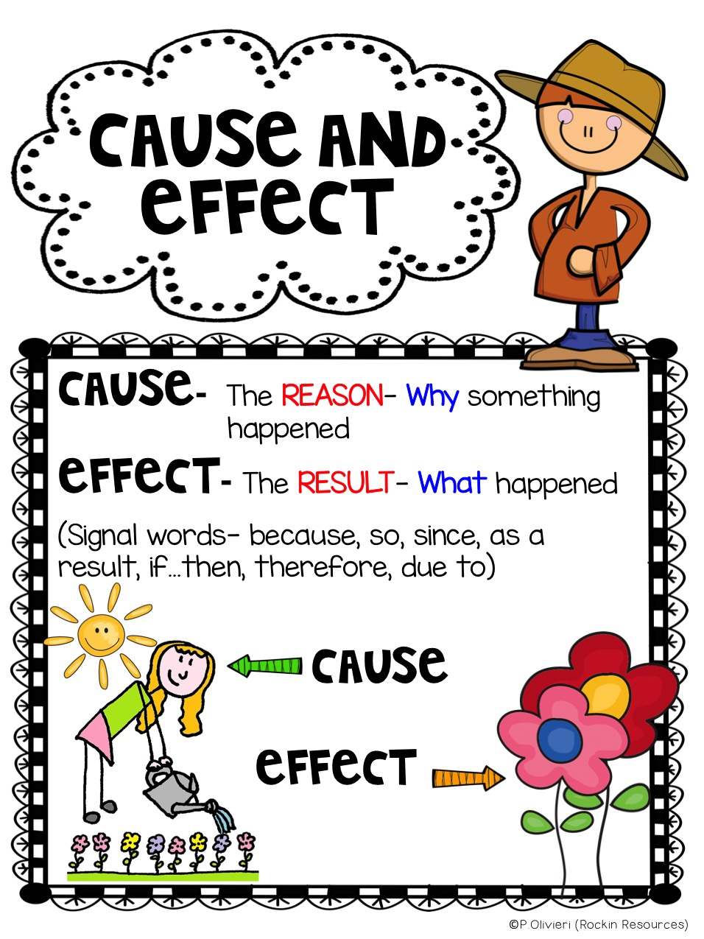
Crosscutting Concepts with MEL Activities
Cause and Effect
Systems & System Models
Energy and Matter
Stability and Change
Notes:
Donna: With 3-Dimensional learning, the Cross Cutting Concepts you choose to emphasize are not always explicit in standards. So, the Cross Cutting Concepts that may be appropriate for these MEL activities will be connected by how you frame the tasks and the questions you ask as students work through the activities. However, tonight we want to concentrate on four Cross Cutting Concepts that we feel most closely tied to the MELs we’ve developed. These are Cause & Effect, Systems & System Models, Energy and Matter and Stability and Change. This doesn’t mean that they are the only ones that could be applied, but for now, we are going to focus on these.

Slide 18
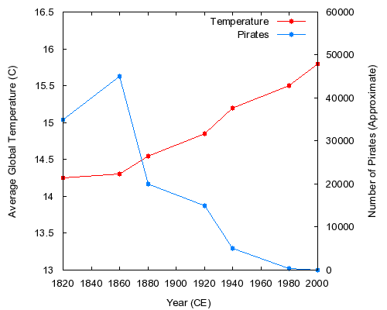
Focus: Cause & Effect
Empirical evidence is required to differentiate between cause and correlation and to make claims about specific causes and effects.
Criteria for causality:
Cause precedes effect
Cause & effect are empirically correlated
Cause and effect have a plausible interaction
Notes:
Donna: A major activity of science is investigating and explaining causal relationships and the mechanisms by which they are mediated. Events have causes, sometimes simple, sometimes multifaceted. These mechanisms can be tested across given contexts and used to predict and explain events in new contexts. It is important that students learn the difference between causality and correlation as they consider cause and effect. For example, the graph in the slide shows that as global temperatures have risen the past couple of centuries the number of pirates has decreased. This is a negative correlation in which there is no plausible interaction, therefore, the two variables are not related in terms of cause and effect.

Slide 19
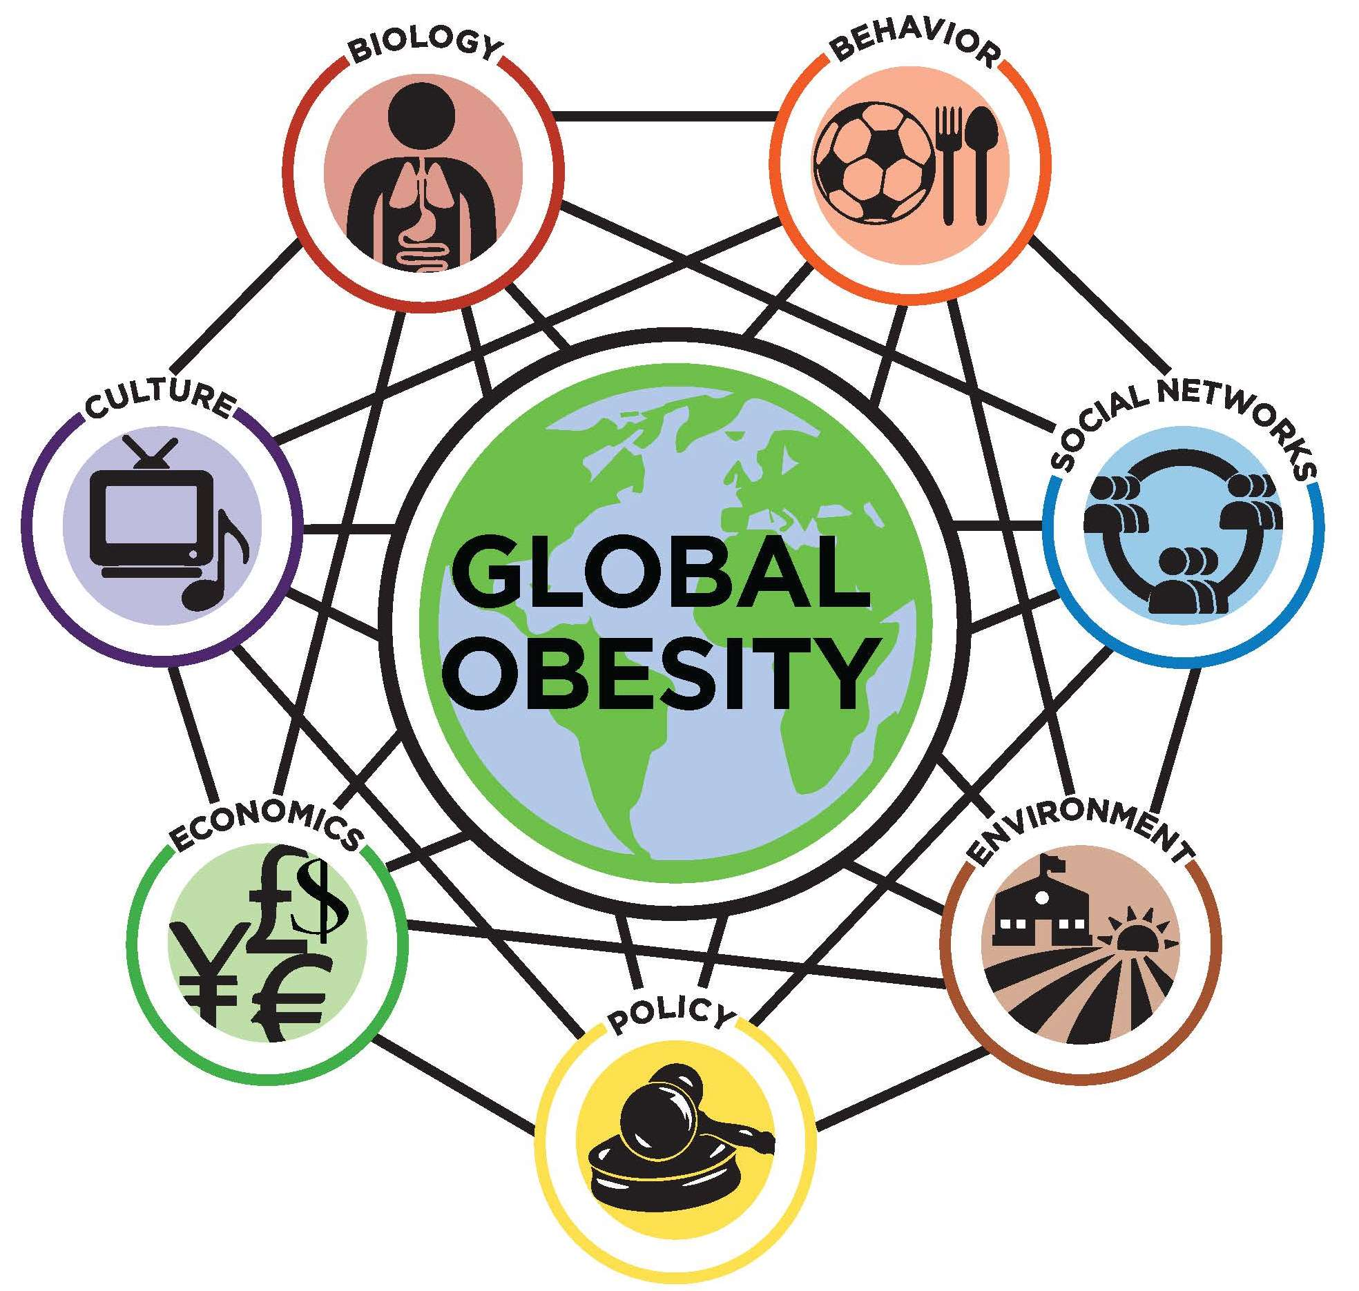
Focus: Cause & Effect
Cause and effect relationships explain and predict behaviors in complex natural and designed systems.
Phenomena may have more than one cause
Some cause and effect relationships can only be described using probability.
Changes in systems may have various causes that may not have equal effects
Deducing the cause of an effect is often difficult, so multiple hypotheses may coexist.
Notes:
Donna: When students engage in scientific argumentation, it is often centered about identifying the causes of an effect. Deducing the cause of an effect can be difficult, so multiple hypotheses may coexist. Having students evaluate connections between evidence and alternative explanatory models of a phenomenon is one of the major activities we ask students to engage in as they construct baMEL diagrams.

Slide 20
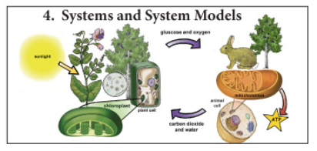
Crosscutting Concepts with MEL Activities
Cause and Effect
Systems & System Models
Energy and Matter
Stability and Change
Notes:
Donna: Systems and Systems Models is also an important Cross Cutting Concept we feel can easily be connected to MEL diagrams. Whether it’s Water in Earth’s Systems, Energy in the Atmosphere, or applying Steno’s Laws to understand stratigraphy in sedimentary rock layers, Systems and Systems Models is an appropriate Cross Cutting Concept to emphasize. It should be noted that the emphasis of Systems and System Models as a Cross Cutting concept is different than developing and using models as a science and engineering practice. As a Science and Engineering practice students construct and use models as part of an investigation. As a Cross Cutting Concept system models become conceptual tools that form the basis of Explanations, Evidence, and Representations. Defining the system under study—specifying its boundaries and making explicit a model of that system—provides a tool for understanding and testing ideas that are applicable for constructing explanations and making prediction.

Slide 21
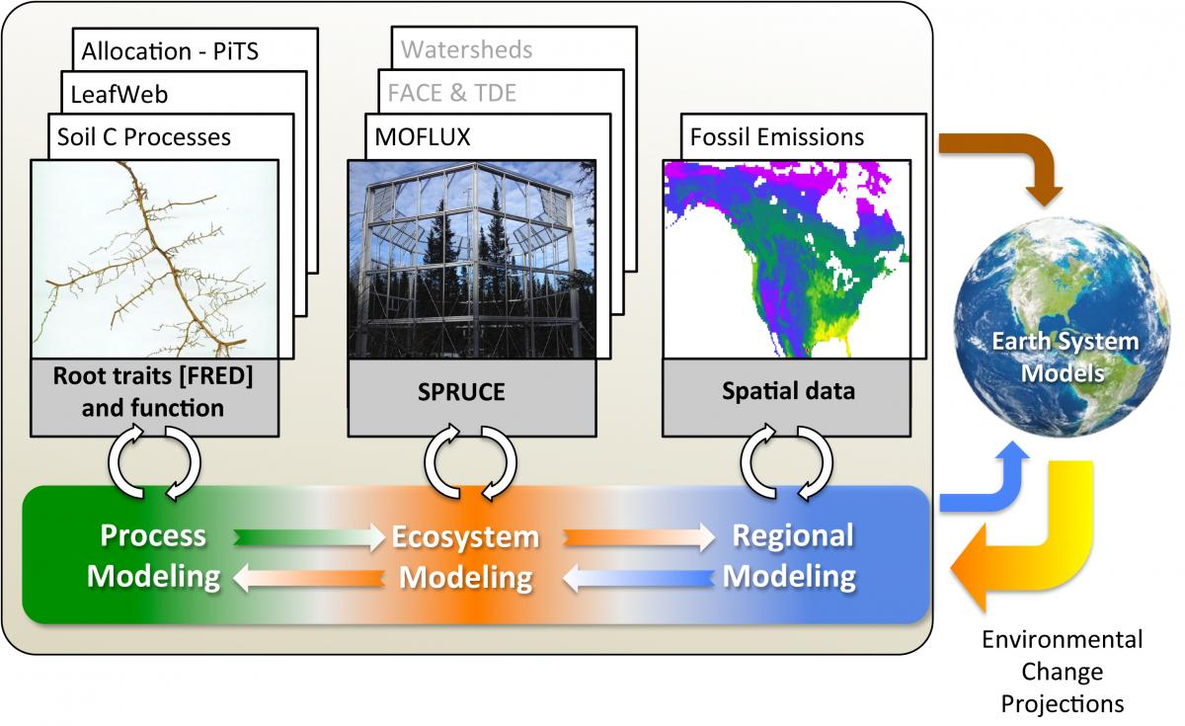
Focus: Systems & System Models
Descriptive models represent systems and interactions
Assumptions and approximations about models limit their ability to predict
Defines systems in terms of:
Boundaries and conditions
Inputs and outputs
Notes:
Donna: There are two types of system models we ask students to work with when emphasizing systems and system models as a Cross Cutting Concept. First, are Descriptive Models. These are models which define systems in terms of their boundaries and conditions. They are impacted by both inputs and outputs and when these systems are understood, explanations and predictions can be made. However, explanations are limited by both the assumptions and approximations about the model. Descriptive models of systems are important in MEL activities as students must understand system dynamics in order to make judgements about the plausibility of different explanatory models.

Slide 22
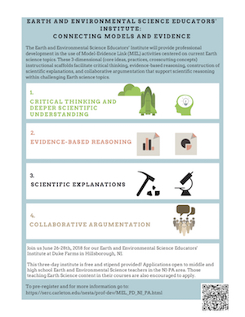
Focus: Systems & System Models
Explanatory models:
Use evidence to predict or explain phenomenon
Explain how and why a phenomenon occurs
Claims in scientific argumentation include explanatory models, with an emphasis on evidence to support the claim.
Notes:
Donna: The second type of model is an explanatory model. Explanatory models are the basis of all MEL activities as students link evidence to alternative models that are presented to explain phenomenon. These are the modeling concepts students will work with in every MEL activity as students are asked to evaluate the plausibility of alternative explanatory models.

Slide 23
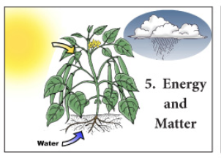
Crosscutting Concepts with MEL Activities
Cause and Effect
Systems & System Models
Energy and Matter
Stability and Change
Notes:
Donna: Energy and Matter are essential concepts in all disciplines of science and engineering, often in connection with systems. Tracking fluxes of energy and matter into, out of, and within systems helps students understand the systems’ potential and limitations.

Slide 24
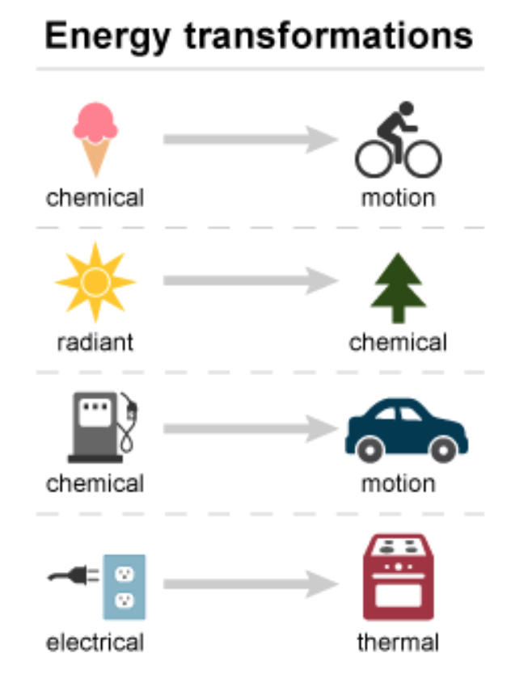
Focus: Energy & Matter
Energy is not created or destroyed, it only moves from one place and form to another
Changes of energy and matter in a system are described in terms of flows into and out of that system
Understanding changes in energy and matter can help develop explanations to explain phenomenon.
Notes:
Donna: Basic understandings of conservation of energy and matter must be considered as students evaluate the plausibility of alternative models. Whether we are asking students to evaluate alternative explanatory models of climate change, freshwater resources, extreme weather or the formation of the moon, the laws of nature and conservation of mass and energy not only apply, but are fundamental to making plausibility judgements.

Slide 25
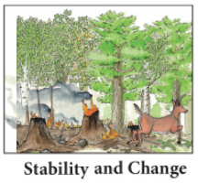
Crosscutting Concepts with MEL Activities
Cause and Effect
Systems & System Models
Energy and Matter
Stability and Change
Notes:
Donna: The fourth Cross Cutting Concept we feel is most appropriate to MEL activities is Stability and Change. Much of science deals with constructing explanations of how things change and how they remain stable. Conditions of stability and determinants of rates of change or evolution of a system are critical elements to examine. Stability indicates a condition in which some aspects of a system are unchanging, at least at the scale of observation. It doesn’t mean things don’t change - but that small disturbances will fade away as systems return to their stable condition. Other systems which include cyclic change - such as planetary orbits - can also be seen as stable, even though they are not static. Time is also a consideration as stability can exist on a small time scale, but on a large time scale, seem to be changing. Systems with steady inflows and outflows, with constant conditions, is said to be in dynamic equilibrium

Slide 26
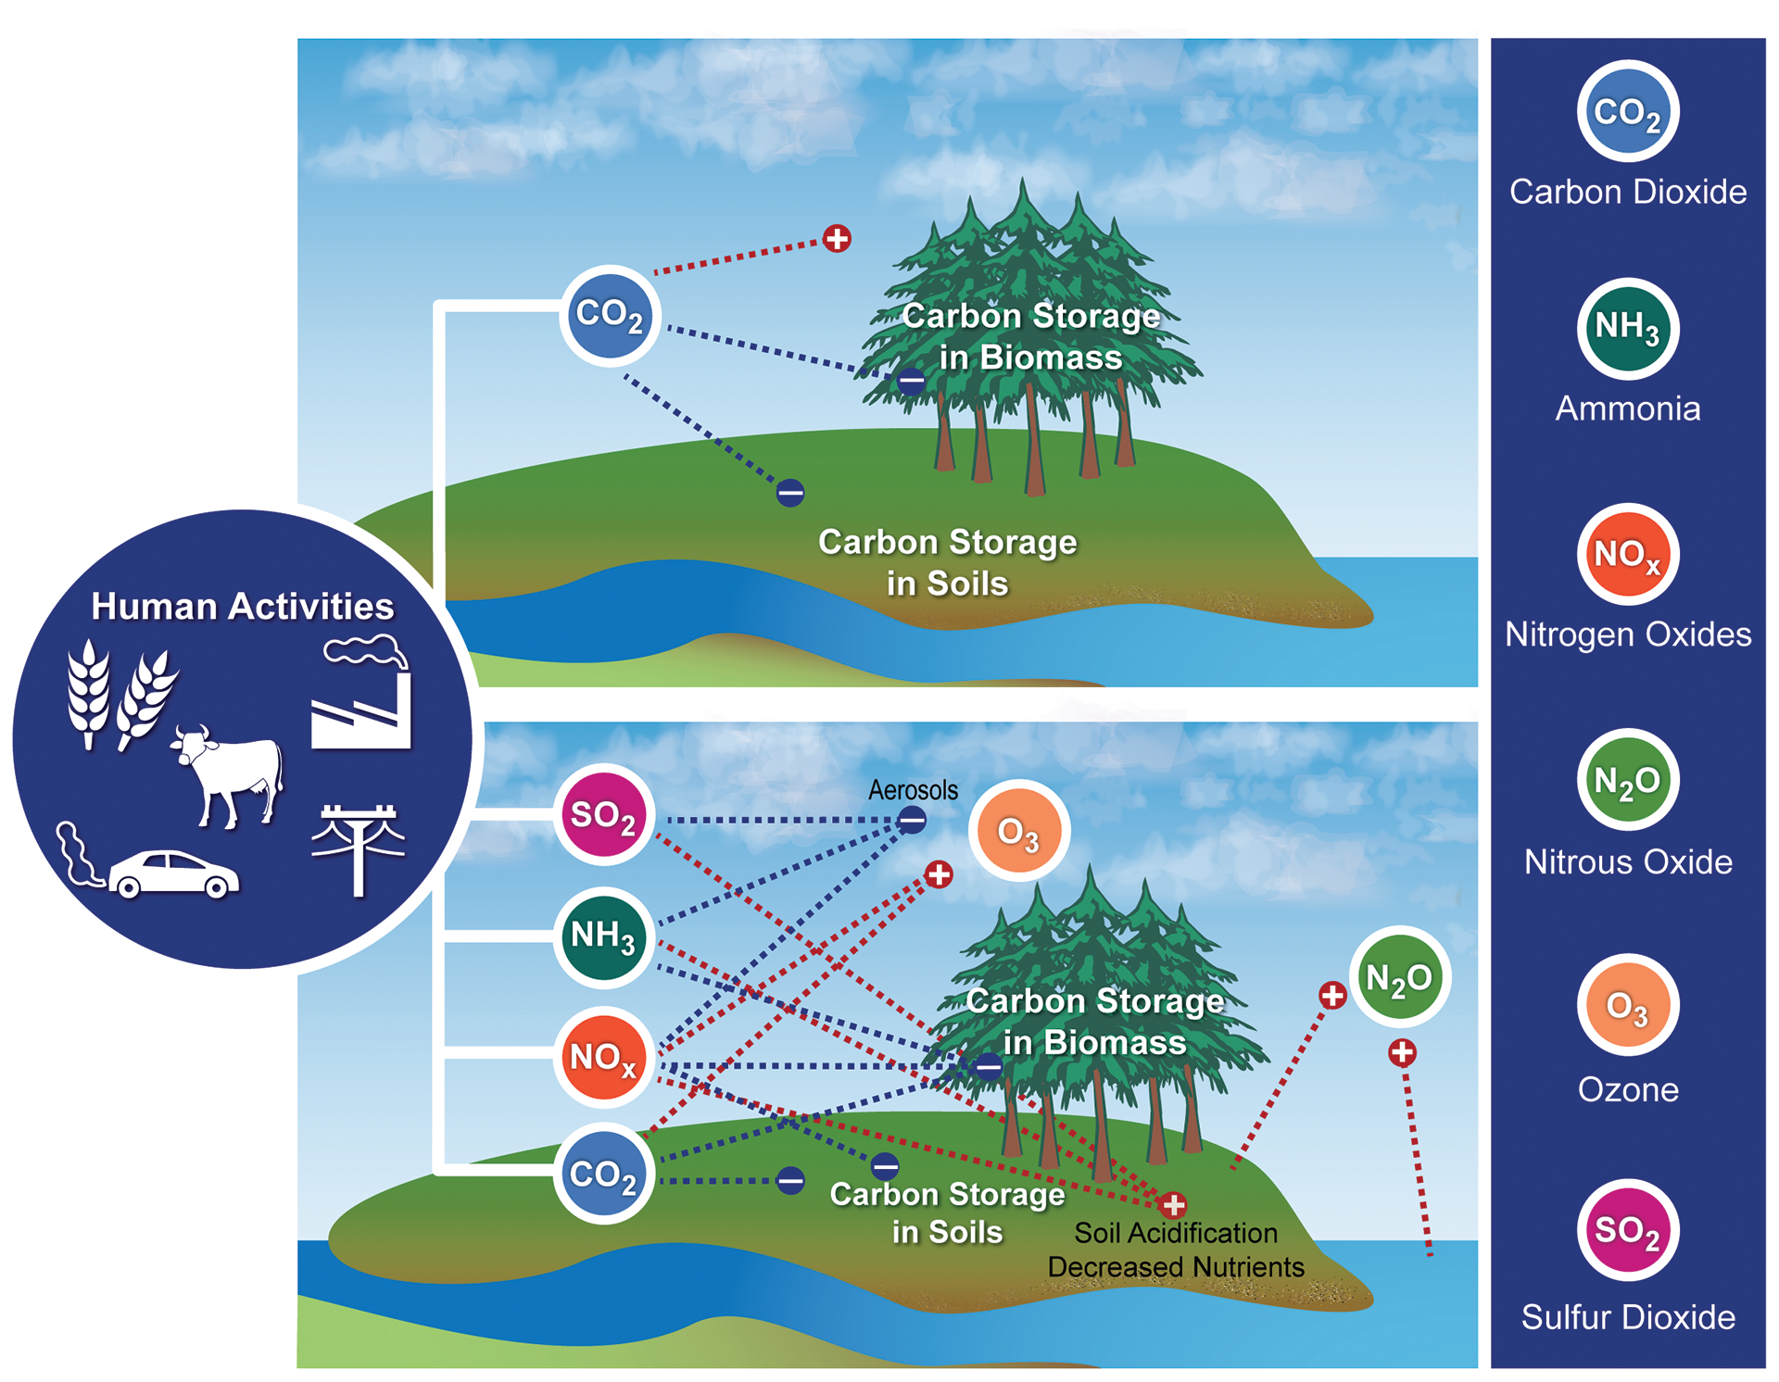
Focus: Stability & Change
Changes in one part of a system can cause large changes in another part
Systems in dynamic equilibrium are stable
Stability can be disturbed by sudden events or gradual changes
Some changes are irreversible
Notes:
Donna: Change is much more complex. When studying a system’s patterns of change over time, it is also important to examine what is unchanging. Small changes in conditions, in or with a single component of a system, can lead to runaway changes in the system, especially if regulating mechanisms are lacking. Students must be able to examine explanations of change in a systems by modeling rates of change and conditions, whether those systems are stable or gradually changing, and account for any sudden changes.

Slide 27
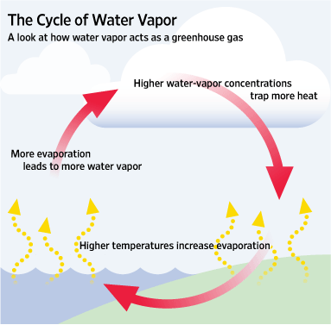
Focus: Stability & Change
Changes over time occur at different scales
Negative feedback can stabilize a system - inputs and outputs are in opposite directions
Positive feedback can destabilize a system - inputs and outputs are in same direction
Notes:
Donna: Understanding the feedback mechanisms that regulate the system’s stability, or drive its instability, provides insights into how the system may operate under various conditions. Understanding that negative feedback can stabilize a system while positive feedback can destabilize a system is important to helping students make plausibility judgements when presented with alternative models.

Slide 28
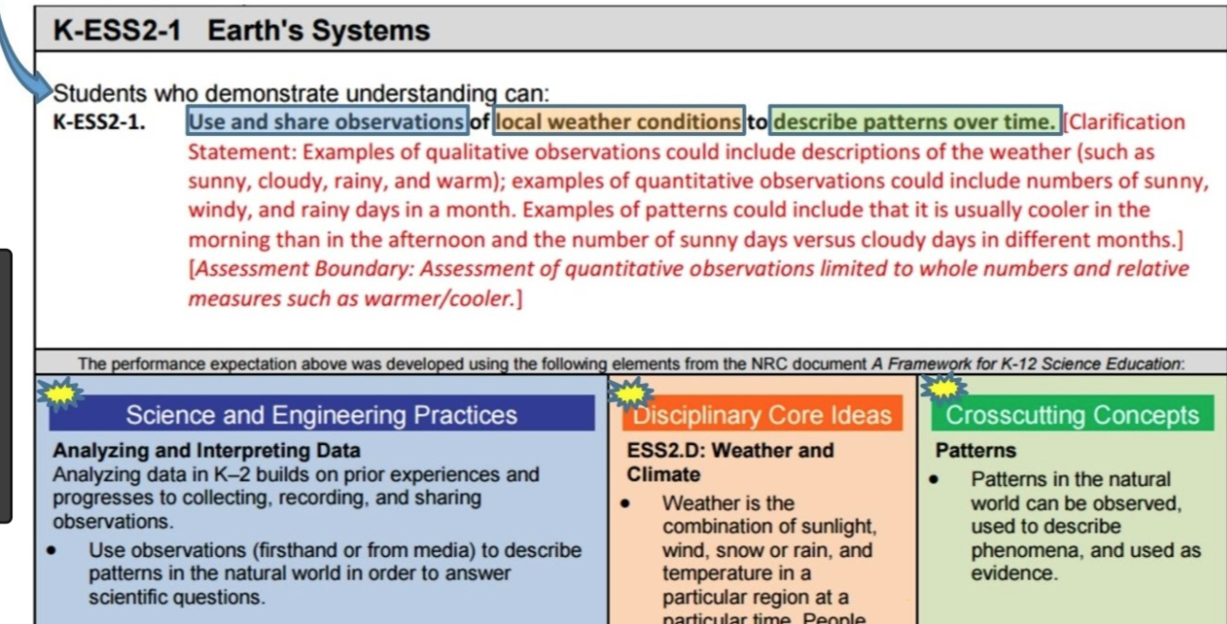
How to Embed Crosscutting Concepts into MEL Instruction?
Crosscutting Concepts are often not explicit
Determine which concepts best connect practices and content
Frame the task and questions to make explicit connections with Crosscutting Concepts
Notes:
Donna: Sometimes Cross Cutting Concepts are explicit in standards, but other times they are not. For example, in the NGSS standard shown here, it is clear that the intent is for students to examine patterns, even though as an instructor you will probably want to also have students explore stability and change and systems and system models while students explore patterns of local weather conditions. So, more than one Cross Cutting Concept may apply as you integrate the three dimensions of learning. In many standards, connections to specific Cross Cutting Concepts are less obvious. The key to understanding how to integrate Cross Cutting Concepts into instruction is in how you frame the task and the questions you ask. If you want students to evaluate a concept, such as climate change, with a focus on Stability and Change as a Cross Cutting Concept, then you frame the task with an emphasis on Stability and Change, and ask questions that relate to Stability and Change. And you look for how these concepts are addressed in student responses.

Slide 29
Webinar Outline
Review S&EP in MEL Diagrams
Introduction to Crosscutting Concepts
Crosscutting Concepts and the MEL Project
Evidence of Crosscutting Concepts - Student Explanation Task
What is a MEL Diagram?
Next Steps
Notes:
Missy takes over here

Slide 30
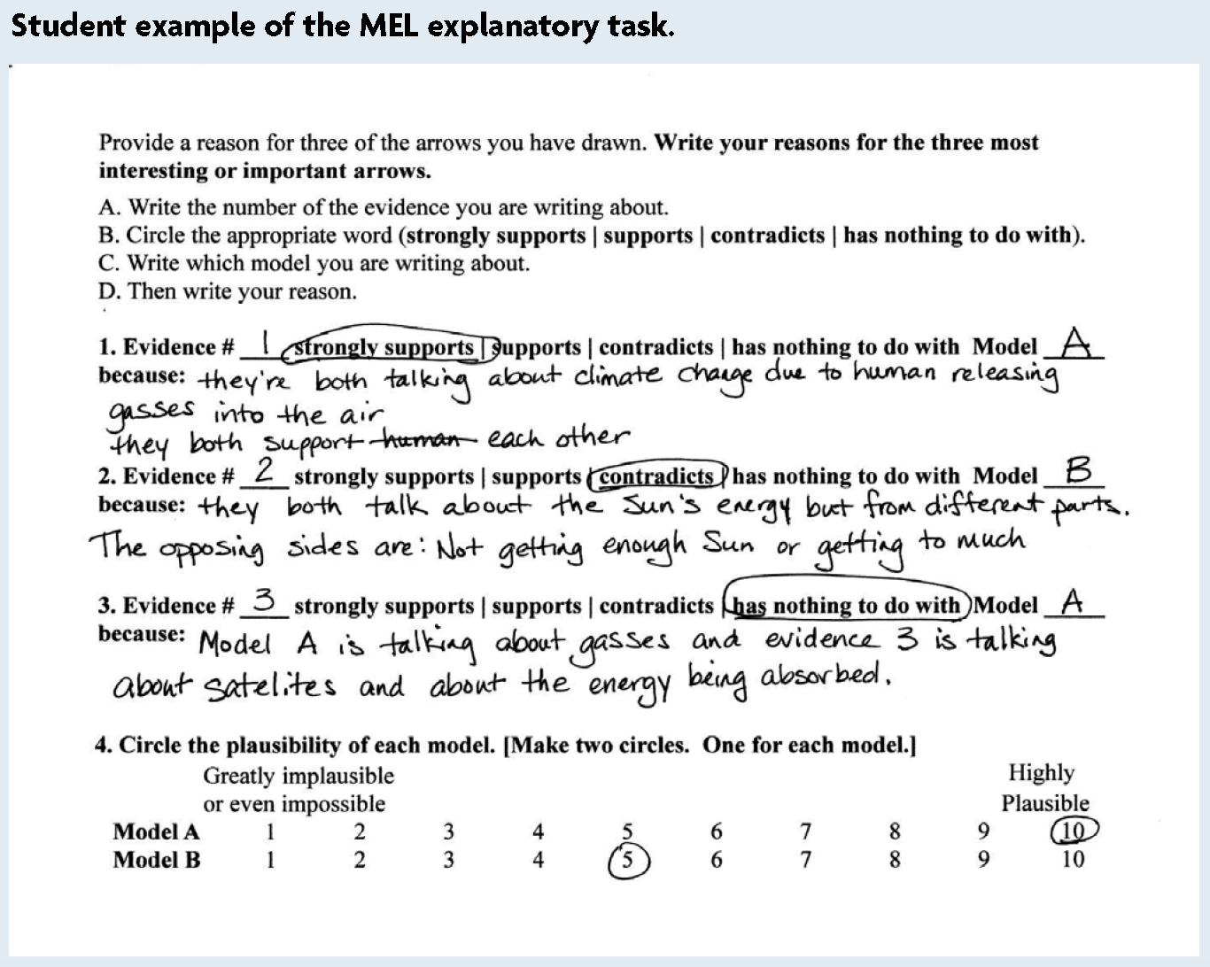
MEL Explanation Task & CCC
Cause & Effect
Energy & Matter
Cause & Effect and Systems & System Models
Notes:
Missy - carefully look at the student’s responses in the explanatory task. Which elements of which crosscutting concepts is the student applying?

Slide 31
Webinar Outline
Review S&EP in MEL Diagrams
Introduction to Crosscutting Concepts
Crosscutting Concepts and the MEL Project
Evidence of Crosscutting Concepts - Student Explanatory Task
What is a MEL Diagram?
Next Steps
Notes:
Missy: You’ve seen an introduction to MEL diagrams in the article we asked you to read last week. We’ll be working extensively with MEL diagrams at our workshop next month, so don’t worry if you don’t feel like an expert yet. Doug, our project lead, has been working with MELs the longest, and we’ve asked him to talk us through a brief overview of these activities at this time.

Slide 32
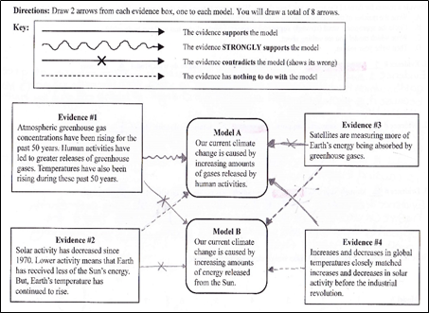
The MEL: a scaffold to help students evaluate the connections between lines of evidence & alternative explanations
The MEL diagram structure was developed by Rutgers Univ. researchers: Clark Chinn, Ravit Golan Duncan, Rick Duschl (now at PSU) & others
Notes:
Doug - add as many as you need - you’ll have about 10 minutes for your part. Remember this is just an overview

Slide 33
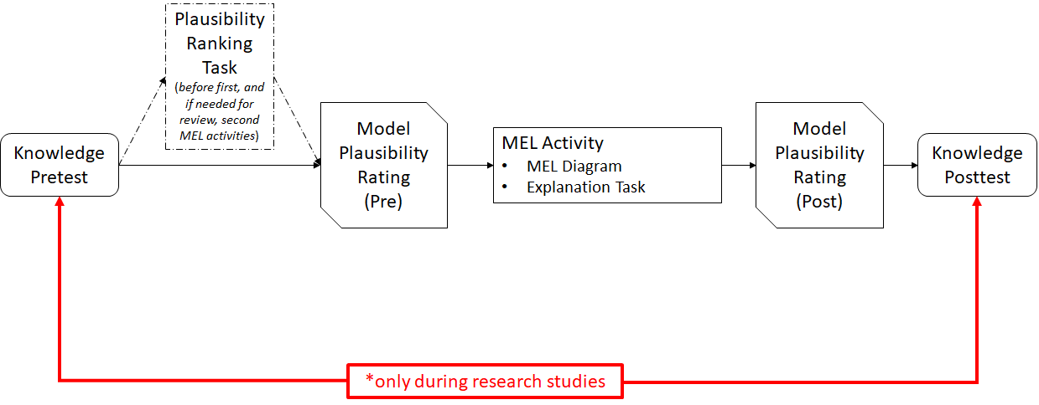
Our team has expanded the MEL into a suite of instructional activities for Earth & space science
Notes:
Doug - add as many as you need - you’ll have about 10 minutes for your part. Remember this is just an overview

Slide 34
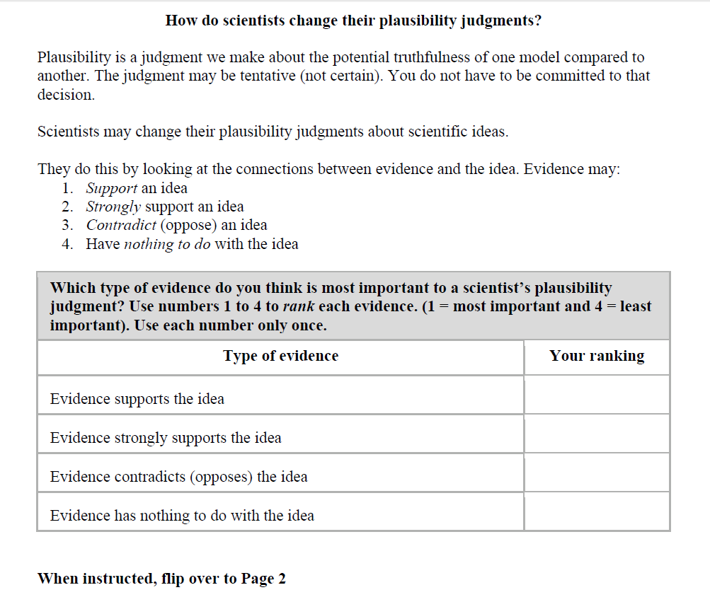
The Plausibility Ranking Task
This task is usually done once a school year, just before students do their first MEL
Notes:
Doug

Slide 35
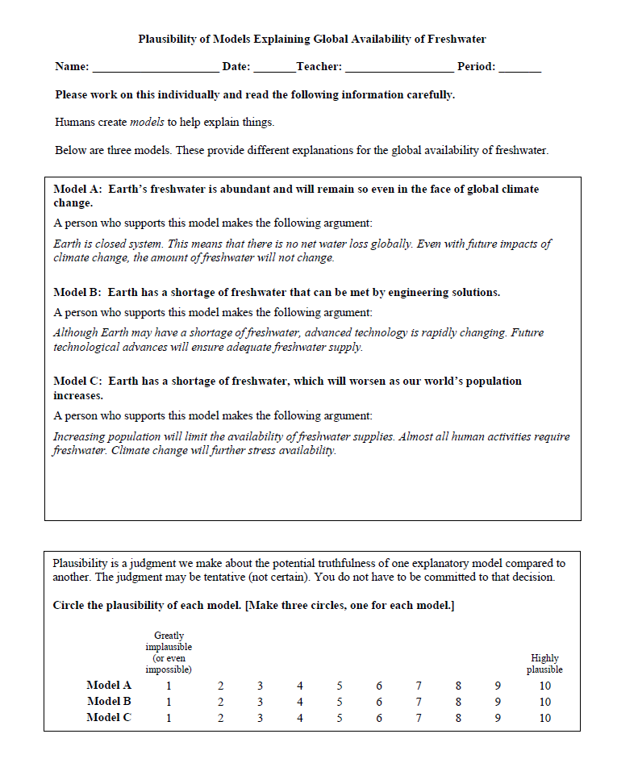
Model Plausibility Ratings
At the start of each MEL activity, students are introduced to 2 or 3 alternative explanatory models about a phenomenon
Notes:
Doug

Slide 36
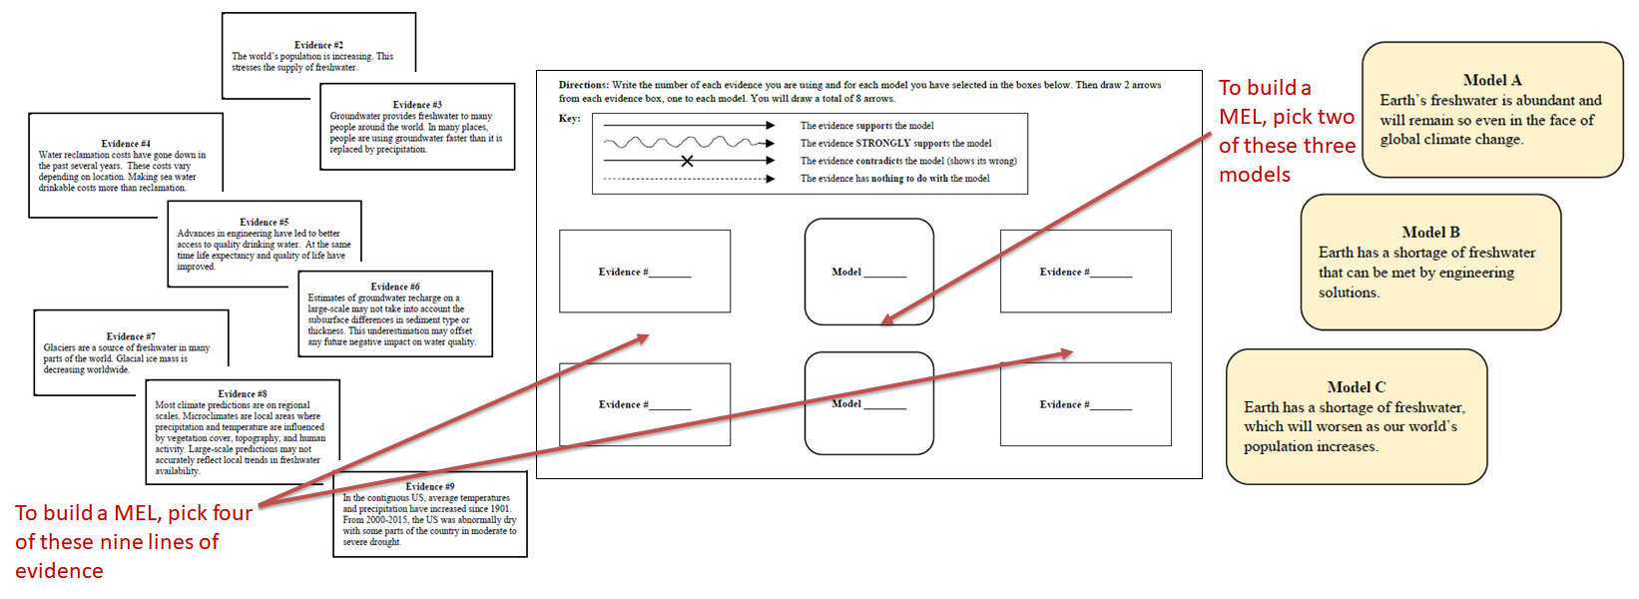
Build-a-MEL
The four build-A-MELs (baMELs) are new and now accompany our other four pre-constructed MELs
Notes:
Doug

Slide 37
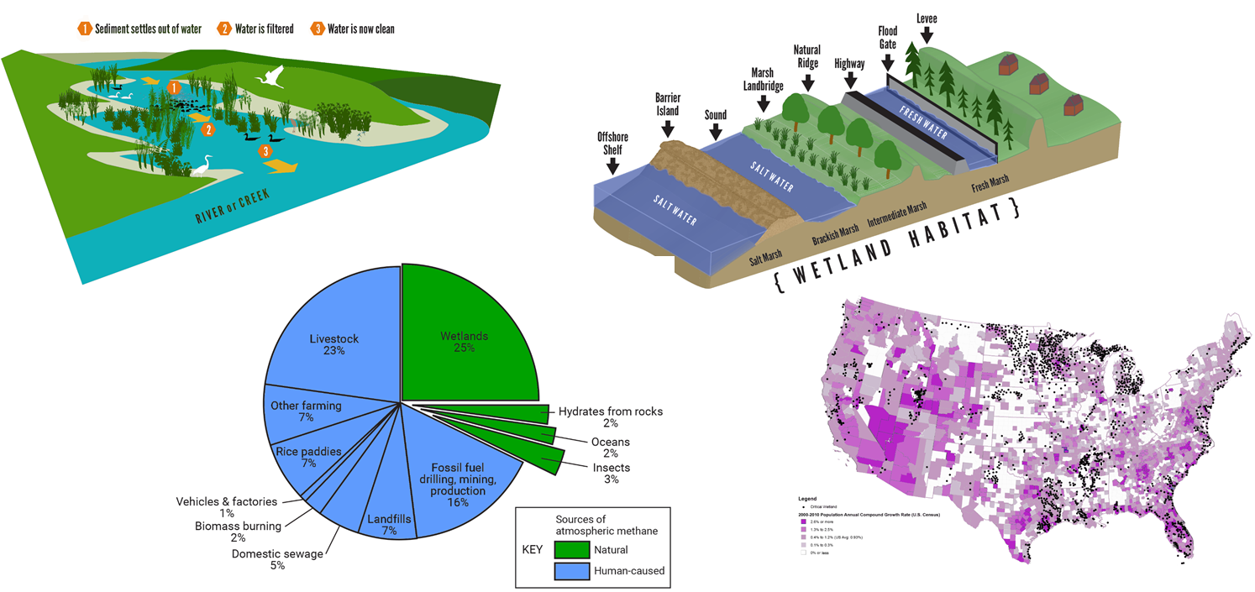
Evidence Texts
These are examples of figures associated with the evidence texts, which are elaborative sources about each line of evidence
Notes:
Doug

Slide 38
Webinar Outline
Review S&EP in MEL Diagrams
Introduction to Crosscutting Concepts
Crosscutting Concepts and the MEL Project
Evidence of Crosscutting Concepts - Student Explanatory Task
What is a MEL Diagram?
Next Steps
Notes:
Missy

Slide 39
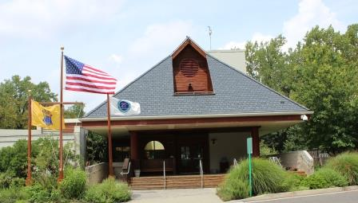

Next Step: See you at the Institute!
About the Institute:
Lunch and snacks will be provided
Bring a laptop
Dress comfortably!
Georgia Teachers:
Complete forms for stipend (from UNG) -
Will be sent the week before the workshop
Bring to the Institute!
June 10-12, Forsyth County District Office
June 25-27, Palmyra Cove NJ
Notes:
Missy & Donna

Slide 40
Questions?
For general questions, use the Chat Box
For specific questions, email us at MEL2institutes@gmail.com
Evaluation: https://www.surveymonkey.com/r/19_MEL_2
Please complete by Wednesday, May 22, 9 pm EDT
MEL2 Project website: https://serc.carleton.edu/mel/index.html
Webinar 2 page on the project website: https://serc.carleton.edu/mel/prof_dev/webinar_2.html
Summer Institute page on the project website:
Thank you - See you on the first day of the summer institute! Please remember to bring your laptop
Notes:
Missy

Slide 41







ACKNOWLEDGEMENTS
The material in this Webinar is based upon work supported by the NSF under Grant No. DRL-1316057 and Grant No. DRL-1721041. Any opinions, findings, conclusions, or recommendations expressed are those of the authors and do not necessarily reflect the NSF’s views.

