Slide 1
Biodiversity Conservation

Slide 2
In this activity, you will explore the current “Sixth Extinction” and biodiversity conservation.
By the end, you should be able to:
Explain the impacts of humans on biological diversity.
Compare and contrast the causes and rates of the sixth extinction with previous mass extinctions from the fossil record.
Evaluate criteria for setting species conservation priorities.
Distinguish between ex situ and in situ conservation approaches.
Notes:
Goal #4 is optional, depending on time available. This works well in longer (60–75 minute) class periods, but for a 50-minute class period, it is recommended that instructors omit this goal, along with slides 5–8.

Slide 3
What is Biodiversity Conservation?
Maintaining the diversity of species, habitats, and the interrelationships between organisms and the environment to keep ecosystems healthy and functioning.

Slide 4
Why Should We Conserve Biodiversity?
Biological Resources
  Food, fibers, medicine, wood products, etc.
Ecosystem Services
  Decomposition of waste, pollination, water purification, flood control, increased soil fertility, etc.
Social & Spiritual Benefits
  Cultural and aesthetic value, recreation & tourism, etc.
Notes:
Pose the question “Why should we conserve biodiversity?” to the class as a think-pair-share opportunity. Give students a minute or two to answer the question on their own, then another minute to discuss their answers with a partner, then ask students to share answers with the class. Give students the chance to provide multiple answers before clicking to bring up the bulleted points and covering the topic/answers.

Slide 5
How: Ex Situ or In Situ Conservation?
Ex situ: Conservation of the components of biological diversity “off-site,” or outside their natural surroundings.
In situ: Conservation of species, habitats, or ecosystems “on-site,” or in their natural surroundings
Notes:
Optional slide for Learning Goal 4. Omit if not using Learning Goal 4. Omitting this goal and slides 5–8 is recommended for 50-minute class periods.

Slide 6
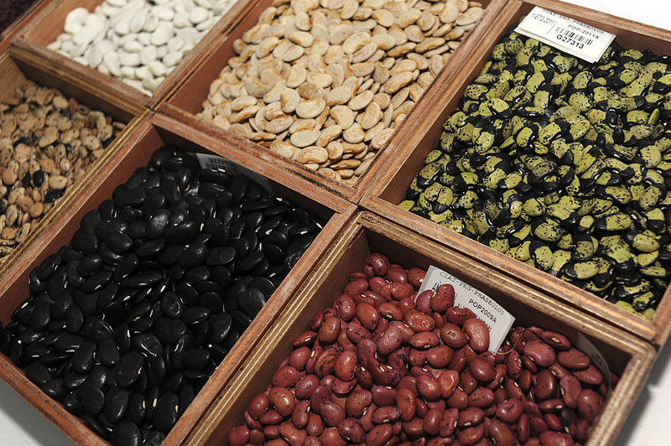
Ex situ conservation
  Zoos, botanical gardens, aquaria
  Storage of tissues, seeds, pollen, semen, ovules, embryos, microbial cultures, DNA
  Field gene banks or livestock parks, if materials cannot be dried or frozen
Beans at the CIAT gene bank in Colombia. Photo by Neil Palmer (CIAT)
Notes:
Optional slide for Learning Goal 4. Omit if not using Learning Goal 4. Omitting this goal and slides 5–8 is recommended for 50-minute class periods.
Image source: http://commons.wikimedia.org/wiki/File%3ASix_bean_varieties_at_a_gene_bank.jpg. This photo is used under a Creative Commons license.

Slide 7
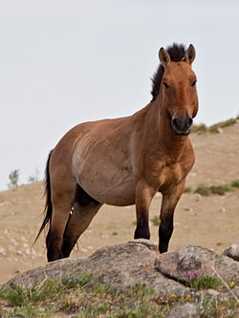
Ex situ conservation
Provides “insurance policy” and can play important role in recovery programs.
Example: Przewalski’s horse, native to the steppes of Asia, went extinct in the wild ~1966.
Captive breeding of 13 individuals in zoos allowed the population to rebound to >1,500 individuals and successful reintroduction in Mongolia.
Photo of Przewalski’s horse at Hustai National Park, Mongolia by Chinneeb.
Notes:
Optional slide for Learning Goal 4. Omit if not using Learning Goal 4. Omitting this goal and slides 5–8 is recommended for 50-minute class periods.
Image source: http://commons.wikimedia.org/wiki/File%3ATakhi_Hustai.jpg. This photo is used under a Creative Commons license.

Slide 8
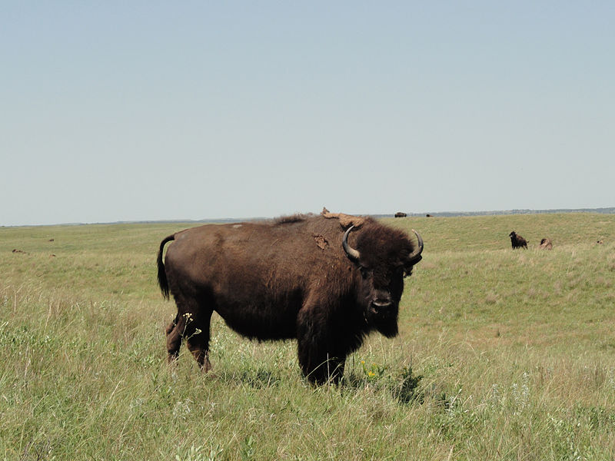
In situ conservation
  Nature reserves
  National parks
  Wildlife refuges
  Habitat management
  Habitat restoration
Bison at Fort Niobrara National Wildlife Refuge, Nebraska, USA.
Photo by Ben Edwards, U.S. Fish and Wildlife Service Headquarters
Notes:
Optional slide for Learning Goal 4. Omit if not using Learning Goal 4. Omitting this goal and slides 5–8 is recommended for 50-minute class periods.
Image source: hhttp://commons.wikimedia.org/wiki/File%3ABison%2C_Fort_Niobrara_National_Wildlife_Refuge_(6450002667).jpg. This photo is used under a Creative Commons license.

Slide 9
Setting Priorities for
Biodiversity Conservation
It is impossible to actively conserve all species because of limited time and money.
As a result, humans must make decisions about how to target conservation efforts so limited resources can have the greatest impact.
So, how do we decide?

Slide 10
Setting Priorities
Iconic or ambassador species (flagship species)
  Examples: Giant pandas, tigers, whales
Large, land-demanding species (umbrella species)
  Often large carnivores or migratory species
Ecologically important species (keystone species and ecosystem engineers)
  Examples: Wolves, beavers, elephants
Economic value/ecosystem goods or services
  Examples: honey bees, wetlands that filter water

Slide 11
Setting Priorities
Biodiversity
  How many species are in the region?
Endemism or distinctiveness
  Are there rare or endemic species in the area? Is it a unique habitat? Is it in country with few other reserves?
Extinction risk
  How threatened is the species or habitat?
  (Least Concern, Near Threatened, Vulnerable, Endangered, Critically Endangered, Extinct in Wild)
Notes:
International Union for Conservation of Nature (IUCN) categories are generally considered the global standard and listed in last bullet point. More information can be found here: https://portals.iucn.org/library/efiles/documents/RL-2001-001-2nd.pdf

Slide 12
Setting Priorities
Likelihood intervention will be successful
Relative cost of conserving the particular species or habitat
Cultural/aesthetic/recreational value
Expected future changes to threats
  Will the proposed area still support the species of concern if climate changes or human impacts in surrounding areas increase?

Slide 13
Evaluating Criteria
Think about the criteria for 1-2 minutes.
Write down the five criteria you think are most important for deciding which species or habitats to conserve.
Notes:
Use a think-pair-share strategy to have students evaluate criteria for deciding on conservation priorities. Ask students to think alone for a minute or two to come up with their top five criteria from the list on the slide that they think should be the most important for deciding which species or habitats to protect. Next, ask students to form a group of 3-4 and share ideas. Have them choose their top three priorities as a group and write a short justification for each. Finally, have each group share one or two (depending on class size/number of groups) of their top priorities and justification with the class.

Slide 14
Evaluating Criteria
Form groups of 3-4 and share ideas.
As a group, choose your top three priorities and write a short justification for each. Be prepared to share these with the class in ~5 minutes.
Notes:
Use a think-pair-share strategy to have students evaluate criteria for deciding on conservation priorities. Ask students to think alone for a minute or two to come up with their top five criteria from the list on the slide that they think should be the most important for deciding which species or habitats to protect. Next, ask students to form a group of 3-4 and share ideas. Have them choose their top three priorities as a group and write a short justification for each. Finally, have each group share one or two (depending on class size/number of groups) of their top priorities and justification with the class.

Slide 15
Applying Criteria
You are members of Conservation World, a large international organization that funds conservation projects.
Your task is to evaluate the potential projects in your packet. Resources are limited, so you must choose one that you will recommend to the board of directors for funding. You must include a justification for your recommendation.
You will make your recommendation to the Board (class) in 15 minutes.
Notes:
Conservation World does not exist. It is a name used to stand in for any large conservation organization such as World Wildlife Fund, Conservation International, The Nature Conservancy, Natural Resources Defense Council, The Ocean Conservancy, Sierra Club, etc. We did not want to endorse one organization over any others, but you could substitute the name of an actual organization if you choose.

Slide 16
References
Maxted, N. 2001. Ex situ, in situ conservation. Encyclopedia of Biodiversity, Volume 2. https://enviro.doe.gov.my/lib/digital/1385455130-3-s2.0-B0122268652001152-main.pdf
Slide 4. Creative Commons Image by Neil Palmer (CIAT) (NP_Genebank2011_1) [CC BY-SA 2.0 (http://creativecommons.org/licenses/by-sa/2.0)], via Wikimedia Commons
Slide 5. Creative Commons Image by Chinneeb (Own work) [CC BY-SA 3.0 (http://creativecommons.org/licenses/by-sa/3.0) or GFDL (http://www.gnu.org/copyleft/fdl.html)], via Wikimedia Commons
Slide 6. Creative Commons Image by U.S. Fish and Wildlife Service Headquarters [CC BY 2.0 (http://creativecommons.org/licenses/by/2.0)], via Wikimedia Commons

