Slide 1

InTeGrating Grand Challenges into Your Course & Supporting Strategic Growth
Sarah Fortner, Amber Burgett
Notes:
Include overview of the InTeGrate project and our materials development team from 3 different institutions.
Our team followed the InTeGrate module development process; in this talk we will highlight key components of the process that were significant to our experience and that informed the final version of the module.

Slide 2

What are the grand challenges humanity faces into the future?
What are the skills & habits needed to face these challenges?
Opportunity: Meeting the needs of our students & the communities they serve to grow strategically
Mission
Societal Relevance
Critical Thinking

Slide 3
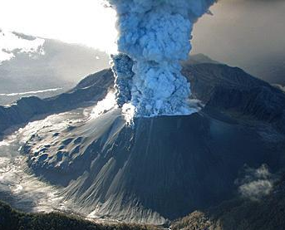
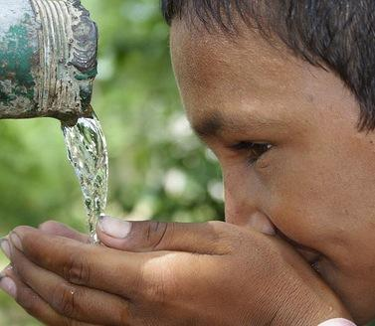
Interdisciplinary Teaching for a Sustainable Future
Meeting these challenges will require a savvy public, a new kind of workforce, and a broader understanding of the earth by all who engage these issues
Approach:
Integrate learning about Earth with an understanding of the issues we face,
  Develop capacity for teaching higher order, interdisciplinary problem solving skills,
  Open up new venues for learning
USGS
Barefoot Photographers of Tilonia

Slide 4
Curricular Approach Supports Faculty & Students
collaboration between faculty & experts
supports shared vision & innovation
learning goals aligned with assessments
builds habits central to addressing challenges:
interdisciplinary, authentic data, systems thinking, scaffolding

Slide 5
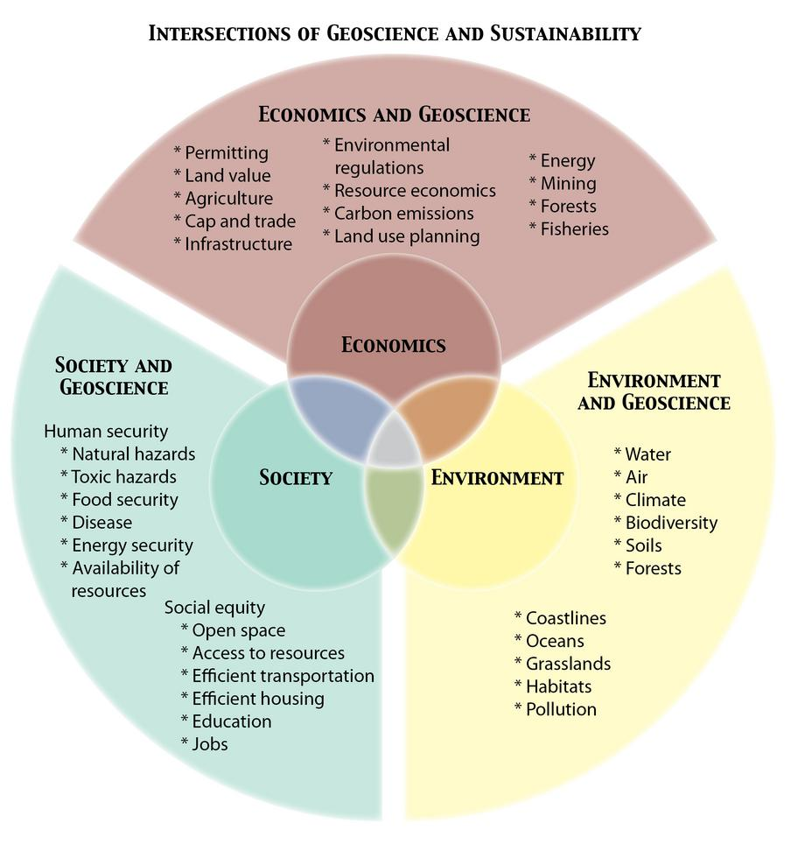
Building Models for Infusing Key Ideas from InTeGrate into the Curriculum
16 Efforts, Single & Cross-Institutional
Goals Fit Participant Interests: Liberal Arts, General Education, TA training, Diverse Students, Online/Hybrid Models

Slide 6
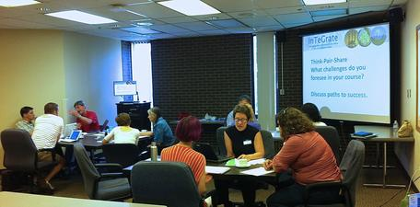
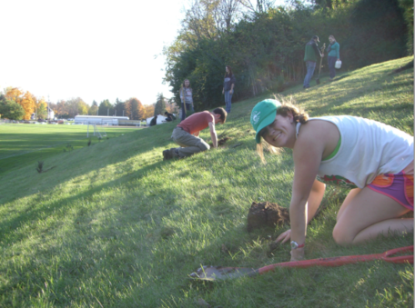
Wittenberg’s Implementation Program:
2014-2016
STEAM Effort to Build Capacity for a Theme or Program Across Disciplines (Module Implementation Underway)
First Year Seminar Programming (Underway)
Interdisciplinary Projects that Address Grand Challenges: Mission-aligned

Slide 7

Wittenberg’s Implementation Program:
Increase in the number of faculty (10 Wittenberg Faculty Participants, 4 SOCHE to date), programs, & students in sustainability courses
Three faculty materials authors
FYE students are introduced to personal role in sustainability (~900 students as of 2016)
Increase in shared programing & curricular exchanges
Student learning gains & positive attitudinal shifts documented across InTeGrate effort
Visibility for sustainability has grown in institutional & local media: 20+ local articles featuring Wittenberg & sustainability topics since 2014, 3 national stories featuring Wittenberg’s InTeGrate Effort
National Recognition (Princeton Review, STARs, GSA, AGU, National Academies)
Notes:
#s of students, #s of faculty, #s of courses (STARS)

Slide 8
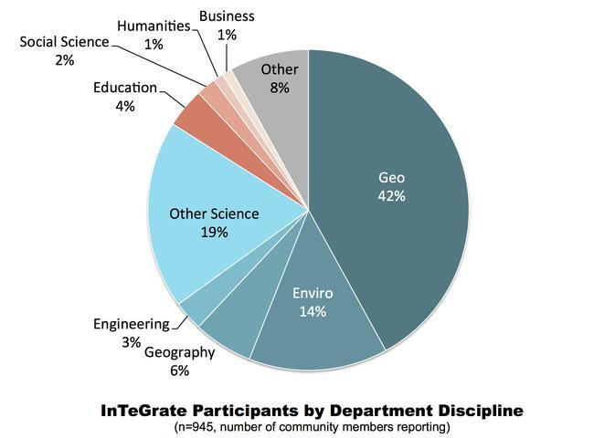
Wittenberg Expands the Disciplines Involved

Slide 9
Wittenberg’s Capacity for Growth: Strength in Engaged Learning
66% of departments indicate that all of their majors interact with professionals in the field
71% of departments have majors working on collaborative projects
Interdisciplinary projects in:
  Economics -Art
  Communication -History
  Political Science -Biology
  Business -Languages
  HFS -Urban Studies
  Geology/ESCI -Psychology
Notes:
81% say at least 75% of majors interact with professionals in field

Slide 10
Wittenberg’s Capacity for Growth: Strength in Engaged Learning (Engaged Learning Audit)
Current Projects on Public Health/Sustainability:
Economics- “Early Plagues and Public Health Care Initiatives”
Communication- “Sustainability Loan Fund Grant for lighting in campus buildings”
Languages- “researching indigenous medicine”
Psychology- “Hagen Center’s Mental Health First Aide for Youth Training”
Exercise Science- “Wittenberg Employee Wellness program”
Environmental Science-”Soil lead evaluation & collaboration” with Clark County Combined Health, SPN, HUD
Current Projects with Stakeholders:
Economics- “Springfield housing price projects”
Communication- “Work with Hagen Center...service learning”
History- “Wescott House, Heritage Center”
Political Science- “Springfield City School District”
Art- “Clark County Juvenile Detention Center”
HFS- “YMCA, NTPRD, and the Chiller”
Women’s Studies- “On-the-Rise Farms, Oesterlen, Restavek Foundation”

Slide 11
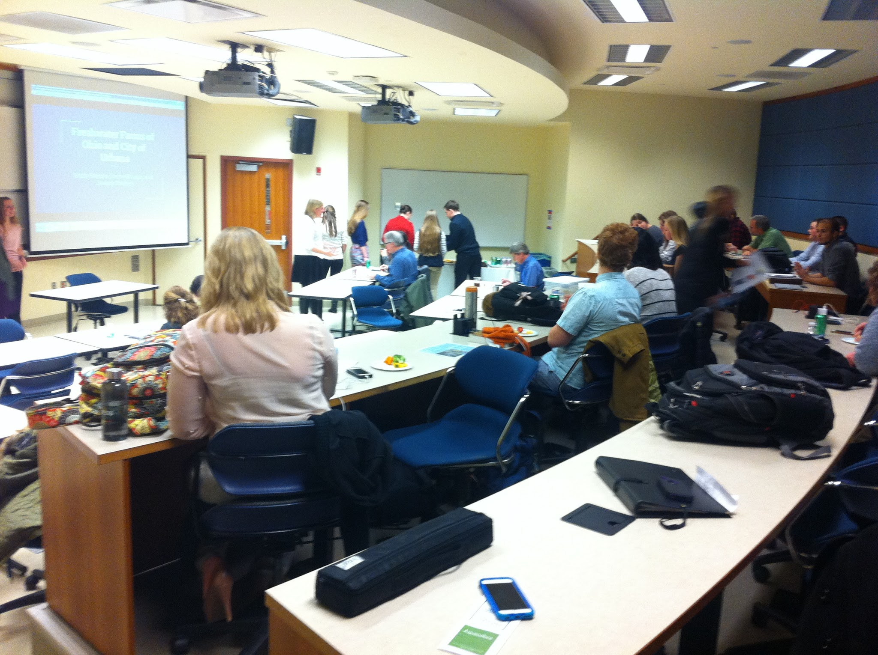
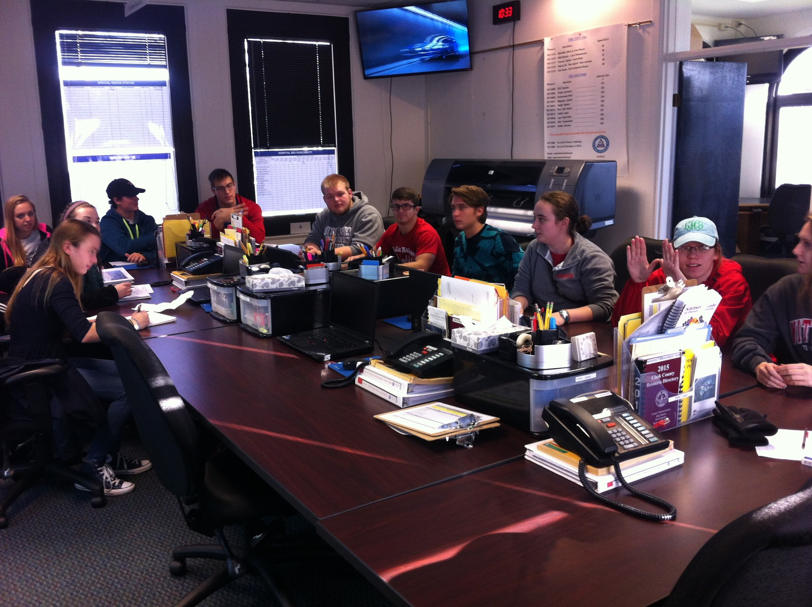
Upcoming Workshop: Sat Feb. 20th
9:00-1:00
Build course-based projects that address grand challenges in sustainability/public health (6 contact hour)
Collaborate with stakeholders
  Community Development
  Stormwater
  Agribusiness
  Risk Management
  Health Department
  Local Food Movement
  Parks & Recreation

Slide 12

Approach
Collective Discussions with Stakeholders on Key Local Issues & Opportunities
Build class projects using backward design using InTeGrate + VALUE Rubric for Inquiry & Analysis (Interdisciplinary, authentic community-based research)
Collect data that will inform the Hagen Center, & a national audience interested in service learning & student success (literature gap: program-wide collaborative efforts)
Share products/case studies of our students in action
Support the development of signature work: (LEAP Challenge)
http://www.aacu.org/sites/default/files/files/LEAP/LEAPChallengeBrochure.pdf

Slide 13

Why should you participate?
You have interest in building capacity for new programs/curricular connections at Wittenberg in Sustainability & Public Health
You are interested in rigorous approaches to service learning aligned with the Liberal Arts Community (AAC&U)
You would like to explore the intersection between your class & stakeholder interests; identifying areas of collective momentum
You are interested in assisting a National Sustainability effort & being part of data that moves curriculum forward & improves visibility
Notes:
This might be the last slide, but 12 & 13 can be shown if there is time

Slide 14
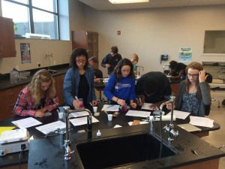
Regional Context
Agribusiness employs 1 out of 7 jobs Ohioans
8 out of 10 Ohio employers (hubs) in the health sector
Municipal decision making centers on infrastructure. Safe water, green designs to improve stream quality
River corridors, lakes are a major source of revenue
Economic activities across sectors are disrupted by climate change (increased flood frequency/drought)
Local 2Y & high schools are building capacity in health & applied environmental sectors (Pathway Options)
Global Impact STEM Academy

Slide 15
A National Survey of Business and Nonprofit Leaders: Key Findings
Nearly all employers surveyed (93 percent) say that “a demonstrated capacity to think critically, communicate clearly, and solve complex problems is more important than [a candidate’s] undergraduate major.”
More than 75 percent of those surveyed say they want more emphasis on five key areas including: critical thinking, complex problem solving, written and oral communication, and applied knowledge in real-world settings.
80 percent of employers agree that, regardless of their major, every college student should acquire broad knowledge in the liberal arts and sciences.
Opportunity: Projects that address grand challenges from multiple perspectives
https://www.aacu.org/press/press-releases/employers-more-interested-critical-thinking-and-problem-solving-college-major

