Slide 1
The sample
Matched pre-post sample, N=182
62% female, 38% male;
13% Hispanic; 83% not Hispanic
80% white, 7% Asian, 3% black
17% freshman; 38% second year; 27% third year; 17% fourth year
Average age = 20.78

Slide 2
Declared Majors, pre and post
Had declared major: 73% pre; 87% post

Slide 3
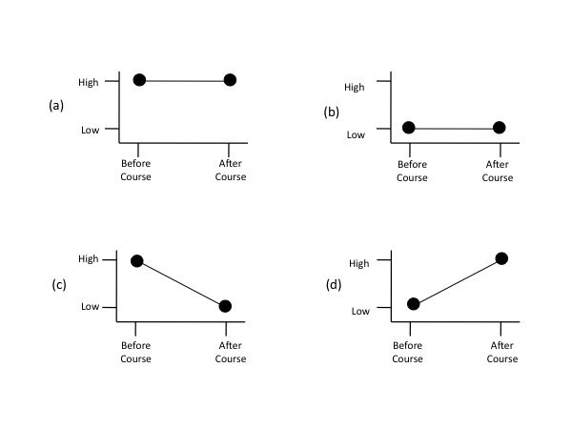
Change in Environmental Sciences career interest (post test)
A= 25%
B= 40%
C= 3%
D= 32%

Slide 4
Concern about global issues, pre and post

Slide 5
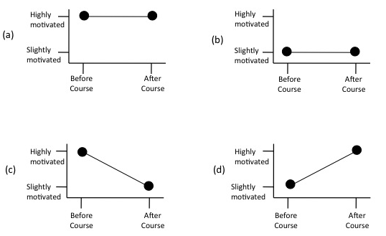
Change in motivation to make sustainable choices (Post test)
A= 35%
B = 23%
C = 1%
D= 42%

Slide 6
Post test
Can you envision using what you have learned in this course to help society overcome problems of environmental degradation, natural resource limitations, or other environmental issues?
YES: 79%
NO: 20%

