Slide 1
Assessment and evaluation results overview
David Steer, The University of Akron
Ellen Iverson, Science Education Resource Center

Slide 2
Road check
Copyright
http://serc.carleton.edu/integrate/info_team_members/currdev/copyright.html
Illustrations
Updating of Materials in the future
  Links; data; relevancy
Structure of the final module

Slide 3
Increasing the credibility of our work
Journal of Geoscience Education
  Curriculum and Instruction Track
A description of how the authors' experiences support (or reject) the effectiveness of the described tool for the target population and setting is included. This should be accompanied by evidence of effectiveness (such as examples of student work). For example, see Chapter 8 of Wiggins and McTighe (2005) for a discussion related to evidence of validity in instructional design.

Slide 4
What we need to show
Increase student geoscience literacy
Better ability to engage in the process of science
Improved capacity to solve interdisciplinary problems

Slide 5
What we have (for some Teams)
Geoscience Literacy Exam questions (Pre/Post)
Geoscience Literacy Exam Essays (Post)
A variety of assessments
Attitude survey (Pre/Post)

Slide 6
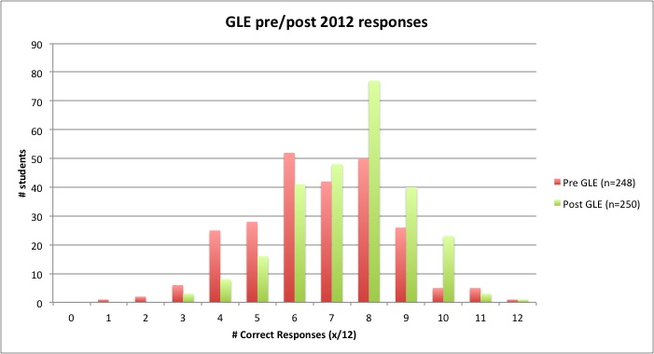
Geoscience Literacy Exam MC

Slide 7
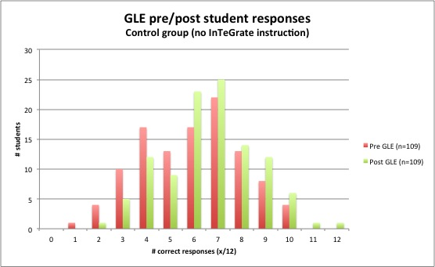
Geoscience Literacy Exam MC Control

Slide 8
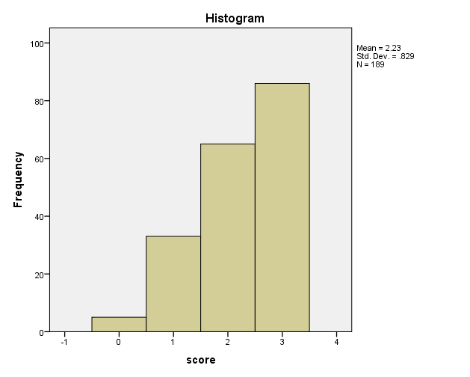
Geoscience Literacy Exam Essay
Civilizations use natural resources as their economies grow, yet many natural resources are non-renewable or limited. Describe three actions humans could take to deal with this reality and why they do or do not take such actions today.

Slide 9
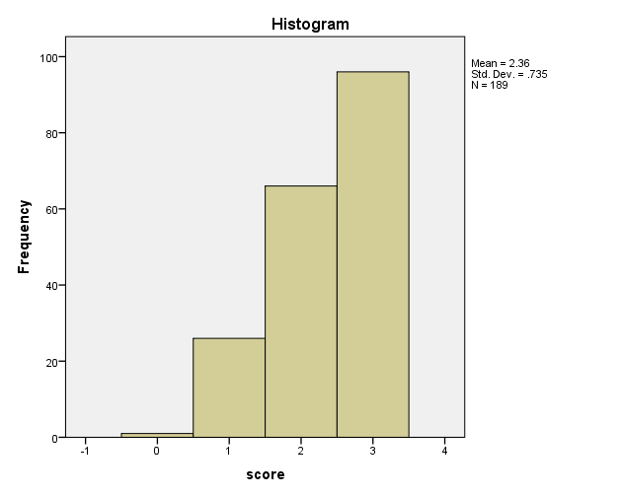
Geoscience Literacy Exam Essay
Modern civilization developed over the last 10,000 years during an unusually stable climate period. Describe three ways that a rapidly warming climate might affect agricultural, economic and transportation systems in the future.

Slide 10
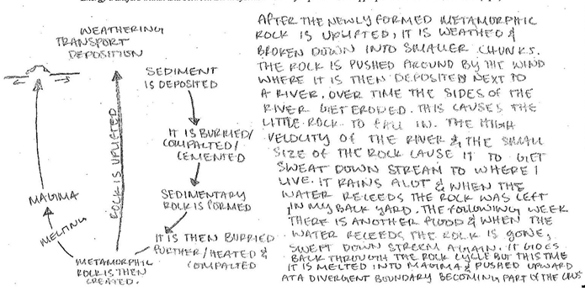
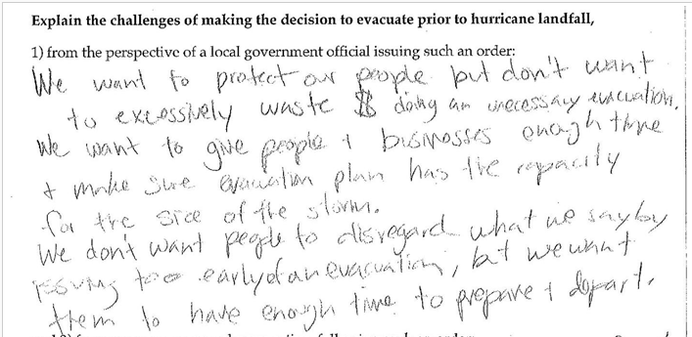
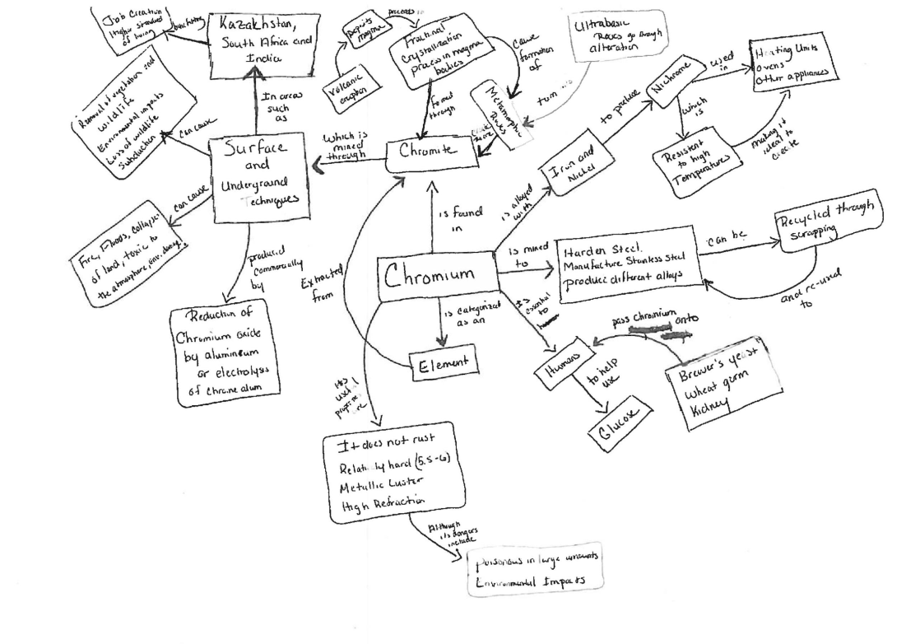
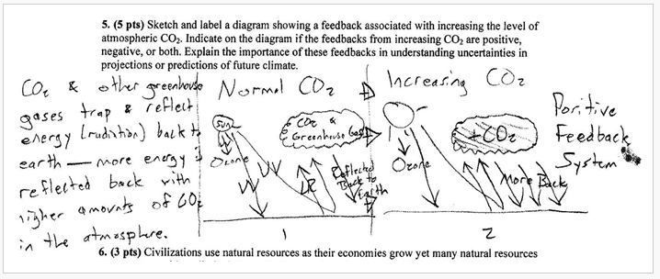
Your Assessments

Slide 11
Attitude Survey

Slide 12
Goals of this session
Develop a plan to document the level of student learning related to the module
  Review analyses of data you supplied
  How do the assessments need to be revised?
  List other relevant artifacts you would be able to supply (e.g. exam questions, student work)
  Discuss efficient use of time in these data collection efforts

