Slide 1

Tutorial: The “Magic” of Geophysical Inversion
Lee Slater
Department of Earth and Environmental Sciences, Rutgers University, Newark, NJ, USA

Slide 2
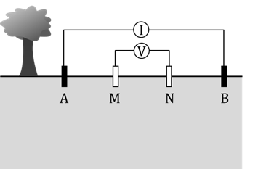

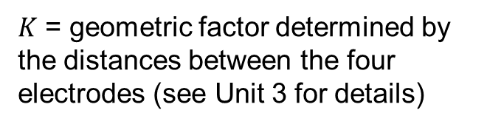

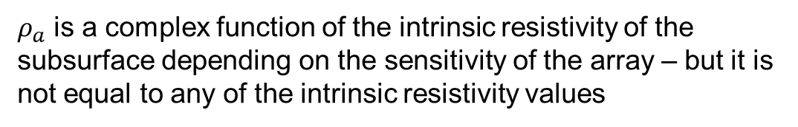



Recap: apparent resistivity – just a measurement in units of resistivity
Apparent resistivity: the resistivity of a homogenous subsurface that the measured voltage and current are equivalent to
$ρ_{a}=K\frac{∆V}{I}=KR_{t}$
Transfer resistance with units of ohms
$$ΔV$$
$$ρ_{3}$$
$K$ = geometric factor determined by the distances between the four electrodes (see Unit 3 for details)
$$ρ_{2}$$
$$ρ_{1}$$
$ρ_{a}$ is a complex function of the intrinsic resistivity of the subsurface depending on the sensitivity of the array – but it is not equal to any of the intrinsic resistivity values

Slide 3

Apparent resistivity
Apparent resistivity: the resistivity of a homogenous subsurface that the measured transfer resistance is equivalent to
$ρ_{a}=K\frac{∆V}{I}=KR_{t}$
$$ρ_{1}$$
Per the definition, in this case of a single resistivity $ρ_{a}=ρ_{1}$
A homogeneous subsurface

Slide 4
Plotting 2D Electrical imaging datasets
a
na
a
We assign the raw apparent resistivity measurements to a location at the midpoint of the array and at a level (or pseudodepth) n determined by the electrode separation
In the dipole-dipole array the pseudo depth is the integer multiplier on the a spacing defining the distance between the current electrode pair and the voltage measurement electrode pair
Larger values of n mean deeper investigation depth – but with lower spatial resolution
I
V
A
B
N
M
n=1
n=2
n=3
n=4
Source: Binley and Slater, 2020, Resistivity and induced polarization: theory and
applications to the near-surface Earth, In Press

Slide 5
Pseudo sections
Resistivity model
100Ωm
50Ωm
500Ωm
ρ_{a}(Ωm)
We can plot an apparent resistivity pseudo section but it won’t represent the true resistivity structure of the subsurface – this is where we need the magic of geophysical inversion
Dipole-dipole (a=5m)
1
n
3
5
ρ_{a}(Ωm)
Wenner (a = n × 5m)
1
n
3
5
7
Source: Binley and Slater, 2020, Resistivity and induced polarization: theory and
applications to the near-surface Earth, In Press

Slide 6
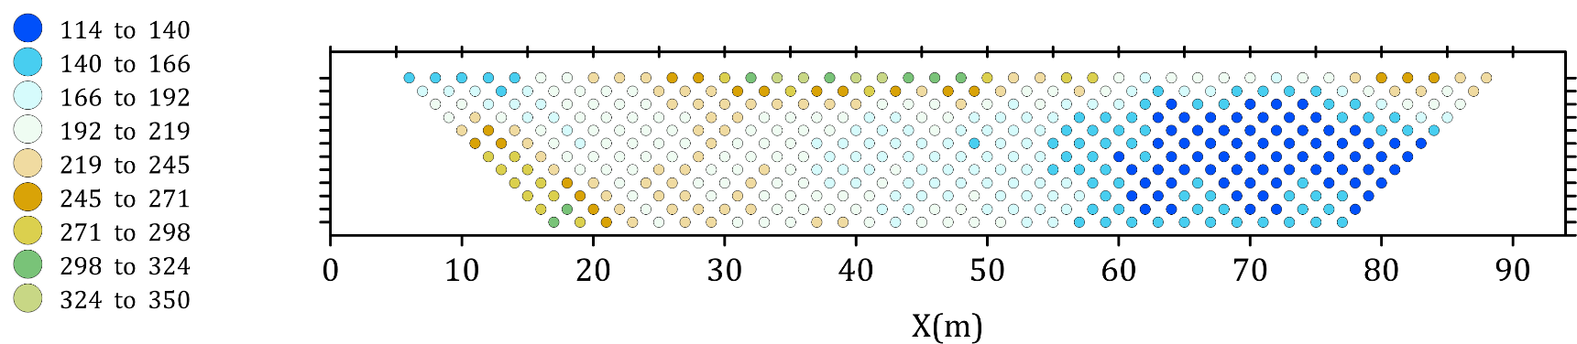


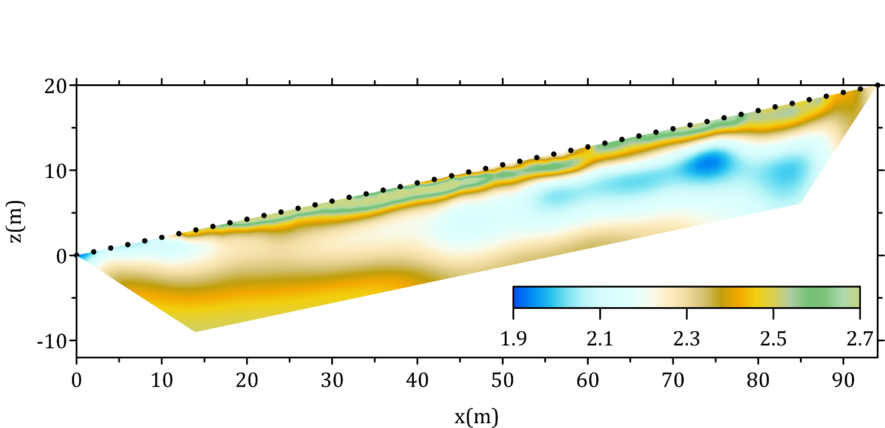
Pseudo section
ρ_{a} (Ωm)
n=1
n=5
n=10
The process by which the transfer resistance or apparent resistivity measurements acquired from the surface are transformed into estimated images of the subsurface resistivity (or conductivity)
Inverse
modeling
Forward
modeling
Resistivity distribution
log₁₀ (resistivity in Ωm)
Source: Binley and Slater, 2020, Resistivity and induced polarization: theory and applications to the near-surface Earth, In Press

Slide 7
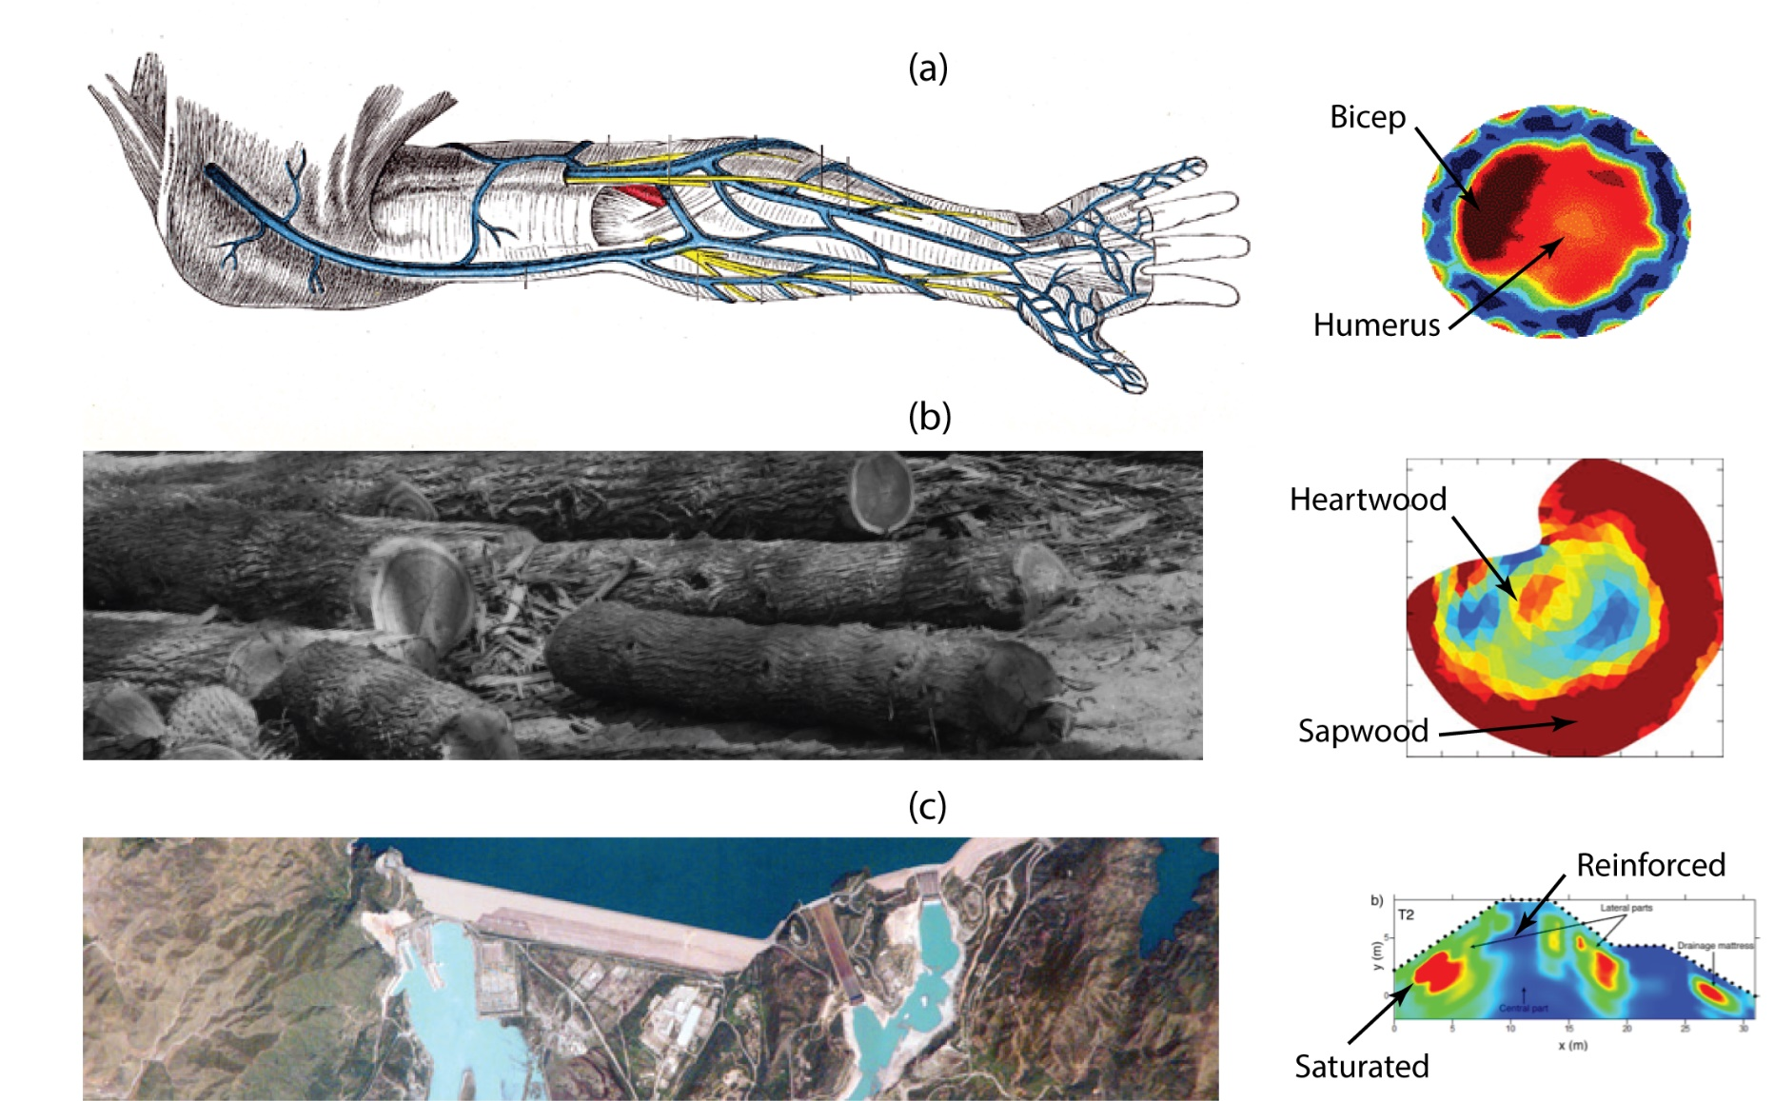
The concepts of inversion are used in many fields and for many applications today. Geophysicists use these concepts to image into the Earth
Hypothetical examples of electrical imaging of internal structure: (a) medical scan of an arm, (b) a tree trunk cross section, and (c) an internal survey of a dam. Modified from Gray (1918), Paulsen et al. (2006), Martin and Günther (2013), Busato et al. (2016)
Source: Falzone et al. (2020), Transport in Porous Media

Slide 8
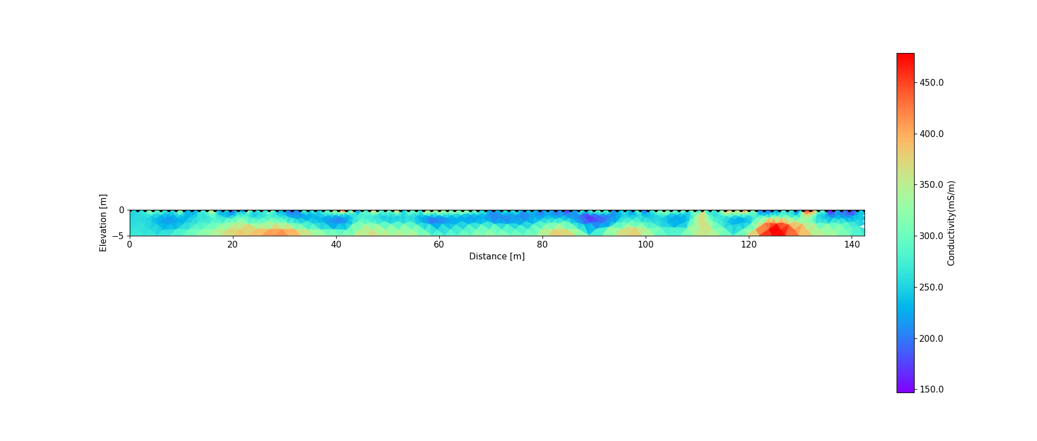
What do images mean?
Infer spatial variation in soil/rock type, chemistry of the fluids in the ground, water content……..
Image of subsurface electrical conductivity from the Harrier Meadow survey
Increasing conductivity – increasing salinity of water in soils?; increasing water content?; increase in porosity; increase in fine-grained sediments?
Notes:
But what do these images really mean? Unit 2 covers the relationships between the electrical conductivity of soils and the physical and chemical properties of soils. Using Archie’s Laws, we learned that electrical conductivity increases with the salinity of the pore fluids, the porosity of the soil and the water content if the soil is not saturated. We also learned that fine grained materials such as clays also increase electrical conductivity. The changes in conductivity observed with electrical imaging result from changes in such factors. At Harrier Meadow we know that the soils are saturated beneath the top 20 cm so the changes in conductivity in this image most likely represent changes in salinity and/or changes in soil type. Distinguishing between such effects is best done using some direct sampling at a few locations – indeed, the interpretation of geophysical datasets is always improved with some direct observations. We will use some direct measurements to explore the significance of these conductivity images further in Unit 5.

Slide 9
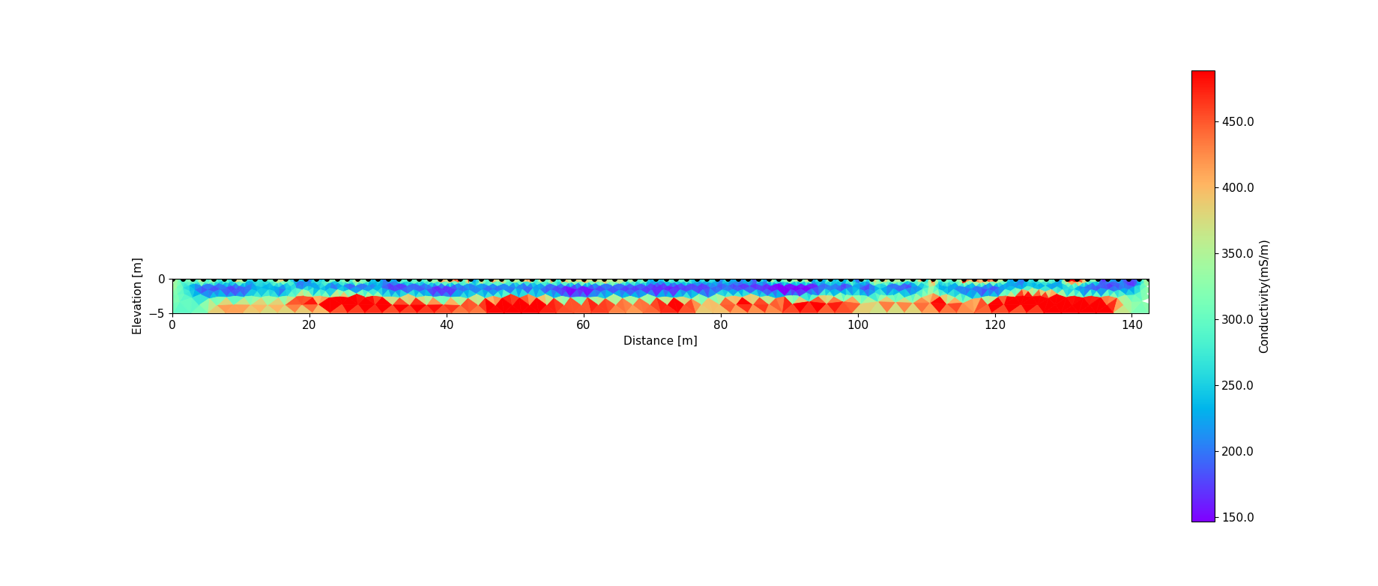
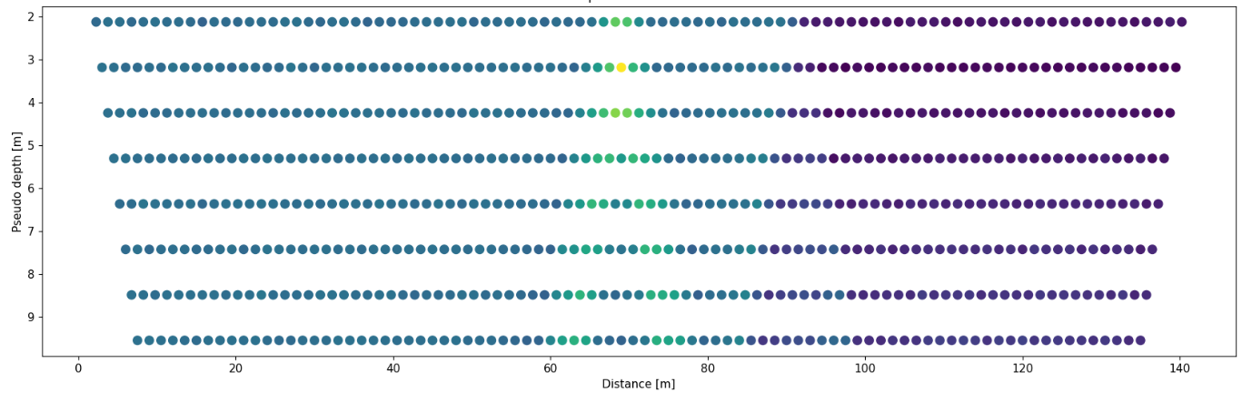
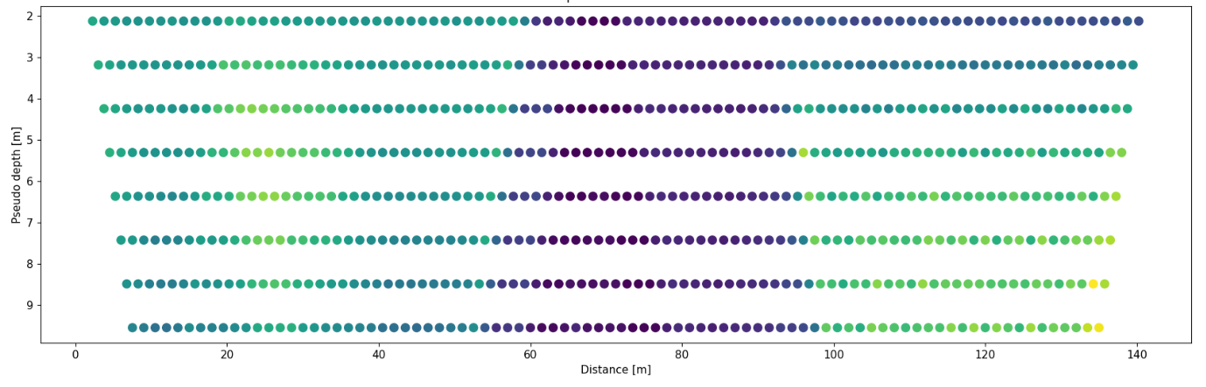
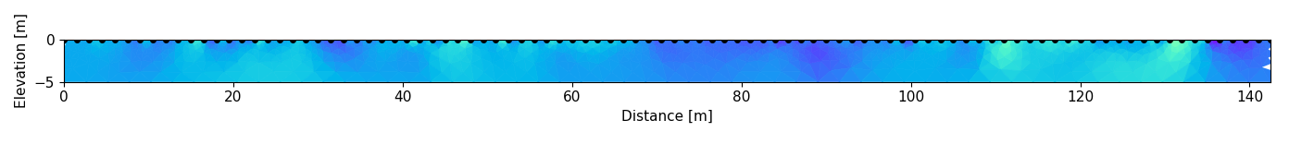
How does it work?
UNKNOWN RESISTIVITY MODEL OF THE EARTH
????
Measured pseudo section (with errors)
Synthetic pseudo section
Statistical comparison
`
Synthetic resistivity model
Forward modeling

Slide 10
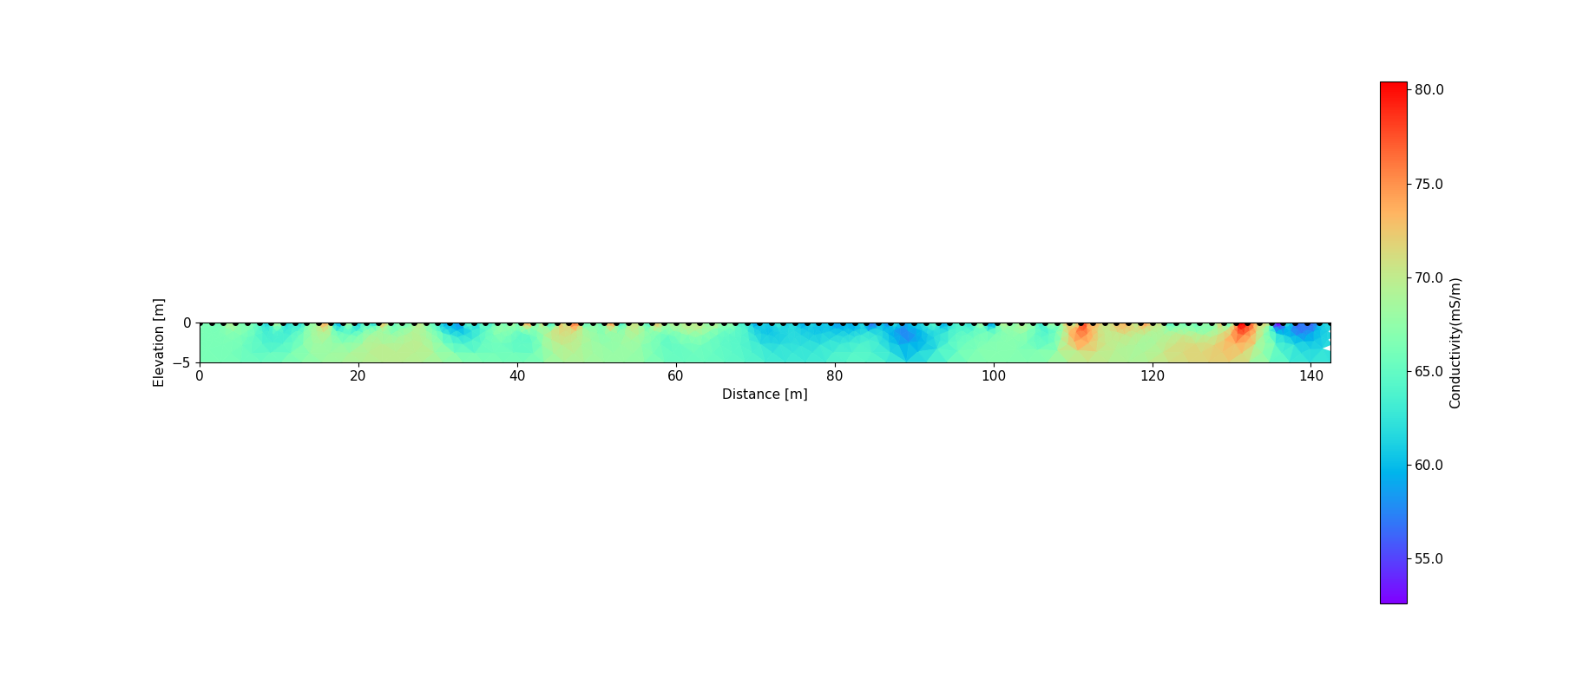
How does it work?
UNKNOWN RESISTIVITY MODEL OF THE EARTH
??
Measured pseudo section (with errors)
Synthetic pseudo section
ADEQUATE GOODNESS OF FIT?
NO
Revise synthetic resistivity model
Forward modeling

Slide 11
How does it work?
UNKNOWN RESISTIVITY MODEL OF THE EARTH
??
Field measurements (with errors)
Synthetic measurements
ADEQUATE GOODNESS OF FIT?
NO
ITERATE
Forward modeling
Revise synthetic resistivity model

Slide 12
How does it work?
ESTIMATED SUBSURFACE RESISTIVITY MODEL
FIELD SUBSURFACE RESISTIVITY ??
Measured pseudo section (with errors)
Synthetic pseudo section
ADEQUATE GOODNESS OF FIT?
YES
Forward modeling

Slide 13
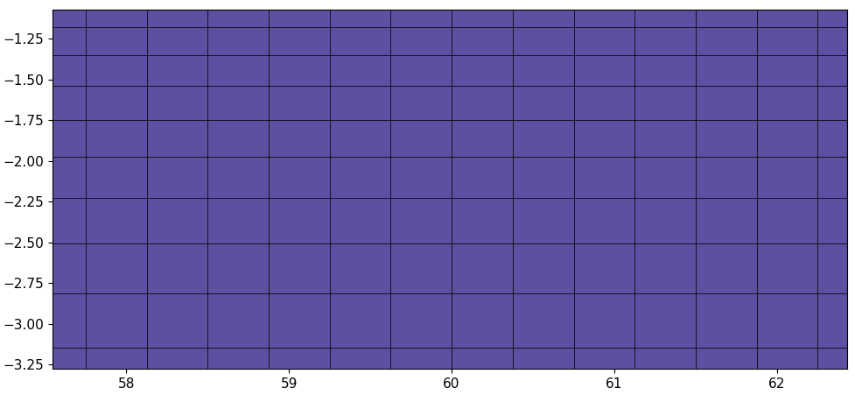
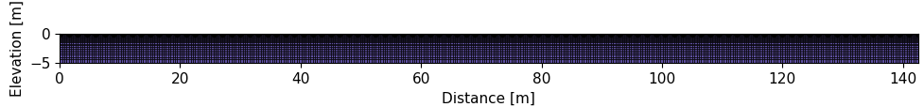
Forward modeling
Solve for distribution of voltages resulting from injection of current into a subsurface with varying resistivity
Numerical approach to approximate a solution to a non-linear partial differential equation: finite difference or finite element discretization
$$\frac{∂}{∂x}\left(\frac{1}{ρ}\frac{∂V}{∂x}\right)≈\frac{1}{∆x}\left[\frac{2}{{(ρ}_{i,j}+ρ_{i+1,j})}\left(\frac{V_{i+1,j}−V_{i,j}}{∆x}\right)−\frac{2}{{(ρ}_{i−1,j}+ρ_{i,j})}\left(\frac{V_{i,j}−V_{i−1,j}}{∆x}\right)\right]$$
$$\frac{∂}{∂z}\left(\frac{1}{ρ}\frac{∂V}{∂z}\right)≈\frac{1}{∆z}\left[\frac{2}{{(ρ}_{i,j}+ρ_{i,j+1})}\left(\frac{V_{i,j+1}−V_{i,j}}{∆z}\right)−\frac{2}{{(ρ}_{i,j−1}+ρ_{i,j})}\left(\frac{V_{i,j}−V_{i,j−1}}{∆z}\right)\right]$$
Δx
i-1,j+1
i,j+1
i+1,j+1
Δz
i-1,j
i,j
i+1,j
z
i-1,j-1
i,j-1
i+1,j-1
x

Slide 14
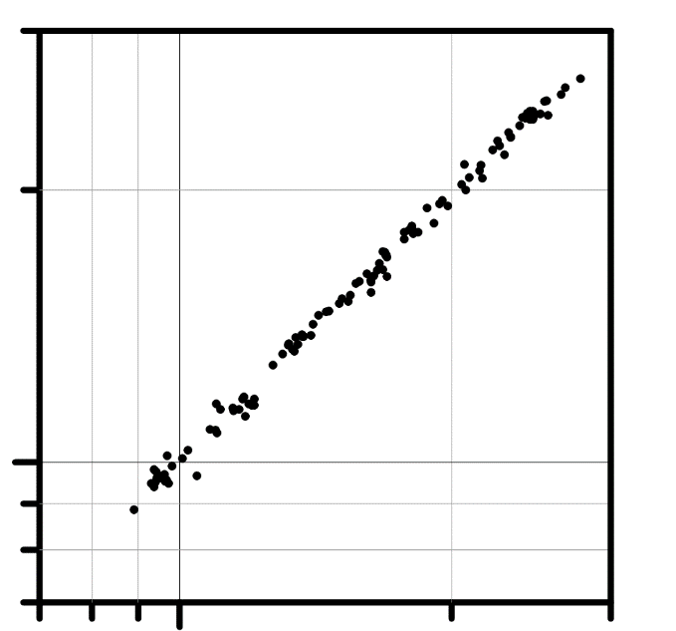

How to assess goodness of ‘fit’?
1:1 line is perfect fit
Measured pseudo section (observed ρ_{a})
synthetic ρ_{a}
measured ρ_{a}
Differences between modeled synthetic ρ_{a} and measured ρ_{a} should be small (and random)
Synthetic pseudo section (synthetic ρ_{a})
relative frequency (-)
relative ‘misfit’ (-)

Slide 15

How to revise the synthetic resistivity model?
PRIOR ITERATION
DATA CONSTRAINT
MODEL CONSTRAINT
synthetic ρ_{a}
improve the goodness of fit
Make sure that model updates are consistent with geological expectation of subsurface structure
measured ρ_{a}
UPDATED MODEL

Slide 16
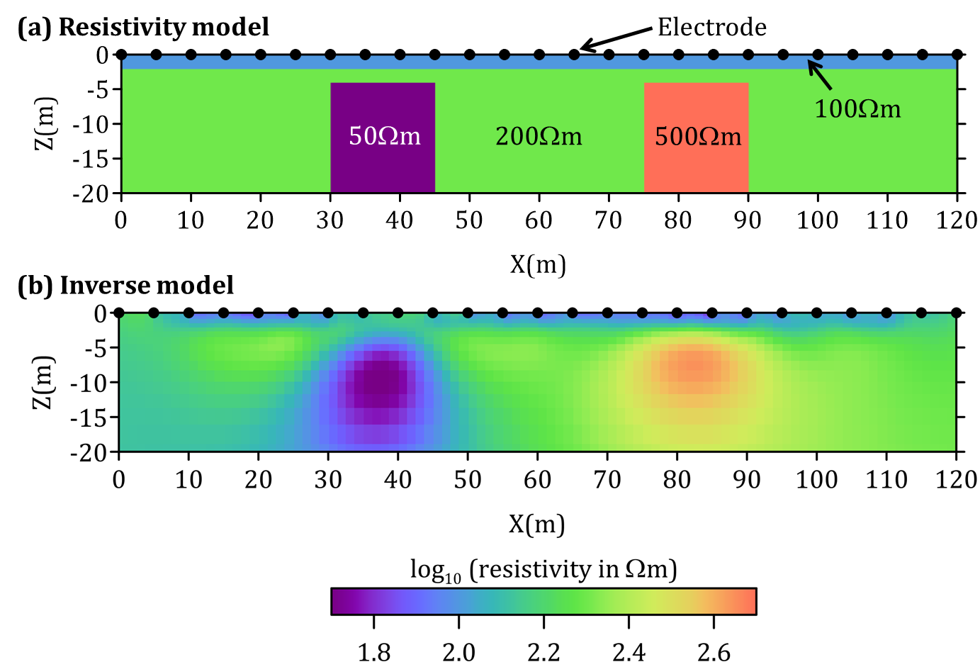
Selecting reasonable models
True model
Making sure that model updates are consistent with geological expectation of subsurface structure
Changes to the model structure are done with a constraint that favors smooth (but likely to be geologically reasonable) models
Model found by inversion
Source: Binley and Slater, 2020, Resistivity and induced polarization: theory and
applications to the near-surface Earth, In Press

Slide 17
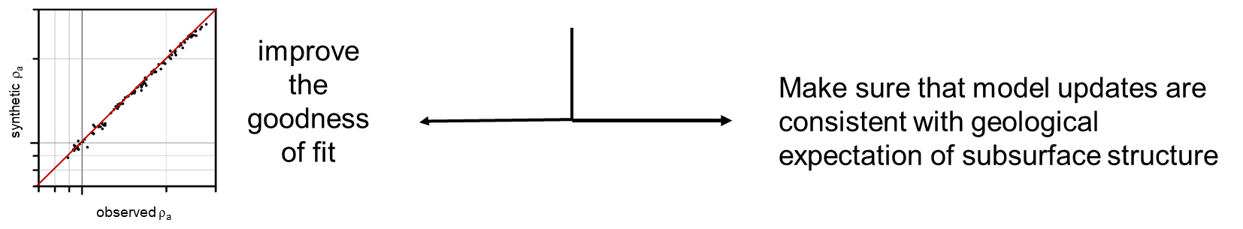
Balancing goodness of fit versus updating the model
High quality data (low measurement errors): improve the goodness of fit more by adding more structure to the inverted model
Low quality data (high measurement errors): accept a lower goodness of fit and a smoother (less structure model)
DATA CONSTRAINT
MODEL CONSTRAINT
weighted by the measurement errors

Slide 18
The importance of measurement errors
The errors in the measurements need to be estimated. Incorrect errors will lead to (1) excessive image structure when errors are underestimated, or (2) excess smoothing of structure when errors are overestimated
ERRORS OVERESTIMATED -> not enough structure
CORRECT ERRORS -> optimal structure
ERRORS UNDERESTIMATED -> too much structure
Notes:
Correct errors are a_wgt=0.001 and b_wgt = 0.005. Overestimated errors: a_wgt = 0.01 and b_wgt = 0.005. Underestimated errors: a_wgt = 0.0001 and b_wgt=0.005

Slide 19
Reciprocal errors
Normal measurement
I
V
A
B
N
M
A robust way to assess the errors in the measurements. The theory of reciprocity states that the normal and reciprocal measurement must have the same resistance (and hence apparent resistivity).
Differences between the two measurements quantify the errors
Reciprocal measurement
switched
I
V
A
B
N
M

Slide 20
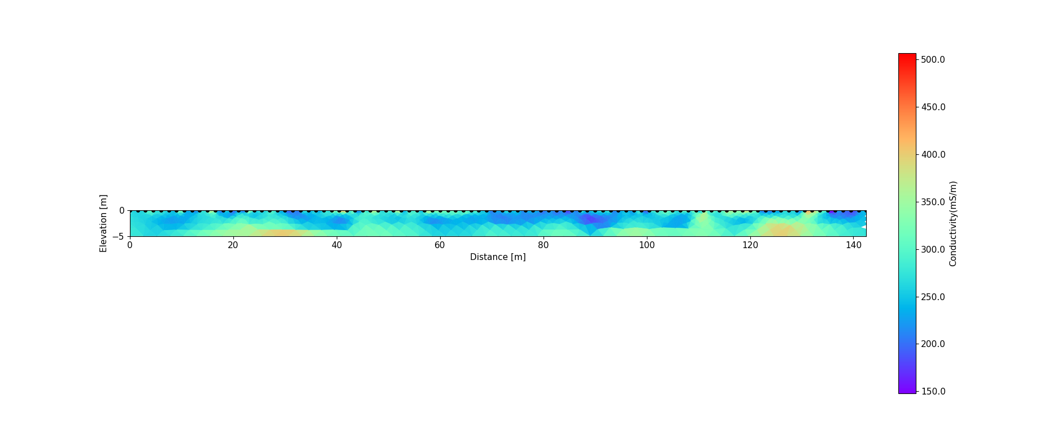
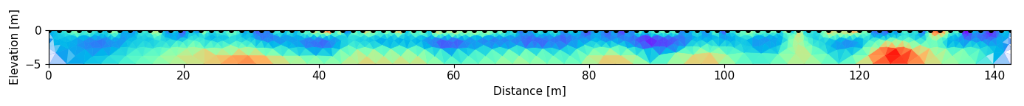

Modification of model constraints
Anisotropic smoothing – stronger horizontal smoothing e.g. sedimentary layering
Isotropic smoothing
Anisotropic smoothing – stronger vertical smoothing e.g. mapping walls of a buried structure
Notes:
Now let’s consider the model constraint. This can actually take many forms depending on the geophysicist’s expectation of the likely variations in model structure in the subsurface. By far the most commonly used model constraint is the smoothness constraint introduced in this unit. However, even this smoothness constraint can be adjusted to result in changes in the predicted inversion result. For example, the constraint can be set to favor stronger horizontal smoothing, or conversely to favor strong vertical smoothing. In this case, the changes to the model constraint result in subtle but important changes to the resolved model structure. We might use a horizontal constraint to image sedimentary layers deposited in a valley but we might use a vertical constraint to map walls of a buried structure.

Slide 21
Addition of borehole electrodes
TRUE MODEL
Can result in dramatic improvement in image resolution at depth
But: expensive, invasive and sometimes impractical
SURFACE ELECTRODES ONLY
borehole electrodes
PREDICTED INVERSION RESULTS
SURFACE ELECTRODES AND BOREHOLE ELECTRODES

Slide 22
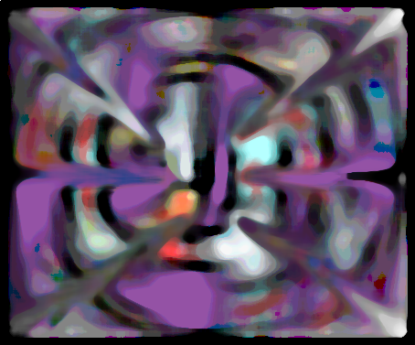
Inversion: a pair of fuzzy glasses
G
S
Inversion of resistivity data is not like donning a pair of x-ray glasses
The fuzzy, indirect information obtained from electrical resistivity inversion should always be interpreted in conjunction with other available datasets.
Note: There is NO such thing as geophysical X-ray vision! No silver bullets!
Image courtesy of Fred Day-Lewis (USGS)

