Slide 1

A Short Tutorial on Resistivity of Soils and Rocks
Lee Slater
Department of Earth and Environmental Sciences, Rutgers University, Newark, NJ, USA

Slide 2
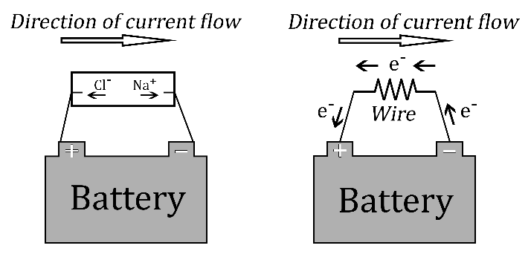
Mechanisms of electrical conduction
Electronic conduction in a metal (e.g. in the wiring of a house)
Ionic conduction in a solution (e.g. in soils)

Slide 3
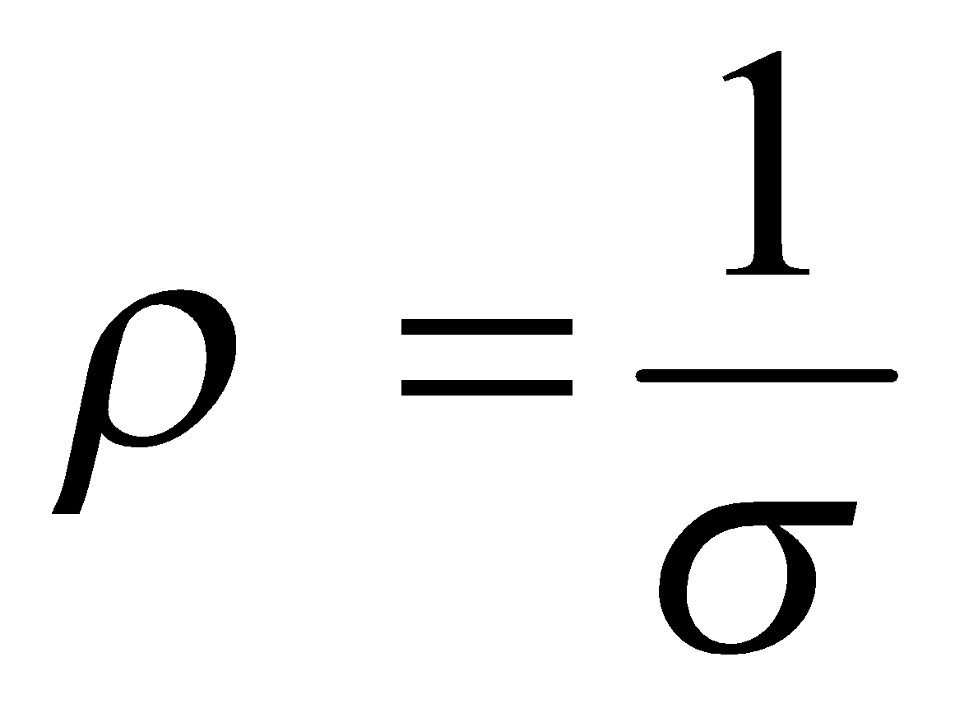
The electrical property resistivity (ρ) – or conductivity (σ)
resistivity
conductivity
Fundamental property determining how difficult it is for electric current to flow in a material
Fundamental property determining how easy it is for electric current to flow in a material

Slide 4
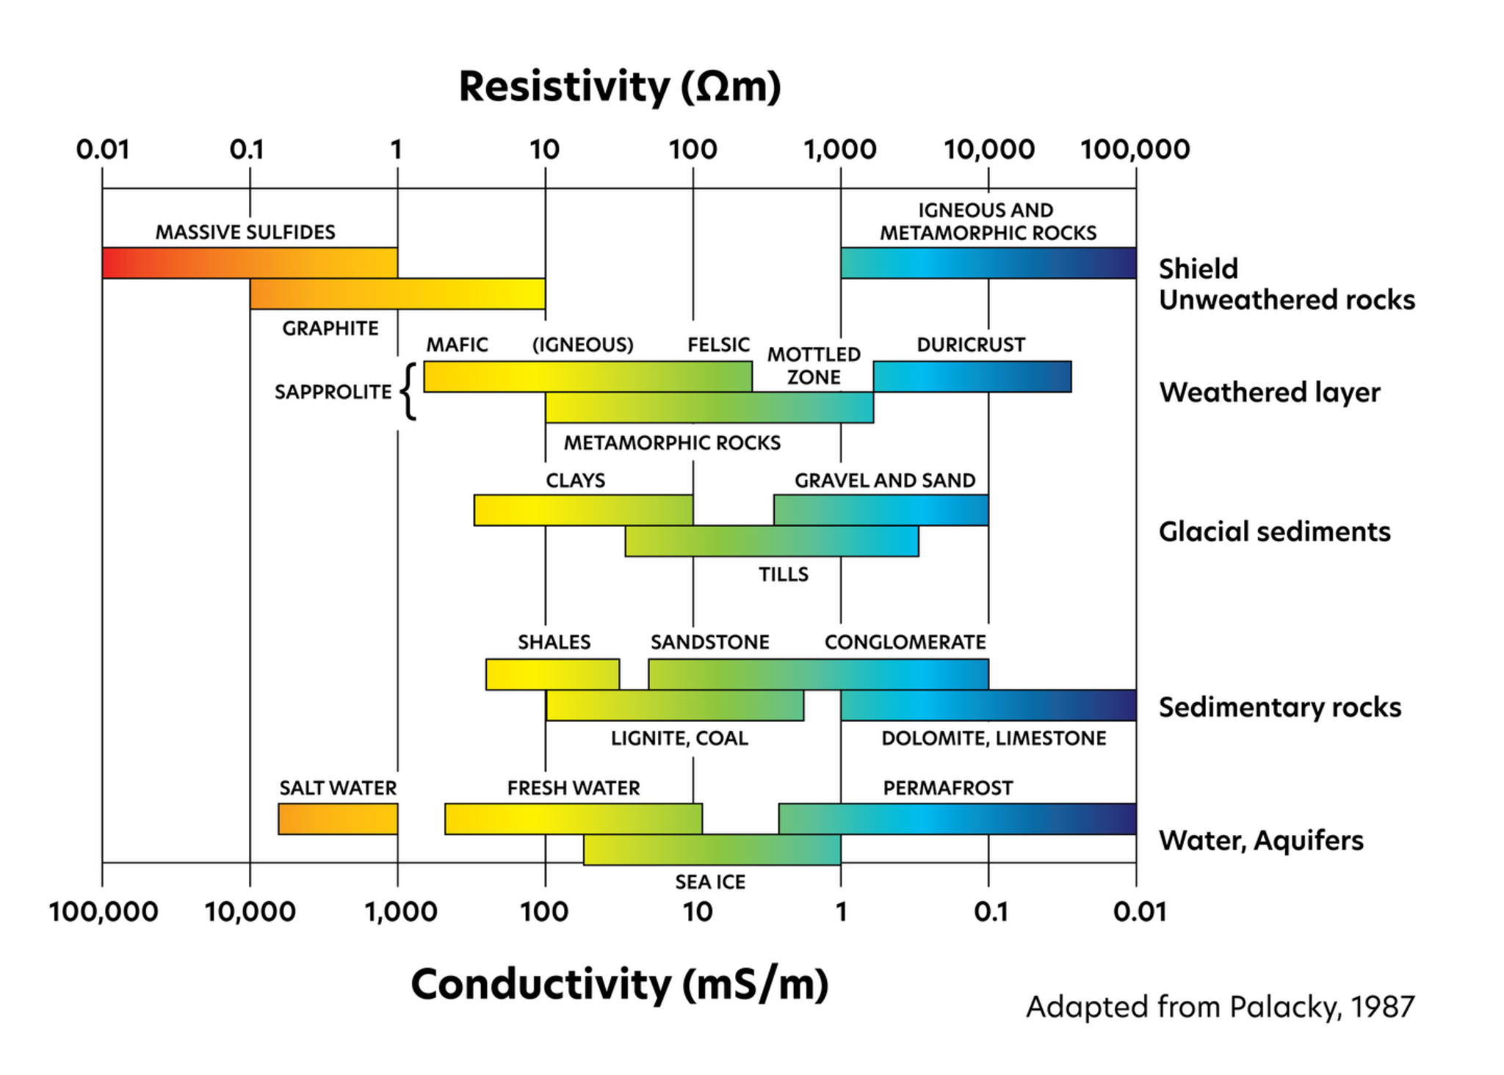
Resistivity of earth materials

Slide 5
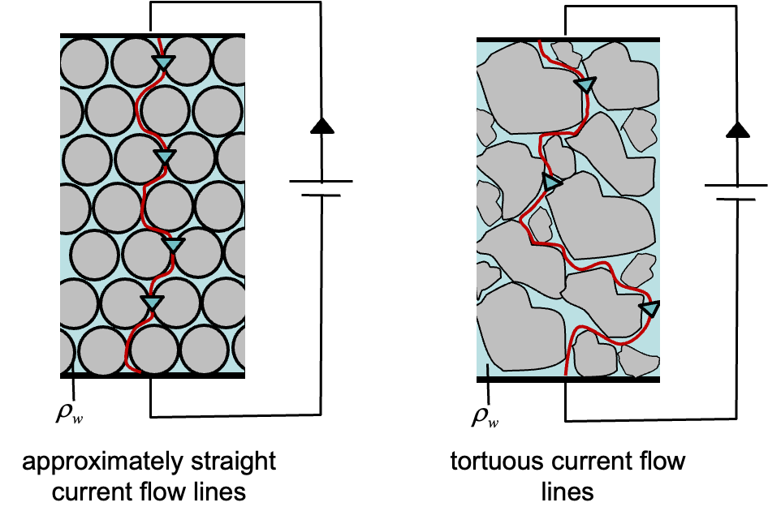
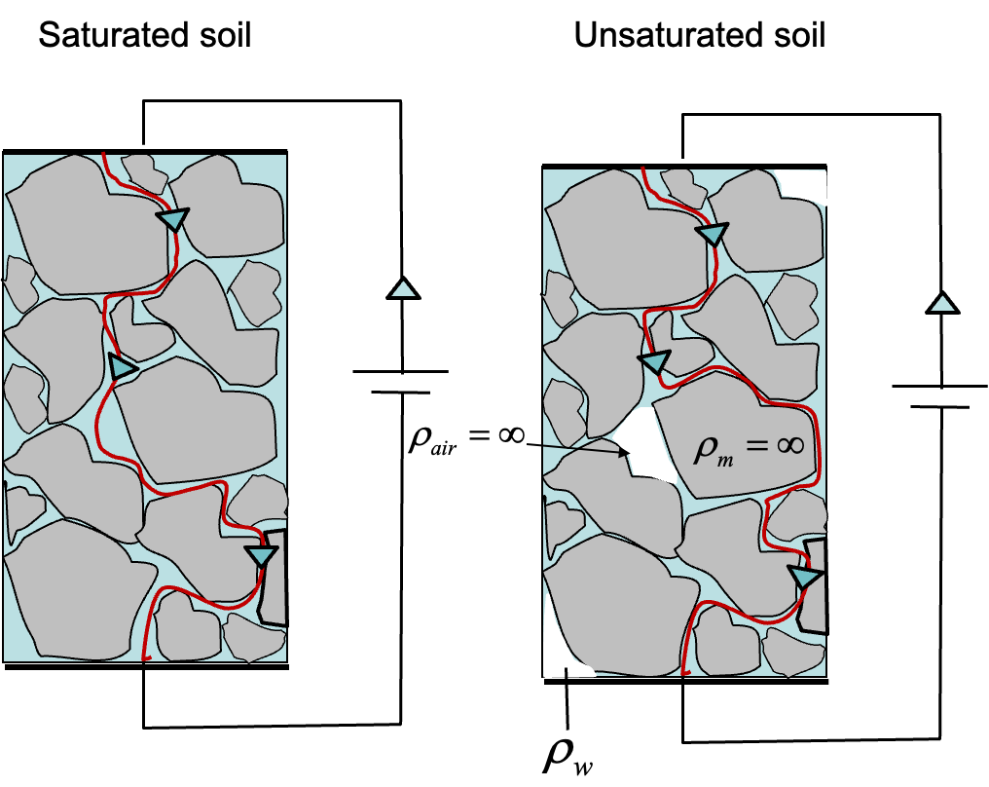
What affects the resistivity and conductivity of geomaterials?
Effect | Resistivity | Conductivity
Increasing porosity | ↓ | ↑
Increasing pore fluid salinity | ↓ | ↑
Increasing surface conductance | ↓ | ↑
Increasing connectedness/connectivity | ↓ | ↑
Increasing saturation | ↓ | ↑
Weathering | ↓ | ↑
Compaction | ↑ | ↓
Increasing formation factor | ↑ | ↓
Increasing tortuosity | ↑ | ↓
Images from Unit 2: Geophysical Properties of the Subsurface
Notes:
Various processes that affect conductivity and resistivity of geomaterials
There is a lot of overlap between these processes
Ex: Increased weathering typically leads to increased porosity, connectedness/connectivity, and decreasing tortuosity, and decreasing formation factor
Top image: less vs more tortuous/connected
Bottom image: less saturation leads to less connectivity and more tortuosity
(New slide: best added to Unit 2 Introduction to resistivity in soils and rocks as supplemental slides)
Glover, P. W. J. (2015). Geophysical Properties of the Near Surface Earth: Electrical Properties.

Slide 6
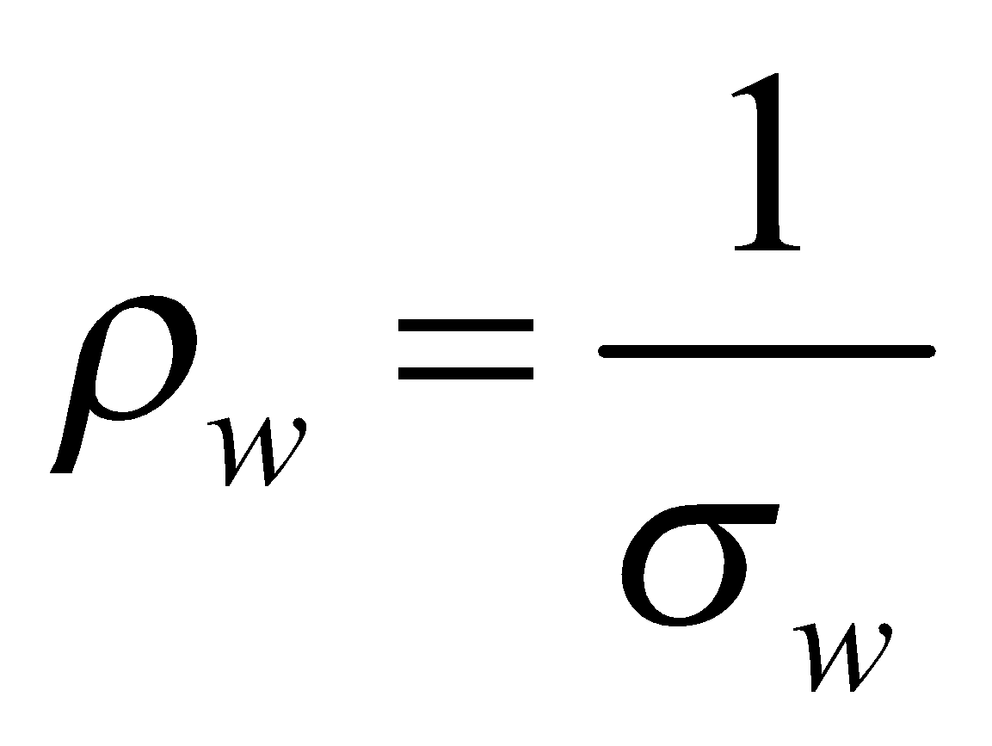
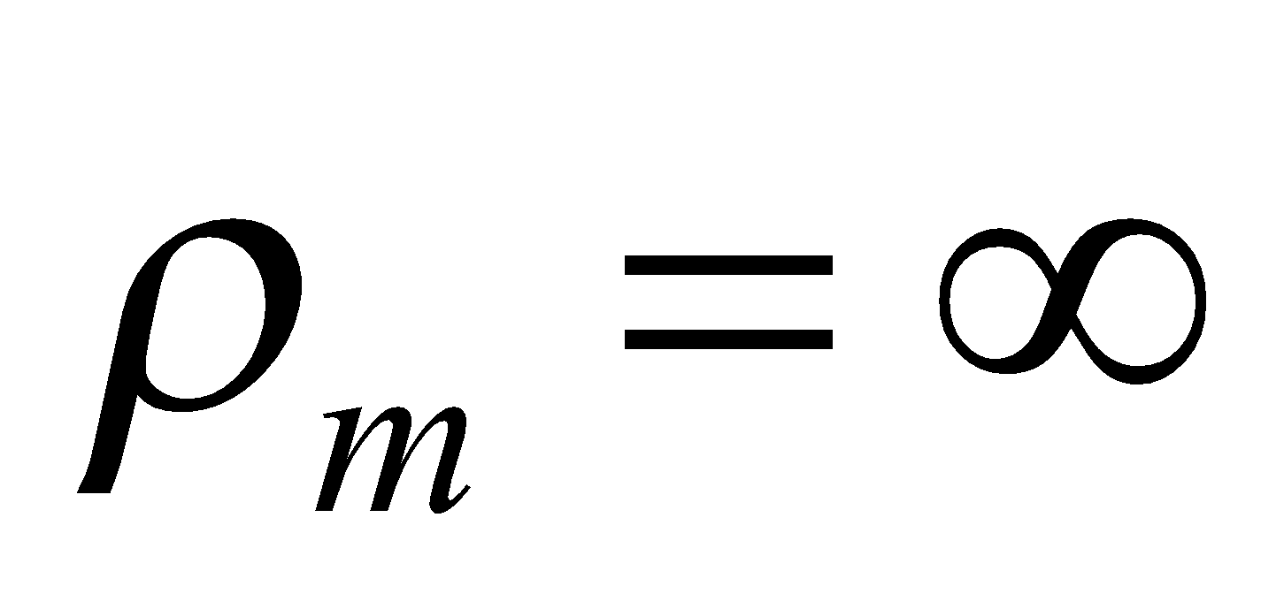
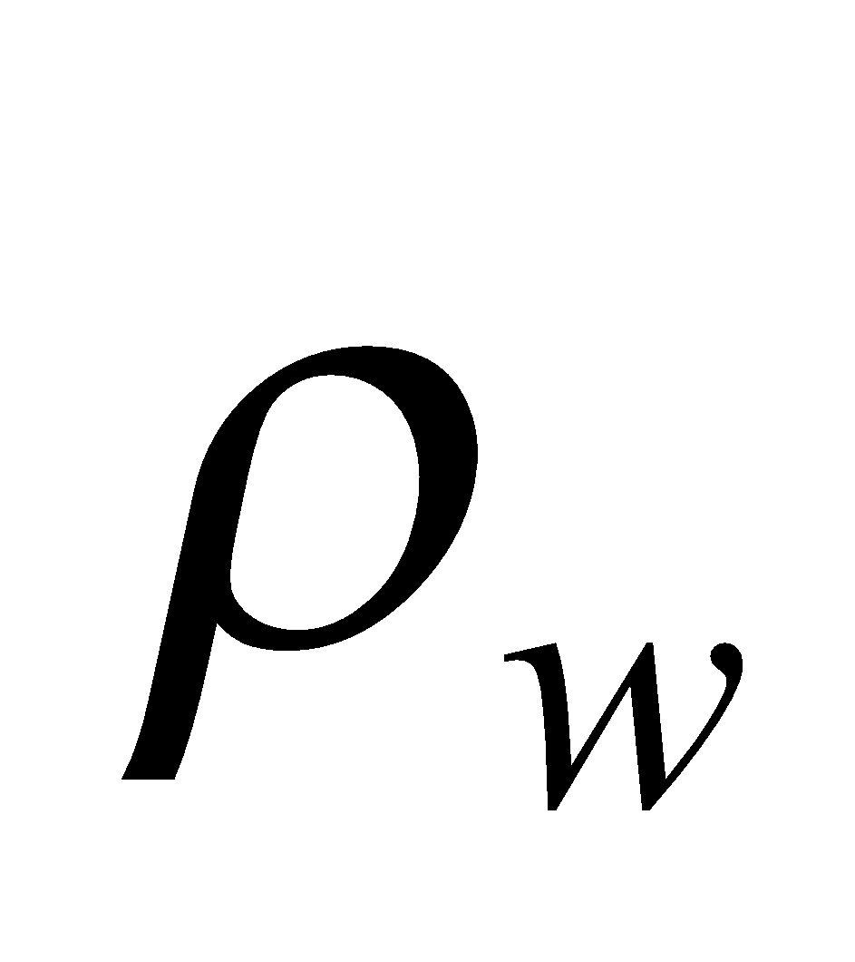
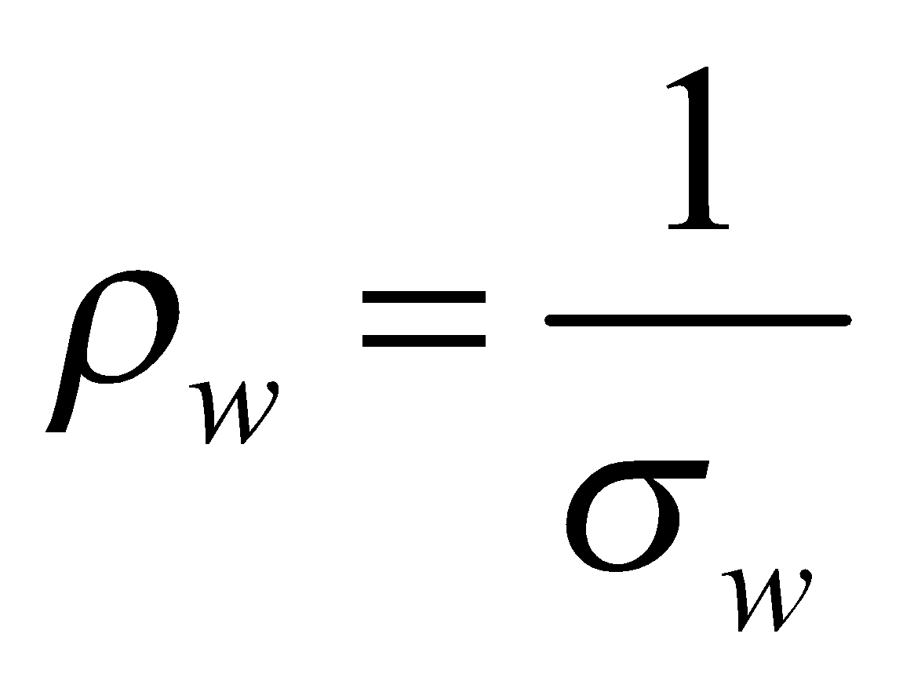
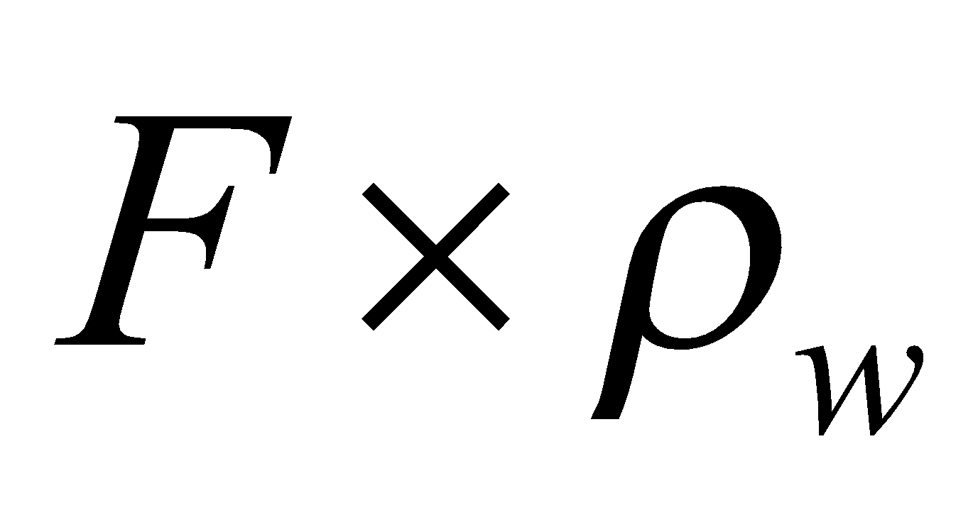
Ionic conduction in soils
soil (or rock) filled with ionic fluid
ionic fluid
Fluid conductivity (σ_{w}) increases with ionic concentration (also with ionic mobility)
F = formation factor
Quantifies how much more resistive the soil is relative to the pore-filling fluid due to the presence of insulating mineral grains
Or how much less conductive it is relative to the pore-filling fluid
-
+
+
-
Fluid resistivity =
Soil resistivity =
Notes:
Next let’s consider how ionic conduction in a soil differs from in a fluid.
In a fluid, the conductivity is determined primarily by the concentration of the ions.
In a soil or rock that is fully saturated with a fluid, the resistivity increases due to the presence of the mineral grains, which are assumed to be perfect insulators.
The electrical formation factor is an important property that describes how much more resistive a soil is relative to the fluid that fills its pores.
Alternatively, the electrical formation factor describes how much less conductive the soil is relative to the conductivity of the fluid filling its pores

Slide 7

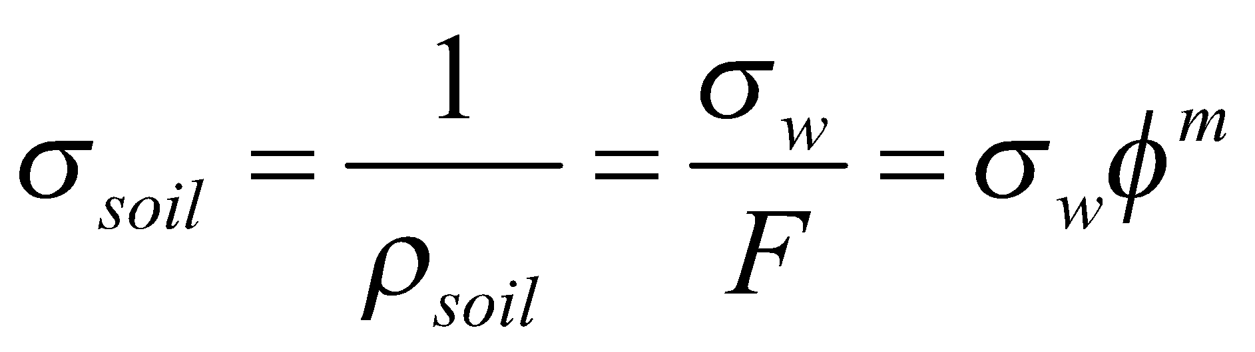
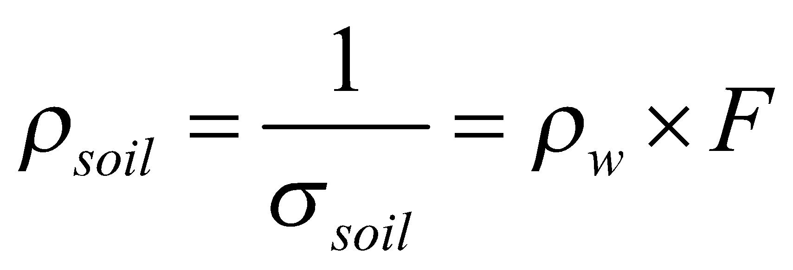
Archie’s law
Gustavus E. Archie (1907-1978: Developed petrophysical relationships whilst working for Shell Oil Company
soil (or rock) filled with ionic fluid
Archie’s Law (1942)
Source: wiki.seg.org
‘cementation’ exponent
interconnected porosity
Archie was interested in petroleum reservoirs but his relationships are now also used to explain electrical conduction in soils
Soil resistivity:

Slide 8
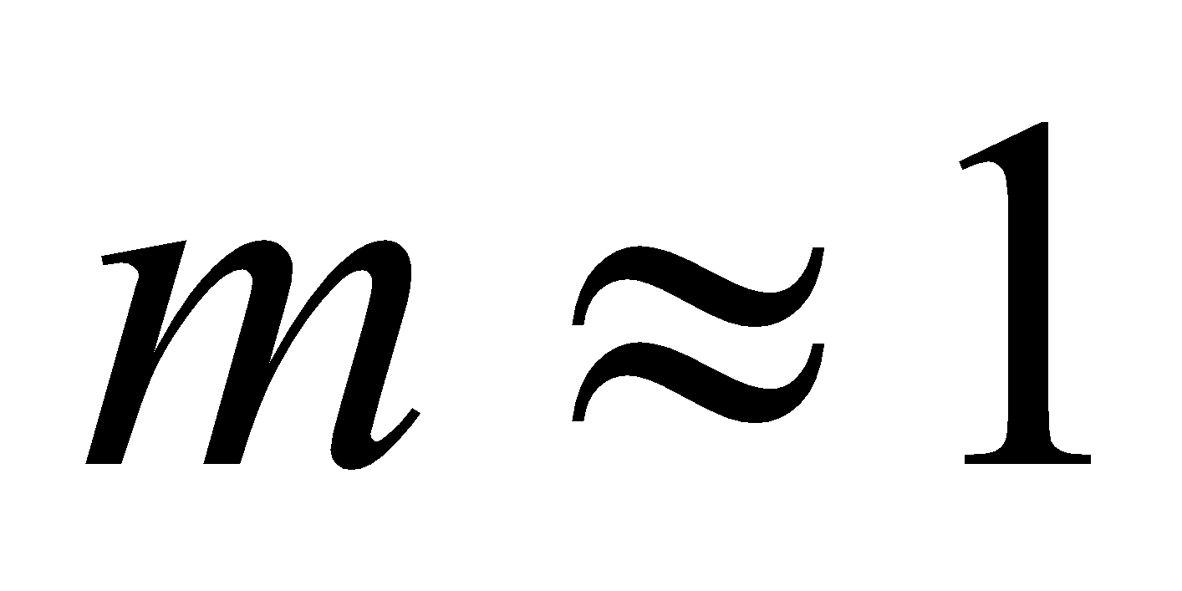
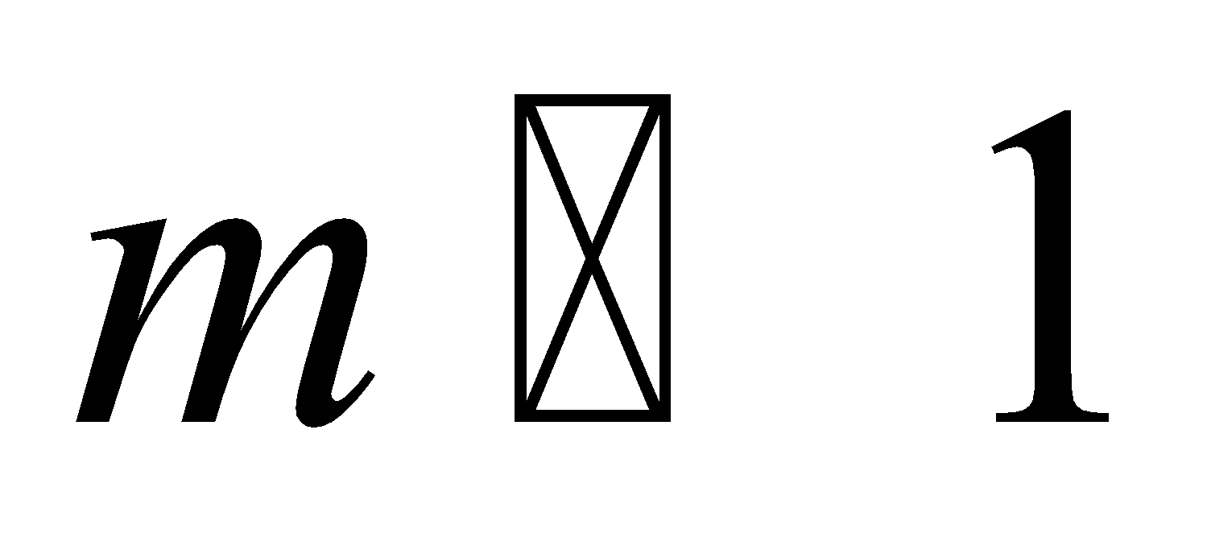
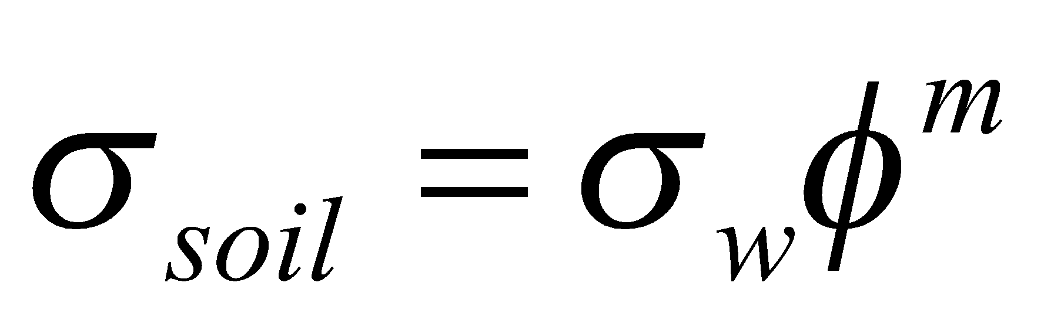
Connectivity in Archie’s law
typically 1.1-1.5 in unconsolidated sediments
typically 1.5-2.5 in sandstones
Archie called m a cementation exponent but we can think about it as a measure of the connectivity of the porosity
approximately straight current flow lines
tortuous current flow lines

Slide 9
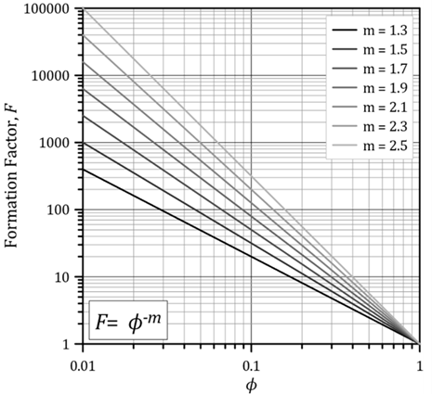
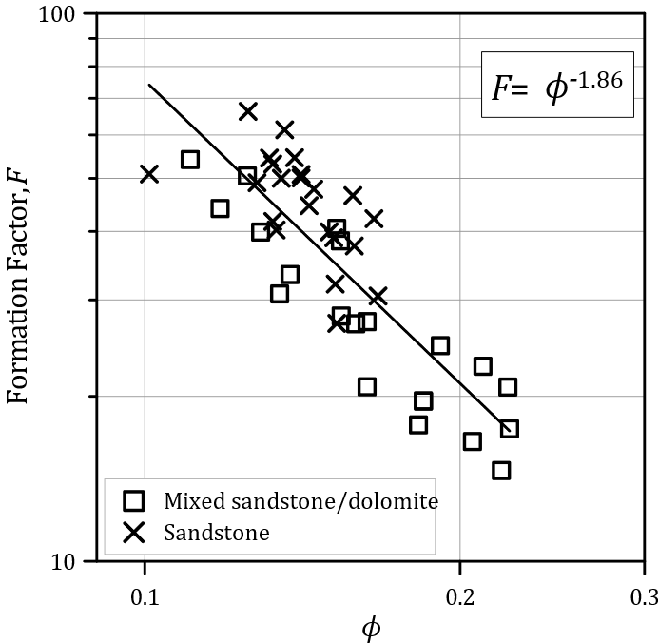
Experimental observations with Archie’s law
Fit of Archie’s Law to a sandstone and mixed sandstone/dolomite samples
Archie’s Law for different values of ‘m’
Source: Binley and Slater, 2020, Resistivity and induced polarization: theory and
applications to the near-surface Earth, In Press

Slide 10
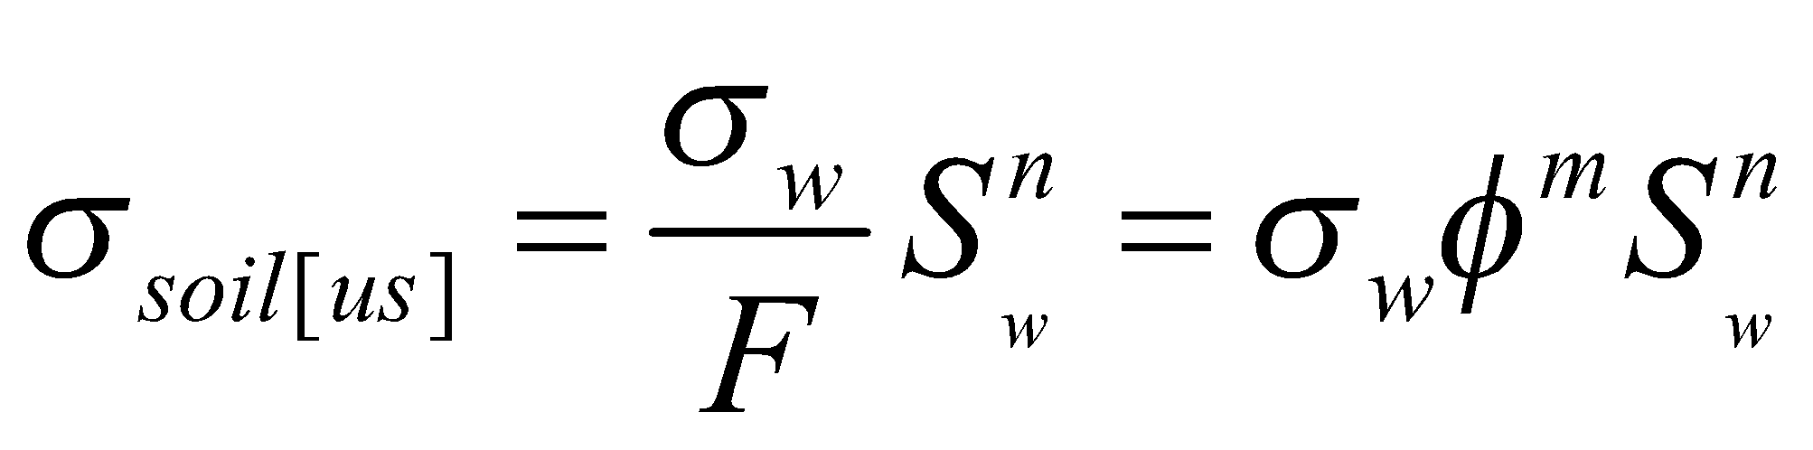
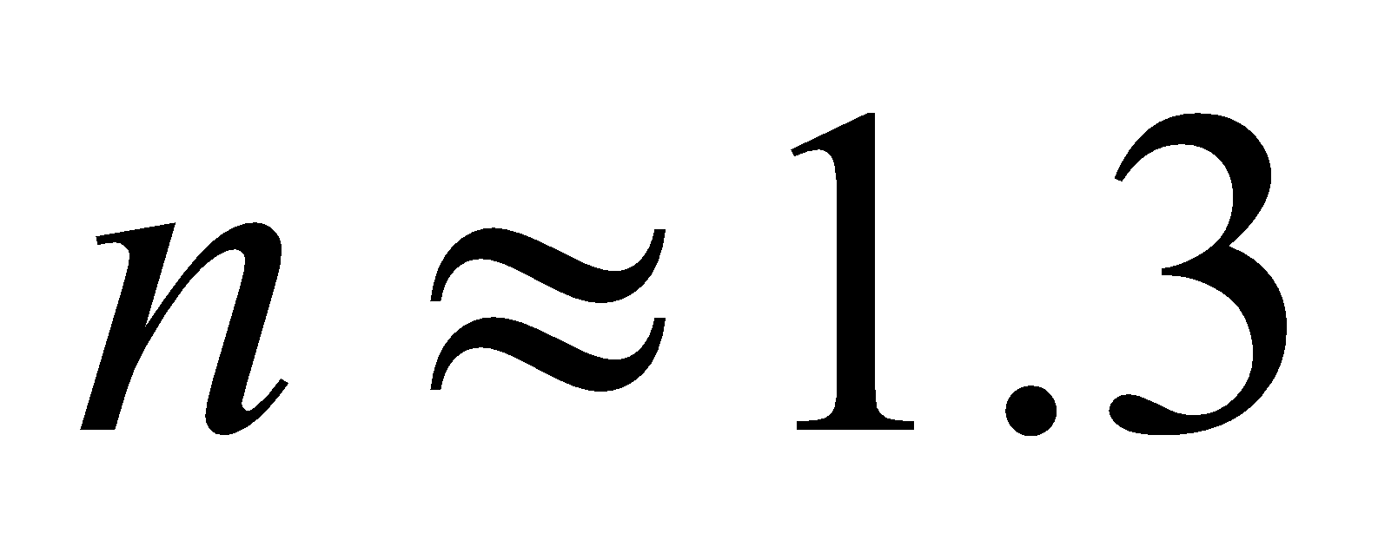
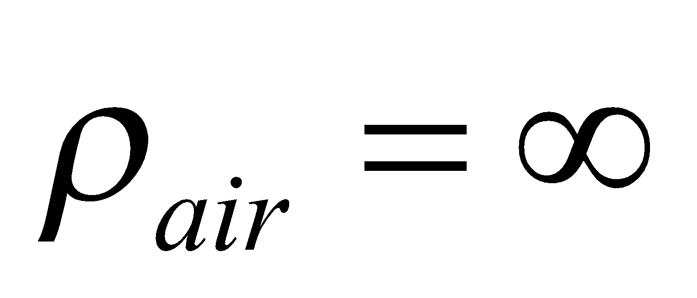
Archie’s second law
Archie’s 2nd Law (1942)
Saturated soil
Unsaturated soil
S_{w} varies from 0-1
n takes similar values to m
in unconsolidated sediments
Undersaturation:
[1] reduces porosity available to conduct current
[2] reduces connectivity

Slide 11

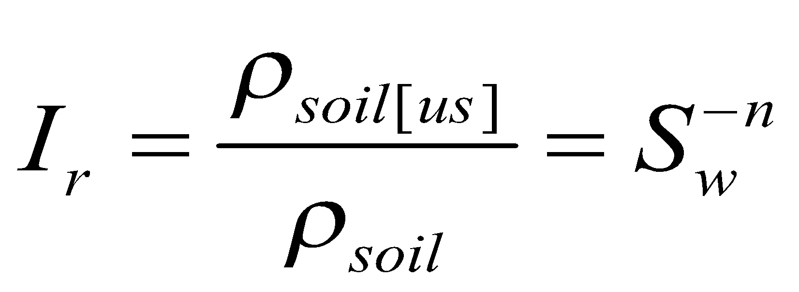
Form of Archie’s 2nd law
Archie’s 2nd law for different values of the saturation exponent n.
Expressed as a resistivity saturation index I_{r} (ratio of resistivity of an unsaturated soil to the resistivity at saturation).
Higher values of n reflect poorer connectivity of the pores due to the replacement of water by air

Slide 12
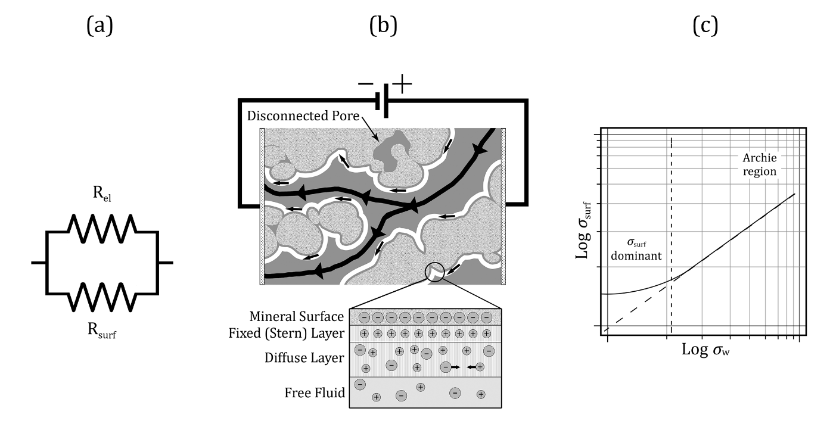
Surface conduction
Archie’s Law neglects a second pathway for ionic conduction in the electrical double layer (EDL) that forms at the soil mineral-pore fluid interface
This is commonly referred to as surface conduction
Conduction through the pore fluid and along the mineral surface is commonly assumed to be in parallel:
Resistance to current flow through pore fluid
Electrical double layer (EDL)
Resistance to current flow along surface
Source: Binley and Slater, 2020, Resistivity and induced polarization: theory and
applications to the near-surface Earth, In Press

Slide 13
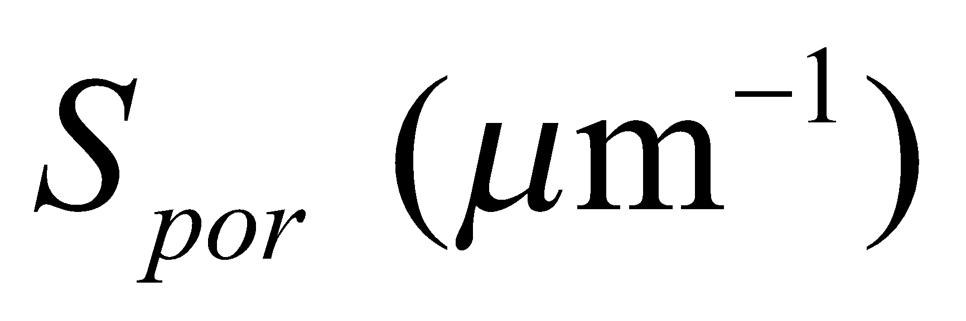
Controls on surface conduction
10⁻¹
Key soil properties
10⁻²
Surface area
Mineral surface chemistry
10⁻³
σ_{surf} (S/m)
10⁻⁴
Fine-grained particles, such as clay minerals, have a very large surface area so surface conduction increases with clay content
10⁻⁵
10⁻²
10⁻¹
1
10
10²
S_{por} = surface area to pore volume ratio
Dashed line shows linear relationship between σ_{surf} and S_{por}
Data are sandstones reported in Börner (1992)

Slide 14
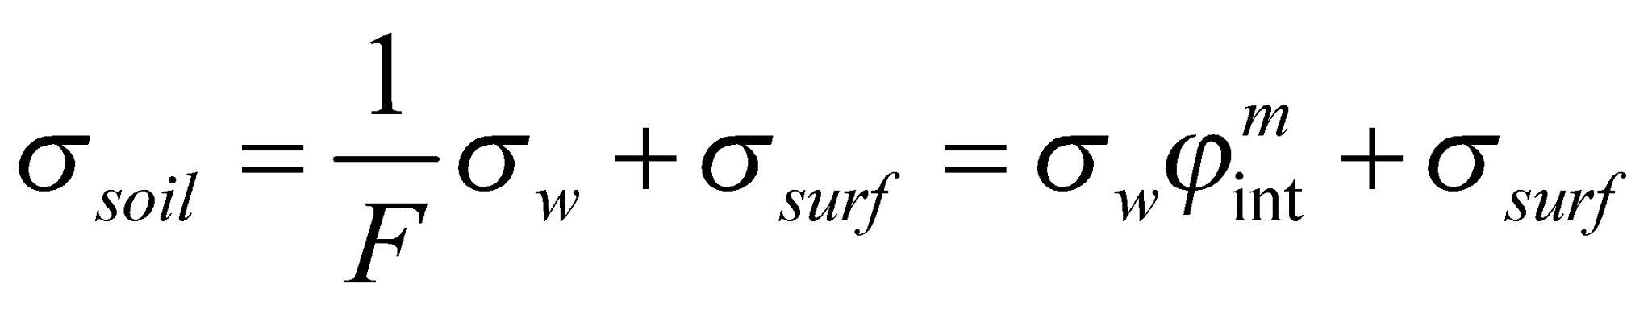
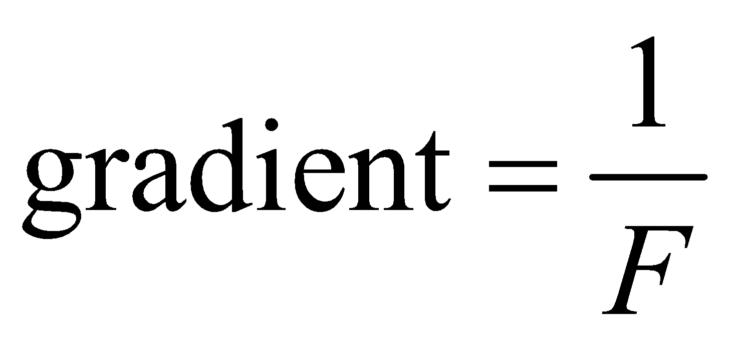
Addition of pore fluid and surface conduction
Basic equation describing electrical conductivity in the presence of surface conduction
Linear plot
Logarithmic plot
Pore fluid conductivity dominant
Surface conductivity dominant
σ_{soil}
Log (σ_{soil})
intercept = σ_{surf}
σ_{w}
Log (σ_{w})

Slide 15
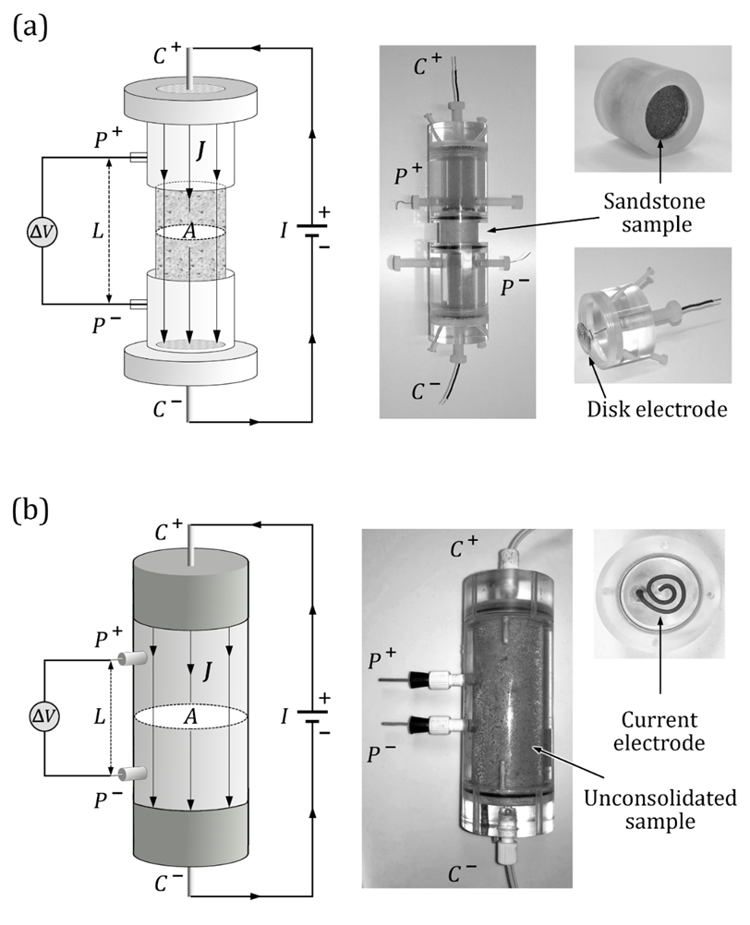
Measuring resistivity: rock cores
Source: Binley and Slater, 2020, Resistivity and induced polarization: theory and
applications to the near-surface Earth, In Press

Slide 16
Measuring resistivity: soils
Source: Binley and Slater, 2020, Resistivity and induced polarization: theory and
applications to the near-surface Earth, In Press

Slide 17
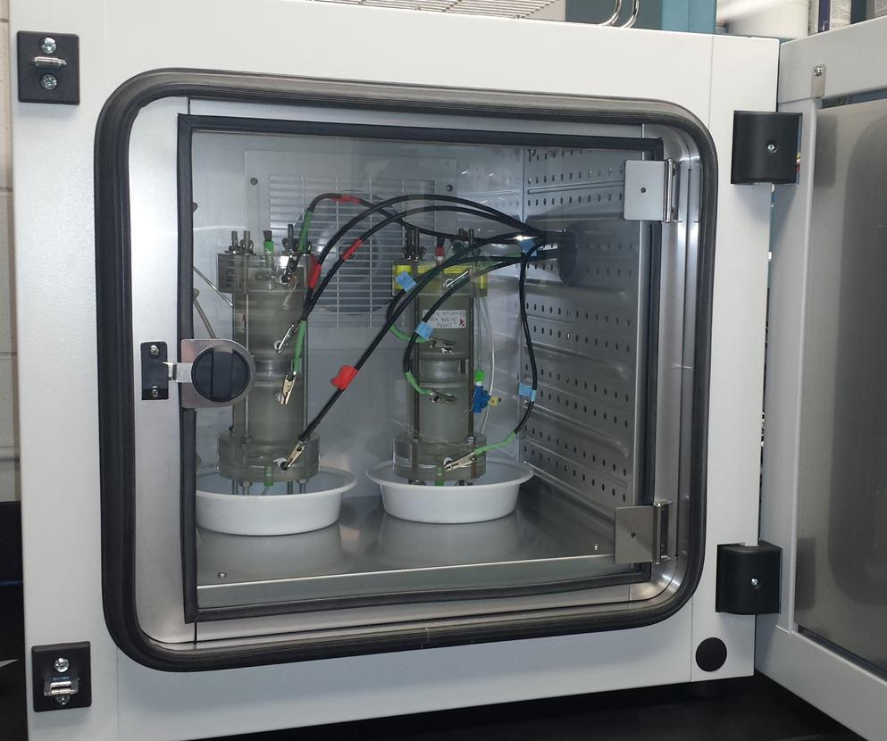
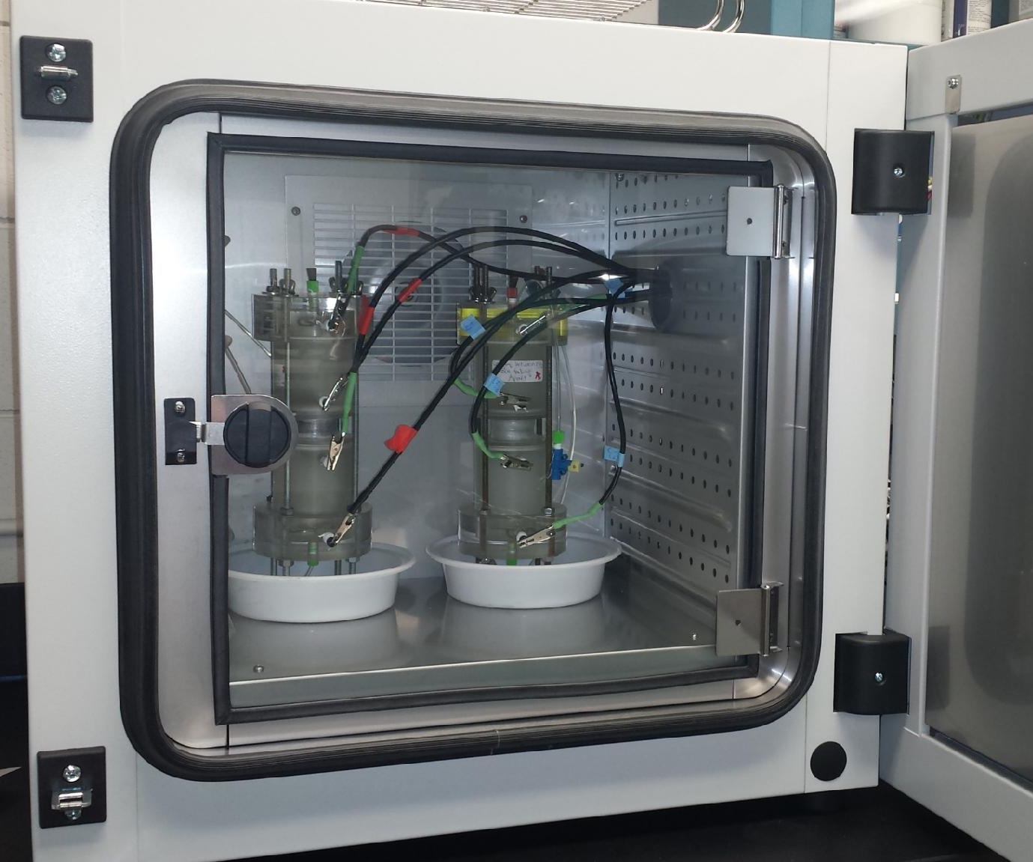
Laboratory measurements of resistivity of soils and rocks

