Slide 1

A Short Tutorial on Geophysical Mapping Concepts with Resistivity and EM methods
Lee Slater
Department of Earth and Environmental Sciences, Rutgers University, Newark, NJ, USA

Slide 2


Introduction to the module
Harrier Meadow
From Unit 1
Persistence and distribution of salinity tolerant plants?
Notes:
Unit 1 of this module introduces Harrier Meadow, where a native plant known as Salicornia (or Pickleweed) is thriving in some selected locations. The unit introduces the hypothesis that the distribution of pickleweed observed at the surface is controlled by the distribution of the salinity (salt concentration) of the pore fluids in the soils.

Slide 3
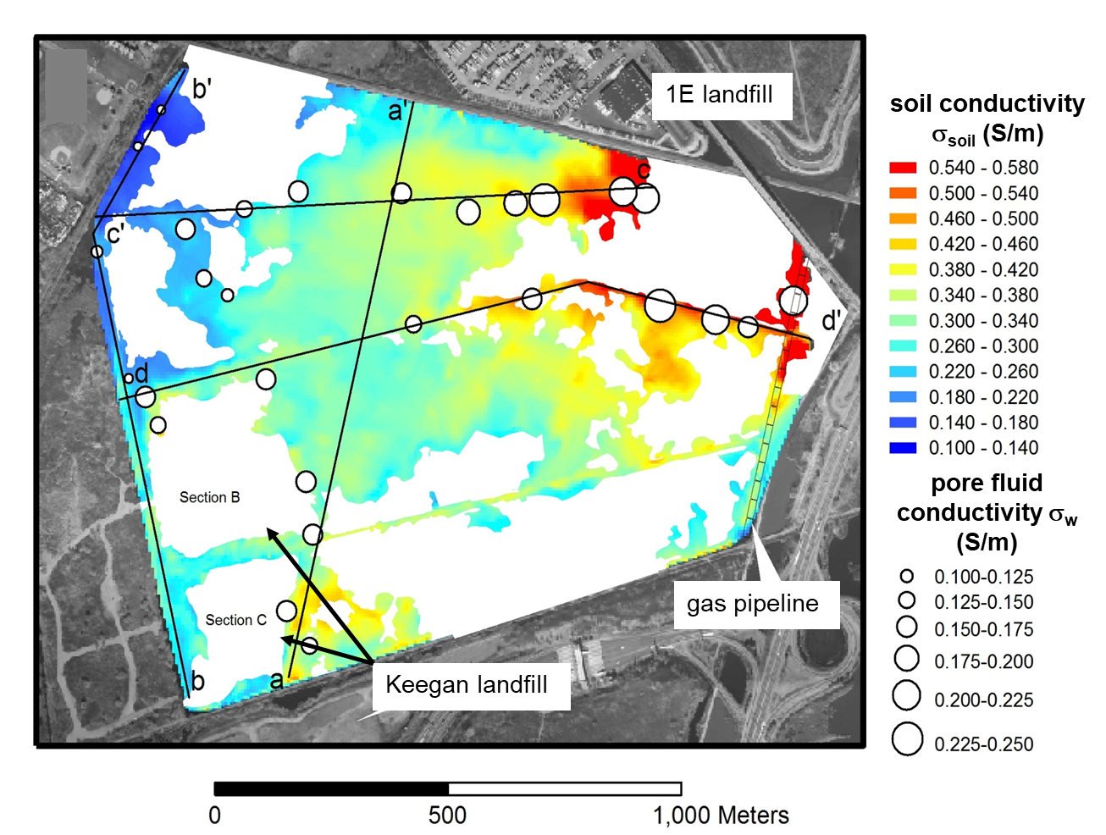
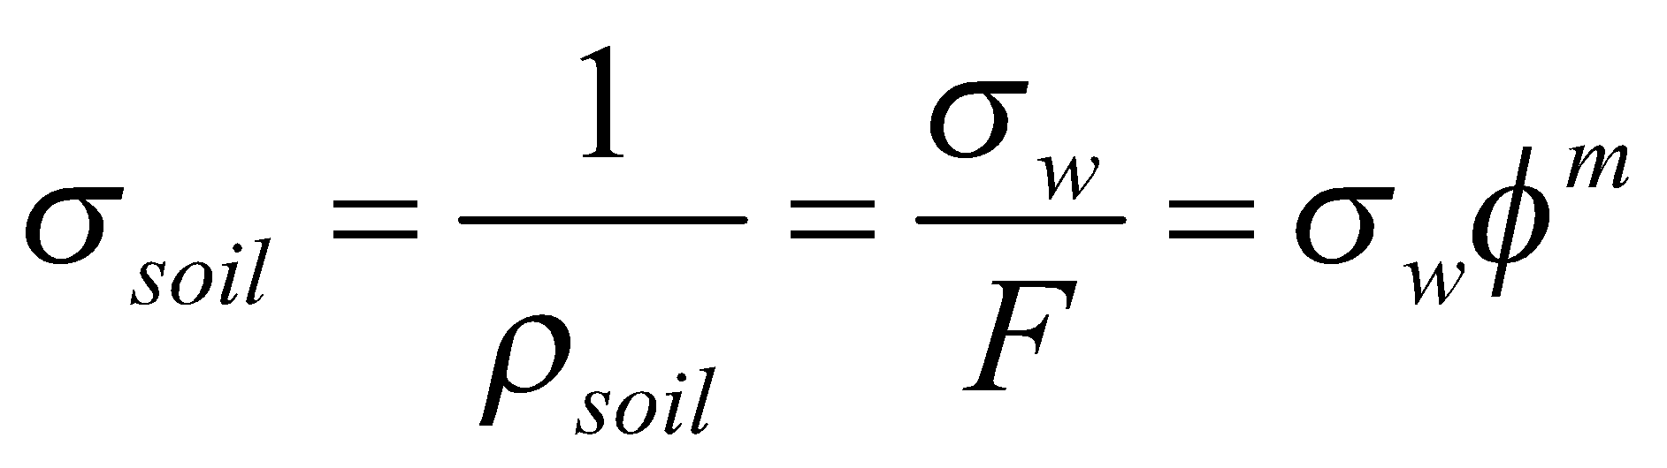
Introduction to the module (continued)
From Unit 2
Archie’s Law (1942)
‘cementation’ exponent
interconnected porosity
pore fluid conductivity
Notes:
Unit 2 of this series of modules describes the controls on the basic electrical properties of soils. It discusses how the electrical conductivity of fluids in the ground is controlled by the salinity. This module then introduces Archie’s Law, which related the electrical conductivity of the soil measured with geophysical instruments to the electrical conductivity of the pore fluids. An example application to a freshwater marsh in New Jersey is provided to demonstrate how geophysical techniques have been used to map subsurface salinity (i.e. pore fluid conductivity) patterns.

Slide 4
ELECTRICAL RESISTIVITY
Notes:
This unit focuses on how measurements of the electrical conductivity (or its inverse, electrical resistivity) of soils are actually made in the field using two geophysical techniques: [1] electrical imaging and [2] electromagnetic conductivity mapping. We will start with looking at the basics of resistivity before turning to the basics of electromagnetic conductivity mapping.

Slide 5
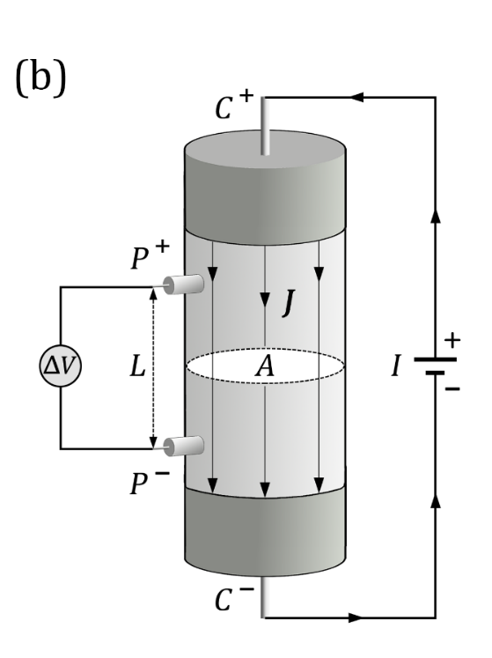
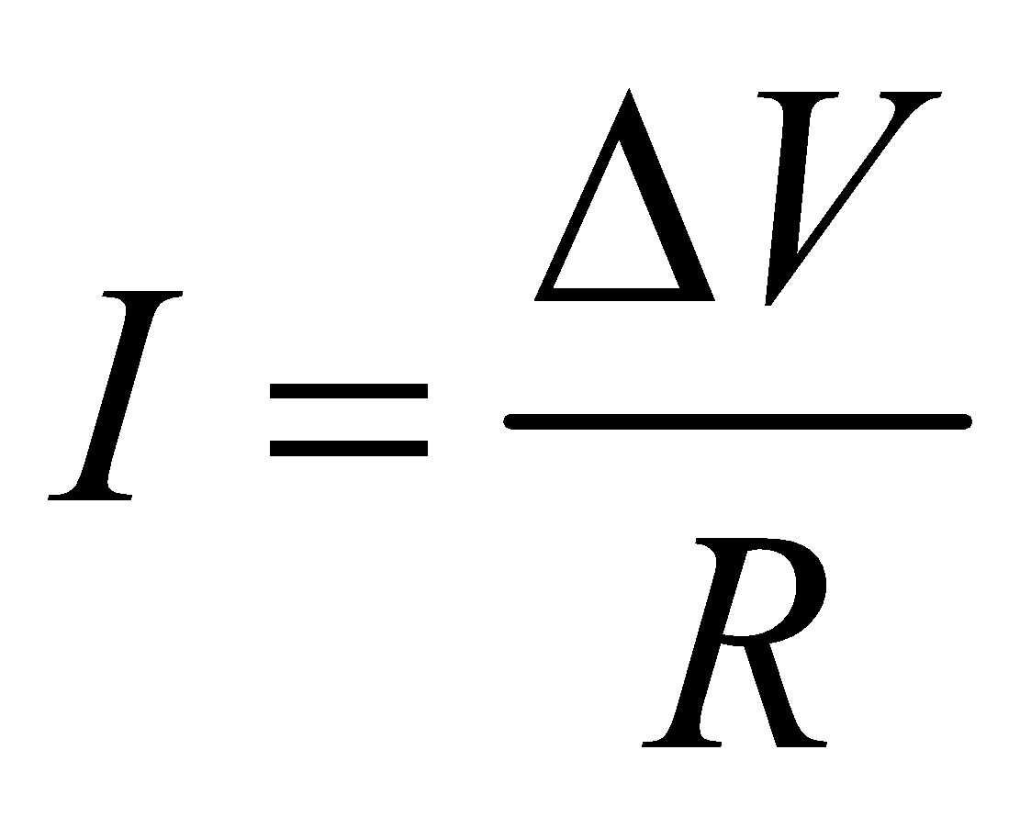
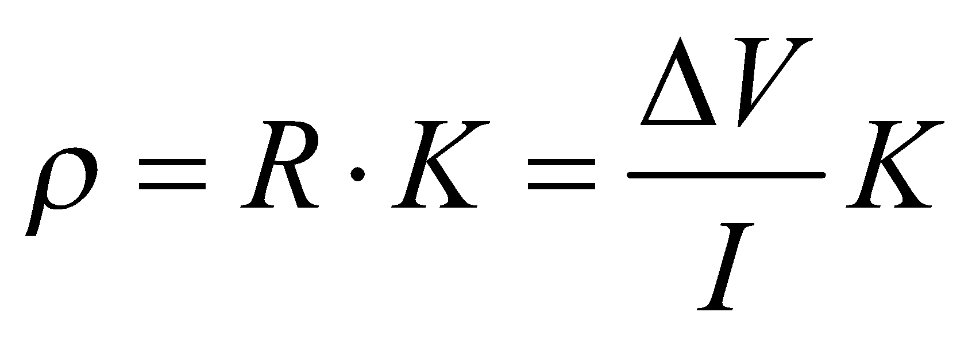
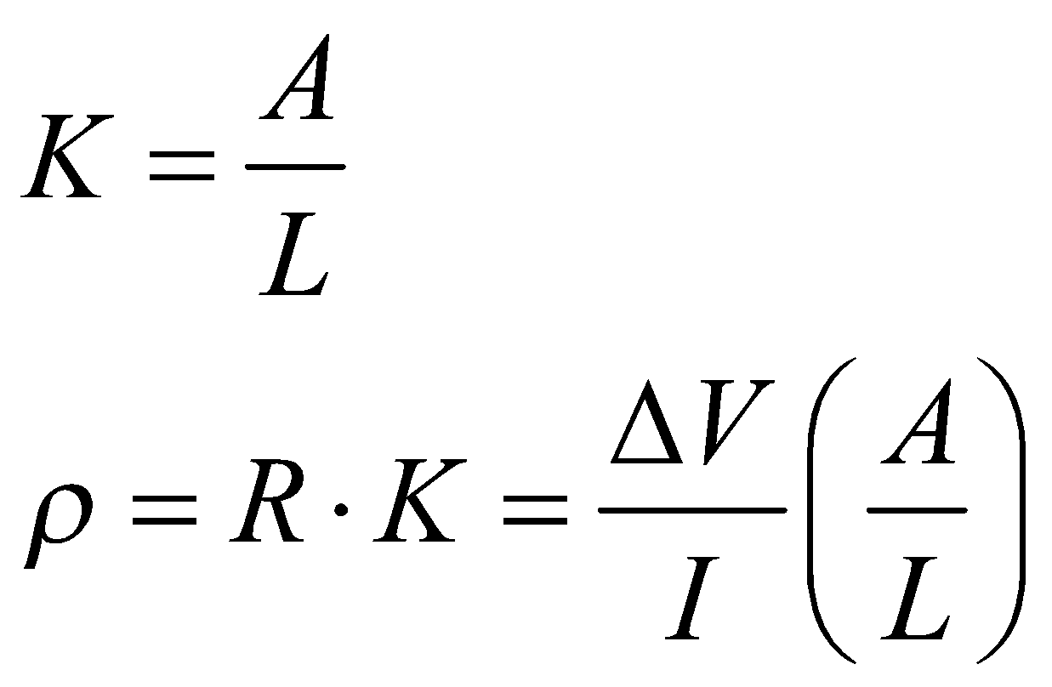
Ohm’s Law
One-dimensional (1D) current flow in a column
Voltage difference (volts)
Current flowing (amps)
Resistance exerted (ohms)
Relationship between resistivity (intrinsic property) and resistance ( what we measure) for one-dimensional current flow:
Units of m
For the specific case of 1D current flow:
Units of Ohm
Units of Ohm m
Notes:
Before looking at how we make electrical resistivity measurements in the field, it is very helpful to first look at how we make the measurement in the laboratory. For this we need to understand Ohm’s Law. Ohms Law related the current flowing in an object to the voltage drop across its ends and the resistance exerted by the object. Resistance is what we can measure with an electrical resistivity imaging instrument. The resistivity, which is an intrinsic property of a material that we explored in Unit 2, is related to the measured resistance by a geometric factor (K). In the case of one dimensional flow in a column, the geometric factor is given by the cross sectional area of the column divided by the length of the column.

Slide 6
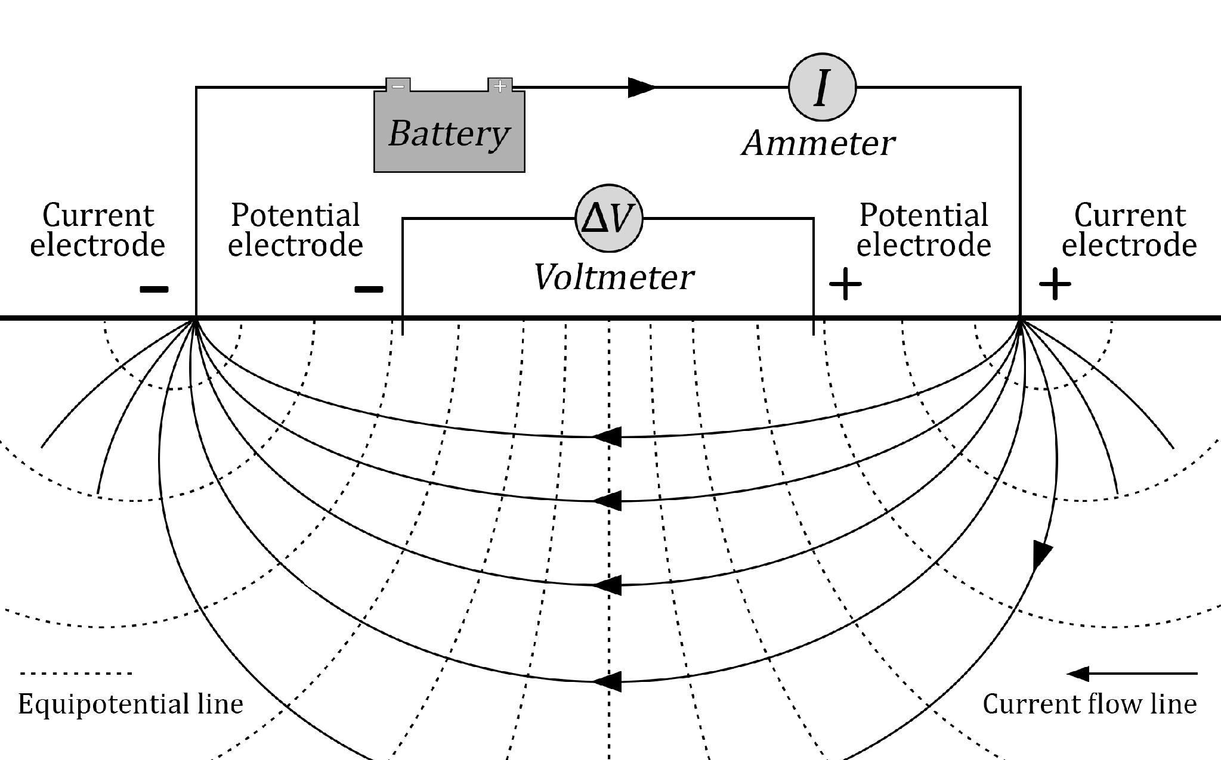
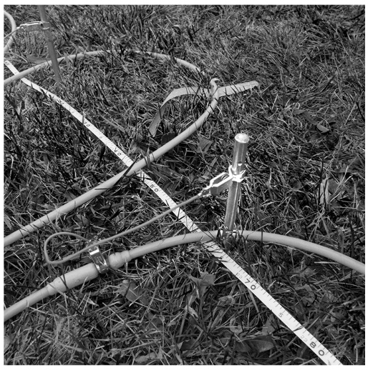
Injection of electrical current into the earth
cable (transmits current and returns voltages)
‘point’ electrode
Source: Binley and Slater, 2020, Resistivity and induced polarization: theory and
applications to the near-surface Earth, In Press
Notes:
Mention dipole, current flow lines and equipotential lines

Slide 7
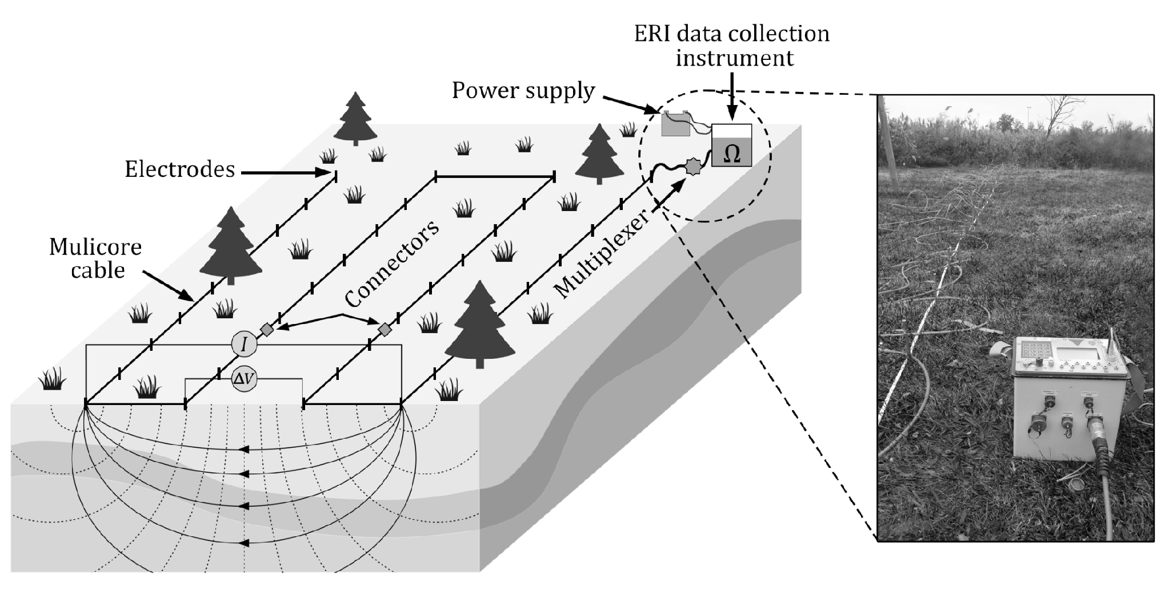
Electrical resistivity imaging
electrodes
Source: Binley and Slater, 2020, Resistivity and induced polarization: theory and
applications to the near-surface Earth, In Press

Slide 8
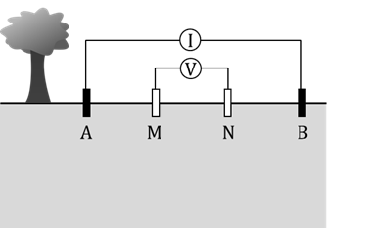



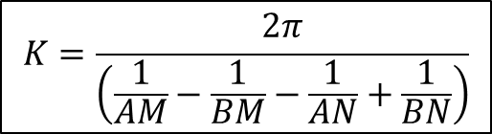

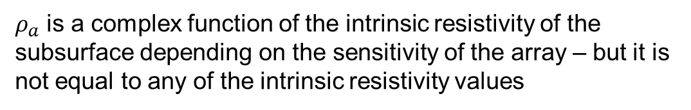
Transfer resistances and apparent resistivity
Apparent resistivity: the resistivity of a homogenous subsurface that the measured voltage and current are equivalent to
Transfer resistance with units of ohms
Geometric factor
Notes:
The ratio of the voltage difference between the pair of potential electrodes and the current injected between the pair of current electrodes, known as the transfer resistance, is measured with a resistivity imaging instrument. When the transfer resistance is multiplied by the geometric factor for the array, the apparent resistivity is computed. This is generally a complex function of the unknown true resistivity structure of the subsurface. The value of the apparent resistivity will depend on the sensitivity of the array being used to different parts of the subsurface. The geometric factor of the array is given by this expression, where the terms, AM, BM, AN and BN represent distances between different sets of electrodes. For example, BM is the distance from the B current electrode to the M potential electrode. The geometric factor is used to calculate the apparent resistivity based from the measured transfer resistance.
In the specific and unusual case that the Earth is homogenous, then the apparent resistivity will be equal to the true resistivity of the Earth. In fact, the apparent resistivity is formally defined as the resistivity of a homogeneous subsurface that the measured transfer resistance is equivalent to.

Slide 9

Apparent resistivity
Apparent resistivity: the resistivity of a homogenous subsurface that the measured transfer resistance is equivalent to
A homogeneous subsurface

Slide 10
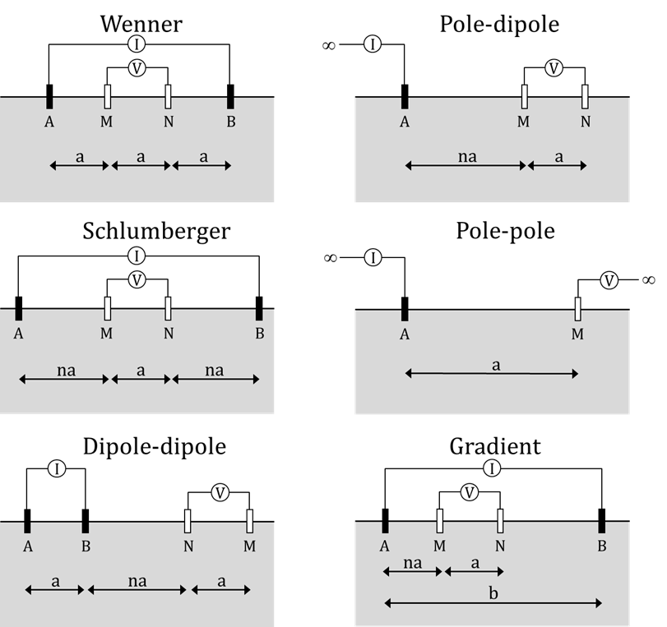



Standard electrode configurations
Specific array types are used with easy to compute geometric factors (K)
Wenner array:
Dipole-dipole array:
For a given Earth resistivity the arrays have very different:
Transfer resistances (R_{t}) and voltages (ΔV)
Sensitivity e.g. to depth below ground
Source: Binley and Slater, 2020, Resistivity and induced polarization: theory and
applications to the near-surface Earth, In Press
Notes:
Partly because the general geometric factor for a 4 electrode array is a bit of a mouthful, geophysicists have adopted the use of standard arrays that yield a simpler expression of the geometric factor. We will work with the Wenner array where the geometric factor is simply 2 times pi times the electrode spacing a. We will also work with the dipole-dipole array. The geometric factor for the dipole-dipole array is a bit more involved but is again determined by a constant electrode spacing, and also an integer n representing the multiplier on a that defines the spacing between current electrode B and potential electrode N. The other reason that geophysicists use such standard arrays is because they have different sensitivity patterns, meaning that some may be quite good for detecting lateral variations in resistivity whereas others will be good at detecting vertical variations in resistivity.

Slide 11
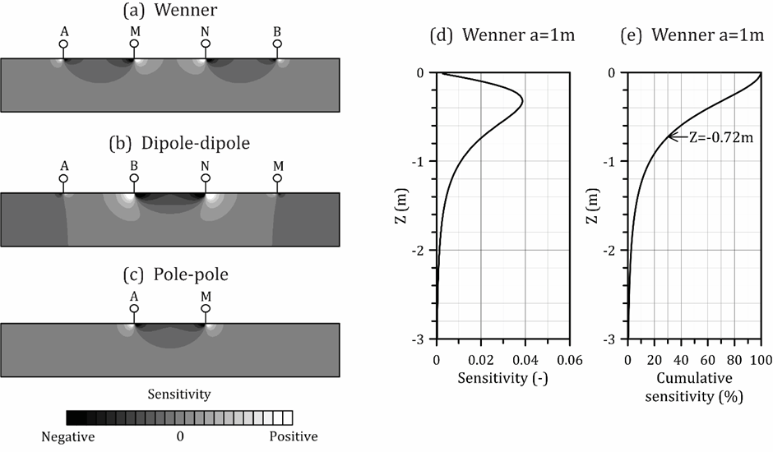
Sensitivities of different array types
Some arrays are good for detecting lateral changes in resistivity and others are good for detecting vertical changes in resistivity
Source: Binley and Slater, 2020, Resistivity and induced polarization: theory and applications to the near-surface Earth, In Press
We will explore these effects using Scenario Evaluator for Evaluating Resistivity (SEER)
Notes:
Refer to SEER activity

Slide 12
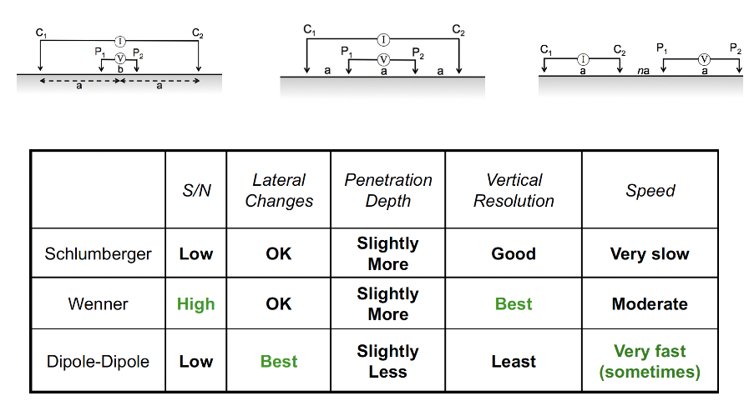
Comparing electrode configurations
Schlumberger
Wenner
Dipole-Dipole
Schlumberger
Wenner
Dipole-Dipole

Slide 13
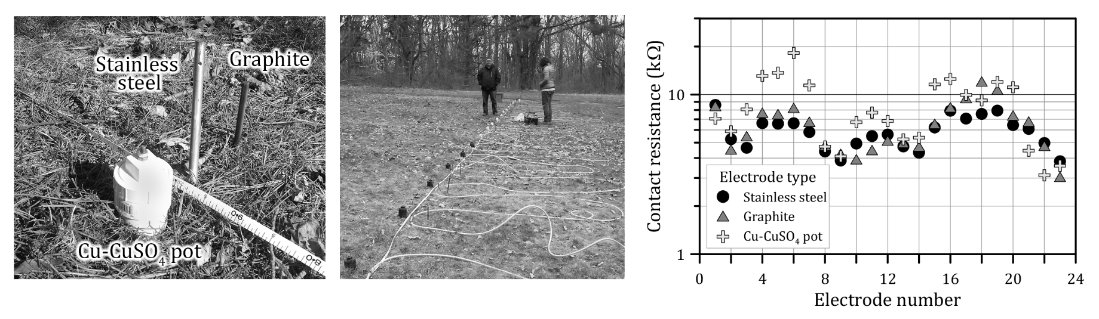
Field challenges: contact resistances
Source: Binley and Slater, 2020, Resistivity and induced polarization: theory and applications to the near-surface Earth, In Press
Contact resistances will vary along line depending on local ground conditions (e.g. moisture content)
Different electrodes can give different contact resistances

Slide 14
RESISTIVITY SURVEYS IN HARRIER MEADOW

Slide 15
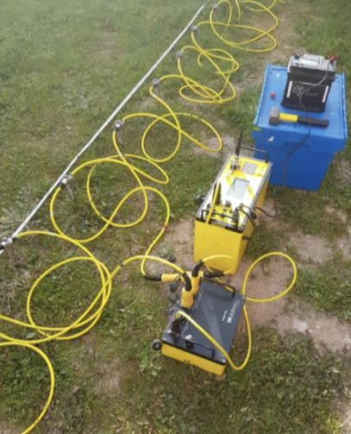
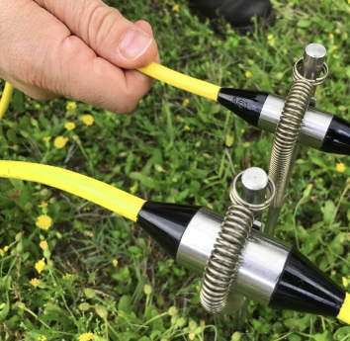
Resistivity surveying equipment
Resistivity Meter
Switchbox
Electrodes and cables

Slide 16

The outbound journey
electrodes (heavy)
cables (heavy)
resistivity system (heavy)

Slide 17
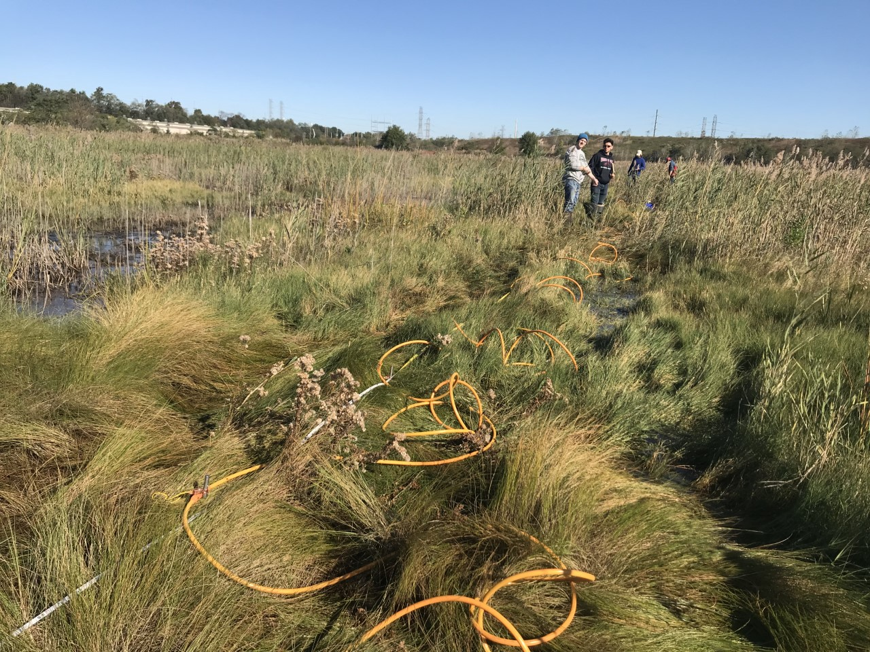
Laying out the line
Line workers
electrodes

Slide 18

96 electrodes spaced 1.5 m apart
Line length: 142.5 m
Time to setup: 1 hr and 30 mins with team of 5
Completed line (part of)

Slide 19
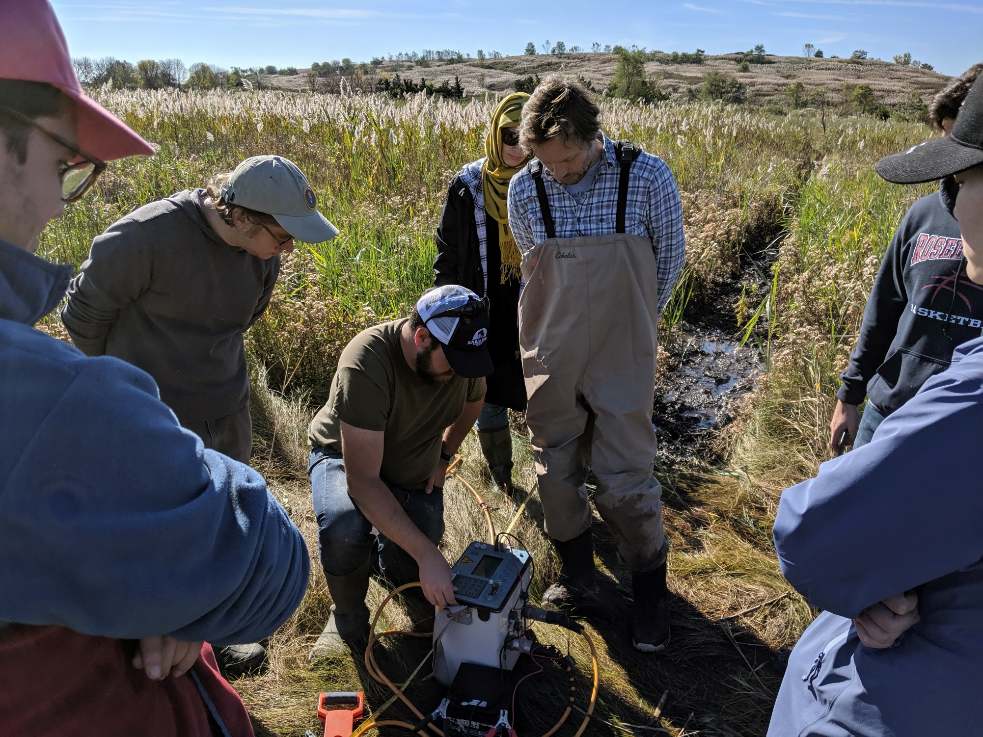
System checks
Contact resistance check
Voltage and current levels (change settings?)

Slide 20
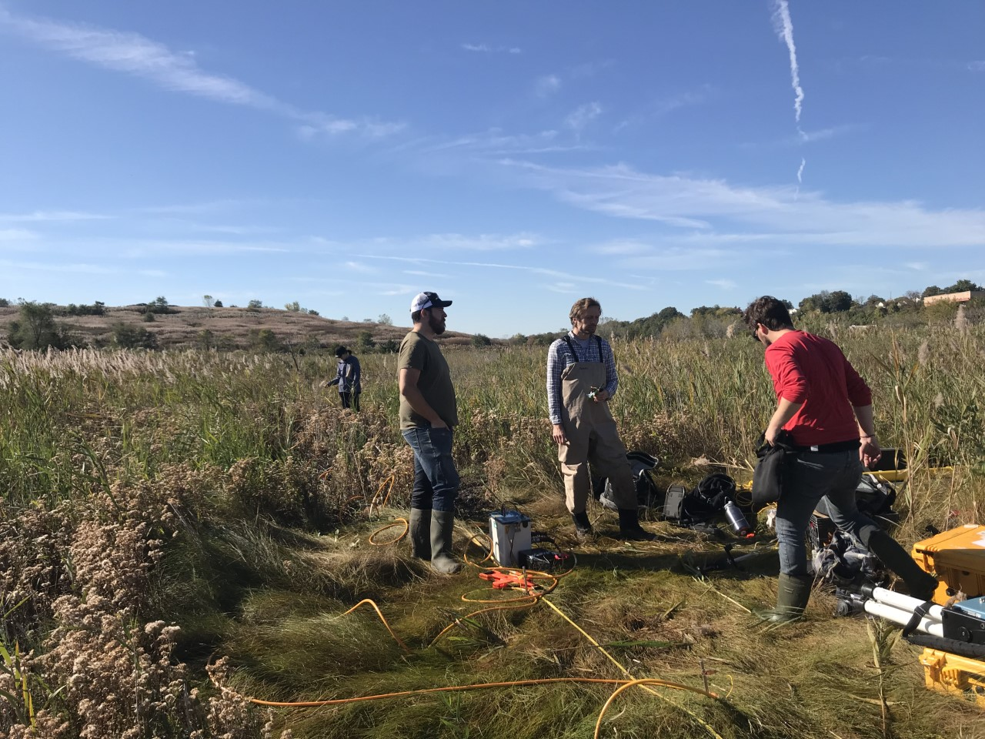
Fixing problems
This electrode isn’t connected!
It’s not working!!
I’ll fix it!!
Dum-de-dum..

Slide 21

Waiting for data to be acquired
Engaged students
Expert(?)

Slide 22
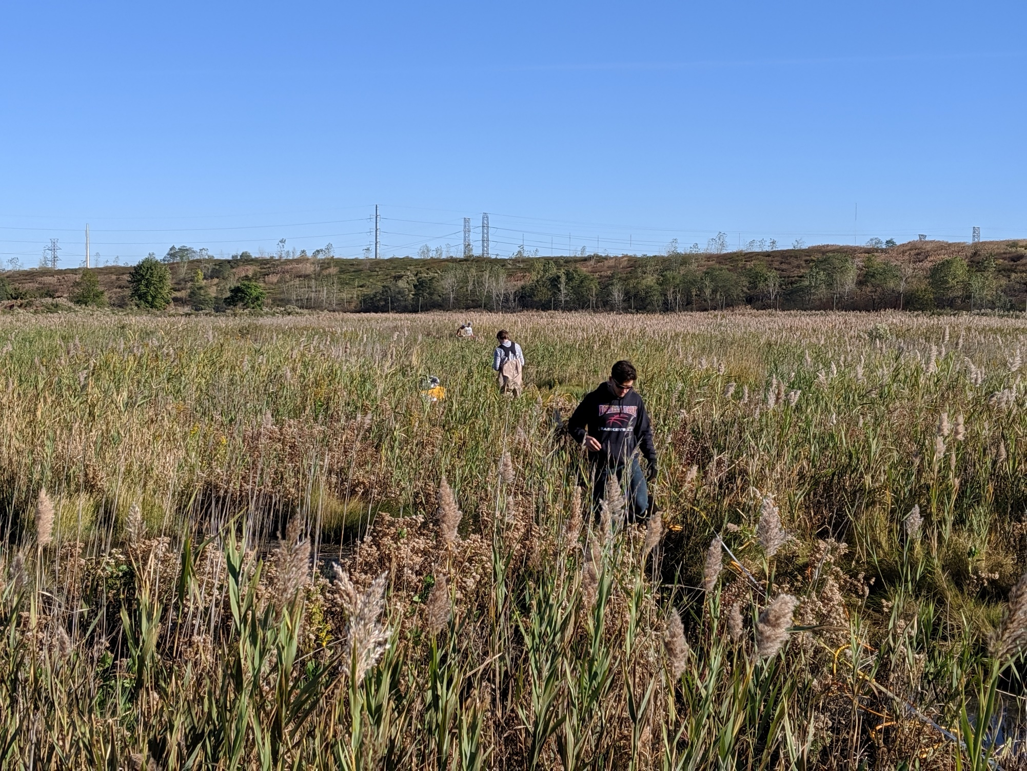
Packing up the line

Slide 23

Return home

Slide 24
ELECTROMAGNETIC (EM) CONDUCTIVITY MAPPING

Slide 25
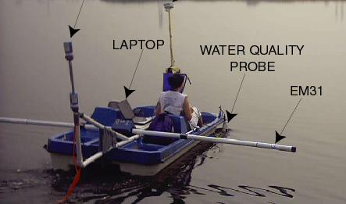

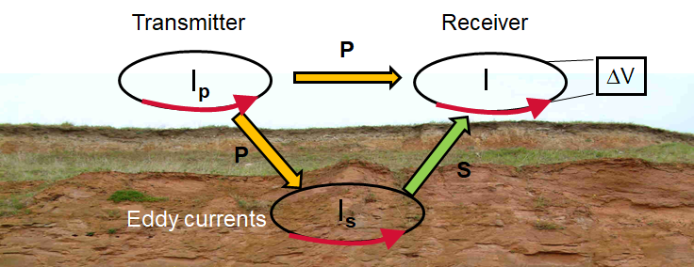
Basic concept
Uses physics of electromagnetic (EM) induction for non-contact measurement of subsurface electrical conductivity
Rapid measurements, larger scale
Not as exact as electrical imaging

Slide 26
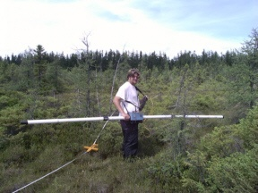
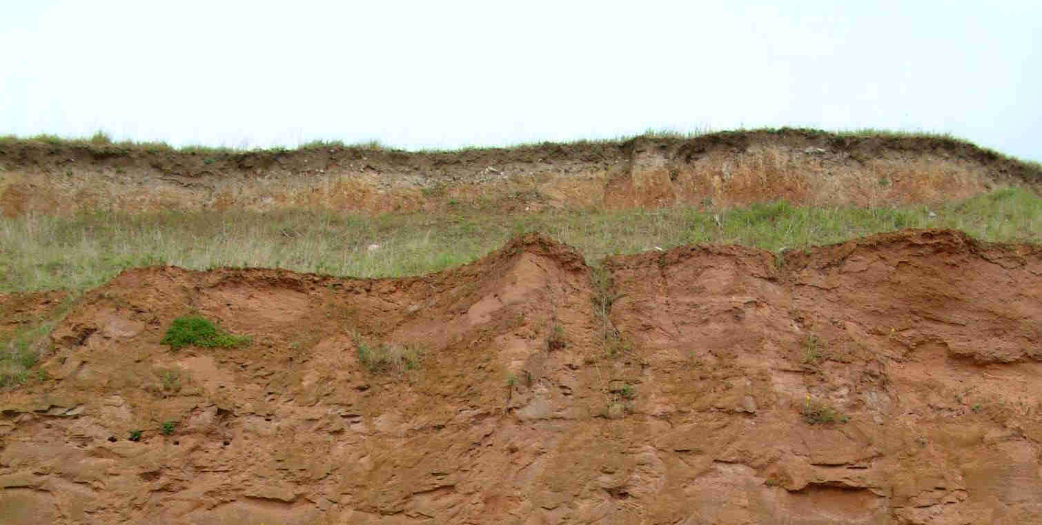
Controlled-source, frequency domain, EM method:
Transmitter coil: produces a primary field
Receiver coil: measures resultant of primary field (P) and secondary field (S) induced by subsurface conductors
Transmitter
Receiver
4 m boom to hold coils a precise distance apart
P
I_{p}
I
ΔV
Coil
Coil
P
S
I_{s}
Electronics unit
Eddy currents

Slide 27
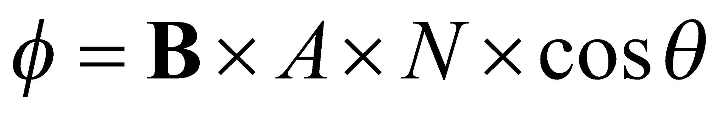
EM Basics 1:
Primary magnetic field induces flux in subsurface target:
Representing the target as another coil:
induced flux
no. turns on coil
B = Magnetic Field
Transmitter
I_{p}
Angle θ
A = cross sectional area

Slide 28
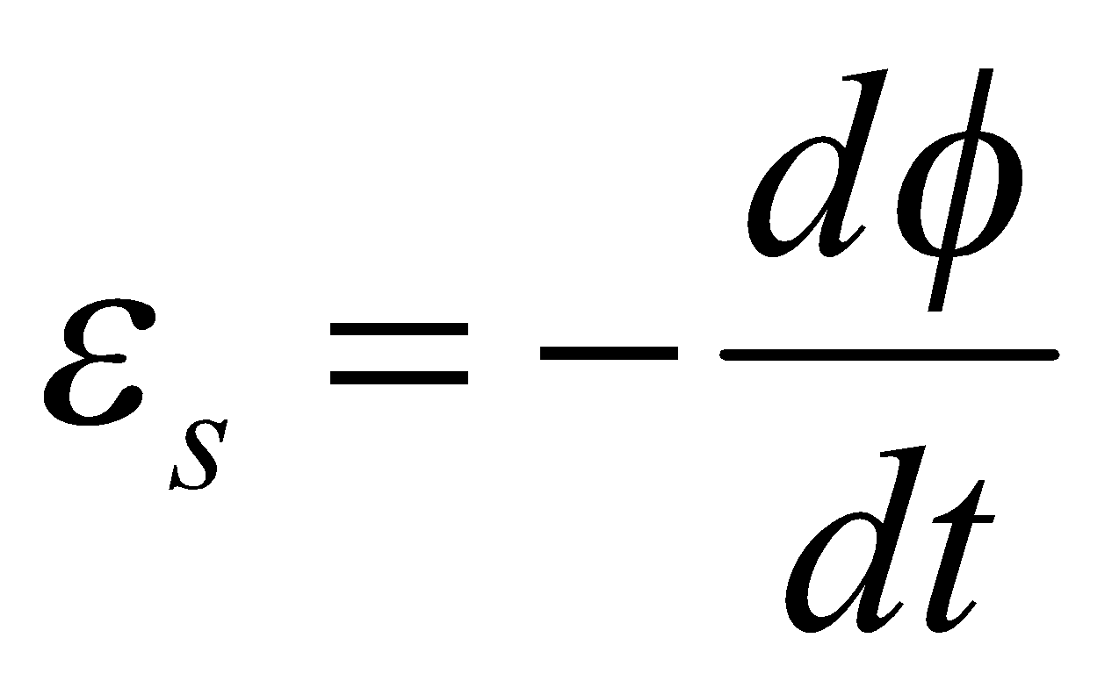
EM Basics 2:
Time varying flux generates an e.m.f.
Time varying flux induces an electromotive force (e.m.f.) or voltage:
causes current flow (I_{t})
e.m.f. “The electromagnetic work that would be done on an electric charge (an electron in this instance) if it travels once around the loop”
Transmitter
I_{p}
I_{t}
A = cross sectional area

Slide 29
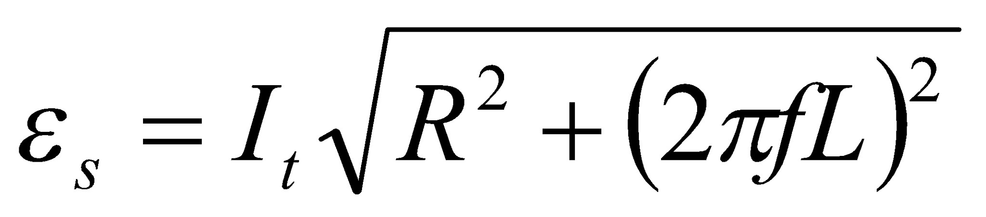
EM Basics 3:
Current flow induces an additional magnetic flux
Produces an additional e.m.f. that tends to decrease rate of current change:
Transmitter
inductance
I_{p}
resistance
frequency
I_{t}
A = cross sectional area

Slide 30
Controlled-source, frequency domain, EM method:
Transmitter coil: produces a primary field
Receiver coil: measures resultant of primary field (P) and secondary field (S) induced by subsurface conductors
Transmitter
Receiver
4 m boom to hold coils a precise distance apart
P
I_{p}
I
ΔV
Coil
Coil
P
S
I_{s}
Electronics unit
Eddy currents

Slide 31
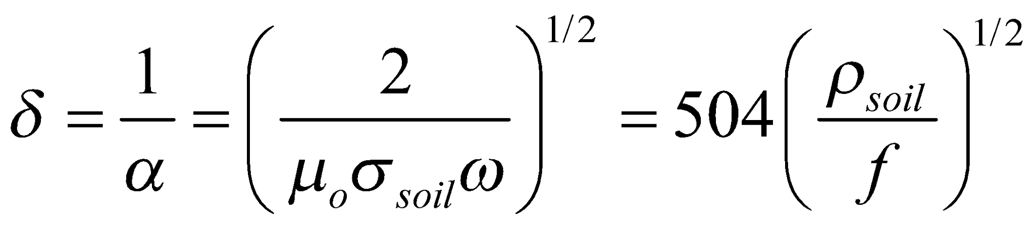
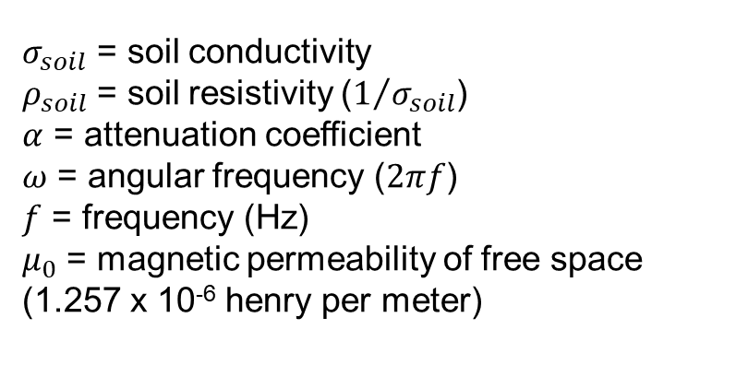

Skin depth (δ):
Approximate measure of optimal investigation depth of EM instrument (true investigation depth will be less)
Skin depth in meters when resistivity is in Ohm m
10000
1000
δ (m)
100
1.2 kHz
10
9.8kHz
80kHz
1
1
100
10000
Notes:
The skin depth of a frequency domain EM instrument is used to provide a measure of an approximate investigation depth. The skin depth, which is inversely related to the attenuation coefficient describing the rate of energy loss of the EM field in the Earth, is controlled by the soil conductivity and the frequency of the induced EM field. . The skin depth in meters is equal to 504 times the square root of the soil resistivity in Ohm m divided by the frequency in Hz. Instruments that transmit at lower frequencies will look deeper, although spatial resolution will be reduced

Slide 32
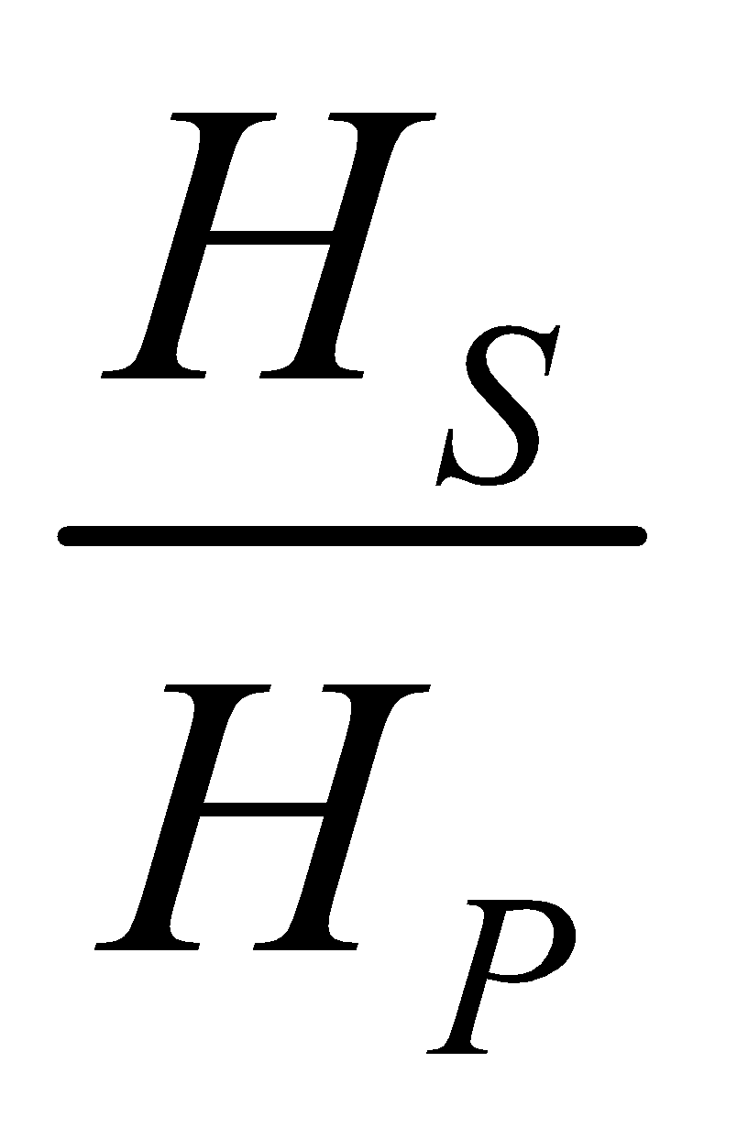
Horizontal loop (Slingram) method:
Records ratio of secondary magnetic field H_{S} to primary magnetic field H_{p}
Survey direction
Transmitter
Receiver
Transmitter
Receiver
Involves simultaneous movement of transmitter and receiver

Slide 33
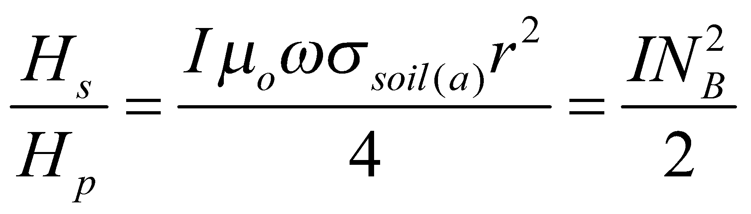
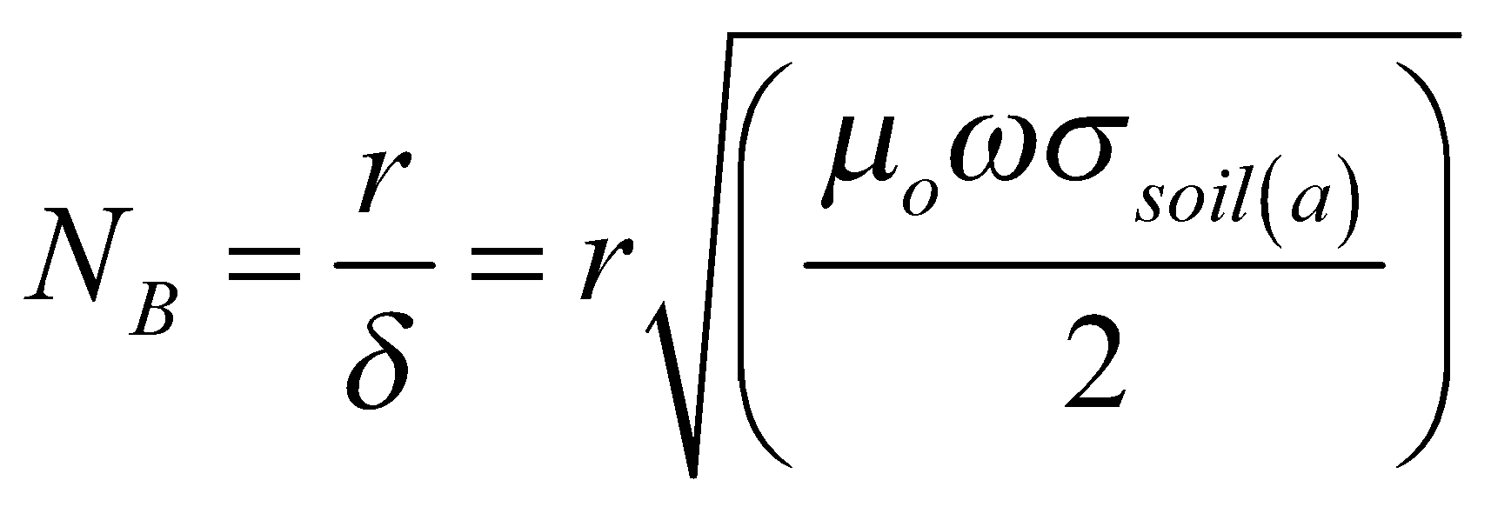
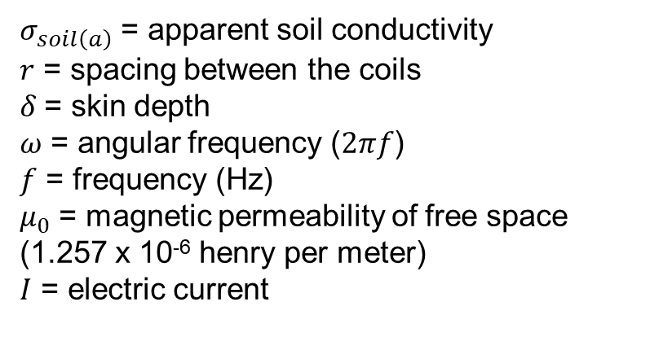
Ground conductivity meters
When N_{B} << 1,
i.e. Hs/Hp is linearly proportional to σ_{soil}
The Induction Number
4 m boom to hold coils a precise distance apart
Coil
Coil
Electronics unit
DIRECT READ OUT OF ESTIMATED APPARENT ELECTRICAL CONDUCTIVITY
Assuming a maximum probable value of σ_{soil} allows selection of a frequency and ispacing between coils such that N_{B} << 1 is satisfied

Slide 34
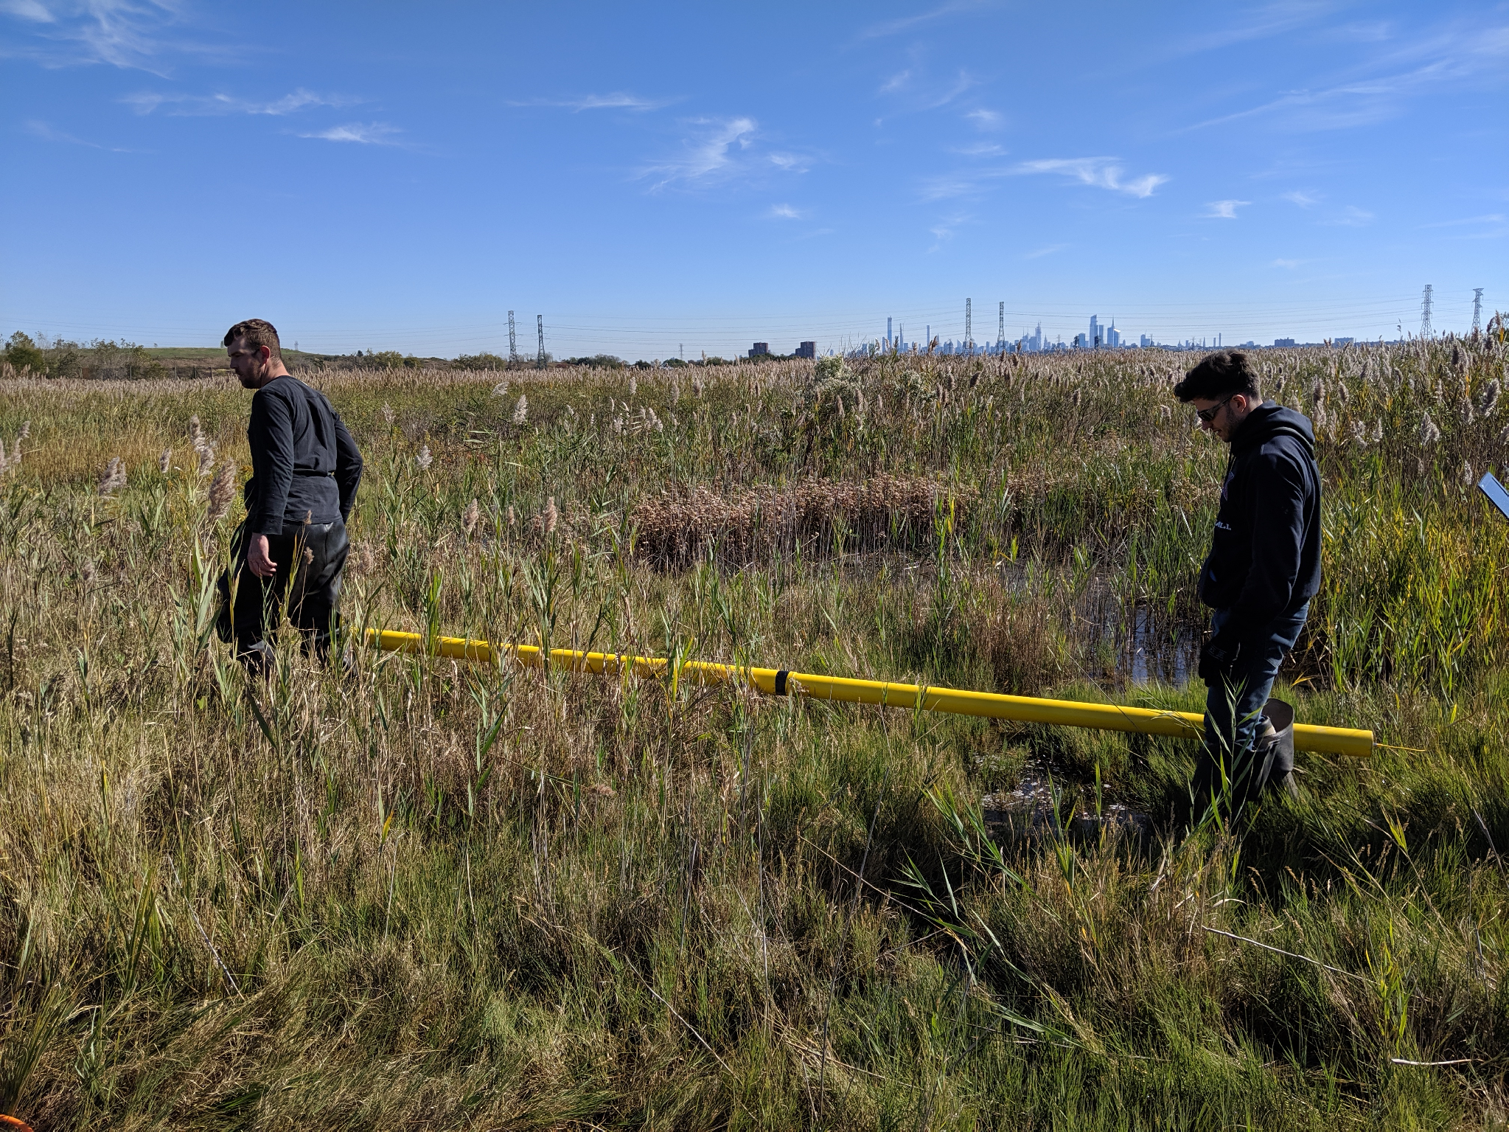
Multi-coil frequency domain EM systems
Dualem 421-S sensor used in Harrier Meadow
Multiple coils, offsets provide a range of sensing depths
These multiple measurements can be used to ‘invert’ datasets for conductivities of different layers of the Earth
2 m coil set
1 m coil set
4 m coil set

Slide 35
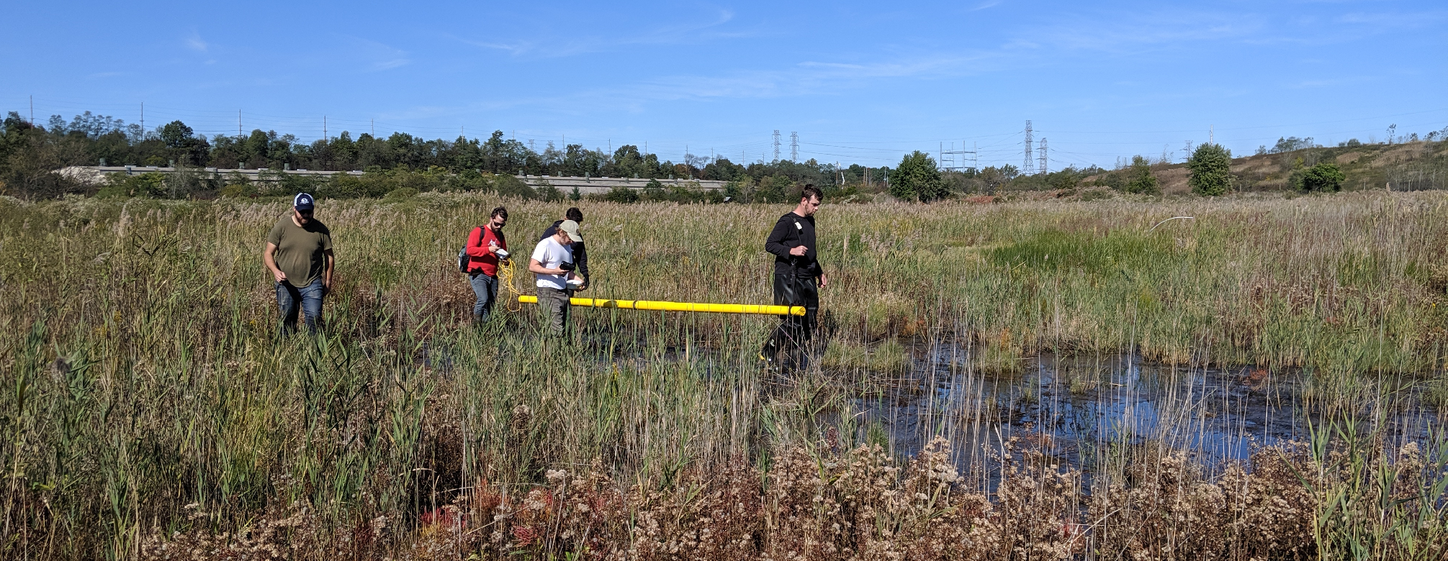
Dualem 421-S surveying in Harrier Meadow

