Slide 1

Geophysical Interpretation and Comparison with Vegetation Patterning
Lee Slater
Department of Earth and Environmental Sciences, Rutgers University, Newark, NJ, USA

Slide 2
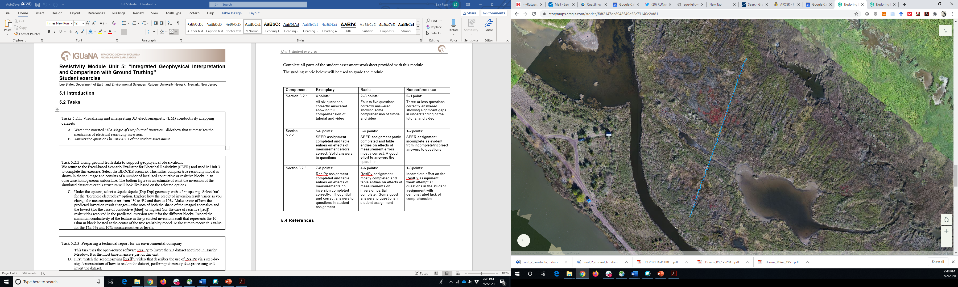
Electrical imaging survey
0 m
Salicornia patches
142.5 m

Slide 3
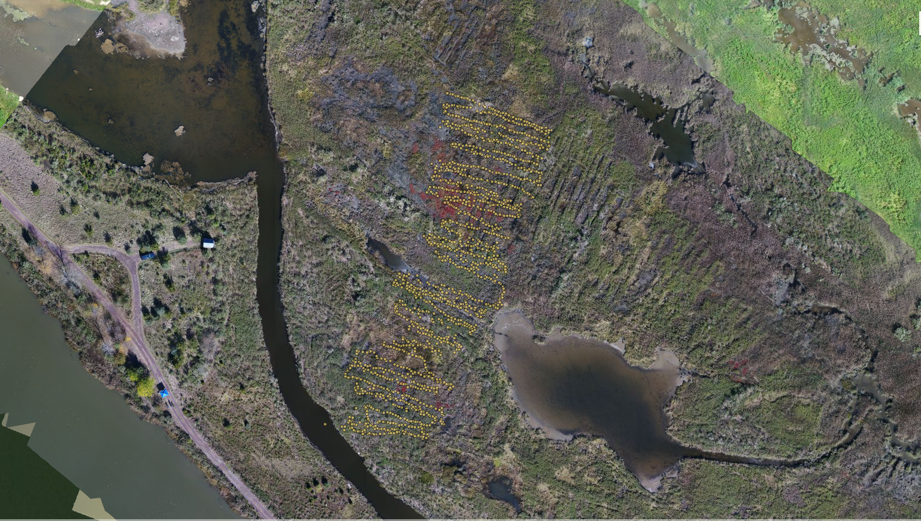
Electromagnetic (EM) conductivity mapping
Salicornia patches

Slide 4
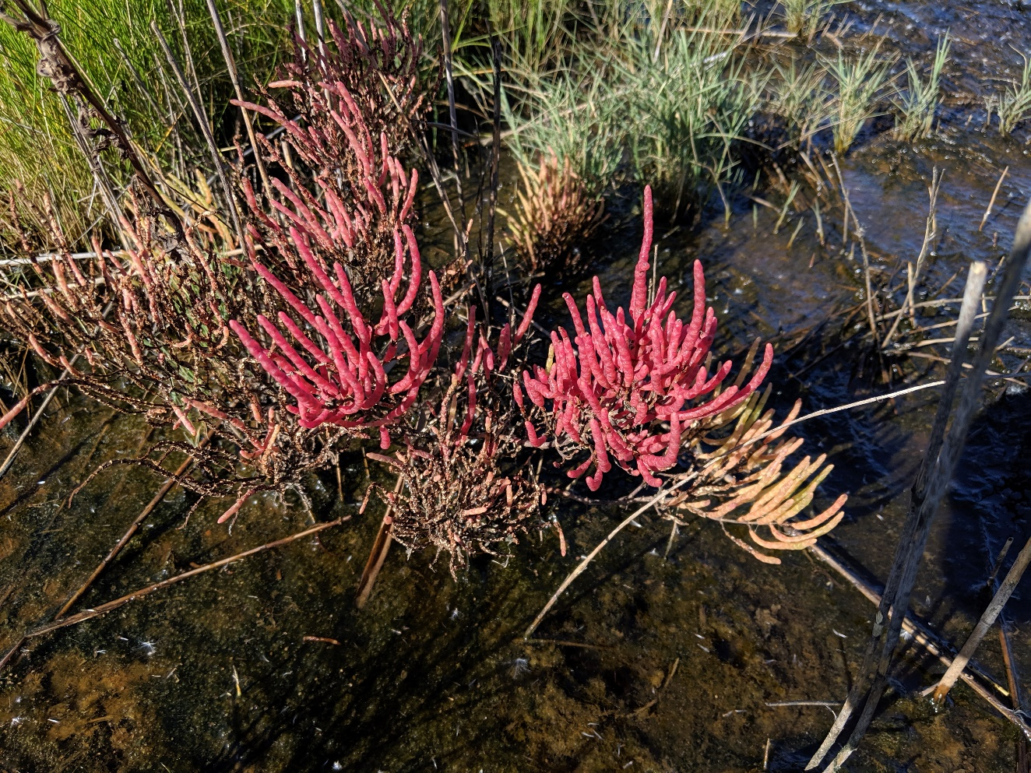
Evaluating our hypothesis
“Salinity-tolerant plants are thriving in regions of locally elevated salinity. As salinity exerts a strong control on electrical conductivity, we expect to map out increases in salinity in regions where pickleweed is thriving”

Slide 5
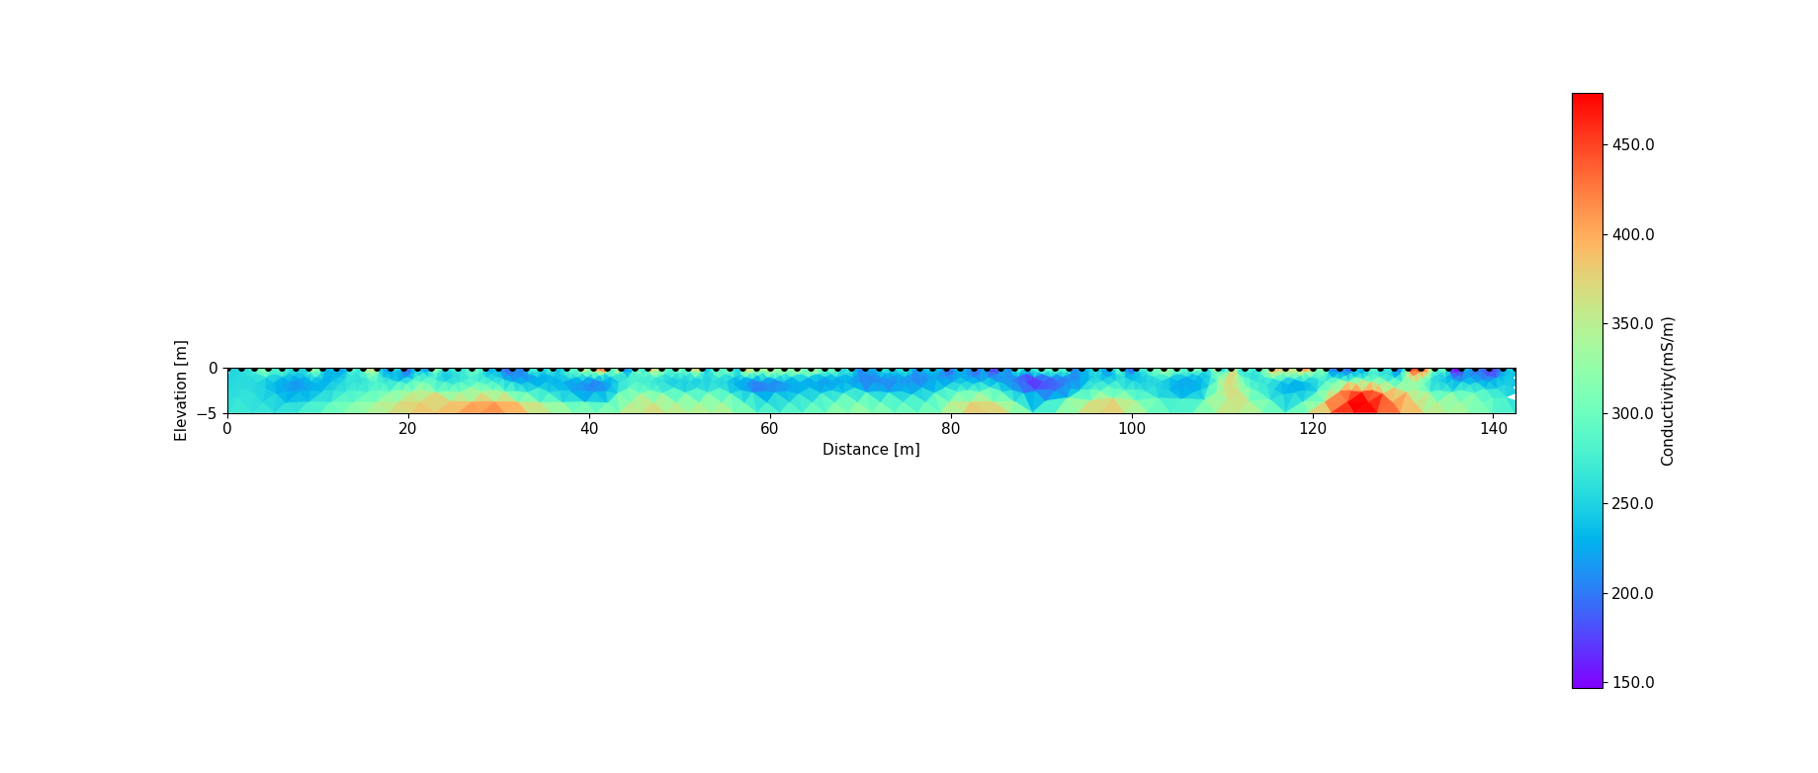
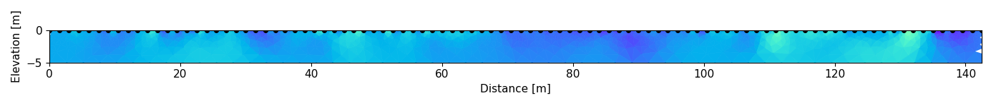
Resistivity images
What evidence do you see for correlations between the vegetation patterns (i.e. the location of the pickleweed) and the mapped conductivity structure in the top 5 m of the subsurface?
0 m
142 m
Conductivity (mS/m)

Slide 6
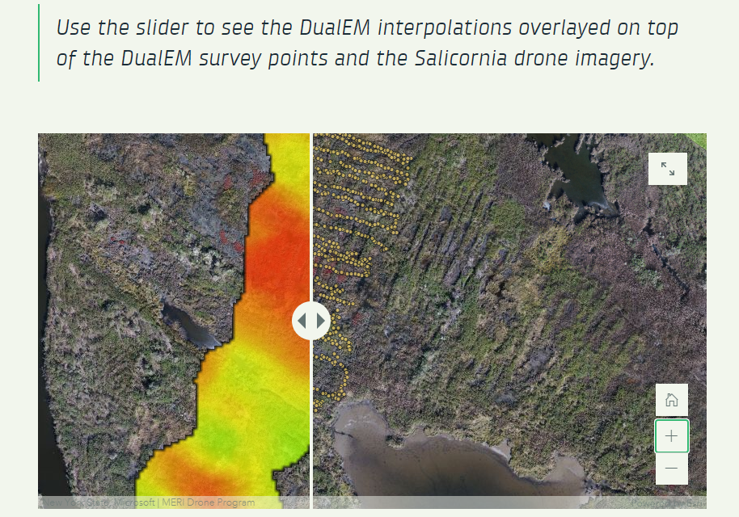
EM conductivity inversion image
Return to the story map ‘Exploring Harrier Meadow’ to view the results of the EM conductivity inversions
Compare the conductivity patterns you observe in the images for the different depths and contrast with vegetation patterns
Layer | Depth interval
1 | 0-0.2 m
2 | 0.2-0.5 m
3 | 0.5-0.9 m
4 | 0.9-1.4 m
5 | 1.4-2.1 m
6 | 2.1-3.0 m
7 | inf

Slide 7
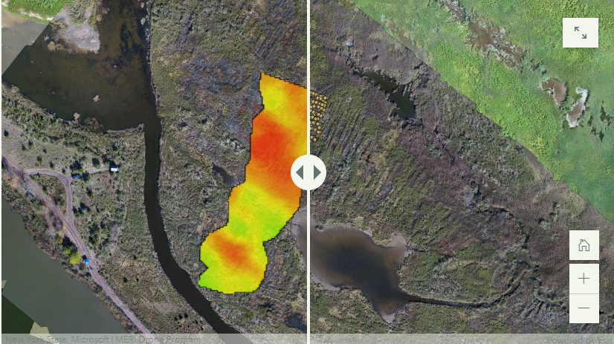
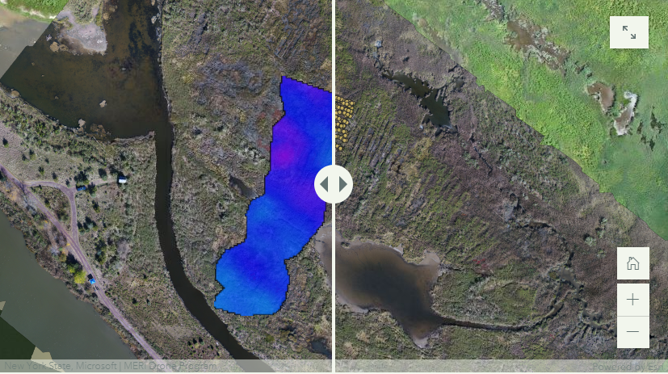
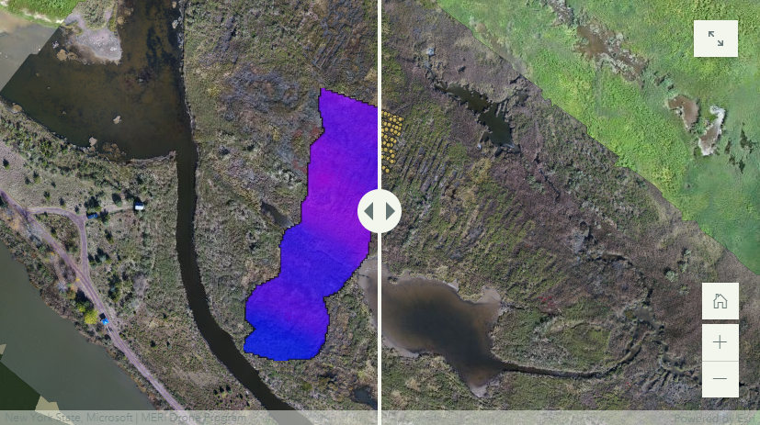
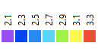
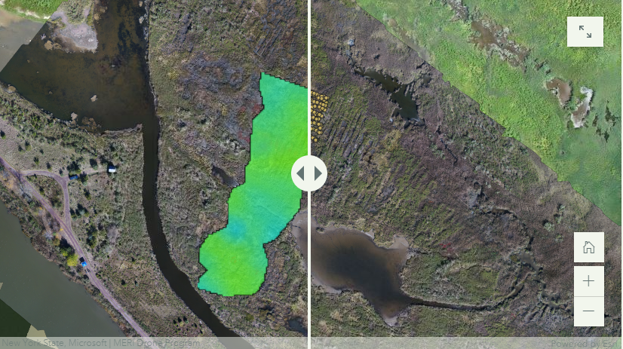
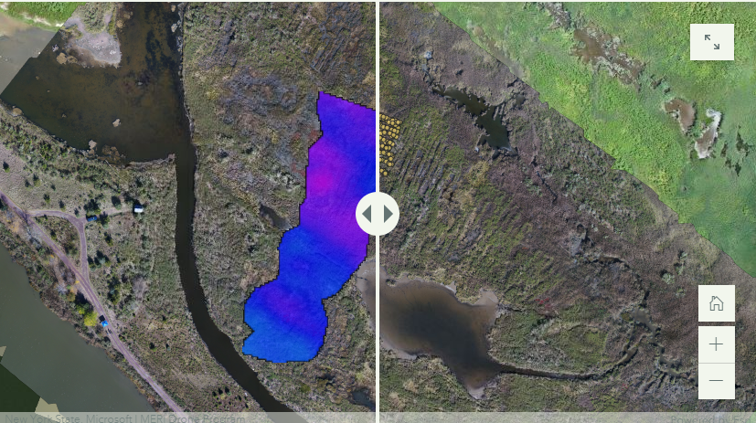
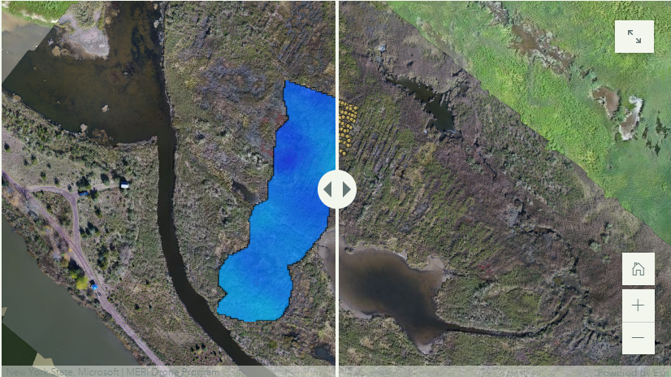
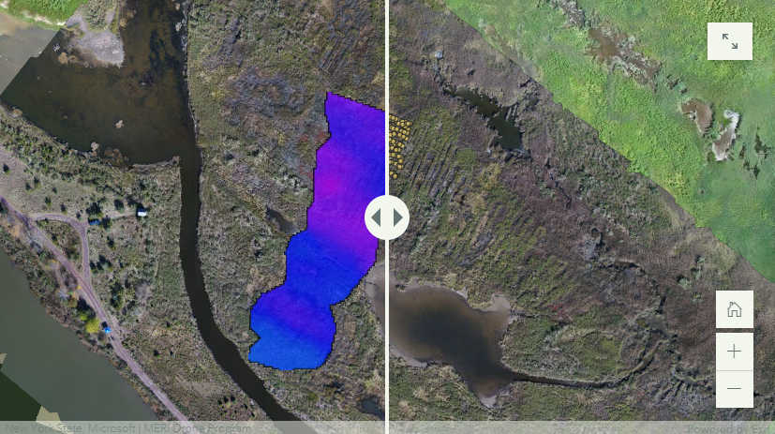
The layers of the 3D EM inversion
Layer 1: 0-0.2 m
Layer 4: 0.9-1.4 m
Layer 7: below 3.0 m
Layer 2: 0.2-0.5 m
Layer 5: 1.4-2.1 m
log₁₀ (conductivity in mS/m)
Layer 3: 0.5-0.9 m
Layer 6: 2.1-3.0 m
The seven layers of the inversion performed on the 3D DualEM conductivity mapping dataset

Slide 8
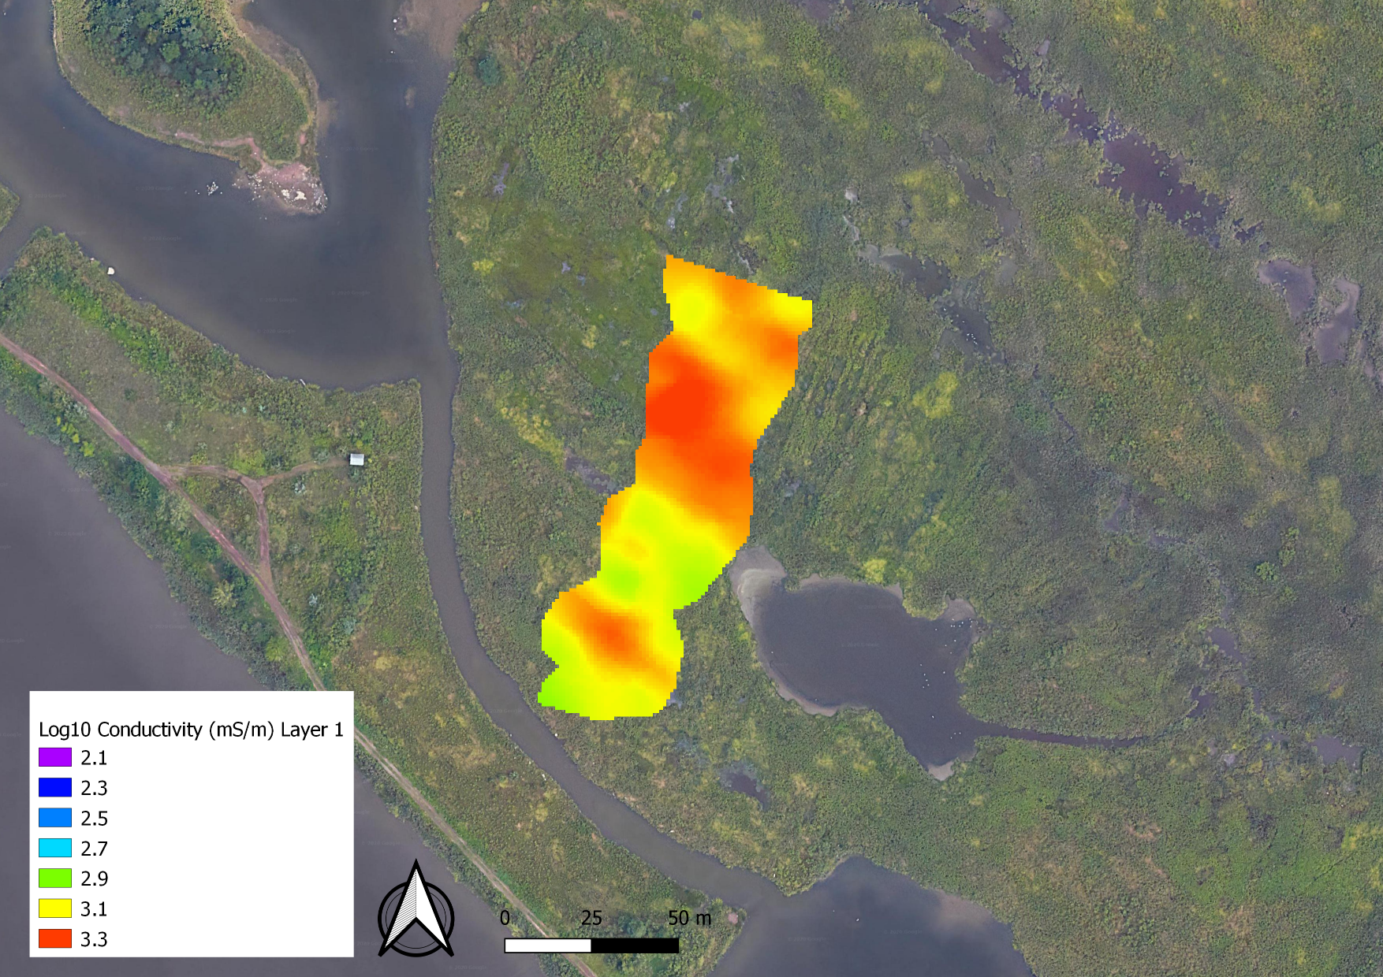
Direct sampling
Inversion for Layer 1:
upper 20 cm of the soil layer
Direct sampling:
Pore fluids
Soil characteristics
Where would you choose to sample if you could afford four sampling locations?
log₁₀ (conductivity in mS/m)

