Slide 1

Geophysical Interpretation and Comparison with Ground Truthing
Lee Slater
Department of Earth and Environmental Sciences, Rutgers University, Newark, NJ, USA

Slide 2
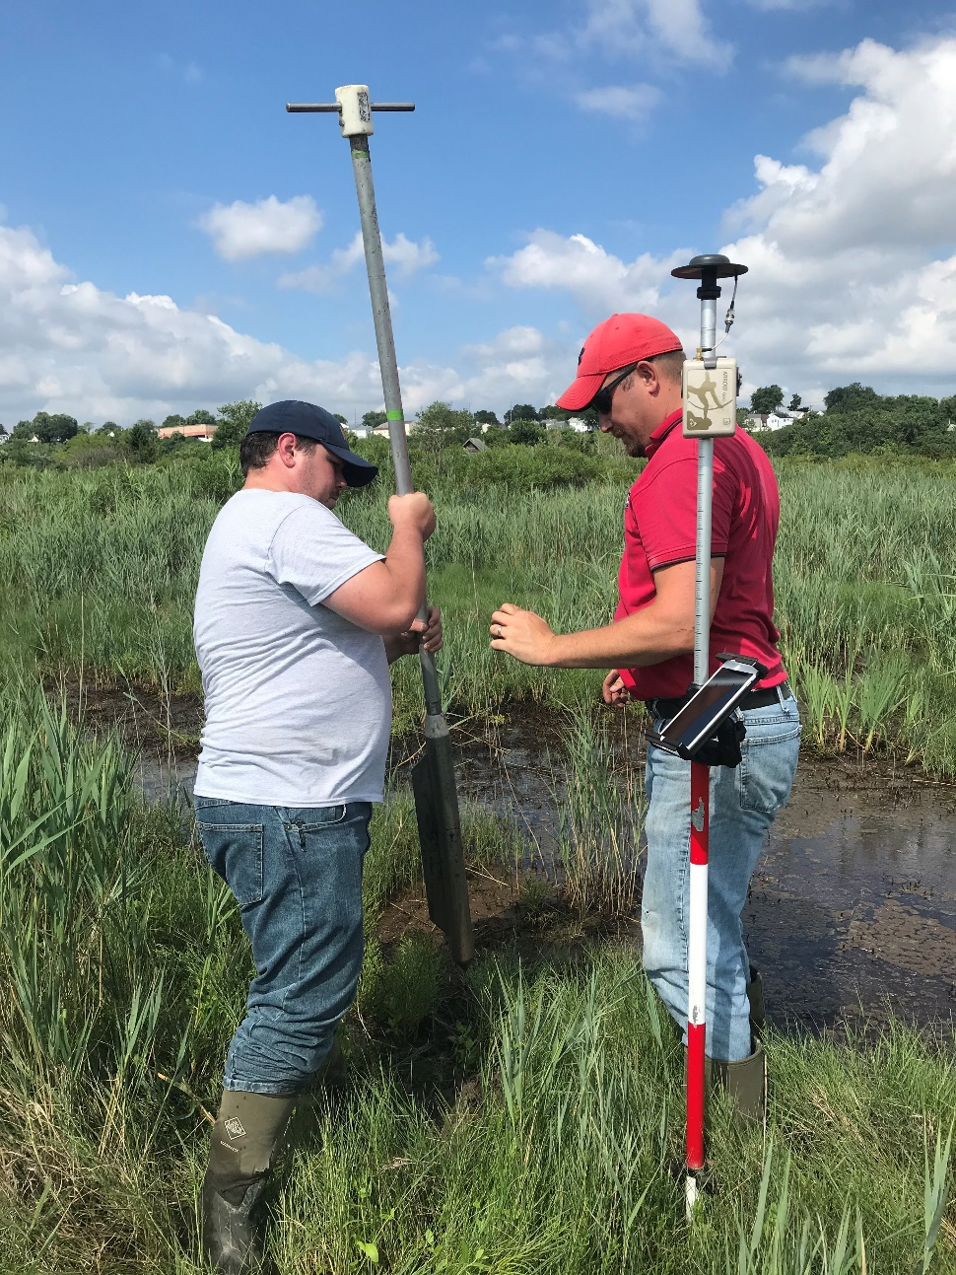
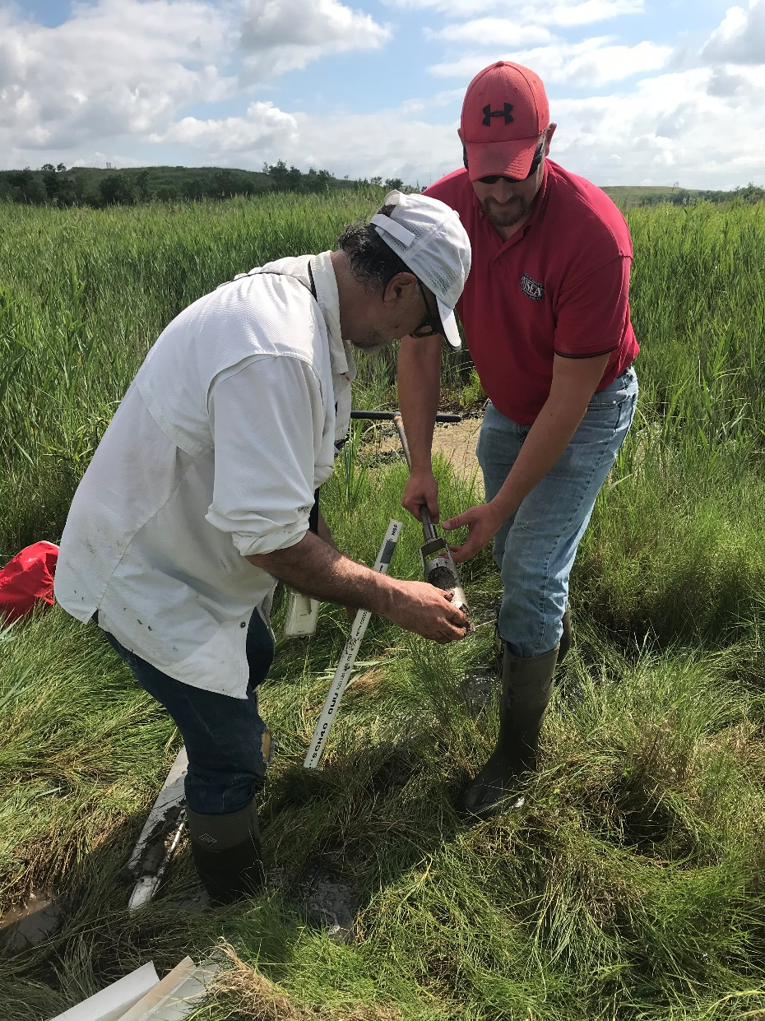
Sampling
Setting up the Russian peat corer for sampling at Site 3
Sampled top 0.27-0.48 m of organic sediments that overly gravel fill material

Slide 3
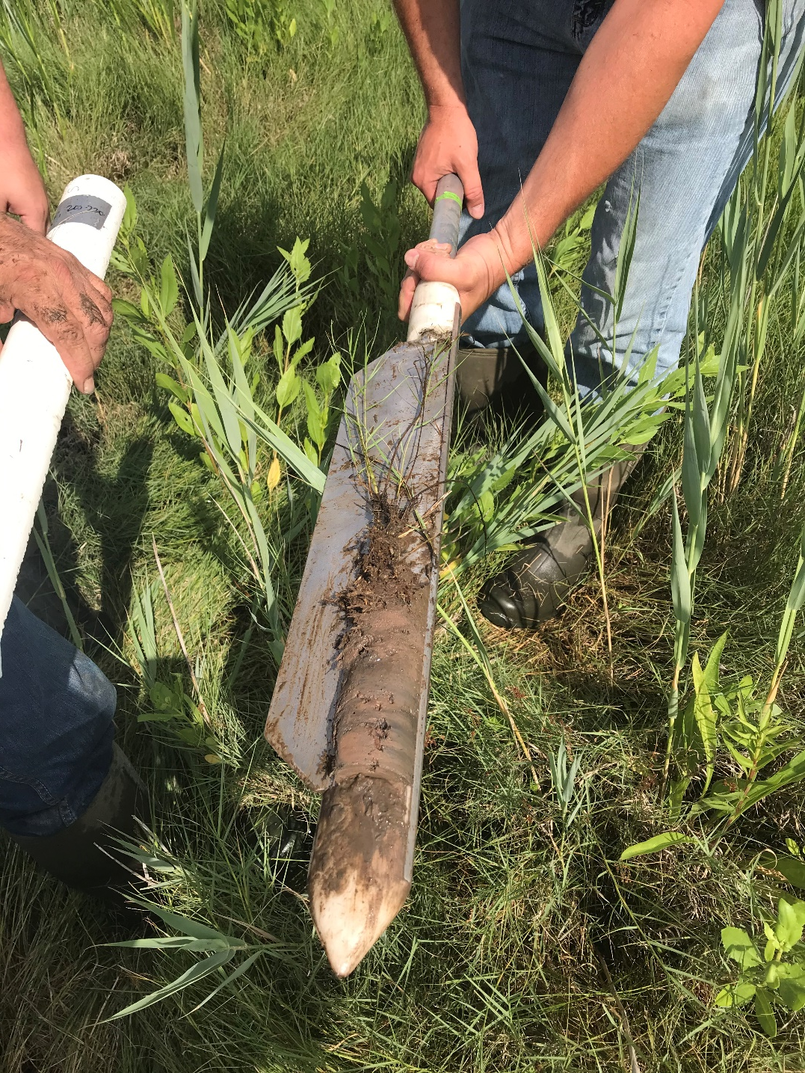
Retrieved core
Russian peat corer is designed to acquire a well-preserved core of organic rich materials as encountered in wetlands
Example of organic rich sediments cored at Site 3

Slide 4
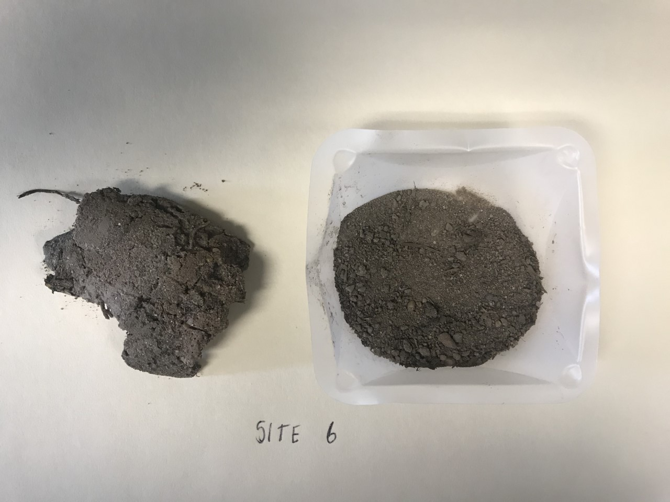
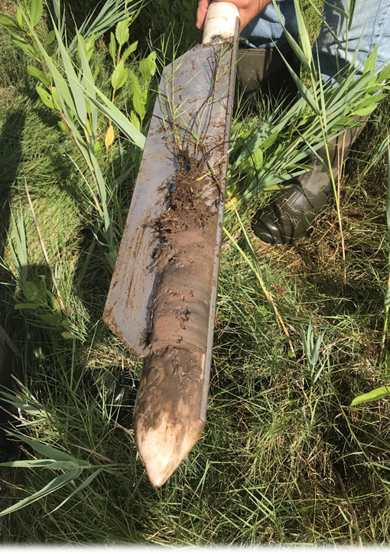
Laboratory analysis
Dried sample for porosity (φ) analysis
Sample prepared for particle size analysis
Original sample
frequency
grain size
V_{v} = volume of voids
V_{T} = total volume

Slide 5
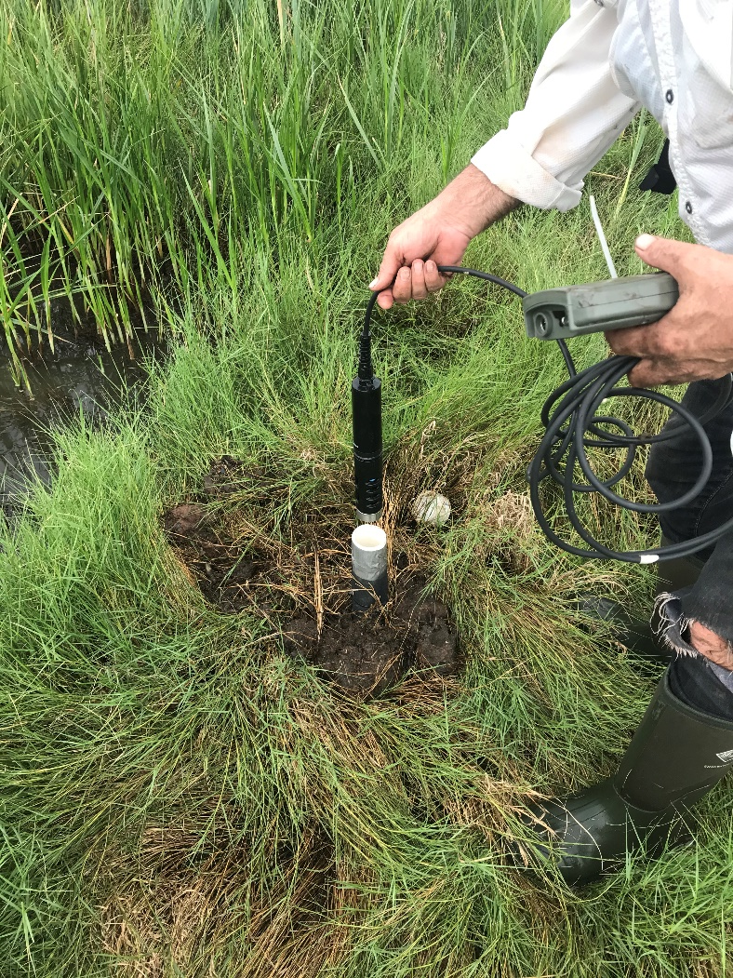
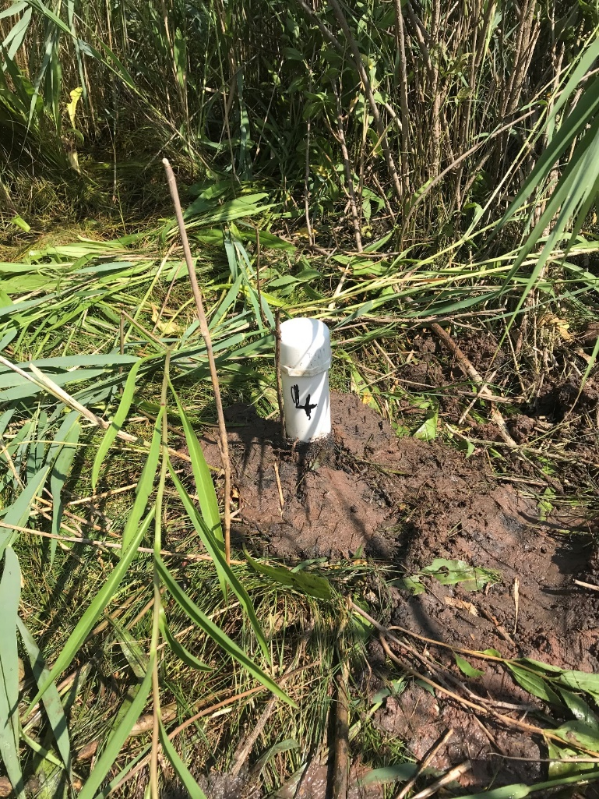
Pore water sampling
Water quality probe used to measure salinity of pore fluids
Installed a ‘lysimeter’ for acquiring a sample of the fluids in the pores of the organic sediments.
Once equilibrium conditions have returned (after disturbance by the coring) the water from the lysimeter is drained with a pump.
Water in the surrounding pores of the sediment then fills the lysimeter tube and it is subsequently sampled.
Lysimeter installed at Site 4

Slide 6
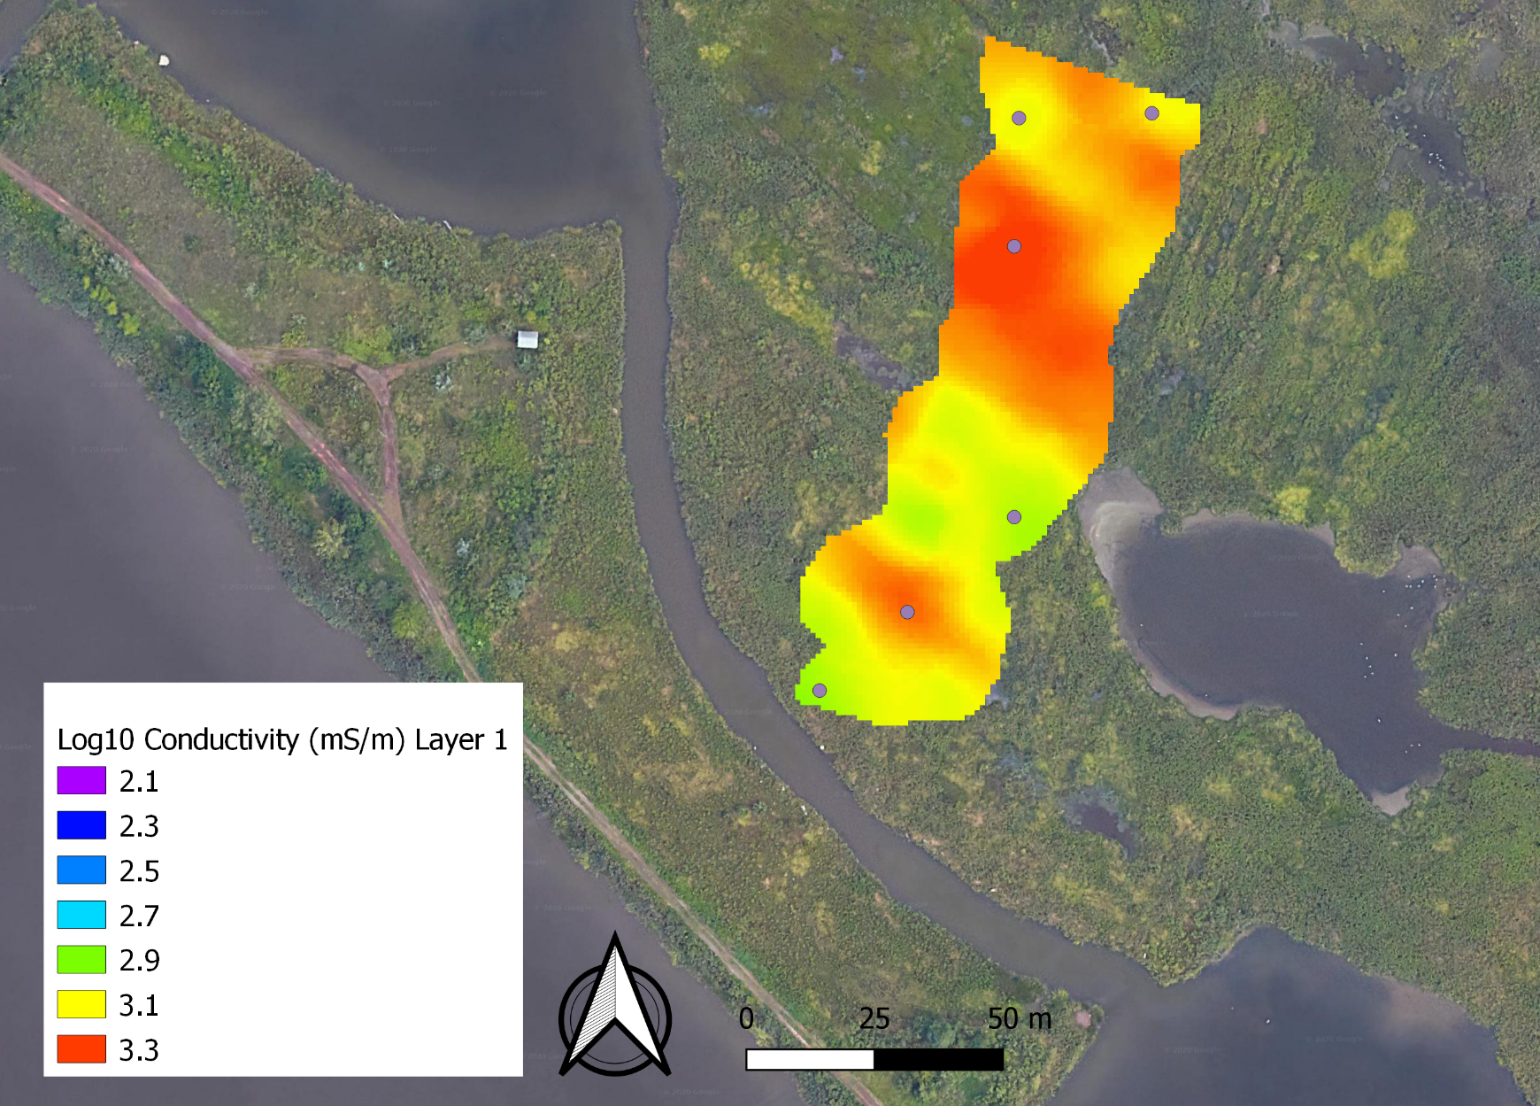
Our sampling strategy
2
1
3
We sampled six locations based on Layer 1 of the EM inversion as it shows a strong correlation with the pickleweed locations – as you should have discovered in your investigations of the EM data using the story map
4
5
6

Slide 7
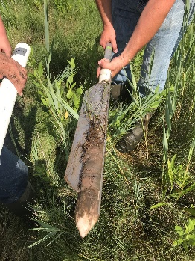
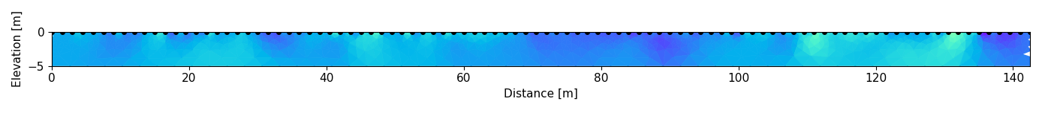
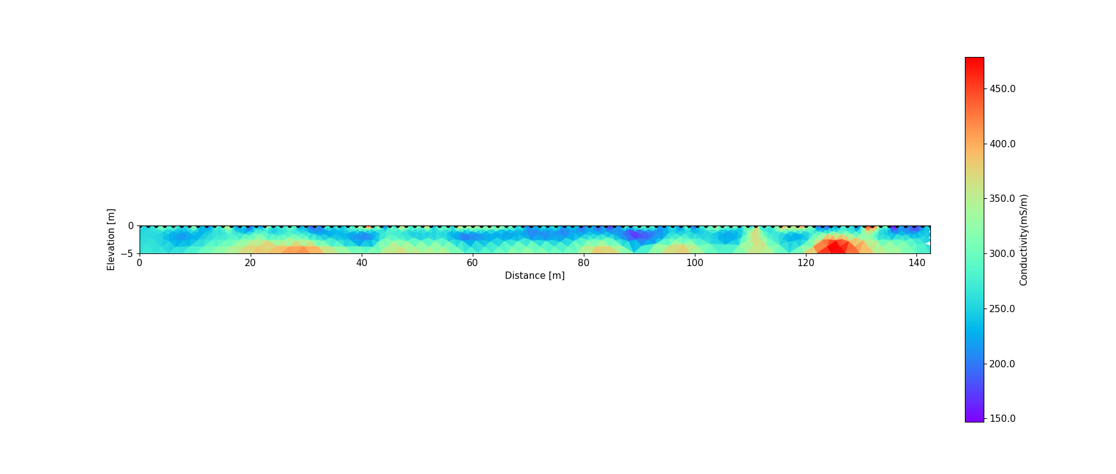
Reinterpreting the resistivity section
organic layer (0.3-0.5 m thick)
contact with hard gravel fill (limit of coring)
?
Conductivity (mS/m)
Notes:
Question students – what evidence is there for the organic layer and contact with underlying hard gravel fill? What evidence is there in the resistivity for another contact below the top of the gravel fill?

Slide 8
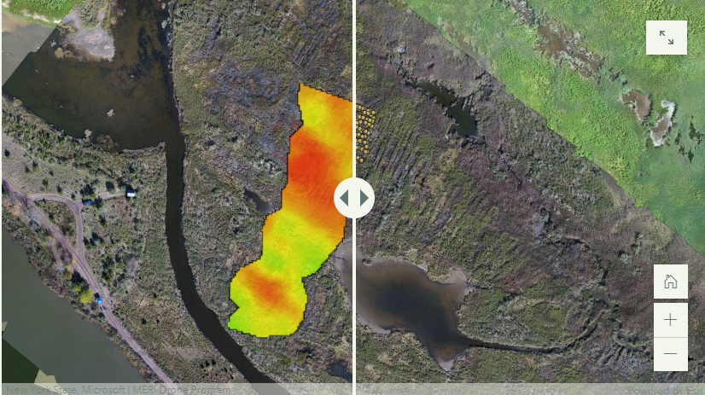
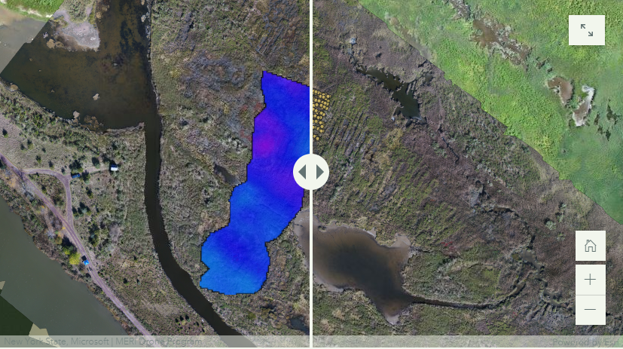
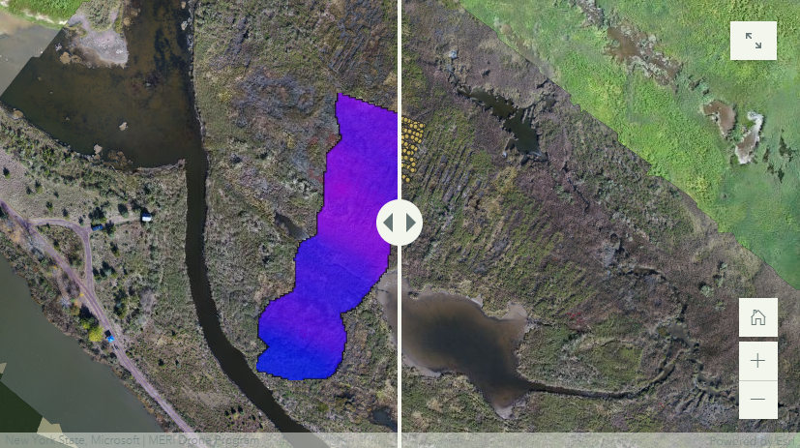
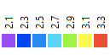
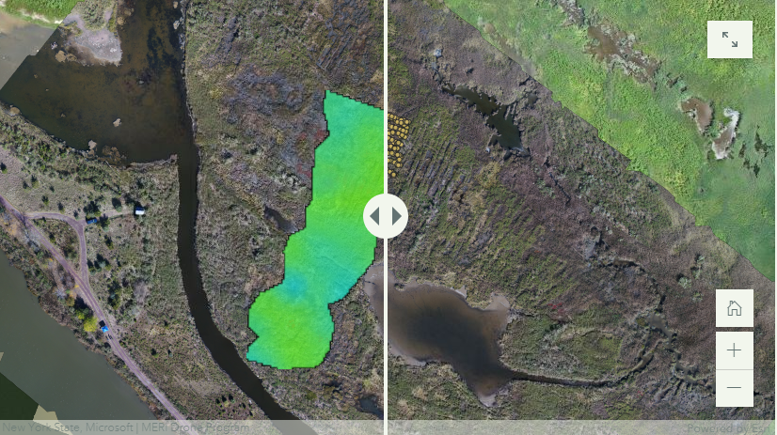
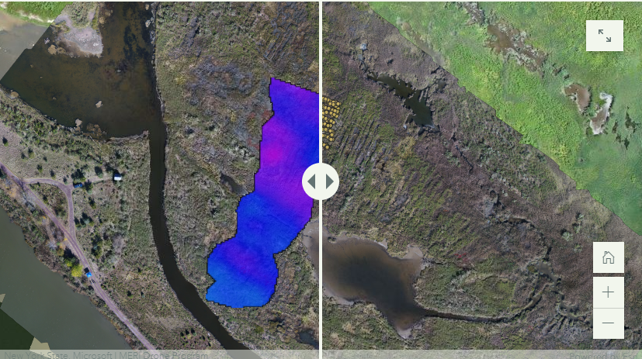
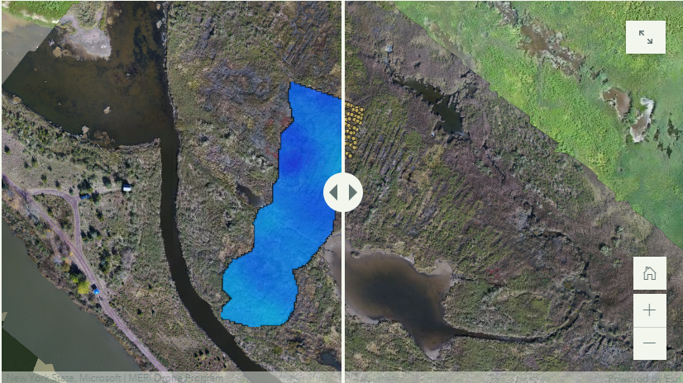
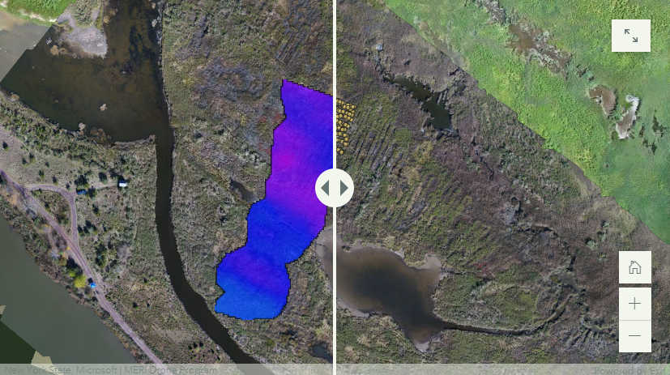
Constraining interpretation of EM conductivity images
Layer 1: 0-0.2 m
Layer 4: 0.9-1.4 m
Layer 7: below 3.0 m
Layer 2: 0.2-0.5 m
Layer 5: 1.4-2.1 m
log₁₀ (conductivity in mS/m)
Questions to consider:
[1] Do the physical and chemical properties measured for the upper organic sediment layer show any correlation with the EM conductivity for the first layer of the inversion?
[2] Is there evidence of a sharp transition to a different layer below 0.3-0.5 m consistent with the gravelly layer encountered in the coring?
Layer 3: 0.5-0.9 m
Layer 6: 2.1-3.0 m

Slide 9
Comparing electrical imaging and EM conductivity mapping
EM inversion is limited to 3 m depth
Conductivity (mS/m)
We cannot see the bottom 2 m of the electrical imaging result in the EM conductivity inversion

Slide 10
Supporting data summary
Summary of directly sampled properties of upper organic sediment layer
 |  |  | Particle size data
 | Thickness (m) | Porosity* (-) | d10 (μm) | d50 (μm) | Specific conductance (mS/cm)
Site 1 | 0.33 | 0.46 | 5.01 | 70.86 | 20.96
Site 2 | 0.33 | 0.22 | 3.93 | 60.42 | 19.79
Site 3 | 0.43 | 0.23 | 10.25 | 110.99 | 29.32
Site 4 | 0.48 | 0.15 | 4.38 | 113.00 | 29.38
Site 5 | 0.28 | 0.19 | 9.92 | 186.89 | 31.00
Site 6 | 0.27 | 0.18 | 18.27 | 304.97 | 30.20
* assuming a particle density of 1.2 g/cm³

Slide 11
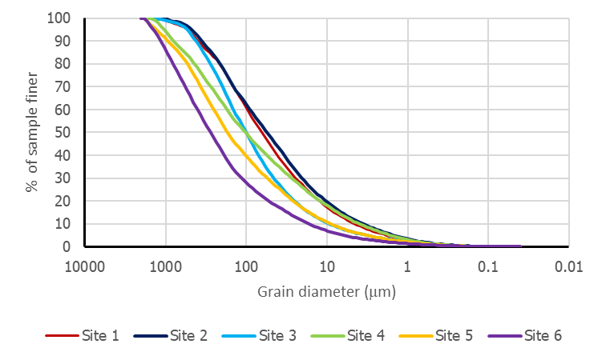

Particle size distribution
Determined using a laser particle size analyzer
Increasing surface area
Increasing surface conduction
2
1
d₅₀
3
d₁₀
4
5
6
d₅₀: 50% of sample is finer than this diameter
d₁₀: 10% of sample is finer than this diameter

Slide 12


