Slide 1
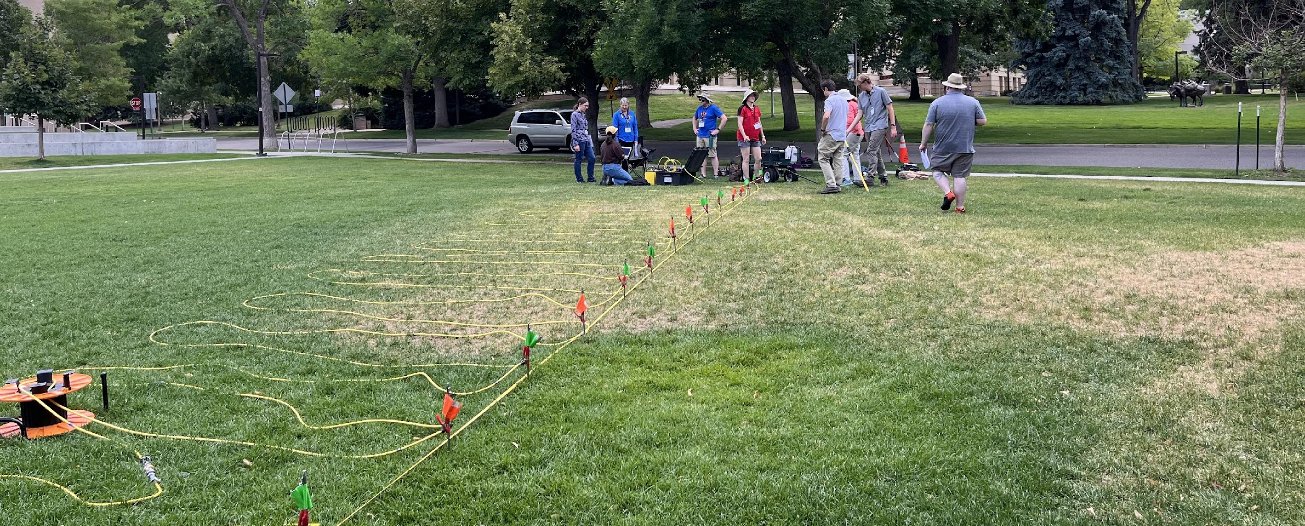
Electrical Resistivity Tomography – Unit 3 Collecting Your Own Data Set
Notes:
Image credit: Beth Pratt-Sitaula (Earthscope)

Slide 2
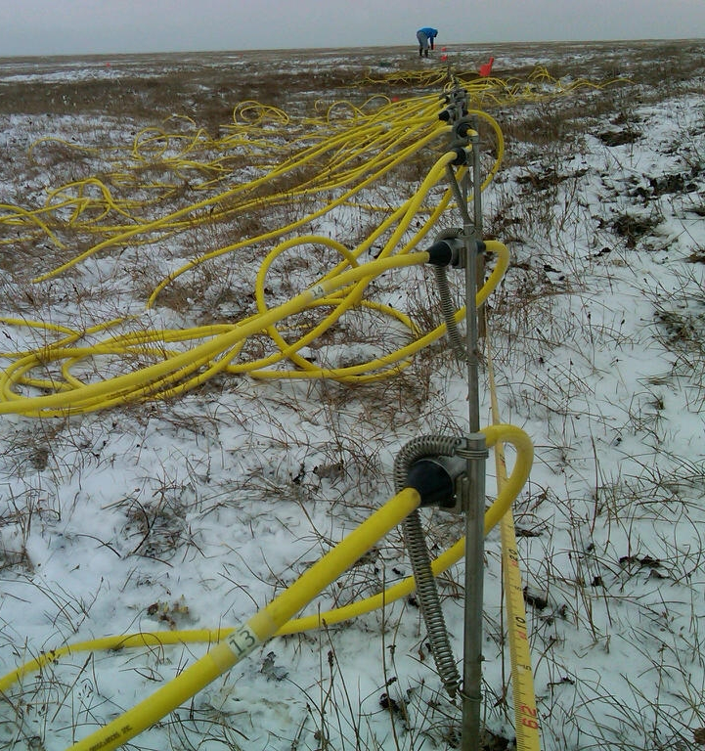
Outline
Where to get instrumentation
Defining a research question
Choosing a survey location
Planning the measurements
Conducting the measurements
Extracting the data and analysis
Making interpretations
Notes:
Image credit: Electrical-resistivity-methods-used-to-explore-subsurface-properties-in-ice-rich-tundra-wikipedia

Slide 3

Where to Get Instrumentation
The EarthScope Primary Instrument Center (EPIC), located in Socorro, New Mexico, maintains a set of Geometrics GEODE multichannel seismometers used for collecting refraction datasets. Instructions for making instrument requests are at EarthScope Geophysics Field Education.
Alternatively, your college or university may have an instrument available. If you’re not sure how to use it, try contacting the manufacturer or identifying a partner at another university or a local geophysics firm who has the same instrument and could provide training.
Some resources may only be available to faculty, while other groups may be willing to lend instrumentation directly to students.

Slide 4
Defining a Research Question
Before making your measurements, it is essential to do some background reading and define your research question.
The question may be simple or complex, but it should be stated clearly to act as a guide when designing your survey.
If possible, try to locate some primary references that could give you a basic idea of the environment around you. For example:
  USGS geological maps: https://ngmdb.usgs.gov/ngmdb/ngmdb_home.html
  Research articles: https://scholar.google.com/
  State, local, and regional datasets: https://www.usgs.gov/core-science-systems/nggdp/core-research-center/links-state-well-data

Slide 5
Defining a Research Question
Try to list some things that motivate you to understand the subsurface better:
  Environmental problems or pollution?
  Buildings, structures, or other construction that requires excavation?
  Infrastructure or transportation?
  Reclamation of disused spaces for recreation or wildlife?
  YouTube: Electrical Resistivity Tomography: Imaging Sub-Surface Structures - this animation might give you other ideas
Think-Pair-Share
On your own, brainstorm some reasons you might have to understand the subsurface in your town, city, or region related to the four question prompts above, or other areas of interest. Then, with one or two partners, present the ideas you come up with, explain when you think they are important, and discuss everyone's contributions to generate three top choices.

Slide 6
Defining a Research Question
Once you have considered your local environment and what motivates you to understand the subsurface, try to pose your idea as a question, and write it down.
Tips:
  Try to be straightforward. A more complicated question is not “better.”
  Be clear in the language you use when writing down your question. This will help to guide your measurements and will make it easier to judge if you have answered your question at the end of the exercise.
  Ask yourself “who cares?” about the answer to your question: Who are different people or groups who might be interested in your result? What is the viewpoint of each of these people or groups?

Slide 7
Choosing a Survey Location
At this point you will have already thought about your local environment and defined a question. Now it’s time to pick the specific place you will make the measurement.
  Permission: Be sure you have permission to make measurements. It is never okay to trespass for the purpose of science. Also, some places, even in public places, have rules about scientific data collection.
  Safety: Field sites may have hazards for a wide variety of reasons such as proximity to traffic, rough or steep terrain, dangerous materials/objects, etc. Carefully consider how to stay safe before deciding on your field site.
  Question: Will you be able to appropriately address your research question? It’s best to list a few reasons for your location—your justification—before making the measurement.

Slide 8
Choosing a Survey Location
Possible Interference:
  Is the site near power lines, underground utilities, metal fences, etc.? If so, it may interfere with the measurements, and you may need to adjust where you place your line.
  Ideally run your line perpendicular to these obstructions and place your first electrode at least one electrode spacing away.
  If you need to run parallel, set up at least 15% of the line distance away.
  With power lines, for safety remain at least 50 meters away.
Consider the site conditions:
  You need to be able to layout a straight line the length of your entire survey line.
  You need soil or soft material to push the electrodes into, You can’t do this on hard rock.
  If the soil is particularly dry, you might have bad soil conductivity and will need to help it by adding water or salt water, bentonite clay, or aluminum foil around your stakes.

Slide 9
Designing Your Survey
Before going into the field, you need to decide the specifics of your survey
  Will you use a Wenner, Dipole-Dipole, or another array type?
    You can always do multiple array designs on the same line.
  What electrode spacing do you want to use?
    Tighter spacing will yield better resolution, but it takes more time to survey a longer line.
  How long do you want your line to be, and will you need to do roll-along to achieve it?
    Your line length will control the depth you can see to.
    Roll-along is when you extend your survey line by leap-frogging one section of cable over the other, allowing you to cover a longer line then what you would be able to do with the number of electrodes and cable length you have.
You can use the SEER tool to help you plan your design.

Slide 10
Creating Command Files
You will need to create a command file detailing the specifics of your array, ideally before you go into the field.
This can easily be done using the Command Creator on the tablet and than uploaded to the supersting.
For roll-along surveys, you use the same command files as you would for a regular survey.
Only examples for creating Wenner and Dipole-Dipole are shown here, refer to the manual for the needed information for other array designs.
You upload cmd files to the supersting using the tablet. Select Transfer Data -> Upload Command Files.

Slide 11
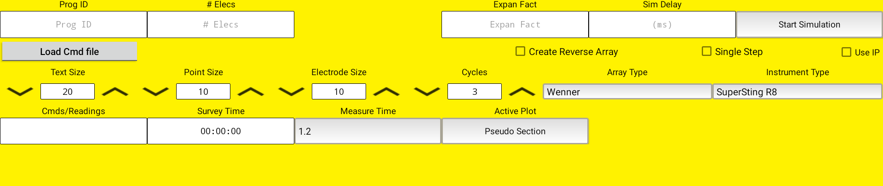
Command File: Wenner Example
The boxes outlined in red are the only ones that you need to fill out, the others are display information.
Press Start Simulation after you have filled out all the needed information
Expansion Factor: Should be equal to or greater than 0.3 times the total number of electrodes in order to sample all possible data points
Number of electrodes
Name of the file
Select Array Type and Instrument type, which should by SuperSting R8

Slide 12
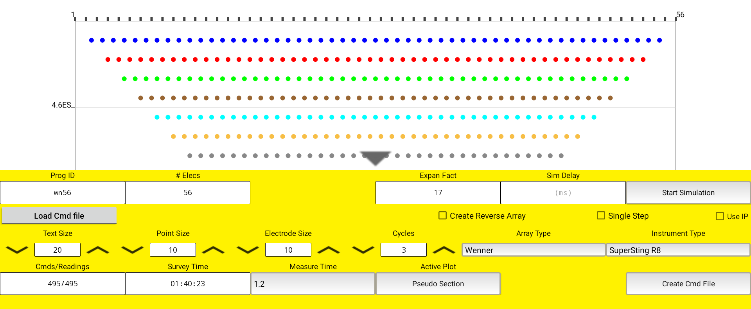
A pseudo section will be created showing you the expected depths that data will be recorded. Click on the grey arrow to see the whole thing.
The number of command lines and the time it will take to run the survey
Select Create Cmd File once you are done

Slide 13
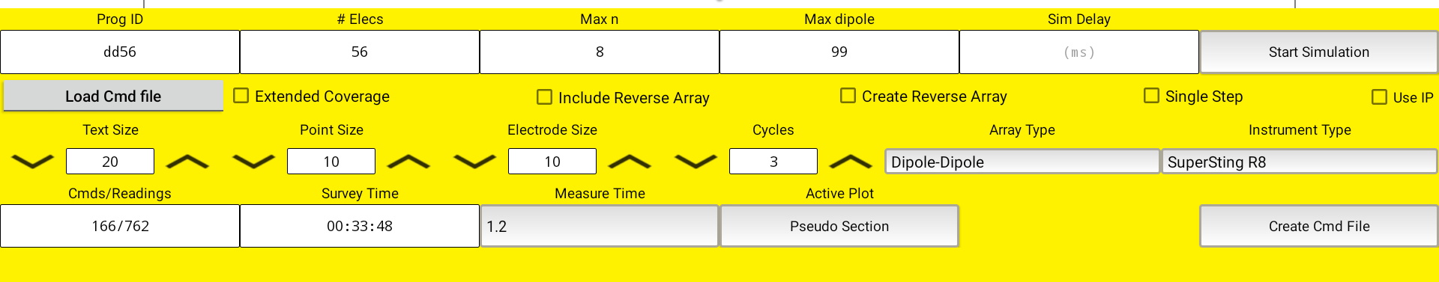
Command File: Dipole-Dipole Example
Max dipole: Controls the depths you sample. Should be at least 10% the total number of electrodes if you want to sample the deepest depth. If you want to be sure you get all data, set an arbitrarily large number. If you only want to sample shallower depths, use a smaller number.
Max n: The distance between the transmitter and receiver dipoles, in units of electrode spacing. 8 is typically a strong enough signal for most surveys.

Slide 14
Conducting the Measurement
Locate your line and mark it with a tape measure
Push the stakes into the ground at intervals selected during planning
Connect the cables as instructed in the instrument manual
Start the supersting and connect the tablet
Begin the survey
Make sure students take good field notes and are safe in the field!
Refer to the quick guide for detailed field procedures and setup information

Slide 15
Field Safety and Good Procedures
Always treat the system as ON when it is connected to a power source. Do not touch any of the electrodes or cables, try to keep a few feet distance.
Do not deploy if there is a chance of lighting, if it starts after you have deployed, immediately move away from the line.
Place flags or caution tape around the line or electrodes if you are working in a busy area.
Work gloves and high visibility vests are highly recommended.
Keep good notes about the field site and your entire setup, including spacing, specifics of the array type used, gps coordinates for at least the first and last electrodes, names of the files and which lines they correspond to if you do more than one, and the start and end times of your measurements.

Slide 16
Extracting the Data and Analysis
Usually, the raw data will be stored on the supersting as “.stg” files.
First you need to download the files to the tablet by selecting Transfer Data -> Download Files.
  From there you can transfer them to your computer, either using one of the wireless options for the tablet or use a cord to connect it directly to a computer. You most likely will have to go into the tablets settings and enable file transfer if you connect with a cord.
You can analyze the data with the program of your choice.
Instructions on how to use ResIPy are shown in the tutorial video from unit 4 of the module.

Slide 17
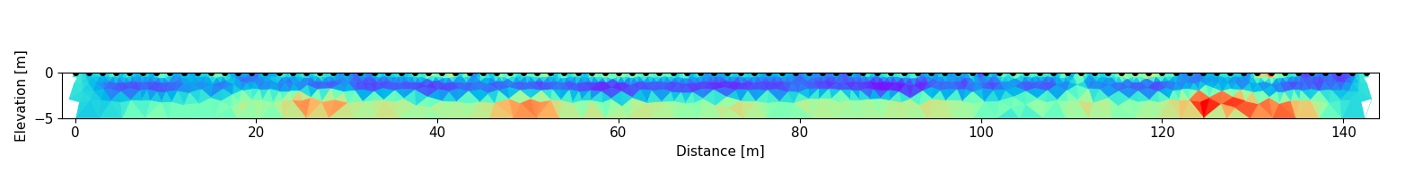
Making Interpretations
Compare your calculated 2D resistivity profile with any background information you have. Are there materials that could plausibly have the resistivities you observe?
Create a conceptual diagram of what layers or structures you think account for the resistivity profile.
Notes:
image credit: Lee Slater (Rutgers)

