Slide 1
Gravity and Magnetism Unit 3: Part 3b Your Own Research
Andy Parsekian
University of Wyoming

Slide 2
Outline
Where to get instrumentation
Defining a research question
Choosing a survey location
Planning the measurements
Conducting the measurements
Extracting the data and analysis
Making interpretations

Slide 3
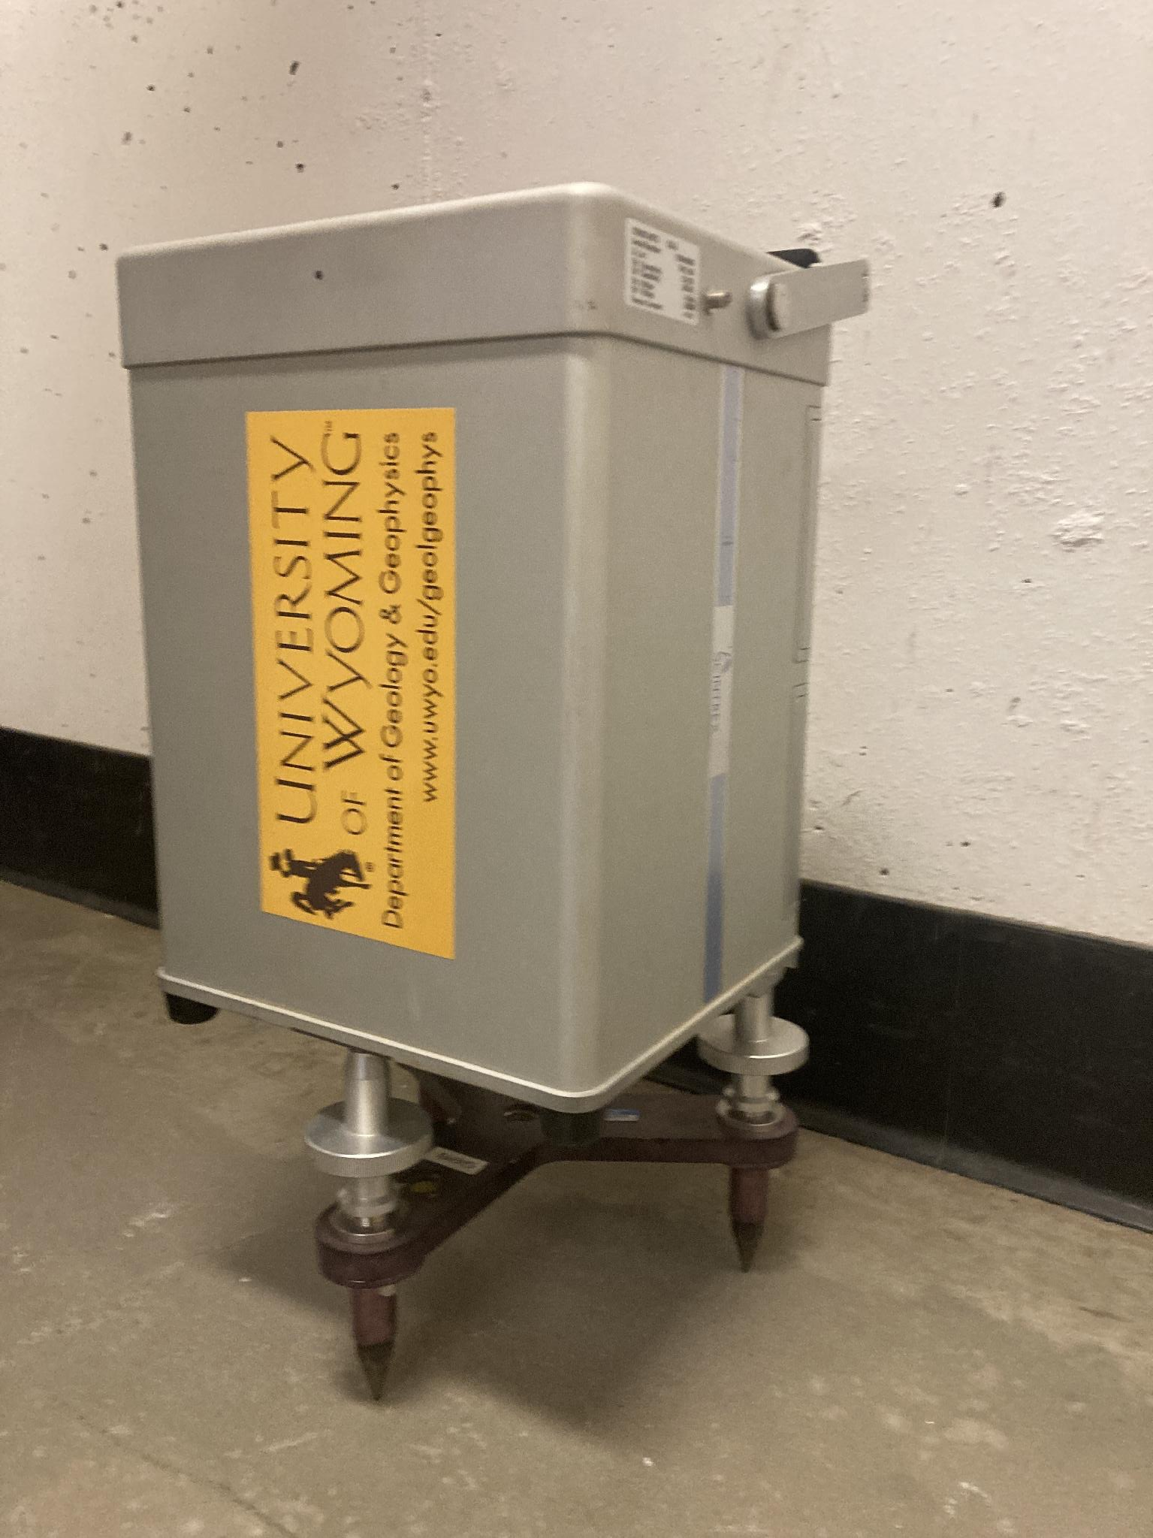
Where to get instrumentation
The University of Wyoming Near Surface Geophysics Instrumentation Center is able to rent out a Scintrex CG5.
Alternatively, your college or university may have an instrument available. If you’re not sure how to use it, try contacting the manufacturer or identifying a partner at another university or a local geophysics firm who has the same instrument and could provide training.
Some resources may only be available to faculty, while other groups may be willing to lend instrumentation directly to students.
While it does not currently have gravimeters, the NSF National Geophysical Facility does have other geophysical instrumentation that may be available for loan for other types of surveys.

Slide 4
Types of targets
For gravity measurements, think about parts of the subsurface that might be more or less dense than average.
  For example, a buried fuel tank that is empty of oil (i.e., air filled only) would be much less dense than the surrounding soil.
  Other examples might include faults, sinkholes, tunnels, and voids associated with mines, quarries, and infrastructure.
The survey will be most successful if it includes an area where you think the ground is "average" as well as some of the "target." Ideally, you could cross both of these with the same line, probably <100m long. If possible, you would be able to design a line that crosses perpendicular to the target.

Slide 5
Defining a research question
Before making your measurements, it is essential to do some background reading and define your research question.
The question may be simple or complex, but it should be clearly stated to act as a guide when designing your survey.
If possible, try to locate some primary references that could give you a basic idea of the environment around you. For example:
  USGS geological maps: https://ngmdb.usgs.gov/ngmdb/ngmdb_home.html
  research articles: https://scholar.google.com/
  state, local, and regional datasets: https://www.usgs.gov/core-science-systems/nggdp/core-research-center/links-state-well-data

Slide 6
Motivation
Try to list some things that motivate you to understand the subsurface better:
  Environmental problems or pollution?
  Buildings, structures, or other construction that requires excavation?
  Infrastructure or transportation?
  Reclamation of disused spaces for recreation or wildlife?
Think-Pair-Share
On your own, brainstorm some reasons you might have to understand the subsurface in your town, city, or region related to the four question prompts above, or other areas of interest. Then, with one or two partners, present the ideas you came up with, explain when you think they are important, and discuss everyone’s contributions to come up with three top choices.

Slide 7
Putting your question into words
Once you have considered your local environment and what motivates you to understand the subsurface, try to pose your idea as a question and write it down.
Tips:
  Try to be straightforward. A more complicated question is not “better.”
  Be clear in the language you use when writing down your question. This will help to guide your measurements and will make it easier to judge if you have answered your question at the end of the exercise.
  Think about “who cares?” about the answer to your question: Who are different people or groups who might be interested in your result? What is the viewpoint of each of these people or groups?

Slide 8
Choosing a survey location
At this point you will have already thought about your local environment and defined a question. Now it’s time to pick the specific place you will make the measurement.
Permission: Be sure you have permission to make measurements. It is never okay to trespass for the purpose of science. Also, some places have rules about scientific data collection, even public places.
Safety: Field sites can have hazards for a wide variety of reasons such as proximity to traffic, rough/steep terrain, dangerous materials/objects, etc. Carefully consider how to be safe and stay safe before deciding on your field site.
Question: Will you be able to appropriately address your research question? It’s best to list a few reasons why—your justification—before making the measurement.

Slide 9
Additional site considerations
Is the site near a road, railway, factory, mine, etc? If so, this may be a noise source and you may need to wait for times when activity is lower (e.g., when traffic stops, after work hours, etc.) to get useful data when measuring.
If possible, aim to select a target below a relatively flat space to avoid the need to correct for the topographic effect. You will still need to precisely measure the relative difference in elevation between each gravity station for other corrections.

Slide 10
Planning your survey
Based on the background reading you did to define your question, consider how large your target is. Think about the gravimeter station spacing. For some targets, 10 m between measurements may be appropriate; for very shallow targets, 2 m spacing may be optimal.
Consider the instrument you have. If you are using a modern digital instrument, it may be straightforward to obtain highly precise measurements.
Read the manual of the instrument to understand the specifics related to making the measurement. If you are using the CG-5, the manual is here: https://scintrexltd.com/download/cg-5-operation-manual/

Slide 11
Conducting the measurement
Locate your line and mark it with a tape measure
Define a base station, usually near the center of the line
Follow the instructions to make a gravity measurement at the base station
Alternate each measurement between the base station and a measurement point along the line at the predefined spacing.
Using differential GPS (DGPS) or visual level-sighting, record the relative elevation at each point along the line. Record the latitude and longitude of the start and end of the line with a GPS.
Record all data on a datasheet.

Slide 12
Data and analysis
Use the example workbooks provided with the Excel-based exercises in the GETSI gravity Unit 3 Parts 1 and 3:
Calculate the drift rate.
Determine elapsed time for each measurement since the start of the survey.
Use the drift rate and elapsed time to compute the drift correction and subtract from each measurement. Be sure that the initial and final values of gravity at the base station are identical after correction.
Plot the elevation on the x-axis and the drift corrected relative gravity on the y-axis of a new scatterplot. Use the “Add Trendline…” tool to add a linear trend with the equation and R² displayed.
Apply free-air, Bouguer, and latitude corrections; remove the local trend.

Slide 13
Making interpretations
Compare your normalized, detrended gravity anomaly to your prior knowledge of the site. Are your results consistent with what you expected?
Create a conceptual diagram of what you think the target might look like based on the gravity data. Explain how several objects with different geometries and properties might produce very similar gravity anomaly curves.

