Slide 1
Gravity and Magnetism Unit 3: Part 3 Stairwell Gravity Lab
Andy Parsekian
University of Wyoming

Slide 2
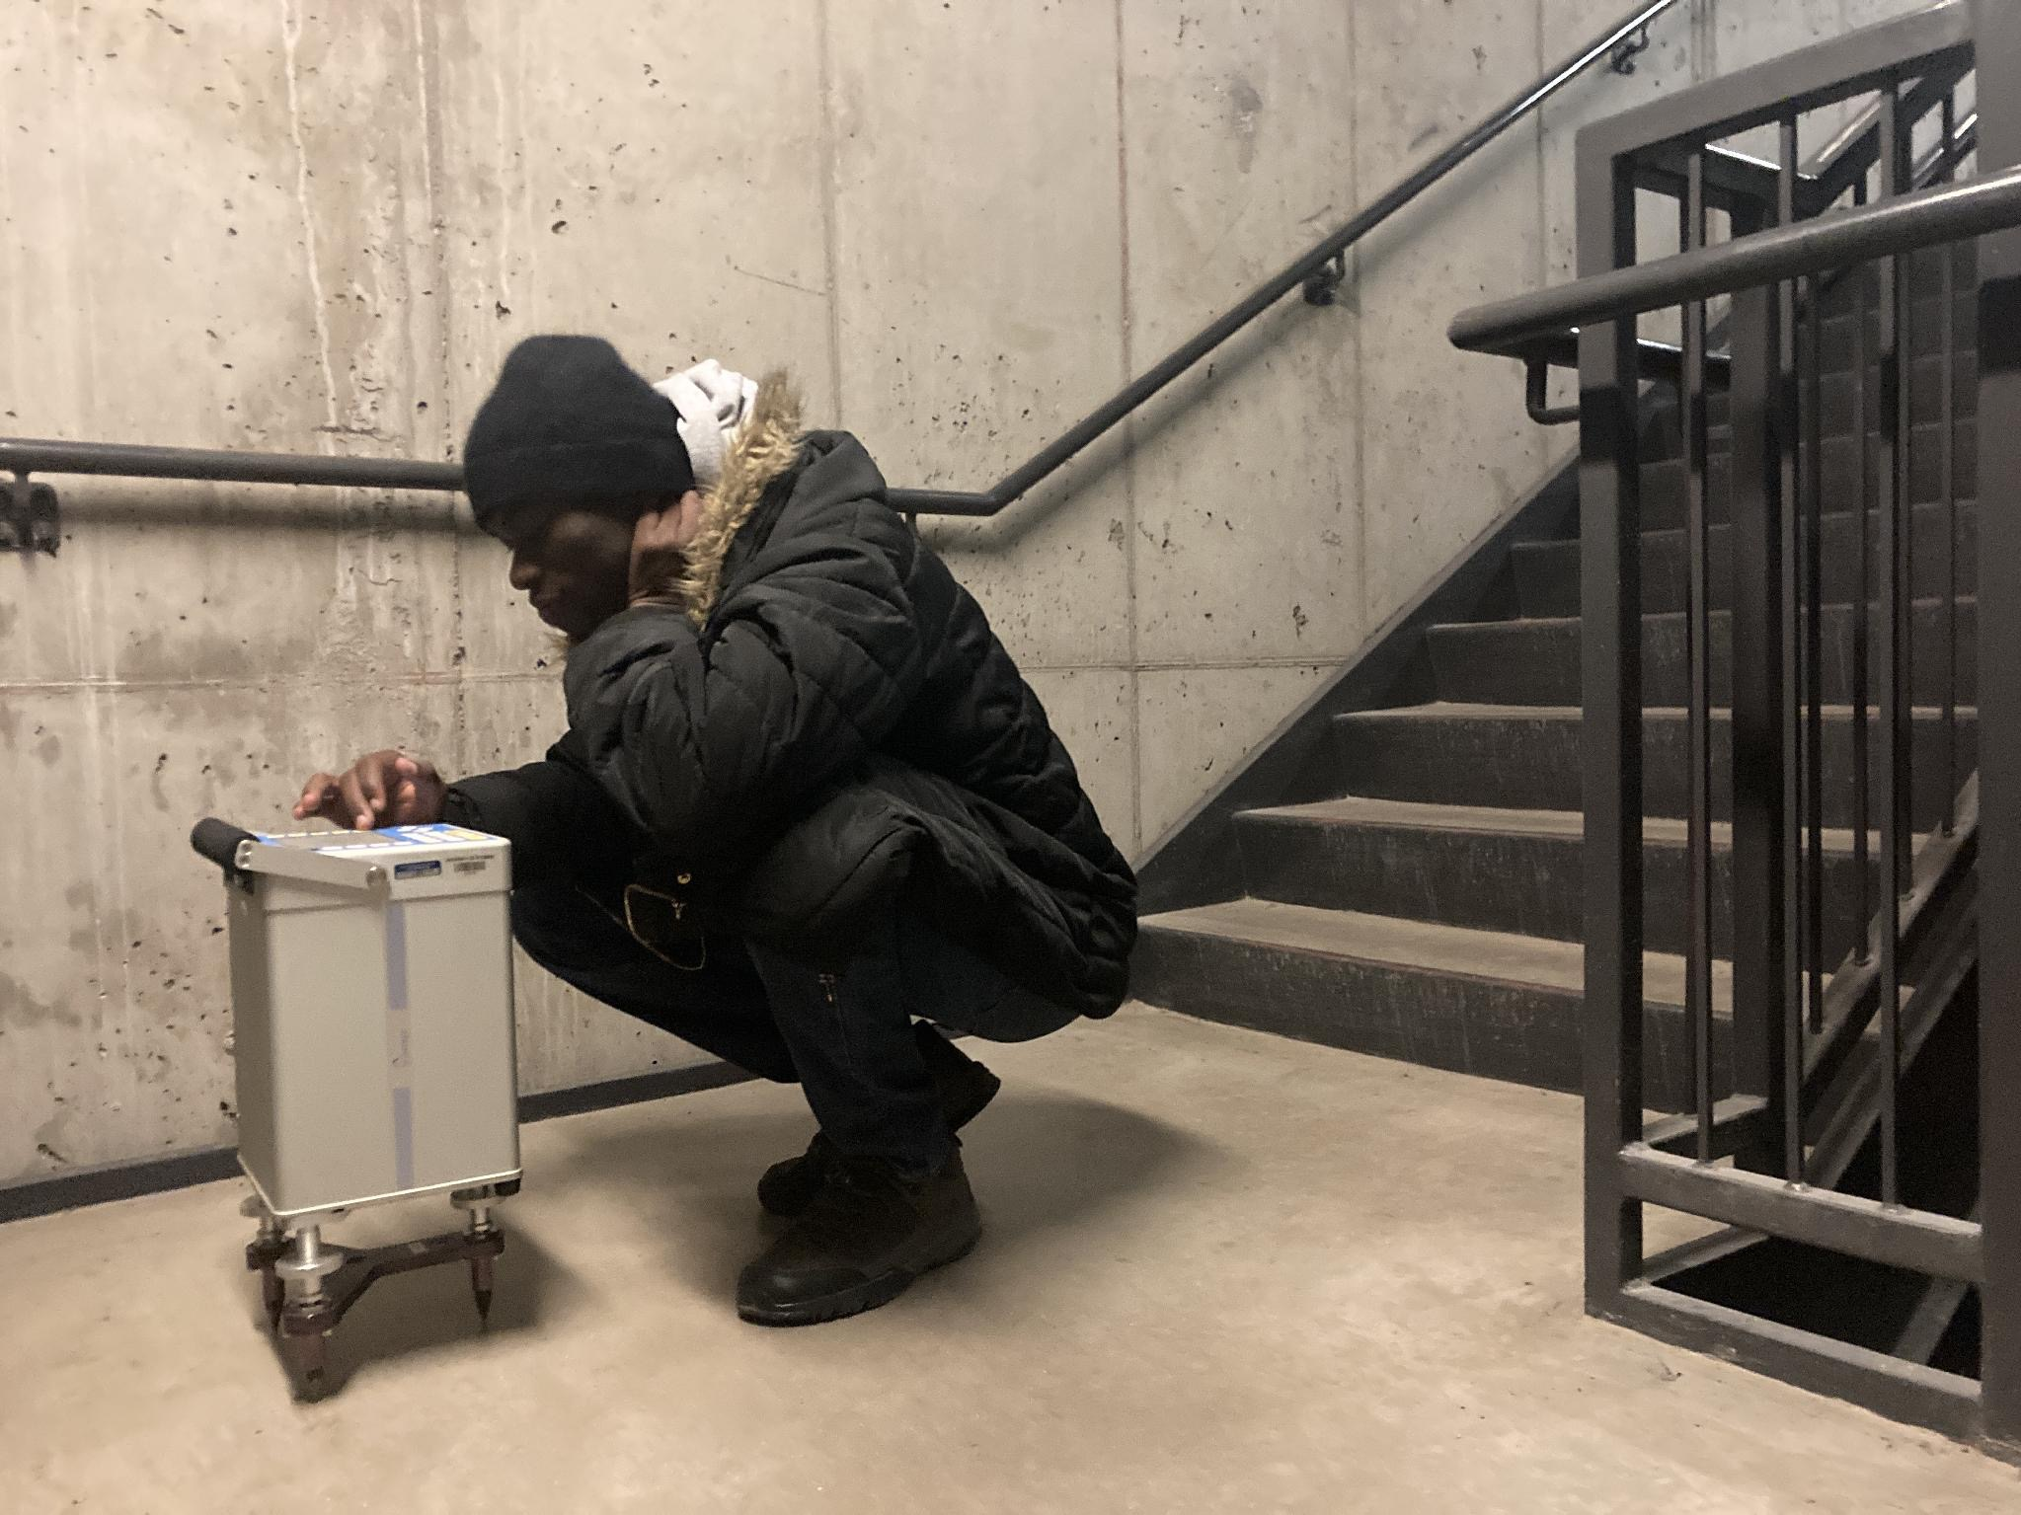
Outline
Where to get instrumentation
Defining a research question
Choosing a survey location
Planning the measurements
Conducing the measurements
Extracting the data and analysis
Making interpretations

Slide 3
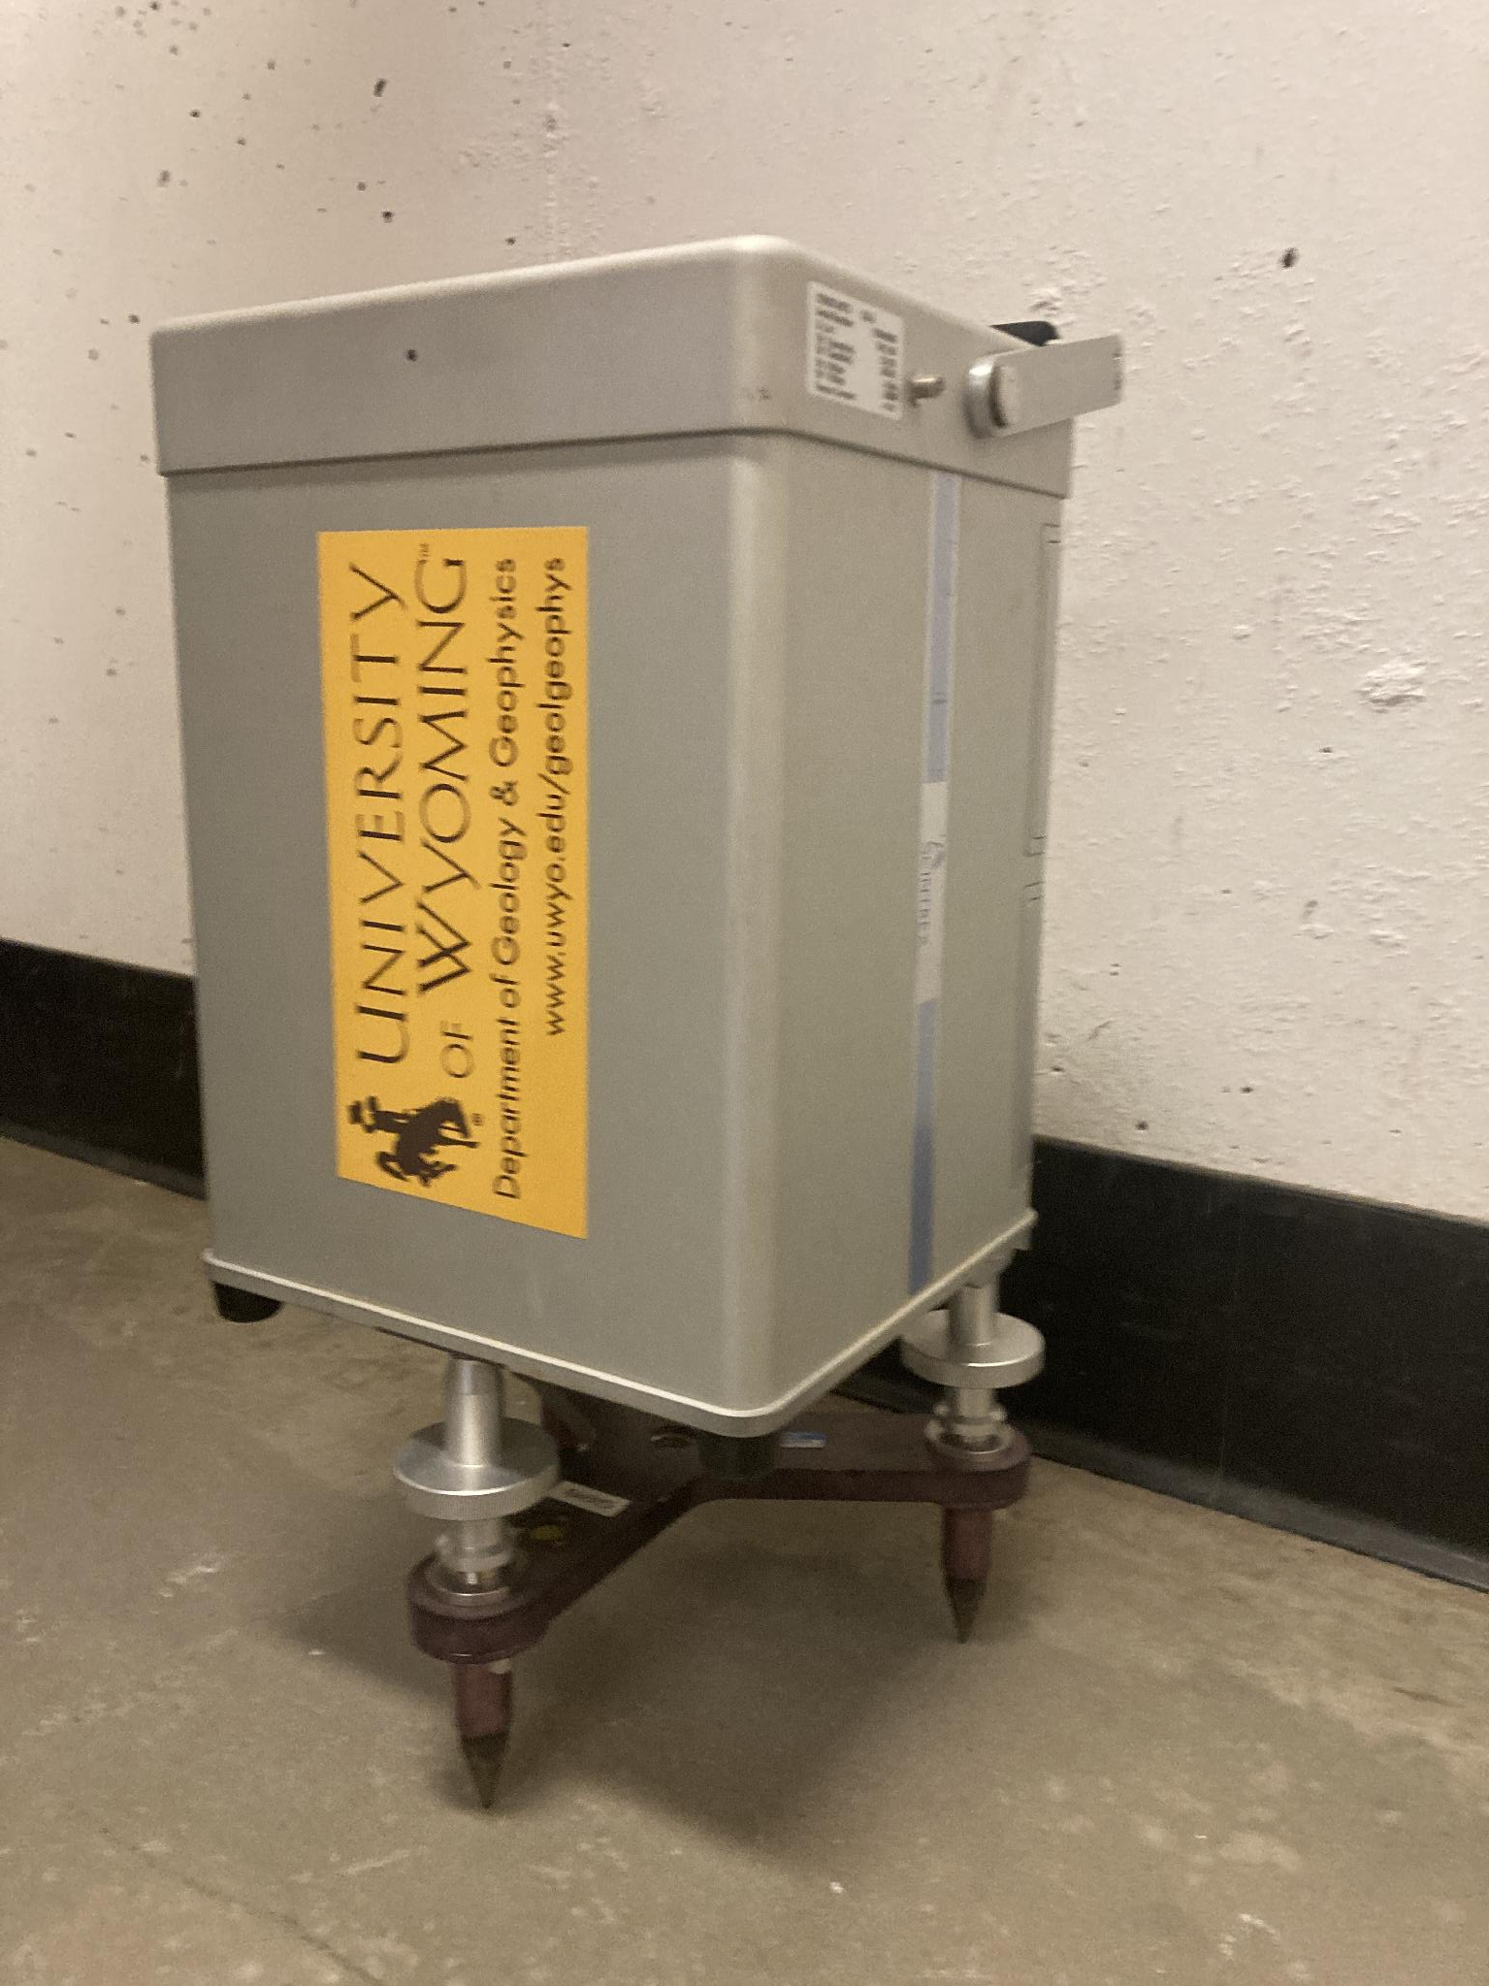
Where to get instrumentation
The University of Wyoming Near Surface Geophysics Instrumentation Center is able to rent a Scintrex CG5.
Alternatively, your institution may have an instrument available. If you are unsure how to use it, try contacting the manufacturer or identifying a partner at another university or a local geophysics firm with the same instrument who could provide training.
Some resources may only be available to faculty, while other groups may be willing to lend instrumentation directly to students.

Slide 4
Experiment overview
Purpose: Demonstrate that the distance from Earth’s center of mass affects the gravity response. This experiment is to “verify” the free-air correction.
Motivation: Why do we care? Gravity measurements can be a useful way to evaluate hazards and map the subsurface. Several “corrections” are needed to remove parts of the gravity signal that otherwise prevent us from detecting our target in the subsurface. The free-air correction is one of these corrections that is essential for accurate interpretation of gravity measurements.
This lab allows for discussion about repeatability statistics, uncertainty, and sources of error. It also demonstrates the functionality and precision of the experiment; even elevating it a fraction of a meter produces a measurable signal.

Slide 5
Procedure
By taking gravity measurements from the bottom to the top of a stairwell, we are moving the gravimeter farther from Earth’s center of mass and not including the effects of additional mass between the gravimeter and the base of the stairwell.
Students will hypothesize how the gravity measurement will change as they go up in a building and why.
Next, students will either use the provided dataset or collect their own data by taking repeat measurements while going up a stairwell. Data from reoccupied stations will be used to correct for drift. The resulting data and differences in elevation obtained from a tape measure will allow students to calculate the free-air correction.
Finally, students will plot gravity (mGal) vs. elevation and compare the calculated slope to the theoretical value (free-air correction, but don’t need to call it that), 𝛿g_{FA} = 0.3087691h mGal.

Slide 6
Lab suggestions
As with any instrument that has a single small screen, most gravimeters are best suited to the smallest group size possible.
The leveling exercise is a great hands-on experience, and as many students as possible should rotate through it
Be aware that people moving around on the staircase during leveling will make it almost impossible to level.
Movement during measurement (i.e., students walking around the stairwell) will reduce the data quality. This can be a teachable moment: some gravimeters (e.g. Scintrex CG5) will plot the measurement in real time; students can watch this under quiet and noisy conditions.
It is best to divide students into groups of five or fewer if possible.

Slide 7
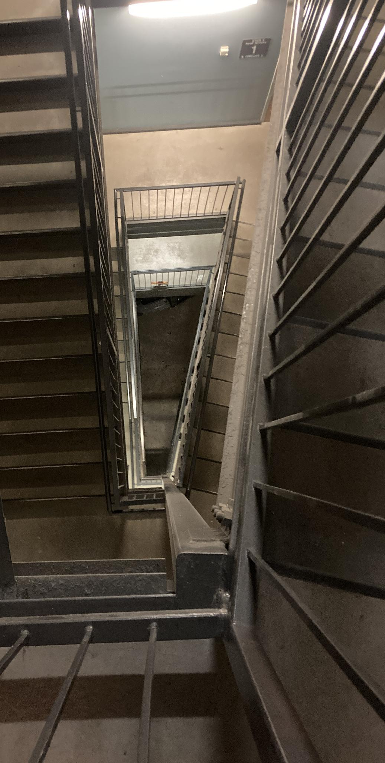
Choosing a survey location
Ideal stairwells for this survey:
Have low foot-traffic (vibrations cause measurement noise)
Are tall (higher signal-to-noise ratio)
Have height that is easy to measure between landings

Slide 8
Planning your survey
Understand how your instrument works; read the manual/SOP
Test your instrument before the lab; how long of a measurement do you need to get data quality at 0.002 mGal? (suggest 30 seconds)
Plan how high you will go in the stairwell
Plan how to mark the measurement stations (tape)
Plan for a time when traffic will be low
Plan to have at least 5 minutes per measurement station
To save time, plan to measure all the heights at the very end
Prepare a measurement data sheet that has a row for each landing and columns for gravity, error, time of day, and height

Slide 9
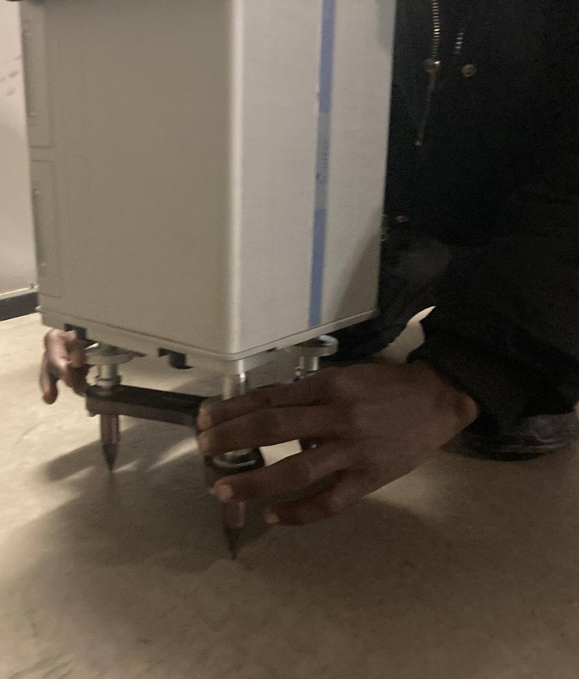
Conducting measurements
Follow the detailed instructions in the lab worksheet to set up the gravimeter and record data. For each landing:
Use a small piece of masking tape to mark the location of the front tripod leg so you can return to the same position later.
Go to the next landing and set up as per instructions there. Repeat previous steps.
Move to each landing and collect data.
At the top of the stairwell, wait five minutes then repeat the data collection at the same location.
Go down one landing and repeat measurement steps in the same location based on your tape mark. Continue until you finish your survey at the point from which you started. Your last reading should be a repeat of the ground floor station.
Using the tape measure, determine the relative elevation of each landing with respect to the ground level.
Leveling the instrument

Slide 10
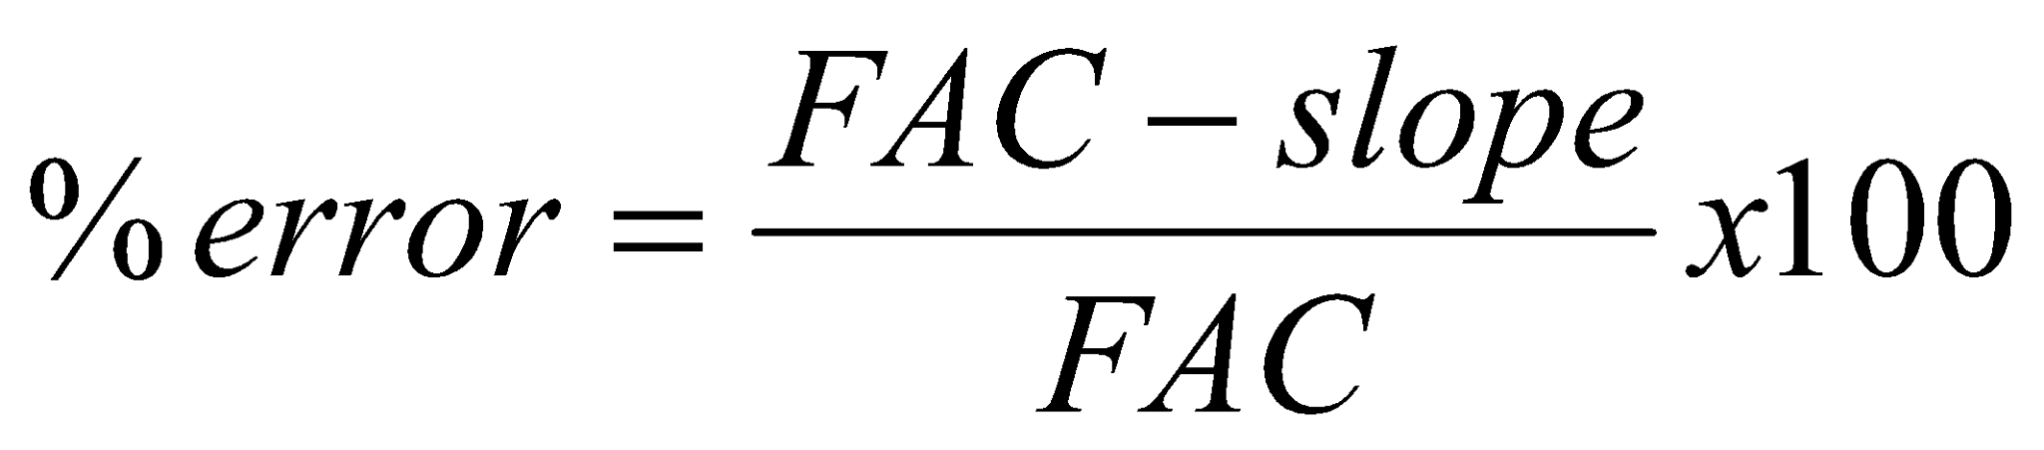
Data analysis
Calculate the drift rate.
Use the calculated drift rate and elapsed time to compute the drift correction for each datapoint.
Correct each individual gravity reading in your dataset by subtracting the drift correction for each relative gravity value. Check to be sure that the initial and final values of gravity at the ground floor station are identical after correction.
Plot the elevation on the x-axis and the drift corrected relative gravity on the y-axis of a new scatterplot.
(Where FAC = Free Air Correction)

Slide 11
Evaluation
Was your calculation the same as the known free-air anomaly? Explain why or why not using physical principles of gravity?
What sources of error could explain the difference?
Why is data quality important to this experiment? What level of precision do you need to achieve? Were any of your measurements poor quality? How do you know? What does the R² tell you about the quality of the line fit?
What could you improve about this experiment? How else could you design a set of measurements to test the free-air anomaly multiplier that avoids some of the pitfalls of the stairwell experiment?

