Slide 1
Gravity and Magnetism Unit 3: Part 2 Magnetic Surveying to Locate Pipes
Andy Parsekian
University of Wyoming

Slide 2
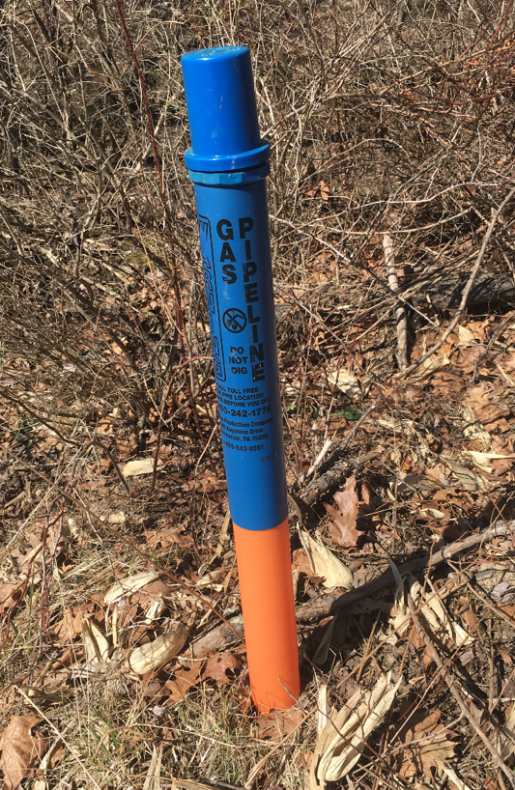
Outline
Description of problem
Site summary
Instrumentation and measurement
Dataset overview
Analysis tasks
Making interpretations
Thanks to Dr. Greg Mount for collecting and supplying the dataset and to John Weyandt for permission to use it.

Slide 3
Description of problem

Slide 4
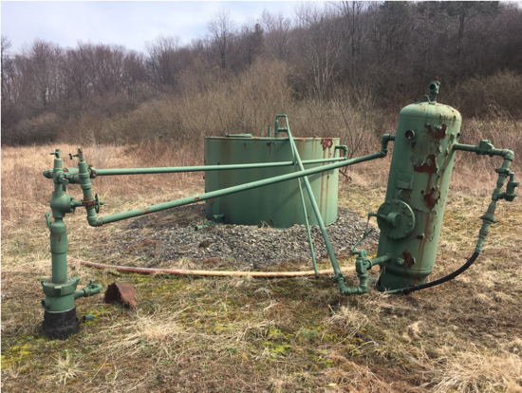
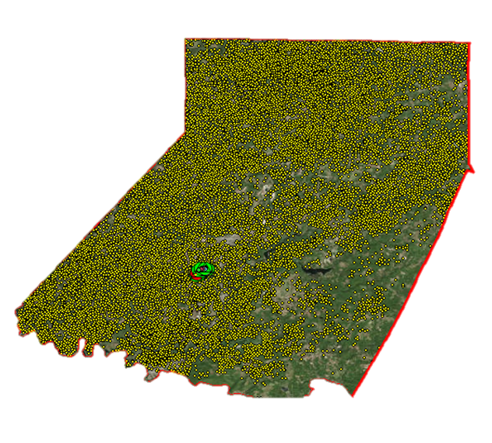
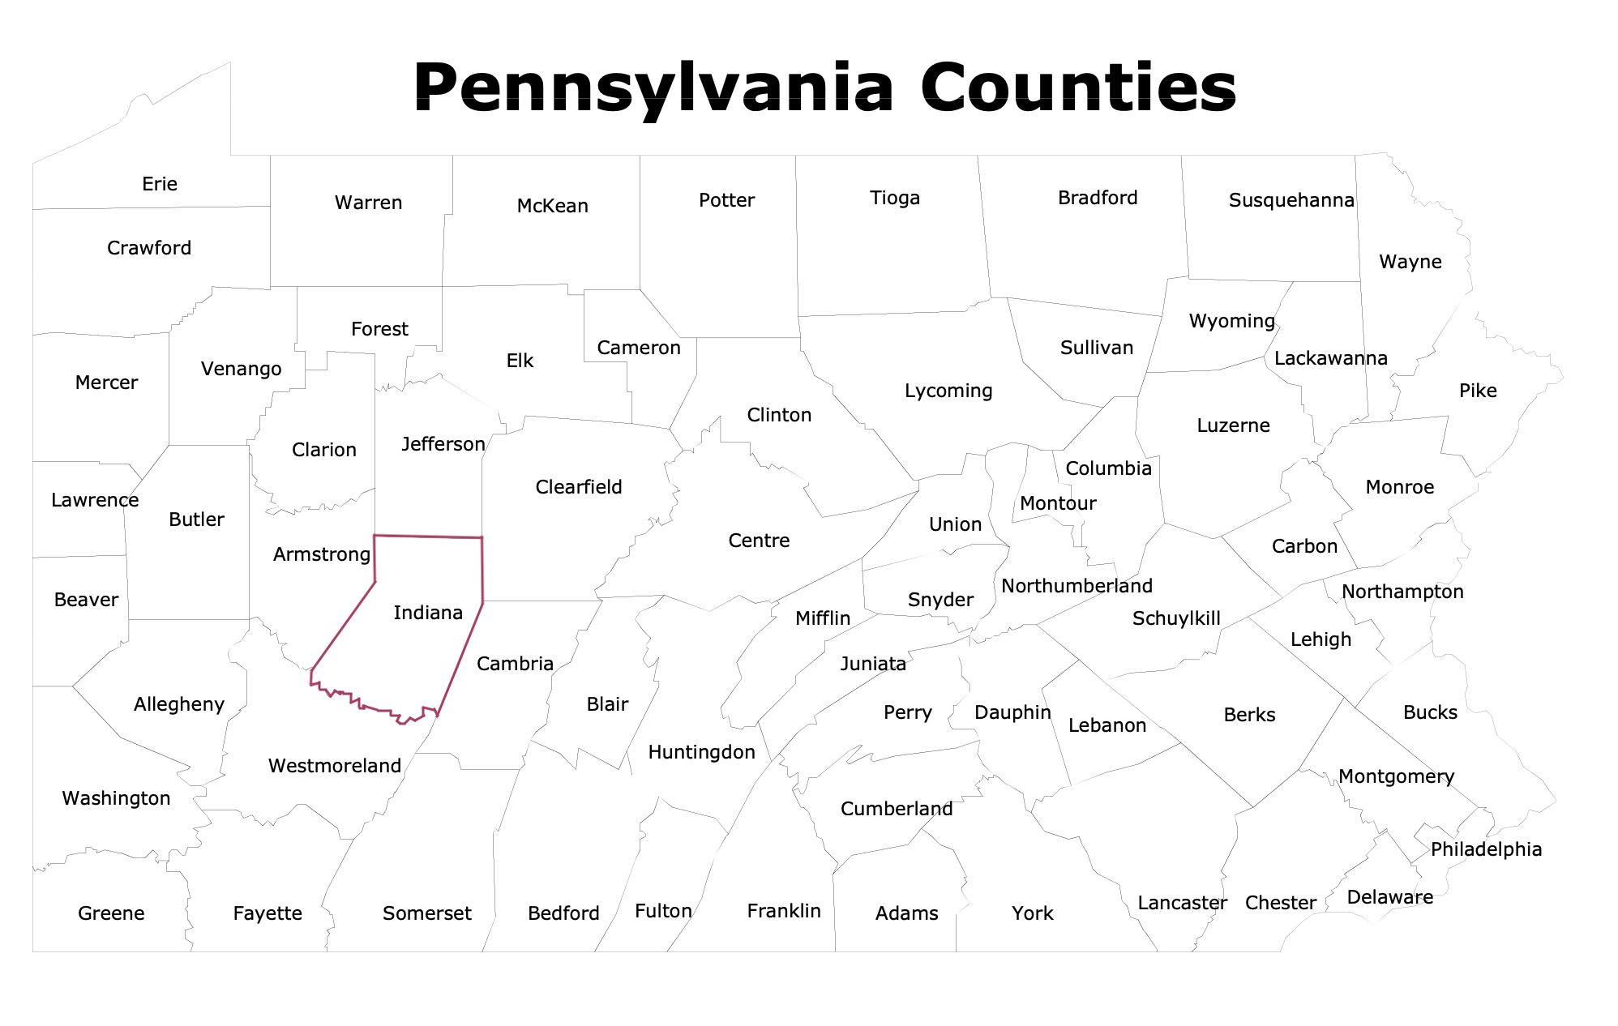
Problem: “Lost” infrastructure
Example old storage and piping equipment
Decades of oil and gas drilling have left in thousands of wells and piping runs in Indiana County, Pennsylvania
Landowners need to know where it is safe to dig
Well and pipe locations can guide remediation
Well locations are often recorded (yellow dots on far-right image)
Buried piping runs can be more difficult to locate
Wells in Indiana County, PA
Map source: www.pa.gov

Slide 5
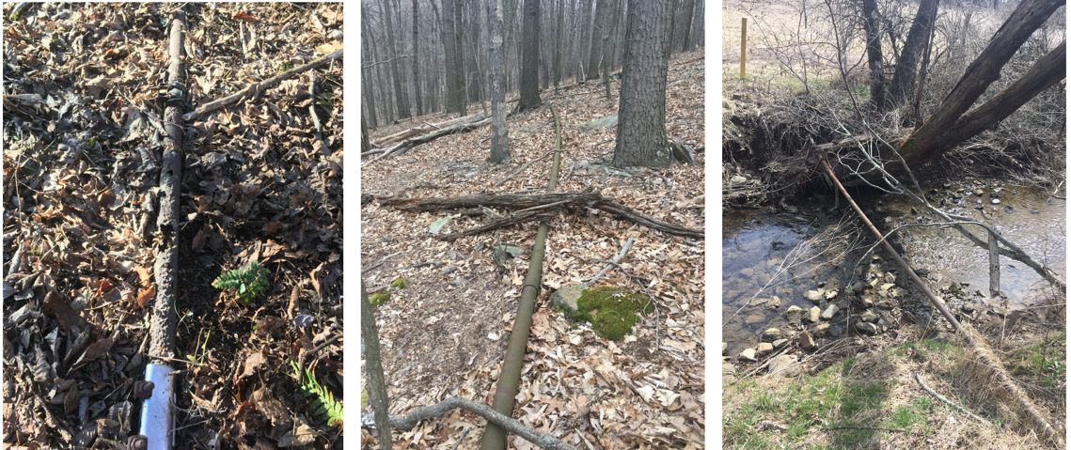
Locating pipes
Some pipes are found on the ground surface, as shown at right
Many times, pipes are buried and pose a bigger risk if they are leaking or someone hits them when digging
Fortunately, most of these pipes are ferrous (iron) and cause a magnetic anomaly

Slide 6
Instrumentation and measurement

Slide 7
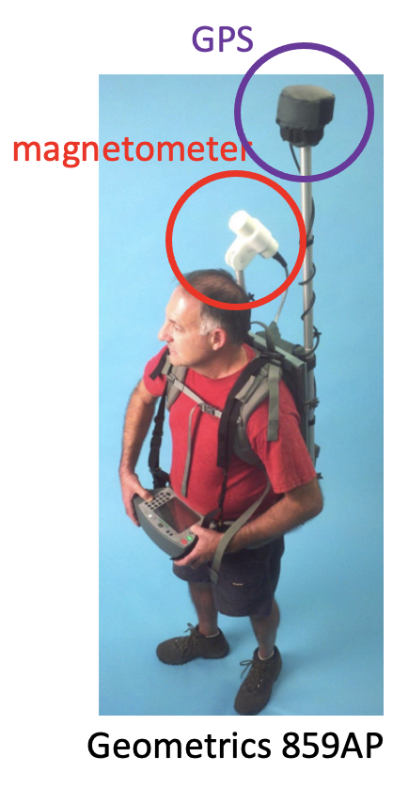
Magnetometer
A magnetometer is used to measure the total field strength of Earth’s magnetic field at points along the ground
At right, a person is shown wearing a backpack magnetometer. The operator traverses the landscape and the magnetometer automatically records a datapoint every second. GPS is used to record the geographic position.

Slide 8
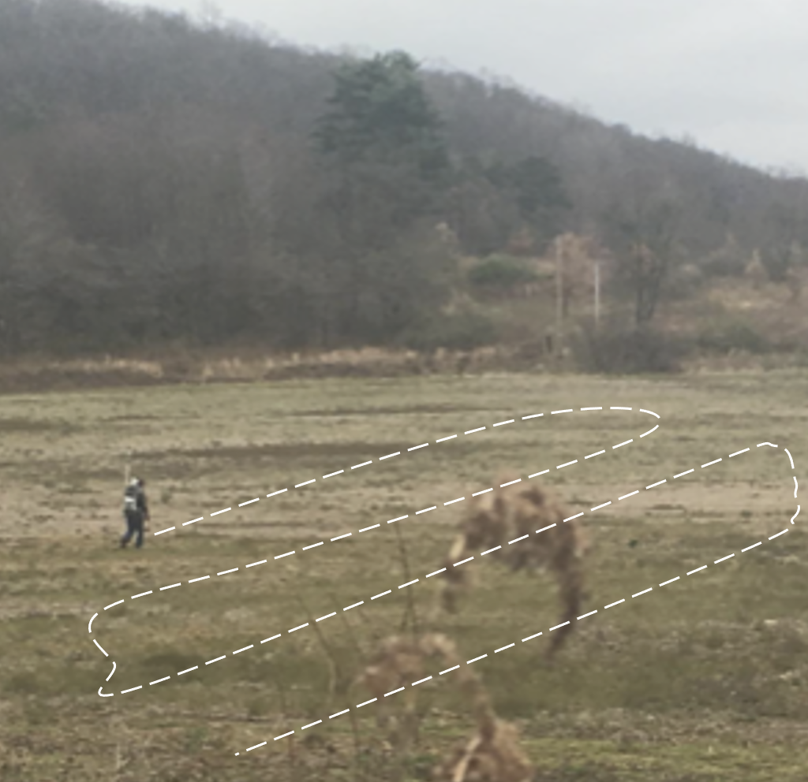
Surveying with a magnetometer
Often the operator will follow a grid or S-shaped pattern to create a map of the magnetic total field
Although ferrous (iron) objects are not magnetic themselves, they interact with Earth’s magnetic field to cause deflections in the measured total field

Slide 9
Site summary

Slide 10
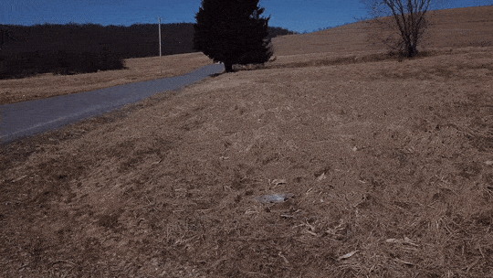
Weyandt farm
The field site where this dataset was collected is the Weyandt farm in Indiana County, Pennsylvania
The farm’s landscape is rolling hills with tilled fields surrounded by forest
Locations of wells are known, but piping runs are not

Slide 11
Dataset overview

Slide 12
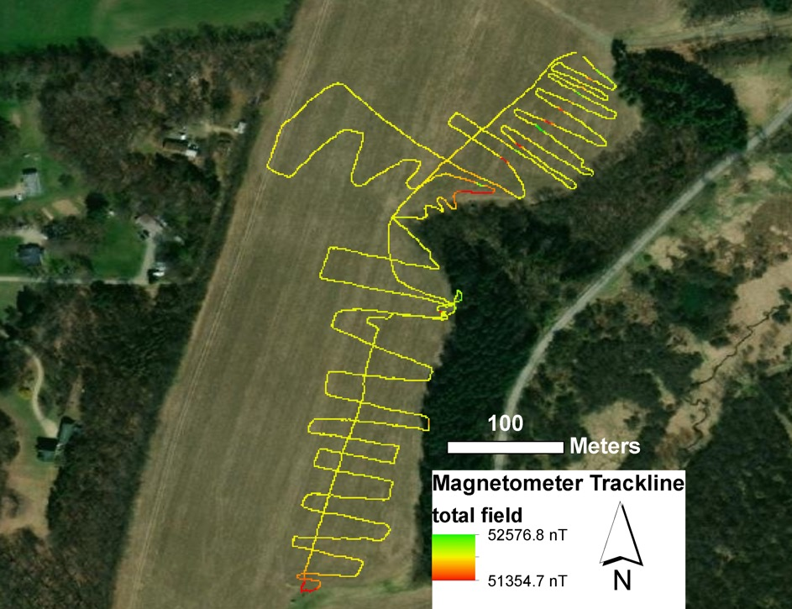
Magnetics survey of Weyandt farm
The operator walked for approximately 3.5 km (the magnetic “trackline”)
They collected magnetic total field measurements every 0.25 seconds (frequency of 4 Hz or 4 measurements per second)
This resulted in ~13,200 datapoints with GPS positions

Slide 13
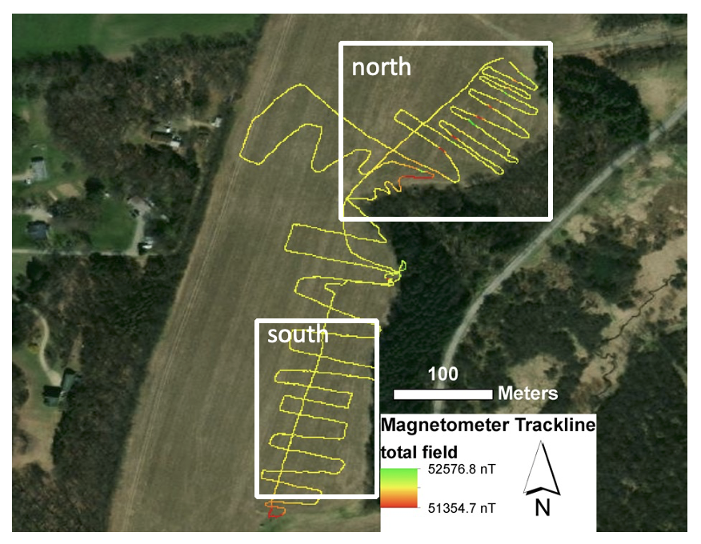
Zones
The color of the line at right indicates the strength of the total field
On the following slides, we will zoom into two subsections as noted on the right—north and south—to view more data detail

Slide 14
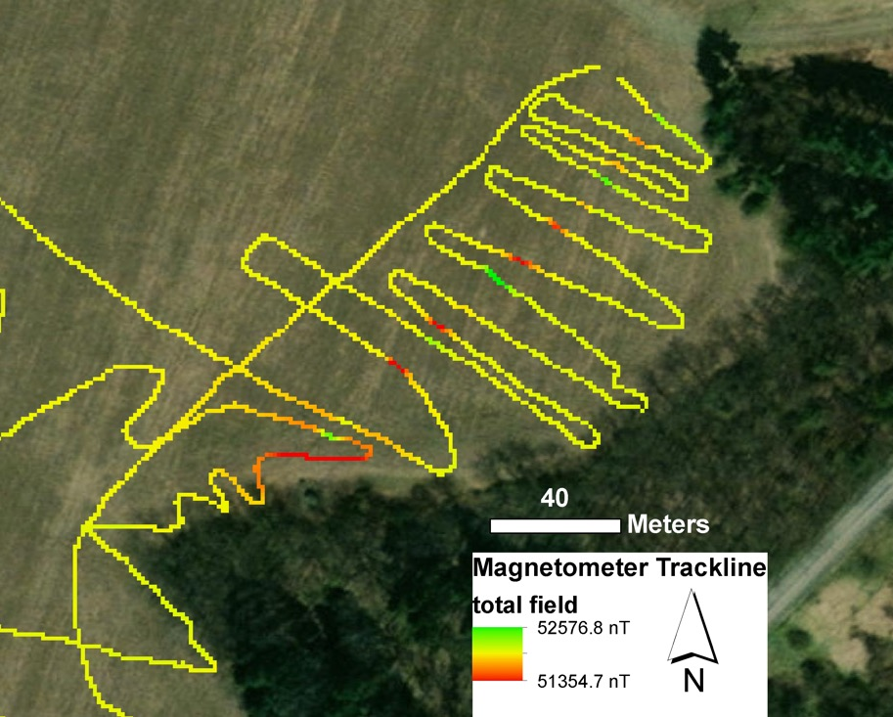
North zone overview
In this part of the survey, we see yellow is the “background” field strength, and red and green are negative and positive anomalies
What spatial patterns do you see in the anomalies?

Slide 15
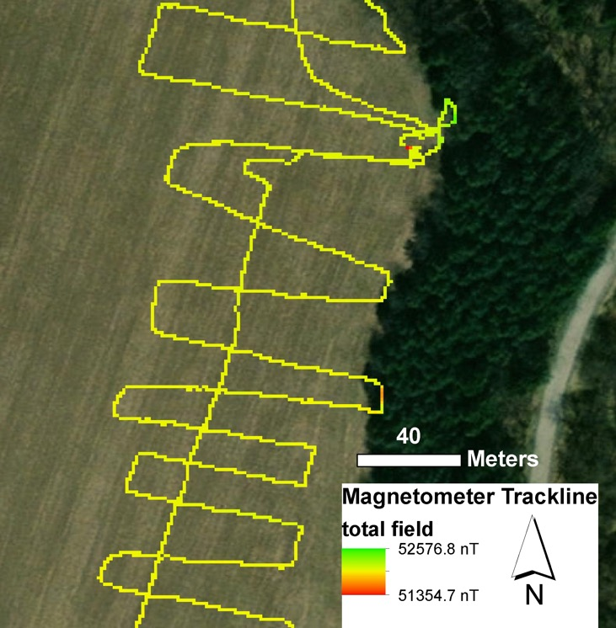
South zone overview
Do you see anomalies in this part of the survey?
What might they be caused by?

Slide 16
Analysis tasks

Slide 17
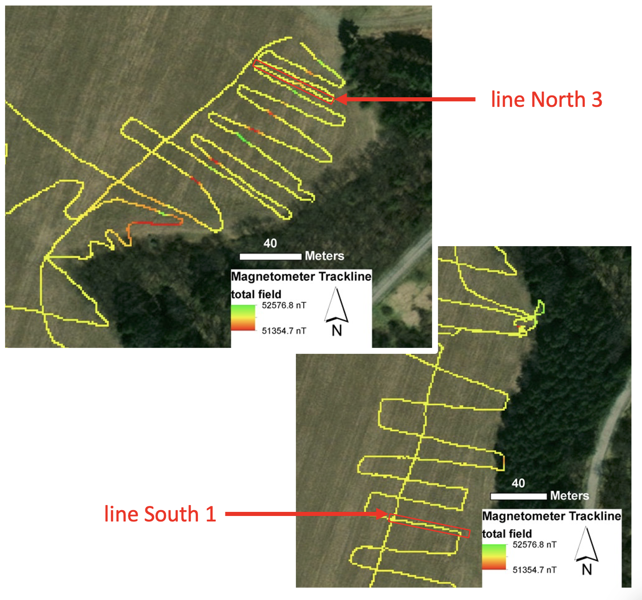
Lines for analysis
On the lab worksheet, you will take this map view of the dataset and identify the locations of suspected piping runs
You have also been provided with the numerical data for a portion of this; plot both examples and analyze any the magnetic anomalies you see

Slide 18
Making interpretations

Slide 19
Questions for interpretation
Do you see any patterns in the mapped data or in the data you plotted?
Where is the piping run most likely located?
How could you explain magnetic anomalies in the data not associated with piping runs?
How do the two lines you analyzed compare with one another?

