Slide 1
Magnetics and Gravity Unit 3: Part 1 GeoPark Gravity Surveying Field Data Example
Andy Parsekian
University of Wyoming

Slide 2
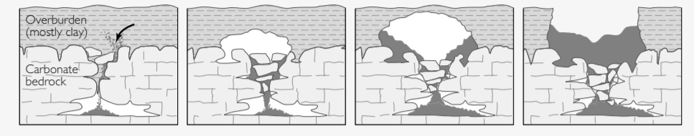
Overview
Sinkholes and karst as a gravity target
The importance of locating sinkholes for hazard mitigation
The GeoPark sinkhole dataset from University of South Florida
Steps for data analysis
Interpretation
Image credit: USGS

Slide 3
Learning goals
Interpret gravity prospecting data to locate anomalies related to geologic hazards (i.e. voids, sinkholes).
Recognize and describe limitations and nonuniqueness (equifinality) in geophysical prospecting map results.
Justify interpretations of measured dataset by invoking physical properties and principles.
Give examples of applications of gravity geophysical prospecting applications in their own neighborhood or region.

Slide 4
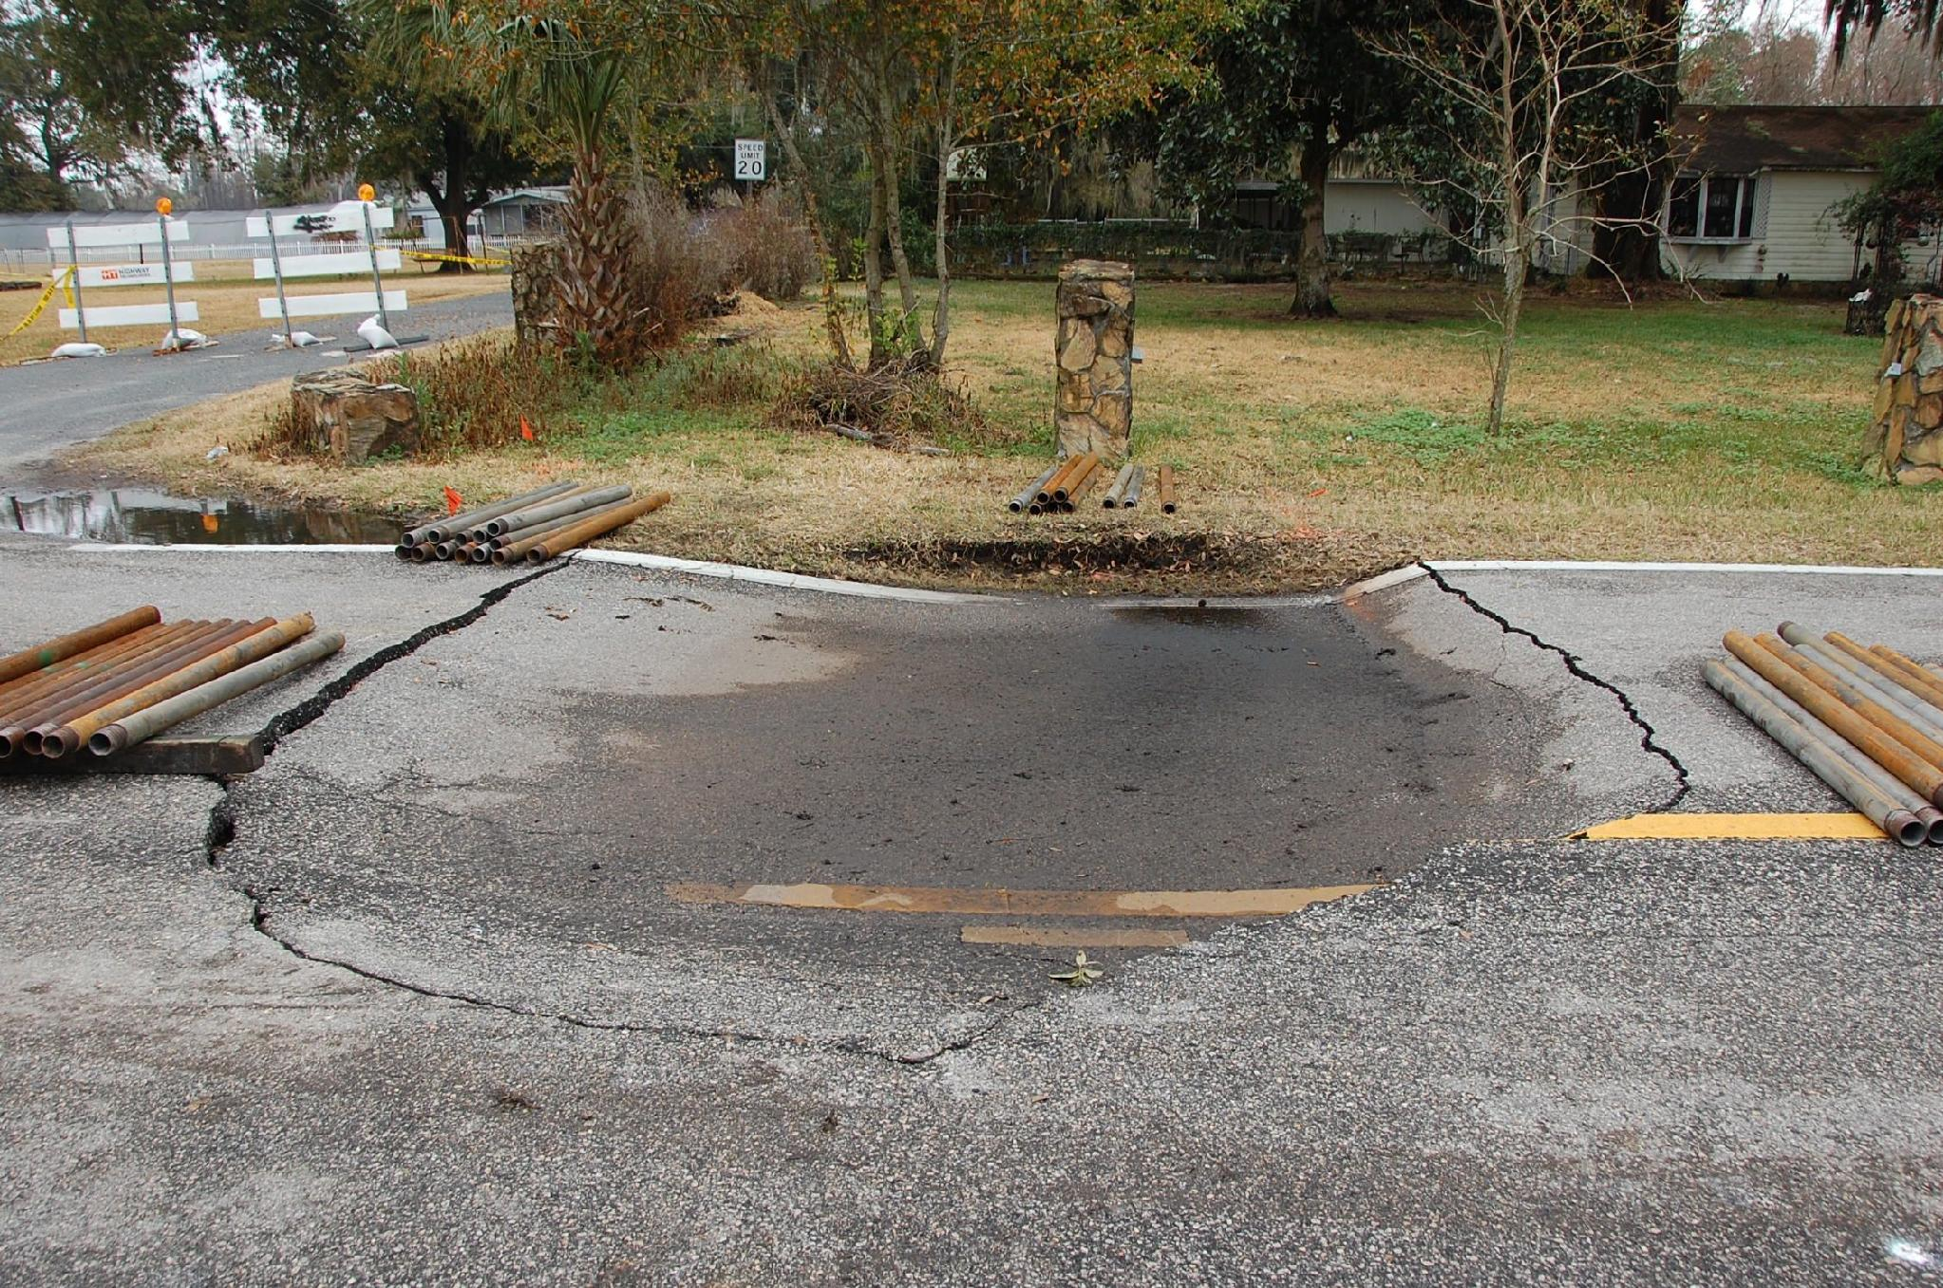
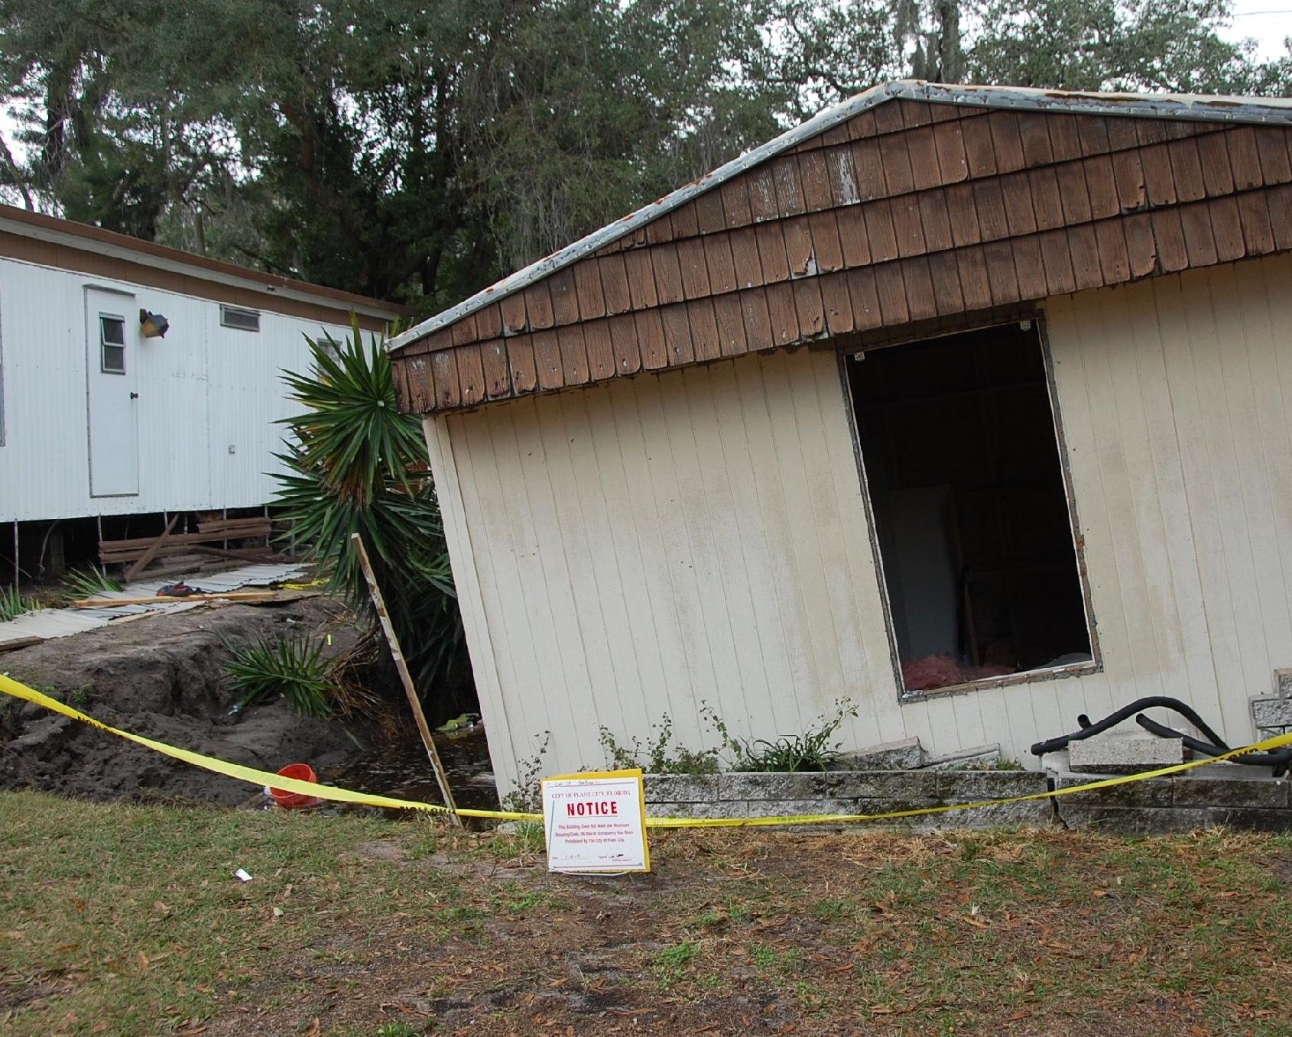
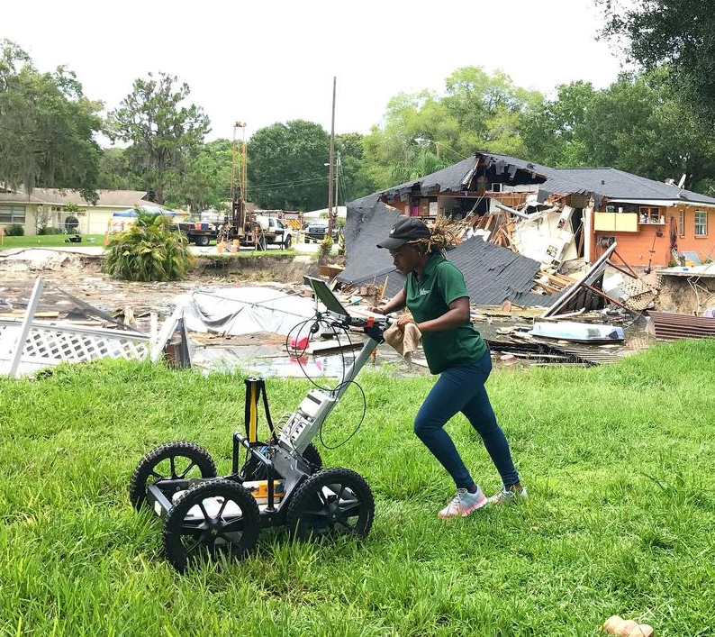
Sinkholes and the built environment
Image credits: USGS/Ann Tiansky – public domain; S. Kruse, USF

Slide 5
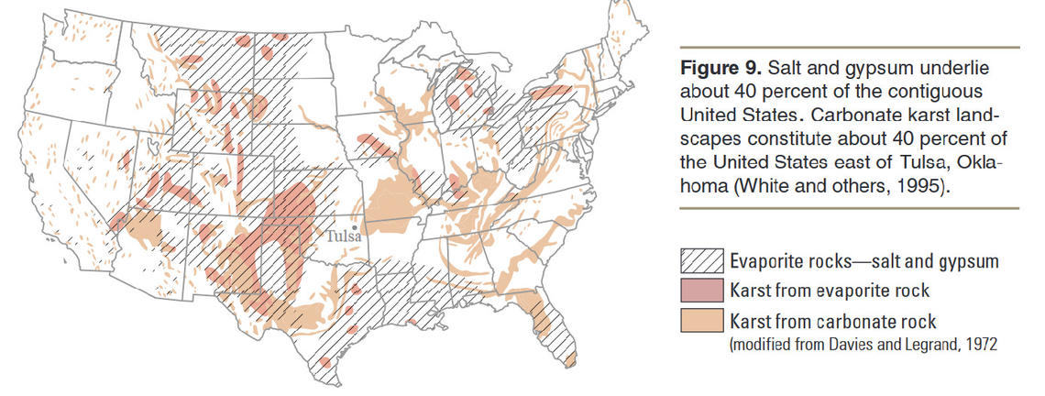
Nationwide distribution of karst landscapes
Karst: A geological landscape where bedrock (gypsum, limestone) dissolution results in sinkholes, sinking streams, caves, springs, etc.
Image source: USGS Land Subsidence in the United States Fact Sheet 165-00
Notes:
Link to USGS Land Subsidence Fact Sheet: https://water.usgs.gov/ogw/pubs/fs00165/

Slide 6
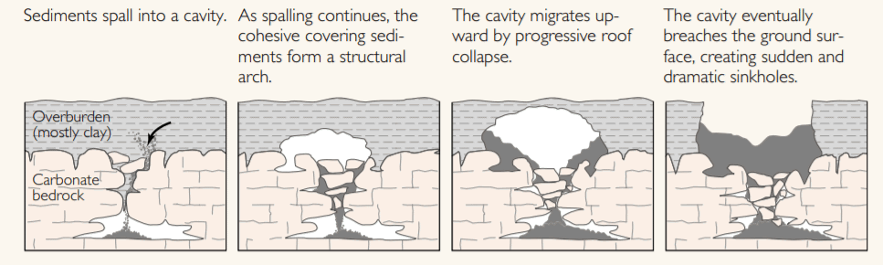
Karst landscapes and sinkholes
Karst: A geological landscape where bedrock (gypsum, limestone) dissolution results in sinkholes, sinking streams, caves, springs, etc.
Image credit: USGS – public domain

Slide 7

Karst cavities can become sinkholes
Karst: A geological landscape where bedrock (gypsum, limestone) dissolution results in sinkholes, sinking streams, caves, springs, etc.
Cavities are hidden before they become sinkholes!
How can we locate them to mitigate risk to structures?

Slide 8
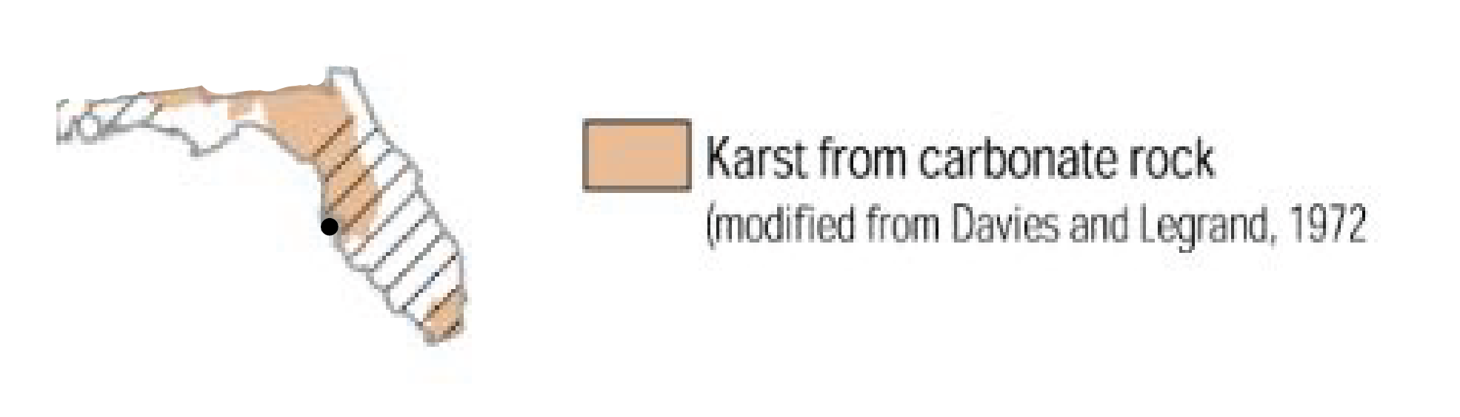
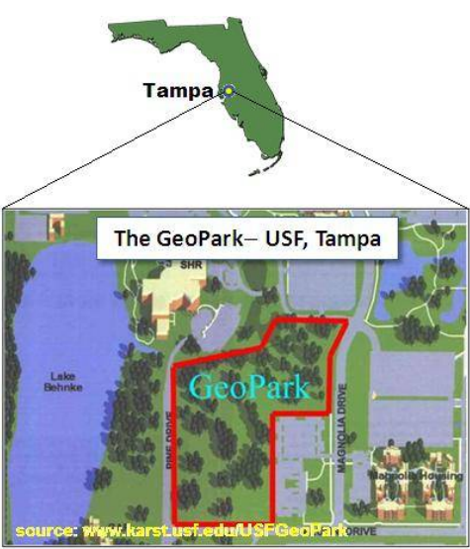
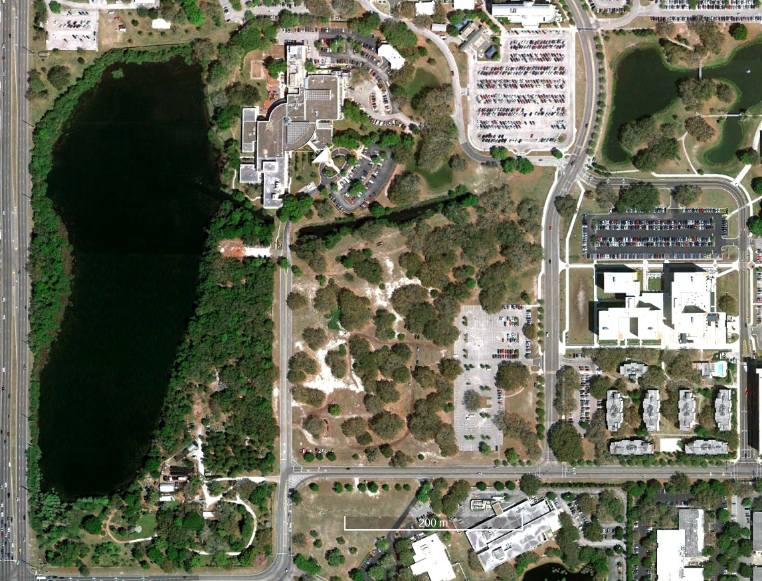
Urban sinkhole site: USF GeoPark

Slide 9
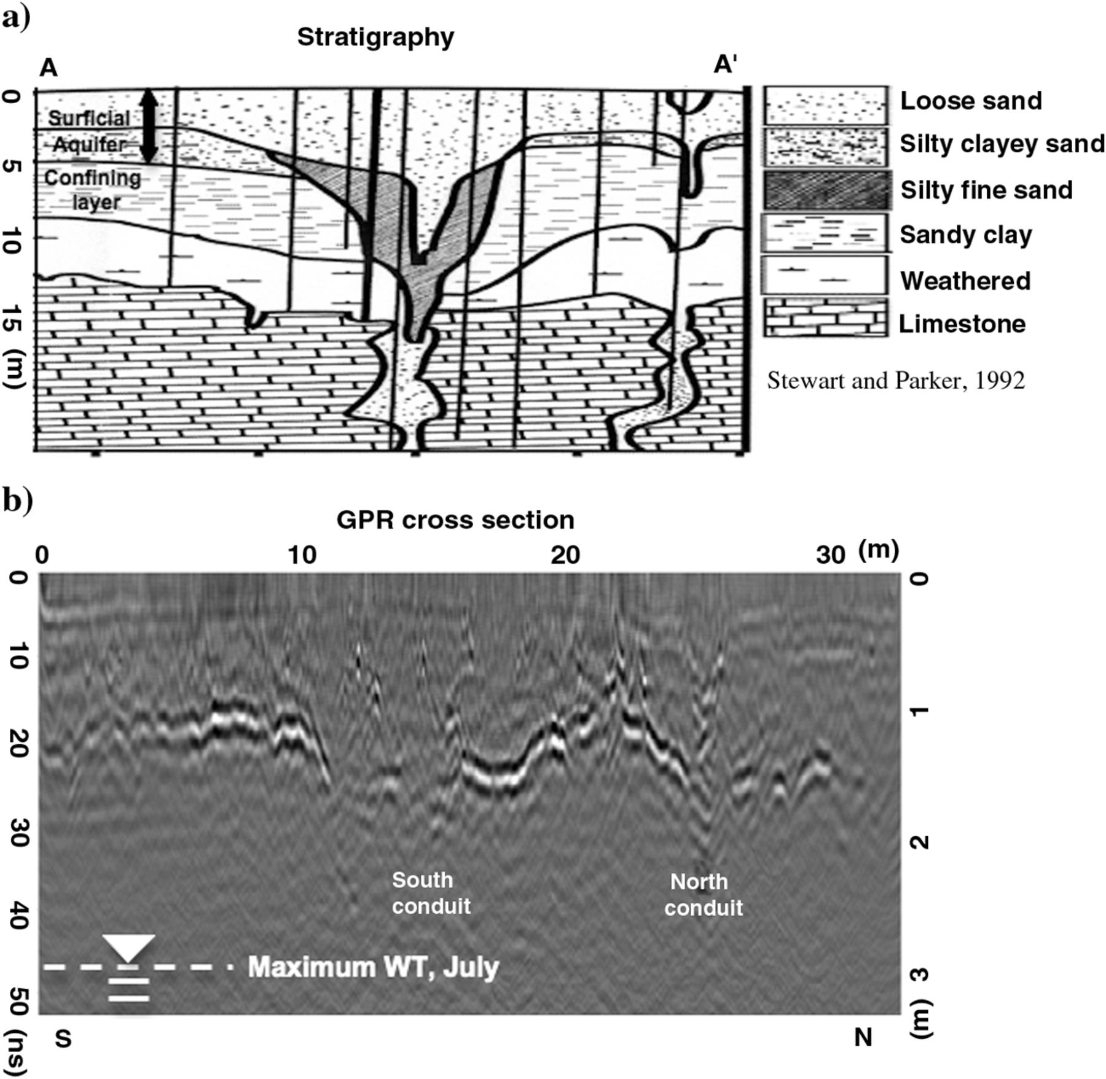
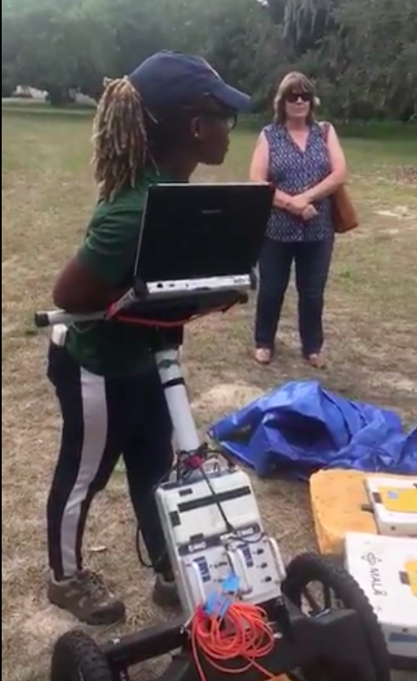
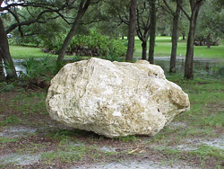
GeoPark: Subsurface data
A boulder on display at GeoPark that was extracted from the limestone aquifer.
Figures a and b: Redrawn from: J. W. Parker (1992). “Surficial Aquifer Hydrogeology in a Covered-Karst Terrain,” Master’s Thesis, University of South Florida, 228 pp
South–north cross section through both conduits. (a) Schematic: The north conduit (x = approximately 27 m) is presumed to be draining the water table aquifer (sand) to the Floridan aquifer (limestone). The south conduit (x = approximately 14 m) has no clear subsidence at the surface, so it was presumed not to drain. Vertical lines show locations of old borings, cone penetration tests, and standard penetration tests (Parker, 1991) that originally located the sinkholes and defined stratigraphy.

Slide 10

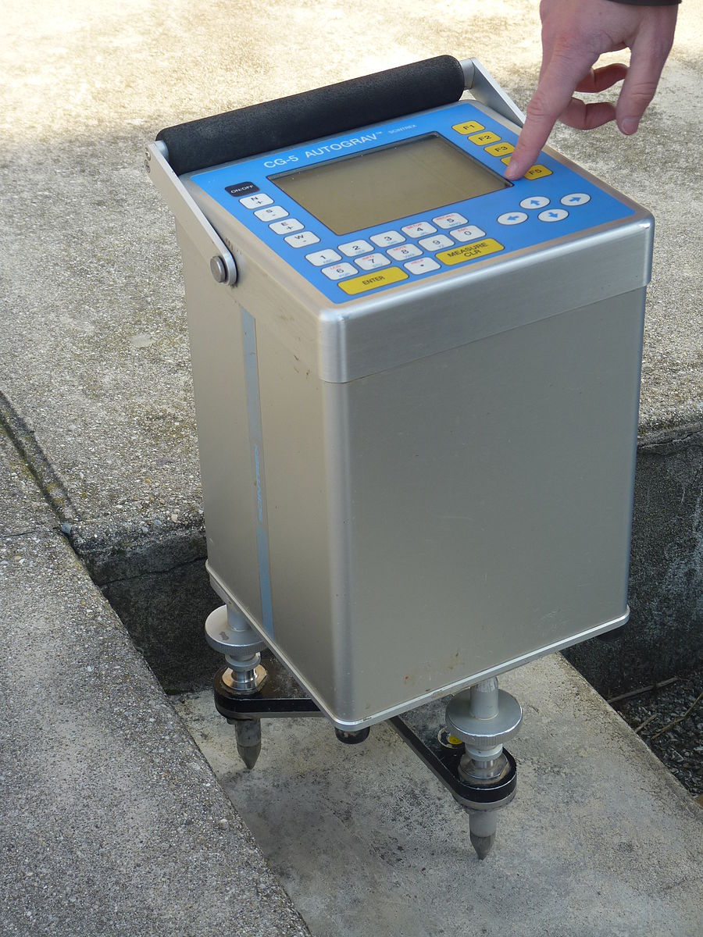
GeoPark: Low density target
Lower density material/voids associated with sinkholes
Less mass acting on the gravimeter
Expect to locate a negative gravity anomaly
Redrawn from: Parker, J.W. (1992). Surficial aquifer hydrogeology in a covered-karst terrain, Master’s Thesis, University of South Florida, 228 pp

Slide 11
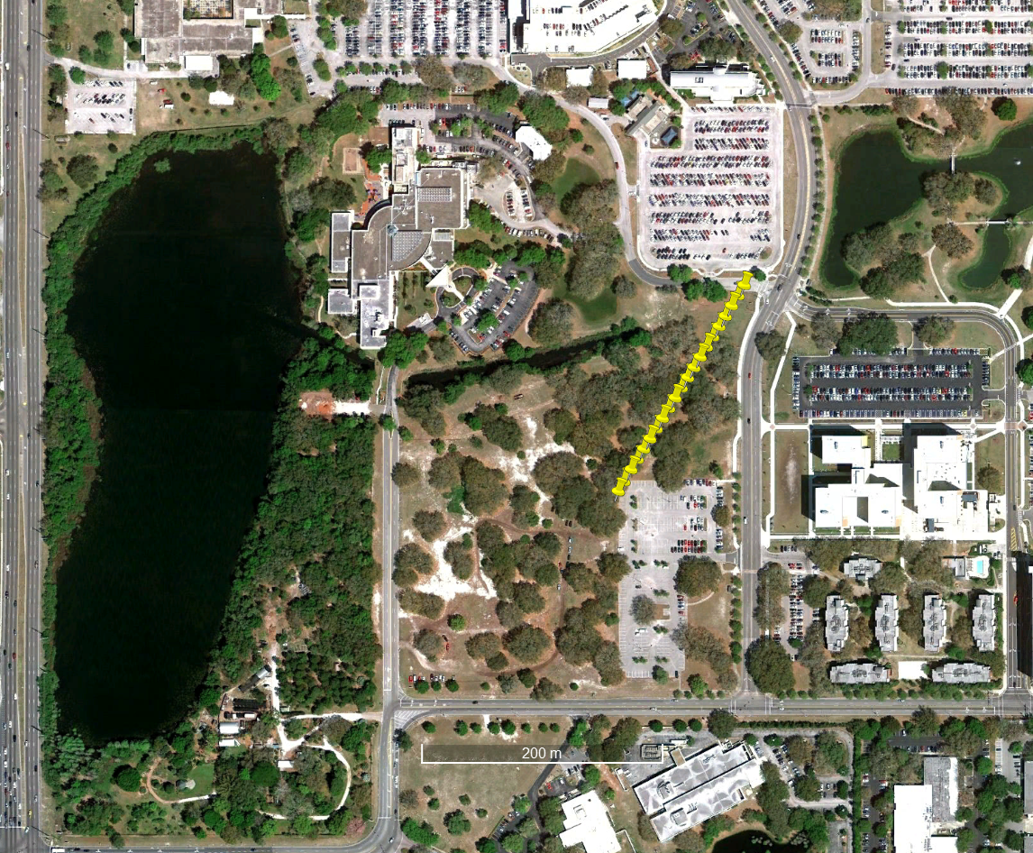
Data acquisition
21 gravity measurement points along the profile
10-meter spacing
Measured April 4-8, 2019
The “Base Station” is at the middle of the line, 100m
  Revisited between every profile point

Slide 12
Data analysis
Instrument drift
Latitude correction
Free Air correction
Bouguer correction
Remove local trend

Slide 13
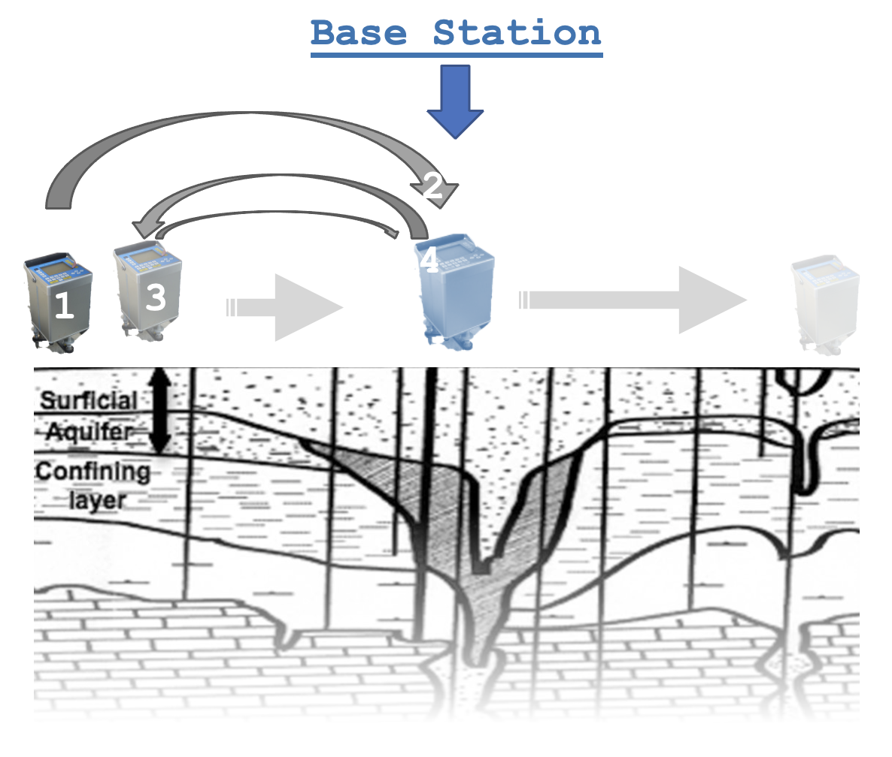
Instrument drift
During acquisition, the base station was remeasured in between every other point on the profile to account for drift.
The dataset provided to you for analysis has already been corrected for drift; you do not need to do this step.

Slide 14
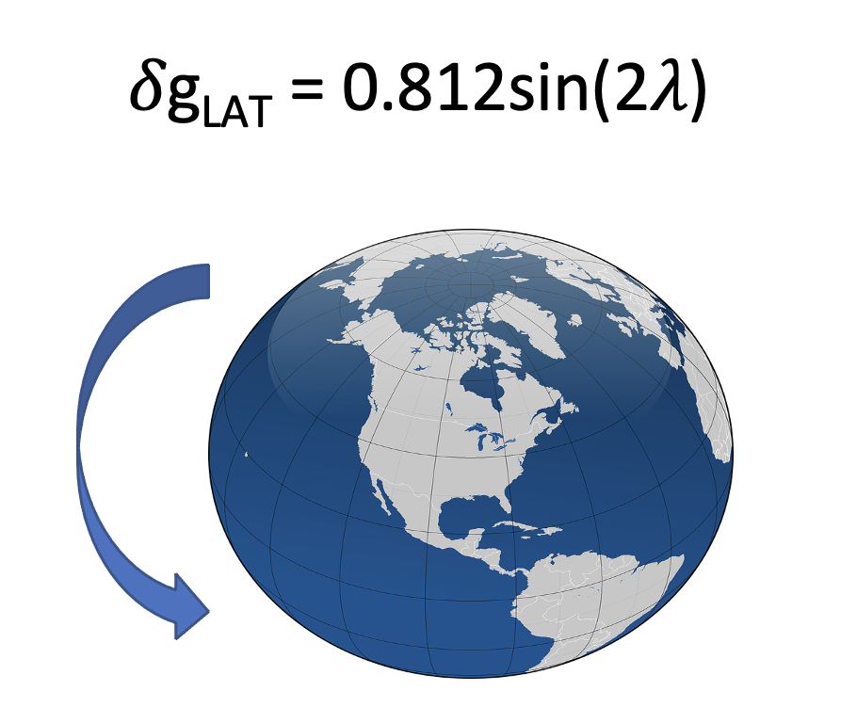
Latitude correction
Centrifugal force and the equatorial bulge are both related to the measurement latitude (𝜆). These can both be calculated at the same time over a short distance using the equation above, producing the latitude correction, 𝛿g_{LAT}.
The latitude of each point on the profile has been provided for you to calculate this correction.

Slide 15
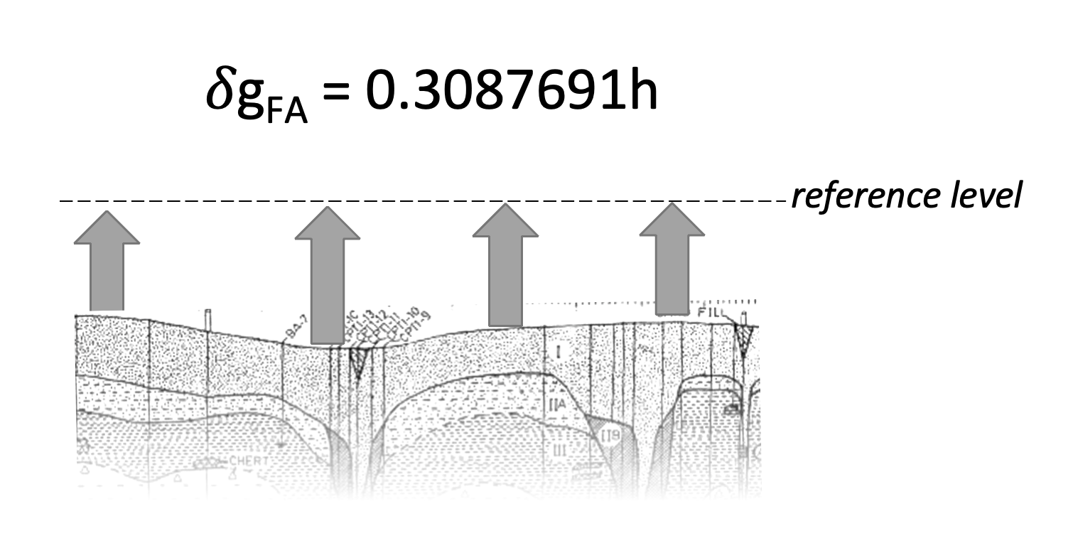
Free Air correction
Each point along the profile is measured at a slightly different topographic elevation due to natural variability in the terrain. These differences in elevation, or height (h) relative to the base station, result in the gravimeter being slightly closer or farther from Earth’s center of mass. The Free-Air correction accounts for this effect.
The height of each point on the profile relative to a reference level (in this case, the base station) has been provided for you to calculate this correction.

Slide 16
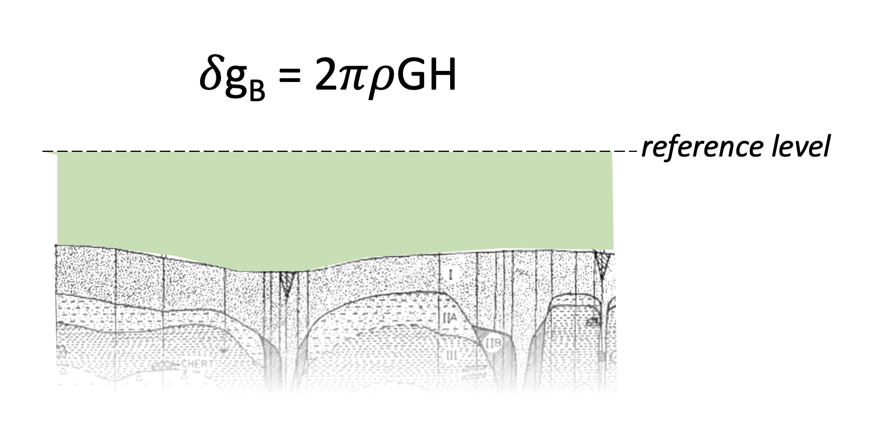
Bouguer correction
After the Free Air correction accounts for the different elevation of each gravity measurement position, the Bouguer Correction accounts for the thickness and density of material between the measurement station and the reference level.

Slide 17
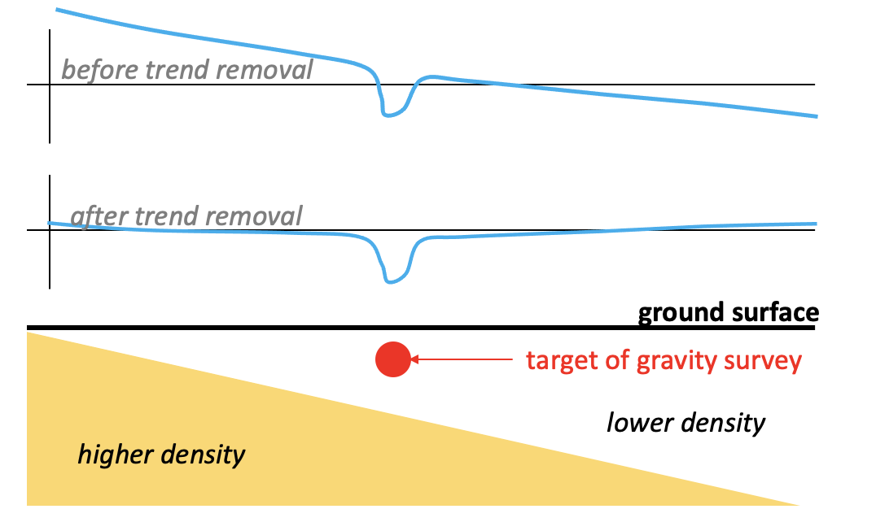
Remove local trend
A “local trend” in a gravity dataset can be caused by large-scale geologic features in the subsurface. For example, in the diagram, there is a sloped higher-density rock layer (yellow) below a lower density layer (white); the high-density layer will cause an apparent slope to the measured gravity data. We want to only see the gravity anomaly of the target.
To remove the local trend, we find the rise over run across all the measurements and subtract that from our data.

Slide 18
Trend questions
What does your result look like? What does that mean?
  Is it a negative anomaly or a positive one?
  What background information do we know about the site or area?
  Is the data erratic (noisy) or does it change smoothly over the distance of the survey?

Slide 19
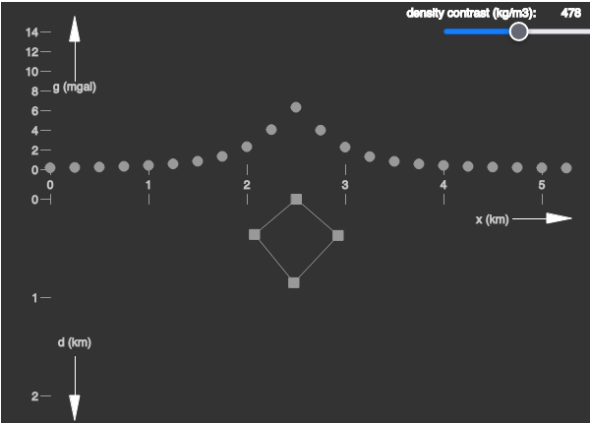
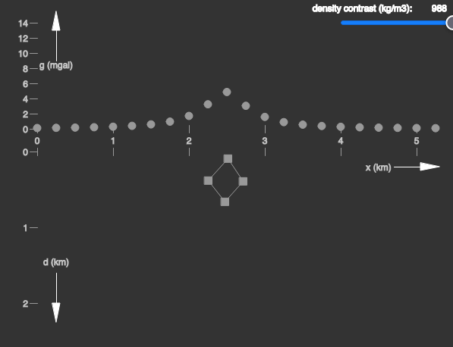
Interpretation
Nonuniqueness
When interpreting gravity results, we always consider that there may be more than one combination of geometry and density that could result in the same anomaly. As illustrated on the right, a large low-density target buried at the same depth as a small high-density target can produce nearly the same gravity anomaly. This makes interpretation challenging!
If we have other information available, we can reduce the nonuniqueness—for example, knowing the depth and size of a target can make it easier to interpret the density of a target. Alternatively, knowing the density and size of a target can enable more confident interpretation of its depth.
Large, low-density target
Smaller, higher-density target

