Slide 1
What Does GPR Data Look Like?
Unit 2: Forensic Geophysics using GPR

Slide 2
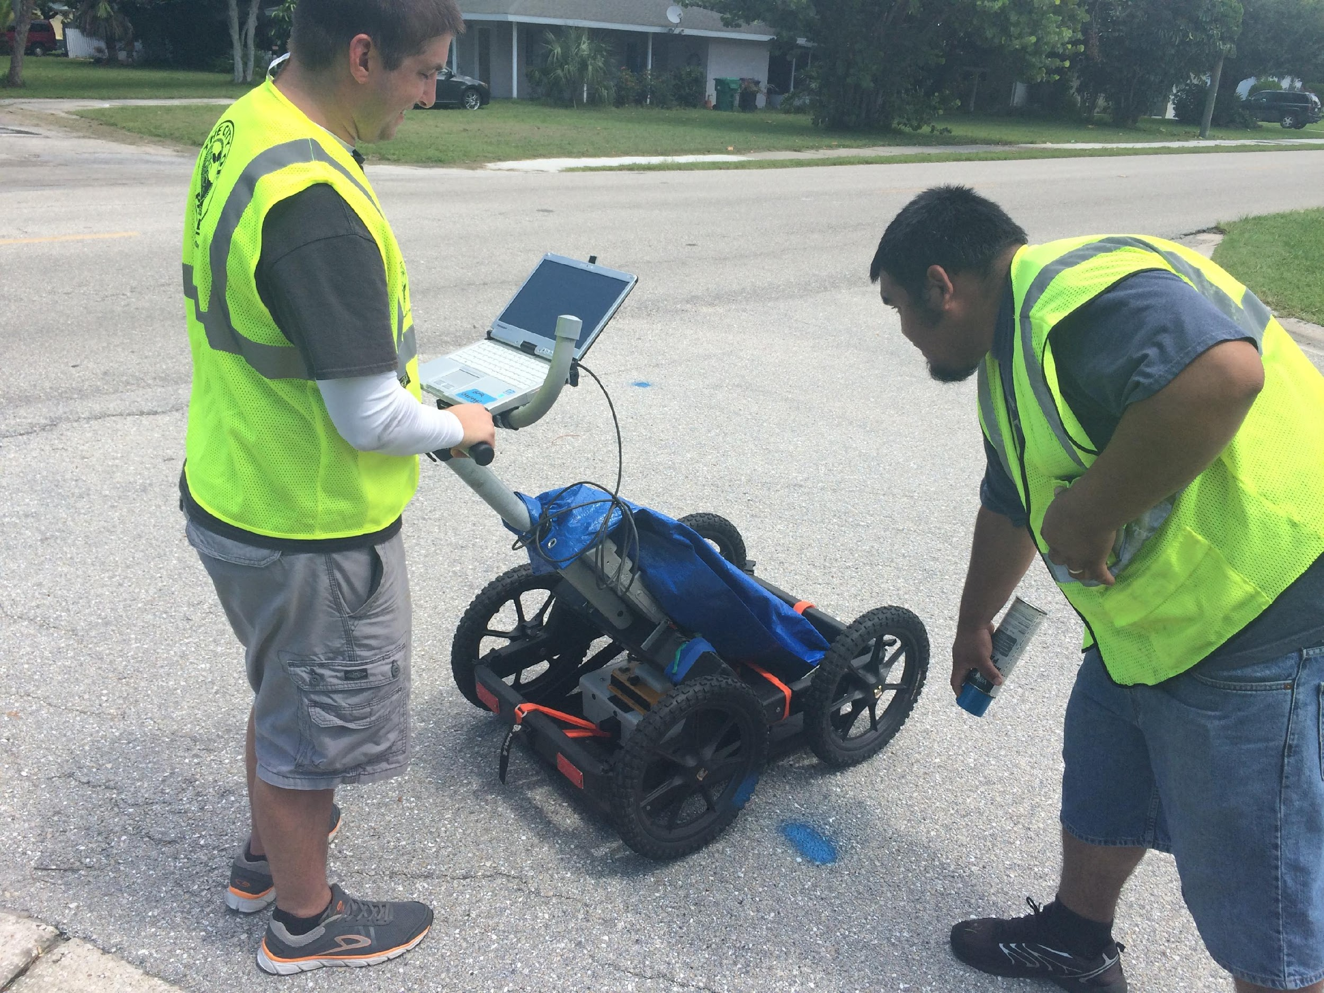
Learning Goals
Explain why knowing the depth of a buried object can be important.
Recognize the direct wave and diffraction patterns in GPR data.
Describe the relationship between diffraction pattern shape and ground velocity.
Interactively fit a hyperbola to a diffraction pattern to estimate wave velocity and
Compute depth to target using velocity.

Slide 3
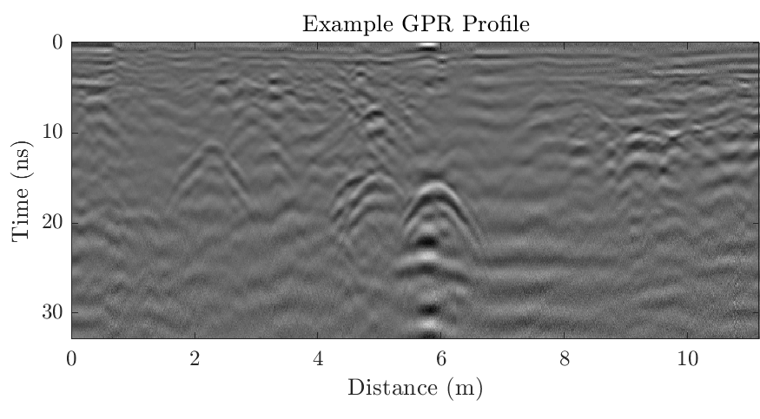
Question: Do you see the upside-down “U”s?

Slide 4
Question: Why do underground features produce upside-down “U”s?
The upside-down “U”s are called hyperbolas

Slide 5
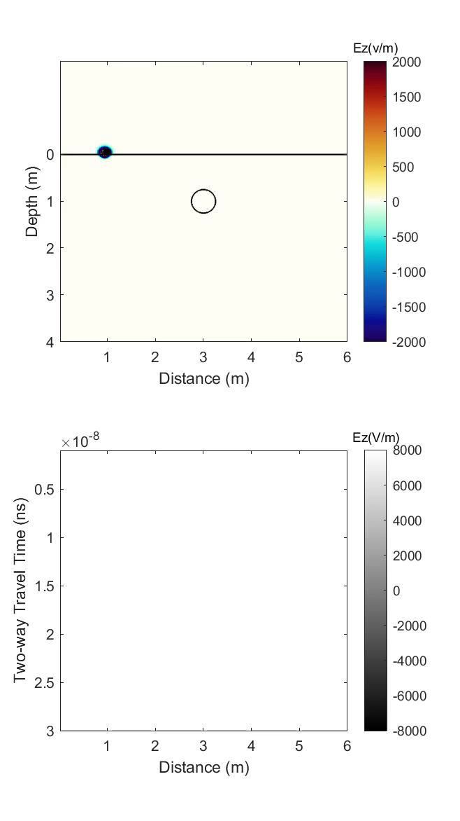
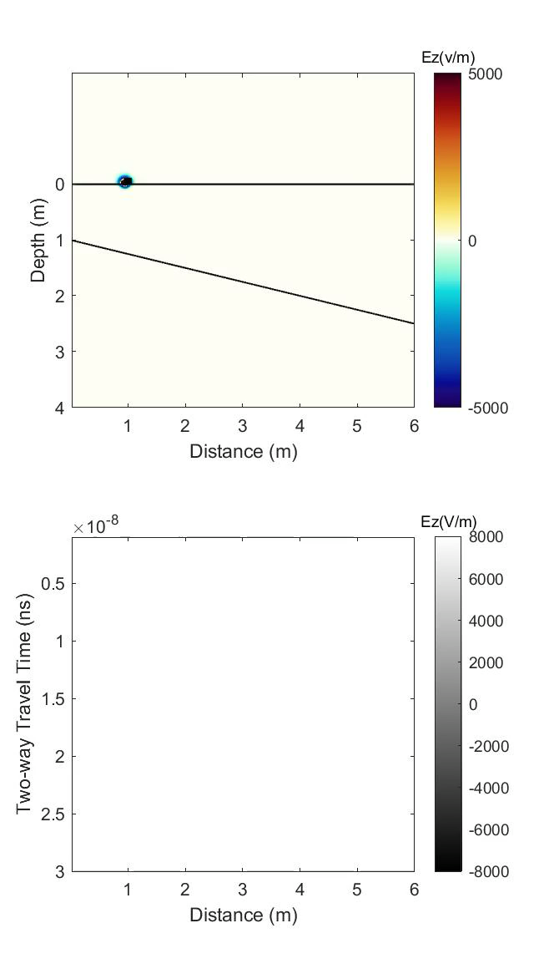
GPR Signal
Diffraction Hyperbolas from Point-like Objects
Imagine a GPR antenna (transmitter and receiver pair) being moved gradually over a buried pipe. The transmitted wave travels out in all directions.
Objects that are not directly beneath the antenna will reflect part of the signal back.
The receiver will record this returned signal and display it at the location of the antenna.
The receiver doesn’t “know” where the object causing the return actually is.

Slide 6
GPR Signal
Diffraction Hyperbolas from Point-like Objects
Note: As the antenna gets closer to the object, the reflected signal is received sooner.
The resulting radargram looks like an upside-down “U”. This is called a diffraction pattern, and follows the mathematical form of a hyperbola.
Note also: The reflected energy that the receiver records is an extended pulse. You can see this in the radargram to the right as blocks of black-white-black or white-black-white. This is the reflected signal of a single buried feature, not multiple features.

Slide 7
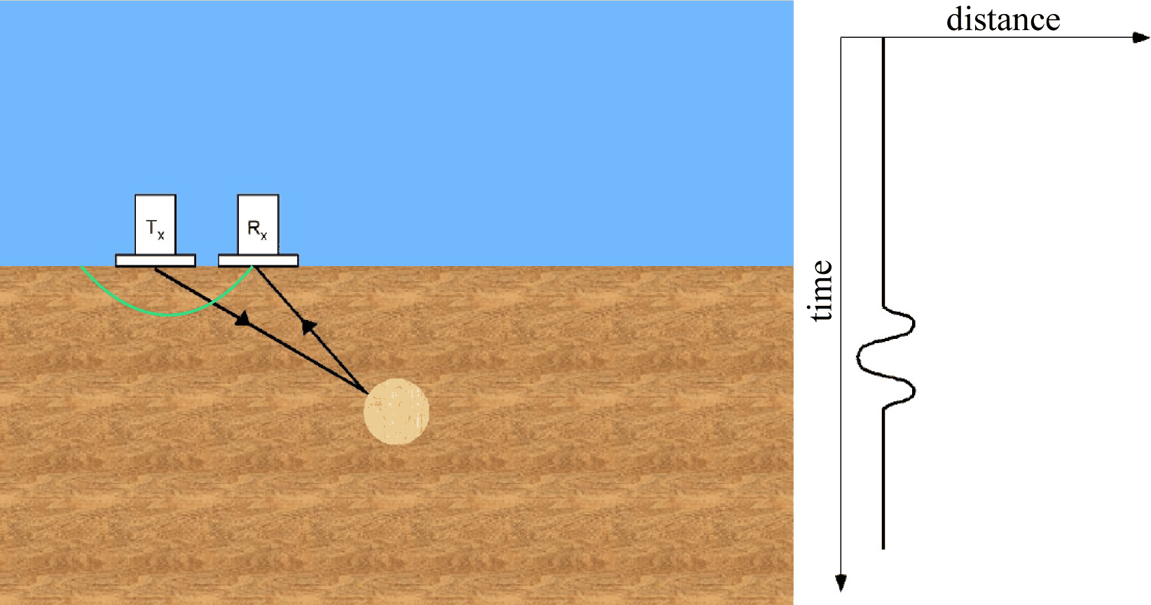
GPR Signal
Diffraction Hyperbolas from Point-like Objects
The only part of the outgoing wave that is ever recorded is the part that travels along the black lines.
These lines are called rays, and show the ray-path of the recorded pulse

Slide 8
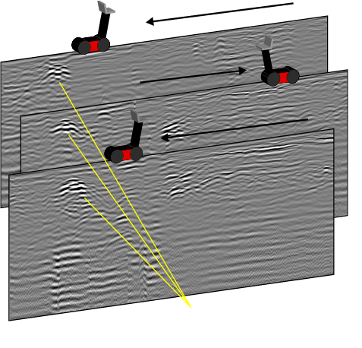
A Note about 2D Profiles
over 3D Objects
A long buried feature, will appear as a single hyperbola in each GPR profile that crosses it.
At each individual profile crossing, the pipe appears as a small circle or point, and is thus a “point-like” object.
With a series of profiles, the same pipe will produce a diffraction in each profile.
Diffraction patterns from the same long feature

Slide 9
A Note about 2D Profiles
over 3D Objects
A long buried feature, will appear as a single hyperbola in each GPR profile that crosses it.
At each individual profile crossing, the pipe appears as a small circle or point, and is thus a “point-like” object.
With a series of profiles, the same pipe will produce a diffraction in each profile.
Diffraction patterns from the same long feature

Slide 10
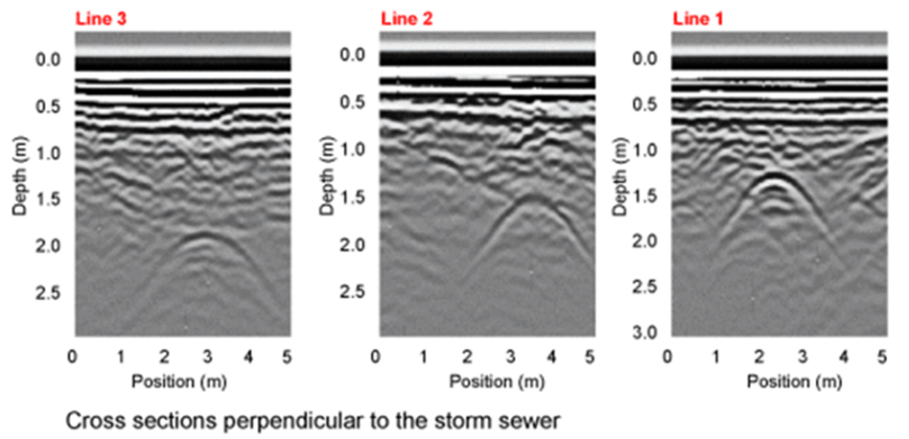
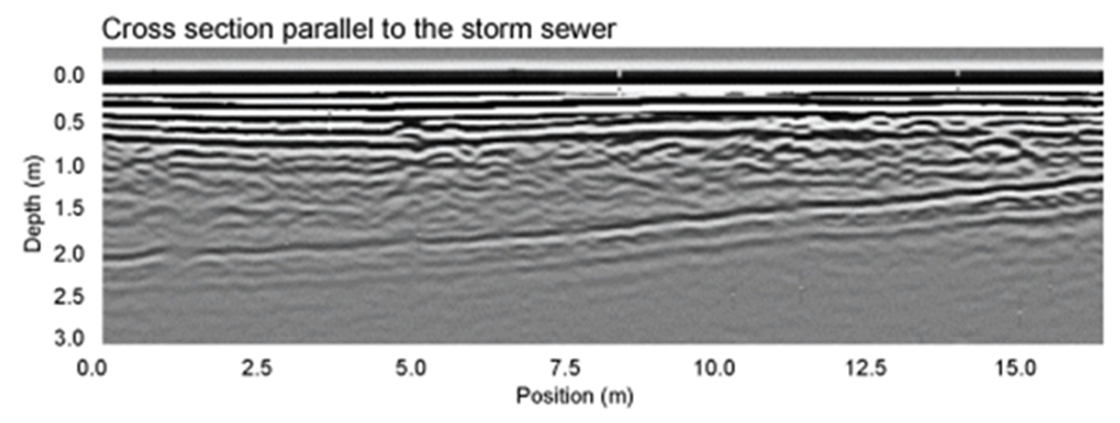
Also, Orientation
Matters
The orientation that you cross over an object can influence whether it appears as point-like.
More on this in Unit 3.

Slide 11
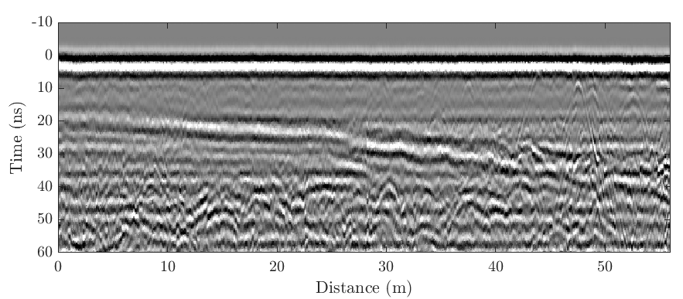
Question: Do you see the dipping horizon?
What kind of feature produces a continuous reflection like this?

Slide 12

Two-Way Travel Time
Imagine a subsurface consisting of two layers. When the electromagnetic wave encounters a change in soil or rock properties— the upper layer differs from the lower layer—some of that wave bounces back up toward the receiver.

Slide 13
GPR Signal
Reflection from a Layer Interface
The GPR system records the amplitude of the reflected signal and the time that passed between the antenna emitting a signal and the reflected signal returning. This is called the two-way travel time.
The deeper the layer, the longer the two-way travel time. In the end the dipping boundary looks like a dipping layer on the radar profile.

Slide 14
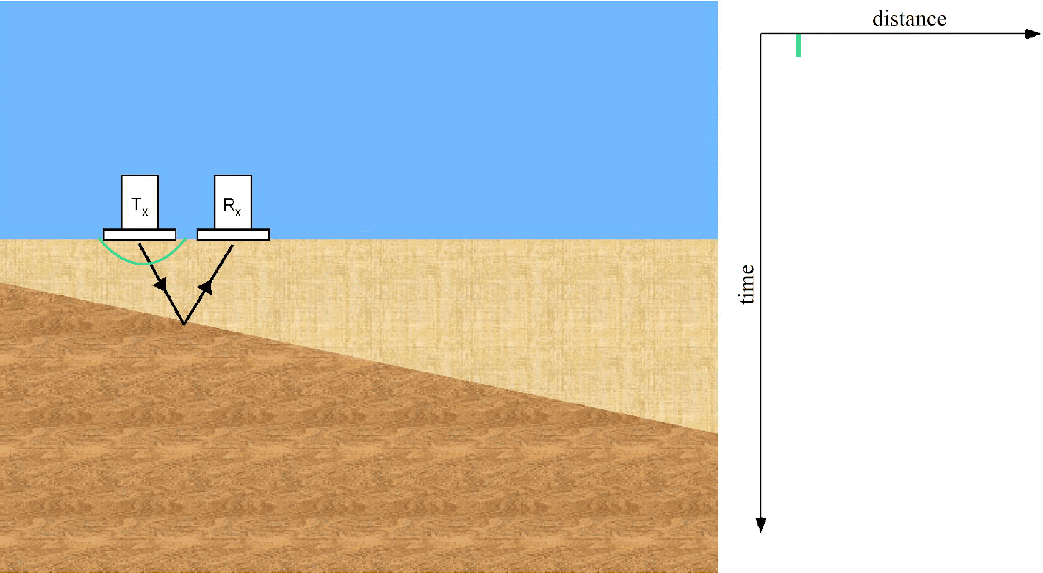
GPR Signal
Reflection from a Layer Boundary
Note where the boundary is deeper, the longer ray path requires longer travel time.

Slide 15
Question: Do you see the horizontal band across the top of the profile?

Slide 16
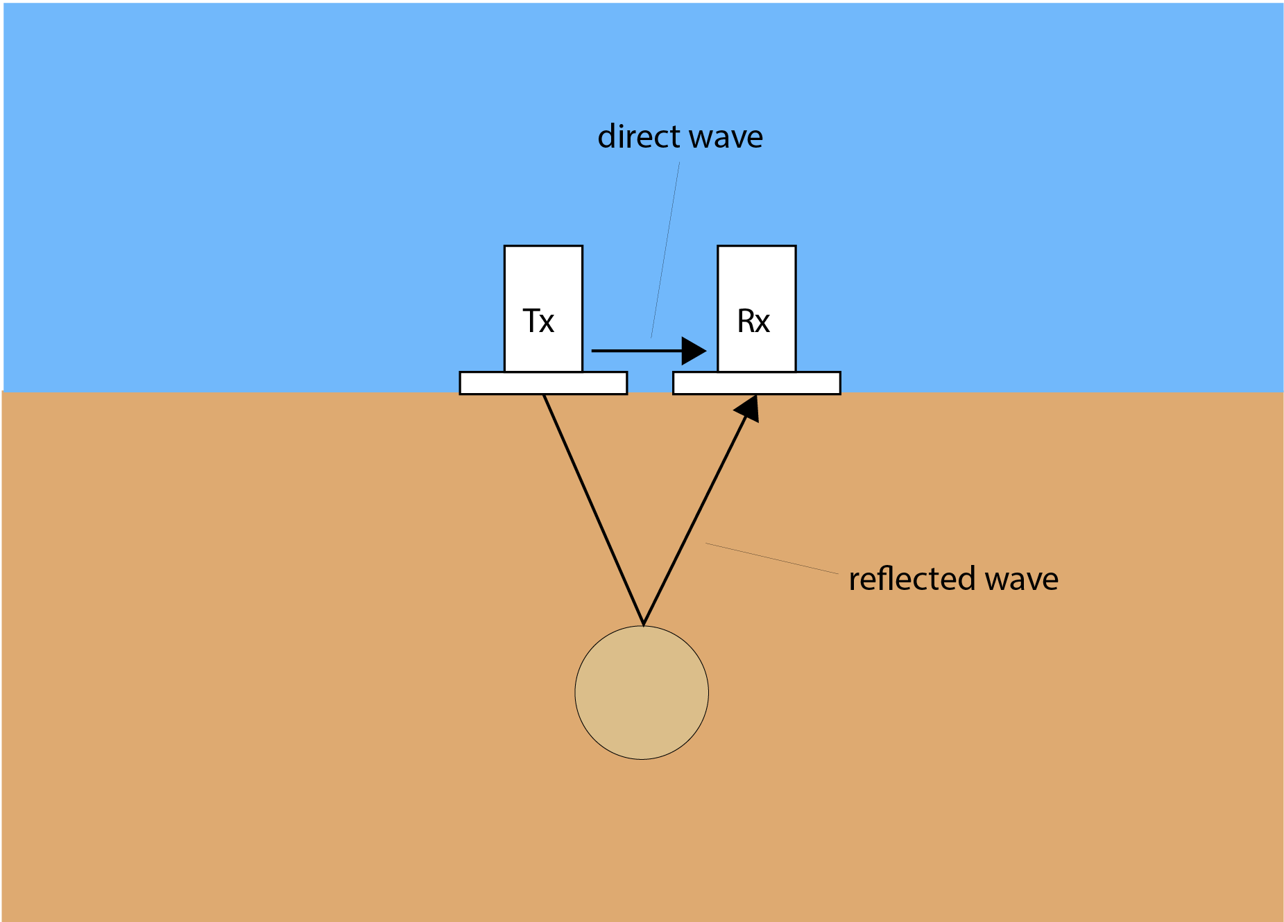
GPR Signal
The Direct Wave
Recall that a GPR consists of a transmitter and a receiver. When the transmitter emits a pulse of energy it moves out in all directions. The receiver records all the signal that comes its way.
The transmitted signal that travels directly from the transmitter, through the air, to the receiver is called the direct wave. It is always the first signal that the receiver records.
The direct wave doesn’t tell us anything about layers or objects in the ground. But it will still appear in the GPR image.

Slide 17
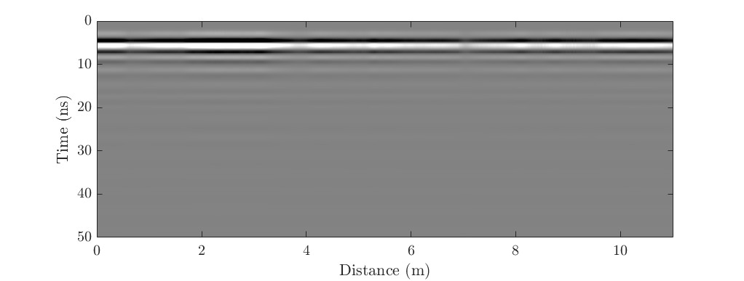
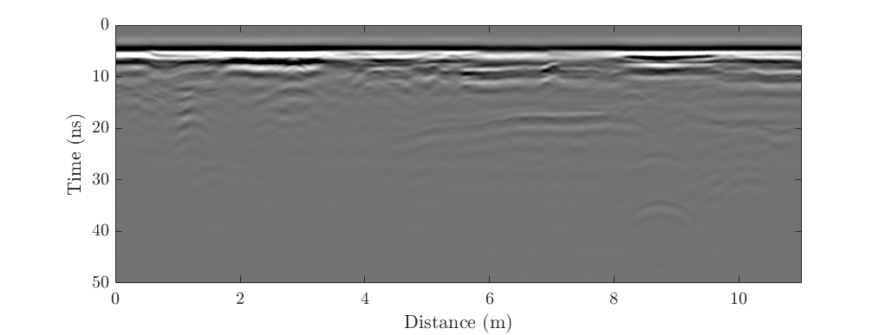
The Direct Wave
A nice, clean, direct wave
A direct wave with interference from shallow objects

Slide 18
Summary
GPR profiles show subsurface features, but the picture is distorted
Point-like objects appear as hyperbolas (upside down “U”s)
Layer boundaries appear with dip directions correct, but the true dip angle may be different from the GPR profile.
The direct wave can overprint real shallow features.
Now we turn to the questions:
What are the factors that control the speed of a wave?
What factors control when a wave reflects?

Slide 19

What Causes GPR Waves to Reflect?

Slide 20
Causes for GPR to Reflect
GPR is very similar to ultrasounds in that a signal is transmitted out
(emitted) and the equipment records the part of the wave that is
reflected.
Reflections occur when the wave encounters a change in
the ground’s electric permittivity, which also controls the ground’s
wave velocity.

Slide 21
Change in… | Examples that cause GPR wave reflection
porosity (amount of air-filled space) | Boundary between: loose sand and compacted sand sediment/rock and an air-filled cavity sediment and hard rock
water saturation | Top of the water table Encountering organic material with a higher water content (i.e., tree roots or buried remains)
composition | Boundary between: sandstone and siltstone rock layers or rock bodies
clay content | Boundary between: sand/silt with little clay and clay-rich sediments
iron content | Encountering a metallic body (GPR waves do not penetrating metal so all of the energy reflects)

Slide 22


Permittivity and Velocity
We now know a change in permittivity causes a GPR wave to reflect. The permittivity (ε) of a material also controls how fast the wave travels through it
$$v=\frac{c}{\sqrt{ε}}$$
Where c is the speed of light ($3×{10}^{8} m/s$)
Note: Overall, GPR waves travel so fast that we report them in meters per nanosecond (m/ns). For reference, a ground velocity of 0.1 m/ns is 223, 700, 000 miles per hour (mph)!

Slide 23
 | Permittivity** (unitless) | Velocity (m/ns)
air | 1 | 0.3*
ice | 3.2–4 | 0.17–0.15
freshwater | 80 | 0.03
saltwater | 70–80 | 0.04–0.03
dry sand | 3–5 | 0.17–0.13
wet sand | 5–20 | 0.13–0.07
saturated sand | 20–30 | 0.07–0.05
dry clay | 5–40 | 0.13–0.05
body tissue | 8 | 0.11
concrete | 4.5–5 | 0.14–0.13
dry wood | 2–6 | 0.21–0.12
metal | + | +
Permittivity of Different Materials
* This is Einstein’s speed of light, c=3*10⁸ m/s, from E=mc².
+ Radar waves do not typically penetrate metal; they completely reflect off metal.
** Note that values of permittivity represent the relative permittivity of a medium, i.e. the ratio of permittivity to the permittivity of free space
* This is Einstein’s speed of light, c=3*10⁸ m/s, from E=mc².
+ Radar waves do not typically penetrate metal; they completely reflect off metal.
** Note that values of permittivity represent the relative permittivity of a medium, i.e. the ratio of permittivity to the permittivity of free space

Slide 24
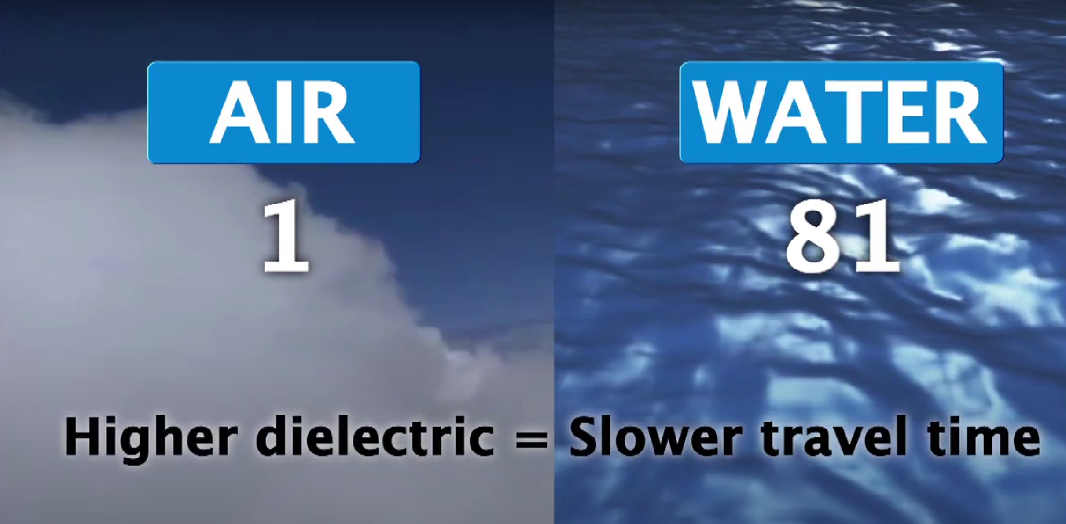
Permittivity = Dielectric
The permittivity is the same property as the dielectric!
Why two names for the same thing?
This happens often in science when ideas are developed by different people at different times.

Slide 25
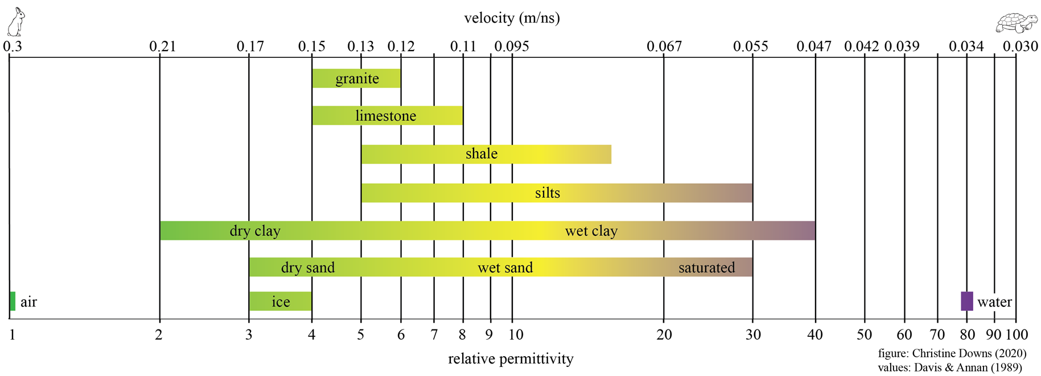
Permittivity and Velocity for Geologic Materials

Slide 26
Causes for GPR to Reflect

Slide 27
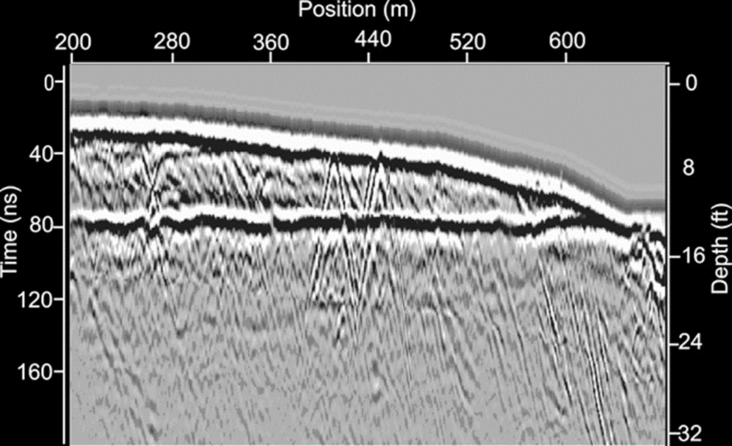
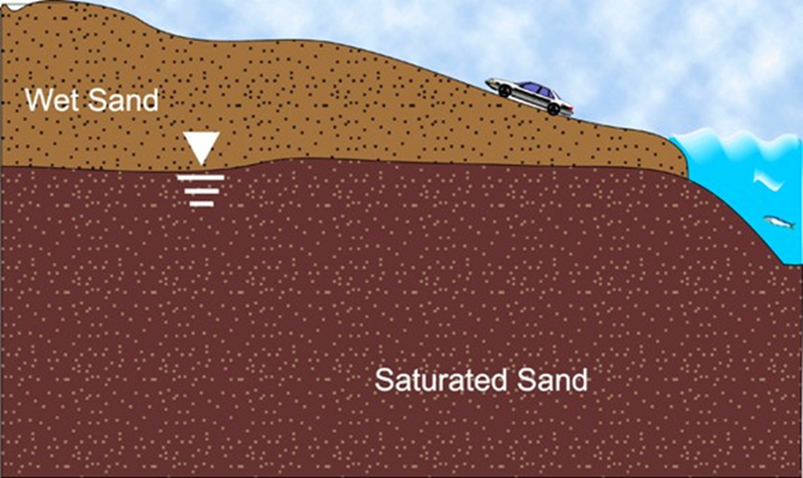
Water Saturation
•Top of the water table
•Encountering organic material with a higher water content (i.e. tree roots or buried remains)

Slide 28
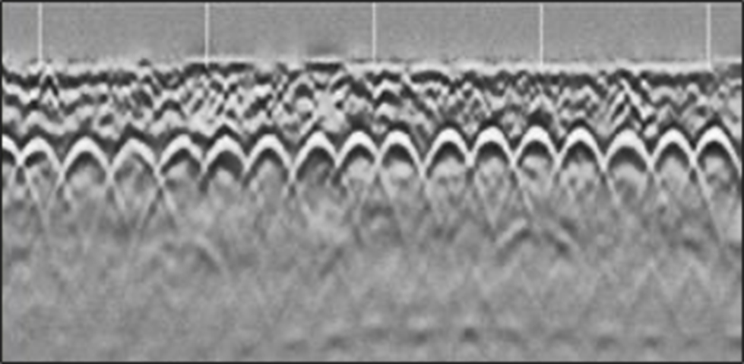
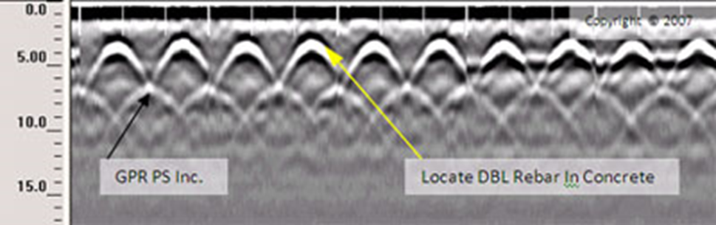
Iron Content
Encountering a metallic body (GPR waves do not penetrate metal so all of the energy reflects)

Slide 29
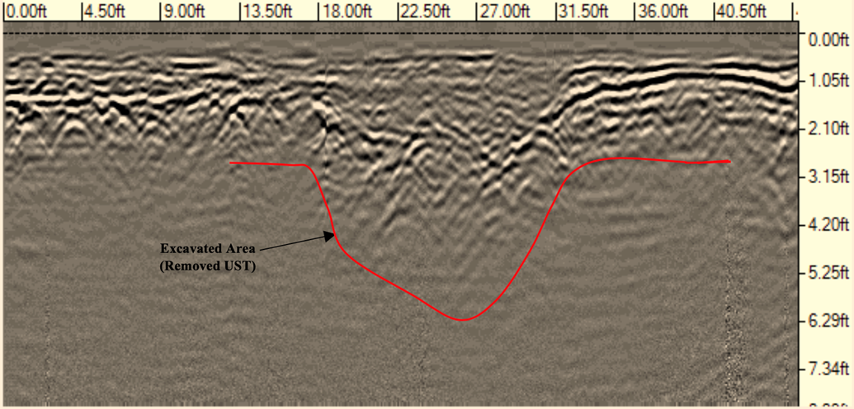
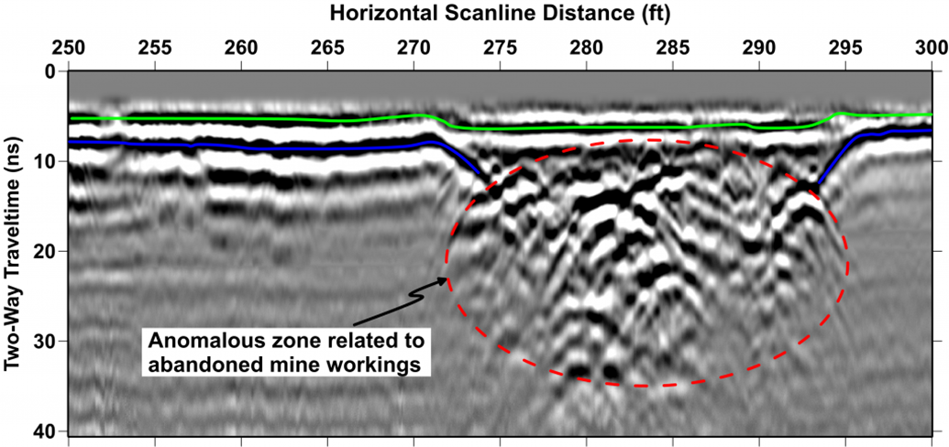
Porosity
Boundary between:
•loose sand & compacted sand
•sediment/rock & an air-filled cavity
•sediment & hard rock

Slide 30
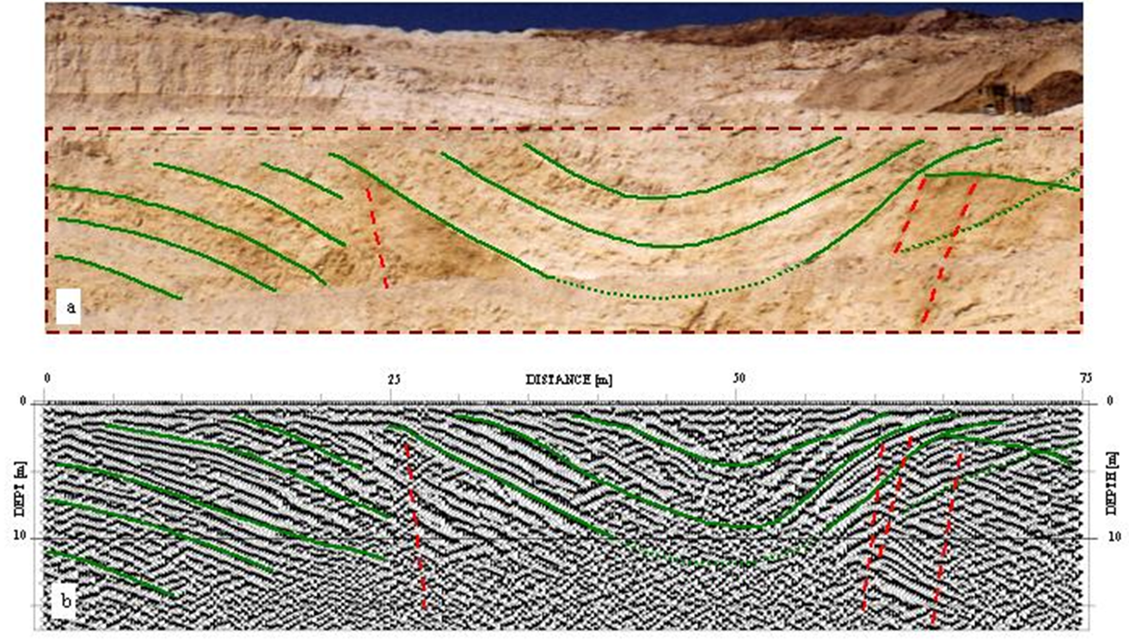
Composition
Boundary between:
•sandstone and siltstone
•rock layers or rock bodies

Slide 31
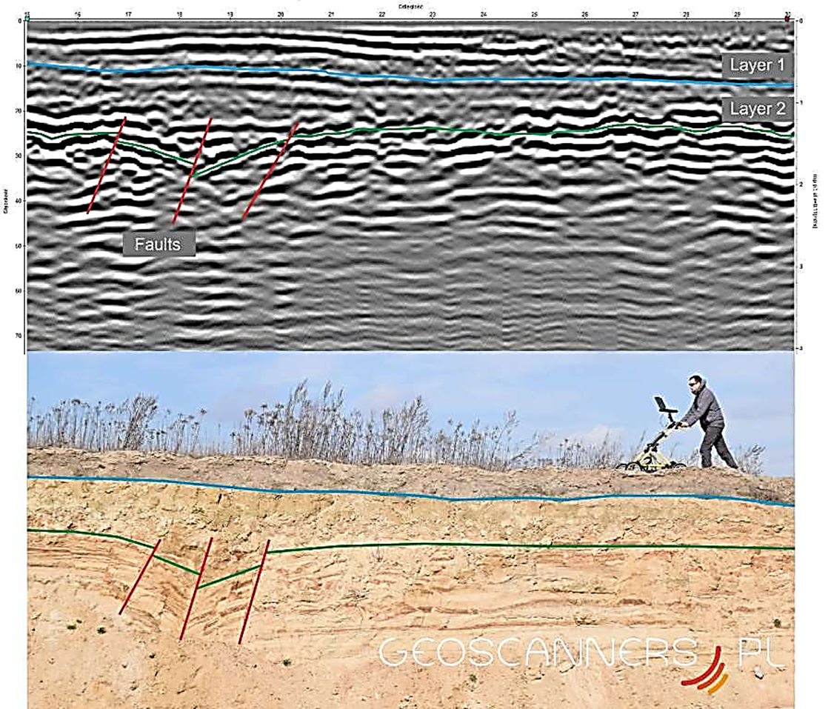
Also Composition
GPR can detect subsurface faults!

Slide 32
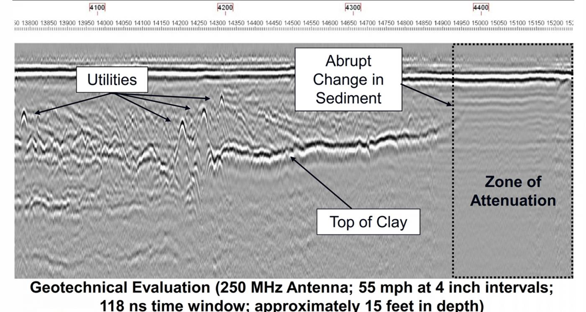
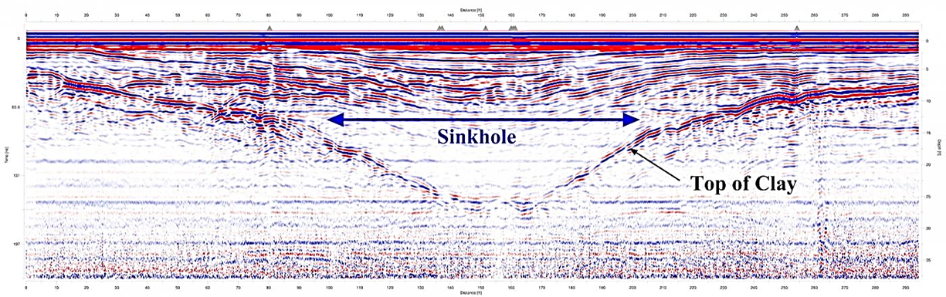
Clay Content
Boundary between:
sand/silt with little clay and clay-rich sediments
We can’t tell just from the GPR data what the layer is made of.
To confirm that it is clay, we’d have to dig or have other information.

Slide 33
Determining Depth
How deep are the features causing the reflections?

Slide 34

Two-Way Travel Time
If we know the ground velocity, we can convert TWTT to depth. And we can estimate the electric permittivity of ground material and compare it to the values for different kinds of materials.

Slide 35
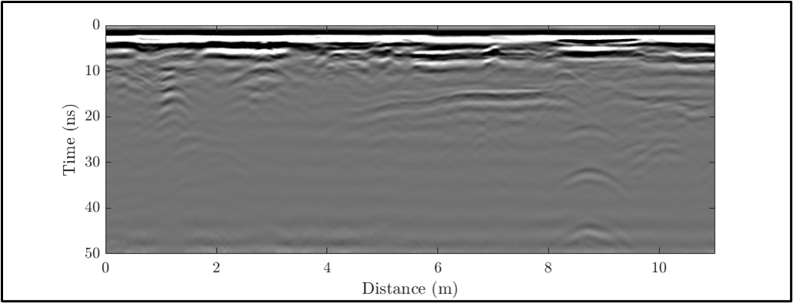
Two-Way Travel Time
In this example, some buried object at about 8.8 meters along the profile produces a diffraction hyperbola with a peak at 31 ns TWTT.

Slide 36
Two-Way Travel Time
But if we don’t know the velocity, the same travel time could be caused by:
Measured TWTT (ns) | If the velocity were (m/ns) | Then the depth would be (m)
31 | 0.05 | 0.78
 | 0.1 | 1.55
 | 0.15 | 2.33
an object at 0.78 m depth with a wave velocity of 0.05 m/ns
an object at 2.33 m depth with a wave velocity of 0.15 m/ns
Or

Slide 37

If the ground velocity is 0.1 m/ns
what is the depth to the top of this diffraction?
What is the two-way travel time at this point?

Slide 38


If the ground velocity is 0.1 m/ns
what is the depth to the top of this diffraction?
TWTT = 15 ns
Depth = $\frac{TWTT}{2}×velocity$
Depth = $\frac{15 ns}{2}×0.1\frac{m}{ns}$
The top of this feature is 0.75 meters below the ground surface.

Slide 39
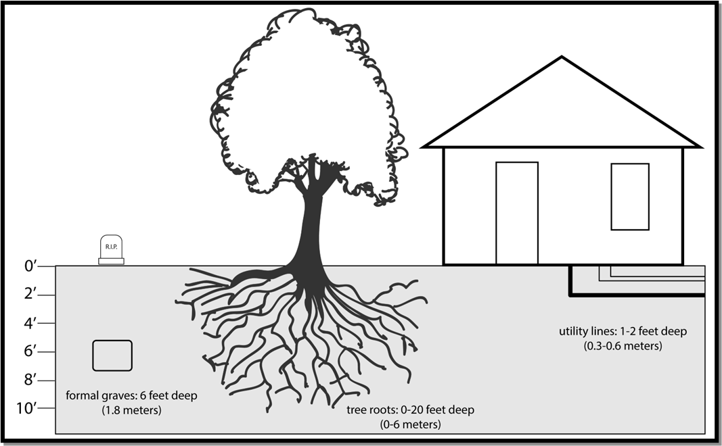
How deep is our target?
Consider the depths that you expect your targets to be. Here are a few common examples:
Utility lines: 1–2 feet (0.3–0.6 meters)
Tree roots: 0–20 feet (0–6 meters)
Graves: 1–6 feet (0.3–1.8 meters)

