Slide 1
Understanding the impact of
uncertainty in experimental
databases on trace element model building
Roger Nielsen
Gokce Ustunisik
South Dakota School of Mines

Slide 2
Much of our knowledge regarding
the differentiation of the
terrestrial planets is based on models
of how trace elements behave.
Such predictive models are calibrated to experimental results and are designed to simulate how differentiation processes influence the trace element composition of natural materials (their geochemical signature).

Slide 3
Sources of uncertainty in
trace element partitioning experiments:
Instrument sensitivity
Achievement of equilibrium
Multiple phases in analytical volume

Slide 4
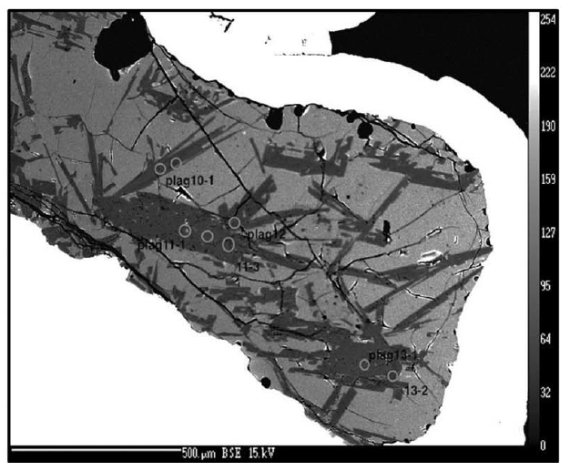
Plagioclase/melt partitioning experiment (TE-32) Nielsen et al. 2017

Slide 5
Nielsen et al 2017 LA-ICP-MS analyses of plagioclase from a single experiment

Slide 6
Nielsen et al 2017 Compilation of Ba partition coefficients

Slide 7
Nielsen et al 2017 Compilation of Pb plagioclase/melt partition coefficients

Slide 8
Betts et al 2026 uncertainty in Sc analyses in olivine

Slide 9
Betts et al 2026 uncertainty in Yb analyses in orthopyroxene

Slide 10
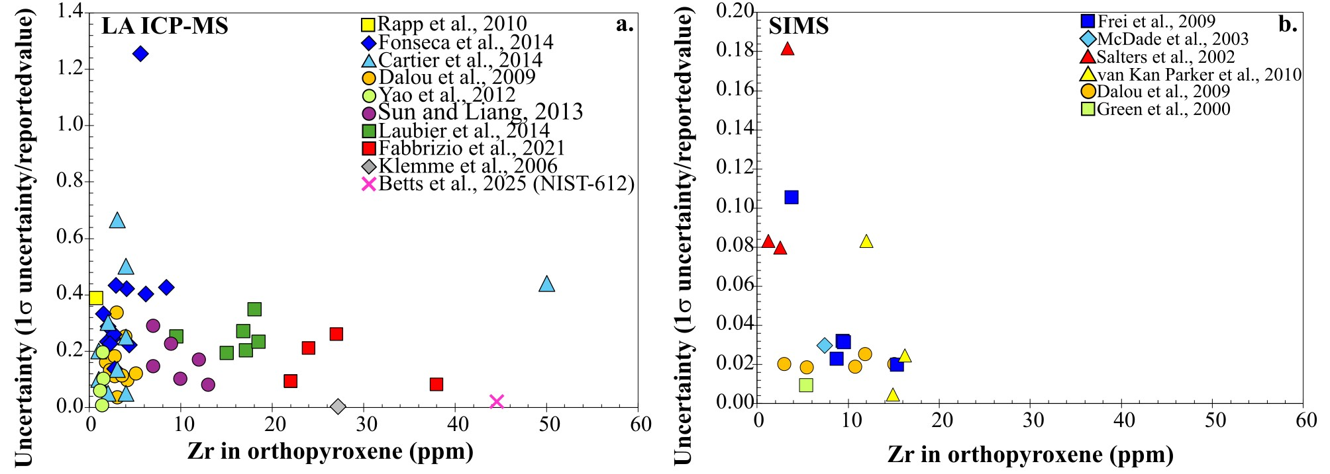
Betts et al 2026 uncertainty in Zr analyses in orthopyroxene

Slide 11
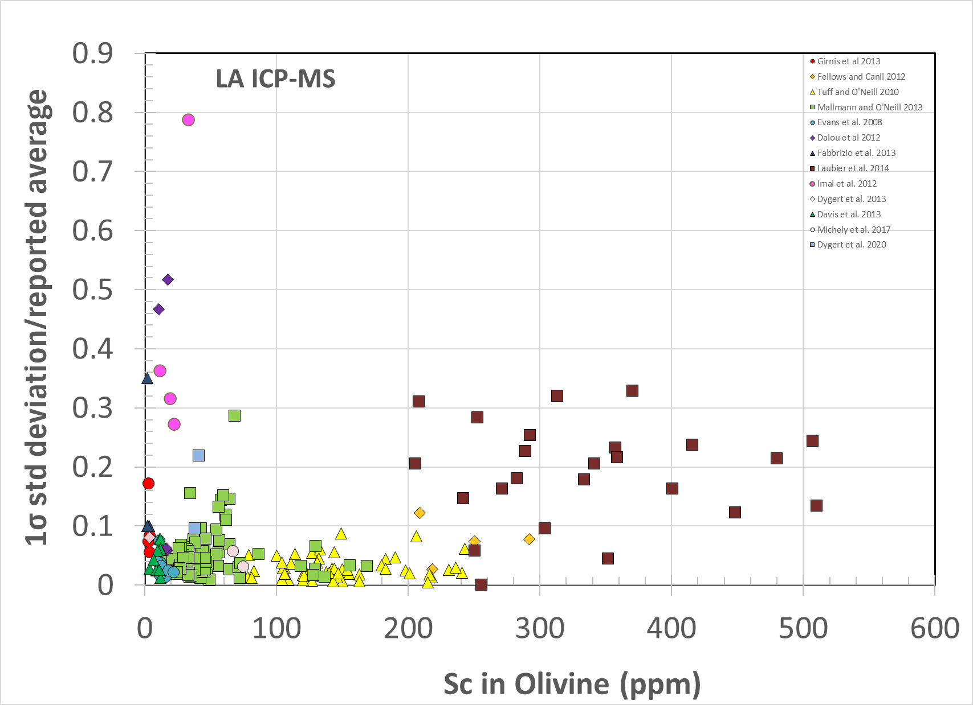
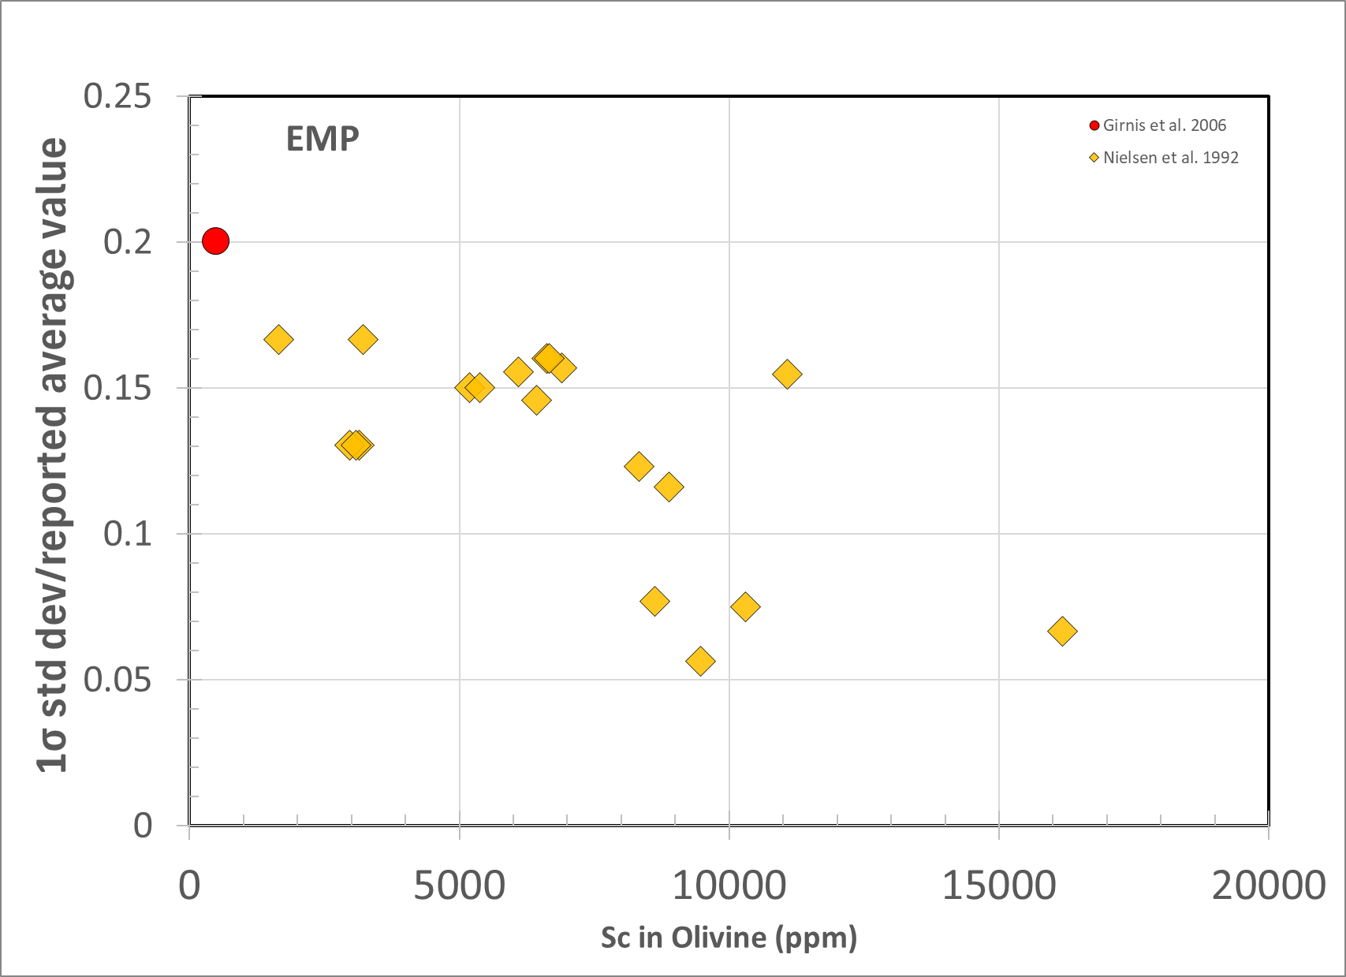
Christiansen 2026 uncertainty in Sc analyses in olivine

Slide 12
Data reduction and processing
may hide the uncertainty implicit in
the raw data
That uncertainty cannot be
“corrected” without access
to the raw data
The extent of contamination
(two+ phases) in the analytical volume
is different for each experiments due to
the fact that the crystal size,
partition coefficients and analytical volume
are different in each experiment

Slide 13
Betts et al 2026

Slide 14
The impact of including
contaminated analyses during
data reduction introduces
a bias in any regression analysis
that is proportional to the
partition coefficient

Slide 15
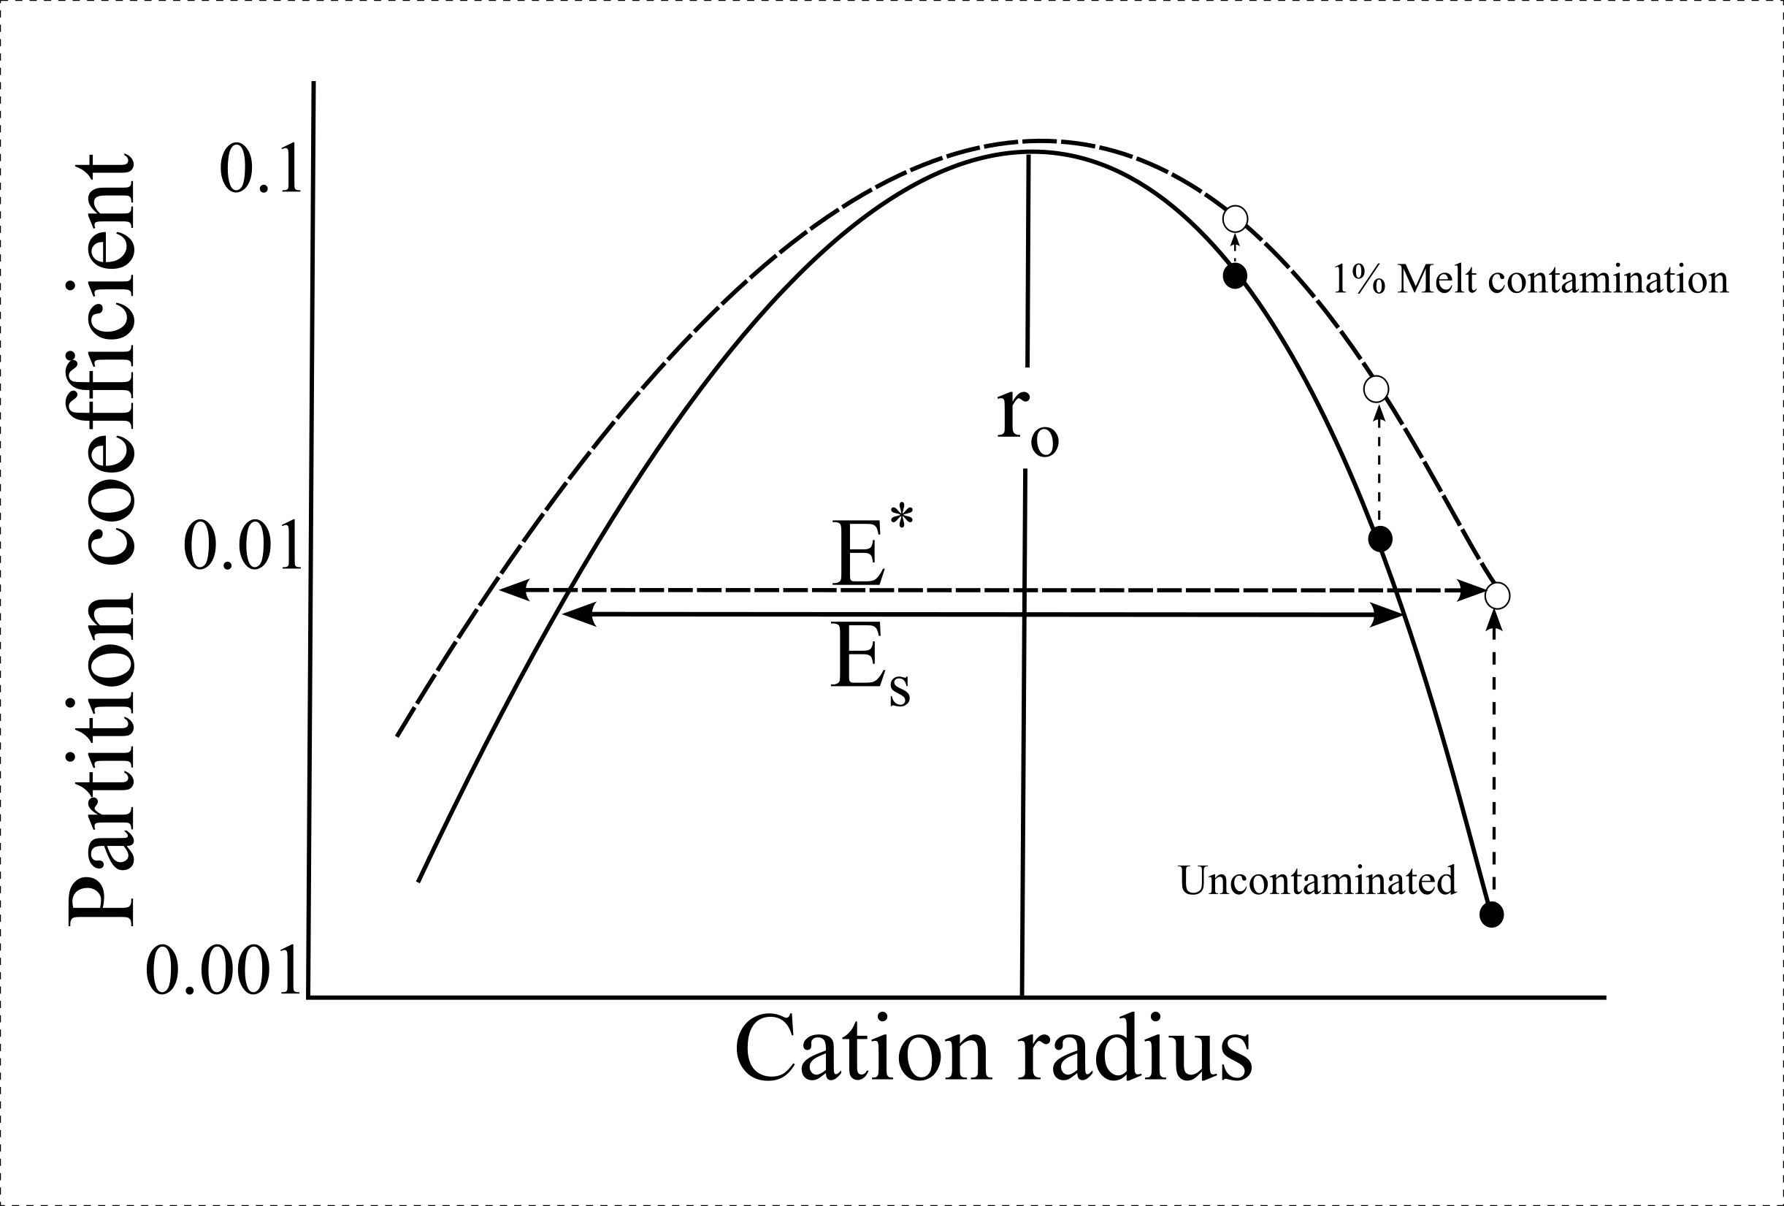
Betts et al 2026

Slide 16
How do we produce an experimental database suitable for petrogenetic modeling?
New best practices recommendations for publication
Individual analyses together with the average and standard deviation of the analyses.
The detection limits for the elements of interests at the relevant set of conditions.
Repeat analyses of a secondary standard as an indicator of the instrument uncertainty (due to reduced influence of heterogeneity and absence of multiple phases).
The results of the application of a projection technique to evaluate the degree to which analyses represent more than one phase.
images of the experimental charges with the analysis spots located on them.
?

Slide 17
Which of the recommendations discussed are:
Possible immediately
Desirable, but secondary
Aspirational
A bridge too far
Other

Slide 18
Betts et al 2026

Slide 19
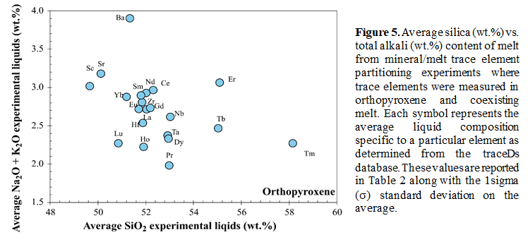
Betts et al 2026

