Slide 1
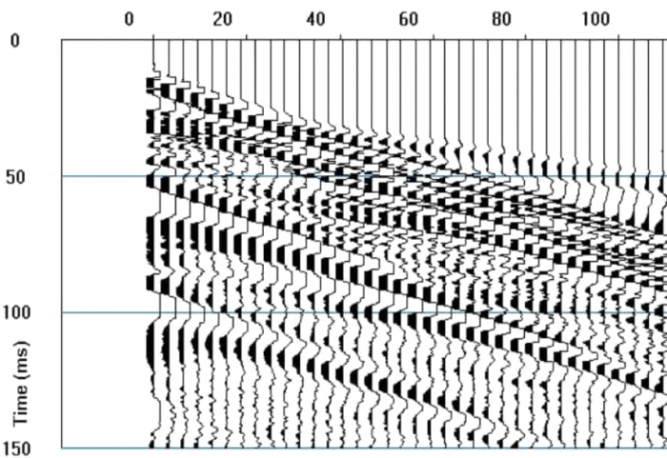
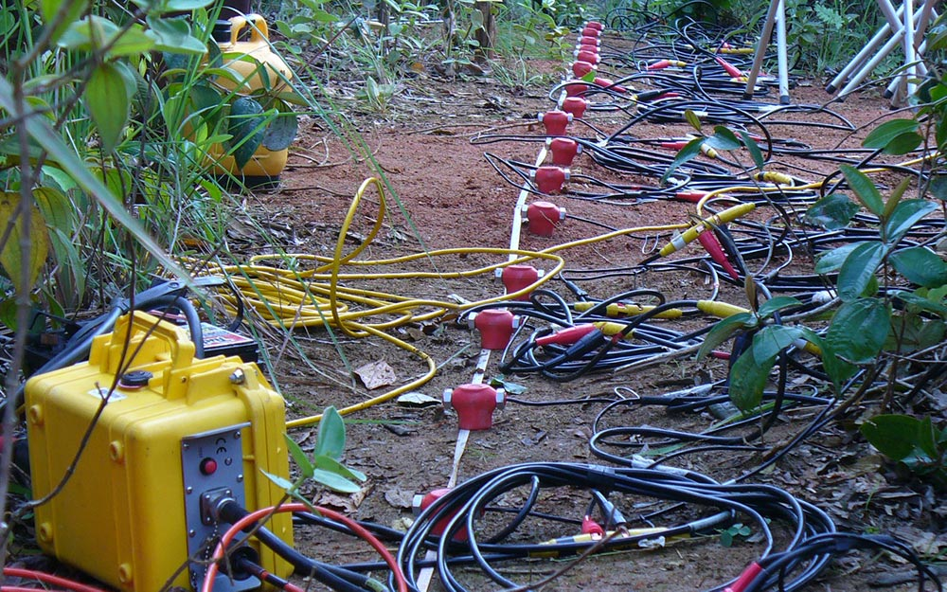
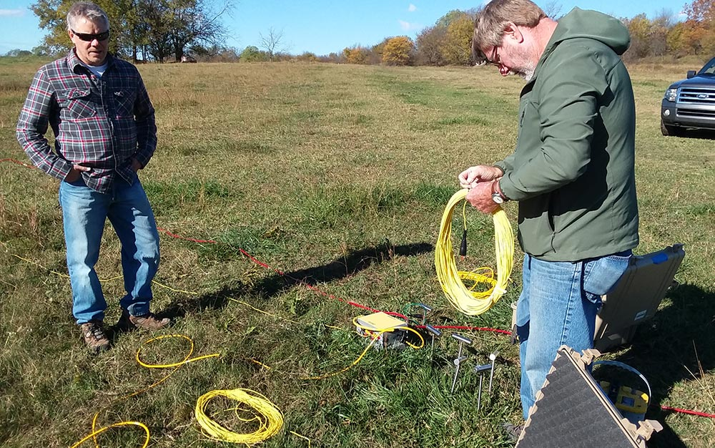
Outline
Shallow Seismic Refraction
4 pm EDT, June 24, 2026, via Zoom
Dr. Lawrence (Larry) Malinconico, Lafayette College
(Acknowledgements to Dr. Andy Parsekian)
geometrics.com

Slide 2
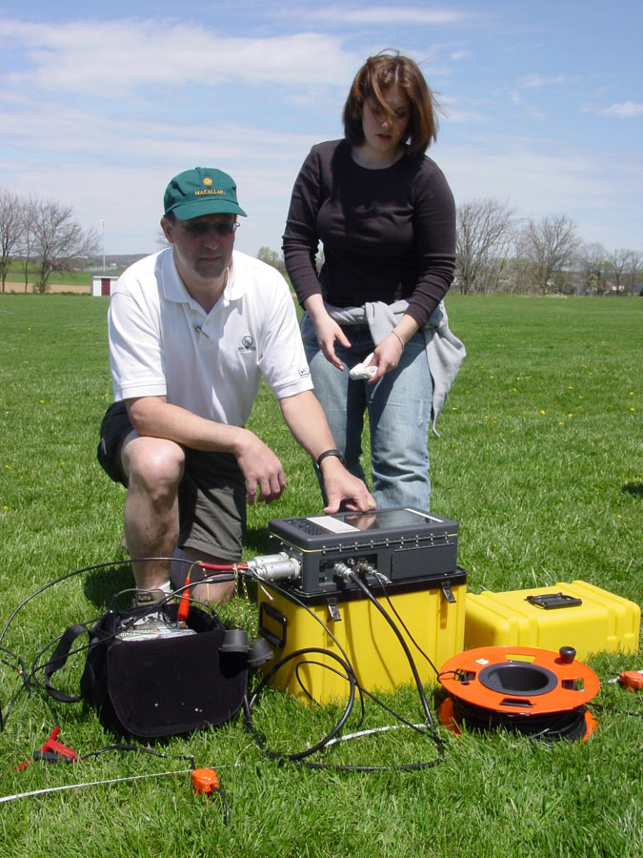
Shallow Geophysics Applications
Shallow (near-surface) geophysics provides a non-invasive, cost-effective way to image the upper tens of meters of the Earth
                Non-destructive & environmentally friendly
                Rapid coverage & cost effective (can optimize follow-on studies)
                Provides accessibility where larger more invasive techniques
    Common uses
    Engineering & Construction
    Geologic and Environmental Studies
    Hyrdogeology
    Archeology
Malinconico
Notes:
Often when environmental scientists, geologists, and engineers need information about what is underground, geophysical measurements are critical for efficiently obtaining data at depth
Digging or drilling is very expensive and time consuming and may be limited because of location
Geophysics can be rapid and obtain information over large areas at low cost

Slide 3
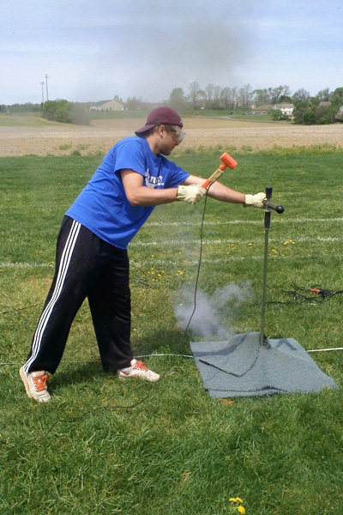
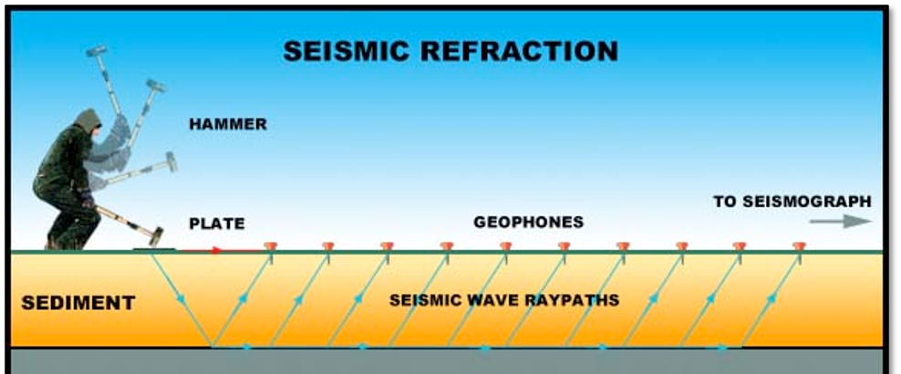
What is Seismic Refraction?
It is a geophysical tool that can be used to determine shallow subsurface structure and other parameters
It uses the passage of energy from either
        passive (earthquakes: Moho) or
        active (hammer, seisgun, etc) energy waves through different geologic materials (active source seismology)
The physical parameter measured is based on wave velocities in the different materials
      velocity is a function of the density and elastic parameters of the material
Malinconico
Notes:
Often when environmental scientists, geologists, and engineers need information about what is underground, geophysical measurements are critical for efficiently obtaining data at depth
Digging or drilling is very expensive and time consuming and may be limited because of location
Geophysics can be rapid and obtain information over large areas at low cost

Slide 4
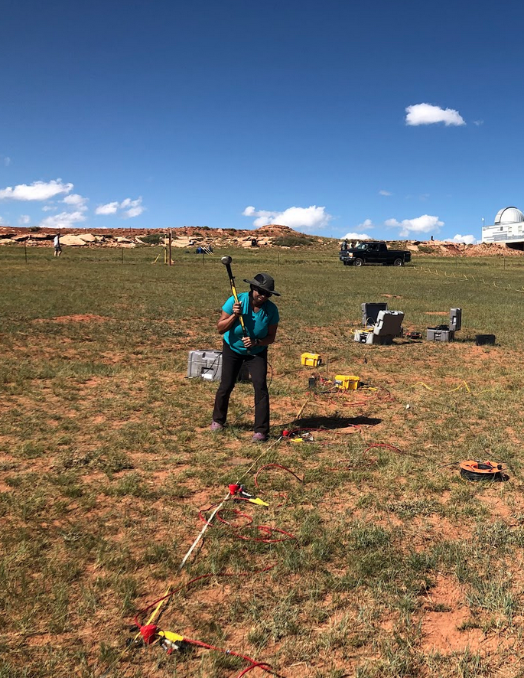
Seismic Refraction
Objectives today: Introduce key concepts to prepare you for hands-on work during the workshop
You should be familiar with:
vocabulary & physical principles;
equation – distance, time ~ subsurface properties;
seismic velocities ~ Earth materials
instrument parts
the workflow you will use for data analysis
Outline
Part 1: Introduction
Part 2: Waves and wave paths
Part 3: Data Acquisition & Processing
Part 4: Additional scenarios
Part 5: Summary Procedures

Slide 5
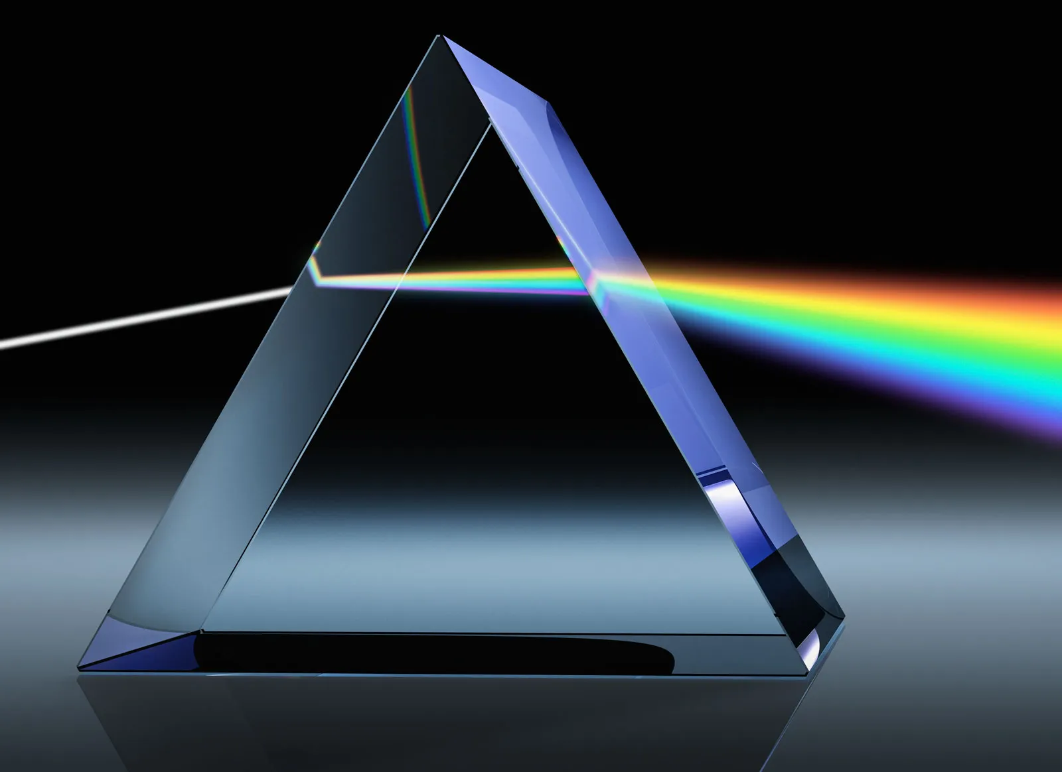
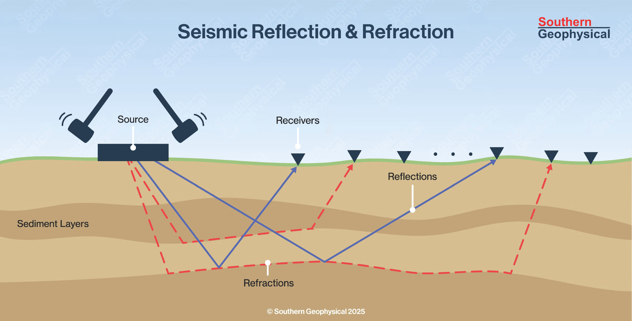
Seismic refraction: the core concept
Refraction is the bending of an energy wave as it passes from one material (medium) into another.
In seismic refraction, “seismic waves”- vibrations in the Earth – may also bend as they pass through different lithologies.
Fundamental parameters are seismic velocity and travel time
This allows for the determination of sub-surface properties and structures.
Notes:
Just like when you look through a glass of water and see how light is bent creating a distortion, sound waves – vibrations known as “seismic waves” in the Earth – also bend.
Seismic refraction geophysics uses the principles of bending waves in the Earth to reveal properties and structures underground.

Slide 6
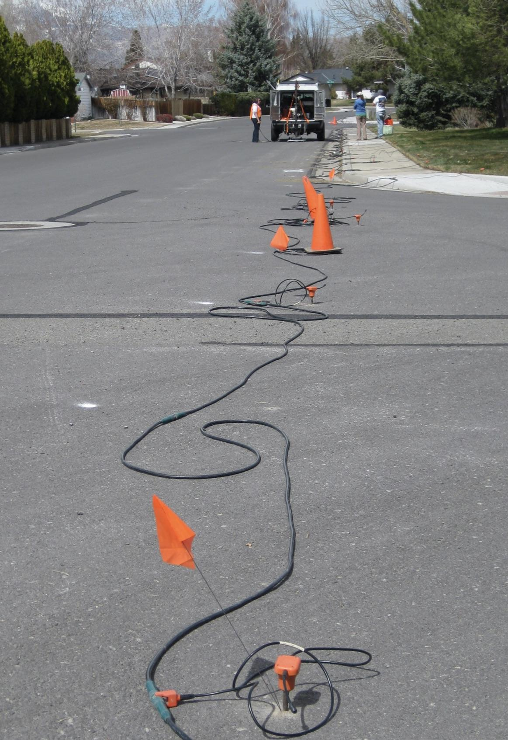
Part 1: Seismic Refraction Introduction
Velocities
Waves
Bedrock
Measurement limitations and advantages
Image credit: J. Louie, University of Nevada-Reno

Slide 7
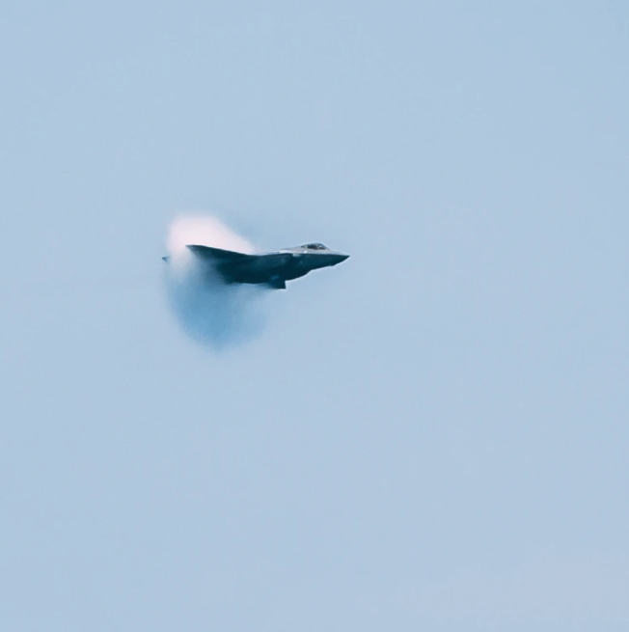
Part 1: Seismic Refraction Introduction
Velocities
In air, sound moves ~ 340 ms⁻¹.
  (1 km = 3sec)
  depends on air density
    temp, humidity, elevation
In solid material
  function of elastic parameters and density
V = d/t
Velocity units - meters per second (ms⁻¹)
Image credit: Stock photo.
Notes:
In air, sound moves at around 340 m/s
This means it takes almost 3 seconds for a sound to travel 1km
This velocity changes slightly depending on the temperature, humidity and elevation, because of small variations in air density
For sounds, we usually record the velocity in units of meters per second.
If you want to add: In theory, if you shouted, you could measure how fast the sound of your voice travels by using a microphone placed across the room to record when the sound has arrived, a tape measure to know how far away the microphone is, and a very accurate stop-watch to observe the elapsed time.

Slide 8
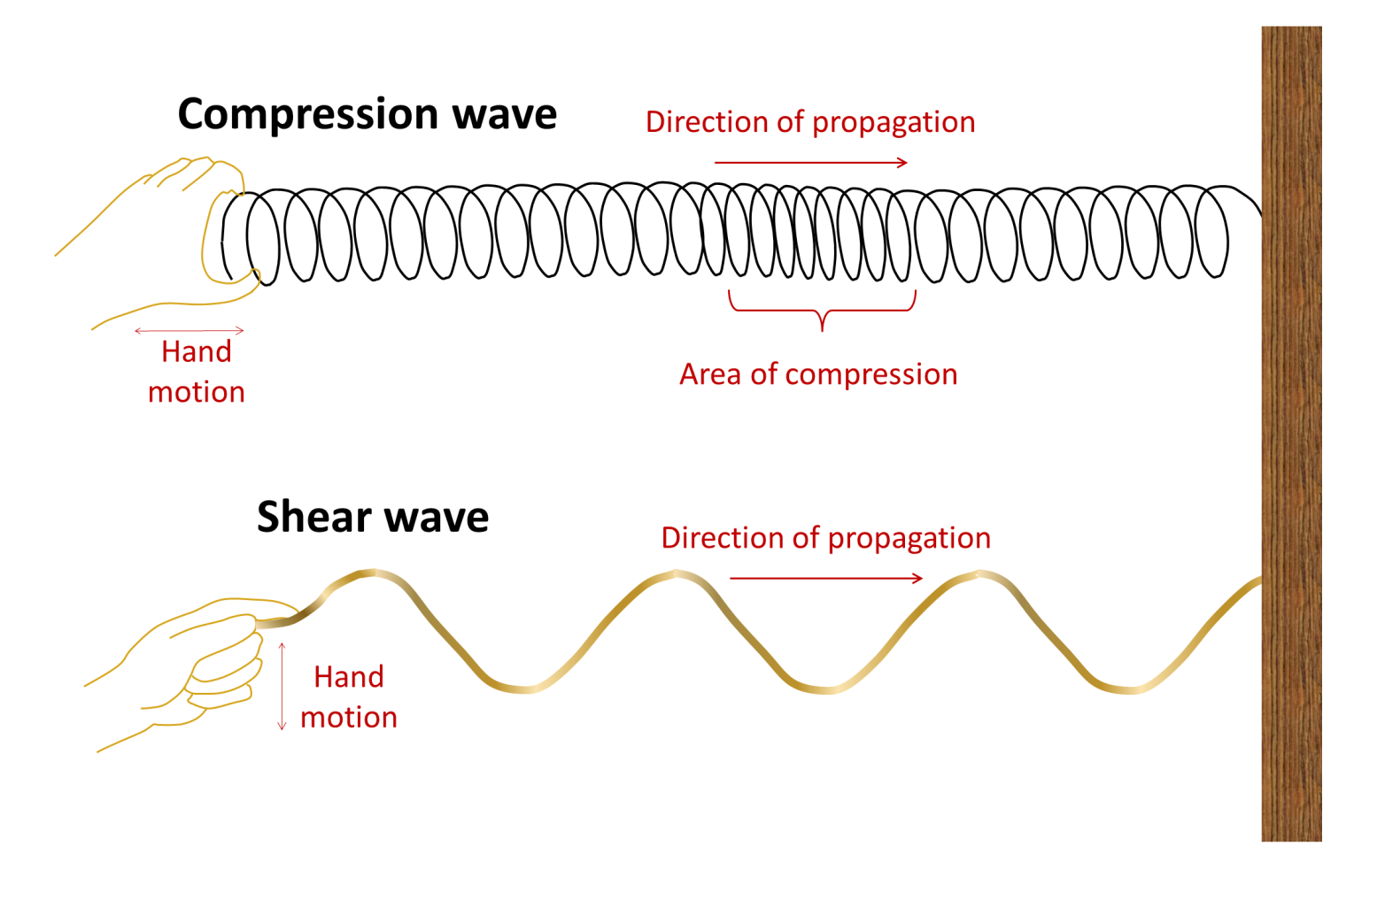
Energy travels as Waves
Part 1: Seismic Refraction Introduction
Wave - an energy disturbance that moves through material
The wave transports energy – not material
  But does cause a displacement of the material
Consider the movement of the Earth’s surface by earthquake waves
P-waves
S-waves
Image credit: Stock photo.
https://opentextbc.ca/physicalgeology2ed/chapter/9-1-understanding-earth-through-seismology/
Notes:
A wave is a disturbance that moves through a material over a distance; in the air we call this “sound”
Sound travels as waves
The particles of the material are not permanently displaced; rather the wave transports energy – not material

Slide 9
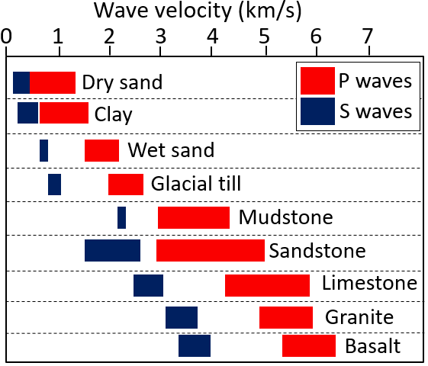
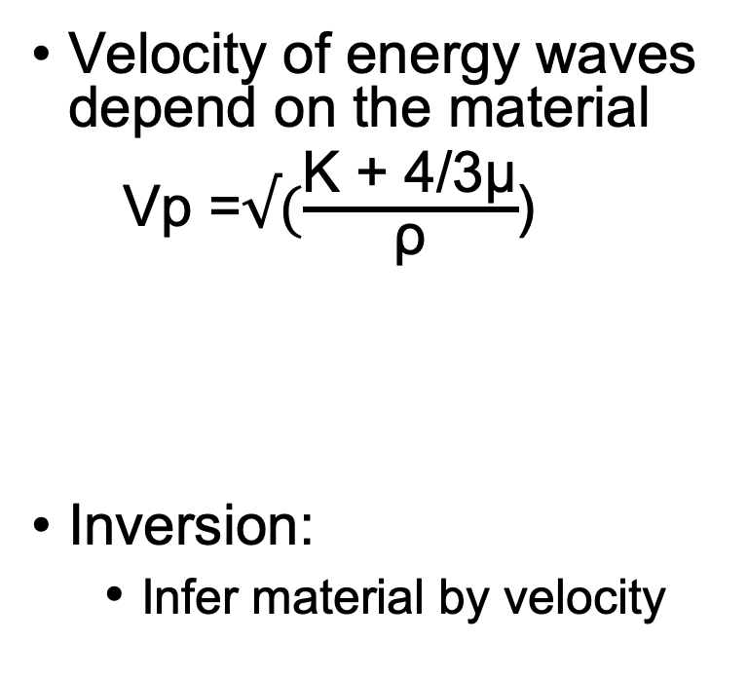
Seismic waves in the Earth
Part 1: Seismic Refraction Introduction
Velocity of energy waves depend on the material
Vp =$√(\frac{\text{K}\text{ + 4/3}\text{μ}}{\text{ρ}}$)
Inversion:
  Infer material by velocity
K = resistance to compression
μ = resistance to shear
ρ = density
Pore Space: Air: .34 km/s, Water; 1.5 km/s
https://opentextbc.ca/physicalgeology2ed/chapter/9-1-understanding-earth-through-seismology/
Notes:
The velocity that a sound wave moves at is different depending on the material
So Different materials support different velocities associated with them
In the Earth, there are materials such as soil, water, and rocks – sound waves usually move faster through Earth materials than through air
We can infer what is in the Earth by the velocity of the wave without having to drill to deep

Slide 10
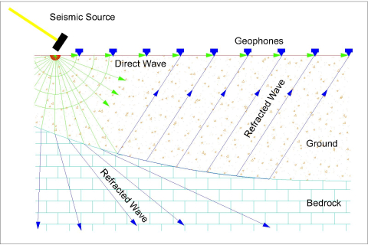
Some refraction opportunities
Part 1: Seismic Refraction Introduction
Depth to bedrock, bedrock topography
  bedrock is the solid & stable layer of rock
  higher velocities than soil
Sediment cover thickness
Perhaps the depth to the water table within the sediment cover
Void detection?
https://ssesb.net/seismicPrinciple.html
Notes:
Geophysicist often want to locate bedrock underground
Bedrock is the solid layer of rock below loose materials such as soil
Bedrock is stable, and therefore very important for buildings, roads, tunnels
Bedrock has different properties than soil, so is also important for underground water, pollution leaking into the ground, and landslides

Slide 11
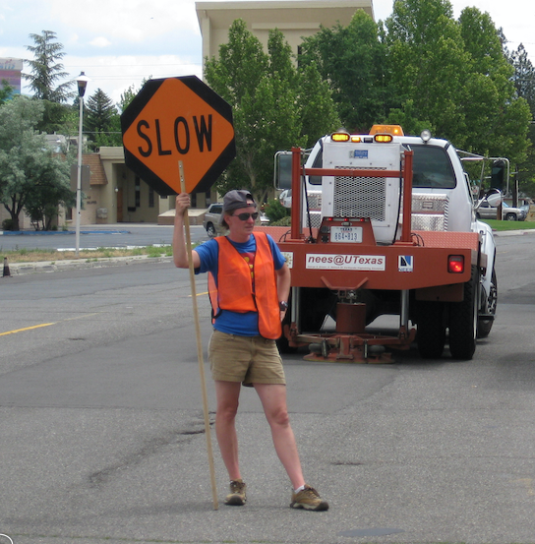
Limitations and advantages of seismic imaging
Part 1: Seismic Refraction Introduction
Advantages
  Cost-Effective
  Rapid Data Collection
  Minimal Crew Requirements
  Non-Destructive Surveying
Limitations
  Velocity inversions
    “hidden” zones
  Blind zones (if the layer is too thin)
  Non-uniqueness:
    based on velocity not “type”
    requires great enough velocity difference
  Depth-resolution tradeoffs
    spacing between geophones
  Environmental & Cultural Noise
    background vibrations
Image credit: J. Louie, University of Nevada-Reno
Notes:
Limtations
Anything else shaking the ground besides the seismic source also causes noise that makes data analysis more difficult: e.g., cars, trains, people…
The locations of roads and buildings may limit where you can place sensors
Due to the details of data analysis, the resulting images are always estimtaes
Advantages
Cost effective on a per-area basis
Does not disturb the subsurface
Saves time by guiding invasive drilling and digging
May retrieve information about depths deeper than could be easily accessed by excavation

Slide 12
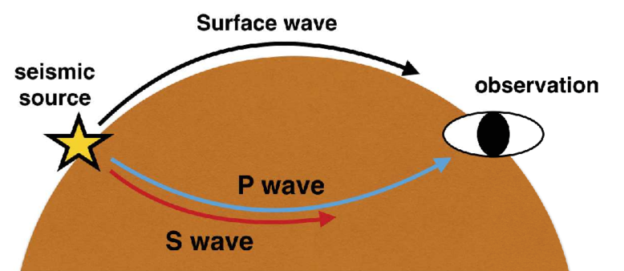
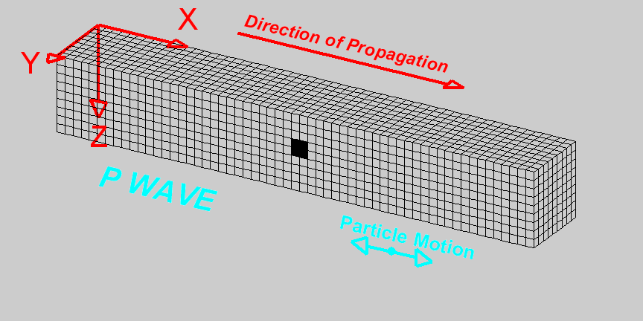
Part 2: Waves and wave paths
When energy is introduced into the ground, several different seismic waves are created
  types of waves are based on
    their path (body versus surface)
    the nature of the vibration (compressional versus shear)
For seismic refraction, we are only concerned with the P-wave (body wave)
“primary” wave
  compressional particle motion
  fastest (first arrival)
Notes:
When sound energy is passed into the ground, it will travel as waves.
The fastest wave is called a “p-wave” and causes compressional movement of the ground

Slide 13
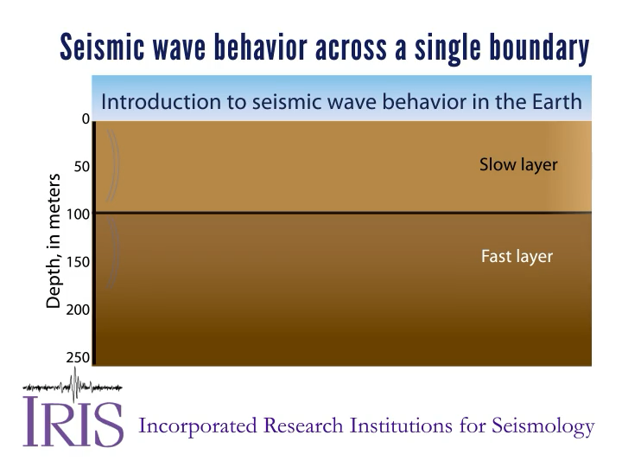
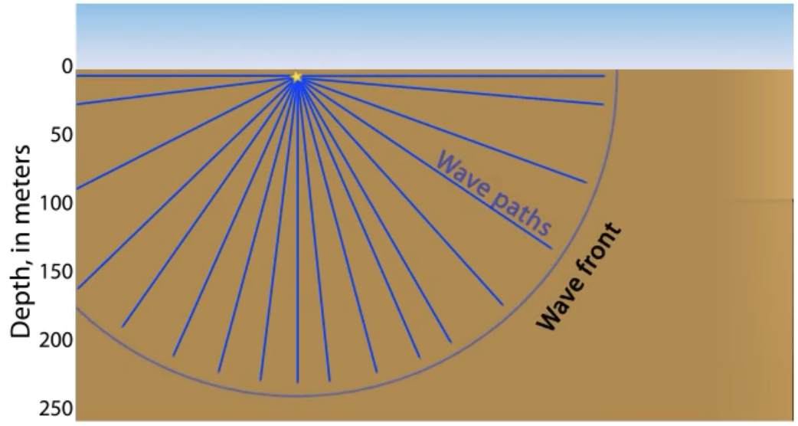
Wave paths
Part 2: Waves and wave paths
Terms
Wave front
  vibrational front
Wave path = Ray
  different paths the vibrations can take
  For our calculations we will be concerned with the paths two different Rays take.
    direct wave
    critically refracted wave
Notes:
When sound energy is passed into the ground, it will travel as waves.
The fastest wave is called a “p-wave” and causes compressional movement of the ground
The speed (velocity) of the wave is determined by the Earth material properties

Slide 14
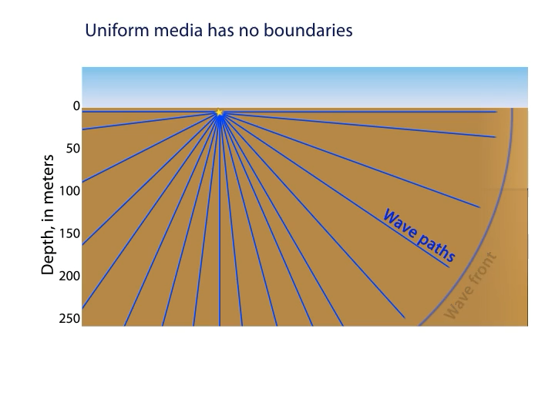
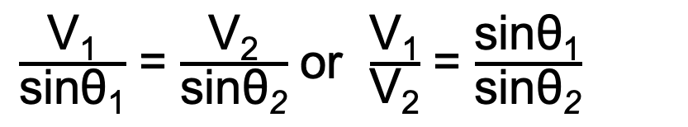
Wave paths
Part 2: Waves and wave paths
θ₁
What happens if a Ray encounters a velocity boundary (i.e. perhaps different lithologies)?
Snell’s Law describes how the Ray will refract based upon the incident angle and velocity differences
v₁
v₂
θ₂
$\frac{\text{V}\text{1}}{\text{sinθ}\text{1}}$ = $\frac{\text{V}\text{2}}{\text{sinθ}\text{2}}$ or $\frac{\text{V}\text{1}}{\text{V}\text{2}}$ = $\frac{\text{sinθ}\text{1}}{\text{sinθ}\text{2}}$
Note: θ = i in the simulation
Notes:
When sound energy is passed into the ground, it will travel as waves.
The fastest wave is called a “p-wave” and causes compressional movement of the ground
The speed (velocity) of the wave is determined by the Earth material properties

Slide 15
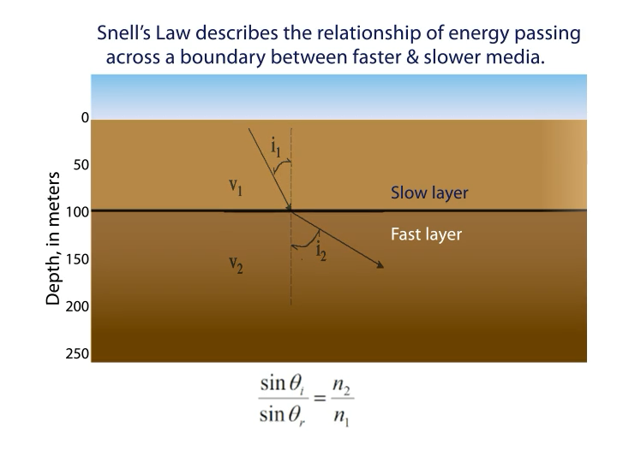
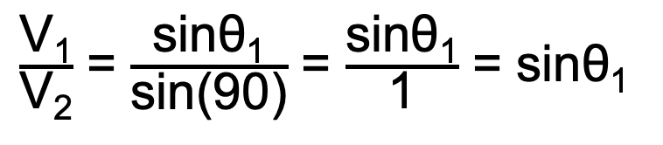
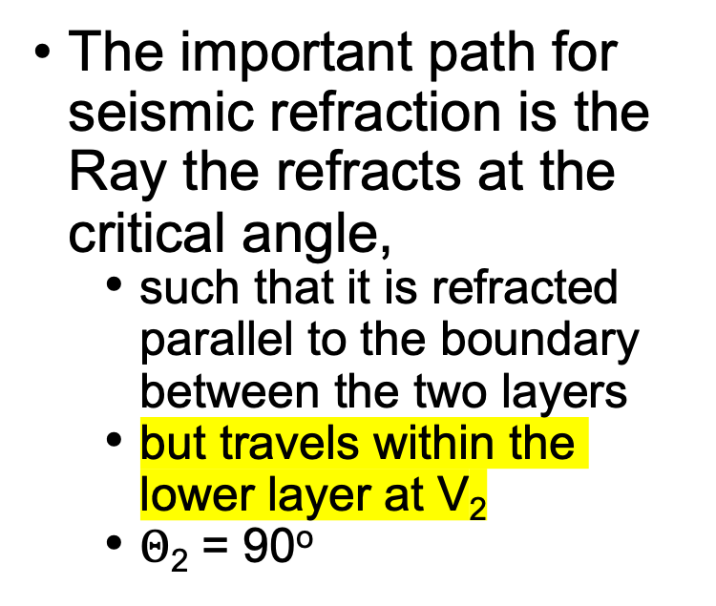
Wave paths
Part 2: Waves and wave paths
The important path for seismic refraction is the Ray the refracts at the critical angle,
  such that it is refracted parallel to the boundary between the two layers
  but travels within the lower layer at V₂
  $Θ\text{2}\text{ = 90}\text{o}$
θ₁
v₁
θ₂
v₂
  Given:
  V₁ = 2000m sec⁻¹ and V₂ = 4000m sec⁻¹
  Determine θ₁ for a critically refracted ray
$\frac{\text{V}\text{1}}{\text{V}\text{2}}$ = $\frac{\text{sinθ}\text{1}}{\text{sin}\text{(90}\text{)}}$ = $\frac{\text{sinθ}\text{1}}{\text{1}}$ = $\text{sinθ}\text{1}$
Critical angle:
Notes:
When sound energy is passed into the ground, it will travel as waves.
The fastest wave is called a “p-wave” and causes compressional movement of the ground
The speed (velocity) of the wave is determined by the Earth material properties

Slide 16
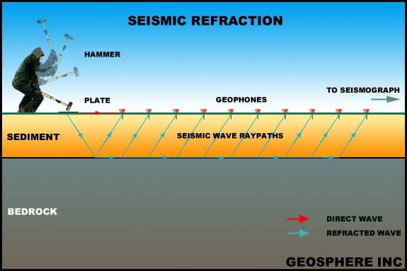
Part 3: data acquisition & processing
What are we trying to learn using seismic refraction?
Thickness(es)
Properties (velocities: V1, V2,…)
What parameters are actually measured during a seismic refraction survey?
TIME and distance

Slide 17
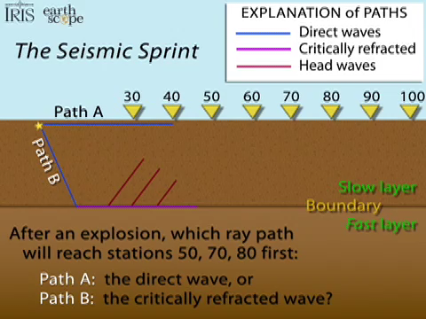
Part 3: data acquisition & processing
What are we trying to determine?
  Thicknesses of layers
Two wave paths to consider arriving at geophone 50
  direct
  refracted
What are we measuring
  Distance (geophones)
  Time (wave arrival @ geophone)
? Which wave will arrive first at a given geophone ?
WHY?
What is this a function of?

Slide 18
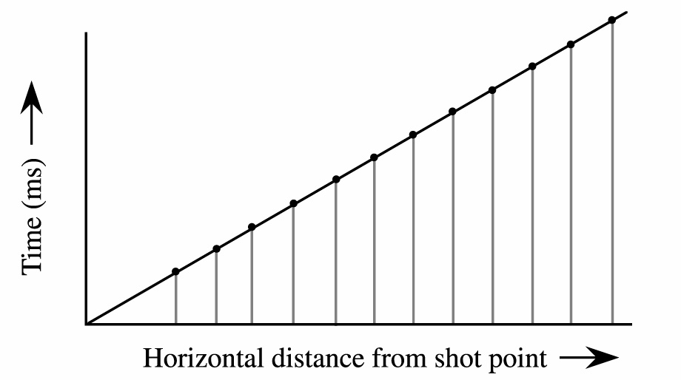
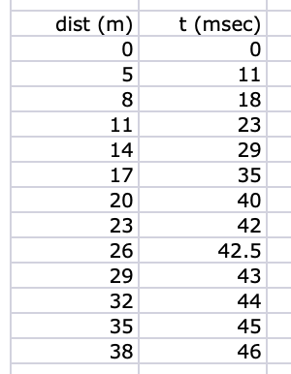
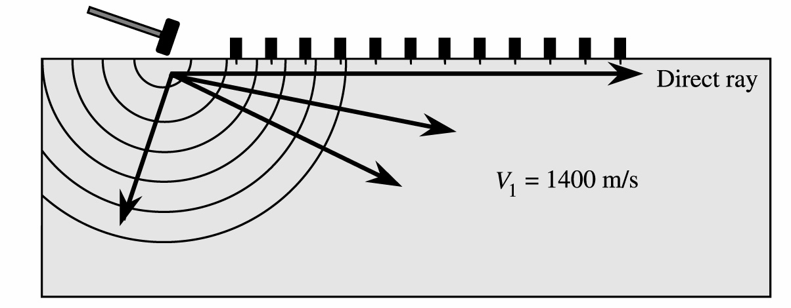
Part 3: data acquisition & processing
Refraction Travel Time Paths:
  Time - distance plots
Direct Wave
  Measure the time to travel from source to geophone
Time - distance plot
  what do we know/measure?
What is the slope of this line?
V₁ = D/t, t/D = 1/V₁

Slide 19
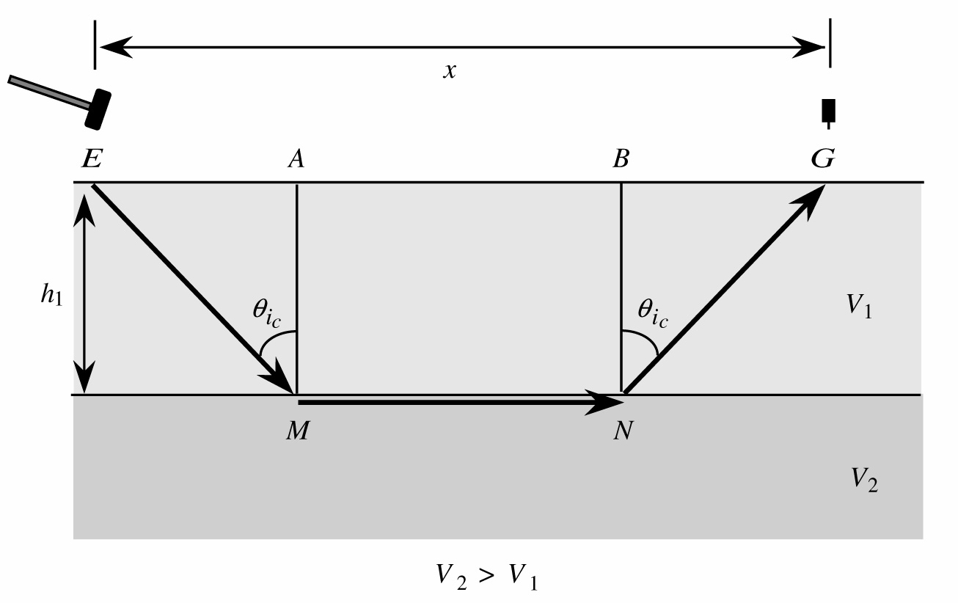
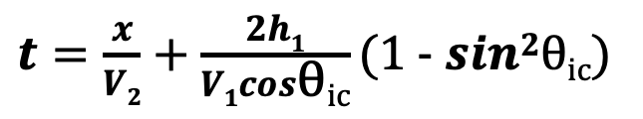
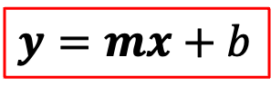
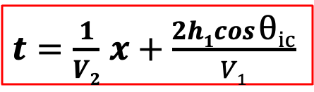
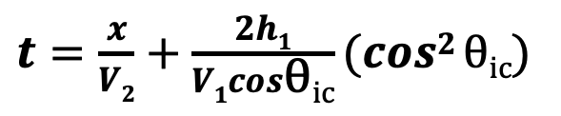
Part 3: data acquisition & processing
Refraction Travel Time: Time - distance plots
$t=\frac{x}{V2}$ + $\frac{2h1}{V1cos\text{θ}\text{ic}}$(1 - $sin2\text{θ}\text{ic}$)
$t=\frac{x}{V2}$ + $\frac{2h1}{V1cos\text{θ}\text{ic}}$($cos2 \text{θ}\text{ic}$)
$t=\frac{1}{V2}$ $x$ + $\frac{2h1cos \text{θ}\text{ic}}{V1}$
$y=mx$ + $b$

Slide 20
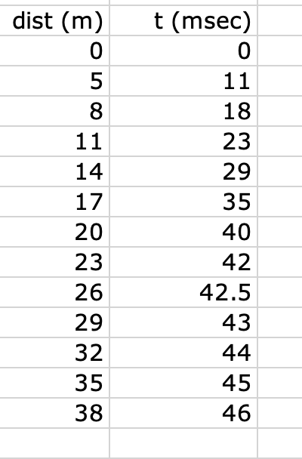

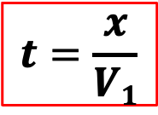
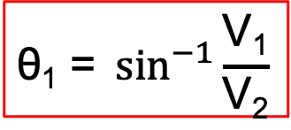
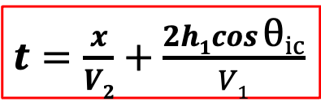
Part 3: data acquisition & processing
Refraction Travel Time Paths: example
$t=\frac{x}{V2}$ + $\frac{2h1cos \text{θ}\text{ic}}{V1}$
$$t=\frac{x}{V1}$$
$$\text{θ}\text{1}\text{ = }\sin^{−1}{\frac{\text{V}\text{1}}{\text{V}\text{2}}}$$
1/V₁ = 2.0575; V1 = 1/2.0575) *1000 = 486 ms⁻¹
1/V₂ = 0.3036; V₂ = 1/.3036 *1000 = 3,294ms⁻¹
$Θ\text{1}$= sin⁻¹(486/3294) = 8.5º

Slide 21
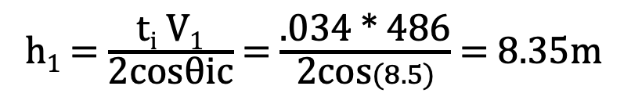
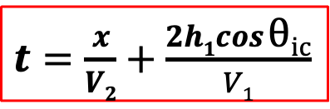
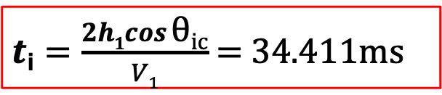

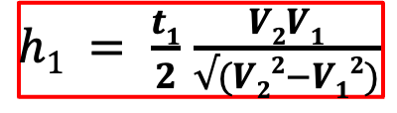
Part 3: data acquisition & processing
Refraction Travel Time Paths: example
1/V₁ = 2.0575; V1 = 1/2.0575) *1000 = 486 ms⁻¹
1/V₂ = 0.3036; V₂ = 1/.3036 *1000 = 3,294ms⁻¹
$Θ\text{1}$= sin⁻¹(486/3294) = 8.5º
What’s missing? → thickness
$t=\frac{x}{V2}$ + $\frac{2h1cos \text{θ}\text{ic}}{V1}$
$t$_{i} $=\frac{2h1cos \text{θ}\text{ic}}{V1}$ = 34.411ms
h₁ = $\frac{\text{t}\text{i} \text{V}\text{1}}{\text{2}\text{cosθic}}$ = $\frac{\text{.034 ∗} \text{486}}{\text{2}\text{cos}(8.5)}$ = 8.35m
$h1 = \frac{t1}{2}$ $\frac{V2V1}{√(V22−V12)}$

Slide 22
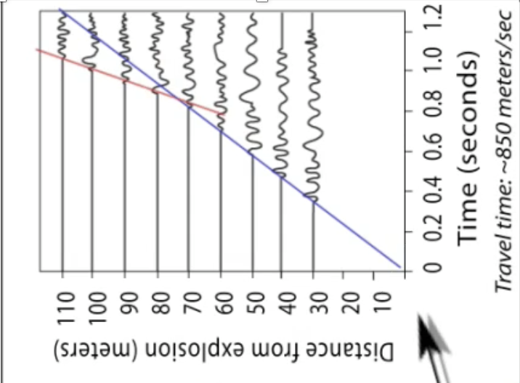
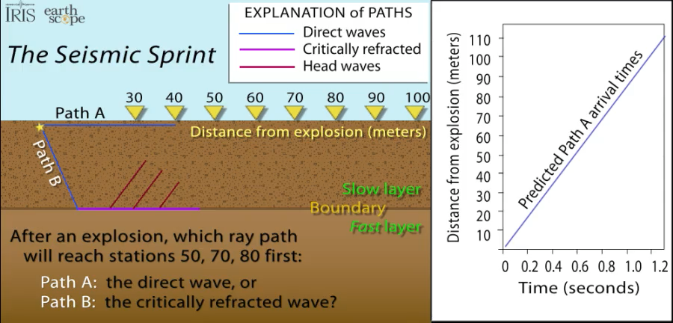
Part 3: data acquisition & processing

Slide 23
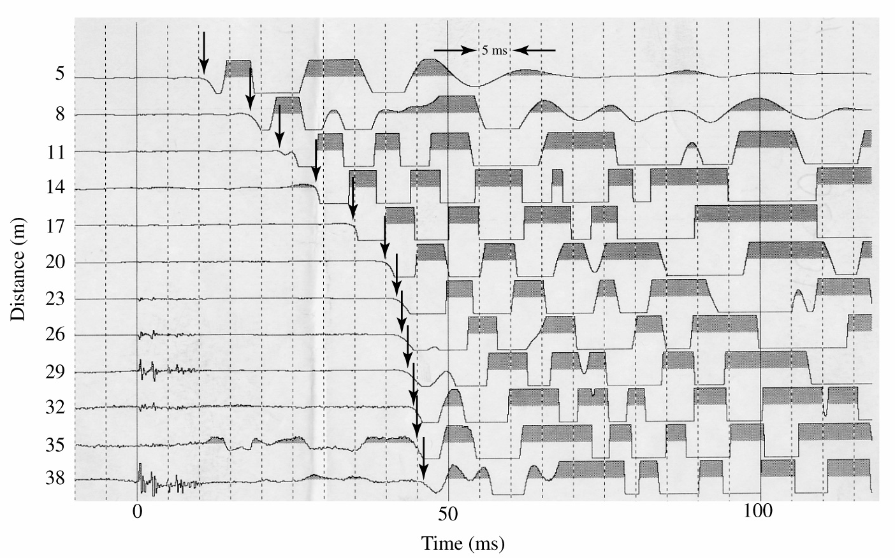
Seismic Methods
Field Plots
Direct Wave
Refracted Wave

Slide 24
Part 3: data acquisition & processing
Field Plots
Direct Wave
Refracted Wave

Slide 25
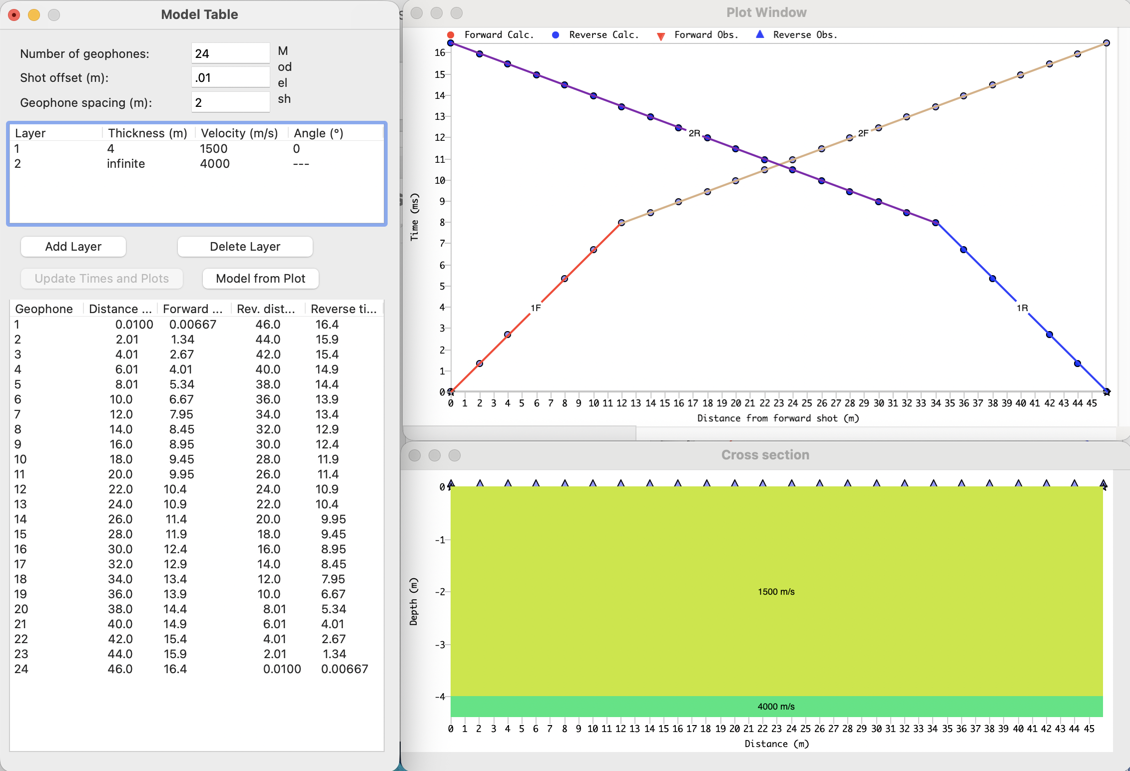
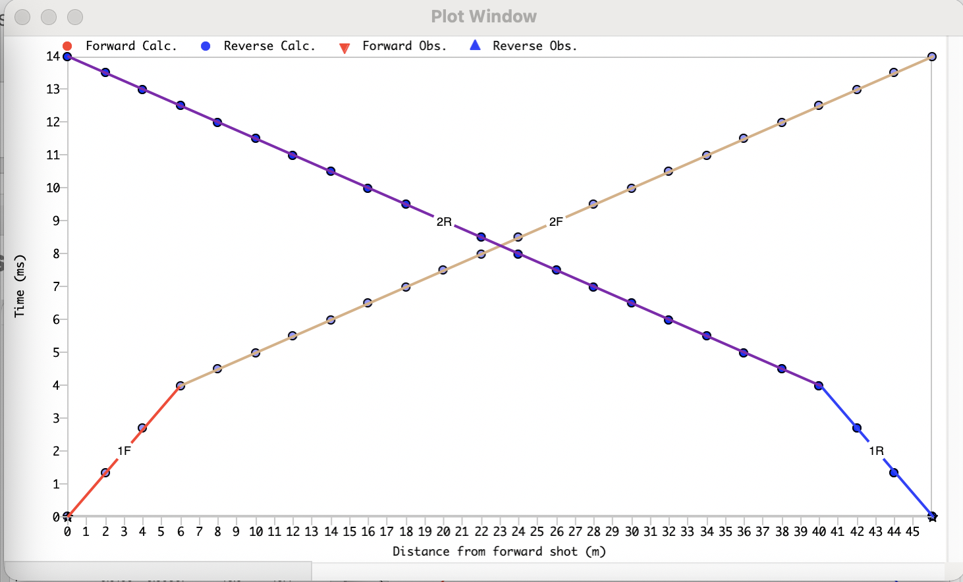
Part 3: data acquisition & processing
Let’s do some thought experiments
How does this plot change if the thickness is less?
2m instead of 4
Why?

Slide 26
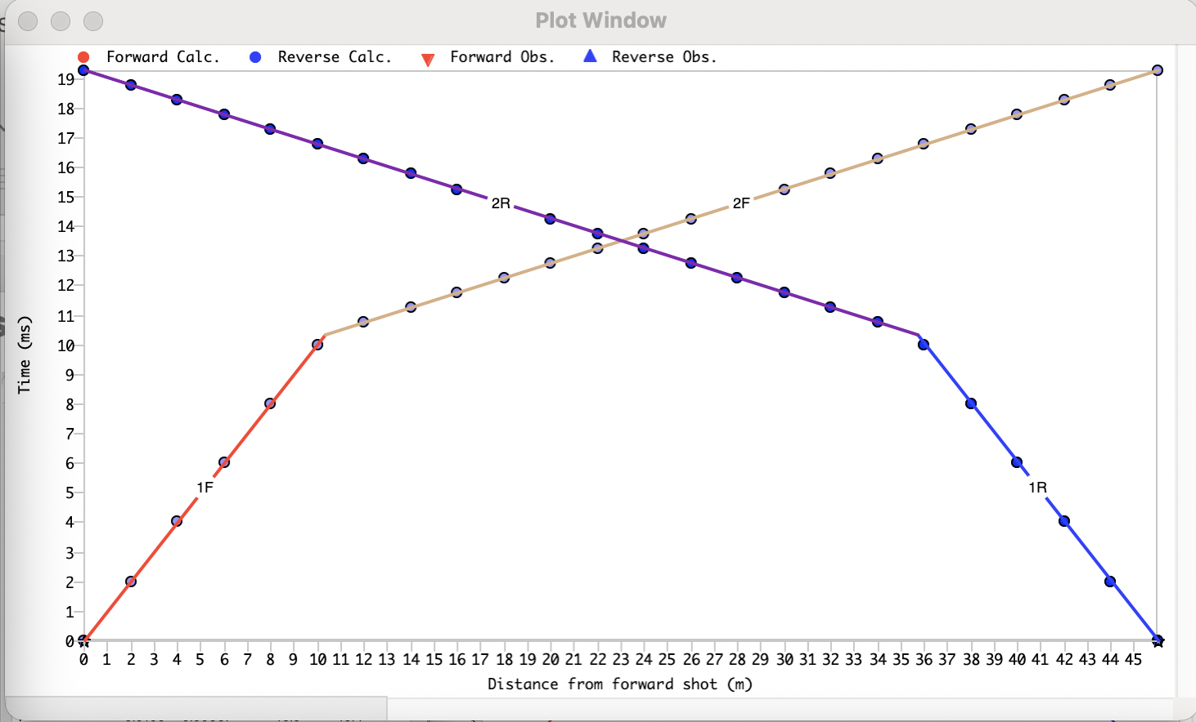
Part 3: data acquisition & processing
Let’s do some thought experiments
How does this plot change if V₁ is less?
1000m/s instead of 1500m/s
Why?
1,000m/s

Slide 27

Part 3: data acquisition & processing
Let’s do some thought experiments
How does this plot change if V₂ is less?
6000m/s instead of 4000m/s
Why?
6,000m/s

Slide 28
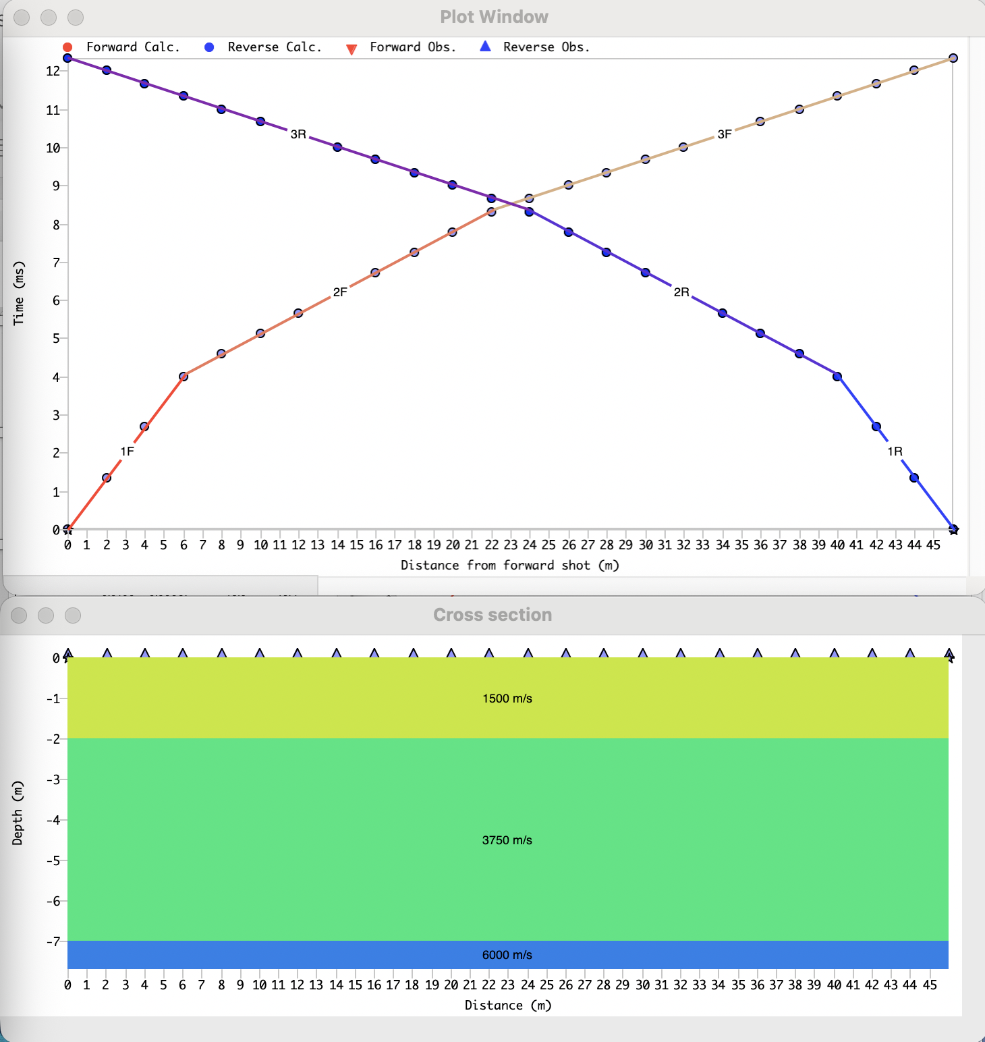


Part 4: additional scenarios
Multiple Layers
Calculate V₁, V₂ & V₃
Determine t_{i1}, t_{i2}

Slide 29




Part 4: additional scenarios
Refraction Travel Time Paths: multiple horizontal layers
t = 2*$\frac{\text{EP}}{\text{V}\text{1}}$ + 2* $\frac{\text{P}\text{R}}{\text{V}\text{2}}$ + $\frac{\text{R}\text{S}}{\text{V}\text{3}}$ Simplify:
= $\frac{\text{RS}}{\text{V}\text{3}}$ + (2* $\frac{\text{PR}}{\text{V}\text{2}}$+ 2*$\frac{\text{EP}}{\text{V}\text{1}}$) (y = mx +b)
t = x/V₃ + (2h₁ $\frac{\text{cosθ}\text{i}}{\text{V}\text{1}}$ ) + (2h₂ $\frac{\text{cosθ}\text{ic}}{\text{V}\text{2}}$)
$h2=\left(ti2 \right.$- $\frac{2h1∗√\left(V32−V12 \right)}{V3V1 }\left. \right)∗\frac{V3V2}{2√\left(V32−V22 \right)}$
Remember
$h1=\frac{ti1V1}{2cos∅ic } =(\frac{ti1 }{2}$)*($\frac{V2V1}{√(V22−V12)})$

Slide 30


Part 4: additional scenarios
Refraction Travel Time Paths: dipping layers
→ Requires shots done at each end of the line
m_{u}
m_{d}
1/V₁
1/V₁

Slide 31




Part 4: additional scenarios
Refraction Travel Time Paths: dipping layers
Dipping-layers
Parameters:
V₁ = ???
1/V_{u} = m_{u}
1/V_{d} = m_{d}
V₂ = V₁/sin($θic$)
$$θic = \frac{\sin^{−1}\left(V1md\right)+\sin^{−1}\left(V1mu\right)}{2}$$
$$β = \frac{\sin^{−1}\left(V1mu\right)−\sin^{−1}\left(V1md\right)}{2}$$
j_{d} = t_{id}V₁/2cosθ_{ic}
j_{u} = t_{iu}V₁/2cosθ_{ic}
h_{d} = j_{d}/cosβ
h_{u} = j_{u}/cosβ

Slide 32

Part 4: additional scenarios
Refraction Travel Time Paths: dipping layers
While it is possible to:
do the calculations manually,
Most interpretation is now done with modeling applications
inversion: create a model from the observed data

Slide 33

Part 4: additional scenarios
Refraction Travel Time Paths: dipping layers
Most interpretation is now done with modeling applications
inversion: create a model from the observed data
fit lines to the observed data – calculate the model

Slide 34


Part 5: Summary
Step 1: Survey Design & Planning
Define Objectives: Determine the required depth of investigation. Survey lines must typically be 3 to 5 times longer than your target depth.
Lay Out the Profile: Mark and clear a straight survey line on the ground surface
Step 2: Field Data Acquisition
Place Geophones: Deploy a line of geophones into the ground at equal, predefined intervals (e.g., 2 to 10-meter spacing) and connect them to a seismograph.
Position Seismic Sources: Set up impact points (e.g., sledgehammer, weight drop, or explosives) at the ends of the geophone line (forward and reverse shots) and at several intermediate points (offset shots).
Record Data: Trigger the energy source and record the exact time it takes for the seismic wave to reach each geophone (known as "first breaks")

Slide 35

Part 5: Summary
Step 3: Data Processing & Interpretation
Pick First Arrivals: Review the recorded waveforms on a seismograph to mark the exact arrival time of the first seismic wave at each geophone.
Plot Time-Distance Graphs: Create a graph plotting distance (offset from the shot) on the x-axis and arrival time on the y-axis.
Identify Layer Velocities: Draw straight line segments through the plotted points. The inverse slope (1 ÷ slope) of each line segment represents the seismic wave velocity (V) of a distinct subsurface layer.

Slide 36

Part 5: Summary
Step 3: Data Processing & Interpretation
Determine Layer Thickness: Use the crossover distances (where the slope of the plotted line changes) and the calculated velocities in standard refraction formulas (e.g., the intercept-time method or generalized reciprocal method) to calculate the depth and thickness of each layer.
Geological Modeling: Convert the mathematical velocities and thicknesses into a continuous 2D geologic cross-section, which can be correlated with nearby borehole data to verify rock/soil types
$h1 = \frac{t1}{2}$ $\frac{V2V1}{√(V22−V12)}$

Slide 37






A Quick Look at the Instrumentation
Computer w/ controller software
Geophones: convert vibrations into electrical signal
Seismograph (collects and converts signals from geophones
Energy source: hammer, shots, weight drop
Cables: connect geophones to the seismograph

Slide 38


Questions?

