Slide 1
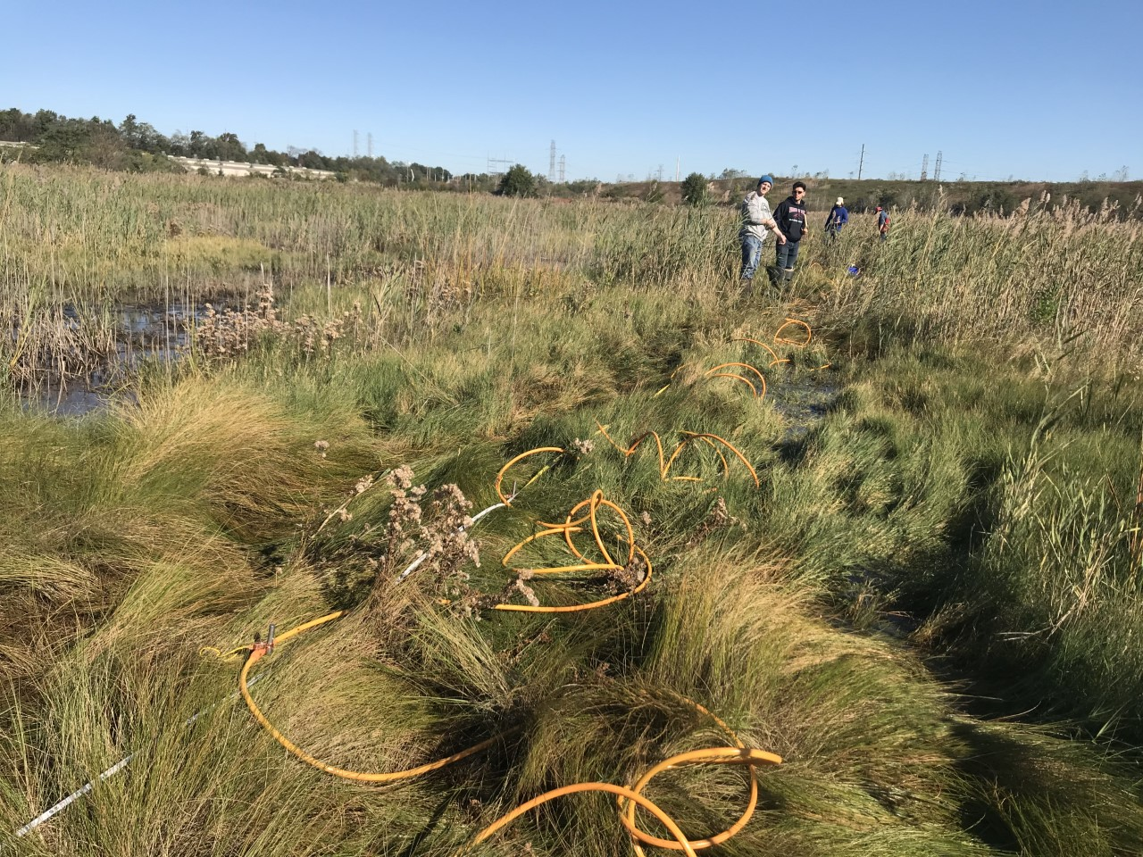
Electrical Resistivity Tomography Technical Overview
June 23 2026, Online Galen Kaip, EarthScope Consortium
Materials and slides modified from Lena Schwebs, University of Wyoming
and Dr. Lee Slater, Rutgers University

Slide 2
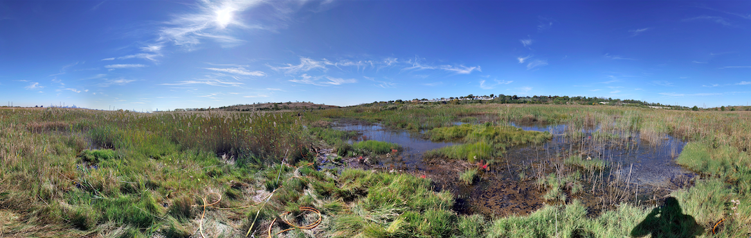
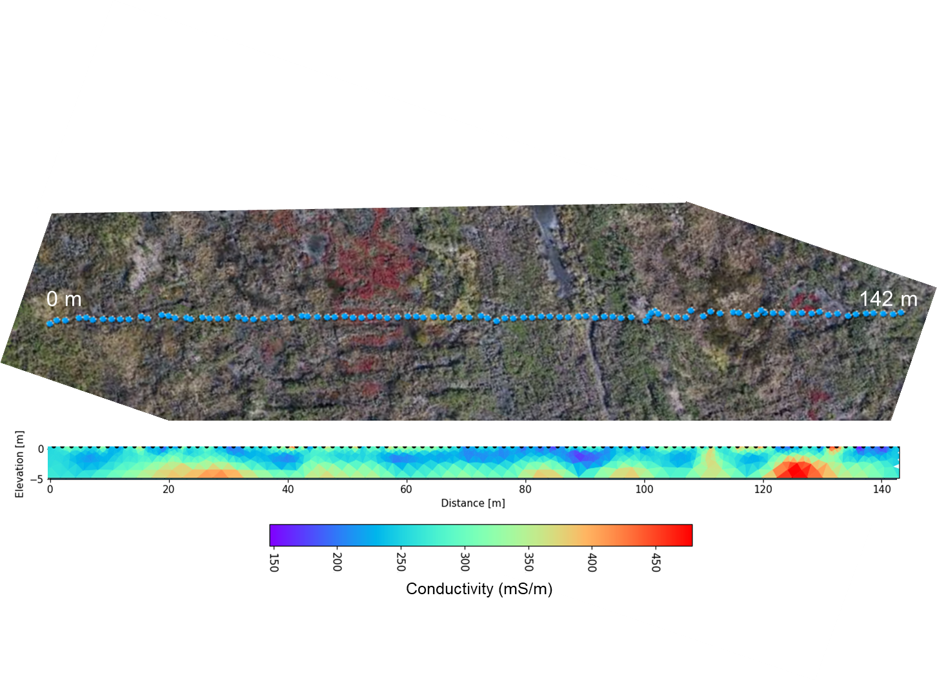
Webinar Outline
ERT Applications
ERT Physics and Resistivity of Soils and Rocks
Field Measurements
Geophysical Inversion

Slide 3
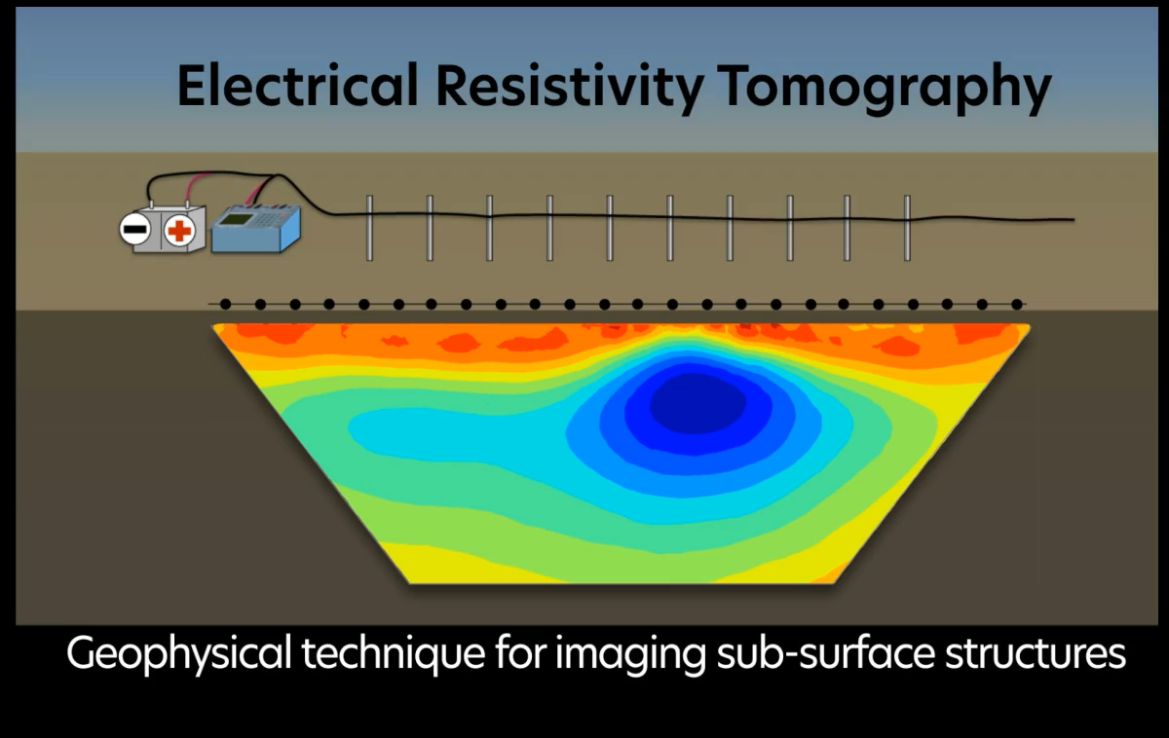
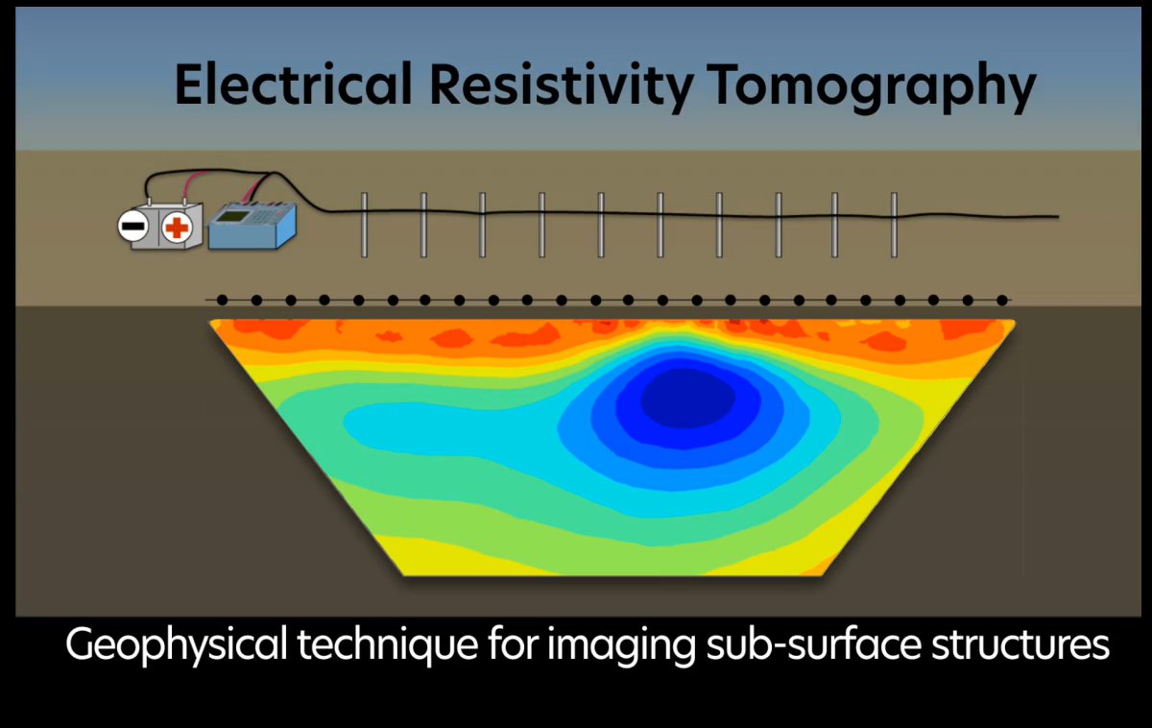
Animation: Electrical Resistivity Tomography

Slide 4
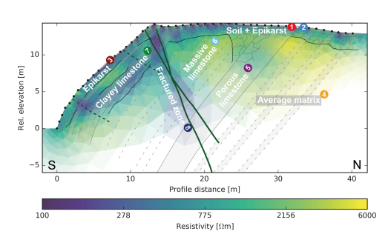
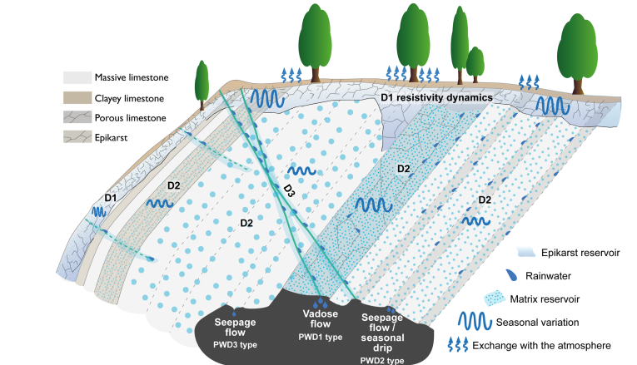
Near-surface ERT Applications
Groundwater exploration
Saltwater intrusions
Agriculture: soil moisture and root zone
Soil/groundwater contaminant mapping
Landfill monitoring
Snowmelt/hillslope dynamics
Watlet et al. (2018)
Notes:
D1 conductive layers, clay-rich, epikarst (highly weathered, catches, stores and filters rainwater). D2 deeper and more resistive limestones with diffuse seasonal variations, D3 conductive fractured layer similar to D1 related to rainfall events.
Expand on your explanations for each application (Beth: looks like DeeDee proposed removing ~4 slides at this point)

Slide 5
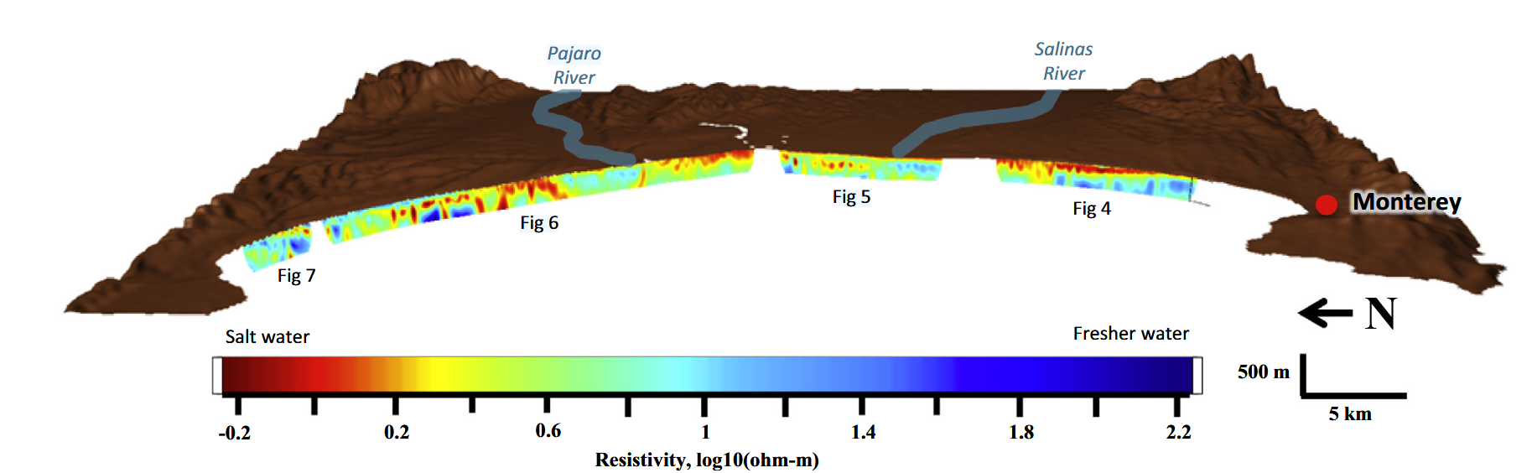
Near-surface ERT Applications
Groundwater exploration
Saltwater intrusions
Agriculture: soil moisture and root zone
Soil/groundwater contaminant mapping
Landfill monitoring
Snowmelt/hillslope dynamics
Goebel et al. (2017)
Notes:
ERT cross sections along the coast where red indicates salt water intrusions due to the very low resistivity. The sporadic pattern of the saltwater intrusions also demonstrate the advantage ERT provides profile monitoring rather than point sources like wells along the coast.

Slide 6
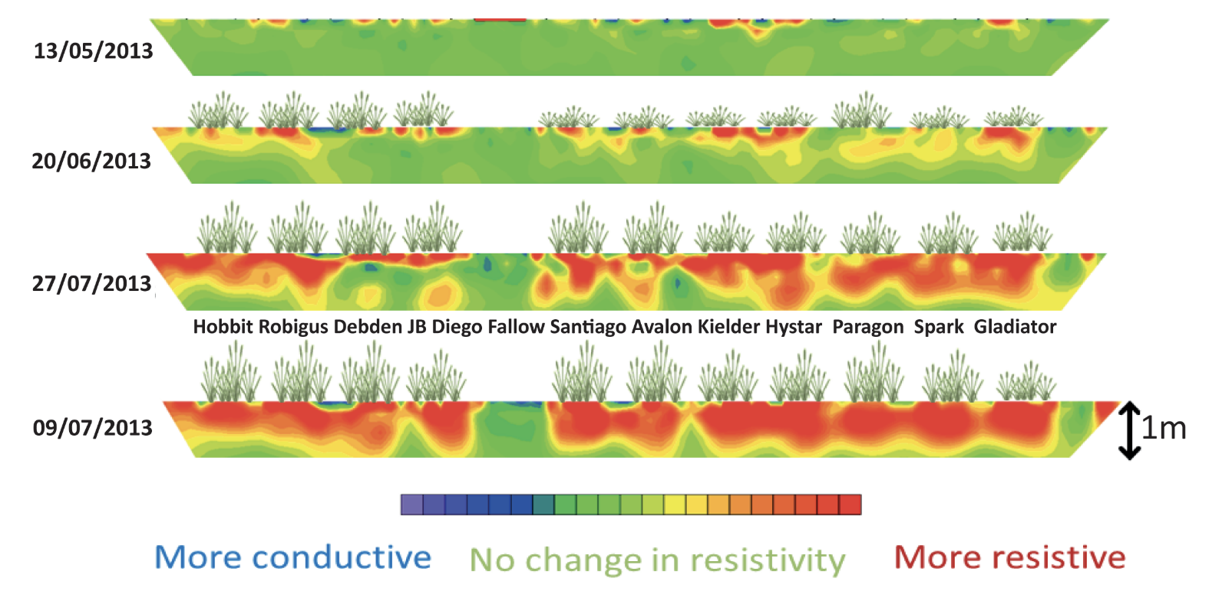
Near-surface ERT Applications
Groundwater exploration
Saltwater intrusions
Agriculture: soil moisture and root zone
Soil/groundwater contaminant mapping
Landfill monitoring
Snowmelt/hillslope dynamics
Whalley et al. (2017)
Notes:
Changes in resistivity over time for several winter wheat varieties. Notice how the higher resistivity (red) section change for each wheat variety. ERT effectively characterizes the differences in root water uptake as well as root system size, especially focusing on deep roots among cultivars under various irrigation regimes. New roots would lower ER but you can see root absorption increases ER much more.

Slide 7
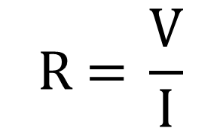
Electricity concepts review:
Voltage (V or ΔV): Difference in potential energy between 2 points. The force or pressure pushing electrons through a conductor. [volts]
Current (I): The amount of electricity that is flowing through a conductor or material; the number of electrons moving through a circuit per unit of time [Amperes]
Resistance (R): The opposition to the flow of electric current, restriction. [Ohms]
Ohm’s Law: Fundamental relationship (V, I, R)
Notes:
Analog of water pipe. Voltage = water pressure, Current = Flow and Resistance = pipe restriction

Slide 8
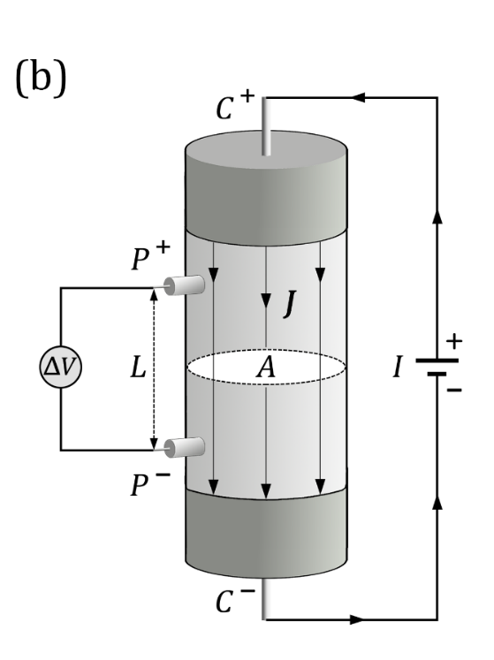
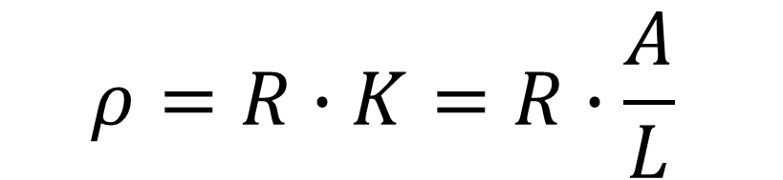
Resistivity (ρ) vs. resistance (R)
One-dimensional (1D) current flow in a column
Geometric factor
resistivity
resistance
Relationship between resistivity (intrinsic/physical property) and resistance (what we can measure) for one-dimensional current flow
From Unit 2
Notes:
We can measure resistance
Both are fundamental properties of a material

Slide 9
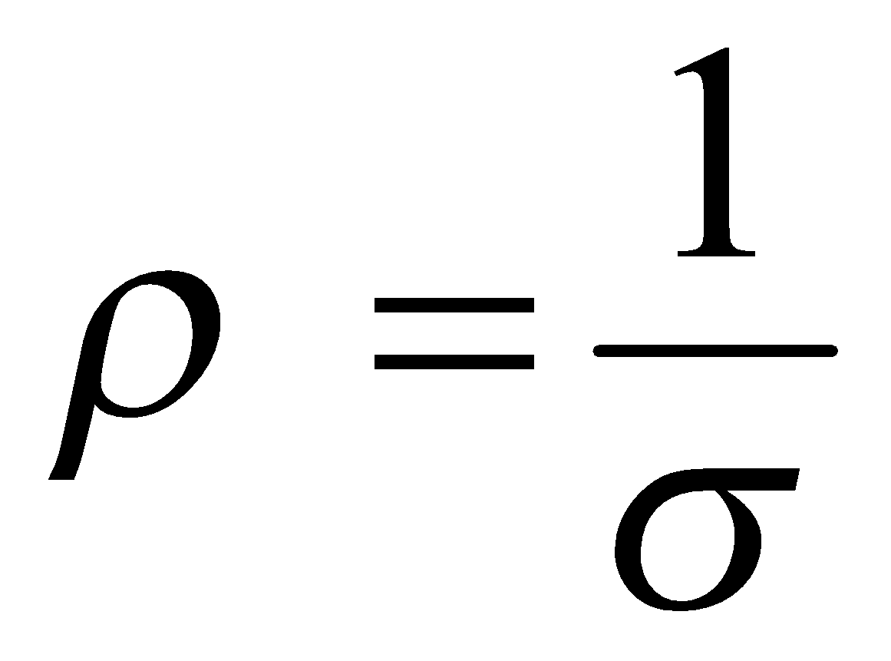
Resistivity (ρ) vs. conductivity (σ)
resistivity
conductivity
how difficult it is for electric current to flow in a material
how easy it is for electric current to flow in a material
From Unit 2
Notes:
Resistivity is the inverse of conductivity
Where resistivity is how difficult it is for electric current to flow in a material and conductivity is how easy
Both properties are plotted throughout the modules so it’s important to check what is plotted in each image
Both properties are plotted throughout the modules so it’s important to check what is plotted in each image
Be careful to watch plots because they are both used throughout the presentation.

Slide 10
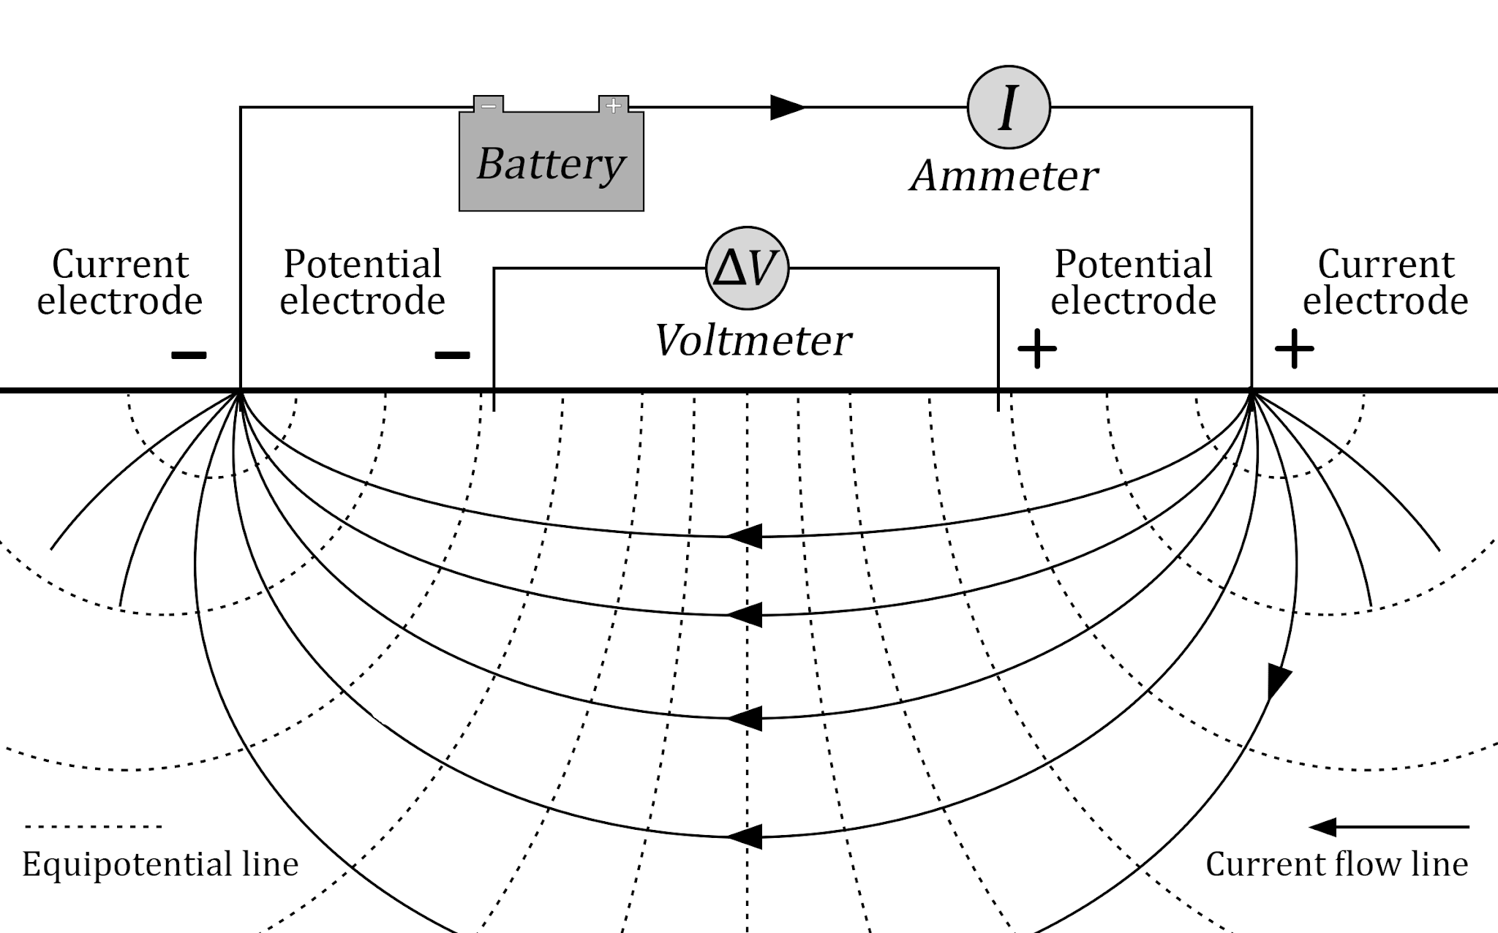
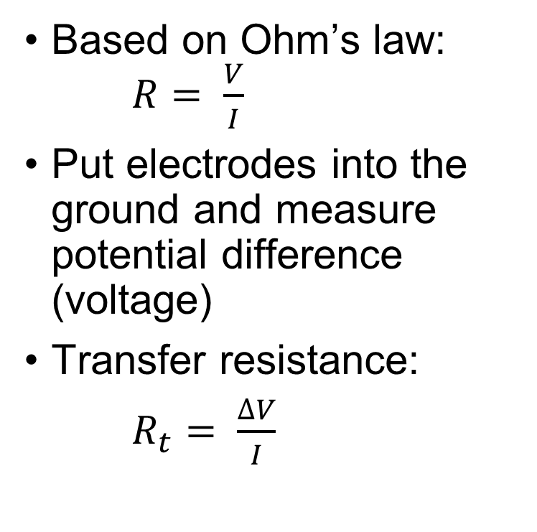
What is ERT?
From Unit 3
Notes:
Explain basics:
I= current – flow of electricity
v = Voltage - pressure that pushes this current
R= resistance - properties of the material that slows the current.
Transfer Resistance is what we measure
So we inject a known current, measure the voltage, and calculate resistance from Ohm’s Law to get what we call our measured transfer resistance

Slide 11
What is Transfer Resistance?
Transfer Resistance is the fundamental measurement. It is measured voltage between electrodes divided by injected current.
Instrument records the transfer resistance.
It is Not true ground resistance because flowing through earth not fixed conductor. It depends on subsurface resistivity distribution, electrode spacing/geometry, topography and near-surface heterogeneity.
From Unit 3
Notes:
Explain basics: Instrument records Transfer voltage. Not true ground resistance. Operators pay attention to R_{t} because low R_{t} may indicate highly conductive ground or poor s/n. Conversely, Very high R_{t} could indicate dry ground, poor current injection, high contact resistance or broken cables.
I= current – flow of electricity
v = Voltage - pressure that pushes this current
R= resistance - properties of the material that slows the current.
Transfer Resistance is what we measure
So we inject a known current, measure the voltage, and calculate resistance from Ohm’s Law to get what we call our measured transfer resistance

Slide 12
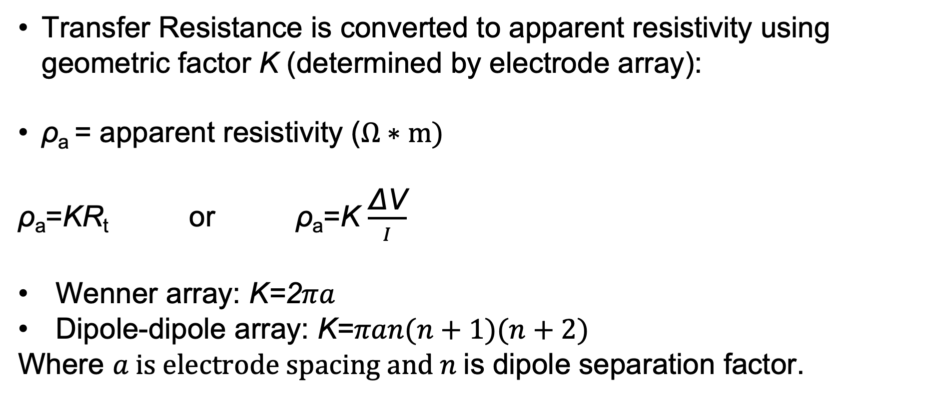
Apparent Resistivity?
Transfer Resistance is converted to apparent resistivity using geometric factor K (determined by electrode array):
ρ_{a} = apparent resistivity ($Ω∗m)$
ρ_{a}​=KR_{t}​ or ρ_{a}​=K $\frac{\text{ΔV}}{I}$
Wenner array: K=2$πa$
Dipole-dipole array: K=$πan(n+1)(n+2)$
Where $a is electrode spacing and n$is dipole separation factor.
From Unit 3
Notes:
Explain basics:
I= current – flow of electricity
v = Voltage - pressure that pushes this current
R= resistance - properties of the material that slows the current.
Transfer Resistance is what we measure
So we inject a known current, measure the voltage, and calculate resistance from Ohm’s Law to get what we call our measured transfer resistance

Slide 13
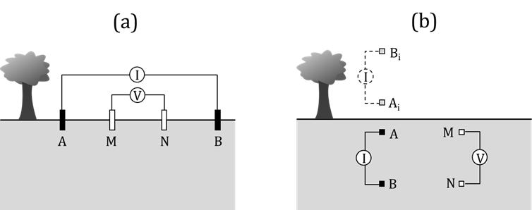
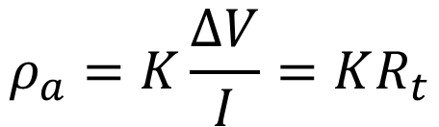



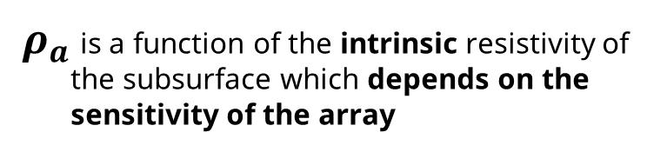
Transfer resistances and Apparent resistivity
Apparent resistivity:
the resistivity of a homogenous subsurface that the measured voltage and current are equivalent to
Transfer resistance with units of ohms
From Unit 3
Notes:
transfer resistance, is measured with a resistivity imaging instrument.
When the transfer resistance is multiplied by the geometric factor for the specific array used, the apparent resistivity is calculated.
This is generally a complex function of the unknown true resistivity structure of the subsurface.
The value of the apparent resistivity will depend on the sensitivity of the array being use

Slide 14
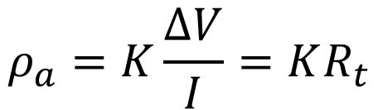
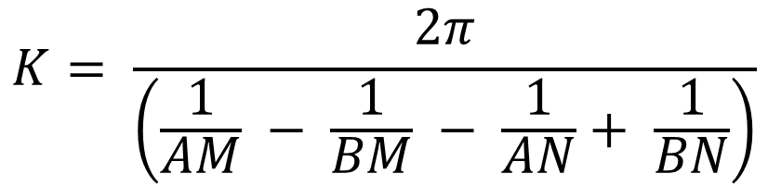
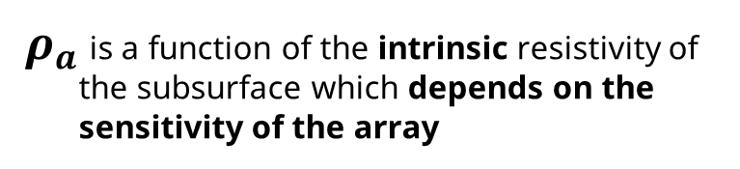
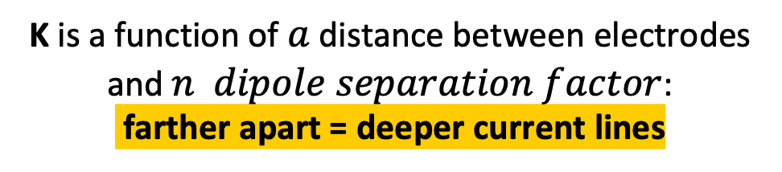
Transfer resistances and Apparent resistivity
Apparent resistivity:
the resistivity of a homogenous subsurface that the measured voltage and current are equivalent to
Geometric factor
Transfer resistance with units of ohms
K is a function of $a$ distance between electrodes and $n dipole separation factor$:
farther apart = deeper current lines
From Unit 3
Notes:
The geometric factor of the array is given by this equation,
The geometric factor is used to calculate the apparent resistivity based from the measured transfer resistance.
but you just need to know it’s a function of the distance between the electrodes and the instrument will calculate it for you.
Apparent resistivity is NOT the true resistivity of the subsurface. Apparent res does not account for the geometry of the subsurface 🡪 inversion takes care of this, more later

Slide 15
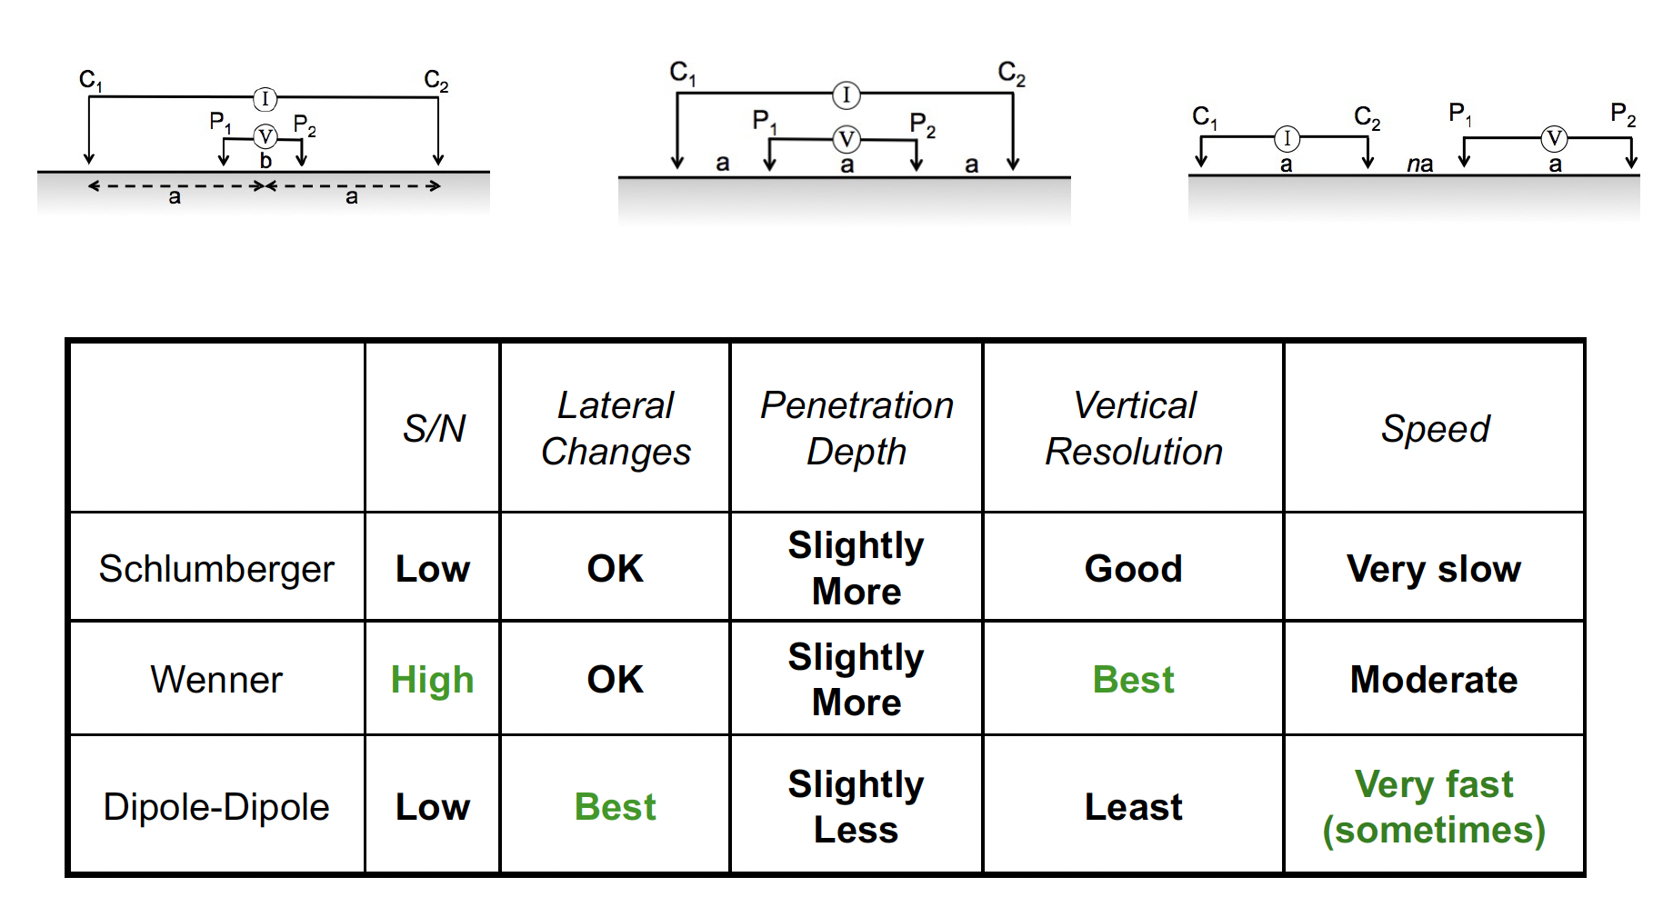
Standard electrode configurations
Schlumberger
Wenner
Dipole-Dipole
Notes:
There are different sensitivities w different arrays
Advantages and disadvantages for each array DOI Wenner 15-25% LL, Schlumberger 20-30%LL, Dip-Dip 10-20%LL and gradient 20-35%
Explain S/N and Speed
Speed factors:
Array only dip-dip, pol-dip and gradient can take advantage of 8 channel (simultaneous measurements)
Injection time
# of measurements
Stacking #
Contact res (does it have to keep trying?)
Reciprocals
Dipole-dipole can take X measurements at once but Wenner and Schlumberger are 1 measurement at a time
Some are better w lateral and others are better w vertical

Slide 16
Plotting 2D Electrical imaging datasets
a
na
a
We assign the raw apparent resistivity measurements to a location at the midpoint of the array and at a level (or pseudodepth) n determined by the electrode separation
In the dipole-dipole array the pseudo depth is the integer multiplier on the a spacing defining the distance between the current electrode pair and the voltage measurement electrode pair
Larger values of n mean deeper investigation depth – but with lower spatial resolution
I
V
A
B
N
M
n=1
n=2
n=3
n=4

Slide 17
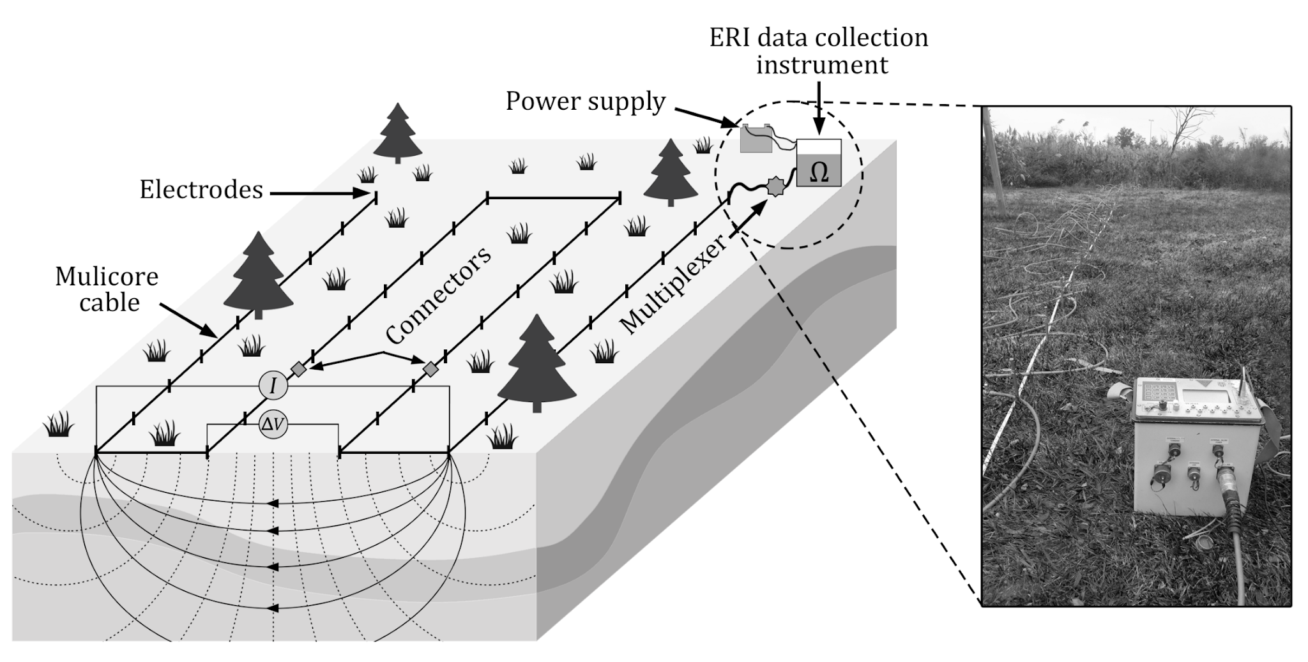
Electrical resistivity imaging
electrodes
From Unit 3
Source: Binley and Slater, 2020, Resistivity and induced polarization: theory and
applications to the near-surface Earth, In Press
Notes:
We typically collect 2D or 3D surveys
2D is a single line
3D is imaged on slide
You can have 10s to 100s of electrodes spaced at custom increments
For teaching and a pretty standard survey would be would be 28-56 electrodes spaced 1-2m
The depth of investigation depends on the subsurface, but we typically expect the depth to be 10-20% of the survey line
Depth is approximate

Slide 18
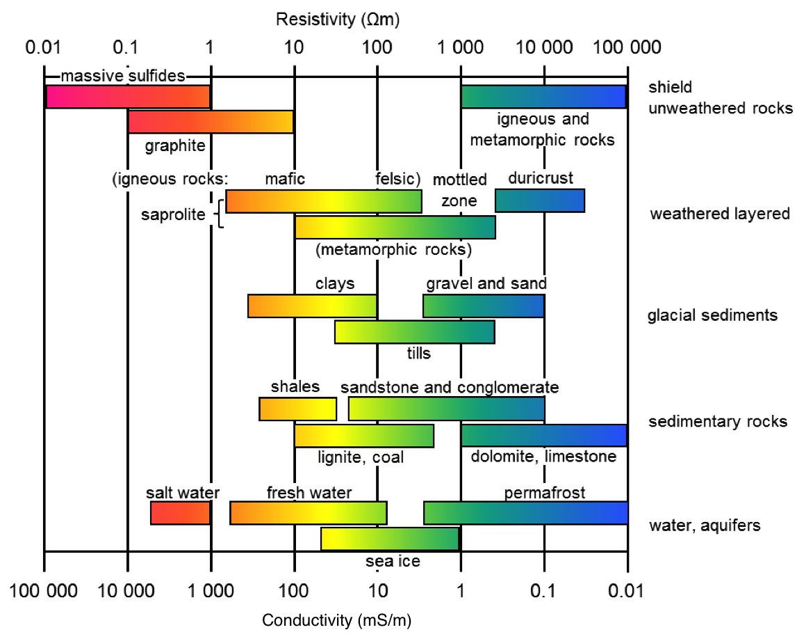
Resistivity of geomaterials
Notes:
Resistivity of geomaterials can be complex with a lot of overlap and dependence on saturation
Highlight ground water and sea water
Also the subsurface is typically composed of multiple materials with overlapping resistivities so it’s important to know about the geology of your field site
Image: https://em.geosci.xyz/content/physical_properties/electrical_conductivity/electrical_conductivity_values.html

Slide 19
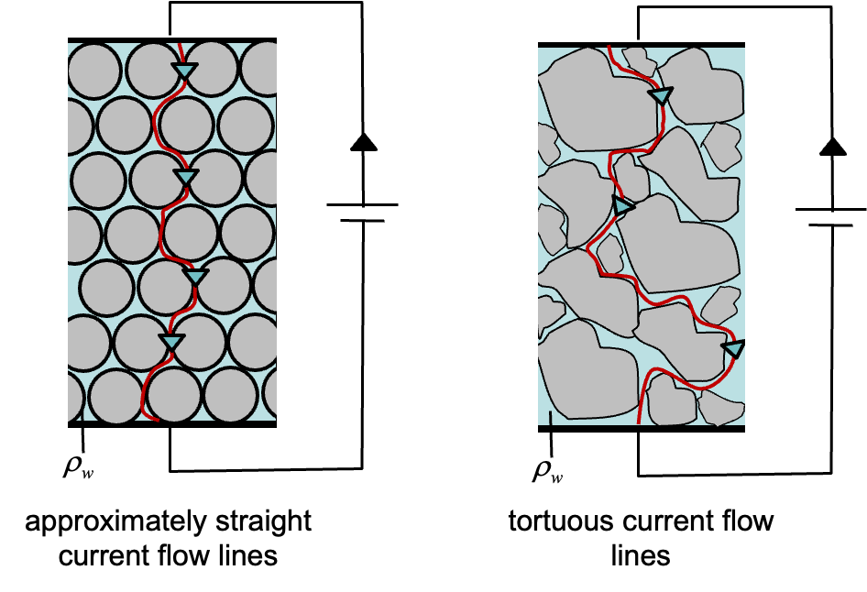
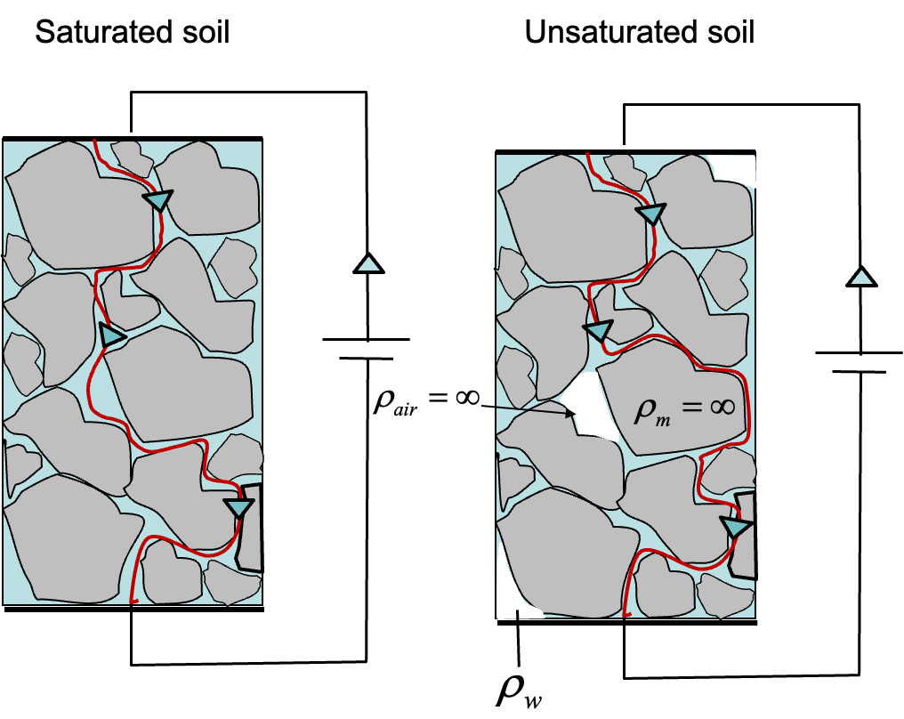
What affects the resistivity and conductivity of geomaterials?
Effect | Resistivity | Conductivity
Increasing porosity | ↓ | ↑
Increasing pore fluid salinity | ↓ | ↑
Increasing surface conductance | ↓ | ↑
Increasing connectedness/connectivity | ↓ | ↑
Increasing saturation | ↓ | ↑
Weathering | ↓ | ↑
Compaction | ↑ | ↓
Increasing formation factor | ↑ | ↓
Increasing tortuosity | ↑ | ↓
Images from Unit 2: Geophysical Properties of the Subsurface
Notes:
Various processes that affect conductivity and resistivity of geomaterials
There is a lot of overlap between these processes
Ex: Increased weathering typically leads to increased porosity, connectedness/connectivity, and decreasing tortuosity, and decreasing formation factor
Top image: less vs more tortuous/connected
Bottom image: less saturation leads to less connectivity and more tortuosity
(New slide: best added to Unit 2 Introduction to resistivity in soils and rocks as supplemental slides)
Glover, P. W. J. (2015). Geophysical Properties of the Near Surface Earth: Electrical Properties.

Slide 20
Field Survey Design Basics
Array (Wenner, Dipole-Dipole)
  Vertical vs lateral sensitivity?
  Signal to noise ratio?
  How much time do you have?
Electrode spacing
  What resolution do you want?
  How deep are you trying to measure/how long of a line do you need?
    Depth of investigation is approximately 10-20% of the length of the line
Stacks
  How many times do you want to repeat individual measurements
  Data quality vs time of survey

Slide 21
Design your own survey
Answer in the Chat
ERT Target:
Magmatic dike in sandstone
Beginning at ~10m depth
Questions:
Q1: What array would be best?
Notes:
Array: Dipole-dipole because of lateral resolution
Line length: 50-100m
Electrode separation: No more than 20m
I think it would be helpful to add something about survey design – Image-able depth from given line length
– Resolvable features with different electrode spacing
Then perhaps you could pose a question or two related to survey design decisions OR changes that you might see given a certain subsurface change (ex. clay-filled cracks vs air-filled)

Slide 22
Design your own survey
Answer in the Chat
ERT Target:
Magmatic dike in sandstone
Beginning at ~10m depth
Questions:
Q1: What array would be best?
  A1: Dipole-dipole for better lateral sensitivity
Notes:
Array: Dipole-dipole because of lateral resolution
Line length: 50-100m
Electrode separation: No more than 20m
I think it would be helpful to add something about survey design – Image-able depth from given line length
– Resolvable features with different electrode spacing
Then perhaps you could pose a question or two related to survey design decisions OR changes that you might see given a certain subsurface change (ex. clay-filled cracks vs air-filled)

Slide 23
Design your own survey
Answer in the Chat
ERT Target:
Magmatic dike in sandstone
Beginning at ~10m depth
Questions:
Q1: What array would be best?
  A1: Dipole-dipole for better lateral sensitivity
Q2: What should be the minimum line length?
Notes:
Array: Dipole-dipole because of lateral resolution
Line length: 50-100m
Electrode separation: No more than 20m
I think it would be helpful to add something about survey design – Image-able depth from given line length
– Resolvable features with different electrode spacing
Then perhaps you could pose a question or two related to survey design decisions OR changes that you might see given a certain subsurface change (ex. clay-filled cracks vs air-filled)

Slide 24
Design your own survey
Answer in the Chat
ERT Target:
Magmatic dike in sandstone
Beginning at ~10m depth
Questions:
Q1: What array would be best?
  A1: Dipole-dipole for better lateral sensitivity
Q2: What should be the minimum line length?
  A2: 10m = 0.1*Line length 🡪 Line length = 100m
Notes:
Array: Dipole-dipole because of lateral resolution
Line length: 50-100m
Electrode separation: No more than 20m
I think it would be helpful to add something about survey design – Image-able depth from given line length
– Resolvable features with different electrode spacing
Then perhaps you could pose a question or two related to survey design decisions OR changes that you might see given a certain subsurface change (ex. clay-filled cracks vs air-filled)

Slide 25
Design your own survey
Answer in the Chat
ERT Target:
Magmatic dike in sandstone
Beginning at ~10m depth
Questions:
Q1: What array would be best?
  A1: Dipole-dipole for better lateral sensitivity
Q2: What should be the minimum line length?
  A2: 10m = 0.1*Line length 🡪 Line length = 100m
Q3: If you have 56 electrodes, what would be a good electrode spacing to reach the line length in Q2?
Notes:
Array: Dipole-dipole because of lateral resolution
Line length: 50-100m
Electrode separation: No more than 20m
I think it would be helpful to add something about survey design – Image-able depth from given line length
– Resolvable features with different electrode spacing
Then perhaps you could pose a question or two related to survey design decisions OR changes that you might see given a certain subsurface change (ex. clay-filled cracks vs air-filled)

Slide 26
Design your own survey
Answer in the Chat
ERT Target:
Magmatic dike in sandstone
Beginning at ~10m depth
Questions:
Q1: What array would be best?
  A1: Dipole-dipole for better lateral sensitivity
Q2: What should be the minimum line length?
  A2: 10m = 0.1*Line length 🡪 Line length = 100m
Q3: If you have 56 electrodes, what would be a good electrode spacing to reach the line length in Q2?
  A3: 2m spacing
Notes:
Array: Dipole-dipole because of lateral resolution
Line length: 50-100m
Electrode separation: No more than 20m
I think it would be helpful to add something about survey design – Image-able depth from given line length
– Resolvable features with different electrode spacing
Then perhaps you could pose a question or two related to survey design decisions OR changes that you might see given a certain subsurface change (ex. clay-filled cracks vs air-filled)

Slide 27
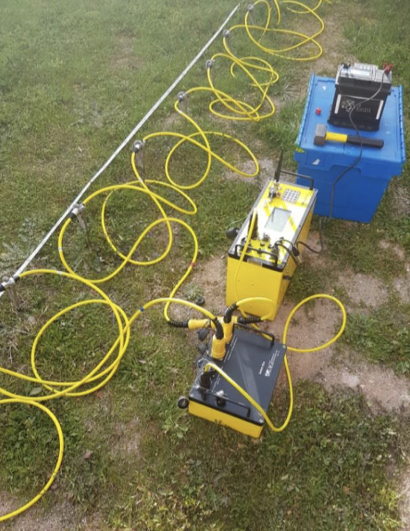
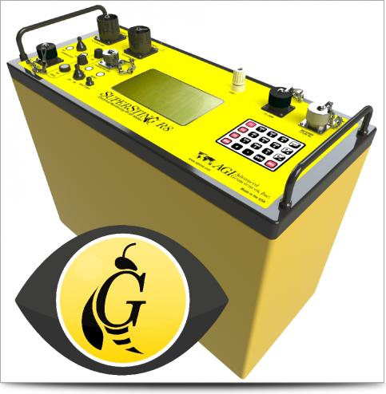
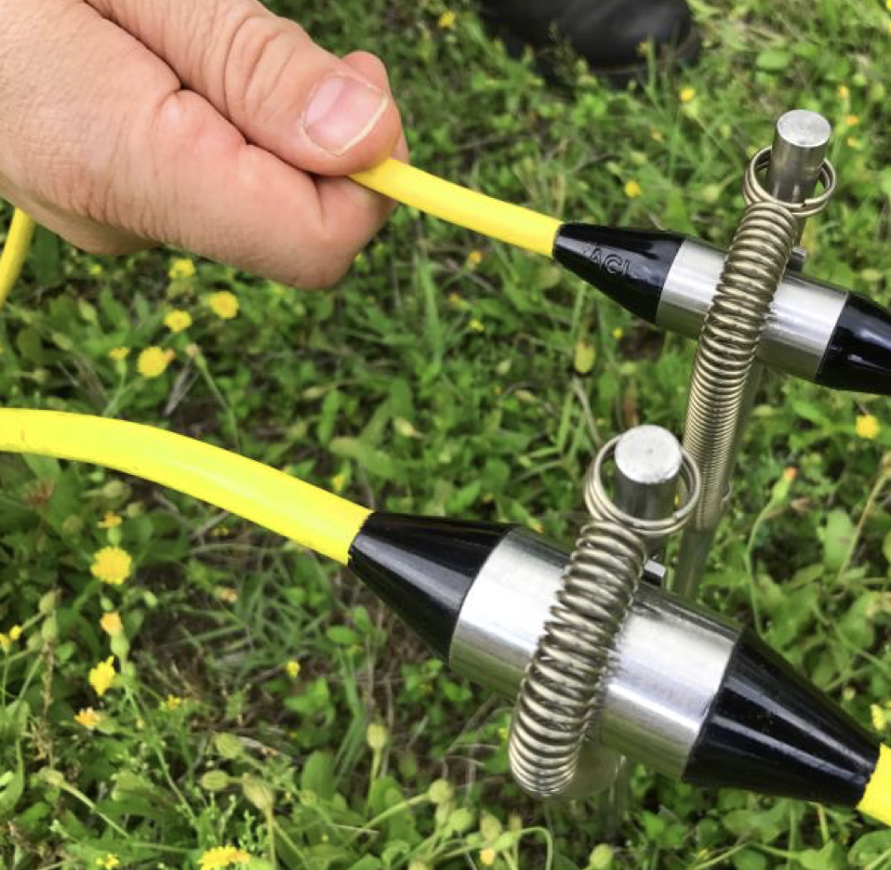
Field Equipment at the Workshop
Resistivity Meter
AGI SuperSting Resistivity Meter
Electrodes and Cables
Switchbox
Image Sources: AGI USA

Slide 28
Laying out the line
Line workers
electrodes
From Unit 3
Notes:
At the field site, a lot of work goes into setting up the survey
First you set up a tape measure of your survey line
You want this as straight as possible!!
Hard to do for long lines
Even harder with trees and such
Hammer in electrodes at designated spots (remember electrode 1 is at 0m)
Lay out the cable with the correct takeout at the correct electrodes and connect them

Slide 29
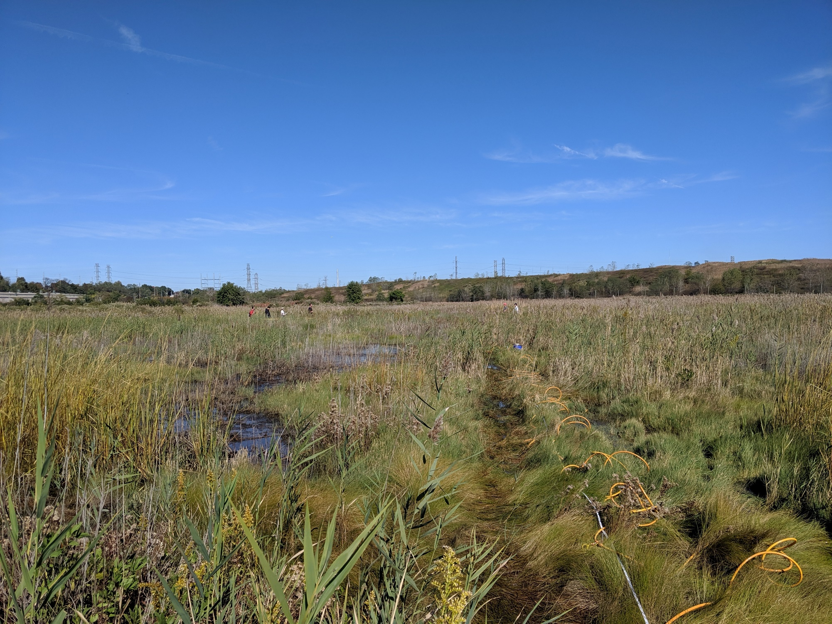
Electrical resistivity imaging
96 electrodes spaced 1.5 m apart
Line length: 142.5 m
Time to setup: 1 hr. and 30 mins with team of 5
Completed line
electrodes
From Unit 3
Source: Binley and Slater, 2020, Resistivity and induced polarization: theory and
applications to the near-surface Earth, In Press
Notes:
Compare schematic to field site

Slide 30
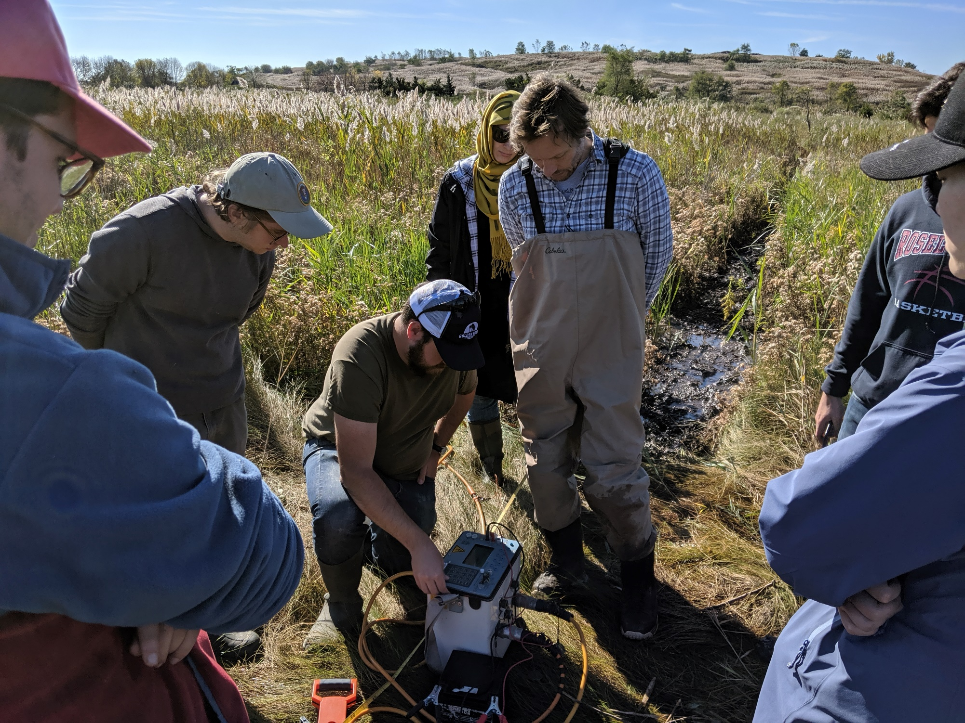
System checks
Contact resistance check
Voltage and current levels (change settings?)
From Unit 3
Notes:
Once the line is set up, the instrument can be connected and settings changed
Contact resistance check

Slide 31
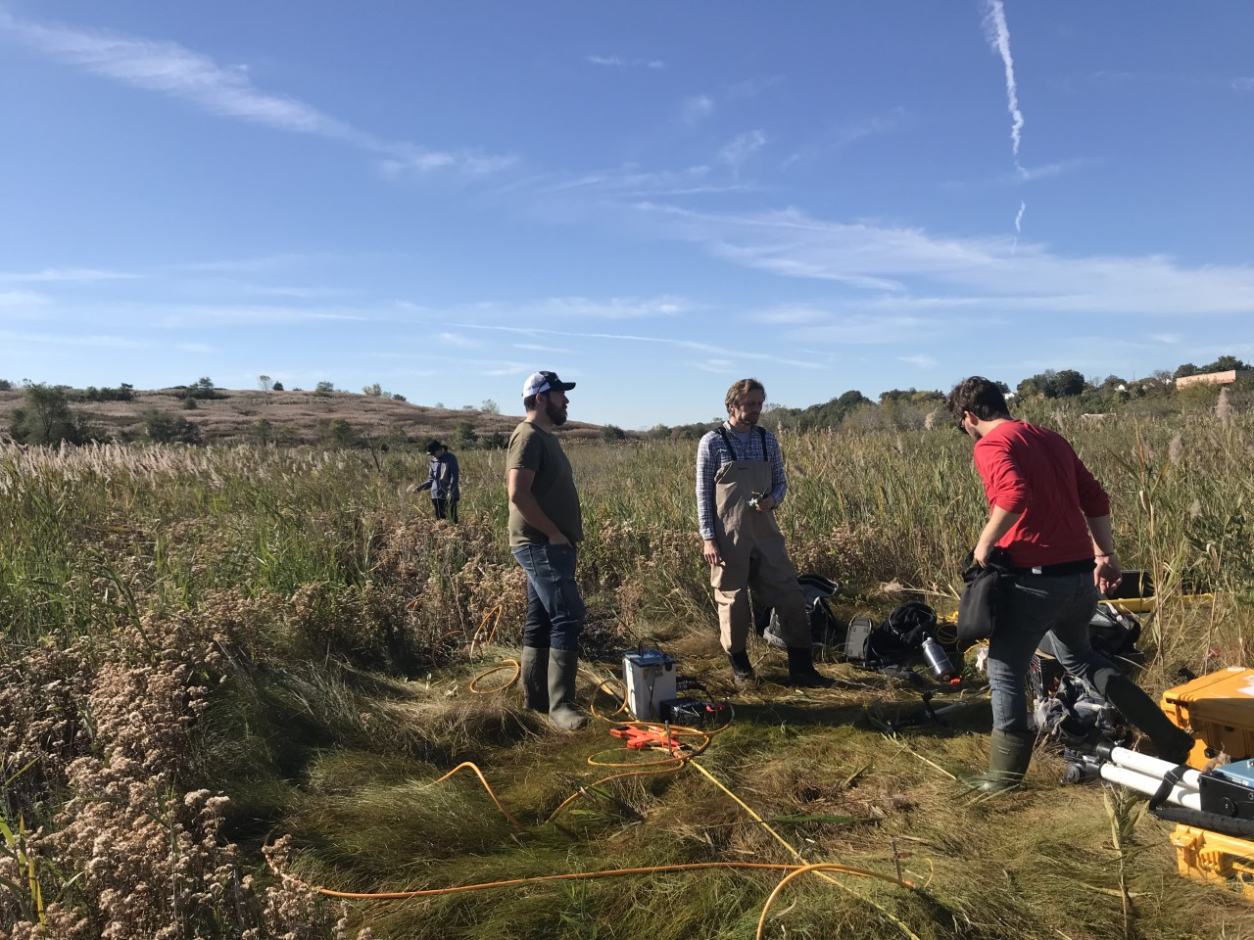
Fixing problems
This electrode isn’t connected!
It’s not working!!
I’ll fix it!!
Dum-de-dum..
From Unit 3
Notes:
Problem-solving
Fix electrodes that don’t have good contact or are disconnected
What is good contact resistance?
2-3k Ohm is suggested by manufacturers
Realistic for wet climates
What about dry arid?
We aim for about 10kOhm but less than 20kOhm is okay

Slide 32
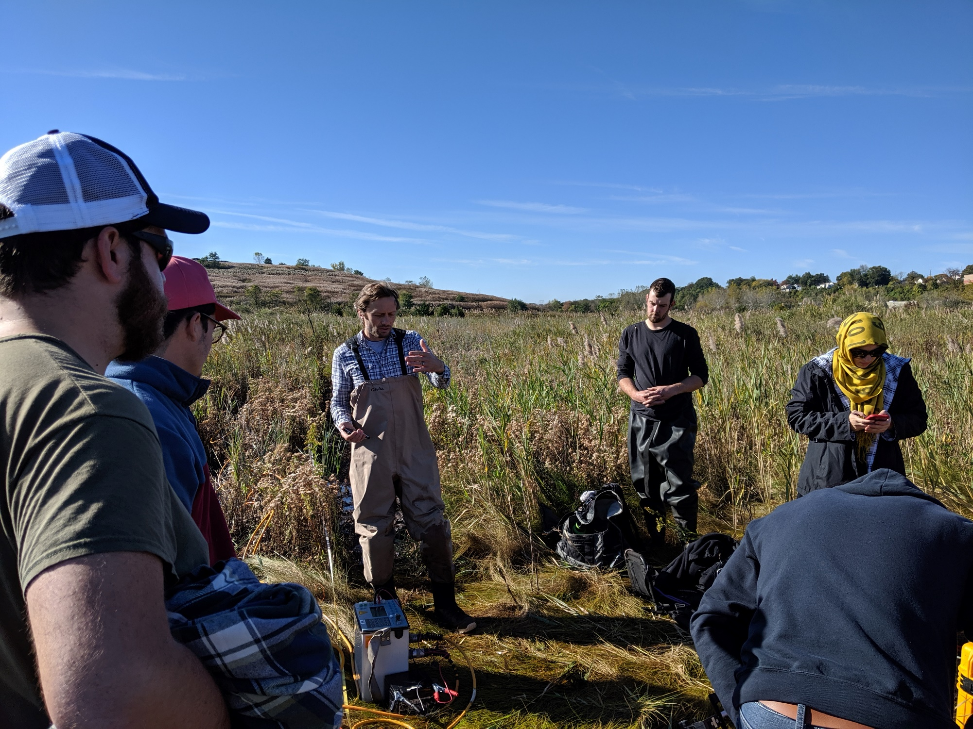
Waiting for data to be acquired
Engaged students
Expert(?)
From Unit 3
Notes:
Start survey
It can take hours. Depends on:
Array
Injection time
Reciprocals
Stacks/Max stacks
Number of electrodes
Good time to talk to students or set up seismic!
Don’t need these slides – they’re not setting it up today

Slide 33
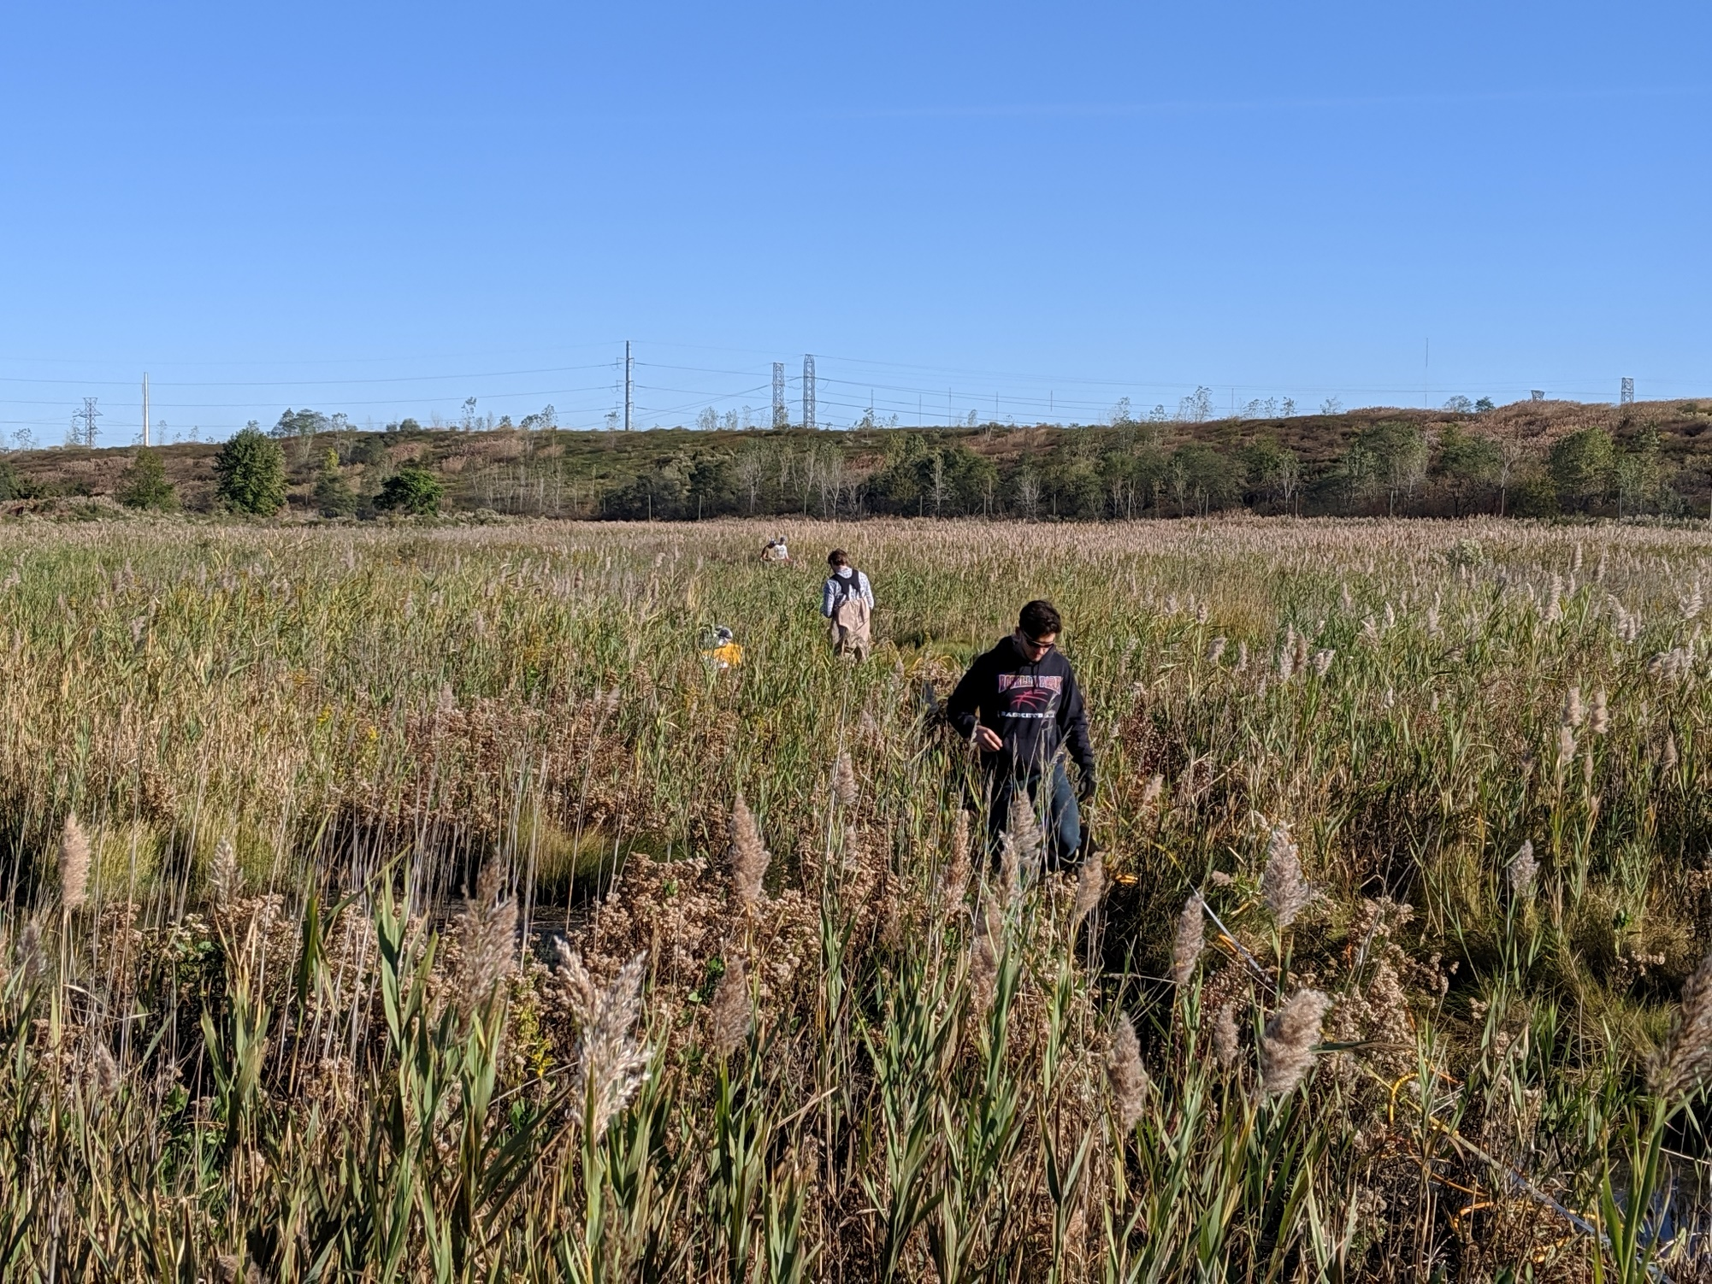
Packing up the line
From Unit 3
Notes:
Once the survey finishes measuring, time to pack up line
Electrodes first !!!!!! then cables and tape measures.
I think the main point for slides 17-20 is a teaser about what they can encounter in the field (esp a view of the field that has higher grass than campus)

Slide 34
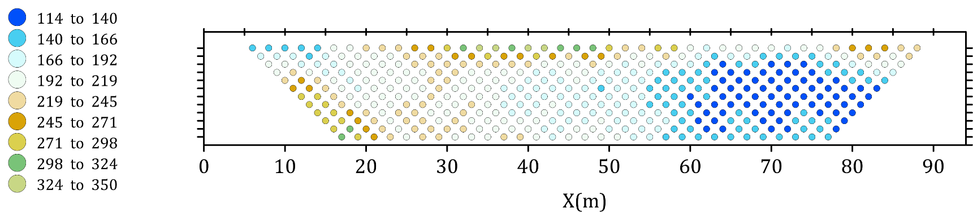


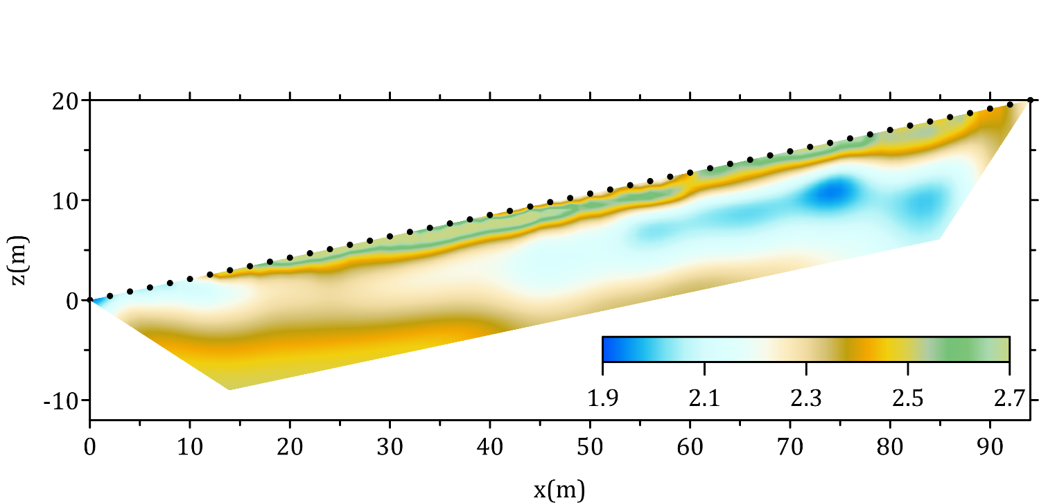
What is inverse
modeling?
Pseudo section
ρ_{a} (Ωm)
n=1
n=5
n=10
The process by which the transfer resistance or apparent resistivity measurements acquired from the surface are transformed into estimated images of the subsurface resistivity (or conductivity)
Inverse
modeling
Forward
modeling
Resistivity distribution
log₁₀ (resistivity in Ωm)
From Unit 4: The Magic of Geophysical Inversion
Source: Binley and Slater, 2020, Resistivity and induced polarization: theory and applications to the near-surface Earth, In Press
Notes:
Don’t need too much since you’ll be going over this during the workshop. Apparent resistivity is not measured at a specific depth. Each measurement is a weighted average of the true resistivity distribution beneath the electrode array. EarthImager uses average apparent resistivity (default which uses homogenious half-space based on the geometric mean of all apparent resistivities, best for noisy datasets.. Interpolated Pseudo-section uses a contoured apparent resistivity map to create initial model, best for high signal low noise datasets. Custom starting model. Default is the homogeneous half-space whose resistivity is calculated as the geometric mean of all apparent resistivity measurements.

Slide 35
Inversion in Electrical Resistivity Imaging (ERI)
What is Inversion?
Converts apparent resistivity measurements into a subsurface resistivity model
Uses an iterative optimization process
Seeks the model that best explains the observed data
Inversion Workflow
1. Collect apparent resistivity data
2. Build an initial earth model
3. Calculate synthetic responses (forward model)
4. Compare observed vs. calculated data
5. Update model and repeat until misfit is minimized
electrodes
From Unit 3
Source: Binley and Slater, 2020, Resistivity and induced polarization: theory and
applications to the near-surface Earth, In Press
Notes:
Import collected data
Build an earth model ResiPy uses halfspace using geometric mean of all apparent resistivity readings.

Slide 36
Inversion in Electrical Resistivity Imaging (ERI)
Practical Workflow
Import data.
Check electrode locations.
Remove bad points.
Check reciprocal errors.
Build mesh.
Run smooth inversion first.
Examine RMS and sensitivity.
Try robust inversion if sharp boundaries are expected.
Compare models.
Interpret only features supported by both geology and data coverage.
electrodes
From Unit 3
Source: Binley and Slater, 2020, Resistivity and induced polarization: theory and
applications to the near-surface Earth, In Press
Notes:
ERT inversion is an optimization problem, not a direct image of the subsurface. The software finds the resistivity model that best explains the measurements while satisfying the chosen regularization constraints.

Slide 37
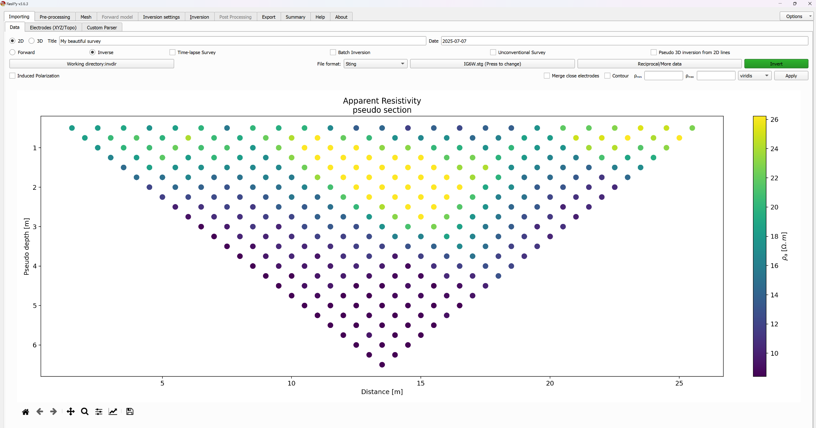
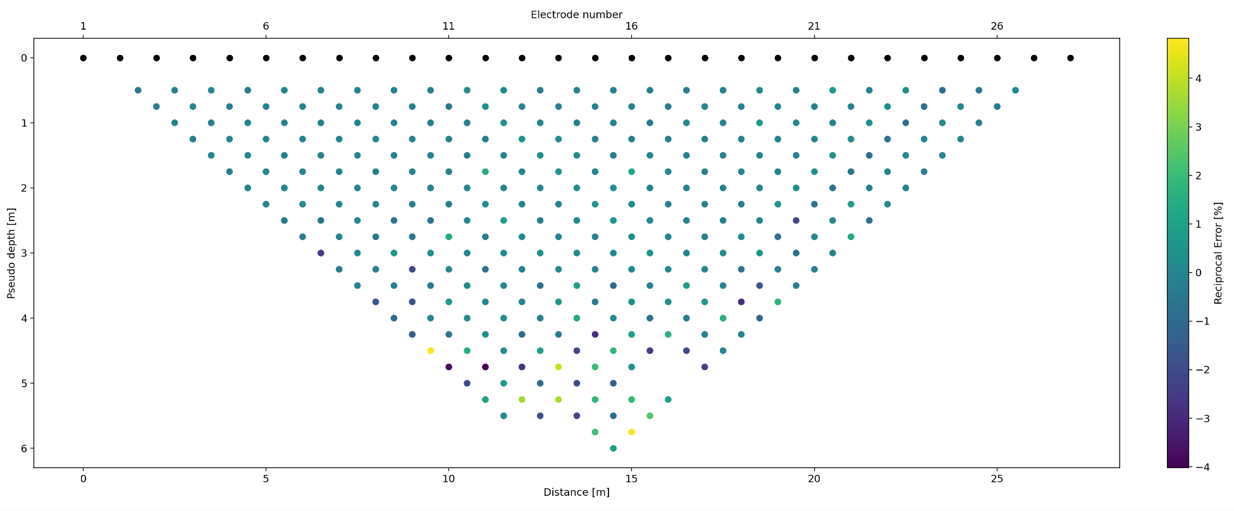
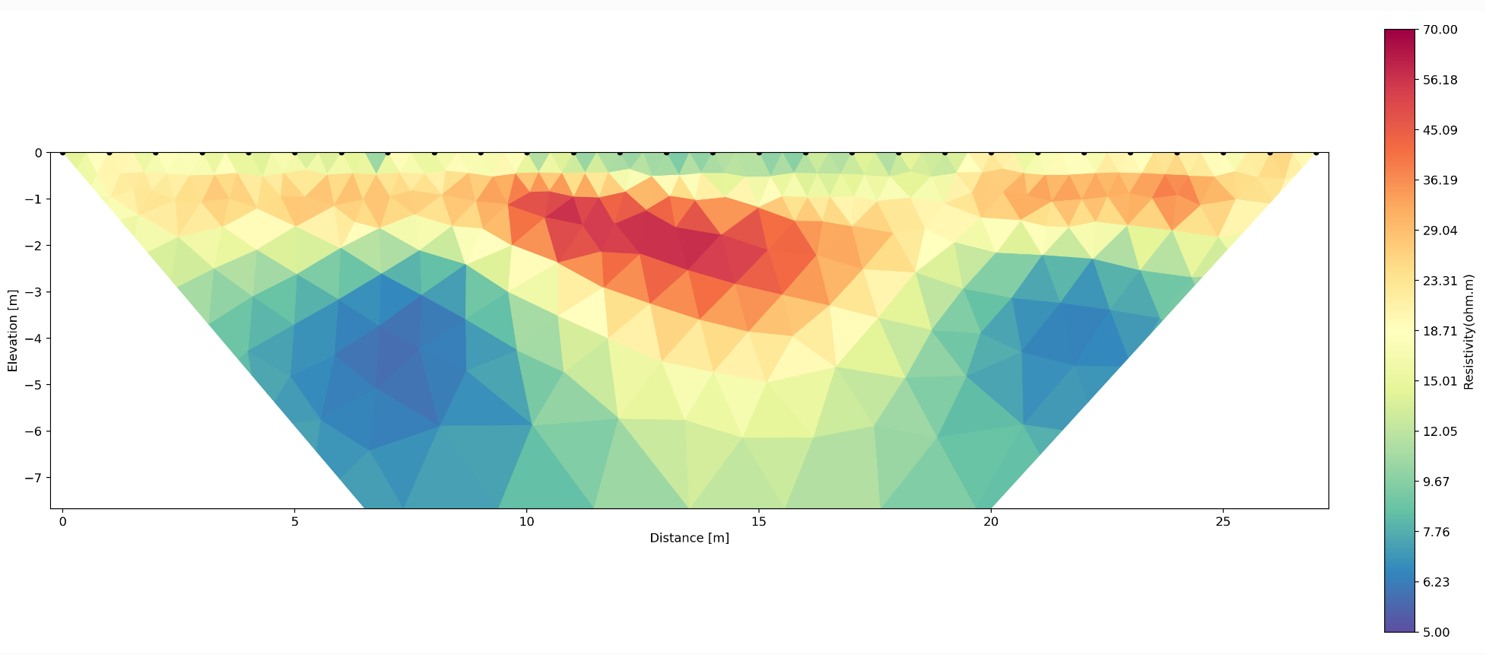
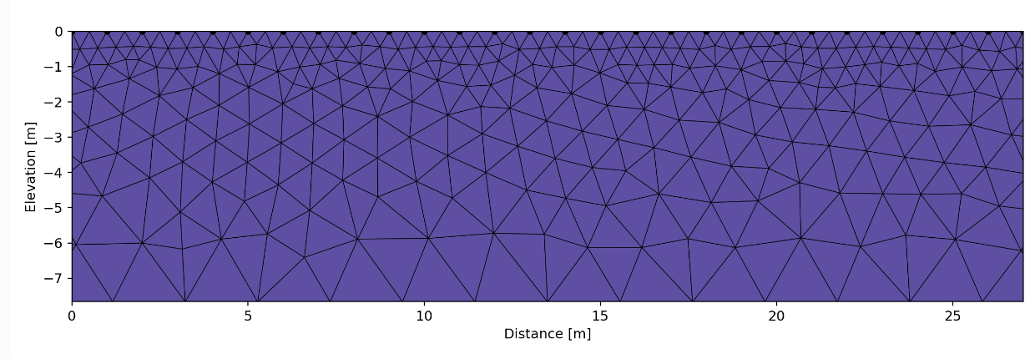
ResIPy Processing Workflow
Load/visualize raw data
Preprocess data
Interpret final model
Build mesh grid for model

Slide 38
Inversion Concepts in Electrical Resistivity Imaging (ERI)
1. Apparent Resistivity ≠ True Resistivity
2. The Starting Model Matters
3. Mesh Quality is Critical
4. Forward Modeling is the Heart of Inversion
5. Regularization Controls Smoothness
6. RMS Error is Not Everything
7. Sensitivity Decreases with Depth
8. Resolution is Not Uniform
9. Inversion Finds a Non-Unique Solution
electrodes
From Unit 3
Source: Binley and Slater, 2020, Resistivity and induced polarization: theory and
applications to the near-surface Earth, In Press
Notes:
1. Inversion estimates true resistivity distribution. NEVER Interpret Pseudosection as actual geology
2. Result is influenced by starting assumptions, especially when coverage is poor
3. Mesh divides subsurface into cells (too coarse - may miss something and too fine – unstable and longer. Determines spatial resolution of the model.
4. calculate voltages from current model-compare with measured-update model. Inversion is repeated forward modeling.
5. Choose inversion style based on expected geology Smooth L2 good for groundwater sedimentary layers and weathering profiles. Robust L1 for faults, cavities and bedrock contacts.
6. low RMS does not meqn model is correct. It is how the inversion desided to stop, based on diminishing returns
7. deep anomalies are less reliable
8. best in center because coverage and less around around edges including depth
9. more than 1 model can fit the data. Always combine with geology, boreholes, trenching, seismic data, hydrologic information

Slide 39
Measurement error
Normal measurement
I
V
A
B
N
M
Reciprocal error: the difference between the normal measurement and the reciprocal measurement
Theoretically, the two measurements should be the same
Requires double the measurements and therefore double the time
Reciprocal measurement
switched
I
V
A
B
N
M
From Unit 4
Notes:
A robust way to assess the errors in the measurements. The theory of reciprocity states that the normal and reciprocal measurement must have the same resistance (and hence apparent resistivity).
Differences between the two measurements quantify the errors
Better assessment of data quality → can account for repeated errors that stacking errors do not
Double the measurements = double the time → think of wenner vs dipole-dipole
Do you think it is helpful to getting these details now OR would it be better during the data processing part?
Maybe fewer slides?
What are the more important elements for them to know ahead of time about processing?
--inversion involves an iterative process
--there are ways to quantify the errors

Slide 40
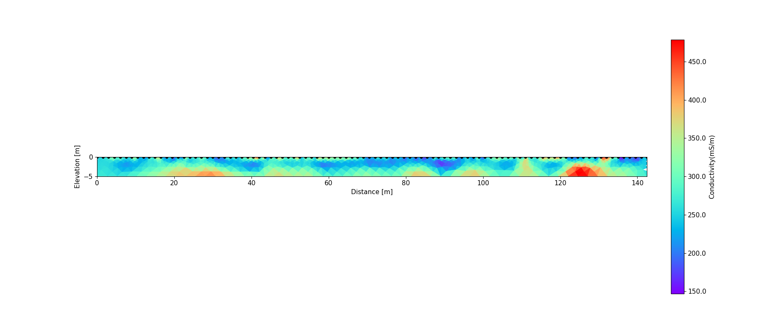
What do images mean?
Infer spatial variation in soil/rock type, chemistry of the fluids in the ground, water content……..
Image of subsurface electrical conductivity from the Harrier Meadow survey
Increasing conductivity – what does it mean?
Increasing salinity of water in soils?
Increasing water content?
Increase in porosity?
Increase in fine-grained sediments?
From Unit 4
Notes:
But what do these images really mean?
Unit 2 covers the relationships between the electrical conductivity of soils and the physical and chemical properties of soils.
Using Archie’s Laws, we learned that electrical conductivity increases with the salinity of the pore fluids, the porosity of the soil and the water content if the soil is not saturated.
We also learned that fine grained materials such as clays also increase electrical conductivity. The changes in conductivity observed with electrical imaging result from changes in such factors.
At Harrier Meadow we know that the soils are saturated beneath the top 20 cm so the changes in conductivity in this image most likely represent changes in salinity and/or changes in soil type.
Distinguishing between such effects is best done using some direct sampling at a few locations – indeed, the interpretation of geophysical datasets is always improved with some direct observations.
We will use some direct measurements to explore the significance of these conductivity images further in Unit 5.

Slide 41
Thank you! Questions?
Image of subsurface electrical conductivity from the Harrier Meadow survey

Slide 42
Supplementary Slides

Slide 43
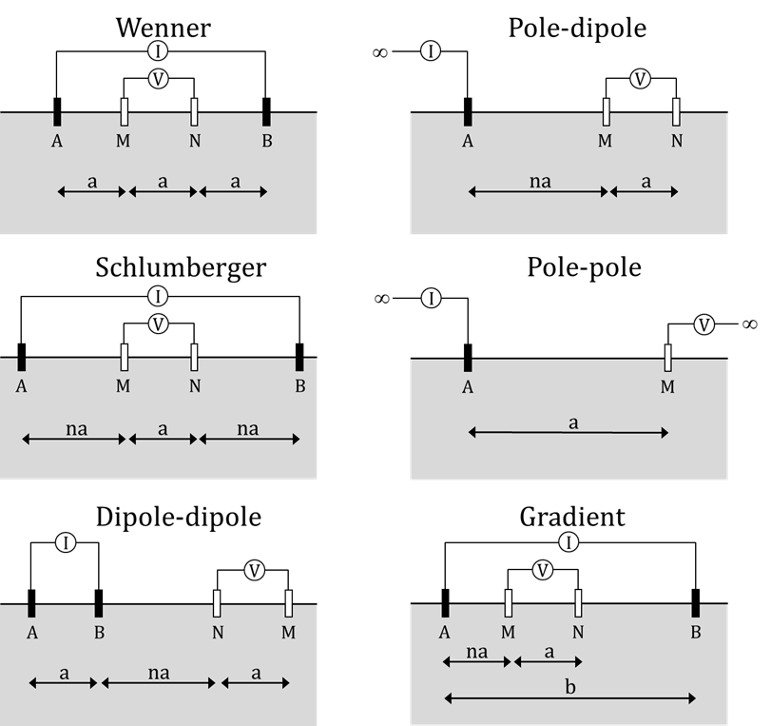



Standard electrode configurations
Specific array types are used with easy
to compute geometric factors (K) – (K depends on array)
Wenner array:
Dipole-dipole array:
The instrument calculates K for you.
From Unit 3
Source: Binley and Slater, 2020, Resistivity and induced polarization: theory and
applications to the near-surface Earth, In Press
Notes:
Partly because the general geometric factor for a 4 electrode array is a bit of a mouthful, geophysicists have adopted the use of standard arrays that yield a simpler expression of the geometric factor.
We will work with the Wenner array where the geometric factor is simply 2 times pi times the electrode spacing a.
We will also work with the dipole-dipole array. The geometric factor for the dipole-dipole array is a bit more involved but is again determined by a constant electrode spacing, and also an integer n representing the multiplier on a that defines the spacing between current electrode B and potential electrode N.
The other reason that geophysicists use such standard arrays is because they have different sensitivity patterns, meaning that some may be quite good for detecting lateral variations in resistivity whereas others will be good at detecting vertical variations in resistivity.
NOT SURE IF YOU NEED THIS SLIDE

Slide 44
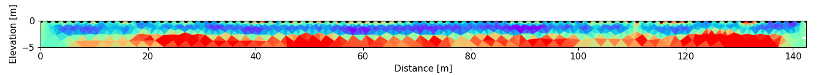
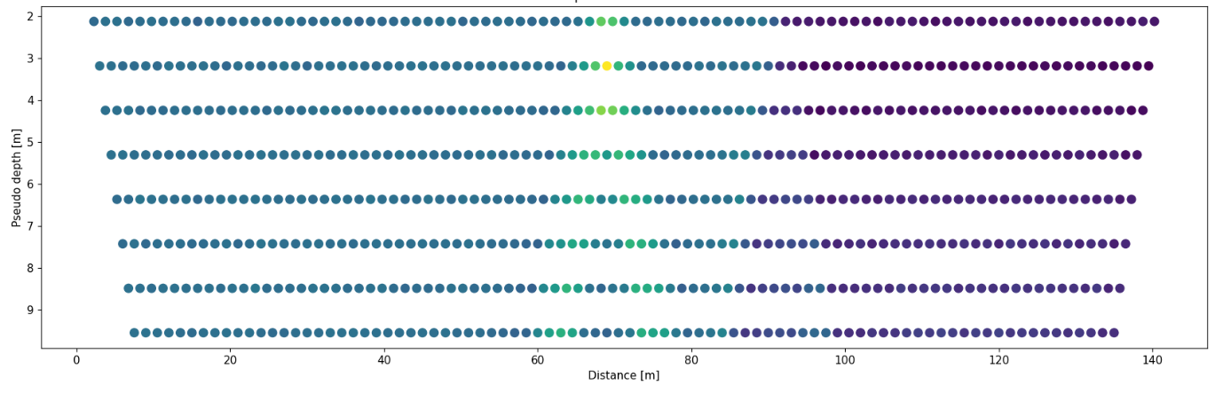
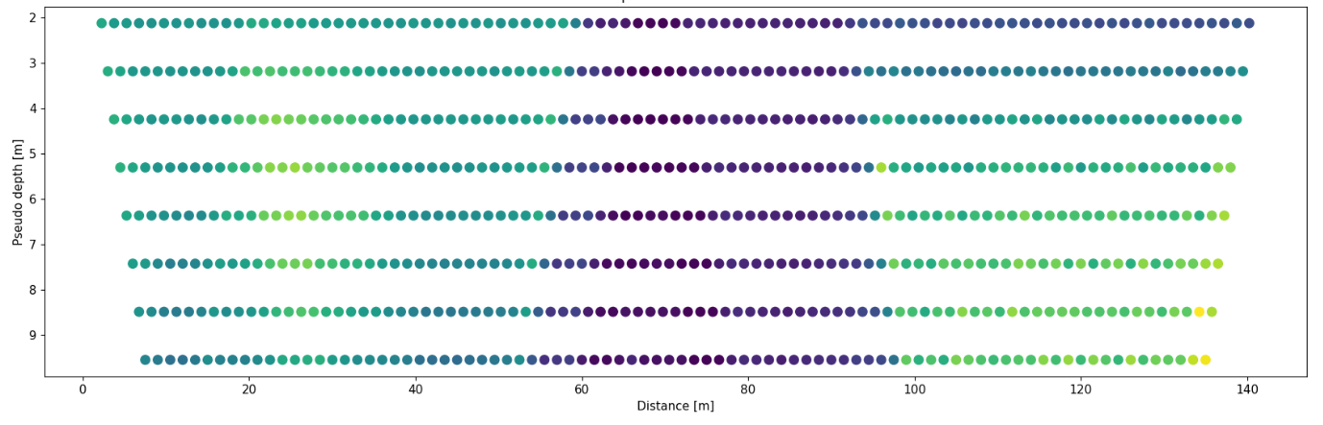
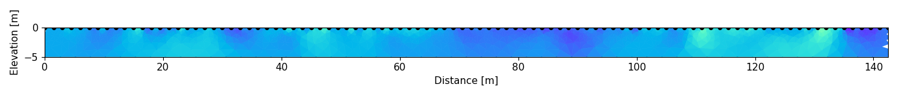
How does it work?
UNKNOWN RESISTIVITY MODEL OF THE EARTH
????
Measured pseudo section (with errors)
Synthetic pseudo section
Statistical comparison
`
Synthetic resistivity model
Forward modeling
From Unit 4: The Magic of Geophysical Inversion
Notes:
Go into this a little – explain it so there’s a transition.

Slide 45
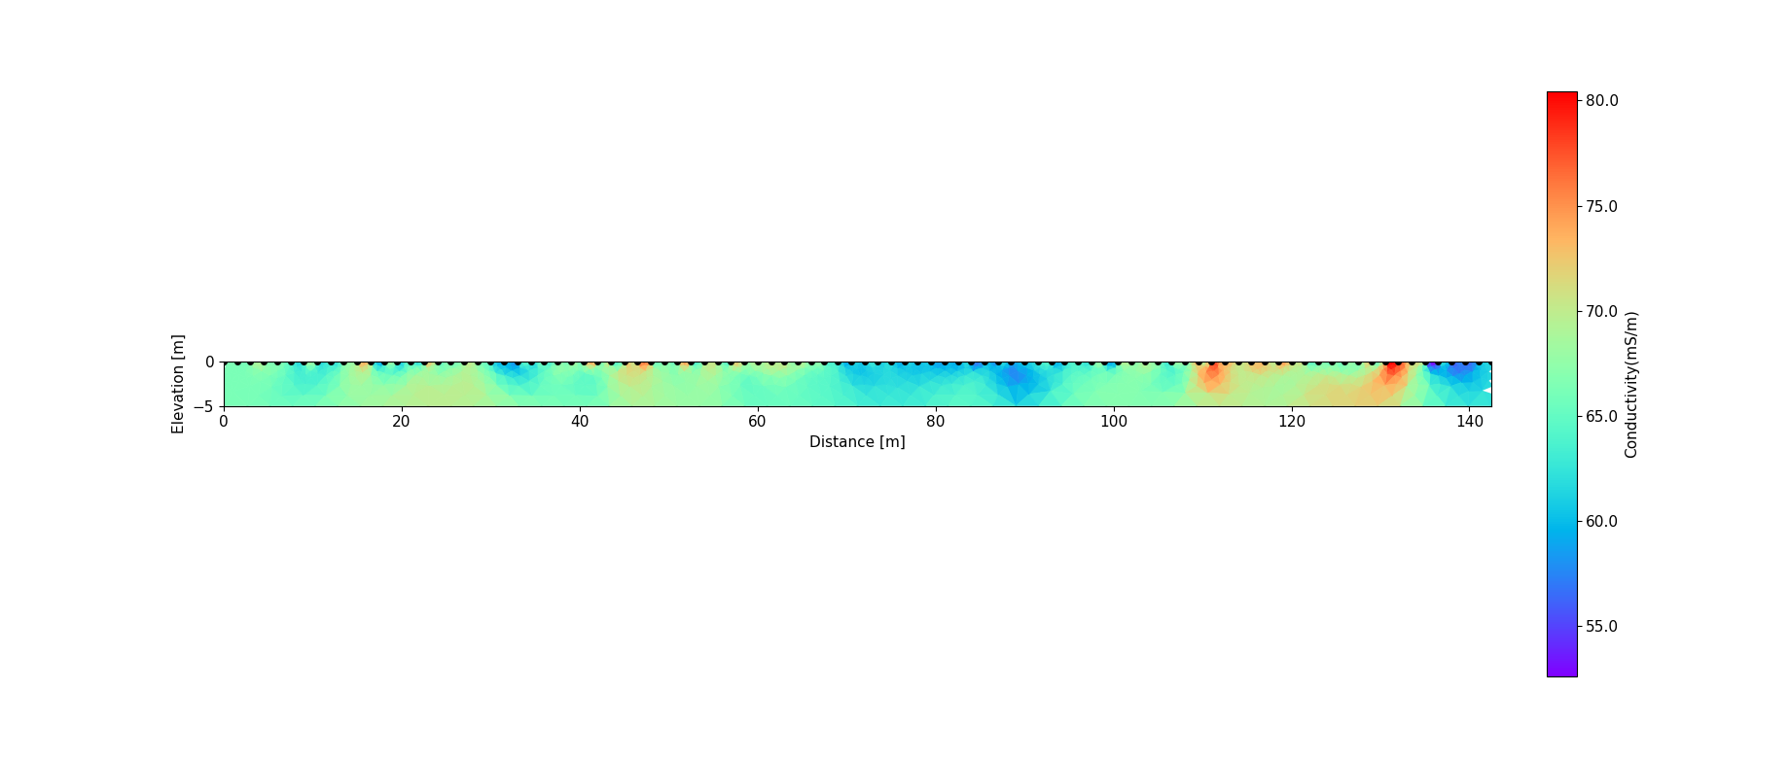
How does it work?
UNKNOWN RESISTIVITY MODEL OF THE EARTH
??
Field measurements (with errors)
Synthetic measurements
ADEQUATE GOODNESS OF FIT?
NO
ITERATE
Forward modeling
Revise synthetic resistivity model
From Unit 4: The Magic of Geophysical Inversion

Slide 46
How does it work?
ESTIMATED SUBSURFACE RESISTIVITY MODEL
FIELD SUBSURFACE RESISTIVITY ??
Measured pseudo section (with errors)
Synthetic pseudo section
ADEQUATE GOODNESS OF FIT?
YES
Forward modeling
From Unit 4: The Magic of Geophysical Inversion

