Slide 1
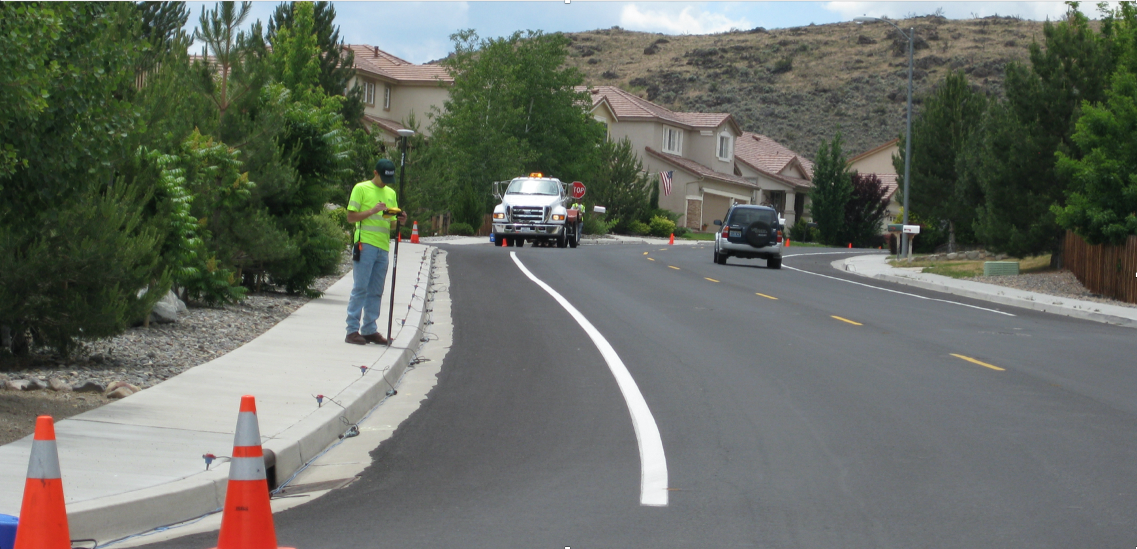
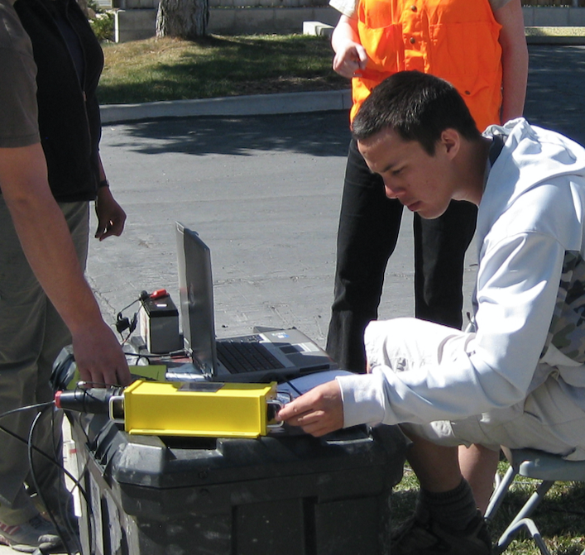
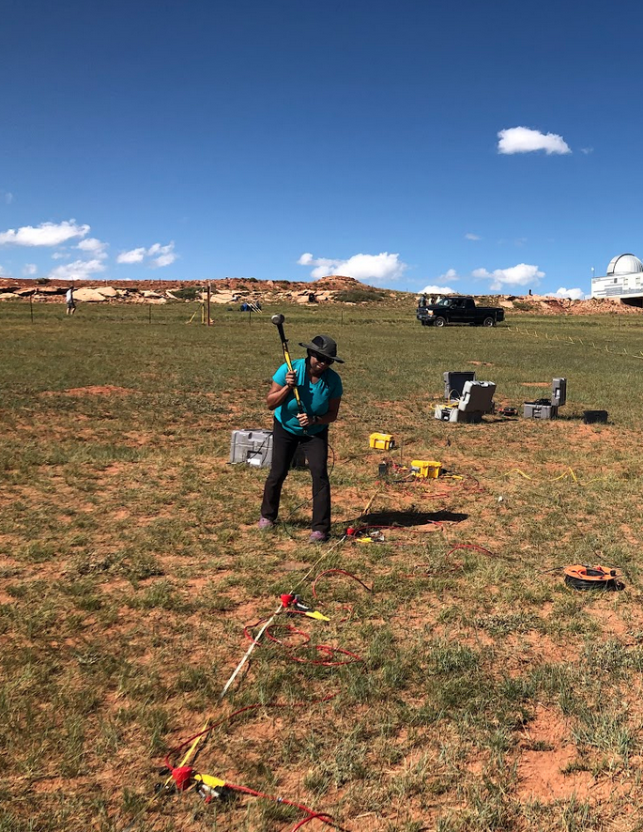

Shallow Seismic Refraction Technical Overview
10am MTN, July 15, 2025, Online
Dr. Andy Parsekian, University of Wyoming
Image credit: J. Louie, University of Nevada-Reno

Slide 2
Outline
Purpose: Introduce key concepts to prepare you for hands-on work
You should be familiar with:
vocabulary & physical principles;
Equation – distance, time ~ subsurface properties;
seismic velocities ~ Earth materials
Instrument parts
The workflow you will use for data analysis
Part 1: Introduction
Part 2: Waves and the Earth’s subsurface
Part 3: Physics of refraction
Part 4: Measurement and analysis of data

Slide 3
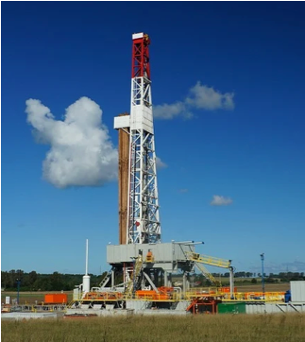
Why is geophysics important?
Geophysical measurements are critical for data at depth
Digging or drilling is expensive and time consuming and may be limited because of location
Geophysics can be rapid and obtain information over large areas at low cost
Stock photo
Notes:
Often when environmental scientists, geologists, and engineers need information about what is underground, geophysical measurements are critical for efficiently obtaining data at depth
Digging or drilling is very expensive and time consuming and may be limited because of location
Geophysics can be rapid and obtain information over large areas at low cost

Slide 4
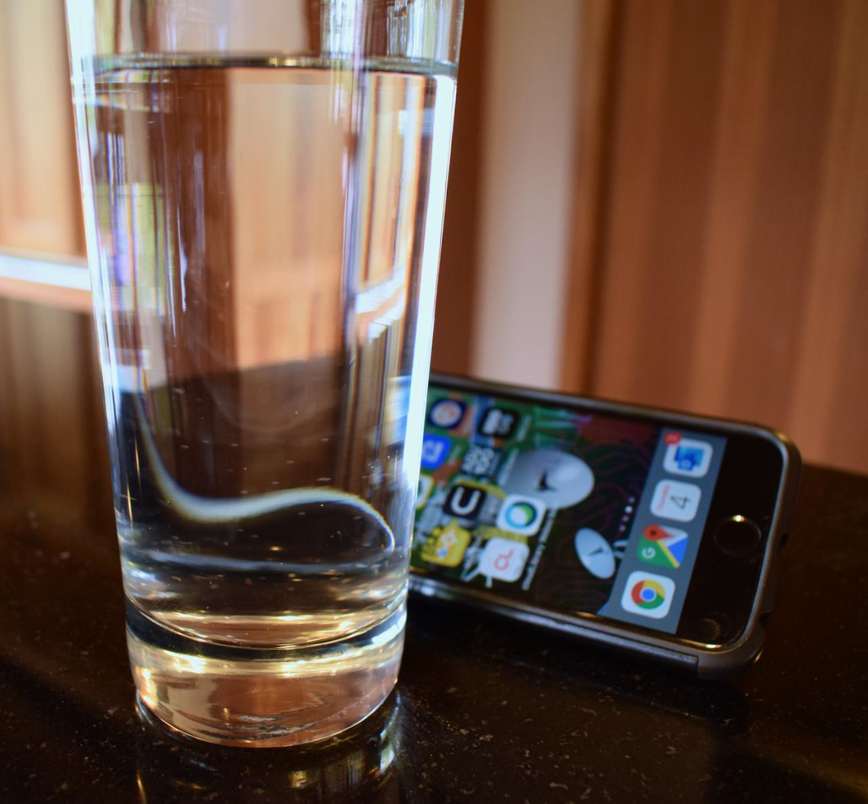
Seismic refraction: the core concept
Light bending through water creates a distortion.
Sound waves – vibrations known as “seismic waves” in the Earth – also bend.
Seismic refraction geophysics reveals properties and structures underground.
Source: A. Parsekian, U Wyoming
Notes:
Just like when you look through a glass of water and see how light is bent creating a distortion, sound waves – vibrations known as “seismic waves” in the Earth – also bend.
Seismic refraction geophysics uses the principles of bending waves in the Earth to reveal properties and structures underground.

Slide 5
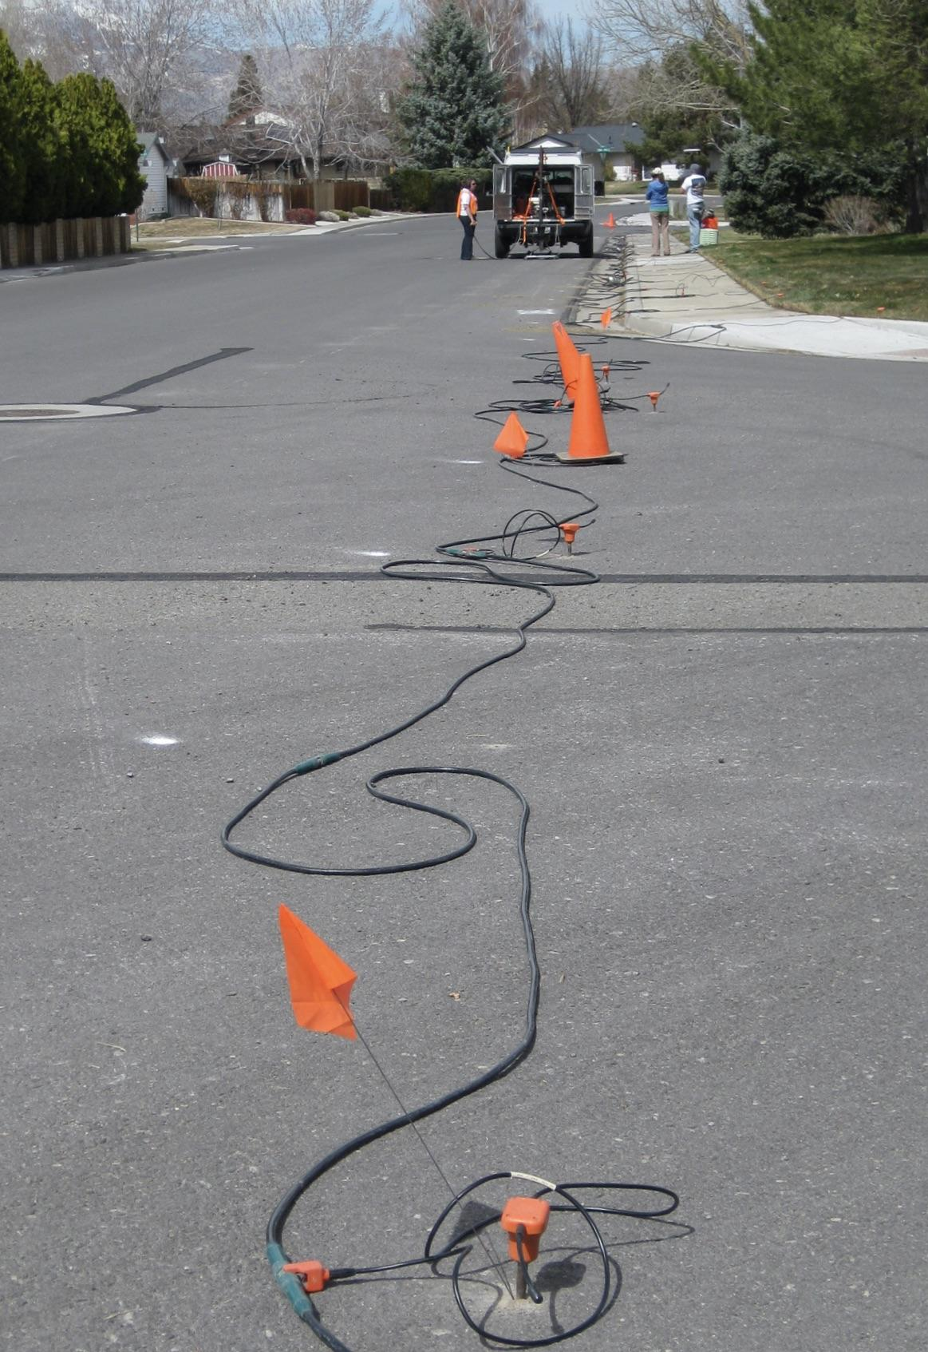
Part 1: Seismic Refraction Introduction
Speed of sound
Waves
Bedrock
Measurement limitations and advantages
Image credit: J. Louie, University of Nevada-Reno

Slide 6
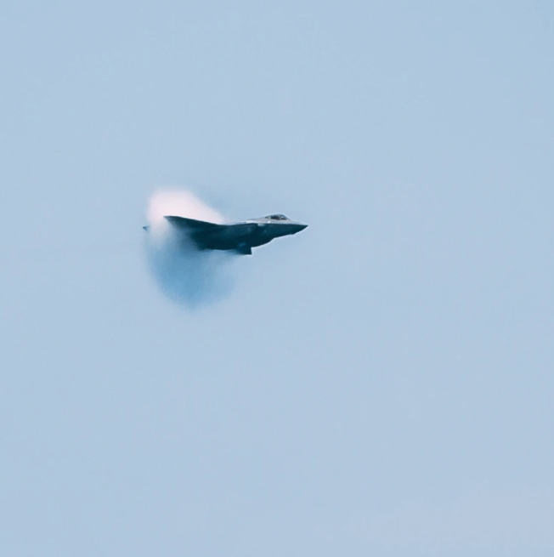
Speed of sound
Part 1: Seismic Refraction Introduction
In air, sound moves ~ 340 m/s.
(1 km = 3sec)
depends on air density
Temp
Humidity
Elevation
Velocity units -meters per second (m/s)
V = d/t
Image credit: Stock photo.
Notes:
In air, sound moves at around 340 m/s
This means it takes almost 3 seconds for a sound to travel 1km
This velocity changes slightly depending on the temperature, humidity and elevation, because of small variations in air density
For sounds, we usually record the velocity in units of meters per second.
If you want to add: In theory, if you shouted, you could measure how fast the sound of your voice travels by using a microphone placed across the room to record when the sound has arrived, a tape measure to know how far away the microphone is, and a very accurate stop-watch to observe the elapsed time.

Slide 7
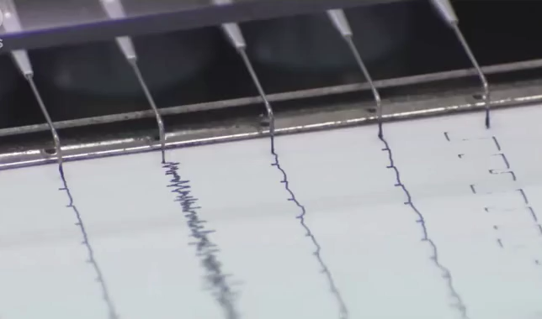
Sound travels as Waves
Part 1: Seismic Refraction Introduction
Wave - a disturbance that moves through a material over a distance
“Sound” – wave in the air
The wave transports energy – not material
Image credit: Stock photo.
Notes:
A wave is a disturbance that moves through a material over a distance; in the air we call this “sound”
Sound travels as waves
The particles of the material are not permanently displaced; rather the wave transports energy – not material

Slide 8
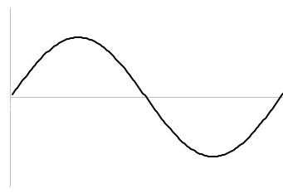
Waves
Part 1: Seismic Refraction Introduction
wavelength
Wave vocabulary
Peak/trough
Amplitude – Min/Max of peak/trough
Wavelength
Geophone - records wave energy over time in ground.
“seismic” waves – vibrations moving through the Earth
+
peak
amplitude
trough
-
time
distance
Notes:
If you could “feel” the vibrations in a material while a wave passes – the same way your ear works if someone is talking to you – the strength of the wave could be represented as diagramed on the right.
The same concept works for observing sound waves in the Earth, except we have special high precision sensors that act as our “ears on the Earth” known as seismometers or geophones. We call vibrations moving through the Earth “seismic” waves.

Slide 9
Waves
Part 1: Seismic Refraction Introduction
wavelength
+
The wave velocity (v) and the wavelength (λ) together control the frequency (f), which has units of Hertz (Hz), or cycles-per-second.
peak
amplitude
trough
meters per second
-
time
meters
distance
See Unit 1, Exercise 1
Notes:
The wave velocity (v) and the wavelength (λ) together control the frequency (f), which has units of Hertz (Hz), or cycles-per-second.

Slide 10



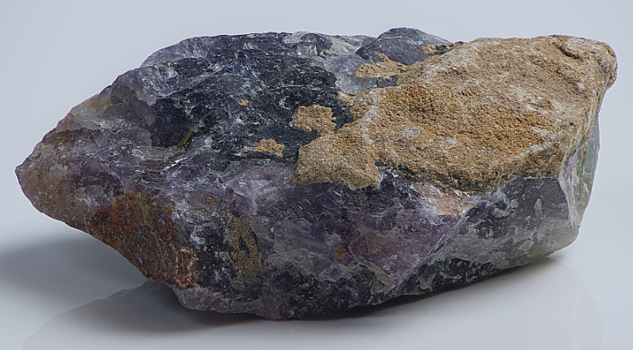
Waves in the Earth
Part 1: Seismic Refraction Introduction
air = 340 m/s
Velocity of sound wave depends on material
Infer material by velocity
soil = 400 m/s
water = 1,450 m/s
rock > 3,000 m/s
Image credit: Stock photos
Notes:
The velocity that a sound wave moves at is different depending on the material
So Different materials support different velocities associated with them
In the Earth, there are materials such as soil, water, and rocks – sound waves usually move faster through Earth materials than through air
We can infer what is in the Earth by the velocity of the wave without having to drill to deep

Slide 11



Bedrock
Part 1: Seismic Refraction Introduction
air = 340 m/s
Bedrock is the solid & stable layer of rock
Different properties than soil
Important for
buildings, roads, tunnels
underground water
pollution leaking into the ground
Landslides
Geophysical Target due to fast velocity
soil = 400 m/s
water = 1,450 m/s
rock > 3,000 m/s
Image credit: Stock photos
Notes:
Geophysicist often want to locate bedrock underground
Bedrock is the solid layer of rock below loose materials such as soil
Bedrock is stable, and therefore very important for buildings, roads, tunnels
Bedrock has different properties than soil, so is also important for underground water, pollution leaking into the ground, and landslides

Slide 12
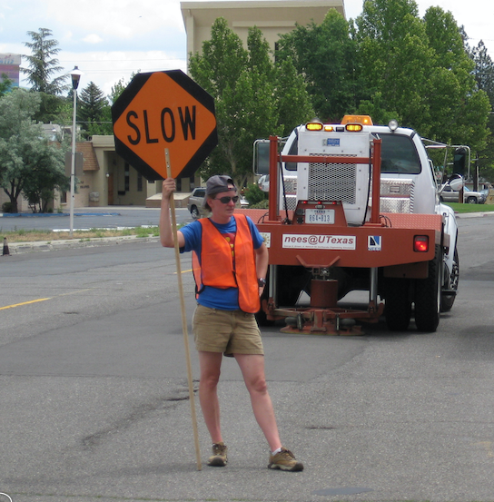
Limitations and advantages of seismic imaging
Part 1: Seismic Refraction Introduction
Limitations
noise that makes data analysis more difficult
images are always estimates
Advantages
Cost effective on a per-area basis
Does not disturb the subsurface
Saves time
May retrieve information about deeper depths
Image credit: J. Louie, University of Nevada-Reno
Notes:
Limtations
Anything else shaking the ground besides the seismic source also causes noise that makes data analysis more difficult: e.g., cars, trains, people…
The locations of roads and buildings may limit where you can place sensors
Due to the details of data analysis, the resulting images are always estimtaes
Advantages
Cost effective on a per-area basis
Does not disturb the subsurface
Saves time by guiding invasive drilling and digging
May retrieve information about depths deeper than could be easily accessed by excavation

Slide 13
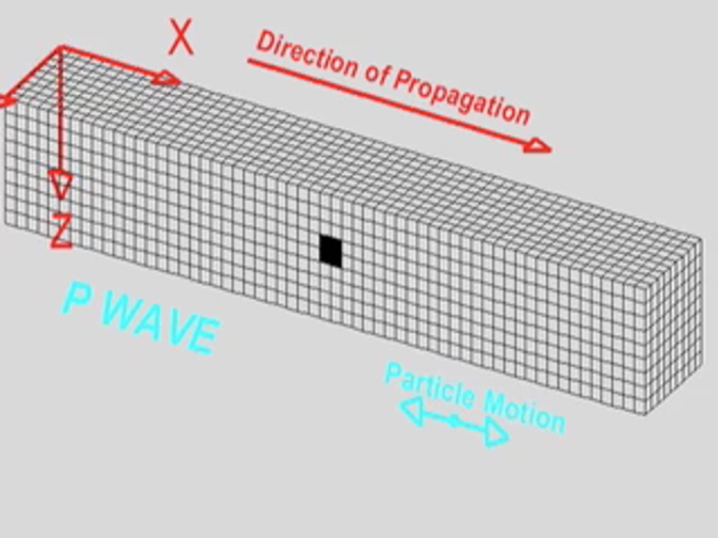
Part 2: Waves and the subsurface structure
What are seismic waves
Types of waves
Wavefronts & rays
Conceptual models of the subsurface
Important materials and geometries

Slide 14
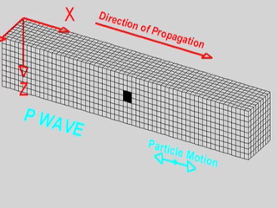
What happens when the ground shakes?
Part 2: Waves and the subsurface structure
P-wave - compressional waves along X-axis
The fastest seismic wave
The wave speed (velocity) determined by the Earth material properties
Notes:
When sound energy is passed into the ground, it will travel as waves.
The fastest wave is called a “p-wave” and causes compressional movement of the ground
The speed (velocity) of the wave is determined by the Earth material properties

Slide 15
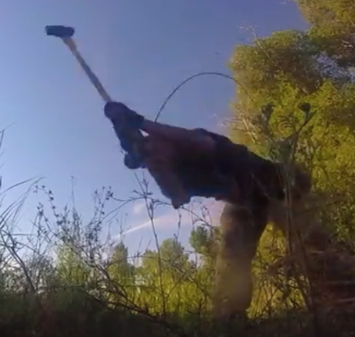
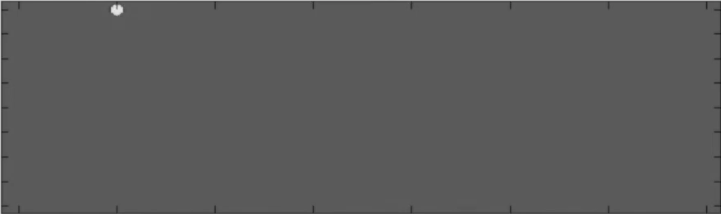
Waves traveling underground
Part 2: Waves and the subsurface structure
Watch as the refracted wave overtakes the direct wave at the surface here
SLOWER material
FASTER material
When there are two layers that support different wave velocities, some energy is returned to the surface.

Slide 16
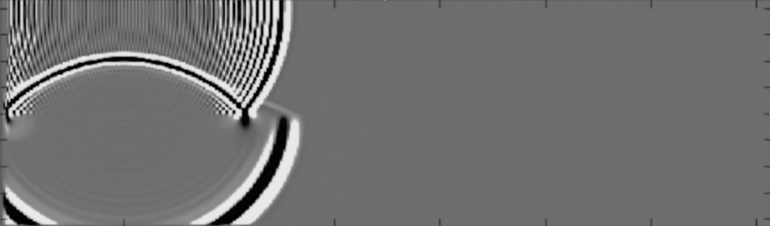
Waves traveling underground
Part 2: Waves and the subsurface structure
SLOWER material
this is the refracted wave as it begins to emerge from the interface
FASTER material

Slide 17
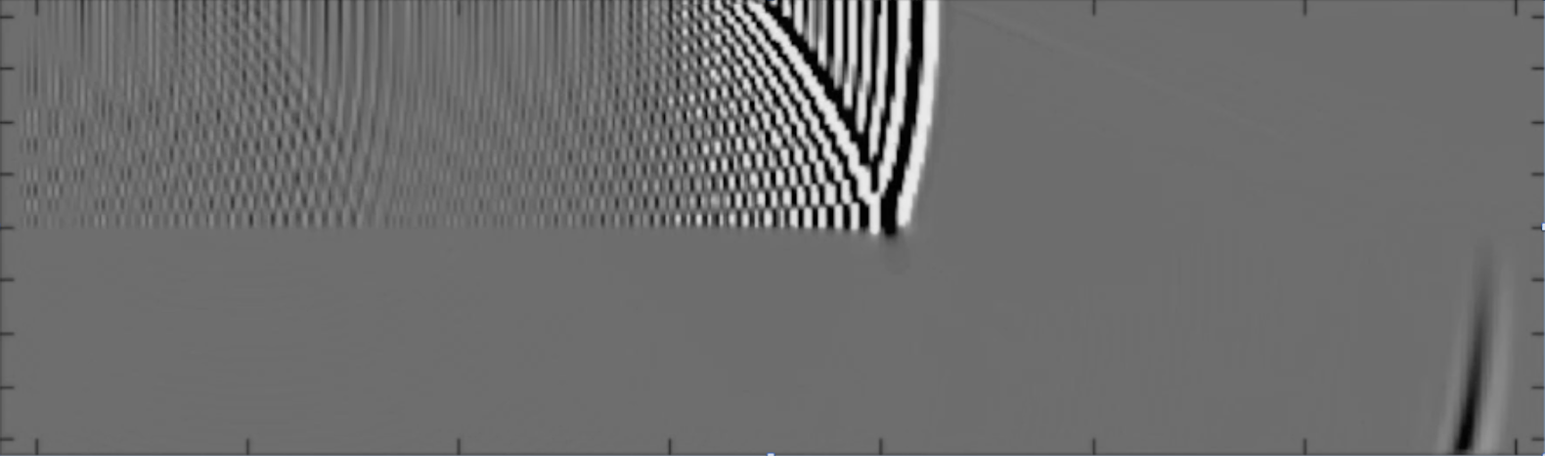
Waves traveling underground
Part 2: Waves and the subsurface structure
SLOWER material
here, the refraction is just beginning to appear at the surface ahead of the direct wave
FASTER material

Slide 18
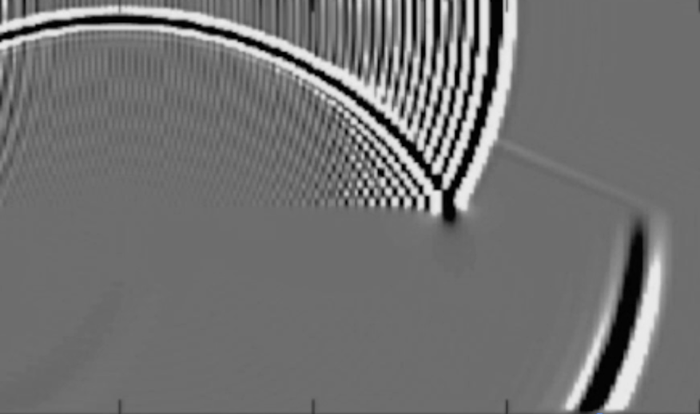
Waves and rays
Part 2: Waves and the subsurface structure
ground wave
Often, the most important information is only the POINT where the waves start from and the POINT where we record them – therefore, we don’t care as much about the entire wave.
We can simplify the waves into RAYS that connect the source and receiver points.
The example on the left is a simple example of the ground structure, however these ray paths become more complicated under natural conditions.
reflected ray
critically refracted ray
refracted ray
transmitted ray

Slide 19
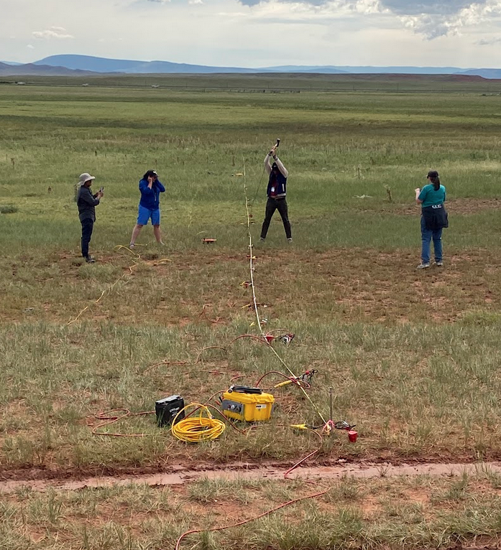
Part 3: Physics of Refraction
What is refraction?
Refraction equations for seismology
Material properties

Slide 20
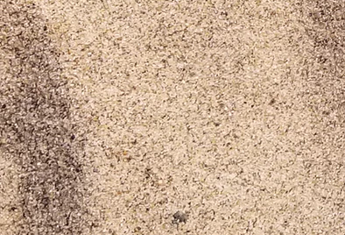
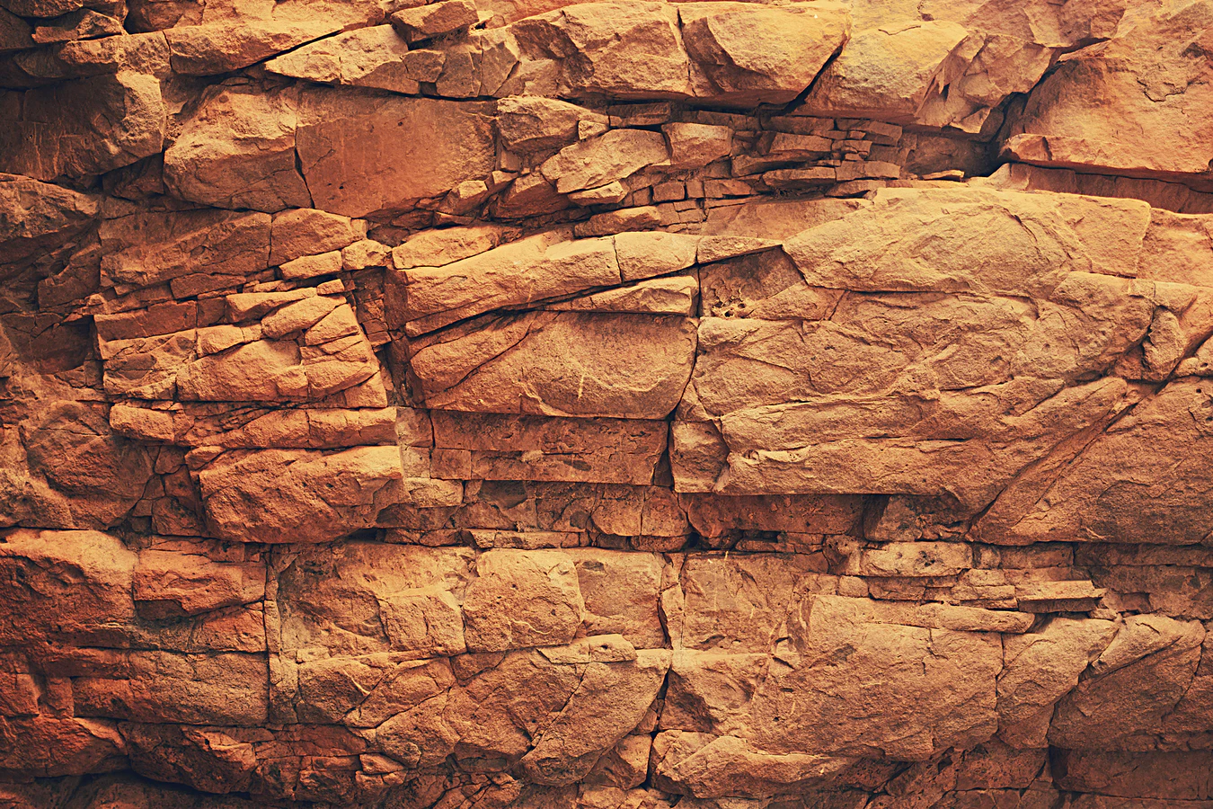
Speed of sound in the Earth
Part 3: Physics of Refraction
Different materials allow sound waves to travel at various speeds,
material type,
what materials are present,
shape of individual material.
Faster velocities at depth:
The lower layer is rock
SLOWER material
FASTER material
Notes:
Different materials allow sound waves to travel at various speeds, mostly controlled by material type, what materials are present, and the shape of each individual material.
In our example, the top layer is sand with air surrounding each grain, and this combination allows relatively slow seismic energy movement.
The lower layer is rock with a few fractures. Since the rock is stiff and dense, it allows for faster velocities.

Slide 21
Speed of sound in the Earth
Part 3: Physics of Refraction
SOURCE!
RECEIVER!
Velocity (v) of a material =how long it takes (t) sound to travel over a distance (d) – between the source and receiver: v = d/t.
The same can be done for other rays
SLOWER material
FASTER material

Slide 22
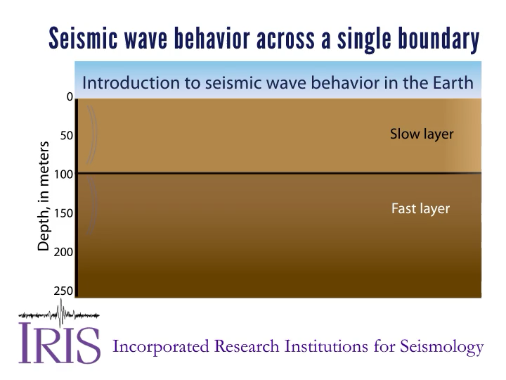
Speed of sound in the Earth
Part 3: Physics of Refraction
Slow layer above fast = refracted rays bent towards surface
(Critically refracted – travel along interface.)
Fast layer above slow = refracted rays bent away from surface so we never see it.
Notes:
https://www.iris.edu/hq/inclass/animation/seismic_wave_behavior_a_single_boundary_refracts__reflects

Slide 23
Snell’s Law: Refraction
Part 3: Physics of Refraction
SOURCE!
RECEIVER!
Refraction: bending of a ray as it crosses a boundary or interface.
SLOWER material
θ₁
Critical refraction, θ2 = 90°
v₁
refraction
FASTER material
θ₂
v₂
Notes:
It is caused when there are two materials with different seismic velocities.

Slide 24
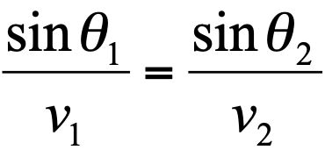
Snell’s Law: Refraction
Part 3: Physics of Refraction
We will always measure t the same way as before. d is the sum of the lengths of the three red rays, and that changes depending on these angles. To calculate d, we need to figure out what these angles are: Snell’s law can be used to calculate this.
SOURCE!
RECEIVER!
these angles
SLOWER material
θ₁
v₁
θ₂
v₂
FASTER material
Critical refraction, θ2 = 90°

Slide 25
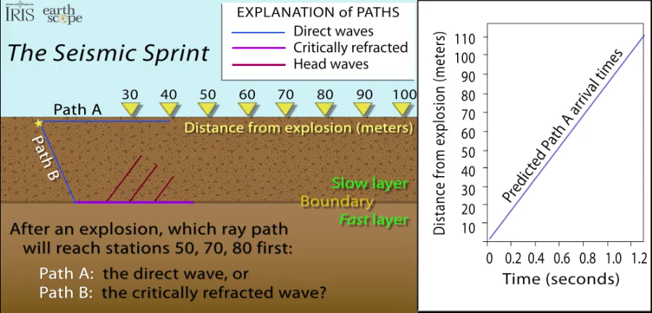
Part 3: Physics of Refraction
Notes:
https://www.iris.edu/hq/inclass/animation/seismic_wave_behavior_critically_refracted_rays

Slide 26
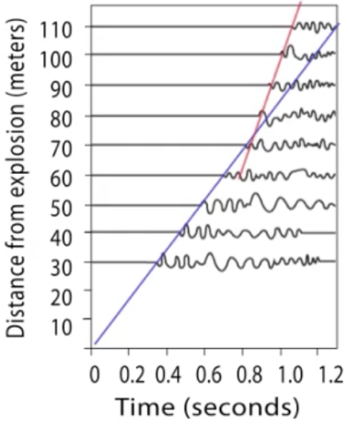
Travel time vs. offset plots
Part 3: Physics of Refraction
SOURCE!
RECEIVER!
Since we are limited to measurements made at the ground surface, the two observations we have are “Travel time” (time since our source/hammer-blow) and offset (distance between locations where we measure travel time, known as ‘receivers’). Plotting these together produces a “travel-time/offset plot.”

Slide 27
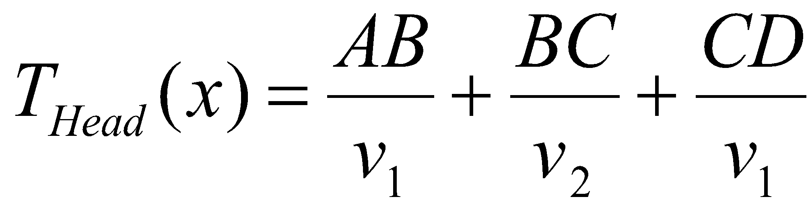
Travel time for a two layered subsurface
Part 3: Physics of Refraction
SOURCE!
RECEIVER!
A
D
V₁
B
C
V₂

Slide 28
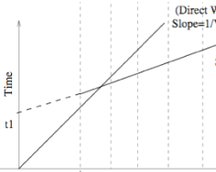
Travel time for a two layered subsurface
Part 3: Physics of Refraction
R1
R2
R3
R4
R5
SOURCE!
A
D
Direct wave
Slope = 1/V₁
V₁
Refracted wave
Slope = 1/V₂
B
C
V₂
R1
R2
R3
R4
R5
Offset
Offset = distance

Slide 29
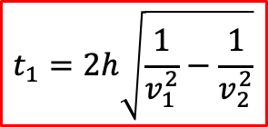
Travel time for a two layered subsurface
Part 3: Physics of Refraction
R1
R2
R3
R4
R5
SOURCE!
A
D
Direct wave
Slope = 1/V₁
V₁
Refracted wave
Slope = 1/V₂
B
C
V₂
v₁ and v₂ can be read off of the travel-time/offset plot
t₁ can be projected on the graph based on the slope of v₂
Rearrange algebraically to solve for h (h= thickness of the top layer)
R1
R2
R3
R4
R5
Yellow circles show what we need to know

Slide 30
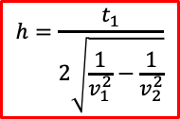
Travel time for a two layered subsurface
Part 3: Physics of Refraction
R1
R2
R3
R4
R5
SOURCE!
A
D
Direct wave
Slope = 1/V₁
V₁
Refracted wave
Slope = 1/V₂
B
C
V₂
v₁ and v₂ can be read off of the travel-time/offset plot
t₁ can be projected on the graph based on the slope of v₂
Rearrange algebraically to solve for h (h= thickness of the top layer)
R1
R2
R3
R4
R5
See exercise #2: Calculate the velocities of both layers (v₁, v₂) and the thickness of the top layer (h) based on travel-time/offset seismic refraction data

Slide 31
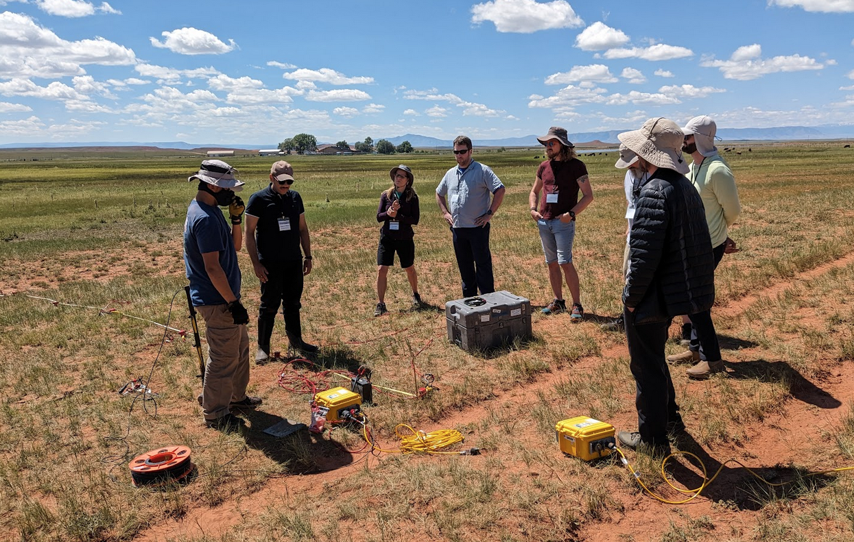
Part 4: Data acquisition and analysis
Materials and supplies
Survey planning and setup
Measurement
Looking at the data

Slide 32
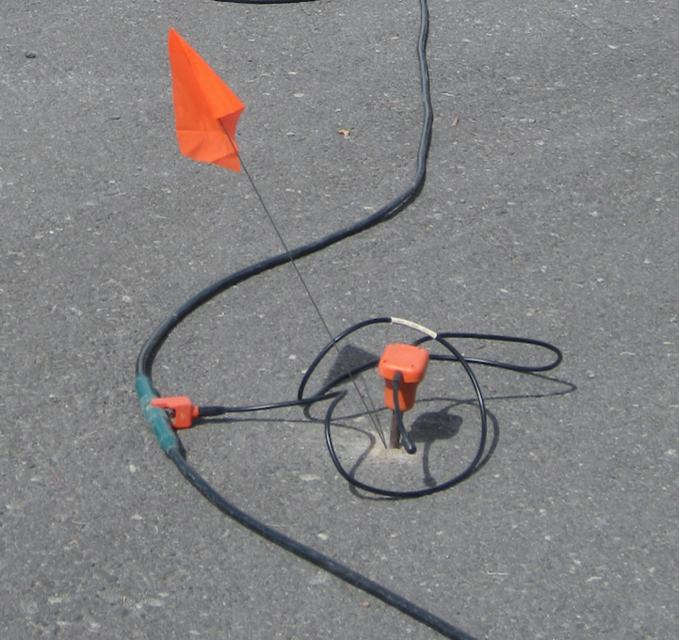
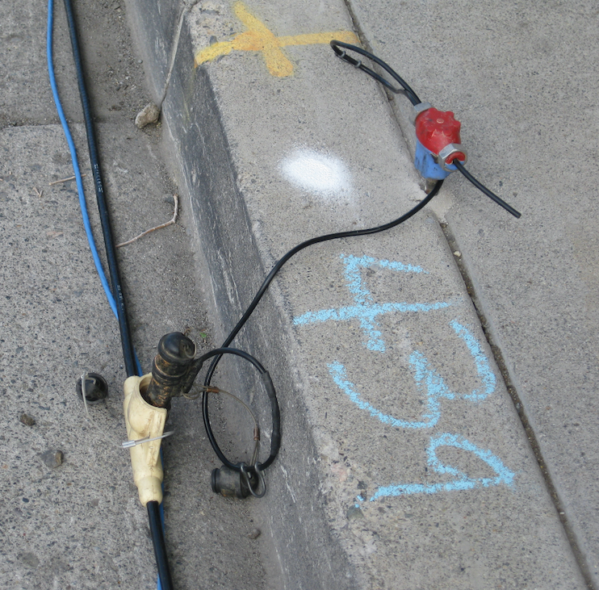
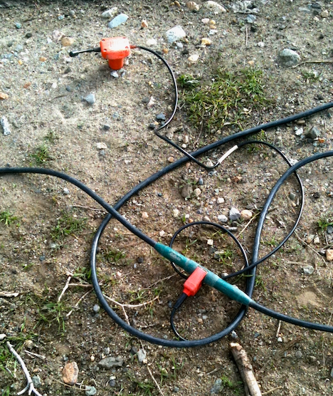
Data acquisition: equipment
Part 4: Data acquisition and analysis
Geophones (“receivers”):
converts the seismic vibrations into an electrical impulse.
attached to the ground,
Image credit: J. Louie, University of Nevada-Reno
Notes:
Geophones (“receivers”): these are the sensor that converts the seismic vibrations into an electrical impulse that is recorded on the seismograph. They are securely attached to the ground, either by drilling into pavement, finding cracks in concrete, or pushed into soil.

Slide 33
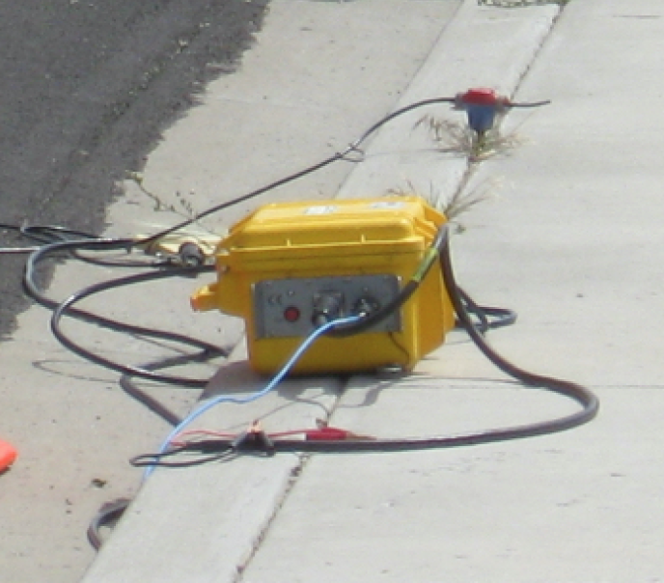
Data acquisition: equipment
Part 4: Data acquisition and analysis
Seismograph:
converts the signals from the geophones into data
inside a box with cable connectors on the outside.
has a set number of channels, or connections available for geophones. (usually ~24)
Image credit: J. Louie, University of Nevada-Reno
Notes:
This is the part of the instrument that converts the signals from the geophones into data that is sent to a laptop computer. Usually the seismograph is inside a box with cable connectors ont the outside, though some seismographs have built-in computers. A seismograph has a set number of channels, or connections available for geophones. You cannot use more geophones than the number of channels your seismograph has available (usually about 24).

Slide 34
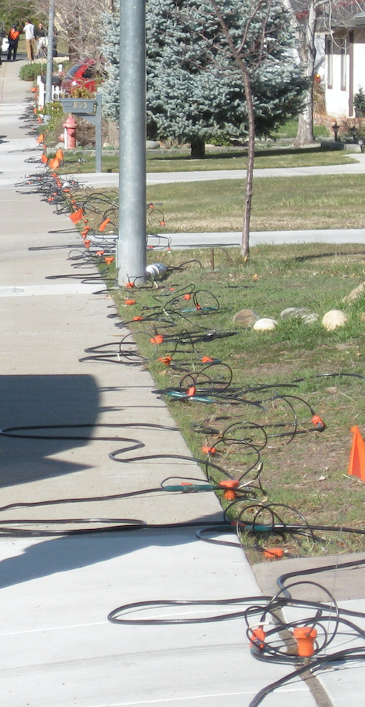
Data acquisition: equipment
Cables:
connect each geophone to the seismograph
evenly spaced takeouts along the long wires
TAKEOUT
TAKEOUT
TAKEOUT
Image credit: J. Louie, University of Nevada-Reno
Notes:
The seismic cables connect each geophone to the seismograph. There are evenlys paced takeouts along the long wires to connect the geophones.

Slide 35
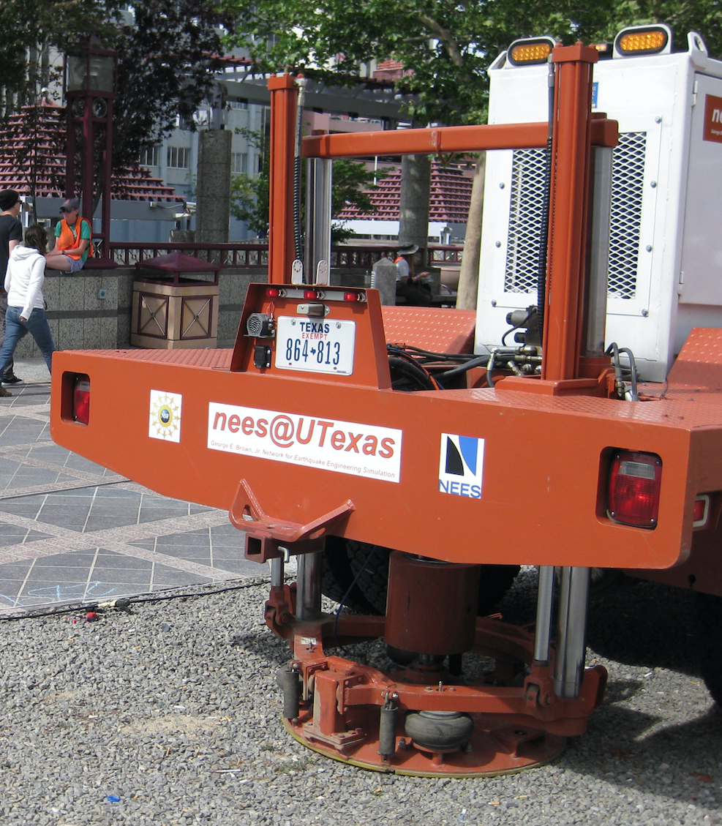
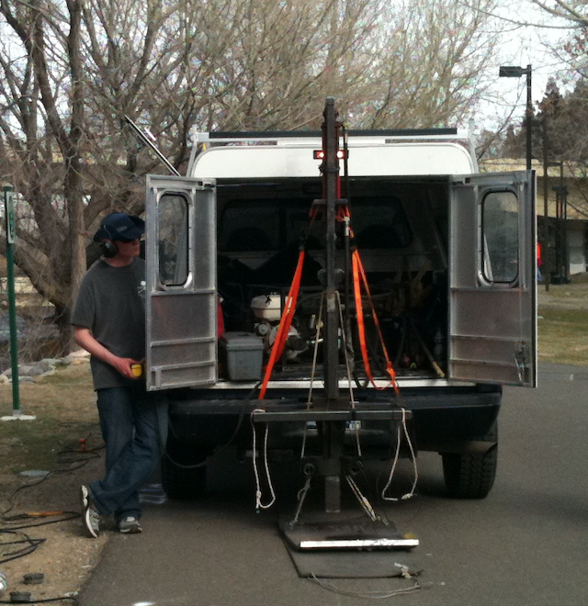
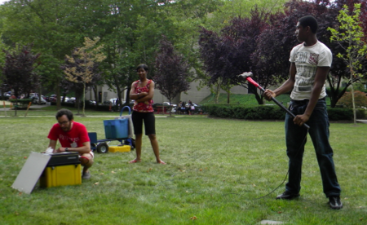
Data acquisition: equipment
Seismic source (“shot”):
To generate waves in the ground, some kind of mechanical impulse is used.
Sledgehammer swung by a person to strike a steel plate (10-30m depth~ earth properties)
heavy weight with the help of a machine (couple hundred meters)
Special trucks with large vibrating weights (potentially to kilometers)
VIBRO-SEIS
WEIGHT-DROP
SLEDGE HAMMER
Image credit: Andy Parsekian, U. Wyoming
Image credit: J. Louie, University of Nevada-Reno
Notes:
To generage waves in the ground, some kind of mechanical impulse is used. Most frequently this is a sledgehammer swung by a person to strike a steel plate, or a heavy weight that is dropped with the help of a machine. Special trucks with large vibrating weights are also used as a seismic source.

Slide 36
Data acquisition: equipment
Control computer:
connect to a computer for overall measurement control and data storage.
Surveyors make choices about parameters:
Location of source
Geophones distribution
How waves are recorded
Etc.
Image credit: J. Louie, University of Nevada-Reno
Notes:
Control computer: The seismograph is connected to a computer for overall measurement control and data storage. Surveyors make choices about where the seismic sources are located, where and how geophones are distributed, and how waves are recorded, all based on what kind of data they want to collect.

Slide 37
Data acquisition: setup
Line length:
depends on the subsurface structure and the measurement objective (see Exercise 1 of Unit 3).
Geophone spacing:
The closer the spacing, the easier it will be to detect thin layers.
Depends on the soil on the surface which can be less than one meter thick.
Image credit: J. Louie, University of Nevada-Reno
Notes:
Line length: A common consideration is how long to make the seismic line. These are almost always straight, if possible. This will depend on the subsurface structure and the measurement objective (see Exercise 1 of Unit 3).
Geophone spacing: A related choice is the spacing between geophones. The closer the spacing, the easier it will be to detect thin layers. Often this is very important with the soil on the surface which can be less than one meter thick.

Slide 38
Data acquisition: setup
Stacking: - “repeated measurements.”
By repeating the seismic source “shot”
– can produce a dataset with higher signal strength and lower noise.
Image credit: Andy Parsekian, U. Wyoming
Notes:
Stacking: This is simply a geophysics word that means “repeated measurements.” By repeating the seismic source “shot” – whether it is a hammer strike, weight drop, or something else – it is possible to combine the data from each repetition and produce a dataset with higher signal strength and lower noise.

Slide 39


Data acquisition: setup
Shot locations:
ONE shot - estimate of velocity over depth
(horizontal layered subsurface)
TWO shots - estimate the angle of subsurface layers if dipping.
MANY shots can allow for 2D images
one shot
two shots
Image credit: J. Louie, University of Nevada-Reno
Notes:
Shot locations: Once you have set up the geophones on your seismic line, you can make one, two, or many shots on and near the line. ONE shot can give you an estimate of velocity over depth, assuming a horizontally layered subsurface. TWO shots can also allow you to estimate the angle of subsurface layers if they are dipping. Using MANY shots can allow for 2D images to be calculated. With 1-2 shots, students can do calculations w paper and pencil

Slide 40
Conducting the measurement
Locate your line and mark it with a tape measure
Push the geophones into the ground at intervals selected during planning
Connect the cables
Start the computer and launch the acquisition software
Strike the hammer at the predetermined shot locations

Slide 41
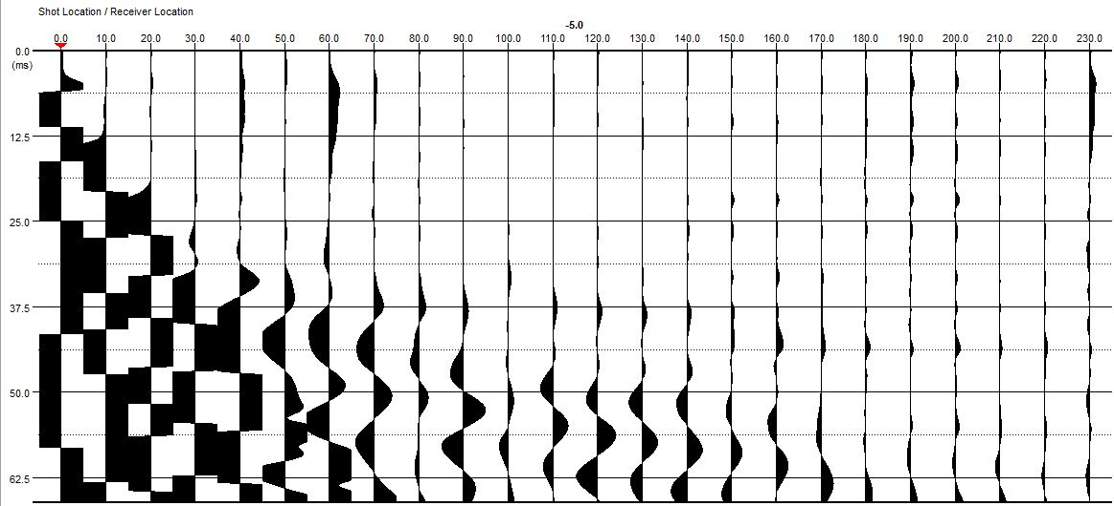
What’s in a seismogram? A first look at the data
SHOT!
Line #3
distance [feet]
“Wiggle Plot”
y-axis shows the time
x-axis is the distance in feet.
The wiggle indicates positive and negative amplitude of the seismic energy.
time [milliseconds]
The seismic refraction data was collected by Rick A. Hoover, PG of Quality Geosciences Company, LLC. We also recognize the York County Economic Alliance and their Codorus Creek Beautification Initiative.
Notes:
This image is usually produced on the field laptop or sometimes on the instrument itself. It is often called a “wiggle plot” due to the wiggly line recorded for each geophone. There were 24 geophones on the instrument, so there are 24 corresponding lines. The y-axis shows the time and the x-axis is the distance along the line in feet. The wiggle is shaded to indicate positive and negative amplitude of the seismic energy as it passes each geophone.
Different shapes of wave shapes are just from plotting

Slide 42
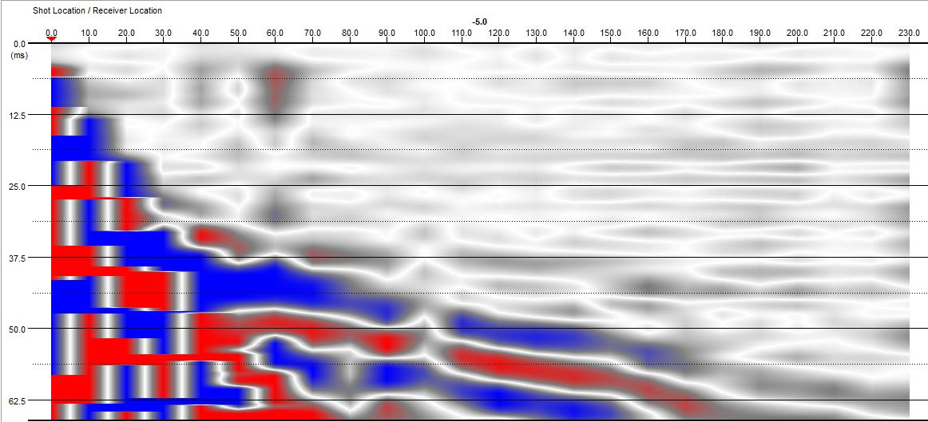
What’s in a seismogram? A first look at the data
SHOT!
Line #3
“Colorplot.” - SAME data
one shot –one seismic source location at -5 ft along the line, and the associated records – known as “traces”
changes in color are known as the “first arrivals” - first energy to arrive from the hammer source.
The seismic refraction data was collected by Rick A. Hoover, PG of Quality Geosciences Company, LLC. We also recognize the York County Economic Alliance and their Codorus Creek Beautification Initiative.
Notes:
“Colorplot.” - SAME data
It is mostly a matter of personal preference - some geophysicist find it easier to look at the wiggles, and others like the colorplot.
This images shows one shot – that is, this is one seismic source location at -5 ft along the line, and the associated records – known as “traces” - for all 24 geophones.
All of the changes in color on each trace immediately below the yellow line are known as the “first arrivals” because they are the first energy to arrive from the hammer source.

Slide 43
What’s in a seismogram? A first look at the data
SHOT!
Line #3
Everything ABOVE the yellow line – the subtle variations in gray – represent ambient noise at the site. -- we can ignore it
noise below the yellow line is combined with the hammer strike signal.
The seismic refraction data was collected by Rick A. Hoover, PG of Quality Geosciences Company, LLC. We also recognize the York County Economic Alliance and their Codorus Creek Beautification Initiative.
Notes:
Everything ABOVE the yellow line – the subtle variations in gray – represent ambient noise at the site. This may be caused by trucks, cars, trains, even wind and trees. There is also noise in the part of the data below the yellow line, but is is combined with the hammer strike signal.

Slide 44
What’s in a seismogram? Extracting information
SHOT!
Line #3
we need the velocity of each layer, and t₁ intercept time.
The velocity of the surface material, v1 - slope of arrivals that point directly to the shot location at -5 ft.
The seismic refraction data was collected by Rick A. Hoover, PG of Quality Geosciences Company, LLC. We also recognize the York County Economic Alliance and their Codorus Creek Beautification Initiative.
Notes:
As you’ll recall, we need to get the velocity of each layer, as well as the t₁ intercept time.
The velocity of the surface material, v1, can be found by estimating the slope of the arrivals that point directly to the shot location at -5 ft.

Slide 45
What’s in a seismogram? Extracting information
SHOT!
Line #3
The velocity of the lower layer – the refraction interface -
v₂ - slope of the arrivals that bend away from the direct arrival that you already drew.
A sharper bend indicates a larger contrast between layers.
The seismic refraction data was collected by Rick A. Hoover, PG of Quality Geosciences Company, LLC. We also recognize the York County Economic Alliance and their Codorus Creek Beautification Initiative.
Notes:
The velocity of the lower layer – the refraction interface - v₂, can be found by estimating the slope of the arrivals that bend away from the direct arrival that you already drew.
A sharper bend indicates a larger contrast in material properties between layers.

Slide 46
What’s in a seismogram? Extracting information
SHOT!
Line #3
As you’ll recall, we need to get the velocity of each layer, as well as the t₁ intercept time.
The t₁ intercept time can be read off the y-axis.
The seismic refraction data was collected by Rick A. Hoover, PG of Quality Geosciences Company, LLC. We also recognize the York County Economic Alliance and their Codorus Creek Beautification Initiative.

Slide 47
What’s in a seismogram? Extracting information
SHOT!
Line #3
It’s possible to just estimate these slopes from the image using a simple rise over run calculation for each slope…
(63 ft, 37.5 ms)
v₂ = (50 ms-37.5 ms)/(155 ft – 63 ft)
= 12.5 ms / 92 ft
= 0.136 ms / ft
= 7,360 ft /s
(155 ft, 50 ms)
The seismic refraction data was collected by Rick A. Hoover, PG of Quality Geosciences Company, LLC. We also recognize the York County Economic Alliance and their Codorus Creek Beautification Initiative.

Slide 48
What’s in a seismogram? Extracting information
SHOT!
Line #3
… be more precise and pick the first arrival on every trace to plot as a travel time-offset diagram.
There is some natural variation in the first breaks due to noise and uncertainties
Note the coordinate pair for each first arrival in a list in excel.
(63 ft, 37.5 ms)
(155 ft, 50 ms)
The seismic refraction data was collected by Rick A. Hoover, PG of Quality Geosciences Company, LLC. We also recognize the York County Economic Alliance and their Codorus Creek Beautification Initiative.
Notes:
… but it’s better to be more precise and pick the first arrival on every trace to plot as a travel time-offset diagram.
There is some natural variation in the first breaks due to noise and uncertainties, so by picking the arrival on every trace, we can calculate the slope of the line as precisely as possible.
Note the coordinate pair for each first arrival in a list in excel.

Slide 49
Interpretation
conceptual model
travel time-offset diagram
refraction analysis equation
t_{1,a}
v_{1,a}
v_{2,a}
v₁
h
t_{1,b}
v_{1,b}
v_{2,b}
v₂
Once we’ve reduced the data to a conceptual model that has quantitative information included from the refraction survey, we are ready to provide answers to our posed questions.

Slide 50
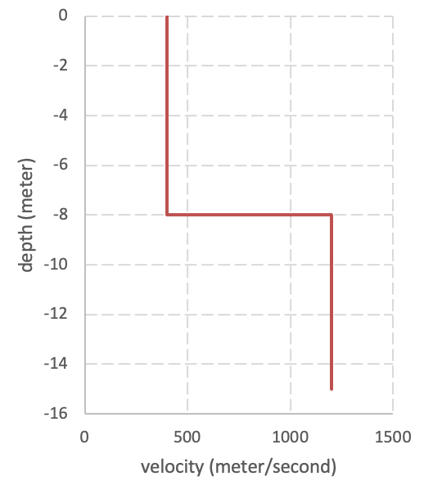
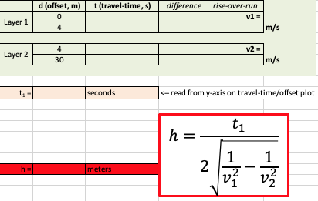
Processing workflow
Load/visualize raw data
Digitize/pick first arrivals
Calculate slopes/y-int
Follow PickWin tutorial
(see Unit 3, Part 2a)
Follow PickWin tutorial
Excel/pen & paper/ regression
Compute velocities & thickness
Graph velocity model output
Excel/pen & paper
Unit 2: 2-layer refraction exercise

Slide 51
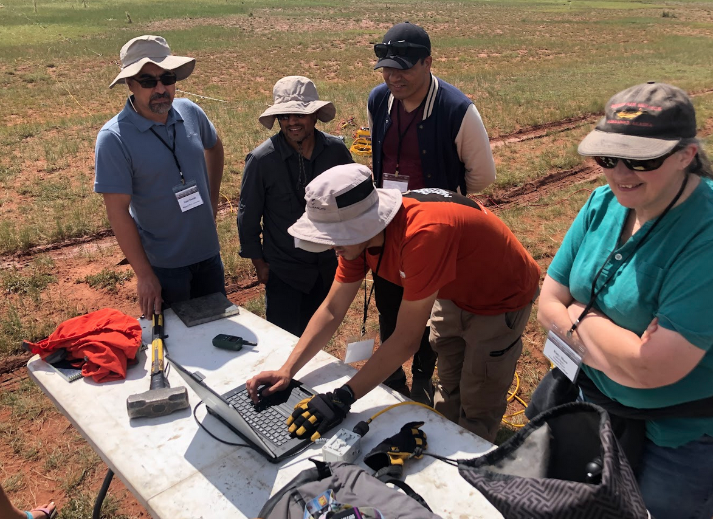
IGUaNA Workshop 2023: Seismic Refraction

Slide 52
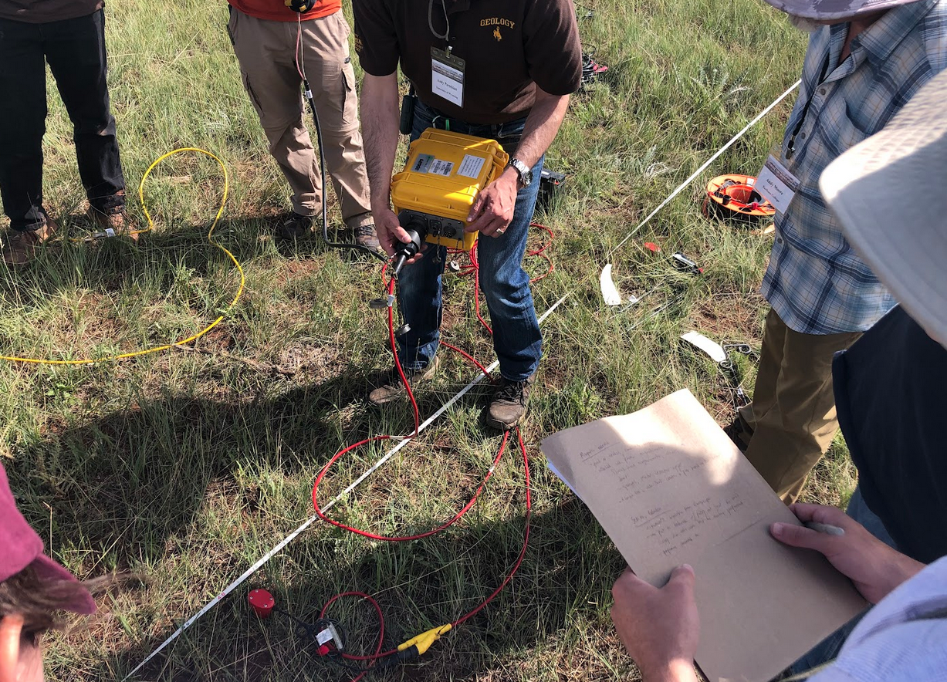
IGUaNA Workshop 2023: Seismic Refraction

Slide 53
IGUaNA Workshop 2023: Seismic Refraction

Slide 54
IGUaNA Workshop 2023: Seismic Refraction

Slide 55
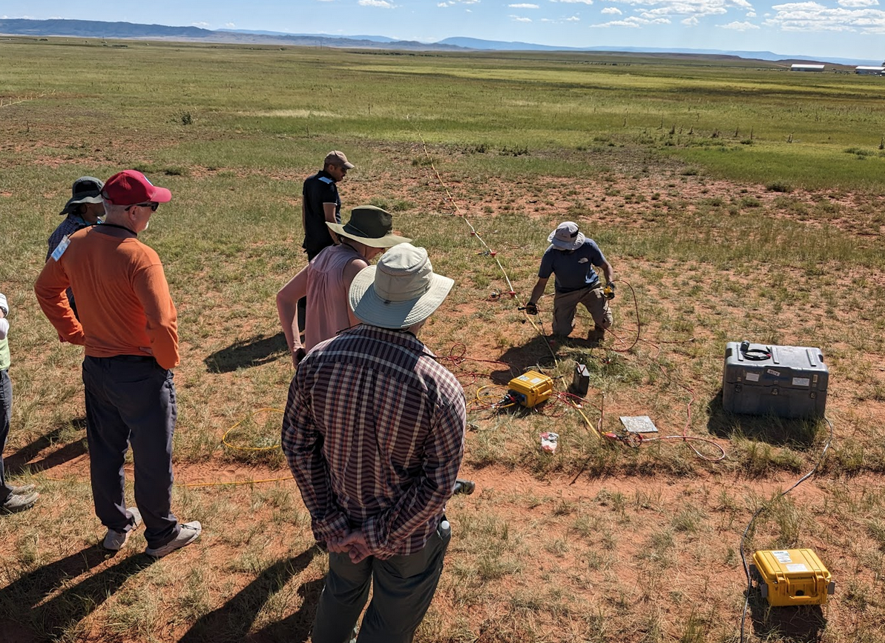
IGUaNA Workshop 2023: Seismic Refraction

Slide 56
IGUaNA Workshop 2023: Seismic Refraction

Slide 57
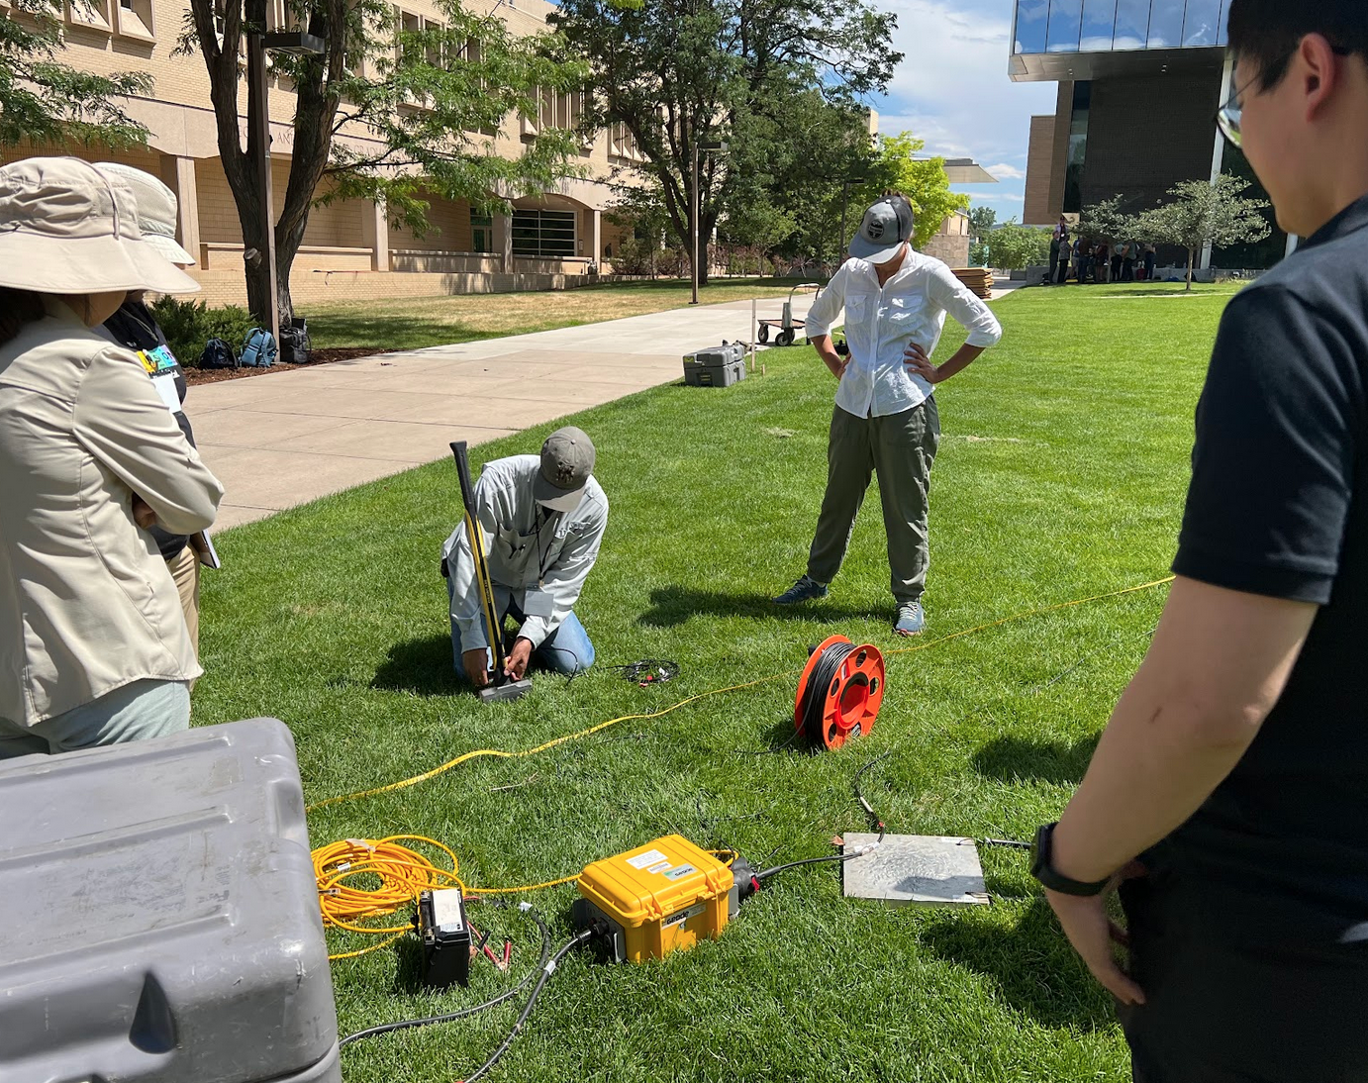

Slide 58
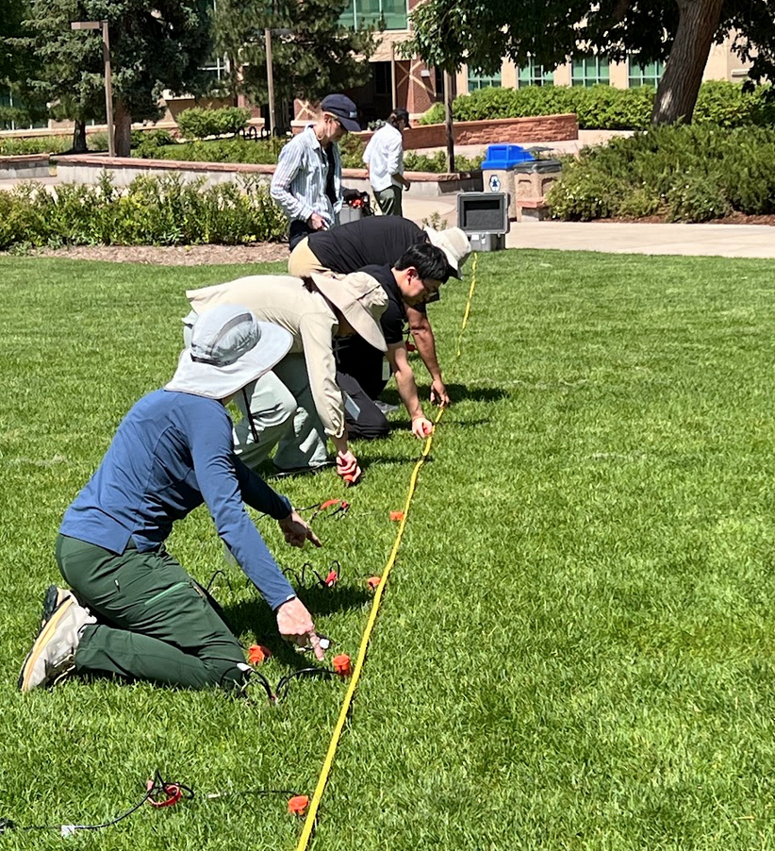

Slide 59
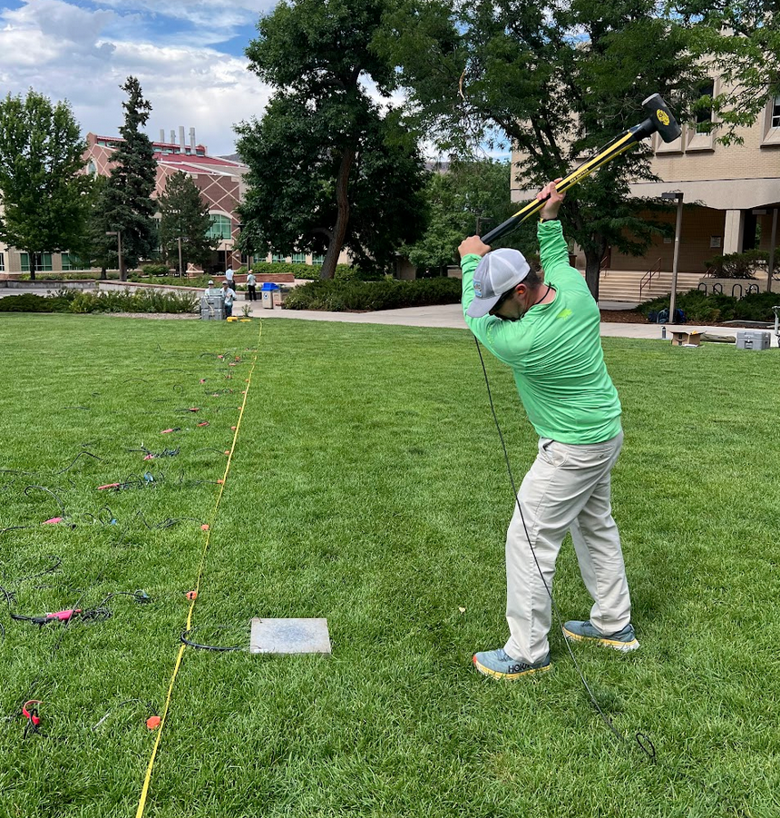

Slide 60
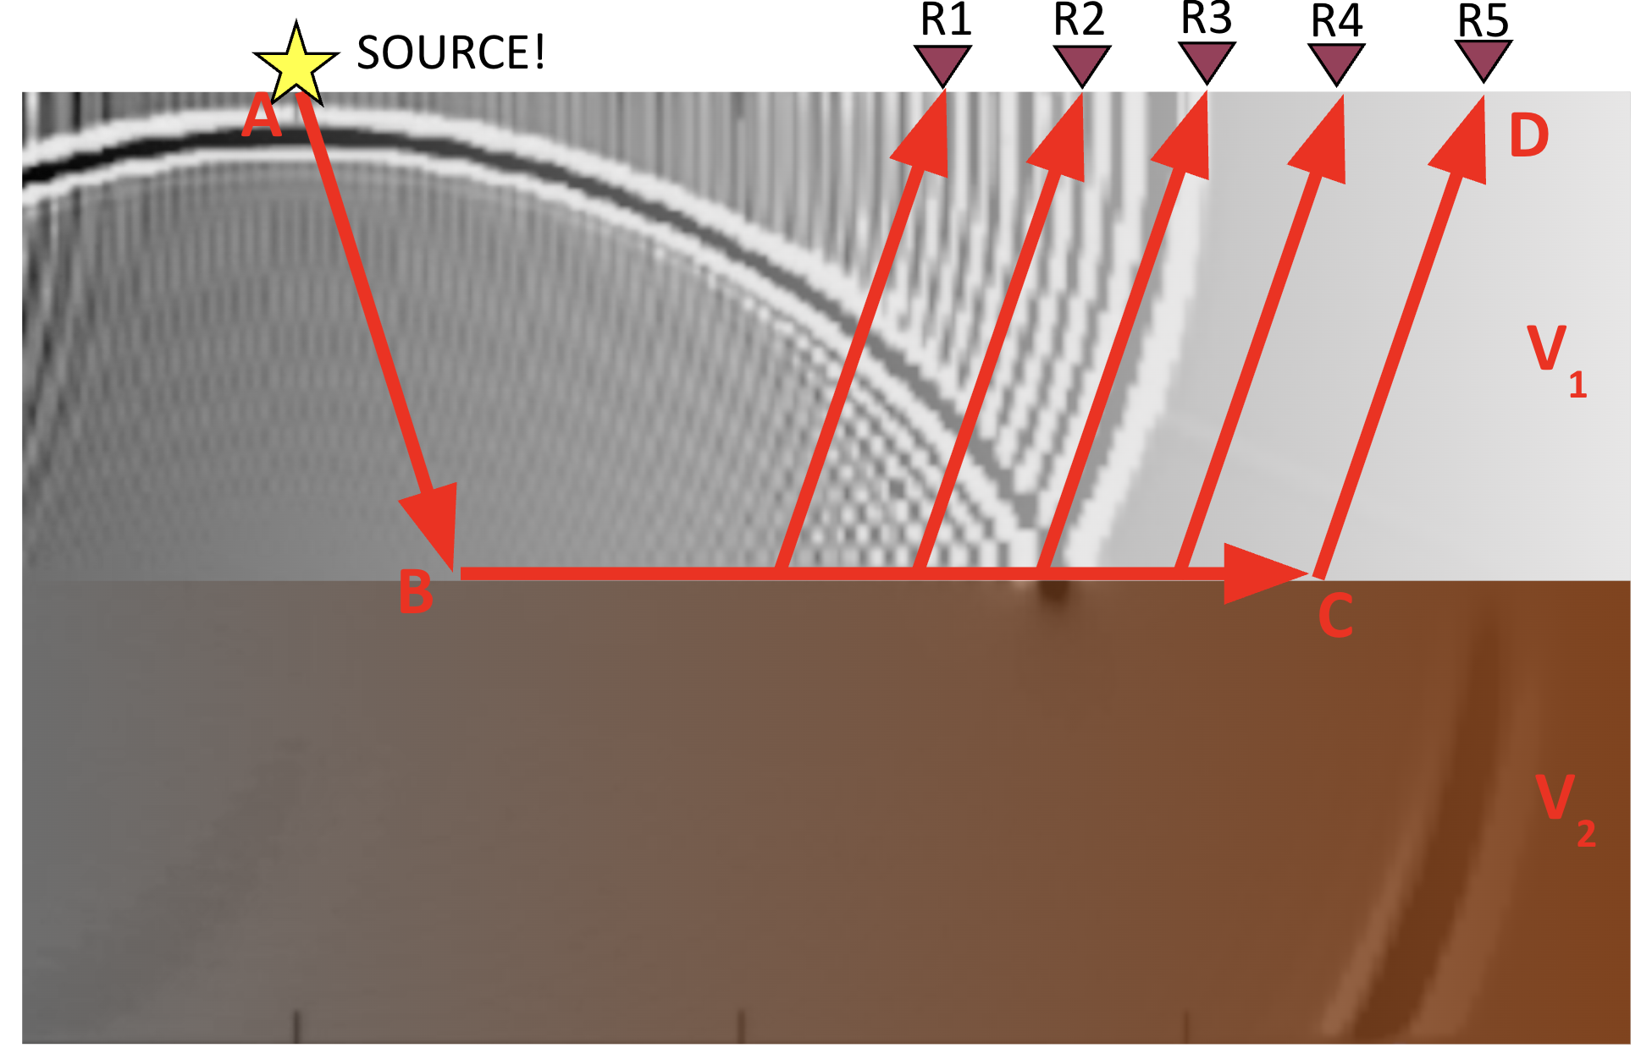
Questions?

Slide 61
Participant Checklist
serc.carleton.edu/getsi/workshops/Summ2025_field/participant_checklist.html
Some general tasks (complete by Friday July 25)
Short knowledge assessment (will be emailed in the next day)
Complete the field trip waiver form (will be sent via DocuSign)
IF YOU HAVE NOT ALREADY, make the following accounts
EarthScope instrument request system: https://epic.earthscope.org/sdb/newuser_application
SERC: https://serc.carleton.edu/account/loginout.php
Look through teaching modules
Download software
Watch helpful videos

