Slide 1
Kinematic GNSS Systems
Units 2, 2.1, and 2.2
Benjamin Crosby & Ian Lauer
(Idaho State University)
Version: 05 25, 2017
Questions, contact education-AT-earthscope.org
Notes:
This slideshow goes over the basics of how the global positioning system (GPS) works. GPS is the USA-based component of the GNSS (global navigation satellite system), which includes many more satellites than just the ones in orbit by the USA.
Questions or comments please contact Vince_Cronin AT baylor.edu or education AT earthscope.org

Slide 2
Motivations
Briefly describe:
  The components of a kinematic system
  The concepts behind kinematic GNSS systems
  The survey design of a kinematic system
  The data collection/post-processing workflow
2.1: Measuring Topography with Kinematic GNSS
2.2: Change Detection with Kinematic GNSS

Slide 3
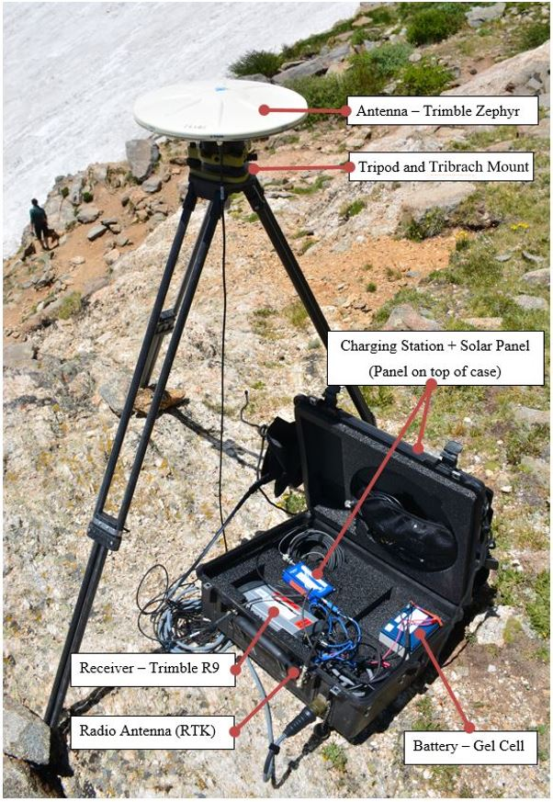
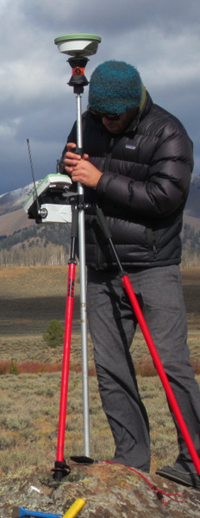
Kinematic Components
Base Station and Radio
Rover Antennas and Receiver
(Images: Ian Lauer, Ben Crosby)

Slide 4
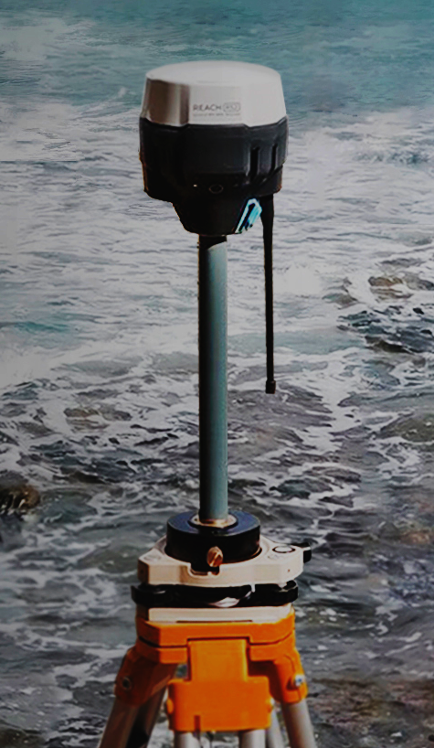
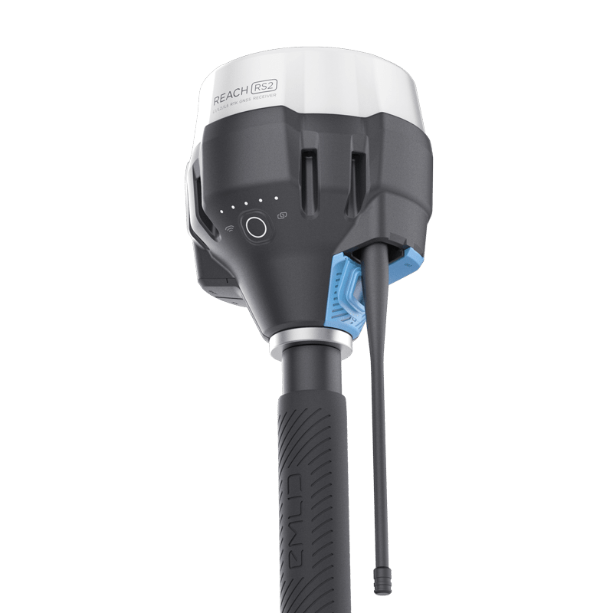
Kinematic Components
Base Station and Radio
Rover and Radio
(Images: Emlid)

Slide 5
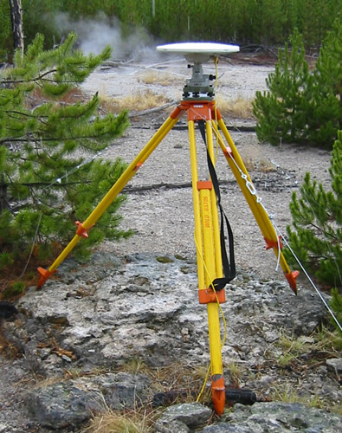
Kinematic Systems
Base station antenna receives data from satellites.
The position drifts over time relative to the known, stable location of the antenna. This offset is communicated to the rover as a correction.
At the same time, rover antenna also receives position data from satellites.
Rover also receives a position correction from the base, in real time for RTK.
Base
Rover
(Images: Ben Crosby)
Notes:
Can you put multiple emlids on one base and have each of the groups work at the same time on one base? or does it have to be one base to one emlid so each group would need their own set?

Slide 6
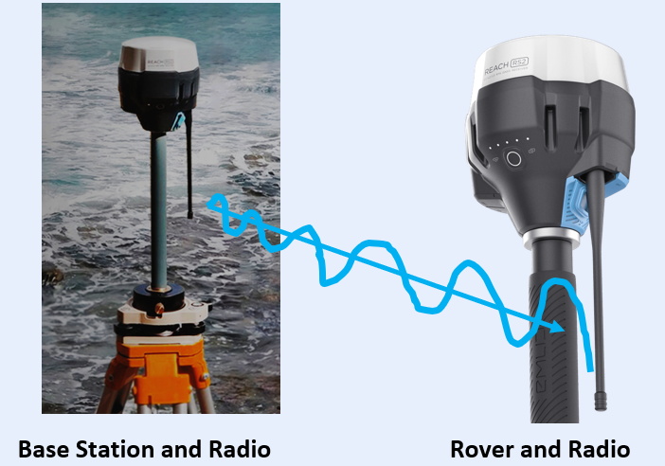
Two Types of Kinematic Surveys (add your P/C)
RTK: Real-Time Kinematic
  Corrections are sent from a known base location to the unknown rover location immediately.
  Pros: immediate accuracy, and…
  Cons: requires radio comms., and…
PPK: Post-Processed Kinematic
  Corrections made to base and rover positions after survey is done
  Pros: no need for radio communication, and…
  Cons: base can fail and you don’t know, and…
X

Slide 7
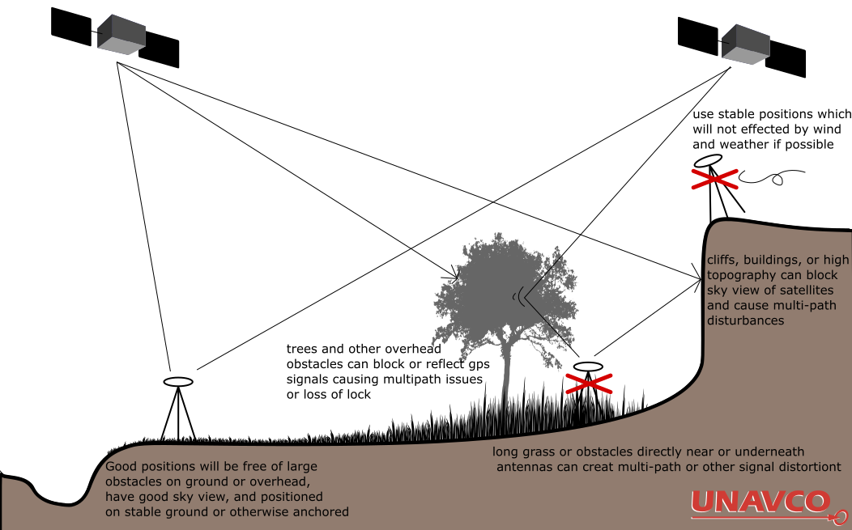
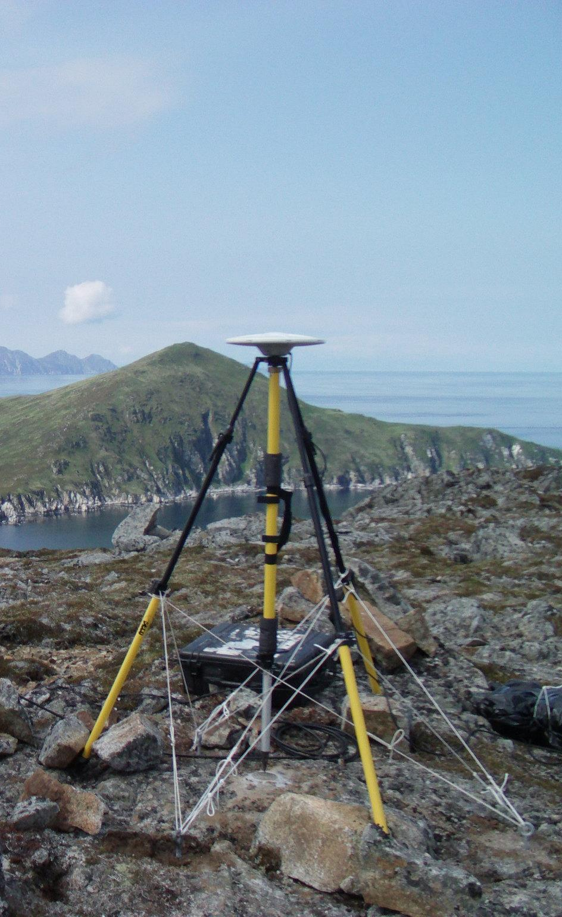
Thinking About Base Stations
Site Access
Site Permissions
Site Security
High Ground
Stable Ground
Clear sky view
Line-of-Sight and distance to Rover
Minimal multipath issues
cliffs, buildings, or high topography can block sky view of satellites and cause multi-path issues
good positions will be free of large obstacle on ground over overhead, have good sky view, and positioned on stable ground or otherwise anchored
long grass or obstacles directly near or underneath antennas can create multi-path or other signal distortions
Notes:
Images: Weston Renoud (https://www.flickr.com/photos/weston/3666328474/), EarthScope (Ian Lauer)

Slide 8
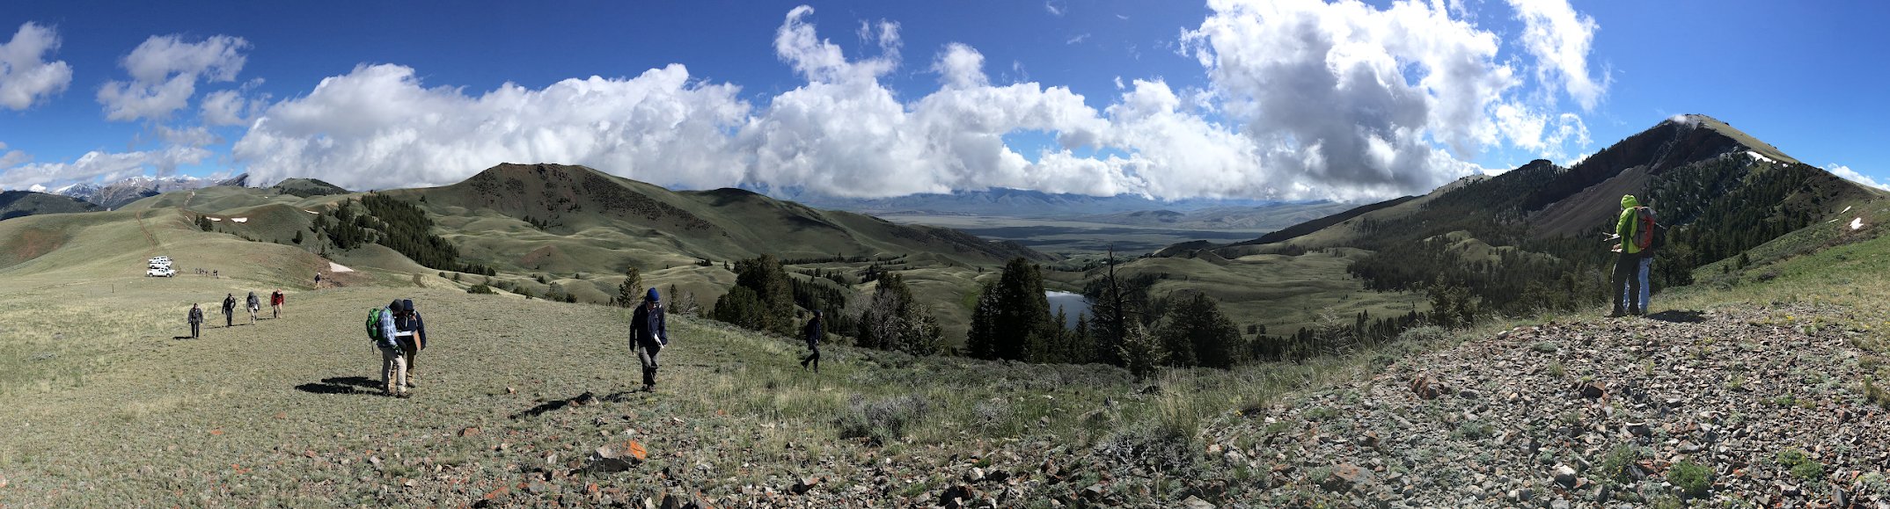
Collecting GNSS on a Landslide
Where would you put a base station in this landscape?
Notes:
This is an example from field camp. The large basin in the center of the image (with the lake) is ringed by the headscarp of an enormous landslide. If you were to collect GPS data in the image, where would you position a base station?

Slide 9
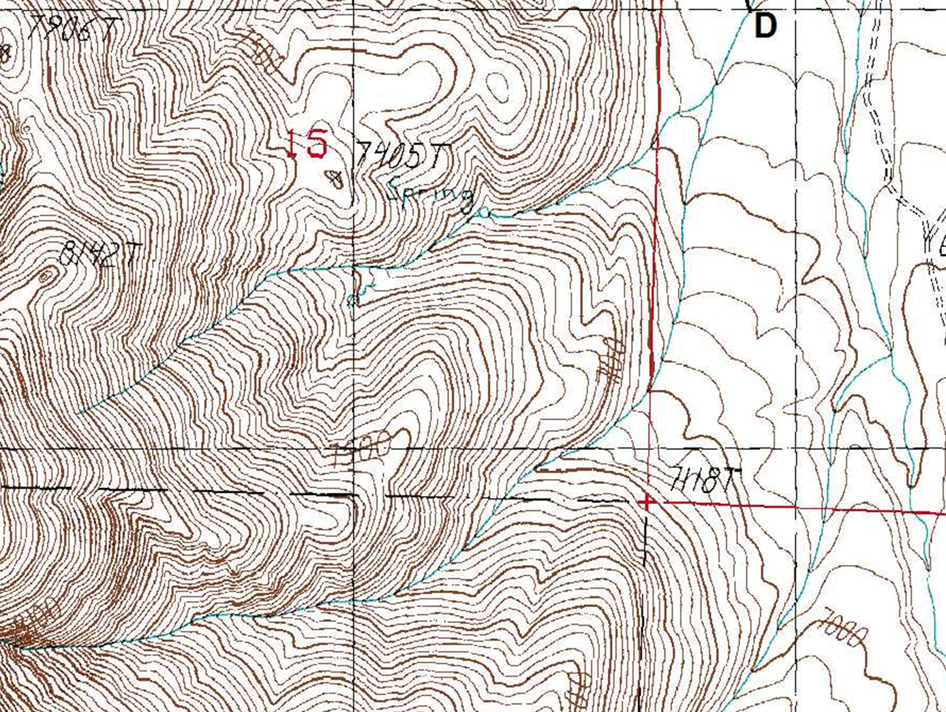
Map View of an RTK Survey
Base Station
Three Different Rover Positions
assumed ‘here’
raw base obs.
raw rover obs.
rover RTK adj.
t₁
corrected base
t₂
t₁
corrected rover
t₃
t₂
t₃

Slide 10
Kinematic Survey Design
Base Station
  Located in a stable, safe, unobstructed place
  Line of sight for radio communication to rover
  < 10 km from rover location
  Ideally set up over known monument
Rover
  Close to and in line of site with base for corrections
  Occupy points for 5–120 sec, keep pole vertical
  Name and describe each point in field book
  Avoid cover and multi-path, confirm corrections

Slide 11
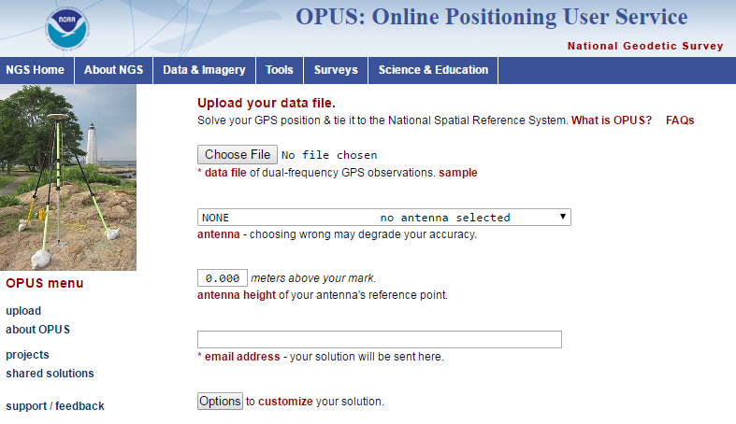
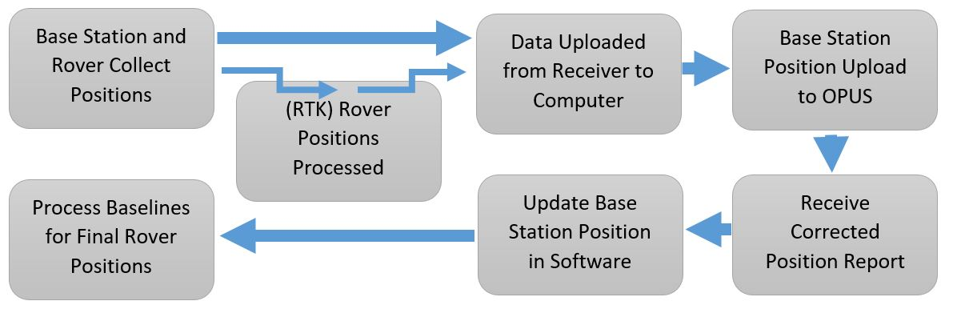
Kinematic Workflow
If base is not over a known point, you must post-process to get an accurate position
Notes:
post processing because you have to account for errors in positioning ?

Slide 12
Kinematic Post-Processing
Post processing is only necessary if the base was set up over an unknown point or you use a PPK system.
Download data from base to PC software for your hardware.
Export base dataset as a RINEX formatted file
Upload RINEX to OPUS website, specifying all necessary information regarding base antenna type and height (best to wait 4+ hours after collection before uploading)
Update your base position with the new, OPUS-corrected position in your PC software
Propagate the change in base to all your rover positions

Slide 13
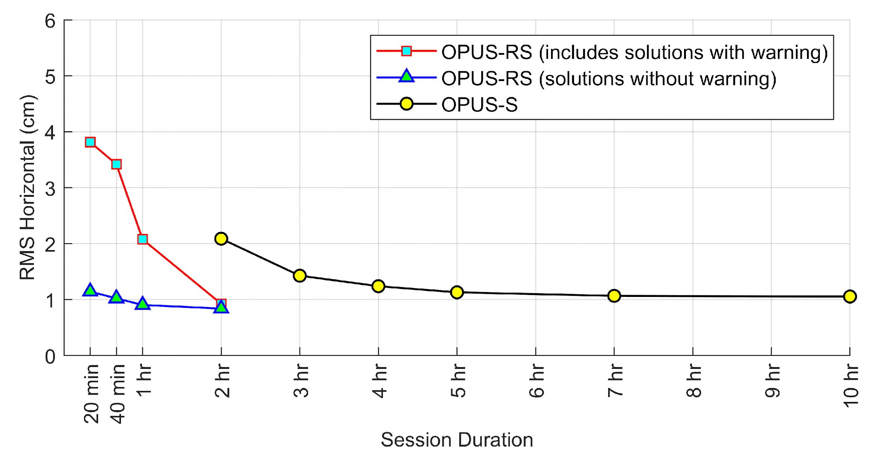
Data Collection Duration
Data Processing
NRCAN
(CSRS-PPP)
2hrs +
Ultra Rapid
Rapid
Final Orbits
2hr 24hr 14 days
Time Post-Survey
15min – 2hrs
Rapid Static
OPUS
2hrs +
Static

Slide 14
Applications of RTK GNSS
Students discuss at first:
Delineating or measuring migration of a river channel with proximity to a valuable resource or infrastructure
Measuring movement on a natural hazard such as a landslide, earthflow, or slump
Delineate or measure motion of monuments on a glacier, glacial retreat or snowpack change
Measuring a scarp surface or profile to determine potential hazard to infrastructure with earthquakes
Creating topographic models of flood plains to calculate flood volume and determine potential for flood hazard at various stage levels
Create digital elevation models to determine slope stability with addition of roadcuts or other infrastructure

Slide 15
2.1: MEASURING TOPOGRAPHY WITH KINEMATIC GNSS

Slide 16
2.1 Measuring Topography with Kinematic GNSS
Introductory slide
  Previous tools for creating topography
    Photogrammetry, Level surveys
    Advantages versus Disadvantages
  How we do it now
    Airborne or ground-based LiDAR, Radar
    Stereo high-resolution imagery
  Uses of topographic data
    Hydrology, hazard analysis, navigation, etc.
    Research, industry, public, military, etc.

Slide 17
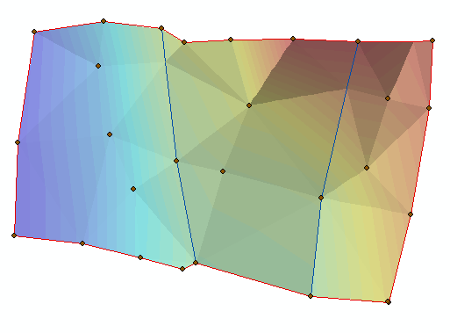
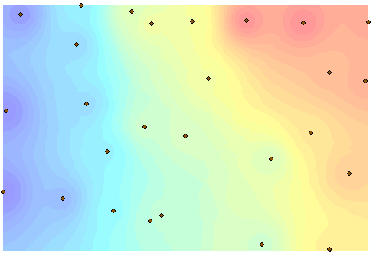
Technical Slides
  Field and office workflow
    Collect high-precision x, y, and z points
    Interpolate elevations between points (raster or contour)
    Examine if interpolation created unrealistic outcomes
Triangulate Irregular Network (TIN) Inverse Distance Weighted
Notes:
There are different methods for creating an topographic file from measured GNSS survey points.

Slide 18
Benefits of Kinematic Derived Topography
Kinematic GNSS topography decreases time and cost relative to LiDAR and analog tools.
Kinematic GNSS points avoid the uncertainty of point cloud data.
Applications for kinematic GNSS topography
  Measuring volumetric change
    Landslide or other mass-movement hazards
    Water quantity and other natural resources
  High-precision topography in dense vegetation
    River restoration, aquatic habitat, etc.

Slide 19
2.2: DETECTING CHANGE WITH KINEMATIC GNSS

Slide 20
Motivations for this Lecture
Focused on:
  Change detection basics
  Change detection with kinematic GNSS
  Applications of the technique
  Calculating change
  Interpretation of change

Slide 21
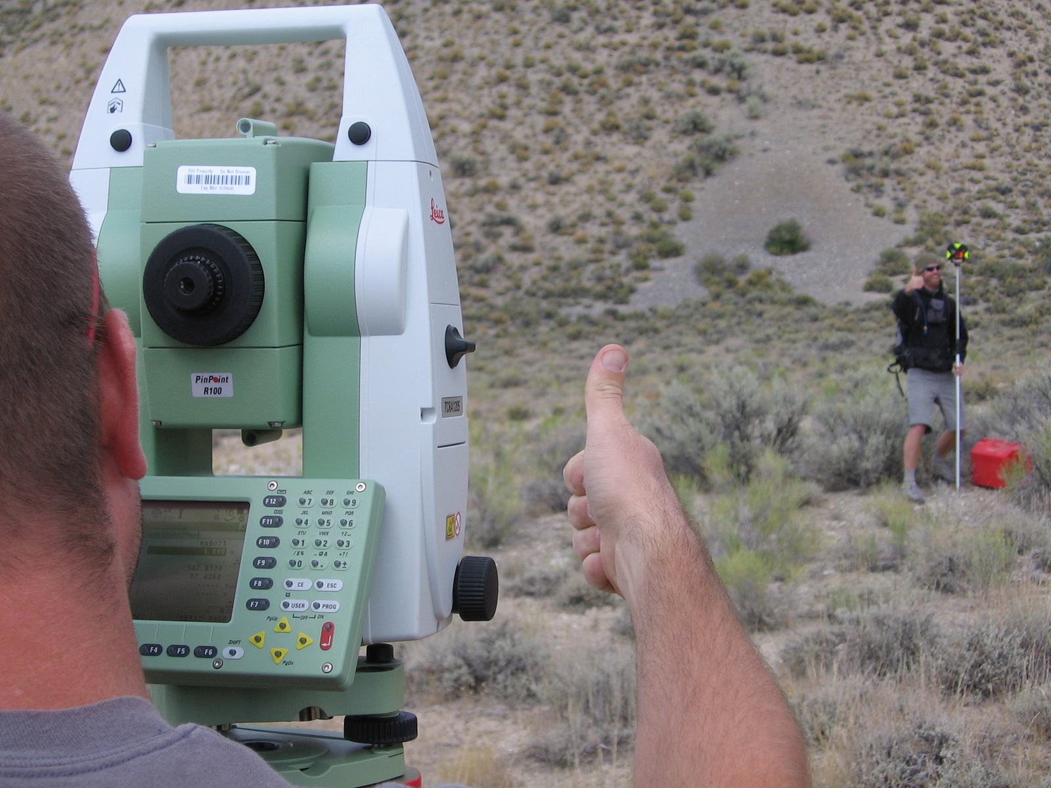
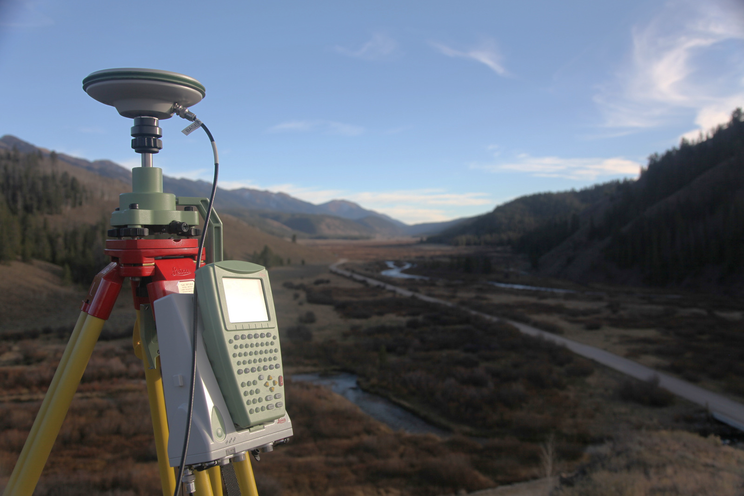
Basic of Change Detection
Many techniques
  Manual
  Automated
  Geodetic
  GNSS-based

Slide 22
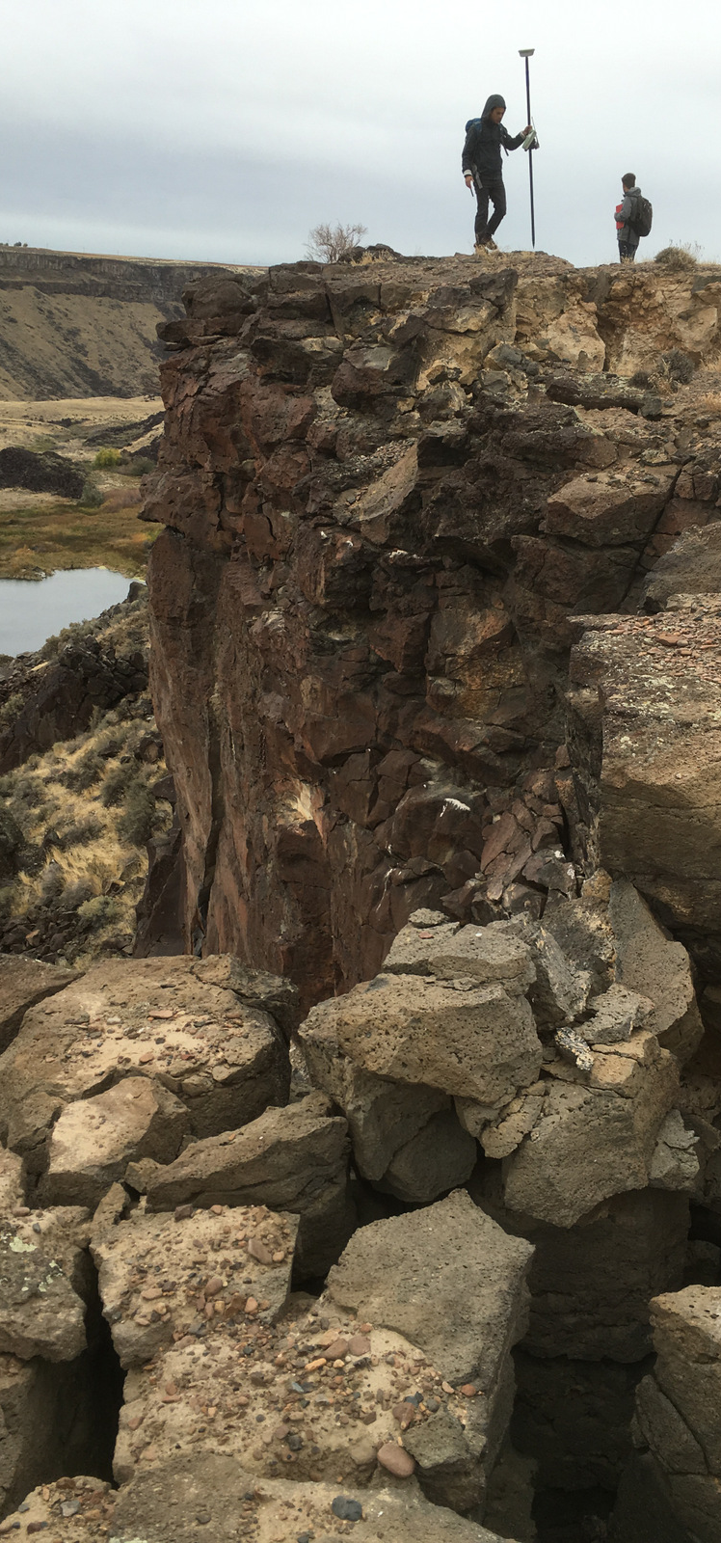
Change with Kinematic GNSS
Pros
  Many points collected in short time.
  Easy to operate
  Accuracy of ~1.5cm
  Data is in global coordinates, not local
Cons
  Expensive
  Cannot detect very small changes
  Not automated
(Images: Ben Crosby)

Slide 23
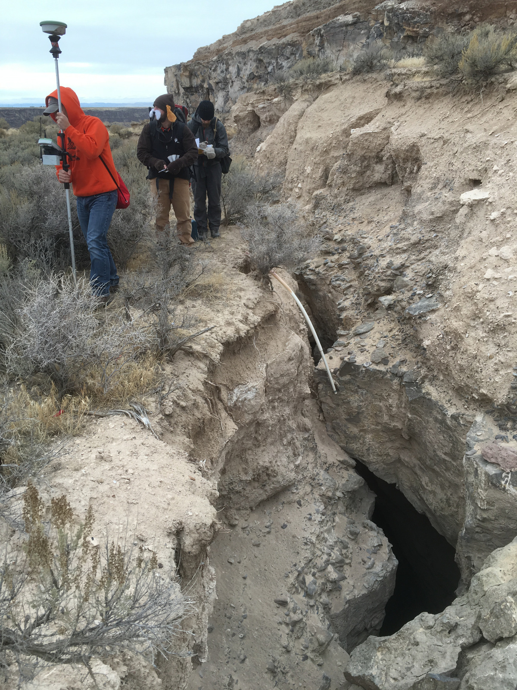
Applications of Kinematic GNSS
Industry
  Machine automation
  Property and construction surveying
Research
  Mass-movement deformation
  Post-rupture surveys
  Tracking objects (glaciers, river rock, etc.)
  Inflation/collapse structures (caldera, volcano, etc.)
Discuss other applications and societal benefits
(Images: Ben Crosby)

Slide 24
Applications of Kinematic GNSS
Discuss other applications and societal benefits
  Kinematic GNSS can recognize changes if the displacement is greater than 2 cm.
    These changes are typically below our human perception
  Hazard assessment and early warning
    Slow-moving hazards are revisited to detect change
      Volcano or caldera doming
      Landslide slip
      Fault creep
  Tracking of objects of interest
    Measuring sediment transport rates or glacier flow dynamics, which help with sediment and water budgets

Slide 25
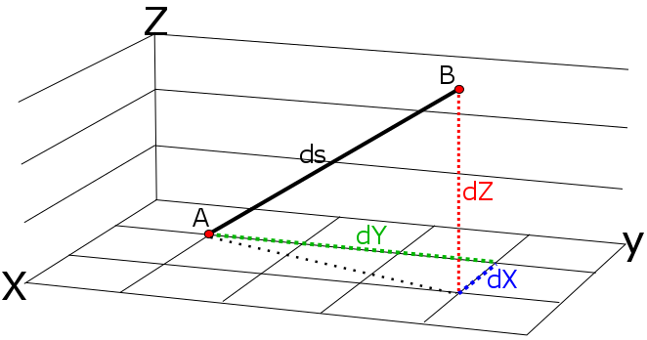
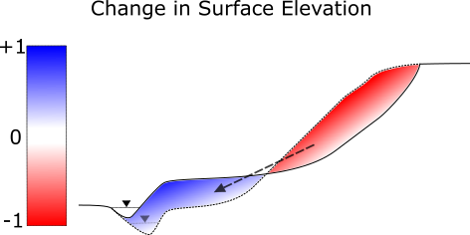
Calculating Change
3D change
2D change
(Figures: Ian Lauer)

Slide 26
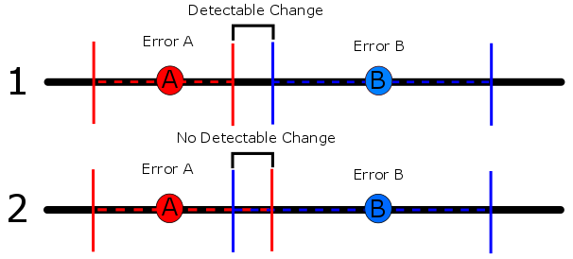
Interpretation of Change
Is the change greater than the uncertainty?
Is change sudden or gradual?
  How do we interpret the change that occurs between measurements?
(Figures: Ian Lauer)

