Slide 1
Introduction to GPS/GNSS Basics
Vince Cronin (Baylor University) & Shelly Olds (EarthScope)
Revisions by Beth Pratt-Sitaula (EarthScope) &
Benjamin Crosby (Idaho State University)
Notes:
DO REMEMBER to include attribution information for all the figures you include. Even if you took the picture or made the diagram, it will make it easier later if we just have that recorded.
ALSO – it is much easier to make notes (at least preliminary ones) for each slide NOW compared to several months later. Think about the information that future instructors using this materials will need to know in order to understand what the point of the different slides are. If all the relevant text is on the slide, notes may not be necessary, BUT if there are images, most likely some notes will be needed for future users.

Slide 2
Motivations
Describe the Global Navigation Satellite System (GNSS) and how it enables positioning within a reference frame
Distinguish different grades of GNSS receivers, their uses, and their accuracies.
Highlight applications of GNSS in the Geosciences and Society

Slide 3
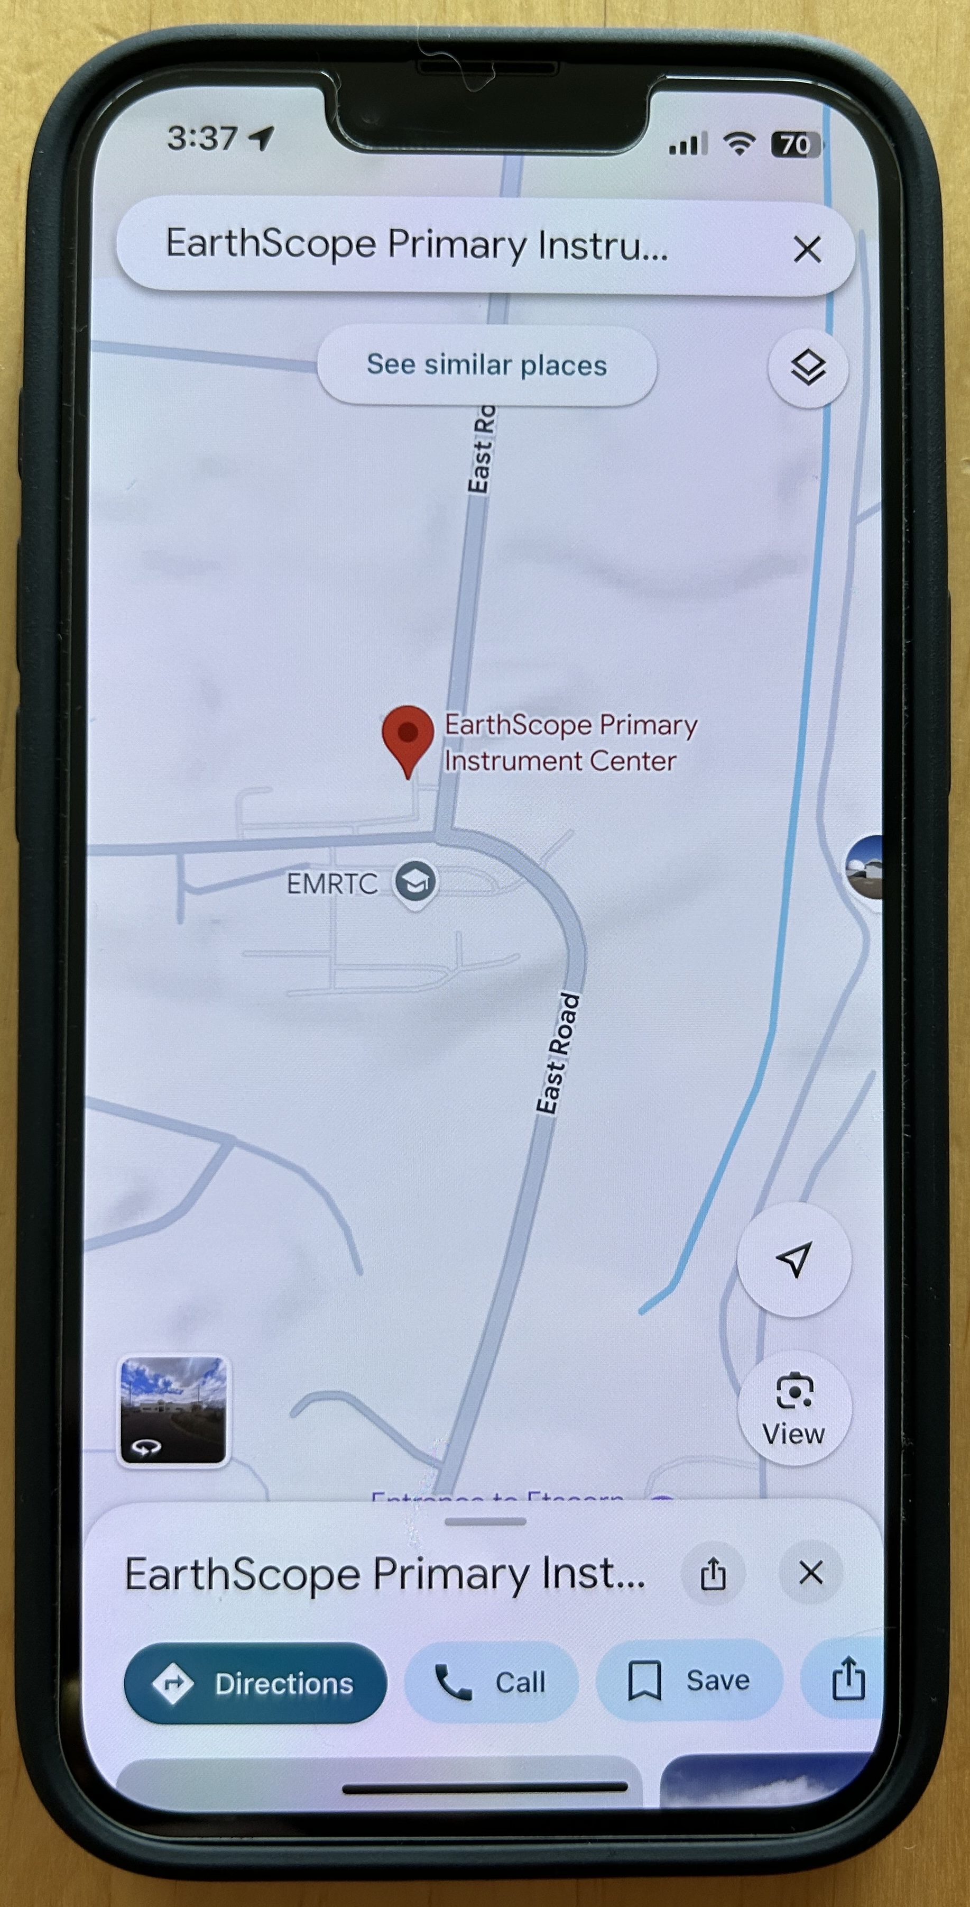
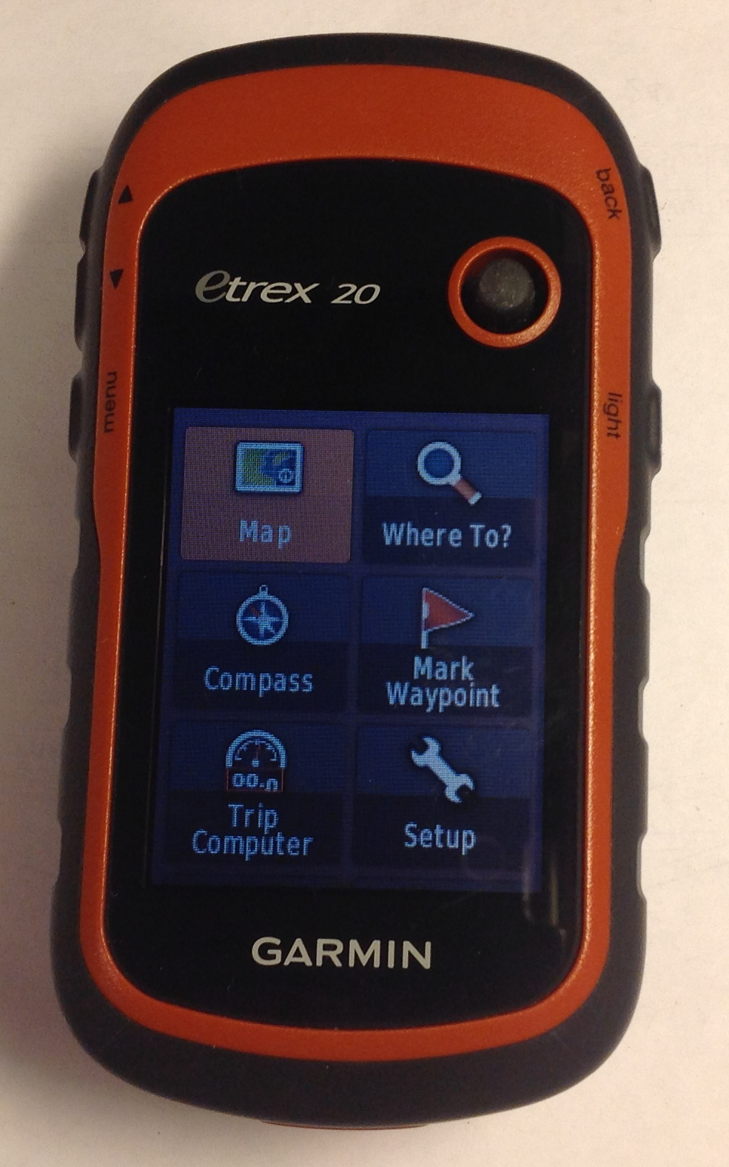
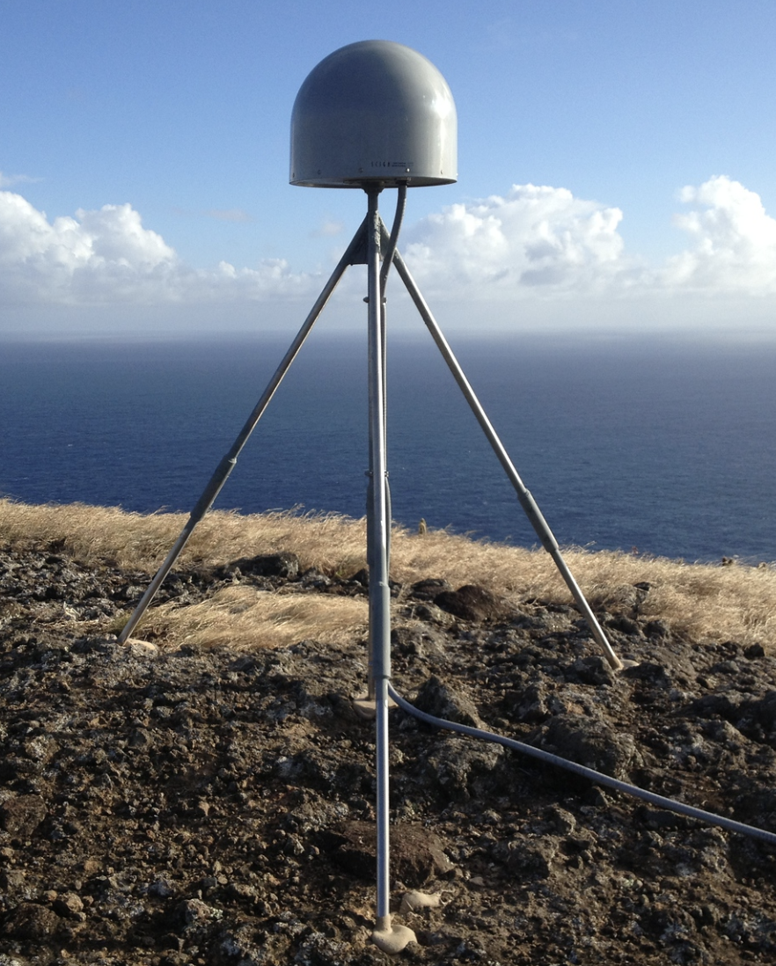
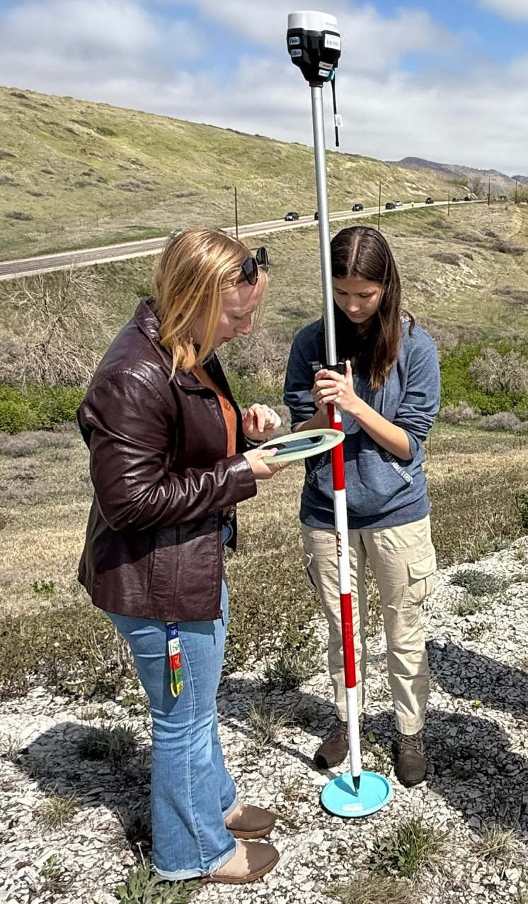
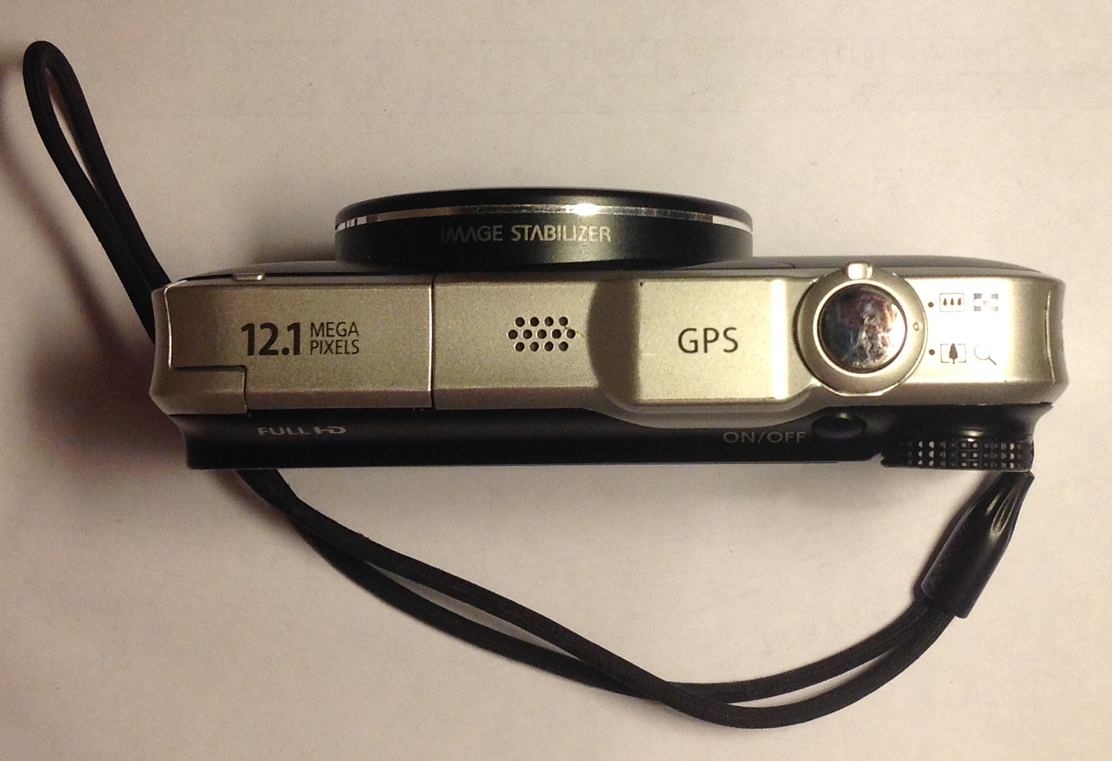
GNSS Receivers All Around Us
Notes:
Whether they know it or not, students use GPS receivers daily in their cars, phones, cameras, and handheld recreational GPS. Most have heard the term “GPS” but few know much about how the system actually works or high-precision GPS for science and industrial use.
Images from EarthScope; student surveyers: John Galetzka (NGS)

Slide 4
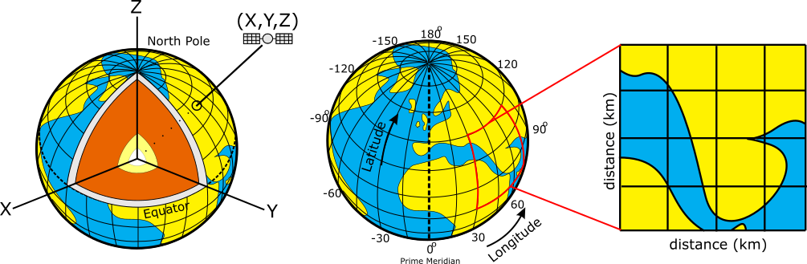
GNSS Provides 3D Positioning; Various Ref Sys
Positions on the Earth can be reported using:
  Geocentric coordinates (relative to the Earth’s center, m)
  Geographic coordinates (lat/long/elev; in degrees)
  Projected coordinates (UTM/state plane, in m or ft)
Geocentric (X,Y,Z)
Geographic System
Projected System
Notes:
It is important for students to understand that position data can be reported to a user in a number of different formats.
Geocentric (also Earth-Centered Earth-Fixed) Coordinate system (a type of Cartesian coordinate system) will probably be least familiar to students. While it isn’t used much by typical geoscientists, it is often used by people processing GPS data for research or calculating satellite locations.
Geographic is widely used and will be familiar (at least vaguely) for most geoscience students and more generally, people familiar with maps.
Projected coordinate systems are used a fair amount by scientists and surveyors working on a local/regional scale -- for whom distances (meters, feet) will be more useful than lat/long locations.
Figures: Ian Lauer, modified from Public Domain

Slide 5
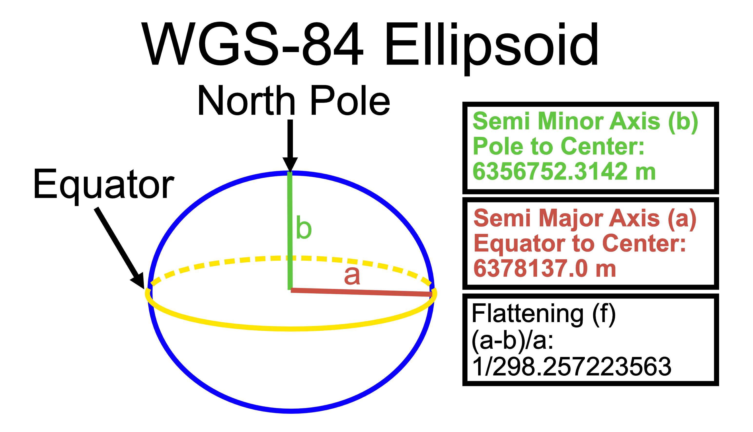
Typical GNSS Coordinates – WGS 84
Most survey GNSS data is recorded and reported using: World Geodetic System 1984 (WGS 84)
  WGS 84 defines a reference surface (an ellipsoid)
  And a set of parameters to relate latitude, longitude, and altitude to points on or near the Earth's surface
21.4 km
difference
Notes:
Figure: Ian Lauer

Slide 6
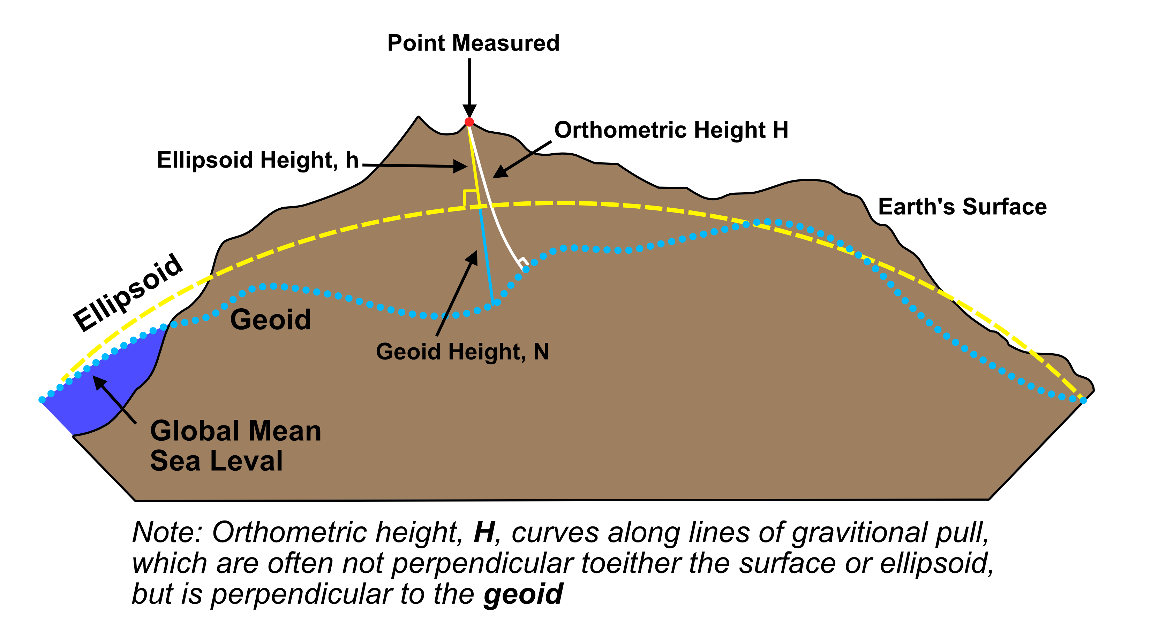
Typical GNSS Coordinates - Vertical
Geoid - gravitational equipotential surface
(i.e. what “sea level” would be) (ex. EGM96)
GPS reports ellipsoid height
Orthometric height = height above “sea level” of the geoid (more common for maps)
Notes:
Figure: Ian Lauer

Slide 7
GNSS Composed of Multiple Satellite Systems
There are multiple Global Navigation Satellite Systems (GNSS)
  GPS: USA, global
  GLONAS: Russia, global
  BeiDou: China, global
  Galileo: Europe, global
  India, France, and Japan: regional systems
Notes:
Most modern systems take advantage of the first two systems listed here…even smartphones. The more satellites, the more likely you will get a position even in areas with limited sky such as in a city with tall buildings.

Slide 8
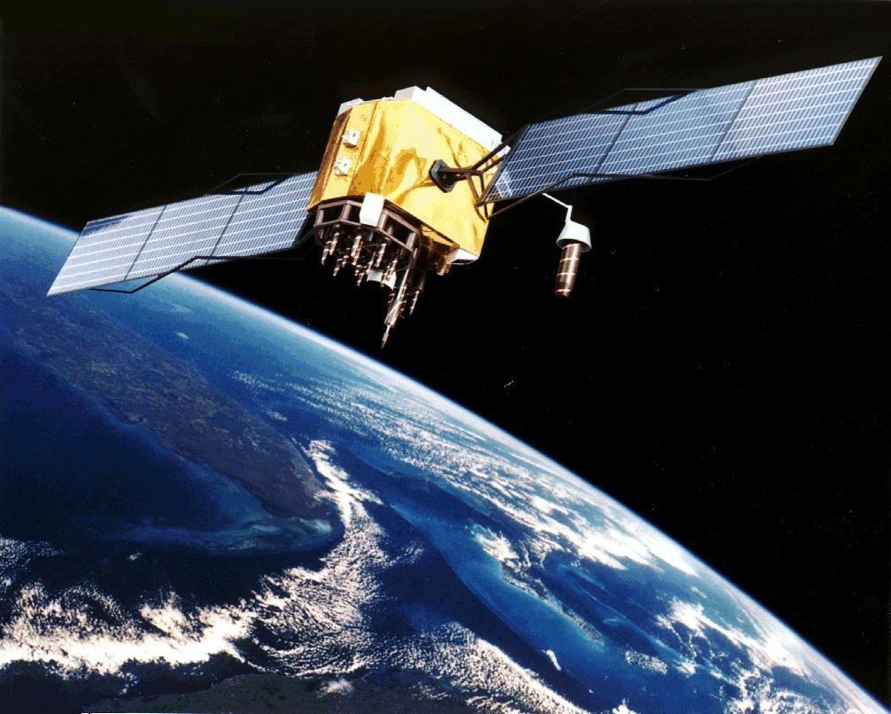
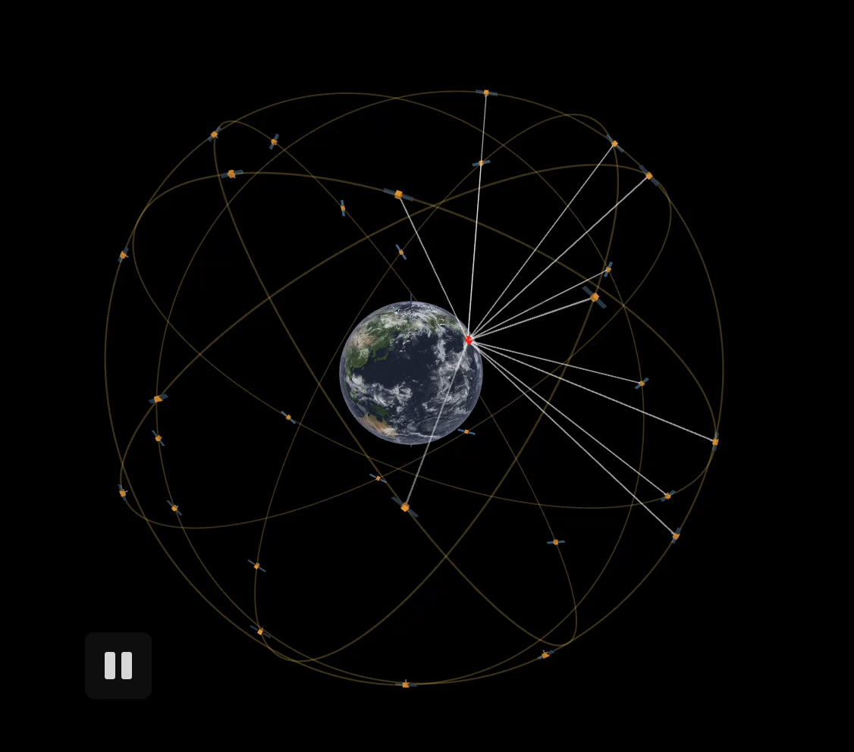
The Global Positioning System
24–32 satellites
20,200 km altitude
55 degrees inclination
12-hour orbital period
Ground control stations
Notes:
From the users point of view, GPS is a passive system: you need only a low-powered receiver to obtain the signals, which contain all the information you need to determine your position. This requires that the satellites carry atomic clocks to keep accurate time and transmit to the user the position of the satellite in the sky. The orbits are computed by the Department of Defense (DoD) by tracking the satellites from ground control stations. GPS control segment consists of a global network of ground facilities that track the GPS satellites, monitor their transmissions, perform analyses, and send commands and data to the constellation. The current (as of 2015) operational control segment includes a master control station, an alternate master control station, 12 command and control antennas, and 16 monitoring sites. The ground control stations have known positions and are then uploaded to the satellites, which then transmit the information continuously along with the time. With handheld receivers, it is possible to find your position within a few meters, limited primarily by the accuracy of the broadcast orbits. As we shall see, the civilian scientific community uses more than 200 stations to determine the orbits with an accuracy of a few centimeters, allowing millimeter positioning after several hours of tracking.
Upper image: Artist’s conception of a GPS Block II-F satellite in Earth orbit (public domain from NASA)
Lower image: https://ciechanow.ski/gps/ (2/17/22)

Slide 9
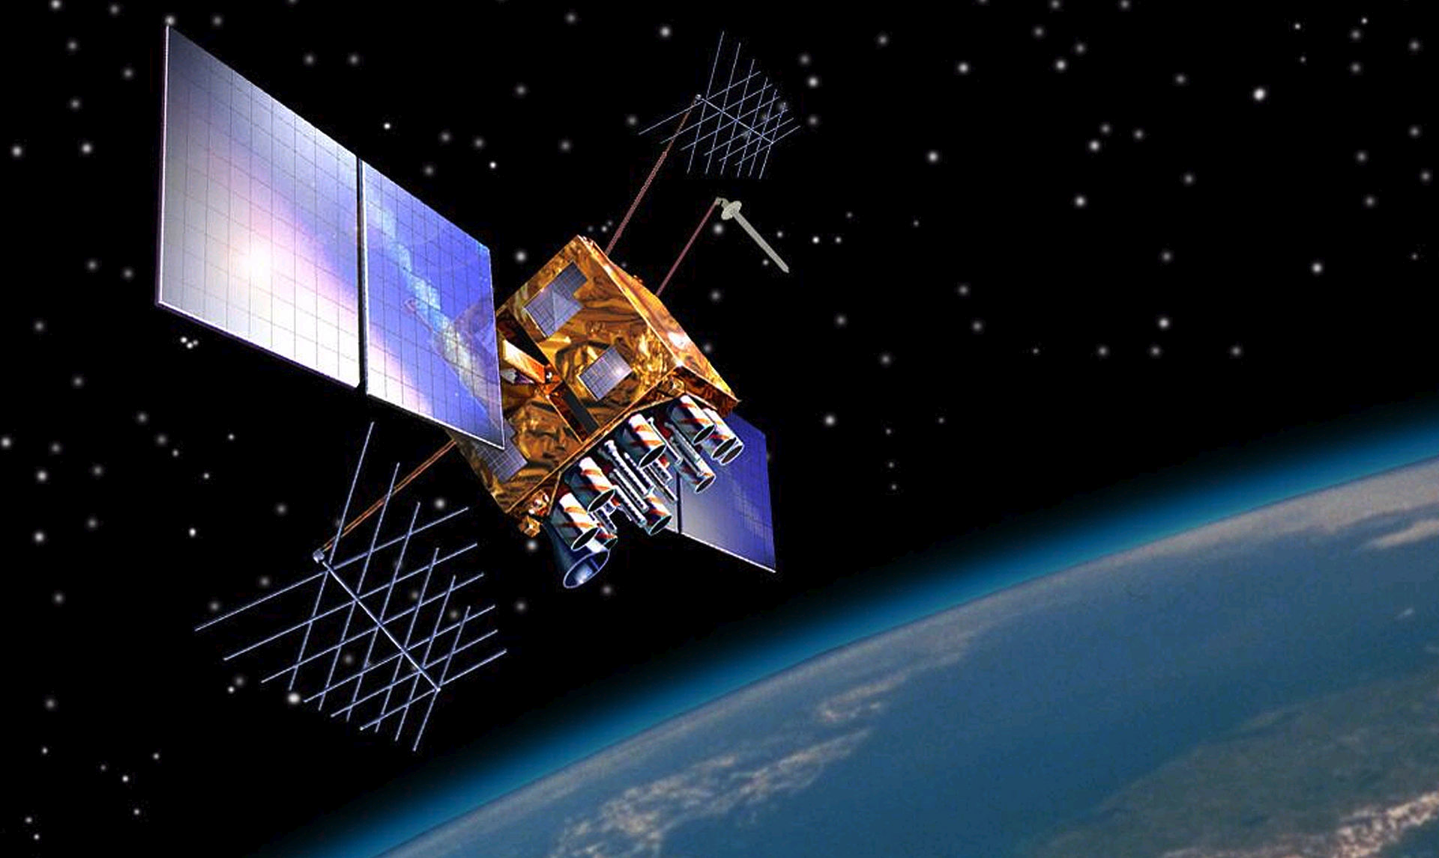
GPS & Atomic Clocks
Each GPS satellite has 4 atomic clocks, to be sure that one is always working. Each costs ~US$100,000 and is accurate to 1 billionth of a second (1 nanosecond).
Notes:
GPS depends on extremely accurate time keeping, so the very best clocks must be used.
Image by US Government - US National Executive Committee for Space-Based Positioning, Navigation and Timing, Public Domain, https://commons.wikimedia.org/w/index.php?curid=7567464

Slide 10
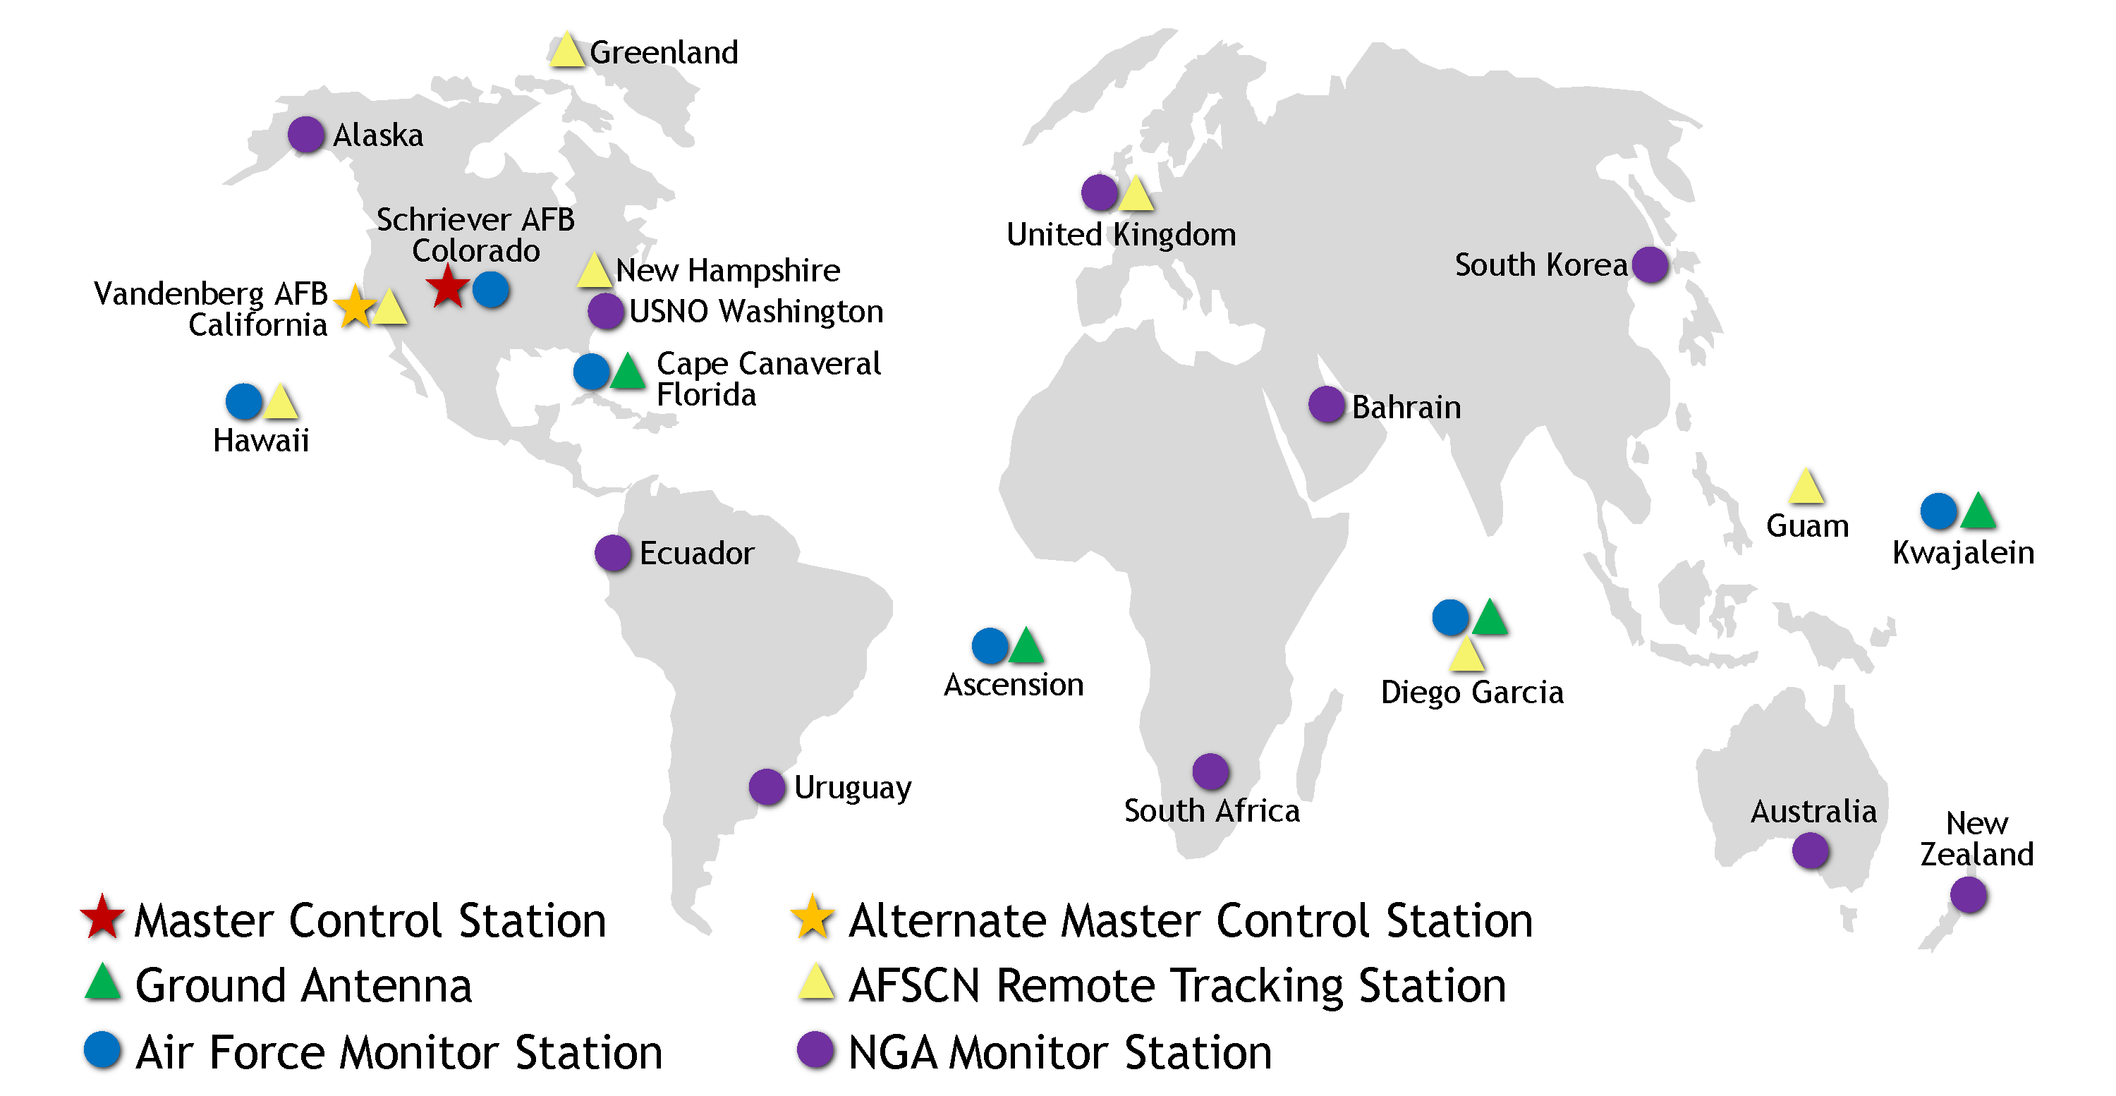
Ground Control Stations
Network of ground-based monitoring stations track GPS satellites
Updates re-synchronize satellite atomic clocks to within nanoseconds of each other and adjust info of
each satellite’s
orbital model
Notes:
Image: https://www.gps.gov/systems/gps/control/
Tracking information from the monitoring stations is sent to the Air Force Space Command, which is operated by the 2nd Space Operations Squadron (2 SOPS) of the US Air Force.
2 SOPS contacts each GPS satellite regularly with a navigational update using the dedicated ground antennas.
These updates synchronize the atomic clocks on the satellites to within a few nanoseconds of each other and adjust the ephemeris of each satellite's internal orbital model.

Slide 11
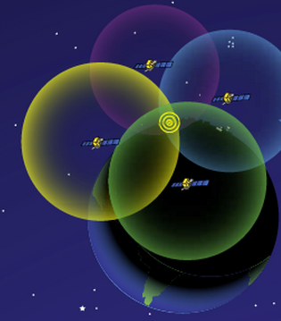
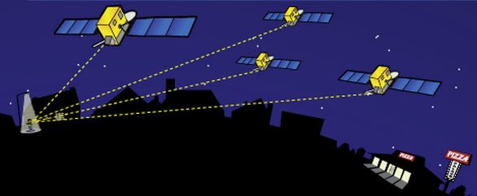
How Actual Location is Determined
http://spaceplace.nasa.gov/gps-pizza/en/
Antenna position is determined by calculating the distances to at least 4 satellites. This enables the solving for four variables: x, y, z and time using trilateration.
Notes:
The time element is needed because of the difference between the highly accurate atomic clock on the satellites ($100,000 each) and the much cheaper clock in the GPS receivers.
Although 4 is a technical minimum number of satellites, for geoscience research work it is highly recommended to have at least 6 satellites.
Although people will often refer to this process and “triangulation” in fact it is “trilateration” because it depends on distances rather than angles.
For a nice explanation of trilateration versus triangulation, visit https://gisgeography.com/trilateration-triangulation-gps/.
Images from NASA (public domain) http://spaceplace.nasa.gov/gps-pizza/en/

Slide 12
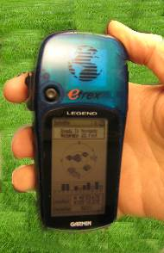
Antennas Receive Data Streams
Your location is:
37º 23.323’ N
122º 02.162’ W
The time is:
11:34.9722 (UTC)
ERRORS (after 24 hrs)
Horiz: ± 1–2 mm
Vert: ± 5 mm
ERRORS
Horiz: ± 10 m
Vert: ± 15 m
Notes:
Since each satellite maintains time very accurately (~1 nanosecond = 30 cm), it can tag its signal with the time of transmission. This information, together with the location of the satellite, also transmitted to the receiver, is sufficient to allow the receiver to calculate the range to each satellite, provided that the receiver also knows the time. Equipping receivers with atomic clocks would be very expensive, so the receiver tags the signal with the time of its internal clock to create a “pseudorange” (range plus an unknown clock correction). The software in the receiver then uses the pseudoranges from four satellites to solve for the four unknowns: three coordinates and the receiver clock correction.
Images: Vince Cronin (Baylor University)
High precision rates taken from GAMIT/GLOBK 10.6 release notes - http://geoweb.mit.edu/gg/

Slide 13
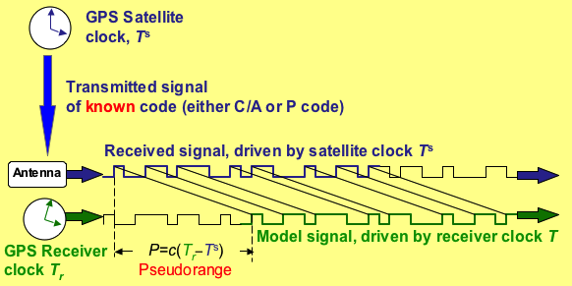
How Satellite-Receiver Distance is Measured
Radio signal from satellite tells GNSS receiver the satellite-clock time and provides the most recent corrections to the satellite’s position relative to Earth (ephemeris)
GNSS receiver compares the satellite-times to receiver-time to determine the distance to each satellite
Notes:
This slide is not needed for all learners – maybe only needed for more advanced students.
Image by Vince Cronin (Baylor University)

Slide 14
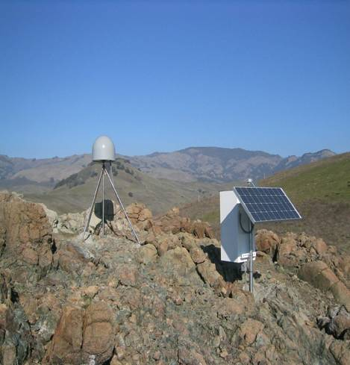
Anatomy of a High-Precision Permanent GNSS Station
Antenna inside of dome
Monument solidly attached into the ground with braces.
If the ground moves,
the station moves.
Solar panel for power
Equipment enclosure
GNSS receiver
Power/batteries
Communications/radio/modem
Data storage/memory
Notes:
Example of a typical remote GPS station. In urban areas, some are also fixed to the roof of large reinforced buildings and hooked into grid power supply with battery backup. Many stations are now being equipped with “real-time” communication to allow immediate transfer of data to researchers. In other places logistics or country-specific regulations require that data not be transmitted but is instead downloaded manually on a given schedule (monthly, quarterly, or annually, depending on the site).
Image from EarthScope

Slide 15
Almanac & Ephemeris Data
GPS satellites include almanac and ephemeris data in the signals they transmit
Almanac data are coarse orbital parameters for all GPS satellites
Ephemeris data are very precise orbital and clock correction for that particular GPS satellite—necessary for precise positioning
Notes:
A receiver that has recently (within the last several months) downloaded almanac data will know which satellites to expect in the sky for a given region and time. It helps a receiver “lock” into the satellite constellation more quickly. Think of the almanac as a catalog with general locations for all the GPS satellites.
Ephemeris data is critical to precise positioning. When ephemeris data is encrypted (selective availability which ended in 2000), real-time GPS positions become significantly less accurate. In all cases ephemeris data can be obtained several weeks later so that non-real-time applications can achieve full accuracy. Each satellite only broadcasts its own ephemeris data.
Information from http://gpsinformation.net/main/almanac.txt

Slide 16
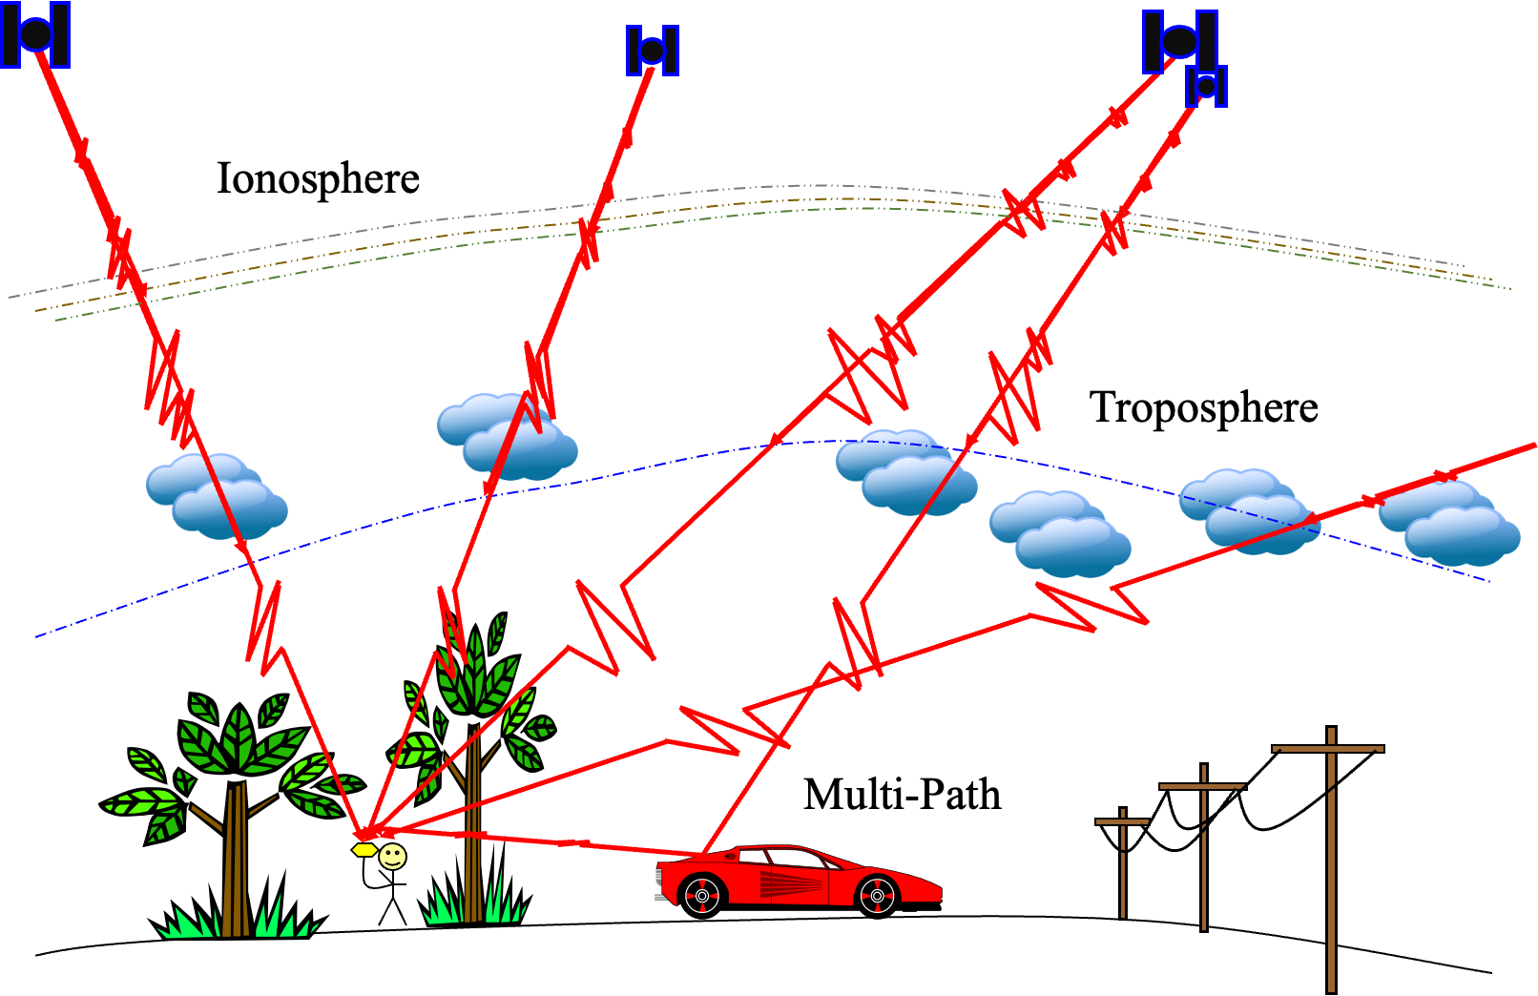
Sources of Error
Notes:
Marianne Okal (EarthScope)

Slide 17
Sources of Error
Clock errors (bias and drift, including relativity)
Satellite orbit irregularities
Atmospheric delays – speed of light is affected by water content and other variables (ex. Ionosphere, dual freq. helps)
Multi-path – GNSS signals can bounce off the ground or objects and then enter the antenna
Human error – Incorrect
base or rover antenna
heights, errors in post-
processing, datum and
projection errors.
Notes:
There is a complex field of engineering and science behind post-processing GPS data to reduce error sources.
In addition to those mentioned above, specific sites may measure movements not associated with the parameter the researcher wants to measure. For instance:
Seasonal groundwater fluctuations may cause the ground to rise and fall annually, in a way that is not related to plate motion at all.
A site could be sliding downhill because of a creeping landslide.
A melting glacier or a falling lake level will “unweight” an area, leading to rebound and upward movement measured by the GPS.
It is best to collect multiple years of data before trying to draw conclusions.

Slide 18
Grades of GNSS Systems
Consumer or Recreational Grade
  Phones, tablets, watches, hiking devices
  ~5 meters, No post-processing required
Mapping Grade
  Purpose built, GIS enabled, data collectors
  ~30 cm, Post-processing/correction required
Survey Grade
  Professional tools, Longer occupations, Static and kinematic devices
  ~3 mm to 2 cm precision. Considerable post-processing required

Slide 19
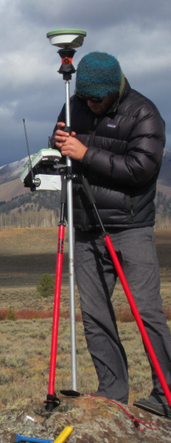
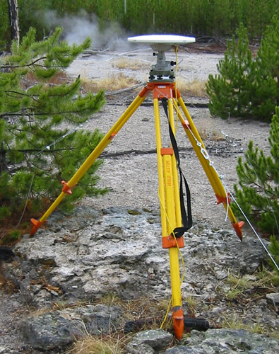
Precision depends on system
Static, Geodetic Campaign Systems
Occupation Time - Effort Required - $$
Kinematic Systems
Easy Hard
Consumer & Mapping Systems
Survey Grade
0.5-5 m 0.01–0.03 m 0.005m
Precision of Position
(Images: Ben Crosby)

Slide 20
Applications of GNSS
Recreational & Mapping Systems (phones, consumer-type, mobile GIS devices)
  Inexpensive, low complexity, short occupations, rapid results, low-precision positions
Kinematic Systems (Unit 2)
  Expensive, moderate complexity, short occupations, positions can be rapid or require post-processing, high-precision positions
Static Systems (Unit 3)
  Expensive, high complexity, long occupations required, long and complex post-processing required, extremely high-precision positions.
Notes:
Images: EarthScope, Ben Crosby, EarthScope

Slide 21
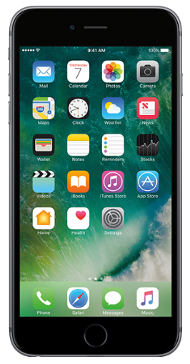
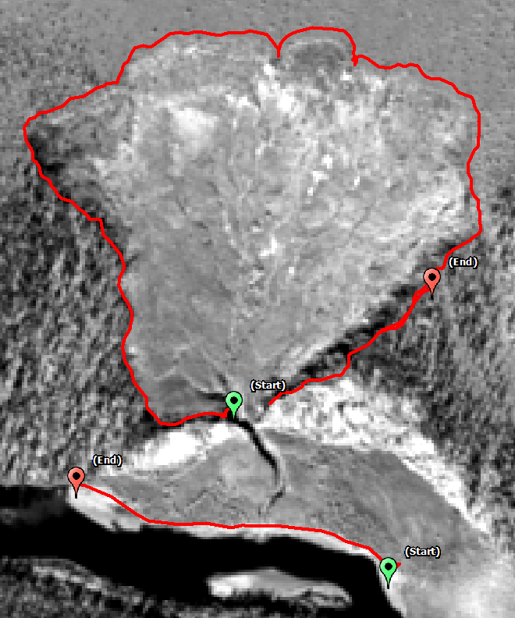
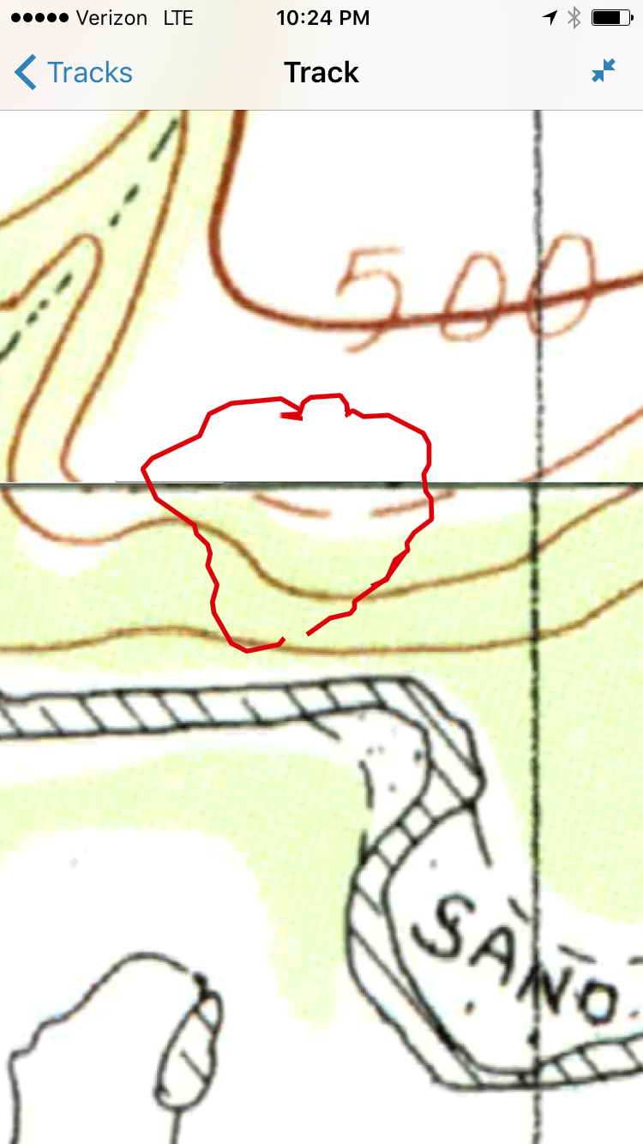
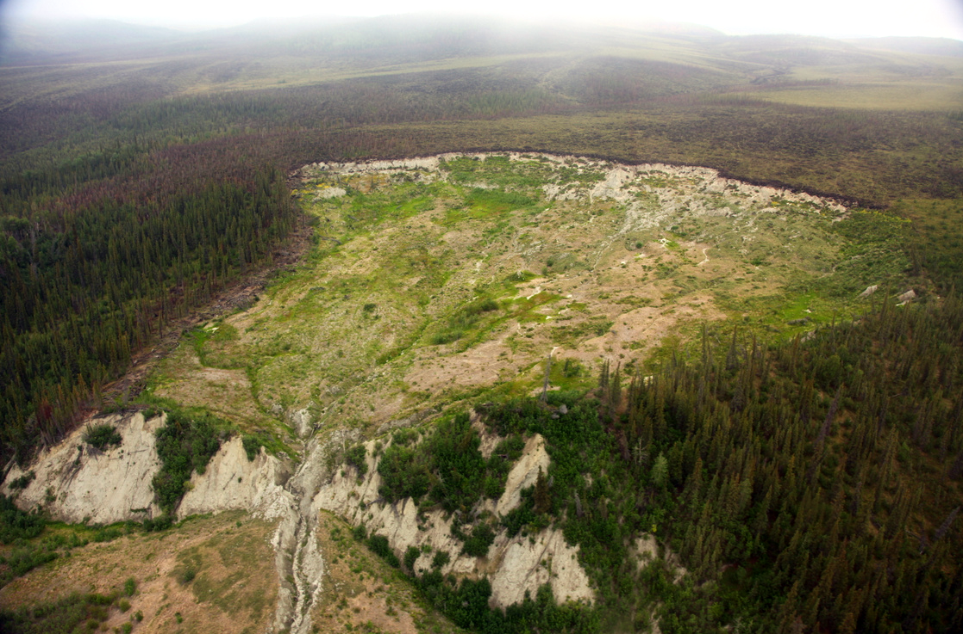
Example 1: Tracking Position
Using Recreational Systems
  Use a phone to track your position during a field day.
  Can quickly assess the area or position of an object.
From the field… …to the phone… …to analysis in GIS.
Notes:
Images: Ben Crosby

Slide 22
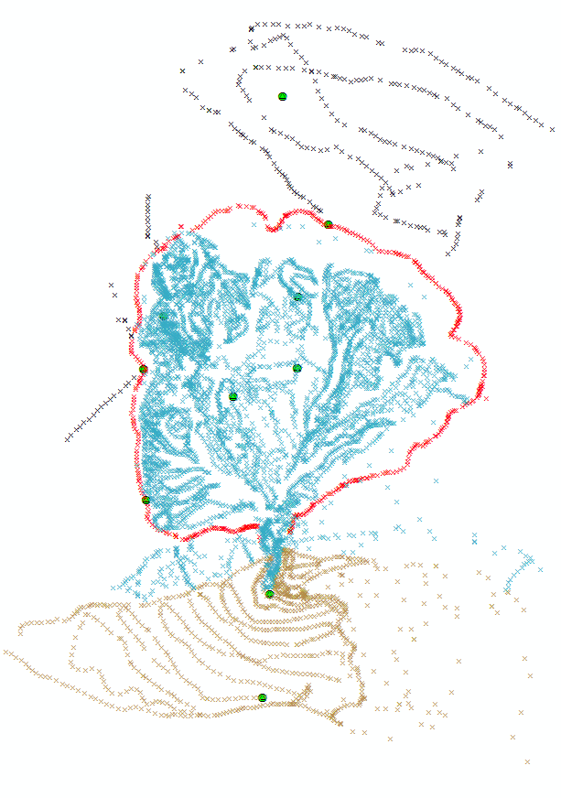
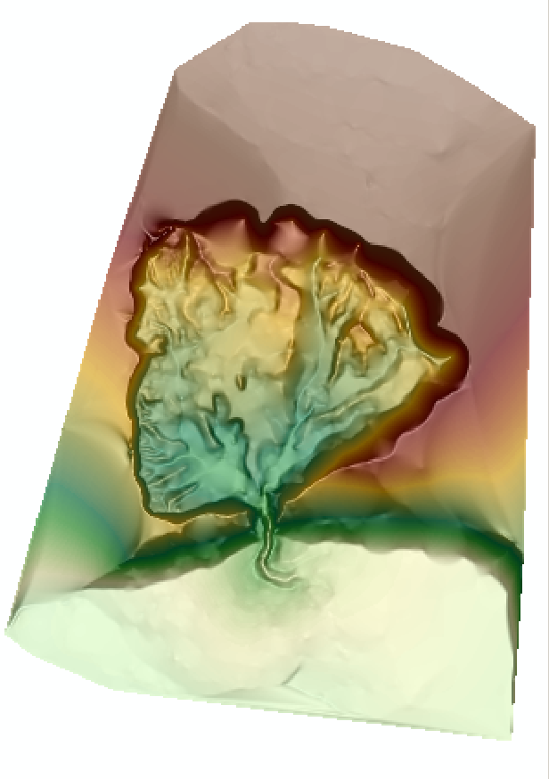
Example 2: Creating Topography
Using Kinematic Systems
  Quickly measure many points with high accuracy and precision
  Compare different surfaces to quantify permafrost thaw
From the field … … to post- … to surface generation
processed points … using GIS.
Notes:
Images: Ben Crosby

Slide 23
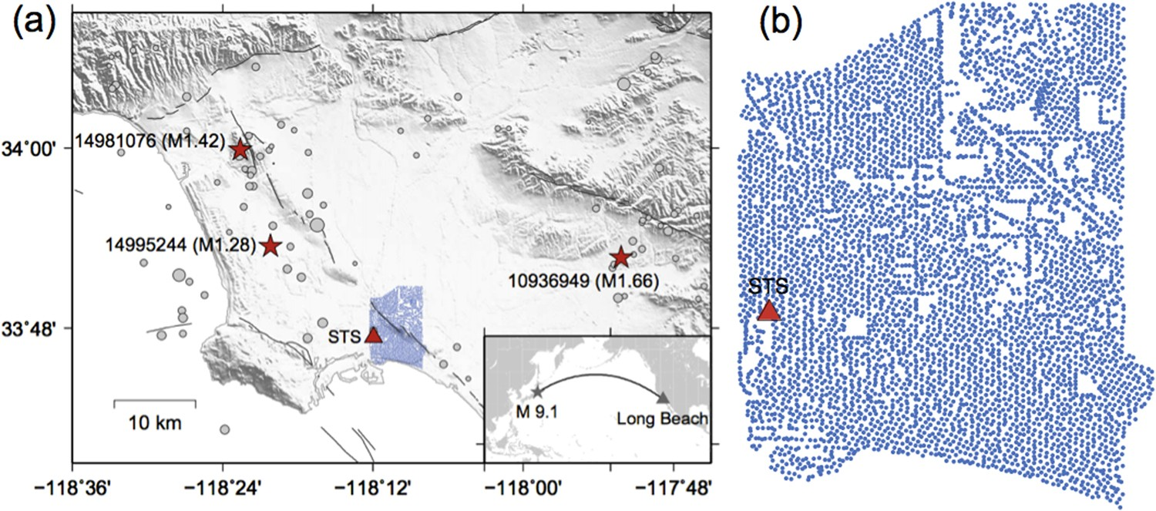
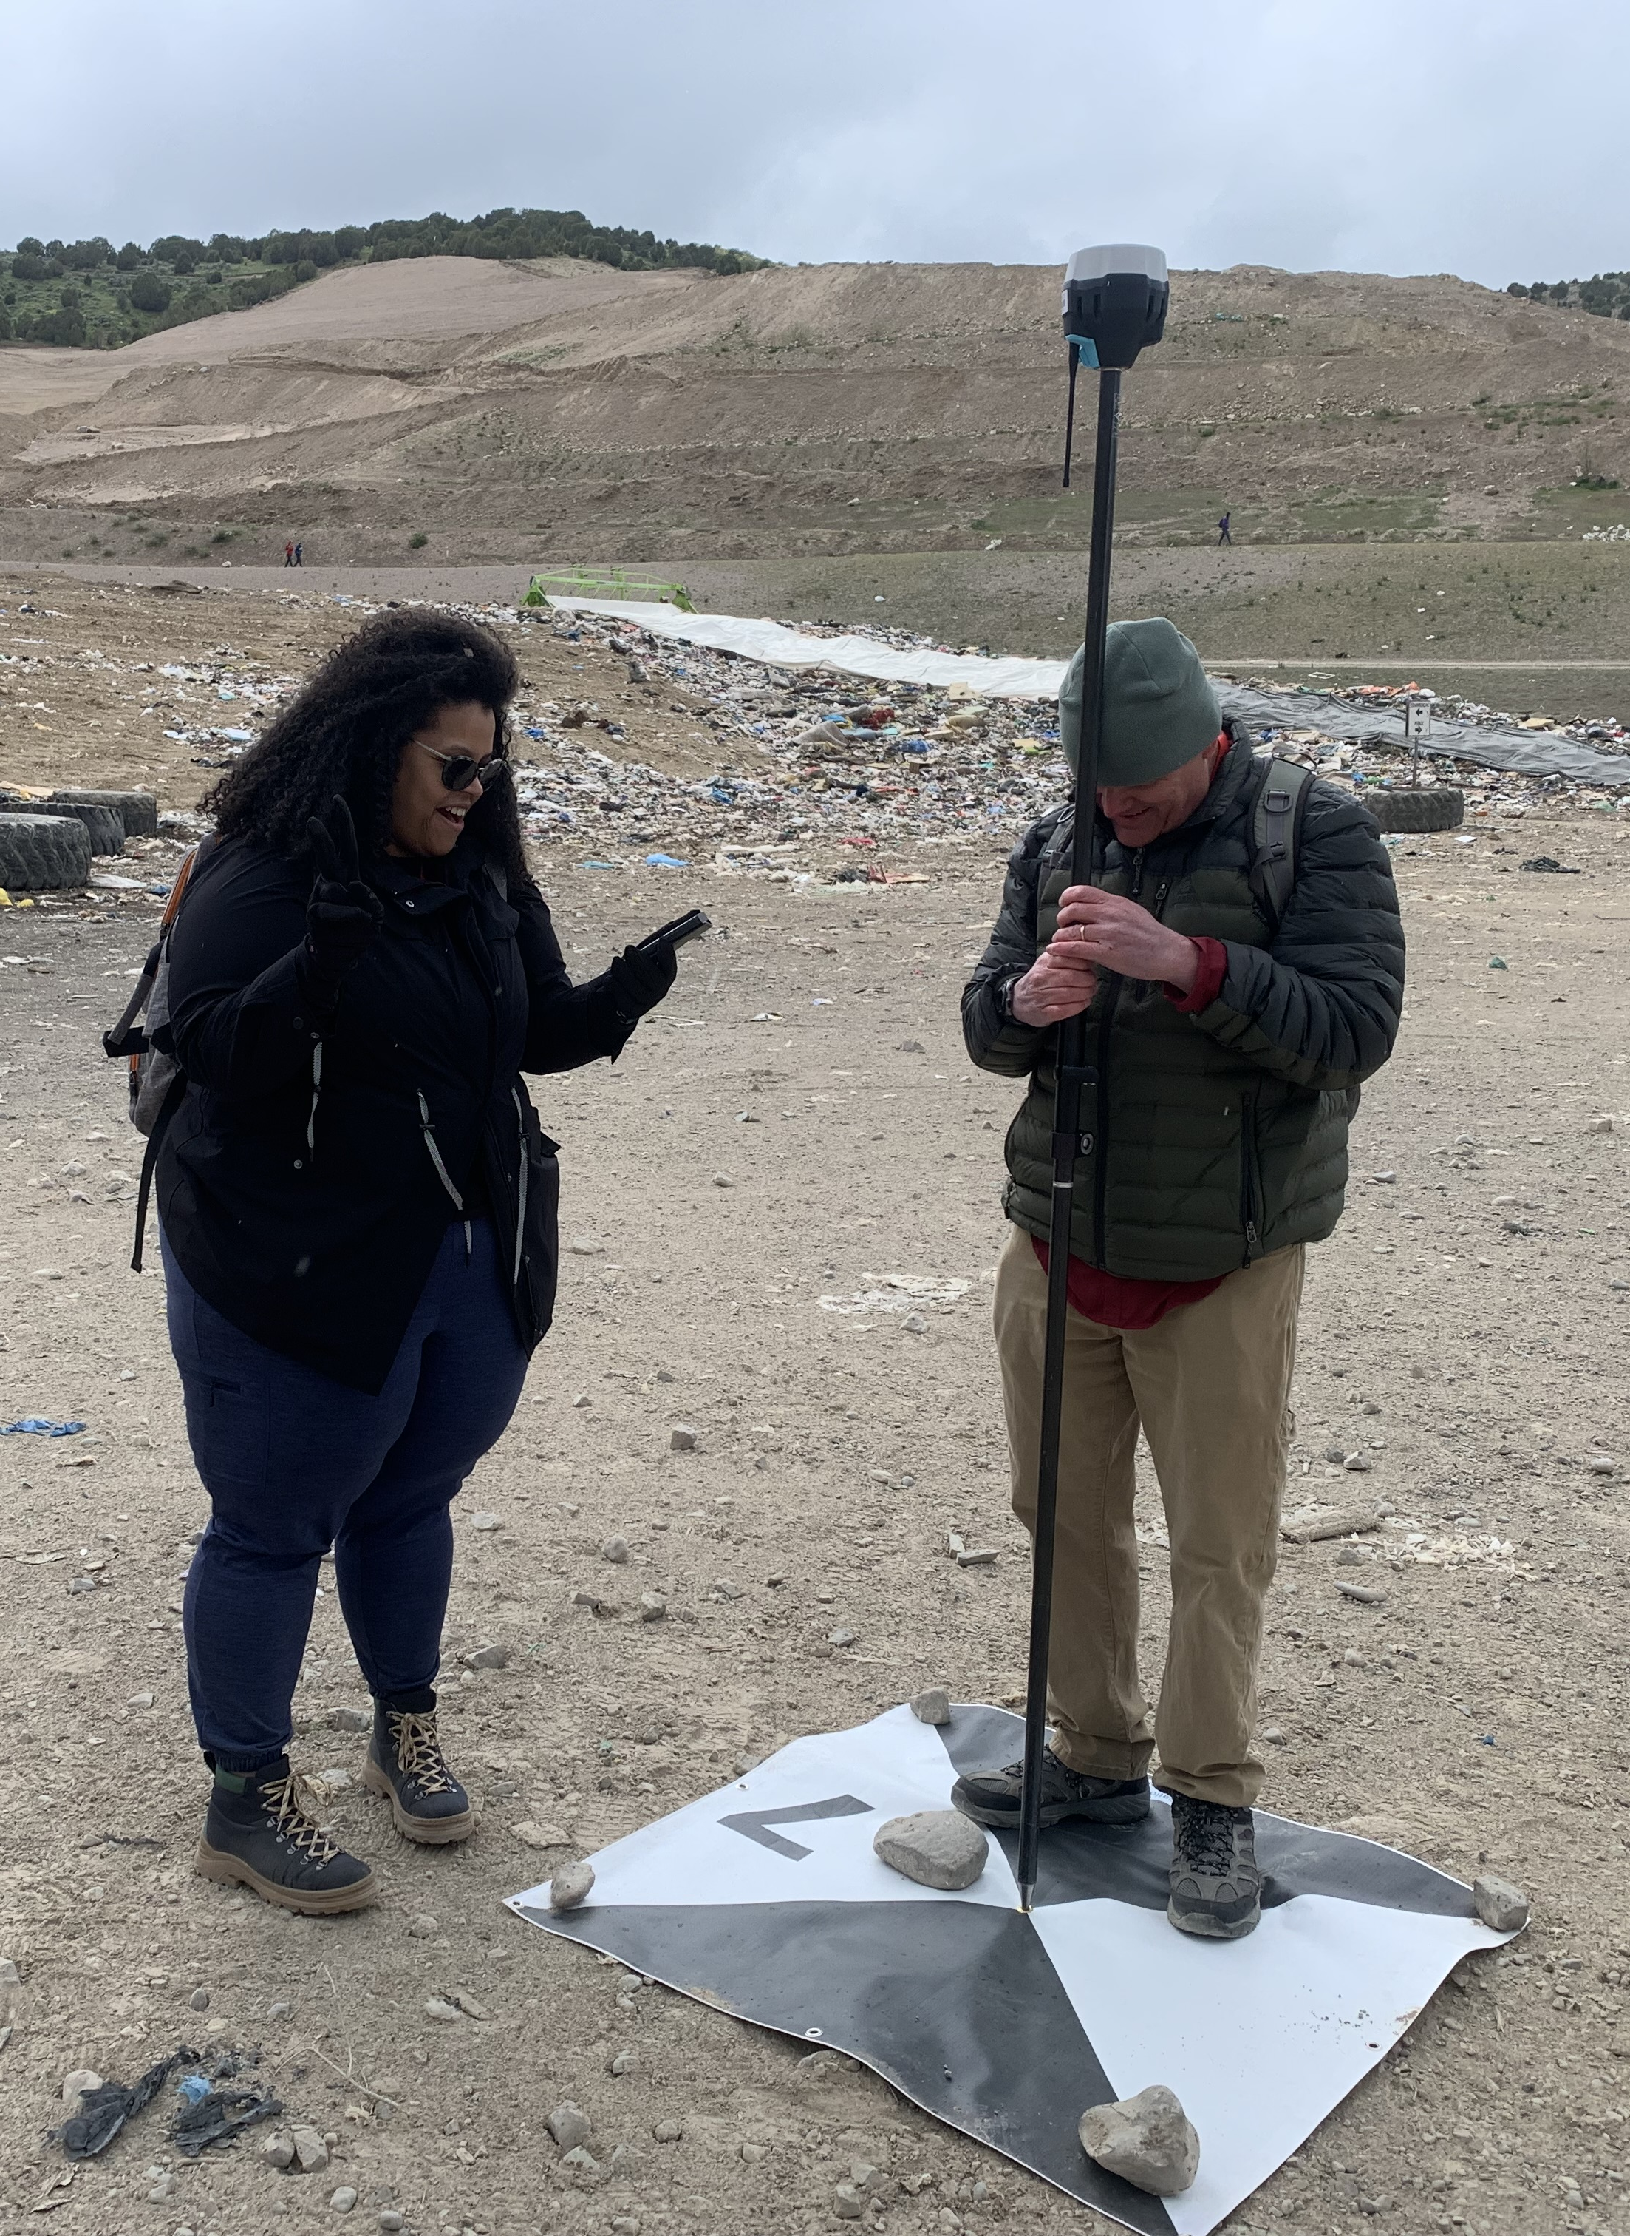
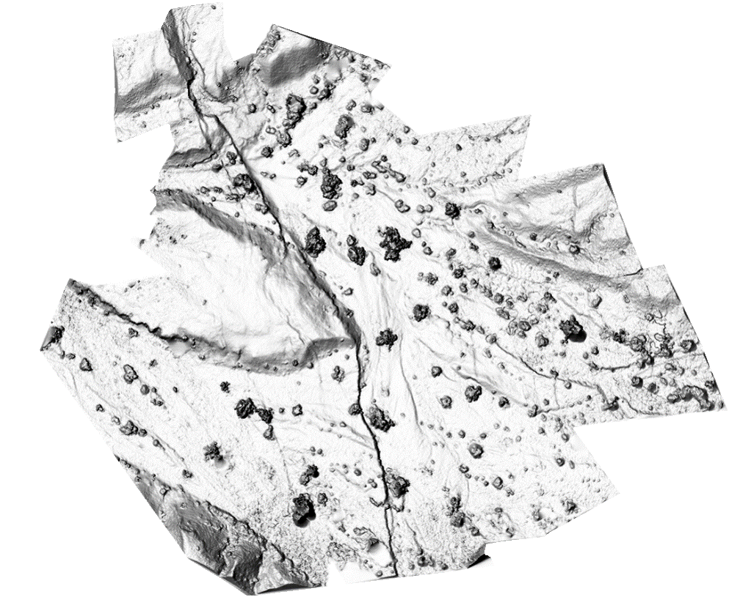
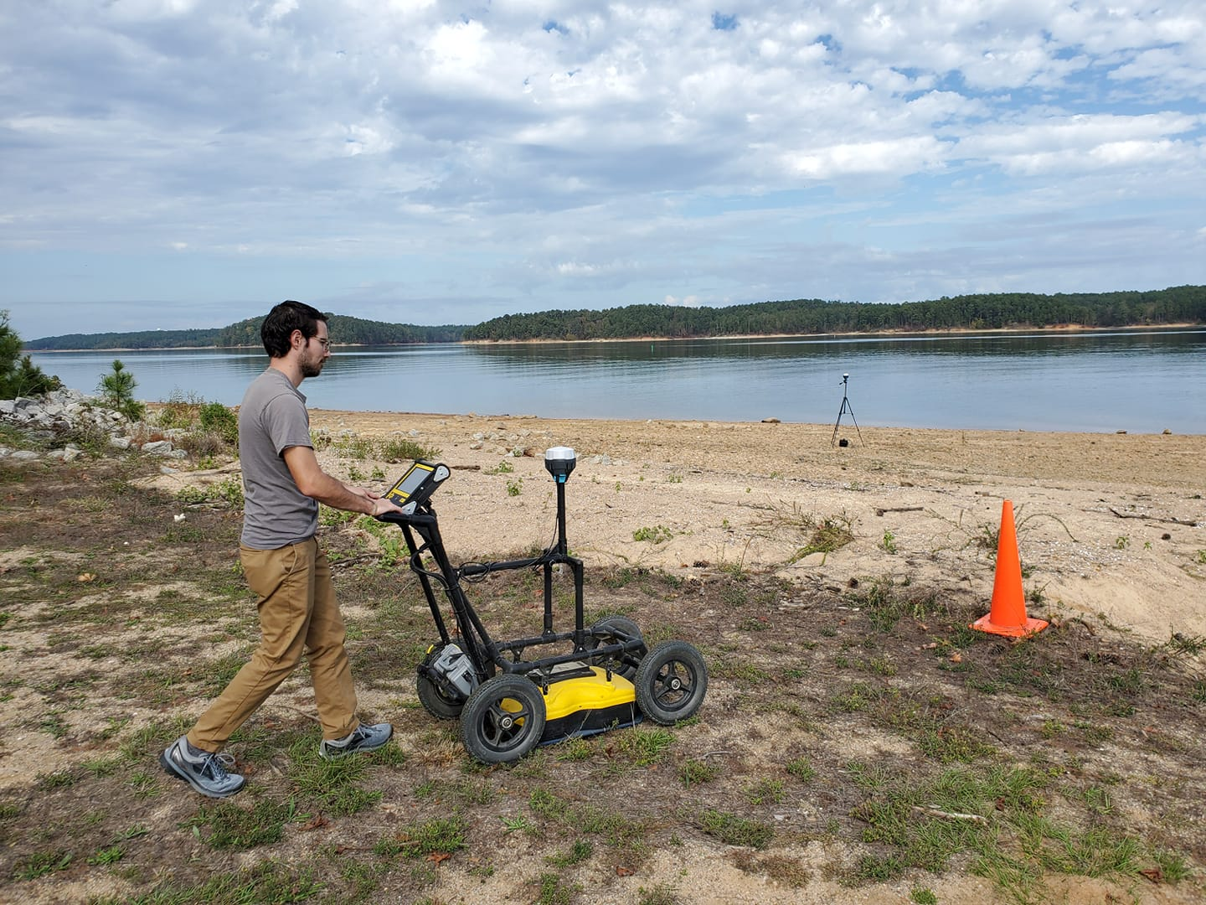
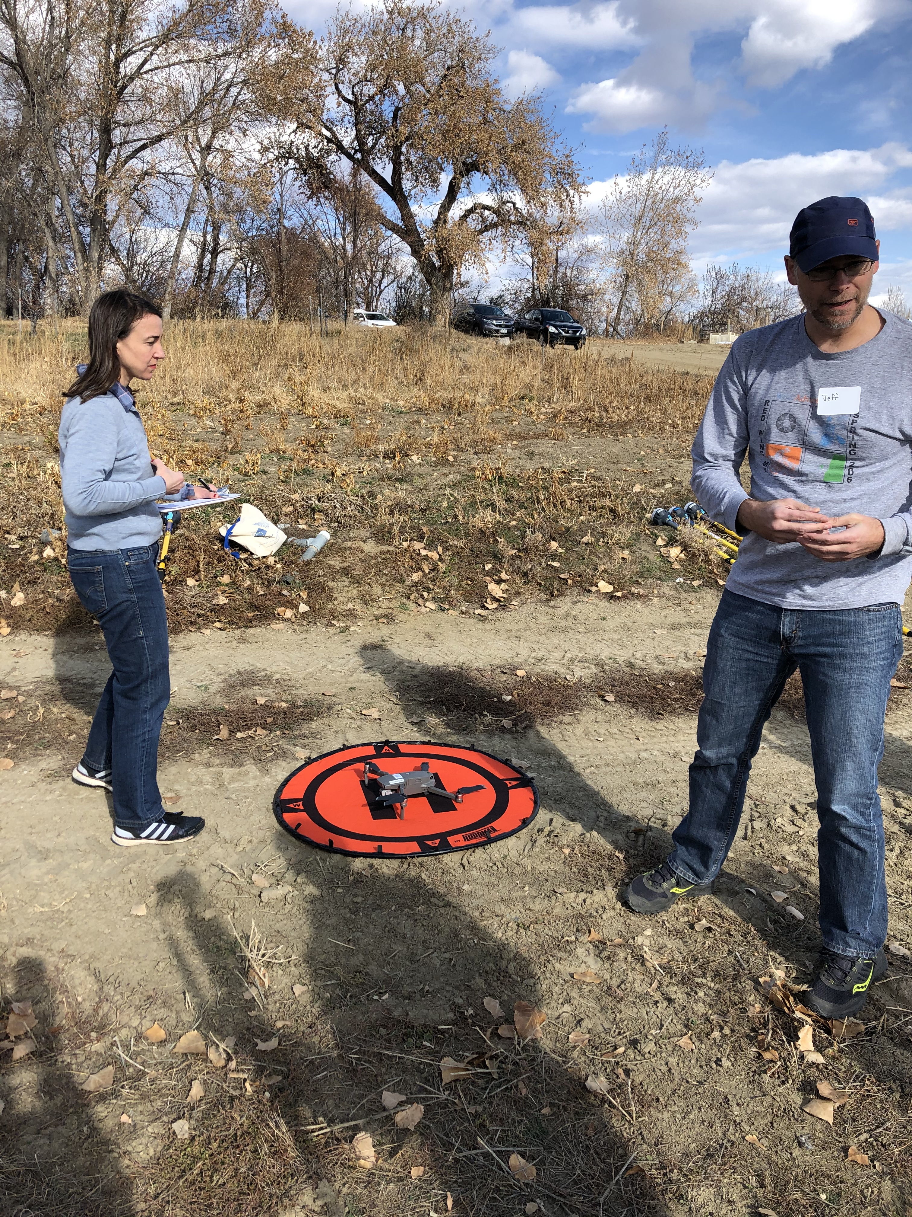
Example 3: Georeferencing other surveys
Photogrammetry survey (ex. drone)
Nodal array deployment
Other surveys (ex. GPR)
Notes:
Images
SfM: EarthScope Consortium (Beth Pratt-Sitaula) and Ed Nisson.
Nodal array: https://www.nature.com/articles/s41598-018-19728-w/figures/1
GPR: Bigman Geophysical

Slide 24
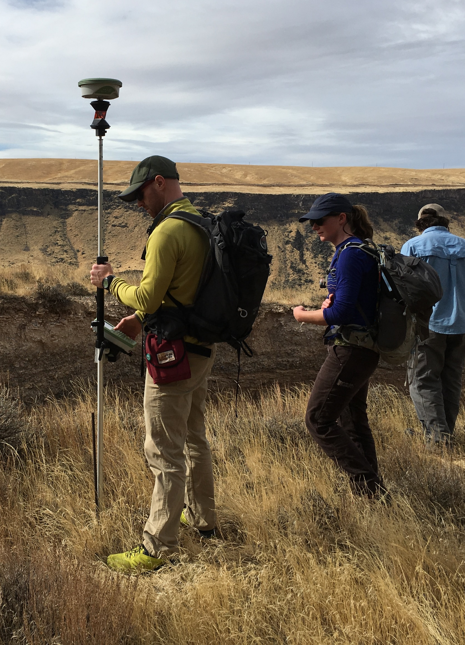
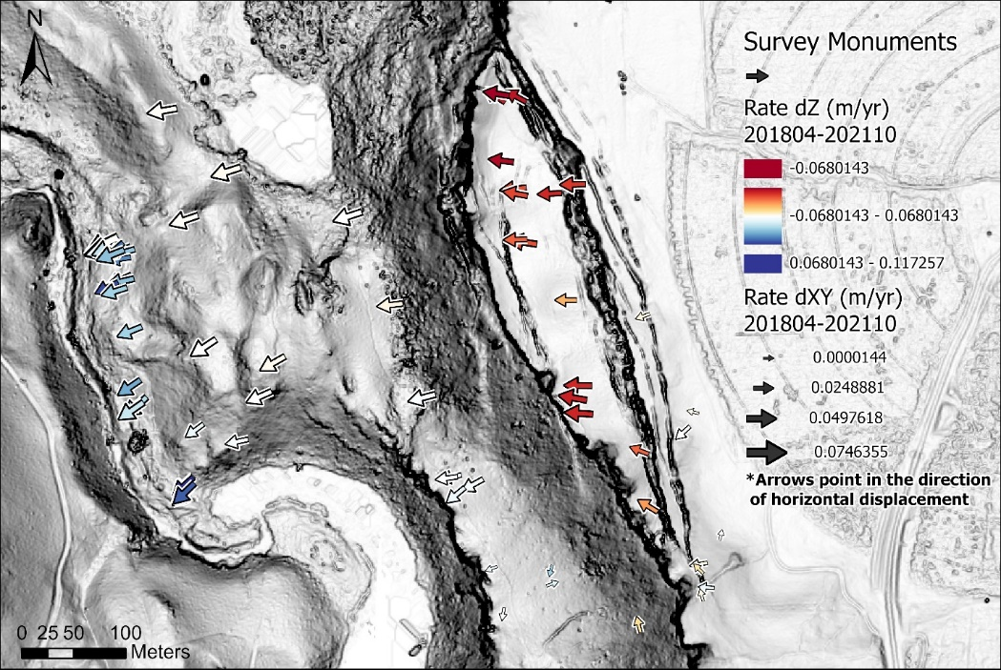
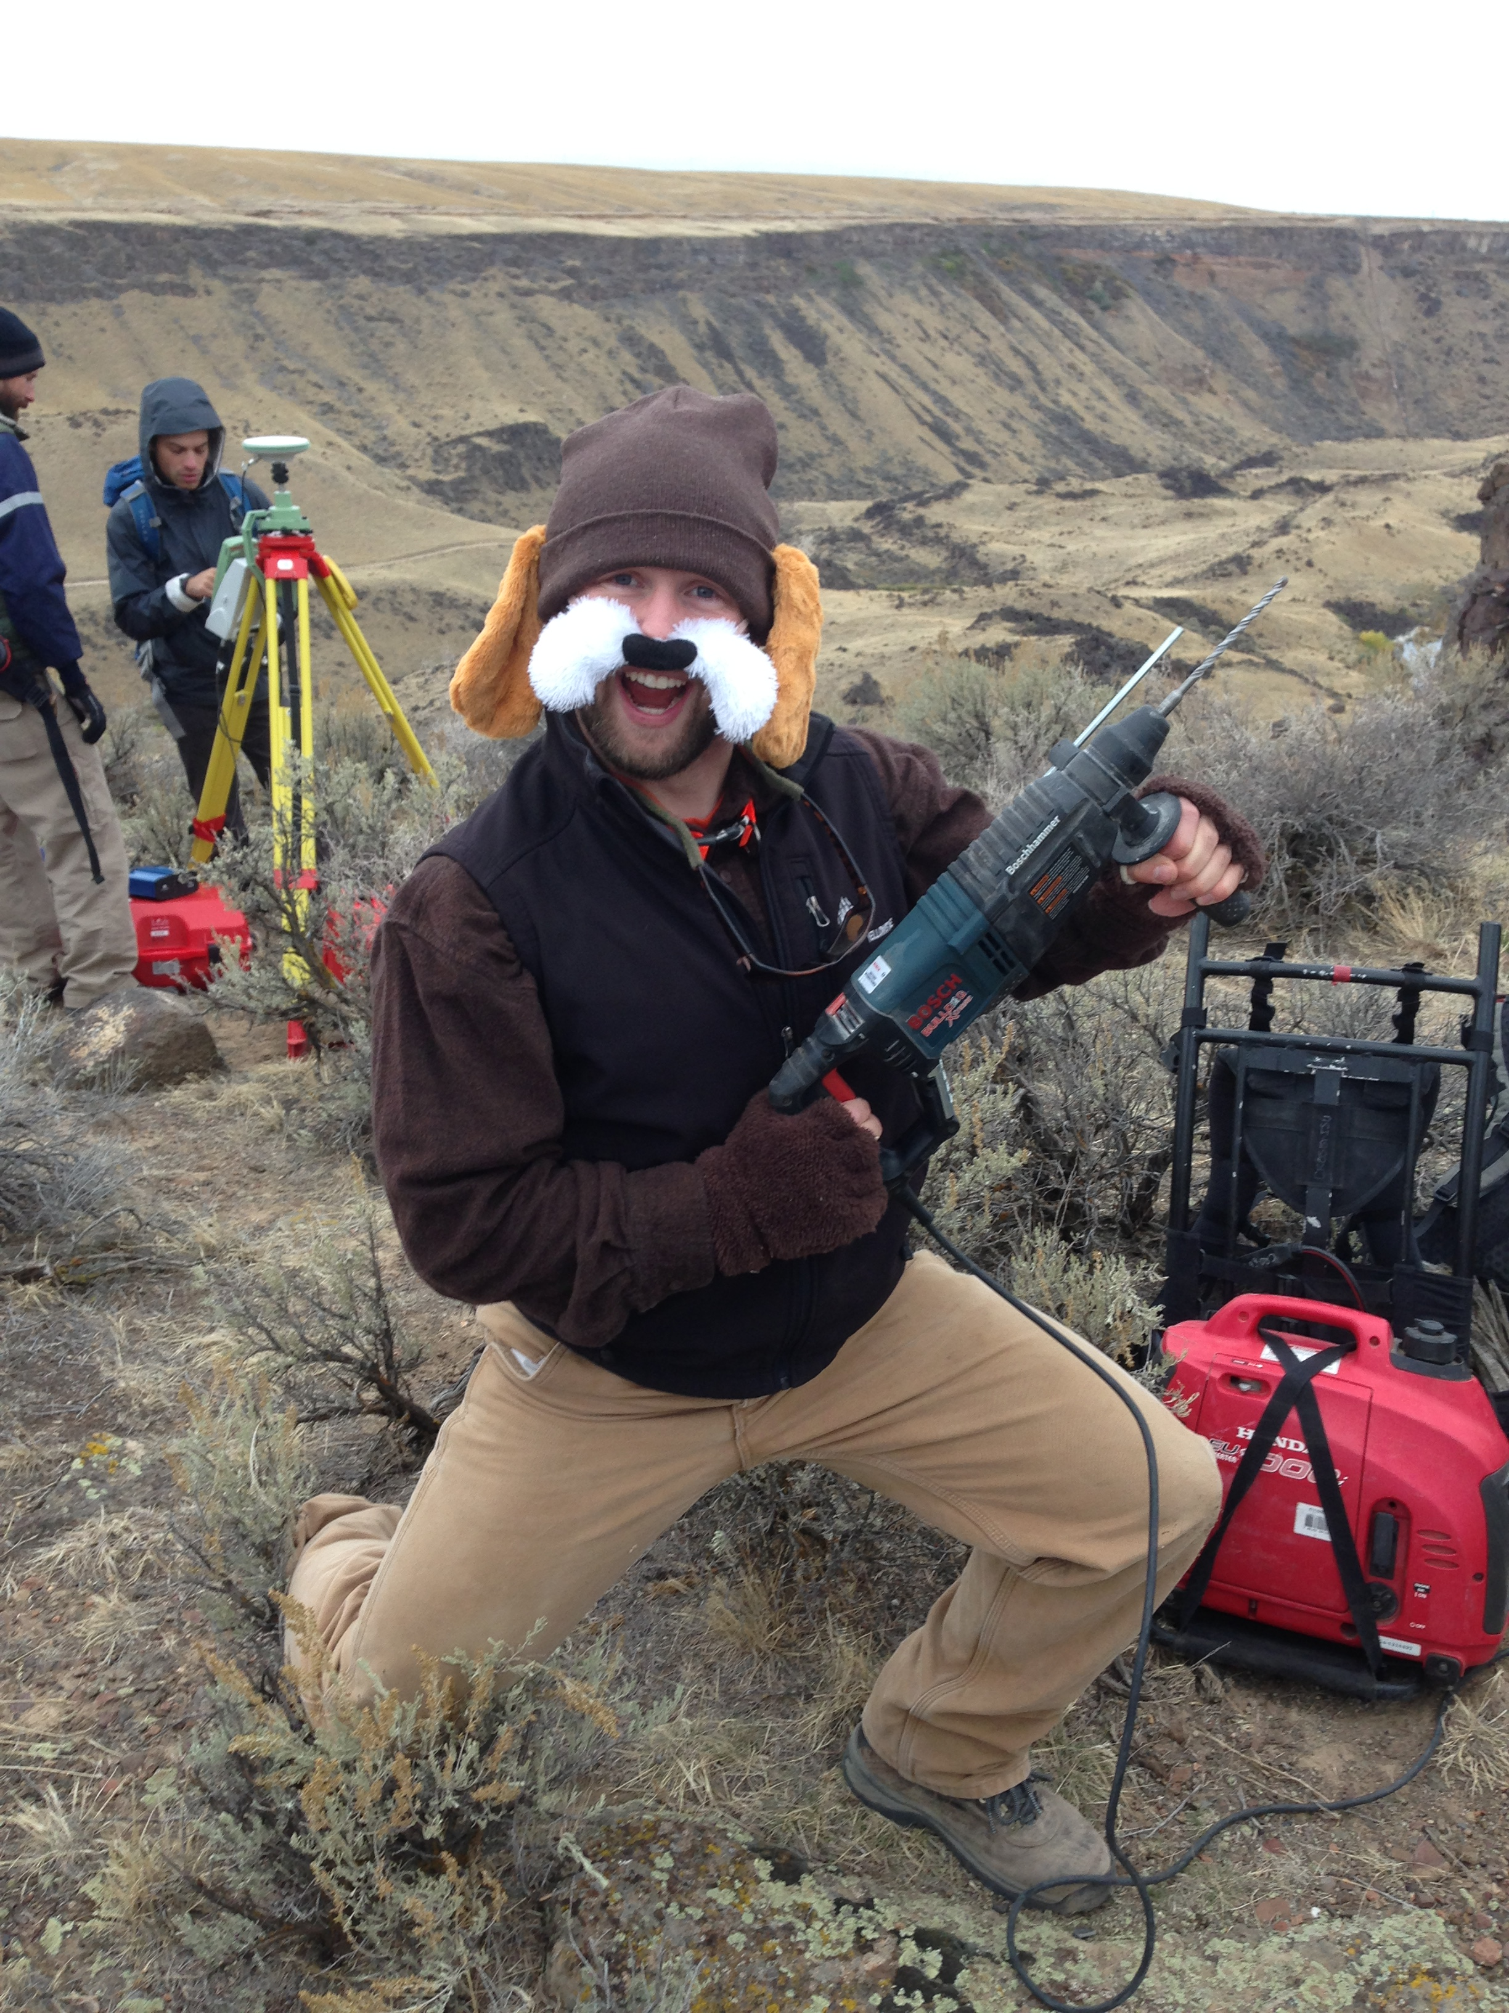
Example 4: Change Detection
Using Kinematic Systems
  ~85 points surveyed across slide (rebar and pin monuments)
  Can resolve small changes in position, e.g. tracking landslides
Notes:
Images: Dorsch, 2004 Thesis

Slide 25
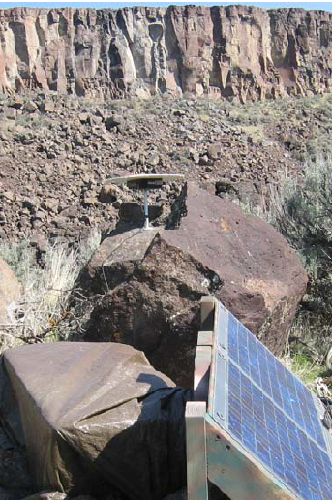
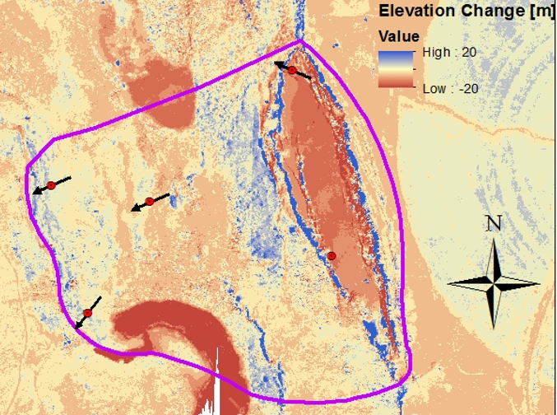
Example 5: Change Detection
Using Static Systems
  Measure a small number of points over a long duration
  Can resolve small changes in position, e.g. tracking landslides
From the field … … to four post- … to mm scale
processed points … time series.
Notes:
Images: Dorsch, 2004 Thesis

Slide 26
Societal Value of GNSS-enabled Research
Most people use it for location and navigation, but how do earth scientists use GNSS?
  Think-Pair-Share discussion
  How do earth scientists use GNSS?
    List as many applications as you can.
  How do these uses benefit society?
    Categorize each as a direct or indirect benefit.
      Direct benefits are immediate and improve lives
      Indirect benefits help humans, but are a few steps removed

Slide 27
Societal Value Of GNSS-enabled Research
Most people use it for location and navigation, but how do Earth Scientists use GNSS?
  How do earth scientists use GNSS?
    [type student ideas here]
  How do these uses benefit society?
    Direct
      [type student ideas here]
    Indirect
      [type student ideas here]

Slide 28
Societal Value of GNSS-enabled Research
Most people use it for location and navigation
But … GNSS-enabled science also provides:
  Hazard early warning systems, saving lives
    Landslide activity
    Volcano inflation
    Fault movement
  Precise measurements of objects
    Water resources (aquifers, snow pack, etc.)
    Tracking of objects (organisms, rocks, currents)
  Without GNSS, we could not know where things are when without directly measuring them.

Slide 29
End Lecture

