Slide 1
Introduction to Structure from Motion
Katherine Shervais
modified by Beth Pratt-Sitaula
Notes:
DO REMEMBER to include attribution information for all the figures you include. Even if you took the picture or made the diagram, it will make it easier later if we just have that recorded.
ALSO – it is much easier to make notes (at least preliminary ones) for each slide NOW compared to several months later. Think about the information that future instructors using this materials will need to know in order to understand what the point of the different slides are. If all the relevant text is on the slide, notes may not be necessary, BUT if there are images, most likely some notes will be needed for future users.

Slide 2
Introduction to structure from motion
Katherine Shervais modified by Beth Pratt-Sitaula

Slide 3
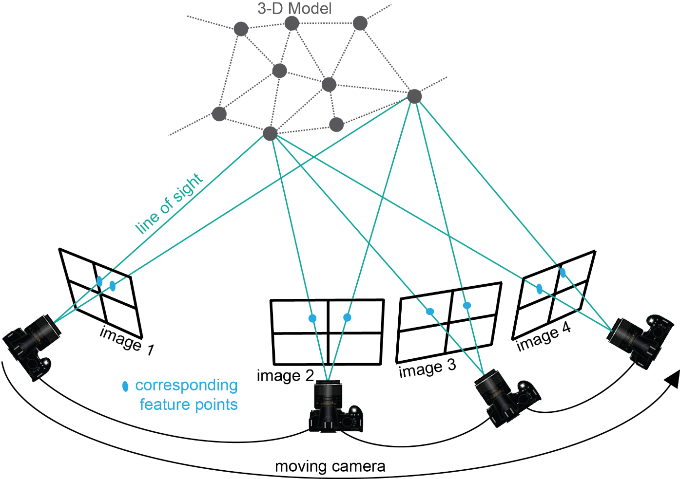
Structure from Motion
Uses the locations of the camera (motion) to interpret the geometry or 3D model (structure) of a scene
Figure Kate Shervais
Notes:
Structure-from-Motion photogrammetry is an emerging technique used to create three-dimensional point clouds with associated color—basically a three-dimensional model of the area of interest. The key things to notice here are that the camera needs to continually be moving (no two photos taken from the same location) and the photographs need to include the same features, so that features are in multiple photographs. You can see here that many of the gray dots on the 3D model are captured by multiple images, not just one. Scientists use this for many applications, which you will learn about today. The next slide will show what Structure-from-Motion actually produces.

Slide 4
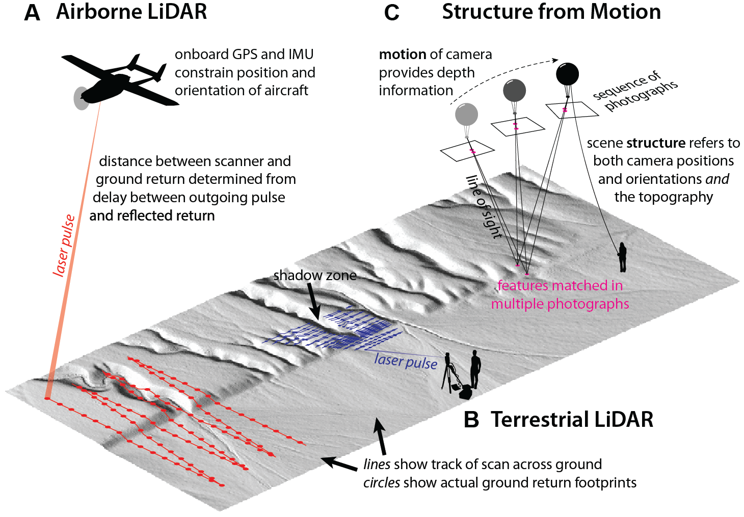
What can we compare sfm to?
Figure Johnson 2014
Notes:
Structure-from-Motion is not the only way to create a georeferenced point cloud like the one on the previous slide. The other option is using something called LiDAR. LiDAR laser scans an area of interest to create a 3D point cloud. Two example platforms for LiDAR are shown. You can fly a plane over an area at an altitude of roughly 1 km to get a point cloud or have a scanner on a tripod as shown in B. LiDAR can be used with many other platforms not seen here. Typically, LiDAR is how scientists are able to collect 3D point clouds for research. We will see some direct comparisons between LiDAR and SfM in later slides. (Kendra Johnson, Geosphere 2014)
Note: GSA Publications allow the reproduction of a single figure or table under without permissions. http://www.geosociety.org/pubs/copyrt.htm

Slide 5
Applications of Sfm
Notes:
Can be fun to stop at this point and ask the students to give ideas on what applications they imagine high rez 3D models/topography.

Slide 6
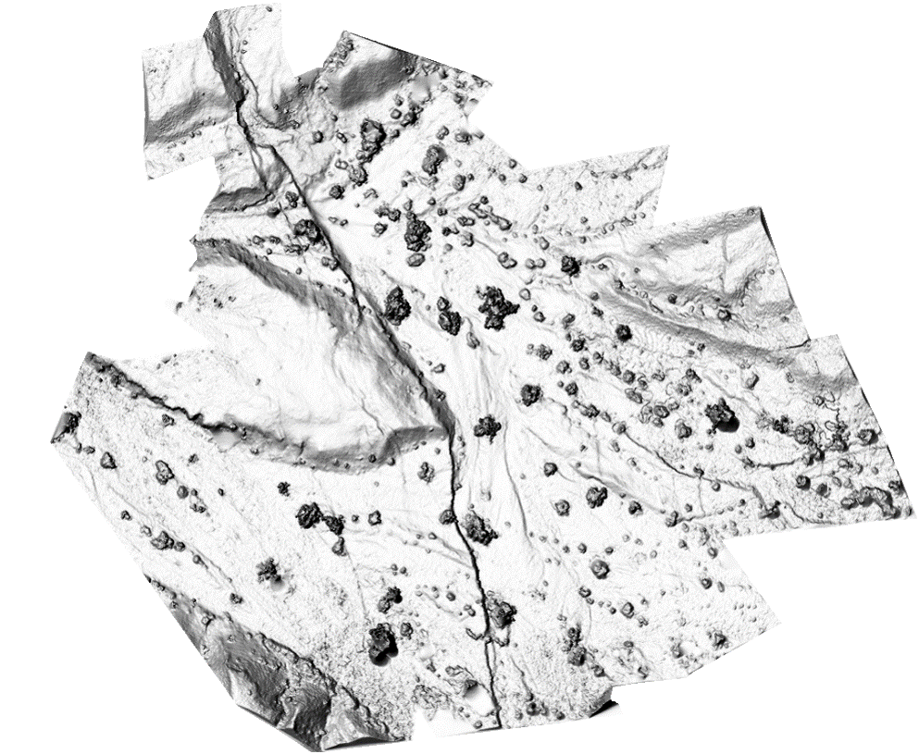
Shaded digital elevation model
Figure Ed Nissen
Notes:
DEM – Digital elevation model. This one has hillshade, so it seems like the sun is shining and it is partially in shadow to show off the features. You can see that different features stand out in the DEM in comparison to the orthomosaic, so they can be used for different research applications. You can use this to measure features.

Slide 7
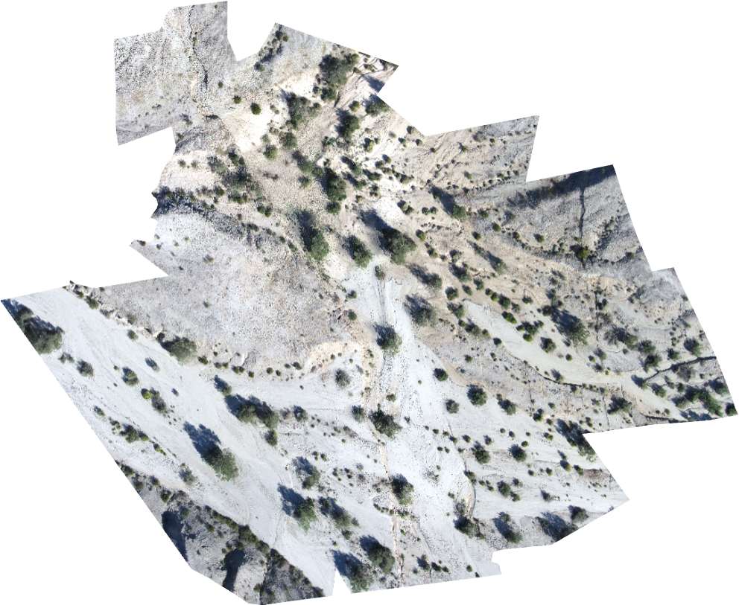
orthomosaic
Figure Ed Nissen
Notes:
The orthomosaic is a high-resolution photograph of the area created by associating color with each point in the model. This can be used to view the features on the surface.

Slide 8
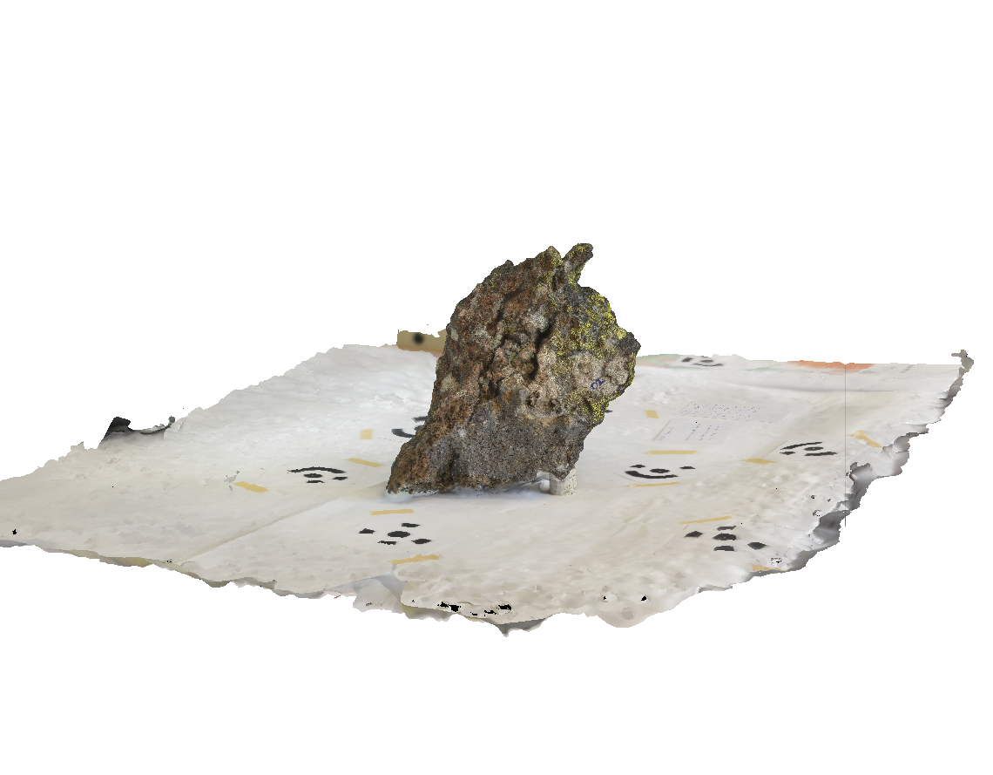
Rock sample model
Figure Sean Bemis
Notes:
This model of a handspeciman is used for students; they can look at hand samples in a digital form in addition to (or during remote learning) instead of the hand sample in the classroom.

Slide 9
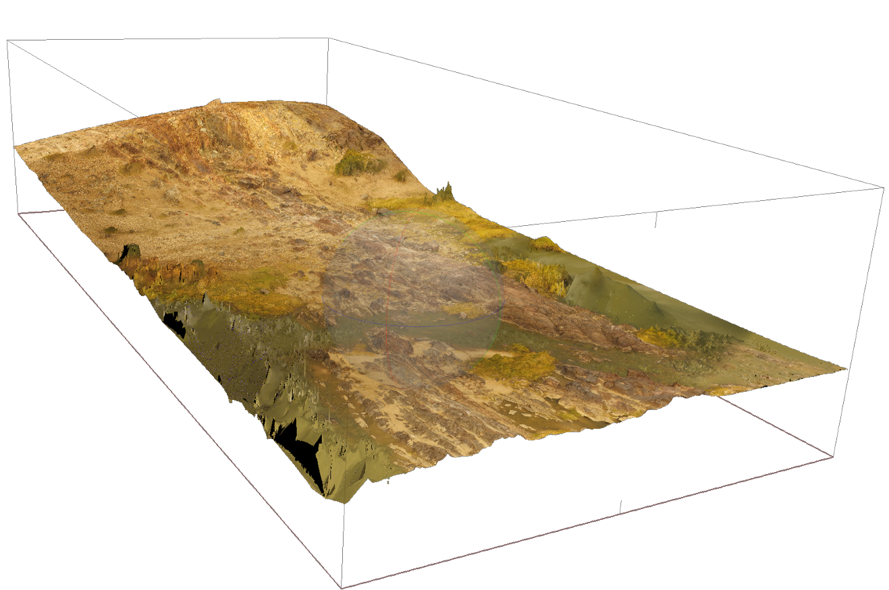
Outcrop model – Pofadder shear zone
Figure Jamie Kirkpatrick
Notes:
In this view, you can see the 3D topography of the area shown in the flight video.

Slide 10
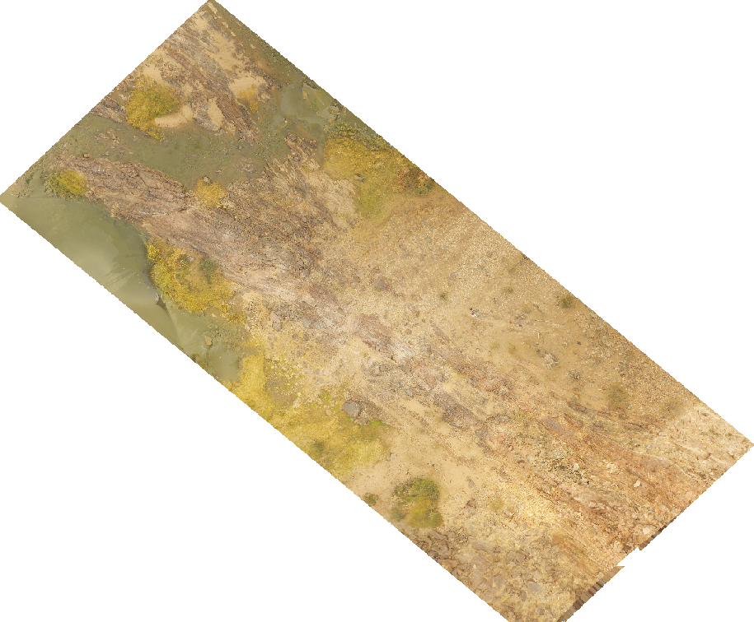
Outcrop model – pofadder shear zone
Figure Jamie Kirkpatrick
Notes:
The orthomosaic looks like this. This orthomosaic was used as the base for a geologic map.

Slide 11
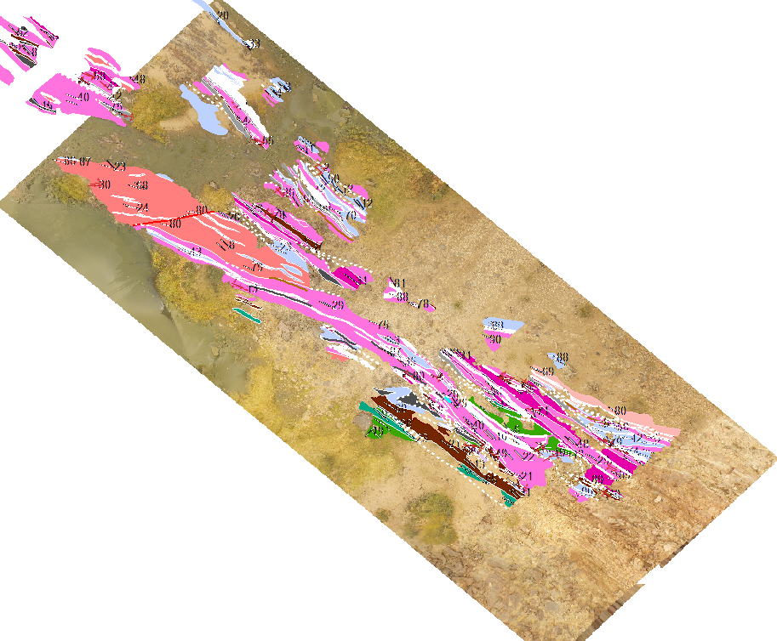
Outcrop model – pofadder shear zone
Figure Erik Young
Notes:
The map characterizes the shear zone based on rock type and orientation. Like a typical geologic map, the different colors correspond to different rock types. The white lines correspond to faults or fold axes.

Slide 12
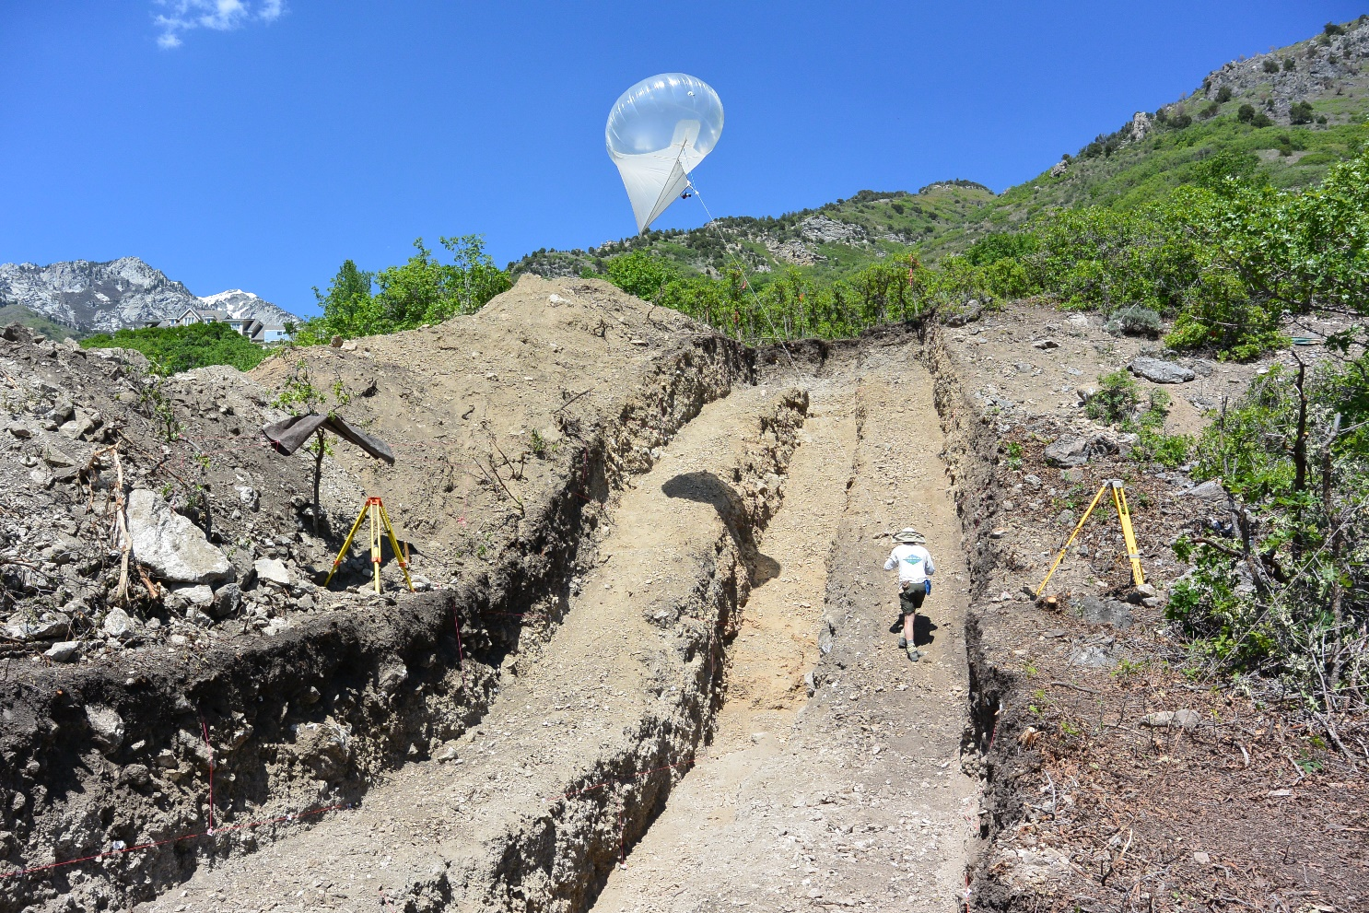
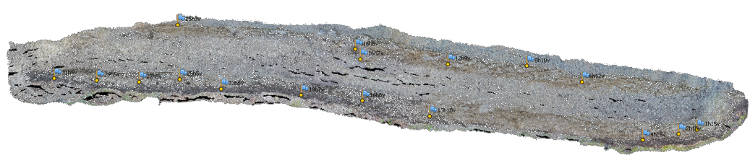
Paleoseismic trench
Figure Nadine Reitman
Notes:
This example of a paleoseismic trench is in Alpine, Utah, and is on the Wasatch Fault. Classically, trenches are dug to show the Quaternary deformation history of a fault. The trench crosses a fault scarp, like the ones shown on earlier slides. The walls of the trench have layers of material displaced by the fault that can be dated to find the age of the slip event. In addition, the layers are mapped. These maps used to take tens of hours to generate, but using SfM, they are relatively efficient to create. However, this model shows one issue – the areas that lack enough photographs result in black areas with no data as circled here. [spacebar]
[spacebar] The photo in the top right shows a heli kite; this is not used for trench data collection but is a cool platform!

Slide 13
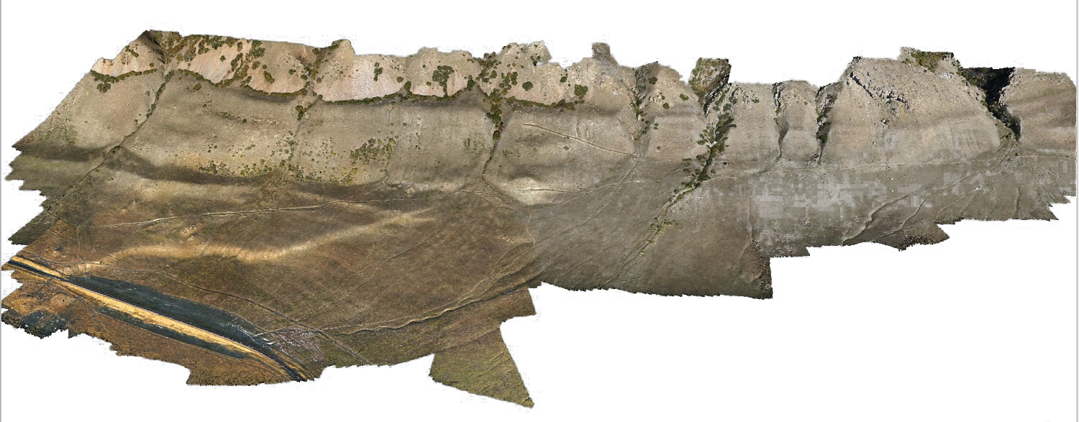
Oquirrh fault scarp
Figure Mike Bunds
Notes:
The Oquirrh fault scarp is located in western Utah. This fault is a normal fault, like many of the faults in Utah (Basin and Range extension). This survey was conducted using a UAS: a drone. You can clearly see the fault scarp [spacebar] as the break in slope on the hill.

Slide 14
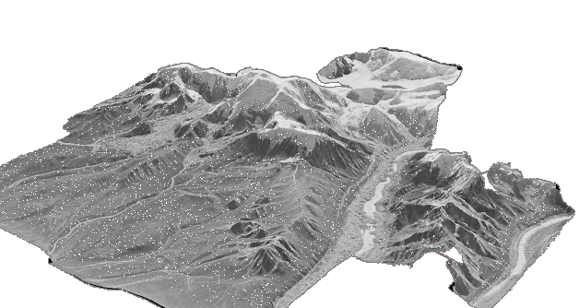
Airphoto models
Figure Sean Bemis
Notes:
Aerial photographs have been used in the geosciences as a base for mapping and to see structures from another viewpoint. These aerial photos can also be used for SfM. This model was made from only five photographs, but the topography is very clear. These models can then be used as a base map for planning geologic research.

Slide 15
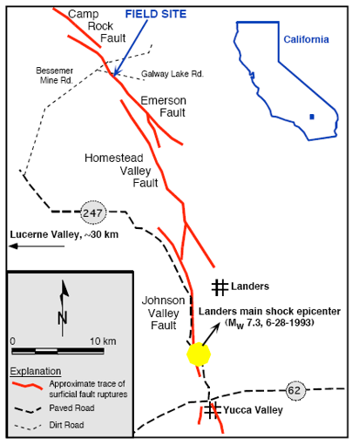
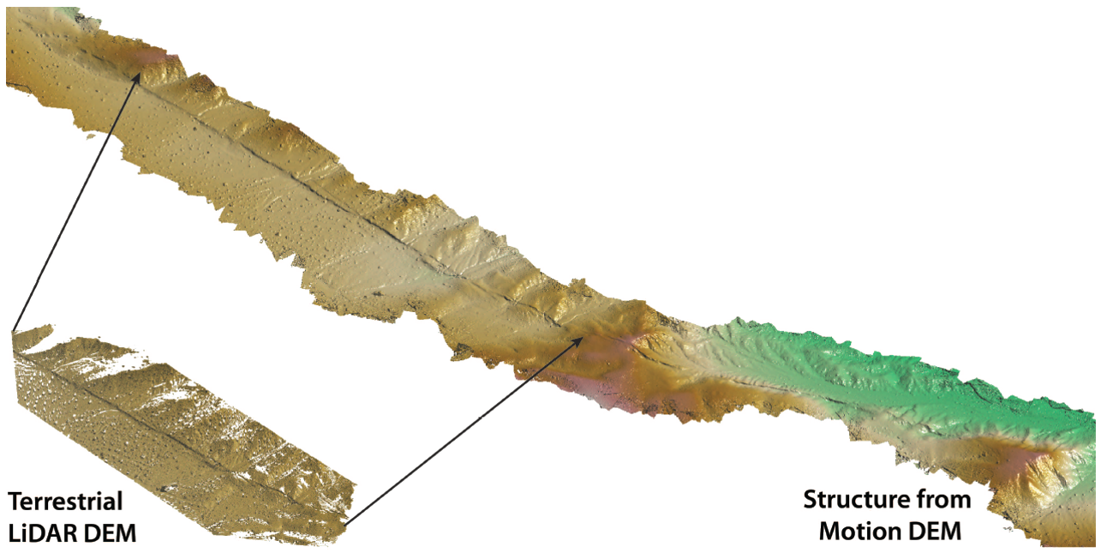
Comparison of sfm to tls - landers
Figure Ed Nissen, Map Ramon Arrowsmith
Notes:
This slide also shows images of a fault scarp. The Landers fault scarp, located in Southern California, resulted from a M7.3 earthquake in 1993. The image above shows examples of the SfM DEM (top) and a DEM generated using TLS (terrestrial laser scanning). TLS requires expensive equipment (hundreds of thousands of dollars) and a higher level of expertise to conduct a survey. As you can see, the point clouds are quite comparable. The TLS point cloud has a lower point density away from the fault scarp.

Slide 16
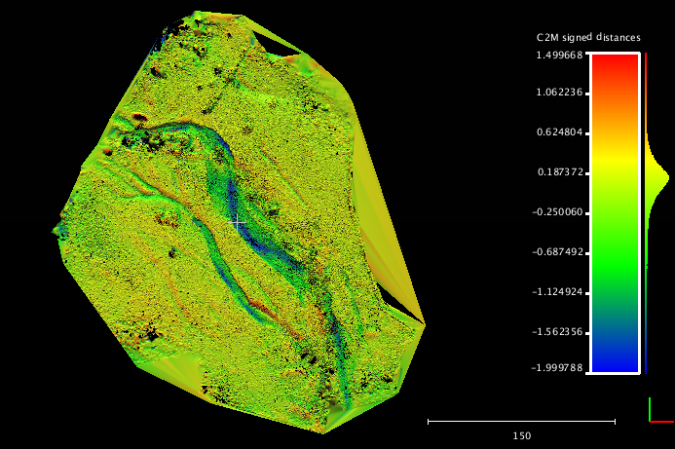
Four mile creek differencing (sfm-als)
Figure Kendra Johnson
Notes:
Another application of SfM is looking at geomorphologic change. In 2013, a major flood occurred in Boulder, Colorado. Prior to the flood, an ALS survey was conducted of the Four Mile Creek area in North Boulder. After the flood, SfM and TLS surveys were conducted. “Change detection” is when you take a dataset from two different times and subtract them—think of it as simple math. At the point on both surfaces with the same GPS location, what’s the difference in elevation? This uses the SfM model and the ALS survey. The color corresponds to how much the elevation has changed in that place. On the next slide we will see a very similar figure produced using TLS and ALS.

Slide 17
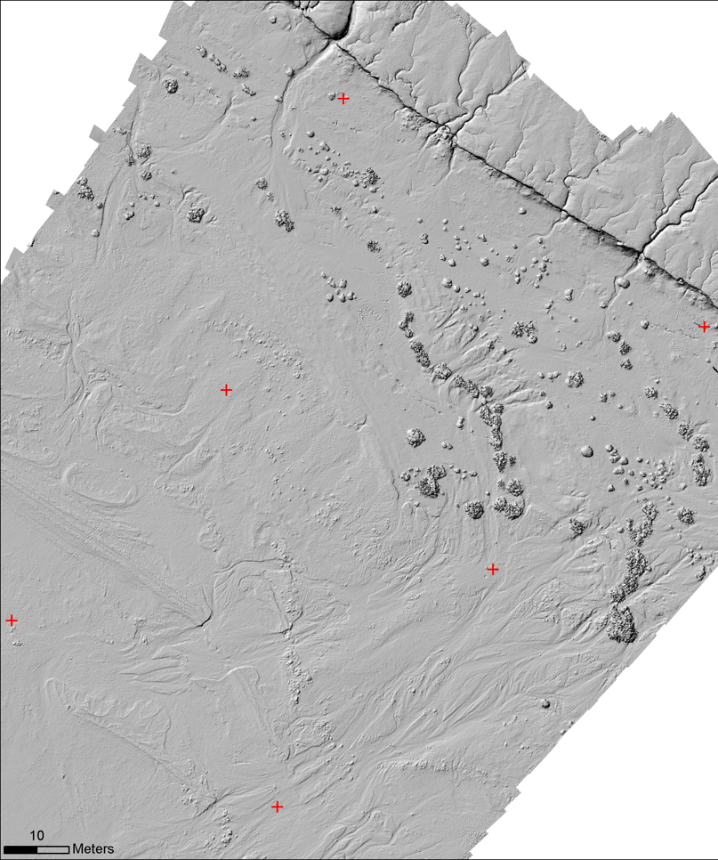
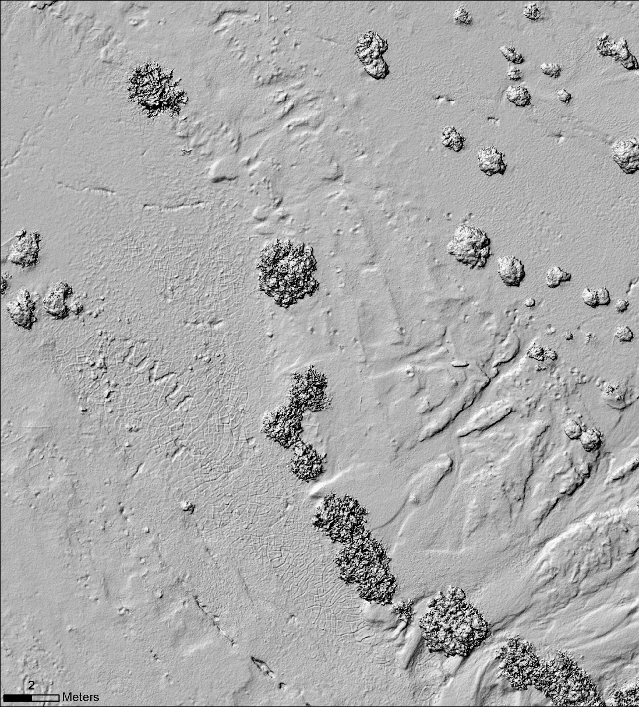
Shoreline of the Salton sea
footprints
mudcracks
strandline
Figure Mike Bunds
Notes:
This is the DEM created from the model shown on the previous slide. In the DEM, some features appear that were difficult to see with the orthomosaic. For example, you can see mudcracks [spacebar], as well as footprints in the sand [spacebar] and strandlines (lines created by stranded fish carcasses that show the previous furthest extent of the water). [spacebar].

Slide 18
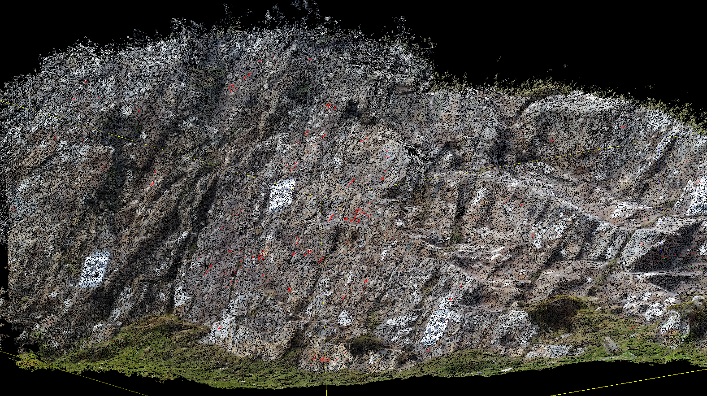
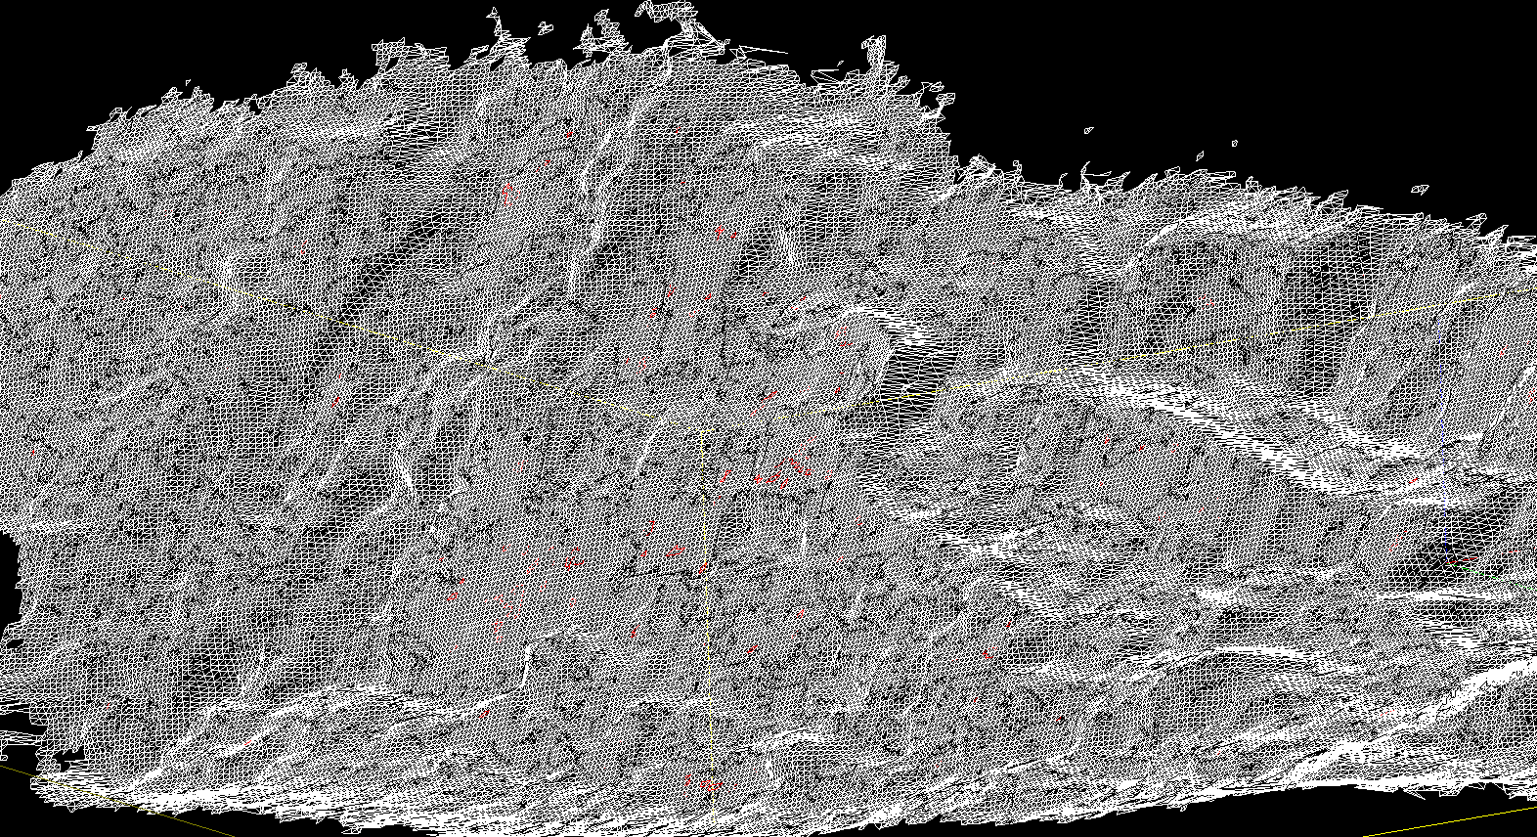
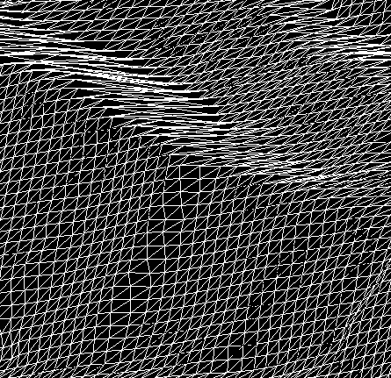
Road cut design
Point Cloud to Discontinuities
1) Point Cloud from SfM
2) Mesh surface from point cloud
3) Patches of relatively little change are identified by SplitFX software
these define joints and bedding where rocks are most likely to fail
4) Design safer cut slope (like road cut)
Notes:
1) Point cloud can be created from either TLS or SfM.
2) Mesh will then be created using SplitFx software.
3) Discontinuities will be identified as smooth surfaces with relatively little angle change over a region. Patches in the mesh are defined using SplitFX.

Slide 19
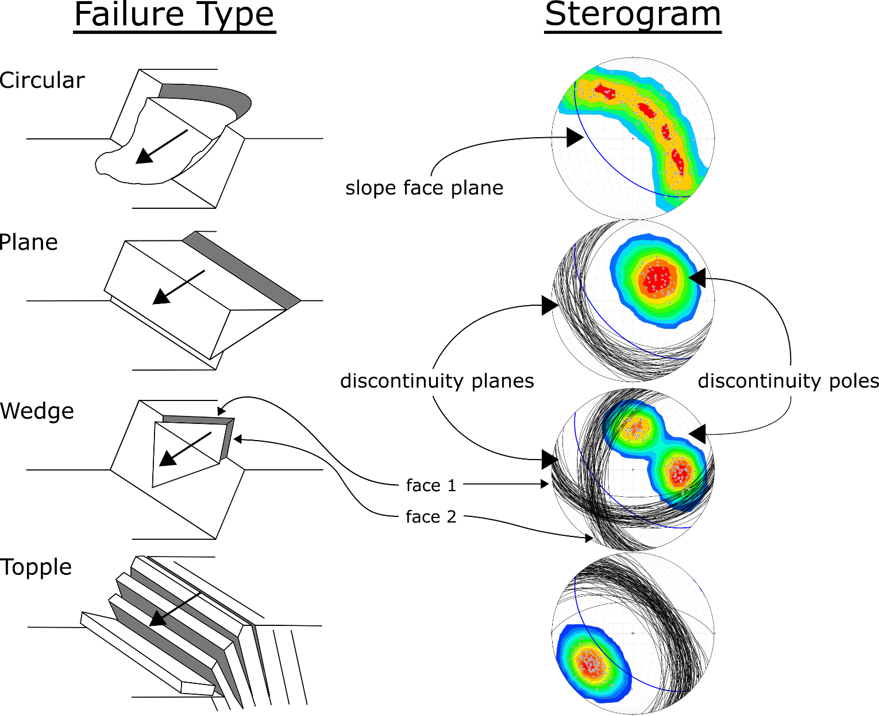
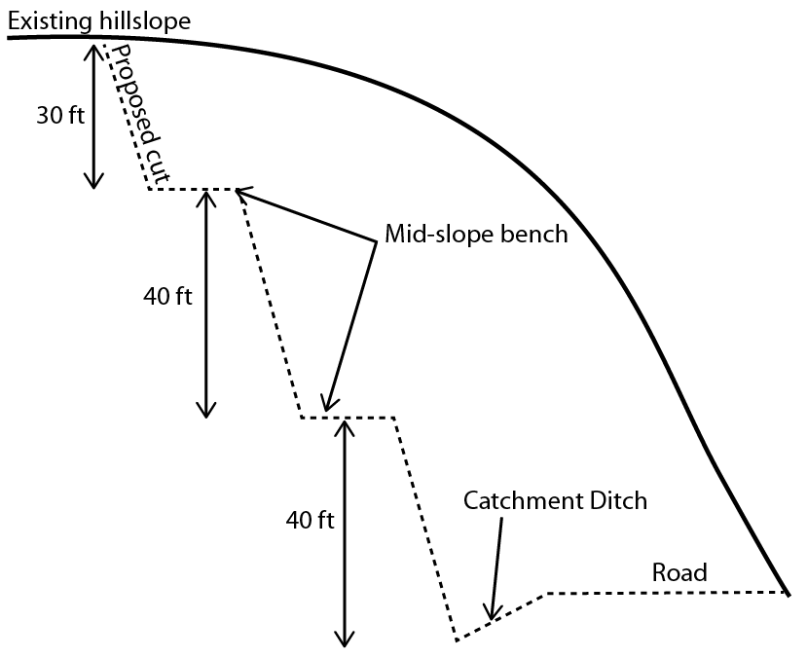
Road cut design
Notes:
Slope angles are designed based on kinematic analysis of discontinuities plotted on stereonets.
Different types of failures show diagnostic patterns on sterograms.
Right drawings modified from Hoek & Bray 1981 by Ian Lauer (UNAVCO and Idaho State University)

Slide 20
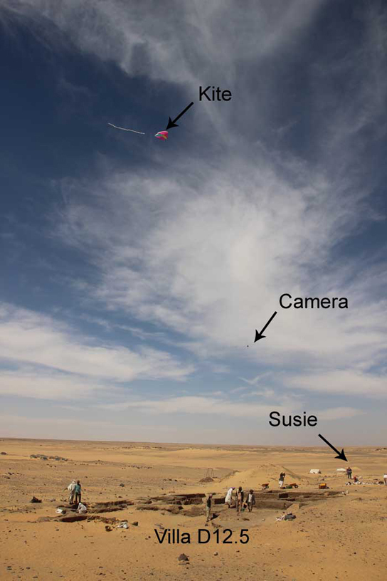
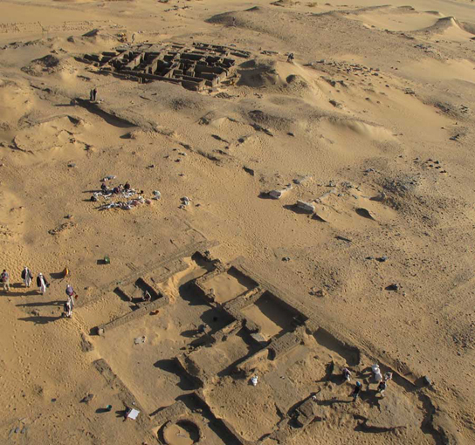
Archaeology – Amara West
Figure Neal Spencer
Notes:
Another application of SfM is archaeology. This example is from the British Museum’s Egypt department. They primarily use kite-based photogrammetry. The setup is shown in the left photo and a photograph from the camera attached to the kite on the right.

Slide 21
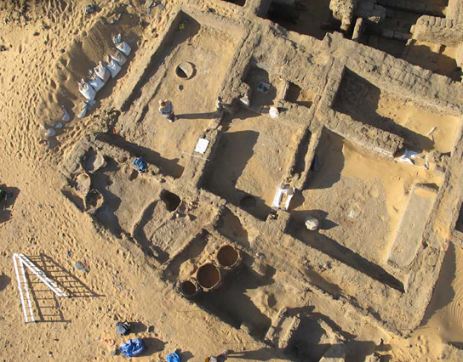
Archaeology – Amara West
Figure Neal Spencer
Notes:
Here is a portion of a model created from the kite photography.

Slide 22
HOW SfM works

Slide 23
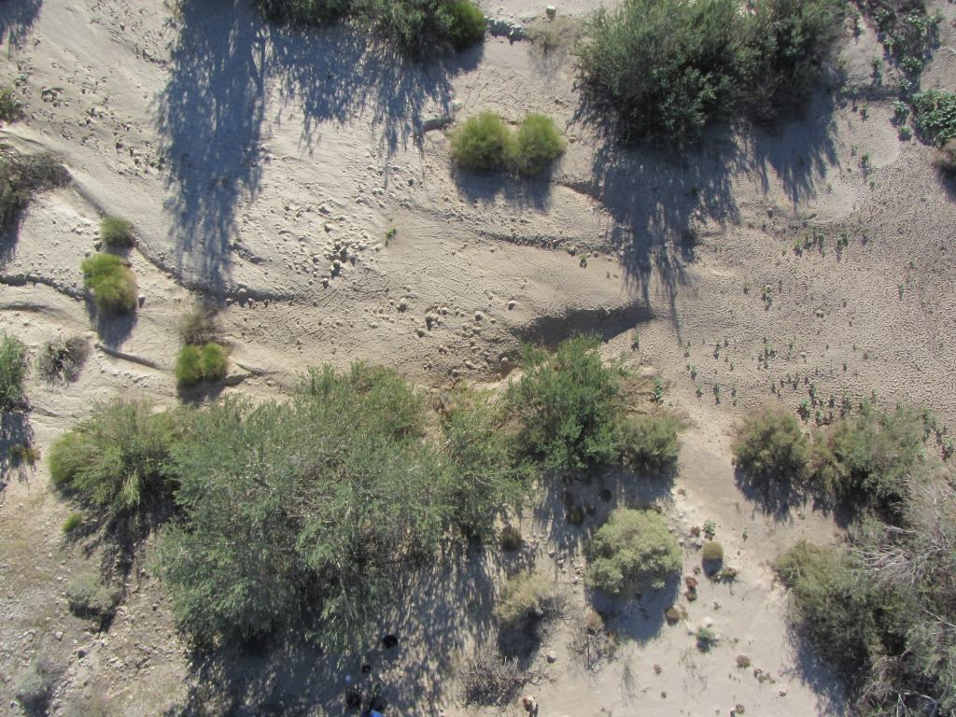
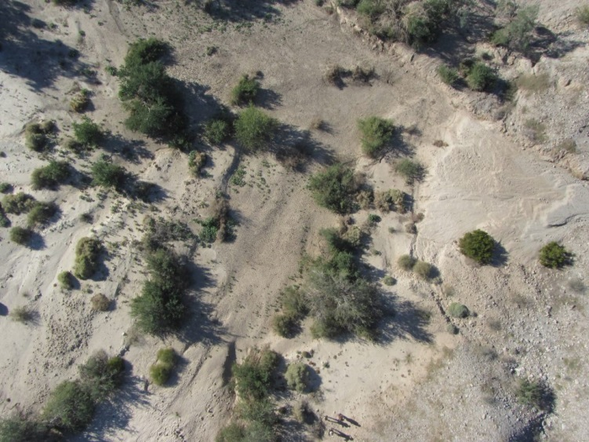
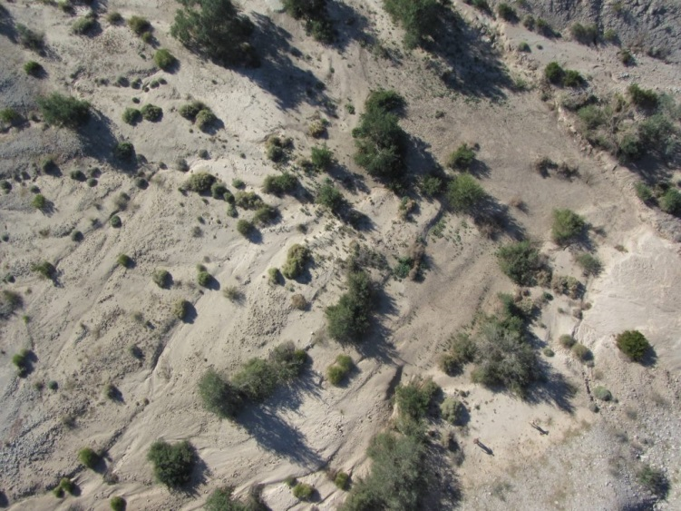
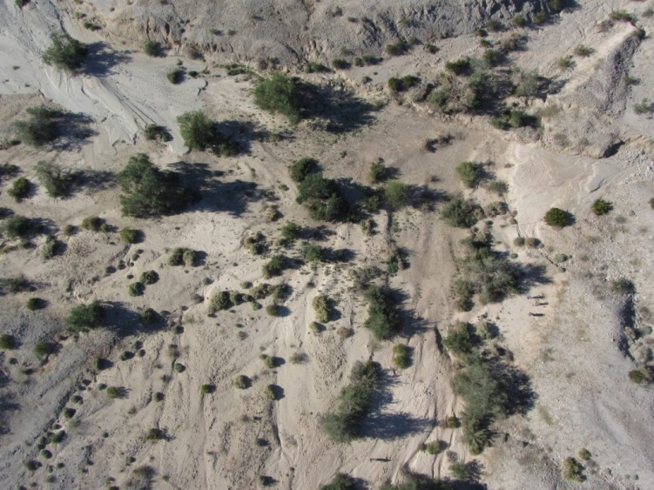
Scale-invariant feature transform (SIFT)
Figure Ed Nissen
Notes:
Each red box shows the same feature in multiple photographs. The SIFT algorithm recognizes these as the same feature.

Slide 24
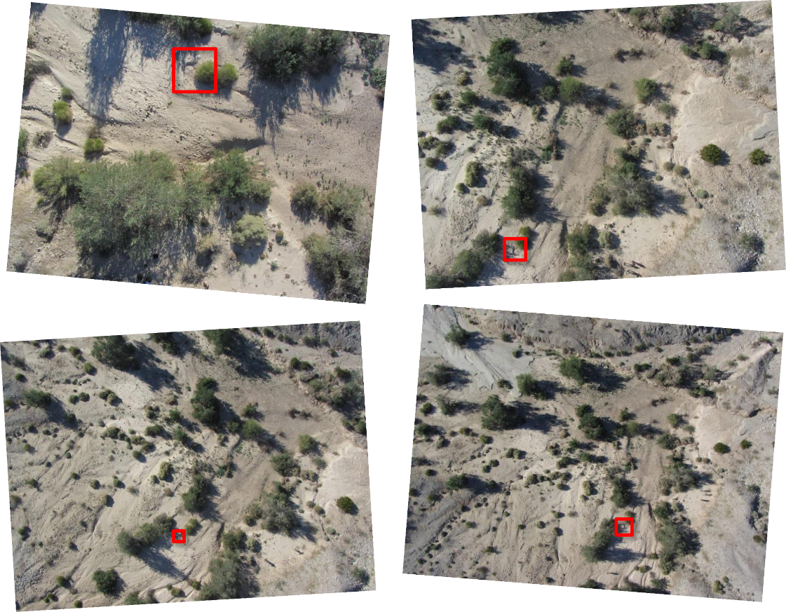
Scale-invariant feature transform (sift)
Finds matching features in multiple photographs
Scale, perspective, and illumination of the feature in the photograph do not affect algorithm
Used as the input for calculating camera locations
Figure Ed Nissen
Notes:
[Read the slide.]
A primary pioneer for the SfM method is: Lowe, D.G., 1999. Object Recognition from Local Scale-invariant Features. International
Conference on Computer Vision, Corfu, Greece, pp. 1150–1157.

Slide 25
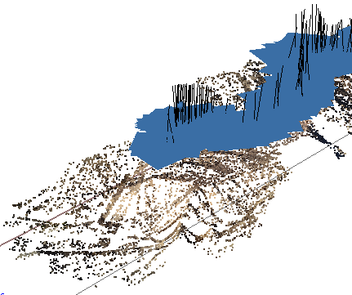
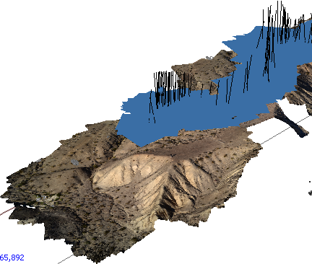
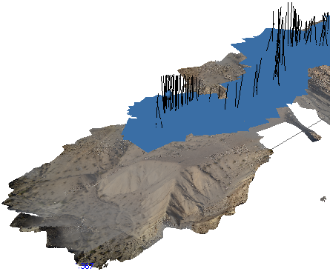
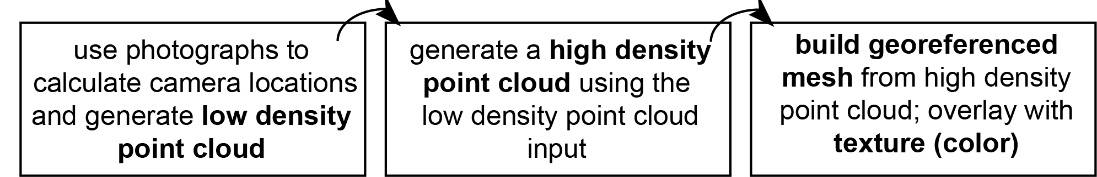
Software workflow
Notes:
The photographs, after a quality check, will be aligned. This means the matching features are found, generating a sparse point cloud and the camera locations. The next step is to generate the high density point cloud. This is one of the products you may end up using; millions of points will be in the point cloud, creating a very realistic model of the feature. This point cloud can be used to calculate a mesh. The “mesh” uses the points to create a surface composed of thousands of triangles. This mesh can be draped with the texture atlas, like draping a photograph.
Image: UNAVCO

Slide 26
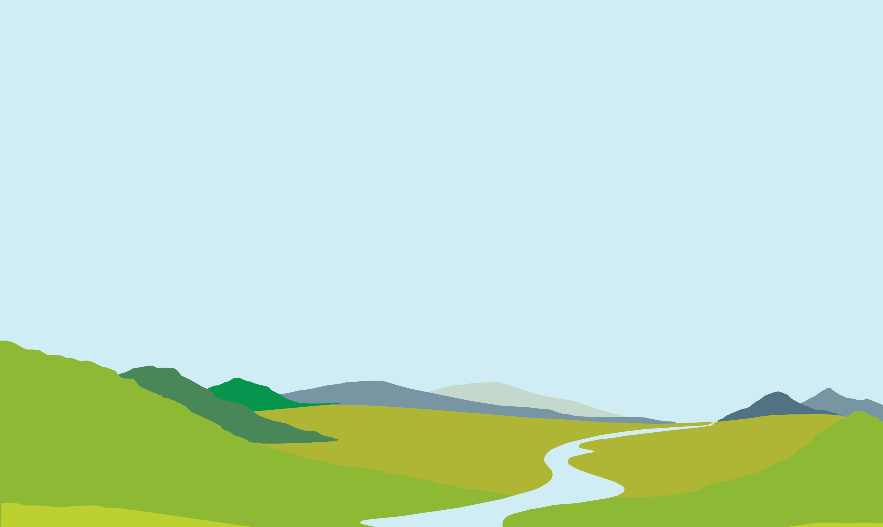
Matching features
d
Step 1
Match corresponding features and measure distances between them on the camera image plane d, d’
The Scale-Invariant Feature Transform is key to matching corresponding features despite varying distances
d'
Figure Ed Nissen
Notes:
The first step in actually creating the product we saw on the previous slide is to find the same feature in multiple photographs. You can see [spacebar] the red and purple lines tracing the line of sight from the two camera locations to two different features on the ground. This is done using an algorithm called SIFT: Scale-Invariant Feature Transform.

Slide 27
Find camera locations
d
Step 2
When we have the matching locations of multiple points on two or more photos, there is usually just one mathematical solution for where the photos were taken.
Therefore, we can calculate individual camera positions (x, y, z), (x’, y’, z’), orientations i, i’, focal lengths f, f’, and relative positions of corresponding features b, h, in a single step known as “bundle adjustment.”
f
(x, y, z)
i
f’
d'
(x’, y’, z’)
i’
h
b
Figure Ed Nissen
Notes:
When we have the matching locations of multiple points on two or more photos, there is usually just one mathematical solution for where the photos were taken. [spacebar] This step, bundle adjustment, results in the locations of the cameras and a sparse point cloud—like the one we saw on the earlier slide, but with significantly fewer points.

Slide 28
Software workflow
Notes:
The photographs, after a quality check, will be aligned. This means the matching features are found, generating a sparse point cloud and the camera locations. The next step is to generate the high density point cloud. This is one of the products you may end up using; millions of points will be in the point cloud, creating a very realistic model of the feature. This point cloud can be used to calculate a mesh. The “mesh” uses the points to create a surface composed of thousands of triangles. This mesh can be draped with the texture atlas, like draping a photograph.
Image: UNAVCO

Slide 29
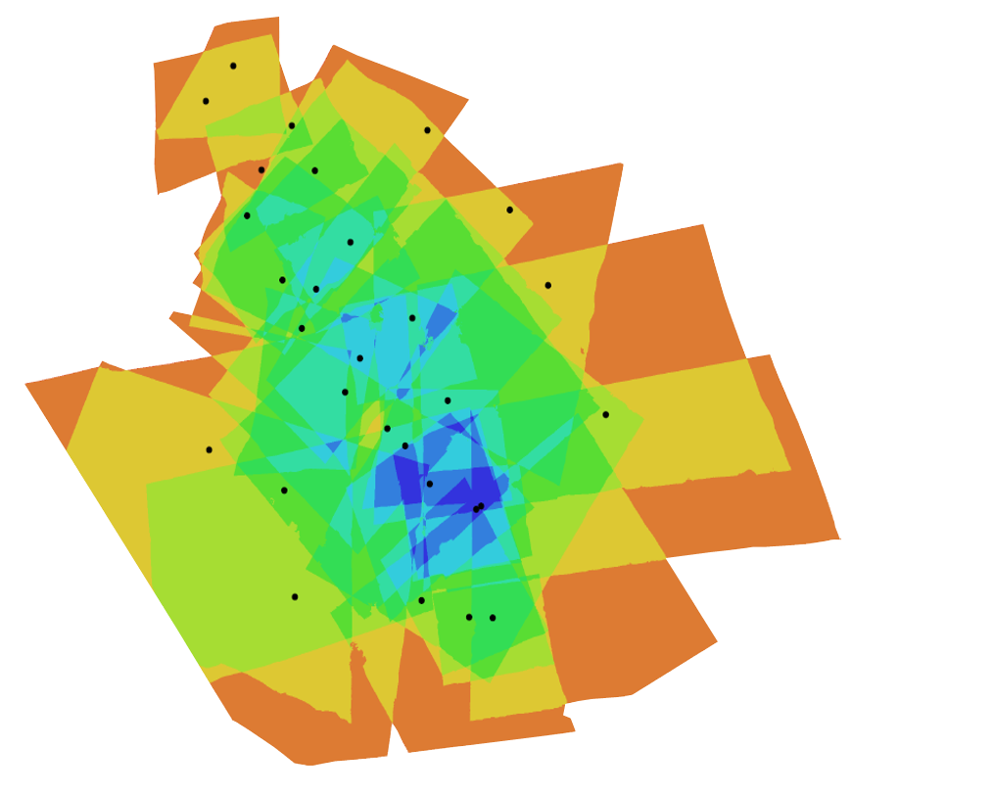
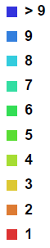
Photo density map
Figure Ed Nissen
Notes:
This photo density map shows the amount of overlap between the photos in a dataset. Each dot is a camera location. You can see the photos are the most dense around areas with lots of camera locations like the center, but that in this model every spot was seen by at least two photographs.

Slide 30
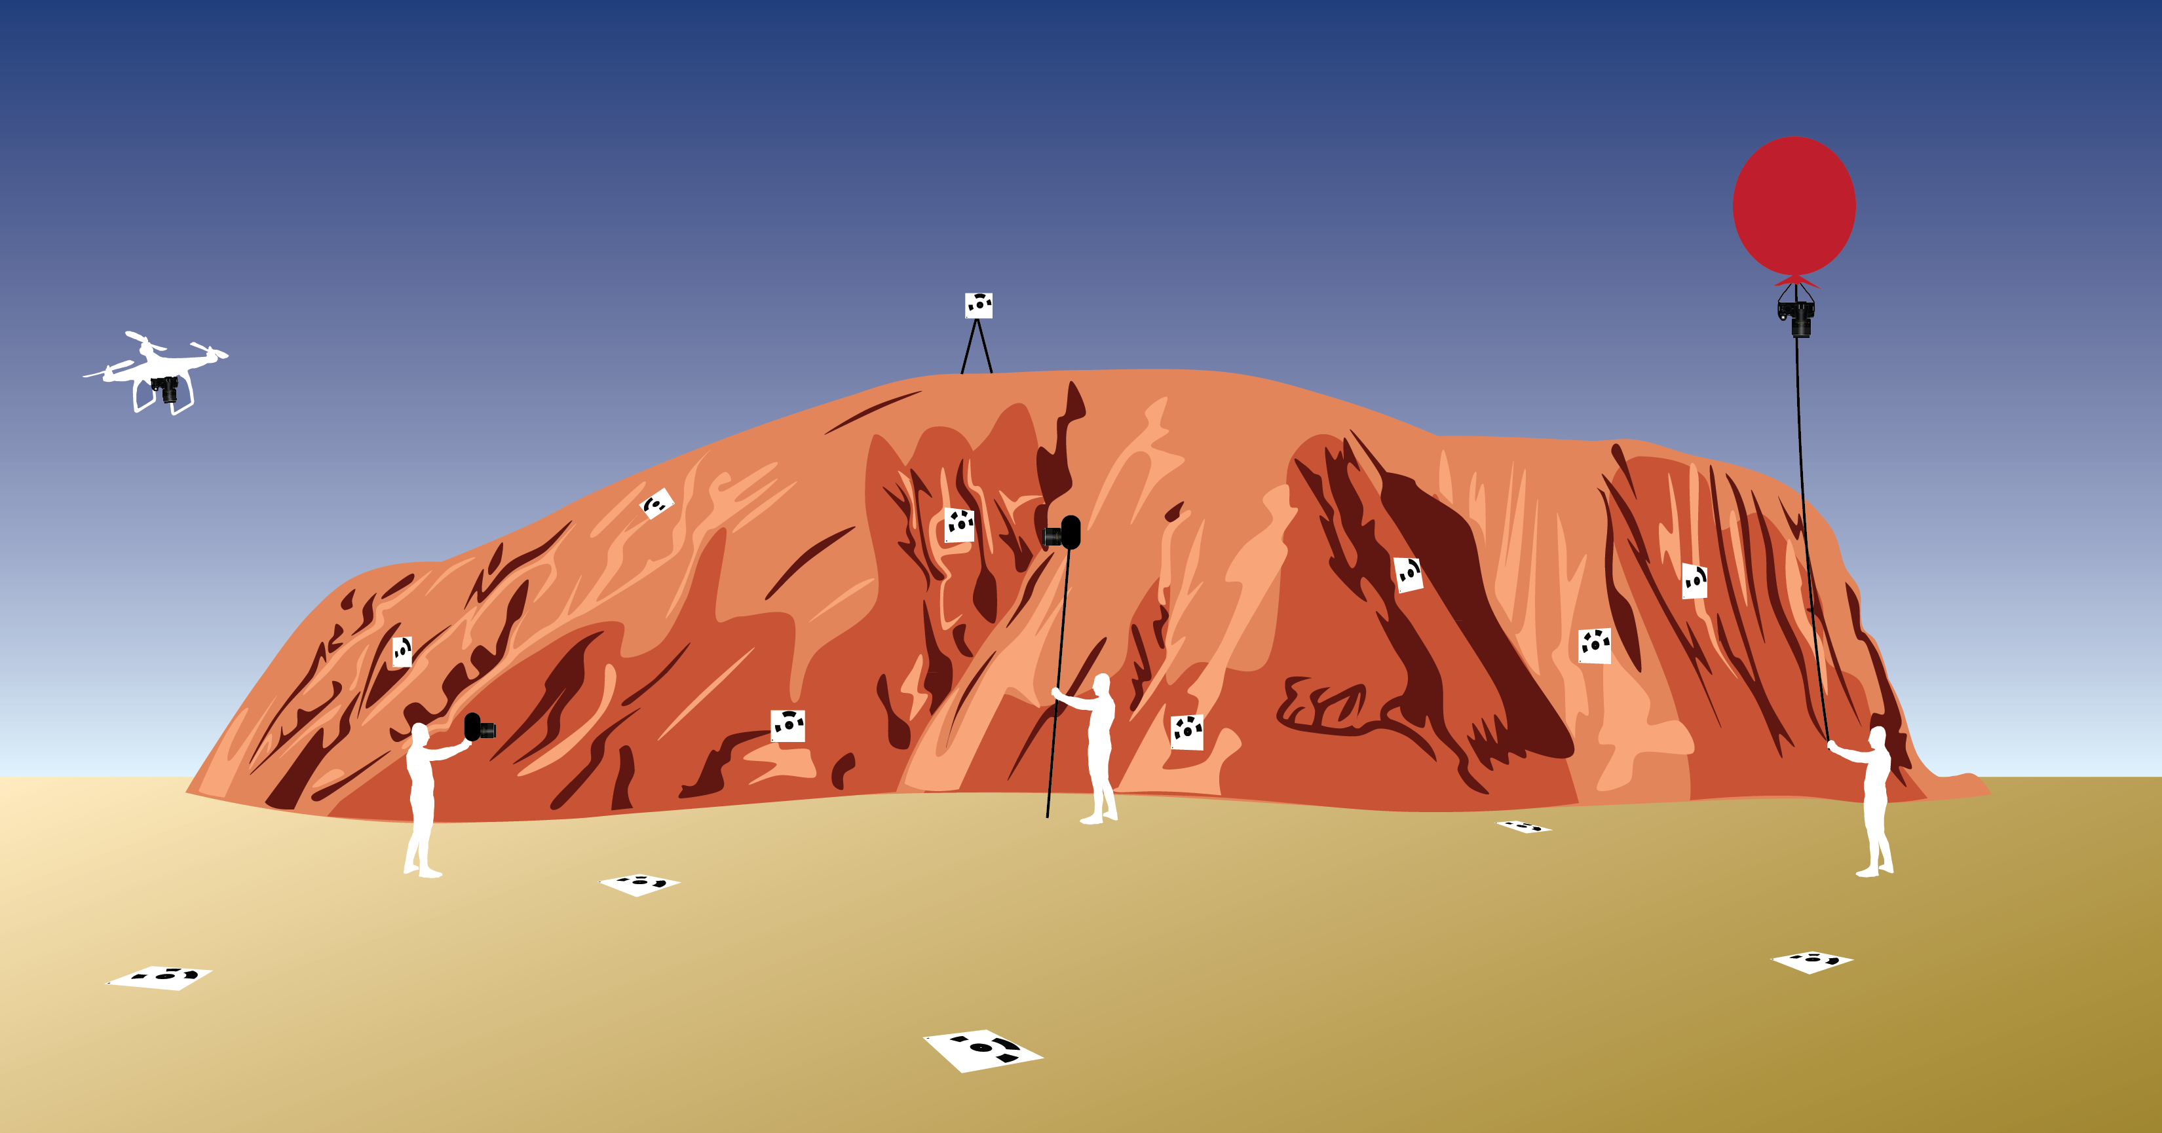
platforms
Figure Kate Shervais
Notes:
Many platforms exist to assist in capturing SfM data. The figure above shows a range of platforms, from UAV on the far left, handheld mid-left to pole photography on the mid-right and a balloon on the far right. The squares with a black pattern are targets, places to survey in, so the model can be linked to geographic coordinates. A handheld platform is best for doing detail work and some outcrop scale work, but has limited applications and is not ideal for areas larger than 100–200 square meters. The slides following will go into the details of the other platforms.

Slide 31
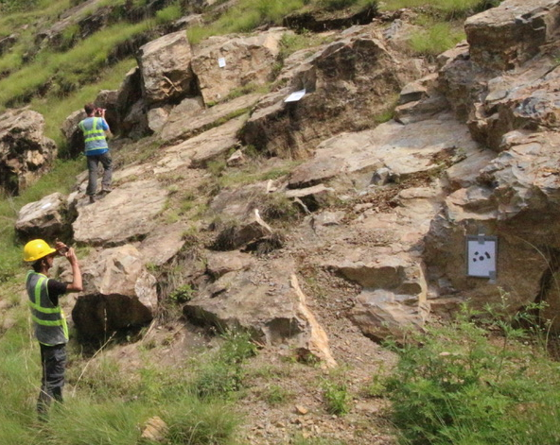
Platforms - handheld
Notes:
Although it does not work for large aerial areas, just simply taking pictures with a handheld camera can work great for small-scale fairly-vertical outcrops. Sometimes handheld combined with a pole can be a good combination.

Slide 32
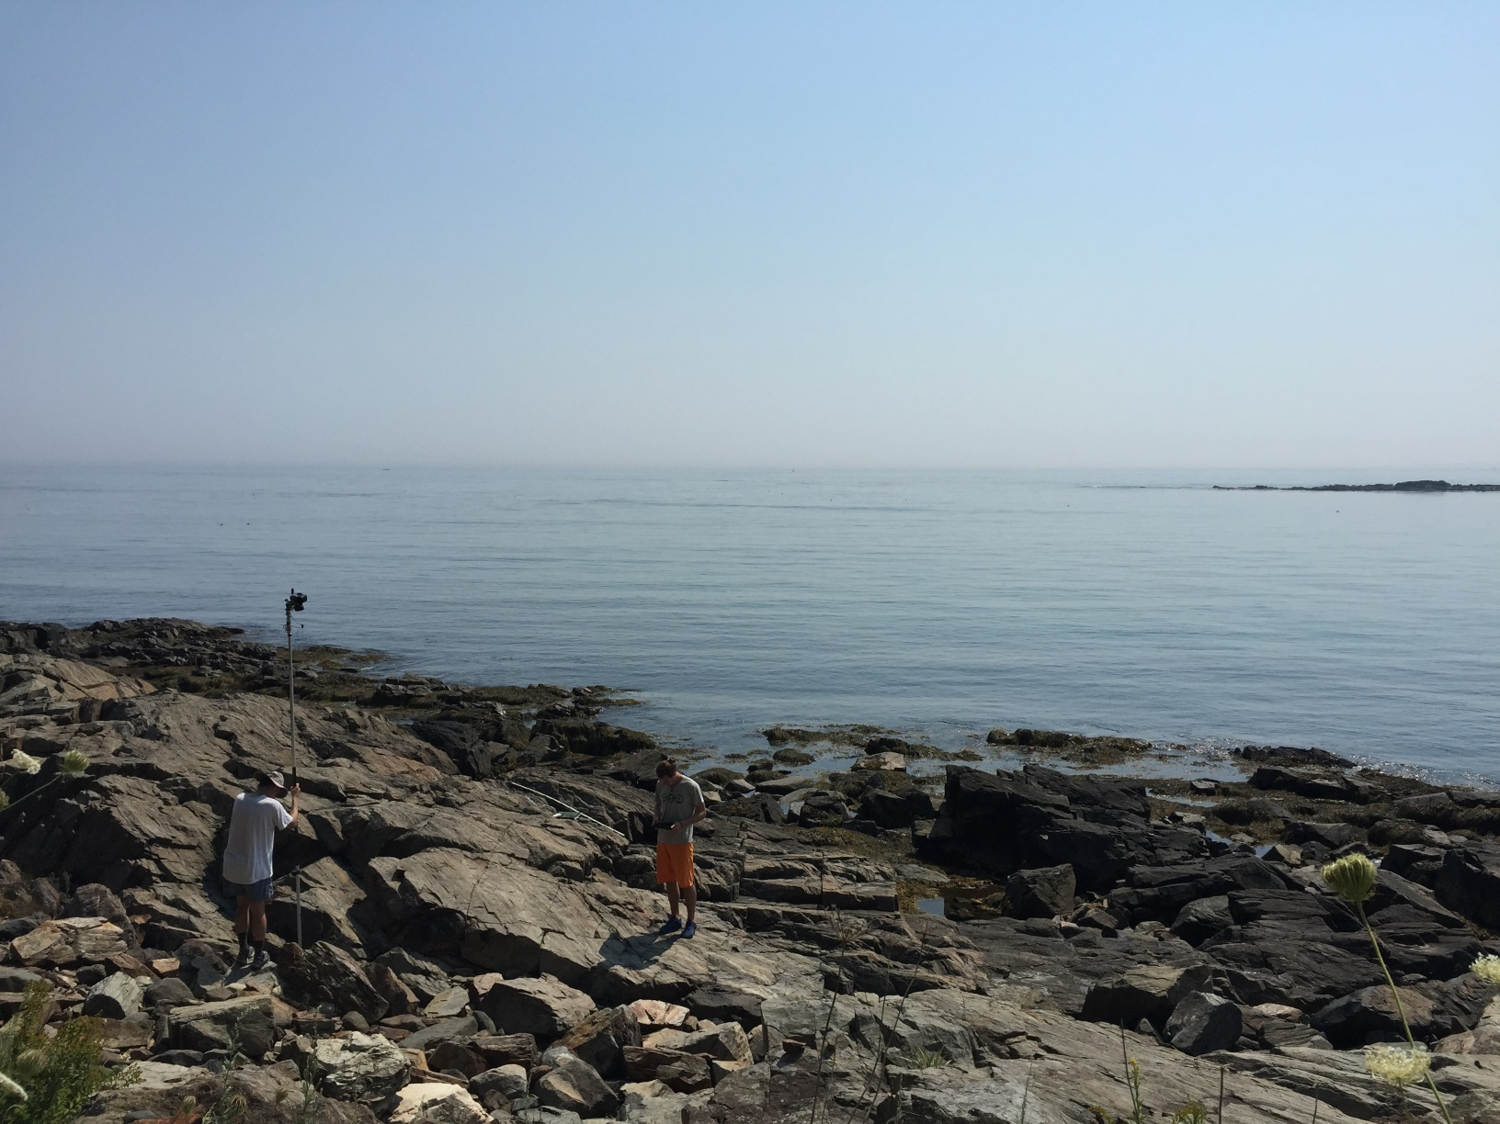
Platforms – pole
Figure Kate Shervais
Notes:
One form of ground-based SfM is pole photography. In the photo shown, the pole is used to take photographs of the horizontal outcrop. For scale, the man holding the pole is 1.85 m tall. Poles are useful because they are inexpensive, good for photographing outcrops, easy to use, and lightweight. They can be quite high—although poles higher than around 20 feet generally need a tripod for stability. However, poles are inefficient in comparison to using an aerial system and require a mount for the camera, as most poles are intended for other applications.

Slide 33
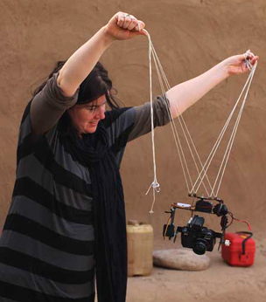

Platforms – kite
Figure Neal Spencer
Notes:
Kites are used frequently as a platform. This example is from Amara West, an archaeological site. Kites are inexpensive, but reliant on wind. Kites also require a picavet (shown in the left photo). Kites allow photographs from a useful height for photographing topography, require no helium (unlike balloons), and have no legal complications (unlike UASs) because they use a tether.

Slide 34
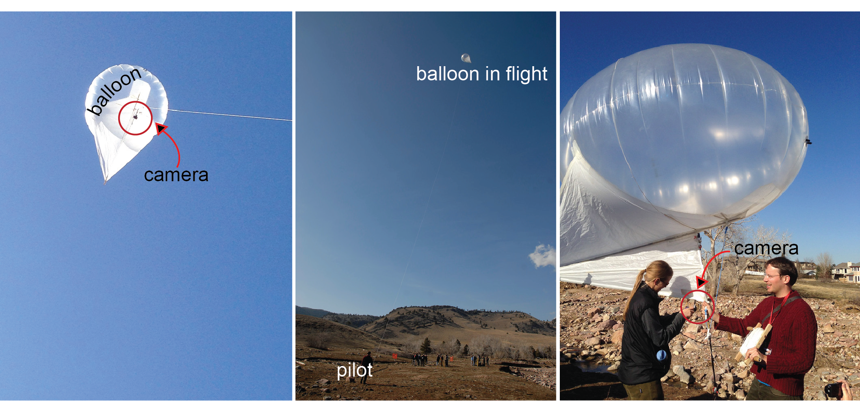
Platforms - balloon
Figure Kate Shervais
Notes:
This is just an example of one type of balloon. This one is called a heli kite because it has a kite-like tail but is filled with helium. The heli kite carries small cameras only (other balloons may carry larger cameras). Balloons and kites having similar advantages/disadvantages, as well as similar applications. The main difference is balloons have no weather requirements, but do need helium (~$180 per canister). Figure Kate Shervais, photographs taken by UNAVCO

Slide 35
Platforms – UAV (uncrewed aerial vehicle)
Figure https://commons.wikimedia.org/wiki/File:DJI_Mavic_Pro.jpg
Notes:
UAVs are the final category of SfM platform. This had become much more common since about 2017 when FAA rules changed to give clearer guidance on UAV useThe cost is highly variable depending on type—one can spend thousands of dollars. The UAV shown in this photograph was around 1000 dollars. The height, camera position, and flightlines are easily controlled using an UAV. However, they require a skilled operator, batteries may limit the survey time (to ten minutes or less), and may require a lighter camera than a balloon. The legal landscape is also quite complex and frequently changing, so consult legal counsel before using.

Slide 36
Conducting an SfM survey

Slide 37
Structure-from-motion
Use the locations of the camera (motion) to interpret the geometry or 3D model (structure) of a scene
Notes:
As a review, Structure-from-Motion works by finding matching features in multiple photographs and then using the relative size and orientation of the matching features to construct the geometry of a scene. In this presentation, we will walk through the process of designing and conducting a survey as well as the steps in a SfM program to create a model.
Image: Kate Shervais (Figure modified from Chris Sweeney, UCSB)

Slide 38
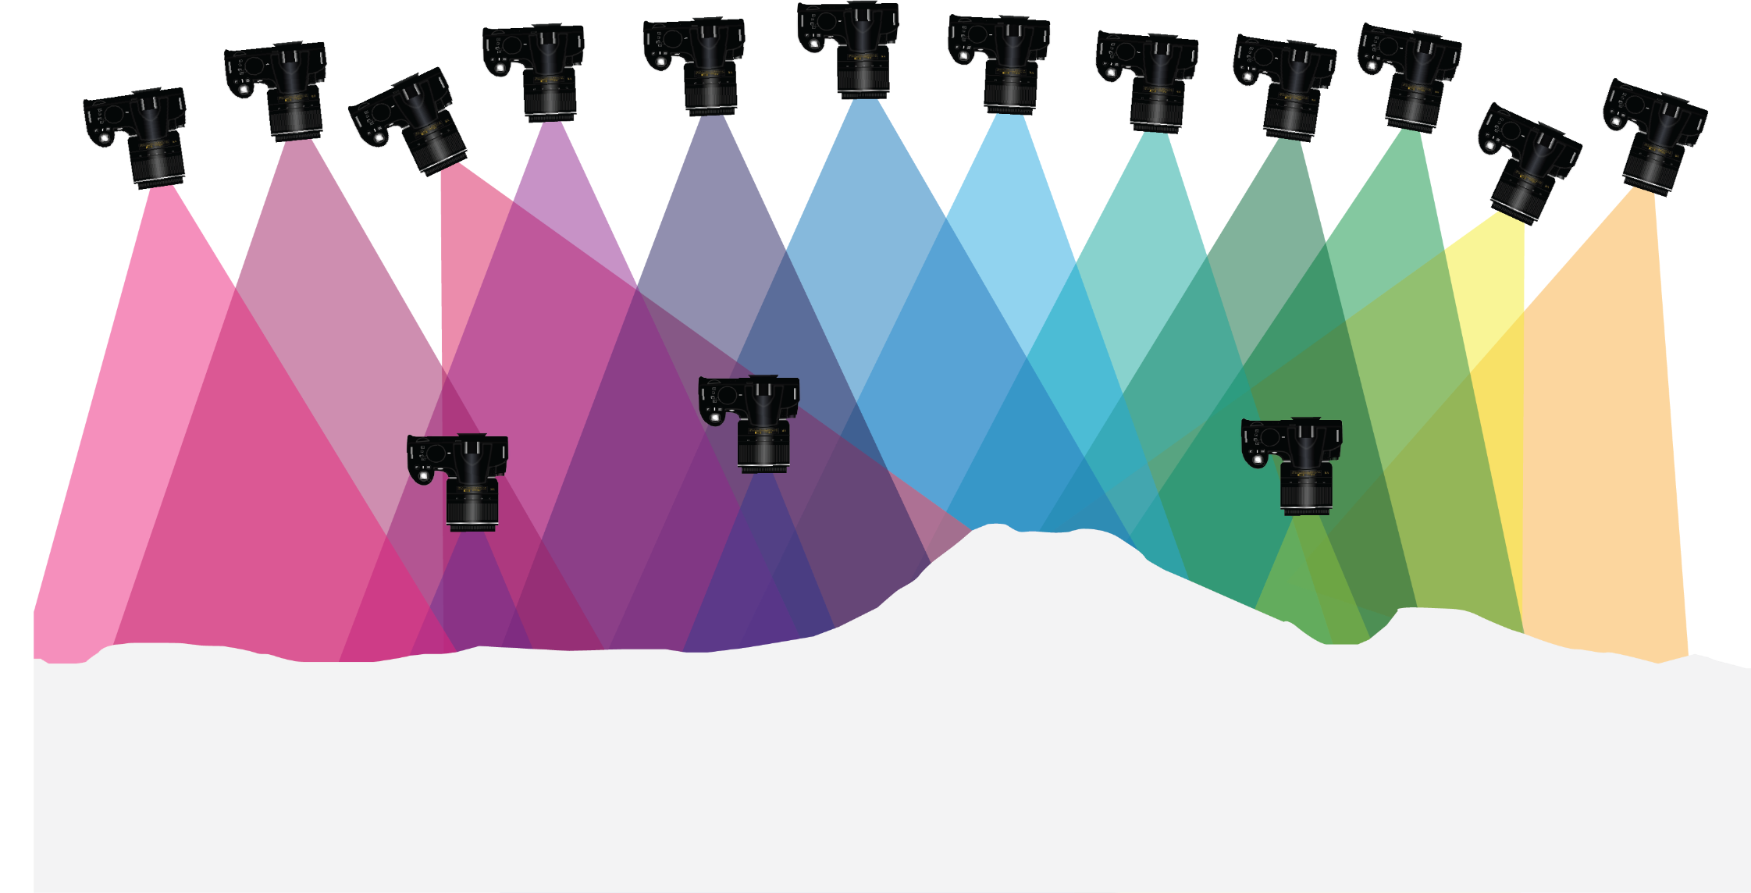
overlap, distance from feature
Notes:
Photos also need to overlap. The amount of overlap depends on the specific software program, but approximately 60–80% overlap is needed. The other factor shown here is distance from the feature of interest; a range of photos both close and far away will add detail to the model without a large increase in processing power.
Image: Kate Shervais

Slide 39
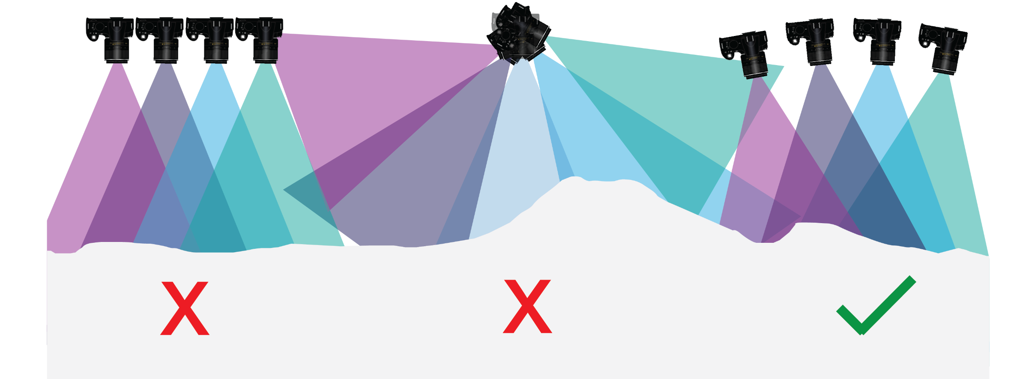
Angle of photographs
Nadir
Divergent
Convergent
Ok
best
Notes:
There are three ways to orient the photographs: nadir, or exactly orthogonal to the feature of interest in a plane; divergent, or with a rotating camera based in one location; and convergent, or converging on the scene. The nadir may have more distortions and divergent methods will not be able to create a model effectively.
Image: Kate Shervais

Slide 40
platforms
Figure Kate Shervais
Notes:
Many platforms exist to assist in capturing SfM data. The figure above shows a range of platforms, from UAV on the far left, handheld mid-left to pole photography on the mid-right and a balloon on the far right. The squares with a black pattern are targets, places to survey in, so the model can be linked to geographic coordinates. A handheld platform is best for doing detail work and some outcrop scale work, but has limited applications and is not ideal for areas larger than 100–200 square meters. The slides following will go into the details of the other platforms.

Slide 41
Platform selection
How large is the area of interest?
What is financially feasible?
How large is the intended camera?
Are UAV allowable? Or would a tethered option (balloon, kite) be needed?
What additional components are needed and does the field area support these? (i.e., batteries, helium, specific weather)
Notes:
How large is the area of interest?
Larger areas of interest will need aerial platforms. The dimension of individual photographs will be large enough to not require an egregious amount of time to collect photographs. Smaller areas may be described by handheld or pole photography.
2. What is financially feasible?
The platform should not be cost prohibitive; select a platform that is appropriate for the area of interest but also for your budget.
3. How large is the intended camera?
The camera must be able to be supported by the platform. If using a DLSR (so higher resolution photographs) is more important to you, a platform like a balloon or pole may be more appropriate. If using a point and shoot, balloons with smaller amounts of lift or some UAVs may be usable.
4. Is the survey collection path accessible or will a UAV need to be used?
If the area is non-accessible, a UAV may need to be used instead. UASs should always be in your line of sight, but if they are and the area that needs to be photographed is hazardous, they are a more appropriate platform.
5. What additional components are needed, and does the field area support these?
If batteries are needed to power the platform, these are only useful (for multi-day surveys) if you have a way to charge them or many, many batteries (cost-prohibitive). If using a kite, the weather needs to include enough wind to lift a kite, picavet camera mount, and camera. If using a balloon, helium is necessary (~180 dollars a canister). The helium will need to be transported or the balloon filled prior to approaching the field area.

Slide 42
Georeferencing
In nearly all cases it is important to georeference the point cloud. This can be in a local or global coordinate system
Local – references to a local zero point
  Hand measuring with tape and compass
  Total station – laser for distance, inclinometer for angles
Global – latitude/longitude (possibly converted to UTM projection or other)
  GPS (global positioning system) – high grade survey system
  (note: GPS is the US system. The broader term is GNSS [Global Navigation Satellite System] and includes satellites from other countries such as Russia, China, and Europe. But we retain the use of GPS here because that is more familiar)

Slide 43
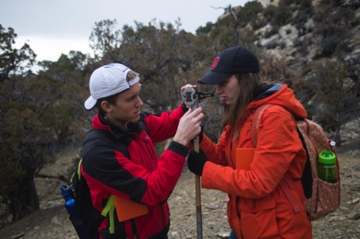
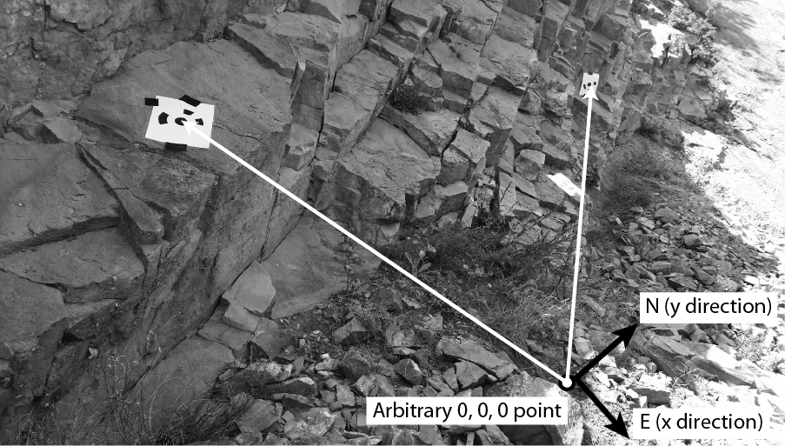
Local system
Reference to a local zero point
Notes:
Left image: https://scotthuckphoto.wordpress.com/2014/03/05/geology-sed-strat-spring-break-day – used with permission
Right image: https://commons.wikimedia.org/wiki/File:US_Navy_070801-F-8678B-039_Engineering_Aide_2nd_Class_Randy_Felipe_attached_to_Naval_Mobile_Construction_Battalion_(NMCB)_4,_trains_on_the_new_Trimble_5600DX_Total_Station_series,_survey_equipment.jpg

Slide 44
Global positioning system
Constellation of ~30 satellites; each houses an atomic clock.
Precise time information is sent to a receiver on Earth.
A minimum of 4 satellites in sky view is needed to obtain a coordinate (but >6 is better)
X,Y,Z
Notes:
Constellation of 31 satellites; each houses an atomic clock.
Precise time information is sent to a receiver on earth.
A minimum of 4 satellites in sky view is needed to obtain a coordinate.
[This slide is fairly straightforward; the information off the slide is really all that needs to be included.]

Slide 45
Equipment list
Platform: pole, kite, balloon, UAS
Camera
Camera mount: how are you going to attach the camera to the platform?
Targets/Ground Control Points (GCP)
GPS for global georeferencing
Scale bars and/or distance/angle measuring devices for local georeferencing
Extra SD cards (SD card organizer) and batteries for camera
Extra supplies for platform (helium for balloon, batteries for UAS) if necessary
Notes:
Once you have considered the GPS stations nearby and the accessibility of your site, check that you have all equipment before you leave for the field.

Slide 46
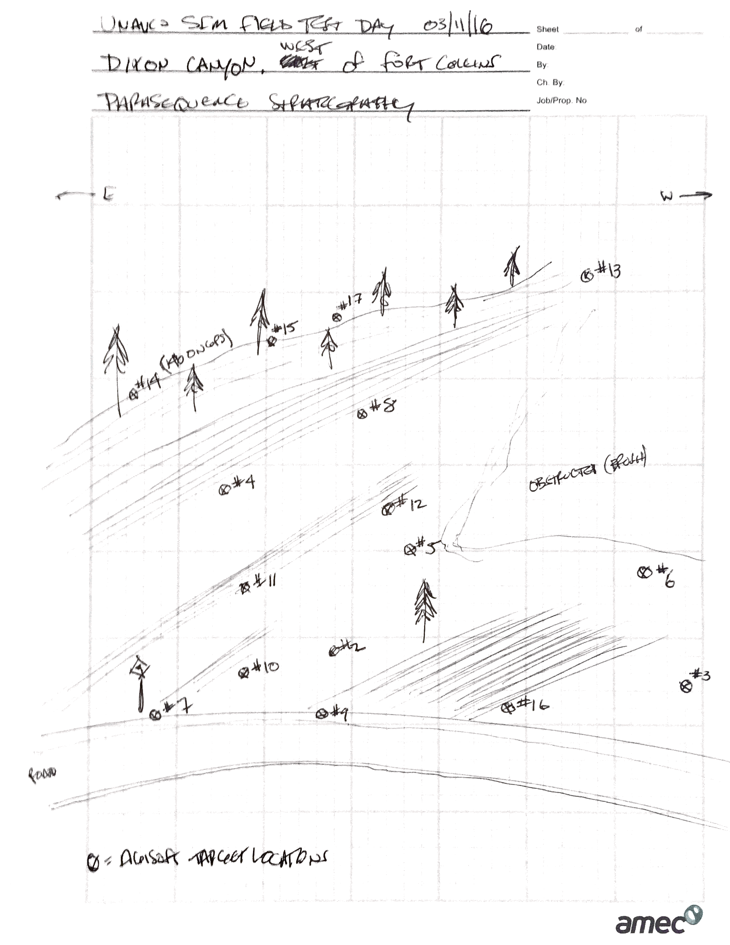
Survey workflow: in the field
Make a plan
  Is everything visible?
  Collection path
Always record metadata
  Number of photos, where they are stored, file names
  Target type(s), locations
  Planned collection path
  Anything that went wrong during the day—how did the plan change?
Notes:
Read the slide. You might look at data a few days later—it is hard to remember the details.
Image: Chris Crosby

Slide 47
Survey workflow: target placement
Evenly distributed
Don’t bunch the targets or put them in a single straight line
Example to the left shows a good target distribution, because targets are in every section
Make sure targets are not obscured by vegetation or other features
Notes:
[Read this slide.]

Slide 48
Intro to Sfm Project – Day 1 midday exercise
You will pick a simple feature such as sofa, small berm, two adjoining walls, side of a shed, rock pile, etc.
Place 3-4 ground control points (GCP) or “targets” and measure location from an arbitrary zero
Take 15-20 pictures using best practices
Take local measurements of GCPs
Process using Agisoft MetaShape into 3D point cloud model
Files you should have with you
  Prep exercise – should have all these things ready
  Student exercise for today – will guide what you do today
  MetaShape Quick Guide – what you need to start photo processing
  SfM Instructor Guide - for reference about the method

Slide 49
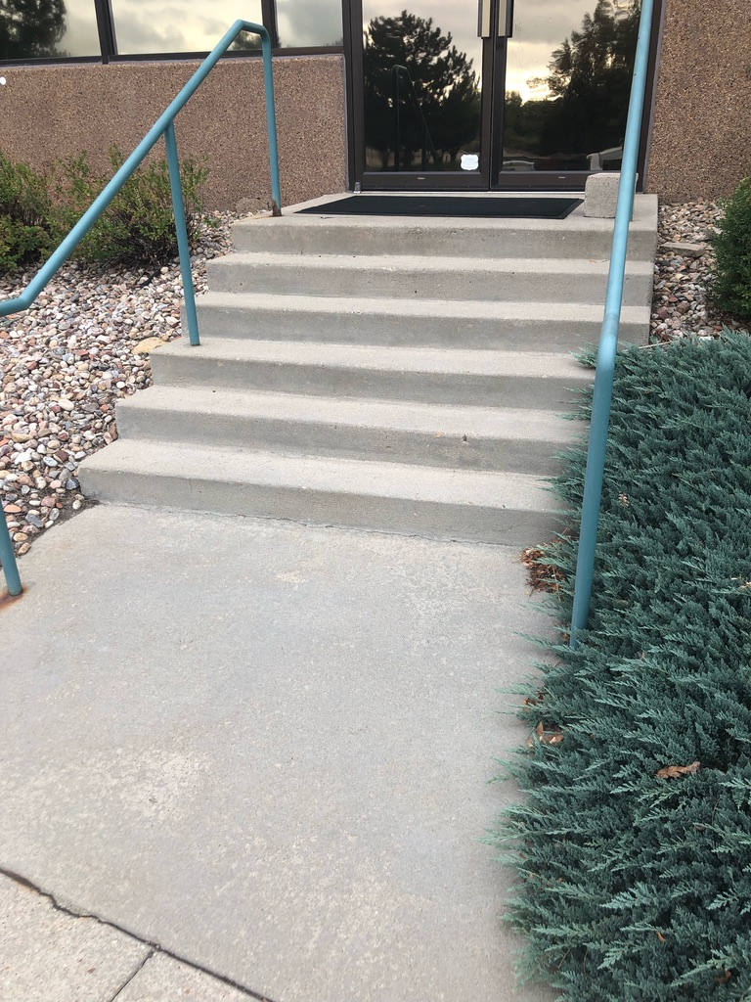
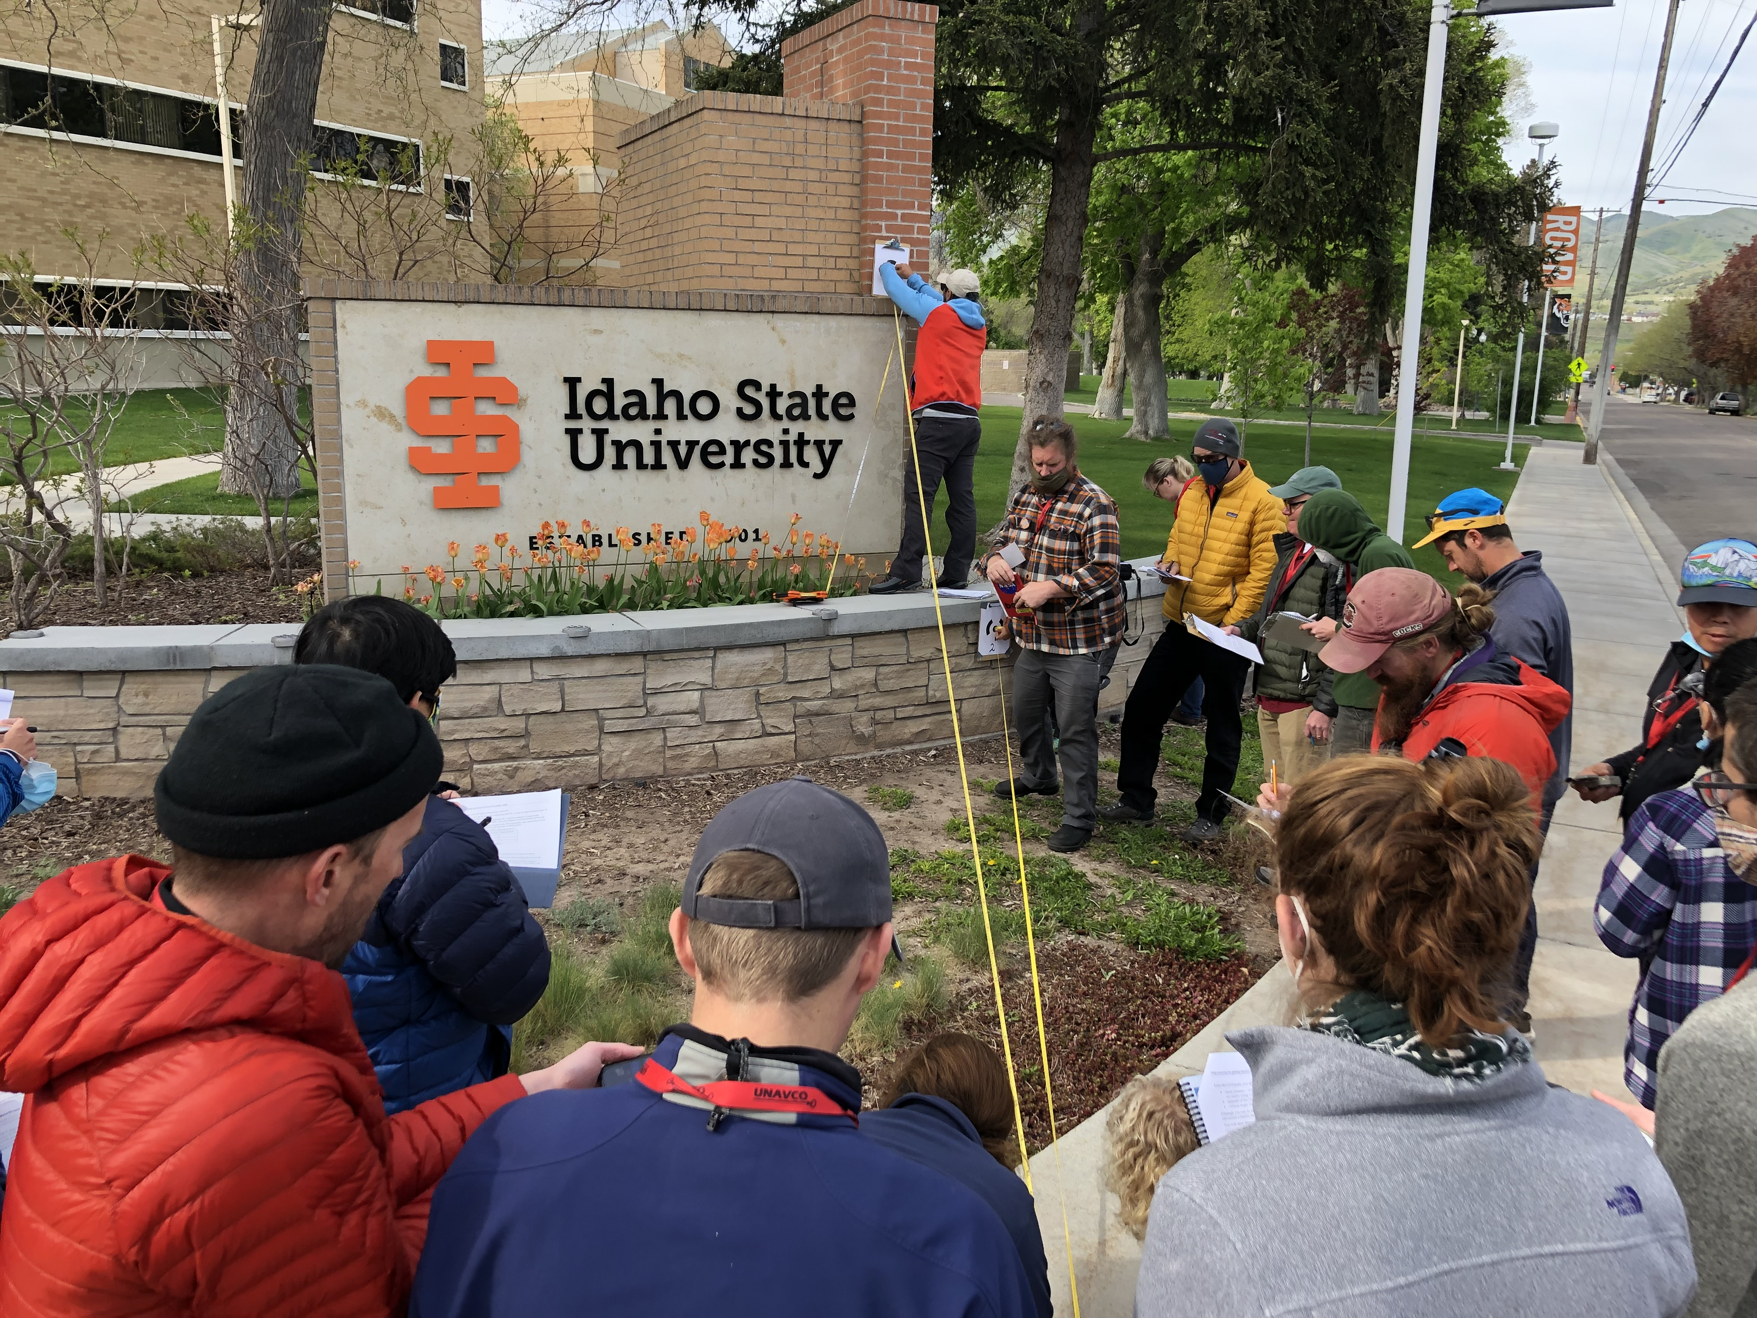
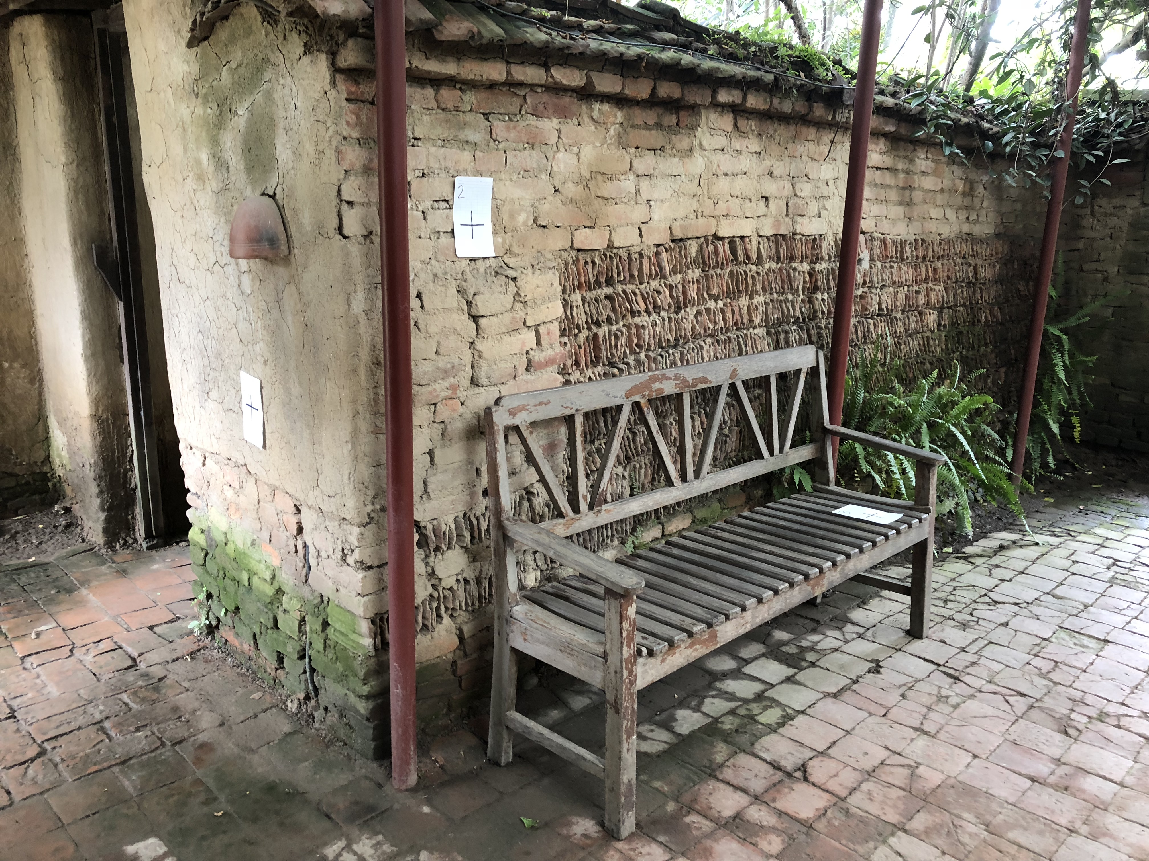
Examples of “Intro to SfM” sites

Slide 50
Apps / Supplies you should have
?
?
?
?
?
?
Notes:
Discuss with student and generate list based on their prep exercise

Slide 51
Apps / Supplies you should have
Compass (physical or app)
Inclinometer (physical or app. Ex. iMetalBox, protractor)
Measuring tape (or marked string – along w ruler & marker)
Camera (digital)
GCP (paper, markers, tape)
Software (Agisoft MetaShape Professional)
Notes:
Discuss with student and generate list based on their prep exercise

Slide 52
Measuring GCP
What measurements are needed?
?
?
?
Notes:
Have the students give input on what measurements are needed. They should come up with distance (diagonal), azimuth, inclination

Slide 53
Measuring GCP
What measurements are needed?
Distance (diagonal)
Azimuth
Inclination
Notes:
Have the students give input on what measurements are needed. They should come up with distance (diagonal), azimuth, inclination

Slide 54

Doing the trigonometry
Sin 22º = z / 7 meters
In Excel = 7*sin(22*(pi()/180))
2.62 meters
Cos 22º = h / 7 meters
In Excel = 7*cos(22*(pi()/180))
6.49 meters

Slide 55

Doing the trigonometry
Sin 34º = x / 6.5 meters
In Excel = 6.5*sin(34*(pi()/180))
3.64 meters
Cos 34º = y / 6.5 meters
In Excel = 6.5*cos(34*(pi()/180))
5.39 meters

Slide 56
Cut to showing the webpage and prep exercise

Slide 57
Work Flow – for Day 1 midday activity
Place your GCP in the field
Measure their locations
Take your photos
Transfer photos from camera to computer
Do the trig (or use the Excel calculator that I supply) to find GCP x-y-z coordinates

Slide 58
Discussion questions
What are some errors associated with the local coordinate system GCP method we used?
What are some shortcomings of the model you built?
What are some better parts for the model you built?
What else could you apply this SfM method to?
What are pros and cons of SfM method?
Knowing you will need to do SfM again, what is at least one piece of advice you want to leave for yourself?

Slide 59

Summative assessment – annotate screenshot
Notes:
Sharon Bywater-Reyes (U of Northern CO) – student work example

Slide 60
MetaShape issues
If you find that the 30-day trial is not activating for you, try:
redownload --> repair --> free trial

