Slide 1
Unit 1.1: UAV with GCP Survey Design - Pre-trip Introduction and Activities
Sean F. Gallen (Colorado State University)
Version: 7.11.2025
Questions, contact education-AT-earthscope.org
Notes:
This slide deck covers an introduction to survey design for a UAV survey with ground control points (GCPs). The slides should be presented after assigning a pre-class reading the covers similar material to reinforce key points. This introduction is meant to be interactive with the students and primarily emphasizes GCP placement for surveys of varying complexity and survey design workflow. There is an in class activity that in google earth that the instructor should prepare for prior to class which involved picking a survey location and making a kmz polygon of the area of interest and taking some screenshots to be placed in this presentation. The students should come prepared to class with google earth pro installed on their computer (or the lecture can be given in a computer lab) and the instructor should disseminate the kmz to the students prior to class via email or course website.
Questions or comments please contact XXXXXXXXXXXXor education AT earthscope.org

Slide 2
Road Map
Today:
  UAV survey design with GCPs - best practices, considerations, and workflow
  Pre-plan a survey - in class activity
Next session:
  Conduct a UAV survey based pre-planning
  Take good field notes
Later:
  Make an SfM model with GCPs from the data collected in the field.
  Write a short report on what you did and interpreting your data.
Notes:
Go over the basic plan for this Unit to give students an idea of what is to come. This is basically (1) survey design and best practices, (2) conducting the survey, and (3) data processing and short report.
You can add dates to the main bullet points to make this specific to your class or change things accordingly.

Slide 3
Learning Goals for Today
By the end of this Unit students will be able to:
  List the steps needed to conduct a structure from motion (SfM) survey with ground control points (GCPs) - aka a survey workflow.
  Explain best practices in distributing GCP targets and picking the base station location.
  Pre-plan a SfM survey considering site-specific characteristics and science objectives
Notes:
Cover the learning goals for this introductory lecture. We will revisit these at the end.

Slide 4
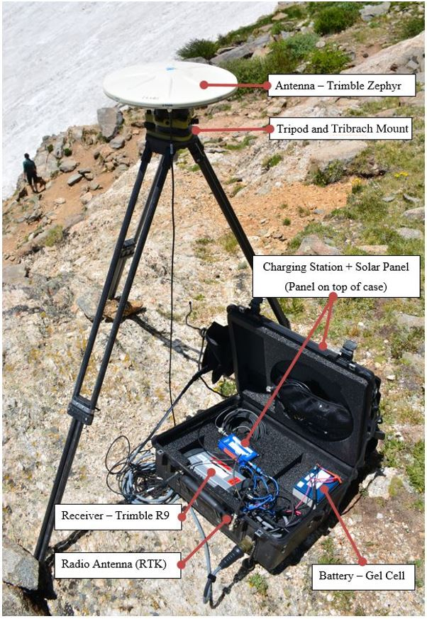
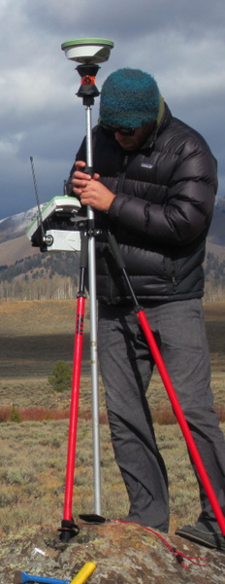
Ground Control Points (GCPs)
Base Station and Radio
Rover Antennas and Receiver
(Images: Ian Lauer, Ben Crosby)
Notes:
Students are assumed to be familiar with real time kinematic GNSS, so the pictures should make sense to them above. Here just describe that GCPs are geographic locations precisely measured with an RTK system. For a UAV survey, we use targets. Targets can be easily identified geographic features, but are more commonly pieces of cloth or spray pained X marks place throughout the area of interest for the survey.

Slide 5
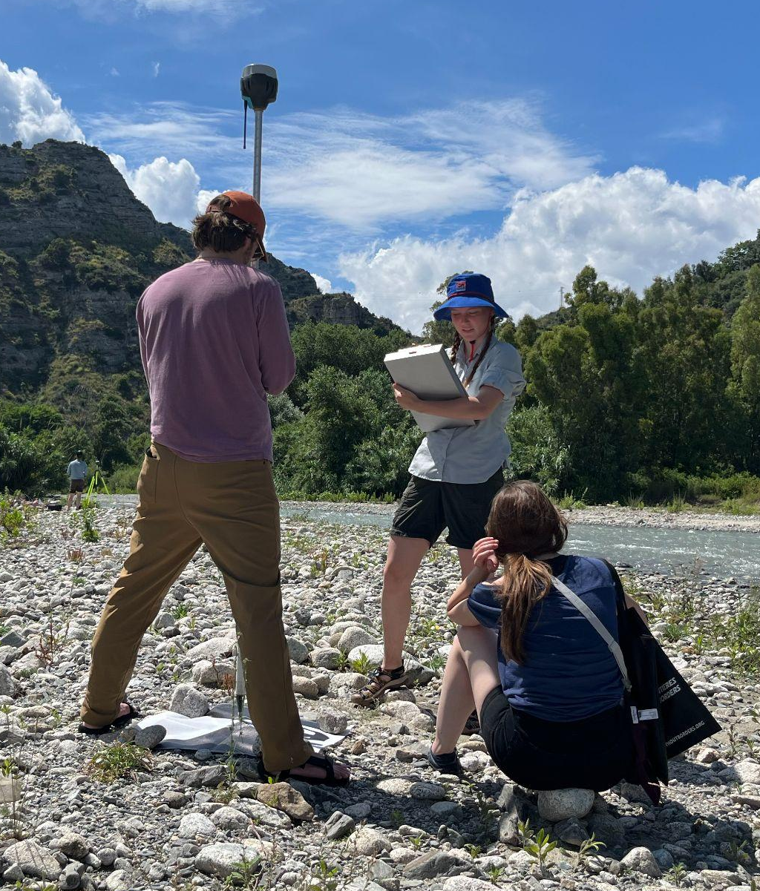
Ground Control Points (GCPs)
Targets are features easily identifiable in the UAV photos.
When surveyed with RTK GNSS, they serve as GCPs that improve resolution and quality of SfM model.
Allow data to be place in absolute coordinate system.
Rover Antenna and Target
(Image: Sean Gallen)
Notes:
More on targets - note the target being surveyed in the image. Explain that GCP improve the resolution, quality and geographic precision of an SfM model in an absolute reference frame on the globe. This is also advantageous and in many cases necessary for repeat surveys where the goal is looking at changes in the earth’s surface, for example, after a flood or landslide event.
Image: Sean Gallen (CSU)

Slide 6
Ground Control Points (GCPs) - Best Practices
Define area of interest (AOI) before leaving for the field.
Plan where to place target within AOI before leaving for the field.
Place targets as evenly as possible across the AOI and cover as much of the AOI as possible.
Make sure the GCPs are within the AOI boundaries.
Need a minimum of 3, but more should be used for redundancy and improve accuracy.
Notes:
A very basic workflow for planning a UAV survey with GCPs. First, define the area of interest and think about study objectives. Second, plan where the targets should go considering maximizing survey quality, logistics, and safety. Third, for best quality, make sure the target are evenly distributed and close to the AOI boundaries. Finally, a minimum of three GCPs are needed, but usually six or more are used.

Slide 7
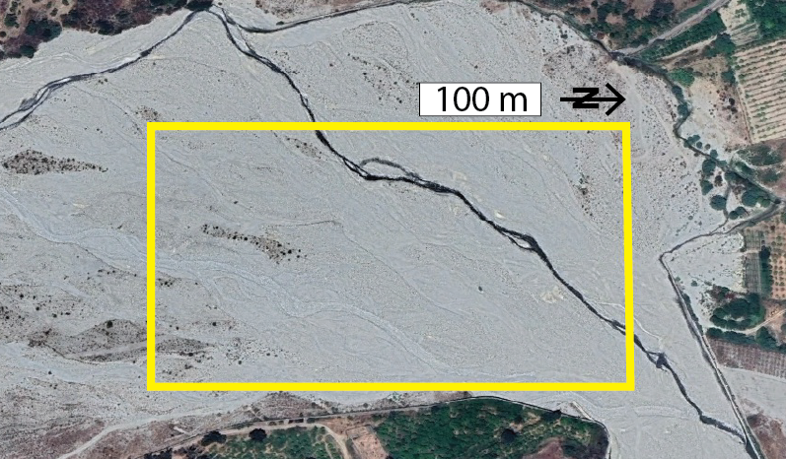
Simple Survey Design Example
Given 6 targets how to distribute GCPs?
Notes:
Simple survey design. Ask the students given this setting of a braided river channel, where the goal is to have a 3D model of the channel and braided sediment surface, where would the students place 6 targets for GCPs? Ask them to consider survey quality, logistics and safety. Note that this area is flat and the access point of the survey is the small dirt road in the middle, bottom (east) in the image.

Slide 8
Simple Survey Design Example
Is this a good design?
Notes:
After the students have had time to think, show this slide and ask them if they like this design or not. Ask them what is good and bad about the target distribution.
Bad - not evenly spaced, clustered on one corner.
Good - logistically easy, but probably too lazy

Slide 9
Simple Survey Design Example
Is this a good design?
Notes:
Ask about this design. What is good and bad about it? What questions do they have about this one?
Good - evenly distributed along AOI boundaries
Questions - how large and deep is the river. Can we cross it?
Also, ask where they would place the base station considering that it needs line-of-sight to the targets.

Slide 10
Simple Survey Design Example
Where would you place the base station?
Notes:
Also, ask where they would place the base station considering that it needs line-of-sight to the targets.

Slide 11
Simple Survey Design Example
If you have 2 more GCP where is good?
Notes:
If there are more GCP targets available, a few in the middle can help reduce internal distortion

Slide 12
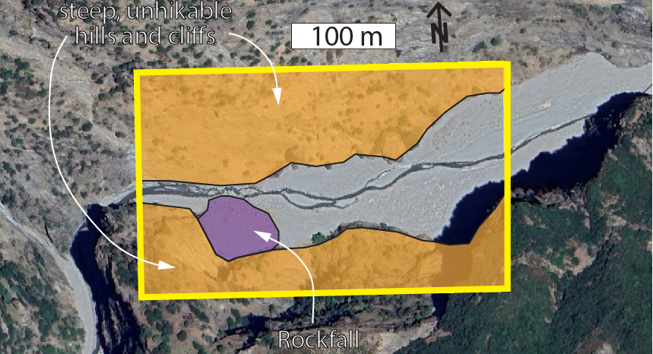
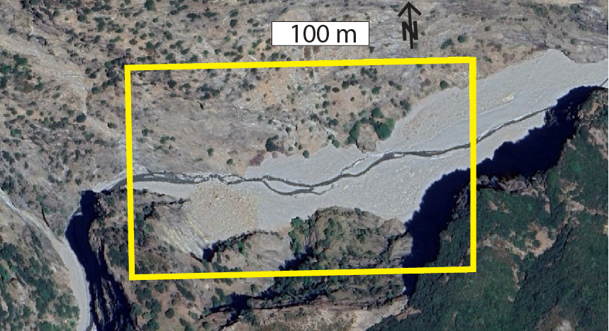
Complex Survey Design Example
Notes:
In a more complex area, what do we need to consider. Here we are looking at another braided river system at roughly the same scale as the last one. However, this river is in a steep bedrock gorge. The walls adjacent to the sediment in the valley bottom are very steep such that we cannot climb them. However, we are interested in not only surveying the sediment in the valley bottom, we want to image the valley walls within the AOI as well.
Considering these logistical and safety constraints what do we need to think about before planning GCP target locations?

Slide 13
Complex Survey Design Example
Notes:
First, what are inaccessible or dangerous areas within the AOI?
The orange shows inaccessible, steep, bedrock walls. The purple shows a recent rockfall we should avoid for safety reasons. It is good practice to identify and even map these hazardous areas before planning the survey and going to the field.

Slide 14
Complex Survey Design Example
Is this a good design?
Notes:
Considering these limitations, ask the class if this is a good survey design? Why or why not? what is good and bad about it?
Good - evenly spaced, along AOI boundaries
Bad - unsafe or impossible to get to these locations. base station might not have line-of-sight

Slide 15
Complex Survey Design Example
Is this a good design?
Notes:
What about this design? What are the pros and cons
Good - relatively safe and logistically reasonable. Distributed as widely and evenly across the AOI as possible given safety and logistical considerations. Has line-of-sight to base station.
Bad - not evenly spaced across the full AOI
Given the realities of this field area, something along these lines is what can best balance safety, accessibility, and survey design. This design would still require river crossings which may not always be possible.

Slide 16
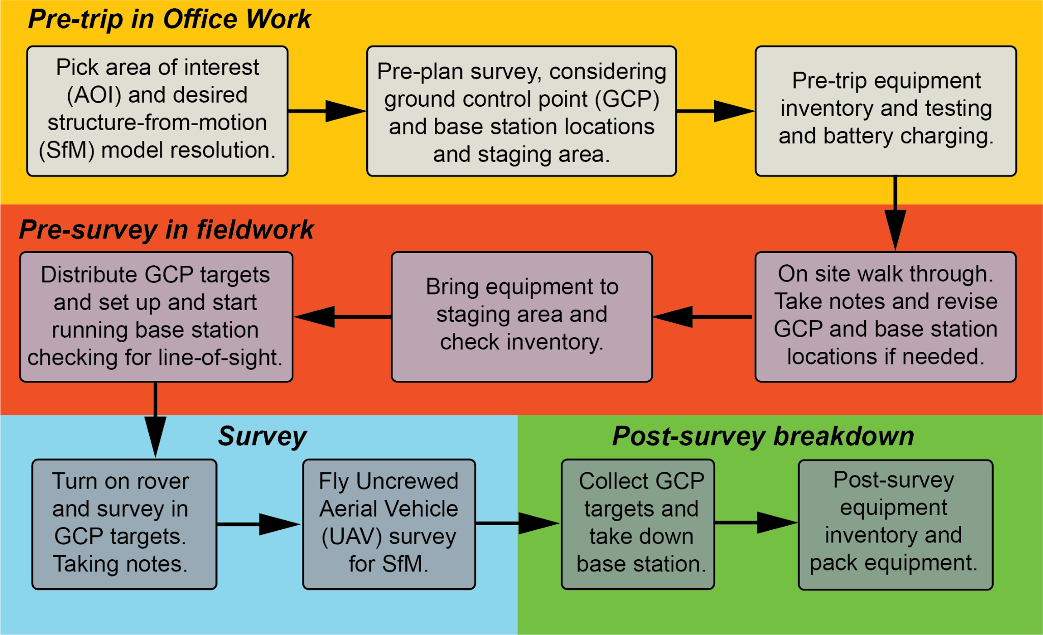
Survey Design Workflow
Notes:
Here is a more comprehensive workflow for an entire UAV survey with GCPs. it includes the pre-planning steps, what to do in the field with set up, survey, and break down. This workflow is provided with the materials and it is a good idea to disseminate it to the students for reference via email or the course website.
Go over this workflow. Ask the students if they have questions and discuss things before moving on.

Slide 17
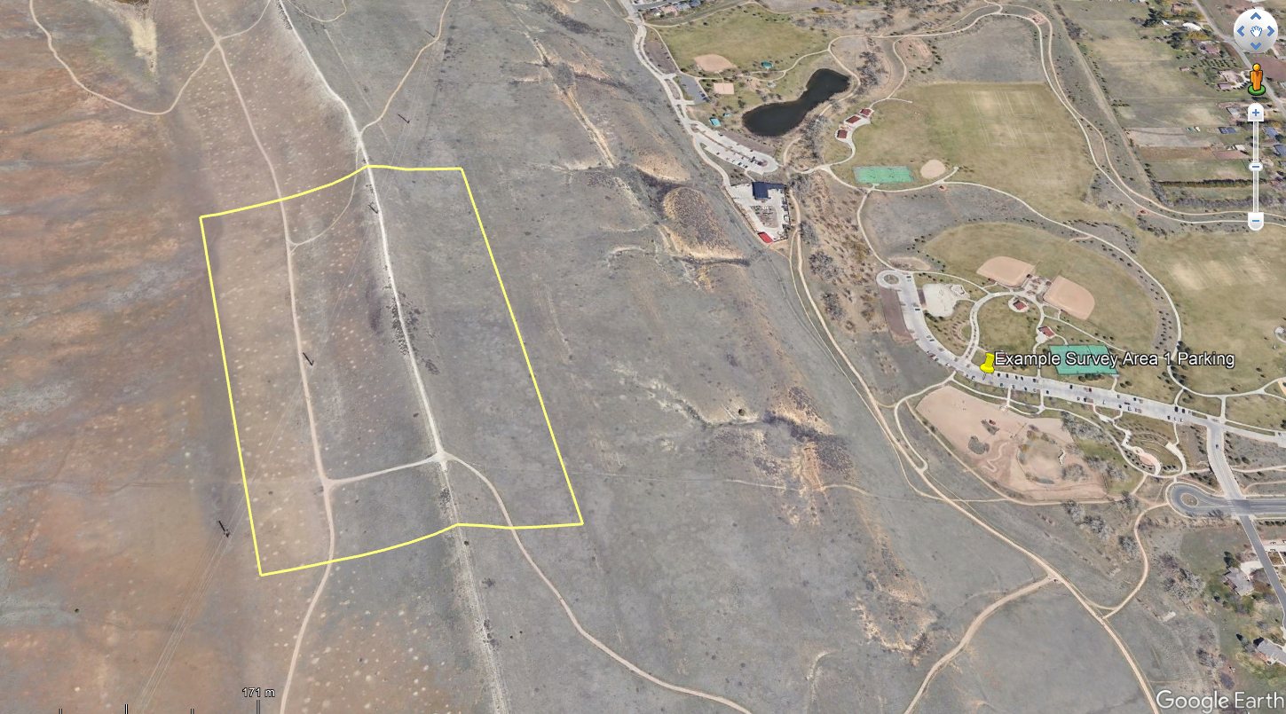
In-Class Activity
Notes:
In-class activity. Here instructors should have prepared a location of the field survey in good earth and made a kmz polygon over the AOI. On this slide replace the existing google earth screenshot with the one of your AOI. Make sure the student have the kmz and google earth installed on a computer they have access to during class.
Describe the basic objective of the survey and provide some details on the location (e.g., where is it, where do we park, is it public or private land, do we have cell service, etc.).
Hand out the in-class activity and go over what they are supposed to do.
in groups of two to three, plan the GCPs target locations. Consider the “staging area”. Where will they place the base station.
Have them make a plan of where to place the targets using pin points in google earth. Include the location of the staging area and base station as separate pin types.
Come together as a class after they are done.
The instructor should open google earth and make decisions as a class to place GCP target locations and decide on the staging area and base station location.
Make sure to emphsize that this is flexible. Once in the field, plans might change, but we are going to use this as a starting place for our survey and change it if needed given logistical and safety considerations.

Slide 18
Applications & Societal Issues
Landslide monitoring and hazard assessment: High-resolution surface models can identify ground deformation and help forecast potential landslides.
Post-earthquake damage and fault mapping: UAV-SfM allows rapid documentation of surface rupture, offset features, and structural damage.
Floodplain and river morphology analysis: Captures detailed topography for understanding erosion, sediment transport, and flood risk.
Archaeological site documentation: Creates 3D records of cultural heritage sites vulnerable to natural or human impacts.
Agricultural land management: Maps crop health, field drainage, and soil erosion for precision agriculture.
Urban planning and infrastructure inspection: Supports planning in growing cities and helps assess structural conditions of bridges, buildings, and roads.

Slide 19
Applications & Societal Issues
Natural disaster preparedness and response: Improves the ability to assess hazards and deliver aid efficiently.
Climate change impacts: Monitors changes in glaciers, coastlines, and ecosystems to inform climate adaptation strategies.
Water resource management: Enhances understanding of watersheds and sedimentation affecting water quality and availability.
Conservation and land-use conflicts: Provides data to mediate between development and environmental protection efforts.
Cultural heritage preservation: Digitally preserves sites threatened by urban development, conflict, or environmental degradation.

Slide 20
Learning Goals for Today
By the end of this Unit students will be able to:
  List the steps needed to conduct a structure from motion (SfM) survey with ground control points (GCPs) - aka a survey workflow.
  Explain best practices in distributing GCP targets and picking the base station location.
  Pre-plan a SfM survey considering site-specific characteristics and science objectives
Notes:
Cover the learning goals for this introductory lecture. We will revisit these at the end.

Slide 21
Road Map
Today:
  UAV survey design with GCPs - best practices, considerations, and workflow
  Pre-plan a survey - in class activity
Next session:
  Conduct a UAV survey based pre-planning
  Take good field notes
Later:
  Make an SfM model with GCPs from the data collected in the field.
  Write a short report on what you did and interpreting your data.
Notes:
Go over the basic plan for this Unit to give students an idea of what is to come. This is basically (1) survey design and best practices, (2) conducting the survey, and (3) data processing and short report.
You can add dates to the main bullet points to make this specific to your class or change things accordingly.

