Slide 1
Generative AI and the Geoscience Classroom
December 5, 2025
Sean Fox, SERC
Carleton College

Slide 2
Today’s Agenda
Introduction
Landscape
Building our own Fluency
  Breakouts
Guiding Student Use: Learning, Assessment
  Breakouts
Ethics and the Future
This meeting is being recorded. Please mute your audio. Captions can be enabled in the Zoom Control bar

Slide 3
About SERC
SERC is a grant-funded office at Carleton College, founded to improve education in the Earth sciences and beyond.
Since 2002 we’ve collaborated on over 100 Earth education projects
The majority of geoscience faculty in the U.S. report using the materials on the websites we host to support their teaching
We recognized a need for community dialog around how to navigate AI
We don’t have the answers (no one does) but we’re hoping to catalyze conversations that will lead us to them collectively.
https://serc.carleton.edu

Slide 4
Who’s in the room
I haven't really used AI tools but I'd like to learn more | 44%
I have used AI in my teaching | 41%
I have engaged with AI efforts on my campus | 30%
Majority of registrants are at U.S. colleges and universities.
90% of those who provided a written response were specifically interested in the pedagogic implications of generative AI (according to a rough categorization by Claude)

Slide 5
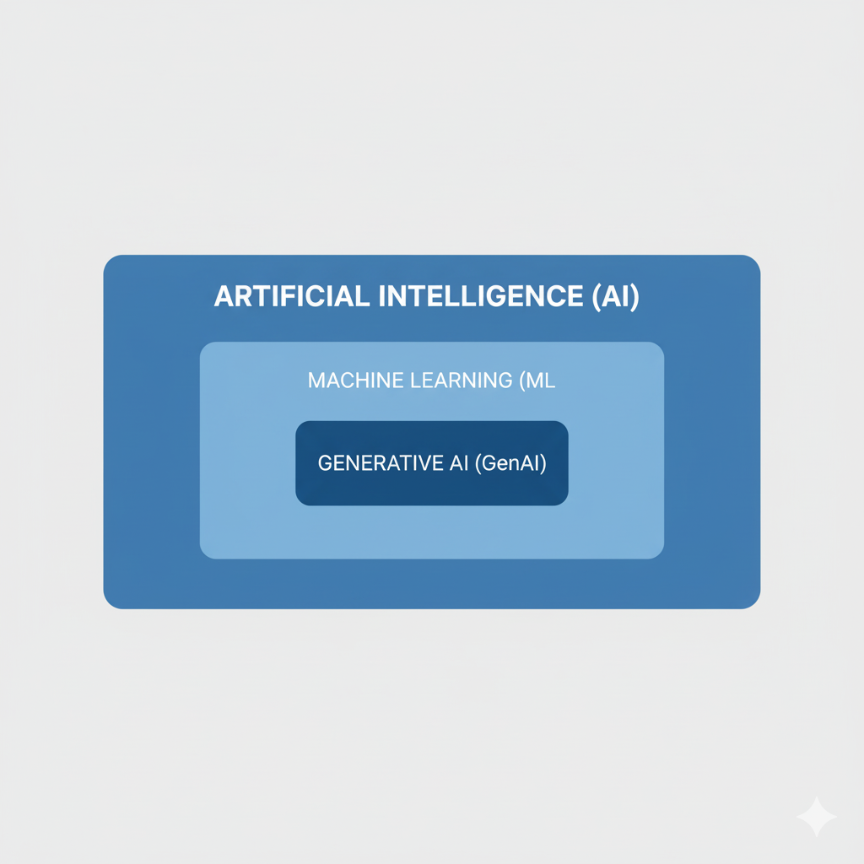
Our focus for today
AI is a broad field that has been around since the 1950’s.
Machine learning has applicability as research tool in the geosciences (image processing, hurricane predication….)
Generative AI is having a big impact on pedagogy
Our focus today is to start a conversation about how generative AI tools such as ChatGPT, Gemini and Claude impact geoscience teaching and learning.
Gemini failing to make the diagram I wanted….

Slide 6
The Landscape and Practical First/Next Steps
The technology is evolving almost as rapidly as the diversity of products.
Despite huge incentives to the contrary there is rapid commoditization
The ‘free’ versions are limited and give up privacy.
Keep your use portable – take advantage of the ‘universal interface’. This is not the time to invest a lot of your time in a specific product
Use a paid version, with privacy – ideally one your institution is buying and doing the privacy due diligence for. Claude (Anthropic), Gemini (Google), ChatGTP (OpenAI) are the biggest players.

Slide 7
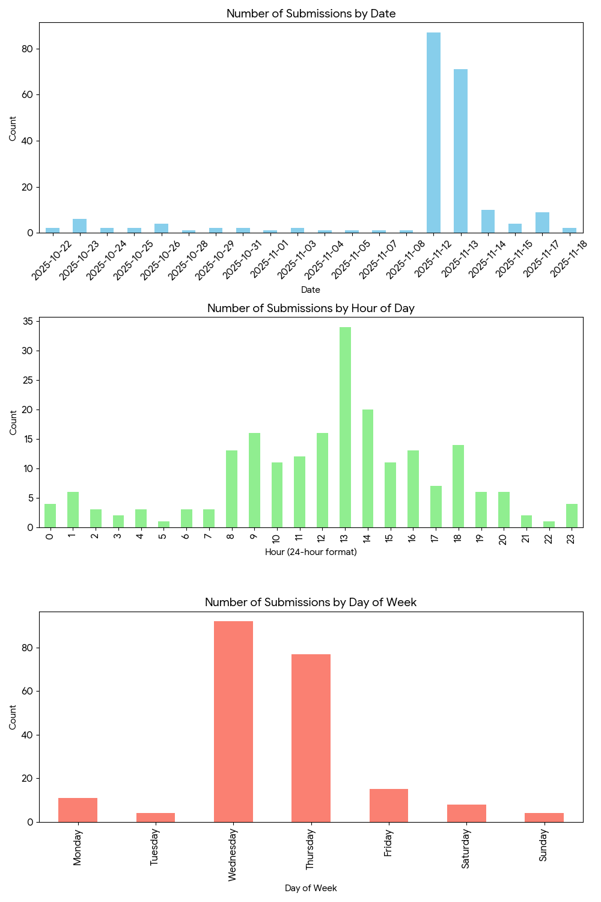
Building your own expertise
“Write a program to analyze trends in submission times for this data”
Experiment with using the tools for low stakes, busywork tasks. Build up to using them in things that matter after you get a feel for the limits.
Figure out how to put relevant information into the prompt. The major tools have ‘upload buttons’. Remember privacy. There are specialized tools for larger numbers of documents (NotebookLM, ExamAI, Learnwise AI) that work like Google’s ‘AI overview’
Remember they fail in unfamiliar ways. Have a strategy for dealing with this (expert review, analysis with multiple strategies, keep it low stakes)
They can write (and run) code.
Like people they do better if you give them clear instructions, access to relevant supporting information, and redirect them if they go off track. But they don’t learn, so sometimes starting fresh can be useful.
https://www.oneusefulthing.org/p/an-opinionated-guide-to-using-ai

Slide 8
Things you can try this week to get a feel for the limits of GenAI
Ask it to solve problems you are assigning your students (homework, exams)
Give it your lecture slides and ask it what it would find confusing as a student. Then ask it to generate example exam questions that draw from this content.
Ask it to do an analysis of some data you have lying around (research data you collected in the field, enrollment data for your department, student course evaluations etc…). Give it a little context for the data and let it decide what’s worth analyzing. Then give it more specific instructions and see if it does better
Ask it to summarize a complex document you’ve written (your last publication? a department report?) Where does it fall short?
Writing some code, even just using R to make a graph? Experiment with telling the GenAI what you want and having it generate the code.
Ask it to provide a diagram to illustrate a problem you’re writing for an exam.

Slide 9
Pick one of these two questions to answer. Be ready to share your 1-minute answer with your peers.
Describe a specific case where you’ve tried to use generative AI to help you in your work as an educator. Did it work well or poorly?
Describe a specific case where you’d like to explore using generative AI in your work as an educator. What do you an anticipate will be the challenges?
Take a minute to think through your answer. Then we’ll go into breakouts.
Give others 30 seconds to arrive in the breakout, then go one by one around your breakout and share. The goal is to hear from everyone. You’ll be given a 1-minute warning before we pull you back. When we return you’ll have a chance to share what you learned/found interesting in the chat.

Slide 10
Supporting appropriate student use:
Learning
What does it look and feel like to use GenAI in a way that supports learning? Students need guidance from folks who have relevant experience and expertise.
“what is the learning I’m trying to experience in this activity and is this particular use of tools helping me?”
Only possible if students clearly understand the learning goals.
Consider involving your students in this dialog

Slide 11
Supporting appropriate student use:
Summative Assessment and Grades
Understand the ways in which students can circumvent learning with your specific assignments.
Give students guidance, grounded in your learning goals, on what use of AI is/isn’t appropriate. Students want to know.
Increase the friction for cheating: in-class tests, group work, less emphasis on high-stakes final products.
The ungrading philosophy encompasses many practices that are AI-resistant: grading on process (including reflection) rather than final product, grading on authentic problems, focus on student motivation
Can you use GenAI to provide more formative assessment opportunities and to help with more time intensive pedagogies?
“You may not use it and I will catch you if you do” is unlikely to be effective.

Slide 12
Pick one of these three questions to answer. Be ready to share your 1-minute answer with your peers.
Describe a specific case where you modified an assignment or assessment in reaction to AI (beyond saying “don’t use AI”). Did it work well or poorly?
What is something you teach your students that you’re confident GenAI will never be able to stand-in for? How can you increase emphasis on this skill in your courses?
What is something taught in geosciences courses today that you think we can remove from the curriculum because our students will have access to GenAI throughout their career?
Take a minute to think through your answer. Then we’ll go into breakouts.
Give others 30 seconds to arrive in the breakout, then go one by one around your breakout and share. The goal is to hear from everyone. You’ll be given a 1-minute warning before we pull you back. When we return, you’ll have a chance to share what you learned/found interesting in the chat.

Slide 13
The Ethics of AI
Impactful new technologies always raise new ethical considerations
There are frameworks that can help you get a handle on the issues – but there aren’t easy answers. The issues raised are often intertwined with those that are broader than AI.
Students are negotiating this and need your support.
There are some starting points available on the website: https://serc.carleton.edu/geo_ai/ai_ethics.html

Slide 14
The Future
“Today's AI is the worst AI you will ever use” –Ethan Mollick
”Agents”: giving GenAI access to other tools (like the ability to write and execute traditional code) and interconnecting multiple GenAI processes.
Machine learning approaches tools in the geoscience toolbox.
More exploration, sharing and discussion is needed.

