Slide 1
Orientation Session Slideset

Slide 2
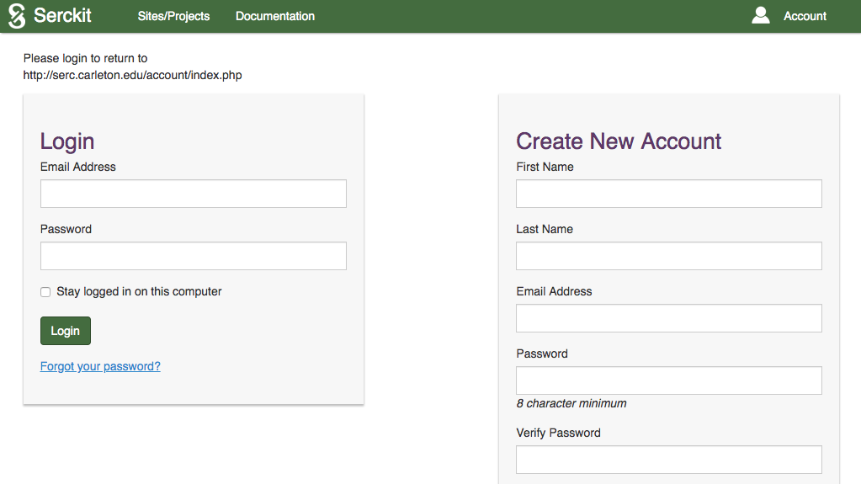

UNIQUE USERNAME
AND PASSWORD

Slide 3
1. Introduced to comprehensive list of competencies and skills that include but going beyond subject area knowledge that they will need to pursue graduate work and/or succeed in the workplace
2. Provided with regular feedback about their progress through repeated assessments and follow-up conversations with mentors
3. Obtain a realistic picture of their strengths and weaknesses across all competencies and skills they should strive to achieve
4. Develop or enhance their metacognitive skills
5. Gain greater self-awareness and confidence as they track their academic growth
6. Strengthen their applications to graduate programs or resumes for entering the workplace
Benefits to Students

Slide 4
Able to observe their research student(s) over an extended period of time and have multiple opportunities to familiarize themselves with student work
Able to make more consistent and reliable assessments of their student’s academic strengths and weaknesses
Able to focus mentoring efforts on specific areas where student may need extra guidance thereby making the research more productive
Benefits to Mentors

Slide 5
Benefits to Mentors
1. Able to observe their research student(s) over an extended period of time and have multiple opportunities to familiarize themselves with student work
2. Able to make more consistent and reliable assessments of their student’s academic strengths and weaknesses
3. Able to focus mentoring efforts on specific areas where students(s) may need extra guidance thereby making the research more productive

Slide 6










10 Outcome Categories
Communication
Creativity
Autonomy
Obstacles
Intellectual
Development
Critical Thinking
Problem Solving
Inquiry
Disciplinary
Knowledge
Content
Knowledge
Ethical
Conduct

Slide 7
Is not discouraged by setbacks or unforeseen events and perseveres when challenges are encountered.
5—Always
4—Usually
3—Often
2—Seldom
1—Never
Obstacles
Shows flexibility and a willingness to take risks and try again.
5—Always
4—Usually
3—Often
2—Seldom
1—Never
Trouble-shoots problems and searches for ways to do things more effectively.
5—Always
4—Usually
3—Often
2—Seldom
1—Never

Slide 8
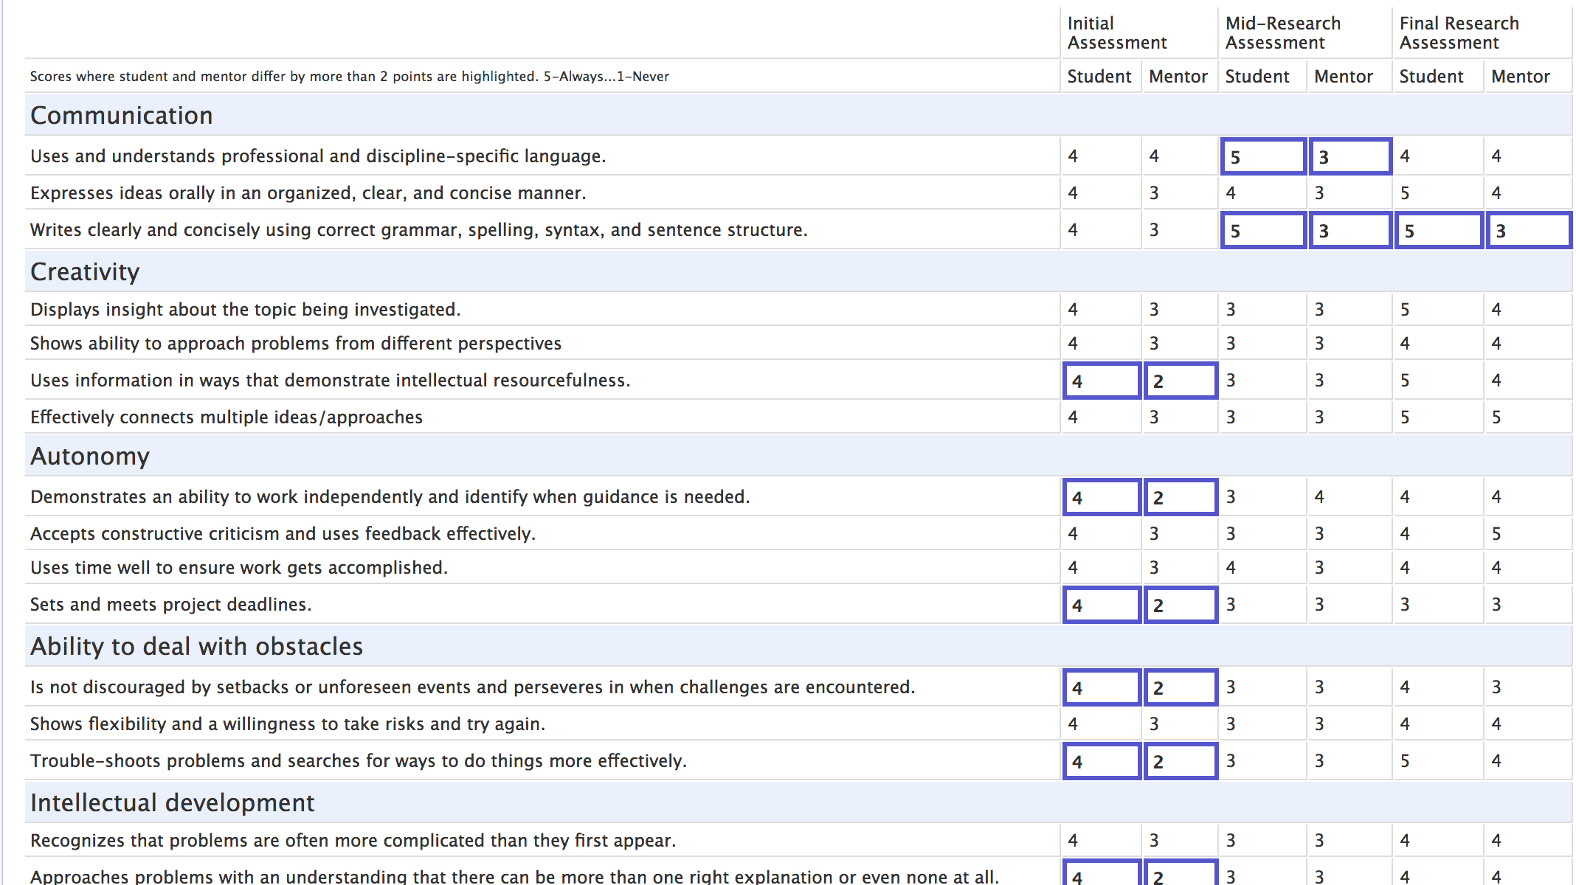

SCORE
REPORTS

Slide 9

Welcome Jill Singer, as the first step in the research evaluation process you need to visit the website and activate your account by providing a password. You’ll then be automatically directed to Pre-Research Reflection.
AUTOMATED
MESSAGES

Slide 10

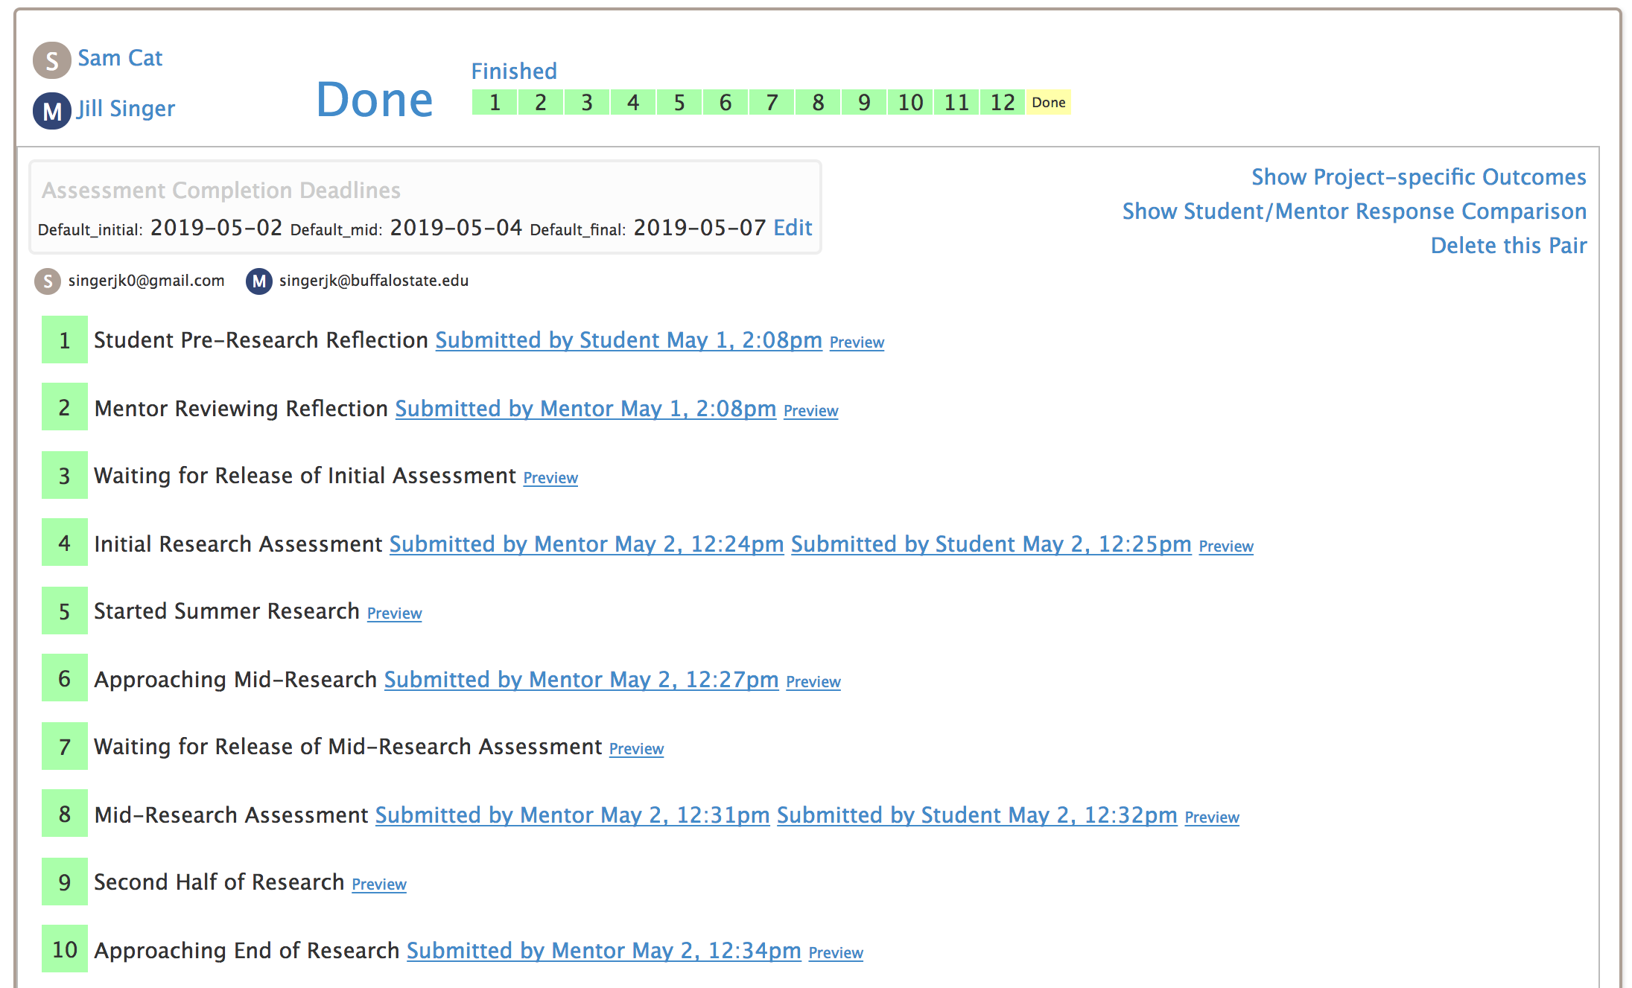
ONLINE
DASHBOARD

