Slide 1
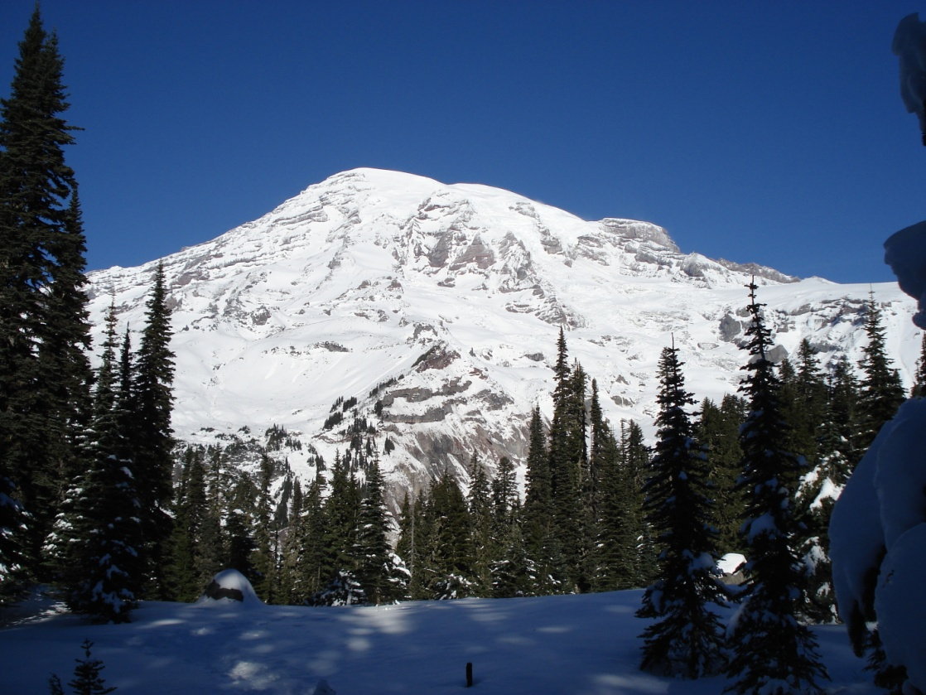
Tectonic Plate Motion
Using the Global Positioning System (GPS) to Measure Plate Motion

Slide 2
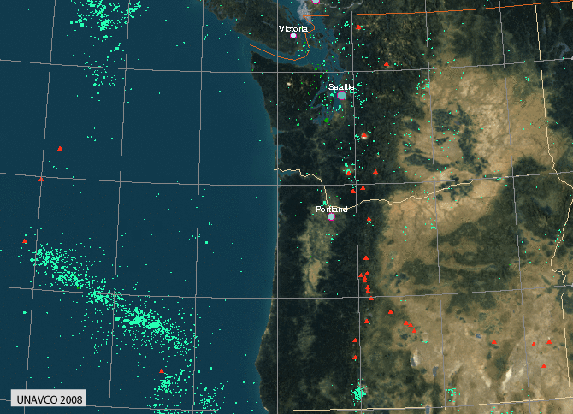
Locations of Earthquakes and Volcanoes in the Northwest

Slide 3
What is GPS
Do you have a GPS system in your car?
What does it do?
How could it be used to measure plate motion?

Slide 4
The Global Positioning System (GPS)
The global positioning system (GPS) is a fleet of about 30 satellites orbiting Earth approximately 20,000 kilometers above the planet's surface. A GPS receiver on the ground picks up signals from these satellites, and processes them to determine its position via a sophisticated form of triangulation. A position can be calculated using signals from three satellites, but at least four satellites are always used to minimize errors due to signal timing and less-than-optimal satellite spacing in the sky. You may already be familiar with handheld GPS units which people use for navigation in cars, recreation (hiking and geo-caching), mapmaking, and land planning. There are several important differences between handheld GPS units and the high-precision ("differential") GPS units that Earth scientists use in their research.

Slide 5
The Global Positioning System (GPS)
Differential GPS uses two GPS receivers to calculate a position: a stationary receiver ("base station") whose location is accurately known from surveying, plus a roving (moving) receiver. Both receivers continuously calculate their positions from the satellites. The base station compares the calculated position with its known location and "differences" the two measurements to determine the error in the GPS signal. Then, the base station sends the error corrections to the roving receiver. Using differential GPS for navigation allows scientists to minimize the errors associated with measuring positions.

Slide 6
Using GPS to study plate motion and crustal deformation
GPS stations used for geodesy are cemented into the ground so that the instrument is tightly coupled with the bedrock. Changes in the location of a GPS station are therefore caused by movement of the Earth's surface. By comparing the motion of several GPS stations in a region over time, scientists can detect motion of tectonic plates and infer deformation of the Earth's crust.
Although slight motion occurs continuously, during an earthquake, the ground on either side of the fault moves instantaneously, sometimes resulting in strong shaking. GPS measurements enable scientists to map the location and distance of these displacements. Although we cannot feel it, the crust on either side of the fault continues to slip even when earthquakes are not occurring. Scientists can record this motion with GPS. By comparing the locations of GPS monuments on different plates, scientists can detect the rate at which the plates are moving.

Slide 7
Case Study
When Albert Wegener first proposed the idea of continental drift, many scientists viewed him as the laughingstock of his day. Except for the "coincidental" fit of a few coastlines and some interesting fossil distributions, most members of the scientific community could not accept that continents moved, because they saw no evidence of motion. Today, Global Positioning System (GPS) technologies are providing direct evidence of plate motion. High-precision GPS data document tectonic motion, and these data are being used to refine models and create visualizations that convey our current understanding of plate tectonics.
Most plates move less than a millimeter per day; this movement is imperceptible to human senses. However, this daily motion translates to 1-10 cm of movement over a year, and that yearly motion translates to 10-50 km of movement over a million years. This slow but relentless motion eventually results in soaring mountains, rumbling earthquakes, and exploding volcanoes.

Slide 8
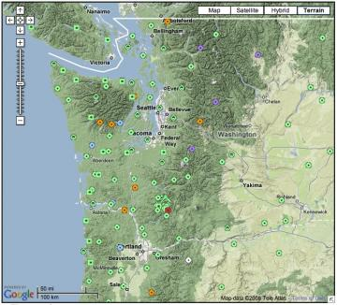
The Plate Boundary Observatory (PBO) collects location data from a network of continuous high-precision GPS units that are coupled to bedrock across the CSZ (Cascade Subduction Zone).

Slide 9
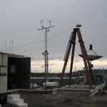
GPS Site in Seattle

Slide 10
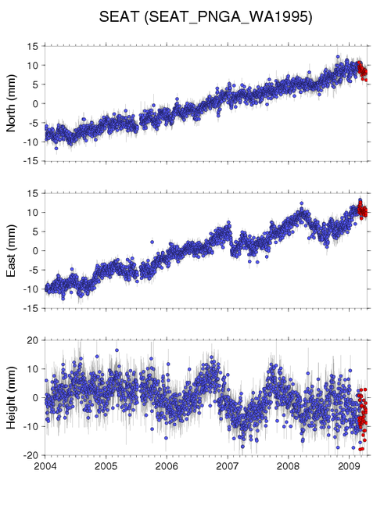
GPS Data for Seattle, WA

Slide 11
Plate Motion Time Series Plot (TSP)
Find the rate of motion using y=mx+b
Slope (m) = Change in y / Change in x

Slide 12
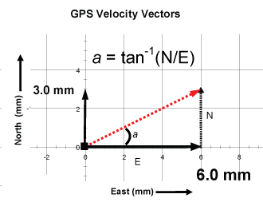
How to Find the Distance Travelled

Slide 13
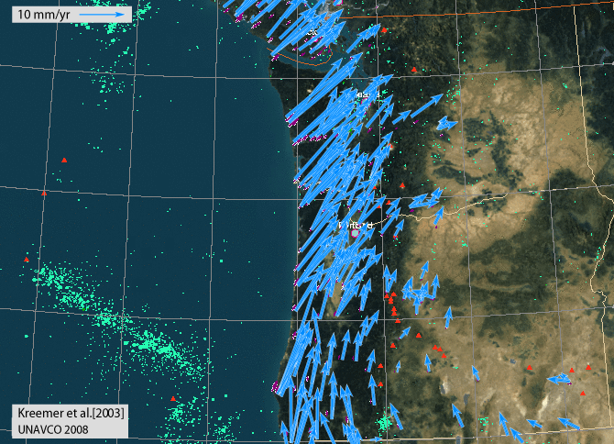
Plot of Earthquakes, Volcanoes, and Motion Vectors in the Northeast

