Slide 1
Exploring Air Quality
Tim Martin
Greensboro Day School

Slide 2
The following 4 slides are from class notes on Air pollution
Tim Martin © 2004

Slide 3
Atmospheric Pollution
Pollutants
  Primary source: burning fossil fuels
  CO₂, SO₂, CO, Pb, NO……..
    NO + Sunlight = Smog
Factors that increase surface pollution
  Temperature Inversion
  Geography

Slide 4
Temperature Inversion
Normal Inversion
Cold
Cold
Cool
Warm
Warm
Cool

Slide 5
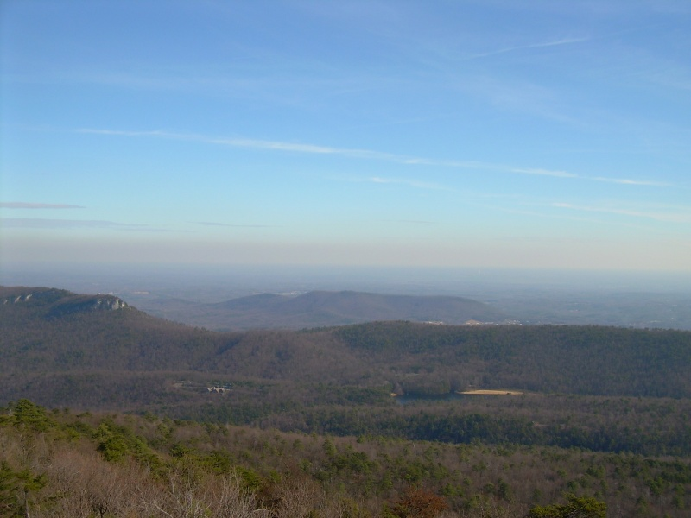
Air over Piedmont Triad NC
Photographed from Hangining Rock SP NC

Slide 6
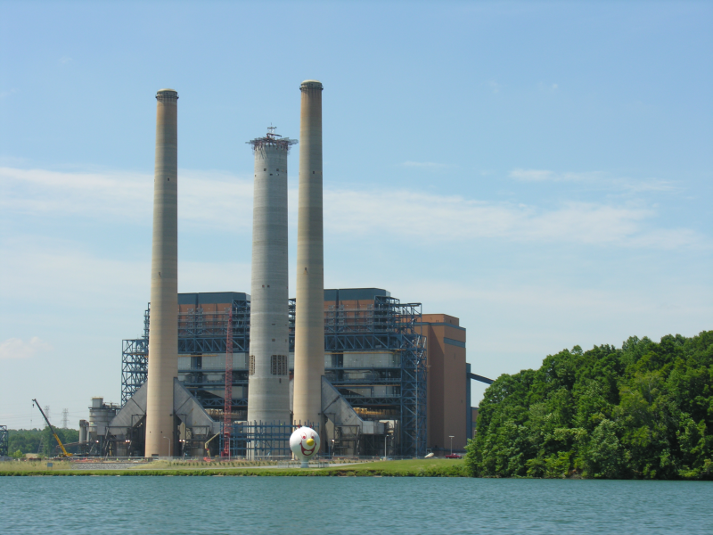
Duke Power Blews Creek Coal plant

Slide 7
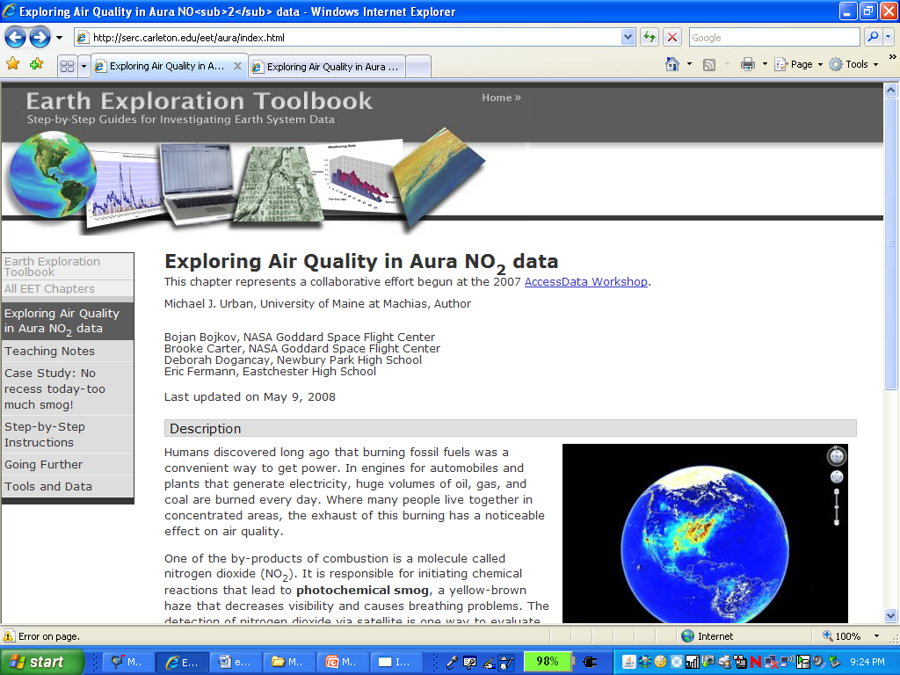

Slide 8
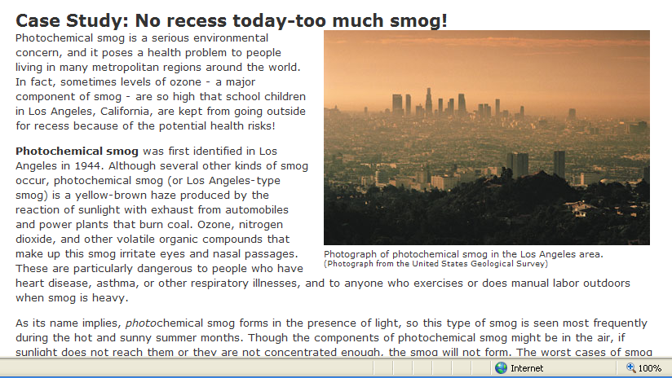
Students were assigned to read

Slide 9
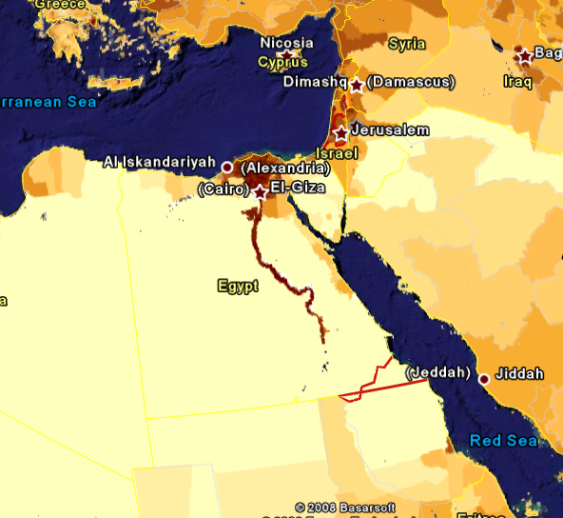
Example of population as tool to view geography– Nile River.

Slide 10
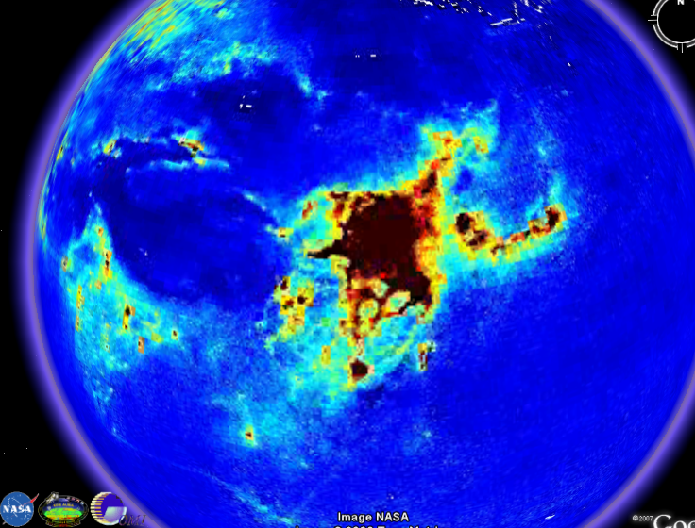
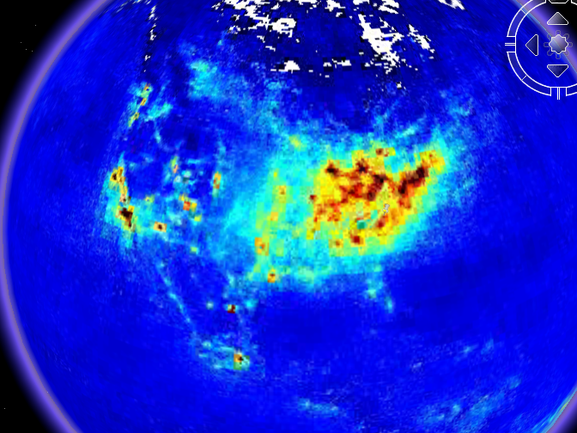
USA v.s. China NO produciton

Slide 11
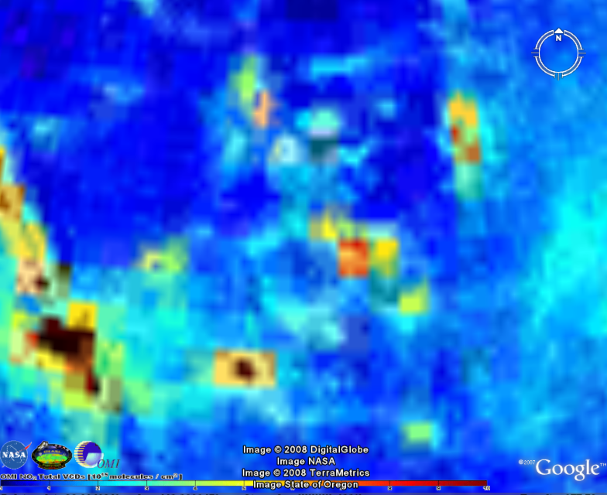
Population concentration with NO
Salt Lake City
Denver
?????????
Los Vegas
Phoenix
Los Angeles

Slide 12
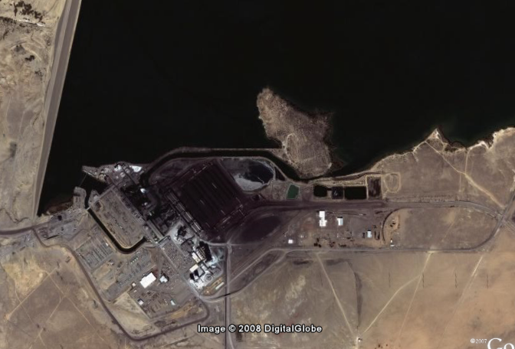
Zoom in on the ?????
Moffit Lake

