Slide 1
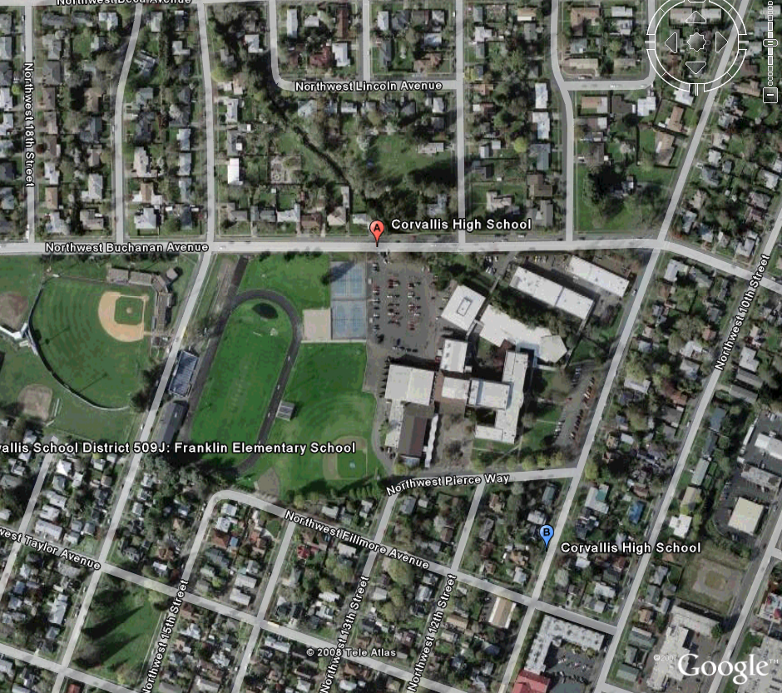
Michelle Kinzel
Robert Peckyno
Brianna Strauch
GPS and GIS in Our World

Slide 2
Brianna Strauch
Junior at OSU
Double Major Education and Geography
From California, lived in Belgium for 4 years
Future Earth Science Teacher
Bob Peckyno
Graduate Student at OSU
Majoring in Geography, pursuing a PhD
Works for NASA
Volcano Mapping Expert

Slide 3
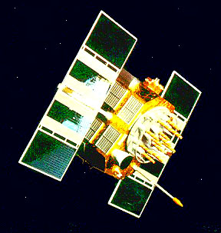
How GPS Works
27 Satellites
  Solar Powered
  Circle Globe at 12,000 miles/19,300 km
  2 complete rotations/day

Slide 4
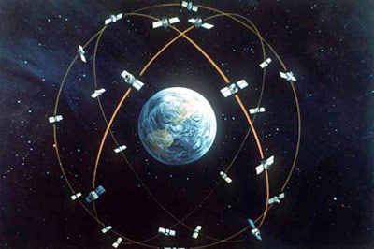
GPS Satellite Constellation
  At least 4 “visible” in sky from anywhere on Earth

Slide 5
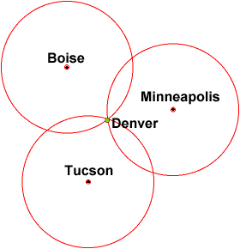
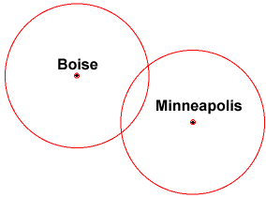
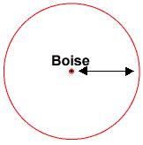
Trilateraion

Slide 6
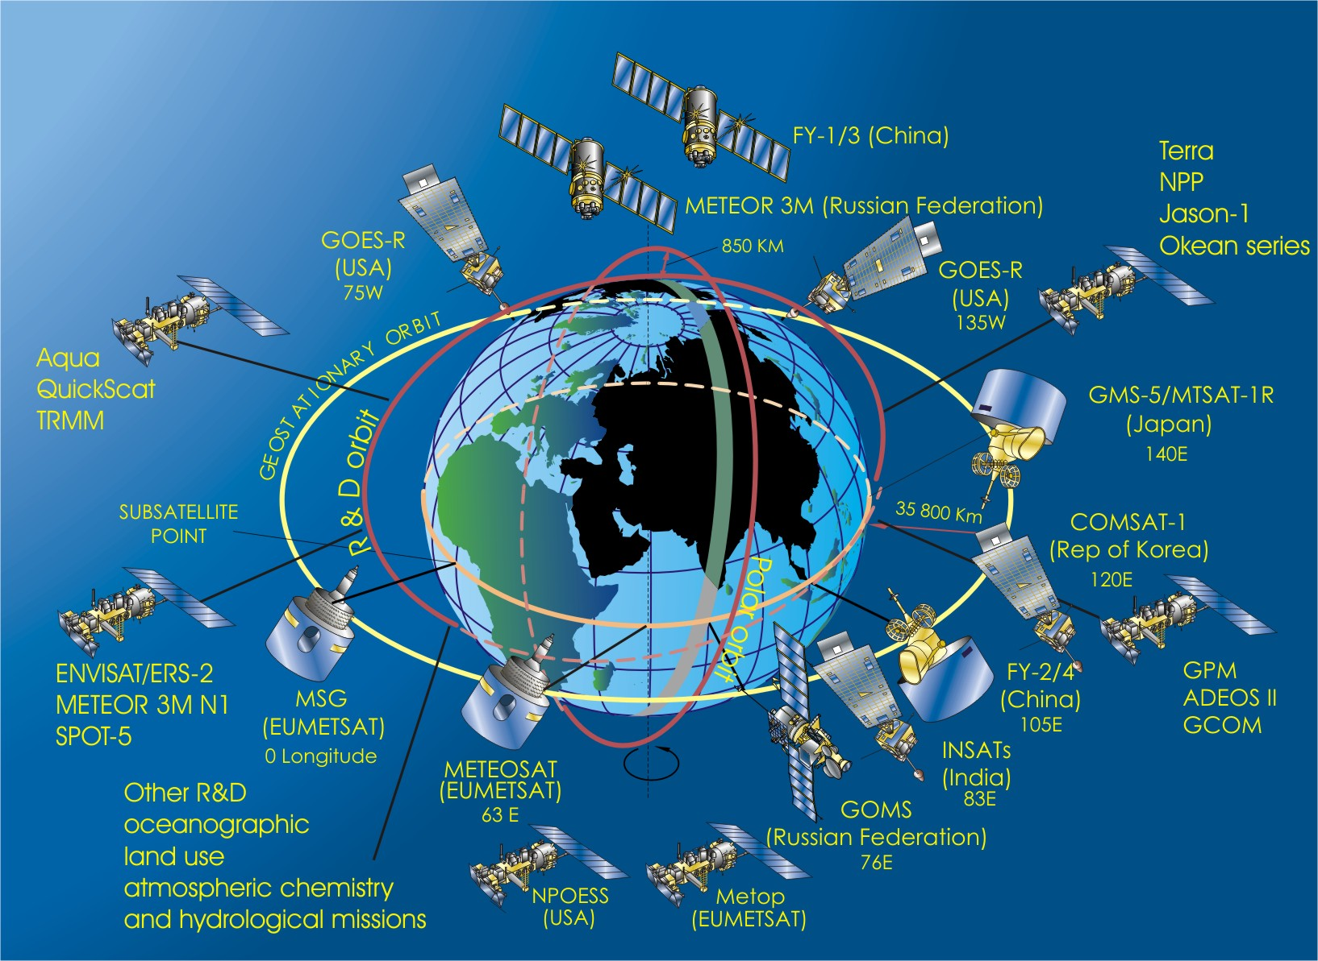

Slide 7
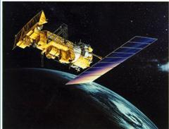
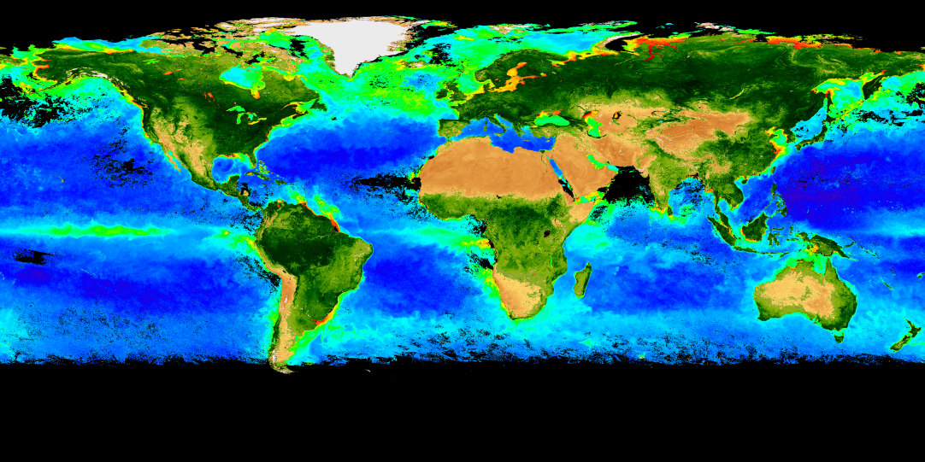
Satellites can survey an entire ocean in 1 hour
  Clouds – weather
  SST
  Wave height
  Wave direction
  Chlorophyll

Slide 8
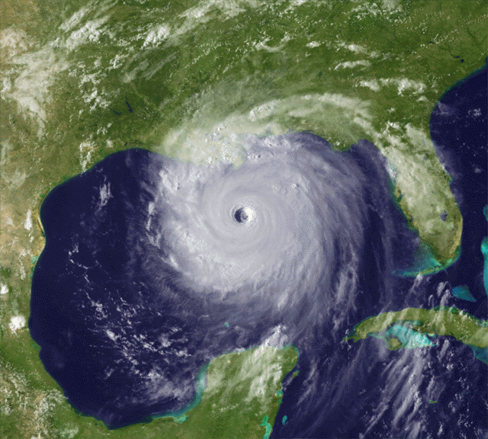
Weather
Hurricane Katrina – Gulf of Mexico

Slide 9
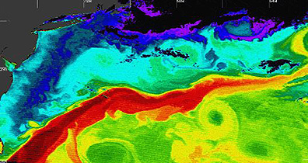
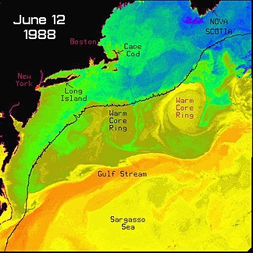
MODIS Satellite Image
of the Gulf Stream

Slide 10
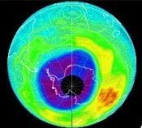
TOMS (Total Ozone Mapping Spectrometer)Satellite Data measures a hole
in the Ozone layer, September 24, 2003, slightly larger than North America

Slide 11
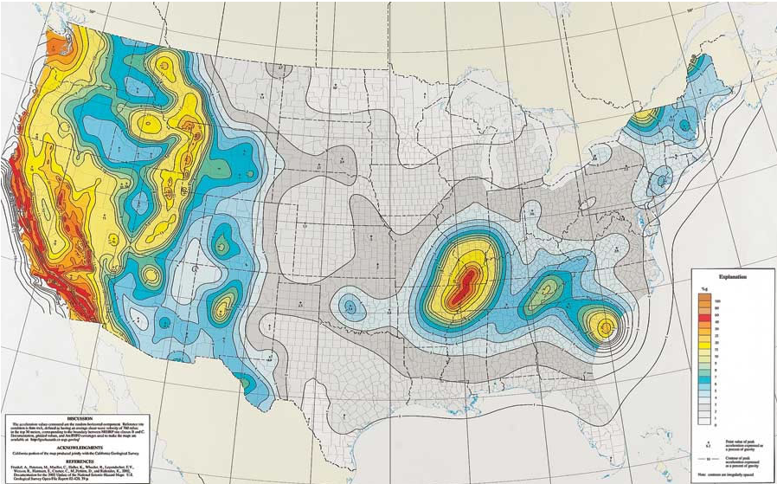
Mapping Patterns of Natural Events: Earthquake Maps

Slide 12
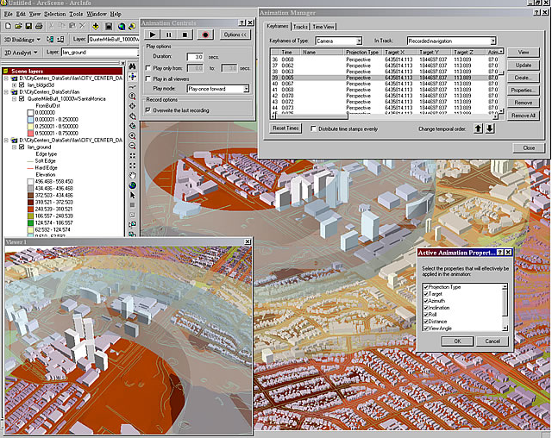
Where things are?
Determine distance of drug related arrests to schools, crimes occurring within 1000 feet eligible for higher sentences

Slide 13
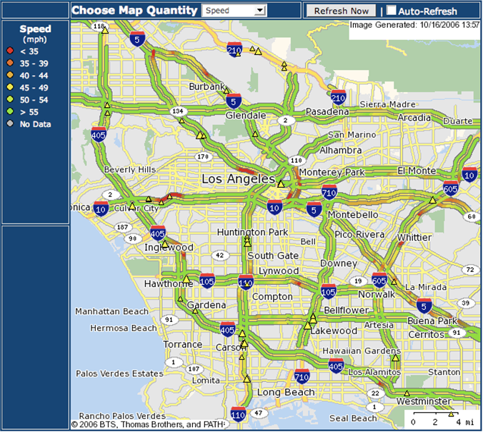
Patterns, what do you think the colors represent?

Slide 14
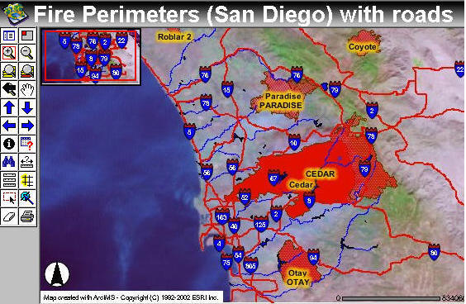
Disaster Management

Slide 15
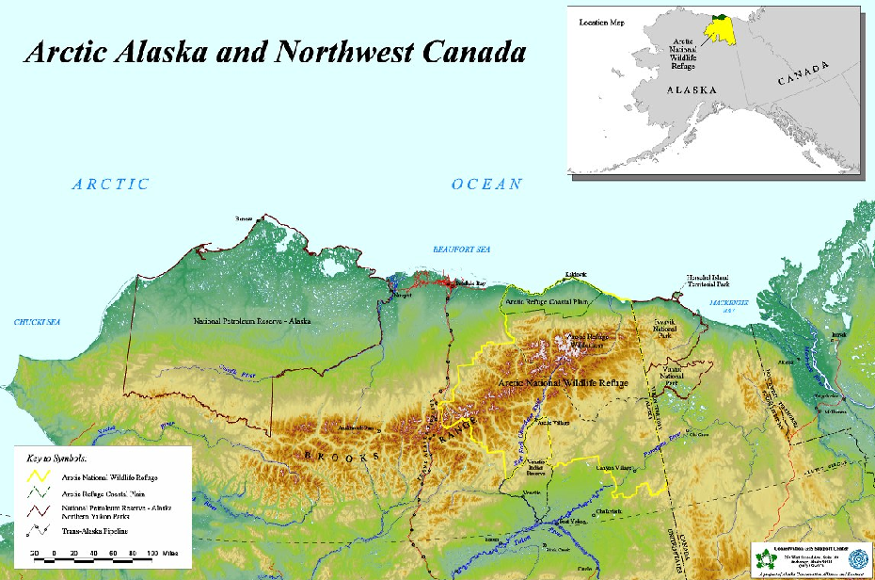
Conservation: Wildlife Refuge

Slide 16
Conservation Planning

Slide 17
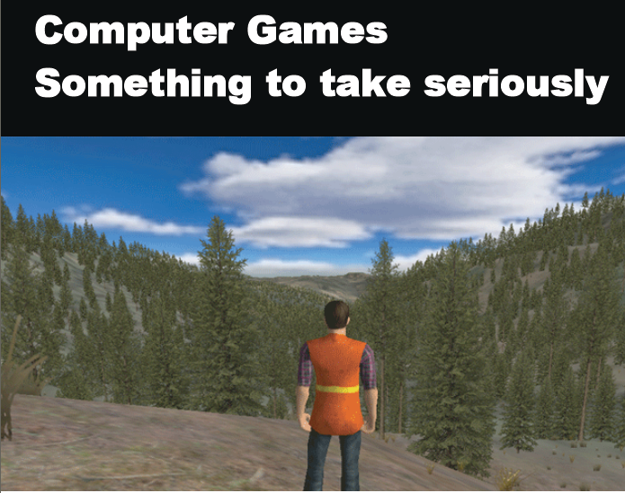
GIS Visualizations

Slide 18
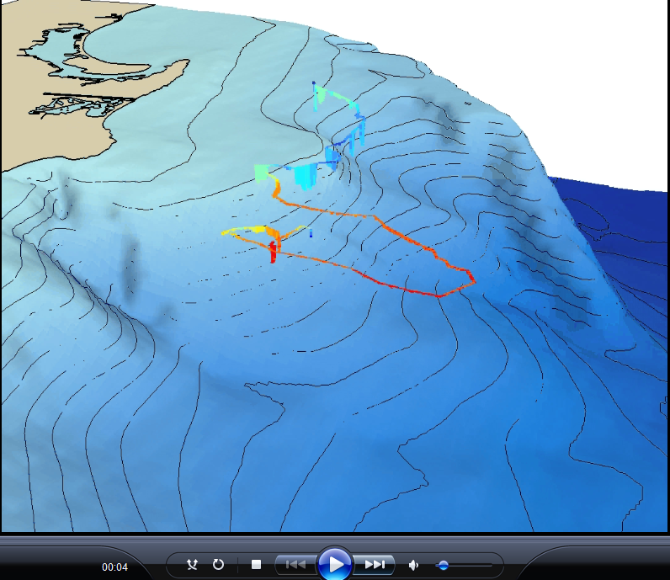
Animations

Slide 19
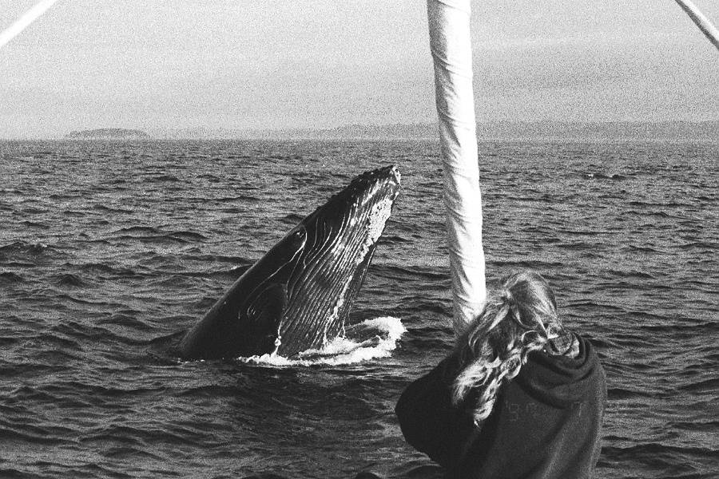
My Research

Slide 20
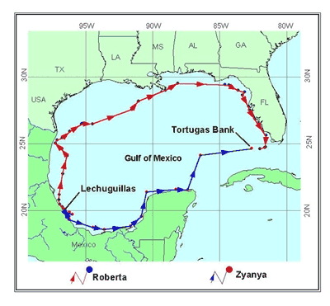
Satellite Tagging of Green Sea Turtles
GIS Maps of the Data

Slide 21
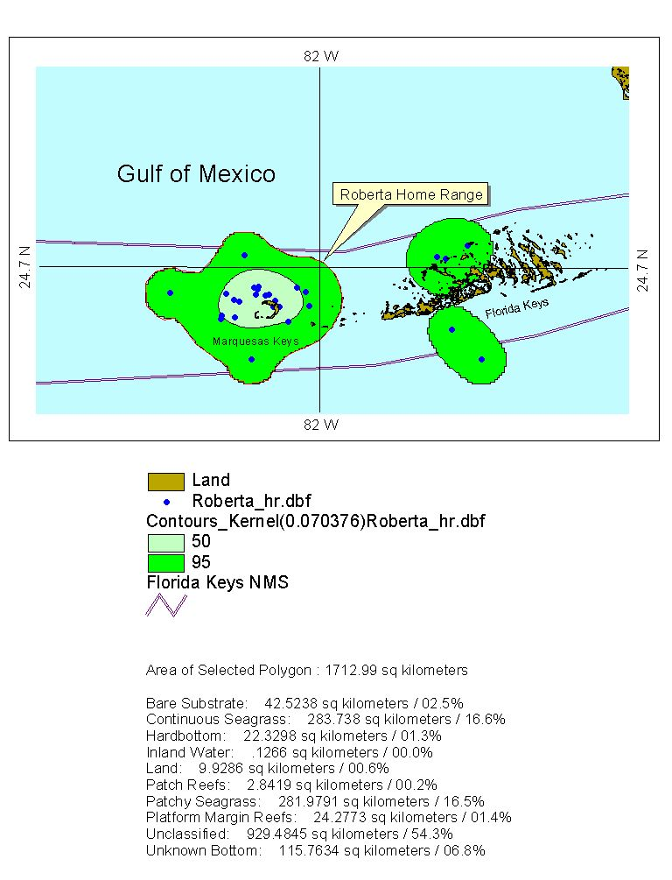
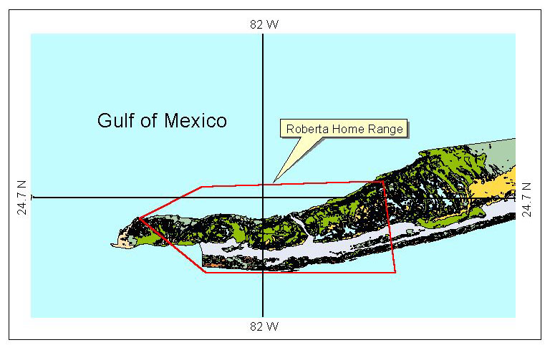
Research Results
Home Ranges
Satellite Image Coded for Habitat Types

Slide 22
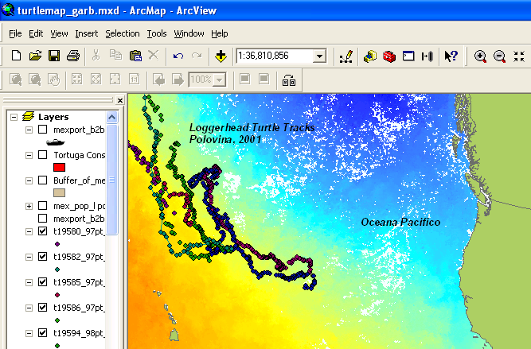
Migration patterns of sea turtles

Slide 23
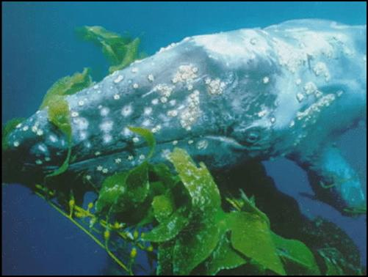
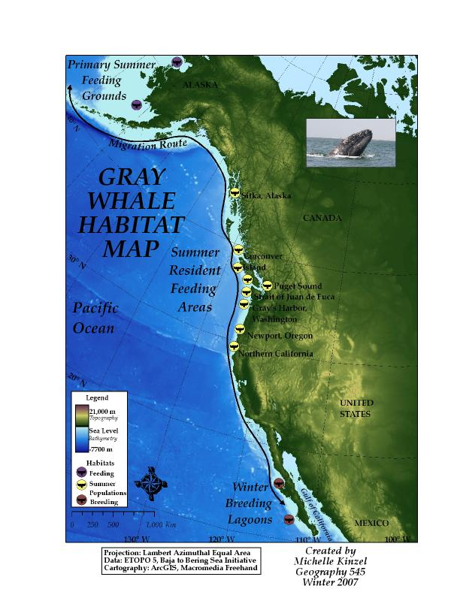
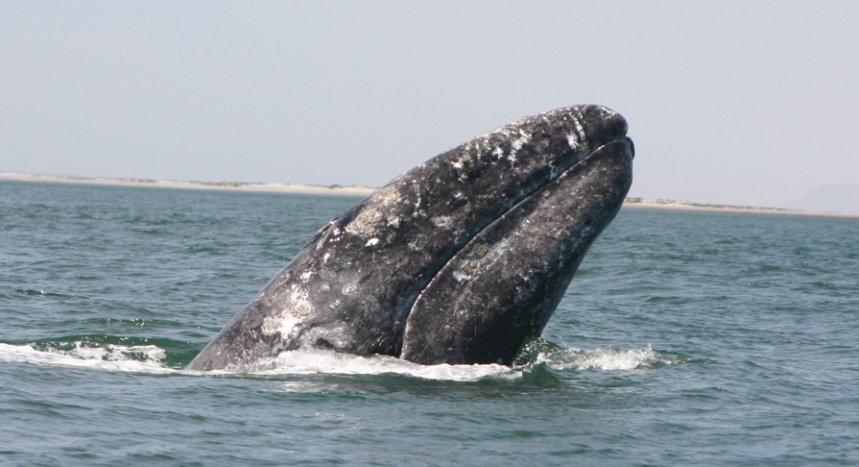
Satellite Tracking and GPS Technology Used to Track Whale Migrations

Slide 24
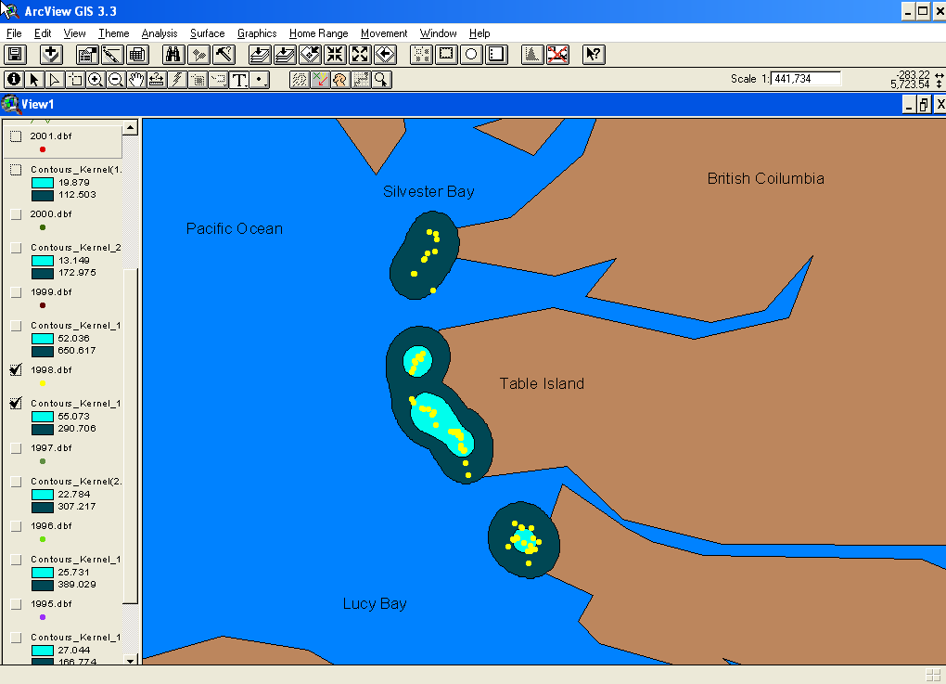
Gray Whale Home Range Changes
Hypothesis: Variations in chlorophyll
related to El Nino effects causes shifts
in food web

Slide 25
Your Research

Slide 26
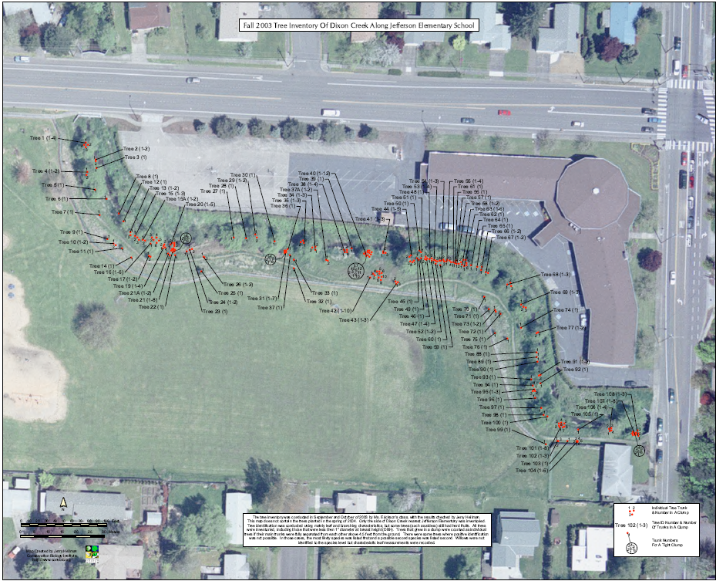
Dixon Creek Project

Slide 27
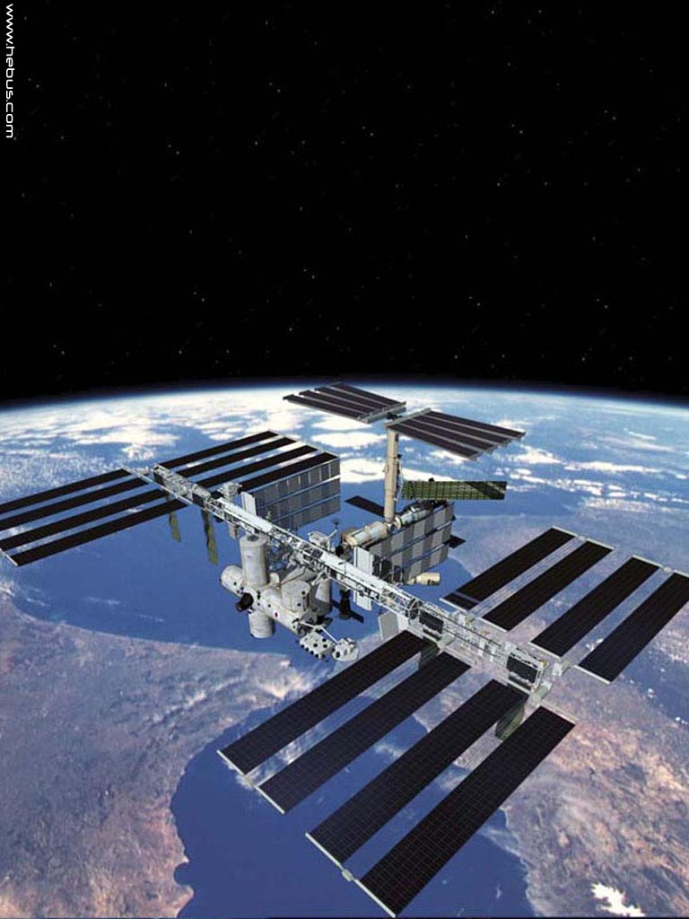
Questions?

Slide 28
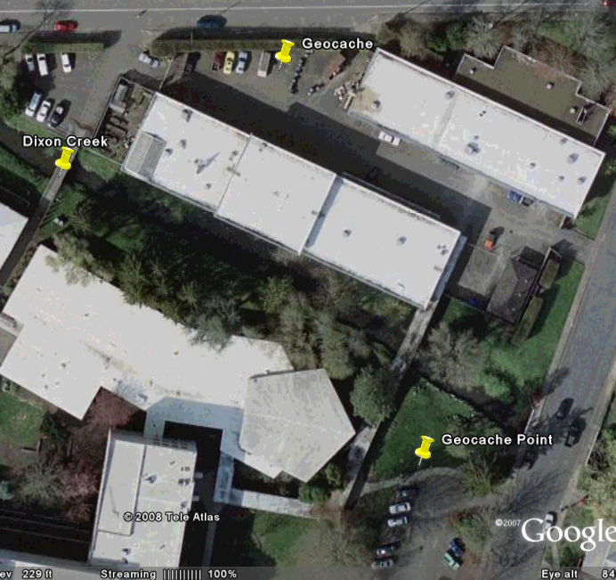
Let’s do a GPS Activity
First we will take waypoints
Next, we will geocache back to those locations

