Slide 1





Macrosystems EDDIE: Time Series Modeling and Prediction of Environmental Data
Lofton, M.E., M.R. Hipsey, K. Kurucz, and C.C. Carey. 8 August 2025.
Macrosystems EDDIE: Time Series Modeling and Prediction of Environmental Data.
Macrosystems EDDIE Module 11, Version 1.
https://serc.carleton.edu/dev/eddie/teaching_materials/modules/module11.html
Module development supported by NSF EF 2318861, DEB 2213550, OISE 2330211
Notes:
Welcome to the Macrosystems EDDIE module: Time Series Modeling and Prediction of Environmental Data. This module has been developed in collaboration by scientists at the University of Western Australia and Virginia Tech, leveraging data from the Swan Canning Estuary Virtual Observatory and the U.S. National Ecological Observatory Network. The module is part of the Macrosystems EDDIE program, which stands for Environmental Data-Driven Inquiry and Exploration, and is supported by grants from the United States National Science Foundation.

Slide 2
Overview of today
Introduce concepts related to time series modeling and environmental data case studies
Activity A: Visualize data from a selected environmental data case study, and fit and assess a time series model
Activity B: Choose a new environmental dataset or upload your own dataset and fit and assess a time series model
Activity C: Fit additional time series models to your environmental dataset from Activity B and compare performance across models
Notes:
This module includes three activities, which are all designed to introduce concepts related to time series modeling in the context of environmental science. In Activity A, students will visualize data from a selected environmental data case study and fit and assess a time series model. In Activity B, students will choose a new environmental dataset or upload their own dataset and fit and assess a time series model. In Activity C, students will fit additional time series models to their environmental dataset and compare performance across models.

Slide 3
Our focal question for today:
How can we use time series models to understand and predict ecosystem conditions?
Notes:
All of the activities are designed to address the focal question for this module, which is: How can we use time series models to understand and predict the state of ecosystems?

Slide 4
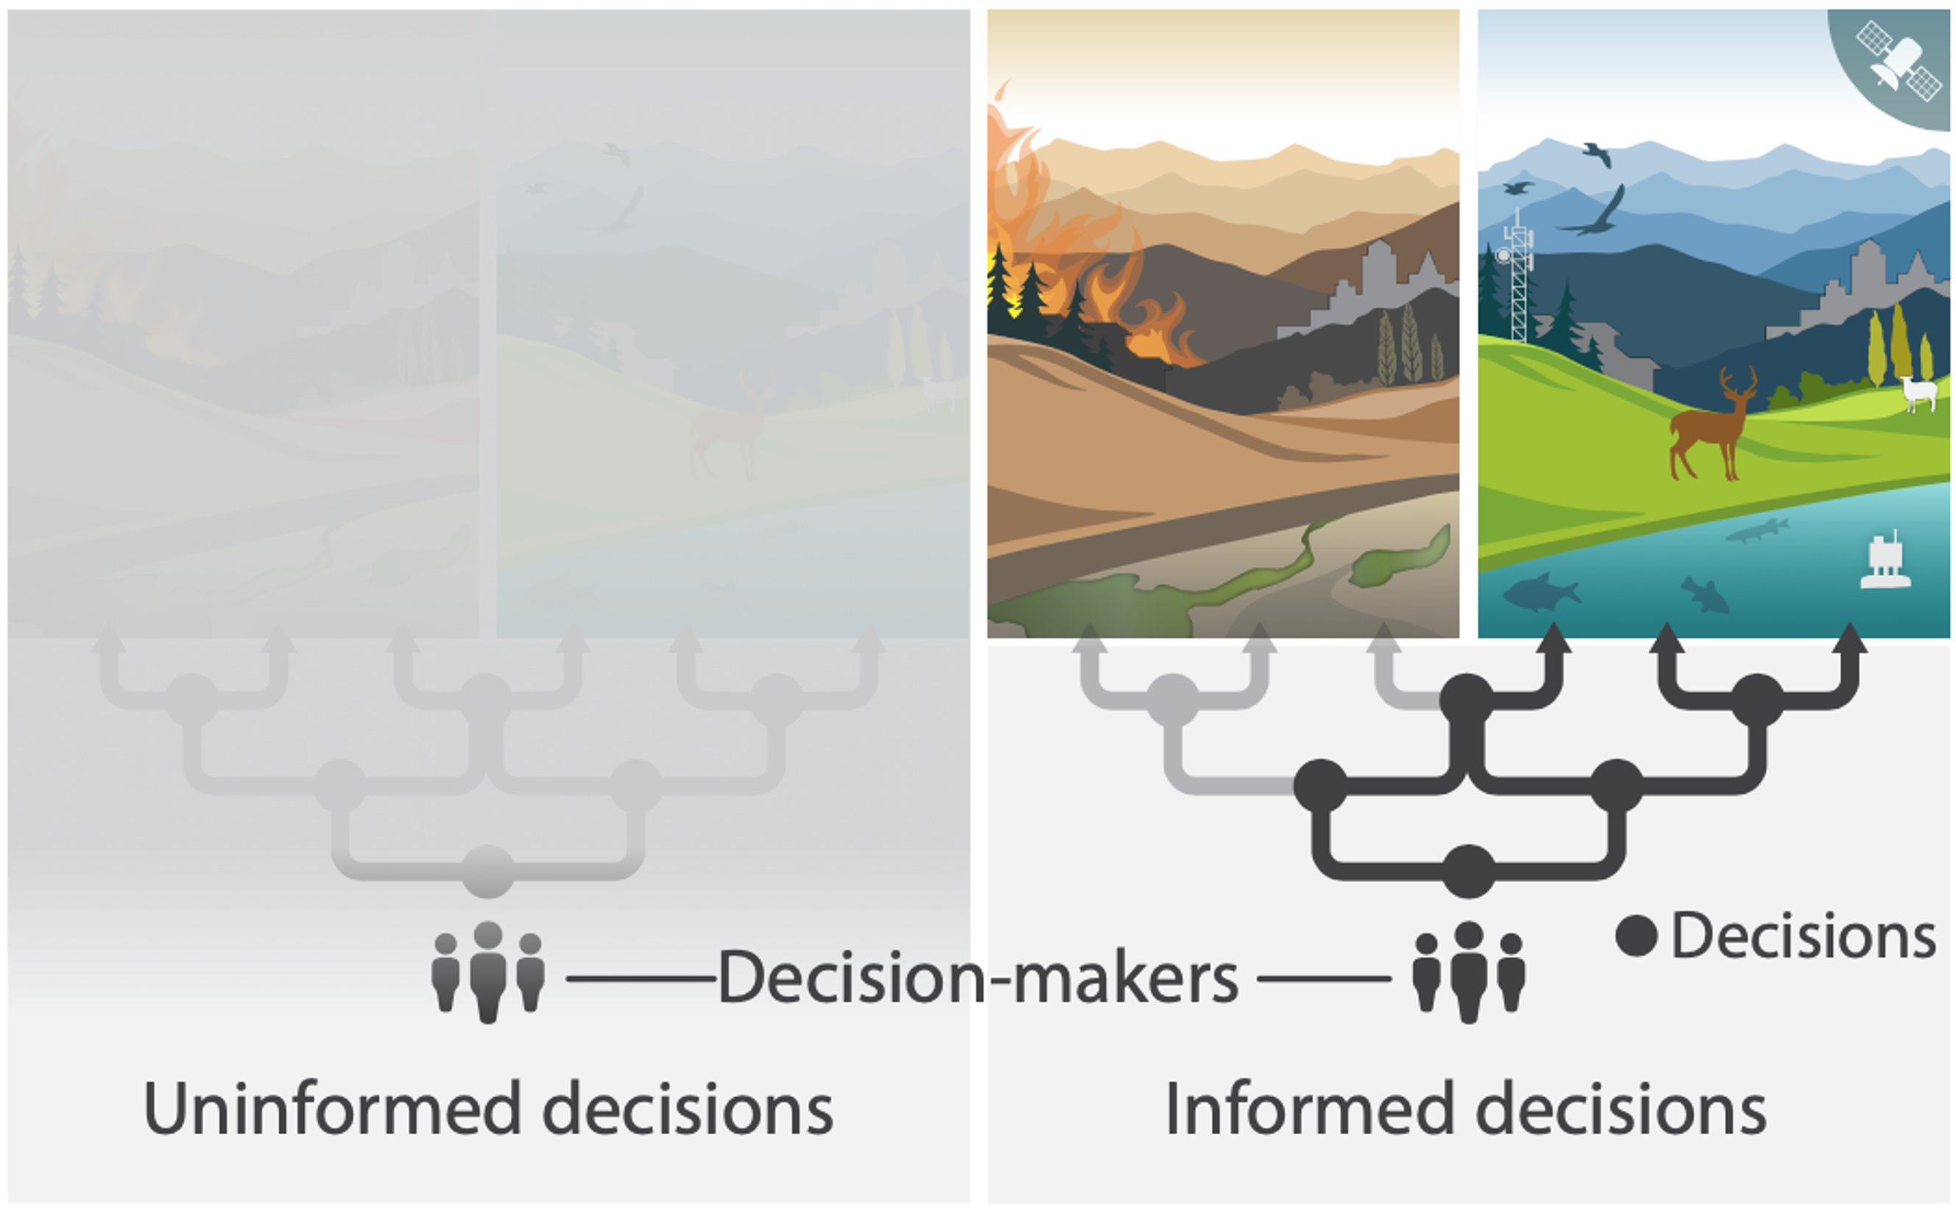
Importance and urgency of environmental prediction in a changing world
Figure credit: Dietze et al. 2024 Nature Climate Change
Notes:
As ecosystems change rapidly due to human pressures, historic conditions can no longer be used to predict future conditions. Use of time series models can help inform managers and decision-makers about the likely future state of ecosystems, helping them to make more informed decisions regarding use and conservation of environmental resources.

Slide 5
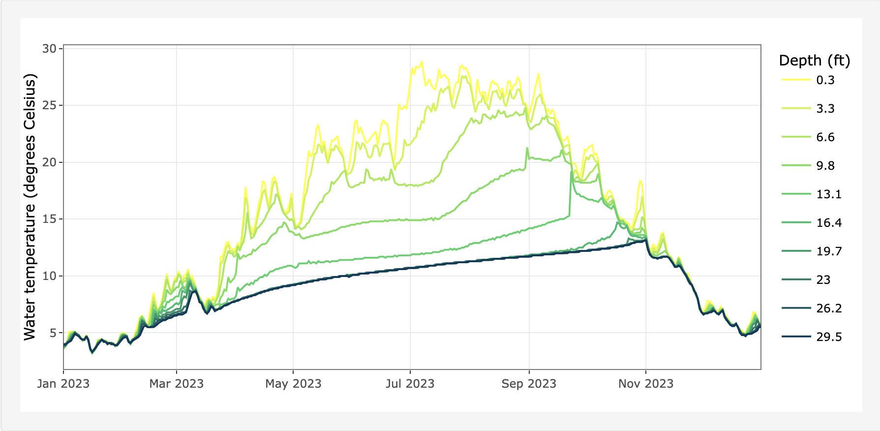
High-frequency environmental data can be used to develop predictive models
Measurements taken many times per day or week (for example, every 10 minutes or every day)
Allows managers and scientists to see patterns that were not observable using low-frequency data (for example, once a week or once a month)
Notes:
In recent decades, our increasing ability to collect high-frequency environmental data has enabled greater application of time series models in ecology. High-frequency environmental data are measurements of various attributes of an ecosystem that are taken many times during a day or during a week (for example, every 10 minutes). This is different from low-frequency data, which are only collected perhaps once a week or even once a month. High-frequency data allow managers and scientists to observe and analyze patterns and trends in ecosystems that were not previously measurable using low-frequency measurements. For example, the plot on the bottom of the slide shows water temperature data collected from many different depths in a reservoir every day over the course of a year. You can see there is a lot of variability in this data that would not be visible if the data were collected once a month, for example.

Slide 6
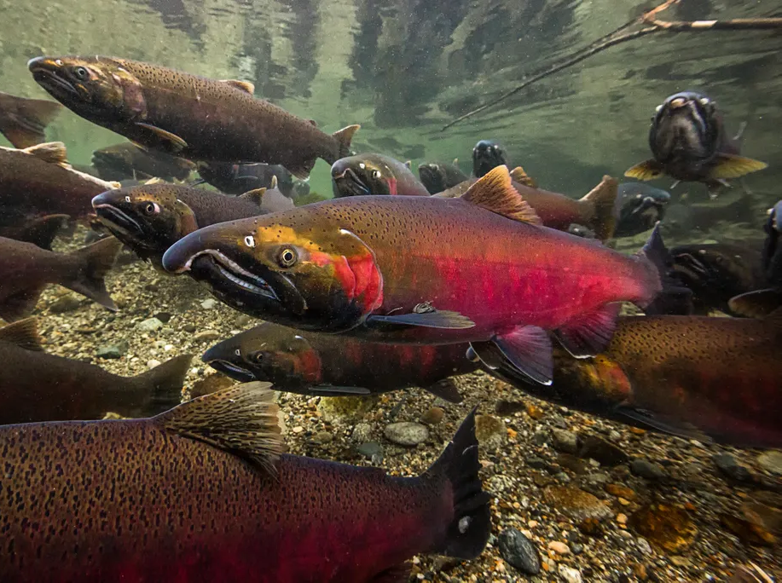
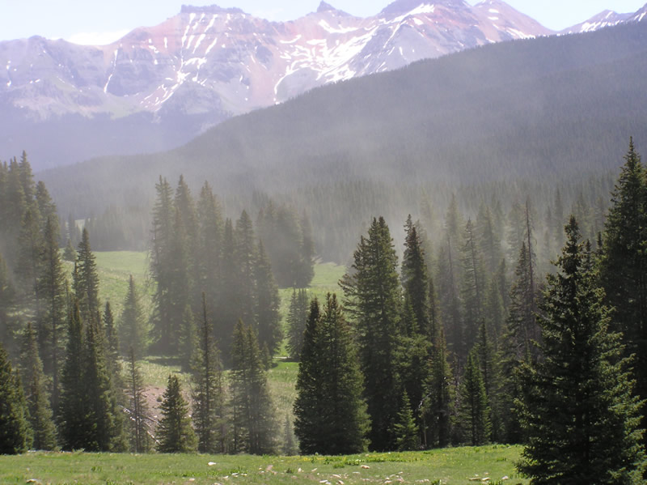
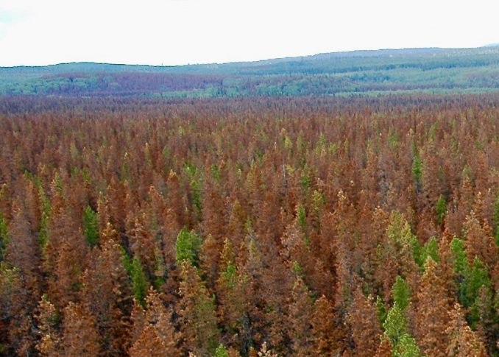
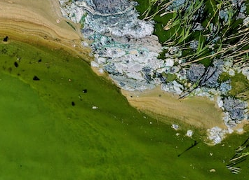
Time series models are often applied to analyze and make predictions using environmental data
Salmon population size
Airborne pollen concentration
Forest pest outbreaks
Harmful algal blooms
Photo credits: Coho salmon: Jessica Newley, Smithsonian magazine; Engelmann spruce pollen: Al Scheider, USDA; Mountain pine beetle attack: Matthew Brown, CC-BY 2.0; Baltic Sea bloom: Pontus Lundahl, TT News Agency via Reuters
Notes:
Due to increasing availability of large quantities of environmental data, time series models are increasingly applied in ecology to analyze and make predictions using environmental data across a wide variety of ecosystems. A few examples of how time series models are currently used in ecology and environmental science are shown here. Predictions of future salmon population sizes can be used to inform salmon harvests; predictions of future pollen concentrations can help people make decisions about when to take allergy medication or how much time to spend outside; predictions of forest pest outbreaks can help inform forest management, and predictions of harmful algal blooms can inform drinking water advisories or recreational area closures. So understanding how to develop and apply time series models is an important skill for students of ecology and environmental science.

Slide 7
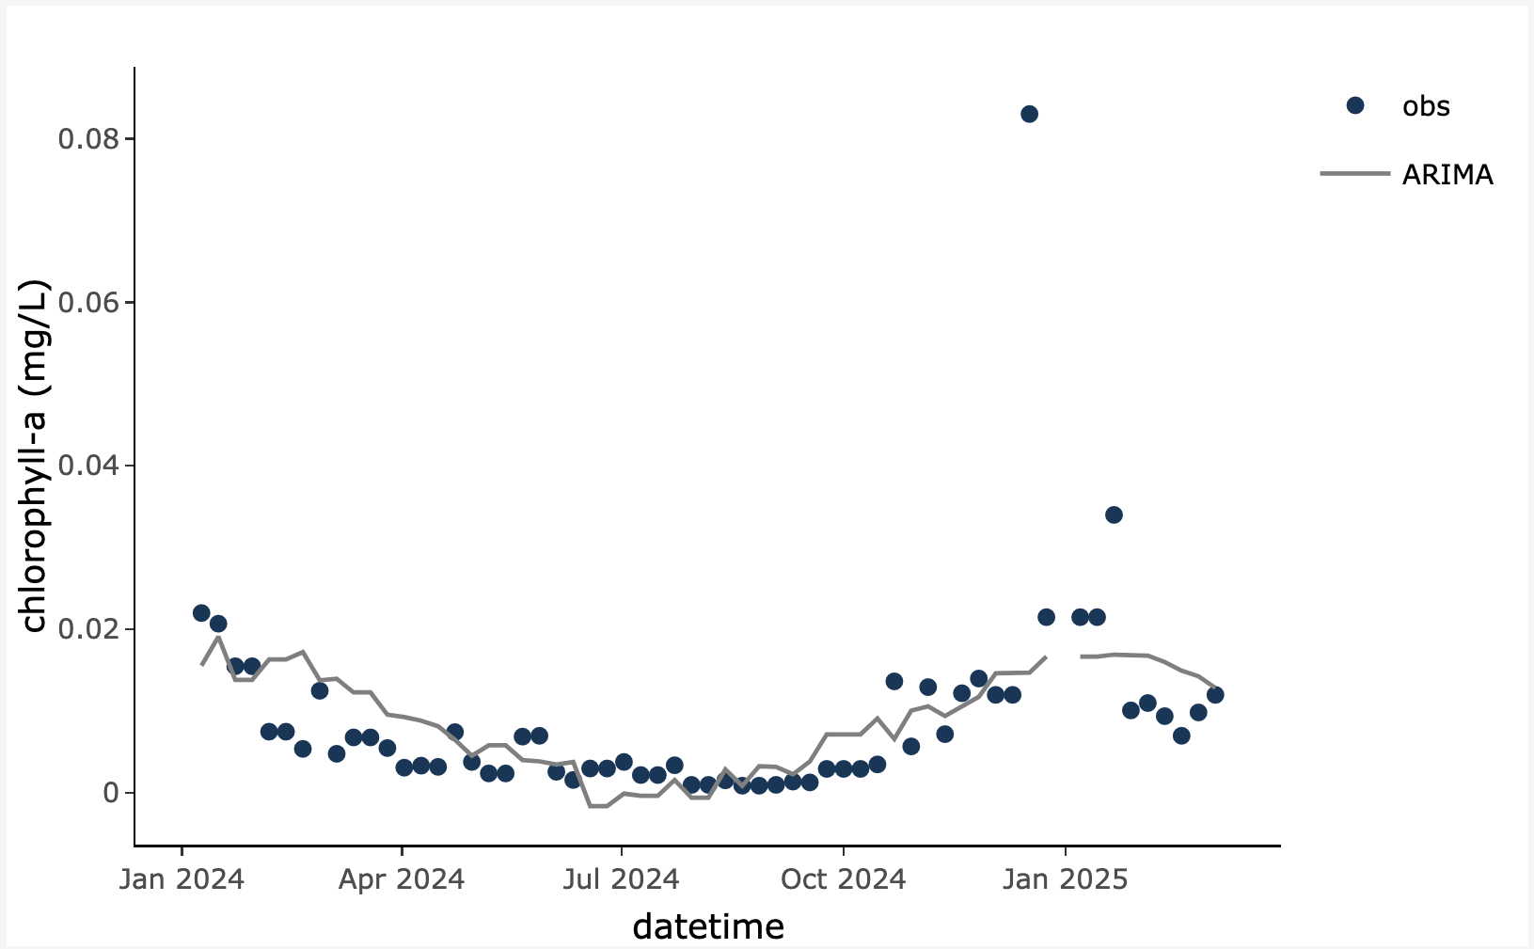
Today…
We will explore time series modeling and out-of-sample prediction of standardized environmental datasets using several different models.
Time series model: a statistical representation of data that occur in a particular order over time. Time series models can be used to make predictions of future observations.
model
Why is there a gap in the model line? Because there is a gap in the time series data!
Target variable being predicted
Notes:
Today, we are going to explore time series modeling and out-of-sample prediction of standardized environmental datasets using several different models. A time series model is a statistical representation of data that occur in a particular order over time. Time series models can be used to make predictions of future observations. The figure is showing an example of a time series model fit to chlorophyll-a data from a river. Chlorophyll-a is the variable we are trying to predict, and we refer to that variable as the “target variable”. Note that gaps in the data can result in gaps in the fitted model values.

Slide 8
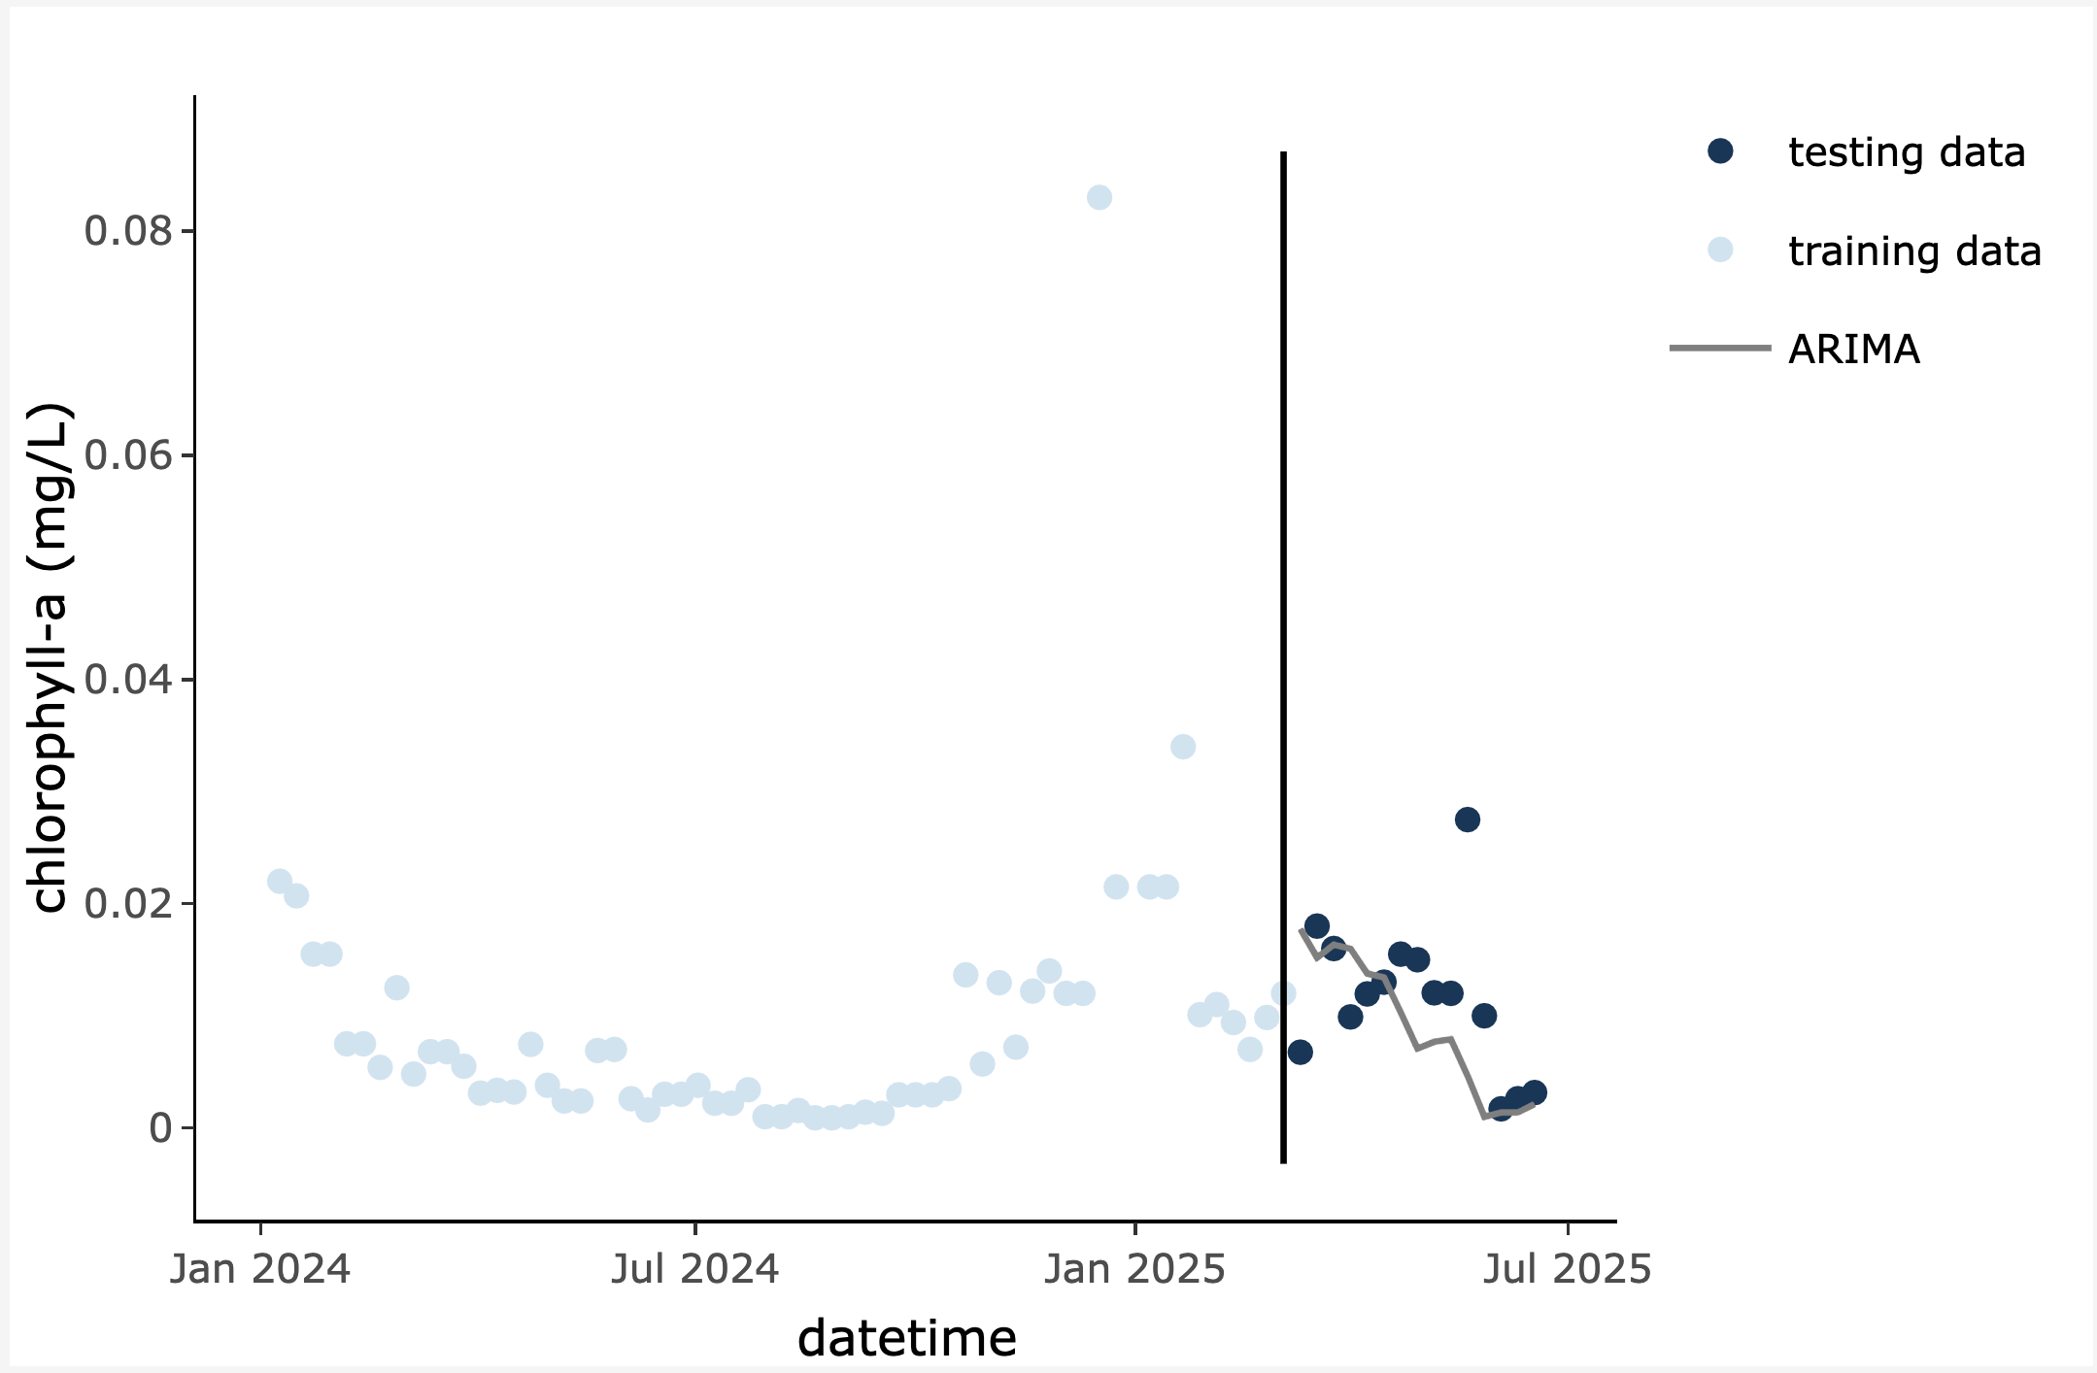
Today…
We will explore time series modeling and out-of-sample prediction of standardized environmental datasets using several different models.
Out-of-sample prediction: model predictions made for observations during a time period that was not used for training
Training data: observations used to fit a model
out-of-sample
prediction
Testing data: observations held “in reserve” to evaluate a model after it has been developed
Notes:
First, we will fit, or train, or models using a subset of the available environmental data, known as training data. We will then generate predictions on data that we withheld from the model during training, known as testing data. Use of out-of-sample predictions is a robust way to test the skill of our model using data it has not previously seen. A typical “split” of data for training and testing is to use 80% of the data for training and 20% for testing. This is because many time series models require large volumes of data to get a good fit.

Slide 9

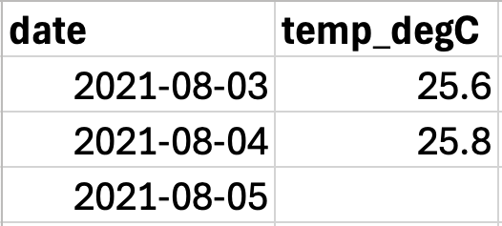
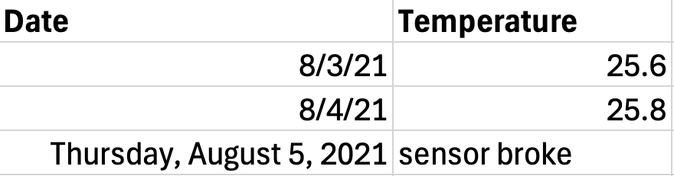
Today…
We will explore time series modeling and out-of-sample prediction of standardized environmental datasets using several different models.
X
Good! Dates are formatted consistently and there are only numeric values in the temperature column.
Bad! Dates are not consistently formatted and there is a mix of numeric and character entries in the temperature column. A computer won’t know how to handle this without extra work on your part! ☹
Notes:
To be able to fit our time series models, we will need to work with data in a standardized format. This is because the models are run using computer programs that expect a particular format of the data; if the data are not in the correct format, the model will not run and will throw an error. Standardized data follow specified guidelines regarding column headers and the format of values within columns. On the left is an example of a standardized data frame; all the dates are formatted similarly and all the values in the temp_degC column are numeric. On the right is an example of a “messy” dataset – a computer won’t be able to read these data without some data cleaning on your part! Dates have inconsistent formatting and there are notes embedded along with numeric values in the temperature column.

Slide 10

Today…
We will explore time series modeling and out-of-sample prediction of standardized environmental datasets using several different models.
Researchers use different types of models because they provide complementary predictions: some may be more accurate than others, and provide unique information about an ecosystem
Commonly-used ecological time series models include statistical time series models, machine learning models, and baseline models
Photo credit: Megan Kelly, Arrupe College of Loyola University Chicago
Notes:
We will use the standardized datasets in this module to fit several different time series models, which we will introduce next. Researchers use different types of models because they provide complementary predictions: some may be more accurate than others, and provide unique information about an ecosystem. Commonly-used ecological time series models include statistical time series models, machine learning models, and baseline models against which more complex models are compared.

Slide 11
Today…
AutoRegressive
ARIMA models use past values of a variable to predict future values
We will explore time series modeling and out-of-sample prediction of standardized environmental datasets using several different models.
Historical data
Forecast
Past
Future
Integrated
Models we will use:
1. ARIMA (AutoRegressive Integrated Moving Average)
The target variable may be differenced, meaning that each number is subtracted from the one after it
Moving Average
ARIMA models use past model errors to help make predictions of future values
Notes:
In the module, you will learn about, fit, and assess four different time series models that are commonly applied in environmental science. The first is an AutoRegressive Integrated Moving Average, or ARIMA model. You can think of ARIMA models as having three key components: the autoregressive component, the integration or differencing component, and the moving average component. The autoregressive component means that ARIMA models use past values of a variable to help predict future values. Integration refers to the fact that the target variable, or the variable we are trying to predict, may be differenced, meaning that each number is subtracted from the one after it in the time series. The moving average component means that ARIMA models use past model errors to help make predictions of the future. While this is a very brief overview of ARIMA model structure, we will go into more detail once you begin working through the module.

Slide 12
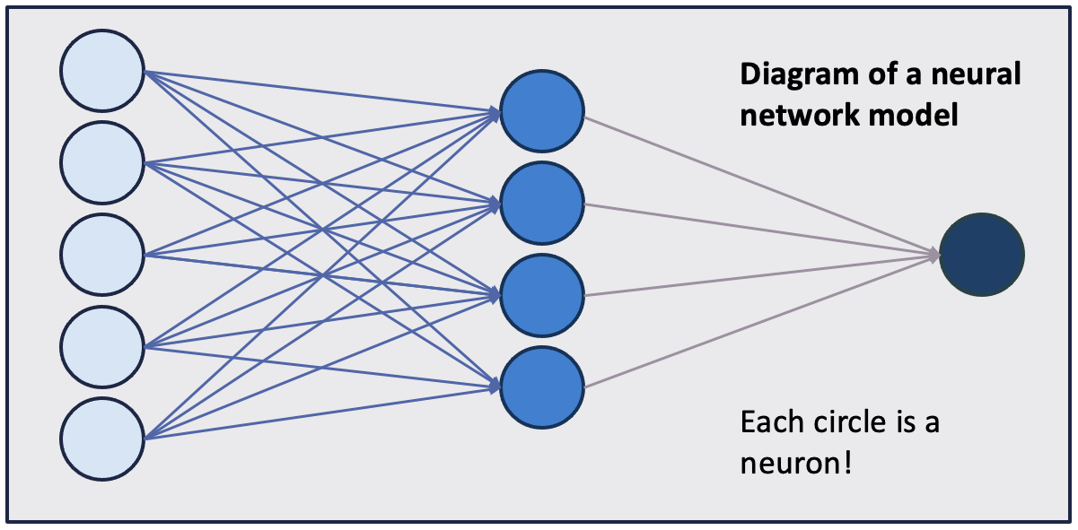
Today…
Input
Hidden layer
Output
We will explore time series modeling and out-of-sample prediction of standardized environmental datasets using several different models.
Models we will use:
ARIMA
NNETAR (Autoregressive Neural Network)
A neural network is a model whose structure is designed to mimic the structure of the human brain and nervous system. They are good at capturing complex, nonlinear relationships in data.
Notes:
The second model you will work with is an autoregressive neural network, or NNETAR model. A neural network is a model whose structure is designed to mimic the structure of the human brain and nervous system. They are good at capturing complex, nonlinear relationships in data. The figure on the right shows a conceptual presentation of a neural network model. The light blue circles are inputs to the model (environmental variables such as air temperature, for example). The medium blue circles are the hidden layer of the neural network, where the data undergo a non-linear transformation, and the dark blue circle is the output layer, which is the model predictions. Again, we will go into more detail about this model in Activity C, when you fit the model to environmental data.

Slide 13
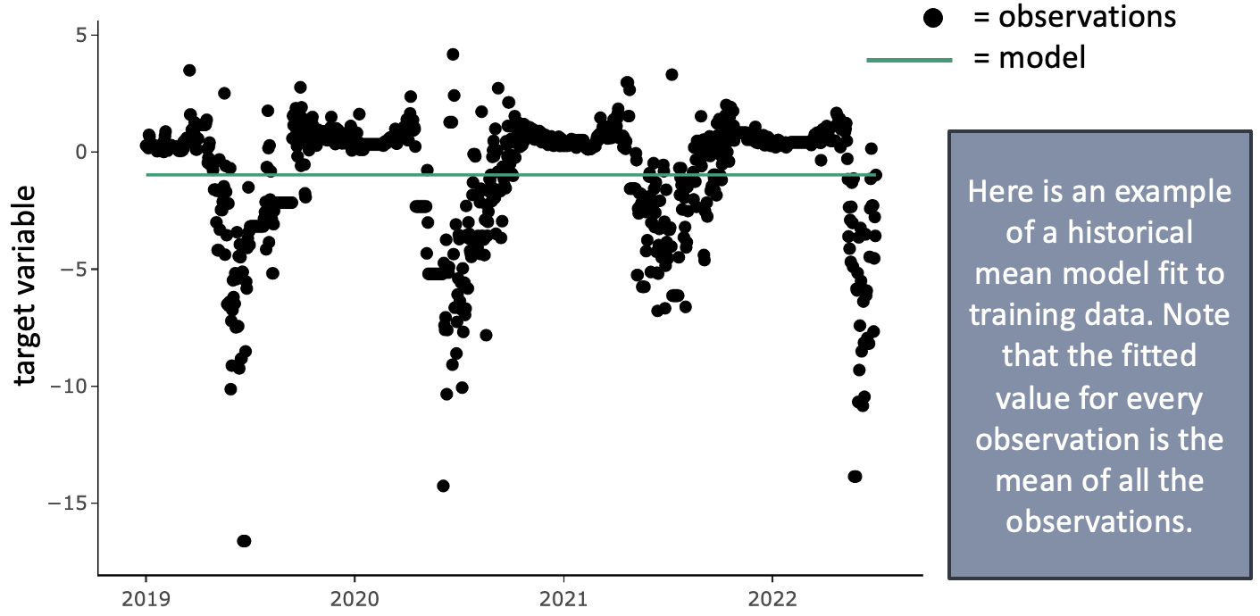
Today…
We will explore time series modeling and out-of-sample prediction of standardized environmental datasets using several different models.
Models we will use:
ARIMA
NNETAR
Historical mean
A historical mean model uses the mean of the previous observations as the prediction for the next timestep.
Historical mean models can be useful baseline models against which to compare more complex models.
Notes:
The third model we will fit is a historical mean model. A historical mean model simply uses the mean of the previous observations as the prediction for the next timestep. Historical mean models can be useful as baseline, or null, models against which to compare more complex models. If the more complex model doesn’t outperform the historical mean model, the additional complexity is not adding predictive value. The figure on the right shows a historical mean model fit to net ecosystem exchange data (the net exchange of carbon dioxide between an ecosystem and the atmosphere). You can see the model fit is just a flat line representing the mean of all the previously observed data.

Slide 14
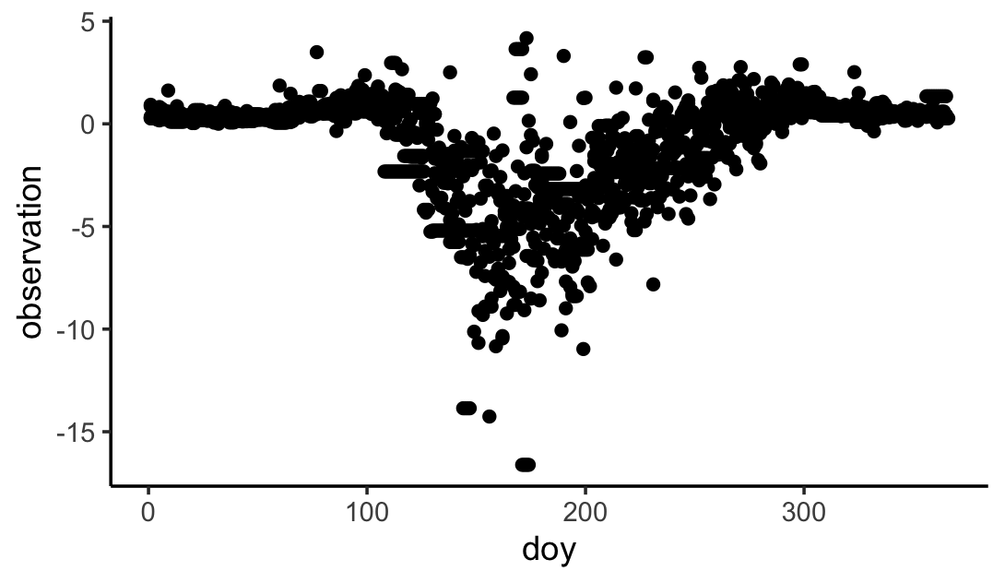
Today…
Example figure of net ecosystem exchange (NEE) observations vs. day-of-year (doy).
We will explore time series modeling and out-of-sample prediction of standardized environmental datasets using several different models.
Models we will use:
ARIMA
NNETAR
Historical mean
DOY (day-of-year)
A day-of-year model uses the Julian day of the year to predict the target variable.
The Julian day ranges from 1 for Jan. 1 to 365 for Dec. 31 (or 366 if it is a leap year!).
Notes:
The final model we will learn about today is a day-of-year model, which uses the Julian day of year (from 1-365 or 366 in a leap year) to predict the target variable. The figure on the right shows net ecosystem exchange data plotted vs. day of year. You can see there is a clear annual pattern in NEE, which indicates that day-of-year might be a helpful predictor for these data. Day-of-year models are also good baseline models against which to compare more complex models.

Slide 15
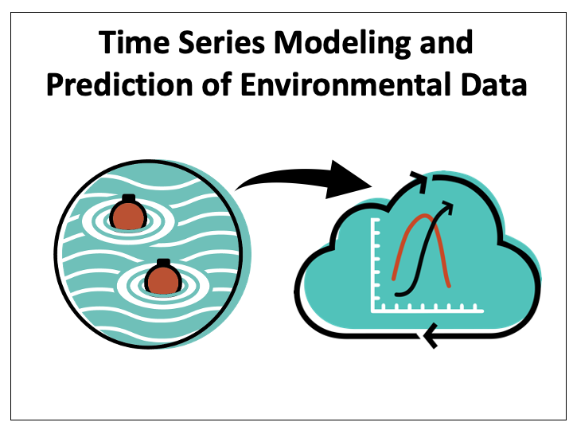
Learning objectives of today’s module:
Explore relationships between ecological variables from environmental case studies.
Understand the structure of four time series models (including machine learning models) that are commonly applied in environmental science.
Fit time series models using environmental data and assess the importance of ecological driver variables in making model predictions.
Process environmental datasets into standardized formats suitable for training and assessing time series models.
Compare multiple time series models to assess their performance on out-of-sample predictions.
Notes:
This module has five learning objectives (read objectives).

Slide 16

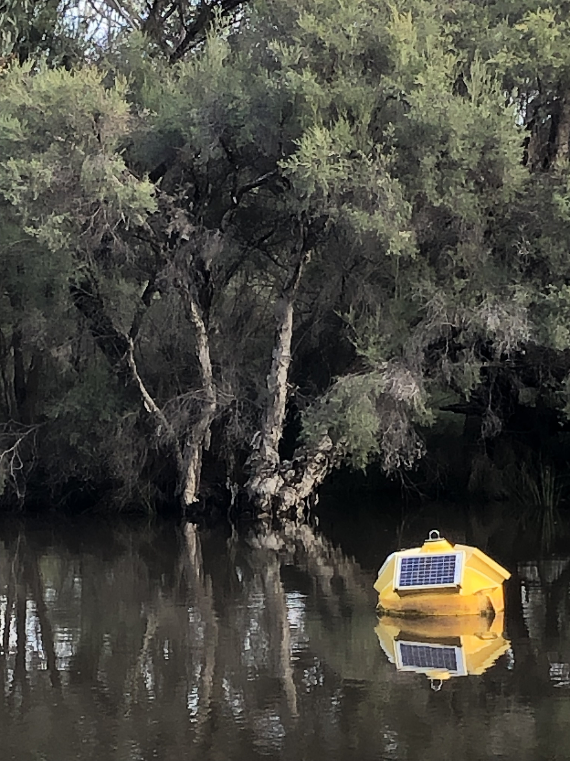
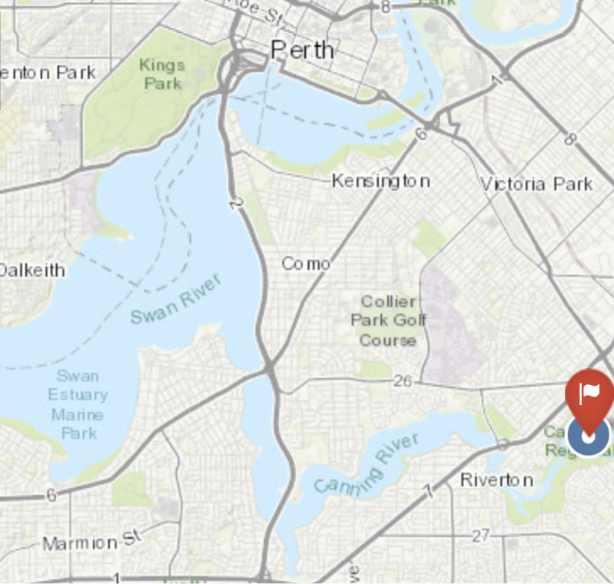
Aquatic case study: Canning River, WA, AU
Notes:
In Activity A, you will pick an environmental case study. You will use data from this case study to fit and assess an ARIMA time series model. The module includes two case studies: an aquatic and a terrestrial case study. If you choose the aquatic case study, you’ll be working with data from the Canning River, located in Western Australia.

Slide 17
Aquatic case study: Canning River, WA, AU
Part of the Swan-Canning Estuary
Urban estuary system that runs through Perth, the capital of Western Australia
Freshwater flushing from terrestrial catchments and salt water intrusion from the Indian Ocean leads to complex hydrology and biogeochemistry
Increasing nutrient loading from human activity, resulting in water quality impacts for this drinking water supply
Notes:
The Canning River is part of the Swan-Canning Estuary, an urban estuary system that runs through Perth, the capital of Western Australia. Perth has a population of about 1.5 million people. The estuary experiences both freshwater flushing from terrestrial catchments as well as salt water intrusion from the Indian Ocean, which leads to complex hydrology and biogeochemistry. Due to its urban location, the Canning River has experienced increased nutrient loading from human activity, resulting in water quality impacts.

Slide 18
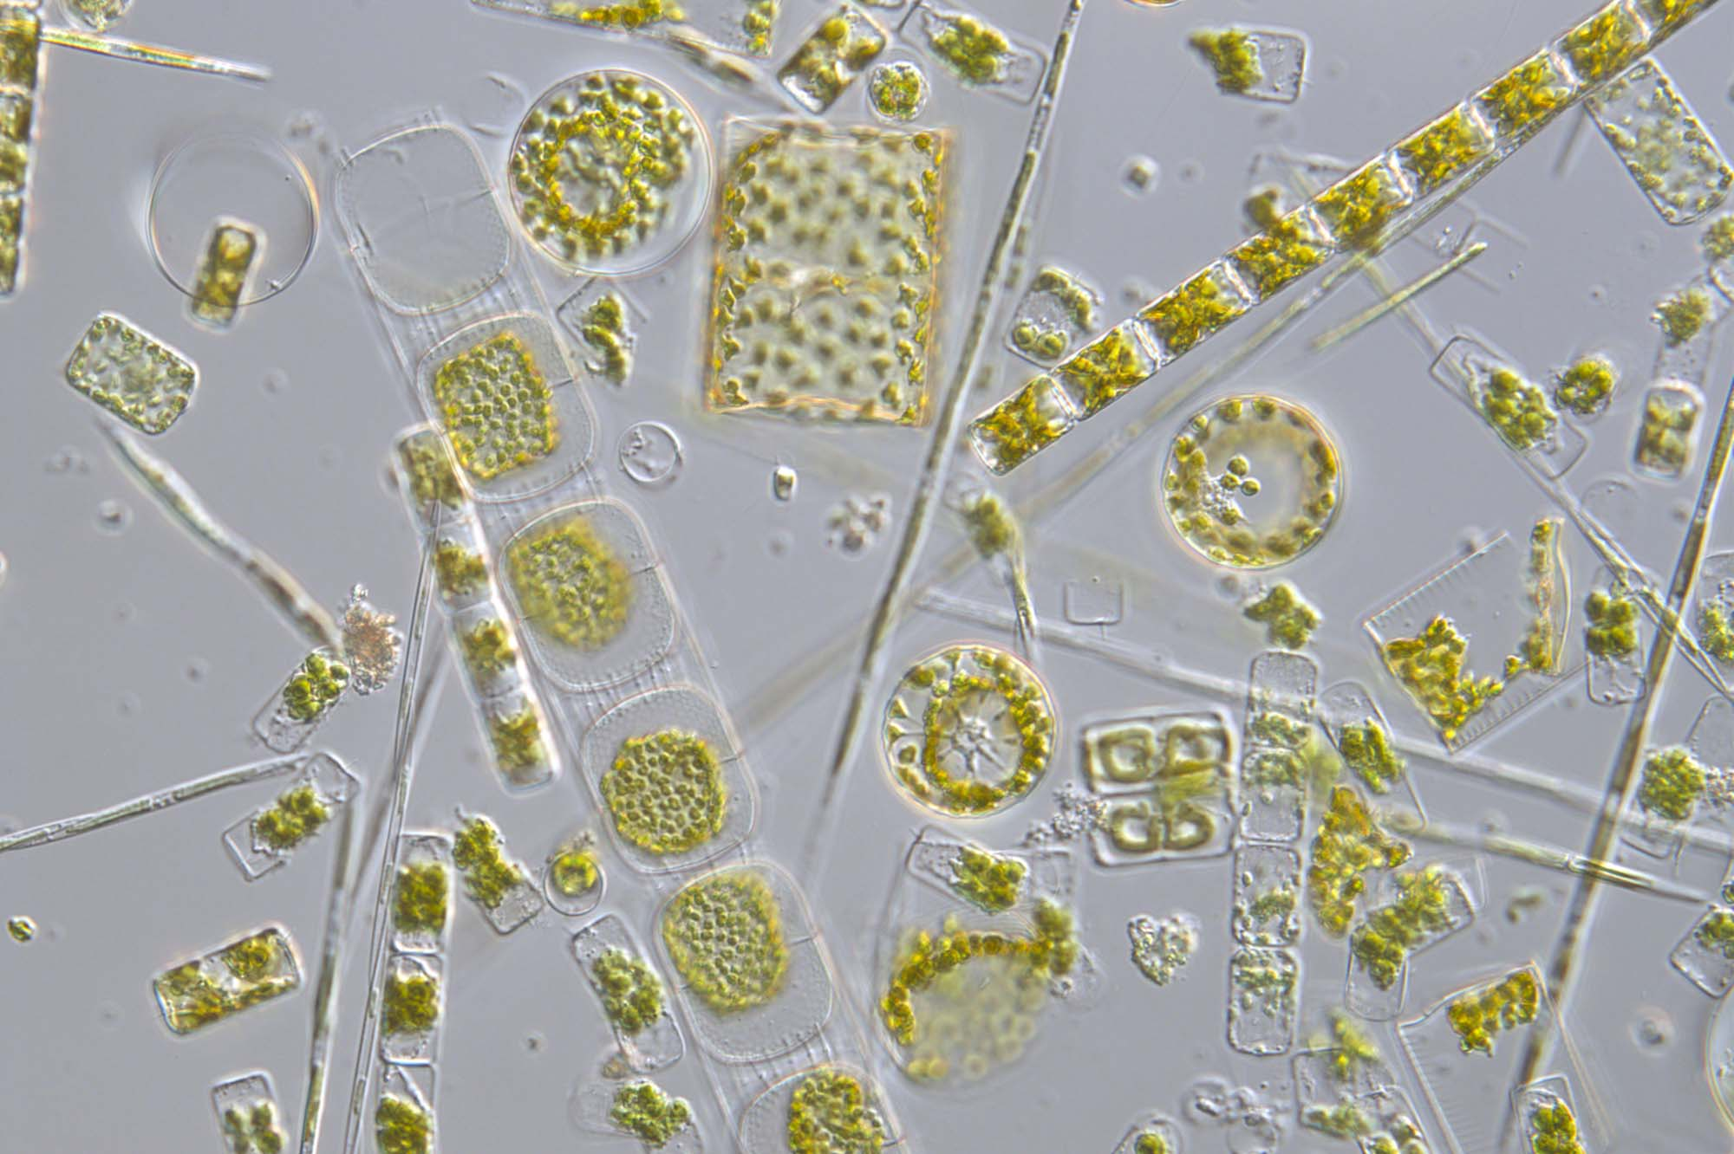
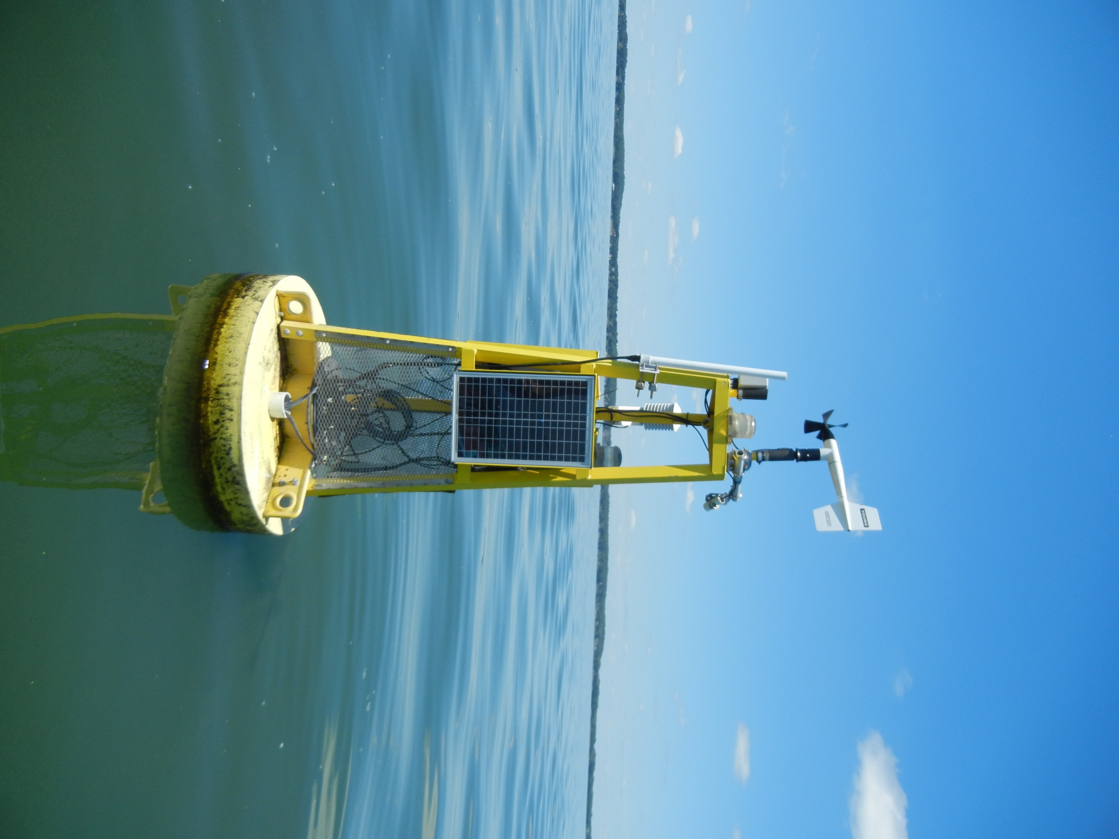
Target variable: phytoplankton (chlorophyll-a)
Phytoplankton under a microscope
Image source: Plymouth Marine Laboratory
Phytoplankton are key primary producers in aquatic ecosystems
Chlorophyll-a is a pigment used in photosynthesis and a proxy for phytoplankton biomass
However, proliferation of phytoplankton can lead to problematic blooms
Blooms can release toxins, cause taste and odor problems, and form unsightly scums
Chlorophyll-a is measured using high-frequency sensors which can be deployed on buoys
Photo credit: Jonathan Thom
Notes:
Our focal target variable for this case study is chlorophyll-a, a photosynthetic pigment that is commonly used as a proxy for phytoplankton biomass. Phytoplankton are tiny aquatic organisms which are key primary producers in many aquatic ecosystems. However, over-proliferation of phytoplankton can lead to harmful blooms, which can release toxins, cause taste and odor problems, and form unsightly scums. Chlorophyll-a can be measured using high-frequency sensors deployed on buoys.

Slide 19
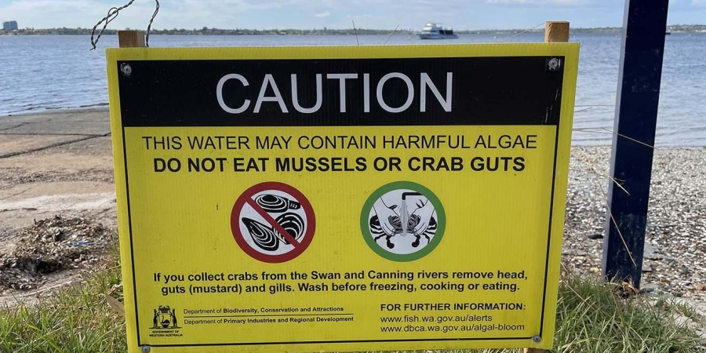
Management implications of chlorophyll-a
The Swan-Canning estuary has historically experienced harmful blooms of different phytoplankton species
This can lead to fish kills, fisheries warnings, recreational area closures, and other impairment
Prediction of high chlorophyll-a levels may indicate an impending bloom
Image credit: Western Australia Dept. of Biodiversity, Conservation, and Attractions
https://www.dbca.wa.gov.au/management/swan-canning-riverpark/waterway-health-swan-canning-riverpark
Notes:
Periodically, the Swan-Canning Estuary and the Canning River experience harmful blooms of various phytoplankton species. This can lead to fish kills, fisheries warnings, and recreational area closures. Models that can provide predictions of high chlorophyll-a levels can be a useful tool as managers try to anticipate and mitigate the effects of these blooms.

Slide 20
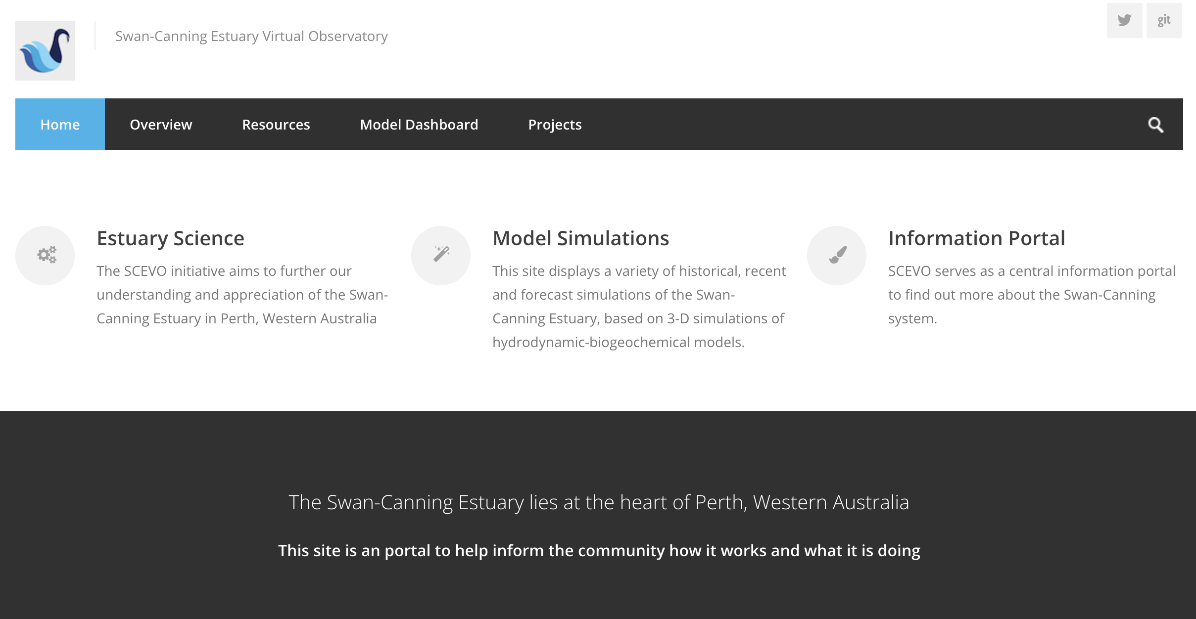
Data source: Swan-Canning Estuary Virtual Observatory (SCEVO)
https://swan.science.uwa.edu.au/
Notes:
The data for the Canning River case study is retrieved from the Swan-Canning Estuary Virtual Observatory, or SCEVO, which is operated by the University of Western Australia. To learn more about SCEVO, you can visit the link on the slide.

Slide 21
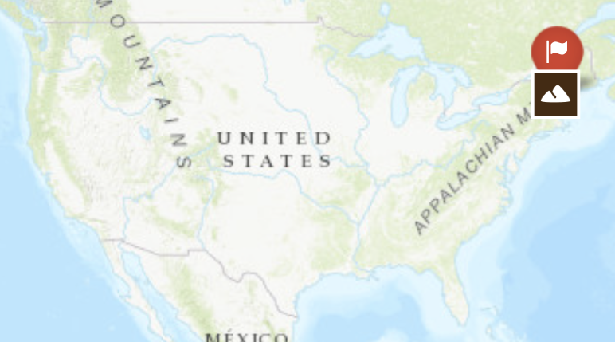
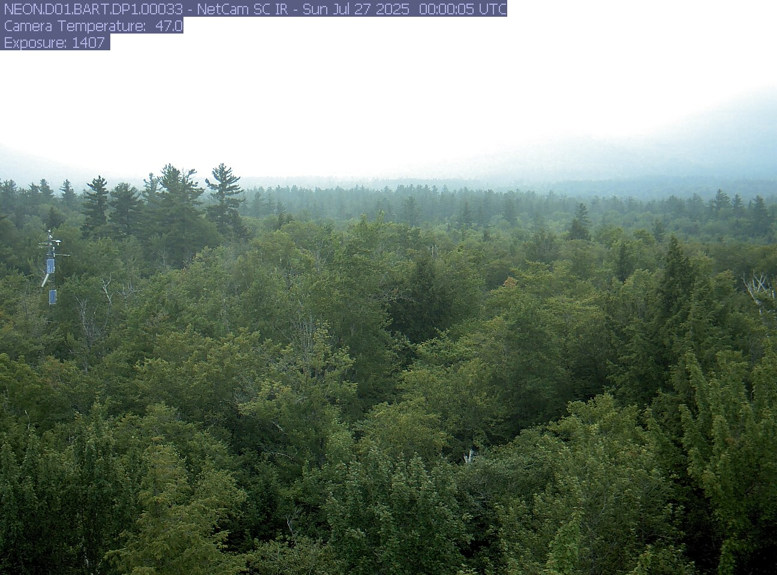
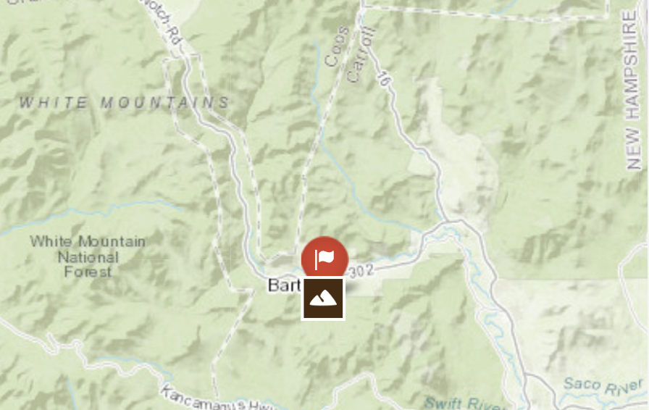
Terrestrial case study: Bartlett Experimental Forest, NH, USA
Image credit: U.S. National Ecological Observatory Network (NEON)
Notes:
The terrestrial case study for the module is Bartlett Experiment Forest, which is located in Carroll County, New Hampshire, USA.

Slide 22

Terrestrial case study: Bartlett Experimental Forest, NH, USA
Old-growth northern deciduous hardwood forest (beech, maple)
Located within the White Mountain National Forest
Historically logged
Research monitoring station established in 1931
Managed by the U.S. Department of Agriculture Forest Service and monitored as part of NEON
Notes:
Bartlett Experimental Forest is an old-growth northern deciduous hardwood forest (primarily beech and maple) located within the White Mountain National Forest. It was logged historically but has been dedicated as a research station since 1931, and is currently managed by the U.S. Department of Agriculture’s Forest Service and monitored as part of US National Ecological Observatory Network (NEON)

Slide 23
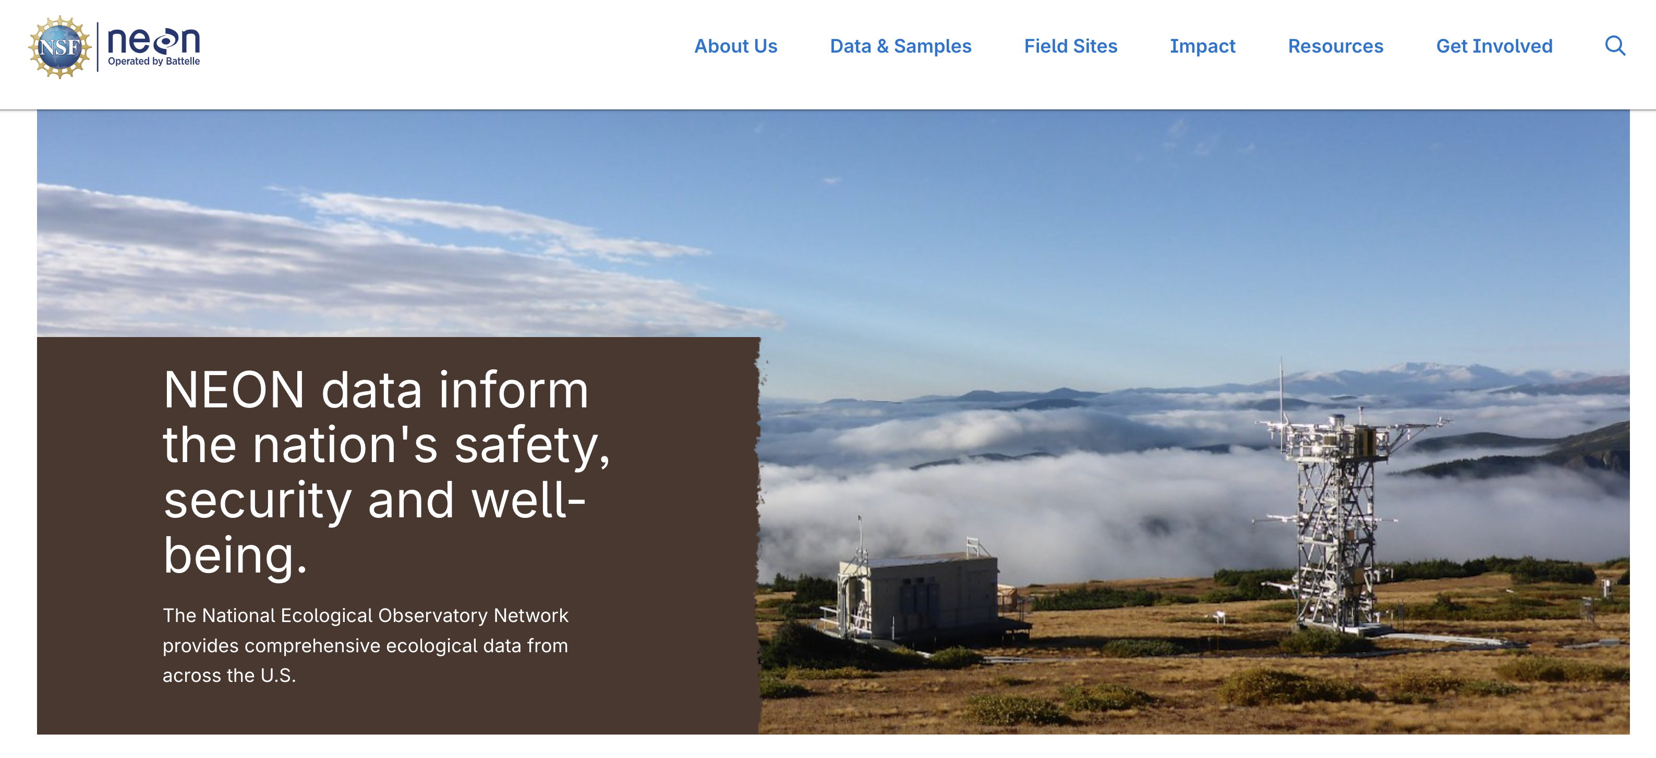
Data source: U.S. National Ecological Observatory Network (NEON)
https://www.neonscience.org/
Notes:
Our data source for the Bartlett Experimental Forest case study is the U.S. National Ecological Observatory Network, or NEON, which coordinates comprehensive collection of ecological data from a variety of ecosystems across the U.S. You can learn more at the link on the slide.

Slide 24
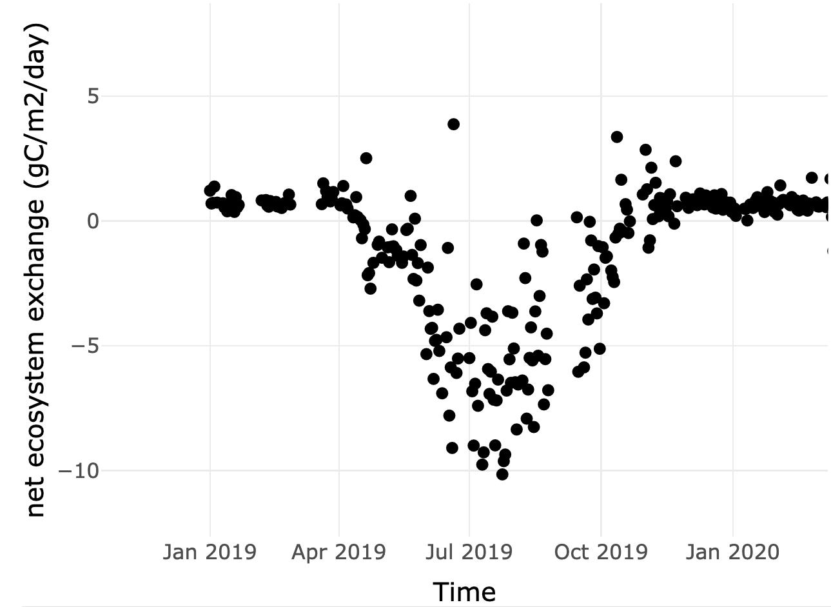
Target variable: net ecosystem exchange (NEE)
In winter, photosynthesis rates decrease so respiration leads to emission of carbon to the atmosphere from the ecosystem
Net ecosystem exchange is the net exchange of carbon dioxide between the air and an ecosystem
NEE magnitude depends on the rates of photosynthesis and respiration of the ecosystem’s vegetation
If NEE is positive, the ecosystem is emitting carbon to the atmosphere; if it is negative, the ecosystem is taking up carbon
positive = emission
negative = uptake
In summer, high rates of photosynthesis lead to uptake of carbon from the atmosphere by the ecosystem
Notes:
Our focal target variable for the Bartlett Experimental Forest is net ecosystem exchange, or NEE. NEE is the net exchange of carbon between the air and a terrestrial ecosystem. The magnitude of NEE depends on the rates of photosynthesis and respiration of the ecosystem’s vegetation. If NEE is positive, the ecosystem is emitting carbon to the atmosphere; if it is negative, the ecosystem is taking up carbon. The figure on the right shows NEE over the course of a year in the Bartlett Experimental Forest. You can see that in summer, high rates of photosynthesis lead to uptake of carbon from the atmosphere by the forest. In contrast, during the winter, leaves drop off trees and photosynthesis rates are low. In this case, respiration of vegetation leads to emission of carbon to the atmosphere from the ecosystem.

Slide 25
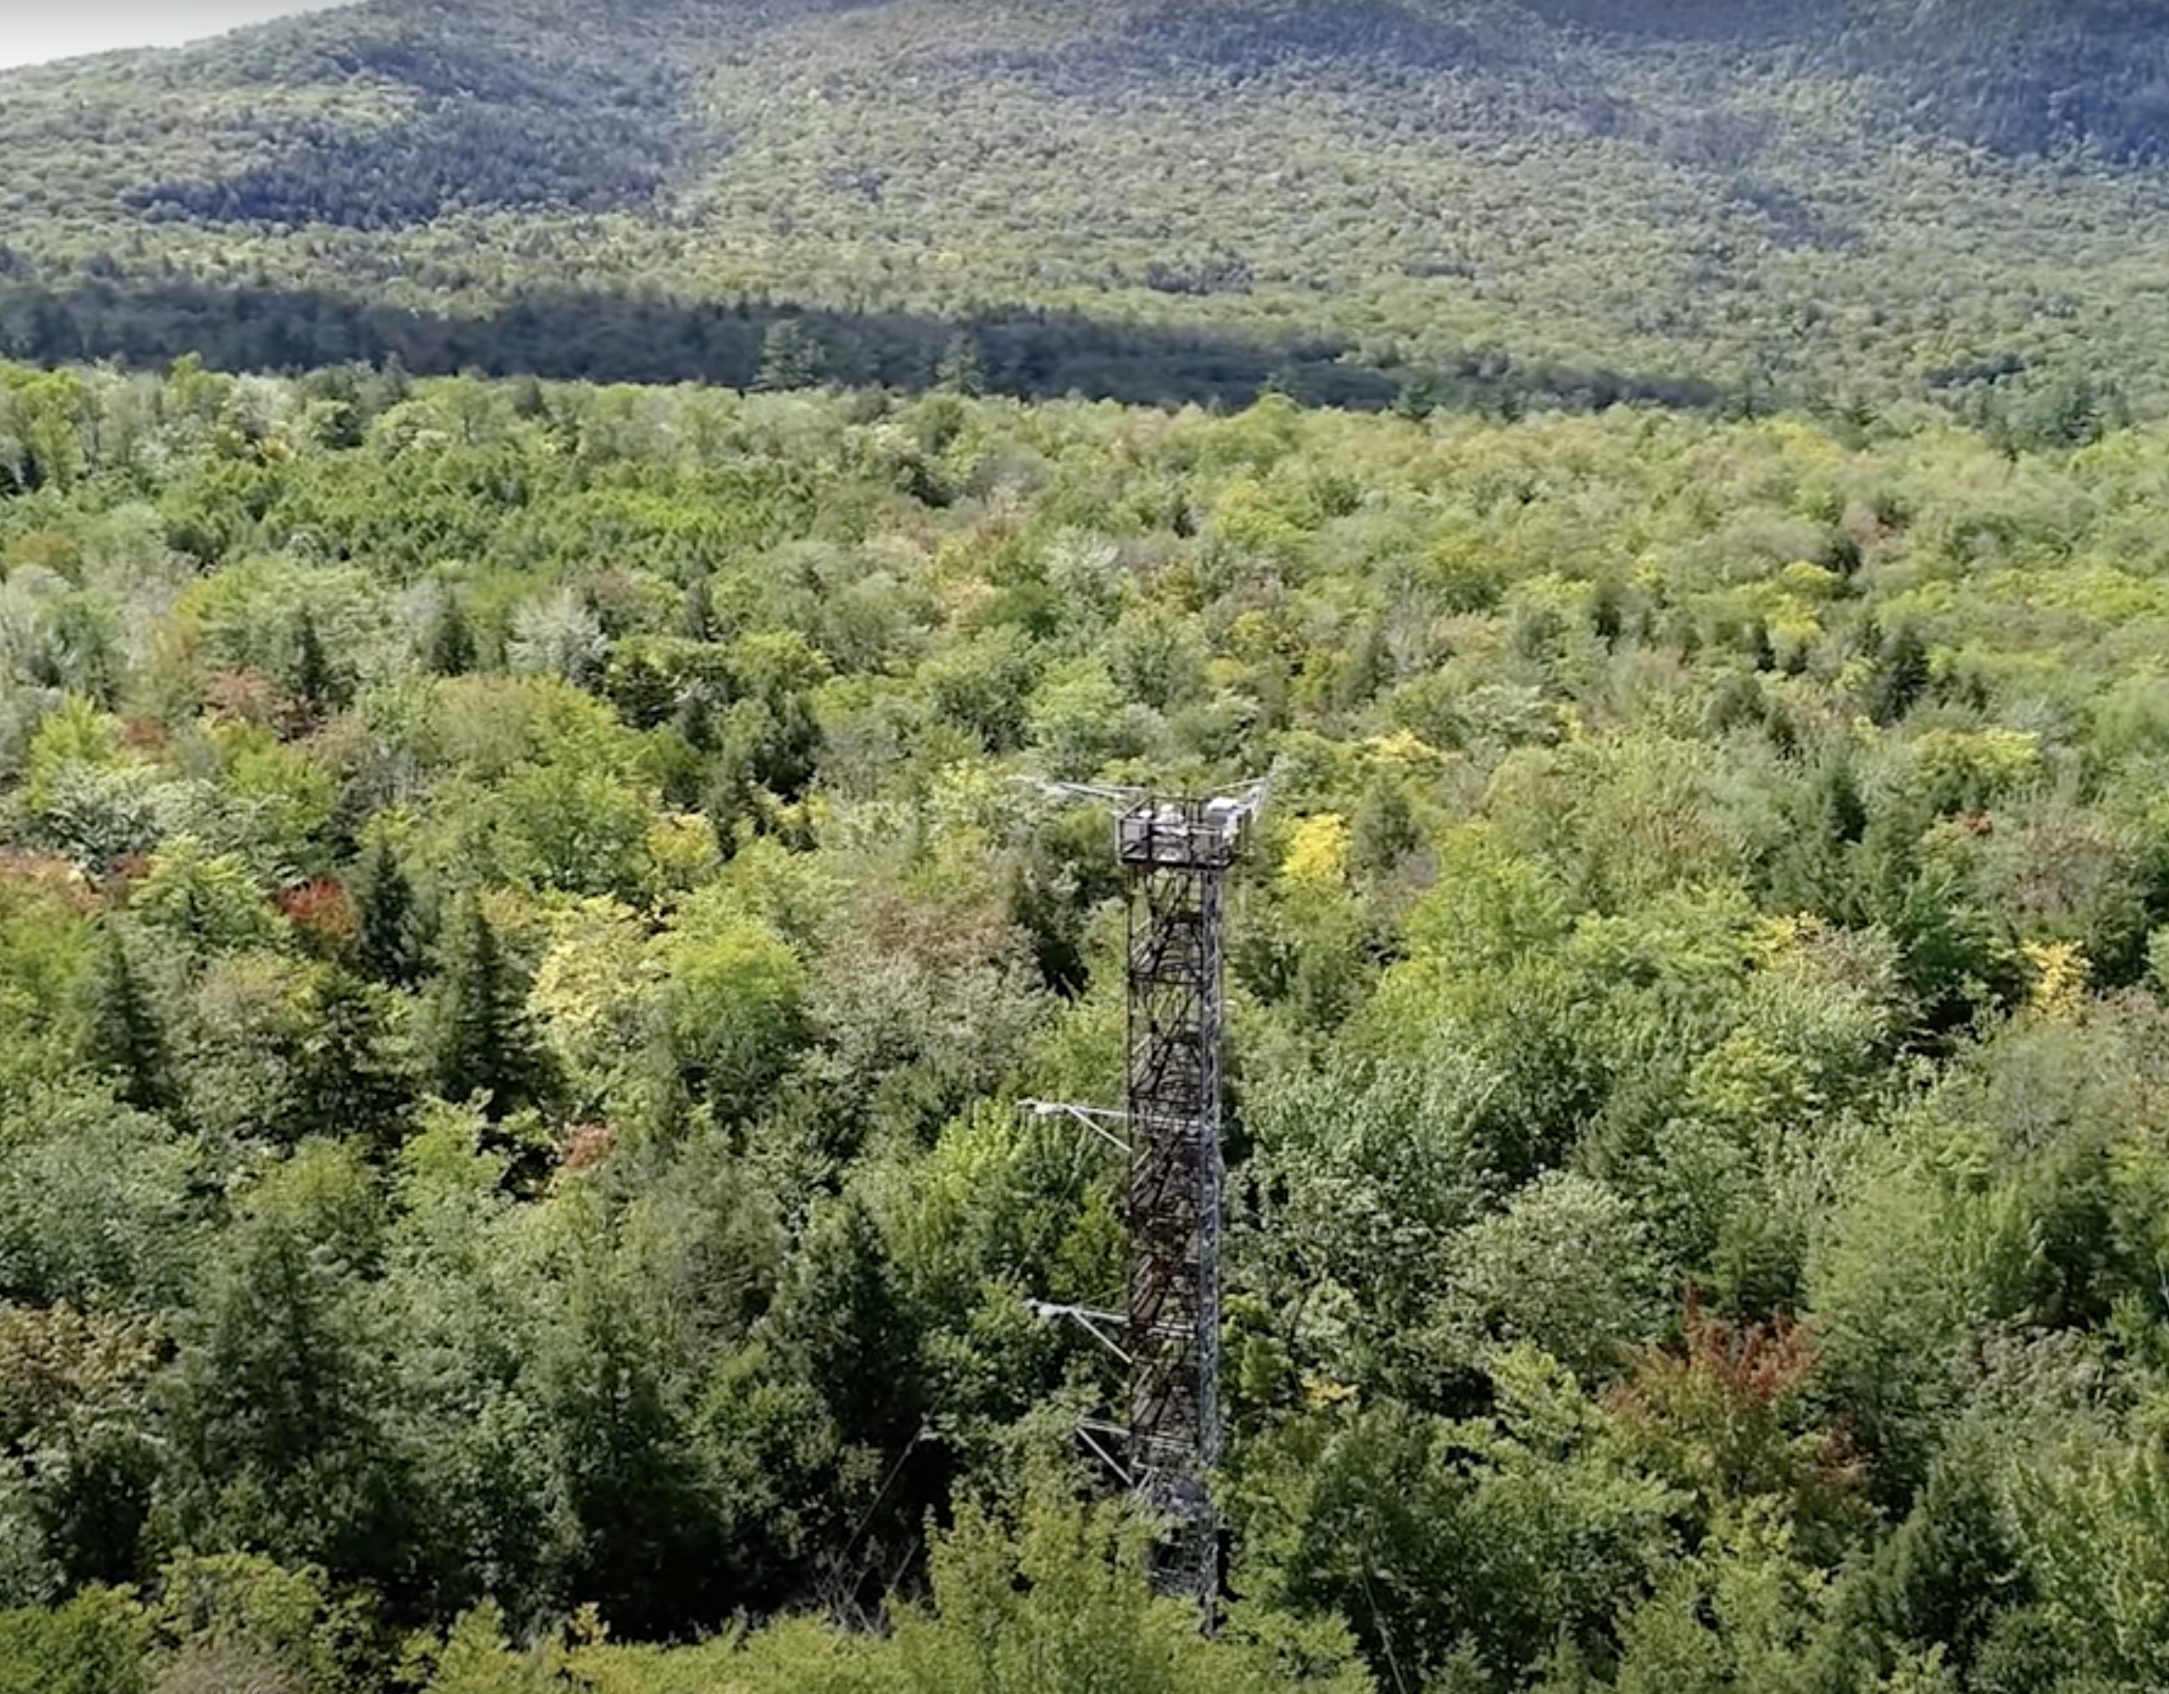
Climate implications of NEE
NEE measures the exchange of carbon dioxide, a greenhouse gas
Thus, NEE measures the degree to which an ecosystem contributes to or mitigates climate change
Because NEE is affected by temperature and moisture, changes in climate can affect NEE, creating a feedback loop between ecosystems and climate
Image credit: U.S NEON
NEE is measured by high-frequency sensors deployed on towers which extend above the canopy of an ecosystem
Notes:
Understanding the magnitude and patterns in NEE has important climate implications. NEE measures the exchange of carbon dioxide, a greenhouse gas. As a result, NEE measures the degree to which an ecosystem contributes to or mitigates climate change. Because NEE is affected by temperature and moisture, changes in climate can affect NEE, creating a feedback loop between ecosystems and climate. NEE is measured by high-frequency sensors deployed on towers which extend above the canopy of an ecosystem.

Slide 26
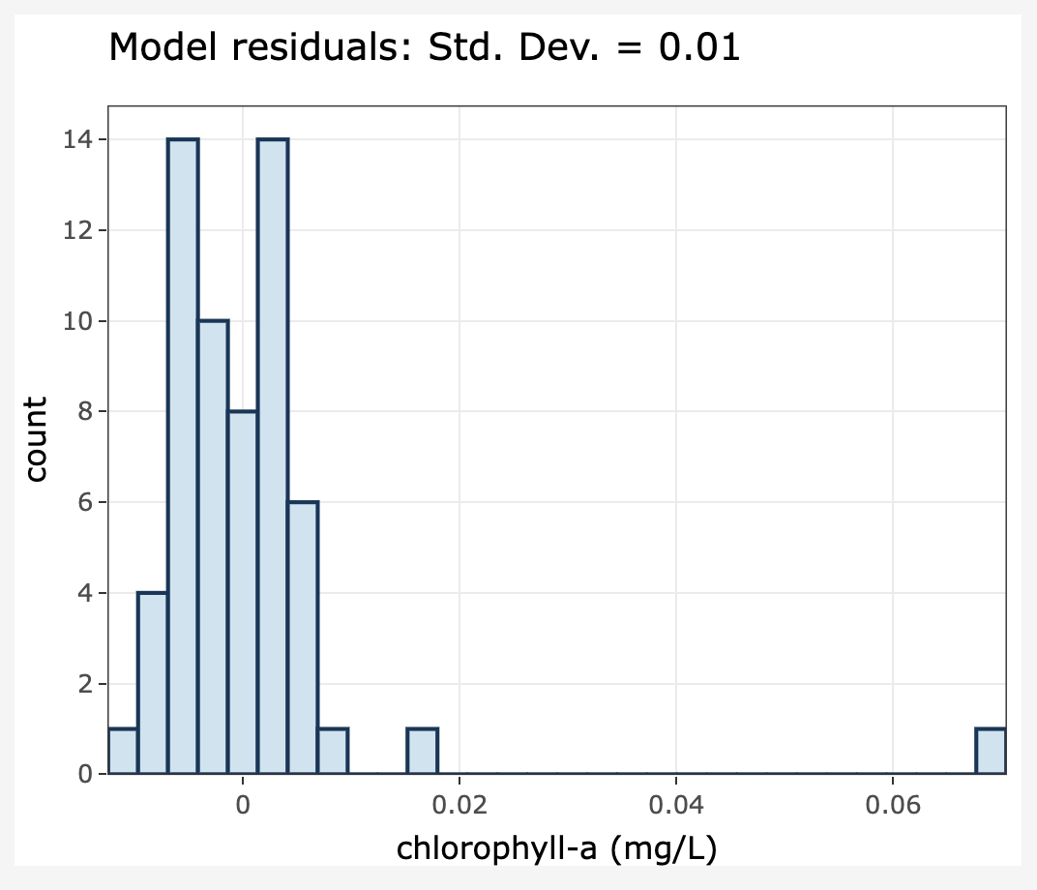
Activity A: Visualize data from a selected environmental data case study, and fit and assess a time series model
Objective 1: Select an environmental case study
Objective 2: Explore data
Objective 3: Learn about ARIMA time series model structure
Objective 4: Fit an ARIMA model to environmental case study data
Objective 5: Assess the ARIMA model fit
Notes:
I will now give a brief overview of the module activities. In Activity A, you will complete five objectives. You will select an environmental case study to work with in Objective 1 and explore the data from that case study in Objective 2. Then, you will learn more details about the structure of ARIMA models and fit an ARIMA model to your environmental case study data in Objectives 3 and 4. Finally, in Objective 5, you will assess the ARIMA model fit by generating out-of-sample predictions for data from your environmental case study.

Slide 27
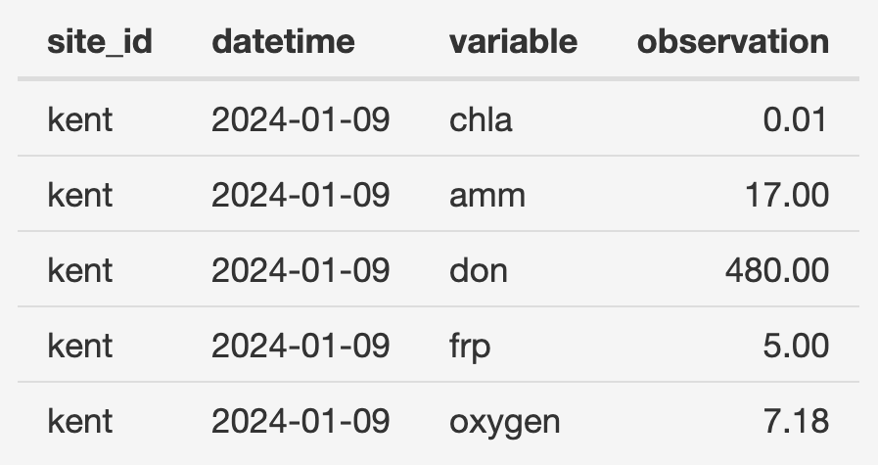
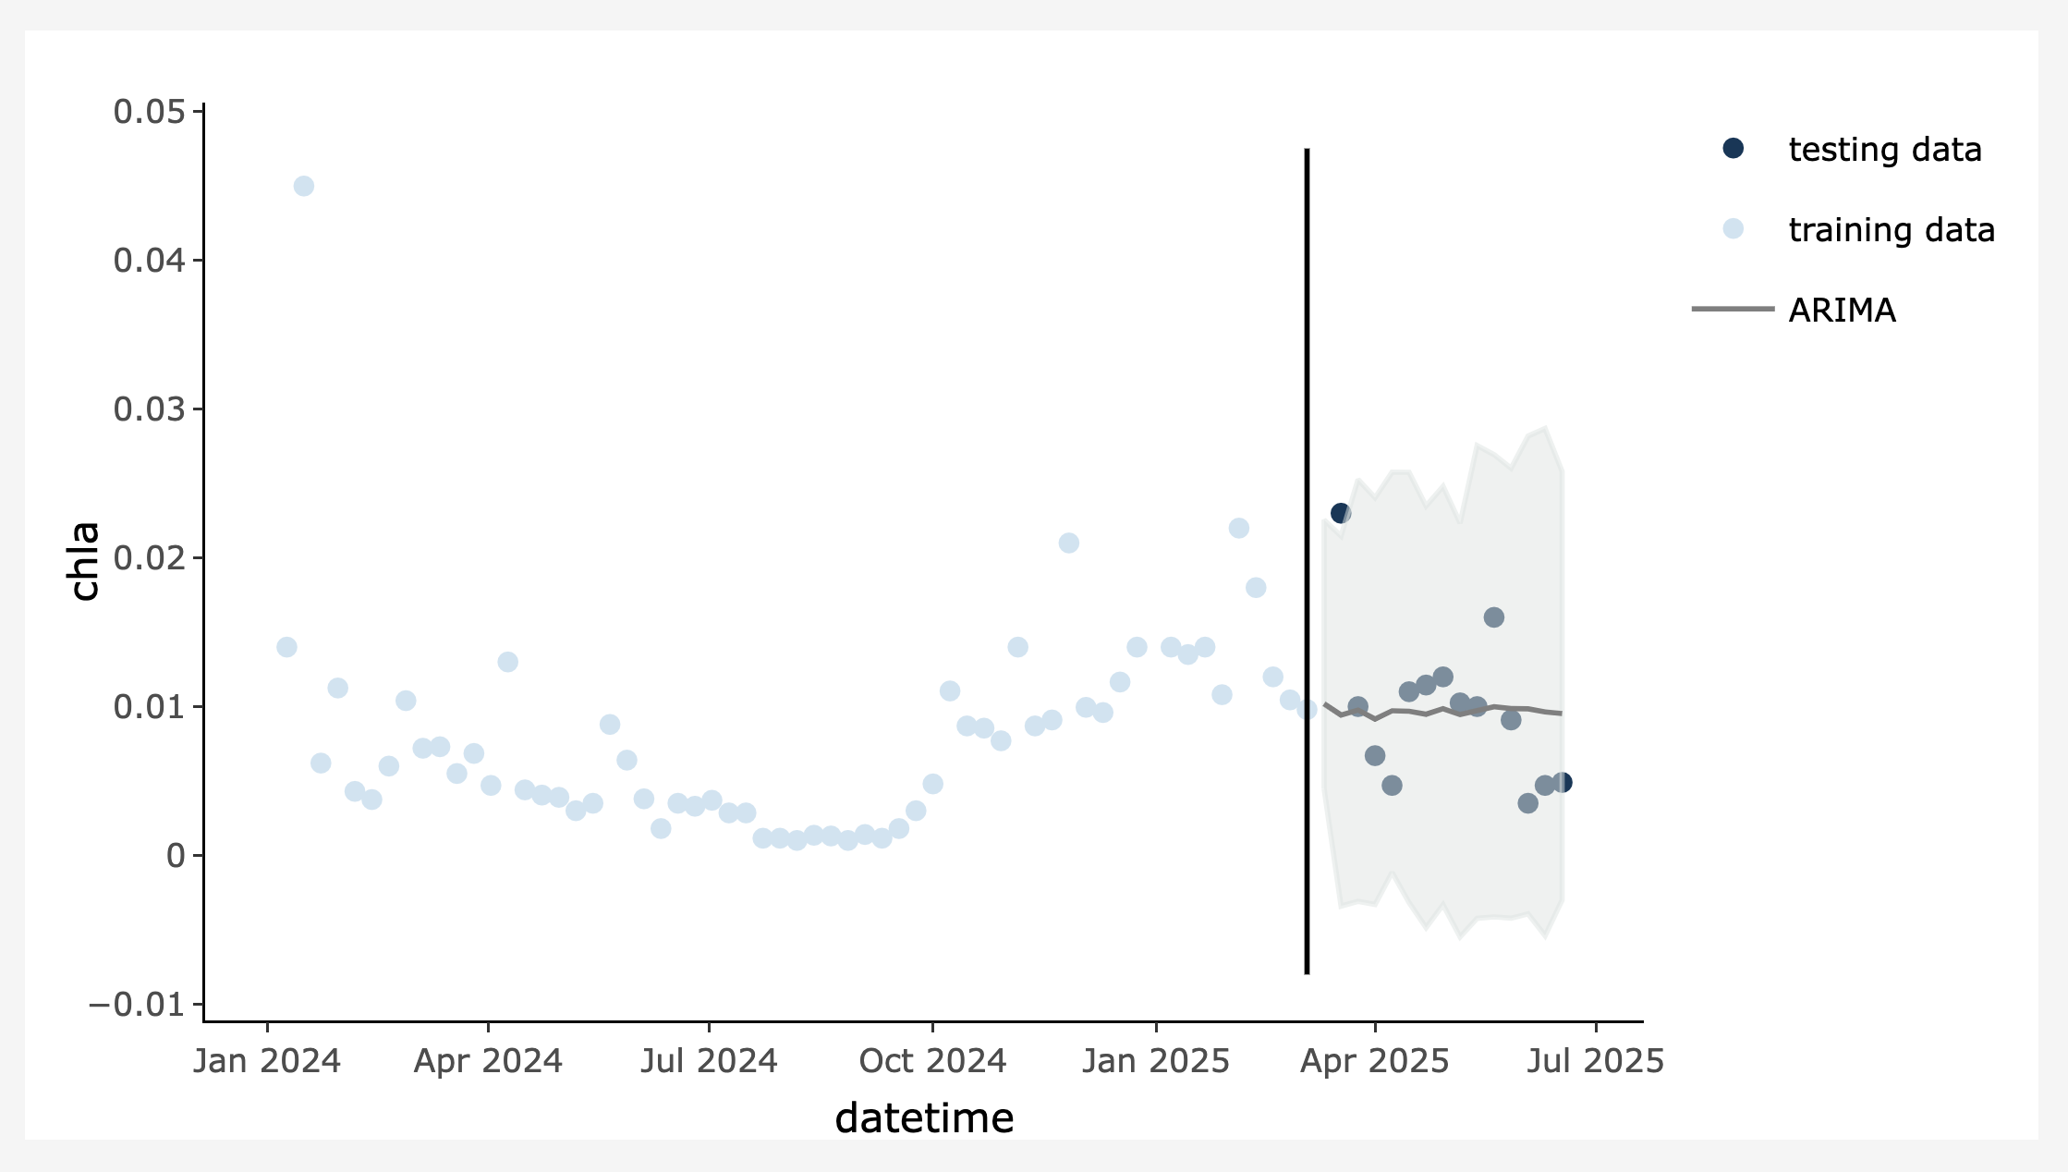
Activity B: Choose a new environmental dataset or upload your own dataset and fit and assess a time series model
Objective 6: Format and upload a new environmental data set of your choosing!
Objective 7: Fit an ARIMA model to your new environmental dataset
Objective 8: Assess the ARIMA model fit
Notes:
In Activity B, you will either choose a new environmental dataset to work with from within the module or upload a dataset of your own in a standardized format. Instructions regarding the standardized data format are provided within the module. Once the data are uploaded, you will once again fit and assess an ARIMA model using you own dataset.

Slide 28
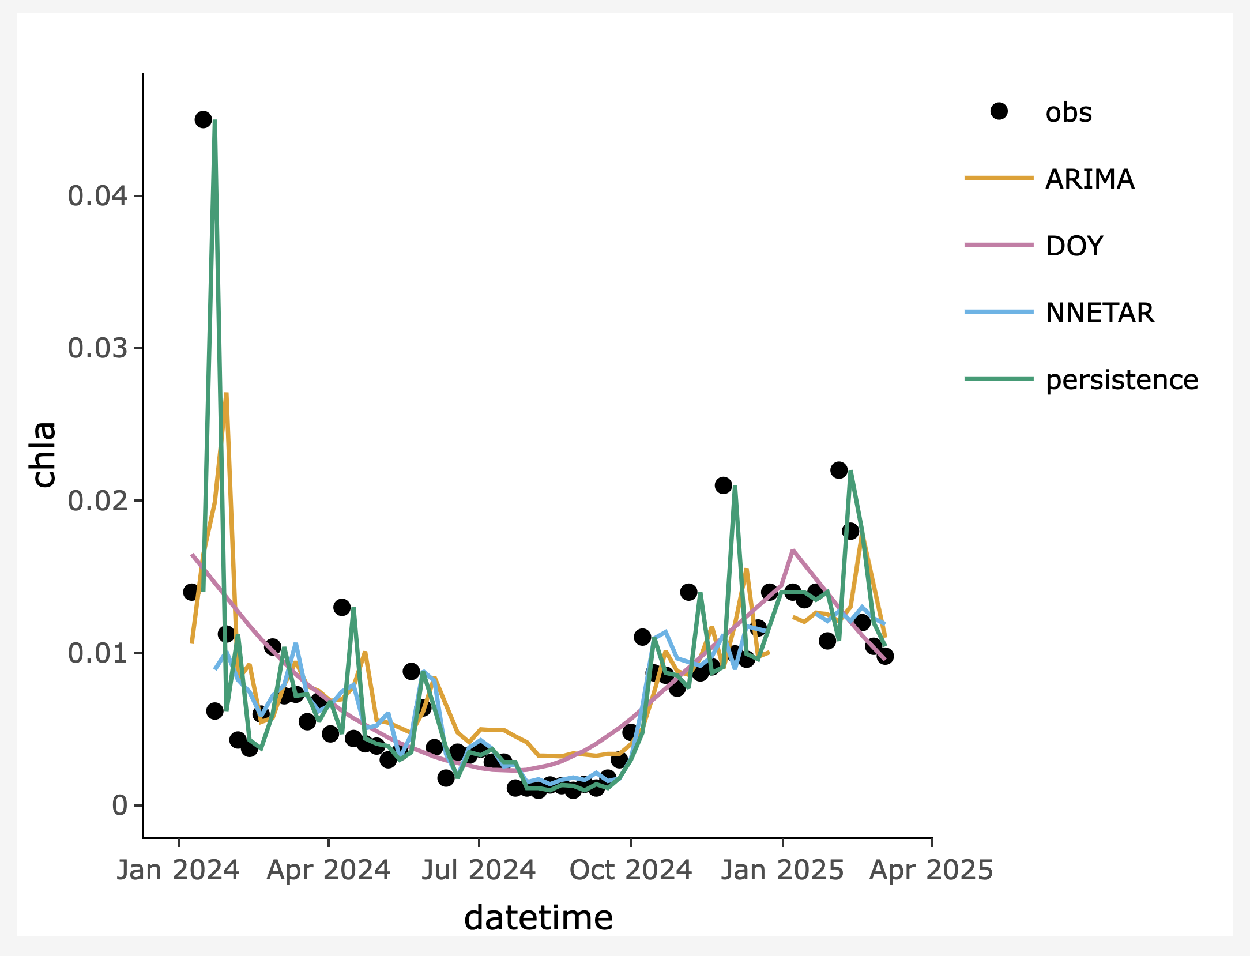
Activity C: Fit additional time series models to your environmental dataset and compare performance across models
Objective 9: Fit additional models to the data you used in Activity B
Objective 10: Compare performance across models using out-of-sample predictions
Notes:
Finally, in Activity C, you will fit three additional models to the dataset you uploaded in Activity B. This is when you will learn more about the neural network, historical mean, and day-of-year models. You will then compare performance across models using out-of-sample predictions, and use this comparison to make conclusions about which variables are important for predicting the target variable in the dataset you uploaded.

Slide 29

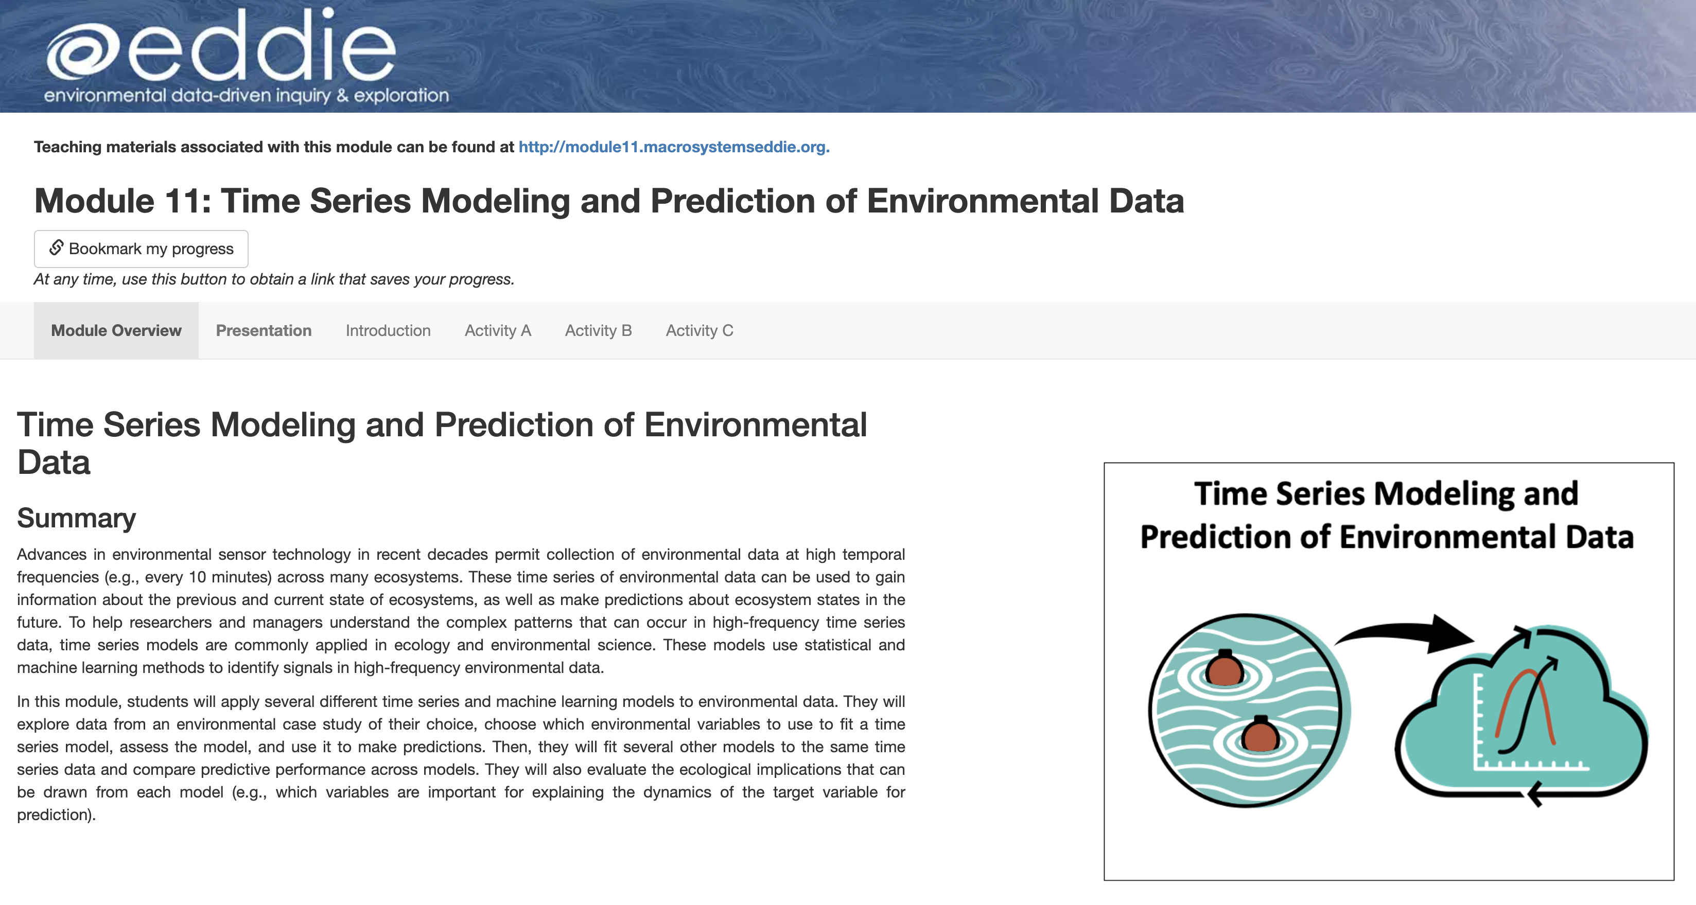
R Shiny App
You will complete module activities in an R Shiny app, which is an interactive website
Be sure to complete the “Quick-start” guide to the module and watch the video that explains the interactive module features
Questions are embedded in the app and you will answer these in a Word document that you download from the app
http://macrosystemseddie.shinyapps.io/module11/
Notes:
The module can be accessed at the link on this slide. You will complete module activities in an R Shiny app, which is an interactive website. Be sure to complete the ”Quick-start” guide to the module and watch the video that explains the interactive module features. Questions are embedded in the app and you will answer these in a Word document that you download from the app

Slide 30
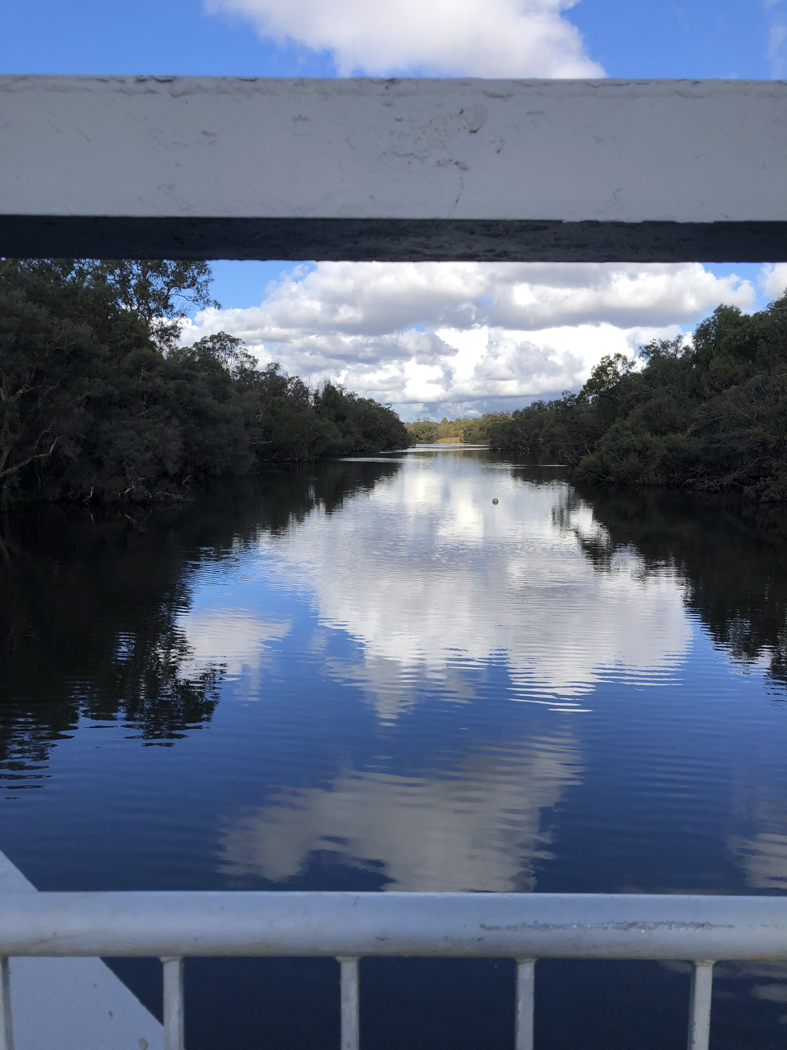
Thank you for participating!
Check out our other modules!
Find out more at: MacrosystemsEDDIE.org
Canning River, WA
Photo credit: Mary Lofton
Note: All photos, graphs, and diagrams without credits were taken or developed by the module author team.
Notes:
Thank you for participating!

