Slide 1
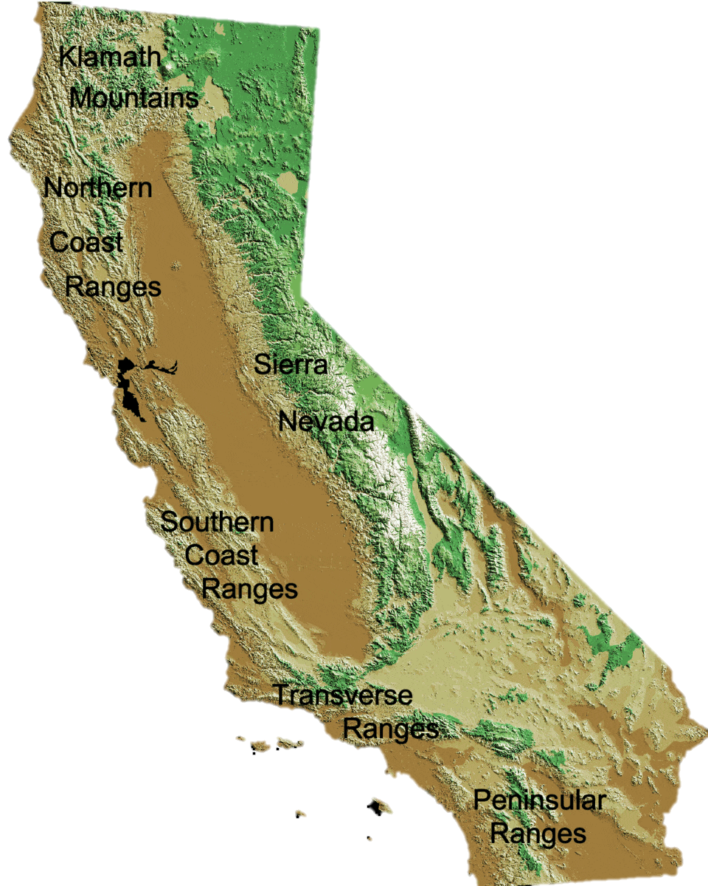
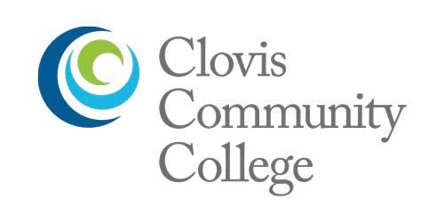
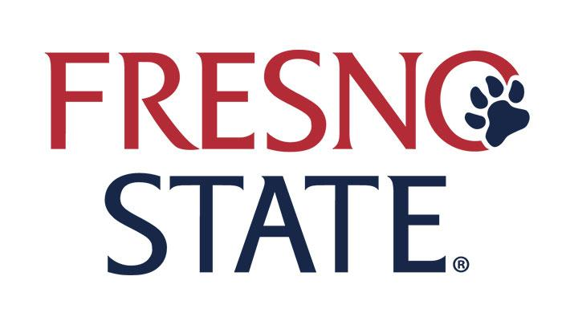

Successful discipline-based cultural change within geoscience and interdisciplinary programs
to support altruistically motivated 2YC and 4YC students
Michelle Selvans, California State Polytechnic University-Humboldt (Arcata, CA); formerly tenured at Clovis Community College (Fresno, CA)
Co-authors:
Mara Brady, Mathieu Richaud, Aric Mine – California State University-Fresno
David Tinker – Clovis Community College (Fresno)
Joshua Smith, Jacky Baughman, Monty Mola – Cal Poly Humboldt

Slide 2
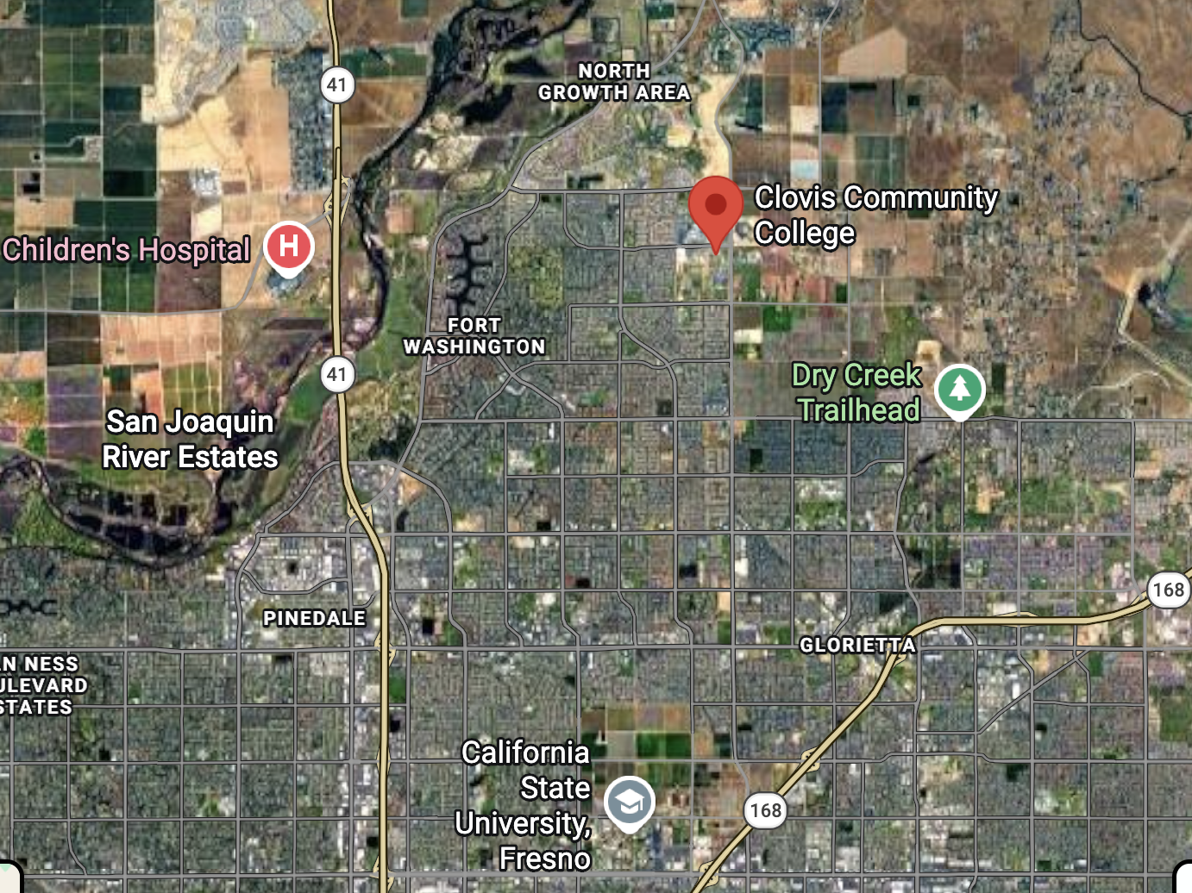
While I share our experiences… questions (for you)
How are your institution(s), learning ecosystem, or program goals similar to (or different from) ours?
What barriers do you face when making changes to better serve your students?
Notes:
The GEOBOND (Building Opportunities through Networks of Discovery in the Geosciences) project was a collaborative effort centered at Fresno State and SCCCD, focusing on developing new pathways for students to enter and succeed in Geology and Environmental Science careers. Located in California's agriculturally-rich San Joaquin Valley (SJV), the project was specifically designed to support students who represent the region’s diverse population - many of whom are first-generation and Pell-eligible (Table 1).
These students often carry a strong personal commitment to giving back to their community (e.g., (Carter et al., 2021; Public Policy Institute of California, 2025), which the project aimed to connect directly to solving the region’s critical environmental challenges, such as severe air pollution, drought, water contamination, and climate change impacts (Burow et al., 2013; Ingram & Malmud Roam, 2015; Ganesh & Smith, 2018; Zhu et al., 2019).
Culturally-sustaining pedagogy emphasizes connections to students’ everyday lives while also acknowledging the value of gaining new knowledge and access through education (Gutierrez, 2008).

Slide 3
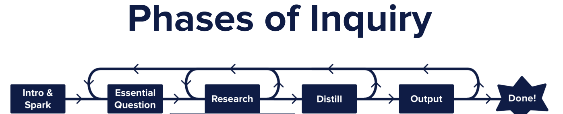
Practitioners’ perspective: Cultural change in access-oriented institutions, through 2YC+4YC collaboration
Project goals for CCC and Fresno State (and broader Geoscience Learning Ecosystem)
  Broadening participation, increasing enrollment, environmental justice frame for projects
  Increase sense of belonging for 2YC+4YC students (and ourselves!)
GEOBOND (Building Opportunities through Networks of Discovery in the Geosciences); NSF (GeoPaths) funded 2021-2025 – and Professional Learning Community (PLC) work is ongoing
  PLC Summer Institute (curriculum design focus) + Cohorts + Community partners
  Pedagogy: project-based, place-based, culturally sustaining
“Four frames model” analysis (Reinholz et al., 2019: Structures; symbols; people; power)
Epilogue: 4YC 1st year courses, multi-disciplinary approach: Cal Poly Humboldt’s Stars to Rocks, for incoming bio/chemistry, geology, physics students; etc.

Slide 4
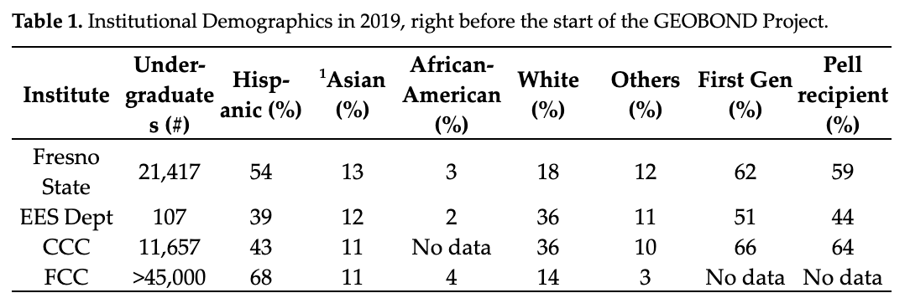
Demographics of State Center CC District (CCC, FCC…) and Fresno State/EES Dept. (access-oriented HSIs)
CCC = Clovis Community College
FCC = Fresno City College
EES = Earth and Environmental Sciences
¹Includes Asian and Hmong

Slide 5
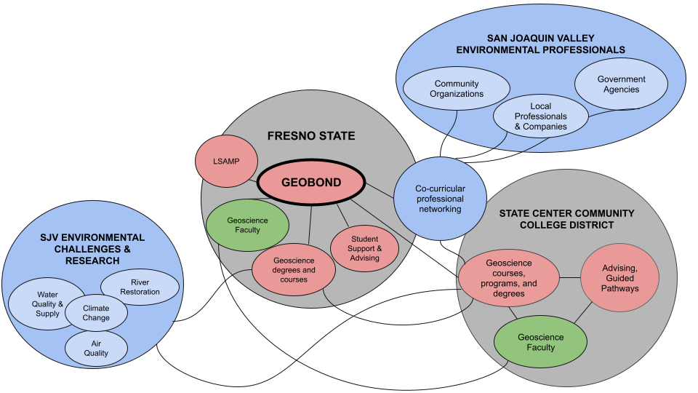
GEOBOND regional geoscience learning ecosystem
Partnership emerged from shared professional development and networking opportunities: NAGT Traveling Workshop, URGE
Cross-institution formal partnership aligned with NSF and internal funding opportunities
Reflection on our own PLC experience helped us understand how cultural change occurred
Notes:
Figure 1. This figure shows a conceptual framework of the San Joaquin Valley Geoscience Learning Ecosystem (SJV GLE). Institutional components of the system are grey with student cohort components colored red, professional learning community components colored green, and community-based research components colored blue.

Slide 6
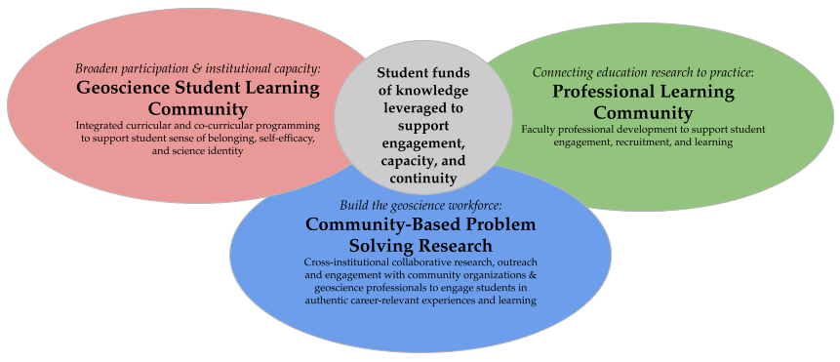
Student funds of knowledge basis for GEOBOND, and support for altruistic career interests
A key goal of curriculum redesign (assessed with pre/post surveys): create opportunities for students to leverage their lived experiences, and make connections between their career aspirations and social values
Funds of knowledge (our working definition):
“skills, experiences, and information cultivated within students' households and regional communities”

Slide 7
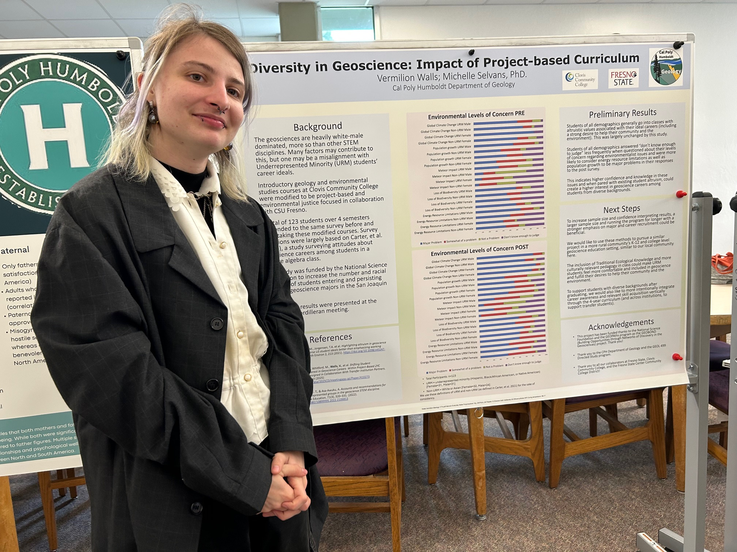
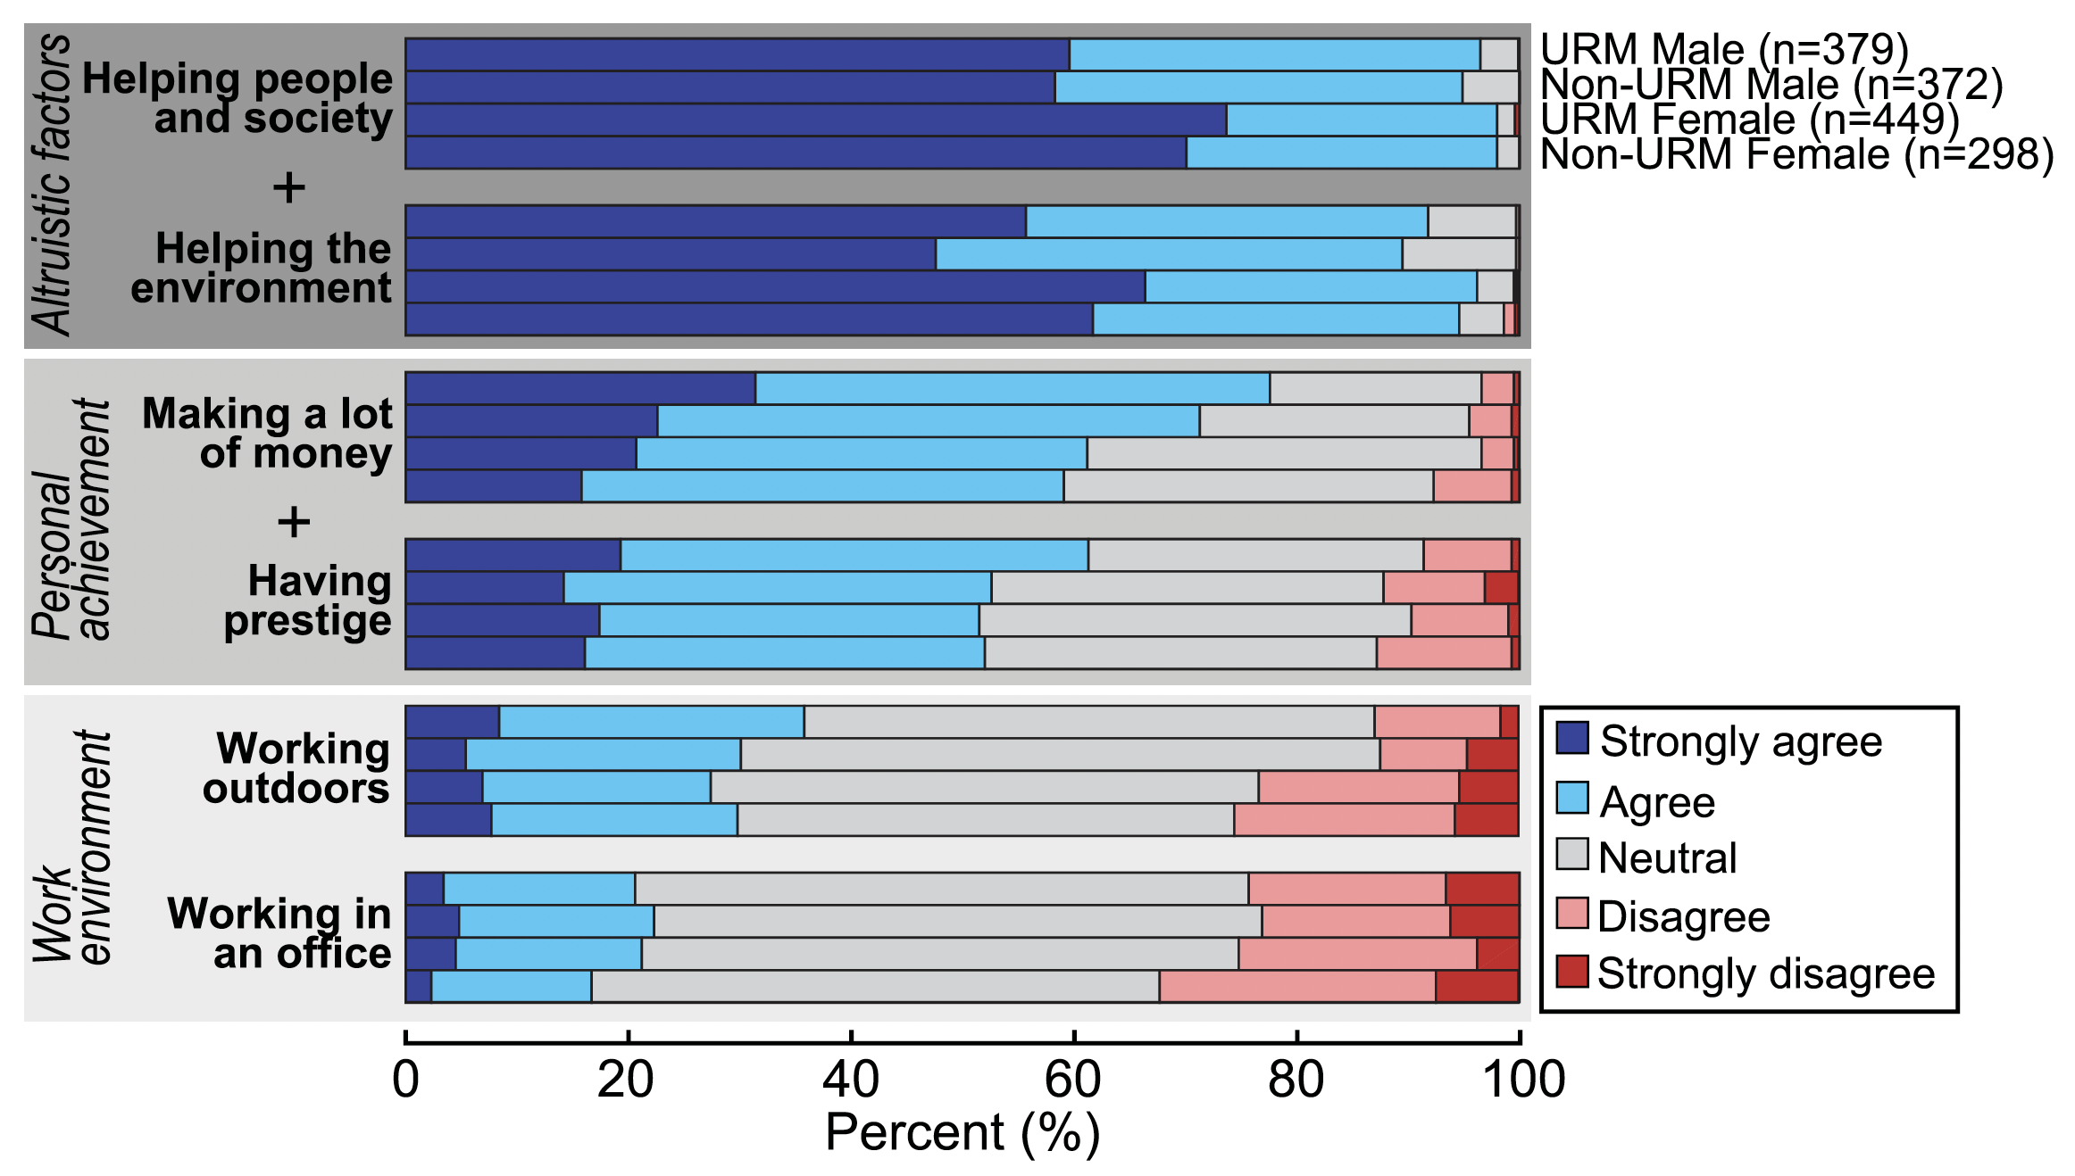
PLC Summer Institutes, and pre- and post- attitude survey as a useful assessment tactic
Used survey questions from Carter et al. (2021) – see their results below (n = 1550) – and InTeGrate survey
After Summer Institutes, we each implemented projects in our courses, with shared goals but full design autonomy
Cal Poly Humboldt Geology student Vermilion Walls, ideaFest (on campus symposium), Spring 2025
Summer Institutes (2022, 2023)
1 week, hosted at Fresno State
Learn from experts/each other
Work time for course redesign
Accountability/deadlines
Analysis/feedback in year 2

Slide 8
Preliminary CCC Levels of Concern data [n = 123; FA22 – SP24]
Your level of concern for this topic? | Group: URM/Non-URM & Male/Female | Major problem PRE (%) | Major problem POST (%) | Somewhat of a problem PRE (%) | Somewhat of a problem POST (%) | Not a problem PRE (%) | Not a problem POST (%) | Don’t know enough PRE (%) | Don’t know enough POST (%)
Population Growth | URM/M | 56 | 40 | 31 | 34 | 6 | 23 | 7 | 3
 | Non-URM/M | 38 | 54 | 29 | 21 | 8 | 4 | 25 | 21
 | URM/F | 47 | 55 | 24 | 29 | 0 | 3 | 29 | 13
 | Non-URM/F | 32 | 45 | 43 | 39 | 9 | 6 | 16 | 10
Loss of Biodiversity | URM/M | 59 | 60 | 9 | 20 | 12 | 10 | 20 | 10
 | Non-URM/M | 46 | 54 | 21 | 29 | 0 | 0 | 33 | 17
 | URM/F | 50 | 68 | 17 | 10 | 0 | 7 | 33 | 15
 | Non-URM/F | 59 | 61 | 12 | 13 | 9 | 7 | 20 | 19

Slide 9
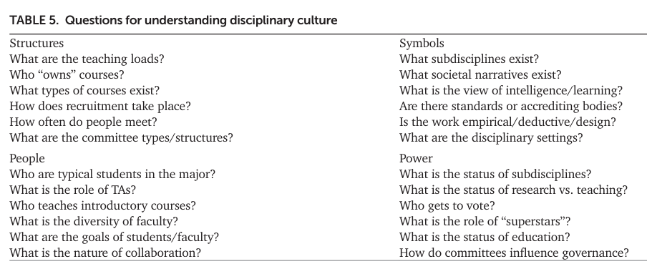
Reflective analysis: How did cultural change happen?
(from Reinholz et al. (2019): 2017 DBER workshop survey data analysis)
Structures (example): questions in boxes have different answers, per institution/dept./program

Slide 10
Reflective analysis: How did cultural change happen?
(jumping off from Reinholz et al. (2019), DBER paper from workshop data analysis)
Recommendations for fellow practitioners:
2YC+4YC (mutualism): creating cross-institutional partnerships between four-year regional comprehensive universities and local community colleges results in mutual benefits to a learning ecosystem
Step back: creating space for multiple people to share expertise from their role can disrupt academic hierarchies that may inhibit change
Be opportunistic*: Aligning change efforts with institutional values and priorities leverages resources and professional development opportunities easily available to faculty [*in the ecological sense, of thriving on what is available]
Be yourself/your discipline: Designing learning around authentic practices and community partners’ needs increases students’ commitment to project/assignment completion
Selvans et al. (in review), Education Sciences; Special Issue: Creating Cultures and Structures of Opportunity in STEMM Ecosystems
Notes:
from analysis of our barriers, changes, and relationships [access-oriented HSIs, in Central Valley/very obvious env. Problems/funds of knowledge, with large population from area (80%) and big commitment to staying local (80%)
EXAMPLES per ”four frames”
STRUCTURES: Another barrier to structural change encountered by CCC faculty (unlike four-year institution counterparts) was being unable to access information about who had declared a major in Geology or Environmental Science; CCC faculty instead worked regularly and directly with the lead STEM Counselor, who was able to directly contact Geoscience majors with information about discipline-related campus and community activities, club events, and career opportunities. For example, the CCC STEM Counselor could email out invitations to geoscience-related events on campus and at Fresno State, and could directly encourage students to meet with faculty for discipline-specific mentoring. One effort made to combat this barrier was to offer a Saturday field trip each semester to nearby national parks, led by CCC geoscience faculty, with funding from a separate college-wide STEM initiative. Invitations to participate were sent out via email by the STEM Counselor to majors first, before inviting the entire student body
SYMBOLS
PEOPLE
POWER

Slide 11
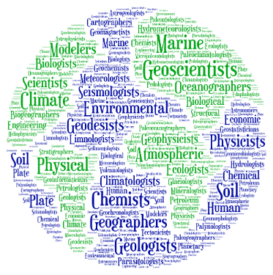
Epilogue: Stars to Rocks, Cal Poly Humboldt
Fall term, place-based learning community (PBLC); multi-disciplinary
(e.g., Johnson et al., 2020: Effect of a Place-Based Learning Community on Belonging, Persistence, and Equity Gaps for First-Year STEM Students)
Stars to Rocks (bio/chem, geol, phys)
  2 several-week-long projects, team-based work with scaffolding and sense-making for how & why to work in teams (check-ins, peer review, feedback)
  Skills goals: presenting, collecting and analyzing data, teamwork, college/STEM success strategies
PBLC context & Spring term course redesign
  PBLC = current events & environmental problems, Transition Curriculum included; started 2015
  Co-instructor 2025-2026: focus on local geoscience problems (to be interdisciplinary) and on-campus stream health data collection
  Individual curriculum redesign for Spring term (with co-authors’ review): includes new community partners/opportunities, new/local environmental issues, reading Robin Kimmerer’s The Serviceberry
Notes:
students new to college (many 1st gen), also HIS
PLBC is project-based, place-based, culturally sustaining, fostering belonging and skills for navigating college successfully
Community partners: Env Studies, farm, dunes restoration/NP, new ag MS, offshore wind energy Tribal representative
Key resource: use research vessel…

Slide 12
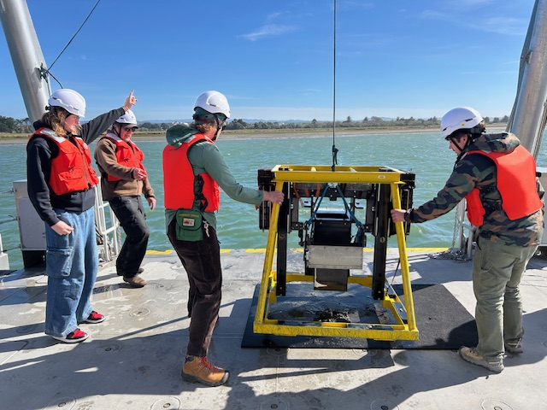
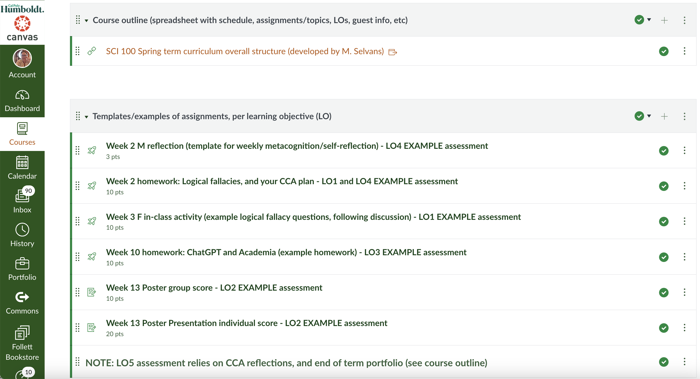
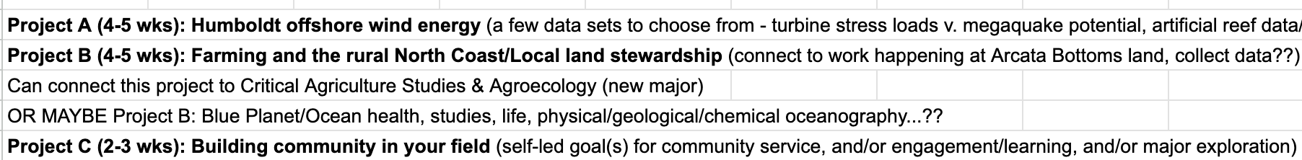
Epilogue: Spring term PBLC course redesign
Geology students, R/V North Wind
Notes:
students new to college (many 1st gen), also HIS
PLBC is project-based, place-based, culturally sustaining, fostering belonging and skills for navigating college successfully
Community partners: Env Studies, farm, dunes restoration/NP, new ag MS, offshore wind energy Tribal representative
Key resource: use research vessel…

Slide 13
To create cultural change:
Questions:
How are your institution(s), learning ecosystem, or program goals similar or different to ours?
What barriers do you face when making changes to better serve your students?
Please connect to talk more! michelle.selvans@humboldt.edu
2YC+4YC (mutualism)
Step back/make space
Be opportunistic (in a good way!)
Be yourself/discipline
Notes:
Caveats: we expect these takeaways to be most relevant for fellow practitioners (instructors, program coordinators/department chairs, administration) at similar institutions: access-oriented, public, PUI, HSI, and particularly in 2YC+4YC partnerships

Slide 14
Extra slides

Slide 15
Preliminary CCC Levels of Concern data [n = 123; FA22 – SP24]
Your level of concern for this topic? | Group: URM/Non-URM & Male/Female | Major problem PRE (%) | Major problem POST (%) | Somewhat of a problem PRE (%) | Somewhat of a problem POST (%) | Not a problem PRE (%) | Not a problem POST (%) | Don’t know enough PRE (%) | Don’t know enough POST (%)
Population Growth | URM/M | 56 | 40 | 31 | 34 | 6 | 23 | 7 | 3
 | Non-URM/M | 38 | 54 | 29 | 21 | 8 | 4 | 25 | 21
 | URM/F | 47 | 55 | 24 | 29 | 0 | 3 | 29 | 13
 | Non-URM/F | 32 | 45 | 43 | 39 | 9 | 6 | 16 | 10
Loss of Biodiversity | URM/M | 59 | 60 | 9 | 20 | 12 | 10 | 20 | 10
 | Non-URM/M | 46 | 54 | 21 | 29 | 0 | 0 | 33 | 17
 | URM/F | 50 | 68 | 17 | 10 | 0 | 7 | 33 | 15
 | Non-URM/F | 59 | 61 | 12 | 13 | 9 | 7 | 20 | 19

Slide 16
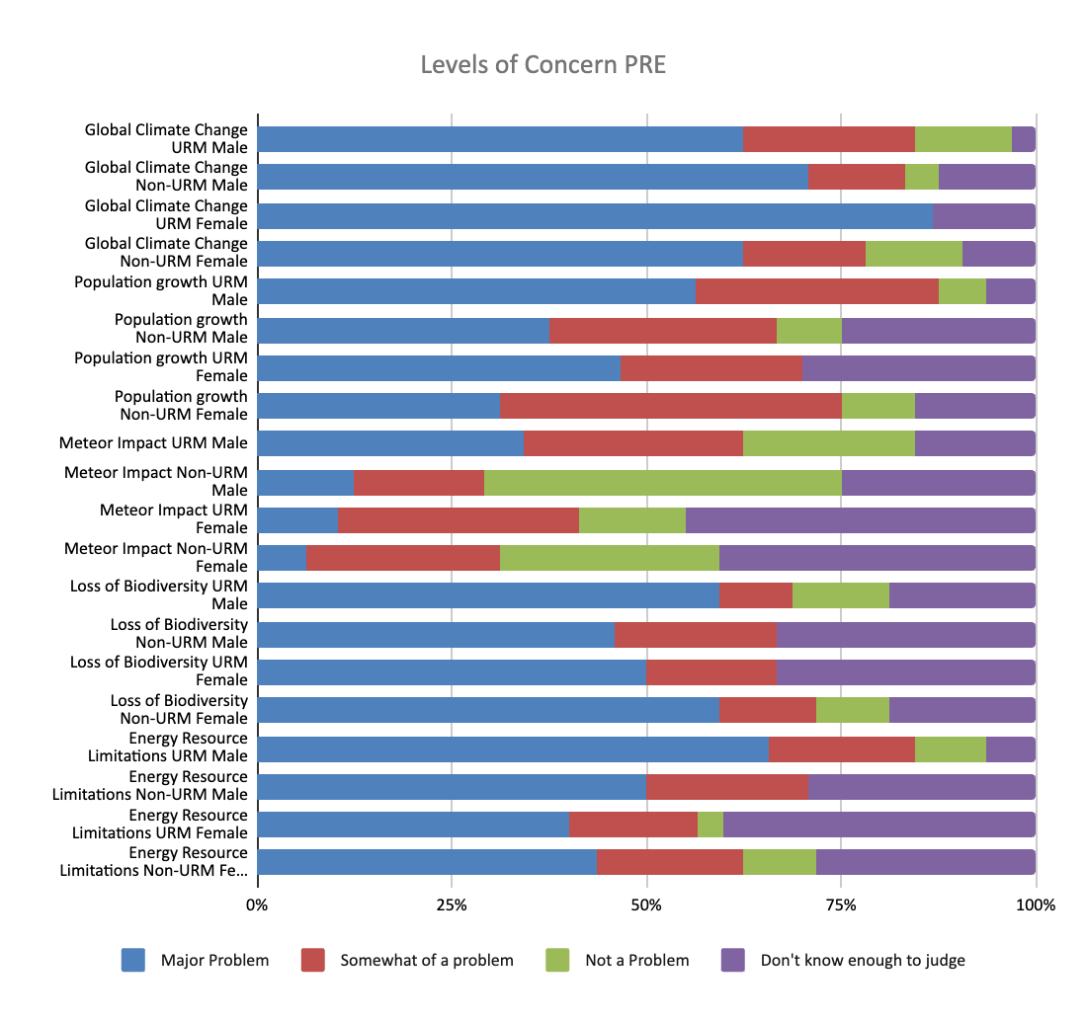
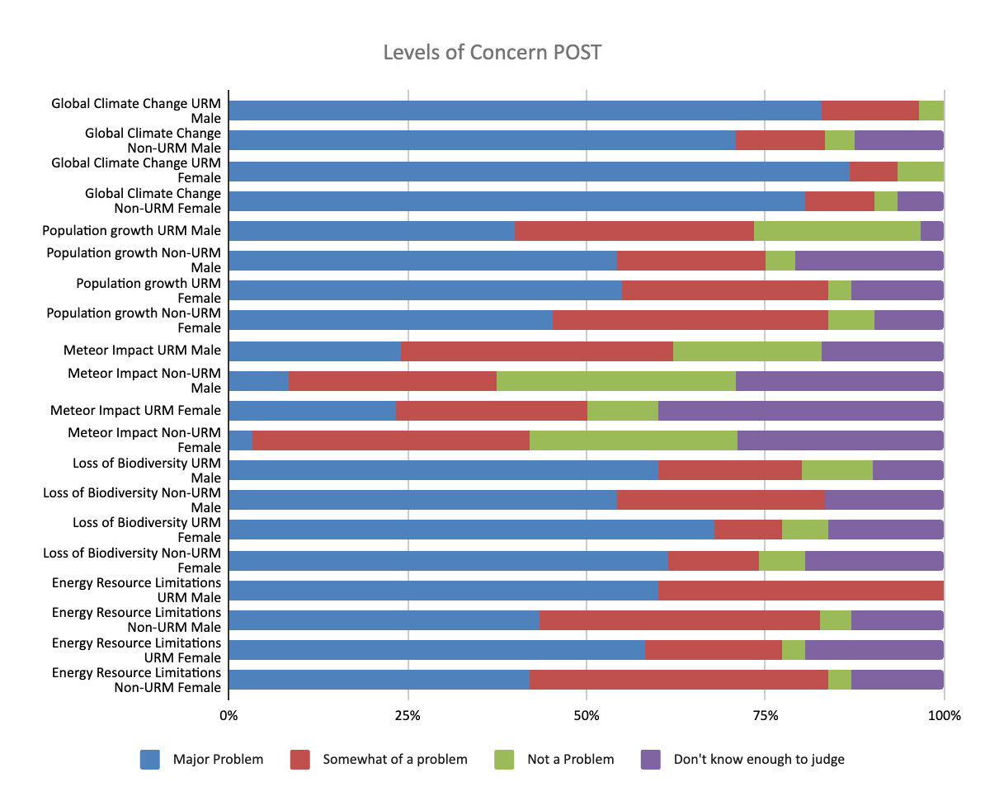
Preliminary pre/post survey results of student attitudes at CCC (2YC courses); n=123; FA22-SP24

Slide 17
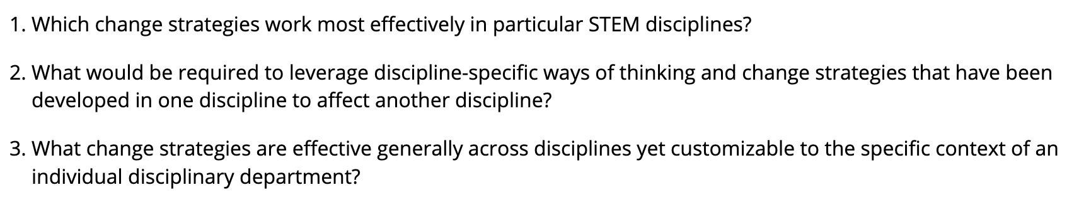
Possible implications for GER, and DBER across STEM
GER = Geoscience Education Research
DBER = Discipline-based Education Research
From Reinholz et al. (2019), study of DBER survey data from participants of the 2017 Transforming Research in Undergraduate STEM Education workshop data analysis:

Slide 18
Recommendations for change-making practitioners, focused on empowering 2YC colleagues in your geoscience learning/teaching ecosystem
Partner across institutions – leverage 2YC strengths
Invite/empower 2YC faculty in your own Geoscience Learning Ecosystem to be co-practitioners
  Who is in your regional GLE?
  How are they situated in their institutions?
  What are your/their barriers to supporting students?
  Which students do you want to be more mindful of including in your program(s)?
See Selvans et al., 2025 (GSA Cordilleran abstract); Brady et al., 2025 (GSA Cordilleran abstract)

