Slide 1

Open Educational Resources
Erin Smoak, Aaron Price, Beth Mills
AMS Education Department

Slide 2

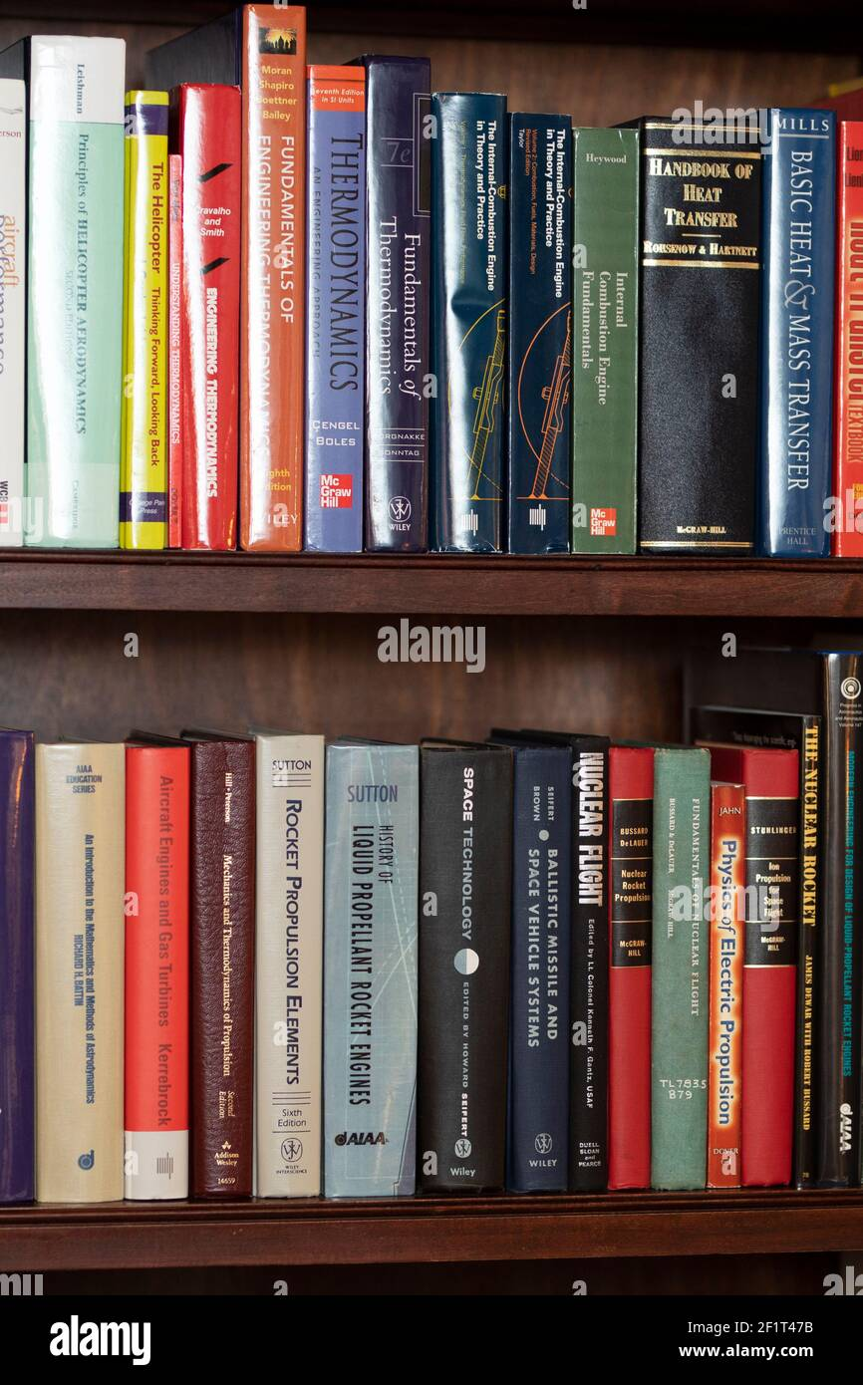
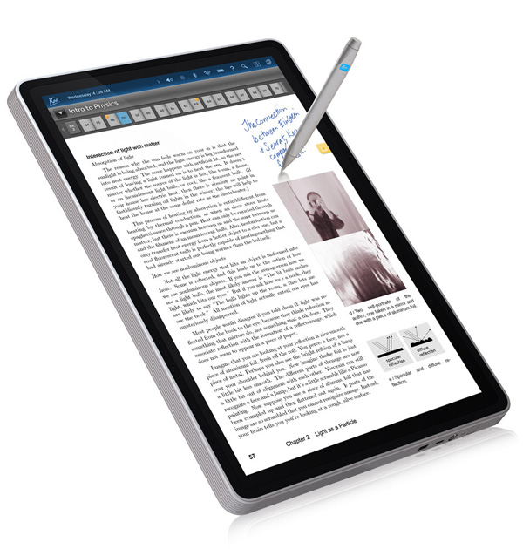
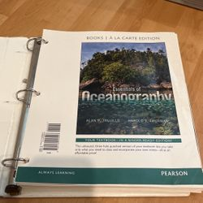
What is a textbook?

Slide 3
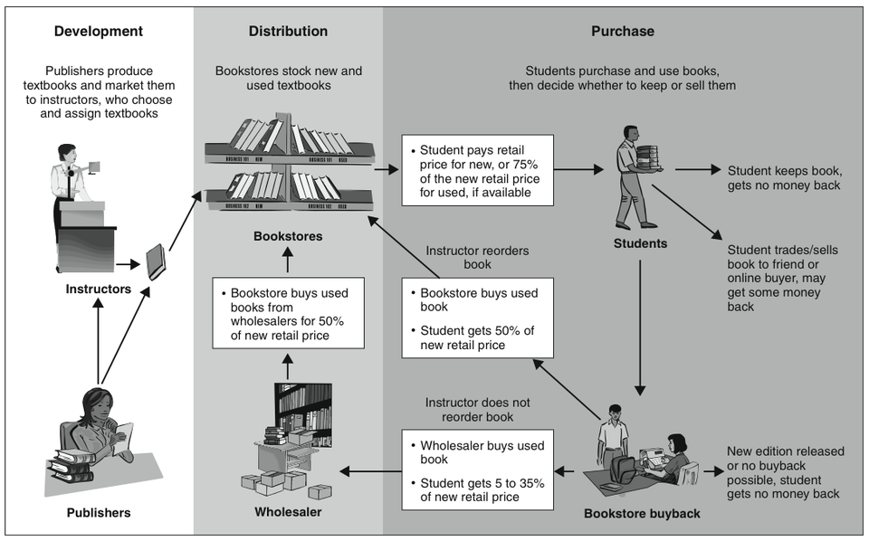
Where do students get textbooks?
Government Accountability Office, 2005

Slide 4

How many of you...
Are not satisfied with your textbook?
Don’t even use a textbook anymore?
Aren’t satisfied with the content because it is inaccurate or out of date?
Have felt like you are recreating the wheel?
Feel like your students are not using the textbook?

Slide 5
UNESCO defines Open Educational Resources (OER) as
learning, teaching and research materials
in any format and medium that
reside in the public domain or are under copyright that have been released under an open license,
that permit no-cost access, re-use, re-purpose, adaptation and redistribution by others.

Slide 6
OER Commons defines OER as
teaching and learning materials
that you may freely use and reuse at no cost, and without needing to ask permission
licensed by their authors to permit no-cost access, reuse, adaptation, and redistribution

Slide 7
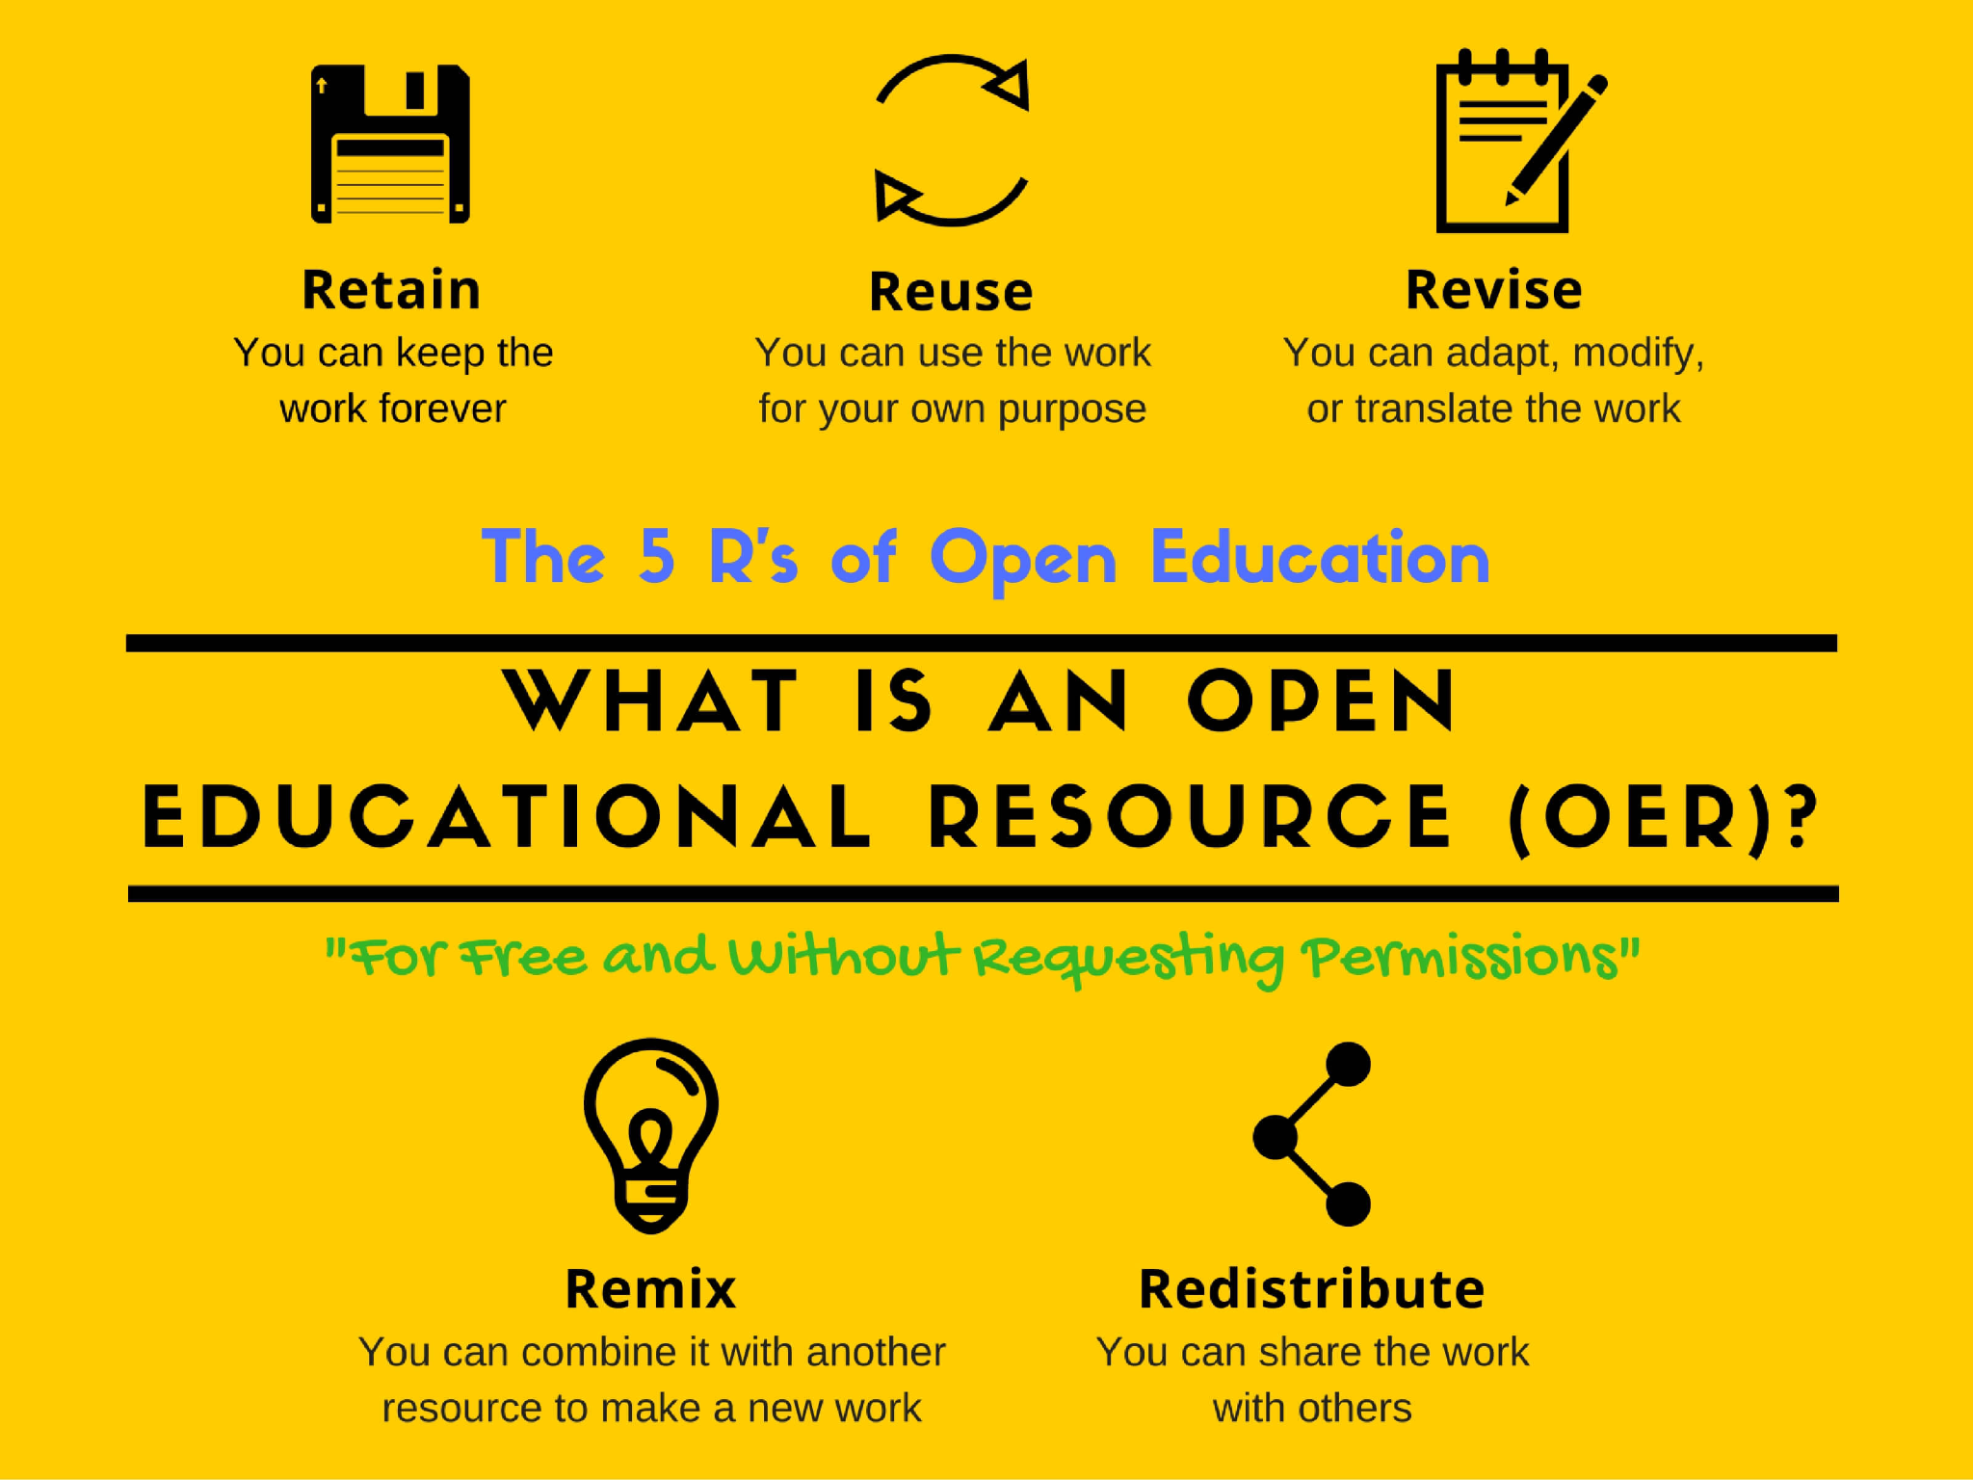
Aquinas College

Slide 8
How many of you have...
Retained material from previous years/classes?
Reused a text, questions, or discussions that were not originally intended for that use?
Revised something you bought to make it work for your students?
Remixed materials, pulling some questions from one source and some from another?
Given a copy of something to another colleague?
Under copyright law, you can’t do that. (well mostly)

Slide 9
Cost/Benefit
Vary in quality
Less or no additional resources
Inconsistently updated
Cheaper
Adaptable
Shareable
Updated regularly without a whole new edition
Often only online

Slide 10
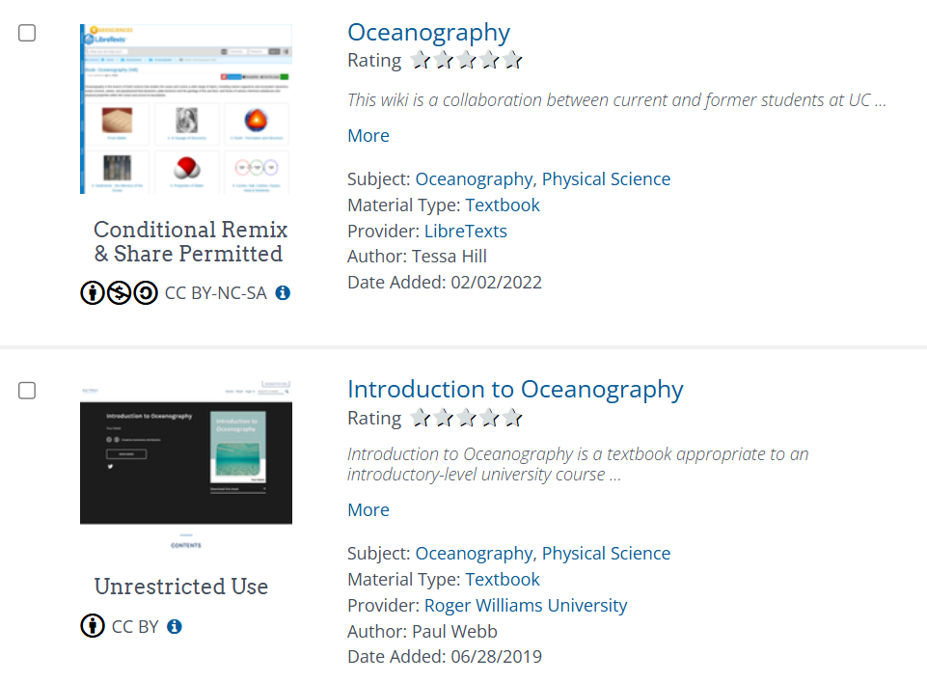
Where to find OER
Not an exhaustive, but a good place to start.
OER Commons
LibreTexts
OpenStax
Pressbooks
Many universities

Slide 11
AMS’s Textbooks are transitioning to OER
3 Books: Ocean Sciences, Meteorology, and Climate
Supported by AMS’s long-standing experience and expertise
Routinely updated and maintained
Include lecture slides, quizzes, and test banks
Everything you need to teach an introductory-level course: an open-access textbook and an optional companion student manual for $99 per student.

Slide 12
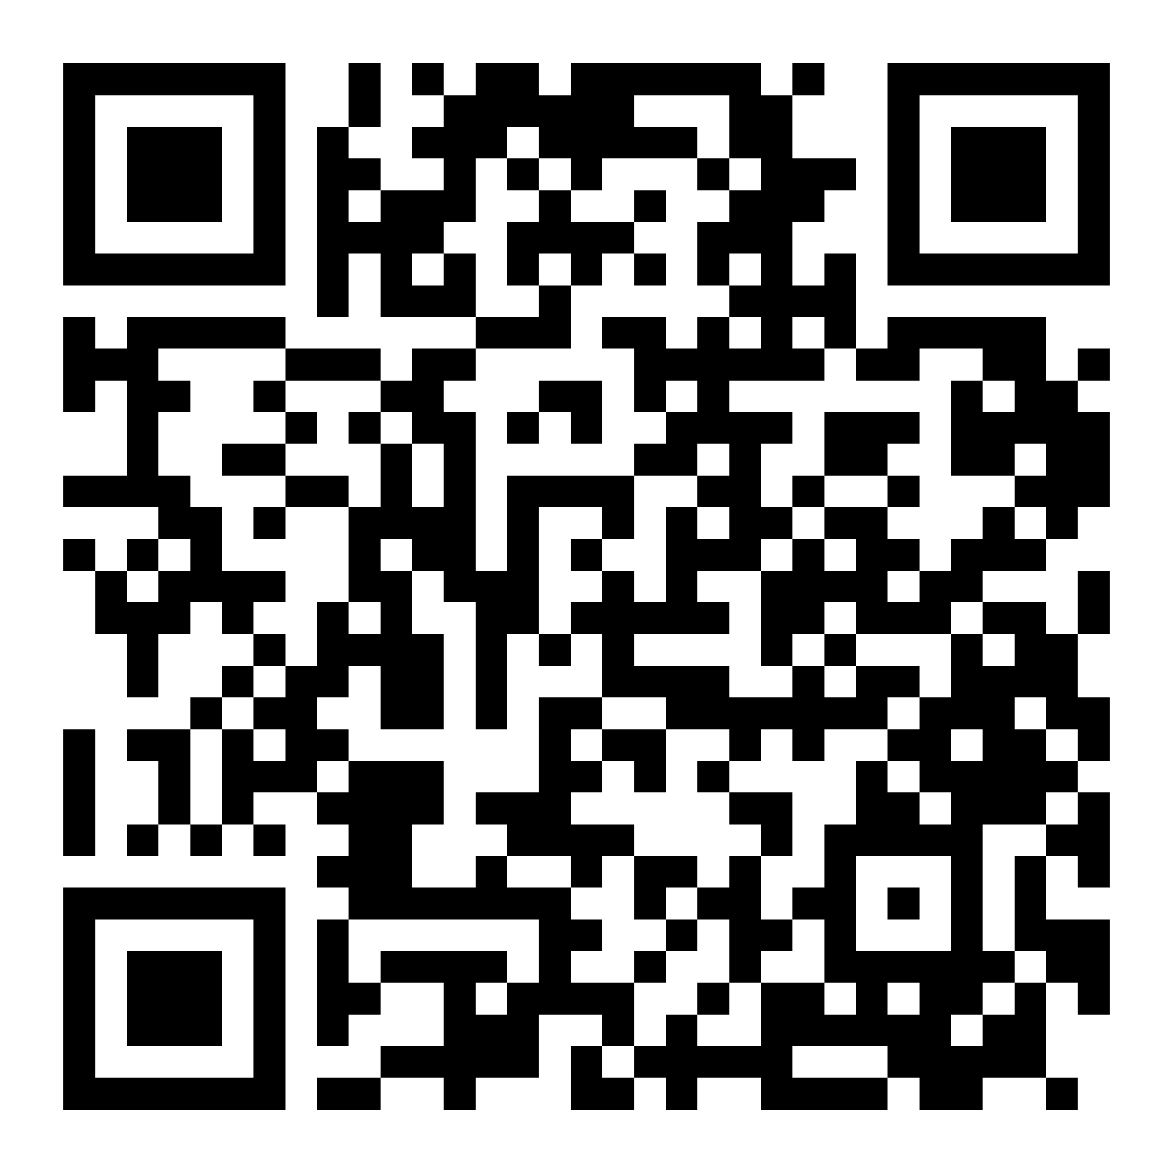
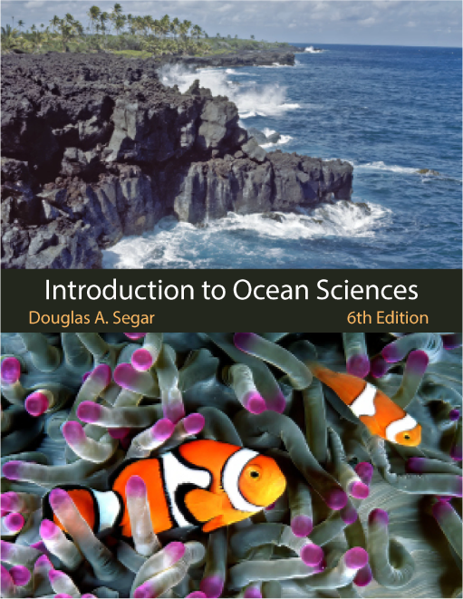
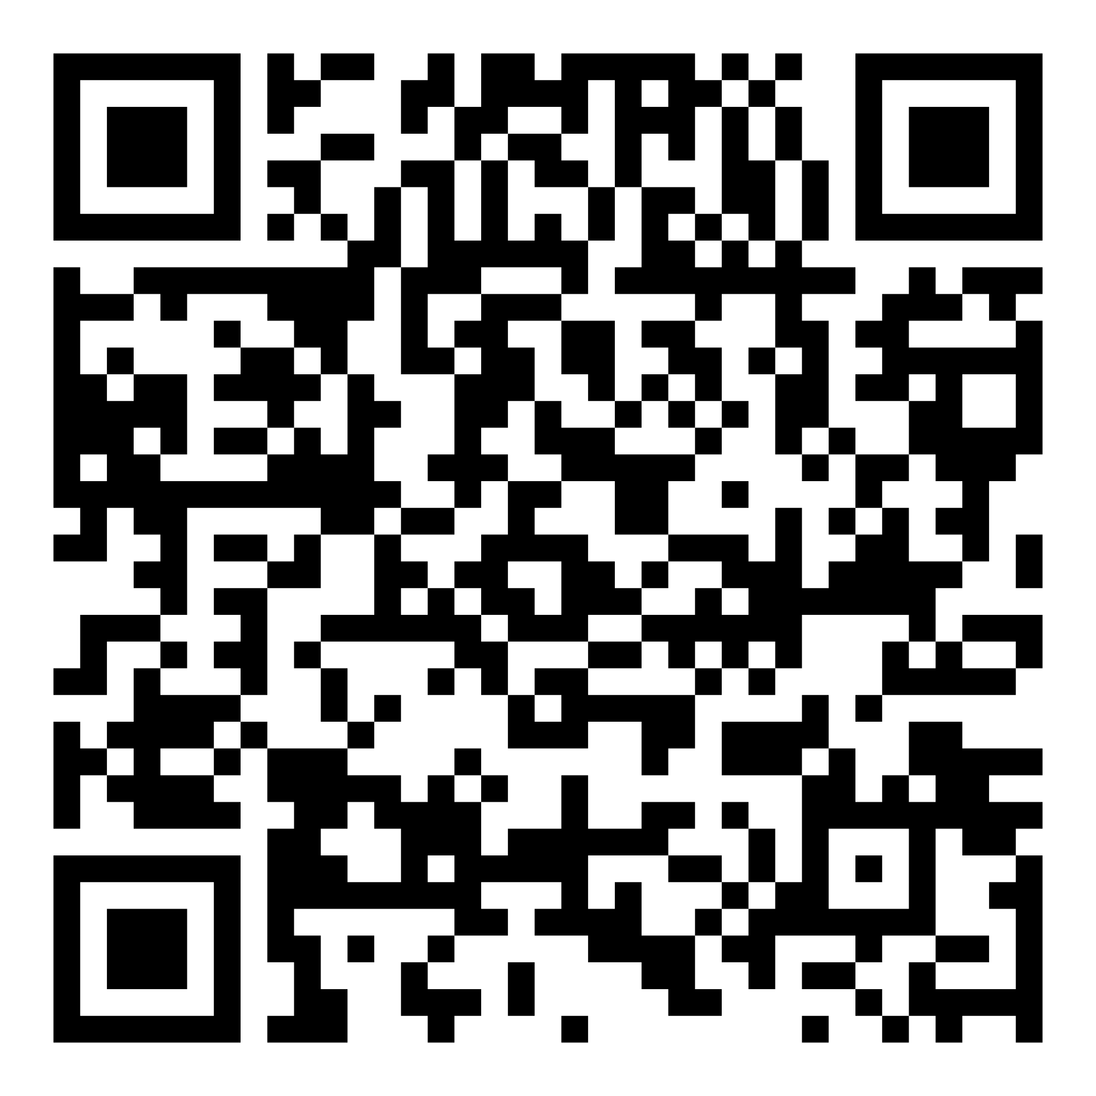
Introduction to Ocean Sciences
Read it now!
AMS Website - PDF
Or at Libretext
Accessible eReader

Slide 13
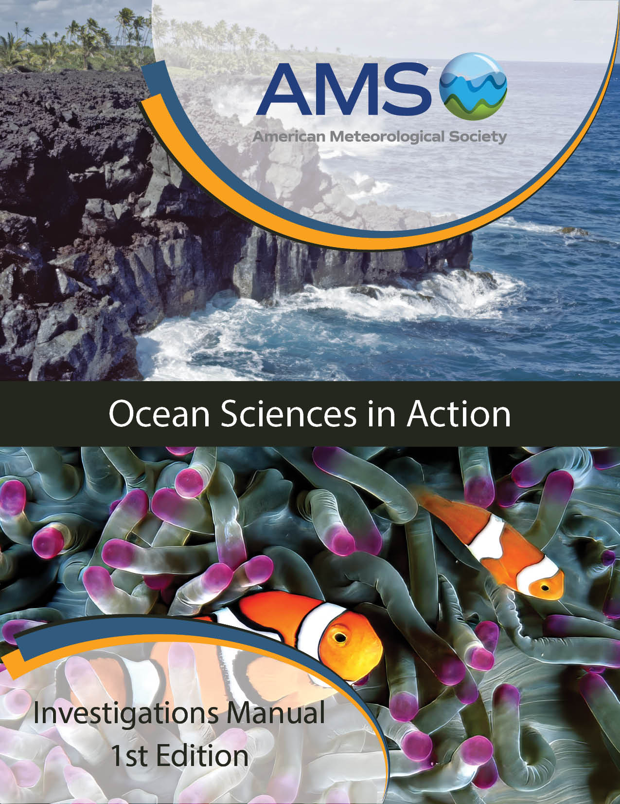
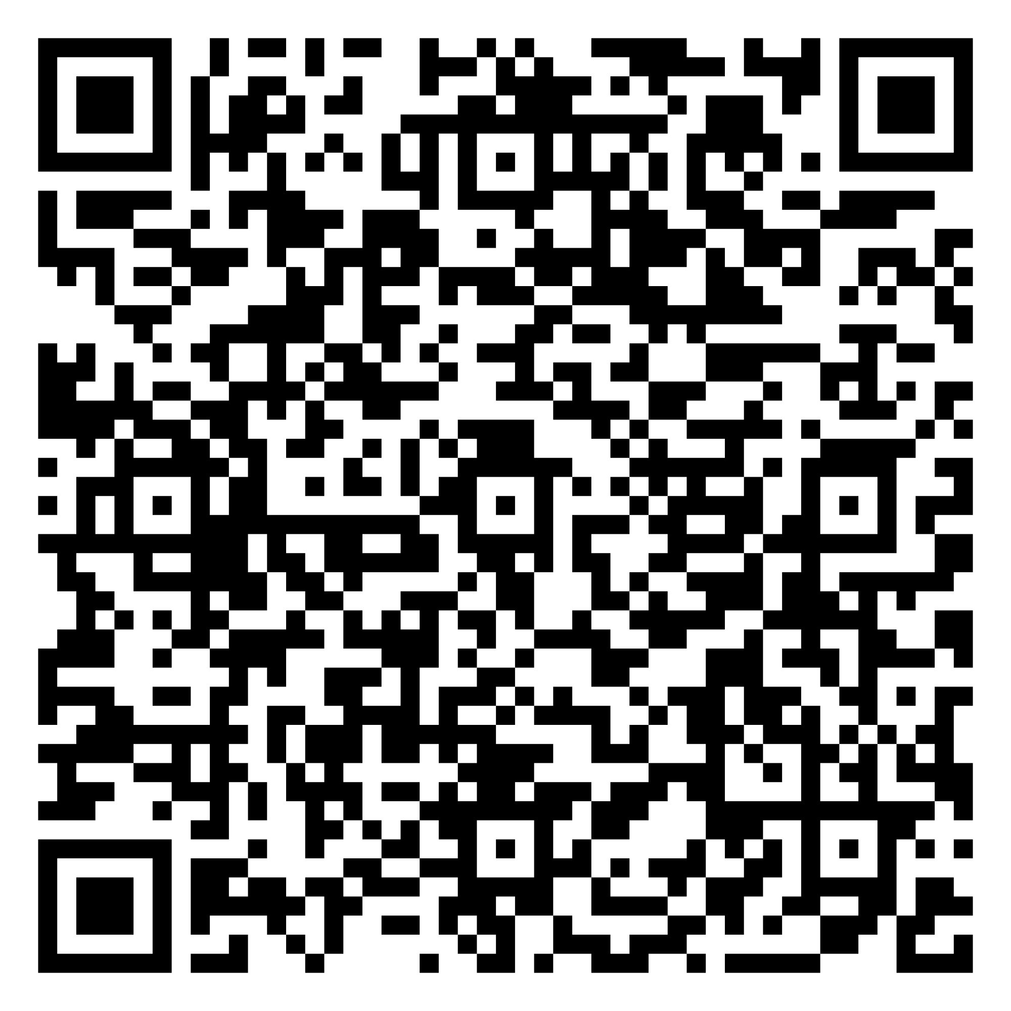
Ocean Sciences in Action Manual
Aligned with the book
Free student manuals for new adopters this school year
See example
investigations and
request an Exam Copy

Slide 14
Takeaways
Check out some Open Educational Resources
Watch for the release of Introduction to Ocean Sciences in the spring
The next AMS OER textbook will be Weather Studies!!

Slide 15
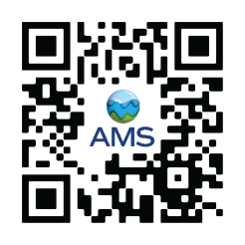
Questions?
Erin Smoak (she/her)
Content Specialist
AMS Education Department
esmoak@ametsoc.org

