Slide 1


From Imagined Disasters to Real Solutions: Empowering Geoscience Students Through Generative AI to Explore Critical Thinking and Resilience
Prajukti (juk) Bhattacharyya
UW-Whitewater
bhattacj@uww.edu
Linda Barnum
University of Oklahoma
las@ou.edu

Slide 2
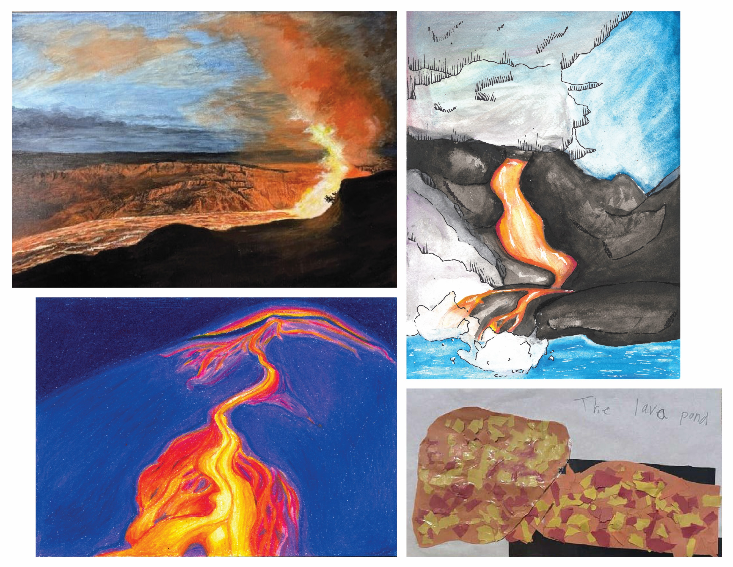
"Fairy tales do not tell children the dragons exist. Children already know that dragons exist. Fairy tales tell children the dragons can be killed".
G.K. Chesterton.
In today’s world, those “fairy-tale dragons” show up as environmental degradations, natural hazards, resource scarcity, and consequent socio-economic impacts
We need to teach our students how to face those dragons with imagination, creativity, and resilience
Volcano Awareness Month 2025 Art Contest Winners. Source: USGS

Slide 3
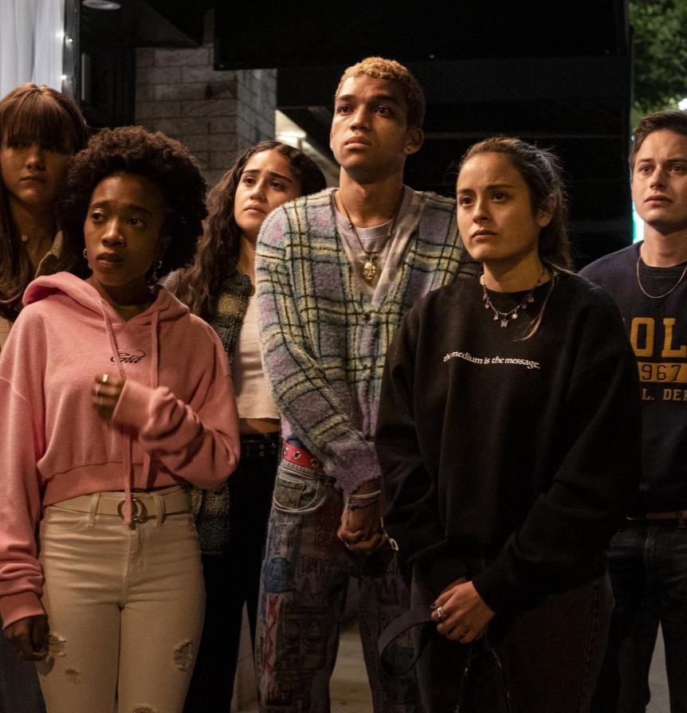
American Psychological Association:
Young people were more anxious about climate change.
Of those aged 18-34, 66% were anxious about its effect on the planet, 51% were worried about its impact on their mental health, and 59% worried about its impact on future generations.
They were also more likely to believe it was already having an effect on the health (64%) and mental health (57%) of Americans.
https://www.psychiatry.org/news-room/news-releases/americans-report-mental-health-effects-of-climate?

Slide 4
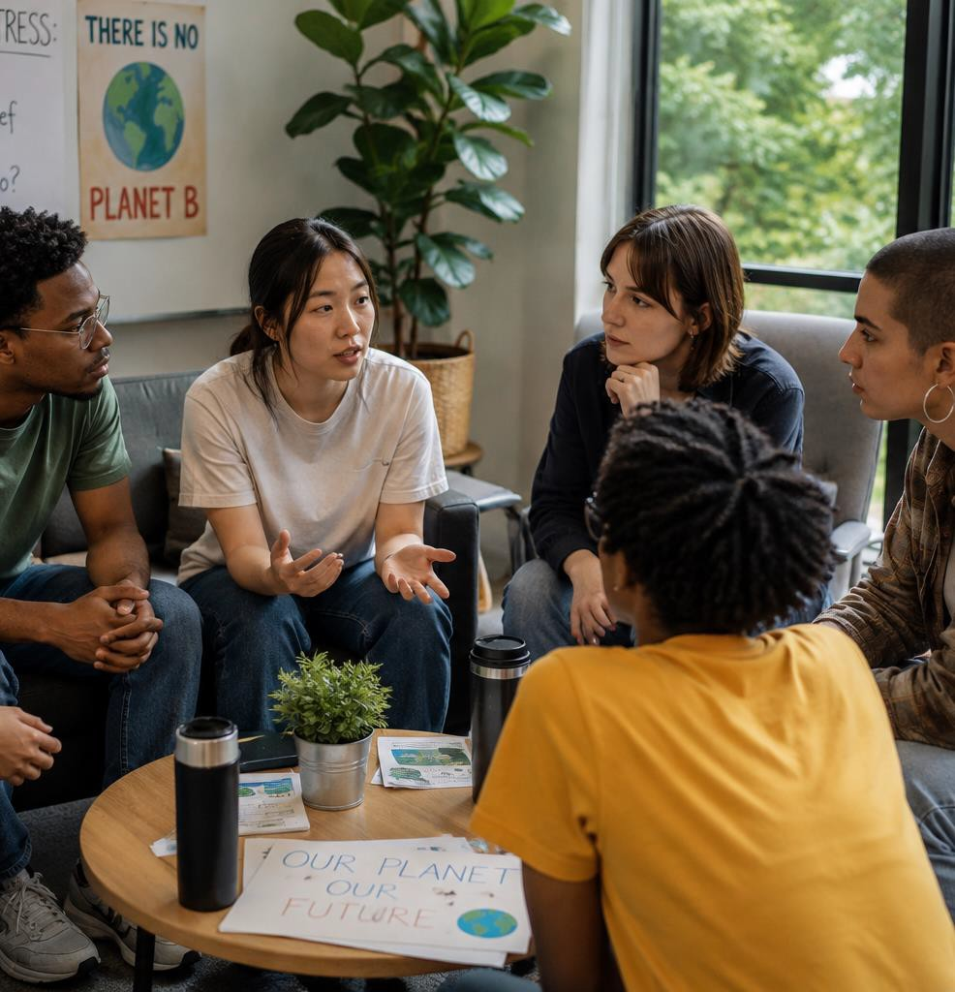
The Anxiety is Real:
Climate anxiety in children and young people and their beliefs about government responses to climate change: a global survey
Hickman C, Marks E, Pihkala P et al. The Lancet Planetary Health, 5, e863-e873 (December 2021)
METHOD: "We surveyed 10,000 children and young people (aged 16–25 years) in ten countries (Australia, Brazil, Finland, France, India, Nigeria, Philippines, Portugal, the UK, and the USA; 1000 participants per country)."
FINDINGS: Respondents across all countries were worried about climate change (59% were very or extremely worried and 84% were at least moderately worried).
More than 50% reported each of the following emotions: sad, anxious, angry, powerless, helpless, and guilty. More than 45% of respondents said their feelings about climate change negatively affected their daily life and functioning, and many reported a high number of negative thoughts about climate change (eg, 75% said that they think the future is frightening and 83% said that they think people have failed to take care of the planet.)

Slide 5

Resilience in Young People
What is resilience?
  Resilience is the ability to adapt, recover and continue growing after adversity and stress
Key characteristics:
  Emotional regulation, hope and optimism, problem-solving skills, strong relationships and social support, sense of purpose and meaning, confidence that challenges can be managed.

Slide 6
Project: Use generative AI to explore direct and indirect impacts of Yellowstone supervolcano eruption on local cities and identify potential solutions
Target courses
GEOLGY 301: Environmental Geology
GEOLGY 203: Volcanoes
Required for Environmental Science (Geoscience) majors as well as a non-lab science elective
Non-lab science elective
25 students in Spring 2026 semester (2 Geo students)
30 students in Spring 2026 semester (15 Geo/EnviSci students)

Slide 7
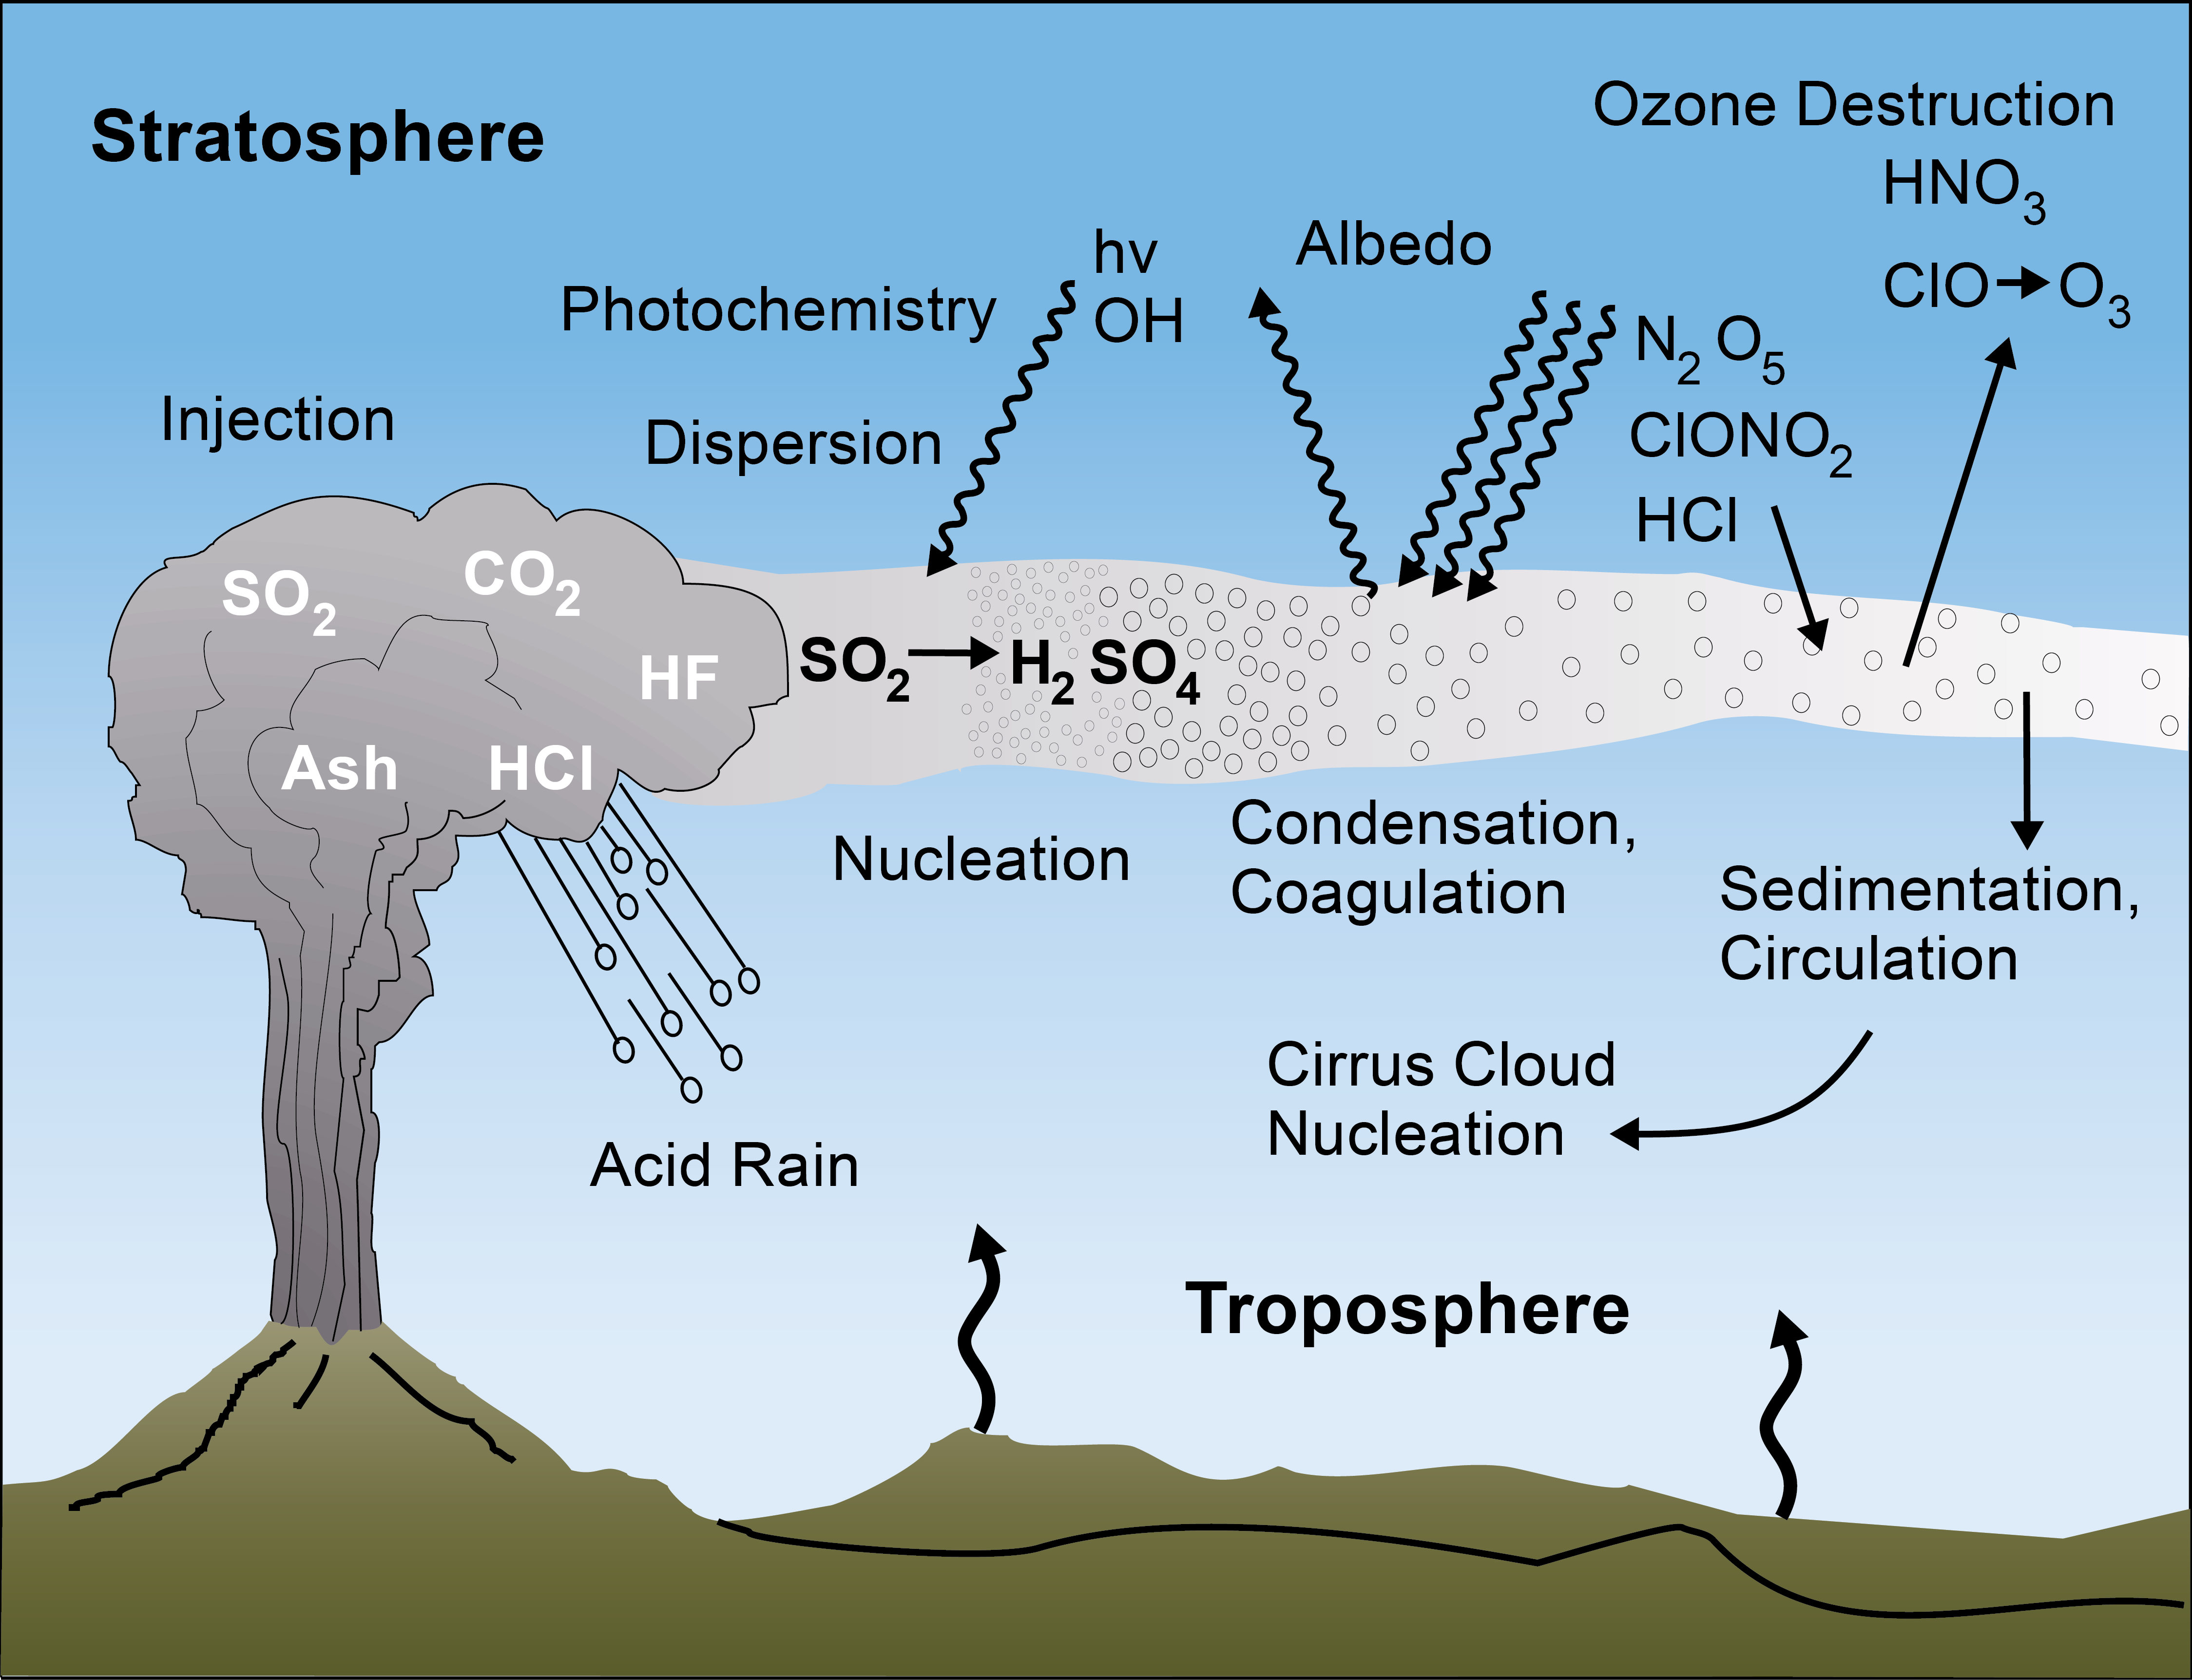
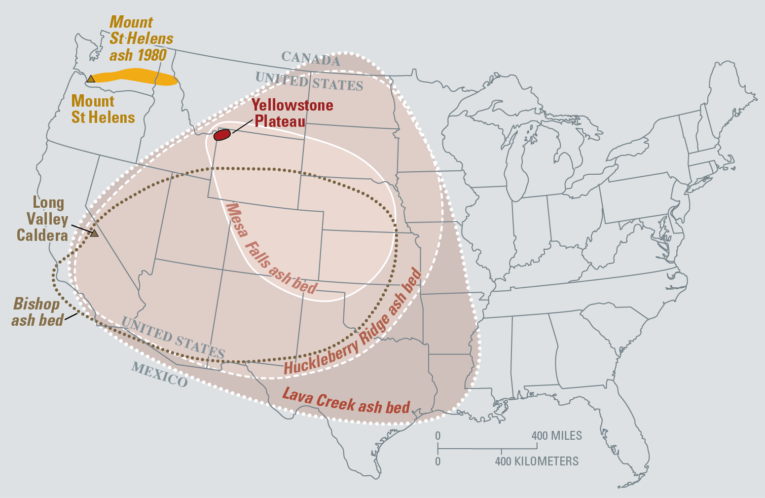
We discussed impacts of volcanic eruptions on climate in both courses
Source: USGS
In addition, we discussed potential impacts of a future Yellowstone supereruption in the Volcanoes course
Source: USGS

Slide 8
Assignment part I: Creating a disaster scenario
Imagine a scenario when the Yellowstone volcano erupts with a VEI=8 (supervolcano eruption). Describe the short term (up to one year) and long-term (1-10 years) impacts on availability of food and fresh water, health, safety, infrastructure, transportation, energy availability and economy for humans living in and around Janesville, WI.
For the same scenario as the previous question, describe the short term (up to one year) and long-term (1-10 years) on non-human living things
Based on your personal knowledge, do you agree or disagree with the analysis conducted by AI? Explain your answer.
Use both chatGPT.edu and Google Gemini for this assignment. I would like you to compare the responses from both generative AI for these questions.
Both platforms are approved by our campus and require campus login credentials for access

Slide 9
Assignment part II: Finding Solutions
Find feasible solutions to address those impacts on food and freshwater shortage, health, safety, infrastructure, transportation, energy availability and economy for humans living in and around Janesville, WI in the short term (up to one year) and long-term (1-10 years)
For the same scenario as the previous question, describe feasible solutions to address the short term (up to one year) and long-term (1-10 years) on non-human living things
Based on your personal knowledge, do you agree or disagree with the analysis conducted by AI? Explain your answer.
Question addressing stress: Explicitly analyze the psychological impact these scenarios have had on you in terms of:
  Stress
  Chronic anxiety towards ecological/environmental disaster
  Developing a sense of hope and resilience in the face of ecological/environmental disaster

Slide 10
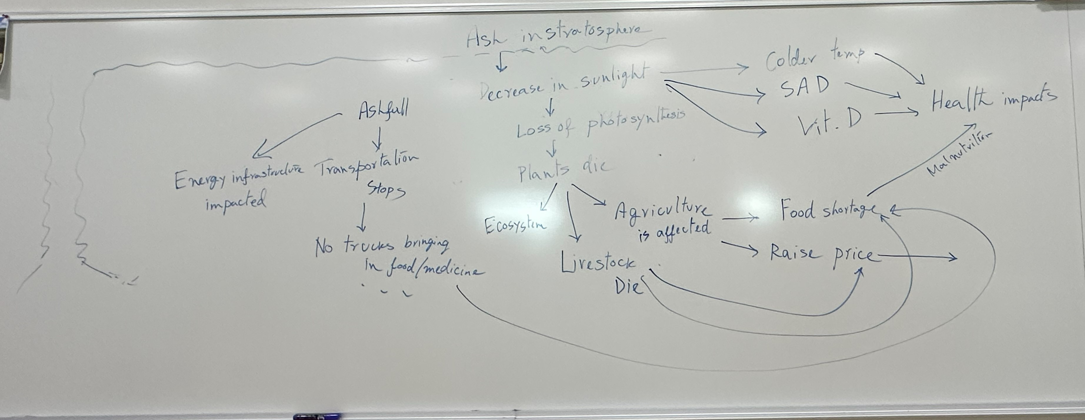
Takeaways:
AI can provide a list of potential issues/solutions, but does not consider how different factors might interact with each other unless specifically asked
Students are more skeptical of AI-generated answers than I expected
  “…I am extremely skeptical of immediately trusting what these chat bots generate. Not because it doesn’t contain accurate information in the mix but deciphering fact from fiction is arduous and would increase my anxiety if I were to rely on this for information in a real ecological/environmental disaster.”

Slide 11
Response analysis to the question addressing stress, anxiety, and resilience
Moderate increase in perceived stress
Hope for Recovery (Very Strong)
Confidence in Adaptation
Self-Efficacy
Previous Adversity as a Protective Factor
Although uncommon, several responses reflected lower resilience
Complete hopelessness was rare
When FACED with the challenge of what to do, students confronted their fears and came out stronger – showing resilience

Slide 12
The assignment appears to have promoted resilience by:
Increasing disaster literacy
Encouraging systems thinking
Fostering realistic preparedness
Enhancing confidence in scientific solutions
Promoting agency rather than helplessness
Supporting adaptive coping through planning
Rather than amplifying ecological anxiety, many students reported that understanding feasible responses reduced uncertainty and strengthened their confidence in future adaptation
Findings suggest that the assignment functioned as a protective educational intervention

Slide 13
What next?
Start the assignment sequences earlier during the semester and allow for more detailed in-class discussion and reflection
Incorporate more likely disasters like flooding, tornadoes, etc.
Ways to improve prompt engineering skills
Questions?
Comments?
Suggestions?
Prajukti (juk) Bhattacharyya
UW-Whitewater
bhattacj@uww.edu
Linda Barnum
University of Oklahoma
las@ou.edu

