Slide 1




Revisiting Spatial Thinking Typologies
in Solid- and Fluid-Earth Geosciences
Advocating for an ecological approach
Peggy M. McNeal Towson University
Stephanie Sabatini NC State University
Thomas F. Shipley Temple University
Supported by NSF DUE-2225637, AGS-2413370, AGS-2413371. Findings and opinions are the authors' and do not necessarily reflect NSF views.

Slide 2
Geoscience is spatial; the theory is straining
Geoscience education research has leaned hard on spatial-thinking theory and coalesced around the Newcombe & Shipley (2014) typology, which currently has 575+ citations
A test for any theory
Galison (1997): a good theory should help solve concrete problems.
Does the typology hold up against the real demands of geoscience practice?
It works in places. Training studies show gains (Atit et al. 2015; Giorgis 2015; Hannula 2019), and typology skills predict geoscience performance (McNeal et al. 2019, 2024).
It also strains. Other studies find weak or no link to learning geologic concepts (Ormand et al. 2014; Polifka et al. 2022; Goldhagen et al. 2023).
Three challenges to the typology → an ecological approach (an adjunct, not a replacement)
2

Slide 3
Two dimensions, four types of spatial reasoning, eleven geoscience skills
INTRINSIC
EXTRINSIC
Chatterjee (2008) argued for two dimensions of spatial reasoning: intrinsic vs. extrinsic (within one object vs. relations among objects) and static vs. dynamic.
Intrinsic · Static
Extrinsic · Static
disembedding, categorization
locating self and other objects, alignment
STATIC
Newcombe & Shipley (2014) mapped eleven spatial skills used in geosciences onto the resulting 2×2, which became an organizing typology for spatial thinking research in the geosciences
Intrinsic · Dynamic
Extrinsic · Dynamic
visualizing 2D from 3D,
penetrative thinking, mental transformation, sequential thinking
perspective taking, relations among objects, updating movement through space
DYNAMIC
This is the typology the next three challenges test.
Newcombe & Shipley (2014), after Chatterjee (2008)..
3

Slide 4
CHALLENGE 1
Is four the magic number?
The 2×2 predicts four types: items within a type should correlate more than items across types.
Mix et al. (2018) tested this with confirmatory factor analysis (children's spatial data), comparing 1-, 2-, and 4-factor models.
“Spatial skill may have a multi-dimensional structure, but perhaps not one that is based on static-dynamic processing.”
The 4-factor model did not fit best. Intrinsic–extrinsic held up; the static–dynamic split was weak.
— Mix et al. (2018), p. 275
Uttal et al. (2024) proposed that scale (large vs. small) may be confounded with the two dimensions and deserve its own axis.
4

Slide 5
CHALLENGE 2
Are the four types of spatial reasoning inherent in the solver or in the problem?
The dimensions may reflect the cognitive strategies a person applies, not a problem built into the geoscience environment. Spatial thinking test items are solvable in multiple ways.
Perspective taking
Mental rotation
Framing steers strategy
To solve a crystallography symmetry problem, one might rotate the crystal in mind or imagine moving around it. Distinct cognition, same result (Hegarty & Waller 2004).
Rotate holistically (dynamic) or count segments piecemeal (static). High scores imply dynamic; low scores are ambiguous.
Khooshabeh et al. (2013): fragmenting the blocks pushes solvers toward a piecemeal approach. How we pose a task shapes the skill used.
5

Slide 6
CHALLENGE 3
Fluid-Earth confronts the typology
Intrinsic vs. extrinsic rests on unit formation: single vs. multiple discrete objects. But fluids aren't clearly “one thing.”
Fuzzy boundaries: Clouds, eddies, fronts, the thermocline: their boundaries are gradients. How do you disembed, categorize, locate, or align something with no discrete edge?
Gradient causation: Pressure-gradient force and Coriolis vary continuously, not in discrete steps.
6

Slide 7
Maybe we're working at the wrong level of analysis
Tests and theory reify each other (Uttal et al. 2024). A narrow typology, tested again and again on a small set of problems, can look compelling, but are we seeing everything that's there?
→
We propose an adjunct strategy that starts from geoscience tasks themselves.
an ecological
approach
7

Slide 8
AN ECOLOGICAL APPROACH
Start from the information in the world
Gibson (1979): the environment is rich in information that can guide goal-directed action. The learner's job is to attend to the information that matters.
A bottom-up, task-centered move:
Old question: What spatial thinking skills are necessary for success?
New question: What information do geoscientists use, and how do we help students see it?
8

Slide 9
AN ECOLOGICAL APPROACH
What could an ecological approach to spatial thinking look like?
1
→
2
→
3
→
4
Identify the information experts use to solve the task
Show it is reliably available in the environment
Show that experts actually use it
Show that novices can learn to use it
9

Slide 10
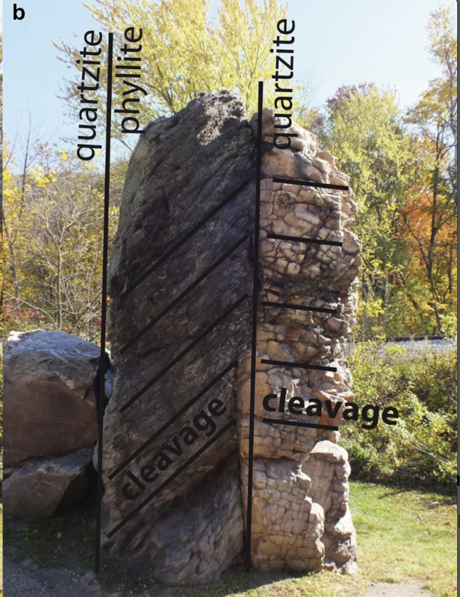
WORKED EXAMPLE · SOLID EARTH
Reading a fault outcrop
Task: sequence the past events recorded at a normal fault.
1
The information: discontinuities, abrupt ends to bedding, offset features, slickenline orientation and texture.
2
2
Reliably available: these cues aren't guaranteed, but they're highly correlated with faults.
“What skills are necessary?”
3
Experts use it: they write these cues into field guides and teaching resources.
“What experiences help students attend to the information?”
4
Novices can learn it: the instructor directs attention to the cues in the outcrop.
10

Slide 11
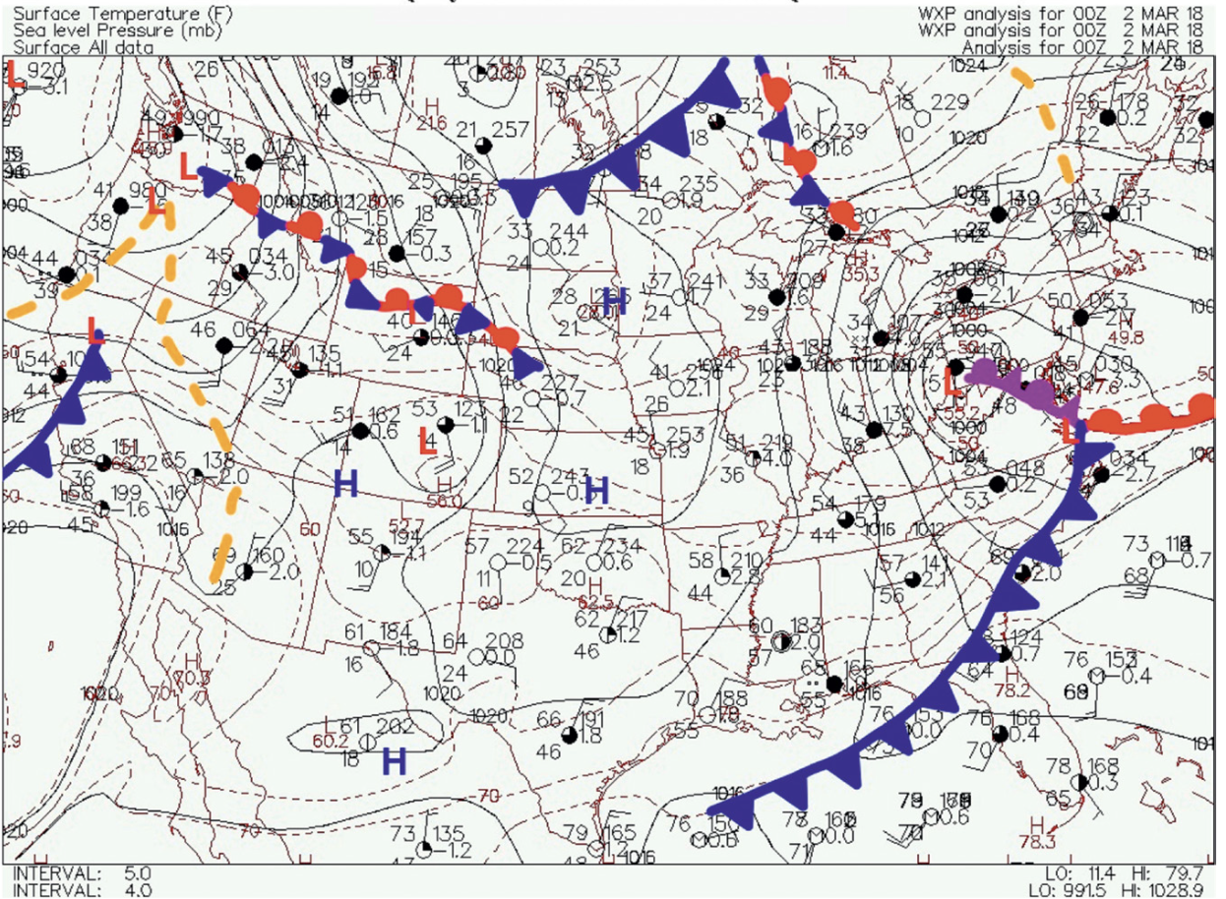
WORKED EXAMPLE · FLUID EARTH
Forecasting a mid-latitude cyclone
Task: predict where the storm will track (McNeal et al. 2019).
1
The information: shifting wind direction, abrupt temperature contrasts; troughs, ridges, jet streaks
2
Reliably available: information available on surface and upper air maps
3
Experts use it: established methods for weather forecasting.
Same reframe: “what experiences help students attend to the information?”
4
Novices can learn it: the instructor directs attention to the cues in the data displays.
11

Slide 12
Research directions and questions
Study expert attention first. Eye tracking, sketch elicitation, gesture, and analogy reveal what experts prioritize and ignore (Gentner & Gunn 2001).
From deficit to design. Less “fix low spatial thinkers,” more helping all students recognize the patterns that matter.
An adjunct, not a replacement. It runs alongside existing frameworks and the research they continue to generate.
12

Slide 13
Questions?
Peggy M. McNeal · pmcneal@towson.edu ·
With thanks to the Spatial Thinking Research Interest Group (STRIG): Lauren Burns, Katharine Johanesen, Annie Klyce, Laura Lukes, and Katherine Ryker; and to Heather Petcovic for feedback on the project.

