Slide 1

What factors impact student learning in introductory geoscience lab courses?
Rachel Teasdale, Katherine Ryker, Kelsey Bitting
Notes:
Introductory laboratory courses play an important role in student learning in introductory geoscience courses. In an attempt to quantify different effects on student learning, we evaluated the influence of six factors: situational interest, course format, course, lab topic, lab level of inquiry, and Teaching Assistant (TA). Data were collected from six introductory geoscience laboratory courses at five public research institutions for four semesters. Student learning was measured using pre- and post- course surveys with three content questions for each of six lab topics considered per course. Lab topics studied were selected by each course instructor and learning survey questions were aligned directly to the lab activities of each course. Unexpectedly, some labs were offered online during the study period, which is included as a potential learning factor (course format). Odds ratio analyses indicate that of all our factors, the topic of the lab activity, the TA lab instructor, and the course students are in, are strong predictors of student learning. Of the lab topics, there are higher odds of student learning for lab activities on Minerals, Earth's Interior, and Earthquakes. We do not propose that student interest, inquiry levels and course format are not important to student learning, but our data collection and analyses show they are not as important as lab topics and course factors in this dataset. These findings suggest that lab topics with lower odds ratios are prime opportunities for potential improvements to support student learning. To address the influence of courses, our further work will consider more nuanced analyses of factors related to individual courses such as individual lab activities at institutions and TA influences.

Slide 2
Guiding Research Question: To what degree do level of inquiry, TA beliefs, and undergraduate student situational interest influence undergraduate student learning in introductory geology labs?
?
Interest
Inquiry
LEARNING
Instruction
(TA Beliefs)
?
?

Slide 3
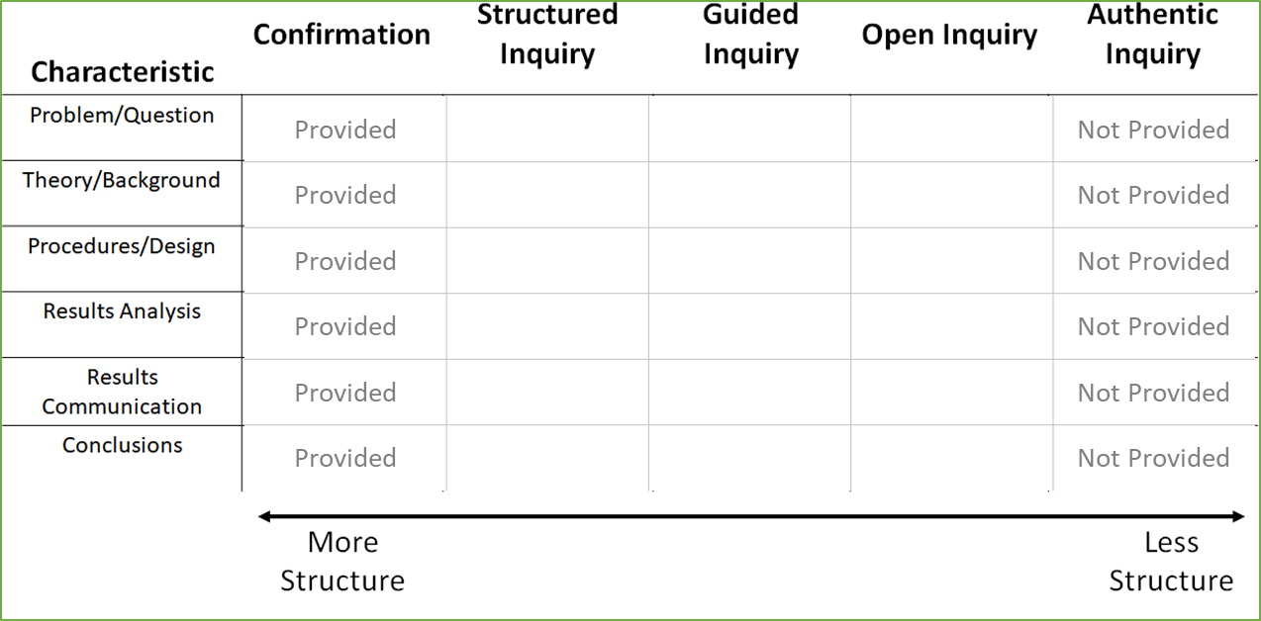

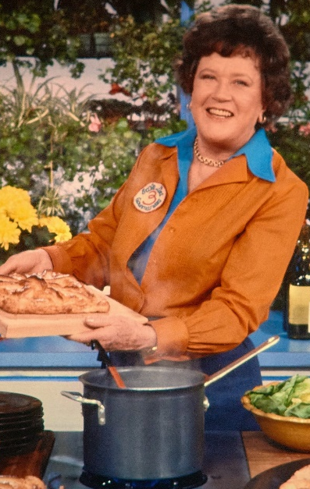
What is Inquiry?
Activities with elements of scientific investigation
Students responsible for asking Qs, formulating hypotheses, methods to test them, interpreting their data, presenting their conclusions (to some extent)
Quantifying Inquiry: Rubric to code elements of lab activities & extent of guidance
(“cookbook”)
(students generated Qs, design, interpretations)
Buck et al., 2008

Slide 4
Timeline
7 courses at 5 doctoral-granting institutions implement at least 3 newly-developed labs
Student Interest and Learning Data
TA Interviews
2020 Spring*
July 2020 (EER)
AY20/21 (OL)
AY21/22 (In Person)
2022-now
Comparison data
(pre- inquiry based labs)
Workshop:
Create Inquiry-based Labs for Intro Geology Courses
Data Analysis & Dissemination
Student Interest (weekly surveys)
Student Learning (pre/post semester – GCI-like MCQs)
TA Interviews (TBI, Luft & Roehrig, 2007)
Transition
Online
Some Hybrid
Some F2F
All
F2F
Notes:
All Fall data impacted _ summer lab development incorporated online versions of labs (so online “inquiry” labs)
TEACHING BELIEFS INTERVIEW

Slide 5
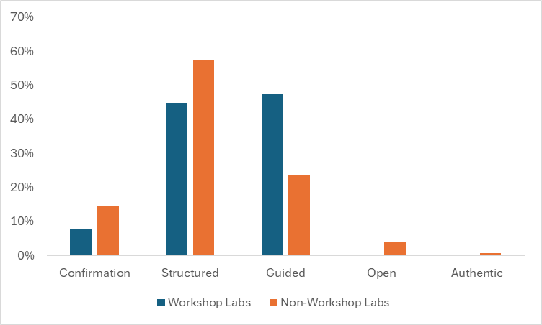
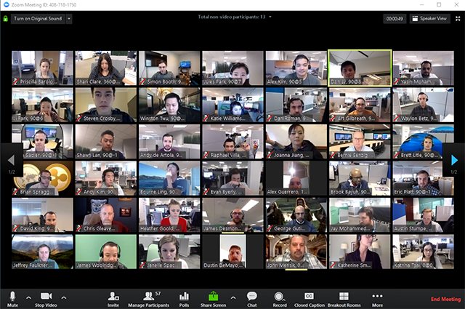
Summer 2020 EER Workshop, 2021 Peer Review, Revise & Publish:
serc.carleton.edu/inquiry_intro_geo
Workshop labs are more often guided inquiry labs than non-workshop labs
New Inquiry-based lab topics:
Plate Tectonics
Groundwater
Geologic Time
Minerals
Rocks (all rocks + Ign, Met)
Climate
Confirmation (“cookbook”)
Authentic Inquiry
(students generated Qs, design, interpretations)
Notes:
Add a QR code for link
Graph and text updated for 2024

Slide 6
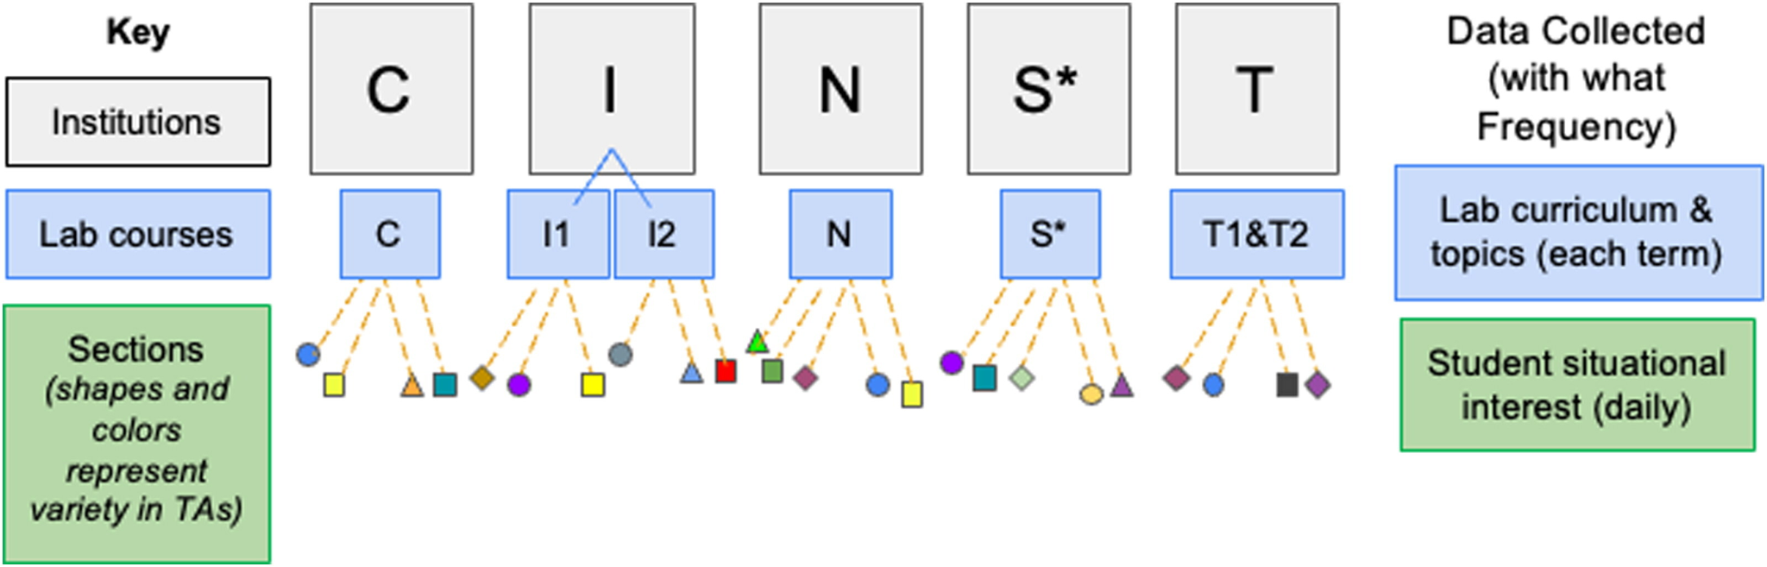
Data Collection: 5 Institutions, 6 Lab courses, 32 TAs
Student learning (pre/post semester)
TA interviews (pre/post semester)
Figure adapted from Bitting, Ryker & Teasdale, 2024 (JGE)

Slide 7


Six courses across four semesters
128 interviews being coded for relevance, gamification, and graduate student ideas about teaching
365 labs coded for inquiry levels
12,808 learning surveys (pre- or post-semester)
15,941 interest surveys (post-labs)
Donat et al., 2021; Piper et al., 2022; Torres et al., 2022; Menser et al., 2023; Williams et al., 2023; Bitting et al., 2024 (JGE); Piper et al., in prep
Notes:
The number of learning, interest surveys varies between notes - these come from the PDA report

Slide 8
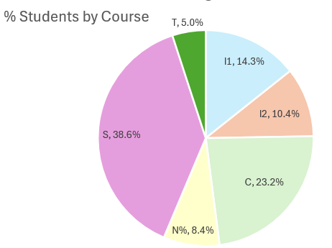
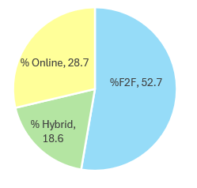
Goal: What factors influence student learning, and by how much?
Factors considered:
Course factors (different institutions, student population, etc.)
Lesson format (F2F, hybrid, online)
Inquiry level of labs (1-6, Confirmation to Authentic)
Topic of labs: Climate, Earth’s Interior, Earthquakes, Geologic Time, Landscape Dev., Landslides, Minerals, Plate Tectonics, Rivers & Streams, Rocks, Topo Maps, Water
Student Interest (1 not very to 4 very interesting)
% Students by format

Slide 9
Is learning happening?
Yes!
Post scores have 2.34 odds ratio of being larger than pre scores (p<0.0001)
What factors are important to learning?
TAs Matter:
For 23 out of 38 TAs, there is a significant difference in students’ pre vs. post scores
Students’ post content scores are more likely to be higher than the pre content scores
“More likely” ranges from 1.76x as likely to 11.67x as likely
(sometimes with large confidence intervals)
Lab Topics Matter
Notes:
2.34 OR - from Helmuth’s base model, June 12 2026
TAs matter - Helmuth table 11 in “Tables for Comparison” Feb 2026

Slide 10
What factors are important to learning?
TAs Matter
Lab Topics Matter: Odds ratios from GLMM indicate:
Topics with significant differences in learning = Climate, Earth Interior, Earthquakes, Minerals, Plate Tects, Rivers & Streams
Minerals largest OR 6.439 (p<0.001)= students are 6.439 times to score correctly on post than on pre
Earth’s Interior LG OR 3.478 (p<0.001)
Earthquakes OR 2.561 (p<0.001)
Climate OR 2.328 (p<0.001)
Rivers & Streams OR 2.314 (p<0.001)
Plate Tectonics OR 1.889 (p<0.001)
Notes:
(Aim 4): PDA says: lab activity by time period interaction (Table 12) suggest lab activity is significantly related to LG with wide range of Odds Ratio

Slide 11
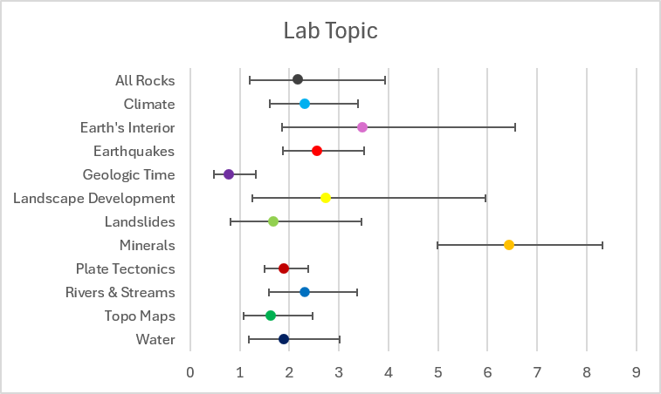
What factors are important to learning?
TAs Matter
Lab Topics Matter: Odds ratios from GLMM indicate:
Topics with significant differences in learning = Climate, Earth Interior, Earthquakes, Minerals, Plate Tects, Rivers & Streams
Minerals largest OR 6.439 (p<0.001)= students are 6.439 times to score correctly on post than on pre
Earth’s Interior LG OR 3.478 (p<0.001)
Earthquakes OR 2.561 (p<0.001)
Climate OR 2.328 (p<0.001)
Rivers & Streams OR 2.314 (p<0.001)
Plate Tectonics OR 1.889 (p<0.001)

Slide 12
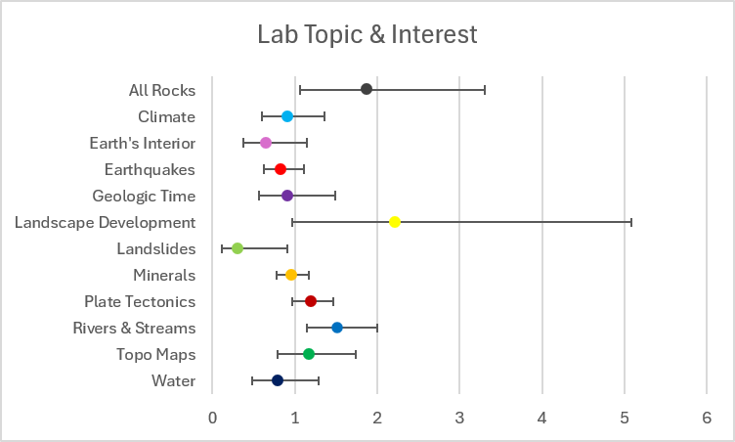
What factors are important to learning?
TAs Matter
Lab Topics Matter: Odds ratios from GLMM indicate:
Interactions of Lab topic and Interest: For every 1 unit increase in the interest score there is an X% higher odds of having a higher post score than pre score for some labs:
All-rocks labs (for every 1 unit increase in interest, there is a 88% higher odds of having a higher content score (post vs. pre) p<.0295)
Rivers & streams labs (for every 1 unit increase in interest, there is a 51% higher odds of having a higher content score (post vs. pre) p<0.0044)
Notes:
Landscape - close to significant - p 0.0586

Slide 13
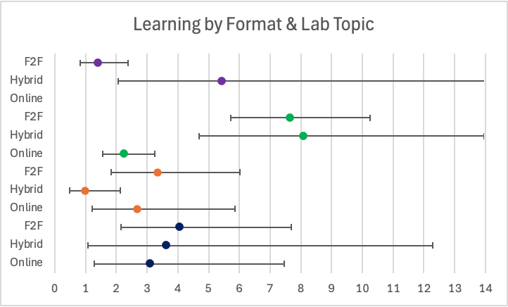
*p<.05
**p<.01
***p<.001
Geologic Time*
***
Minerals***
***
***
***
Topo Maps*
***
*
Water

Slide 14
Current thoughts
Student learning is complicated
Lots of variables
Course factors: institutional, instructor (TA)
Lab activity factors: format, inquiry level, topic
Student factors: interest
Statistical models are homing in on most important factors
Workshop Labs: serc.carleton.edu/inquiry_intro_geo

Slide 15
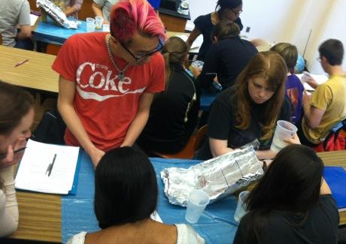
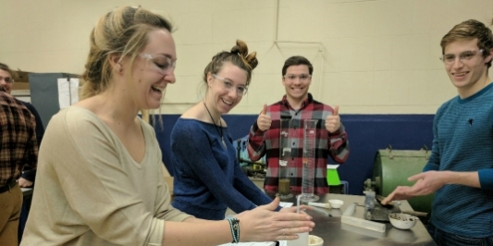

Questions?
Workshop Labs: serc.carleton.edu/inquiry_intro_geo
https://woostergeologists.scotblogs.wooster.edu/2012/04/03/collaborative-and-sticky-inquiry-in-the-geology-of-natural-hazards/
https://www.uvm.edu/sites/default/files/styles/16_x_9__max_width_533px/public/hands_on.jpg?itok=hlE8QxK6
This work is funded by a grant from the National Science Foundation: IUSE 1933488 & 1933355. Any opinions, findings, and conclusions or recommendations expressed in this material are those of the authors and do not necessarily reflect the views of the NSF.

Slide 16
Next are old content slides, I think we can delete

Slide 17
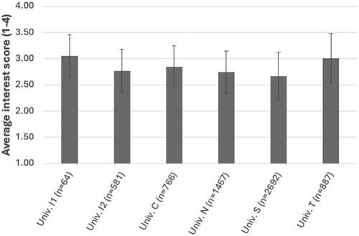
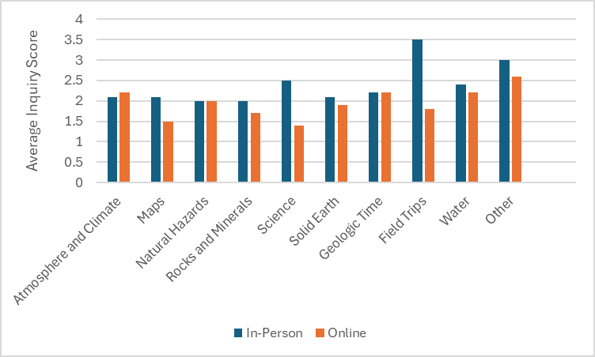
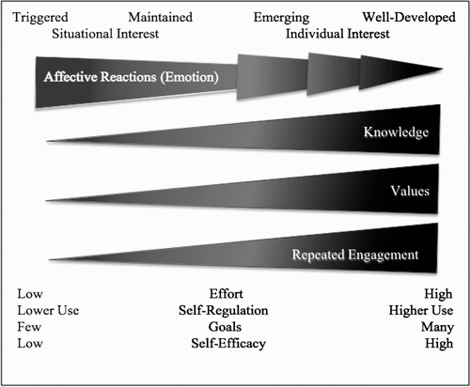
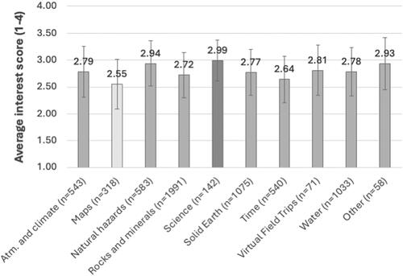
The role of interest & inquiry
Figure 1 from Kraft (2017) illustrating factors that influence development of interest, based on Hidi & Renninger (2006)
Notes:
Analysis showed a statistically-significant interaction between student situational interest and the combined effect of 1) the course the students were enrolled in and 2) the topic of the lab session (F (20, 6395) = 4.038, p < 0.001). However, topic and course together explain only about 4% of the variance in the dataset, indicating that other factors have a large role in triggering interest.
For learning data, used high interest (natural hazards, climate) and low interest (maps) labs. (Hazards represented by a combo of landslides, earthquakes and volcanoes.)

Slide 18
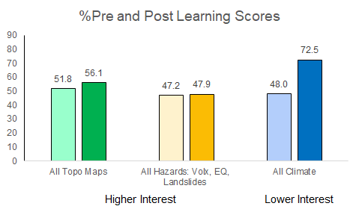
Learning & Interest
Learning
Lower Interest
Higher Interest
Takeaway: Learning not directly/solely related to interest.
Notes:
Learning Gains: 16.9, -0.1, 43.0
RT: Here’s a jpeg of the graph, my interpretation is we don’t know why students learn, b/c the lower interest topic (Maps) has larger increase in post scores than pre scores (and larger gains, which are in the Excel sheet but the chart here shows %). So we’re seeing stronger learning for Maps that they’re less interested in than for Hazards and Climate. Sigh. Could be that factors that guide learning are multi-fold, could be our content questions aren’t good too. I think we can easily make the case that our big ol “lump” of “all Qs, all students” is too broad and we need to look at this with more finesse (yay PDA!!!). So if we had to answer with this graph, I’d say interest is not a strong driver (without fine tuning – PDA!!)

Slide 19
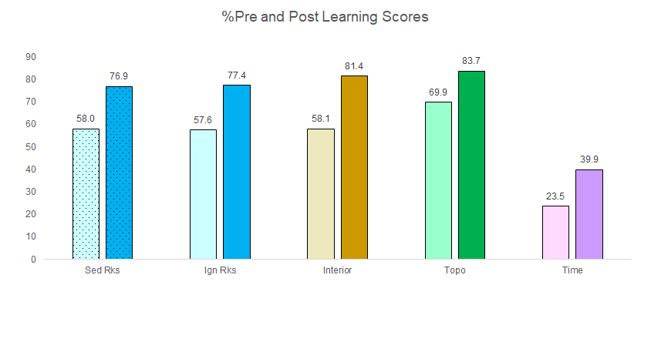
Learning & Inquiry
Learning
Lower Inquiry
Higher Inquiry
Takeaway: Learning not directly/solely related to inquiry.
Notes:
RT: The 2nd new sheet is to look at learning for higher vs. lower inquiry labs, which is in the sheet called: UNC + Colo LowHighInqTopicLrng is set up the same way- but only with UNC and Colorado. The graph below is from columns CH-CO around rows 1238-1250. I can’t get the bars lined up the way I wanted them, so I just drew circles to show what’s being compared. The blues in the graph are the lower inquiry labs from UNC (Sed Rocks and ig/met rocks). The learning gains are about the same as each other (mid 40%s) and are about the same as LG for Topo (high inquiry with LG in mid 40s). Again, I’m not seeing anything obvious. There are higher learning gains (55%) for higher inquiry Earth Interior lab but lower LG (21%) for the high inquiry Time lab (pink). So I don’t see that LG aligned with high or low inquiry.
For both rocks labs: low interest, low inquiry, but reasonable learning
For topo, low interest, high inquiry, but reasonable learning
For earth’s interior, high inquiry, medium interest
For time, high inquiry, low interest, good learning, but on the low end

Slide 20
Learning Gains
EI
Rx
To
Ti
“Sum” of Predictors
 | Inquiry | Interest | Learning Gains
Rocks | Low | Low | Medium
Topographic Maps | High | Low | Medium
Earth’s Interior | High | Medium | Medium-High
Geologic Time | High | Low | Low
Notes:
First step to see how multiple factors may help predict learning - still not an obvious trend. Not a single predictor - humans are complicated! But what if we bring in more predictor variables? Other items?

Slide 21

What comes next?
LG & Inquiry with modifying variables?
LG larger in F2F vs. online?
LG varies based on topics, courses?
How much of LG can we predict from a combo of inquiry, interest, topic, course…

Slide 22
What comes next?
???
Student learning (pre/post semester)
TA interviews (pre/post semester)

Slide 23
Abstract
Introductory laboratory courses play an important role in student learning in introductory geoscience courses. In an attempt to quantify different effects on student learning, we evaluated the influence of six factors: situational interest, course format, course, lab topic, lab level of inquiry, and Teaching Assistant (TA). Data were collected from six introductory geoscience laboratory courses at five public research institutions for four semesters. Student learning was measured using pre- and post- course surveys with three content questions for each of six lab topics considered per course. Lab topics studied were selected by each course instructor and learning survey questions were aligned directly to the lab activities of each course. Unexpectedly, some labs were offered online during the study period, which is included as a potential learning factor (course format). Odds ratio analyses indicate that of all our factors, the topic of the lab activity, the TA lab instructor, and the course students are in, are strong predictors of student learning. Of the lab topics, there are higher odds of student learning for lab activities on Minerals, Earth's Interior, and Earthquakes. We do not propose that student interest, inquiry levels and course format are not important to student learning, but our data collection and analyses show they are not as important as lab topics and course factors in this dataset. These findings suggest that lab topics with lower odds ratios are prime opportunities for potential improvements to support student learning. To address the influence of courses, our further work will consider more nuanced analyses of factors related to individual courses such as individual lab activities at institutions and TA influences.

