Slide 1
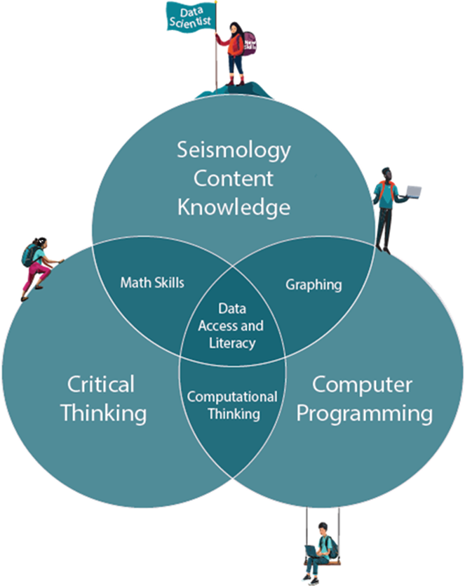
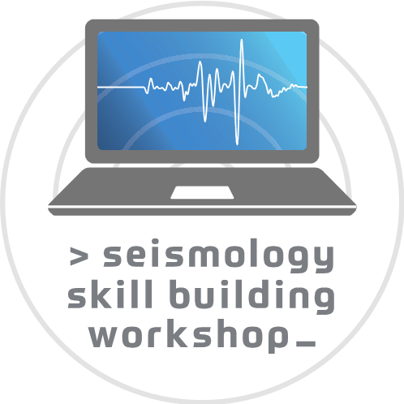
EARTH EDUCATORS' RENDEZVOUS 2026
Long-term Impacts of a Large-Enrollment Scientific Computing Skill Building Training in the Geosciences
A free, fully online scientific-computing workshop (~6 hrs/week over 14 weeks) —> and what participants did years later.
Mike Brudzinski · Miami University-Oxford
Nigar Sultana · University of British Columbia
Michael Hubenthal · EarthScope
Wilnelly Ventura-Valentin
Gillian Haberli · EarthScope
Notes:
Hi everyone, I'm Wilnelly Ventura-Valentín, and today I'll be presenting work on the long-term impacts of the Scientific Computing Skill Building Workshop, or SSBW
Note to Wilnelly: Feel free to change things in this presentation to make it your own. I just used Claude to make it look nice quickly, so there would be a variety things I would change stylistically, but I wanted you to have final say on how things look.

Slide 2
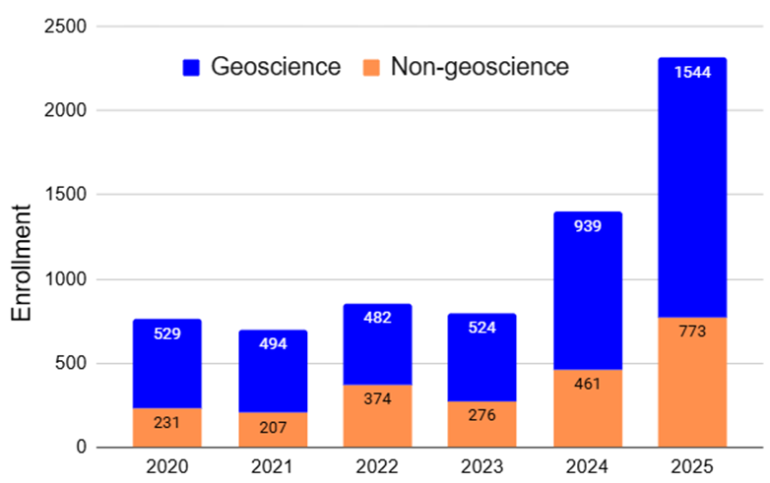
PROGRAM REACH
Large and Diverse Enrollment in the SSBW
~3×
growth in annual enrollment since 2020
~30%
non-geoscience enrollment every year
= recruiting opportunity!
~30%
under-represented minorities (URM)
compared to ~15% for geo degrees
Notes:
This program has grown substantially and reaches students beyond traditional geoscience majors
Enrollment has tripled since 2020.
Around 30% of participants are not geoscience majors, making this a great recruitment pathway.
About 30% are from underrepresented groups, roughly double the proportion typically seen in geoscience degrees.

Slide 3
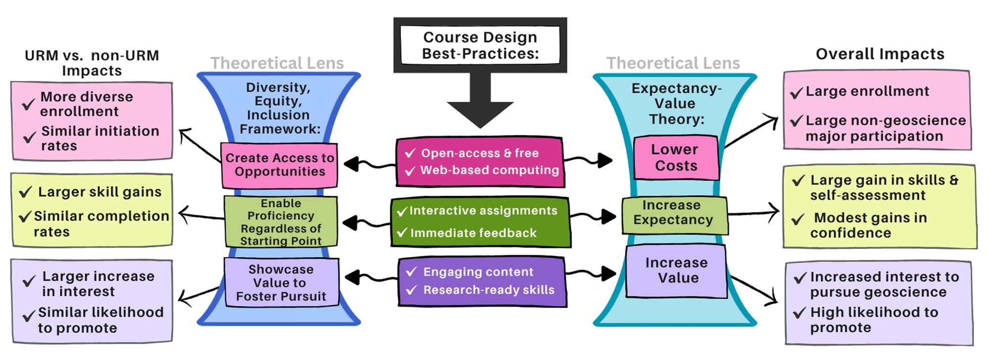
CONCEPTUAL FRAMEWORK
Alignment Between EVT & DEI to Broaden STEM Participation
See Poster #30 for Details!
Notes:
This work is grounded in Expectancy-Value Theory and DEI principles, which together suggest that increasing skills, confidence, and reducing barriers encourages long-term participation. I'll focus on the results today but feel free to stop by my poster tomorrow to talk more about this

Slide 4
RESEARCH QUESTION
What are the long-term impacts of the SSBW on participants' subsequent actions, their perspectives on the workshop's influence and value, and their self-perception of skills and expectancy?
Measured through a follow-up survey linked to registration and pre/post workshop data.
Notes:
Our question was simple:
What long-term impact does participating in SSBW have on participants' actions, perceptions, and confidence?

Slide 5
METHODS
A 35-Question Follow-Up Survey
Developed and implemented in Qualtrics
(Brudzinski et al., 2026, doi: 10.17603/ds2-9a0t-a232)
The invitation email let responses be linked to each participant's registration and survey data at the start and end of the SSBW.
1
Post-workshop actions
What participants did after the SSBW
Perspectives on the SSBW
2
Influence, value, and relevance
Self-Perception
3
Skills, capability, and confidence
4
35
Subgroup variables
4
survey questions
measurement domains
Career status, field, and cohort
Notes:
Follow-up survey sent to former participants.
Four domains:
actions after workshop
perspectives
self-perception
demographic differences

Slide 6
SAMPLE
Participants & Data Collection
The survey was emailed in September 2025 to all participants from summers 2020–2024 who had completed the SSBW.
751
153
completers invited
complete responses
>20%
≥21
response rate
respondents per cohort year
2024 cohort respondents were ~2× as common as earlier years: the most recent participants were the most likely to reply.
Notes:
751 invited
153 responses
just over 20% response rate
This allowed us to examine outcomes several years after participation.

Slide 7
SAMPLE
Who Responded and When They Participated
~50%
were currently employed at follow-up; 42% were currently students
88%
remain at least somewhat involved in geoscience:
Up from the 76% who were geoscience majors during the SSBW
20%
were graduate students when they took the SSBW
30%
were already employed
Though designed for advanced undergraduates, the SSBW increasingly serves graduate students and working professionals, which is consistent with 2026 registration.
Notes:
Half are now employed.
Many others are graduate students.
Nearly 90% are still involved in geoscience.
Although the workshop was originally designed for advanced undergraduates, it's increasingly serving graduate students and professionals as well.

Slide 8
01
Post-SSBW Actions
What participants did after completing the workshop
Notes:
First I'll look at what participants actually did after completing the workshop.

Slide 9
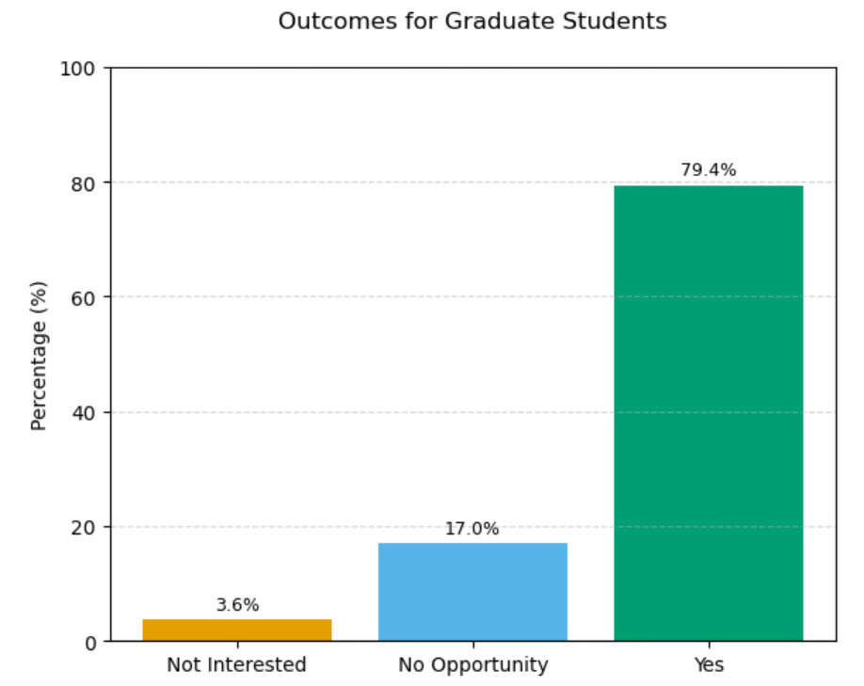
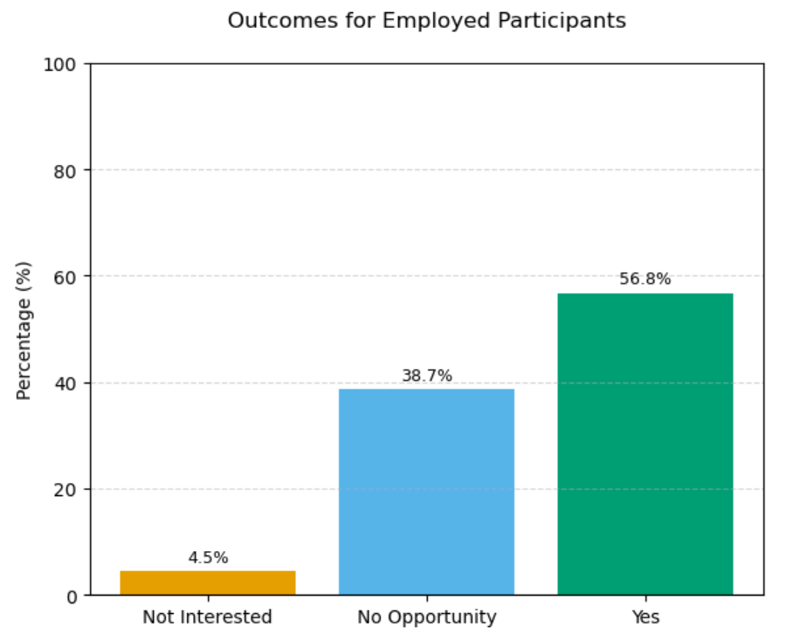
POST-SSBW ACTIONS
Influence of Employment on Post-SSBW Actions
Actions = Additional computing training, Geophysics course, or Geophysics research
Most non-action reflects lack of opportunity rather than lack of interest.
Notes:
Participants who were students generally had more opportunities to continue with computing training, research, or coursework. Those already employed reported fewer actions, but this likely reflects fewer opportunities rather than lack of interest.

Slide 10
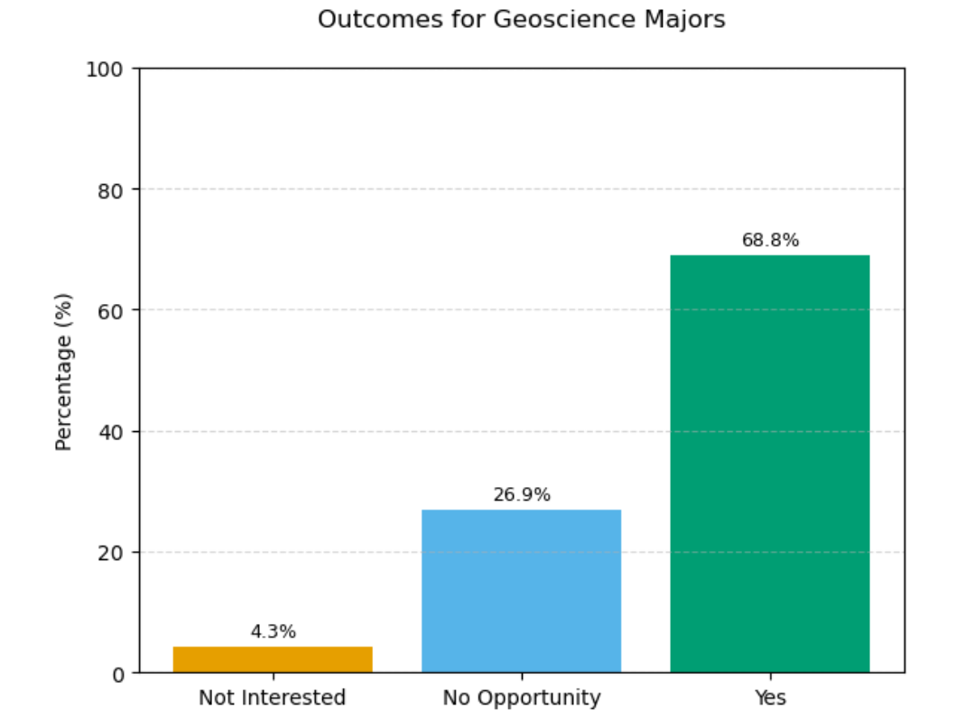
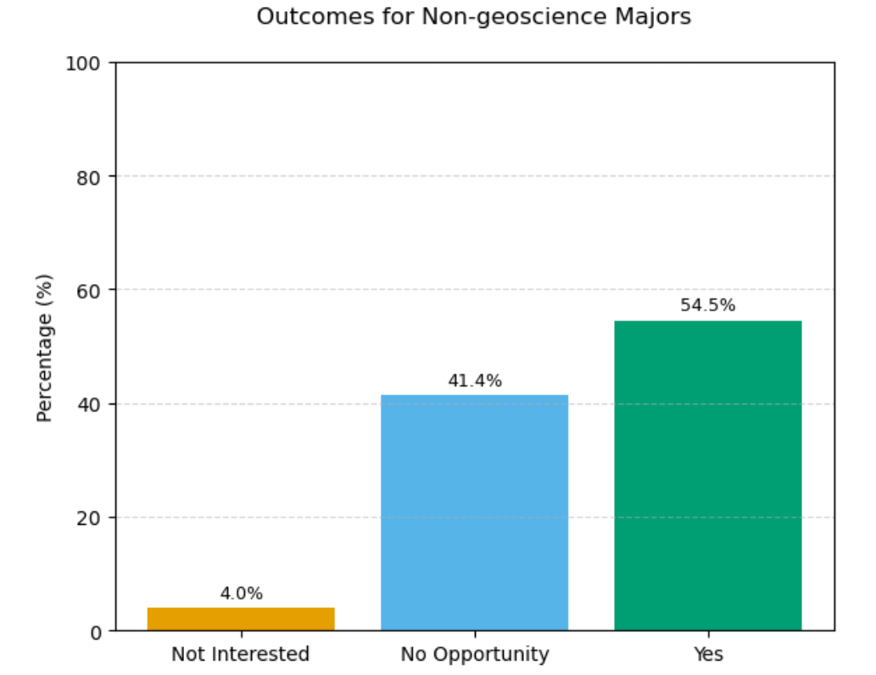
POST-SSBW ACTIONS
Influence of Non-Geoscience Background on Actions
Both groups actions post-SSBW, but non-geoscience majors report fewer opportunities to do so.
Notes:
Participants from non-geoscience backgrounds also took action after the workshop.
They simply reported fewer opportunities to apply those skills, which makes sense given their different career paths.

Slide 11
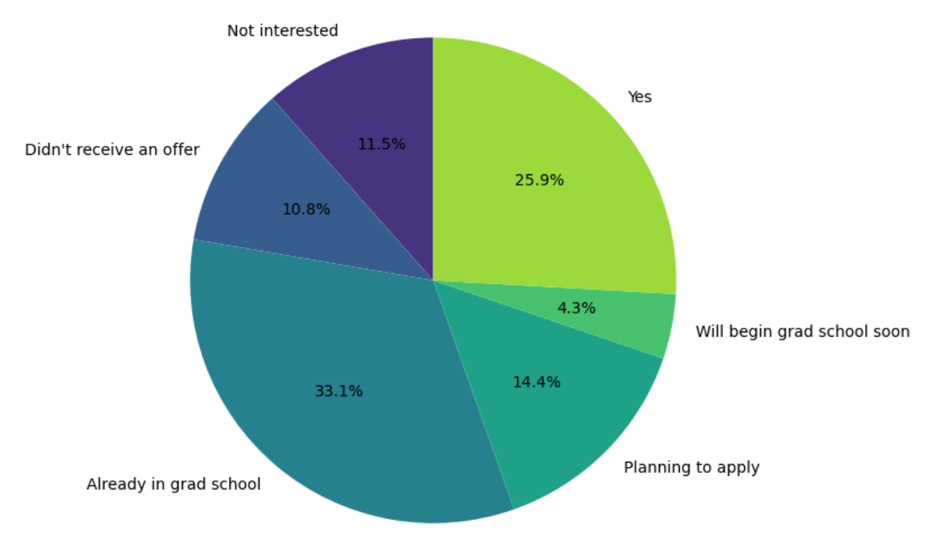
POST-SSBW ACTIONS
Attended Graduate School after SSBW?
22%
were not interested in grad school
or didn't receive an offer
A large share of participants continue into graduate study, and additional respondents are actively planning or about to begin.
Notes:
A large portion of participants eventually attended graduate school or were planning to.
The 22% largely represents people who either weren't interested or didn't receive an offer.

Slide 12
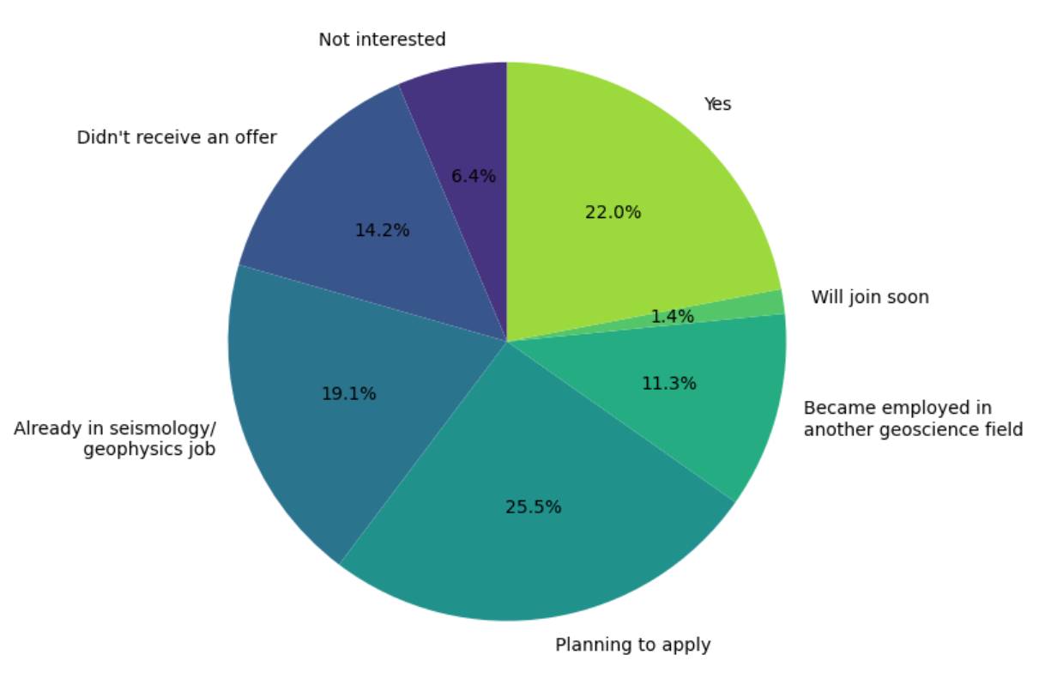
POST-SSBW ACTIONS
Seismology / Geophysics Job after SSBW?
21%
not interested in a job
or didn't receive an offer
Many participants have moved into jobs in seismology/geophysics and adjacent geoscience fields or plan to apply.
SSBW feeds a range of downstream career paths.
Notes:
Many participants moved into seismology, geophysics, or related careers."
The workshop appears to support several different career pathways.

Slide 13
02
Perspectives on the SSBW
How participants rated the workshop's influence and value
Notes:
Our next question was whether participants felt the workshop actually influenced those decisions.

Slide 14
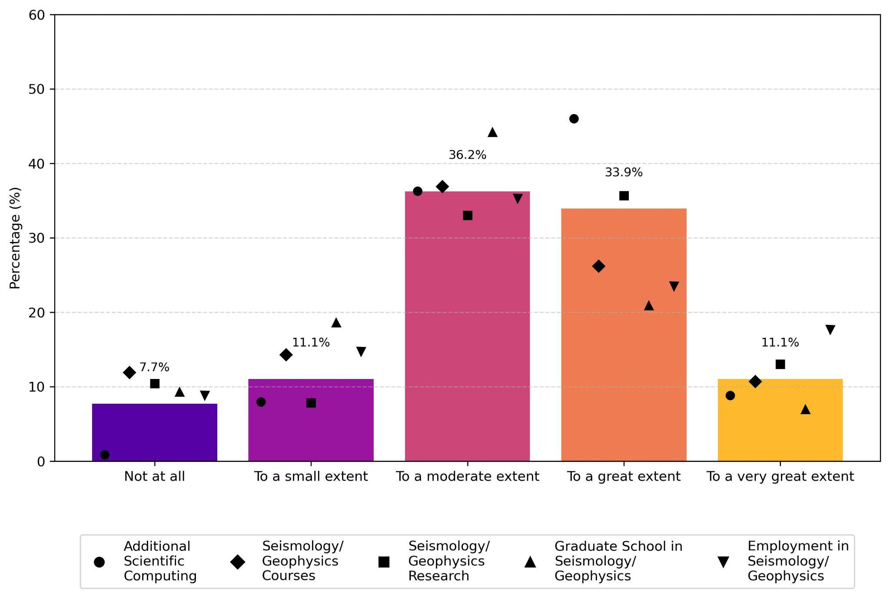
PERSPECTIVES
Influence of the SSBW on Subsequent Actions
>80%
rated the SSBW's influence 'moderate' to 'very great' on their post-SSBW activities
Across all five post-workshop action types, participants credit the SSBW with a substantial role in what they did next.
Notes:
Across every type of post-workshop activity, over 80% of participants reported that the workshop had at least a moderate influence on what they did afterward

Slide 15
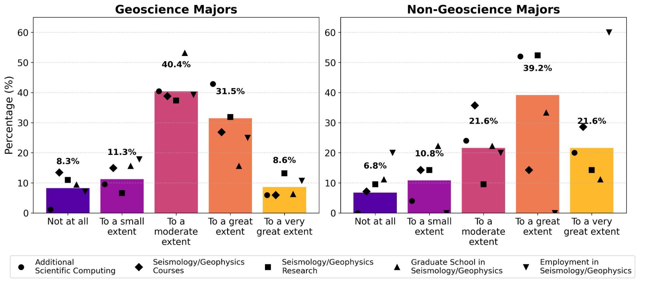
PERSPECTIVES
Greater Influence for Non-Geoscience Majors
>60%
of non-geoscience majors chose 'great' to 'very great'
~40%
for geoscience majors, by comparison
The SSBW's influence is greatest for participants without traditional geoscience training.
Notes:
The workshop had an even stronger impact for participants outside traditional geoscience
Over 60% rated the influence as great or very great, compared with roughly 40% of geoscience majors
This suggests the workshop is especially valuable for bringing new people into the field

Slide 16
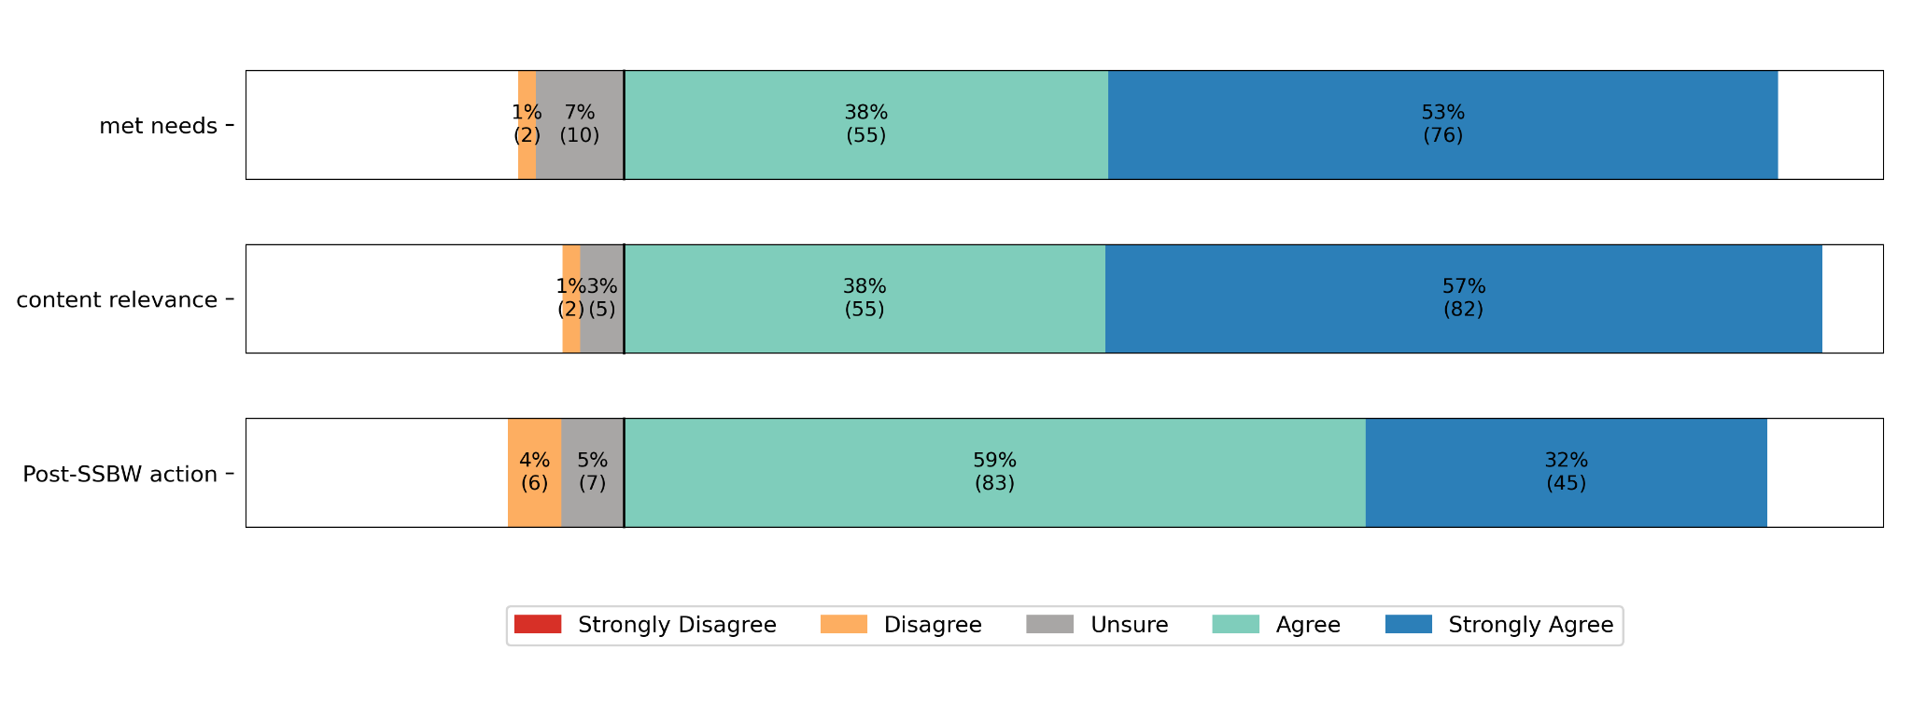
PERSPECTIVES
How Well the SSBW Met Needs & Content Was Relevant
Strongly Agree
the dominant response for whether SSBW met participant needs and whether SSBW content was relevant
Notes:
Participants overwhelmingly agreed that the workshop met their needs and that the content was relevant to their goals."

Slide 17
03
Self-Perception
Participants' sense of their own skills and capability
Notes:
Our final question focused on confidence and self-perception.

Slide 18
SELF-PERCEPTION
Capable of Taking Post-SSBW Action
Agree to Strongly Agree
the dominant responses on capability to act based on what they learned
Confidence in applying methods and effectiveness at tackling scientific-computing challenges follow the same pattern.
Notes:
Most participants agreed they felt capable of applying what they learned.
This wasn't just knowledge—it translated into confidence.

Slide 19
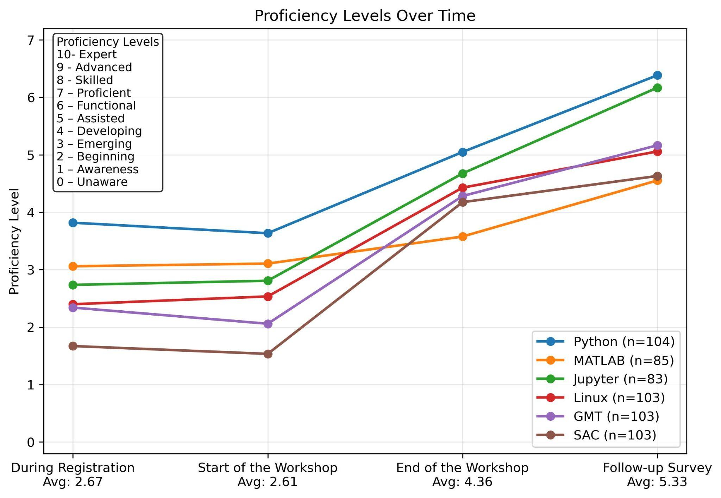
SELF-PERCEPTION
Self-Perception of Scientific Computing Skills
2.6 → 5.3
average proficiency, registration → follow-up
Skill self-perception grew most sharply during the SSBW (2.6 → 4.4) and has kept rising in the years since across all six tools.
Notes:
Participants rated their scientific computing proficiency at about 2.6 before the workshop
That increased dramatically during the workshop, but what's especially interesting is that it continued increasing years afterward, reaching an average of 5.3.
That suggests participants kept using and building on these skills over time.

Slide 20
04
Connections Over Time
Linking interest and preparation during the SSBW to later action
Notes:
Finally, we wanted to connect participants' experiences during the workshop with what happened later.

Slide 21
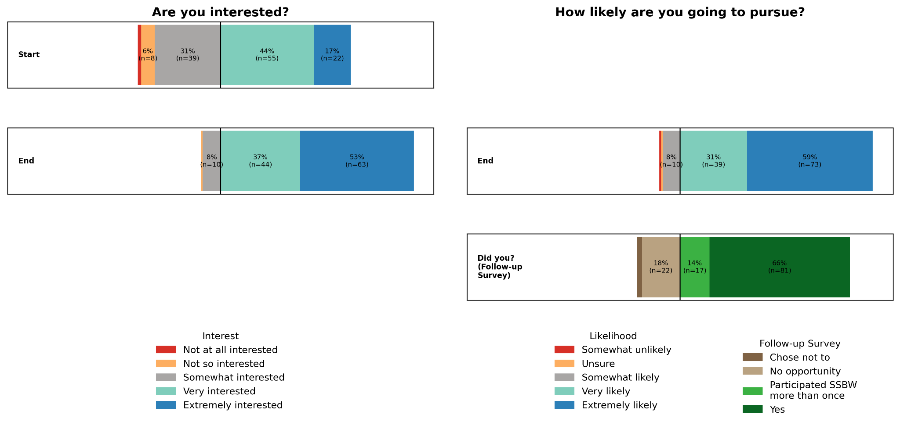
CONNECTIONS OVER TIME
Interest, Pursuit & Result — Scientific Computing
Interest at the start and end of the workshop maps onto stated likelihood to pursue and to the outcomes reported in the follow-up survey.
Notes:
these path analyses show a consistent pattern.
Higher interest and preparation during the workshop were associated with stronger intentions to continue, and those intentions were associated with participants actually taking action later

Slide 22
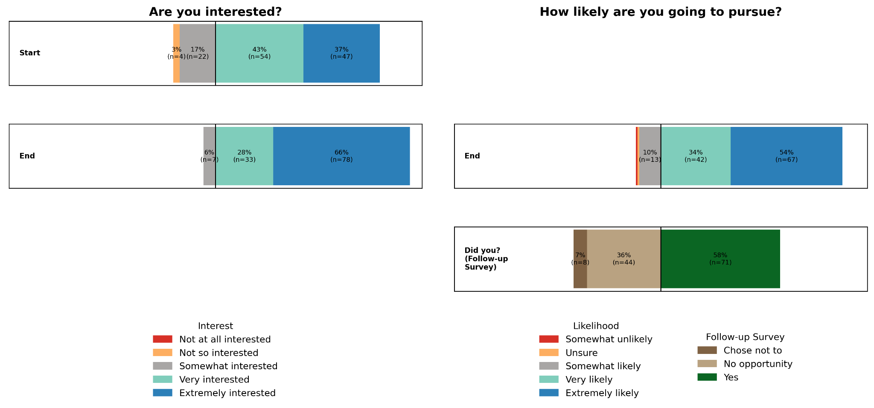
CONNECTIONS OVER TIME
Interest, Pursuit & Result — Seismology
The same interest → pursuit → result chain holds for seismology specifically.
Notes:
We see the same pattern when we look specifically at seismology. Participants who reported greater interest during the workshop were more likely to express intentions to pursue seismology afterward, and those intentions were associated with later actions, such as taking courses, conducting research, or pursuing careers in the field
Interest developed during the workshop is associated with continued engagement in seismology.

Slide 23
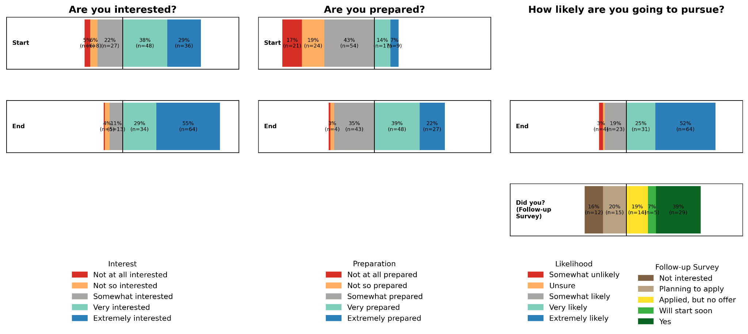
CONNECTIONS OVER TIME
Interest, Preparation, Pursuit & Result — Graduate School
For graduate school, growth in both interest and preparation during the SSBW precedes intent to pursue and later action.
Notes:
For graduate school, we observed a similar pattern. Participants who left the workshop with greater interest and a stronger sense of preparation were more likely to intend to pursue graduate school, and those intentions were associated with actually enrolling later."
This suggests the workshop not only builds technical skills but may also help participants feel prepared to take the next step academically.

Slide 24
CONCLUSIONS
What the Follow-Up Tells Us
1
Upskilling audience
30% were grad students and 20% employed when taking the SSBW, so now serving far more than advanced undergraduates.
Most act afterward
Participants generally take action post-SSBW, though employed and non-geoscience participants report fewer opportunities.
2
Strong influence
For ~80%, the SSBW had a 'moderate' to 'very great' influence on later activities and was highest for non-geo majors.
3
4
Lasting skill gains
Self-perceived scientific-computing skills grew most during the SSBW and have continued to rise since.
Interest predicts action
Gains in interest and preparation during the SSBW correlate with intent to pursue and with action taken afterward.
5
Notes:
Overall, we found five major takeaways.
these findings suggest that relatively short scientific computing training can have lasting impacts on participants' educational and career trajectories. Thank you, and I'd be happy to take questions

Slide 25

Notes:
END here. The Appendix slides are just in case questions come up

Slide 26
APPENDIX
Survey Instrument
Exact items participants responded to, by measurement domain.

Slide 27
APPENDIX · SURVEY INSTRUMENT
Post-Workshop Actions
Participants reported whether, since the workshop, they had…
developed additional scientific-computing skills (a course, a new language, or attending the SSBW again)
taken seismology or geophysics courses
engaged in seismology or geophysics research (paid or unpaid)
attended graduate school in seismology or geophysics
became employed in seismology or geophysics

Slide 28
APPENDIX · SURVEY INSTRUMENT
Perspectives on the SSBW
Participants rated how much the SSBW…
influenced each of the five post-workshop actions
met their needs
was directly relevant to their goals
provided practical skills they couldn't learn elsewhere
exceeded expectations in its value toward their growth
delivered benefits that outweighed their time and effort

Slide 29
APPENDIX · SURVEY INSTRUMENT
Self-Perception & Subgroup Variables
Self-Perception
Subgroup Variables
Participants evaluated:
Participants also provided:
their proficiency in six scientific-computing tools
how capable they were of taking action based on what they learned
their confidence in applying methods
their effectiveness at taking on scientific-computing challenges
current career status at the time of the follow-up survey
whether their current position related to geoscience or to seismology
when they participated in the SSBW

