Slide 1
Entrance Activity
Take 2 note cards and reflect on why you do fieldwork with students. On one card, write some motivating factors, and on the other card, write something that might deter you.
+
-
Why do you take students into the field?
What are the benefits?
What are the major challenges/ barriers to taking students into the field?

Slide 2
Identity as a tool
Empowering students to bring their whole selves to the field
Afternoon Mini Workshop | Earth Educators Rendezvous
July 23, 2026
Bradlee Wahid Cotton & Dr. Stephanie Shepherd
Auburn University

Slide 3
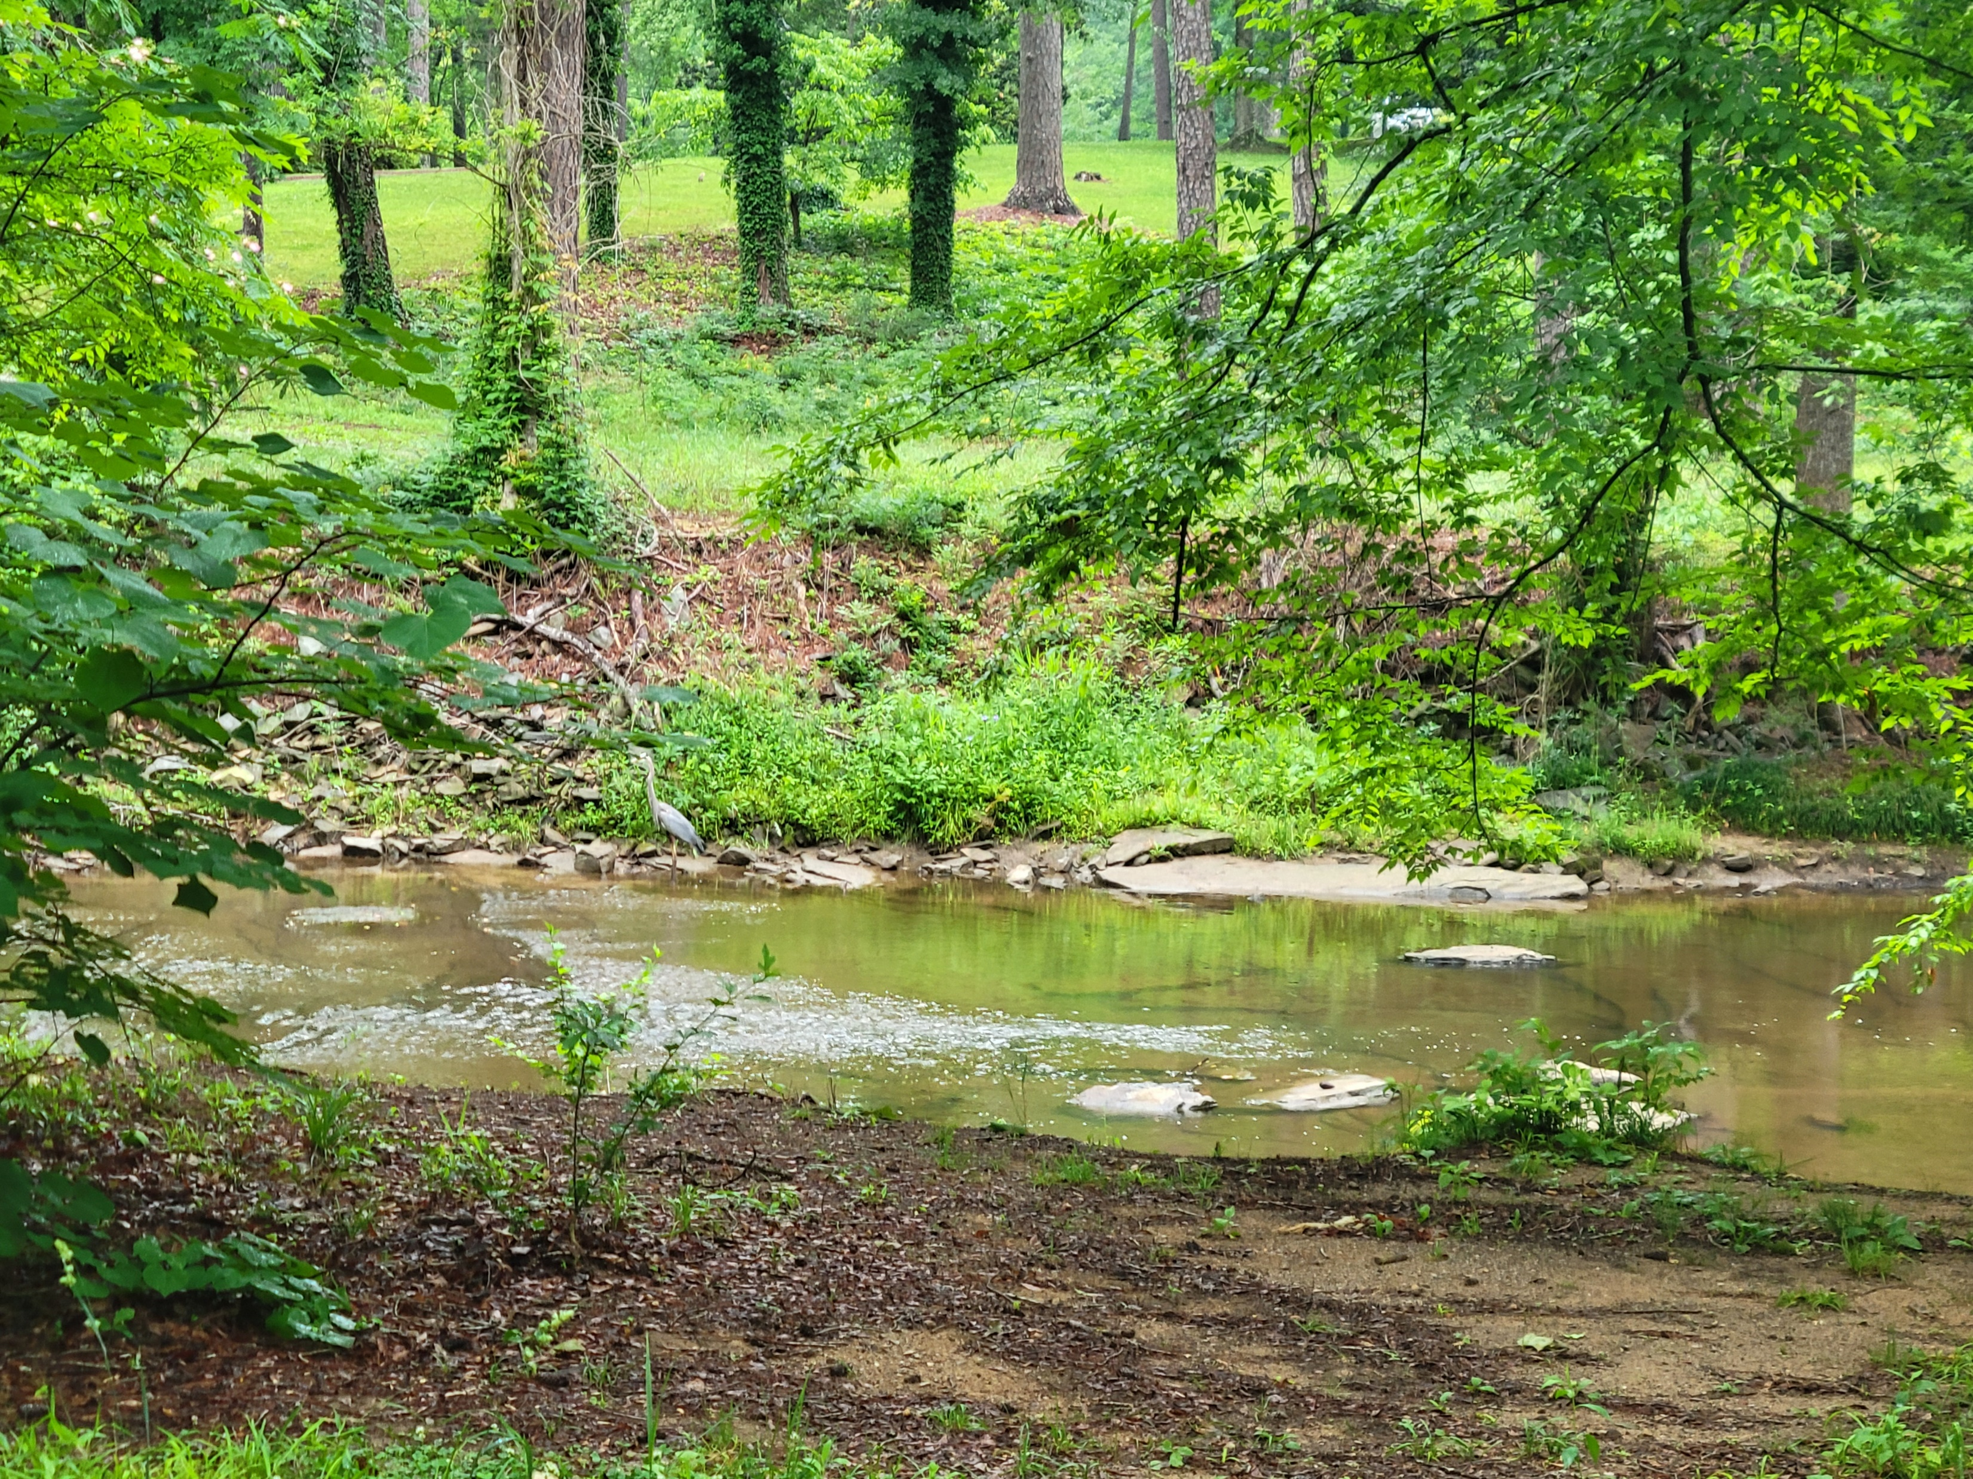
Agenda
Introductions
Identity Overview
Case Study activity
Tools, Tips, and Tricks
Apply to your own work

Slide 4
Introductions
Name
Institution
Career stage
Hometown
In what capacity do you take students to the field (how many, how often, to do what, etc.)?

Slide 5
Entrance Activity
Take 2 note cards and reflect on why you do fieldwork with students. On one card, write some motivating factors, and on the other card, write something that might deter you.
+
-
Why do you take students into the field?
What are the benefits?
What are the major challenges/ barriers to taking students into the field?

Slide 6
What is identity?
Notes:
Ask audience and write on the board

Slide 7
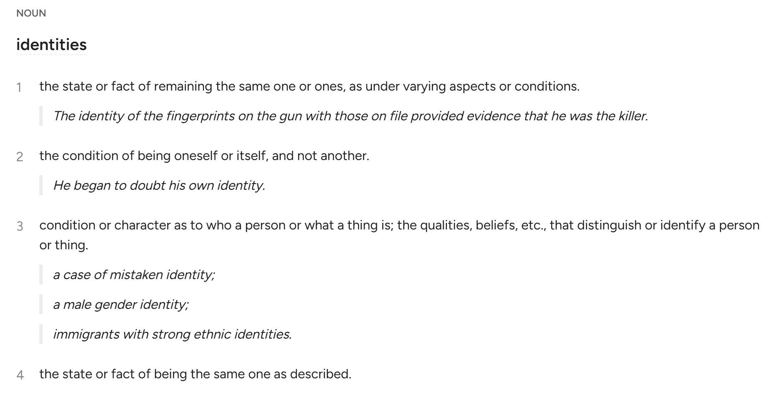
What is identity?
(Dictionary.com)
Notes:
Ask audience and write on the board

Slide 8
What is identity?
Social
“the part of an individual’s self-concept which derives from [their] membership of a social group (or groups) together with the value and emotional significance attached to that membership”
Personal
“some distinguishing characteristic (or characteristics) that a person takes a special pride in or views as socially consequential but more-or-less unchangeable.”
(Fearon, 1999)
(Tajfel, 1998)

Slide 9
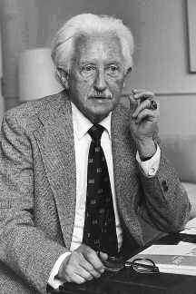
What is identity?
Commitment
In-Depth Exploration
Reconsideration of Commitment
Identity development is a life-long process
Personal and Social identities are intertwined
Values influence identity
Intersectionality of identities
(Crocetti, Rubini, & Meeus, 2008)
Erik Erickson (1950,1968)

Slide 10

Identity in the Field
What are some identity categories that can influence students’ fieldwork experiences?
Hint: Also, think about what things can contribute to our student’s identities
Notes:
Sticky notes on wall? Small group tps discussion?

Slide 11
Identity in the Field
What are some identity categories that can influence students’ fieldwork experiences?
Hint: Also, think about what things can contribute to our student’s identities
Demographics
Career stage
Major
Work experience
Prior life experiences
Hometown
Likes/dislikes
Hobbies
Religion
Relationship with Nature
Health considerations
Dietary restrictions
Notes:
Sticky notes on wall? Small group tps discussion?

Slide 12

Break
10 min
What’s next: how do we do this in practice
Notes:
worksheet

Slide 13
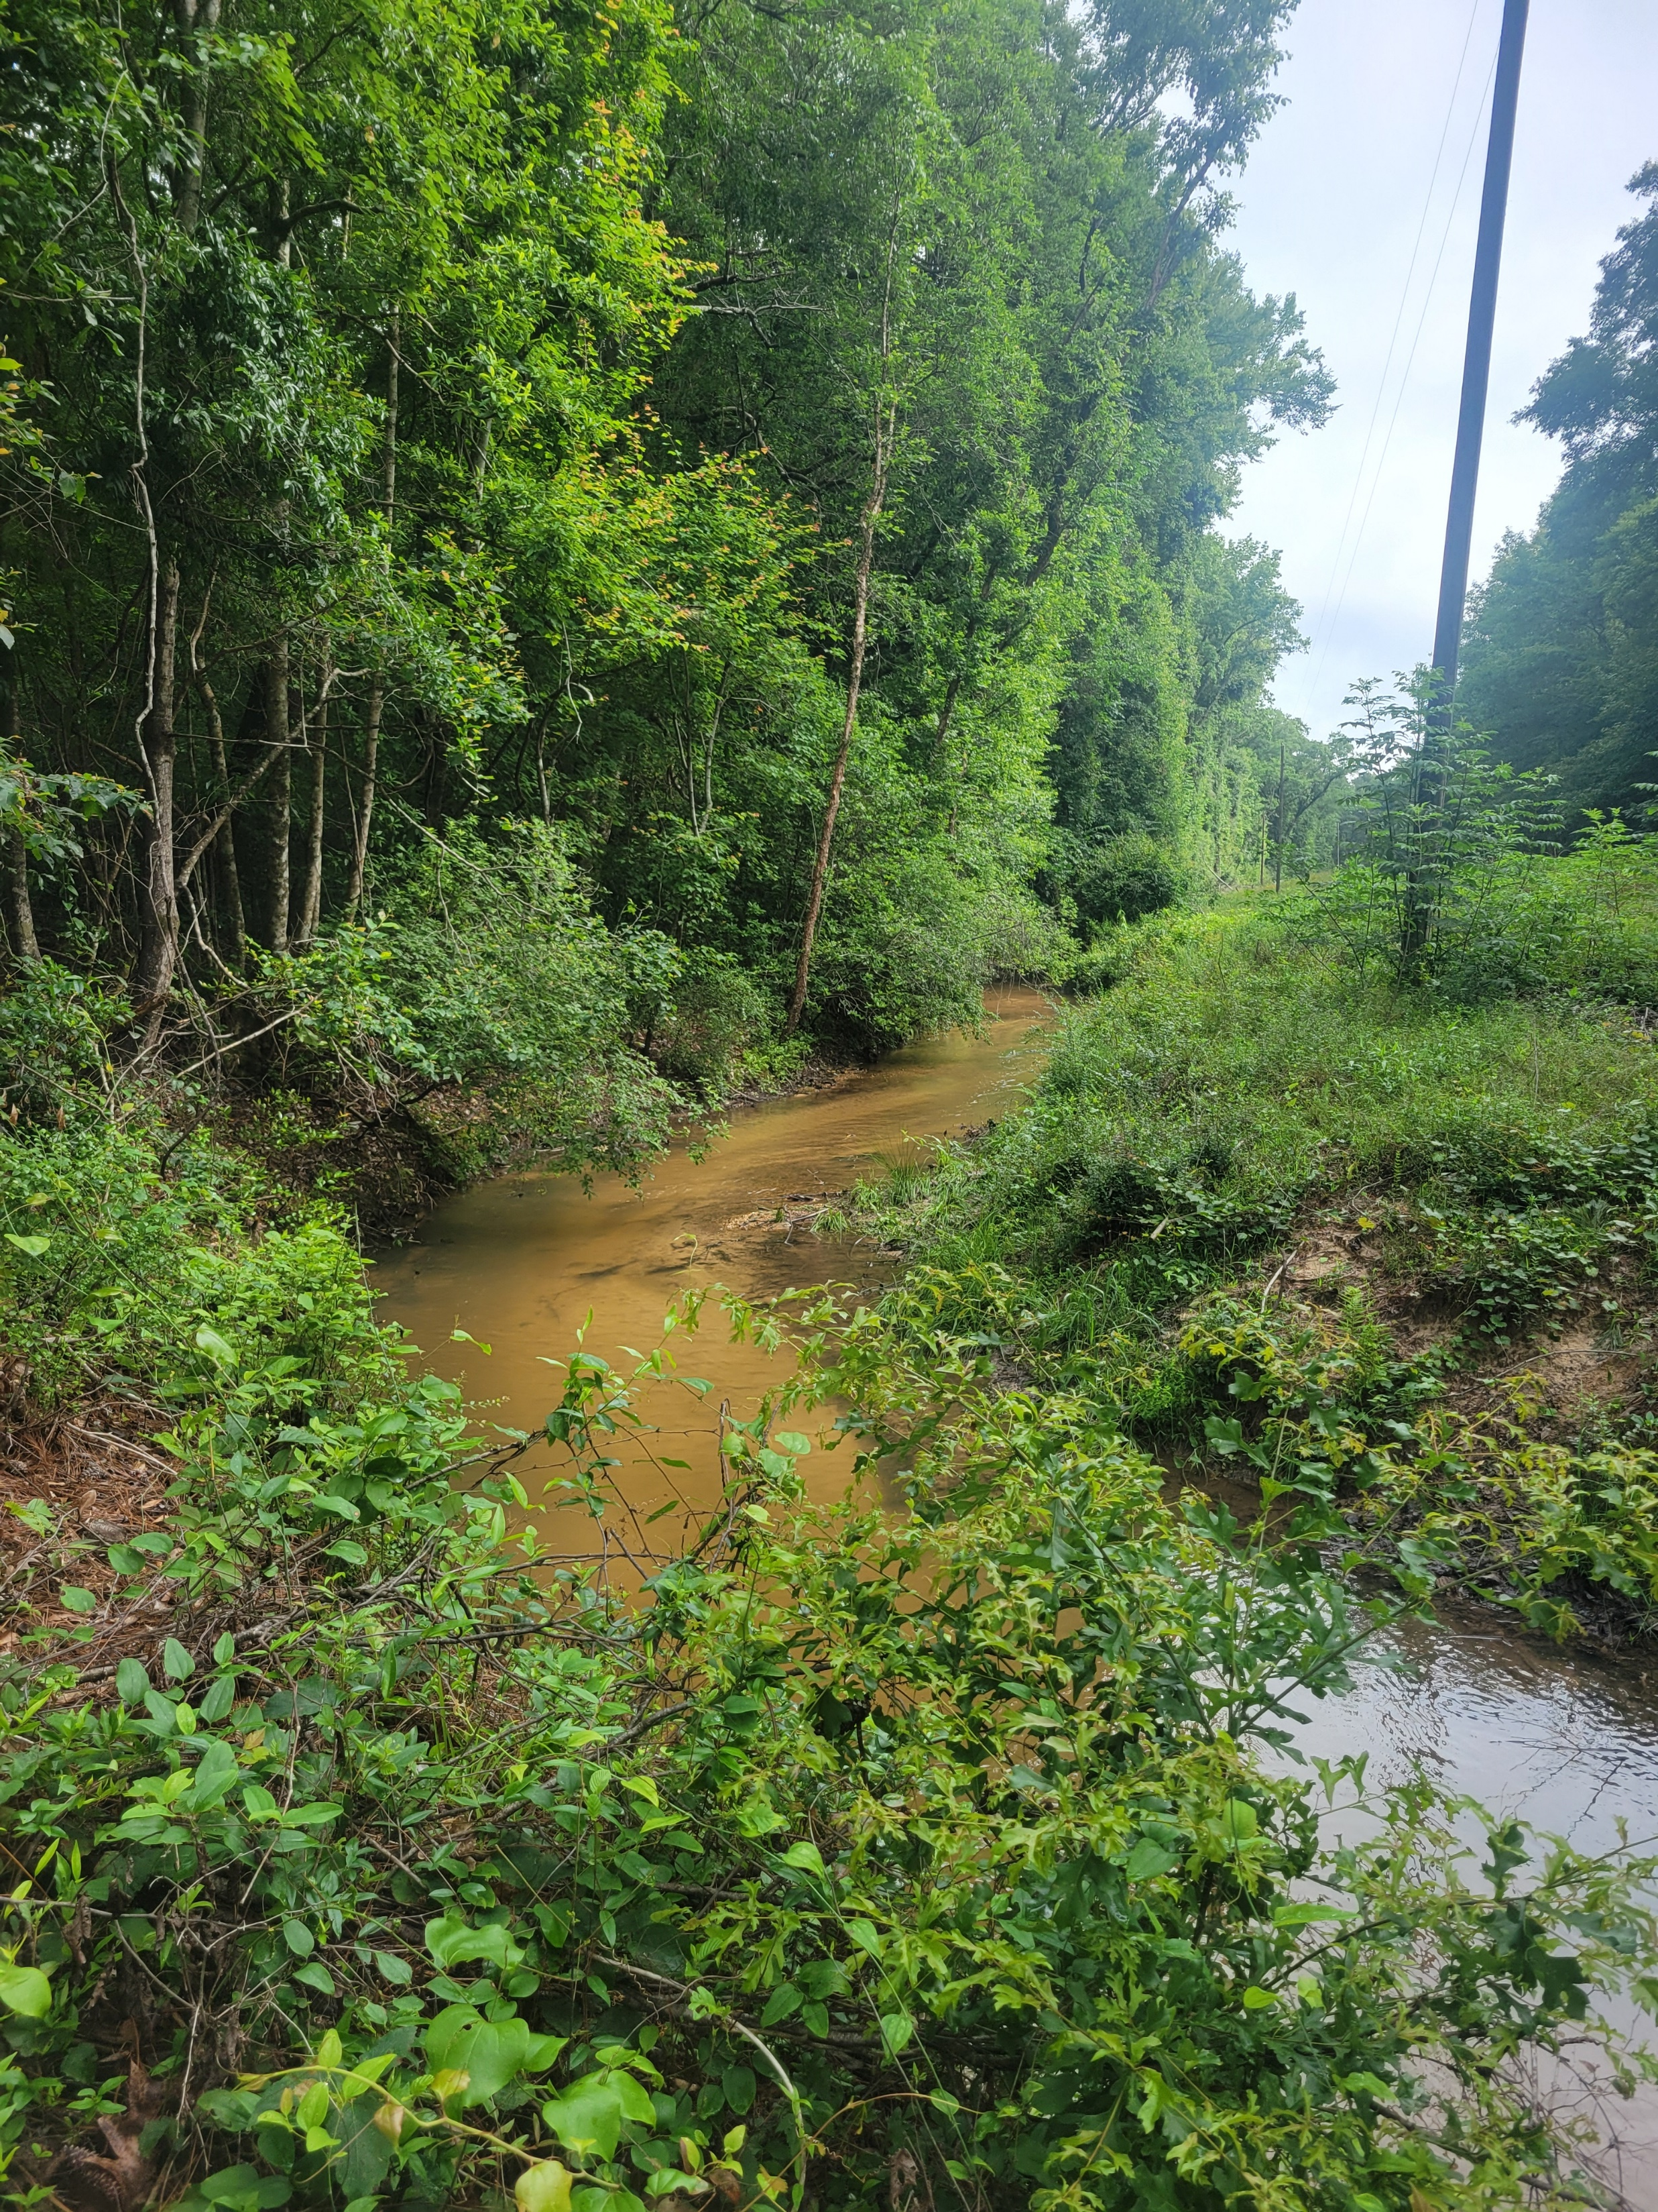
Cahaba Case Study
You are a river scientist trying to measure steam channels across the Cahaba River watershed in central Alabama. You are also interested in understanding how to better teach students how to collect geomorphic data, so you decide to take four novice undergraduate students to help collect your data. On the second Thursday in May, you and your field assistants head to the first site, Williams Branch, which is located outside of Selma, AL (~2.5 hours away from campus).

Slide 14
Identity Considerations
1
Who am I?
2
Where am I going?
3
Who am I taking with me?

Slide 15
Identity Considerations
1
Who am I?
Increasing uncertainty
Decreasing control
2
Where am I going?
3
Who am I taking with me?

Slide 16
Identity Considerations
1
Who am I?
Increasing uncertainty
Decreasing control
2
Where am I going?
3
Who am I taking with me?

Slide 17
Tools for Bringing Identity into the Field
Before leaving
In the field
After returning

Slide 18

Tools for Bringing Identity into the Field
Before leaving
In the field
After returning
Prepare yourself and your students
Pre-departure meeting
Orientation
Surveys
Polls

Slide 19

Tools for Bringing Identity into the Field
Before leaving
In the field
After returning
Prepare yourself and your students
Allow time and space
Pre-departure meeting
Orientation
Surveys
Polls
Discussion
Journalling
Guided observations
Sketching

Slide 20

Tools for Bringing Identity into the Field
Before leaving
In the field
After returning
Prepare yourself and your students
Allow time and space
Encourage reflection
Pre-departure meeting
Orientation
Surveys
Polls
Discussion
Journalling/sketching
Guided observations
Group roles
Summary
Assessment
Evaluation
Feedback

Slide 21
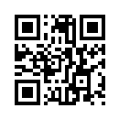
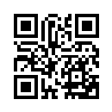
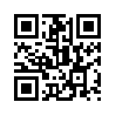
Practice
Break into groups based on where you want to spend some energy working on highlighting identity in your own fieldwork.
Before leaving
In the field
After returning
Prepare yourself and your students
Allow time and space
Encourage reflection
Pre-departure meeting
Orientation
Surveys
Polls
Discussion
Journalling
Guided observations
Sketching
Summary
Assessment
Evaluation
Feedback
Pre-Departure Survey
Impactful Moments Survey
Post Field Survey

Slide 22
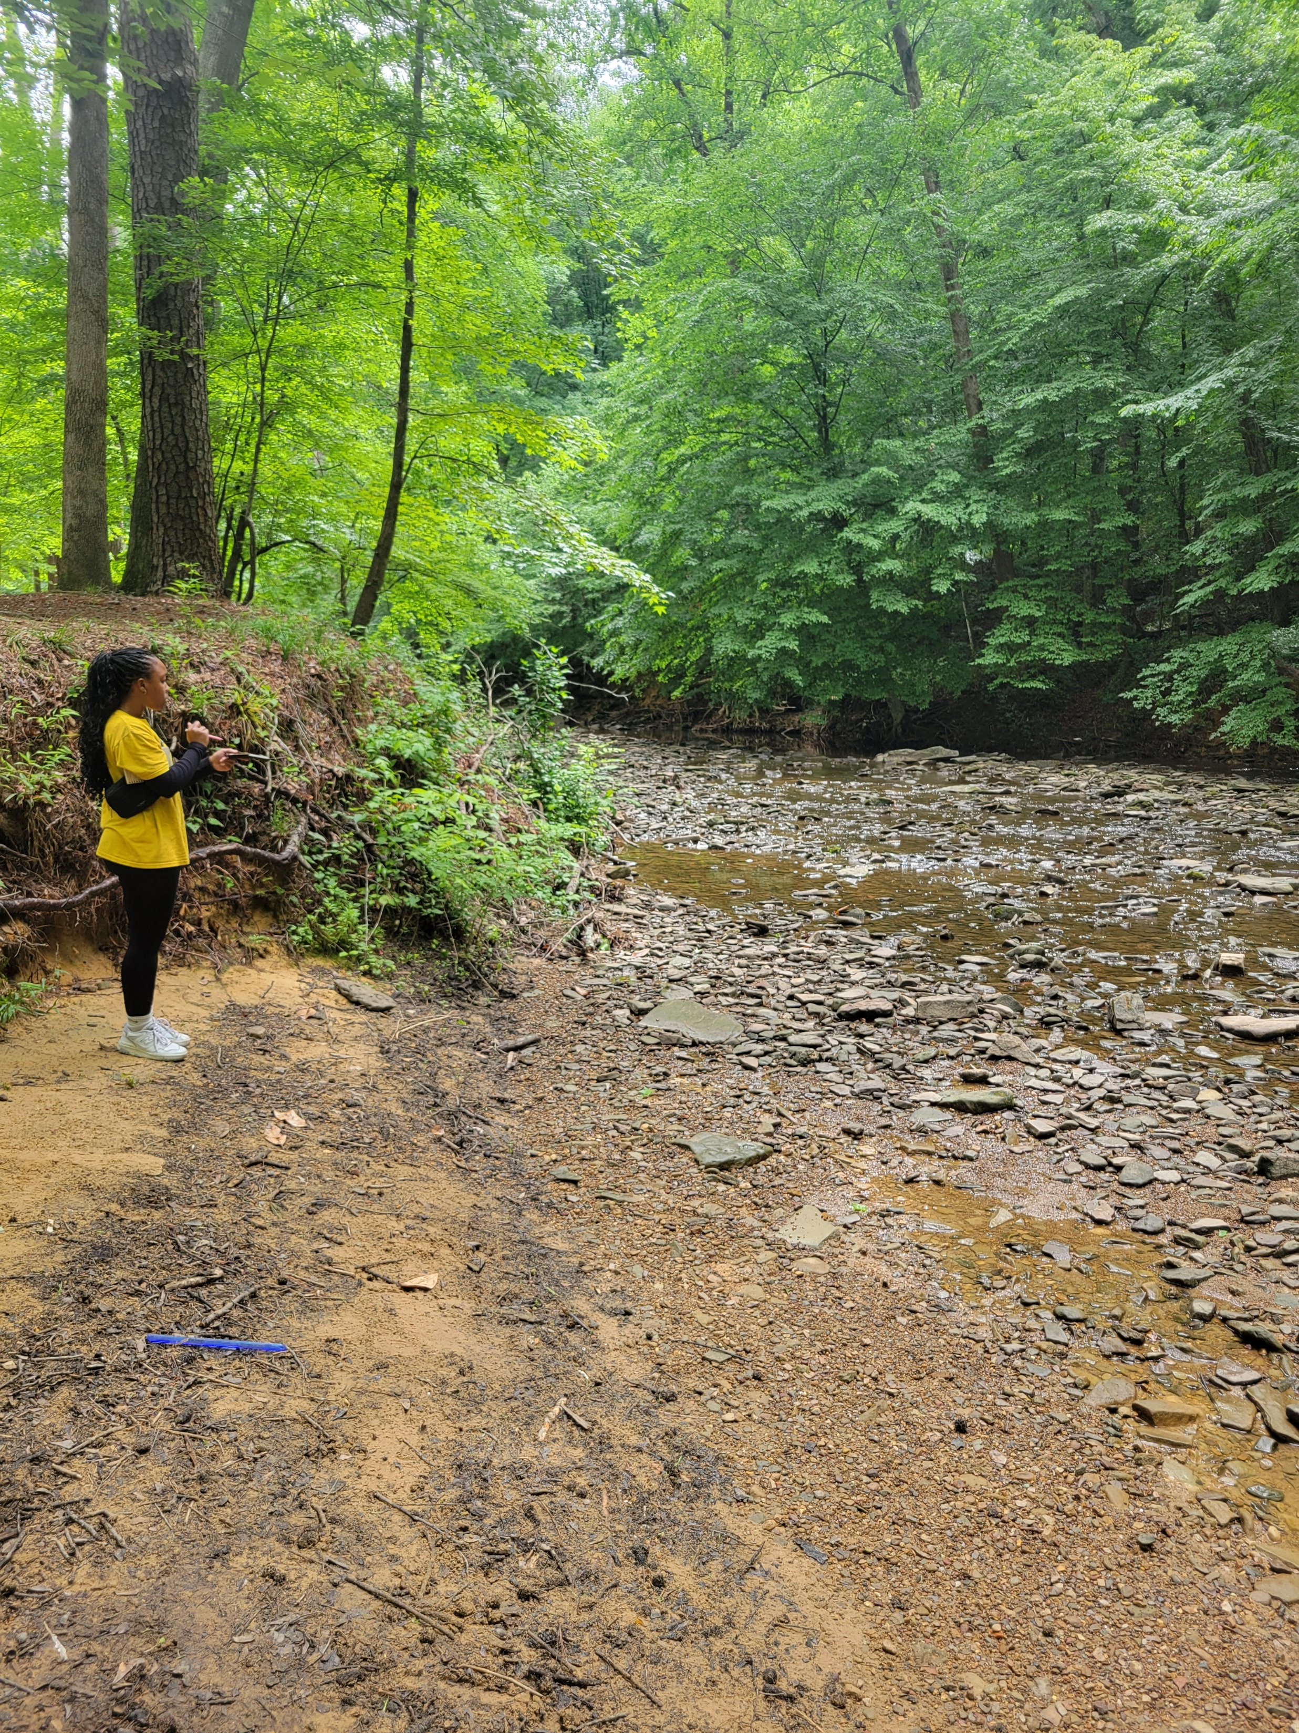
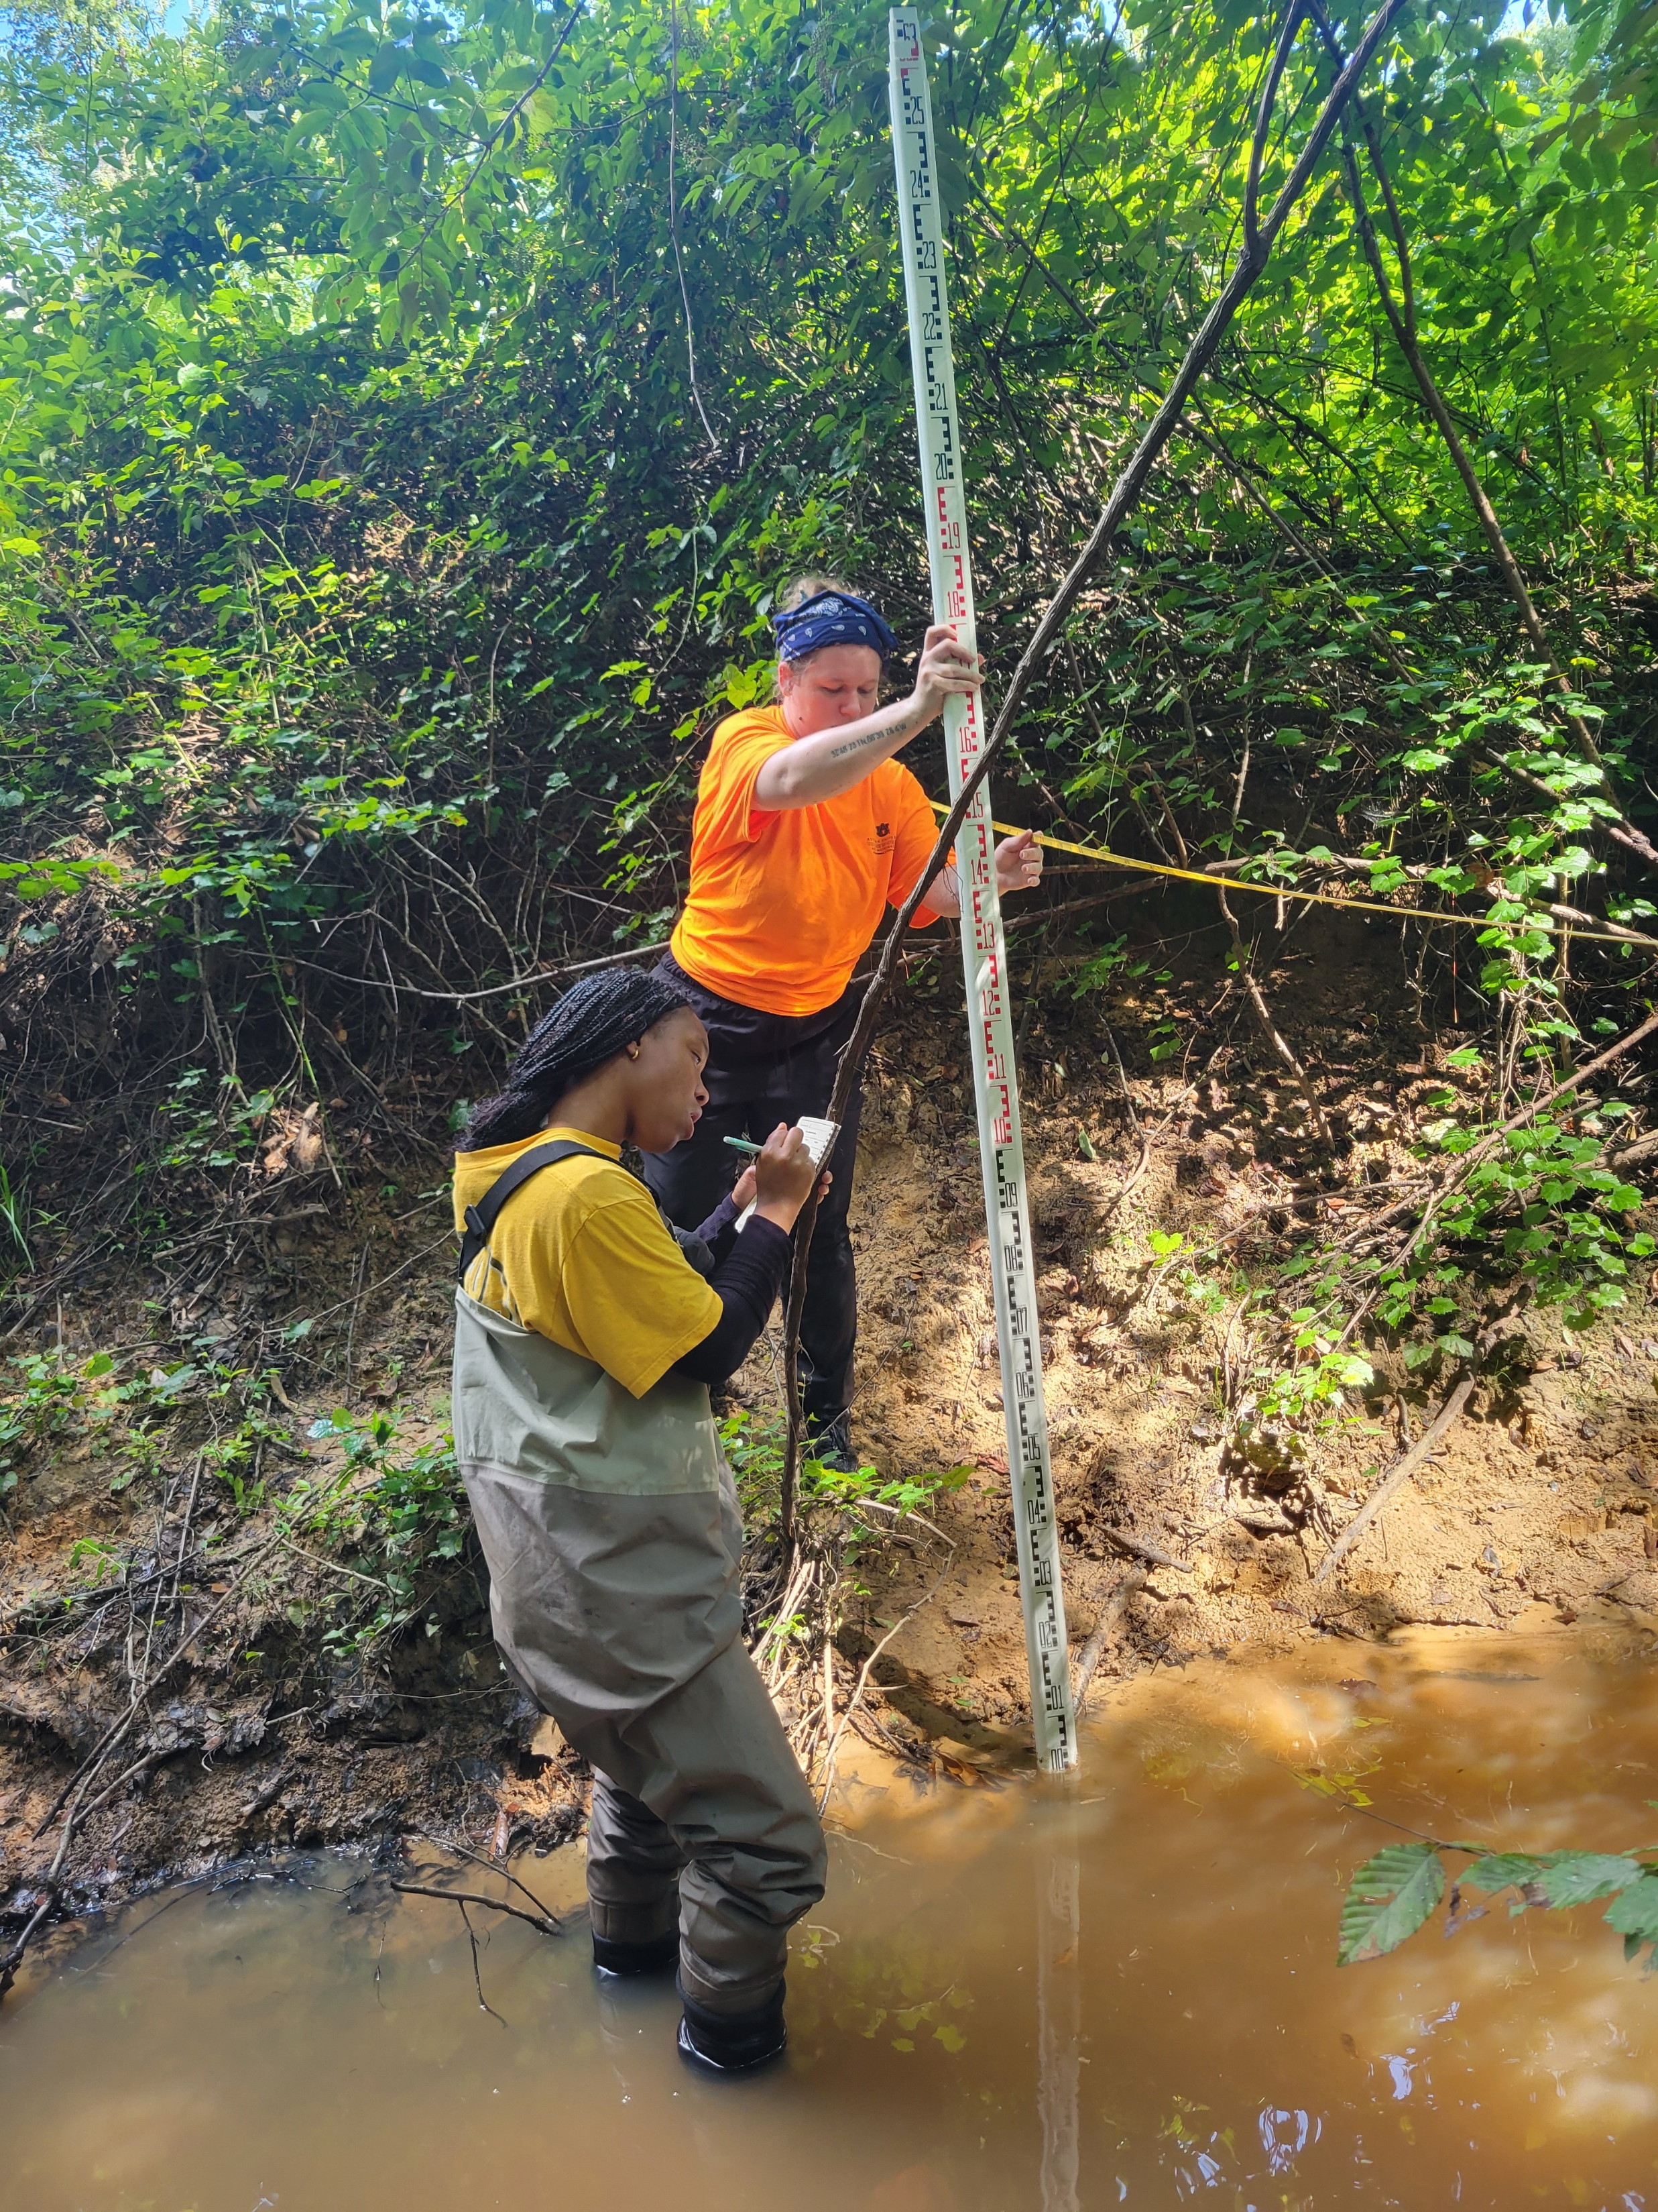
Cahaba Success Story
“Wasn’t as bad as I thought it would be.” (MacKenzie)
“I loved being out in the real world doing real science; it was the first time I felt like I was actually being the person I had always imagined I would become as a kid.” (Lev)
“My greatest takeaway is probably a degree a confidence that I can actually do the work. It’s easy to imagine ‘science’ as something inaccessible or incomprehensible, but it isn’t; you just need to learn and to be taught.” (Lev)
First Day – May 28, 2026
Last Day – July 7, 2026

Slide 23
References

