Slide 1
Listening to Earth's Secrets:
What earthquakes reveal
Sponsored by
NSF National Geophysical Facility
July 20, 2026

Slide 2
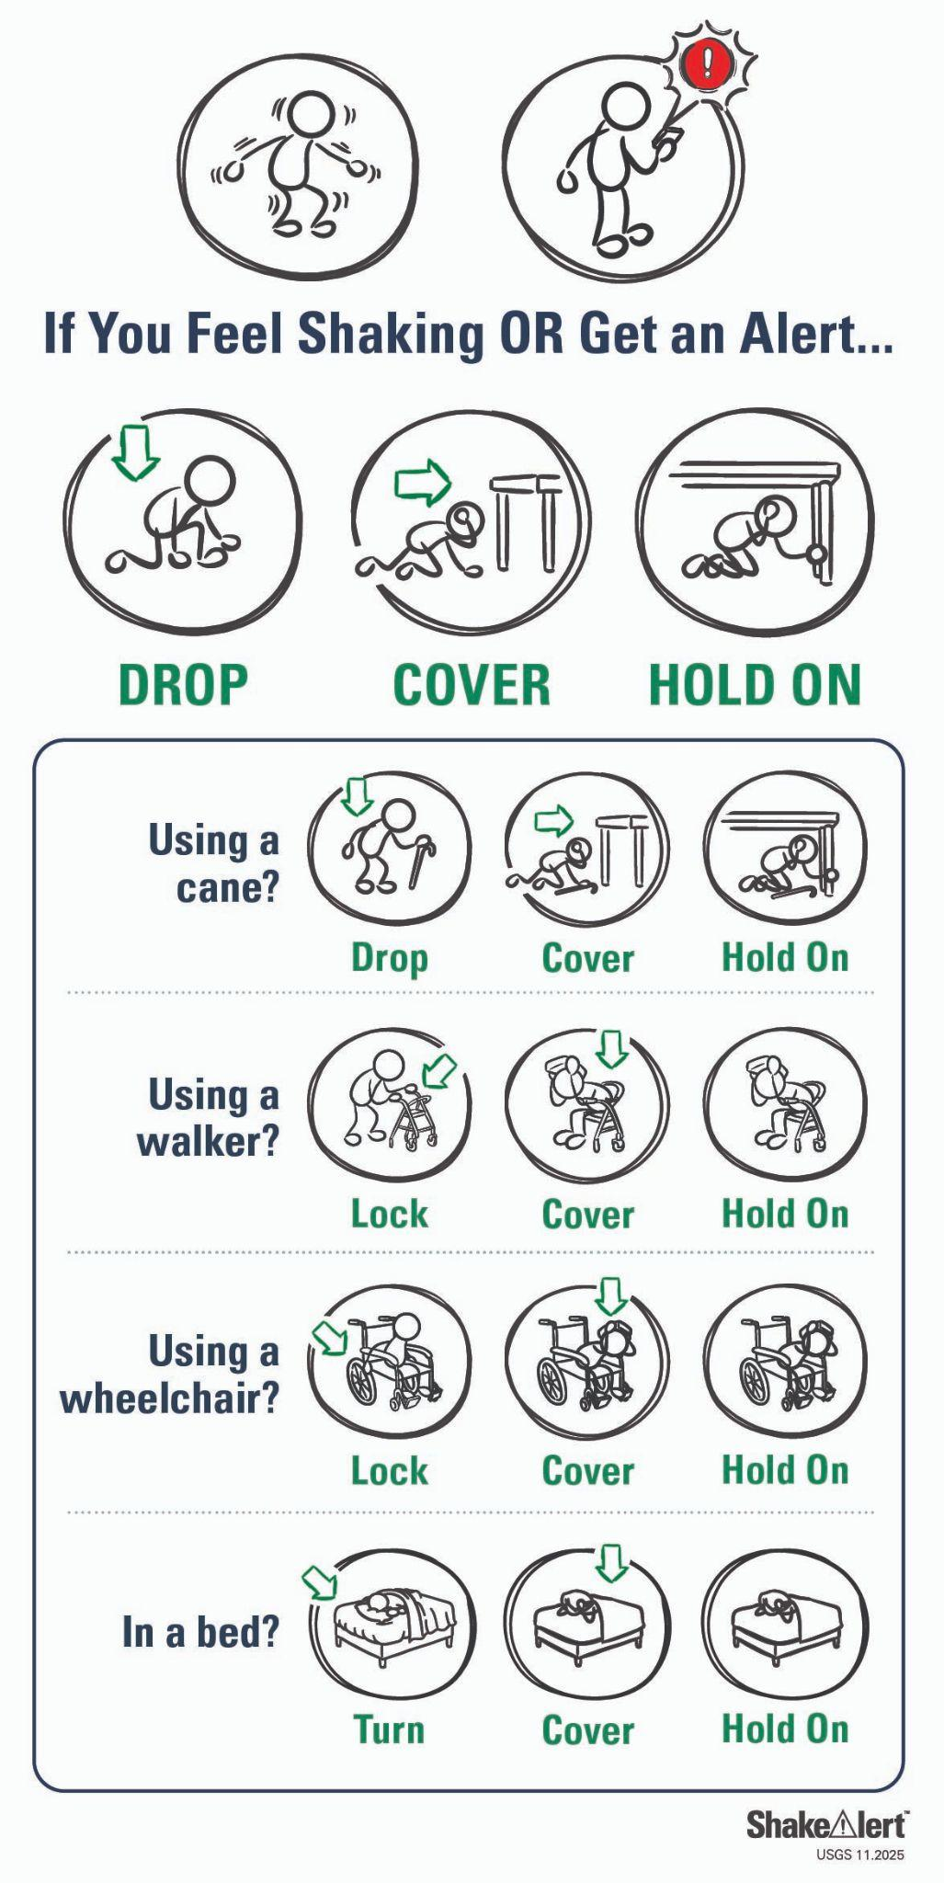

Safety
Earthquake
Evacuation

Slide 3
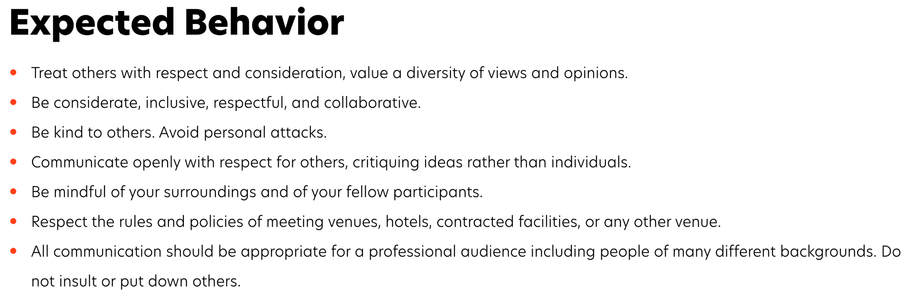
Earthscope Code of Conduct
https://www.earthscope.org/earthscope-code-of-conduct/
(Link is also on the program page)
Notes:
Beth 8-9am for intro and icebreaker -

Slide 4
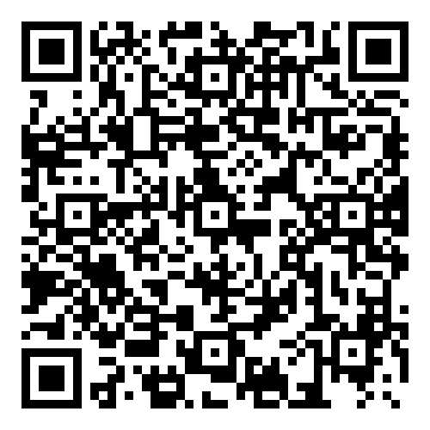
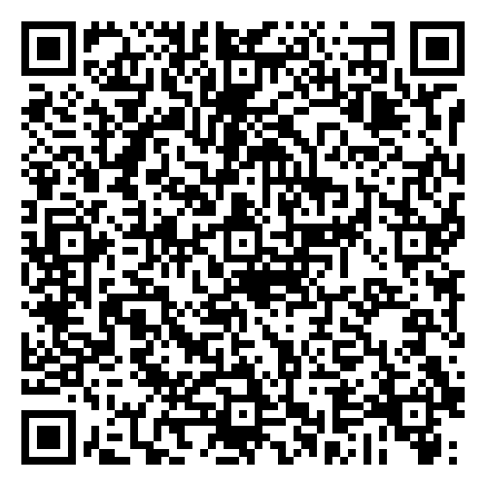
Today's Agenda
1:30-1:55 | Introduction
1:55-2:35 | Digging into Earth's Layers Interactive Poster: What's Inside the Earth? Determining and Measuring Earth's Layered Interior
2:35-2:45 | Break
2:45-3:30 | Apps in Action Interactive Earthquake Browser EQLocate - Gridsearch
3:30-4:00 | Debrief & Next Steps Review strategies Implementation Plan Post survey
Google
Word

Slide 5
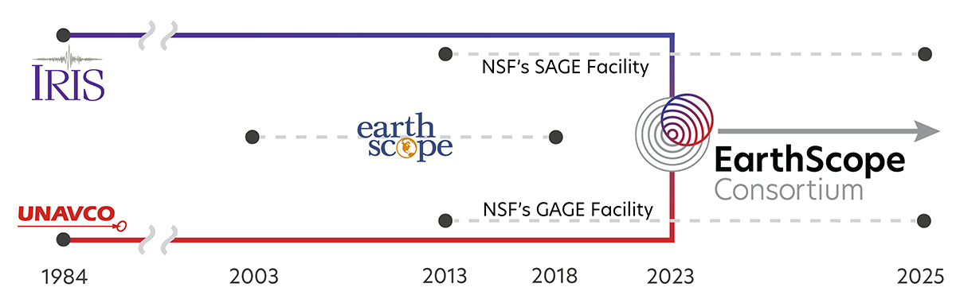
NSF National Geophysical Facility
Supports scientists and educators, in the US and worldwide, in their investigation of the complex dynamic systems that shape our planet.

Slide 6
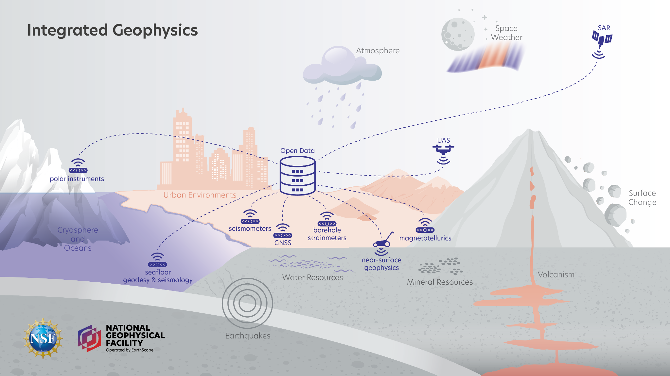
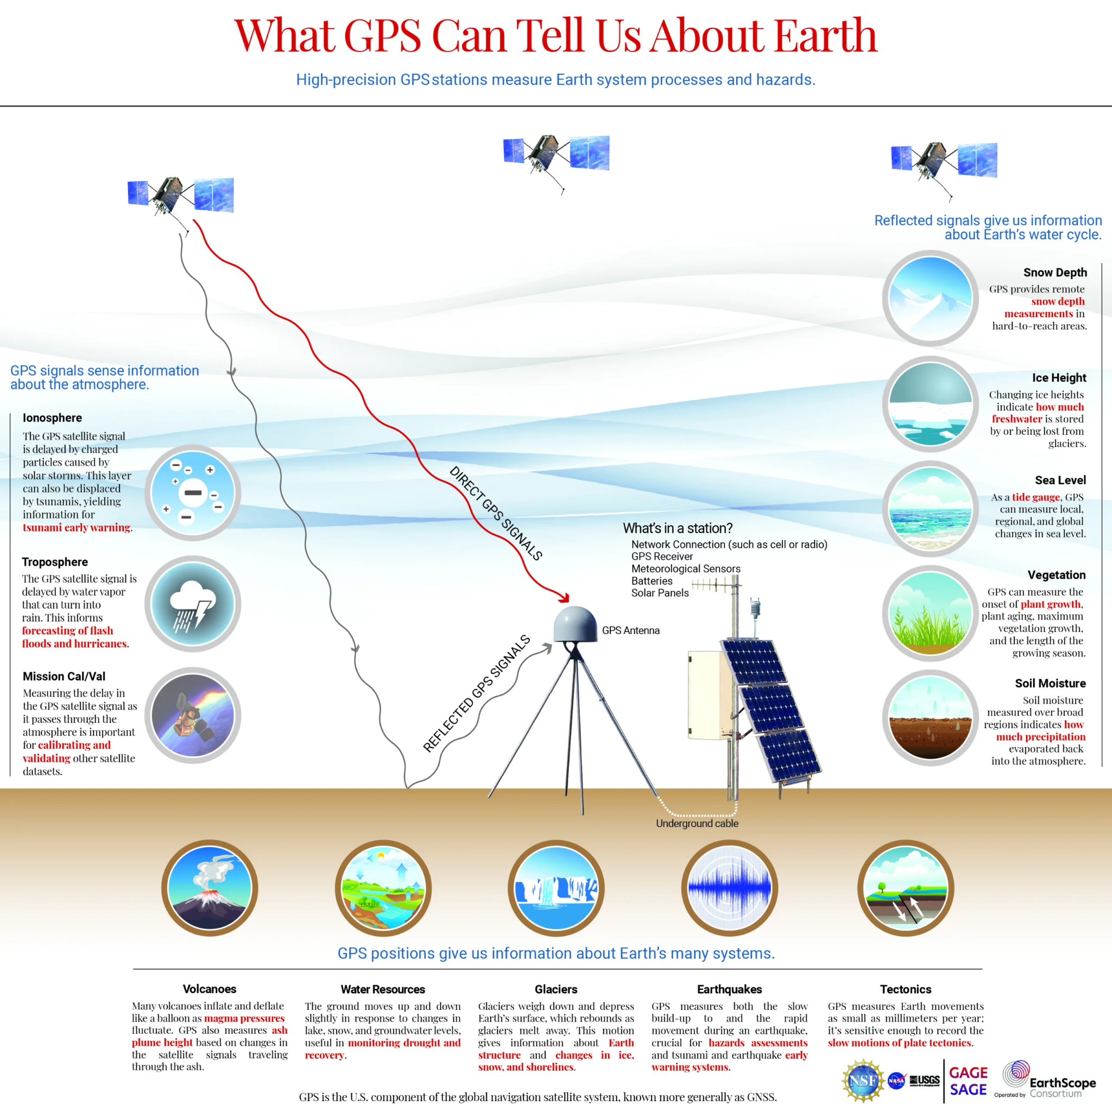
NSF National Geophysical Facility
Instrumentation
Data
Education & Workforce

Slide 7

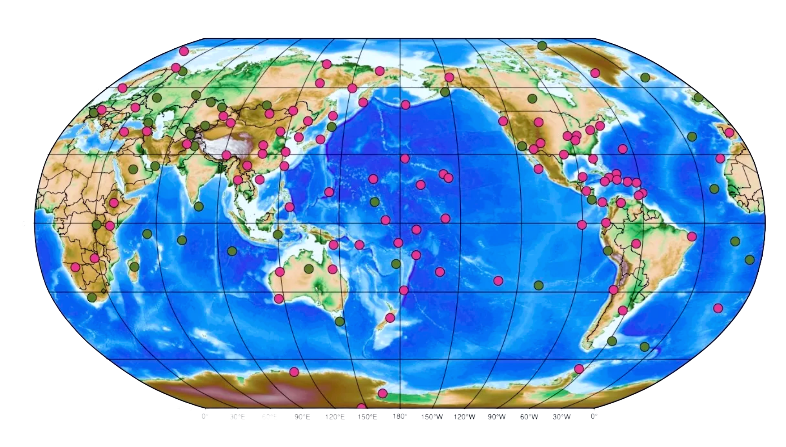
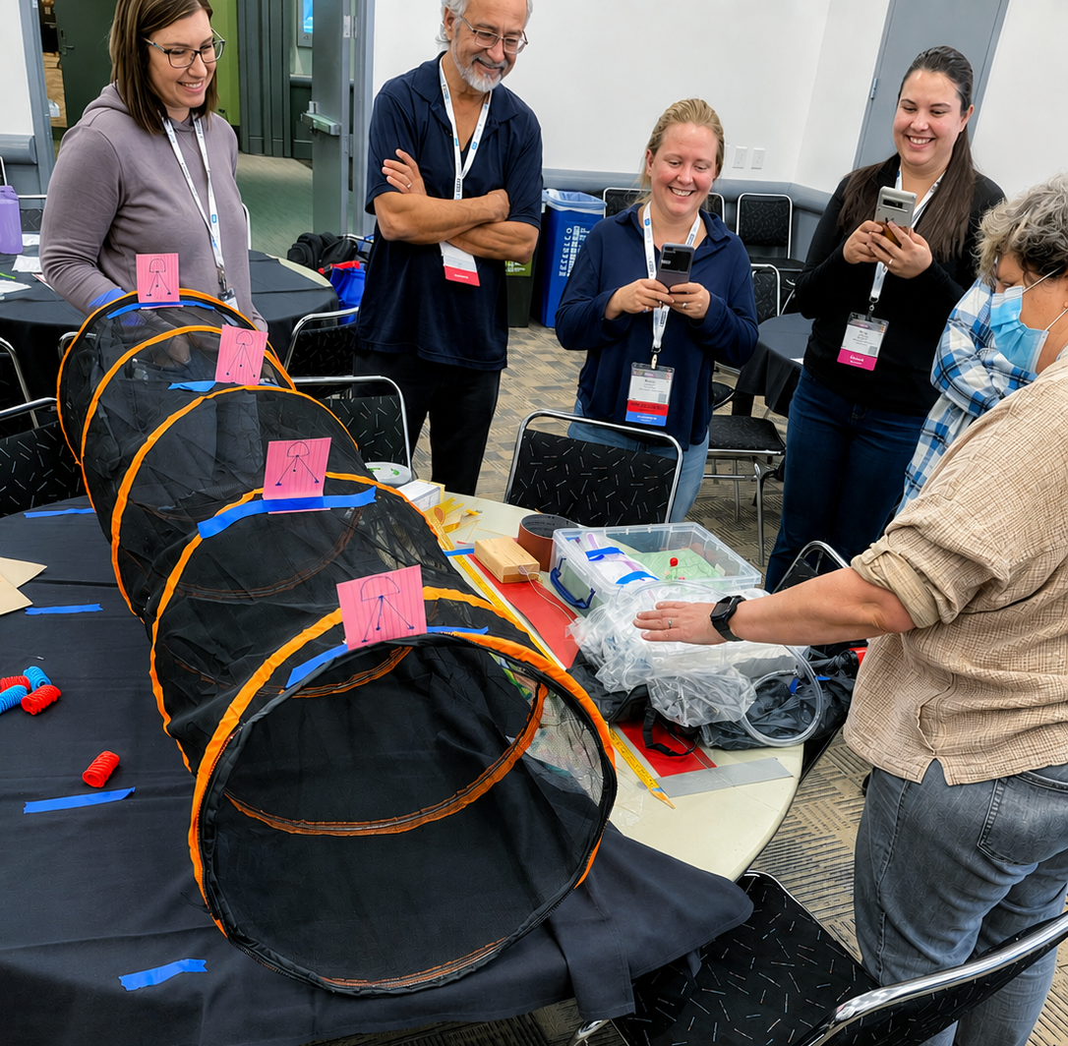
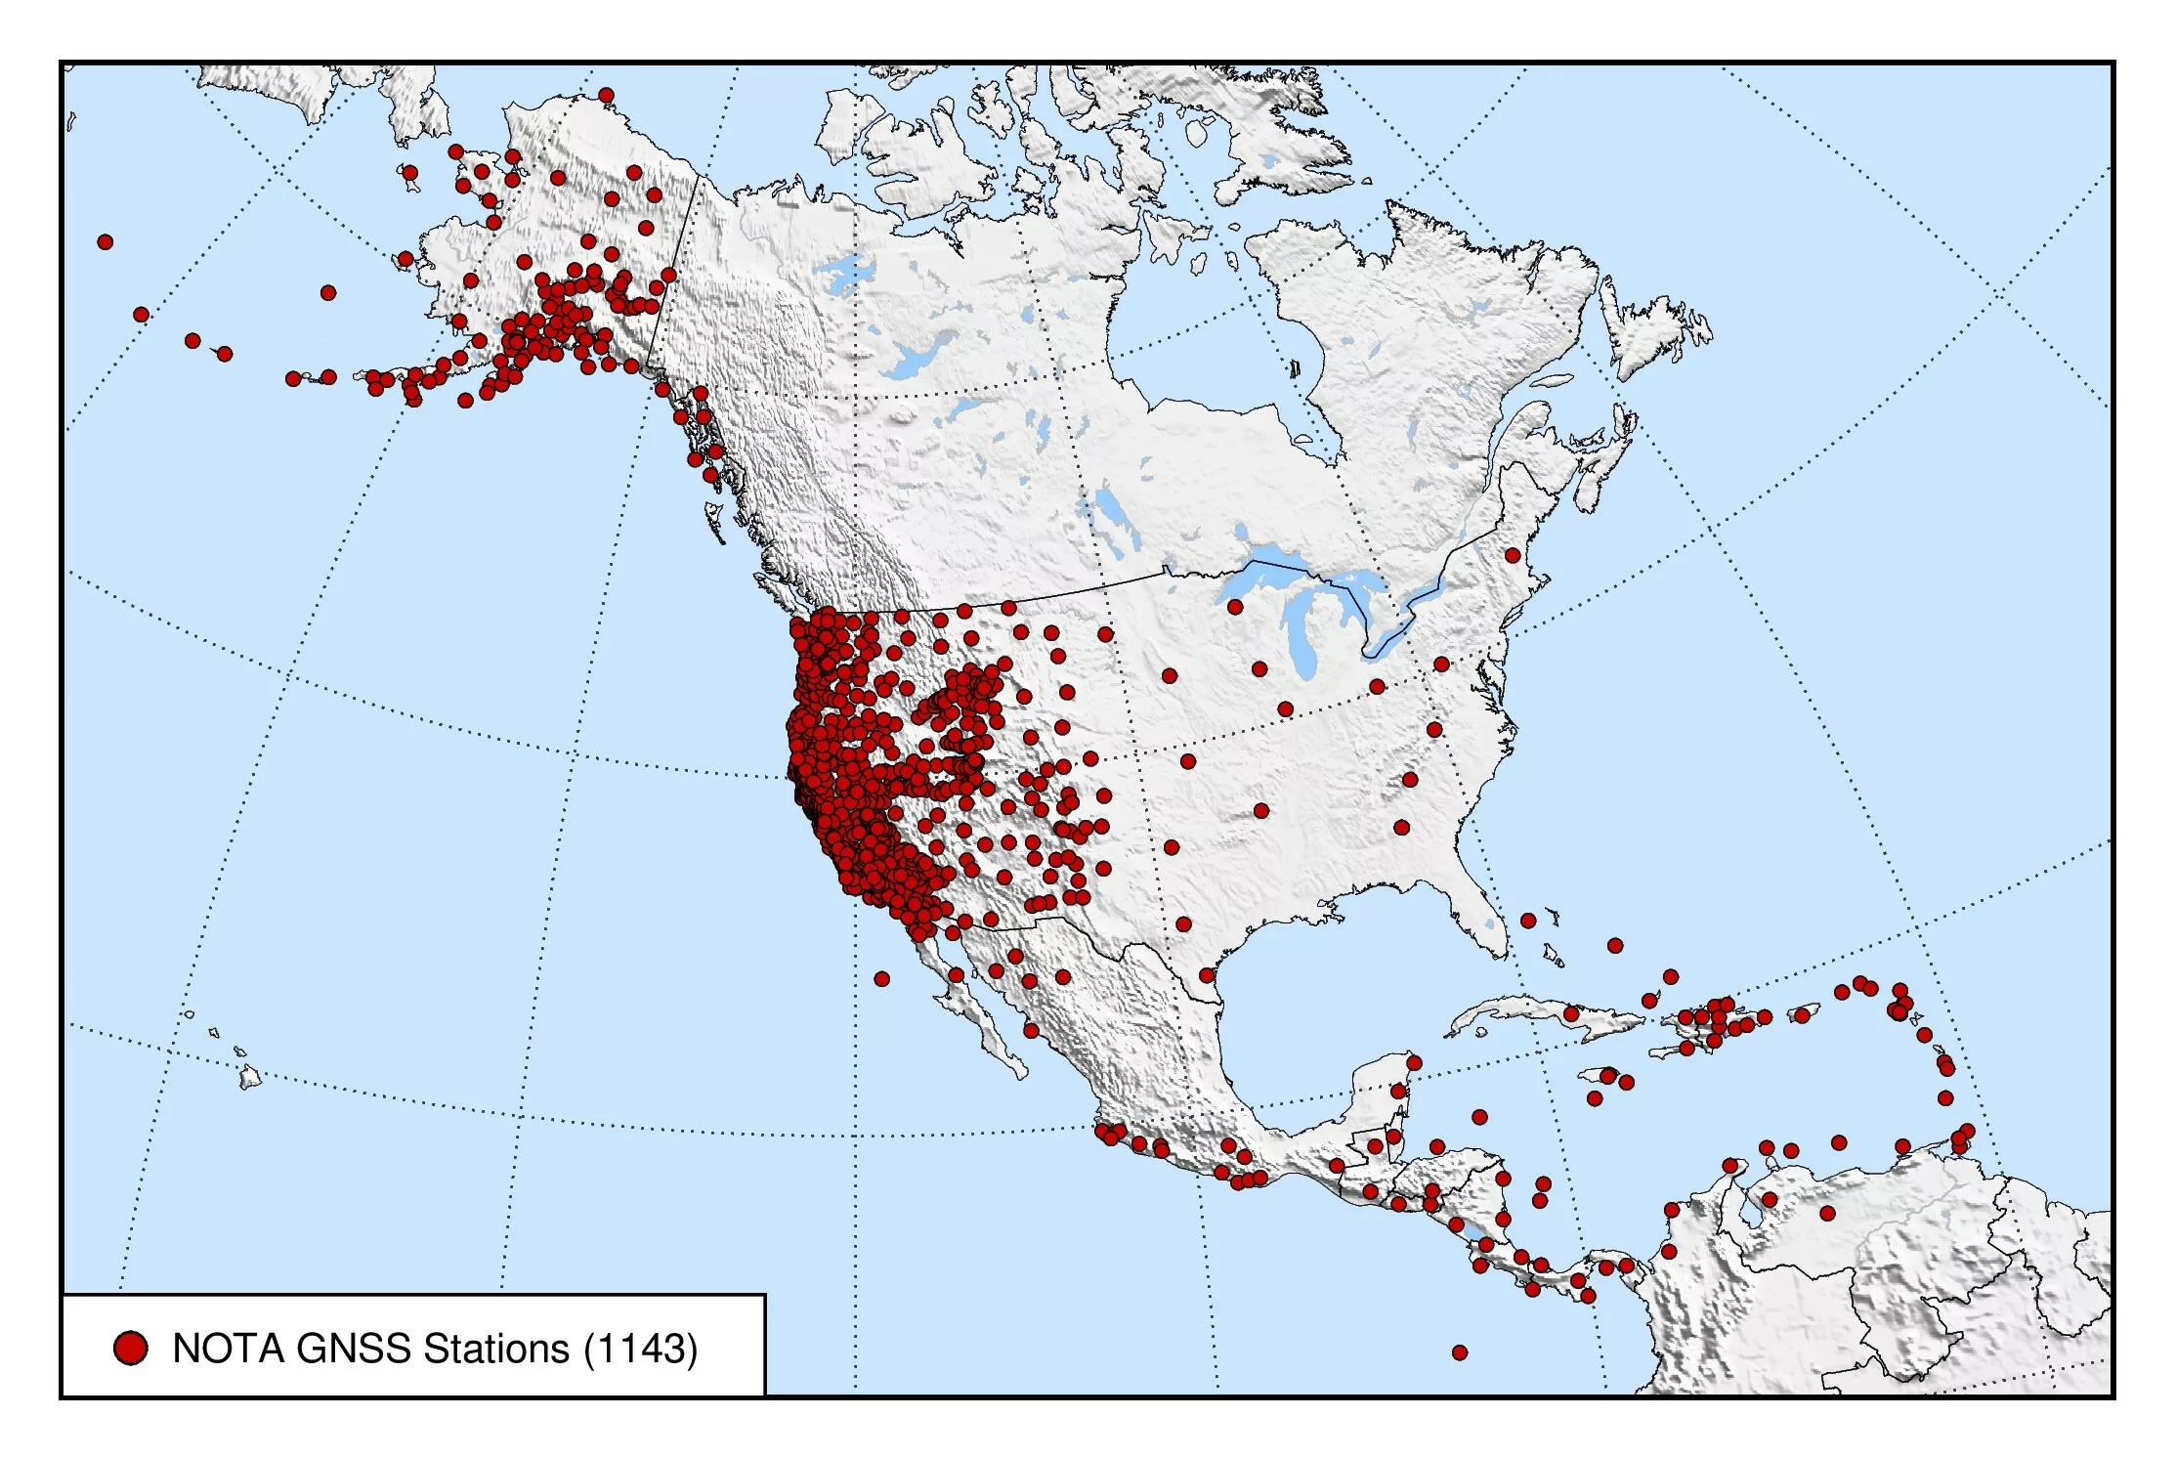
Data
Develops, acquires and maintains
GNSS and seismic networks.
Data products.
Data access.
Data systems.
Education & Workforce
Classroom resources.
Field instrumentation training.
Tech courses.
Internship programs.
Communications support.
Instrumentation
Develops, acquires and maintains
portable instrumentation for research and upper level education.
`
GSN
NOTA

Slide 8
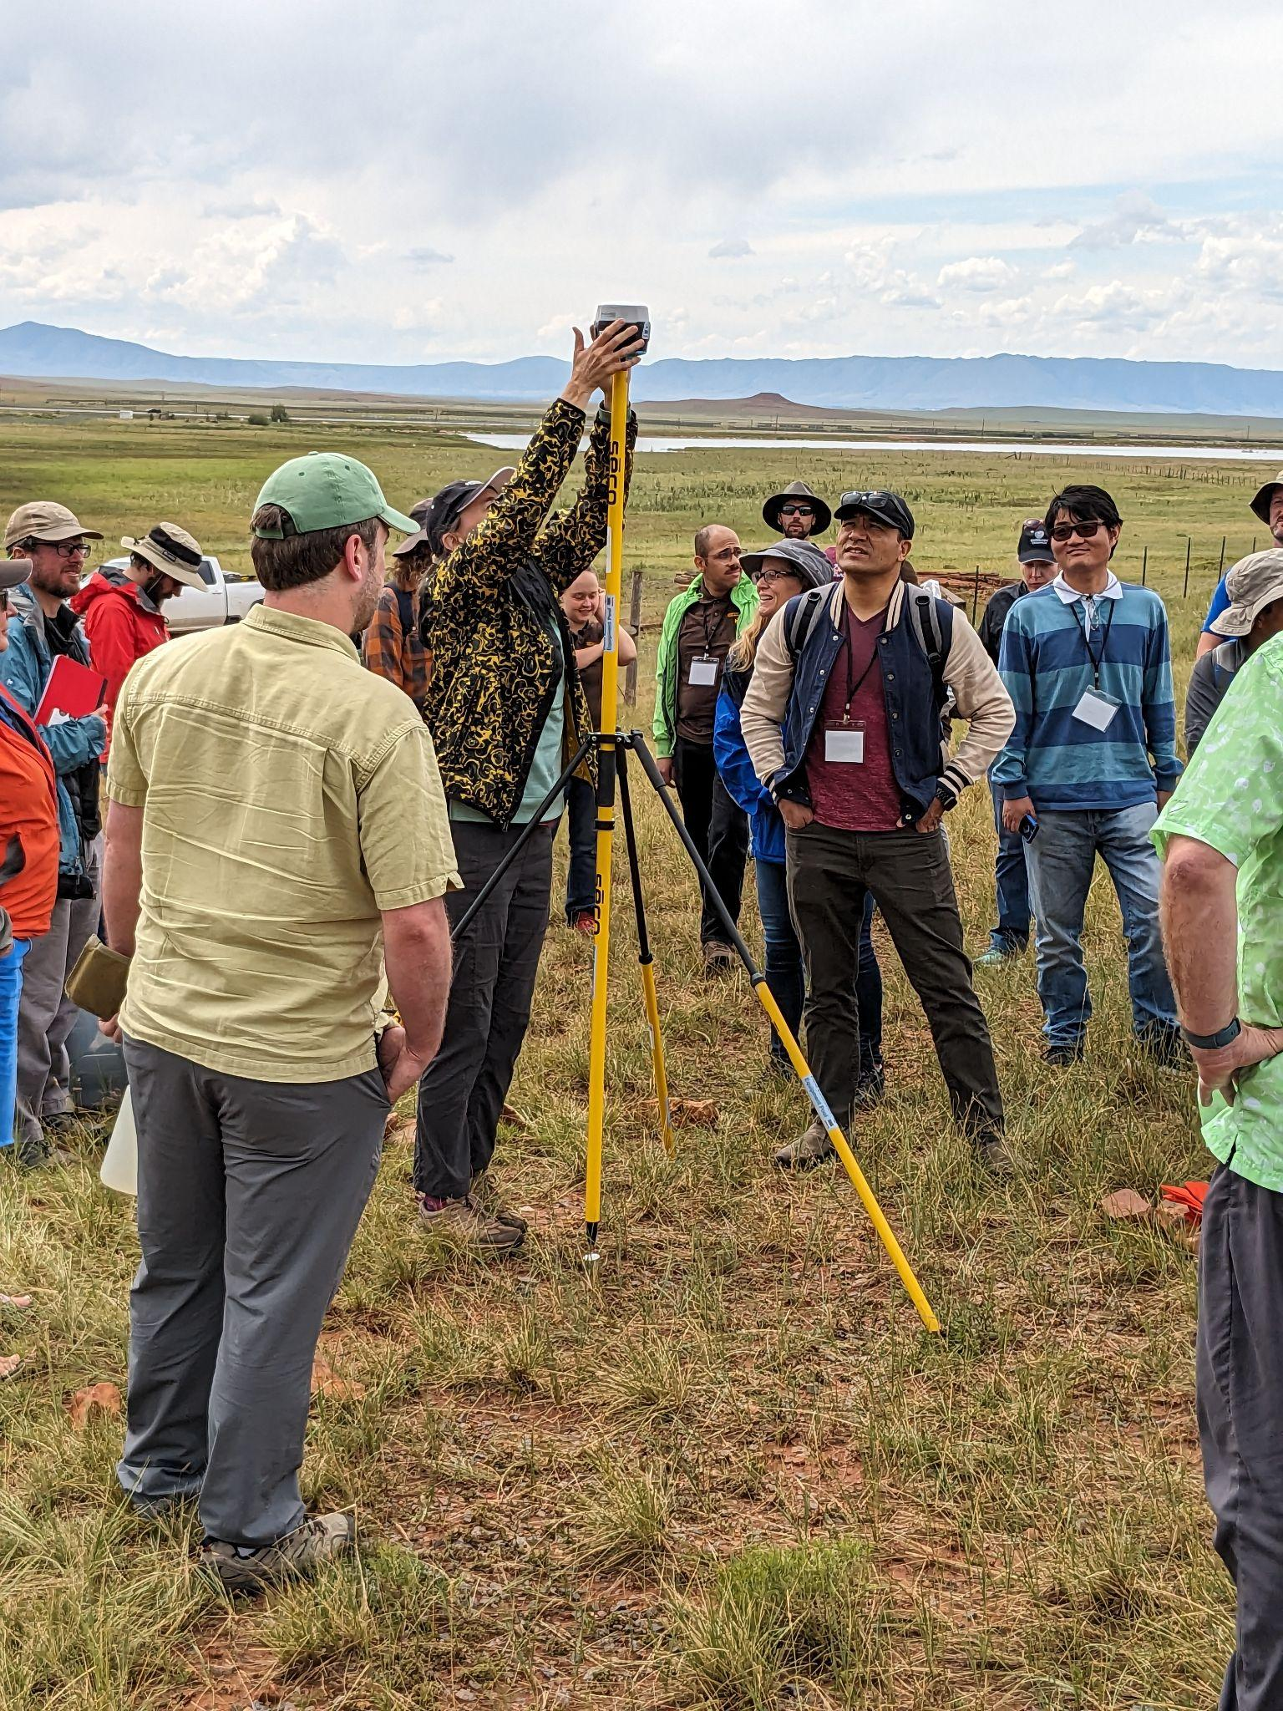
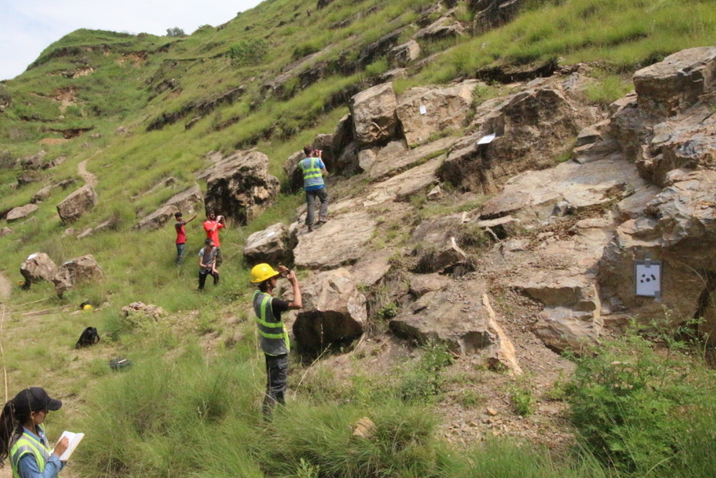
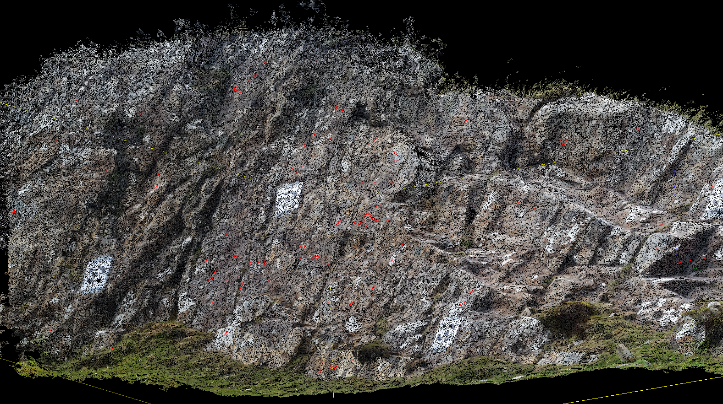
Beth Pratt-Sitaula
GPS/GNSS, structure from motion, lidar
Formerly a field camp director
EarthScope Project Manager for undergraduate education and geophysics field education

Slide 9
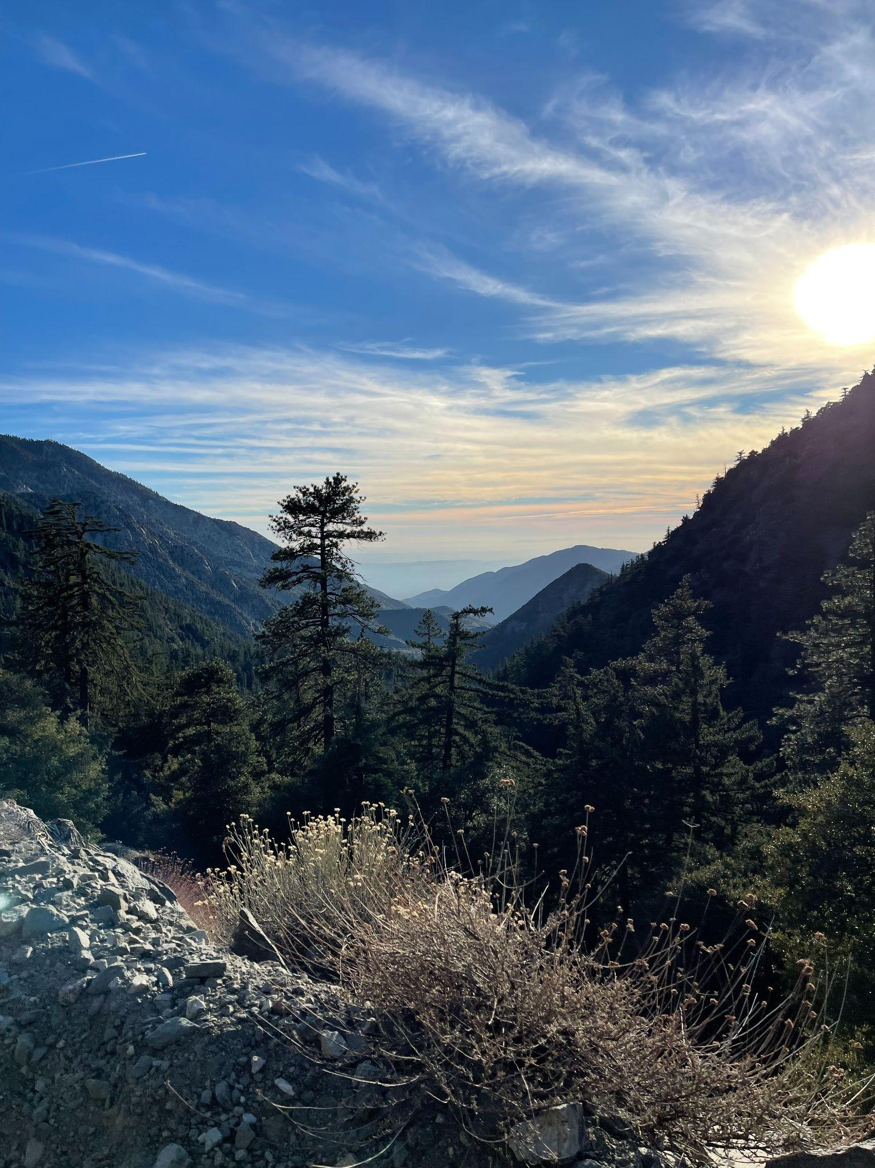
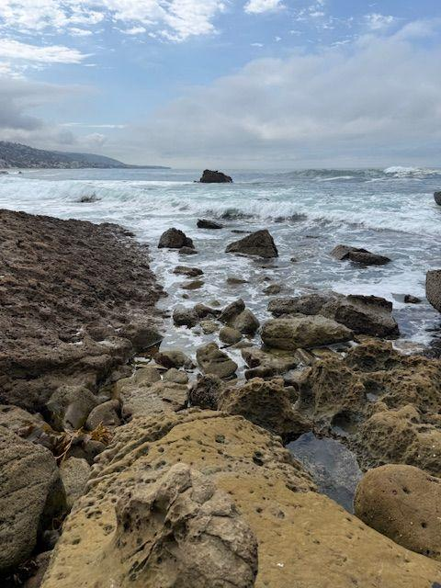
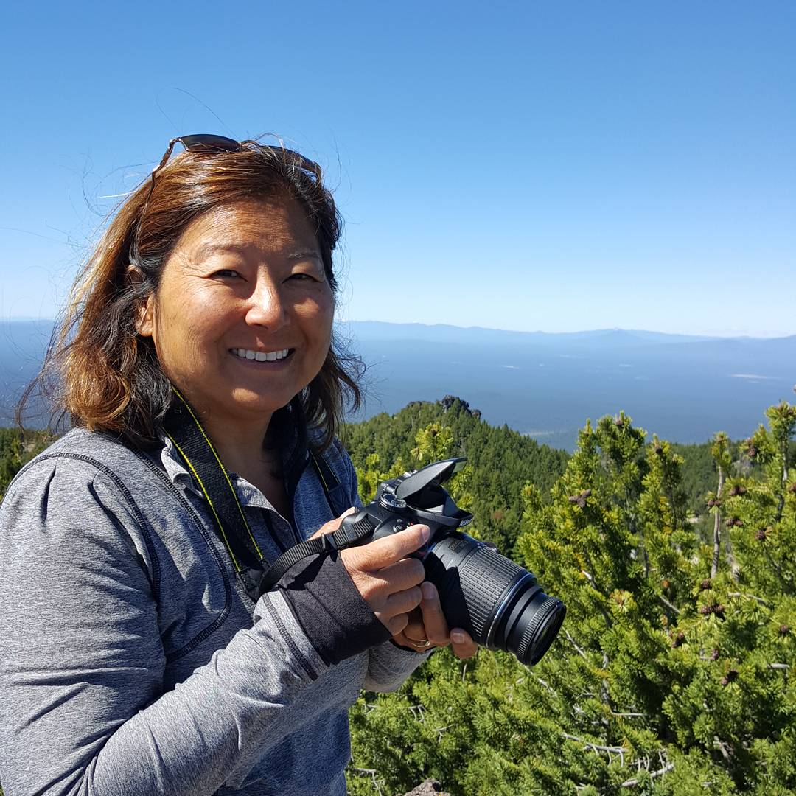
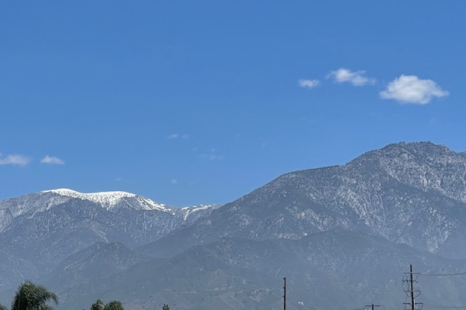
DeeDee Okamoto
Instructional Designer
    Curriculum/activity development
    - secondary education
Background:
  Teacher in secondary education
  for 25 years.
  Earth Science integration

Slide 10
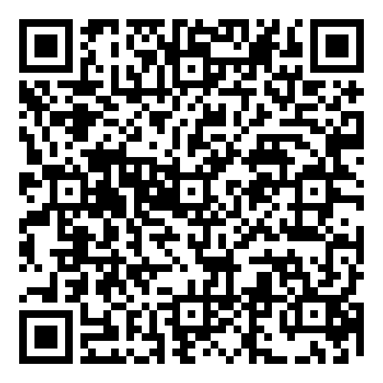
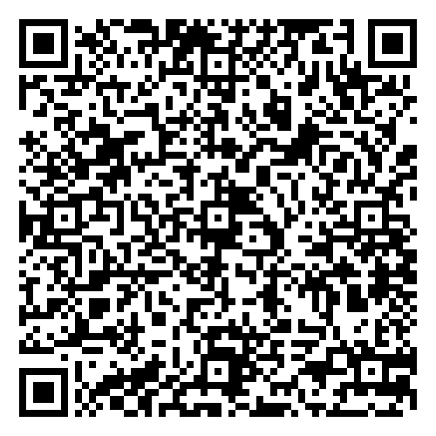
To follow along on your device
Google links: Agenda Workshop notes
Microsoft word: Agenda Workshop notes

Slide 11
Workshop Goals
Participants will be able to:
Integrate instructional principles for student-centered active learning
Utilize NSF NGF resources (web tools) in a logical sequence
Access NSF NGF apps and resources
Record plans to integrate at least one app into a course.

Slide 12
Four Corners
At which level do you primarily teach?
Secondary or below
Undergraduate - Intro level
Undergraduate - Geoscience majors
Graduate

Slide 13
Four Corners
Introduce yourself
Share what classes you teach or have taught

Slide 14
Four Corners
How long have you been an educator?
0-5 years
6-10 years
11-20 years
>20 years

Slide 15
Four Corners
Introduce yourself
Share one of your teaching memories that motivates you to continue teaching.

Slide 16
Four Corners
Which learning goal is your top priority for this workshop?
Integrate instructional principles for student-centered active learning
Utilize NSF NGF resources (web tools) in a logical sequence
Access NSF NGF apps and resources
Record plans to integrate at least one app into a course.

Slide 17
Four Corners
Introduce yourself
Share your biggest challenge in this topic - why is it your top priority?

Slide 18
Whole Group -
Share a challenge your corner discussed

Slide 19
Think-Write-Share
“Student-centered”

Slide 20
Think-Write-Share
“Facilitated Learning”

Slide 21
As we go through the apps:
What do we need to understand to mitigate or respond to the impact of an earthquake?

Slide 22
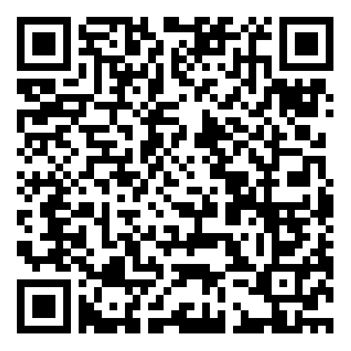
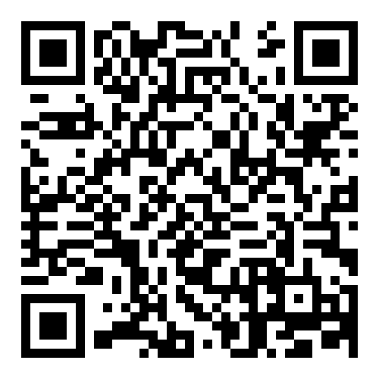
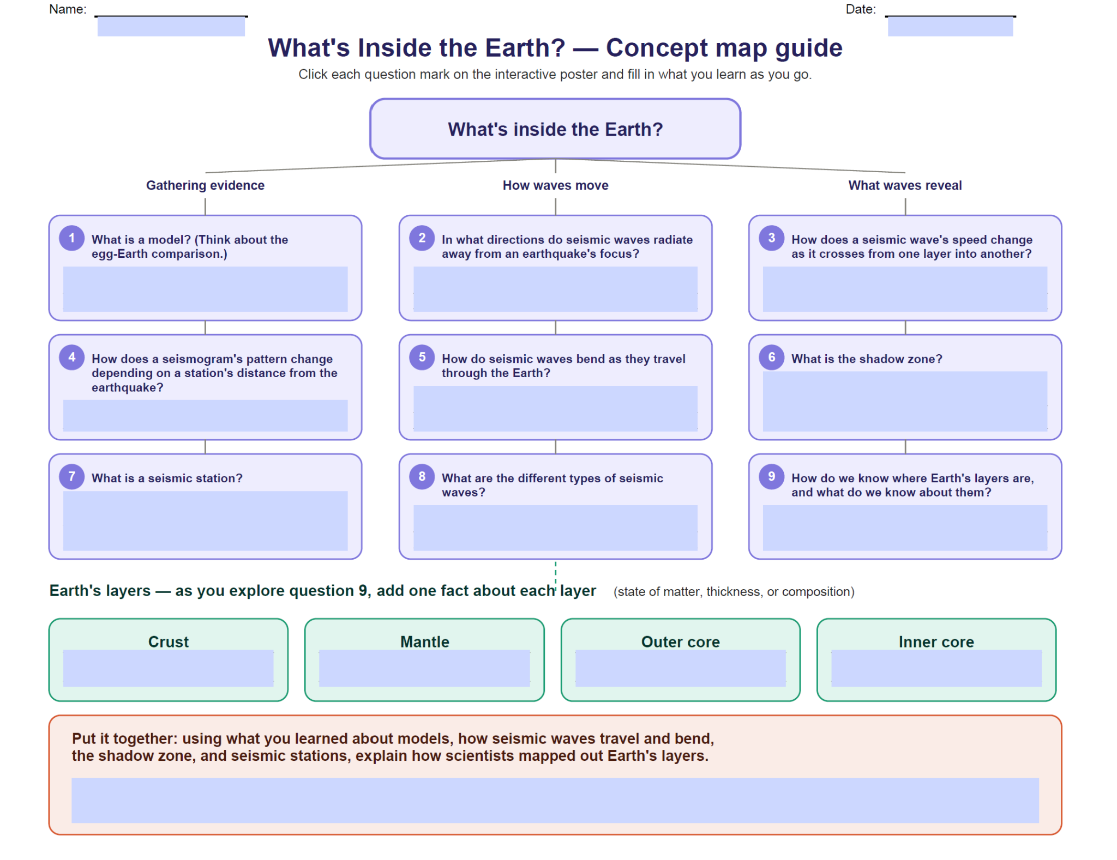
What’s Inside the Earth?
Interactive poster
  Apps, videos, animations, hands-on
Basic seismology concepts
Guide
APP

Slide 23
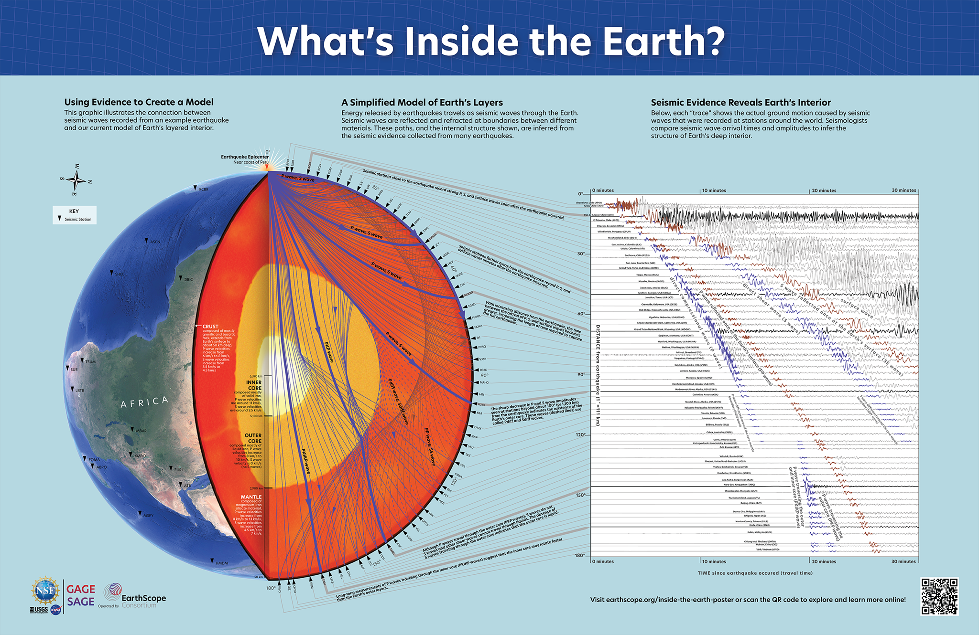
What’s Inside the Earth?
Guided questions – concept map
  Student choice on direction
  Shows relationships
  Room for extra notes

Slide 24
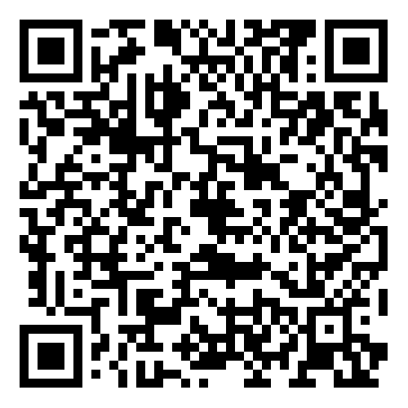
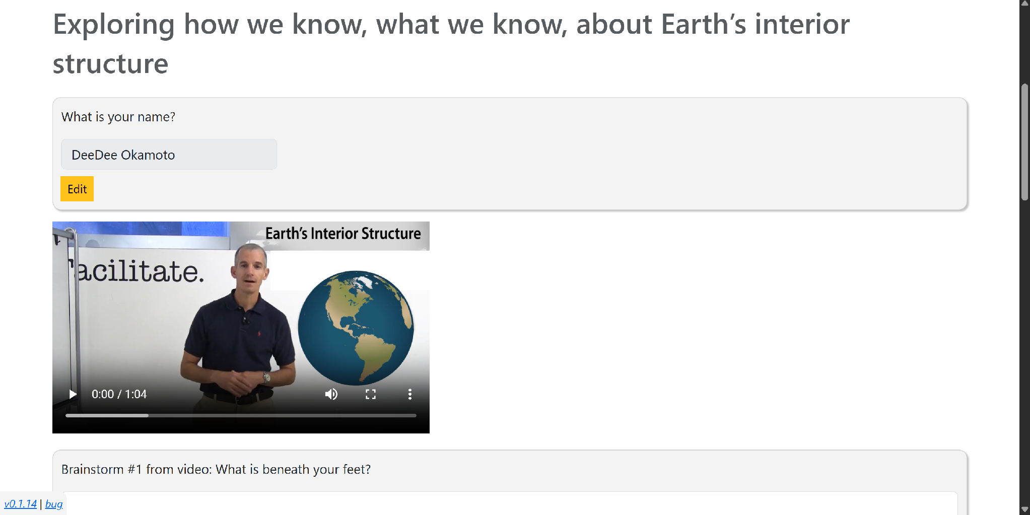
Determining and Measuring Earth’s Layered Interior
Interactive guided on-line
Students use this model to determine that Earth must have internal layers and estimate core size.

Slide 25
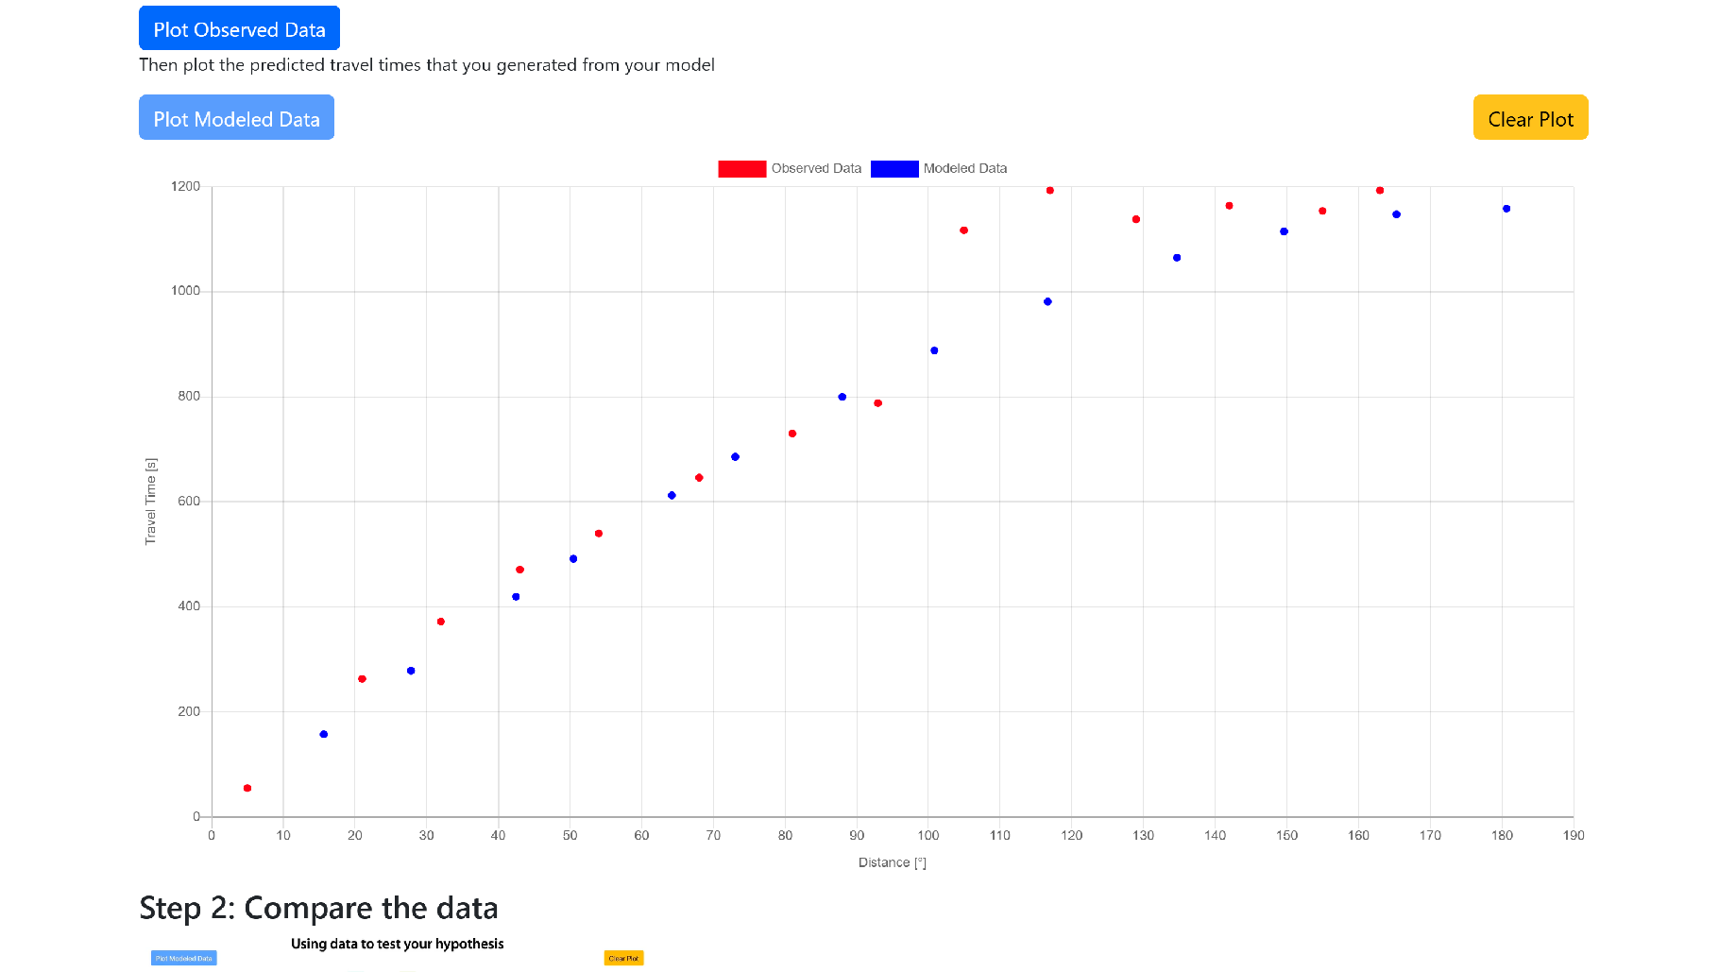
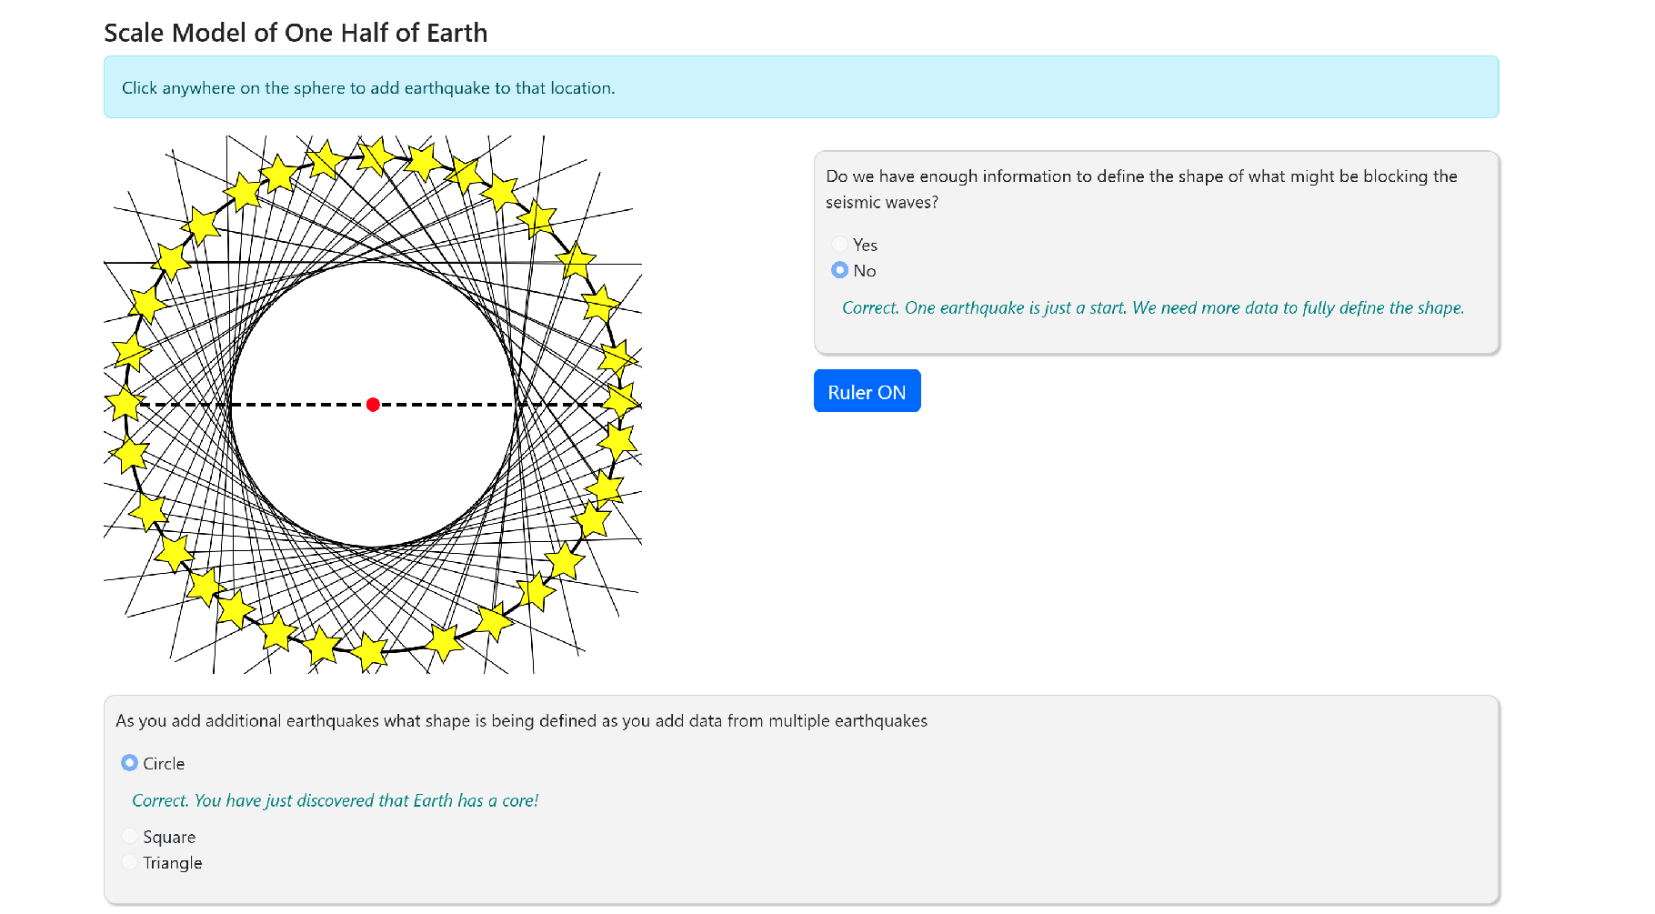

Determining and Measuring Earth’s Layered Interior

Slide 26

Break

Slide 27
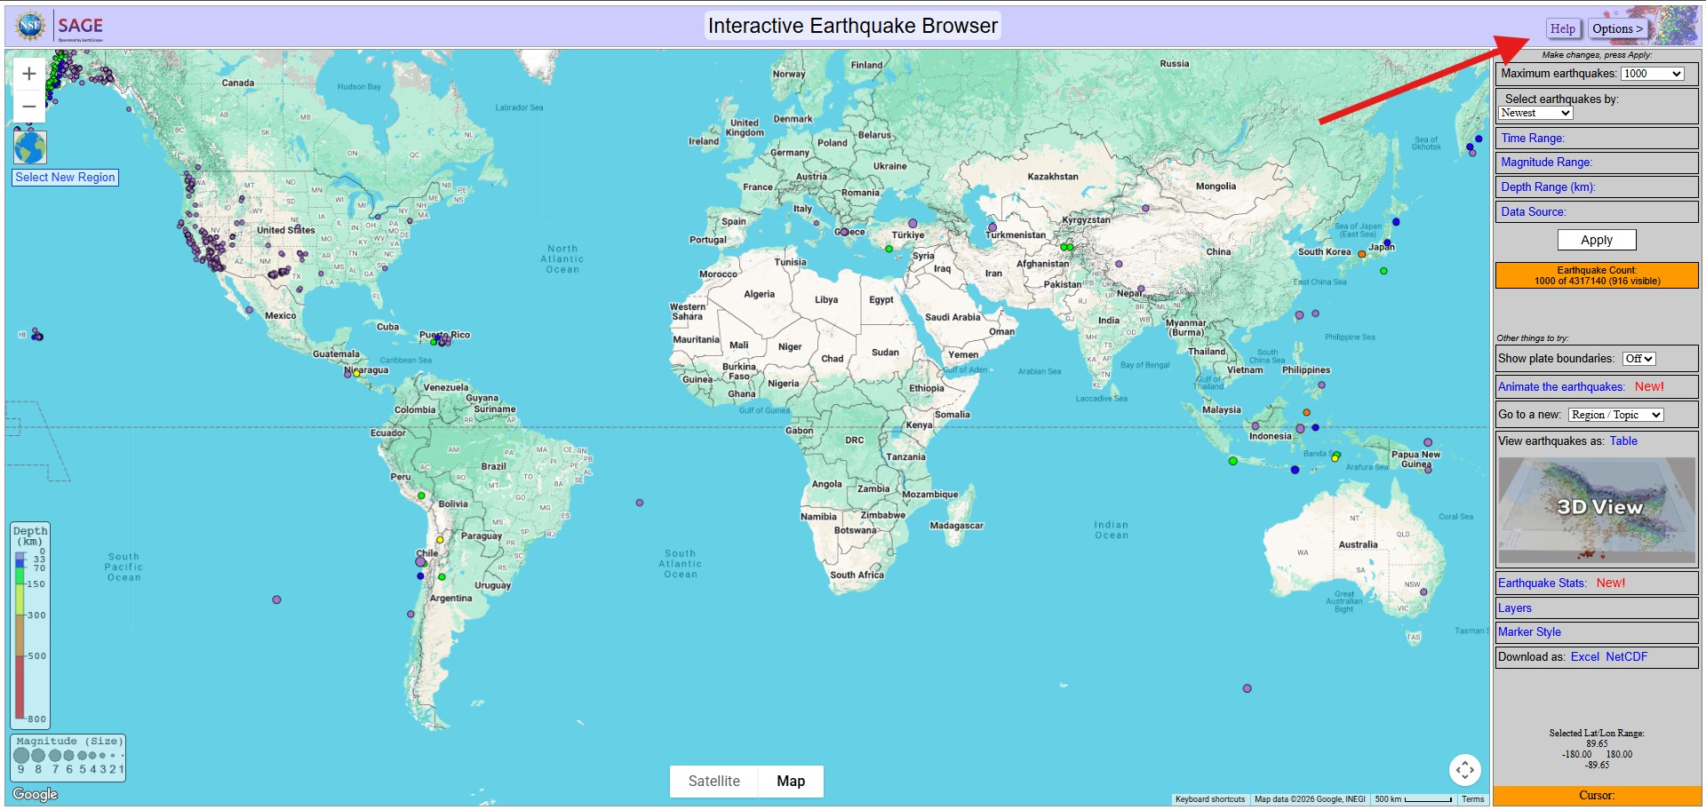
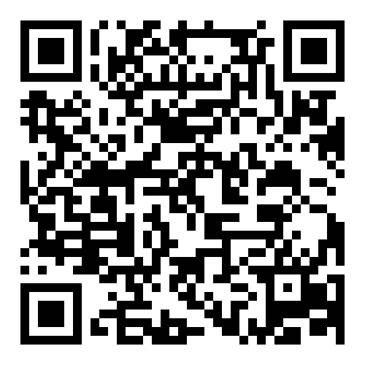
Interactive Earthquake Browser
Up to 25,000 seismic event epicenters
Updated regularly
Update filters

Slide 28
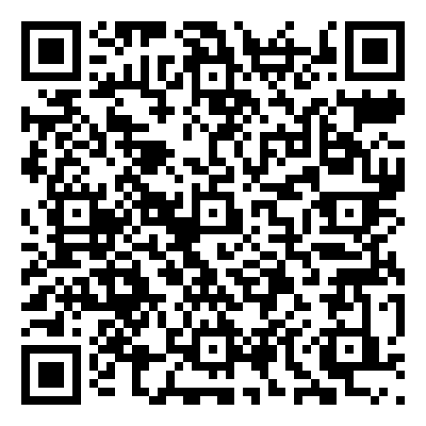
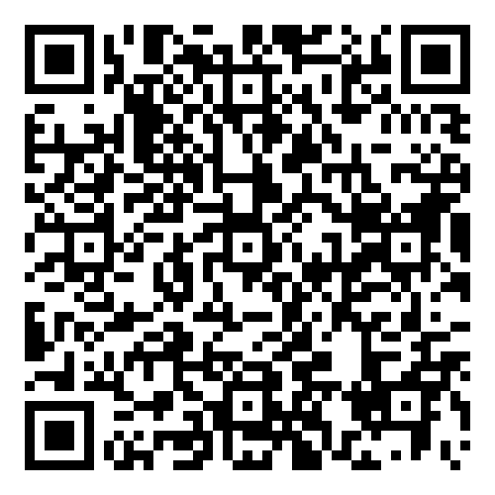
Interactive Earthquake Browser
Could be used as a hook to engage/motivate
Digging in deeper
Exploring Patterns of Global & Regional Seismicity
Mapping Worldwide Earthquake Epicenters

Slide 29
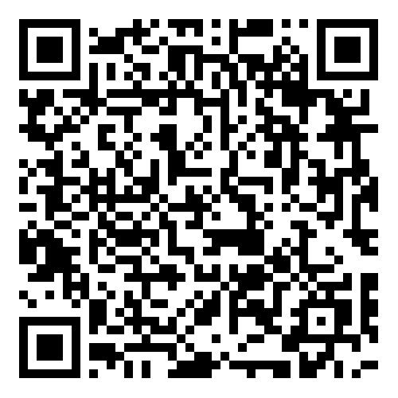
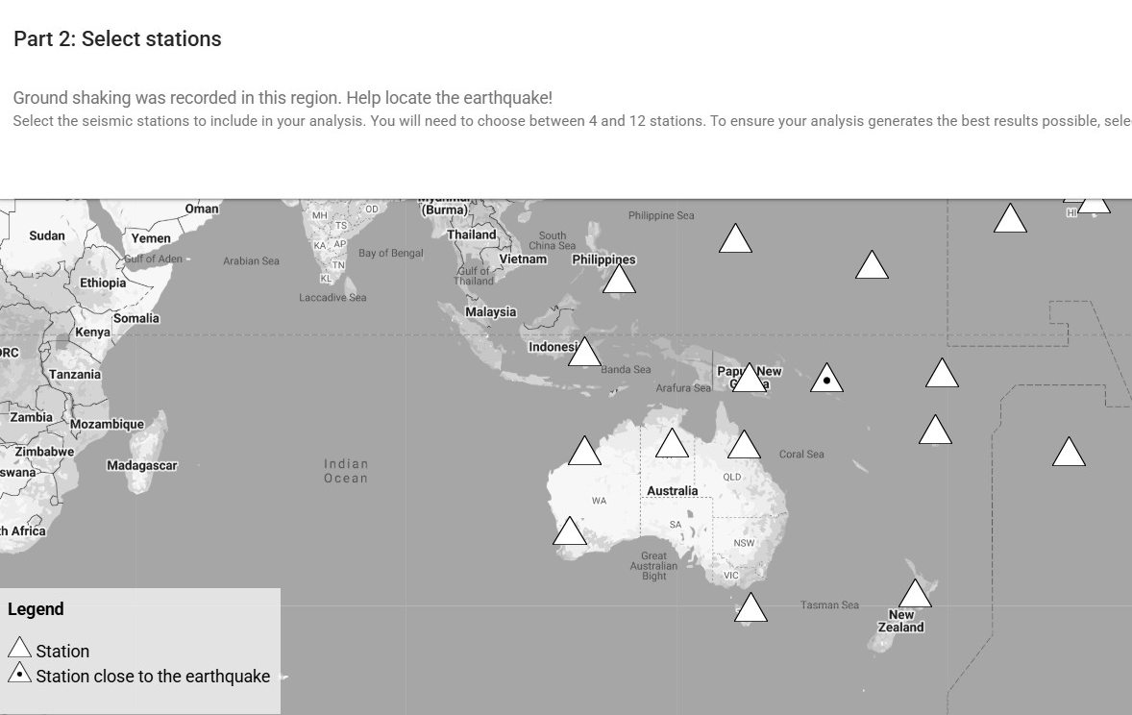
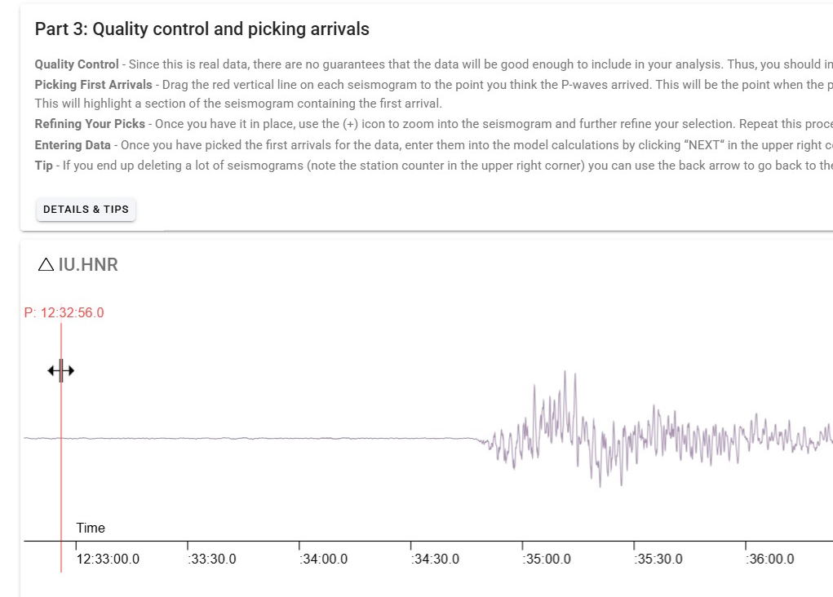
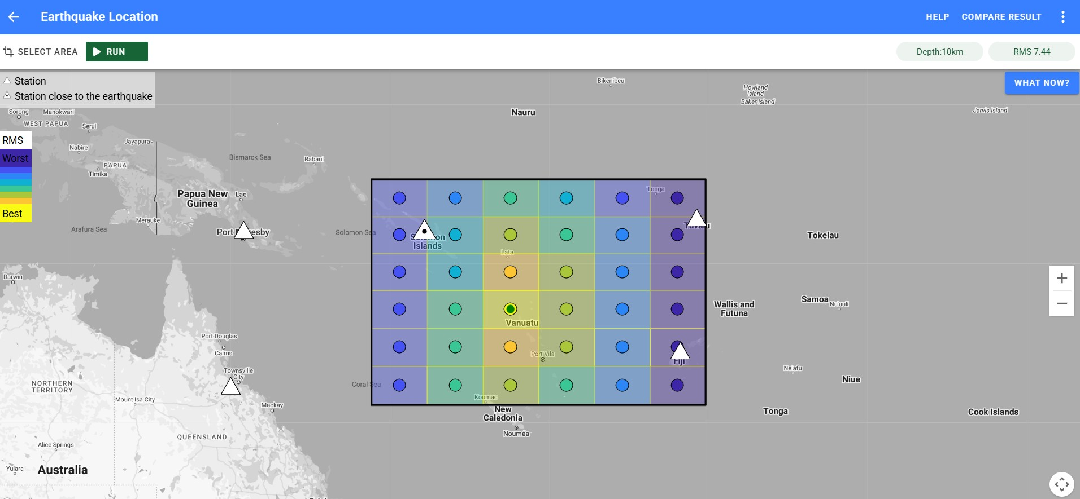
EQLocate
Updated processes for locating earthquakes
Includes RSM error and process steps
GridSearch –

Slide 30
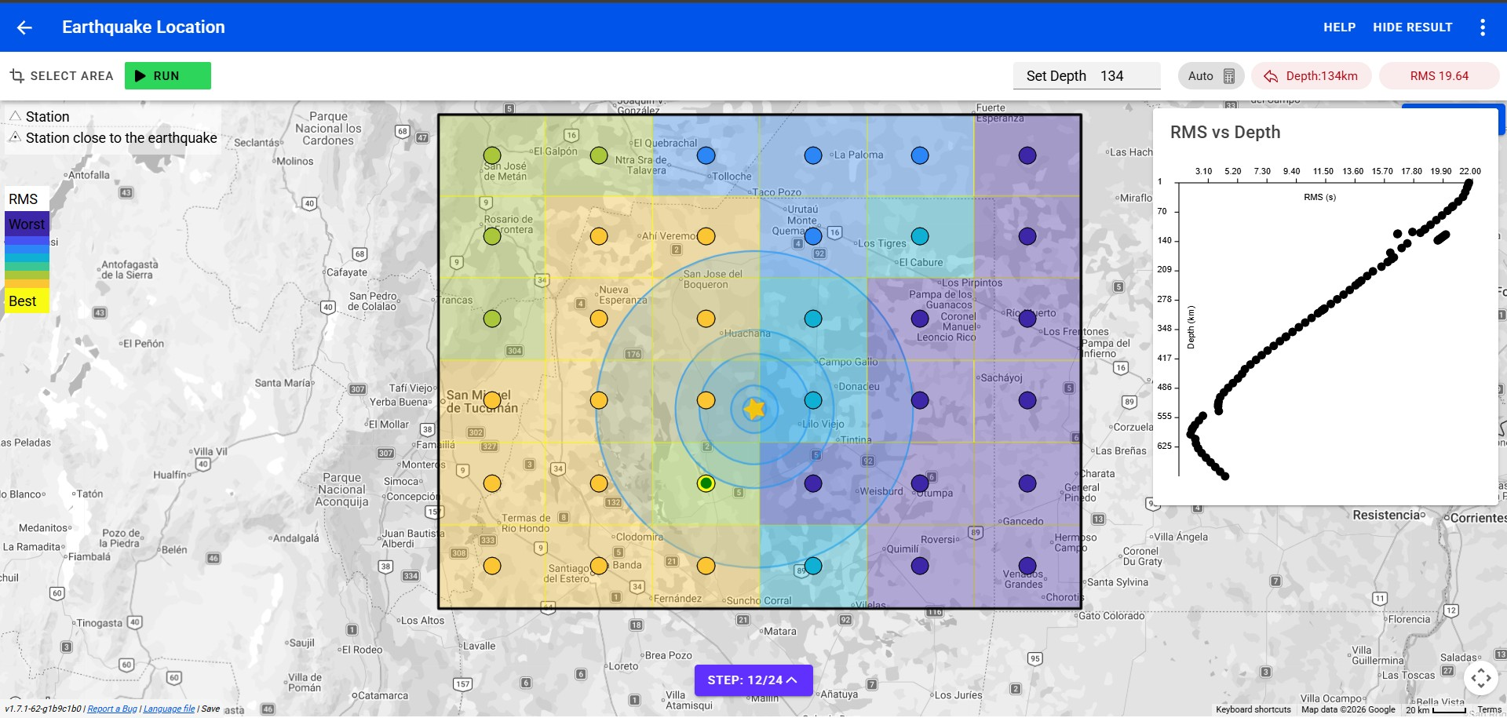
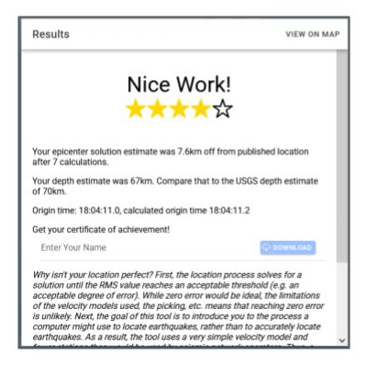
EQLocate
After the guided tour, students have a choice

Slide 31
Why are we changing strategies?
Increased student engagement, performance and satisfaction – Sahito, Z.H., Khosso, F.J., & Phulpoto, J. (2025)
Best Practices:
National Academies of Sciences, Engineering and Medicine 2024
  Active Learning**
  Leverage student diversity to enhance learning. – make connections**
  Involves Affective and social dimensions (groups, collaborative..)
  Identity and sense of belonging**
  Flexibility and responsiveness to situations
Notes:
Transforming Undergraduate STEM Education: Supporting Equitable and Effective Teaching

Slide 32
Today’s Strategies
Four corners – community/belonging
Think-Write-Share – collaborative/peer teaching
  Writing organizes content & solidifies
  Iteration – changing thinking – growth mindset
Concept Map – organization (scaffolding)
Workshop Notes – organization (scaffolding)
Chunking information (scaffolding)
Student choice – motivation
Student as an active participant with instructor as facilitator**

Slide 33
Student-Centered
Shifts focus to student
Students are active participants
Relevant content
Students may have a choice
Eg. Hands-on, simulations, interactives, labs, guided exercises, gamified apps, discussions, collaborative projects, readings (but what are they doing with it?), …

Slide 34


Facilitated Learning
Guide or support learning by:
  Asking questions
  Providing structure or support
  Remove obstacles
  Coach
  Not directly delivering or controlling every step
    Note: Sometimes direct delivery is needed for clarifications.

Slide 35
Why did we introduce the apps in the order we did?
Earth has layers → known through seismic waves
Seismic waves → reveal internal layered structure
Differences in layers → tectonics
Tectonics → patterns at boundaries
Locating earthquakes → natural hazard mitigation
Notes:
If I was teaching the course, I might reverse the order 🡪>> depends on your endgame.

Slide 36
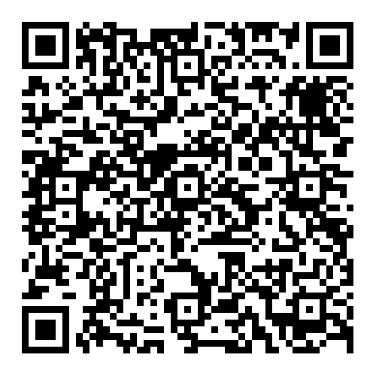
Implementation plan
How will you use these apps in your course?

Slide 37
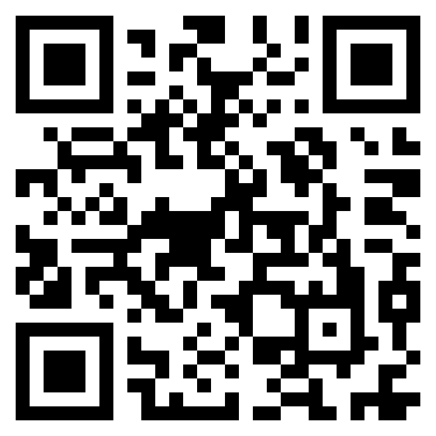
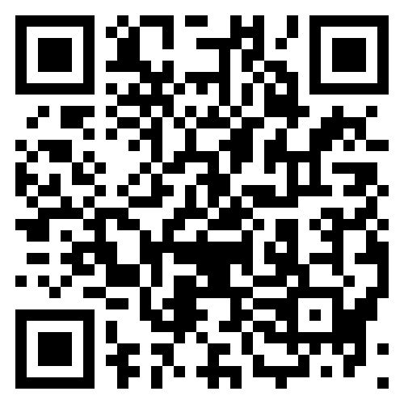
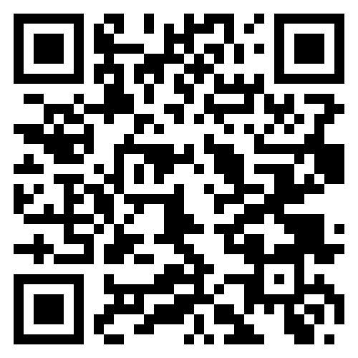
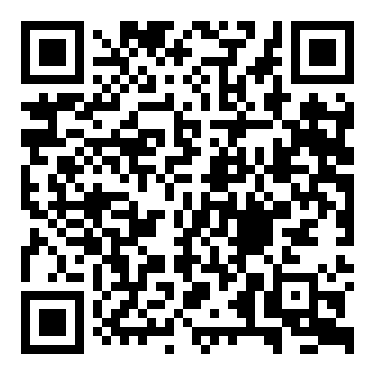
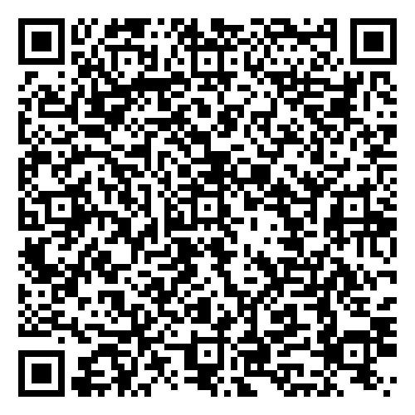
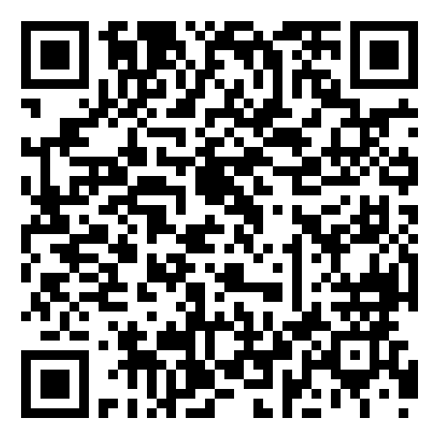
Resources
Earthscope.org >>education>>
resources>>
https://www.youtube.com/@EarthScope_science
GETSI – Geophysics Tools for Societal Issues
The Math You Need
For announcements about higher education resources.
Or send a blank email to
teaching-geophysics+subscribe@earthscope.org
NSF NGF Geodesy Resources
Google Groups page

