Slide 1

Paleoclimate lab
Notes:
Deep time refers to rocks that are older than 2 million years old. So when we talk about deep-time, we are talking about anything from 2 million to 4.5 billion years ago!

Slide 2
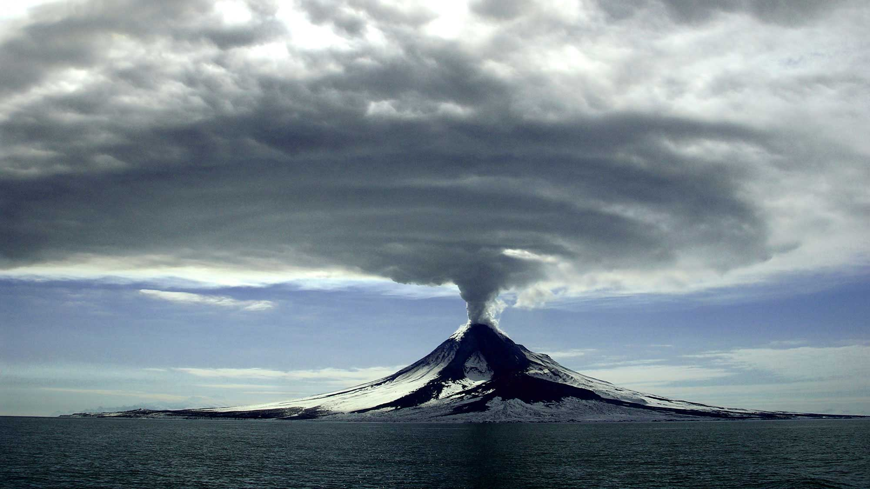
How does CO₂ relate to the end Triassic mass extinction?
Notes:
The question driving this project is how carbon dioxide relates to the end Triassic mass extinction. To answer this question, we need to understand:
How carbon cycle perturbations impact global climate
How sudden and rapid climate change drives extinction

Slide 3
Carbon cycle
Short vs long term carbon cycle
Short term – days to thousands of years
Photosynthesis
Respiration
Decay
Long term – >thousands of years
Rock formation
Deep vs surface reservoirs
Surface reservoir – above ground
Deep reservoir – deep within the earth

Slide 4
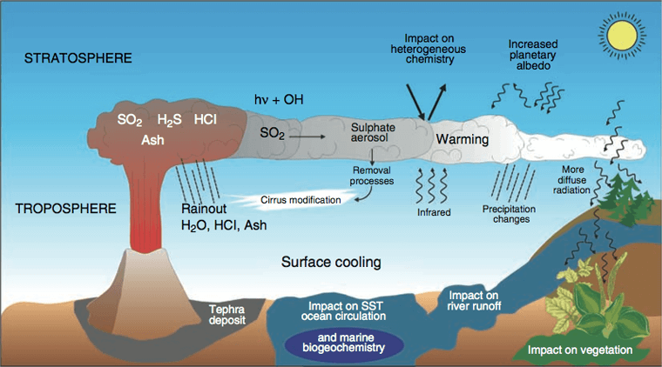
Volcanic impacts on Earth
CO₂
Warming
CO₂
Warming!
Scale
SO₂ → short term (1-10 years) cooling
CO₂ & CH₄ → long term (millions of years) warming
Notes:
How? Most of the sun's energy that falls on the Earth's surface is in the visible light portion of the electromagnetic spectrum. This is in large part because the Earth's atmosphere is transparent to these wavelengths (we all know that with a functioning ozone layer, the higher frequencies like ultraviolet are mostly screened out). Part of the sunlight is reflected into space, depending on the albedo or reflectivity of the surface. Part of the sunlight is changed into infrared. While the dominant gases of the atmosphere are transparent to infrared, the so-called greenhouse gasses, primarily water vapor, carbon dioxide, and methane, absorb the infrared radiation. They collect this heat energy and hold it in the atmosphere. While we worry about possible global warming from the additional CO₂ we put into the atmosphere by burning fossil fuels, if there was no CO2 in the atmosphere the global climate would be significantly cooler.
Because of the role of CO2 in climate, feedbacks in the carbon cycle act to maintain global temperatures within certain bounds so that the climate never gets too hot or too cold to support life on Earth. The process is a large-scale example of LeChatelier's Principle. This chemical principle states that if a reaction at equilibrium is perturbed by the addition or removal of a product or reactant, the reaction will adjust to attempt to bring that chemical species back to its original concentration.
Natural disasters like volcanoes can impact climate change. During major explosive eruptions, huge amounts of volcanic gas, aerosol droplets, and ash are injected into the atmosphere. Injected ash falls rapidly from the stratosphere -- most of it is removed within several days to weeks -- and has little impact on climate change. Gases like sulfur dioxide can cause global short-term cooling (anywhere from 1 -10 years), while carbon dioxide and methane, greenhouse gases, promote long term global warming (millions of years).

Slide 5
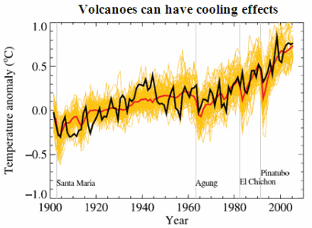
Volcanic impacts on temperature
Short term cooling
Long term warming
Data from the 4th IPCC report. Black line is actual temperature. Yellow lines are temperatures from predictive models. Red line is the average temperature for all simulations. Names are volcanic eruptions.

Slide 6
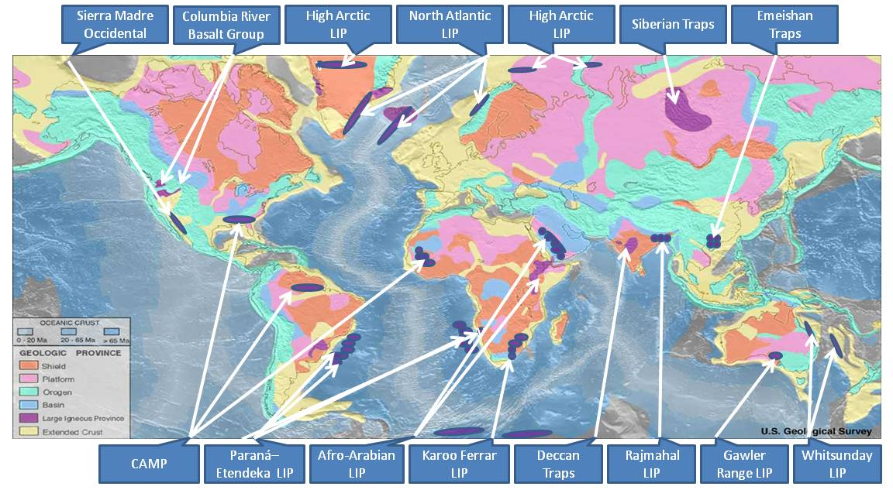
Large igneous provinces (LIPs)
Supermassive accumulation of igneous rocks including intrusive (sills, dikes) and extrusive (lava flows, tephra deposits)
Areas greater than 100,000 km² of igneous rocks emplaced within less than 2 million years
Map showing global distribution of LIPs

Slide 7
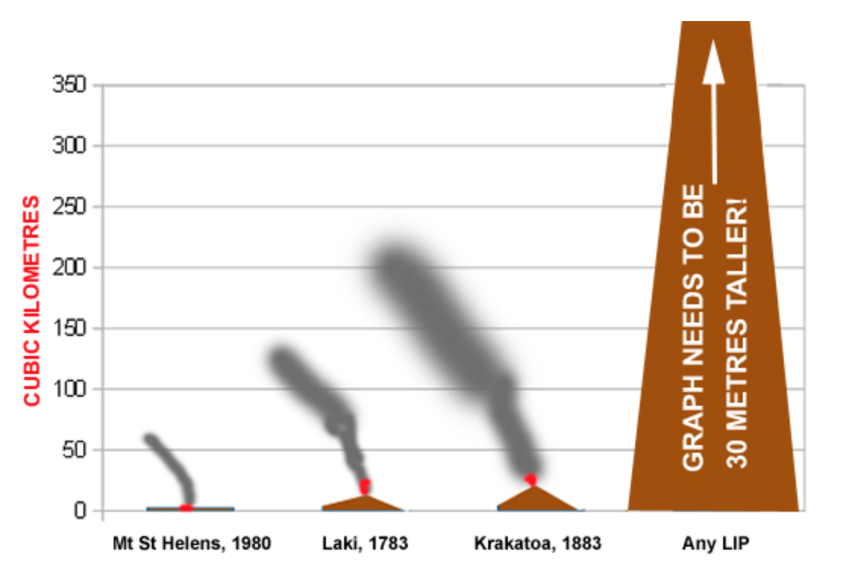
Volcanism vs LIP emplacement
Y axis = km³ of material released
Mt St Helens
1980
Energy released = 24-megaton nuke
Released 2.79 km³ of material
Siberian Traps LIP
250 million years ago
Released 3,000,000 km³ of material

Slide 8
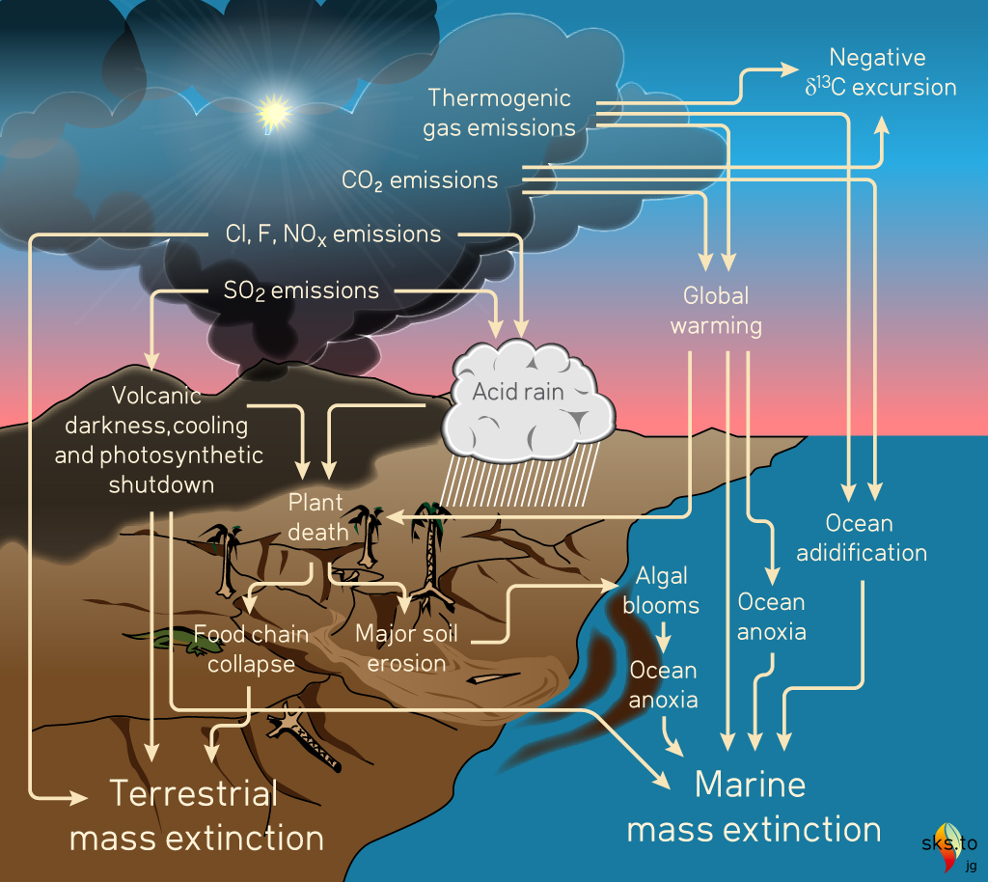
Impacts of lIPs
Potential kill mechanisms associated with large igneous provinces

Slide 9
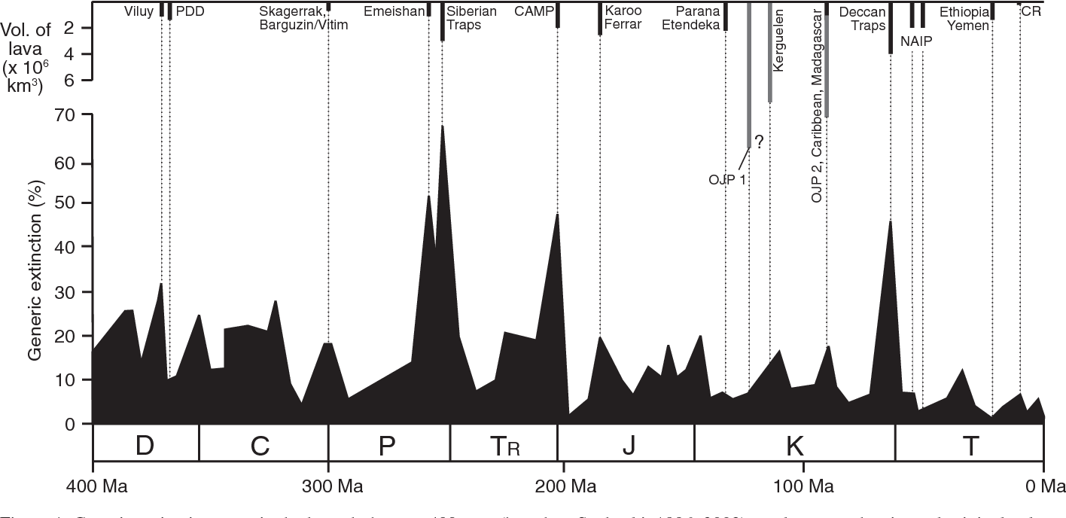
Lips and mass extinctions
Extinction magnitude through the past 400 million years plotted against the age and estimated original volume of large igneous provinces. Continental flood basalt LIPs are shown as black bars, while oceanic plateau basalt provinces are shown as gray bars. Abbreviations: D = Devonian; C = Carboniferous; P = Permian; Tr = Triassic; J = Jurassic; K = Cretaceous; T = Tertiary; CAMP = Central Atlantic magmatic province. Figure is adapted from Bond & Wignall, 2014.
Notes:
https://pdfs.semanticscholar.org/c453/00780450bfc76f4e4fd11c11ea187abd39f0.pdf
Several factors are clearly critical in determining the outcome of a LIP event. The state of the biosphere and climate prior to an eruption - how stressed the systems are - must be important. Any occurrence of other global-scale events coincident with a LIP eruption - such as a large asteroid impact - would only make things worse. But the most important factor must surely relate to the "three D's": distribution, duration and degree of pollution.
Distribution, duration, and degree of a pollution event depends on frequency and intensity of eruptive events (the pollutant supply) and the residence times of the pollutants involved. Continuous or very frequent intense events over tens of thousands of years would not only provide sufficient pollutants but give them adequate time to be spread globally at dangerous levels. On the other hand, continuous low-intensity eruption over a similar time may not raise levels of pollutants to harmful values, or perhaps only do so on a regional basis. Low frequency LIP eruptions occurring over longer timespans may still yield vast volumes of lava, but the low frequency allows ecosystem recovery in between eruptions. Therefore, it is possible for some LIPs to have had little more than local effects whereas in others the global ecosystem has been almost completely overwhelmed.

Slide 10
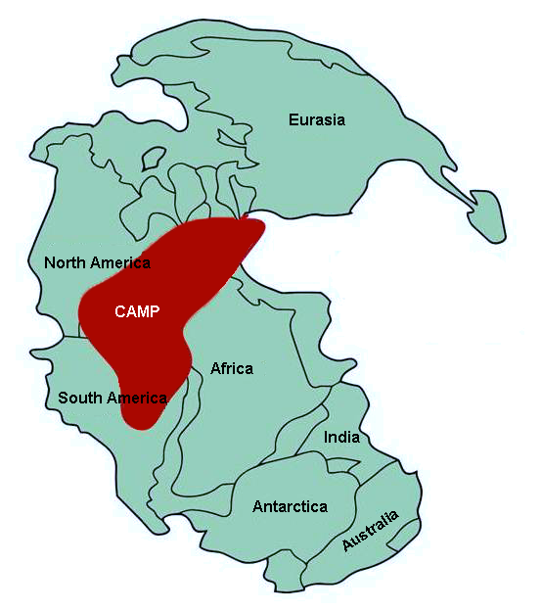
Central Atlantic Magmatic Province (CAMP)
Broke apart Pangea 202 million years ago
3x10⁶ km³ of flood basalts lava flows
Emitted between 8,000 – 9,000 Gt of CO₂ gas
Caused global climate change
Triggered end Triassic mass extinction
Notes:
202 million years ago, the supercontinent Pangea broke apart due to plate tectonics, causing some of the largest volcanic eruptions in Earth’s history. The culmination of these flood basalts is known as the Central Atlantic Magmatic Province (CAMP), which covered most of northern Africa, eastern North America, northern South America, and portions of Europe. The CAMP caused major perturbations within the global carbon cycle because of the immense amount of C released to the atmosphere, which led to major changes in global climate such as increasing global temperatures, ocean anoxia, and increased greenhouse gas emissions. Dramatic changes to climatic regulating systems negatively impacted both global marine and continental ecosystems, triggering the third largest mass extinction on Earth, the End Triassic Extinction (ETE).

Slide 11
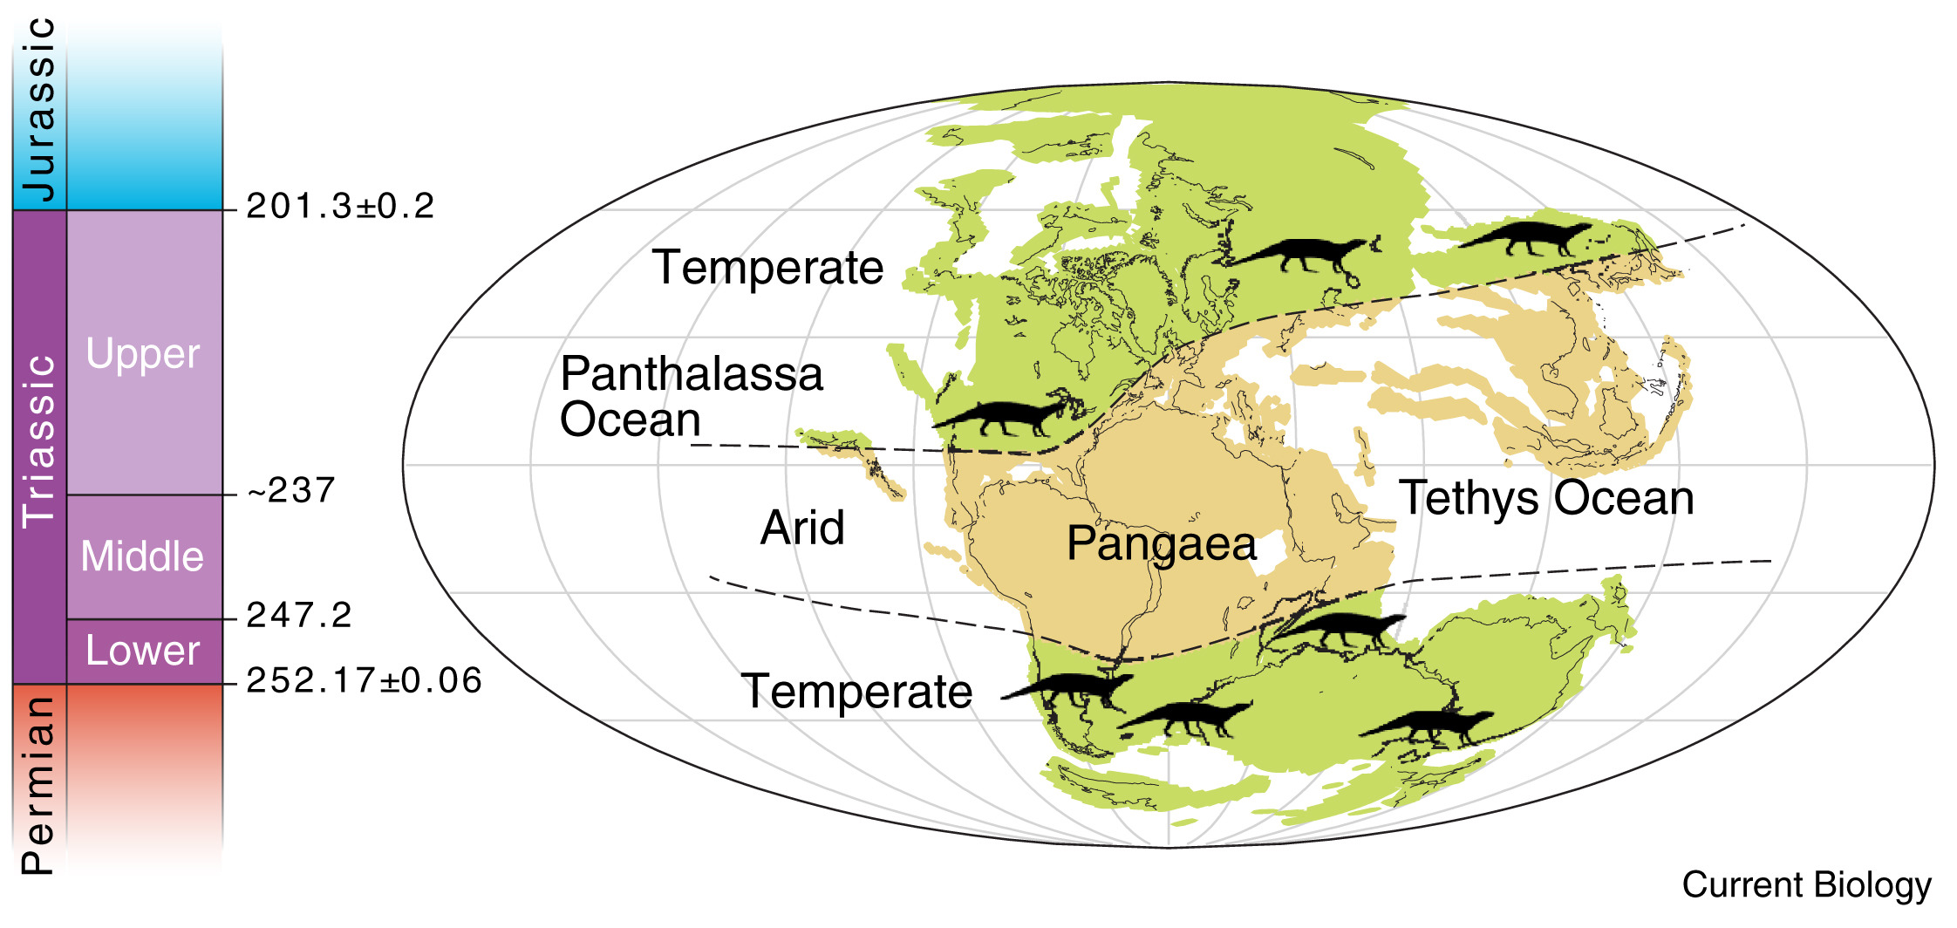
Climate in the Triassic
Pangea Climate
Overall, relatively dry and hotter than today
Continental interior: very hot summers and cold winters
Coasts: seasonal monsoon climate
https://climatearchive.org/
Notes:
Climate was generally very dry over much of Pangaea with very hot summers and cold winters in the continental interior. A highly seasonal monsoon climate prevailed nearer to the coastal regions. Although the climate was more moderate farther from the equator, it was generally warmer than today with no polar ice caps. Late in the Triassic, seafloor spreading in the ancient Tethys Sea led to rifting between the northern and southern portions of Pangaea, which began the separation of Pangaea into two continents, Laurasia and Gondwana, which would be completed in the Jurassic period.
Work by scientists suggests that increasing CO2 concentration created a new latitudinal heat gradient causing terrestrial ecosystems to become unstable at the end of the Triassic. This latitudinal heat gradients that restricted small-bodied dinosaurs like small archosaurs and theropods to the lower latitudes where conditions were warm and dry, while large-bodied dinosaurs such as sauropodomorphs and early ornithischians thrived in higher latitudes where it was cooler and less arid.

Slide 12
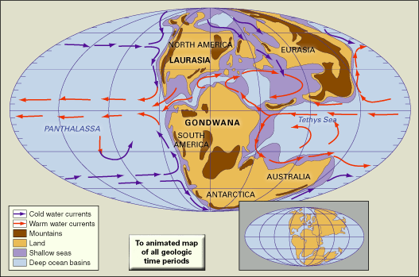
Climate in the Jurassic
Break up of Pangea changed global climate
Overall, warmer than today
Western Pangea = more arid
Eastern Pangea = more humid
Stable climate = ↑ animal diversification
https://climatearchive.org/
Notes:
The climate of the Jurassic period was warmer than many modern-day climates. Modern temperate biomes experienced a tropical climate, and polar regions had a temperate climate. Fossil data suggests the tropical zone expanded. In higher paleolatitudes, ferns and other frost-sensitive plants indicate that there was a less severe temperature difference between the Equator and the poles than exists today. Despite this decreased temperature gradient, there was a marked difference in marine invertebrates from northern higher latitudes—the boreal realm—and the tropical Tethyan realm. Decreased latitudinal temperature gradients probably led to decreased zonal winds.
Large salt deposits dating from the Jurassic represent areas of high aridity, while extensive coal deposits suggest areas of high precipitation. It has been suggested that an arid belt existed on the western side of Pangea, while more-humid conditions existed in the east. These conditions may have been caused by large landmasses affecting wind and precipitation in a manner like that of modern continents.

Slide 13
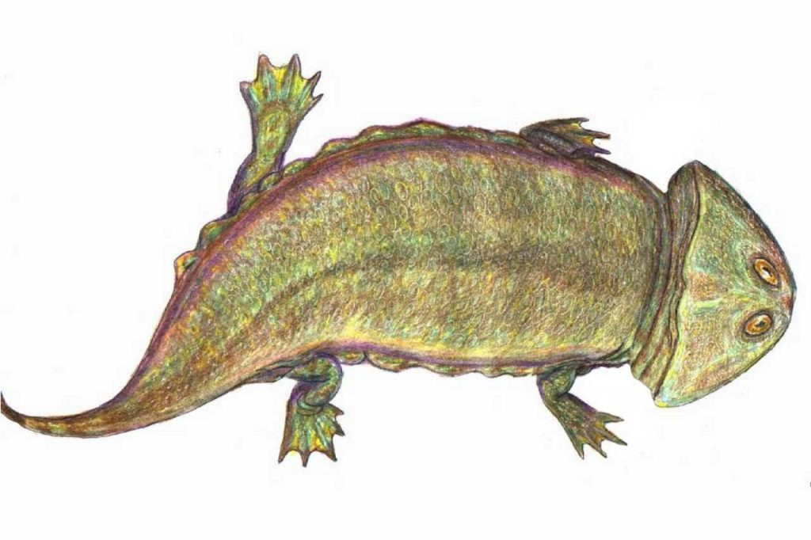
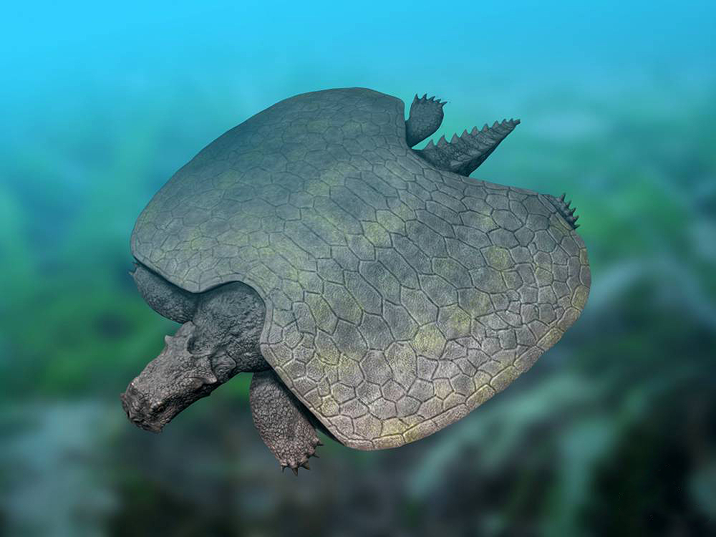
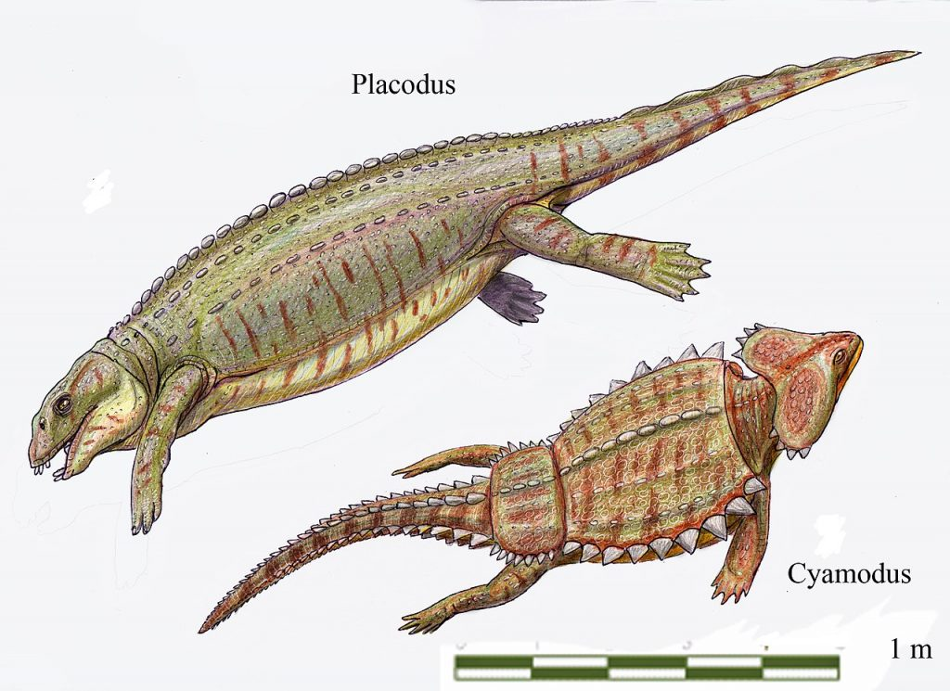
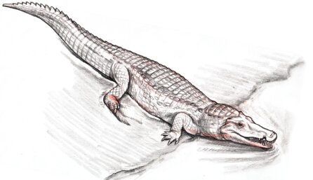
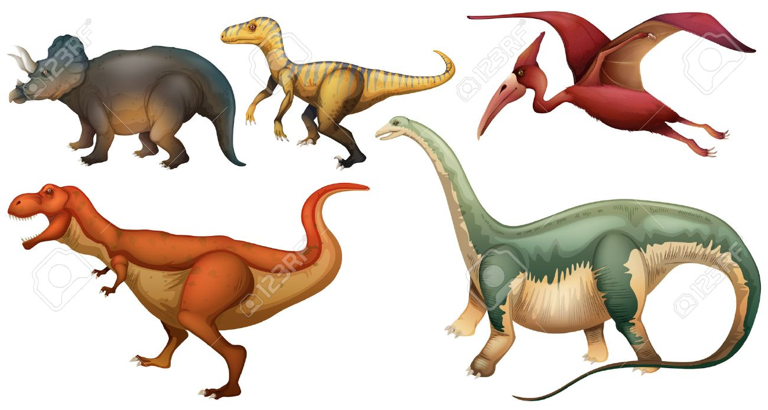
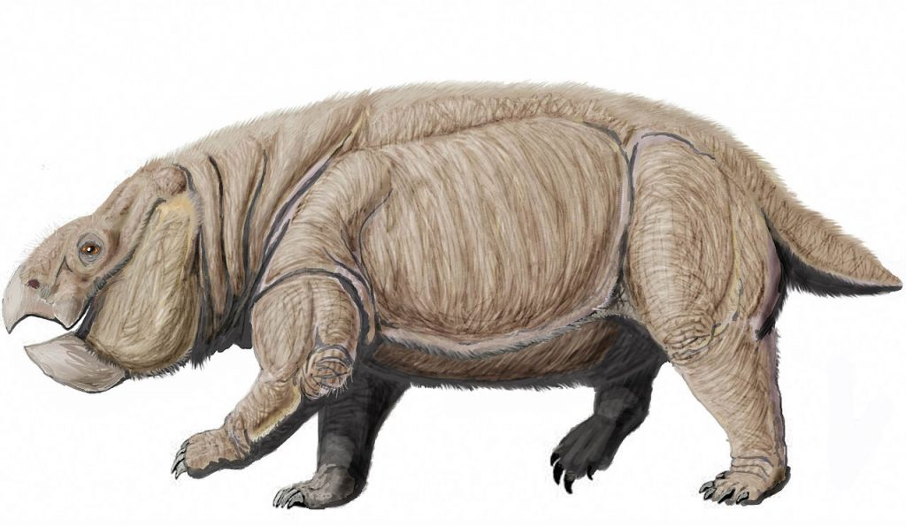
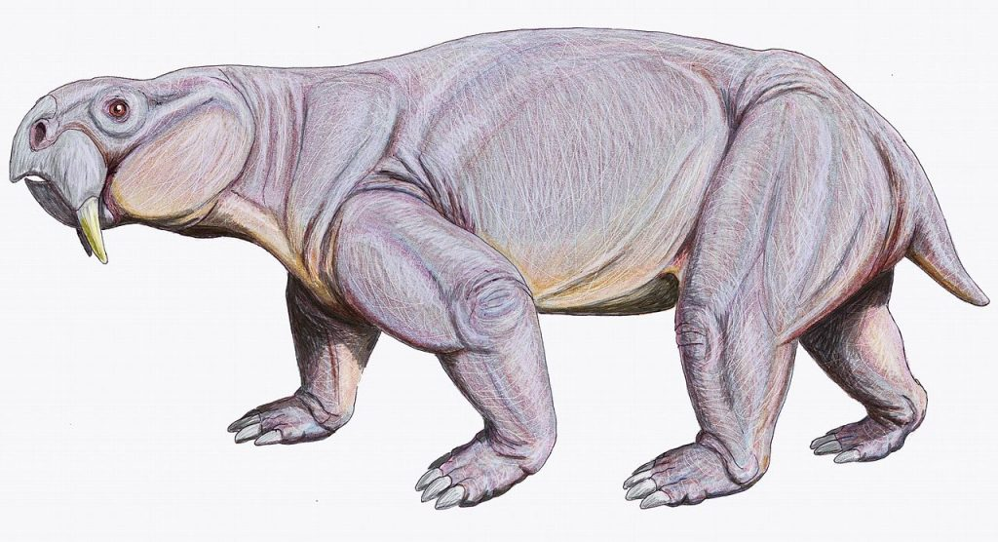




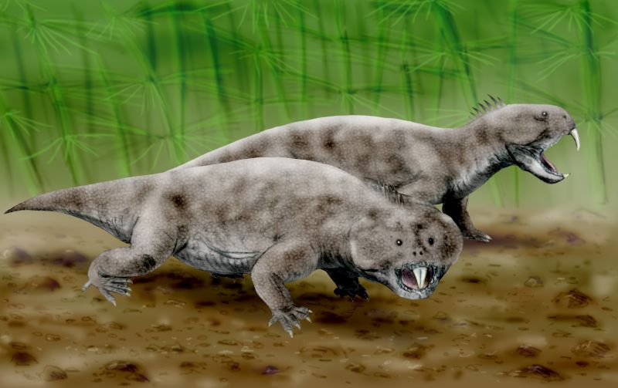




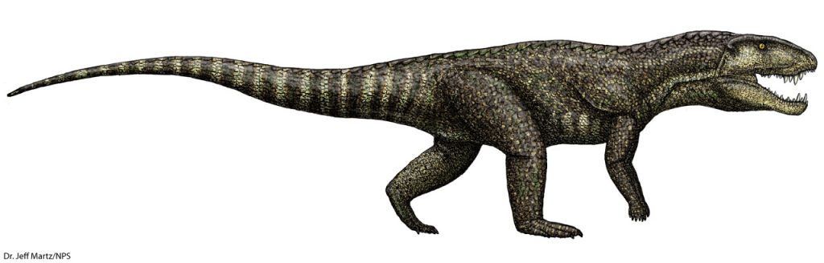
What went extinct?
Extinct
Survived and Thrived
Ancient amphibians and reptiles
Modern crocodiles + birds
Dinosaurs + pterosaurs
Mammal-like reptiles
Modern reptiles and amphibians
Fish
Ancient ancestors to crocs and birds (archosaurs)
Mammals
Notes:
So what went extinct at the end of the Triassic? On land a great part of the vertebrate fauna disappeared, most notably ancient amphibians and reptiles not related to modern amphibians and reptiles. Therapsids which are mammal like reptiles. And ancestral archosaurs (relatives of crocodiles and birds. That being said, many other animal groups survived and flourished after the mass extinction. Modern birds, dinosaurs, crocodiles, turtles, pterosaurs, modern reptiles, and amphibians, as well as mammals and fishes were little affected by the transition. In fact, many authorities maintain that the end-Triassic mass extinction on land opened ecological niches that were filled relatively quickly by dinosaurs.

Slide 14
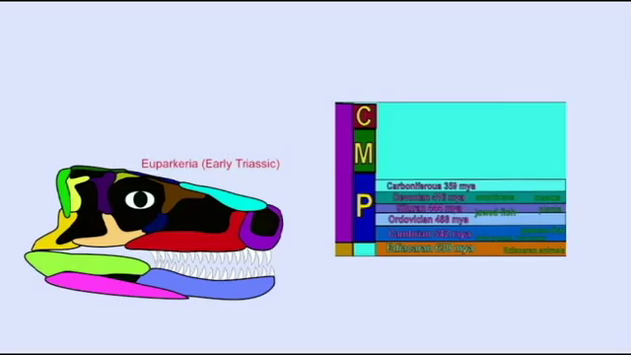
The end Triassic mass extinction video
Notes:
https://www.youtube.com/watch?v=W-YMjW-IFlQ

Slide 15
Carbon and climate

Slide 16
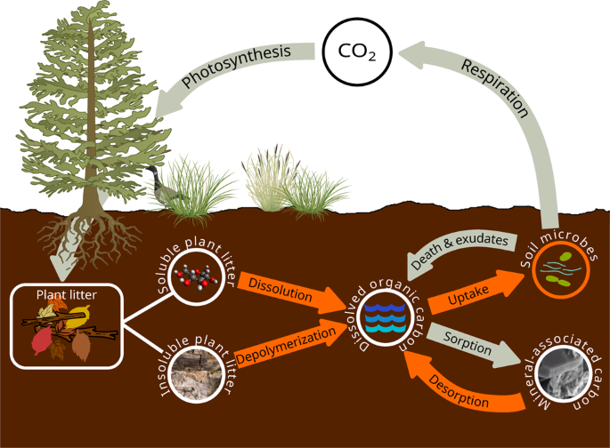
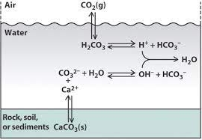
Carbon
Deep time carbon is stored one of two ways
Organic carbon
Derived from lifeforms (i.e., plants, animals, soil, microbes, etc.)
Inorganic carbon
Derived from inorganic processes (i.e., calcium carbonate formation)

Slide 17
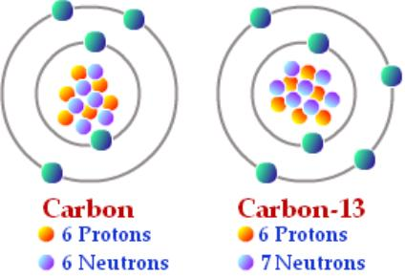
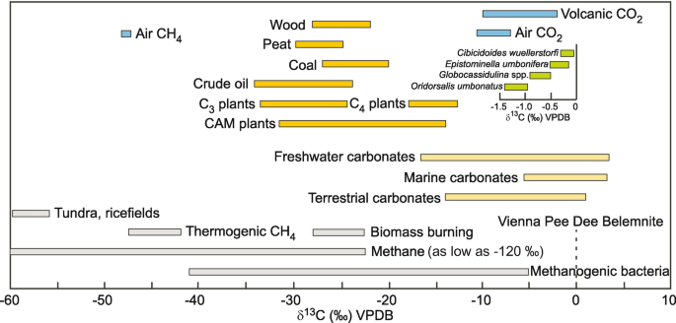
changes in carbon correspond to climate change
δ¹³C
δ¹³C = ¹³C / ¹²C
Ratio of carbon 13 to carbon 12
In climate science, isotopes are reported as δ (delta values) in ‰ (permil) = parts per 1000
Every source of carbon has unique δ¹³C value or range, making them identifiable in deep time records
Photosynthetic organisms use disproportionately more CO₂ containing the lighter carbon 12 than the heavier carbon 13
pCO₂
Partial pressure of carbon dioxide
Describes concentration of CO₂ in gas or dissolved phases relative to total atmospheric gases
In climate science, pCO₂ = atmospheric CO₂ concentration in ppm
How saturated the atmosphere is with CO₂ gas
Parts per million = a unitless ratio of parts relative to 1 million
Ppm is equivalent to 1 milligram / 1 kilogram
Ppm is also equivalent to 1 car in bumper-to-bumper traffic from Cleveland to San Francisco
-12
Notes:
What is an isotope? An atom with a different number of neutrons in its nucleus.
Carbon isotopes come in three forms. By far the most common isotope of carbon is carbon-12, which contains six neutrons in addition to its six protons. The next heaviest carbon isotope, carbon-13, has seven neutrons. Both carbon-12 and carbon-13 are called stable isotopes since they do not decay into other forms or elements over time. The rare carbon-14 (14C) isotope contains eight neutrons in its nucleus. Unlike carbon-12 and carbon-13, this isotope is unstable, or radioactive. Over time, a Carbon-14 atom will decay into a stable product (Nitrogen-14).

Slide 18
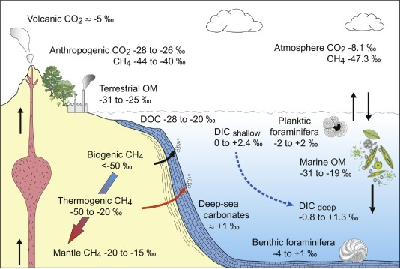
What do c-Isotopes tell us?
Sources of Carbon
Notes:
What do carbon isotopes tell us? They tell us about the origination of carbon. All carbon sources on earth have a distinct carbon isotopic signature, which are related to the biogeochemical processes that form them.
The two primary carbon sources used in paleoclimate research are organic carbon and carbonate carbon. Partitioning of carbon between organic and carbonate reservoirs in the lithosphere, combined with the strongly preferential uptake of Carbon-12 via photosynthesis, results in large variations in the Carbon-13 to carbon-12 ratio of the ocean, atmosphere, and biosphere over time.

Slide 19
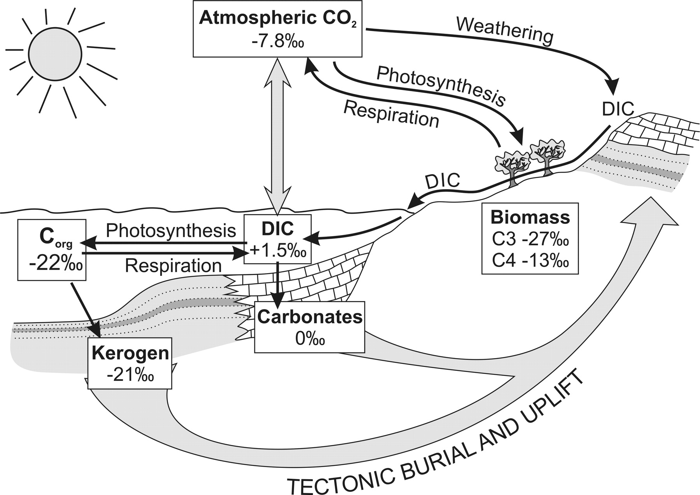
¹³C Values
2 big reservoirs
Atmosphere
Ocean
Everything takes from them
δ¹³C changes due to changes in the carbon cycle
Notes:
Isotopic partitioning occurs during photosynthesis such that all organic carbon molecules are strongly enriched in carbon-12 relative to atmospheric CO2 and therefore carry a comparatively negative carbon isotopic signature. The magnitude of partitioning varies by organism and metabolic pathway; however, the δ13C values of C3 photosynthetic plants are between -23 and -33 per mil, whereas C4 plants have substantially less carbon-12-enriched values of -9 to -16 per mil. Regardless of pathway, all photosynthesis enriches organic matter in carbon-12, providing the mechanism by which partitioning of organic matter into different reservoirs can change the overall carbon isotopic composition.
Variations in isotopic composition of carbonate carbon of the inorganic reservoir are the result of redistribution of carbon, particularly organic carbon, among the surficial carbon reservoirs (atmosphere, oceans, biosphere, soils, etc.) and the lithosphere reservoirs (carbonate and organic carbon rocks, including oil and gas). Partitioning and redistribution of carbon within and among the surficial carbon reservoirs drive the short-term carbon cycle and are largely responsible for changes in the carbon isotopic composition value of the inorganic carbon reservoir on time scales of tens of thousands of years or less. On longer time scales of hundreds of thousands to millions of years, changes in the exchange fluxes between the surficial carbon reservoirs and the lithosphere reservoirs of carbonate and organic carbon drive changes in carbon isotopic composition of inorganic carbon.

Slide 20
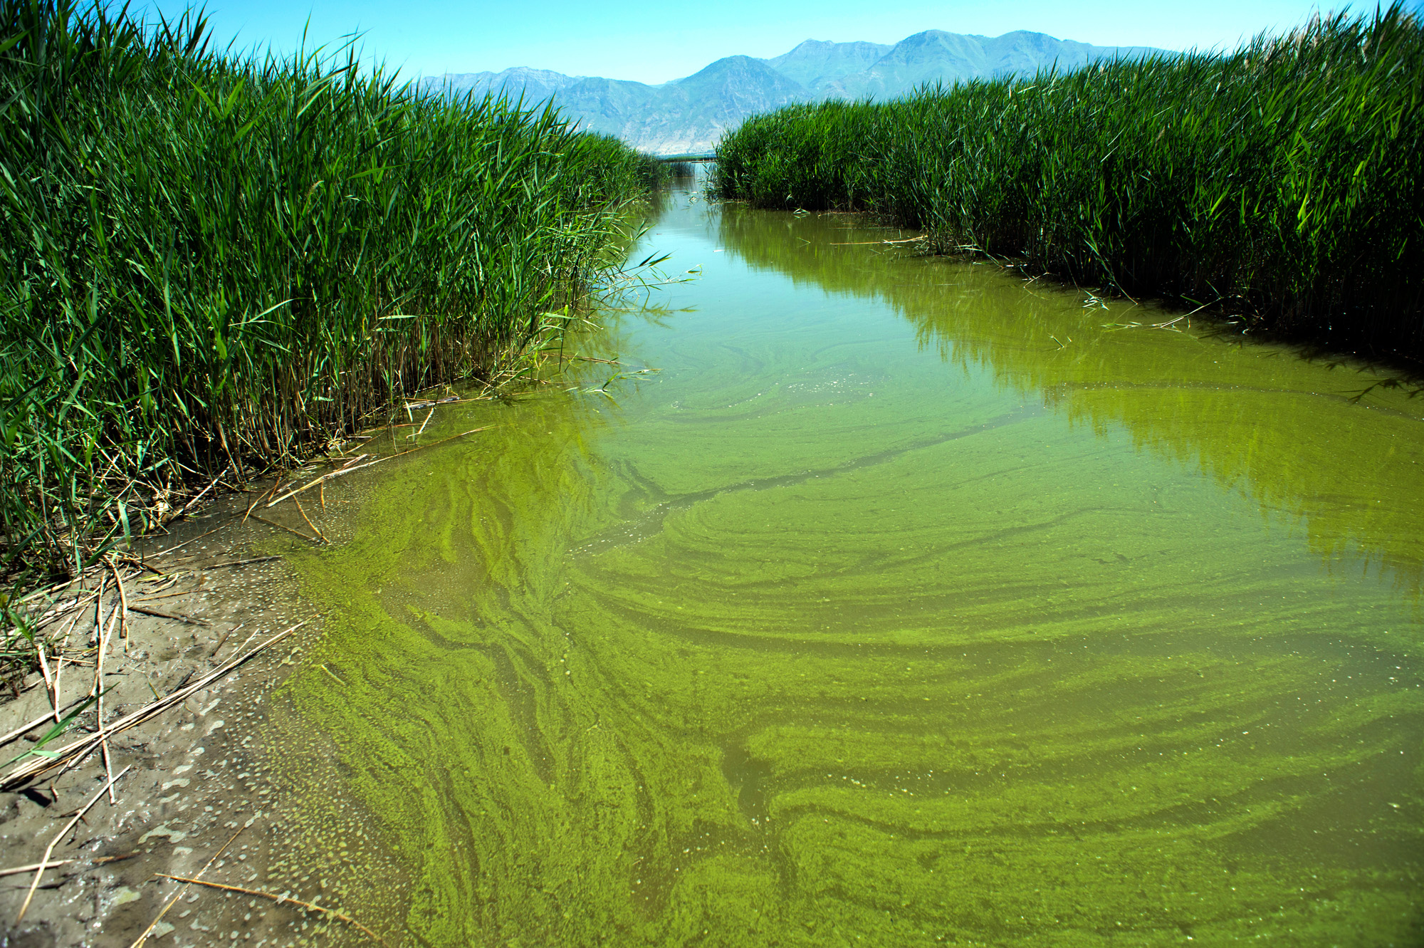

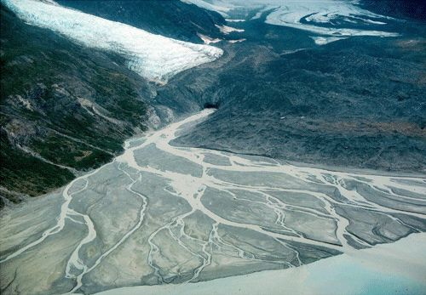
Increased carbon 13
Increased (heavier or less negative) δ¹³C values, generally indicate:
Increased productivity in photosynthesizing organisms
Increased weathering of continent to the oceans
Algal bloom in a river
California Super Bloom (2017)
Delta moving sediment into the ocean
Notes:
Carbon isotope values can be positive or negative. When Carbon isotope values are heavier or less negative, this is associated with the accumulation and retention of carbon-12 compared to carbon-13.

Slide 21
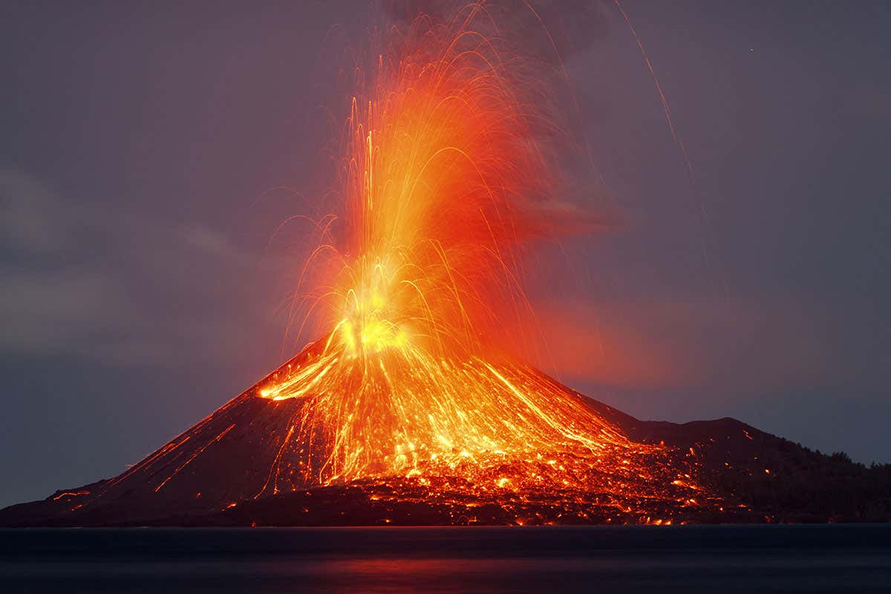
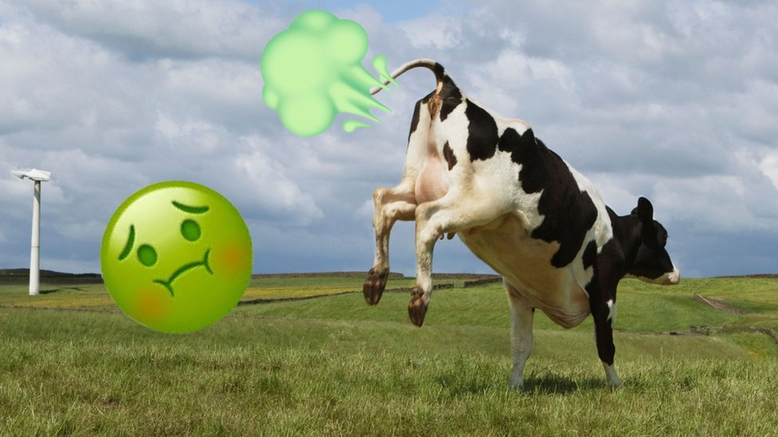
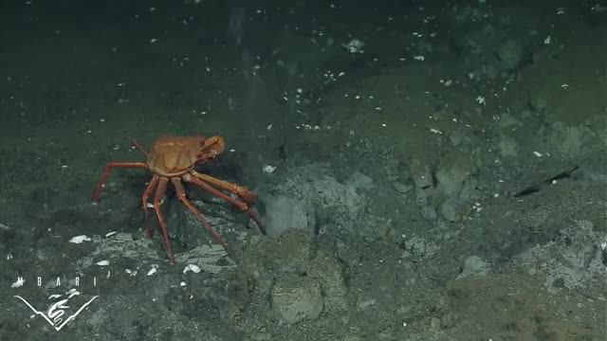
Decreased carbon 13
Decreased (lighter or more negative) δ¹³C values, generally indicate:
Decreased productivity in photosynthesizing organisms
less weathering of the continent
Large volcanic eruptions
“Burning" of organic rich rock during volcanic eruptions
Release of light carbon in the form of methane (CH₄)
Volcano erupting
Methane release
Notes:
Conversely, when Carbon isotope values are lighter or more negative, this is associated with the release of carbon-12. Remember, carbon-12 is more abundant and easier to integrate into molecular structures, so seeing a spike of light C in the isotope record indicates a carbon cycle perturbation.

Slide 22

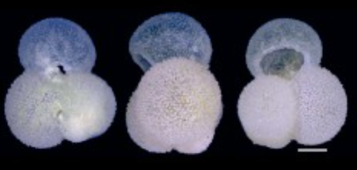



How do C-isotopes record environmental change?
δ¹³C
Time (aka stratigraphy)
Notes:
How do Carbon isotopes record environmental change? During periods of high biological productivity more light carbon 12 is locked up in living organisms and organic matter being buried and preserved in sedimentary rocks. The atmosphere and oceans become depleted in carbon 12 and enriched in carbon 13.
During periods of low biological productivity and decreased burial of organic carbon, for example following mass extinctions, calcareous materials become enriched in carbon 12. The atmosphere and oceans become enriched in carbon 12 and depleted in carbon 13.

Slide 23
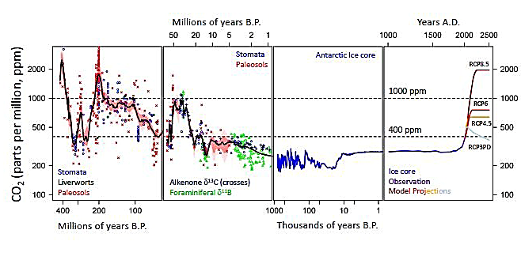
What does pCO₂ tell us?
How much CO₂ is in the atmosphere

Slide 24
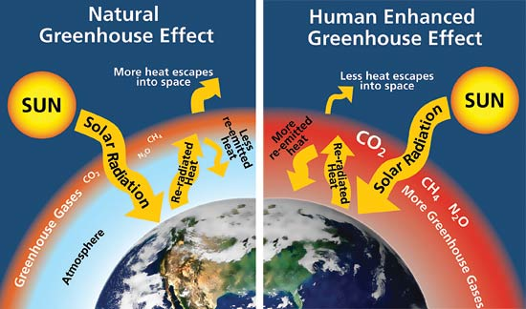
Why is pCO₂ important?
Normal
Greenhouse Effect
Enhanced
Greenhouse Effect
↑ pCO₂ = ↑ CO₂ concentration in atmosphere
Elevated pCO₂ = elevated greenhouse effect
Notes:
Why is p-CO2 important? Because CO2 is a greenhouse gas, when concentrations of GHGs change, this impacts the temperature of the earth. Increasing the concentration of CO2 increases the greenhouse effect, thus causing global temperature warming.

Slide 25
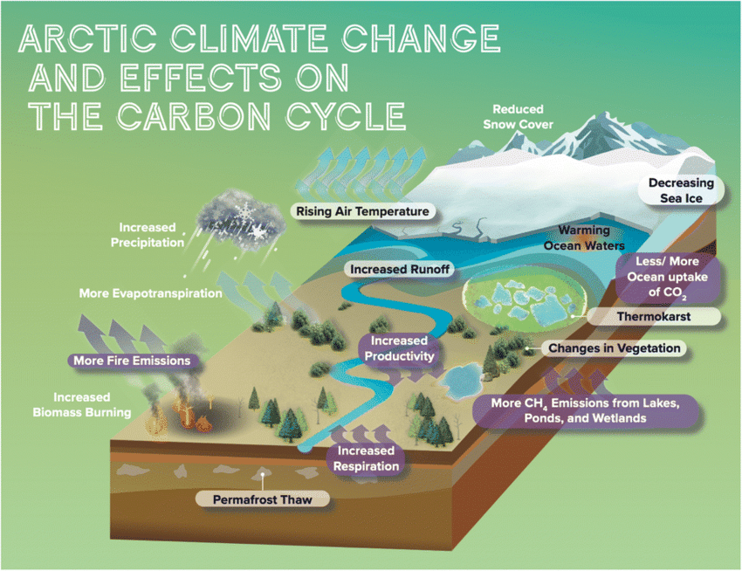
Carbon & climate
Detailed records of C tell us how the Earth + its inhabitants responded to carbon cycle perturbations
C-isotopes tell us the sources of C and identifies perturbations
pCO₂ tells us how much CO₂ is in the atmosphere
Together, these proxies correspond to changes in paleoenvironments and paleoclimate
Notes:
https://www.researchgate.net/figure/Schematic-illustrating-Arctic-climate-change-and-its-effects-on-the-carbon-cycle-Purple_fig1_348974461

Slide 26
How to identify carbon perturbations in the geologic record

Slide 27
Reading carbon curves
Age (Time)
Carbon isotope values
Carbon 13 curve for the latest Triassic – earliest Jurassic. for New York Canyon, NV, USA.
Carbon values are plotted along the top/bottom, and age along the left side.
Notes:
From Bartolini et al 2012 New York Canyon, Nevada, USA
Now that you know what Carbon isotope values mean, let’s dive into how to interpret them in deep time context. The plot is showing data from New York Canyon, Nevada. It encompasses the latest Triassic – earliest Jurassic time periods. On the right side of your screen, you see (from left to right) time, a stratigraphic column which describes the types of rocks, and a carbon isotope curve. Everything encompassed by the orange bracket reflects time. There are different means of reflecting time, we have numerical ages, geologic ages, biostratigraphic ages, and lithostratigraphy. All these chronologies are useful for age bracketing our carbon isotope curves and are read from the bottom up. The right-side plot shows a squiggly line connected by points. The x-axis corresponds to Carbon isotope values in per mil. Each point corresponds to a rock sample that was analyzed. The line connecting them corresponds to the trend. The shifts in the C-isotope record are related to changes in the CO2 concentration in the atmosphere. Thus, by analyzing the C-isotopic record of particular types of rocks, we can calculate the CO2 concentration of the atmosphere millions of years ago!

Slide 28
Reading carbon curves
Base level
+ excursion
+ excursion
Carbon values are expressed as a continuous curve through time
We are looking for excursions
substantial deviations (>2‰) in δ¹³C from the base level
Excursions can be + or – and reflect carbon cycle perturbations (e.g., volcanism)
- excursion
- excursion
Notes:
From Bartolini et al 2012 New York Canyon, Nevada, USA
When reading a carbon curve, there are important pieces of information we want to look for. The first is to figure out what the base level delta 13-C value is. This value reflects the average carbon isotopic value for C3 vegetation and soils. Knowing the base level value will allow us to see any substantial changes in isotope composition, thus reflecting carbon cycle perturbations. Next, we look for excursions; these are dramatic deviations from base level. Any dramatic deviation from base level greater than about 2 per mil is considered an excursion. It is important to note that excursions can be positive or negative. Looking at the carbon curve to the right of you screen, you can see the base level value is negative 27.5 per mil and that there are 4 prominent excursions (2 negative and 2 positive).

Slide 29
Evidence for CAMP Volcanism
New York Canyon, NV, USA
Base level δ¹³C
Average δ¹³C for C3 plants
-27.5‰
CAMP δ¹³C
-6 to -2‰ spike
More negative values
Lasts 600,000 years
Post-CAMP δ¹³C
More + values at first, then going back to equilibrium
Post-CAMP δ¹³C
CAMP δ¹³C
Pre-CAMP δ¹³C
Notes:
From Bartolini et al 2012 New York Canyon, Nevada, USA
Now that we know how to read and pull information from a carbon curve, lets apply what we’ve learned.
This curve is made from data from New York Canyon, Nevada. The time period preserved is the latest Triassic to earliest Jurassic. The base level value is -27.5 per mil and that there are 4 prominent excursions (2 negative and 2 positive). Looking at the curve, we can see evidence for CAMP volcanism (note the orange upward facing arrow). CAMP volcanism is characterized by 2 to 4, -6 to -2 per mil spikes in carbon isotope composition and the excursions occur within a 600,000-year period.
Post-CAMP volcanism, we see enrichment in carbon isotope values for several million years, then a return to pre-CAMP base level as the carbon cycle recovers and reestablishes equilibrium.

Slide 30
Calculating pCO₂
Yes, we can calculate pCO2 from 200 million years ago!
That’s so cool!

Slide 31
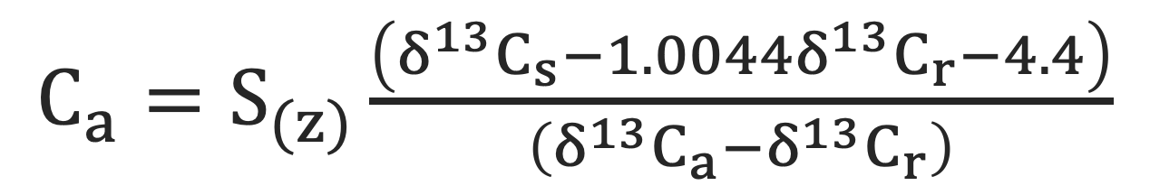
Paleo pco₂ calculation
$C_{a}=S_{(z)}\frac{\left(δ^{13}C_{s}−1.0044δ^{13}C_{r}−4.4\right)}{\left(δ^{13}C_{a}−δ^{13}C_{r}\right)}$
Cerling (1999) paleobarometer equation
Notes:
How do we calculate paleo p-CO2? We use this equation: the paleosol paleobarometer equation. What is a paleosol? A paleosol is a fossilized soil. It no-longer is acting as a modern soil and has turned to rock. The mathematical relationship uses C-isotopes to back calculate for ancient p-CO2.

Slide 32
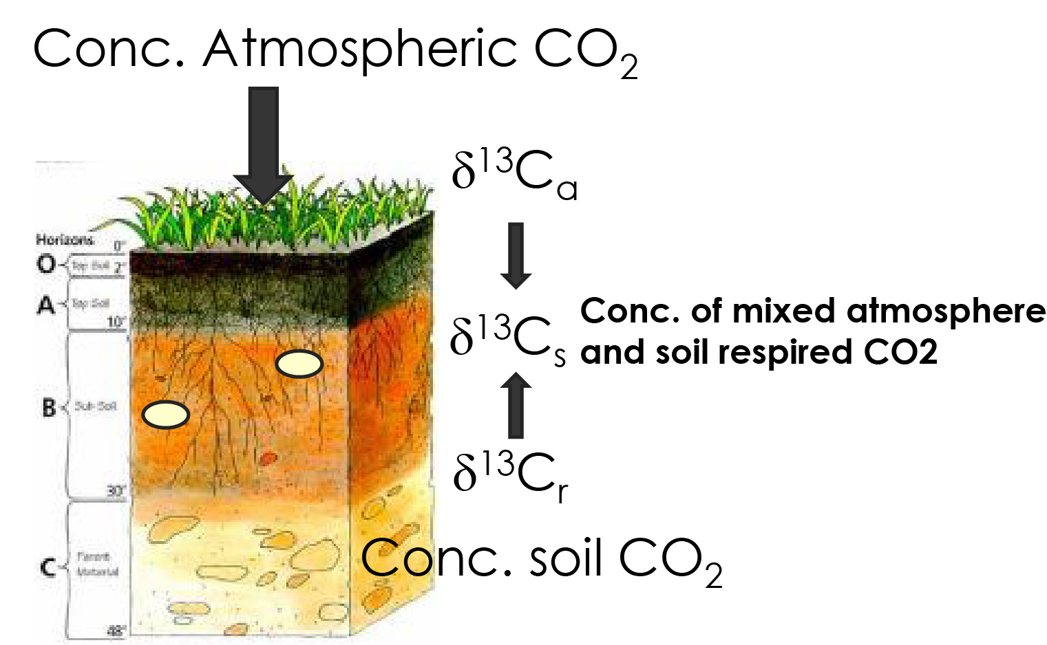
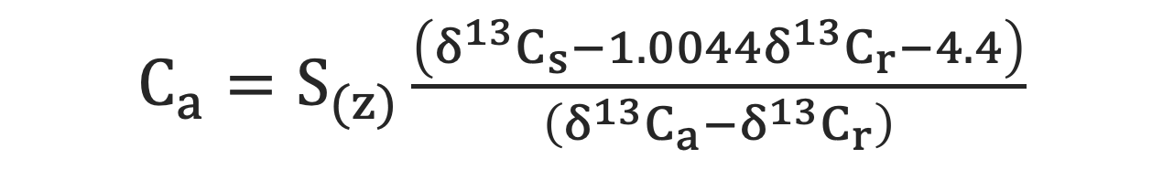
pco₂ calculation elements
Soil CO₂ concentration (ppm)
δ¹³C
(soil CO₂)
δ¹³C (respired)
$C_{a}=S_{(z)}\frac{\left(δ^{13}C_{s}−1.0044δ^{13}C_{r}−4.4\right)}{\left(δ^{13}C_{a}−δ^{13}C_{r}\right)}$
*We are assuming that there is continuous and equal exchange of CO₂ between the atmosphere and soil
CO₂ concentration of the atmosphere (ppm)
Atmosphere δ¹³C
Notes:
This mixing model has several different variables that serve as proxies that when combined, can be used to estimate ancient p-CO2. For this model to work, we assume that there is continuous and equal exchange of CO2 between the atmosphere and soil.
The model equation is based on a mixing of a known isotopic composition of atmosphere (delta 13-C a), the isotopic composition of root respired CO₂ (delta 13-C r) and the soil’s CO2 Carbon isotopic composition (delta 13-C s), which reflects the mixture of respired and atmospheric CO2 isotopic compositions.
The last variable in the model is S(z). S(z) is the soil CO2 concentration in ppm which reflects soil productivity. This value functions as a scaling variable.

Slide 33
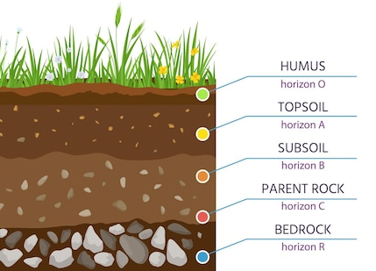

How do the proxies work?
Soil CO₂ concentration (ppm)
δ¹³C
(soil CO₂)
δ¹³C (respired)
$C_{a}=S_{(z)}\frac{\left(δ^{13}C_{s}−1.0044δ^{13}C_{r}−4.4\right)}{\left(δ^{13}C_{a}−δ^{13}C_{r}\right)}$
CO₂ concentration of the atmosphere (ppm)
Atmosphere δ¹³C
δ¹³C_{a}
δ¹³C_{s} = Terrestrial carbonates develop in soils and should be in isotopic equilibrium with soil CO₂ (soil CO₂)
δ¹³C_{r} = Rocks in the soil should be in isotopic equilibrium with soil organic CO₂ (respired CO₂)
δ¹³C_{a} = Atmospheric CO₂ can be estimated or calculated
S(z) = Soil concentration value corresponds to a specific type of soil
δ¹³C_{r}
δ¹³C_{s}

Slide 34

Solve for variables
Estimated from CaCO₃
3000 ppm
δ¹³C Organic
$C_{a}=S_{(z)}\frac{\left(δ^{13}C_{s}−1.0044δ^{13}C_{r}−4.4\right)}{\left(δ^{13}C_{a}−δ^{13}C_{r}\right)}$
pCO₂ (ppm)
-6.3‰
δ¹³C_{a} = carbon isotopic composition of the atmosphere = -6.3‰
δ¹³C_{s} = carbon isotopic composition of soil CO₂ = calculate
δ¹³C_{r} = carbon isotopic composition of soil respired CO₂ = δ¹³C_{OM}
S(z) = soil CO₂ concentration = 3000 ppm
C_{a} = CO₂ concentration of the atmosphere = what we want to know

Slide 35
Reminders!
δ¹³C are ratios
Used to identify carbon cycle perturbations
Source of c isotopes -> organic material and carbonates
Use c isotopes to calculate concentrations of pCO₂

Slide 36
Assignment

Slide 37
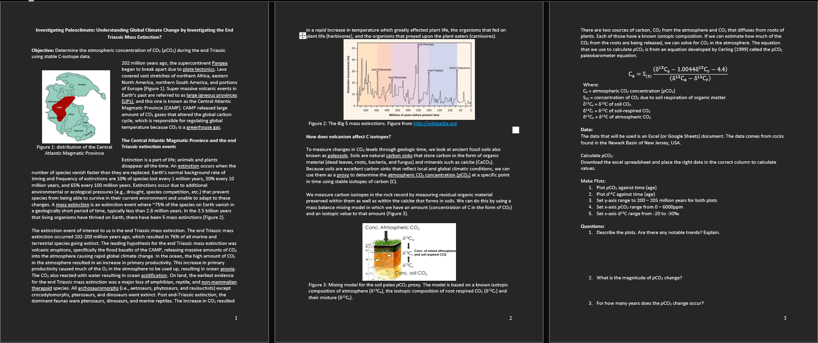
Assignment
Complete the worksheet by:
Collecting field data
Generating isotope data
Performing calculations
Interpreting results

Slide 38
Virtual field trip
Location: Southwestern United States (Utah and Arizona)
Time: latest Triassic (~208 million years ago) – earliest Jurassic (~198 million years ago)
Goal: Collect geochemical data to reconstruct paleoclimate
While in the field:
Pay attention to your surroundings
Work with your peers
Take notes
Notes:
Along with doing an assignment, we would like to invite you to partake in a virtual field experience! You will get the opportunity to go into the field and collect rock data, then go into the lab and generate geochemistry data.
You will be visiting the southwestern united states, specifically Arizona and Utah. The rocks you will see are latest Triassic (~208 million years old) to earliest Jurassic (~198 million years old) in age.
While in the field, remind your students to pay attention to your surroundings, work with their peers, and take lots of notes! You do not know when you will get to return, so treat this trip as your one and only opportunity to take notes.

Slide 39
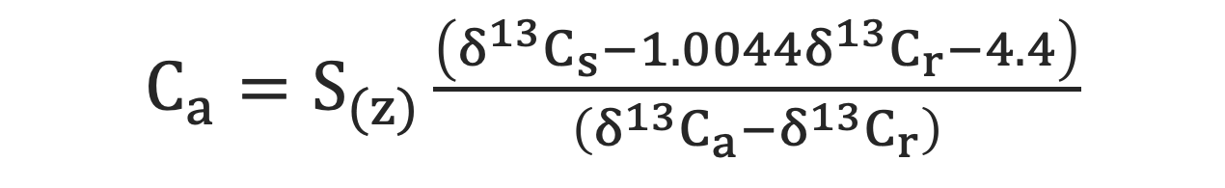
Post field trip Assignment
Estimated from CaCO₃
3000 ppm
δ¹³C Organic
$C_{a}=S_{(z)}\frac{\left(δ^{13}C_{s}−1.0044δ^{13}C_{r}−4.4\right)}{\left(δ^{13}C_{a}−δ^{13}C_{r}\right)}$
pCO₂ (ppm)
-6.3‰
How do the proxies work?
Terrestrial carbonates develop in soils and should be in isotopic equilibrium with soil CO₂ (soil CO₂)
Rocks at the soil surface should be in isotopic equilibrium with soil organic CO₂ (respired CO₂)
Atmospheric CO₂ can be estimated or calculated
Soil concentration value corresponds to a specific type of soil
Notes:
For your assignment, you will use the generated geochemistry data (carbon isotope data from the Newark and Hartford Basins of New York and Connecticut) to calculate p-CO2. You will be using this paleobarometer equation to do this.

Slide 40
Virtual field trip and Lab work
https://gather.town/app/5QUd5EBlTRXWHNHL/Geology%20Field%20Trip
Do the tutorial
Watch the videos
Interact with posters
Take notes
Ask questions
Notes:
Here is the link for the virtual field trip. It will take you to a website called Gather Town. This website is only compatible with Chrome or Firefox. It will not work with Safari. There is a tutorial on the website, I recommend doing it. It is quick and very helpful. Gather Town uses a computer’s web camera and microphone to allow users in the same spaces to interact with each other. This feature is good for the students and should be encouraged as field and lab work are best done in collaboration with other.

Slide 41
Do worksheet together

Slide 42
Group Discussion questions
Why care about climate change?
Is climate change bad? Why or why not?
Are there things humans can do to reduce anthropogenic climate change?
Notes:
Following the completion of the assignment, bring the students back together as a group and use these questions to discuss climate change. These questions do not necessarily have a right or wrong answer but should encourage students to think in greater depth about climate change.

Slide 43
Feedback and Contact information
Please take the time to give us feedback
https://forms.gle/ZNuxWTjwNZ2afonj7
Any additional comments and feedback can be emailed to us
Danielle Oberg (deoberg@uark.edu)
Celina Suarez (casuarez@uark.edu)

