Slide 1
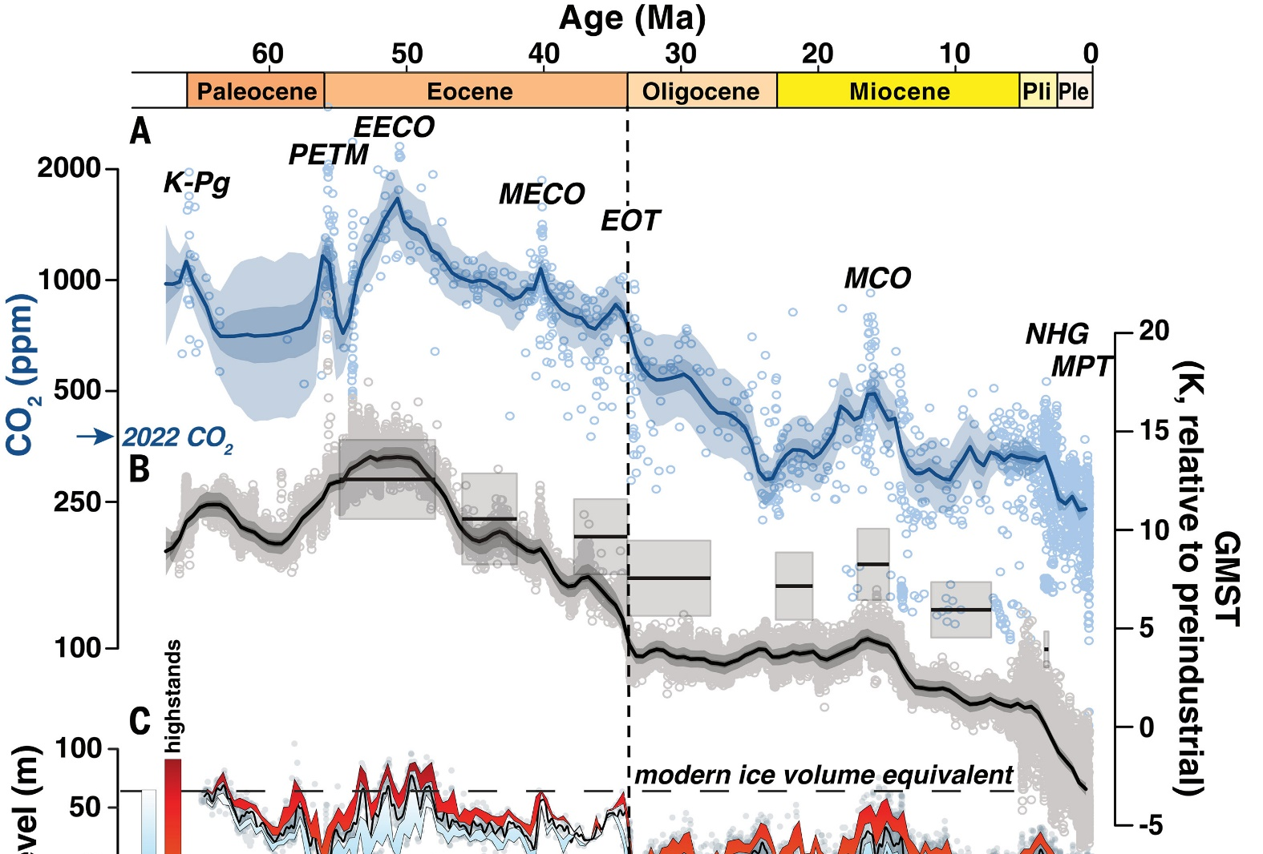
Cenozoic CO₂ and temperature patterns
Hönisch et al. (2023, Science 382: eadi5177)
Notes:
There is a first-order connection between CO₂ and temperature over Cenozoic timescales. An important way for reconstructing paleo-CO₂ on these timescales comes from CO₂ proxies. There are a half-dozen or so well-used CO₂ proxies. They rely on a measurement (or set of measurements) that can be made on fossil or rock materials that we expect to co-vary with CO₂. Each blue circle above is a single estimate based on a single proxy. Today’s lab focuses on a popular proxy based on the distribution of stomata on a leaf surface.

Slide 2
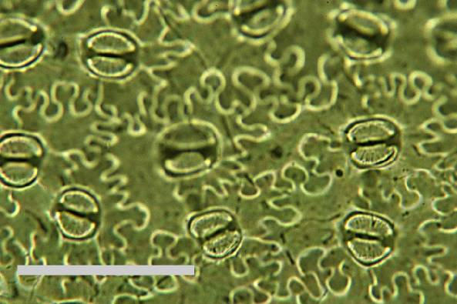
What are stomata?
Image courtesy Barry Lomax
scale bar = 10 μm
Notes:
Microscopic pores for gas exchange, including the uptake of CO₂ for photosynthesis. Because of this, one may expect stomata to be finely tuned to CO₂ concentration.

Slide 3
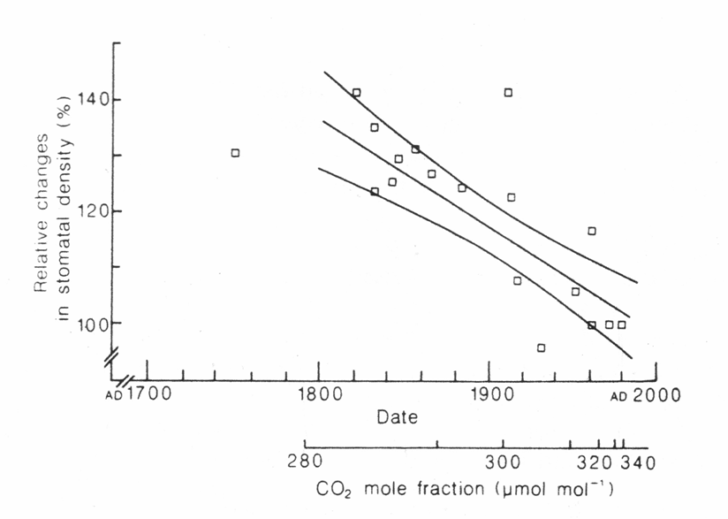
Stomatal response of woody plants to CO₂
over the last 240 years
Woodward (1987, Nature 327:617-618)
Notes:
Foundational paper showing an inverse relationship between stomatal density and CO₂ concentration. Each symbol is the relative change in stomatal density in a single species. The relative change is based on dated herbarium sheets compared to present-day leaves (circa mid-1980s).

Slide 4
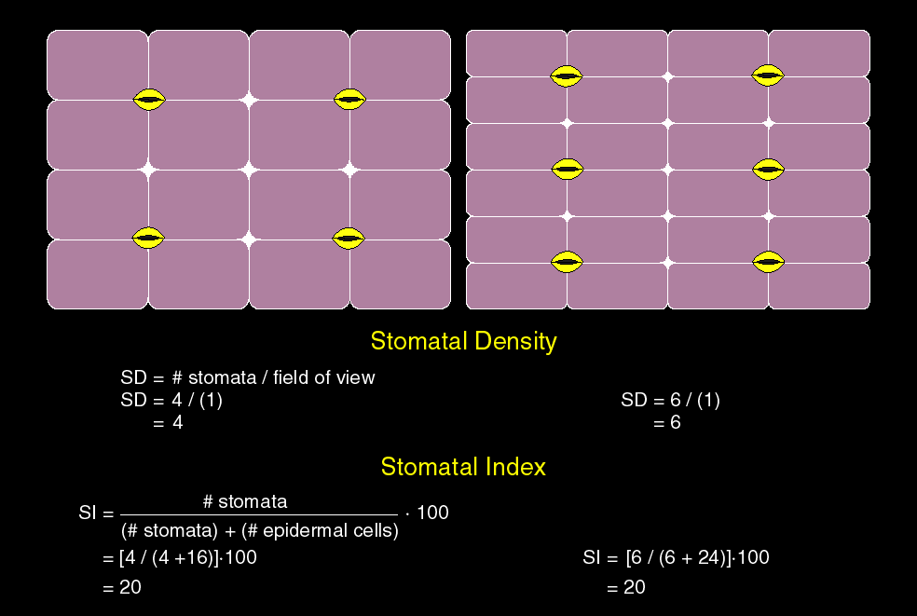
Notes:
Stomatal index is less sensitive to environmental confounders like water stress. It is the percentage of all epidermal cells that are stomatal complexes (defined as pore and two bounding guard cells). Stomatal index is size / area idenpendent.

Slide 5
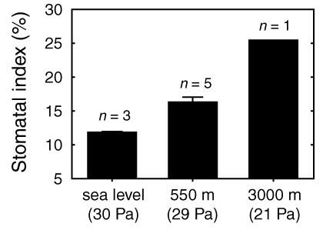
Stomata respond to partial pressure of CO₂ (P_{CO2}), not concentration (e.g., ppm)
Ginkgo biloba
Dana Royer (unpublished)
Notes:
Stomata are tuned to the total amount of accessible CO₂ (that is, partial pressure of CO₂), not the proportional abundance (ppm). This means that for fossil studies, paleoelevation needs to be constrained (ideally near paleo-sea level).
These data are for ginkgo (unpublished from Dana Royer).

Slide 6
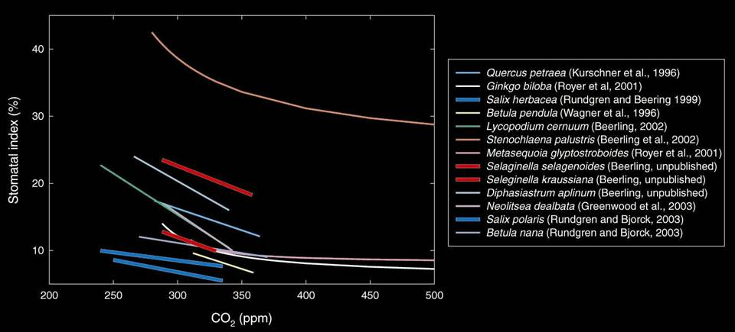
Species-specific character of stomatal responses
Modified and updated from Royer et al. (2001, Earth-Sci. Rev. 54:49-392)
Notes:
Stomatal responses to CO₂ can vary, even for species in the same genus (thick lines in plot above). This means that the pairing of a living species to create a training set needs to be carefully considered. Fossil taxa with a conservative evolution are the most appropriate.

Slide 7
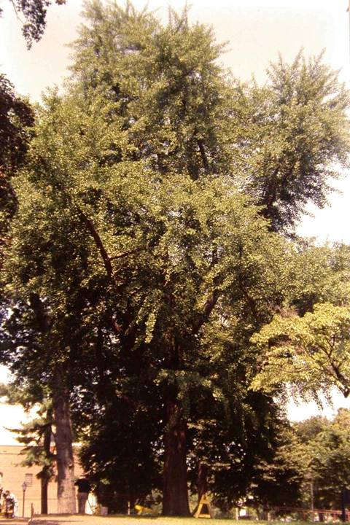
Ginkgo biloba
Notes:
Ginkgo is a conservative taxon with a long fossil record

Slide 8
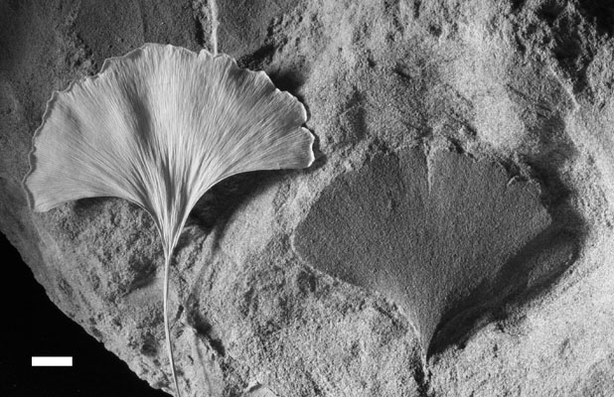
Comparison of modern Ginkgo biloba with Cretaceous (Maastrichtian) G. adiantoides
Royer et al. (2003, Paleobiology 29:84-104)
Notes:
Many ginkgo fossil leaves and seeds (next slide) look identical to extant ginkgo.

Slide 9
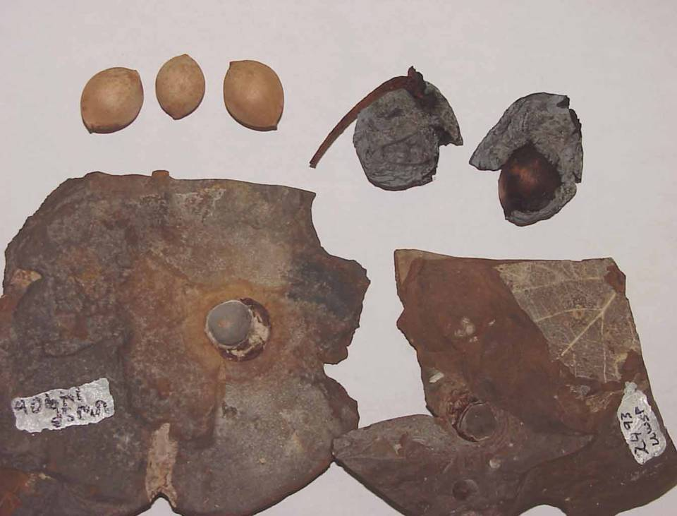
Comparison of modern and Paleocene Ginkgo seeds
Royer et al. (2003, Paleobiology 29:84-104)

Slide 10
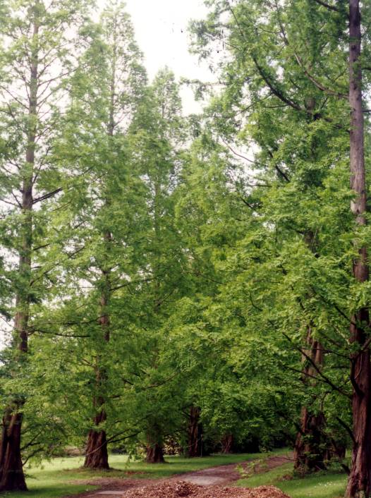
Metasequoia glyptostroboides
Notes:
Metasequoia is another conservative taxon with a relatively long fossil record.

Slide 11
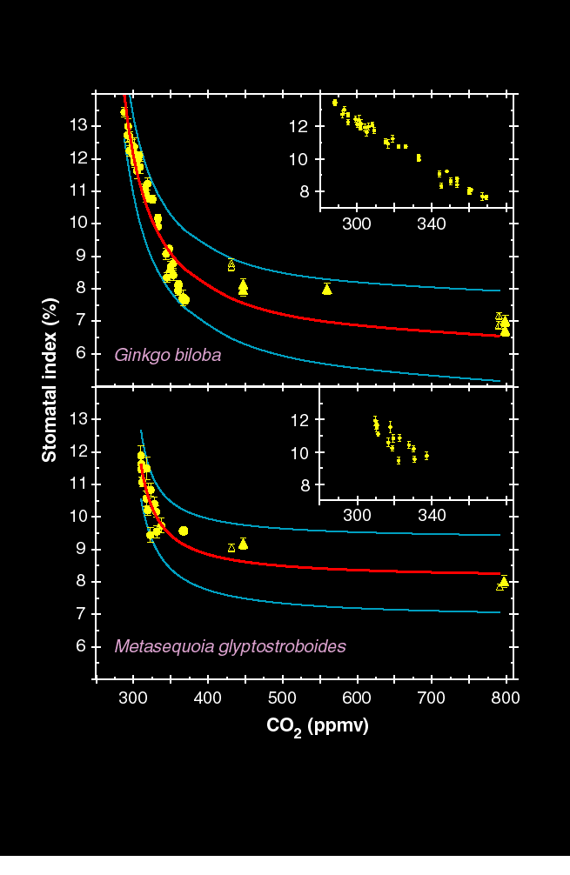
Modern training sets
Modified from Royer et al. (2001, Science 292:2310-2313)
Notes:
These data are based on dated herbarium sheets, fresh leaves from trees grown outside, and fresh leaves from saplings grown in growth chambers at elevated CO₂ for 1-3 years.

Slide 12
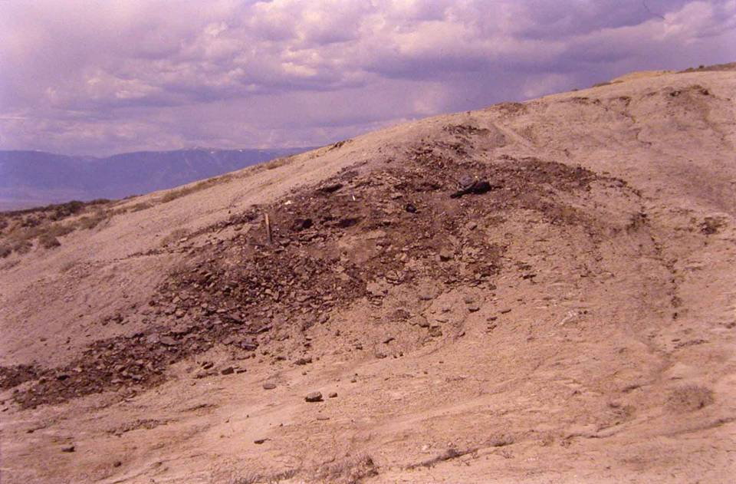
Early Eocene Ginkgo-bearing fossil plant locality
(Bighorn Basin, Wyoming)

Slide 13
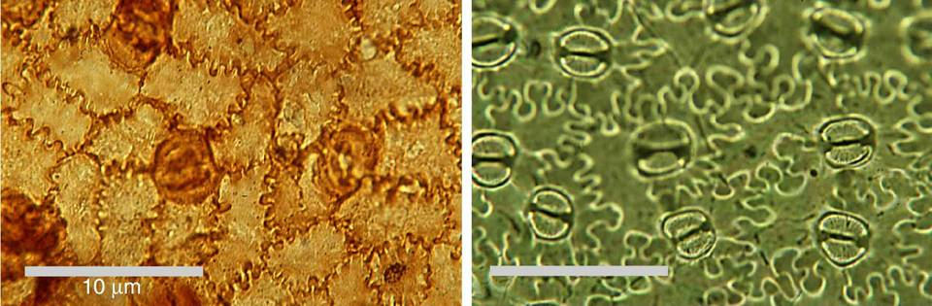
KPg aff. Stenochlaena
modern Stenochlaena palustris
Photos courtesy of B. Lomax
Notes:
Stomatal density and stomatal index in fossil Stenochlaena from just after the end-Cretaceous bolide impact is strikingly lower than in living Stenochlaena. This implies elevated CO₂ at the time after the bolide impact.

