Slide 1

Assignment calculations

Slide 2
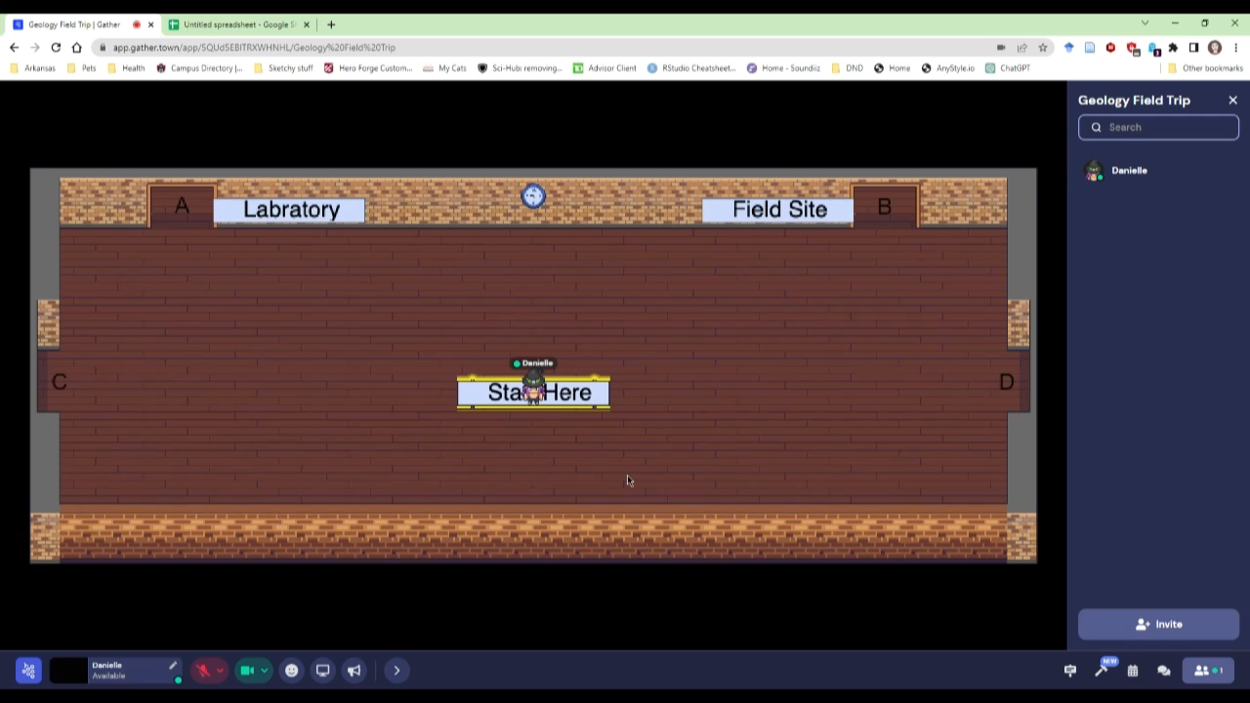
Acquire data
Have your students download the dataset from GatherTown
The data can be downloaded as an .xlsx (Excel file) and/or copy/pasted into a blank Google Sheets document
These instructions are for Google Sheets
Video showing location of dataset to download

Slide 3
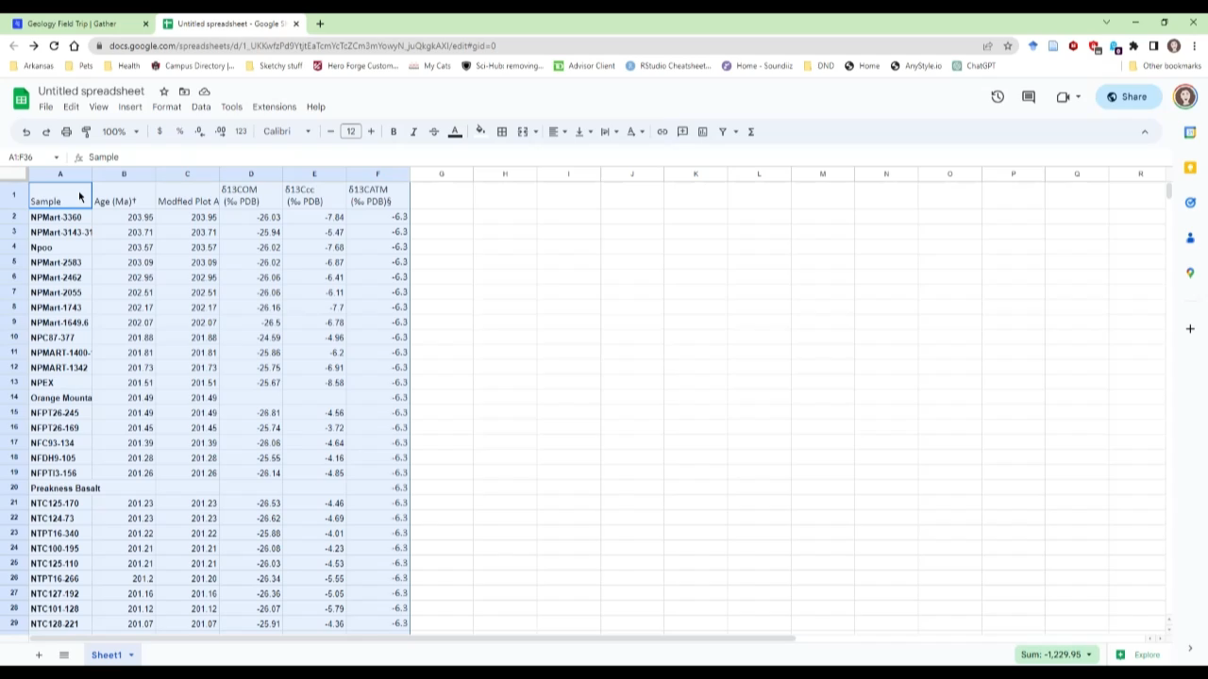
Format spreadsheet
Copy and paste the data from Isotope Data.xlsx into a blank Google Sheet
Write out and solve for the variables
Video showing how to set up a spreadsheet from scratch to do the calculations

Slide 4
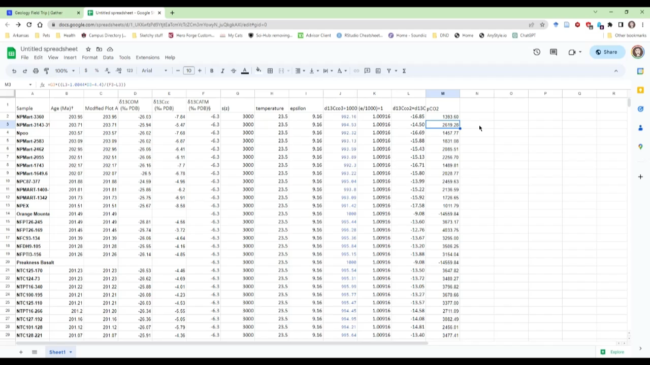
Plot the data
To make a plot, select the type of plot you want to make
Smooth line
Select the data you want to plot
Make sure to use the Modified Age column when plotting
Youngest time should be at the top of the plot
Video showing how to make a graph

Slide 5
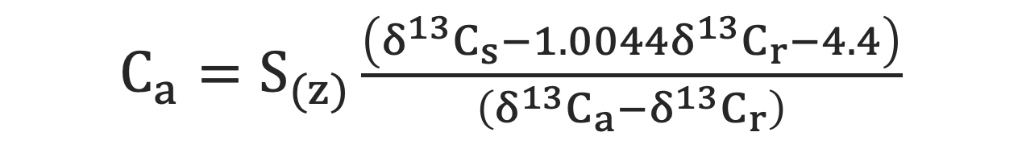
Solve for variables
Soil CO₂ concentration (ppm)
δ¹³C
(soil CO₂)
δ¹³C (respired)
$C_{a}=S_{(z)}\frac{\left(δ^{13}C_{s}−1.0044δ^{13}C_{r}−4.4\right)}{\left(δ^{13}C_{a}−δ^{13}C_{r}\right)}$
CO₂ concentration of the atmosphere (ppm)
Atmosphere δ¹³C
Write out the known variables
δ¹³C_{a}
δ¹³C_{r}
S(z)
Calculate unknown variables
δ¹³C_{s}
C_{a}
δ¹³C_{a} = carbon isotopic composition of the atmosphere = -6.3‰
δ¹³C_{s} = carbon isotopic composition of soil CO₂ = calculate
δ¹³C_{r} = carbon isotopic composition of soil respired CO₂ = δ¹³C_{OM}
Provided in spreadsheet (Isotope Data.xlsx)
S(z) = soil CO₂ concentration = 3000 ppm
C_{a} = CO₂ concentration of the atmosphere = what we want to know

Slide 6

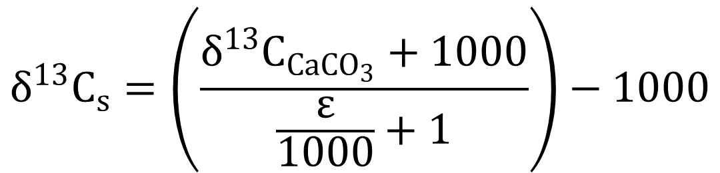
Solve for δ¹³C_{s}
$$δ^{13}C_{s}=\left(\frac{δ^{13}C_{{CaCO}_{3}}+1000}{\frac{ε}{1000}+1}\right)−1000$$
$$ε=11.98−\left(0.12∗Temperature\right)$$
δ¹³C_{CaCO3} = Provided in spreadsheet (Isotope Data.xlsx)

Slide 7
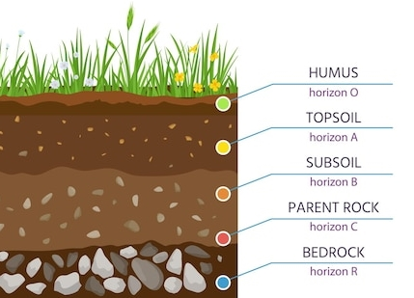

How do the proxies work?
Estimated from CaCO₃
3000 ppm
δ¹³C Organic
$C_{a}=S_{(z)}\frac{\left(δ^{13}C_{s}−1.0044δ^{13}C_{r}−4.4\right)}{\left(δ^{13}C_{a}−δ^{13}C_{r}\right)}$
pCO₂ (ppm)
δ¹³C_{a}
-6.3‰
δ¹³C_{s} = Terrestrial carbonates develop in soils and should be in isotopic equilibrium with soil CO₂ (soil CO₂)
δ¹³C_{r} = Rocks in the soil should be in isotopic equilibrium with soil organic CO₂ (respired CO₂)
δ¹³C_{a} = Atmospheric CO₂ can be estimated or calculated
S(z) = Soil concentration value corresponds to a specific type of soil
δ¹³C_{r}
δ¹³C_{s}

Slide 8
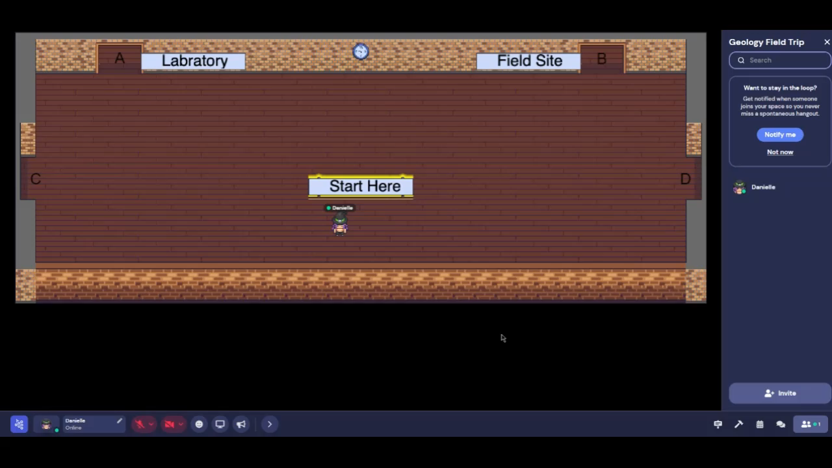
Acquire data (excel)
Have your students download the dataset from GatherTown
The data can be downloaded as an .xlsx (Excel file) and/or copy+pasted into a blank Google Sheets document
Video showing location of dataset to download

Slide 9
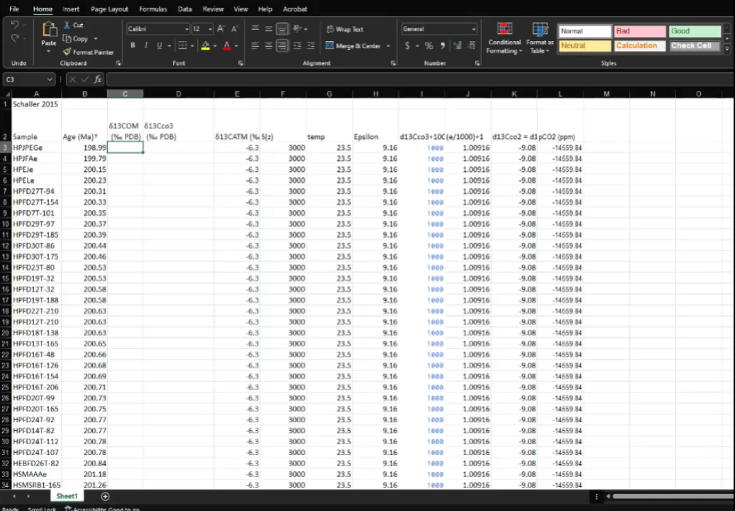
Integrate data (Excel)
For those using the calculation sheet, copy and paste the data from Isotope Data.xlsx into Calculation Sheet.xlsx
The values will auto calculate
Video showing how answers propagate when data is placed in the correct column

Slide 10
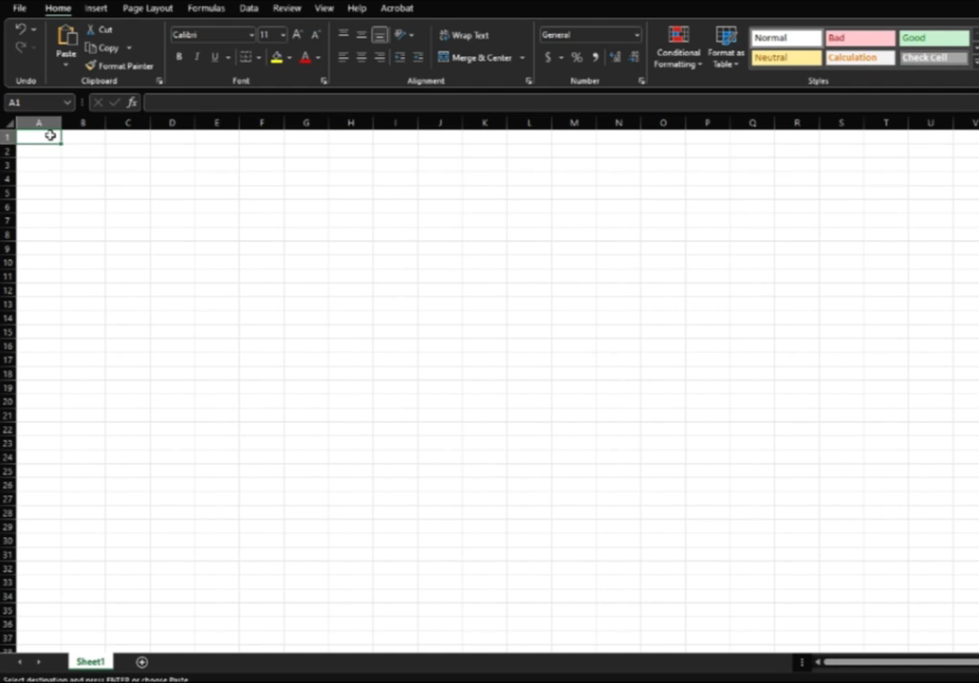
Format spreadsheet (Excel)
For those NOT using the calculation sheet, you will have your students create their own spreadsheet to do the calculations
Copy and paste the data from Isotope Data.xlsx into a blank spreadsheet
Write out and solve for the variables
Video showing how to set up a spreadsheet from scratch to do the calculations

Slide 11
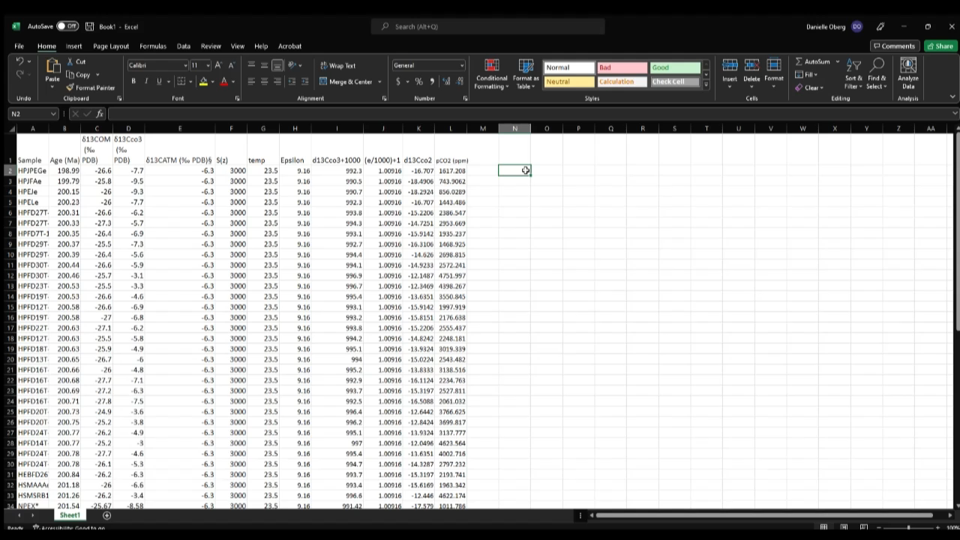
Plot the data (Excel)
To make a plot, select the type of plot you want to make
Scatter plot
Select the data you want to plot in the edit plot area
Make sure to invert the y axis
Youngest time should be at the top of the plot
Video showing how to make a graph

