Slide 1
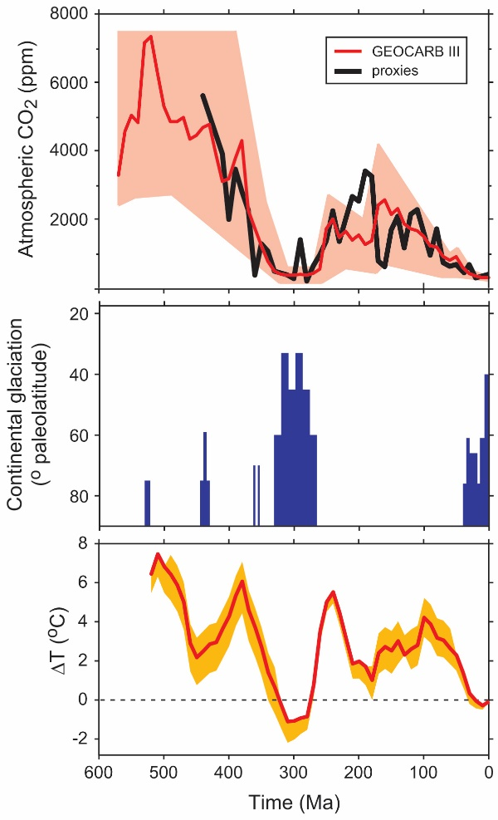
Long-term carbon cycle and paleo-CO₂
Royer et al. (2004 GSA Today 14(3): 4-10)
Notes:
-How does carbon cycle into and out of the Earth’s crust on long timescales?
-Describe the two discrete steps by which carbon is transferred from the atmosphere to the rock reservoir via the chemical weathering of Ca and Mg silicate rocks.
-Describe three ways by which plants enhance the chemical weathering of silicate rocks.

Slide 2
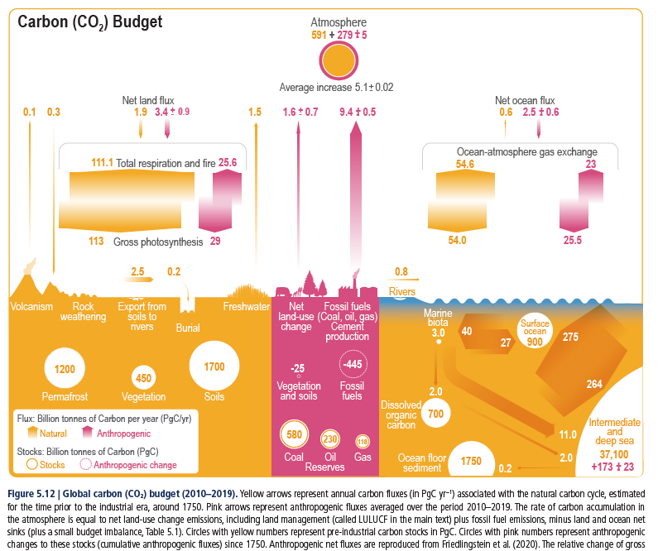
Short-term carbon cycle (<10,000 yr)
From Ch. 5 in IPCC AR6 (2021)
https://www.ipcc.ch/report/ar6/wg1/figures/chapter-5/figure-5-12/

Slide 3
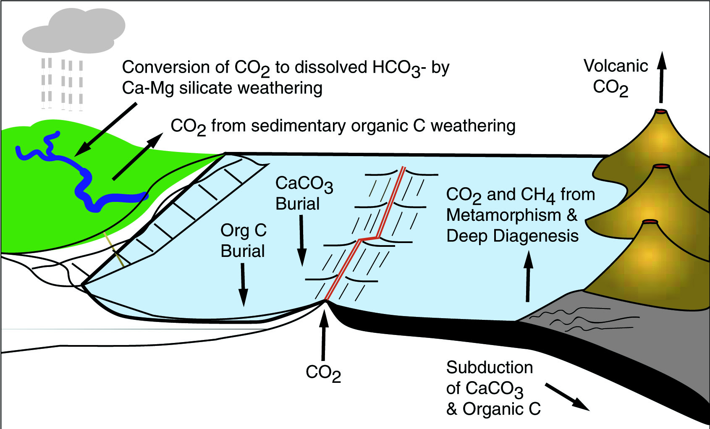
Long-term carbon cycle (>100,000 yr)
Berner (1999, GSA Today 9 (11): 1-6)
Notes:
(mention GEOCARB model)
How does carbon move into and out of the sedimentary rock reservoir?
1. volcanic CO₂ (mid-ocean spreading ridges)

Slide 4
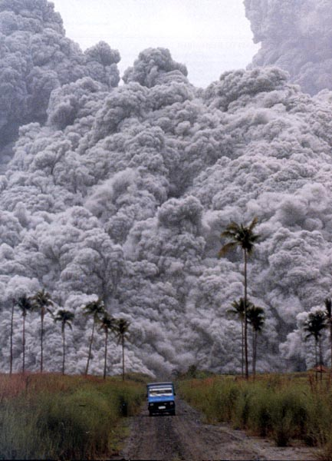
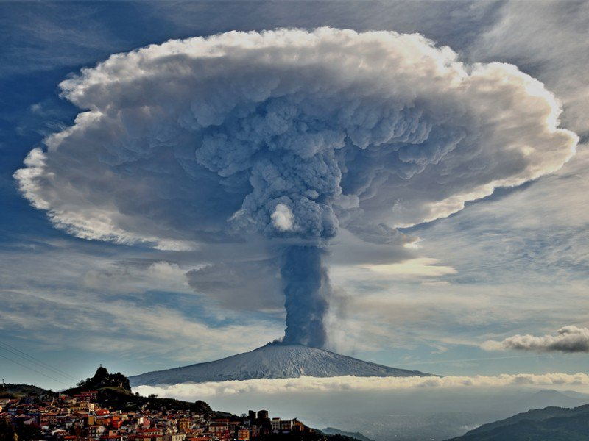
Notes:
On left is Dec 2015 plume from Mt. Etna
Mt. Pinatubo on right

Slide 5
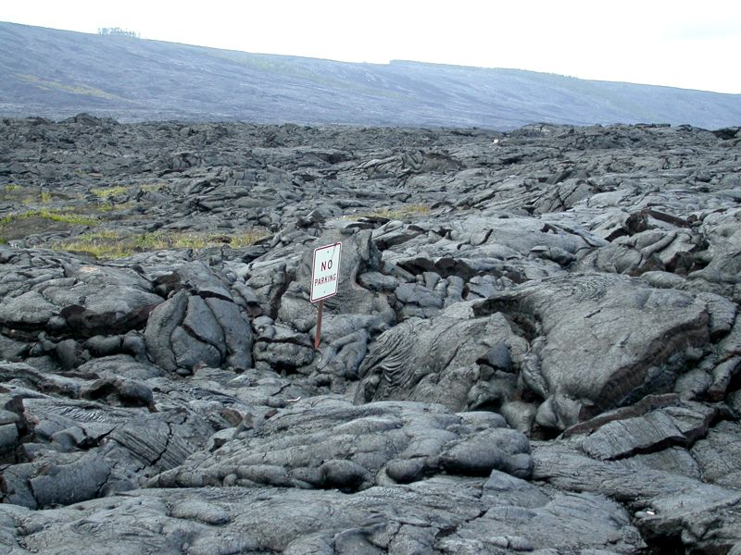
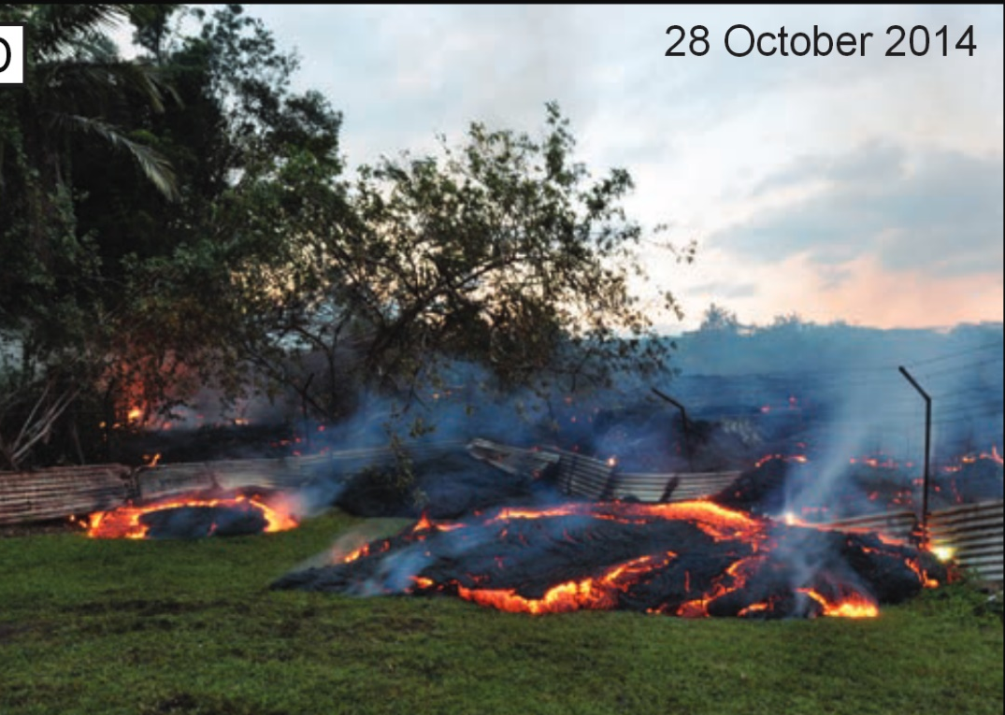
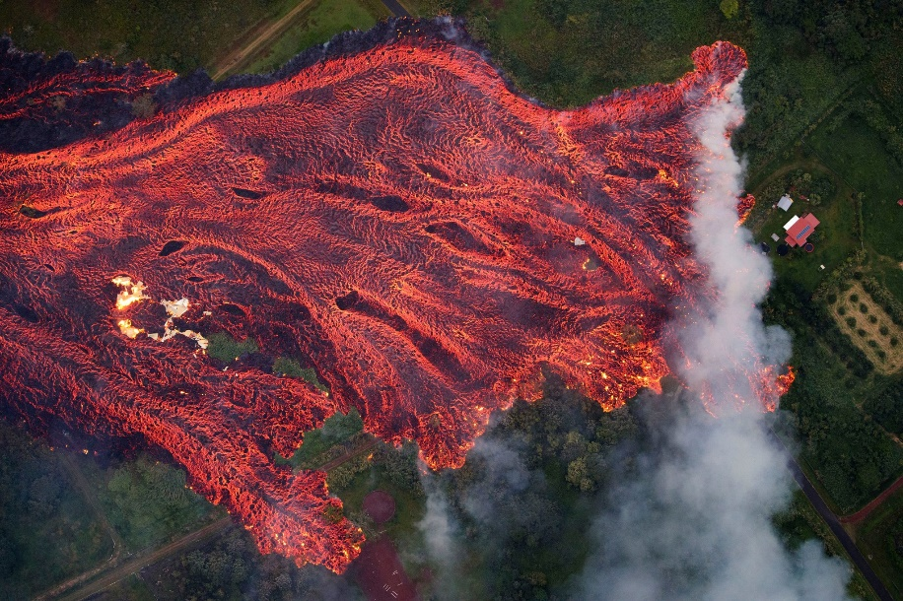
epsc.wustl.edu/admin/resources/meteorites/meteorwrongs/basalt_0932l.jpg
Poland et al. (2016, GSA Today 26(2): 4-10)
NY Times

Slide 6
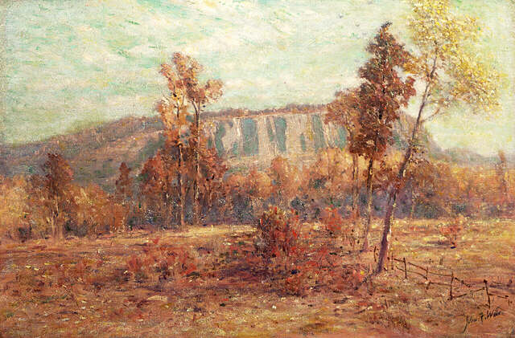
“East Rock, New Haven” (John Ferguson Weir, 1900)
www.artnet.com/artwork_images_252_46409_John-Ferguson-Weir.jpg

Slide 7
Long-term carbon cycle (>100,000 yr)
Berner (1999, GSA Today 9 (11): 1-6)
Notes:
How does carbon move into and out of the sedimentary rock reservoir?
2. burial / subduction of organic carbon
3. weathering of organic-rich rocks
CO₂ + H₂O ↔ CH₂O + O₂
→ organic burial (geo-photosynthesis)
weathering & outgassing (geo-respiration) ←
FF burning is a sped-up version (~100x) of ‘geo-respiration’

Slide 8
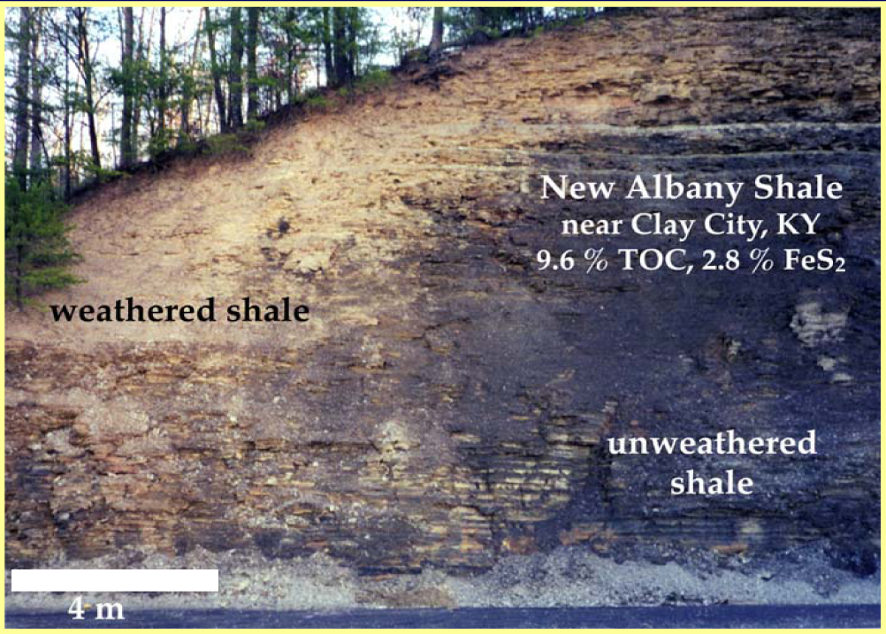
Weathering of organic carbon
Steven Petsch, UMass
Notes:
Road cut showing oxidized rind towards the Earth’s surface

Slide 9
Long-term carbon cycle (>100,000 yr)
Berner (1999, GSA Today 9 (11): 1-6)
Notes:
How does carbon move into and out of the sedimentary rock reservoir?
4. Weathering of Ca- and Mg-rich silicate rocks on land followed by precipitation and burial of Ca- and Mg-carbonates in ocean

Slide 10
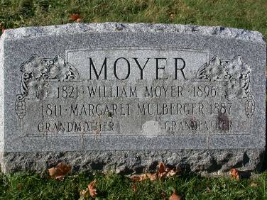
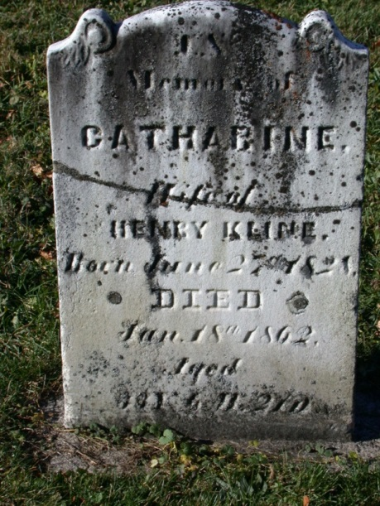
Net effect of weathering on CO₂ levels
Ca-Mg silicate weathering:
CaSiO₃ + H₂O + 2CO₂ → Ca²⁺ + 2HCO₃⁻ + SiO₂
Ca-Mg carbonate precipitation:
Ca²⁺ + 2HCO₃⁻ → CaCO₃ + H₂O + CO₂
NET RESULT on CO₂:
CaSiO₃ + CO₂ → CaCO₃ + SiO₂
carbonate weathering:
CaCO₃ + H₂O + CO₂ → Ca²⁺ + 2HCO₃⁻
carbonate precipitation:
Ca²⁺ + 2HCO₃⁻ → CaCO₃ + H₂O + CO₂
NO net result on CO₂ (on longer timescales)
Notes:
[it’s best to write the equations on the board…]
Water and acid is needed for reaction
Acid (CO₂) has two sources: diffusion from atmosphere, and OM decomposition
Net result: to the right = weathering
to the left = volcanic outgassing
Why are we restricted to Ca-Mg silicate rocks?
Note that this process occurs in two physically different locations (land, sea)
Note the biology involved (carbonate precipitation, acid production in soils)
And there more biology involved than what first meets the eye…(next slide)

Slide 11
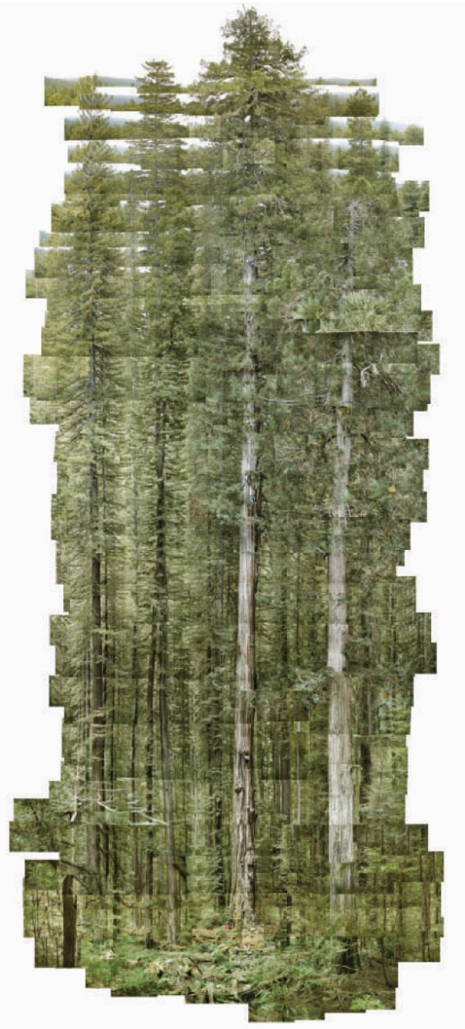
How trees affect the long-term carbon cycle
Woodward (2004 Nature 428:807-808)
Notes:
Roots and rootlets secrete acids (next two slides)
Litter decomposes, producing acids and CO₂
On a regional scale, plants recirculate water (Amazon Basin: ½ to 2/3 of rainwater is recirculated via plant transpiration) (see slide)
Plant anchor soils, slowing down erosion
ALL of these factors increase the amount of chemical weathering of Ca-Mg silicates ***(~3-8X)*****

Slide 12
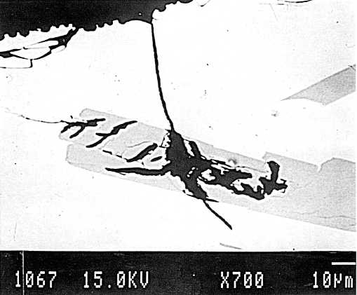
Enhancement of silicate weathering rates: effect of roots
fungal hyphae
calcium plagioclase
Berner & Cochran (1998, J. Sed. Res. 68: 723-726)
Notes:
Mycorrhizal fungi seek out nutrient-rich minerals. The matrix here is volcanic glass.

Slide 13
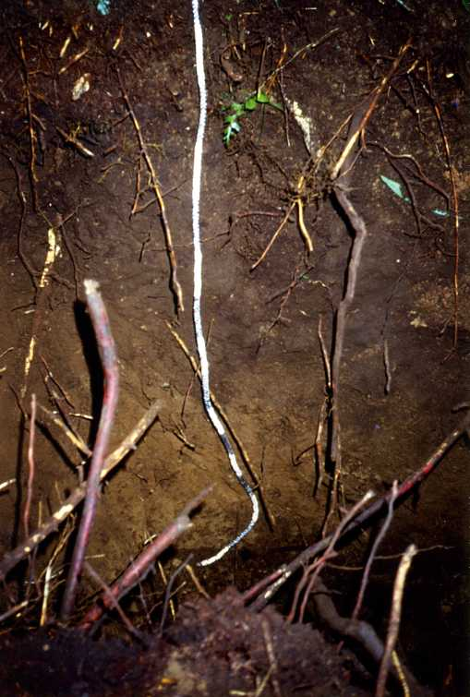
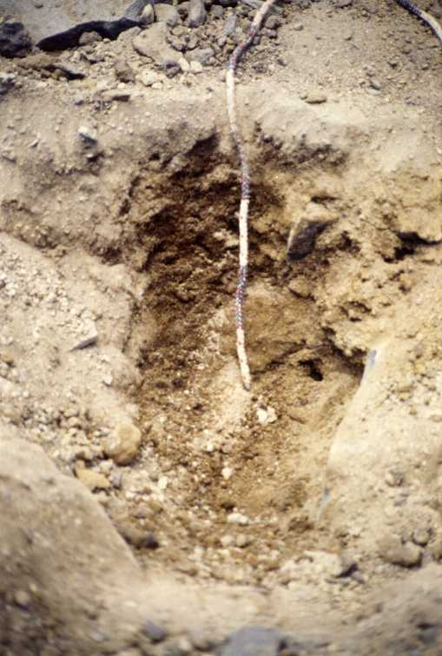
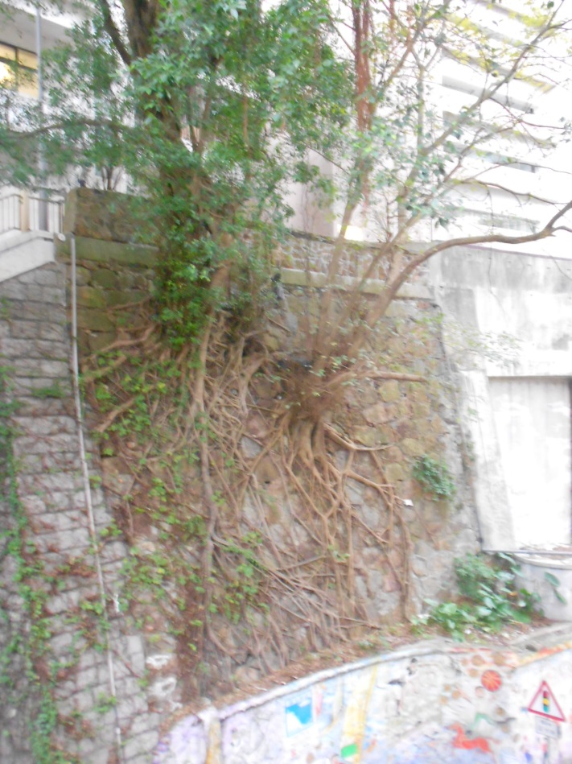
Enhancement of silicate weathering rates: effect of roots
Mt. Kilimanjaro
Hong Kong
2000 m (~6500’)
80 cm deep
4500 m (~14,750’) 25 cm deep

Slide 14
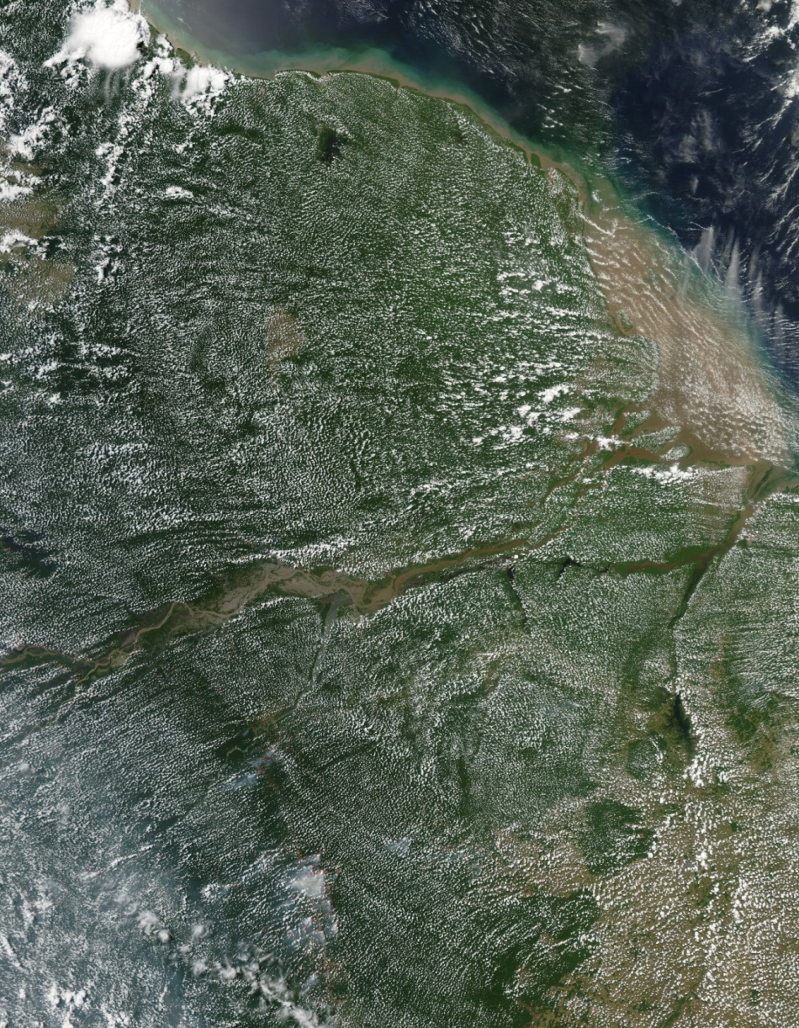
Forests make their own rain
Notes:
Amazon Basin: ½ to 2/3 of rainwater is recirculated via plant transpiration

Slide 15
Geologic fluxes are tiny
~0.1 Pg C/yr
From Ch. 5 in IPCC AR6 (2021)
https://www.ipcc.ch/report/ar6/wg1/figures/chapter-5/figure-5-12/
Carbon in mantle and crust (organic + inorganic)
0.05 Gt/yr
Notes:
(591+279 Gt) / 0.1 yr = 8,700 years
Note that this is a very precarious situation!!!

Slide 16
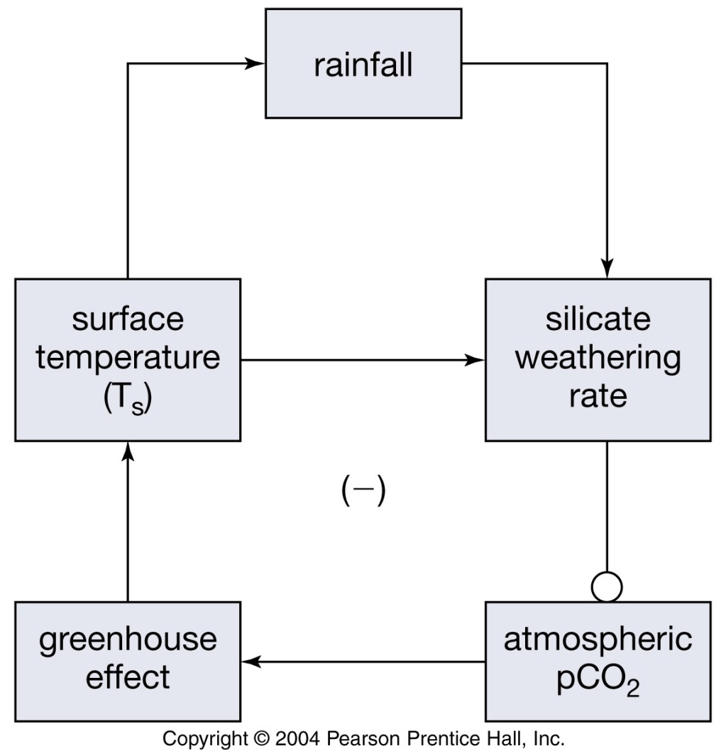
Thank god for negative feedback loops!!
Kump et al. (2004, Earth System Science)
Notes:
Negative feedback loops: our saviors!!!
More CO₂ means more silicate weathering because:
-More HCO₃⁻ in soils
-More rainfall (globally averaged)
-Warmer temperatures leads to faster chemical reaction rates

