Slide 1
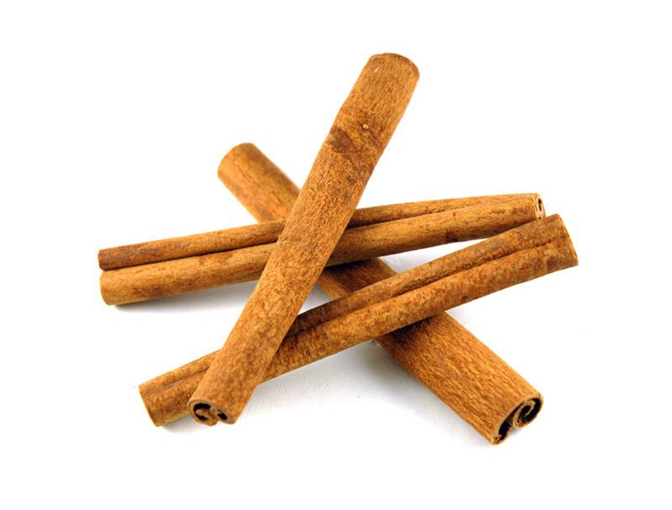

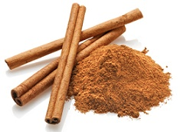
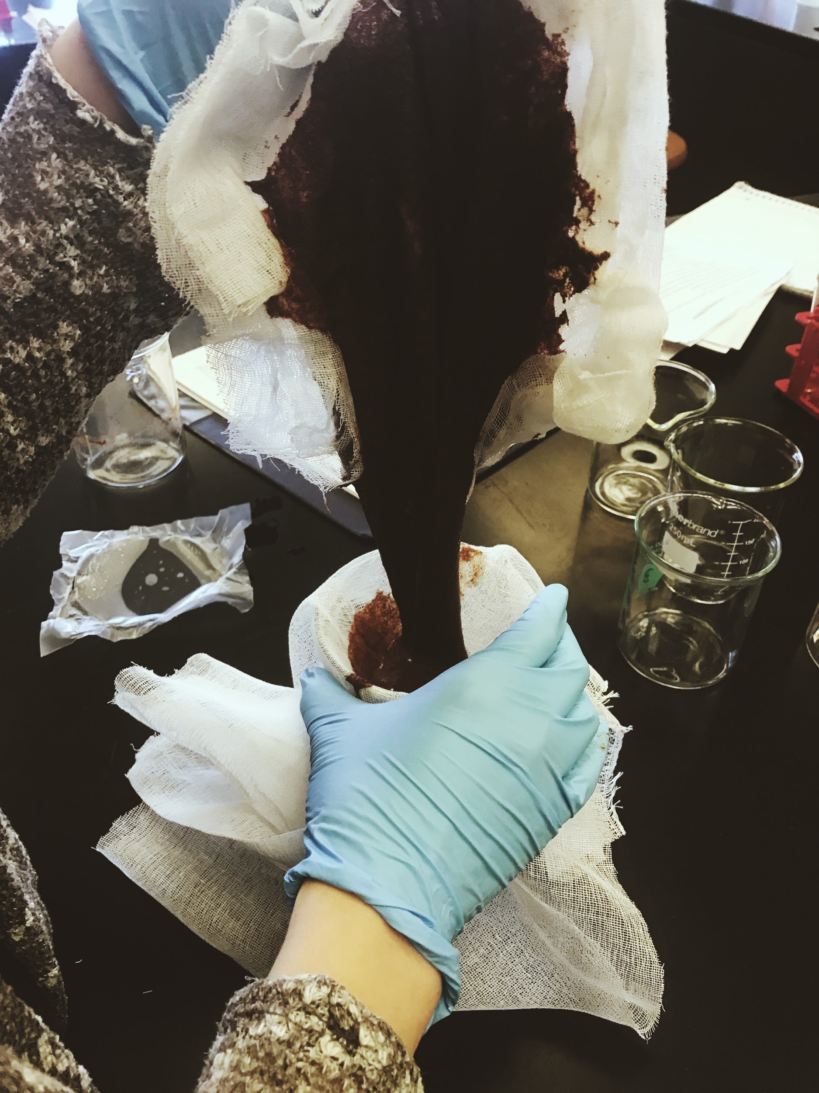
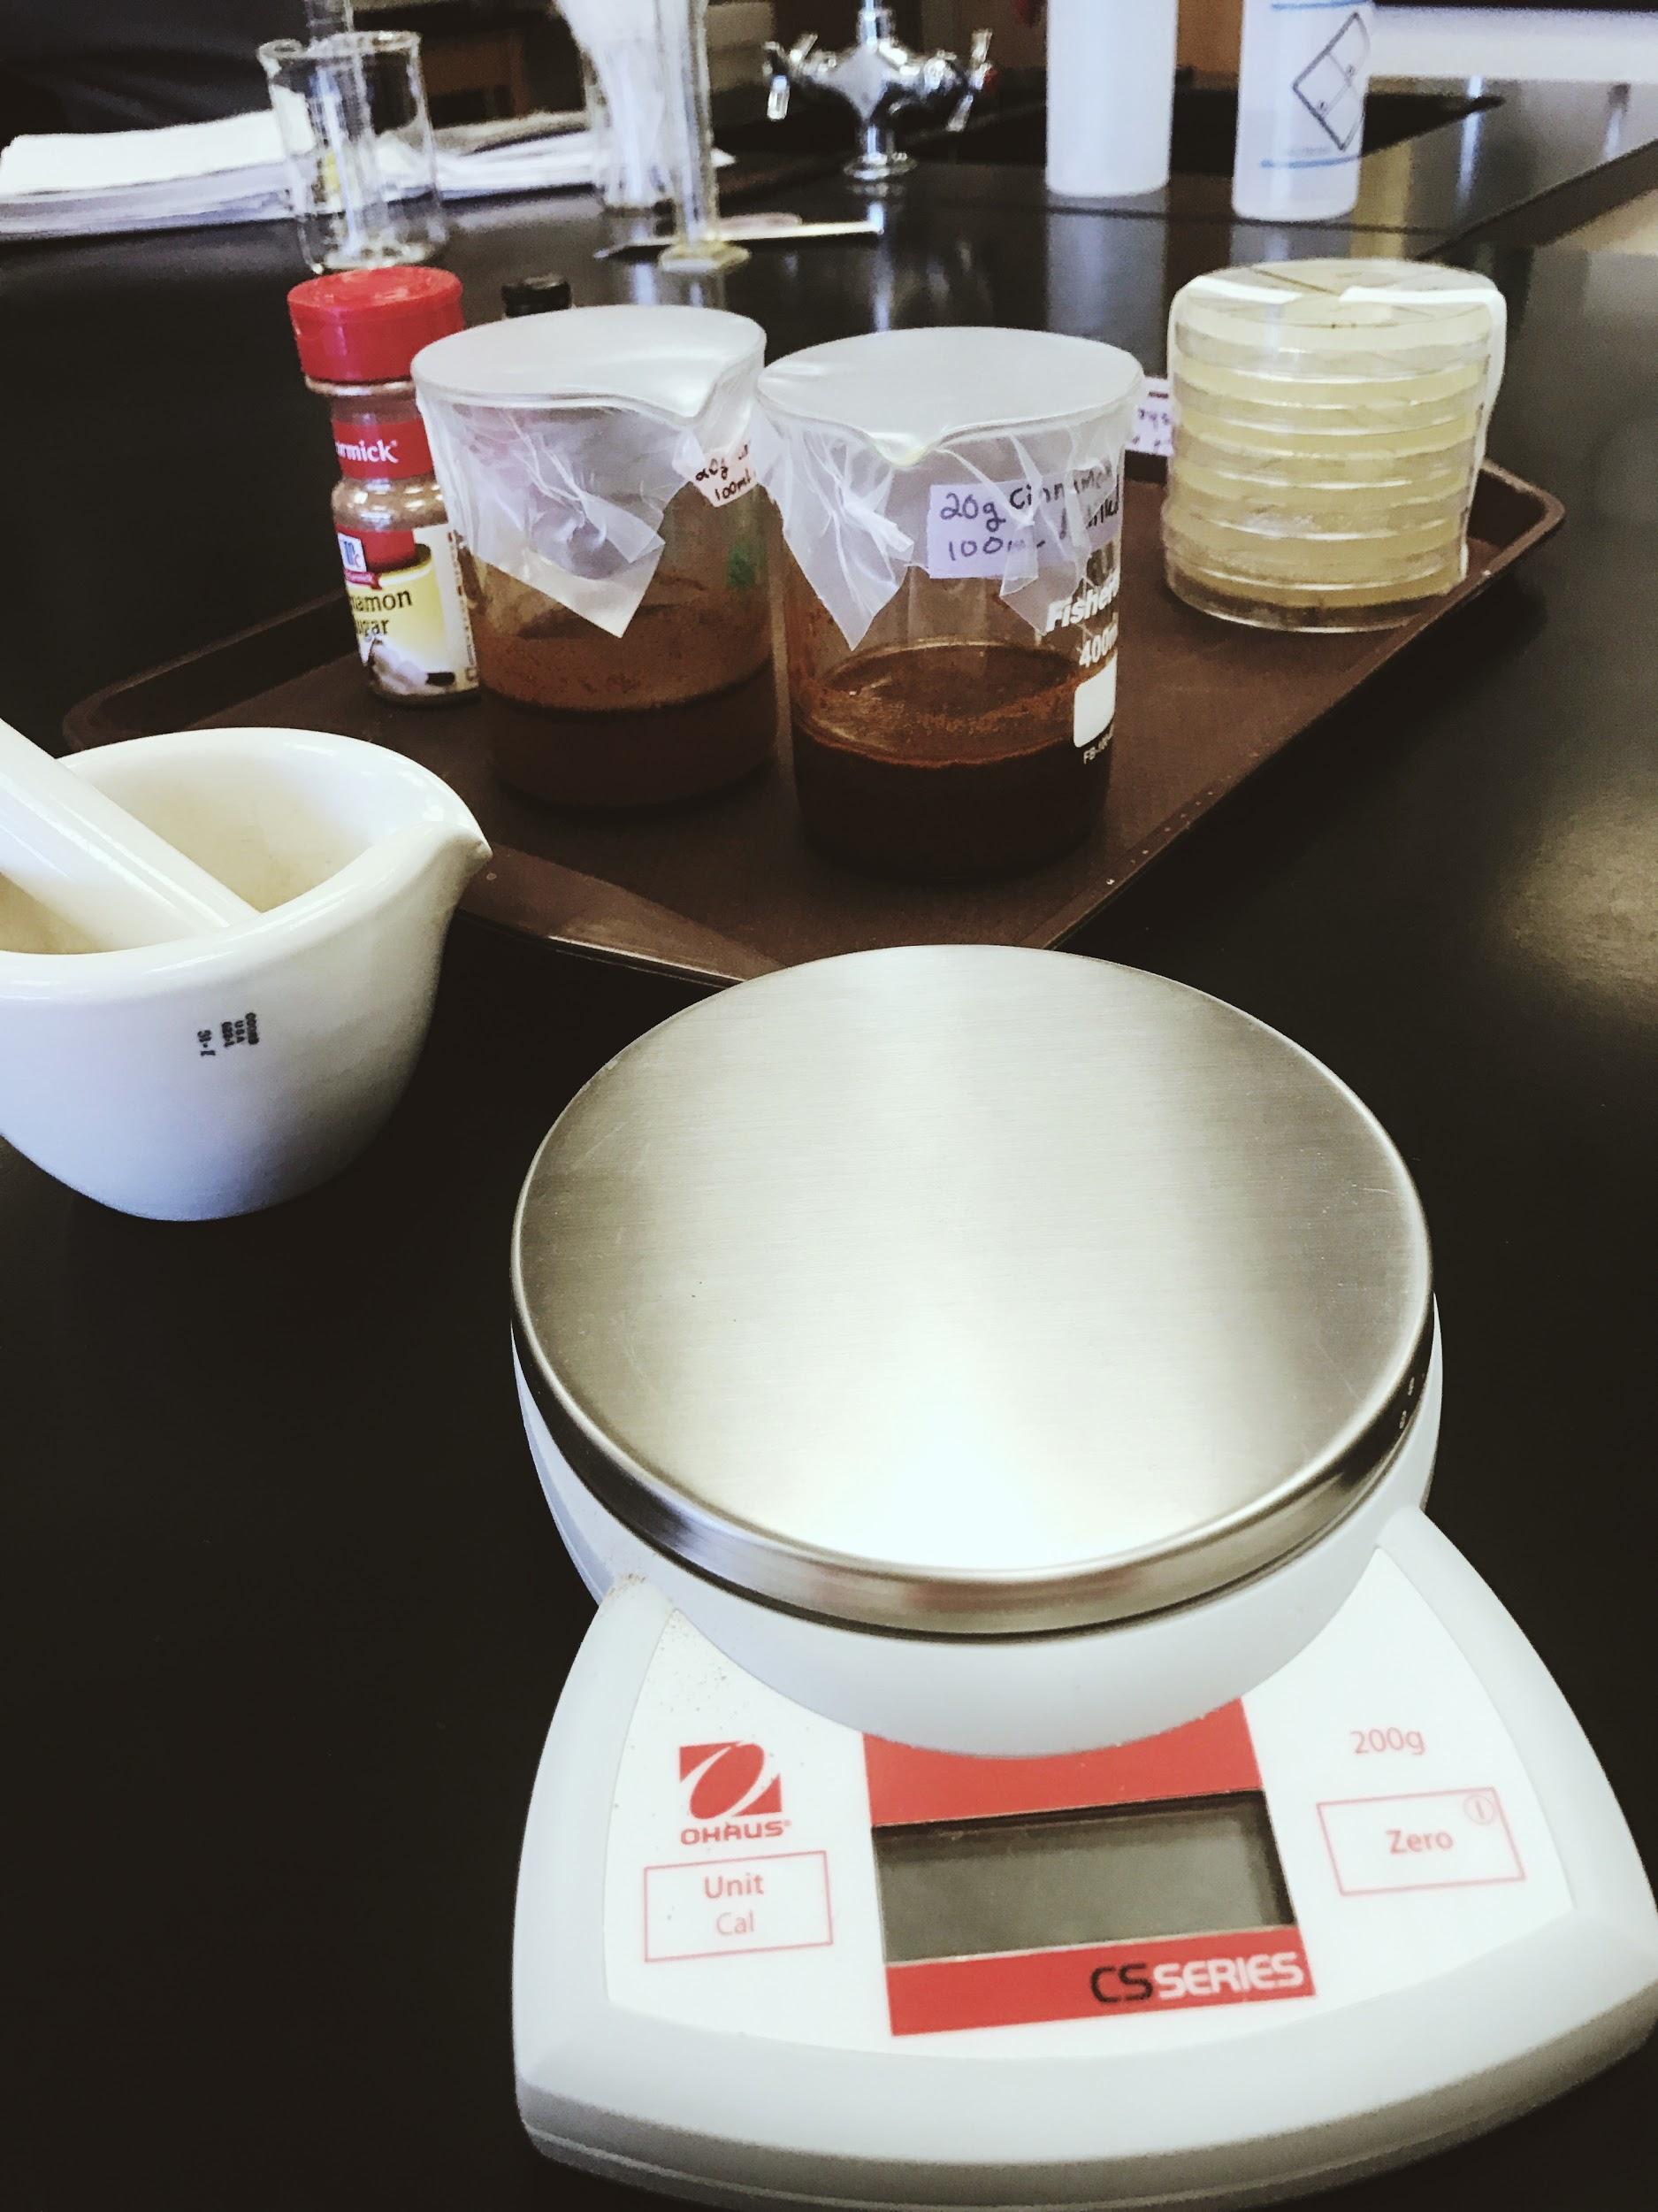
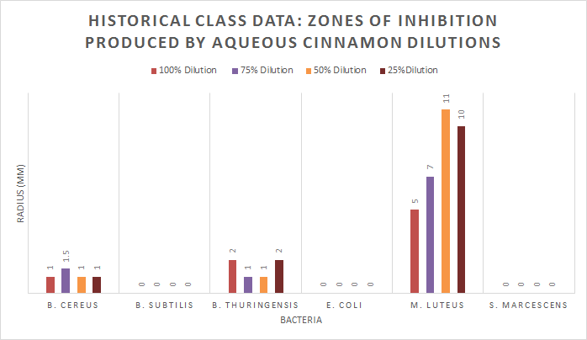
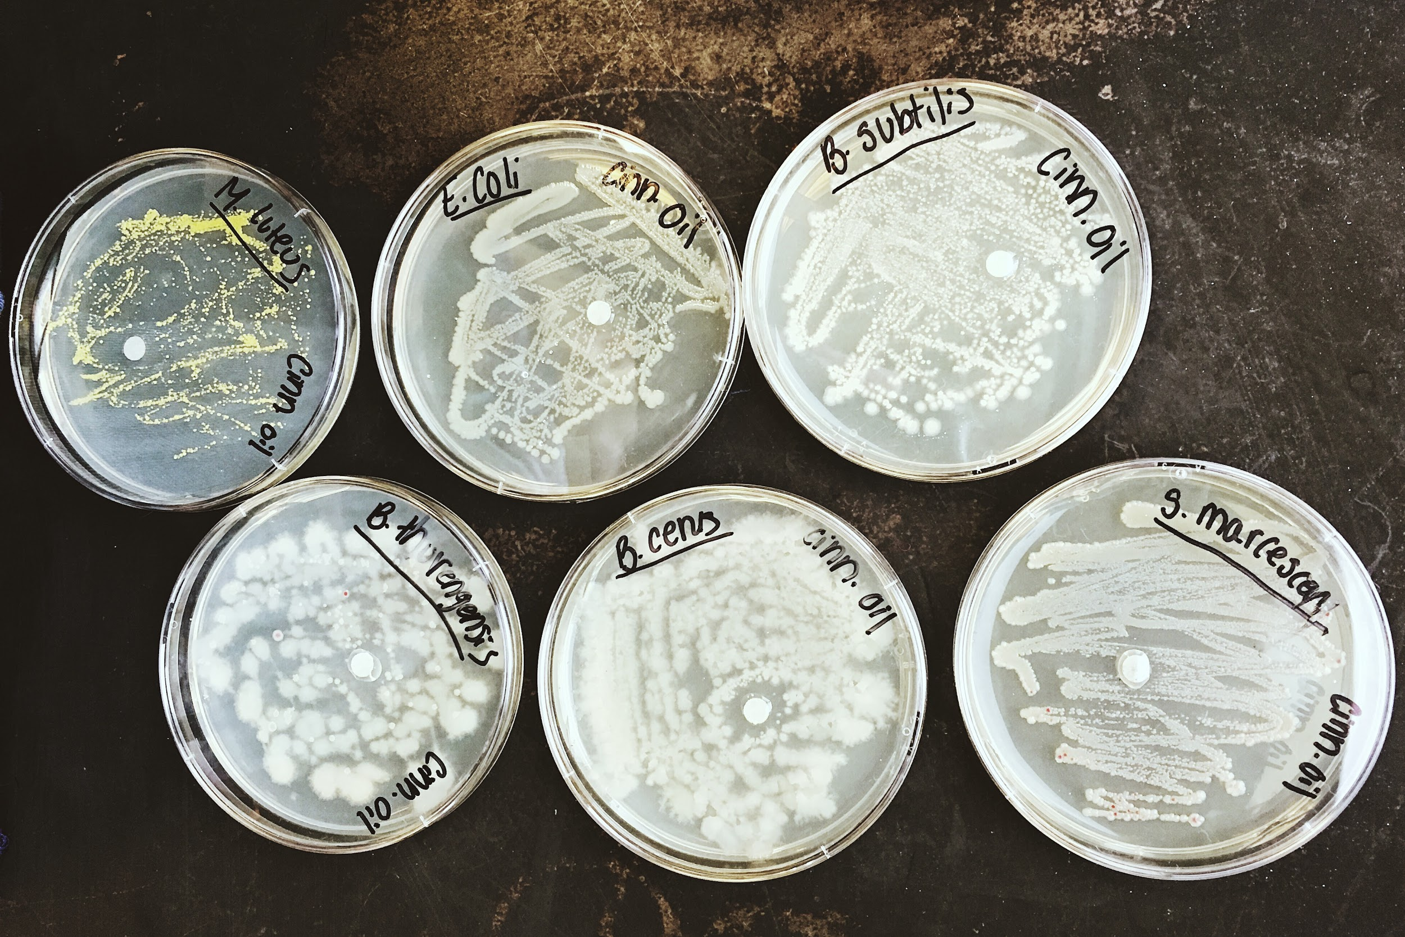
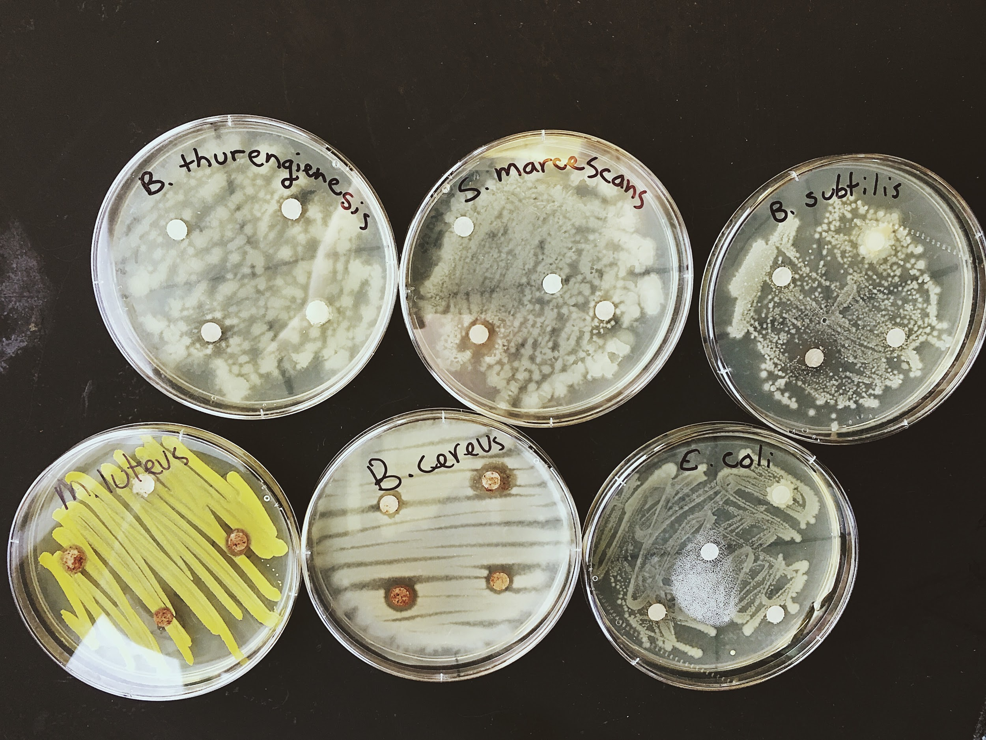
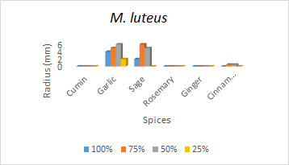
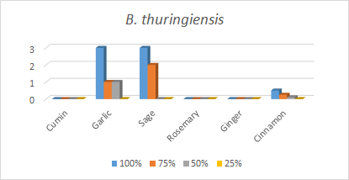
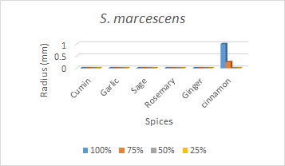
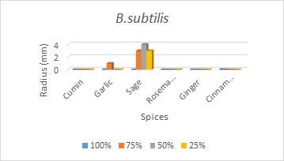
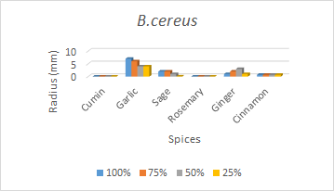
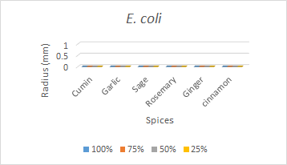
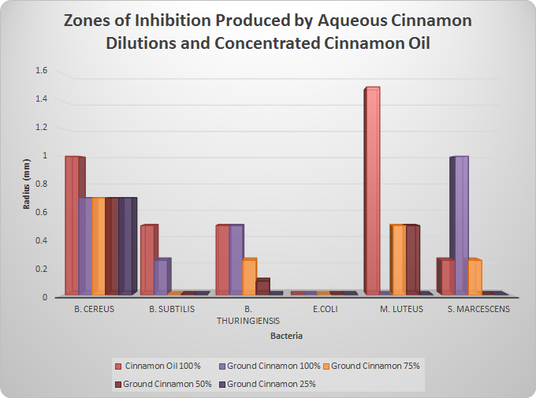
Bacterial susceptibility and the Cinnamomum plant at various extractive dilutions
Introductory Microbiology Spring 2017 Community College of Rhode Island
Authors: Alexandra Amores, Jocelyn Gallo, Rebecca Bagley
ABSTRACT
MATERIALS & METHODS
DISCUSSION
The Cinnamomum plant, otherwise known as Cinnamon, has been known to have antimicrobial effects against certain pathogenic bacterial species. The purpose of this experiment was to determine the effectiveness of cinnamon against six different types of bacteria; Escherichia coli, Serratia marcescens, Bacillus thuringiensis, Micrococcus luteus, Bacillus subtilis, and Bacillus cereus. Ground cinnamon was diluted into 100%, 75%, 50%, and 25% and tested against each bacterial species. Cinnamon oil was also tested against these bacteria at 100% concentration and tested against each of these bacterial species. Cinnamon oil appeared to be more effective overall than ground cinnamon, however both aqueous and oil extractions of cinnamon possessed antimicrobial properties. The higher the concentration of cinnamon, the more effective it appeared to become. The results of this experiment ultimately prove beneficial in providing data that contribute to the body of ever-growing research in finding alternative antibacterials that are effective against pathogenic bacteria.
Six more disks were then used to absorb the cinnamon oil (pre-diluted with sunflower oil) at 100% concentration and placed on the nutrient agar of each bacterial plate of the second set. All plates were placed uninverted in a dark space for one week. Two of the plates tested, M. luteus and B. cereus with the ground cinnamon was shown to have contamination after one week, so the ground cinnamon extract was heated on a hot plate, and again the same process was repeated. Disks with an absence of growth surrounding the disks, or a zone of inhibition (ZOI), were then measured using a ruler.
The results of this experiment suggest that the components in cinnamon have antibacterial properties capable of inhibiting bacterial growth. (Graph 1) Cinnamon oil was generally more effective (had a larger ZOI) in contrast to ground cinnamon except in the case of S. marcescens, where 100% diluted ground cinnamon was found to be more effective against the bacteria. Both cinnamon oil and ground cinnamon was ineffective against E. coli. M. luteus was shown to be the most susceptible to cinnamon oil with a ZOI of 1.5mm radius, while S. marcescens was shown to be the most susceptible to the 100% ground cinnamon dilution with a ZOI of 1mm radius. The results of this experiment are similar to those found in previous studies, which further substantiates cinnamon’s ability to inhibit pathogenic bacterial growth as an alternative to standard antibacterials. (Clemente et al. 2016) This experiment found that B. subtilis and S. marcescens was susceptible to cinnamon, as opposed to previous Fall 2016 class data using cinnamon dilutions where no results were found. (Graph 2) This experiment additionally
tested cinnamon oil against the various
bacteria, however there was no
previous data in the Fall 2016 class
experiments pertaining to cinnamon
oil. In comparison to the class data
(Graph 3), cinnamon is shown to be
more effective against S. marcescens
than any other spice used. Ultimately,
the data from this current experiment
with Cinnamomum extracts indicates
that there is indeed a need for additional experimentation. To support the conclusions drawn from this experiment, additional studies on the specific components of cinnamon against pathogenic bacteria would be beneficial in the search for alternative antibacterials in medicine and beyond. The results of this experiment ultimately prove beneficial in providing data that contribute to this body of ever-growing research.
Materials
· Mortar and pestle
· Scale
· Scooper
· 400mL beaker
· 4 small beakers
· 100mL distilled water per 400mL beaker
· 50mL graduated cylinder
· 20g ground McCormick cinnamon
6 bacteria: Bacillus thurengienesis, Micrococcus luteus, Bacillus subtilis, Bacillus cereus, Escherichia coli, and Serratia marcecescens
· Parafilm
· 12 agar plates
· Bunsen burner
· Inoculating loop
· Sterile disks
· Forceps
· 95% ethanol
· Hot plate
· Organic cinnamon oil/sunflower oil
· Cheesecloth
· Plastic boat
INTRODUCTION
Pathogenic bacteria have become exponentially resistant to common antibiotics due to overuse and misuse. It is therefore vital to find other possible treatments to these bacterial diseases before they become untreatable in the general population. Plants have been traditionally used to treat infectious diseases, and have been shown to be sources of antimicrobial substances. (Clemente et al. 2016) Therefore, interests towards these medicinal plants and their active antimicrobial components have been heightened as the demand for antibiotic alternatives increase.
The species of plants belonging to the genus Cinnamomum, otherwise known as cinnamon, has been used traditionally in eastern medicine to treat infectious diseases, as well as being recognized in the scientific community for its antimicrobial properties. (Zhang et al. 2016) By understanding how cinnamon works to create an unfavorable environment for these bacterial species, we come closer to finding a suitable source to treat these infectious diseases in the human body. Cinnamon’s active constituents such as cinnamaldehyde and eugenol, and well as many secondary polyphenols and volatile phenols, have been shown to be present in both cinnamon extracted from oil (Kaskatepe et al. 2016) and also in other solvents such as acetone, methanol, and ethyl acetate. (Keskin, Toroglu 2011)
Therefore in this experiment, we test both cinnamon oil (diluted in sunflower oil) extracted from cinnamon bark, and ground cinnamon extracted in distilled water in various aqueous dilutions on six bacteria species to compare their antimicrobial activity when introduced to cinnamon’s active biological components.
RESULTS
Results of cinnamon oil inoculation
E. Coli was the only bacteria that had no ZOI. M. luteus had the biggest zone of inhibition with the radius of 1.5mm. B. cereus had the second highest zone of inhibition with a radius of 1mm. B. subtilis and B. thuringiensis both had a zone of inhibition with a radius of 0.5mm. Lastly, S. marcescens had a zone of inhibition with a radius of 0.25mm. (Shown in Image 1)
Results of ground
cinnamon dilution
inoculation
B. cereus, E. coli, and
M. luteus had no
zone of inhibitions in
all dilutions. B.
subtilis had a 0.25mm
radiusi ZOI at 100
percent dilution, and
no results in the 75 percent, 50 percent, or 25 percent dilution. B. thuringiensis had a 0.5mm radius ZOI at 100 percent dilution, 0.25mm radius ZOI at 75 dilution, and no results in the 50
percent or 25
percent dilution.
S. marcescens had
1mm radius at 100
percent dilution,
0.25mm radius ZOI
at 75 percent
dilution, and no
results at 50
percent or 25
percent dilutions.
(Shown in Image 2)
(Graph 2 - Fall 2016)
(Image 1 - Treated with Cinnamon Oil) (Image 2 - Treated with various
aqueous cinnamon dilutions)
MATERIALS & METHODS
In this experiment, 20g of the ground cinnamon was measured and placed in a 400mL beaker with 100mL of distilled water, covered, and allowed to sit for one week in order to get the aqueous extract of the spice. The cinnamon oil supplied was pre-diluted with sunflower oil at an unknown percentage.
After the one week period, the solid ground cinnamon had thickened beyond the ability to strain it through cheesecloth without the use of additional distilled water to liquify it. The resulting aqueous extract was then separated equally (17.5mL each) into beakers, and was diluted accordingly at concentrations of 100%, 75%, 50%, and 25%. Six bacteria were aseptically streaked onto 2 nutrient agar plates, one set for the ground cinnamon and one set for the cinnamon oil: Serratia marcescens, Bacillus thuringiensis, Micrococcus luteus, Bacillus subtilis, Bacillus cereus, and Escherichia coli. For the ground cinnamon set, each plate was divided into four sections, one for each dilution percentage. A sterile absorbent disk was soaked in the appropriate dilutions and were placed onto the nutrient agar of each bacterial plate.
(Graph 3 - Class Data)
REFERENCES
Clemente, I., A. Margarita, F. Silva, and C. Nerin. 2016. Antimicrobial properties and mode of action of mustard and cinnamon essential oils and their combination against foodbourne bacteria. Innovative Food Science and Emerging Technologies. 36:26-33.
Kaskatepe, B., M. E. Kiymaci, S. Suzuk, S..A. Erdem, S. Cesur, and S. Yildiz. 2016. Antibacterial effects of cinnamon oil against carbapenem resistant nosocomial Acinetobacter baumannii and Pseudomonas aeruginosa isolates. Industrial Crops and Products. 81:191-194.
Keskin, D., S. Toroglu. 2011. Studies on antimicrobial activities of solvent extracts of different spices. Journal of Environmental Biology. 32(3):251-6.
Zhang, Y., Z. Liu, Y. Wang, P. Jiang, S. Quek. 2016. Antibacterial activity and mechanism of cinnamon essential oil against Escherichia coli and Staphylococcus aureus. Food Control. 59:282-289.
(Graph 1 - Results)

