Slide 1
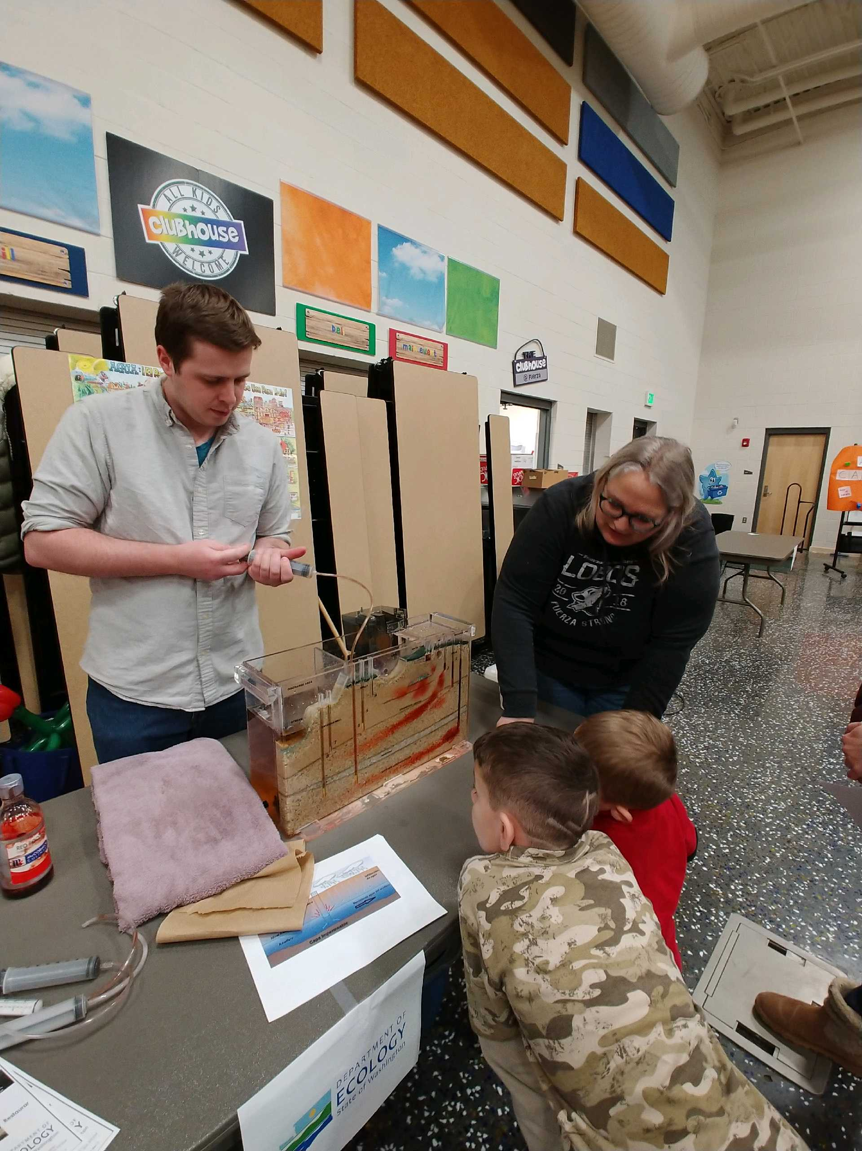
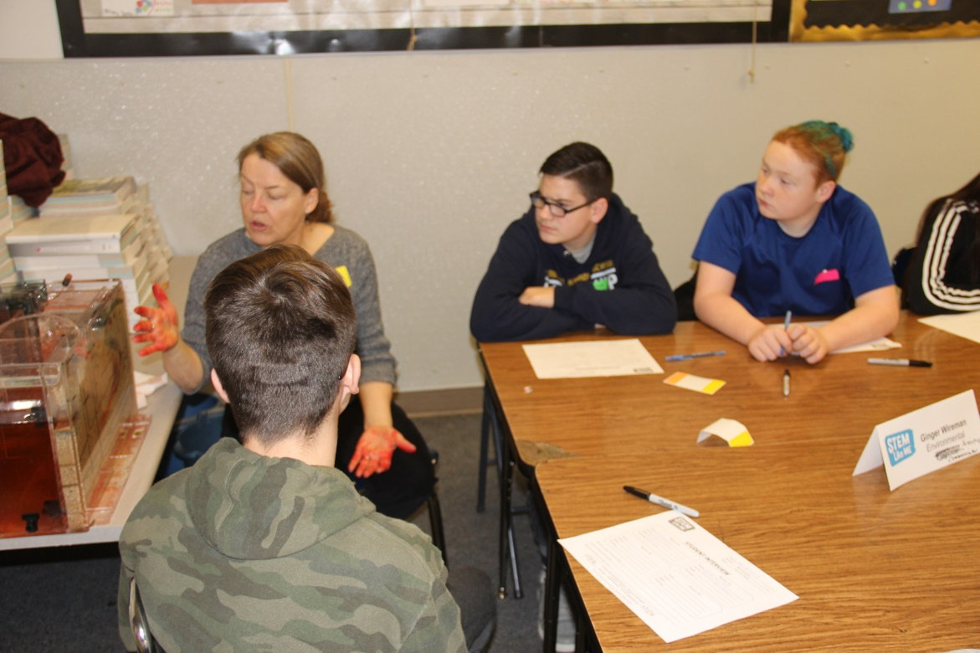
Engaging Education?

Slide 2
MLK Maroon Tiger (January-February 1947)
It seems to me that education has a two-fold function to perform in the life of man and in society: the one is utility and the other is culture.
Education must enable a man to become more efficient, to achieve with increasing facility the legitimate goals of his life.
Education must also train one for quick, resolute and effective thinking. To think incisively and to think for one’s self is very difficult.
We are prone to let our mental life become invaded by legions of half truths, prejudices, and propaganda.
A great majority of the so-called educated people do not think logically and scientifically.
Even the press, the classroom, the platform, and the pulpit in many instances do not give us objective and unbiased truths.
To save man from the morass of propaganda, in my opinion, is one of the chief aims of education. Education must enable one to sift and weigh evidence, to discern the true from the false, the real from the unreal, and the facts from the fiction.
The function of education, therefore, is to teach one to think intensively and to think critically.
Notes:
The Maroon Tiger was the student newspaper at Morehouse College
Fascinating that his words feel like he’s commenting on today’s situation – and they didn’t even have internet or cell phones. He summed this up by saying
But education which stops with efficiency may prove the greatest menace to society. The most dangerous criminal may be the man gifted with reason, but with no morals.

Slide 3
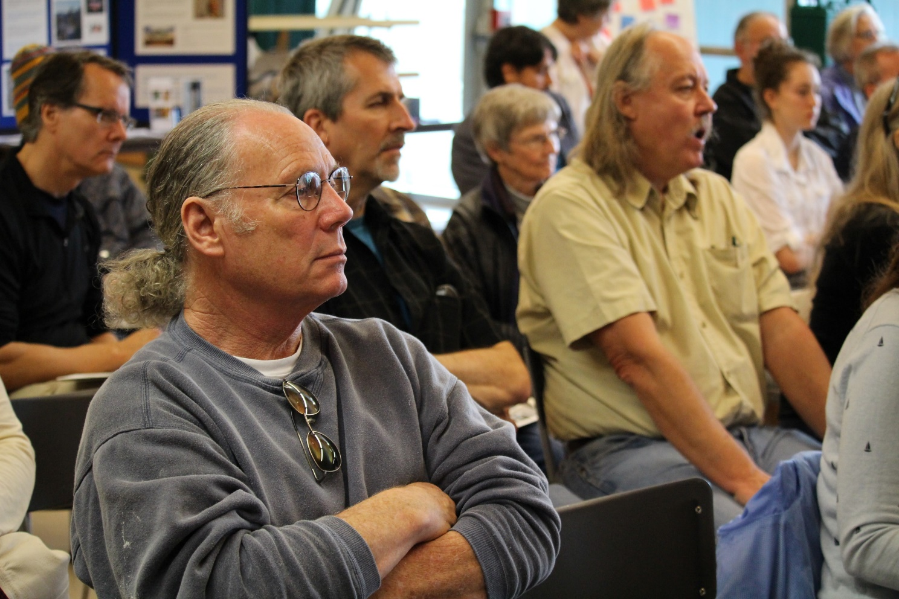
Educate:
Inform:
to provide schooling for
to train by formal instruction and supervised practice especially in a skill, trade, or profession
to develop mentally, morally, or aesthetically especially by instruction
to provide with information : INFORM
to communicate knowledge to

Slide 4
Environmental Education is more than Information about the Environment
Environmental Education | Environmental Information
Increases public awareness and knowledge of environmental issues | Provides facts or opinions about environmental issues
Does teach individuals critical-thinking | Does not necessarily teach individuals critical-thinking
Does enhance individuals' problem-solving and decision-making skills | Does not necessarily enhance individuals' problem-solving and decision-making skills
Does not advocate a particular viewpoint | May advocate a particular viewpoint

Slide 5
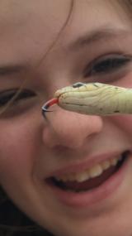
What is Environmental Education?
Environmental education is a process that allows individuals to explore environmental issues, engage in problem solving, and take action to improve the environment. As a result, individuals develop a deeper understanding of environmental issues and have the skills to make informed and responsible decisions. The components of environmental education are:
Awareness and sensitivity to the environment and environmental challenges
Knowledge and understanding of the environment and environmental challenges
Attitudes of concern for the environment and motivation to improve or maintain environmental quality
Skills to identify and help resolve environmental challenges
Participation in activities that lead to the resolution of environmental challenges
https://www.epa.gov/education/what-environmental-education
Notes:
EPA ‘s definition of EE weaves in a whole bunch of engagement and action.

Slide 6
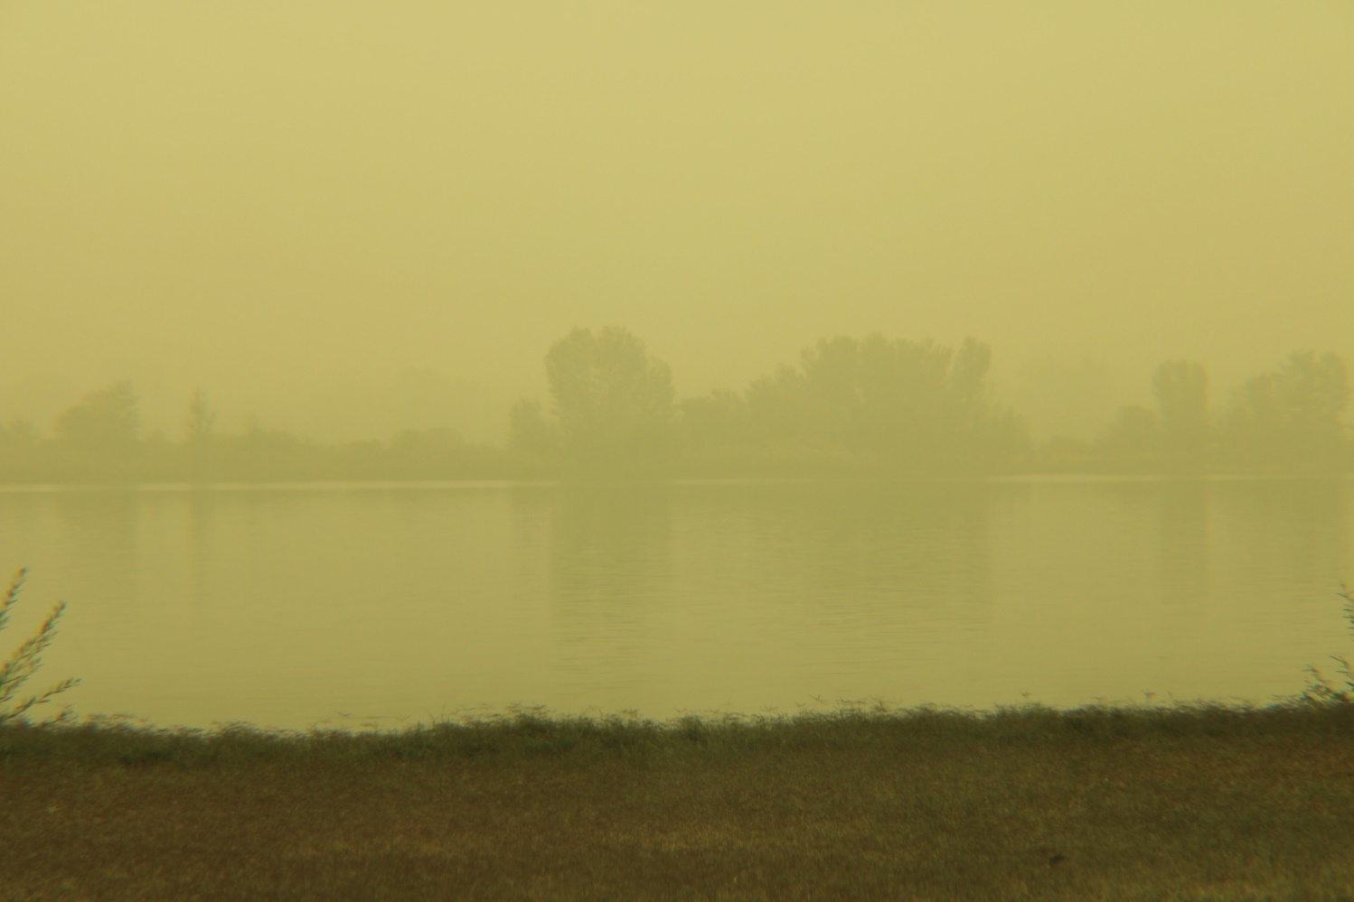
Engage:
to occupy the attention or efforts of (a person or persons)
to attract and hold fast
to occupy oneself; become involved
Notes:
People were very engaged in discussions about the wildfire smoke we experienced. What if we had been prepared to weave that into discussions about resilency.

Slide 7
IAP2 core values
1 Public participation is based on the belief that those who are affected by a decision have a right to be involved in the decision-making process.
2 Public participation includes the promise that the public’s contribution will influence the decision.
3 Public participation promotes sustainable decisions by recognizing and communicating the needs and interests of all participants, including decision makers.
4 Public participation seeks out and facilitates the involvement of those potentially affected by or interested in a decision.
5 Public participation seeks input from participants in designing how they participate.
6 Public participation provides participants with the information they need to participate in a meaningful way.
7 Public participation communicates to participants how their input affected the decision.
The Core Values define expectations and aspirations of the public participation process. Processes based on the Core Values have been shown to be the most successful and respected.
Notes:
IAP2 Code of Ethics is a set of principles, which guide us in our practice of enhancing the integrity of the public participation process. As P2 practitioners, we hold ourselves accountable to these principles and strive to hold all participants to the same standards.
IAP2 developed the Core Values for the Practice of Public Participation for use in developing and implementing public participation processes to help inform better decisions that reflect the interests and concerns of potentially affected people and entities. The Core Values were developed with broad international input to identify those aspects of public participation that cross national, cultural and religious boundaries.

Slide 8
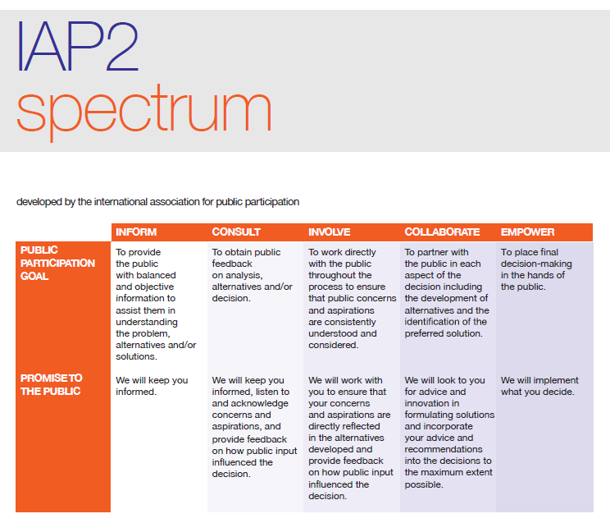
Notes:
International Assoc for Public participation
Founded in 1990 by a group of dedicated P2 practitioners, the International Association for
Public Participation (IAP2 Federation) has grown into an international federation of over 2600
professionals in 26 countries working to advance the practice of public participation (P2).
National affiliates and their members benefit from research, training and networking
opportunities with IAP2 Federation peers.

Slide 9
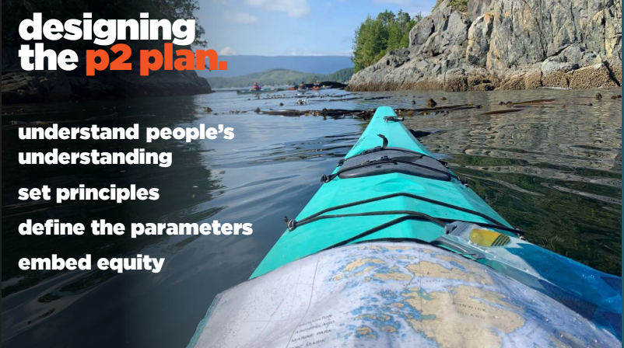
Source: Wide and Fast, P2 for Vancouver’s Climate Emergency Response
IAP2 2020 Virtual North American Conference
Notes:
Understand people’s understanding – for the urban planner, or Public Participation practitioner, who will support them in educating the public so that everyone is on the same page?

Slide 10
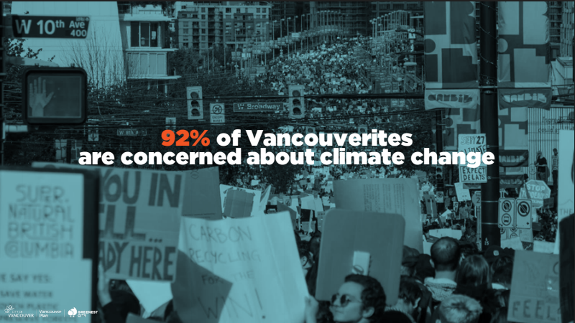
Source: Wide and Fast, P2 for Vancouver’s Climate Emergency Response
IAP2 2020 Virtual North American Conference

Slide 11
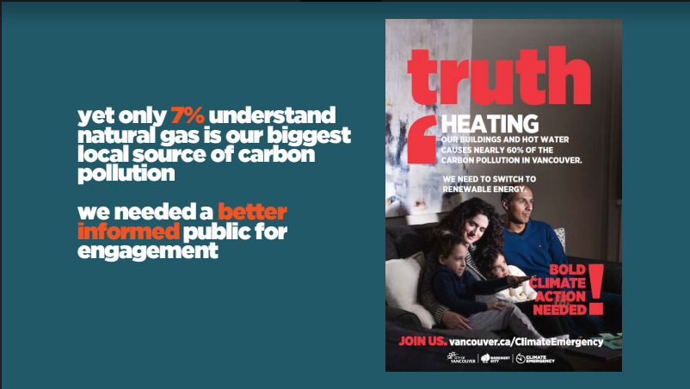
Source: Wide and Fast, P2 for Vancouver’s Climate Emergency Response
IAP2 2020 Virtual North American Conference
Notes:
https://www.youtube.com/watch?v=6WQYKkbdhCM&feature=emb_logo

Slide 12
Environmental education is a process that allows individuals to explore environmental issues, engage in problem solving, and take action to improve the environment. As a result, individuals develop a deeper understanding of environmental issues and have the skills to make informed and responsible decisions.
Source: Vancouver CA , Climate Change Adaptation Action Strategy
Notes:
An infographic like this was also available for fall and spring, outlining differences in frost dates, rainfall, etc.

Slide 13
What to expect:
Creates awareness
Helps with understanding
What you can do to prepare:
Gives the reader skills to identify challenges
Allows them to take ownership and act, means to resolve environmental challenges
Notes:
Awareness and sensitivity to the environment and environmental challenges
Knowledge and understanding of the environment and environmental challenges
Attitudes of concern for the environment and motivation to improve or maintain environmental quality
Skills to identify and help resolve environmental challenges
Participation in activities that lead to the resolution of environmental challenges

Slide 14
Environmental education is a process that allows individuals to explore environmental issues, engage in problem solving, and take action to improve the environment. As a result, individuals develop a deeper understanding of environmental issues and have the skills to make informed and responsible decisions.

Slide 15
Source: Vancouver CA , Climate Change Adaptation Action Strategy

Slide 16
Vancouver’s Climate Action Plan
“Continuous learning and re-navigation is essential for adaptation planning given the underpinning of uncertainty and extended timelines prevalent with many climate drivers and impacts.”
Notes:
From a 2018 update of Vancouver’s initial (2015) Climate Action Plan
Who is learning? Who is teaching? How do we make sound decisions?

Slide 17
Climate Adaptation – The State of Practice in U.S. Communities
Kresge Foundation 2016 report looked at:
17 communities across the USA
49 mentions of education
In Tulsa – “Interviewees believe that public information and education is now the key to ensuring that the public and private sector are prepared for extreme weather…”
In Baltimore – “Conduct climate, resiliency, and emergency planning education and outreach Action: Educate and train community groups to participate in responding to hazards…”
Notes:
https://www.surveymonkey.com/r/GZZM93P Call for Proposals: An Existential Toolkit for Climate Justice Educators, an edited collection

Slide 18
Has your community begun to address climate adaptation or resiliency?
Thumbs up = yes,
Thumbs down = no
Thumbs sideways = I don’t know

Slide 19
Who’s in charge of P2 (Public Participation)?
Municipal staff – utilities, storm water, emergency mgt.
Consultants
Urban planners
Communications consultants

Slide 20
How do they seek Public Participation?
Traditional community planning mechanisms
Social media
Pop up outreach at parks or existing special events
Happy hour events with subject matter experts

Slide 21
Where can CLEAN & EE community fit in?
As individuals and through your institution reach out to municipal officers
Offer support for creation of educational materials and messaging at the local / regional level
Support stakeholder participation
Volunteer scientists to gather on-the-ground data for inclusion in planning processes
Offer to host municipal P2 activities at your institution

Slide 22
Where can CLEAN & EE community fit in?
Assist planning entities in framing plans through environmental justice lens
Help bring underrepresented communities to the table
Engage youth

Slide 23
Breaking down silos
International Association for Public Participation –
IAP2usa.org
American Society of Adaptation Professionals –
adaptationprofessionals.org
Association of Climate Change Officers –
climateofficers.org
American Planning Association
planning.org
Notes:
Organizations educators may wish to explore. Also ACCO has a certification program
IAP2usa.org
adaptationprofessionals.org
climateofficers.org
planning.org

Slide 24
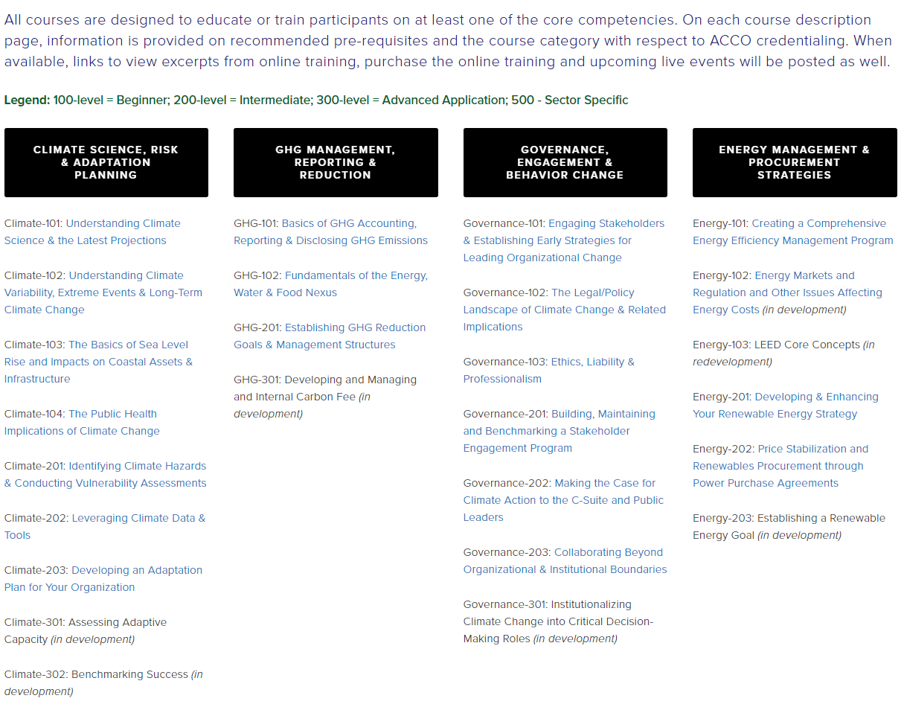
ACCO
Notes:
ACCO is all municipal or corporate officers. Wouldn’t it be good to have educational and science leaders at the table?

Slide 25
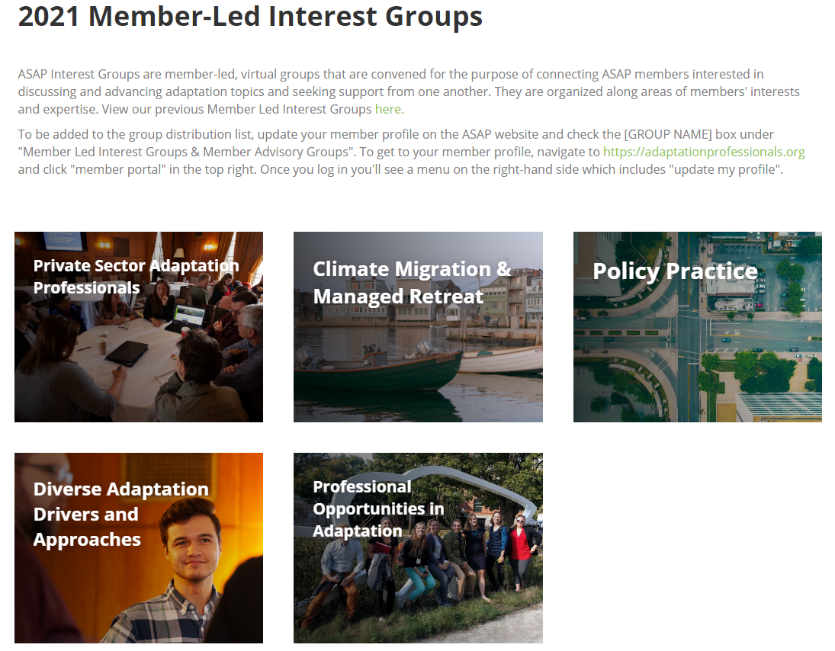
ASAP

Slide 26
- Brainstorm Breakout -
Where else is there room for collaboration?
Are there barriers to partnerships?
Notes:
My entire reason for sharing this today is because we have a climate emergency and to scale up meaningful action it seems we need to break down barriers and collaborate across professions and jurisdictions.

Slide 27
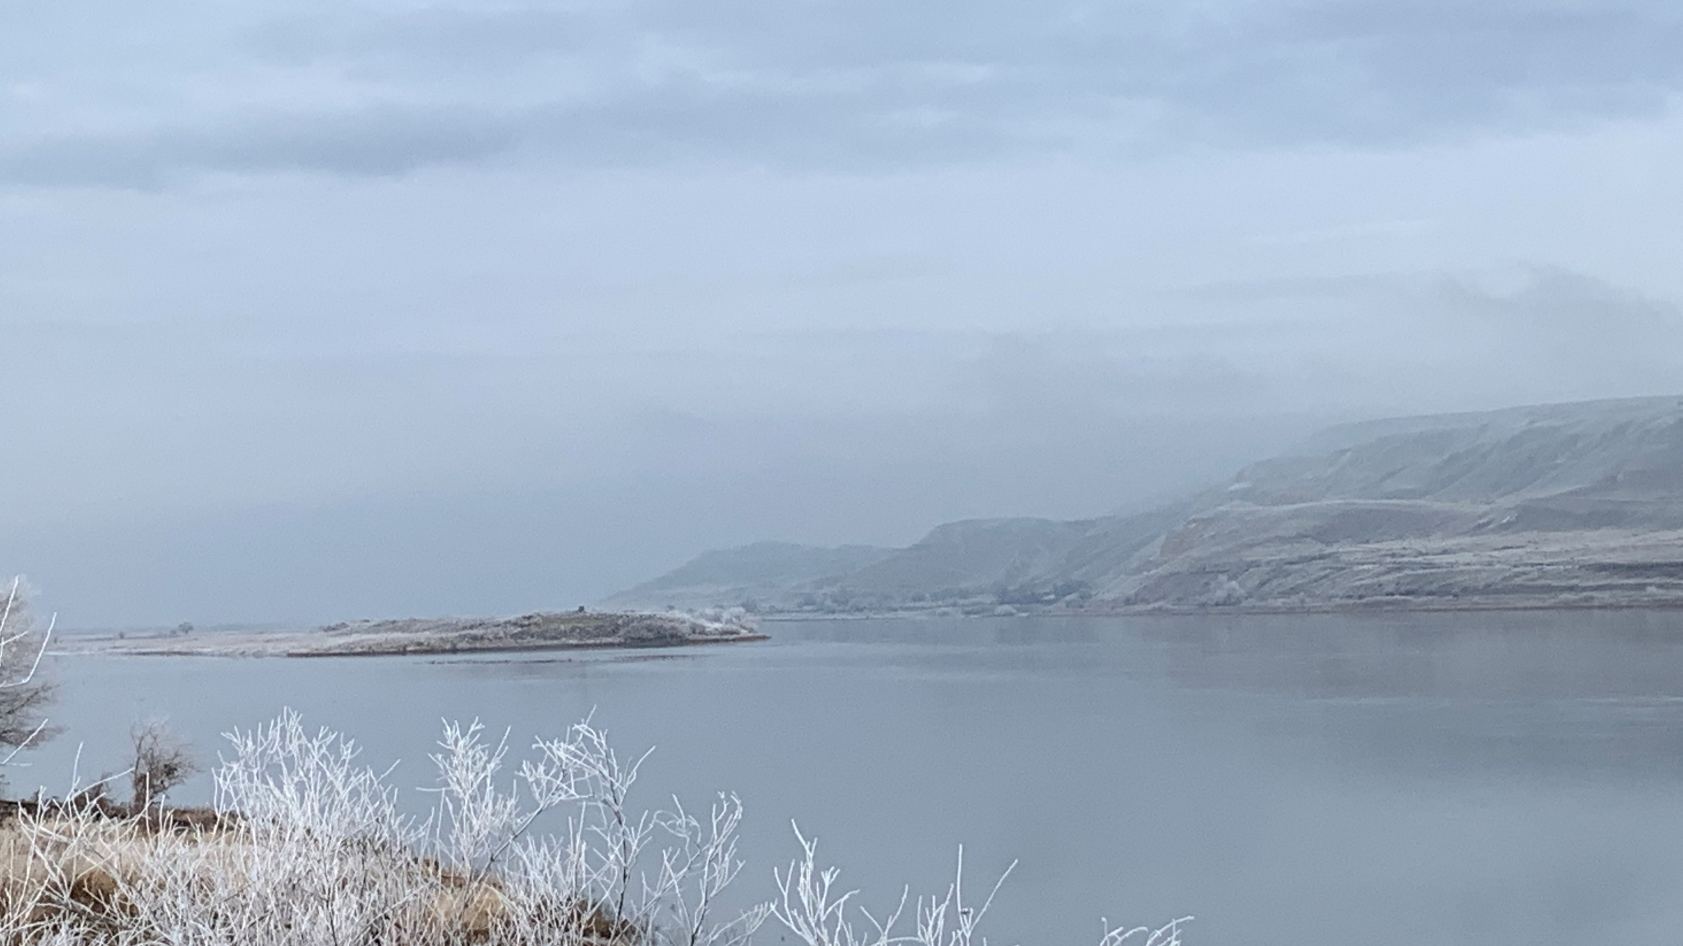
Ginger Wireman (she/her)
Community Outreach & Environmental Education Specialist
Nuclear Waste Program - WA Dept. of Ecology
509-282-2608
Ginger.Wireman@ecy.wa.gov
facebook.com/EcologyWAHanford
Ecology.wa.gov/hanford
>>))):> >>))):>

