Slide 1
C cycle Part 2

Slide 2
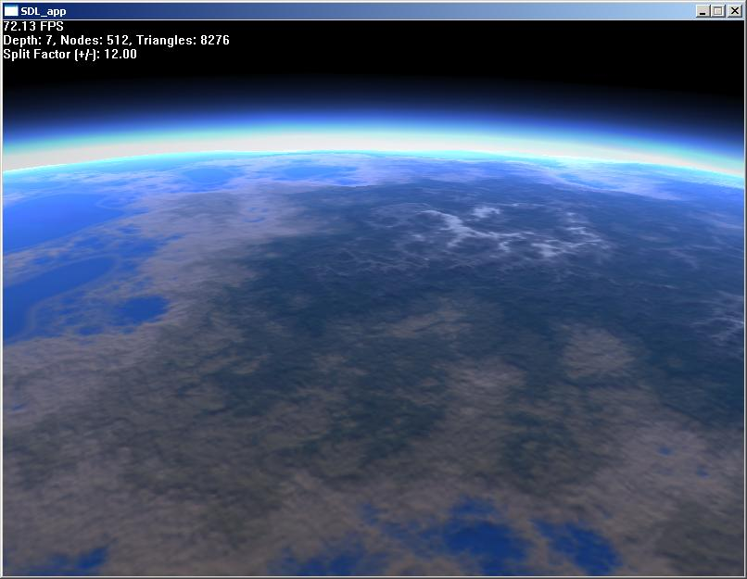
Earth’s atmosphere: infinite sky or a thin layer?

Slide 3
over 90% of the Earth's atmosphere is within about seven miles (12 km) of surface.
The distance from the center of the Earth to its surface equals about 4,000 miles.
The scale of the chalkboard drawing is about 1 foot = 1,000 miles (1610 km).
Notes:
Tie a piece of chalk to one end of the string. Standing next to the chalkboard, place your foot on the free end of the string and draw an arc on the board with a radius of about 4 feet. Your foot represents the center of the earth. The arc represents the surface of the earth.
Ask students to suggest how far the earth's atmosphere would extend above the surface in this drawing. Mark their suggestions on the board above the chalk line.
Tell the students that scientists have found that over 90% of the earth's atmosphere is within about seven miles (12 km) of the earth's surface. The distance from the center of the earth to its surface equals about 4,000 miles. The scale of the chalkboard drawing is about 1 foot = 1,000 miles (1610 km).
So, on this scale, seven miles is a little less than 1/8th of an inch (about as thick as the chalk line), and 90% of the earth's atmosphere lies within the thickness of the chalk line used to draw the surface of the earth.
~Skin of apple

Slide 4

What is “ppm”?
“ppm” = “parts per million”
Percent = “parts per hundred”
  E.g., this jar has 20 parts per hundred blue M&M’s, or 20 blue M&Ms for every 100 total M&Ms
So, 20 ppm blue M&Ms
  = 20 blue M&M’s for every 1,000,000 total M&Ms

Slide 5
Units
Giga (G): 1,000,000,000 = 10⁹
Tera (T): 1,000,000,000,000 = 10¹²
Peta (P): 1,000,000,000,000,000 = 10¹⁵
Ton (t) = 1000 kg; 1 kg = 1000 g
So, 1 Gt = 1 Pg

Slide 6
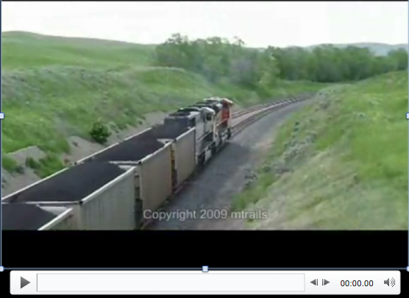
How much CO₂ do we emit?
One hopper ~100 tons of coal
80% of coal is carbon
Each hopper is ~60 feet long
One petagram (billion tons) of coal would be held in a train 156,500 miles
Entire human-caused emissions are ~9 Pg C/year
Train that would wrap around the Earth 54 times!

Slide 7
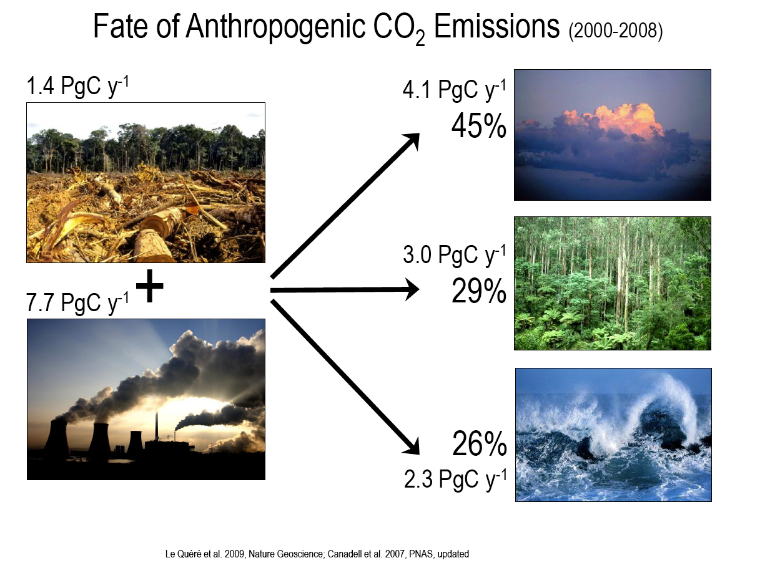

Slide 8
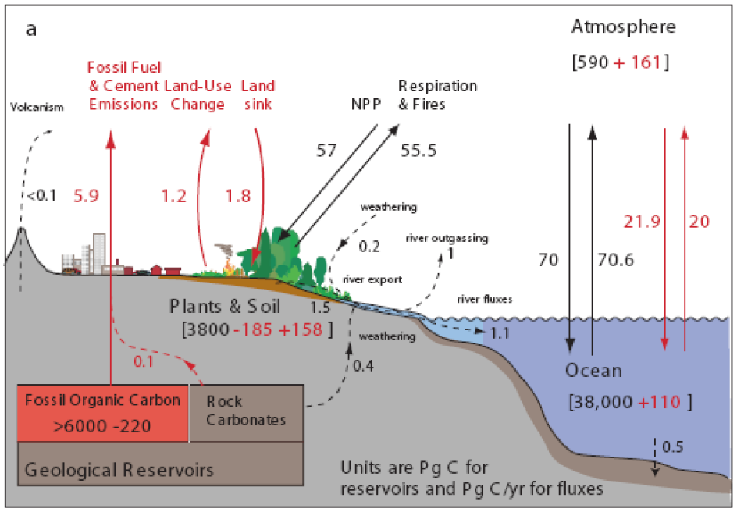
Notes:
Add up sinks:
Terrestrial NPP: 57
Weathering: 0.2
Entering ocean: 70
Sedimentation: 0.5
Total: 127.7
Sources:
Respiration and fires: 55.5
River outgassing: 1
Flux from oceans: 70.6
Volcanism: 0.1
Total: 127.1

Slide 9
Breathing vs. burning?
What about human respiration?
  Breathing produces approximately 2.3 pounds (1 kg) of carbon dioxide per day per person.
  You exhale about 365 kg (0.365 tons, or 803 lbs) CO₂ each year.
  If you stop breathing, will it solve the CO2 problem?
Both convert organic carbon and O₂ to CO₂ and H₂O
Show “Now is the Time” or Competitive Enterprise Institute’s PSA

Slide 10
Stock and flow system demo: atmospheric CO₂ reservoir

Slide 11
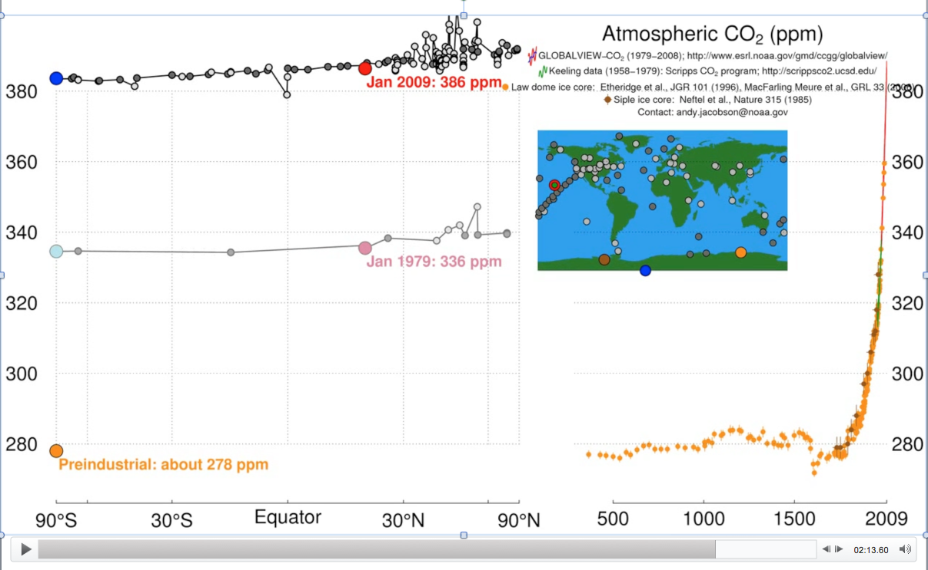

Slide 12
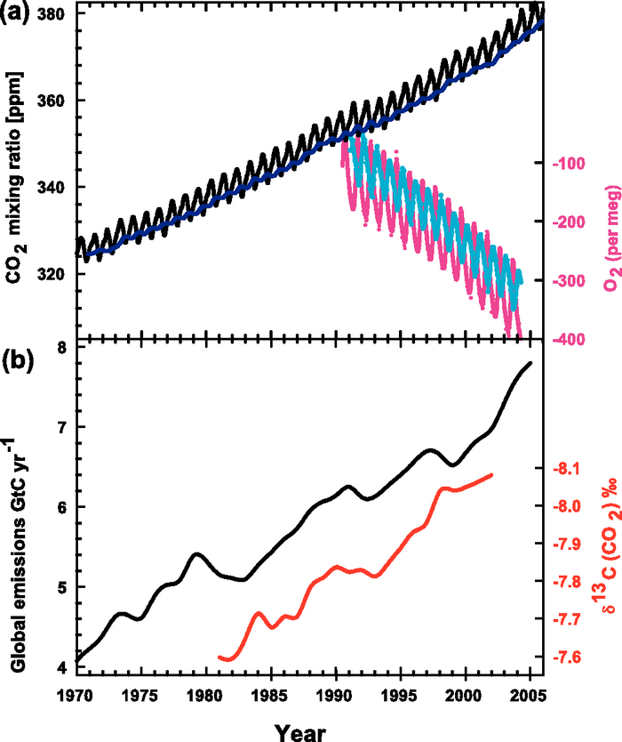
CO2 measured at Mauna Loa, Hawaii
CO2 measured at Baring Head, New Zealand
O2 measured (relative to N2) at Alert, Canada
O2 measured at Cape Grim, Australia
Notes:
Recent CO__{2_} concentrations and emissions. (a) CO__{2_} concentrations (monthly averages) measured by continuous analysers over the period 1970 to 2005 from Mauna Loa, Hawaii (19°N, black; Keeling and Whorf, 2005) and Baring Head, New Zealand (41°S, blue; following techniques by Manning et al., 1997). Due to the larger amount of terrestrial biosphere in the NH, seasonal cycles in CO__{2_} are larger there than in the SH. In the lower right of the panel, atmospheric oxygen (O__{2_}) measurements from flask samples are shown from Alert, Canada (82°N, pink) and Cape Grim, Australia (41°S, cyan) (Manning and Keeling, 2006). The O__{2_} concentration is measured as ‘per meg’ deviations in the O__{2_}/N__{2_} ratio from an arbitrary reference, analogous to the ‘per mil’ unit typically used in stable isotope work, but where the ratio is multiplied by 10_^{6_} instead of 10_^{3_} because much smaller changes are measured. (b) Annual global CO__{2_} emissions from fossil fuel burning and cement manufacture in GtC yr_^{–1_} (black) through 2005, using data from the CDIAC website (Marland et al, 2006) to 2003. Emissions data for 2004 and 2005 are extrapolated from CDIAC using data from the BP Statistical Review of World Energy (BP, 2006). Land use emissions are not shown; these are estimated to be between 0.5 and 2.7 GtC yr_^{–1 _}for the 1990s (Table 7.2). Annual averages of the _^{13_}C/_^{12_}C ratio measured in atmospheric CO__{2_} at Mauna Loa from 1981 to 2002 (red) are also shown (Keeling et al, 2005). The isotope data are expressed as δ_^{13_}C(CO__{2_}) ‰ (per mil) deviation from a calibration standard. Note that this scale is inverted to improve clarity.

Slide 13
Where does the extra CO₂ come from?
Show “It’s Us” from Earth: the Operator’s Manual

Slide 14
Causal loop diagrams
Climate change is expected to cause an increase in wildfires in some areas and to result in decreased moisture in the tropical rainforests.
  How would these impacts affect the atmospheric CO2 reservoir?
  Draw a causal loop diagram showing this effect?
    Variables: atmospheric CO2; climate change; wildfires; carbon sinks (forests)

