Slide 1
Question of the day:
Why is carbon important to life and to energy?

Slide 2
Overview
Basics of Carbon
What is carbon
How it is used biologically
How is carbon cycled
Photosynthesis
Respiration
Sequestration
Sinks
Balance of the cycle
Human intervention
Burning of fossil fuels
Removal of sinks
Disruption of balance

Slide 3
What is Carbon?
The most important element for life on Earth
Backbone of organic molecules
Storage and transfer of energy

Slide 4
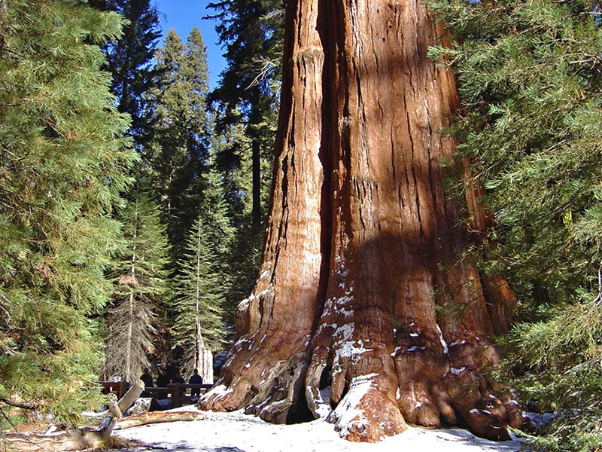
Where did this biomass come from?

Slide 5
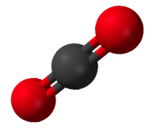
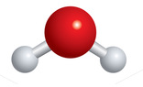
Organic molecules game
What is the most complicated structure you can make?
Use all bonds and all atoms
CO₂
H₂O
Notes:
Give them CO2 and H2O molecules
Debrief: what did you come up with?
How similar are they to each other?
Did anything surprise you?
How many C-C or C-H bonds did you come up with? These bonds are important because breaking them releases energy that can be used by organisms (or for human society)

Slide 6
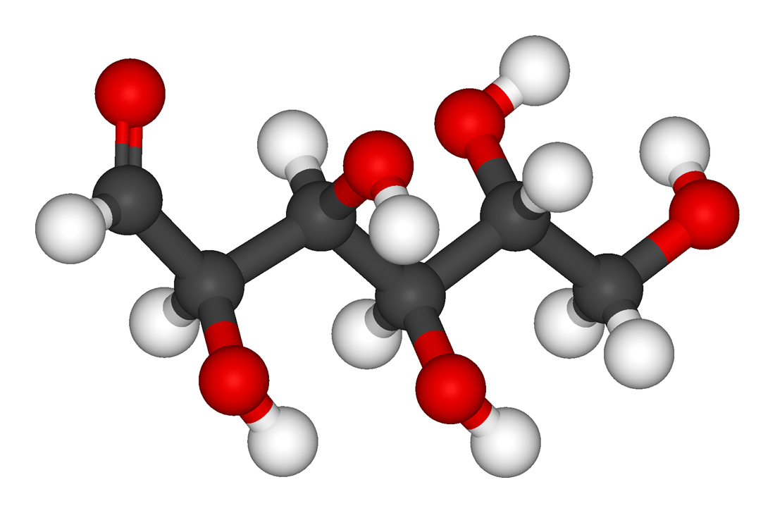

Glucose
Notes:
glucose

Slide 7
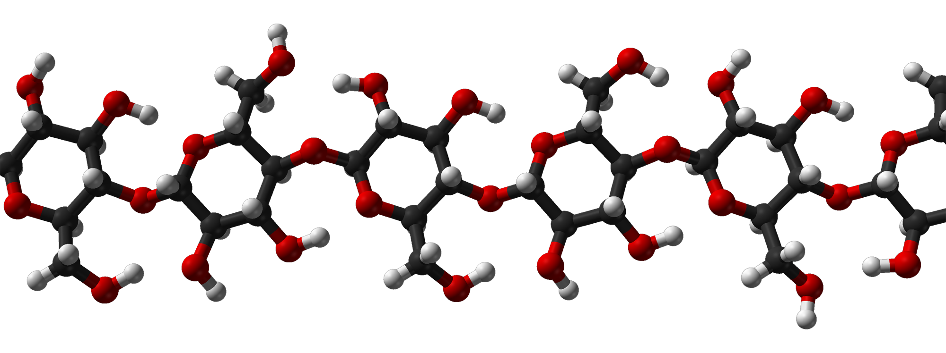
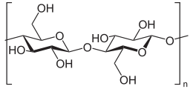
Cellulose
Notes:
Linked glucose units

Slide 8
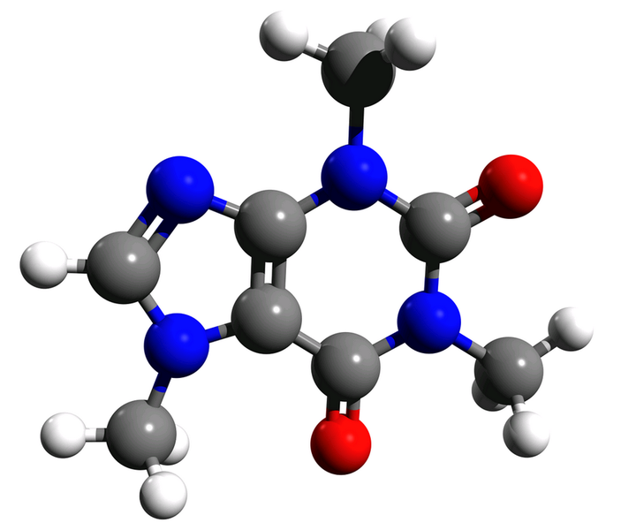

Caffeine

Slide 9
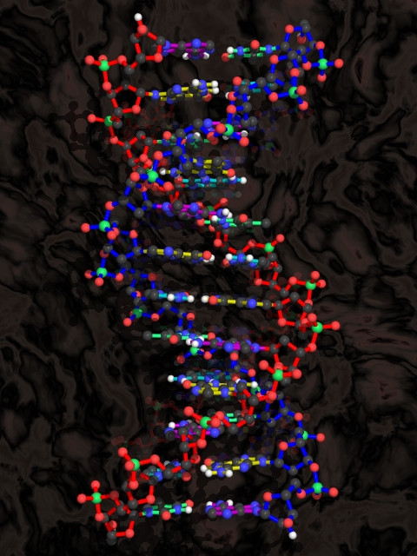
DNA

Slide 10

Photosynthesis
6 CO₂ + 6 H₂O C₆H₁₂O₆ + 6 O₂
Photosynthesis
Carbon dioxide from the atmosphere
Water
Organic matter
Oxygen

Slide 11
Respiration: using energy stored in organic carbon
C₆H₁₂O₆ + 6 O₂ 6 CO₂ + 6 H₂O
Respiration
Organic matter
Carbon dioxide released to atmosphere
Water
Oxygen

Slide 12


Slide 13
Back to the tree…
~50% water by weight
~45% dry weight is C in organic matter
Most of remainder is O, H in organic compounds
Organic matter is rich in C-C and C-H bonds, which release energy when broken
Organic carbon is used as energy ‘currency’
it can be used immediately, stored, or transferred to other organisms

Slide 14
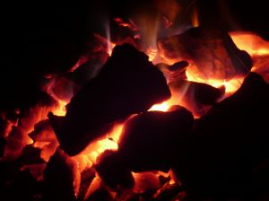
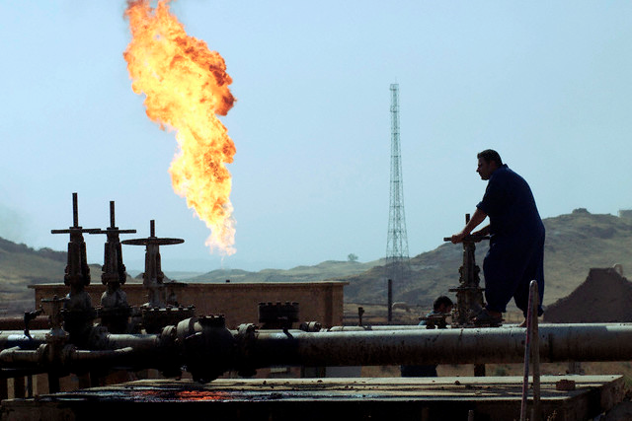

Fossil fuels
“Fossil” or ancient biomass
Formed because of incomplete decomposition of dead organisms (mostly algae and plants), under pressure
Coal
Oil
Natural gas (methane)

Slide 17
Show Formation of Fossil Fuels from Earth: the Operator’s Manual

Slide 18
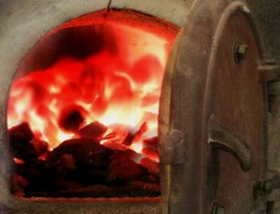
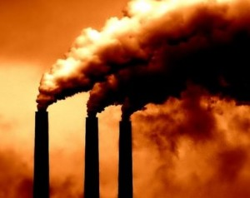
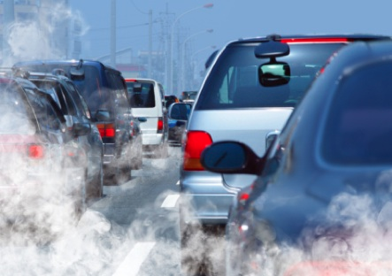
Burning any kind of organic carbon, including fossil fuels, releases energy and carbon dioxide
We are burning fossil fuels about a million times faster than they were formed.

Slide 19
Respiration vs. burning fossil fuels
Both convert organic carbon and O₂ to CO₂ and H₂O
Show “Now is the Time” or Competitive Enterprise Institute’s PSA
Notes:
What about human respiration?
Breathing produces approximately 2.3 pounds (1 kg) of carbon dioxide per day per person.
You exhale about 365 kg (0.365 tons, or 803 lbs) CO₂ each year.
If you stop breathing, will it solve the CO2 problem?

Slide 20
Carbon footprint exercise
http://calc.zerofootprint.net/youth/iEarn
http://footprint.stanford.edu/index.html
http://www.wattzon.com/

Slide 21
CO₂ backpack
What would it feel like if you had to carry around the weight of your emissions?
Notes:
Average American emits

Slide 22
Convert from tons/year to pounds /day
1 metric ton = 2205 pounds
1 year = 365 days
so 1 ton/year = 6.04 pounds/day

