Slide 1
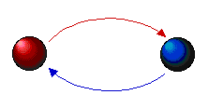
Systems thinking
System:
Interconnected set of elements
Coherently organized in a way that achieves something over time
>> Look for elements, interconnections, and behavior over time
Notes:
Somewhat in contradiction to analysis – which breaks things down into smaller pieces to simplify their study
Anasynthis – study of the whole, and the parts, with hope of developing an appropriate level of understanding

Slide 2
Examples of systems
Your body
Elements?
Interconnections?
Function or purpose?
High School:
Elements (tangible and intangible)?
Interconnections?
Purpose?
Basketball team – what are the elements and interconnections?
Notes:
even though I’m 42 years old, the average age of a cell in my body is 7-10 years old. My cells (elements) are changing all the time, but am I still the same person?

Slide 3
Why is the system perspective important?
Notes:
Climate change and many other issues facing society today are systems problems – they have many elements that are interconnected and cannot be taken into consideration alone
Systems often behave in non-intuitive ways – if we can understand more about how they behave, we’re in a much better position to project what they will do in the future and to intervene in systems to create the change we want
Once you understand key systems concepts, you can apply systems thinking to ANY system! This is great for topics like climate change that require many different disciplines to solve problems – systems thinking becomes a framework that you can use to organize information/ concepts in a way that also helps us understand how they behave.

Slide 4
Why use systems thinking to understand climate change?
Climate/Earth is a system
Human systems are a part of the climate/Earth system
Systems thinking is effective for understanding
complex interactions
behavior that is frequently counterintuitive
non-linear patterns
leverage points or small changes that can have big impacts
Co-create program with you and learn from you

Slide 5
Where in a system do you find the most leverage?
What has the biggest impact – changes to system elements, interconnections, or function/ purpose?
E.g., football team
Changing elements only has a major impact when it also changes interconnections or purpose
Notes:
Football team:
Changing one of the benched players to another benched player does little
Changing the star player to a lousy player influences interconnections and has a big impact
What about changing the interconnections without changing the elements. E.g., same players, but the rules are different. Or same players, but the goal is different.
E.g., my body
I’m 42 years old
But, the average cell in my body is only 7 years old
What has more influence – changing elements (i.e., cells), or changing their interconnections or purpose (i.e., how my brain controls my muscles, or whether my body’s purpose is to maintain health
But, if a cell changes from normal to cancerous, it changes the interconnections and purpose and has a major influence.

Slide 6
System elements: Stocks
NOUNS; something that can accumulate or decline
Physical things
Non-physical things
You can assess what their level is at any point in time
Notes:
Use example of iced tea jug filled with water – stock

Slide 7
System elements: Flows
Movement of things or information
Occur over time – if time stops, flows stop
Verbs
E.g., people entering a room; water flowing into a tub
What happens to a stock when the rate of inflow goes down?
What happens to the stock when the inflow stops?
Notes:
Let’s say you have a room with 20 people in it (stock = people in the room). There are people entering the room (inflow) and people leaving the room (outflow). If the number of people entering the room goes down, what happens to the
Pour water from one cup to the jug; then out of the jug into another cup of water
Key stock concepts:
Correlation heuristic is a common misconception

Slide 9
System elements: Feedback

Slide 10
Paper fold exercise
Take a square napkin
Fold it in half, and half again
Fold it twice more – for a total of four times
How thick is it?
You can’t fold the napkin 29 more times, but if you could, how thick would it be?
Less than a foot?
From the floor to the ceiling?
From here to the top of the building?
Answer: 3,400 miles thick – distance from Boston to Germany
WHY?
Exponential growth – 1, 2, 4, 8, 16, 32, 64, etc. (doubling = 2^{x})
Notes:
A traditional French riddle also illustrates the surprising nature of exponential growth: Suppose a water lily is growing on a pond in your backyard. The lily plant doubles in size each day. If the lily were allowed to grow unchecked, it would completely cover the pond in 30 days, choking out all other forms of life in the water. For a long time, the plant seems small, so you decide not to worry about cutting it back until it covers half the pond. How much time will you have to avert disaster, once the lily crosses your threshold for action? The answer is, "One day."The water lily will cover half the pond on the 29th day, leaving you only 24 hours before it chokes out the life in your pond.

Slide 11
Reinforcing or positive feedback
Thickness
of napkin
+
R
Amount added
by folding
+

Slide 12
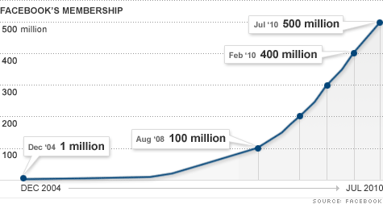
Exponential behavior

Slide 13
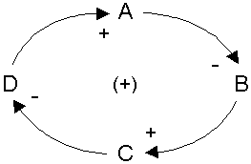
Causal loop diagrams: positive or reinforcing feedback loops

Slide 14
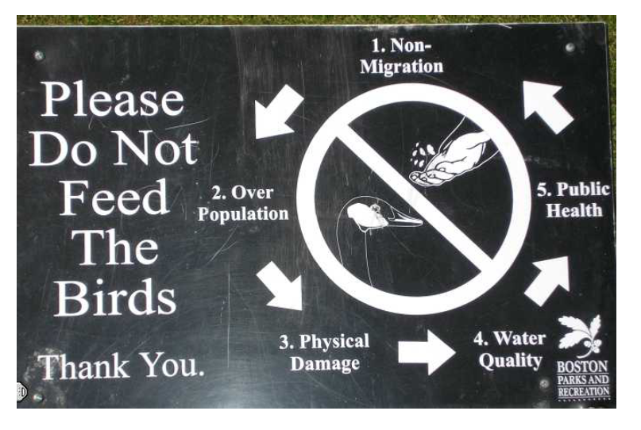

Slide 15
Chain letters
How do chain letters work?
Causal loop diagram:
Number of initial chain letters sent
Number of people who receive chain letters
Number of people who send chain letters
Notes:
(demonstrate syntax on board) – positive feedback loop

Slide 16
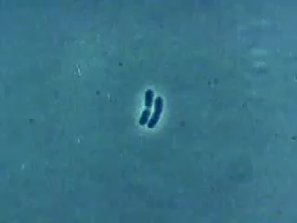
Can exponential growth go on forever?

Slide 17

How many times would a 2 micrometer bacterium need to divide to be able to form a line around the Earth’s equator?
34 times

Slide 18
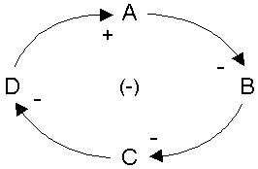
Causal loop diagrams: Negative or balancing feedback loops

Slide 19
Balancing feedback loop
Your body’s temperature
How does your body respond when you get hot?
What effect do these responses have on your body temperature?
Draw causal loop with variables:
Body temperature
Sweat
Evaporative cooling (heat that goes into evaporating moisture)

Slide 20
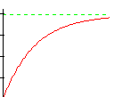

What about negative feedback?
Temperature
Time

