Slide 1
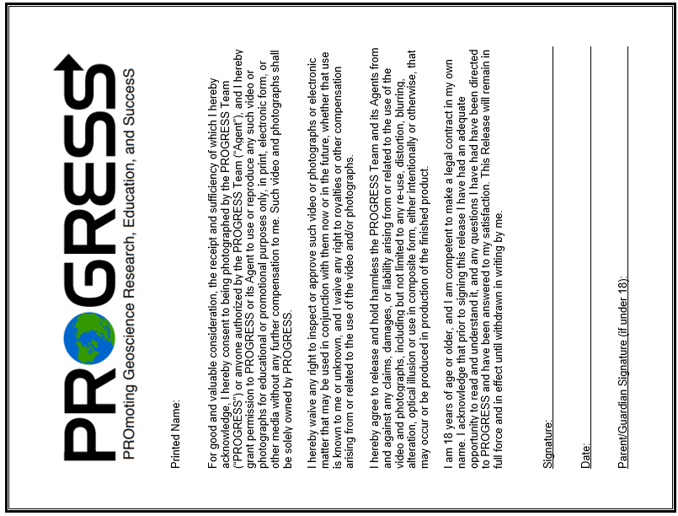
PROGRESS Photo Waiver (updated 09/20/2022)

