Slide 1
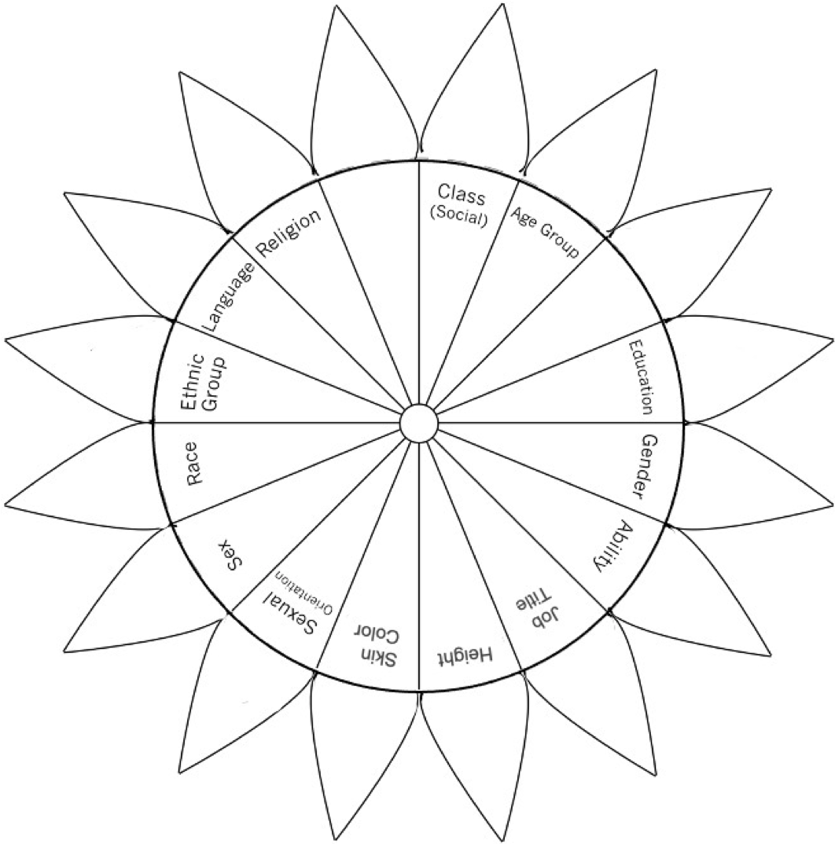

Social Identity
Flower Power Exercise

Slide 2
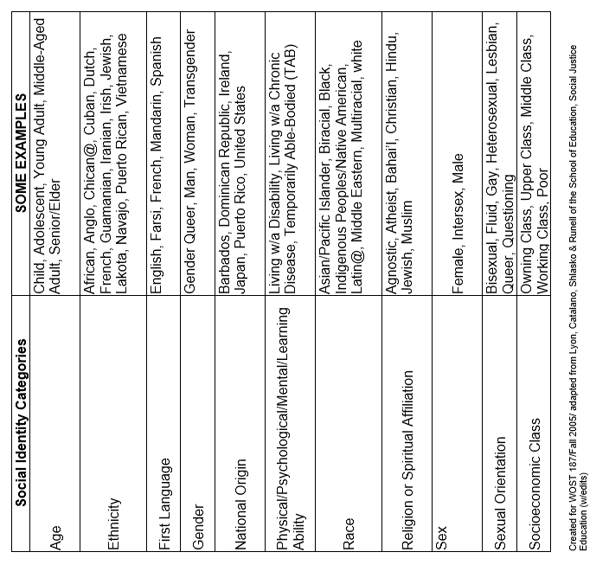
Social Identity
Flower Power Examples

